Slide 1
Gamma Factory Proof of Principle: Vacuum considerations & contributions
Chiara Pasquino, TE-VSC-BVO
25 October 2022

Slide 2
Outline
Vacuum layout in LSS6;
GFPoP: boundary conditions;
Open questions;
Cost, Schedule and resources;

Slide 3
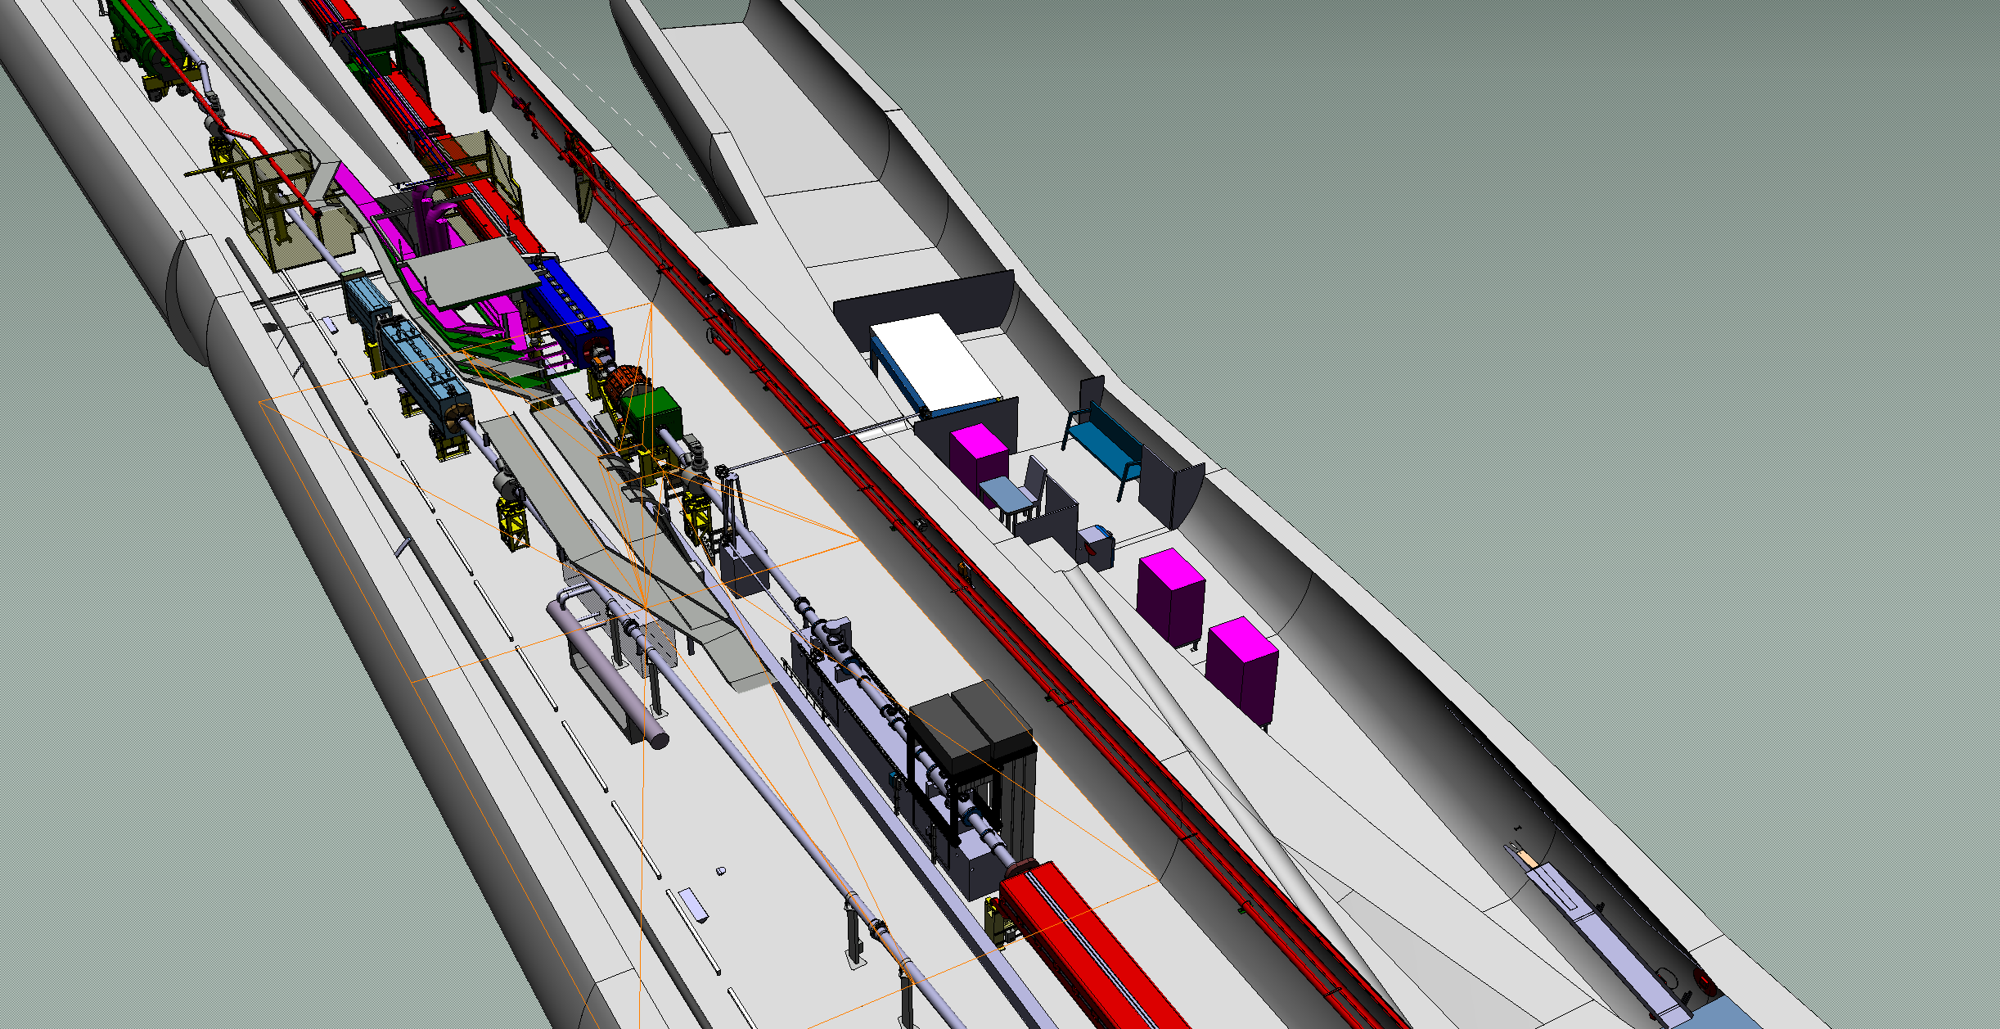
LSS6 – GFPoP Layout

Slide 4
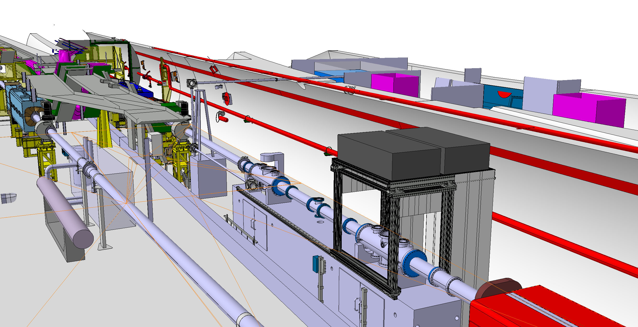
LSS6 – GFPoP Layout
TE-VSC contributions:
Vacuum design, procurement, production of standard tubes, operation and maintenance of the vacuum equipment of the GFPoP LSS6 vacuum sector & the laser line.

Slide 5
LSS6 – GFPoP boundary conditions for Vacuum
LSS6 vacuum line:
  GFPoP will not require a better vacuum than the SPS, both static and dynamic.
  All chambers and instrumentation should be compliant with the SPS vacuum acceptance criteria (EDMS1752123)
  Cleanliness of all in-vacuum equipment, both in terms of Carbon contaminations and dust is crucial for the correct functioning of the cavity mirrors.
  Slow venting and Slow pumping of this sector will be needed to minimize dust displacement.
  Techniques to minimise dust exposure during the installation phase in the tunnel should be studied (portable laminar flow?).
  All standard 156/159mm should be carbon coated.
LASER vacuum line:
  Absolute pressure could be in the primary vacuum range, but with low water content;
  Low vibration are crucial for this line → mechanical pumping is not suitable during operation.
  It is recommended to decouple the laser line from the cavities line via a window, to avoid any type of interference of the operation of the laser line wrt to the SPS machine itself.

Slide 6
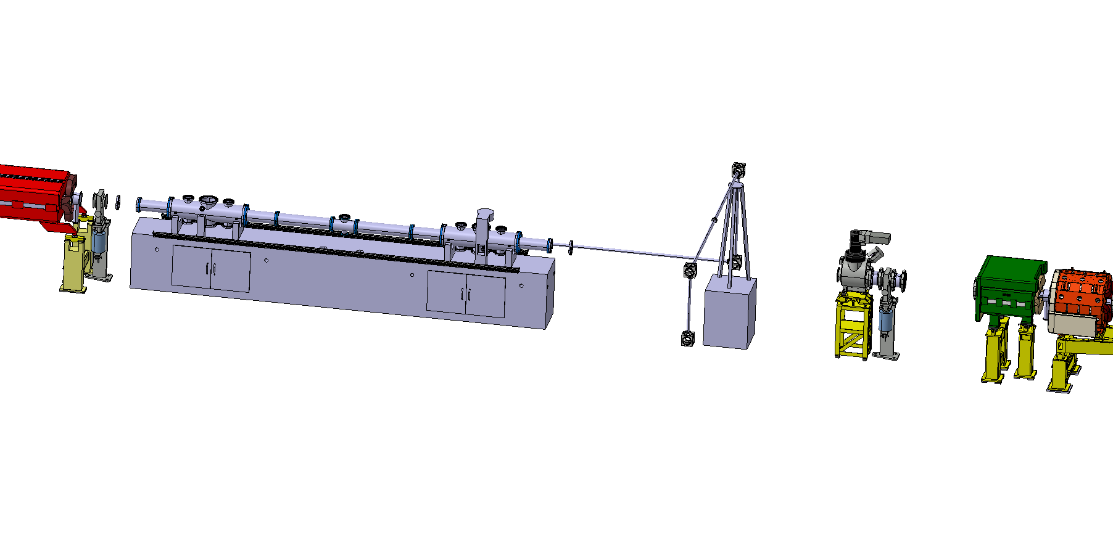
LSS6 – Proposed vacuum layout
Sector valves
Gauges for interlocking
Ion pumps upstream and downstream the cavities
Ion pumps for the laser line, possibly located on the tunnel side to ease the maintenance of the line from a vacuum point of view (no access to the laser hutch needed).

Slide 7
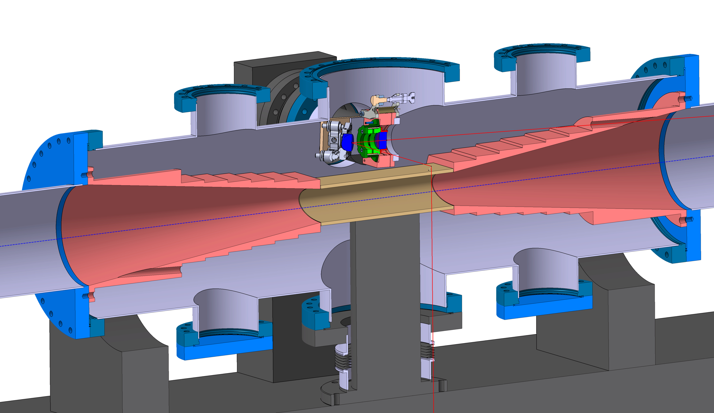
Open questions
Design and production of the non-standard components:
  At CERN? Through EN-MME with TE-VSC support? Is this confirmed?
Expected energy deposition on the downstream dipoles:
  Order of magnitude? Should it be a concern? Anything to add to the vacuum system to absorb this?

Slide 8
Material estimate

Slide 9
Spending Profile

