Slide 1

Multi-VO Rucio Update
7th October 2022

Slide 2
Rucio Update
Rucio instance almost fully running on K8S deployment and running 1.27(mostly) – Auth server last issue
Working on S3 endpoints with FTS service manager at RAL and FTS devs
IRIS-IAM / EGI Check-in integration was investigated, and a newer auth server was required – but groundwork is in place and understood how to implement
Working on improved and more robust database architecture
Implemented some Rucio monitoring

Slide 3
Rucio K8S Deployment
Current IntanceSTFC Cloud - OpenStack
To be deployed to reliability
Master
Master
Master
Control Plane
ETCD
NGINX
Worker
Worker
Worker
Worker
NGINX

Slide 4
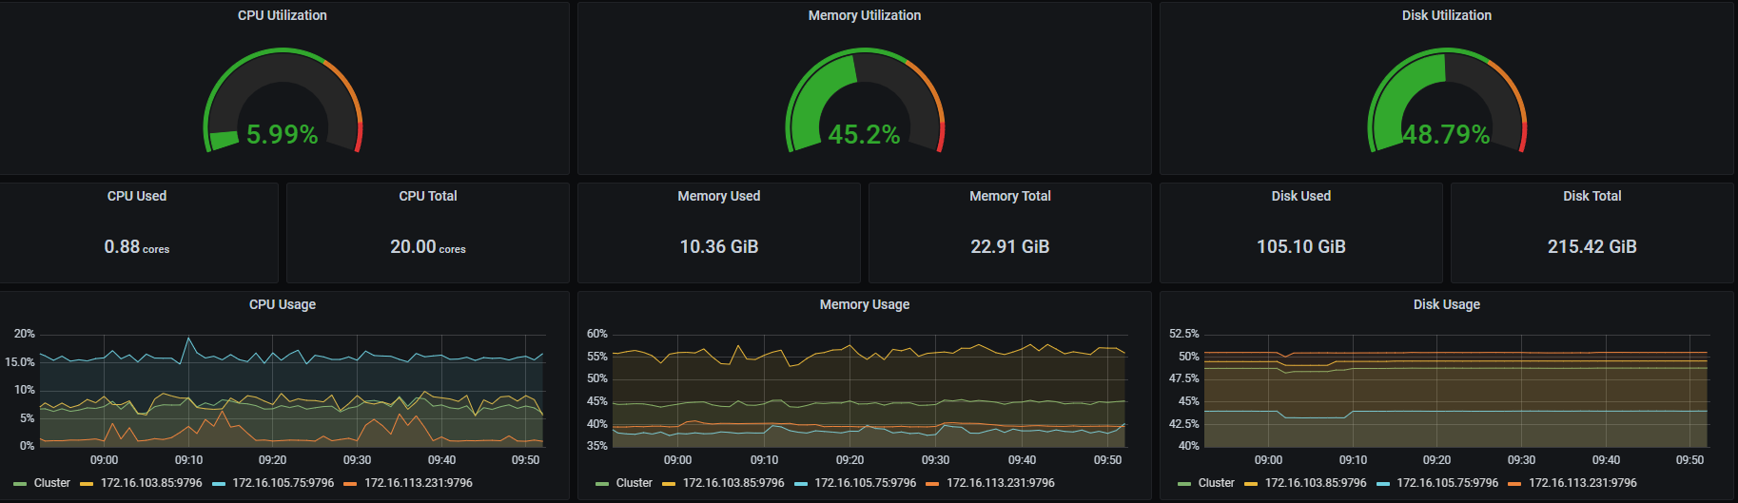
Cluster Monitoring

Slide 5
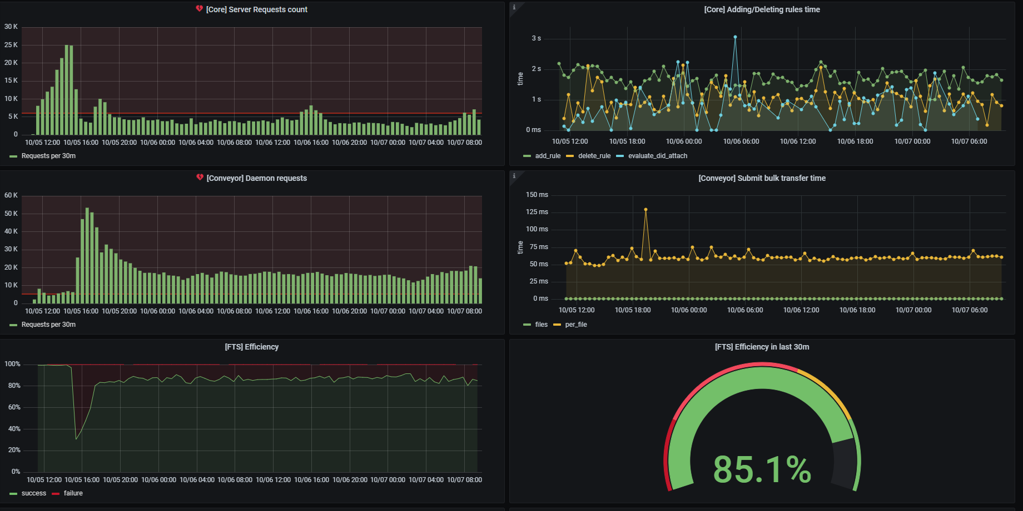
Rucio Internal monitoring

Slide 6
Rucio Dev and infrastructure future work
Working on K8S cluster to make more robust
Final Rucio component converted to K8S deployment
  Once this is complete can begin upgrading to Rucio 1.29 from the current 1.27.X K8S deployment and 1.23.LTS VM deployment
Convert some Rucio Cron-Jobs to be Multi-VO capable and deploy on K8S
Graduate working on Rucio – Focus on WebUI to make it Multi-VO capable, and build pages

Slide 7
Collaboration Future work
Continue working with FTS Service Owner and Devs to get S3 endpoint compatibility
  FTS moving to latest version (python 3) which should allow for S3 endpoints
Continue work on Multi-VO Token authentication
  IAM
  EGI-Check in
DIRAC integration
  SWIFT-HEP work for prototype data lake
  EGI is very interested for the purpose of making it easier for users
Various database improvements

