Slide 1

The Netherlands
EPPCN meeting november 23 2022 CERN

Slide 2
Dutch (astro)particle physics
6 universities
11 research programs
1 institute, workshop, technical groups, R&D
1 communications & outreach department

Slide 3
2021-2022
Covid
Renovation

Slide 4
Outreach & Communication
Small team at Nikhef
Press contacts
Nikhef Magazine ‘DIMENSIES’
Masterclasses
School thesis experiments
Open days

Slide 5
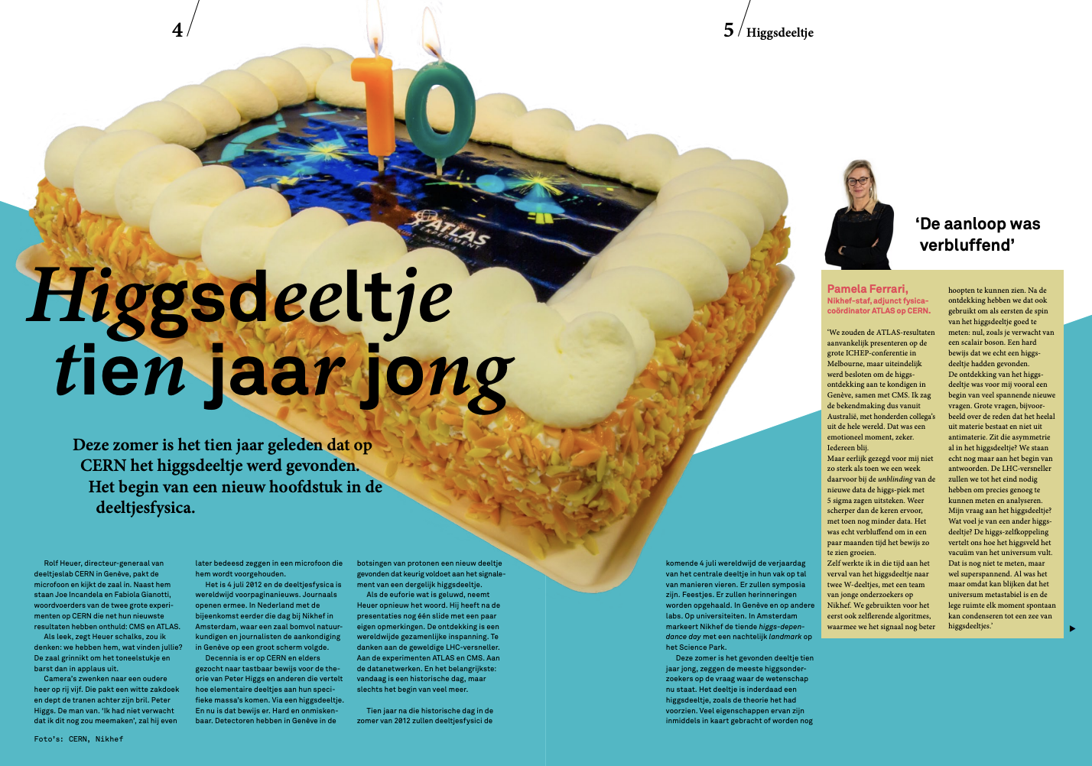

Slide 6
Highlights 2022
Large funding Einstein Telescope > media
Progress with KM3NeT > media
LHC Run3 start > media
Higgs@10 > media, event, laser show

Slide 7
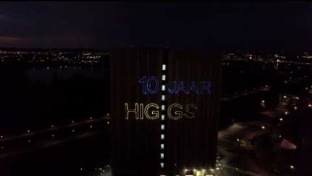

Slide 8
Plans
Building reopening 2023
Showlab
Outreach to less-privileged local schools
Nikhef Expostrip

Slide 9
