Slide 1
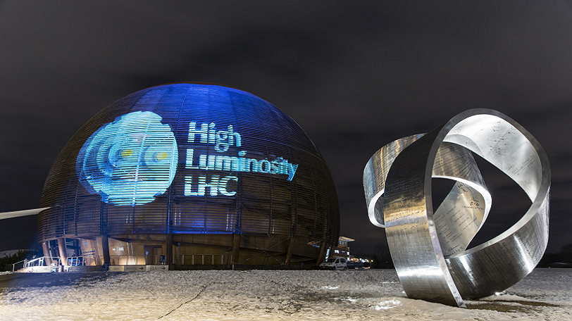
Status of HL-LHC Upgrade Project
EPPCN November 2022
Markus Zerlauth with acknowledgements to O.Brüning, M.Lamont, L.Rossi, J. Wenninger and many other CERN colleagues

Slide 2
Outline
LHC physics achievements and prospects and the HL-LHC physics case
The HL-LHC upgrade project
Civil engineering
Final focusing magnets for lower beta*
Superconducting Link
Crab cavities
Inner Triplet Magnet String in SM18
HL-LHC as a truly international project
Performance ramp-up in the HL-LHC era

Slide 3
Outline
LHC physics achievements and prospects and the HL-LHC physics case
The HL-LHC upgrade project
Civil engineering
Final focusing magnets for lower beta*
Superconducting Link
Crab cavities
Inner Triplet Magnet String in SM18
HL-LHC as a truly international project
Performance ramp-up in the HL-LHC era

Slide 4
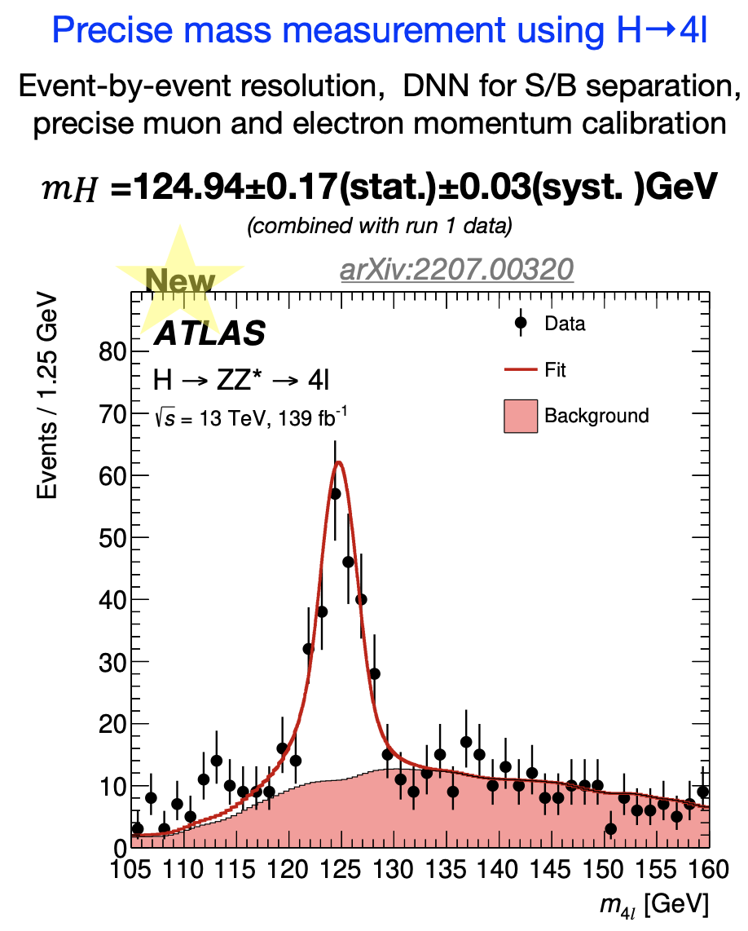
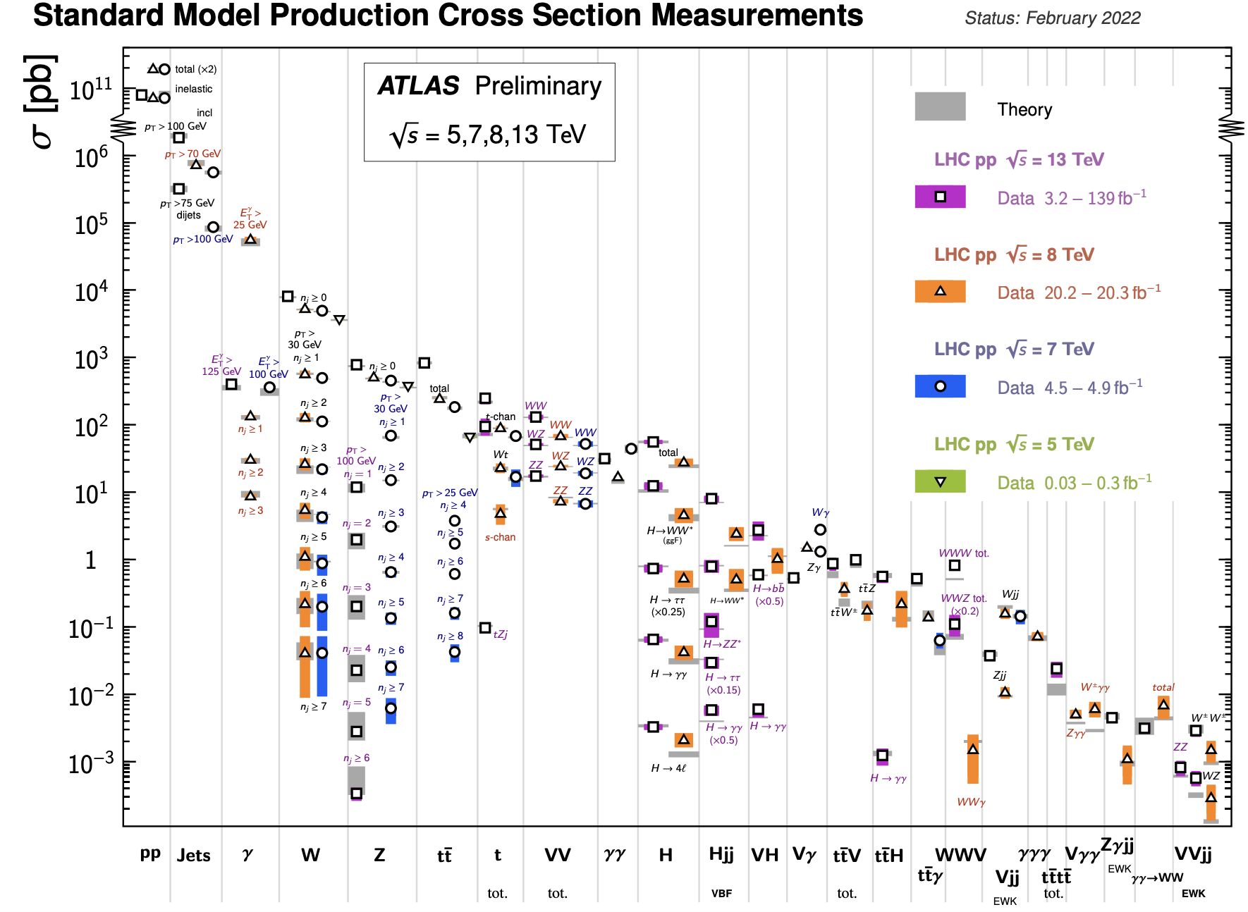
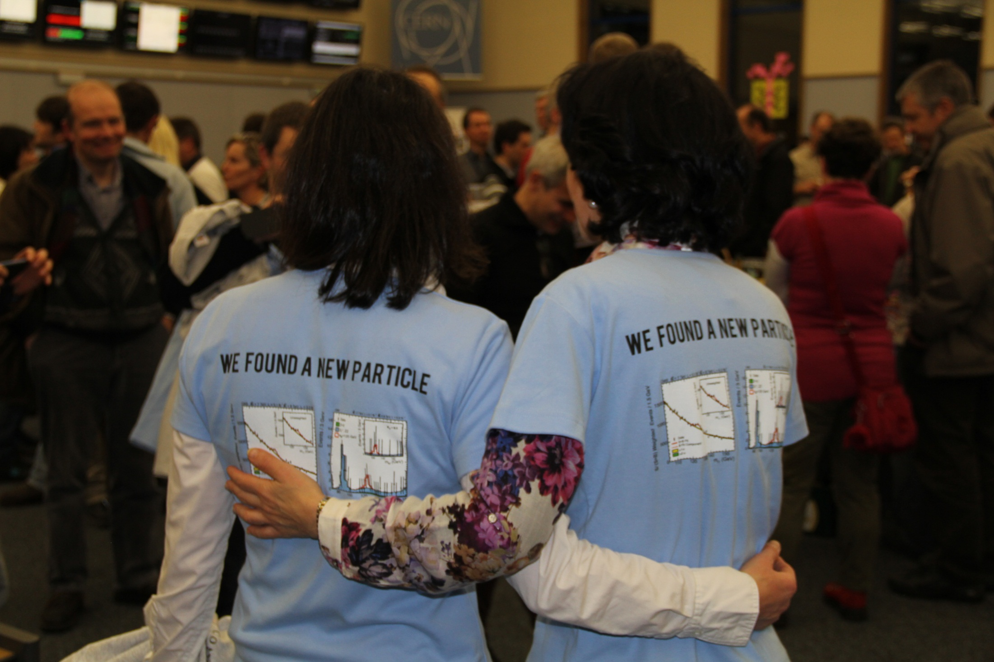
LHC discoveries and prospects

Slide 5
Rich and diverse physics programme
https://www.ichep2022.it
Headline deliverable is 3 ab⁻¹ p-p but the physics programme promises to be impressively diverse…
Ions (ALICE 3 proposed for LS4)
b-physics (LHCb upgrade proposed for LS4)
Forward physics
Neutrinos (SND, FASERnu, FPF)
Long Lived Particles (GPDs, FASER, MoEDAL, CODEX-b, milliQan, MATHUSLA, ANIBUS, FPF)
Fixed target (SMOG-2, Crystal-FT)

Slide 6
Goal of HL-LHC upgrade project
Many questions remain! (Higgs properties/couplings?, more than just 1 Higgs? Beyond SM physics? Dark Matter/energy?)
The main objective of the HL-LHC is to determine and build a hardware configuration and a set of beam parameters that will allow the LHC to reach the following targets:
Prepare machine for operation beyond 2025 and up to 2040
Devise beam parameters and operational scenarios for:
# enabling at total integrated luminosity of 3000 fb⁻¹
# implying an integrated luminosity of 250 fb⁻¹ per year,
# design oper. for μ ≤ 140 (-> peak luminosity 5 x 10³⁴ cm⁻² s⁻¹)

Slide 7
Run3 (physics production) started in July 2022 @6.8 TeV!
R&D phase finished and series production of HL-LHC equipment has started !!
IT String operation to start mid/end 2024
Long EYETS 2024-25
LS3 shifted by 1 year and extended to 3 years

Slide 8
Outline
LHC physics achievements and prospects and the HL-LHC physics case
The HL-LHC upgrade project
Civil engineering
Final focusing magnets for lower beta*
Superconducting Link
Crab cavities
Inner Triplet Magnet String in SM18
HL-LHC as a truly international project
Performance ramp-up in the HL-LHC era

Slide 9
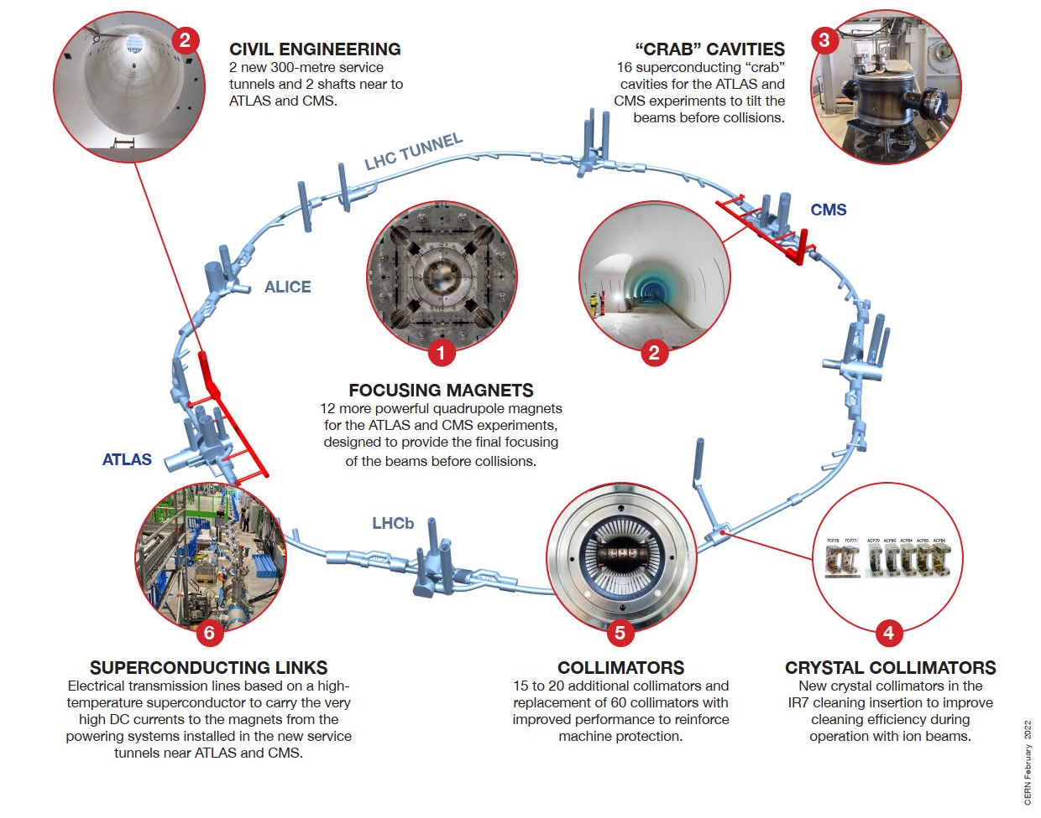
HL-LHC technology landmarks
HL-LHC is an accelerator upgrade project with many challenging novelties covering a broad technology spectrum
Technology intensive project!

Slide 10
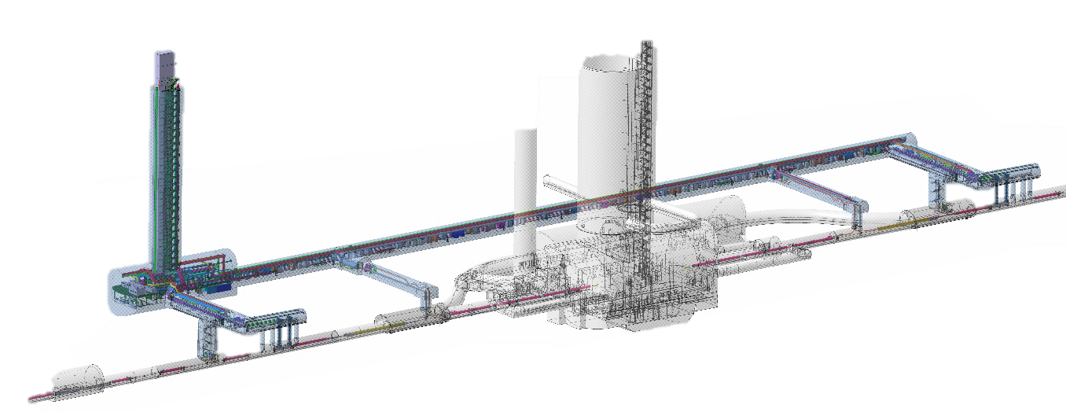
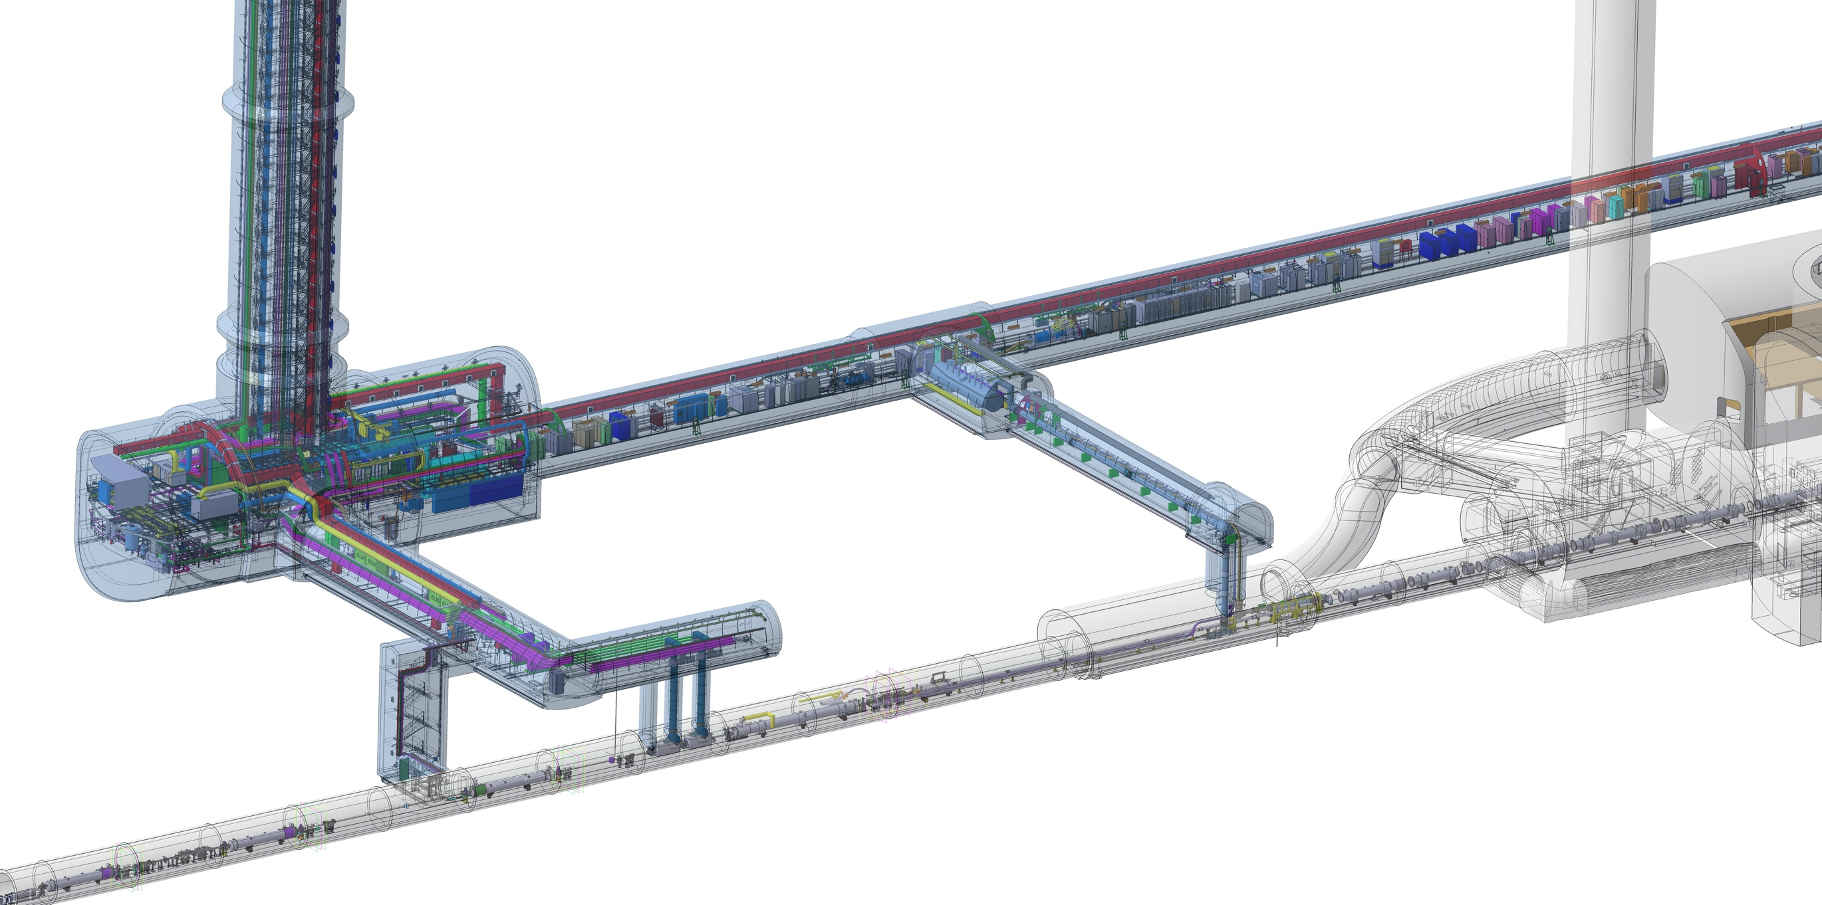
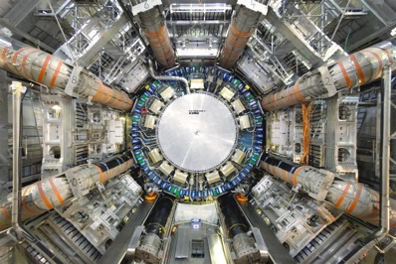
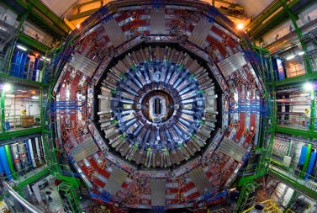
QDS
UR55
Warm Diodes
CLIQ
PIC,BIS
CDBs
OC EE
Valve box
DFHX
D2 OC PCs
DFHM
US57
D2 PC
D1 PC
OC PCs
UW57
PC IT
PCs IT Trims
CDBs
DSHX
D2 OC EE
UL57
Cold box
DSHM
UA57
D1
CP
Q3
Q2B
Q2A
Q1
RF Powering
DFM
DCM
Cooling and Ventilation
DFX
UPR57
Cold Diodes
TAXN
D2
DQHDS
Crab
Cavities
Q4
Q5
Civil Engineering work for HL-LHC will be completed by end of 2022!
Q6
10

Slide 11
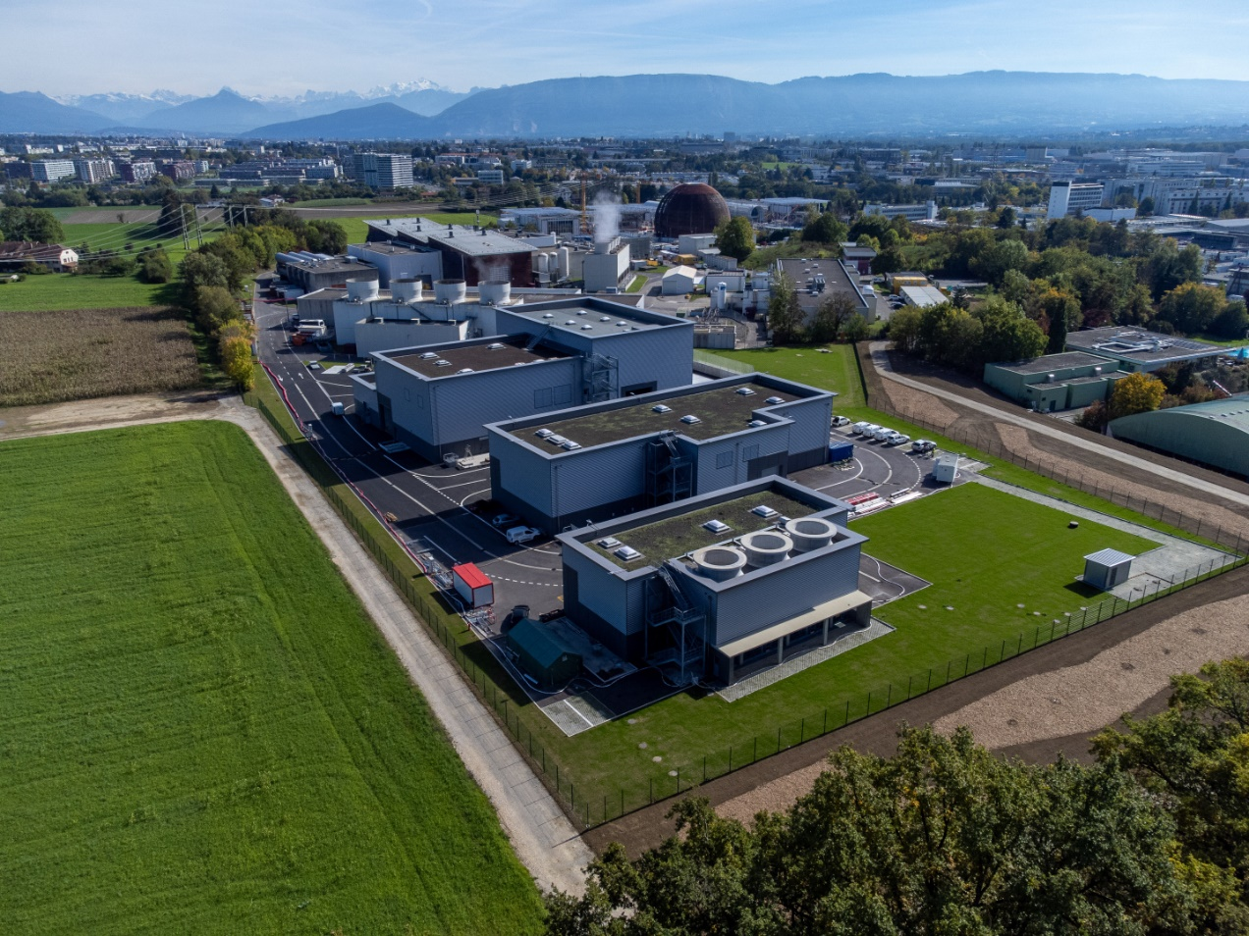
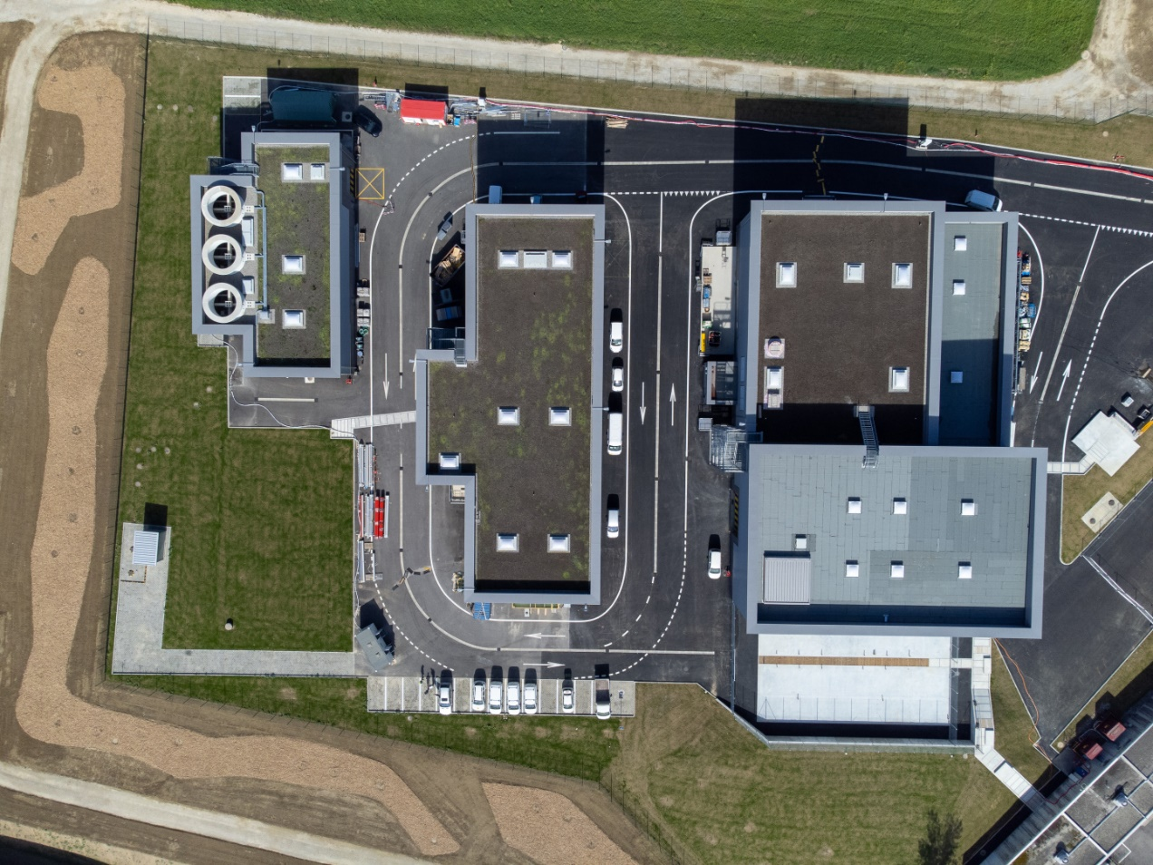
Completion of the civil engineering works at Point 1
SF17
SU17
SE17
SHM17
SD17

Slide 12
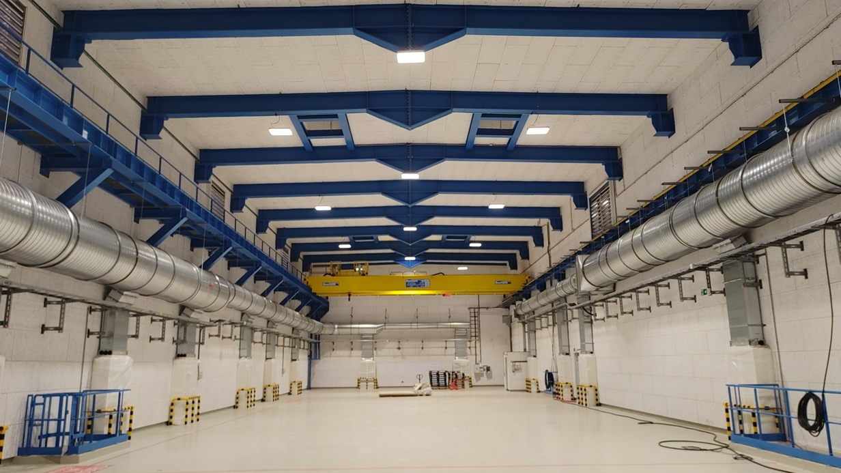
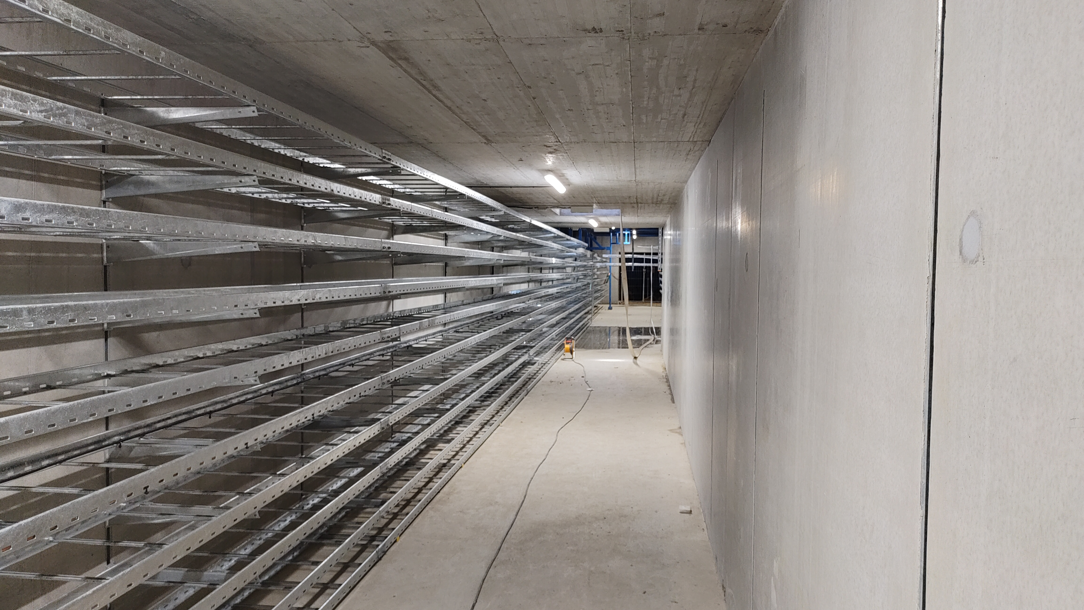
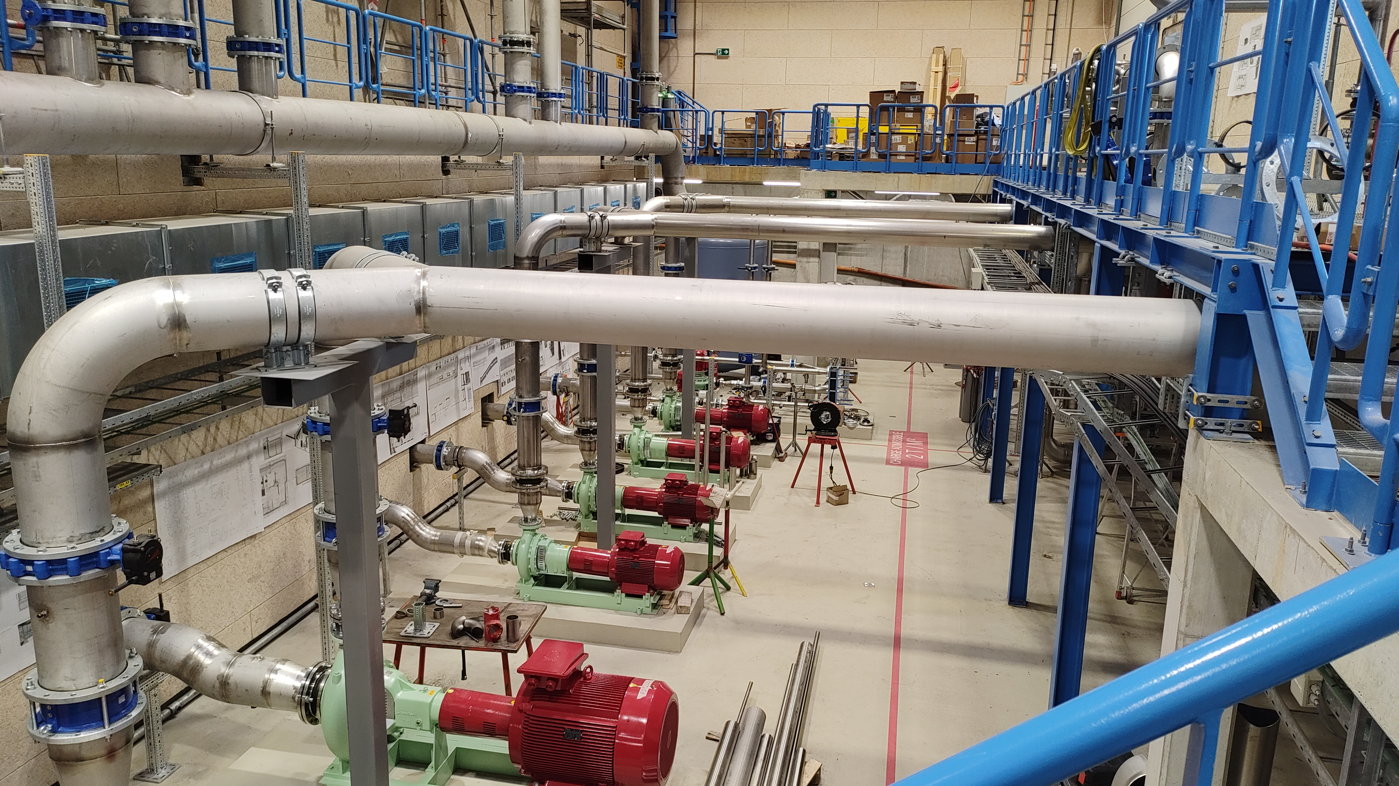
HL-LHC civil engineering status (Point 1)
SD17 Building
Green Spaces
Sectional doors
Cranes
Cable trays & cabling
Lighting
Ventilation system
Primary water system
Notes:
To be updated with latest plots from SCE SC

Slide 13
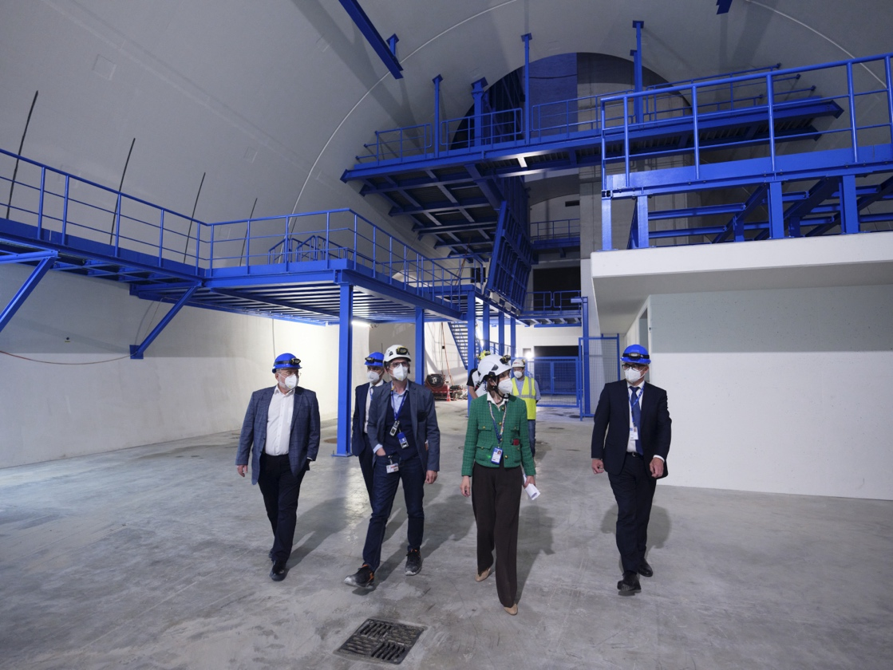
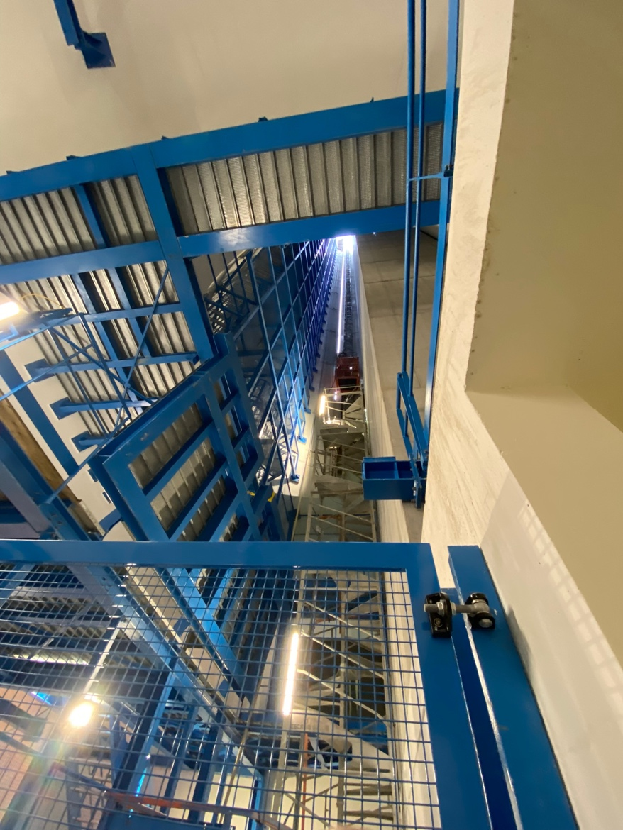
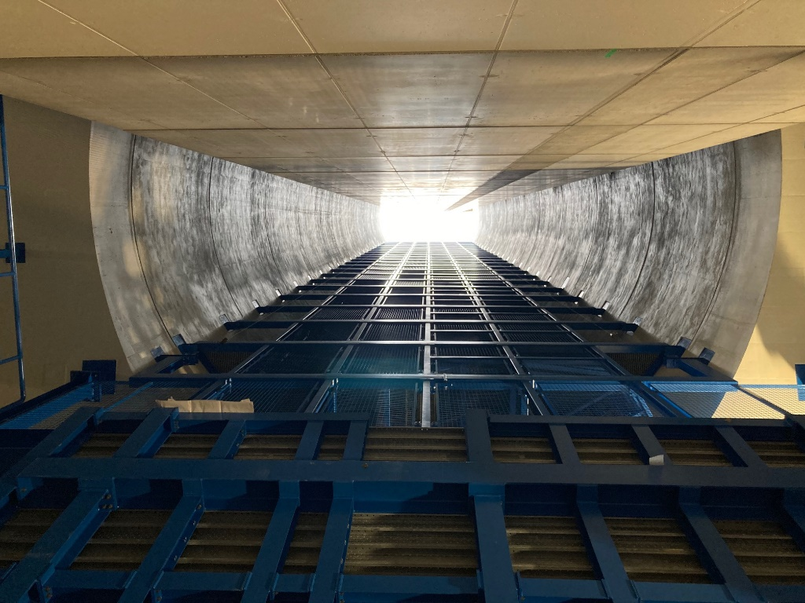
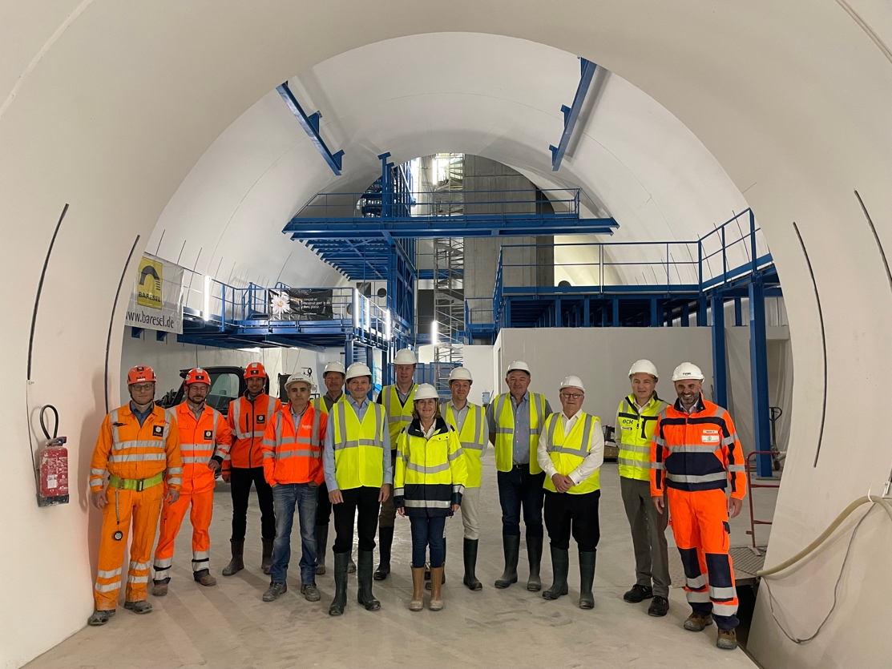
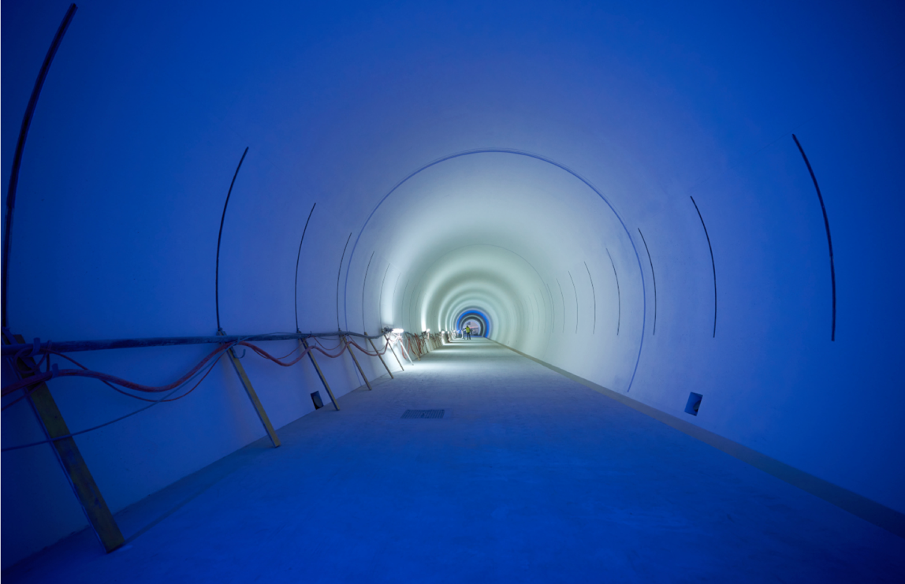
Inauguration Ceremony planned for December 2022
Inaugauration ceremony on 20th of January 2023 !
Notes:
To be updated with latest plans for Ceremony

Slide 14
QDS
UR55
Warm Diodes
CLIQ
PIC,BIS
CDBs
OC EE
Valve box
DFHX
D2 OC PCs
DFHM
US57
D2 PC
D1 PC
OC PCs
UW57
PC IT
PCs IT Trims
CDBs
DSHX
D2 OC EE
UL57
Cold box
DSHM
UA57
D1
CP
Q3
Q2B
Q2A
Q1
RF Powering
DFM
DCM
Cooling and Ventilation
DFX
UPR57
Cold Diodes
TAXN
D2
DQHDS
Crab
Cavities
Q4
Q5
Requires novel cold powering system to connect equipment in new UR galleries to tunnel
Q6
14

Slide 15

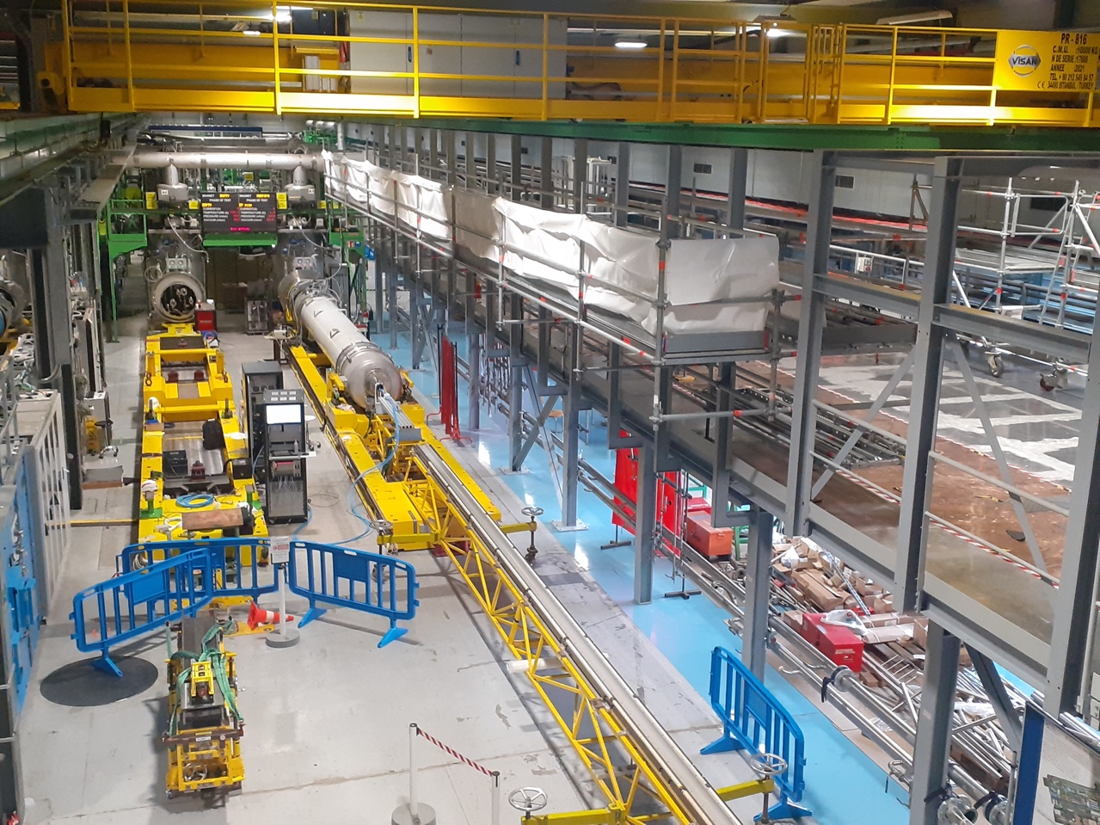
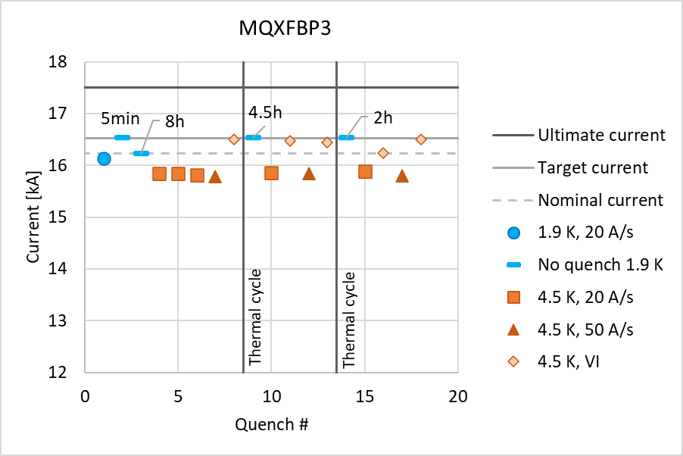
Main Quadrupole Magnets – Q2
August 2022: Successful test of MQXFBP3 test @ SM18
Notes:
To be updated in time

Slide 16

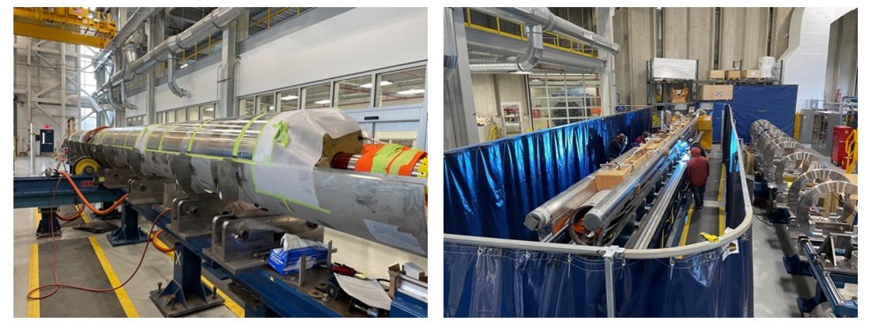
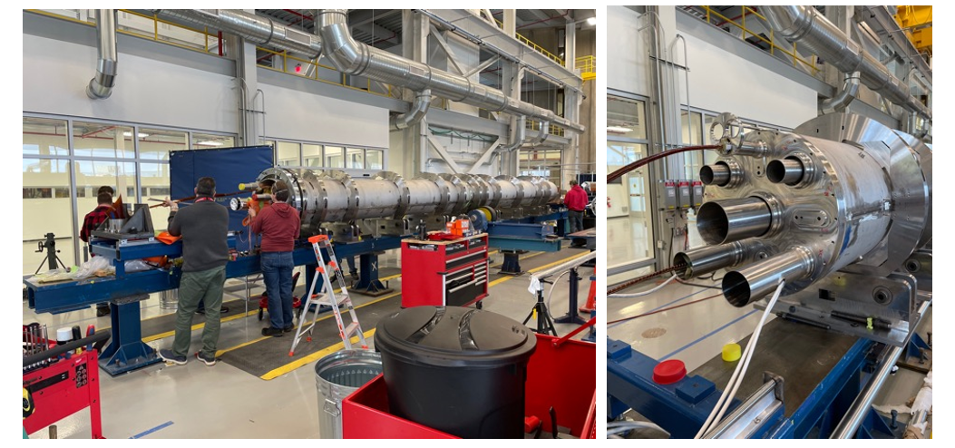
Main Quadrupole Magnets – Q1/Q3
Fitting of bottom SS shell and longitudinal welding
Cryogenics by-pass
Integration of the Cold-Mass components and installation of end plates and pipes

Slide 17
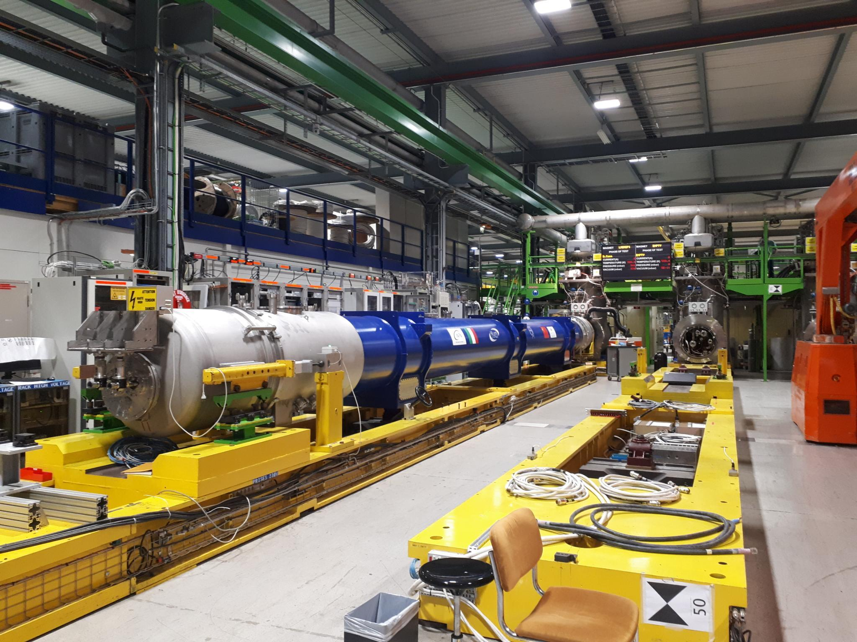
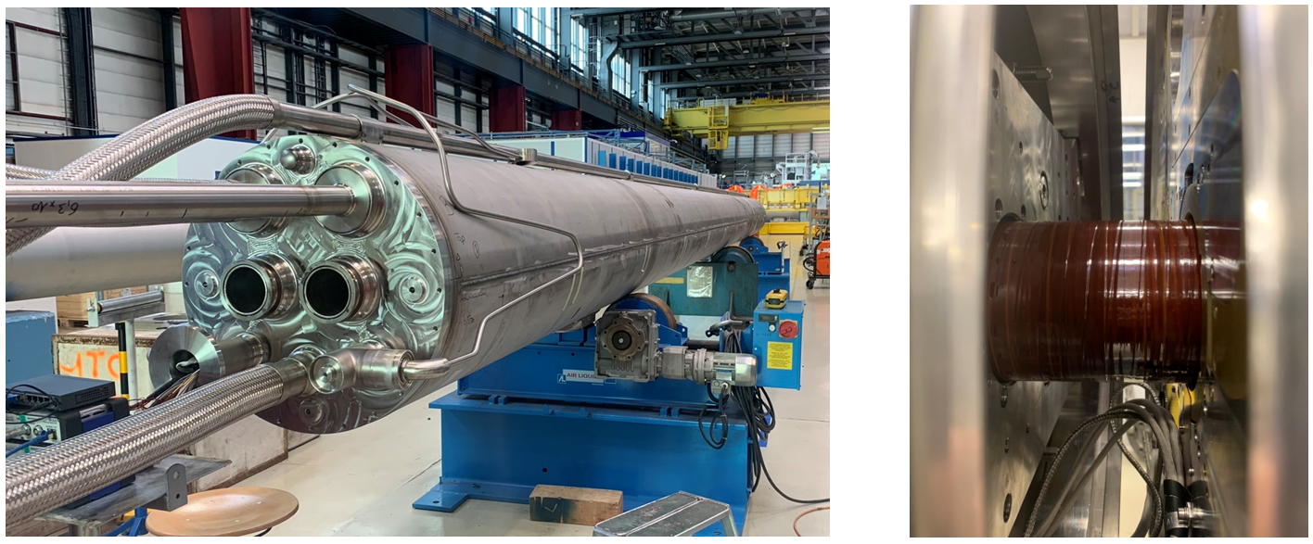
D2 Cold-Mass Assembly
D2 Prototype on the test bench in SM18
Cryogenics by-pass
D2 Prototype Cold-Mass @ CERN in Hall 180

Slide 18
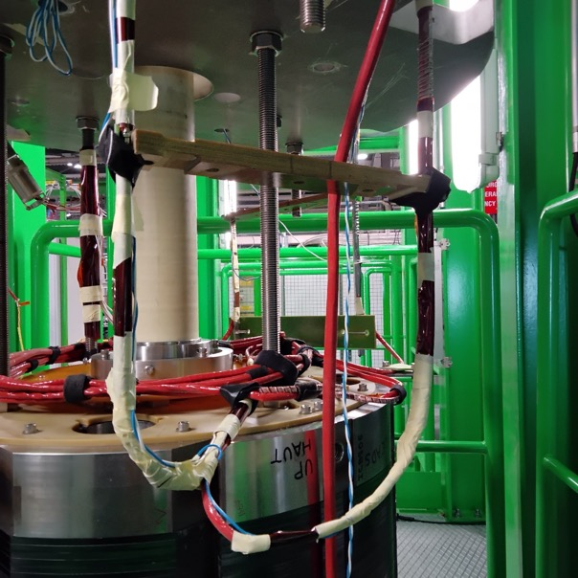
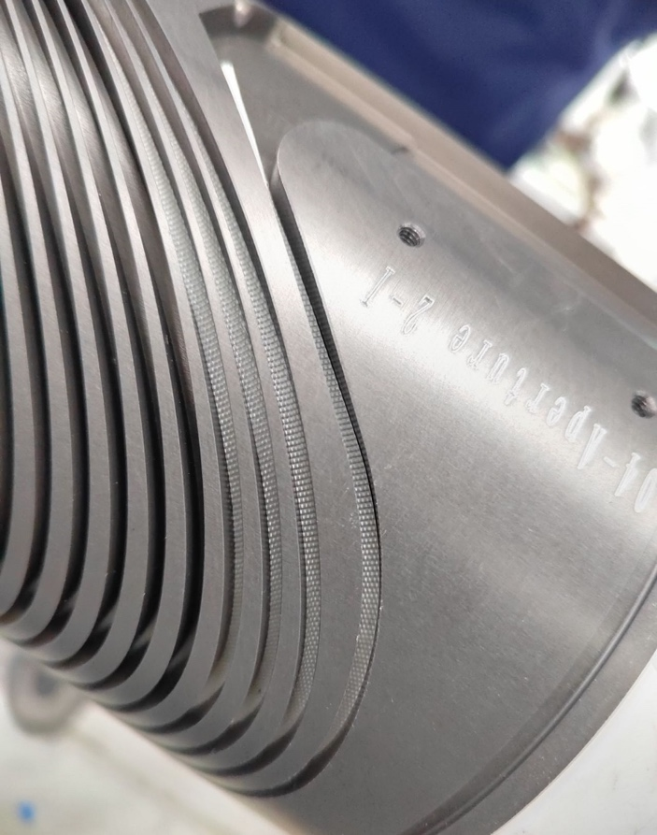
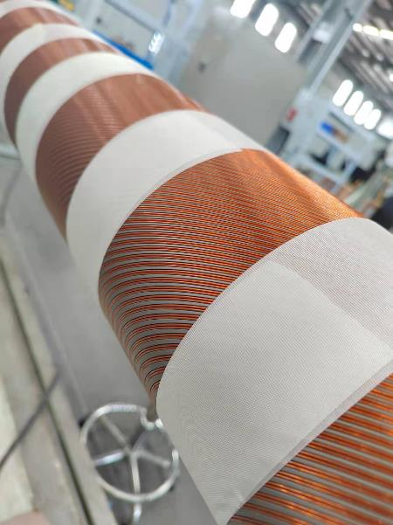

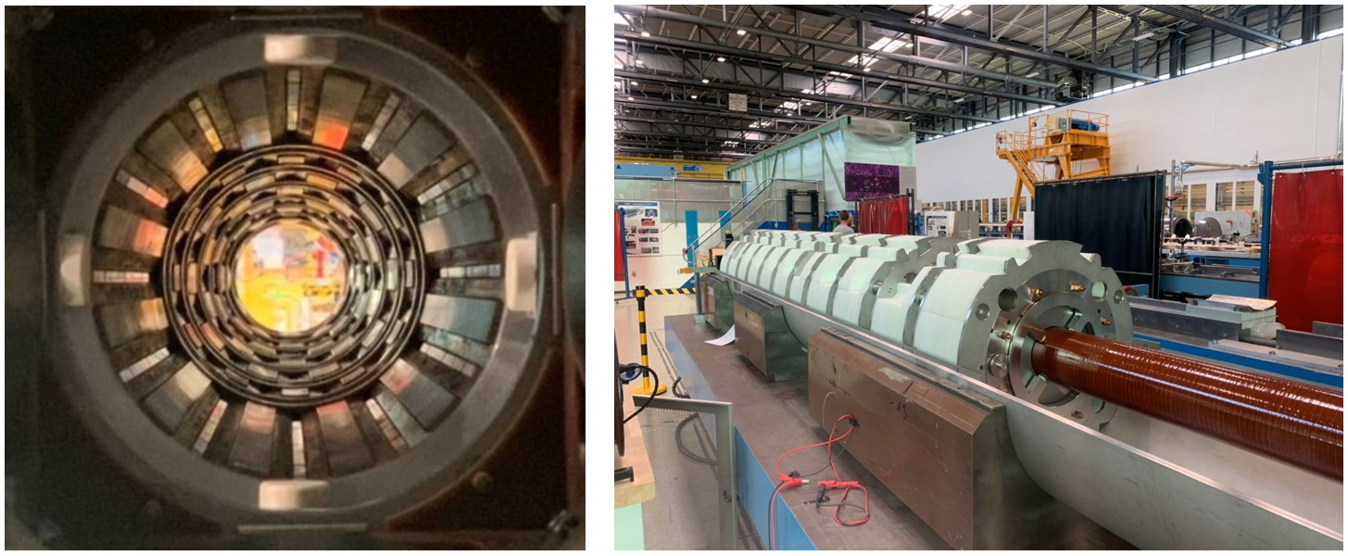


Dipole Orbit and Higher Order corrector magnets
Cryogenics by-pass
Nested dipole orbit correctors from Elytt in Spain
Canted Cosine Theta Corrector production from IHEP/Bama in China
Higher Order Corrector Magnets from LASA in Italy

Slide 19
QDS
UR55
Warm Diodes
CLIQ
PIC,BIS
CDBs
OC EE
Valve box
DFHX
D2 OC PCs
DFHM
US57
D2 PC
D1 PC
OC PCs
UW57
PC IT
PCs IT Trims
CDBs
DSHX
D2 OC EE
UL57
Cold box
DSHM
UA57
D1
CP
Q3
Q2B
Q2A
Q1
RF Powering
DFM
DCM
Cooling and Ventilation
DFX
UPR57
Cold Diodes
TAXN
D2
DQHDS
Crab
Cavities
Q4
Q5
Requires novel cold powering system to connect equipment in new UR galleries to tunnel
Q6
19

Slide 20
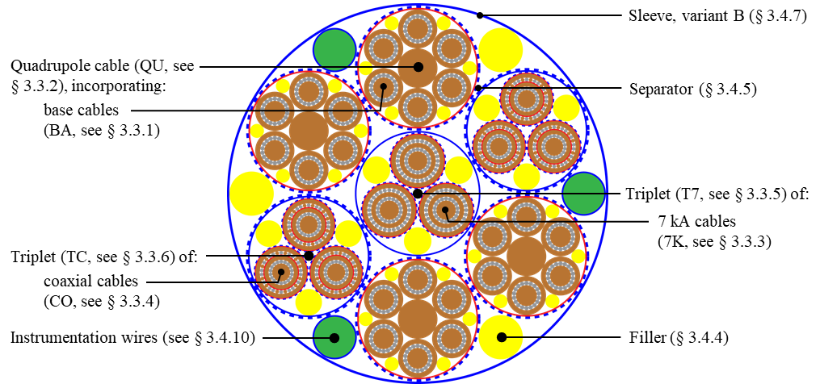
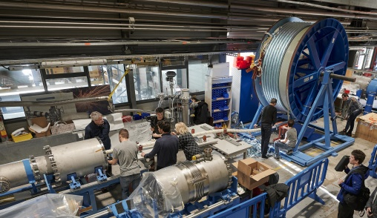
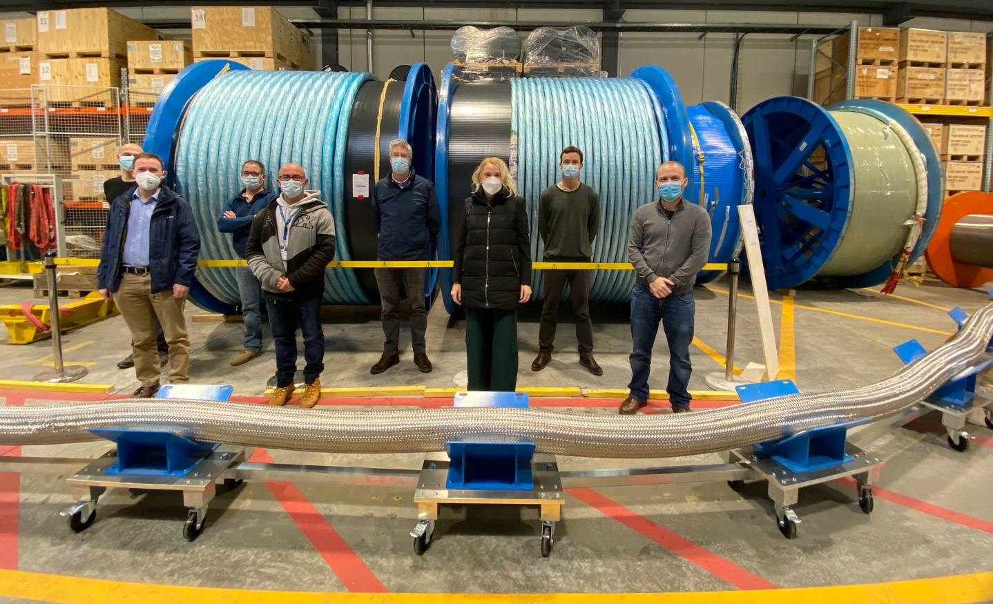
Flexible MgB₂ superconducting links
Demonstration of 2 x 20kA +
2 x 7kA in June’20
in MgB₂ @ 30K
in flexible cryostat
over 60m [54kA total]
MgB₂ cable:
Φ ∼ 90 mm
|Itot| > 100 kA @ 25 K
Φ∼ 90 mm
MgB₂
L= 60 m
20

Slide 21
QDS
UR55
Warm Diodes
CLIQ
PIC,BIS
CDBs
OC EE
Valve box
DFHX
D2 OC PCs
DFHM
US57
D2 PC
D1 PC
OC PCs
UW57
PC IT
PCs IT Trims
CDBs
DSHX
D2 OC EE
UL57
Cold box
DSHM
UA57
D1
CP
Q3
Q2B
Q2A
Q1
RF Powering
DFM
DCM
Cooling and Ventilation
DFX
UPR57
Cold Diodes
TAXN
D2
DQHDS
Crab
Cavities
Q4
Q5
Q6
21

Slide 22
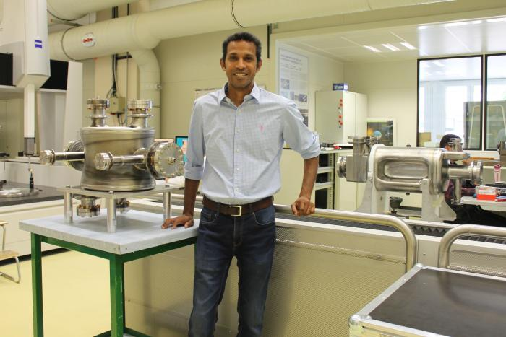
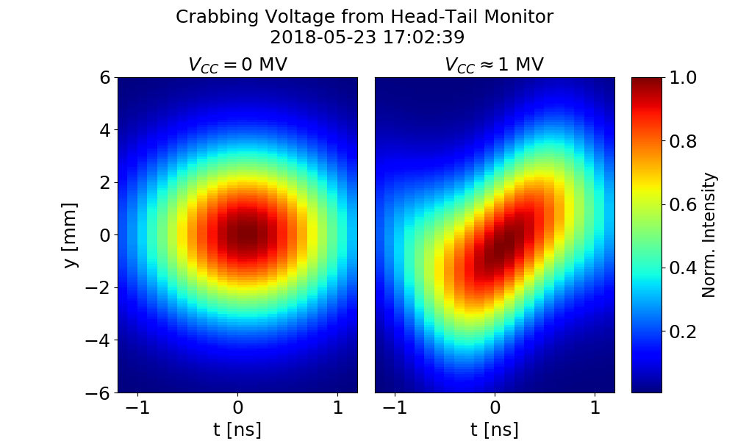
Crab cavity development
Serving to mitigate the effect of the crossing angle at the IP
Create an oscillating transverse electric field that kicks head and tail of the bunches in opposite directions
Double ¼-wave (DQW)
RF Dipole

Slide 23
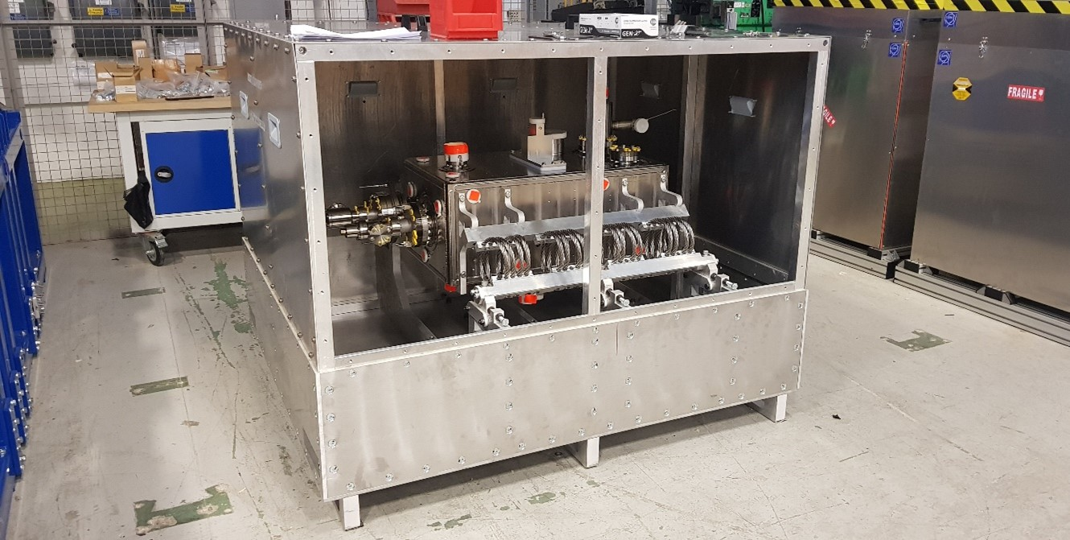
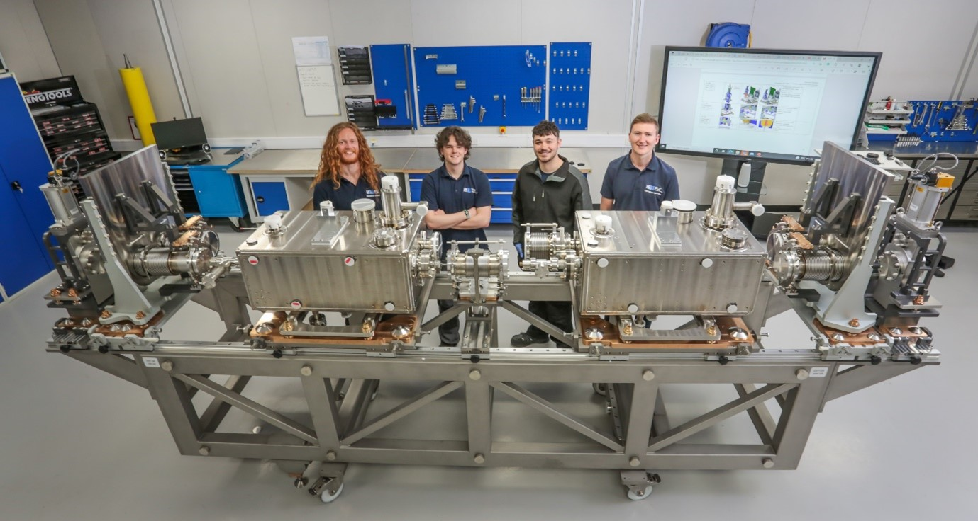
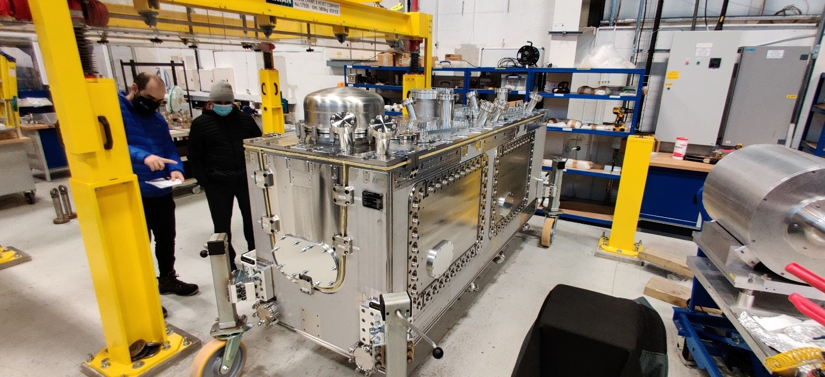
RFD Cryo-Module assembly in UK
Cryogenics by-pass
Completed RFD Cryo-Module to be installed in SPS for final beam validation in 2024
RFD Cavity in Transport Frame on arrival at Daresbury Laboratory
Outer vacuum Chamber
Cavity String prior to Cleanroom assembly

Slide 24
Outline
LHC physics achievements and prospects and the HL-LHC physics case
The HL-LHC upgrade project
Civil engineering
Final focusing magnets for lower beta*
Superconducting Link
Crab cavities
Inner Triplet Magnet String in SM18
HL-LHC as a truly international project
Performance ramp-up in the HL-LHC era

Slide 25
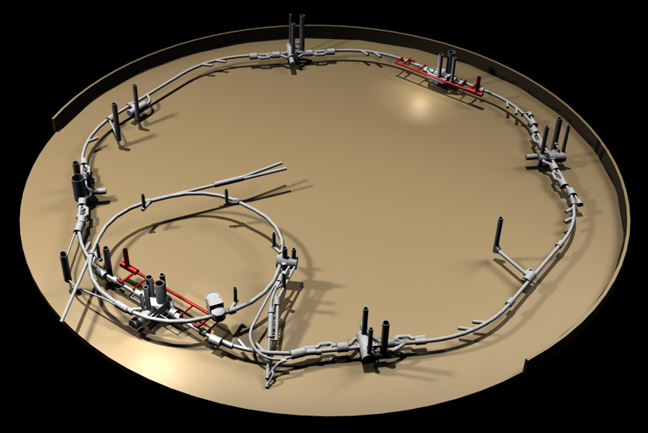
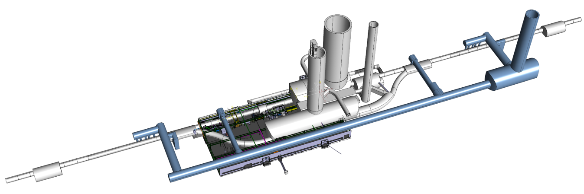
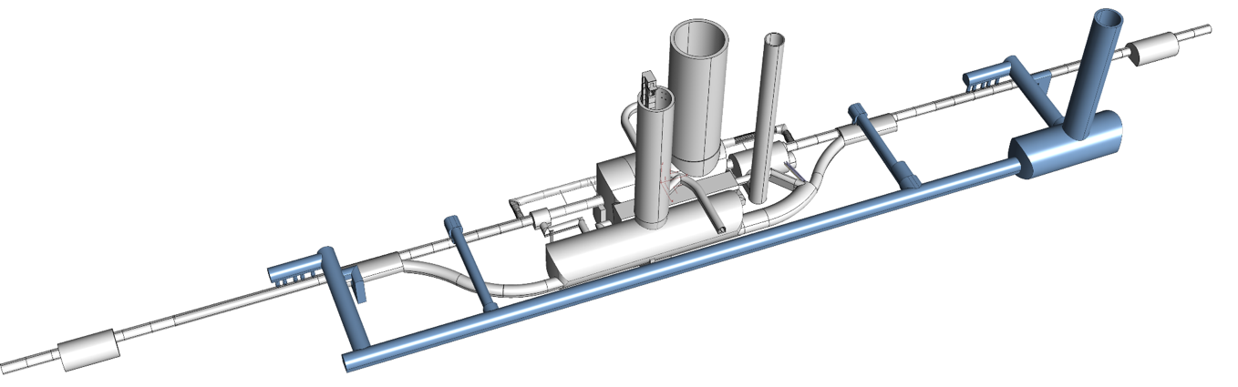

HL-LHC IT STRING: P5L
P4
P5
P5
P3
P2
HL-LHC
P6
P5R
SPS
P7
P1
P5L
P8
HL-LHC Cost & Schedule Review 2022, November 2022

Slide 26
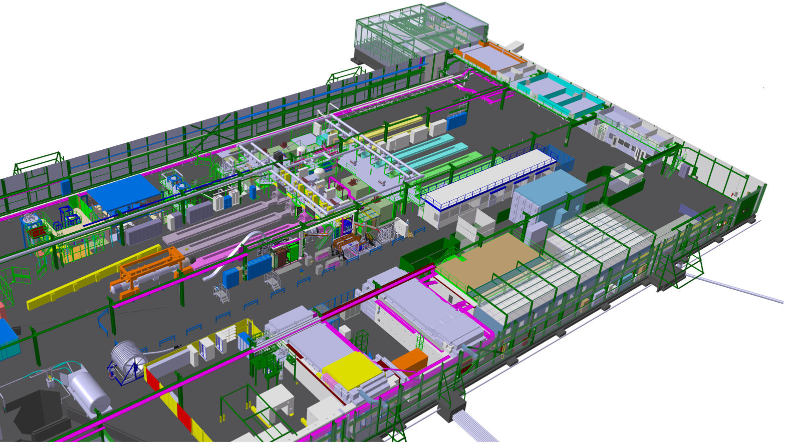
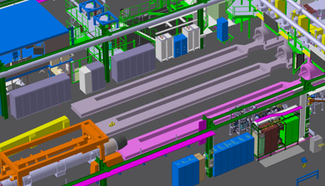

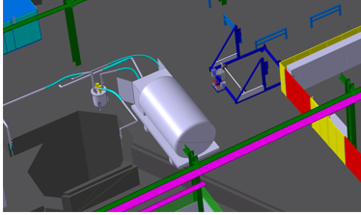
HL-LHC testing facilities in SM18
Magnet Testbenches
IT Test Area
SRF Section
Cold-powering Test Area

Slide 27
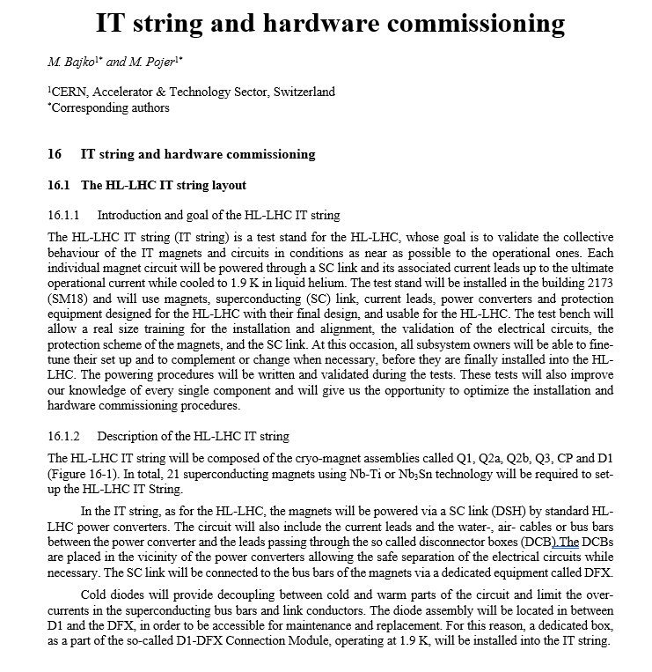
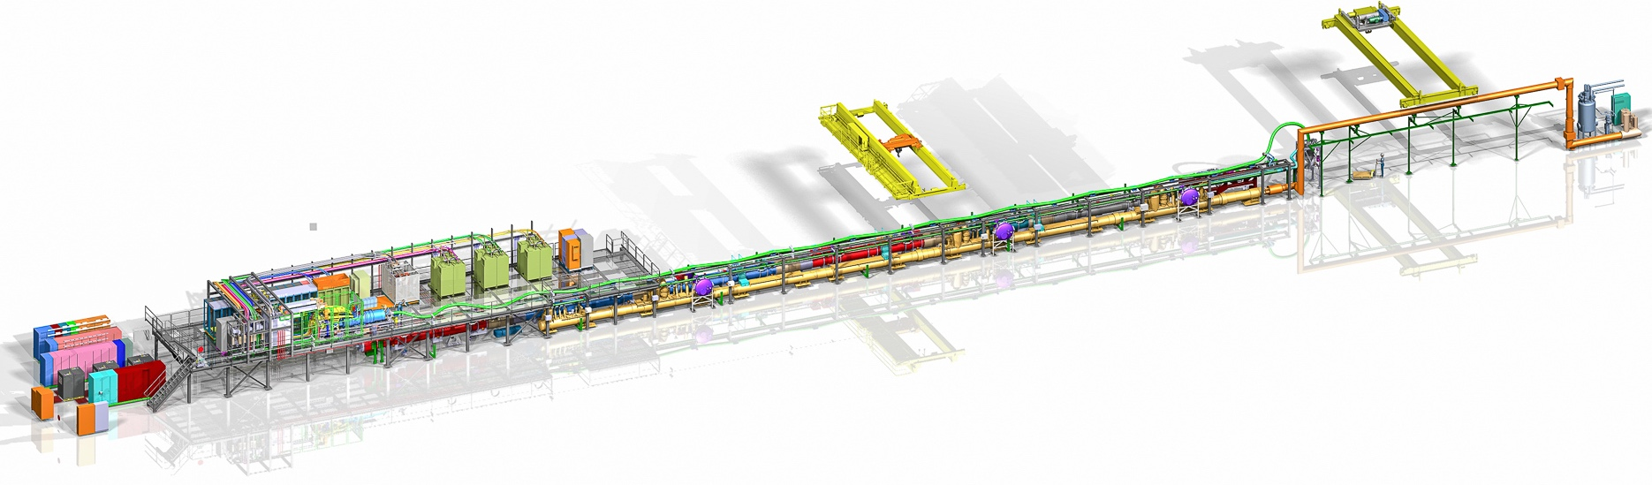
The IT STRING Scope
The scope of the IT STRING is to represent, as best as reasonably achievable in a surface building, the various operation modes to STUDY and VALIDATE the COLLECTIVE BEHAVIOUR of the different systems of the HL-LHC’s IT zone (magnets, magnet protection, cryogenics of the magnets andof the superconducting link, magnet powering, vacuum, alignment, interconnections between magnets, and the superconducting link itself).
The IT STRING will deliver the first complete experience of installing and operating the IT zone
Ref. HL-LHC IT STRING Scope https://edms.cern.ch/document/1693312/1

Slide 28
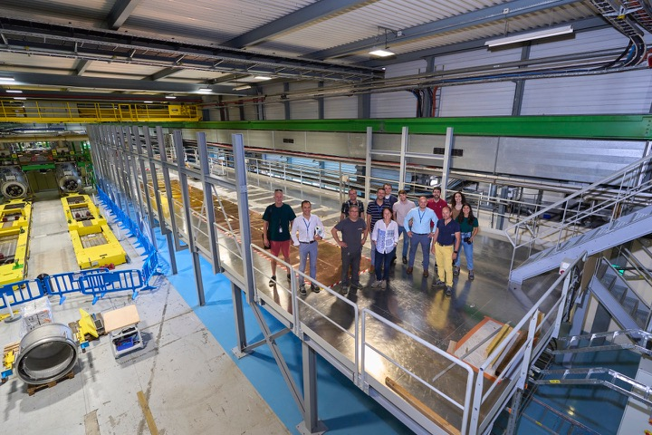
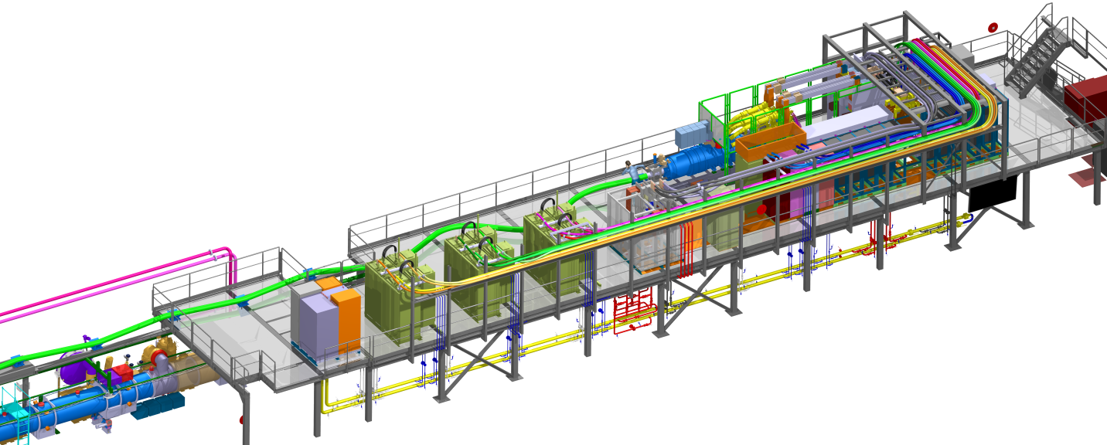
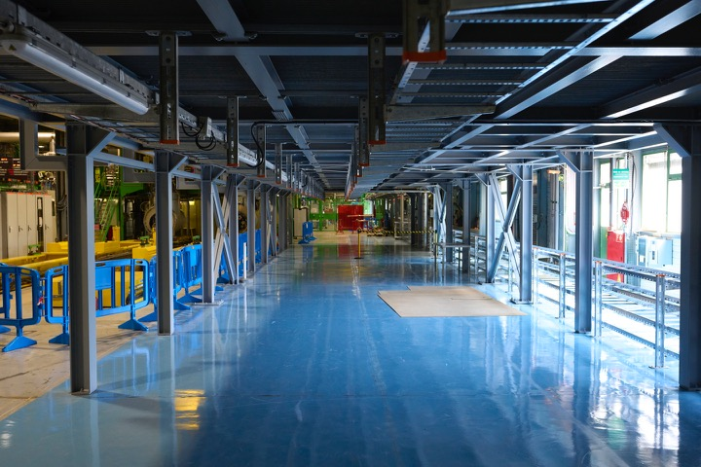
Status in pictures
On top of the metallic structure
Under the metallic structure

Slide 29
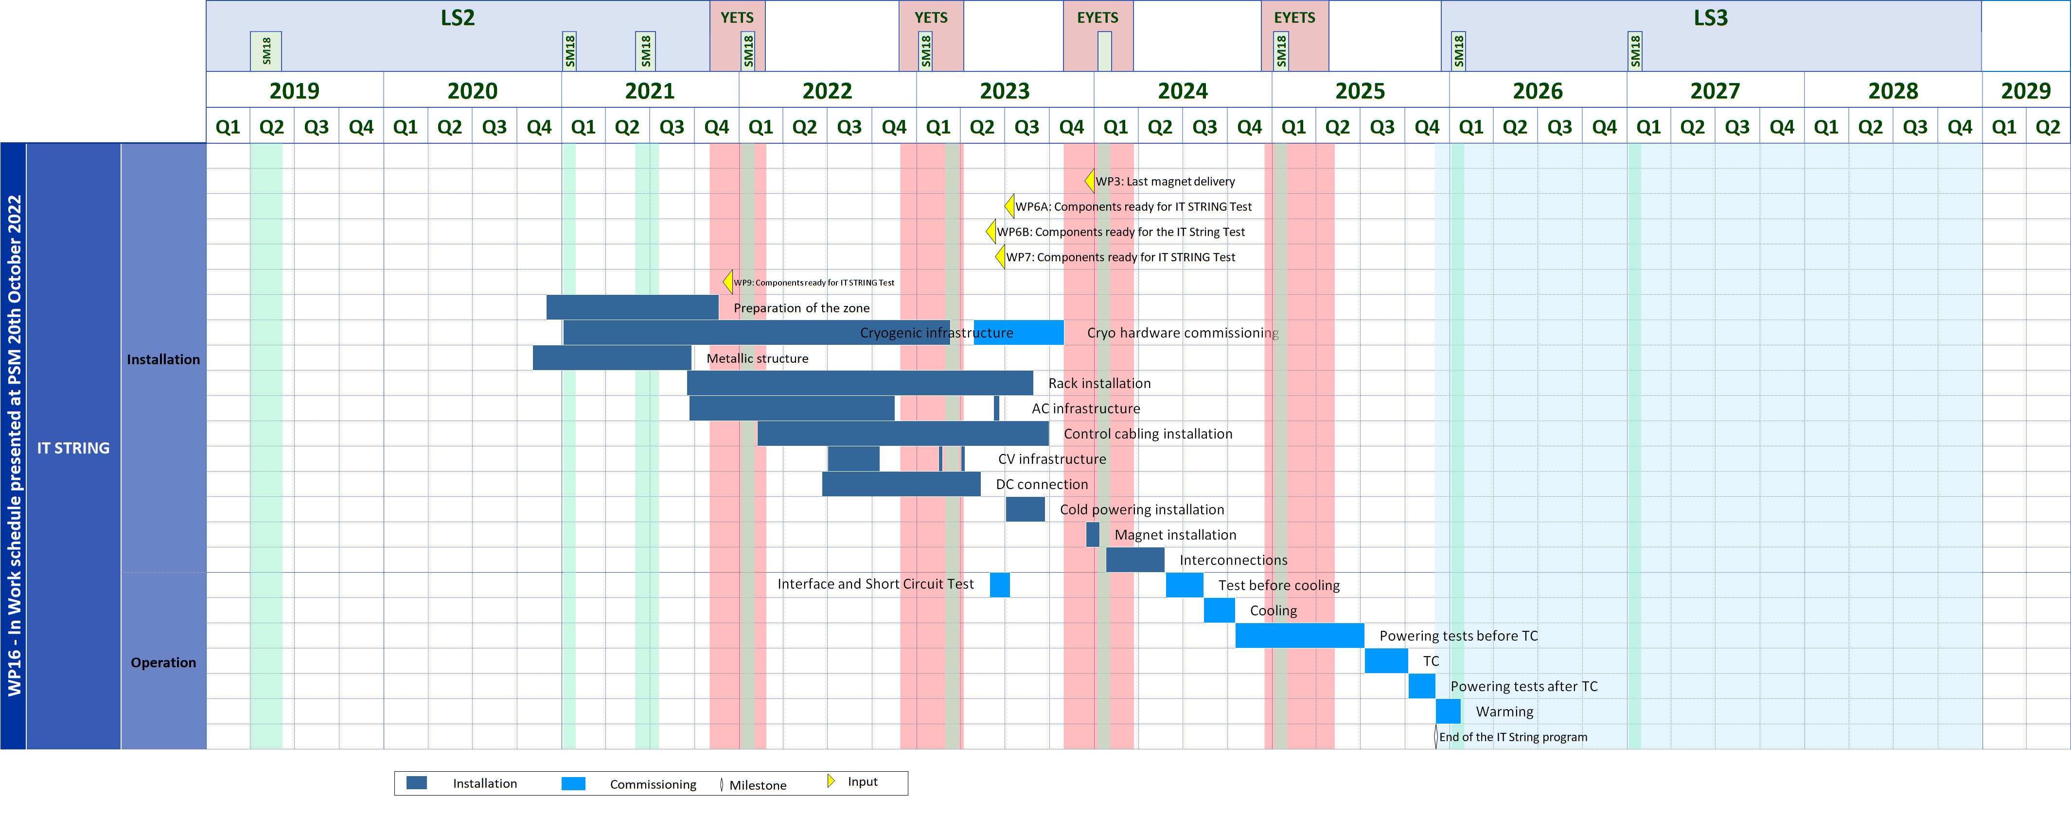
WP16 – The String
Resources for String and LS3 are shared
November 2022

Slide 30
Outline
LHC physics achievements and prospects and the HL-LHC physics case
The HL-LHC upgrade project
Civil engineering
Final focusing magnets for lower beta*
Superconducting Link
Crab cavities
Inner Triplet Magnet String in SM18
HL-LHC as a truly international project
Performance ramp-up in the HL-LHC era

Slide 31
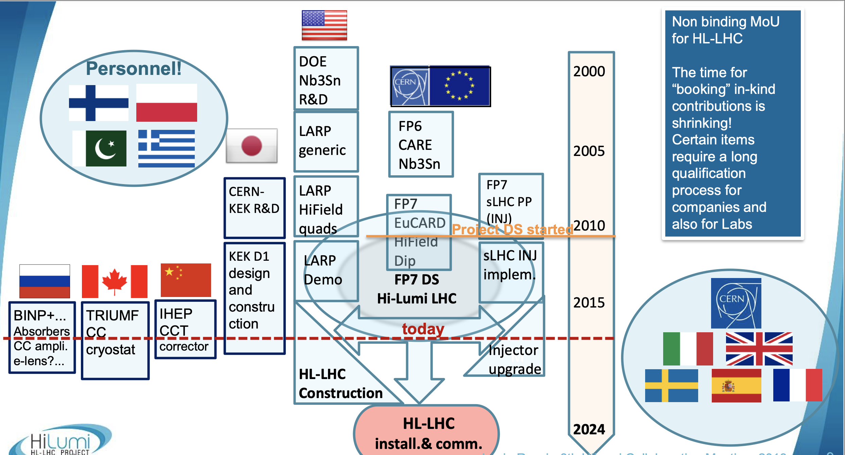
HL-LHC is a world-wide collaboration!

Slide 32






Truly International Collaboration offering exiting opportunities!
Connection to LHC (UL)
Service gallery (UR)
DFHM
DFHX
SC Links
Q2a
Q1
TAXS
Q2b
Q3
CP
DFX
D1
DFM

Slide 33
Truly International Collaboration offering exiting opportunities!
UA gallery
Service cavern
(BBLR)
Q4
Crab cavities
D2
Collimators
TAXN

Slide 34
Outline
LHC physics achievements and prospects and the HL-LHC physics case
The HL-LHC upgrade project
Civil engineering
Final focusing magnets for lower beta*
Superconducting Link
Crab cavities
Inner Triplet Magnet String in SM18
HL-LHC as a truly international project
Performance ramp-up in the HL-LHC era

Slide 36

Start of HL-LHC exploitation and performance ramp-up

Slide 37


TDR V1.0 - The last version of the TDR including the added scope - 2020
V0.1 Published in electronic version for the October 2016 Cost & Schedule review
EDMS: 1723851
and as CERN Yellow Book in October 2017
Updated Version V 1.0 published as
CERN Yellow Book in December 2020
https://e-publishing.cern.ch/index.php/CYRM/issue/view/127

Slide 38
Thank you for your attention!
Question?

Slide 39
SPARE SLIDES

Slide 40


Recall
Injector complex started again in 2021 following deployment of the LHC Injectors Upgrade in LS2. Excellent progress since in achieving the HL-LHC beam characteristics.
LHC in 2021 - hardware commissioning and a long dipole magnet training campaign opening the way to operation at 6.8 TeV (via 3 sector WU-CDs).
Booster
“Beam Size”
Protons per bunch

Slide 41

2022 – Q2
Started Beam Commissioning Friday 22 April
Week’s stop for LHCb VELO side A installation mid-May
1st June
T₀
1st May
Re-commissioning with beam

Slide 42


25th April - First beams at 6.8 TeV
T₀ + 3 days
No big deal on the day but on the back of a long training and powering test campaign

Slide 43





Commissioning progress
First nominal intensity bunches at 6.8 TeV
Stable beams at 900 GeV
T₀ + 35 days
T₀ + 36 days
President of the Swiss Confederation
President of Slovakia
First collisions at 6.8 TeV
T₀ + 40 days

Slide 44

Crab cavity development for the HL-LHC
Attempt to claw back the very significant reduction in luminosity from the large crossing angle
Create an oscillating transverse electric field that kicks head and tail of the bunches in opposite directions
Serving to mitigate the effect of the crossing angle at the IP
Challenging space constraints:
➔ requires novel compact
cavity design
effective cross section

Slide 45
HL-LHC testing facilities in SM18
Magnet Testbenches
IT Test Area
SRF Section
Cold-powering Test Area

Slide 46




IT String Installation in SM18
Important milestone for demonstrating functionality of integrated system before LS3:
Overall interface compatibility
Vacuum and cryogenic functionality
Electrical system performance
Magnet protection system and CLIQ
Final validation of the cold powering system
Validation of installation and
commissioning procedures etc…
Notes:
To be updated: Better pictures from Marta in her C&SR preparation meeting presentation

Slide 47

Operational Scenario for HL-LHC
Event pile-up in experiments >200
Levelling with
crab-cavity
1x10³⁴ cm⁻²s⁻¹

Slide 48


LHC Injector Upgrade
HL-LHC performance relies on more intense and brighter bunches from injector complex (2.2E11p / 2um at SPS extraction wrt to LHC nominal of 1.15E11p / 3.4um)
25ns beam limited by space charge in PS, PSB, SPS; SPS RF power and SPS longitudinal instabilities
50ns beam limited by PS longitudinal instabilities & SPS space charge and SPS TMCI

Slide 49

Peak luminosities of Hadron colliders
LHC
HL-LHC
Worldwide Integrated Luminosity prior to LHC: ca. 11 fb⁻¹
LHC Design Goal: 300 fb⁻¹ ➔ LHC likely to reach end of Run3: 350 fb⁻¹ to 400 fb⁻¹
HL-LHC goal: 3000 fb⁻¹ to 4000 fb⁻¹ !
x 35
x 10
Proton / Proton
Proton / Anti-proton
V. Shiltsev,
Physics Uspekhi 55
(2012) 965
Polarized Proton / Proton
Electron / Proton
2020
2030
49

Slide 50
Introduction: LHC Performance Goals
Collision energy: Higgs discovery requires E_{CM} > 1 TeV
p collisions E_{beam} > 5 TeV LHC: E = 7 TeV
[3.5/4TeV; 6.5TeV; 6.8TeV]
Instantaneous luminosity: rate of events in detector
rare events L > 10³³cm⁻²sec⁻¹ L = 10³⁴cm⁻²sec⁻¹
[2×10³⁴cm⁻²sec⁻¹]
Integrated luminosity: total number of events L
300 fb⁻¹ with 1barn = 10⁻²⁸m² and femto = 10⁻¹⁵
[220 fb⁻¹]
depends on the beam lifetime, the LHC cycle and
‘turn around’ time and overall accelerator efficiency

Slide 51
LHC Performance
Over 160 fb⁻¹ at 13 TeV so far with
Collected ~26 fb⁻¹ at 13.6 TeV
ca. 70 fb⁻¹ / year at hand!!!
Peak Luminosity close to 2x10³⁴ cm⁻²s⁻¹ and
recent fills with close to 1 fb⁻¹/day !!!
➔ > 400 fb⁻¹ expected by the end of LHC Run3!!!
Cours de Printemps du LAL: April 23rd to 25th 2016
L. Rossi and O. Brüning; Visit of Dr. Hasan Mandal; Thursday 28th November 2019
Notes:
To be updated with last version before the CMSDAS meeting

Slide 52

First Stable Beams at 13.6 TeV – 5th July

Slide 53

CMS Integrated Luminosity, pp , 2022

Slide 54

2022 GPD records (courtesy ATLAS)
Stunning performance!

Slide 55
New interaction region layout
New insertion and final focusing magnets
Main quadrupole magnets MQXFA (Q1, Q3) from AUP and MQXFB (Q2) from CERN
Superconducting separation and recombination dipoles, D1 from Japan and D2 from Italy
Higher Order Corrector package (CP) and orbit correctors (MCBX) from Italy and Spain
ATLAS
CMS
LHC
ATLAS
CMS
HL-LHC

Slide 56

SC Magnet technology for HL-LHC
Nb₃Sn
HL-LHC with 11-12T
16 T for HEP
Almost a commodity!
15-20 t per year for MRI
ITER needs 500 t
ca x5 cost LHC Nb-Ti
Brittle material
HTS (needed → 20 T)
➔ on going R&D!
Bi-2212: cost today 2-5x Nb₃Sn
YBCO: cost today 10x Nb₃Sn
56

