Slide 1
Energy communications…
Anna Cook (HSE) & James Gillies (IR-ECO)
EPPCN, 23 November 2022

Slide 2
…it’s a hot topic!
The current energy crisis
Long term concerns
ISO50001
Materiality
A framework for energy communications

Slide 3
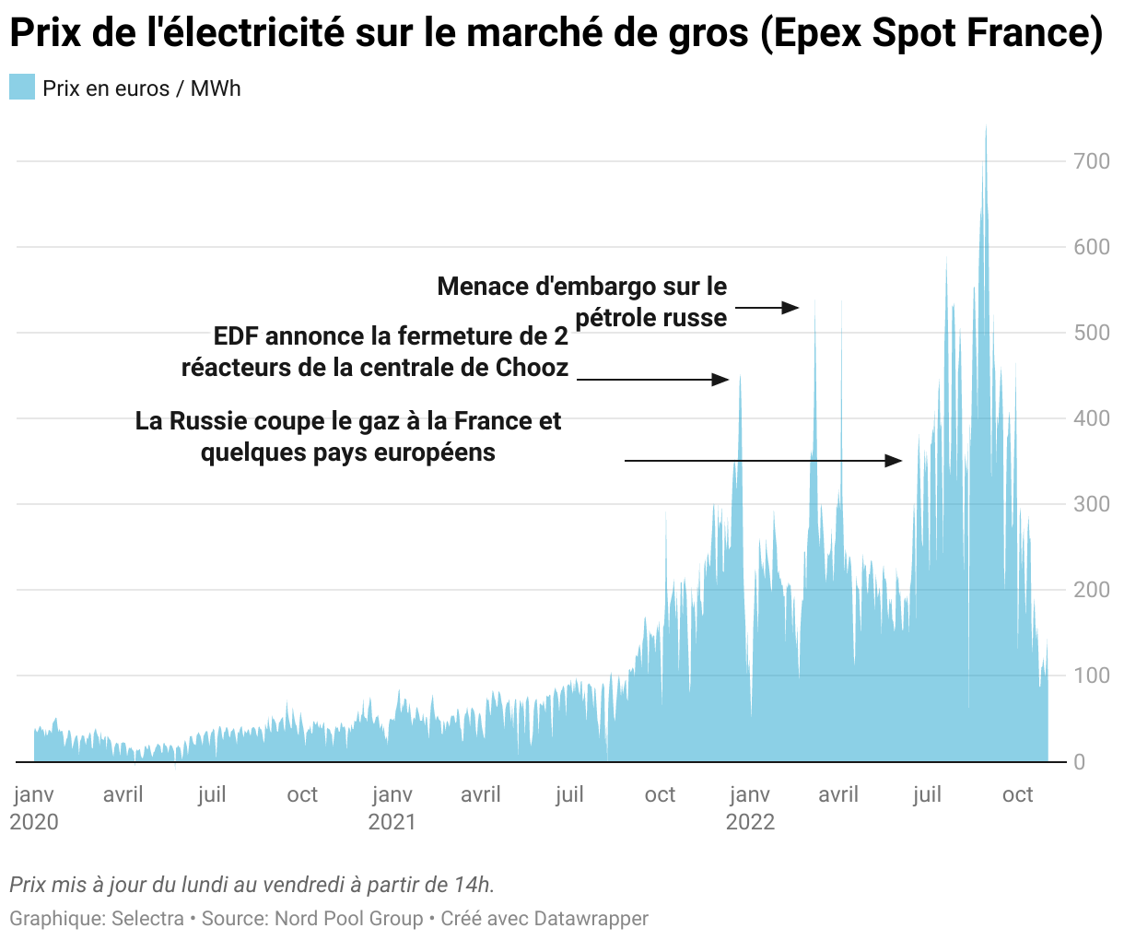
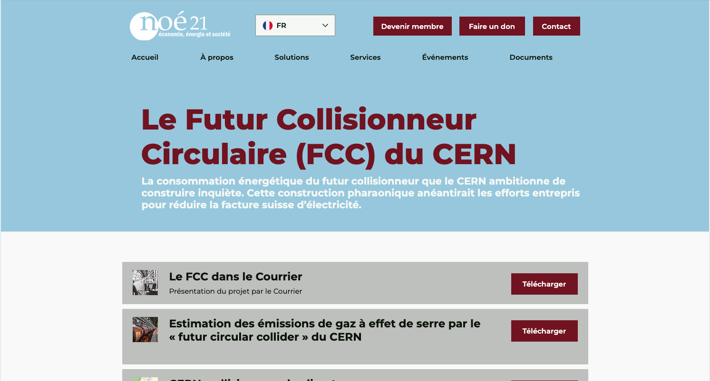
The situation today:

Slide 4
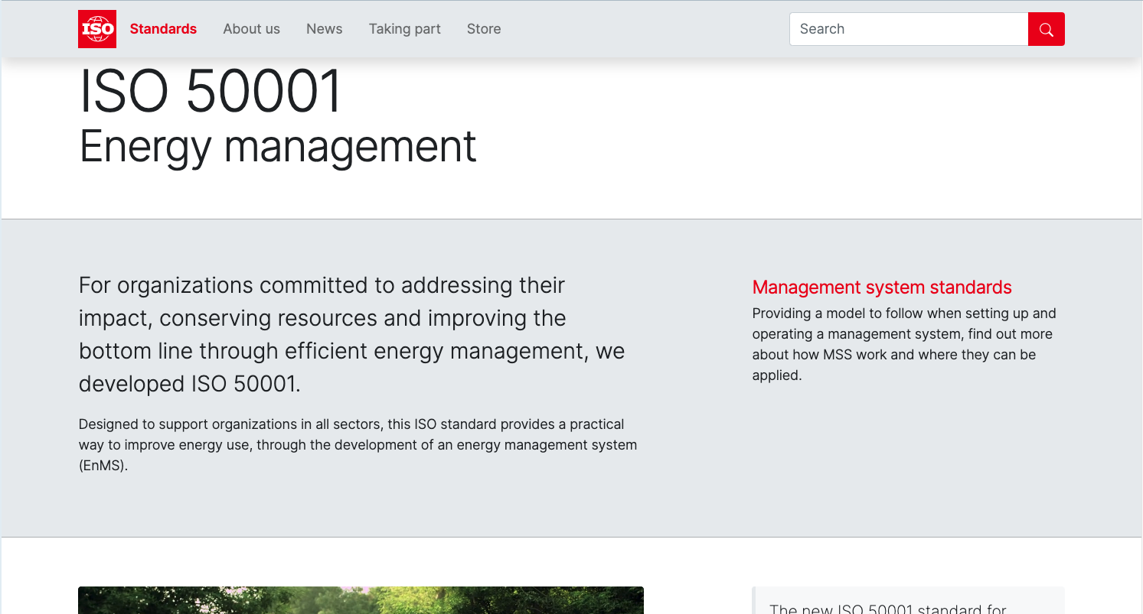
The following slides are from Nicolas Bellegarde, CERN Energy Coordinator

Slide 5
ISO 50001 – Content
1. Plan
2. Do
Leadership and commitment
Energy policy
Organization roles, responsibilities and authorities
Energy planning
Energy review
Energy baseline
Energy performance indicators
Objectives, energy targets and action plans
Resources
Competence, training, awareness
Communication
Documentation
Operation
Operational planning and control
Design
Procurement
Continual improvement
loop
4. Act
3. Check
Monitoring, measurement, analysis
Evaluation of compliance with legal requirements and other requirements
Internal audit
Documented information
Management review
Improvement

Slide 6
Current status
Energy Performance Plan submitted to French authorities on 30 June
Preliminary assessment mid October (go/no go) – AFNOR
Management review to be scheduled by end of October
Internal audit tentatively scheduled on week 45 (7 – 11 November) – EDF
Certification audit scheduled on week 48 (28 November – 2 December) – AFNOR

Slide 7
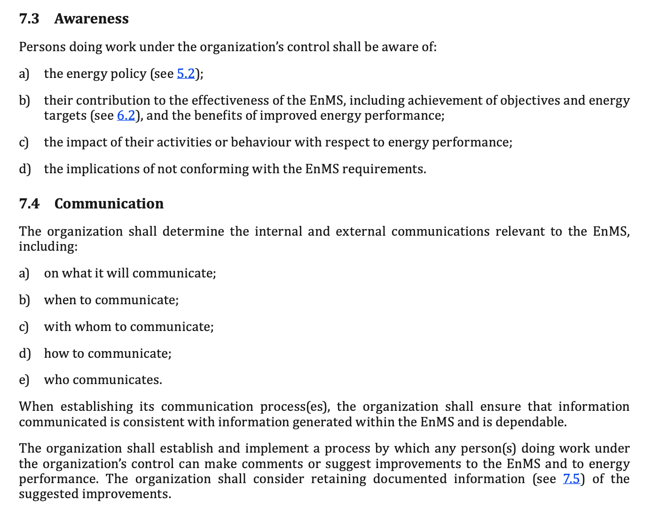
Communication requirements

Slide 8
Communication plan
What | When | With whom | How | Who
Energy policy | First version end of September 2022 Every year if revised | All members of the personnel External (public, voisins, authorities) | Bulletin Screens + Posters Website Email if decided by ED Relevant webistes and meetings for external communication | HSE + IR-ECO
Energy Performance Plan | Every year (around June) | CERN’s management & other relevant internal stakeholders (incl. committees and Council) External (authorities) | Via EDMS Relevant committees’ and authorities’ communication channels Dedicated platform for submission to French authorities | Energy Coordinator + Executive Management
Annual session on energy management | Once a year | All members of the personnel | Annual meeting | Energy Coordinator + CEPS
Community inputs | Continuous | All members of the personnel | Dedicated e-mail address Mattermost channel Ad-hoc suggestion box campaigns | HSE + IR-ECO

Slide 9
Communication plan
What | When | With whom | How | Who
Awareness campaign | Ad-hoc | All members of the personnel | Bulletin Screens + Posters Website Emails | HSE + IR-ECO + Concerned Departments
CERN’s energy consumption breakdown | Continuous | All members of the personnel | Access to WebEnergy (energy.cern.ch) | EN-EL
Official reports (annual reports, environmental reports, annual progress reports) | Every year (annual report and annual progress reports) Every 2 years (environmental reports) | All members of the personnel (annual and environental reports) External (public, voisins, authorities for annual and environmental reports) Other relevant internal stakeholders (incl. committees and Council) for all reports | Bulletin Website Relevant committees’ and authorities’ communication channels | HSE + IR-ECO
ISO 50001 certificate | Every 3 years | All (internal and external) | Press release Press conference Bulletin Website | IR-ECO

Slide 10
CERN 3rd Environment report Materiality Assessment update

Slide 11


Context
CERN as a role model for environmentally responsible research
Choice of the Organization
CERN actively monitors and reports on its environmental footprint:
to Host States and relevant authorities
on diverse subjects (RP, Water etc.)
Public-facing environment reports since 2020 :
1st Report: 2017 - 2018, published in September 2020
2nd Report: 2019 - 2020, published in November 2021
Now time to start the 3rd report (2021 – 2022)
Continued high quality reporting on established priorities according to GRI Global Reporting standards
NB: GRI covers three areas of sustainability: environmental, social and economical. The CERN reports deliberately focus on environmental aspects only.
https://hse.cern/environment-report

Slide 12

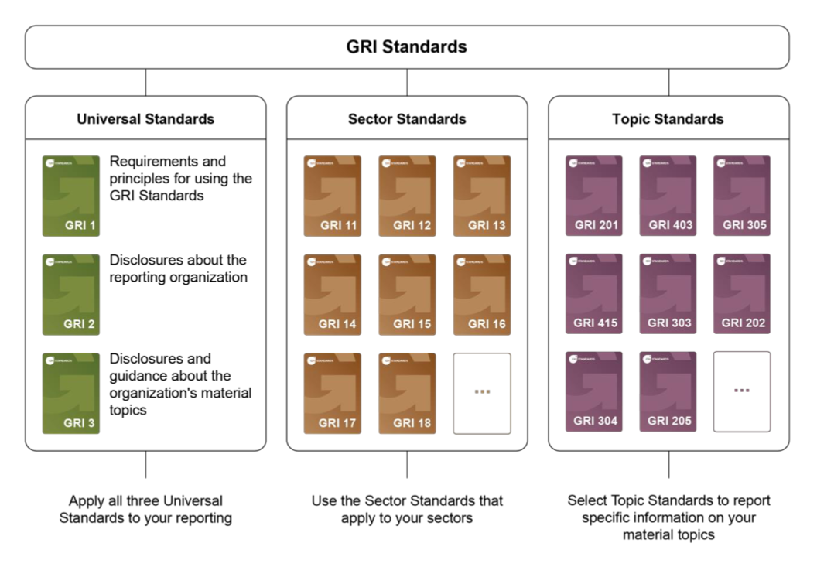
Global Reporting Initiative (GRI)
Methodology used worldwide:
73% of the world’s top 250 companies refer to GRI as part of their sustainability reporting
168 public policies in 67 countries and regions refer to GRI standards
Nearly 450 organizations from 68 countries are active in the GRI community
The GRI provides:
A methodology to conduct a materiality assessment
Guidelines for reporting
The GRI builds reputation and trust.

Slide 13
What is materiality?
“Materiality” is a term used in sustainability reporting.
In the CERN Environment Report context, material aspects are those reflecting the environmental impact of CERN and / or influencing (internal / external) stakeholders.
Materiality is an essential step in transparent reporting and a requirement of the Global Reporting Initiative (GRI).
The Materiality Assessment (MA) is the process of identifying the material aspects of the Organization.
This process includes 4 main steps: Identification, prioritisation, validation and review.
Last MA performed in 2019 with input from key internal and external stakeholders:
a list of significant topics was produced and used as the guiding thread in the development of both 1st and 2nd reports.

Slide 14





Process
Identification of
potentially material topics
Stakeholder interviews (internal/external)
Significance assessment
Analysis
Report-writing
I
Peers
Experts
NGOs
Journalist
II
Internal stakeholders
In-person
7 groups
5-6 participants per group
1.5h duration
External stakeholders
Online
13 interviews
>> Qualitative work based on perceptions
III
Assessment of the significance of potentially material topics
>> Semi-quantitative work
IV
Main material topics
Materiality matrix
Key messages, risks and opportunities
V
Reporting of material topics
3rd Environment Report
Step 1
Identification
Step 2
Consultation, prioritisation
Step 3
Analysis
Step 4
Conclusion

Slide 15
Process: consultations
Internal consultations | External consultations
In-person | Online
7 groups | 10 groups
5-6 persons per group | 1-2 persons per group
N = 31 | N = 13
90 minute discussions | 45 minute discussions
Context
GRI - materiality
Instructions
Top 5 topics selection
Discussion and feedback
“Which topics do you expect CERN to tackle as a priority?”
“Which topics may represent a concern for society if not addressed?”
“On which topic do you think CERN can play the biggest role to improve its impact on the environment?”
+ 2030 vision

Slide 16
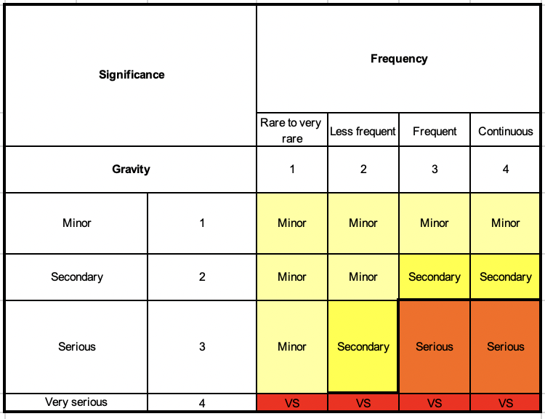
Process: determining the «significance » assessment
In the latest version of the standards (2021), the GRI requires an assessment of the significance of each topic as part of the materiality assessment.
This means a prioritisation of (potential) impacts.
“ The significance of a potential negative impact is determined by the severity and likelihood of the impact.” (GRI)
Therefore, to assess the significance of a given impact, a combination of the gravity and frequency of an impact was evaluated.
Significance assessment

Slide 17
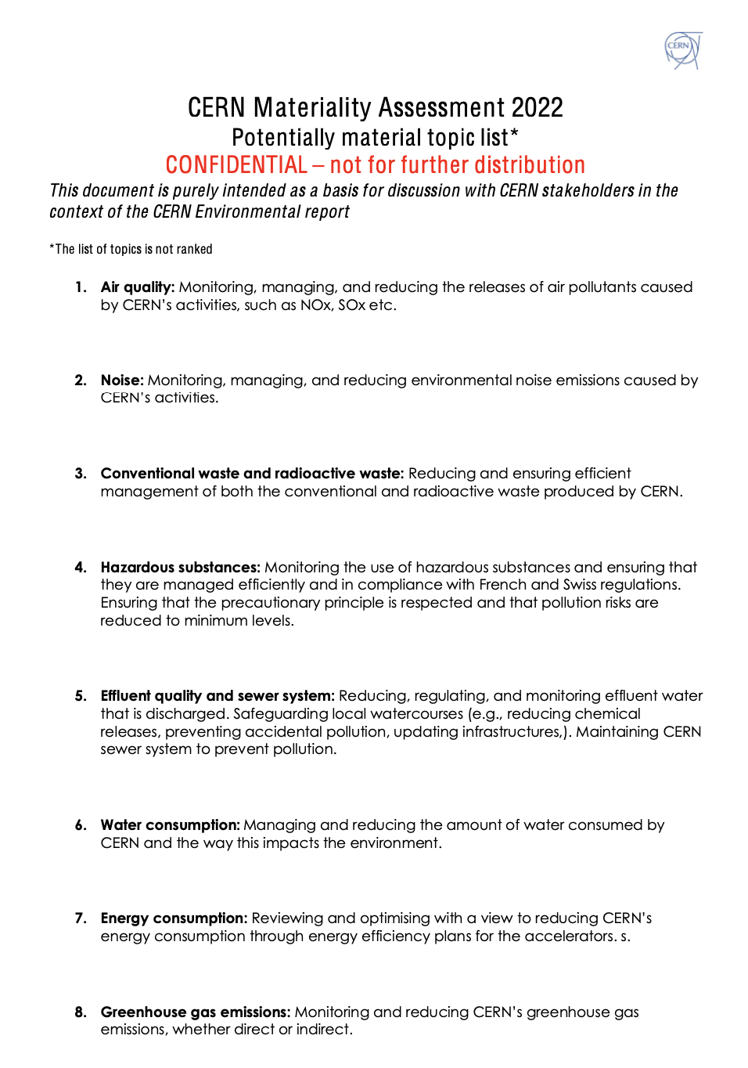
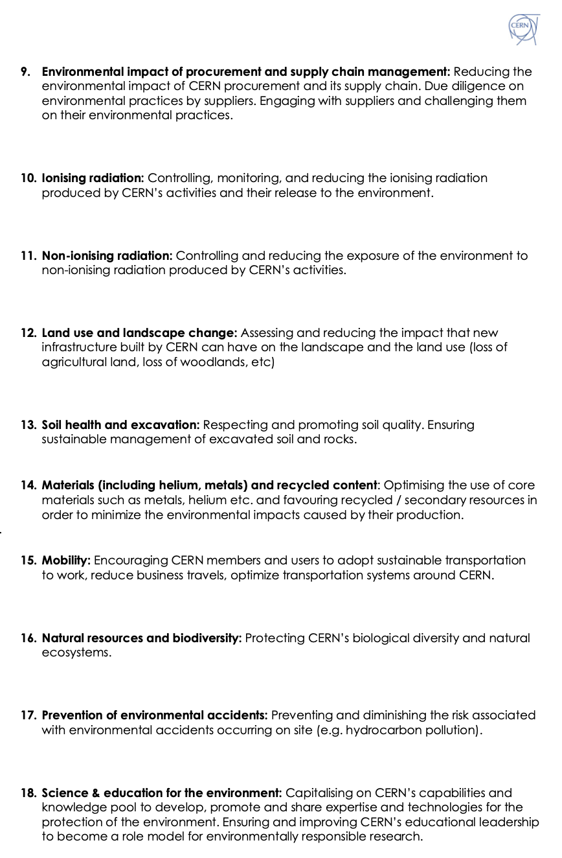
List of topics
Link to document
Most of the topics from the past materiality exercise were re-assessed (pre-prioritisation) and new topics were added e.g. land use and landscape change

Slide 18
Reaching the proposed materiality matrix
Consultations
Each topic was weighted based on their top 5 ranking by the participants (during the stakeholder consultations),
Scores have been brought back on a 10 points scale (including both the occurrence and weighted score based on the ranking).
A (subjective) threshold has been determined in order to identify material topics.
Significance
In parallel with the consultation process, a significance assessment was developed to prioritise impacts based on their gravity and frequency.
All topics that were deemed of serious or very serious significance are also considered to be material.
Materiality matrix
The combination of the consultations and significance assessment resulted in a prioritisation of material topics
Both approaches are complementary in the process of prioritising material topics.
Some topics previously integrated in the report took less priority this year. In this case, the topics were still considered as material, for the sake of continuity and transparency.

Slide 19
The 2022 Materiality matrix
Ionising radiation Natural resources and biodiversity Hazardous substances Materials | Energy consumption Greenhouse gas emissions Conventional waste and radioactive waste
Computer optimisation and networking(*) Soil health and excavation Non-ionising radiation Air quality | Mobility Prevention of environmental accidents Science and education for the environment Water consumption (including effluent quality) Noise Land use and landscape change Environmental impact of procurement, supply chain management
New material topics
Topic maintained for continuity
HIGH
Importance for external stakeholders
MEDIUM
MEDIUM
HIGH
Importance for CERN’s internal stakeholders
Resulting matrix based on results of both the internal vs. External stakeholders’ perceptions as well as the significance assessment.
Topics in the bottom left corner would not be covered in the report.
Although the priority decreased in the assessment this year for the topic in blue, it was decided to keep it in the report for the sake of continuity, transparency and importance in the past report.
(*) suggestion by an internal participant outside of the 18 topics initially identified.

Slide 20
Key messages
Climate change and in particular energy and GHG emissions as main concerns
Crucial need to be “a good neighbour” in France and Switzerland on various themes
(e.g. mobility, energy consumption, effluents quality)
Increased demand for clear indicators and KPIs (e.g. biodiversity)
Request for the report to have a more strategic tone (increased number of targets and how they are met in addition to reporting on progress)
Importance of the risk for CERN’s reputation and public image on many of these topics, if not well managed
Concerns about future projects and the need to strike a balance between pioneering and environmentally-responsible research (importance of acceptability)
Importance of efficient communication and playing the role of pioneer/leader in the scientific arena

Slide 21
External participants’ points of view
On communication
"CERN shouldn’t just pay lip-service but ensure it is honest and credible” (neighbouring town)
“CERN should act and be seen as a good neighbour.” (journalist)
Managing natural resources
“Water is shared by everyone. It’s a topic which can cause tension and lead to debates on a larger scale.”
(Safety authorities)
“Citizens will expect industrial operators, including CERN, to make greater efforts to reduce water consumption.” (Safety authorities)
On science and education:
“CERN should be a role model – that’s why science and communication are crucial.” (Member State)
The future of energy
"CERN must be a high-performer in energy efficiency” (neighbouring town)
"CERN should strive to develop energy-efficient technologies for accelerators to ensure future buy-in” (Member State)
The future of projects
“If we want to build bigger accelerators we need to come up with innovative solutions for the environment.” (Member State)

Slide 22


Top 5 topics (1/2)
Key messages from all stakeholders
#1 Energy consumption
The geopolitical context has put an emphasis on the energy crisis that the world faces.
CERN should continue its efforts in the refurbishment of existing facilities, the expansion of the use of renewables and the improvement of the energy efficiency of the accelerator.
#2 Greenhouse gas emissions
Fluorinated gases, energy efficiency and mobility are three topics that have emerged as important in relation to CERN’s environmental impact.
CERN should report its GHG emissions in a comprehensive way.

Slide 23



Top 5 topics (2/2)
Key messages from all stakeholders
#3 Conventional waste and radioactive waste
A comprehensive A-Z approach needs to be replaced by a more circular and collaborative way of thinking.
e.g. Collaboration is key - how can certain products and materials be used in other departments?
Strong trust in the Radiation Protection Tripartite Committee to deal with radioactive waste matters.
#4 Mobility
The promotion of sustainable travel could be emphasised to reduce GHG emissions while still allowing personnel to attend conferences and to network.
CERN should be fully integrated in the local community and support soft mobility.
#5 Ionising radiation
CERN has a responsibility to demystify for the public what the Organization does in this area.

Slide 24
Other key messages: future projects
Large projects haven't been won yet: “vigilant” enthusiasm expressed by certain interviewees.
If the FCC is built, it needs to be done differently to what has been done in the past.
It's an opportunity to do better for the environment.
The implementation has consequences, and it starts at the design stage (materials, resources, etc.).
This could be a new raison d'être for CERN in its vision of being a leader/pioneer in environmental responsible research.
This flagship project could push research and development towards the reduction of environmental impacts.
However, reticence is clear: the argument of the benefits of scientific research and innovation for Society is not sufficient.
Continued demonstration of an environmentally responsible approach is key.
→ This could help guarantee funding, acceptability for future projects and provide a license to operate.

Slide 25
Communications plan: who?
Ad-hoc working group drawn from these entities to ensure regular, coherent and coordinated communications.
Responsibility for these matters rests with various entities at CERN:
The Energy Coordinator,
The Energy Management Panel,
The Occupational Health and Safety and Environmental protection Unit (HSE),
The Site and Civil Engineering Department (SCE),
The FCC feasibility study,
CERN central communications group, IR-ECO.
IR-ECO: James Gillies (Chair)
CEPS: Benoît Delille (or representative)
SCE: Emeline Dolmazon
FCC feasibility study: Panos Charitos
Energy Coordinator: Nicolas Bellegarde (also representing EMP)
HSE: Anna Cook

Slide 26
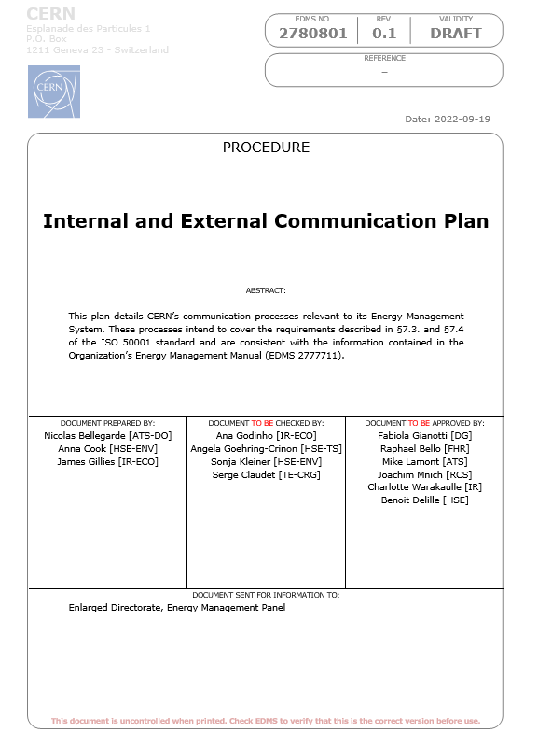
Communications plan: what?
Energy policy
Energy Performance Plan
CERN’s energy consumption breakdown
Annual session on energy management
Community inputs
Awareness campaigns
Official reports
Virtual invoices
ISO 50001 certificate

Slide 27
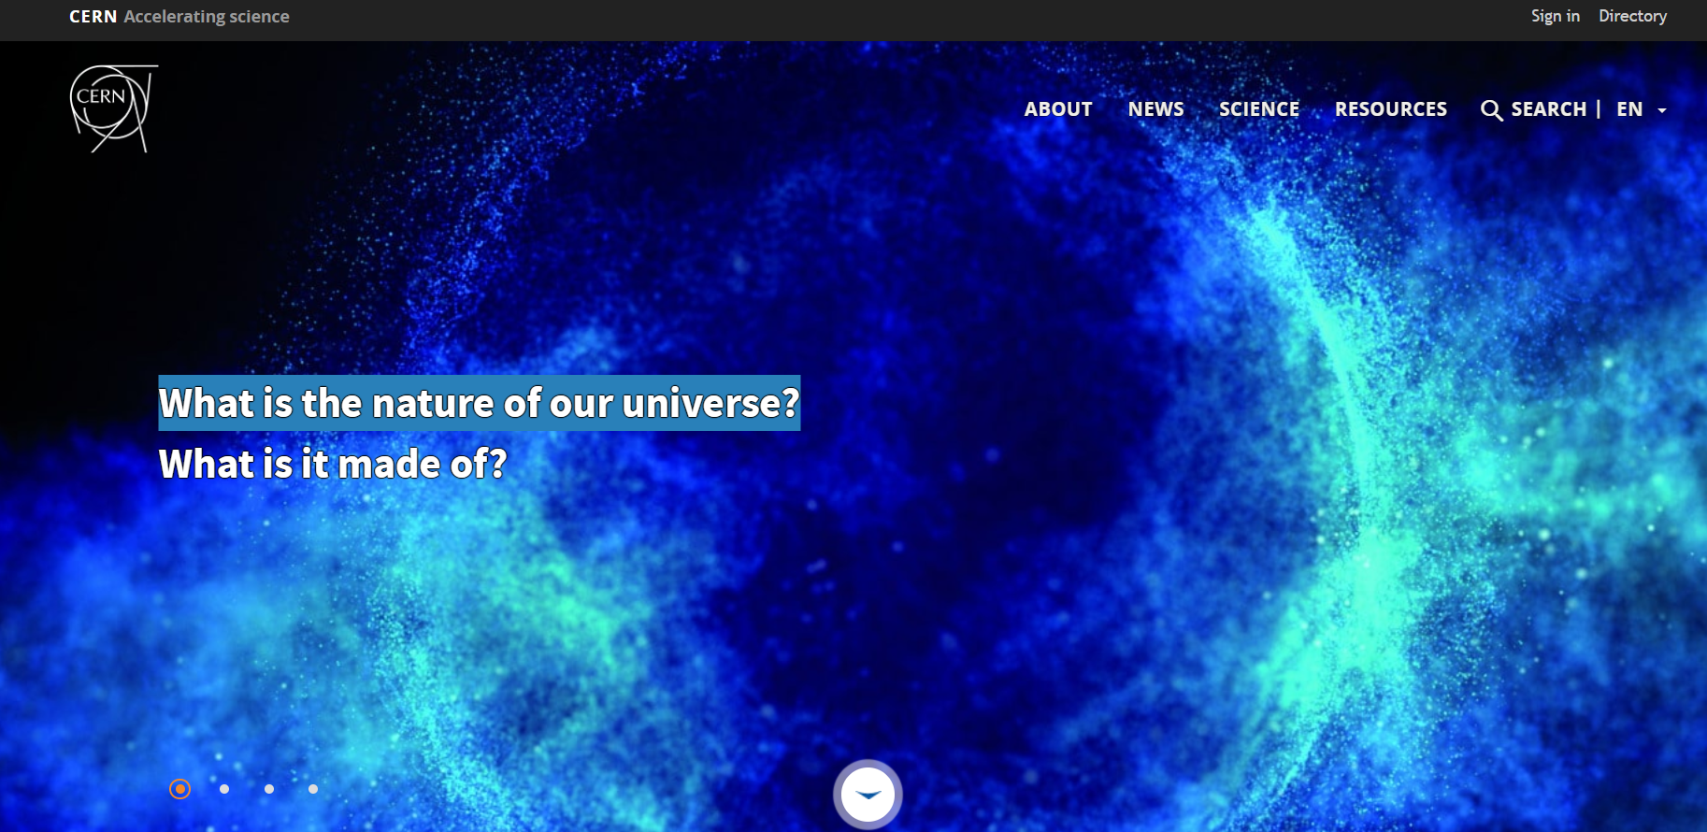
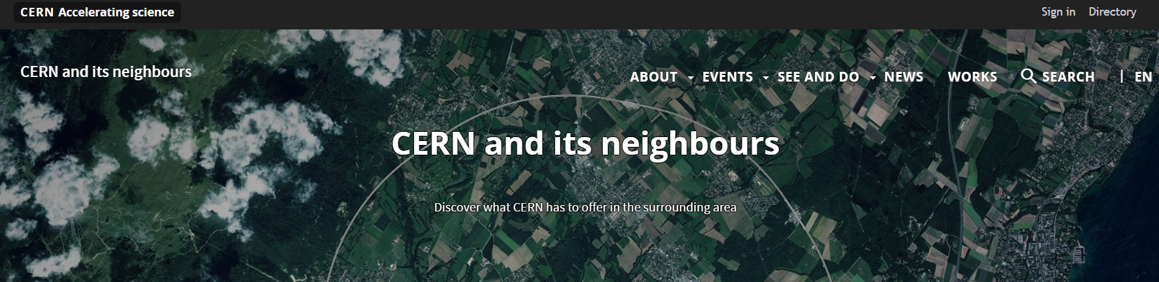
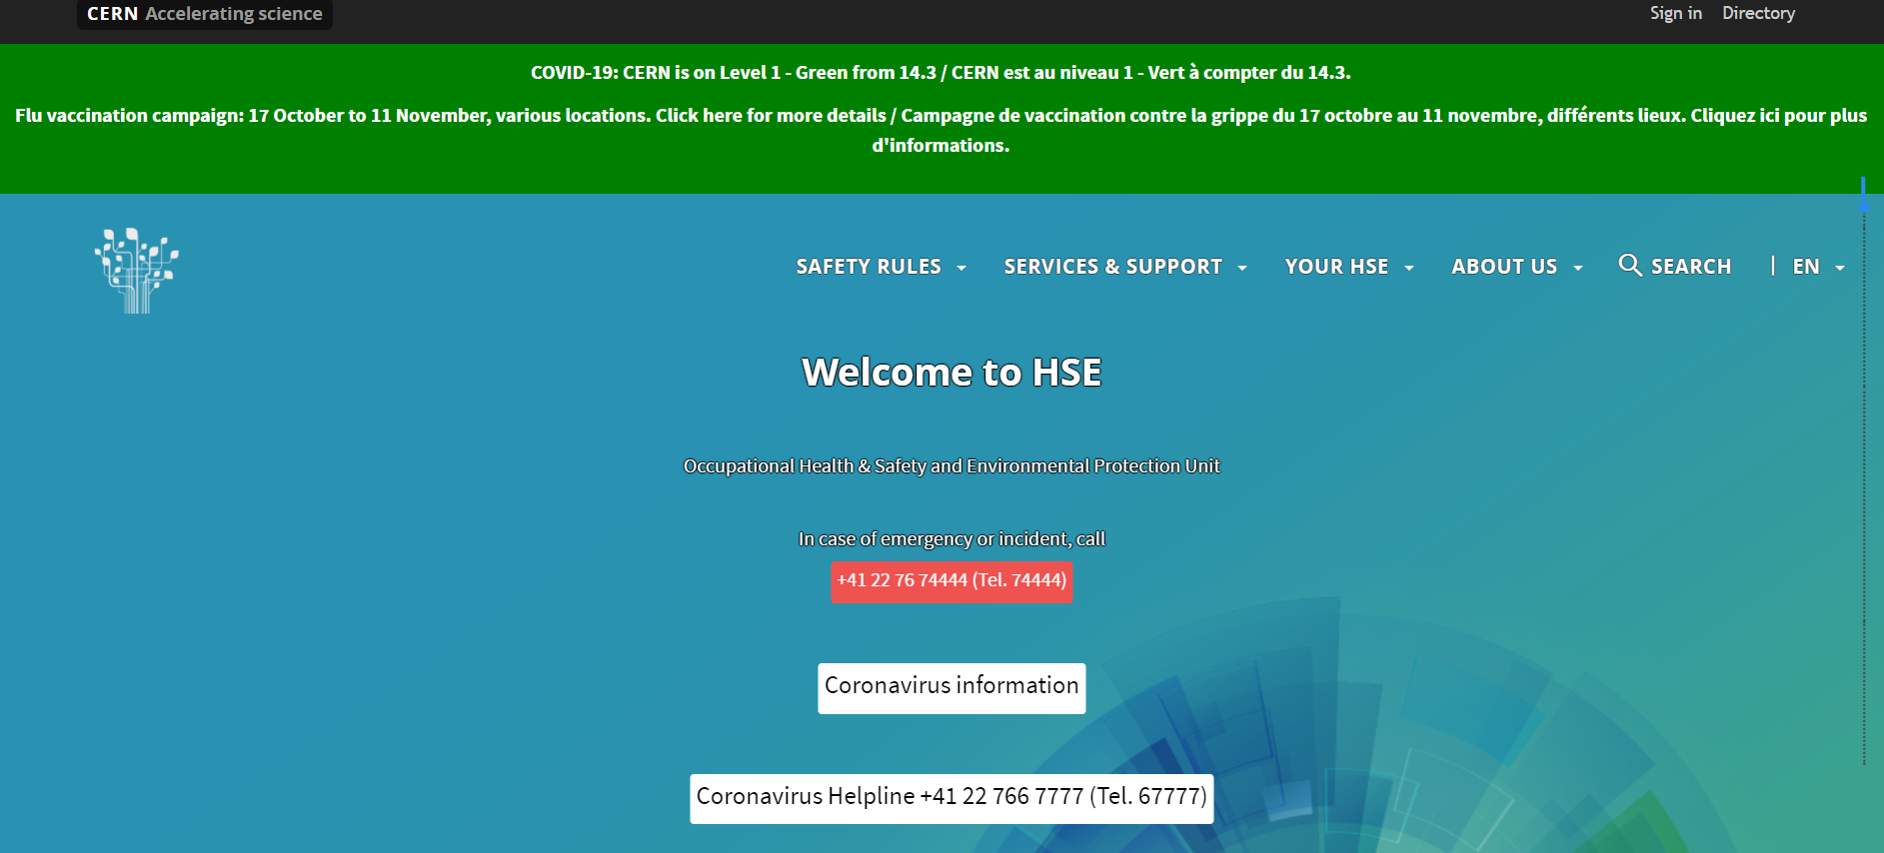
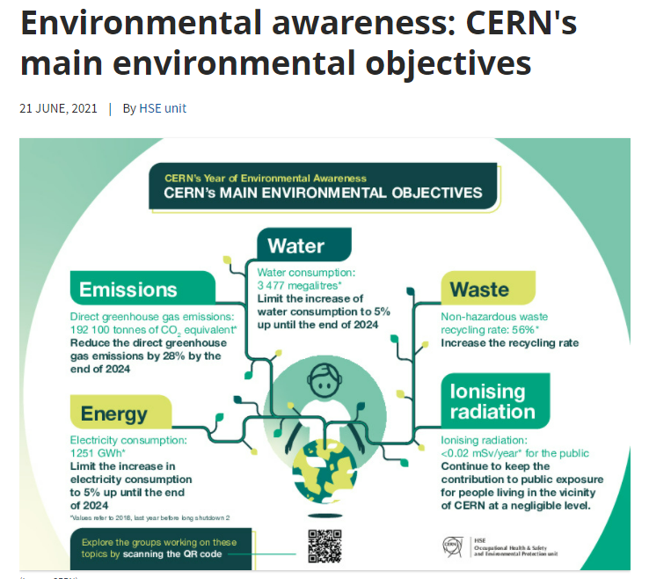
Communication channels
Home.cern and associated websites (voisins.cern, hse.cern…)
Email
Mattermost
Entrance and restaurants screens
Posters around the site
Public meetings, seminars
Social media (for public facing campaigns)…

Slide 28
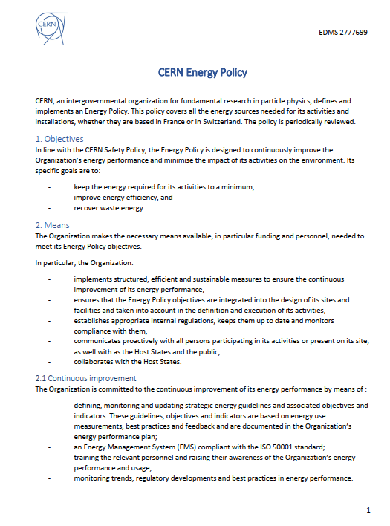
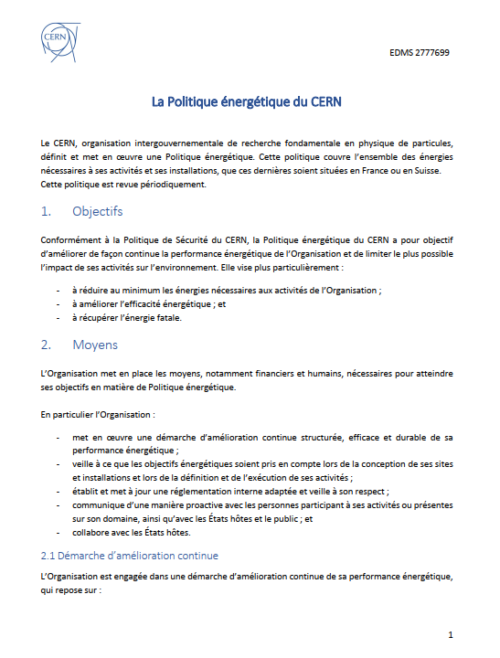
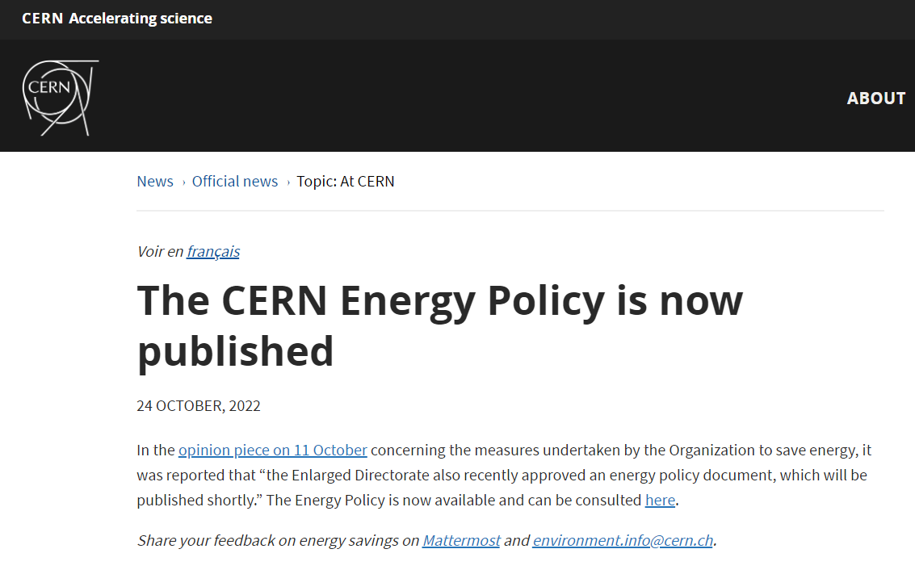

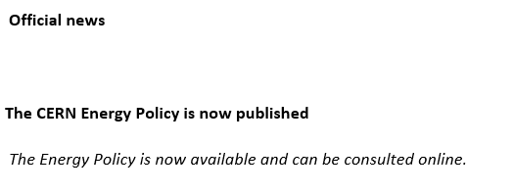
Energy policy
Published on home.cern and in the CERN Bulletin respectively on 24 and 26 October 2022
Next: creation of a dedicated home.cern/energy webpage in which it will feature prominently alongside other actions

Slide 29
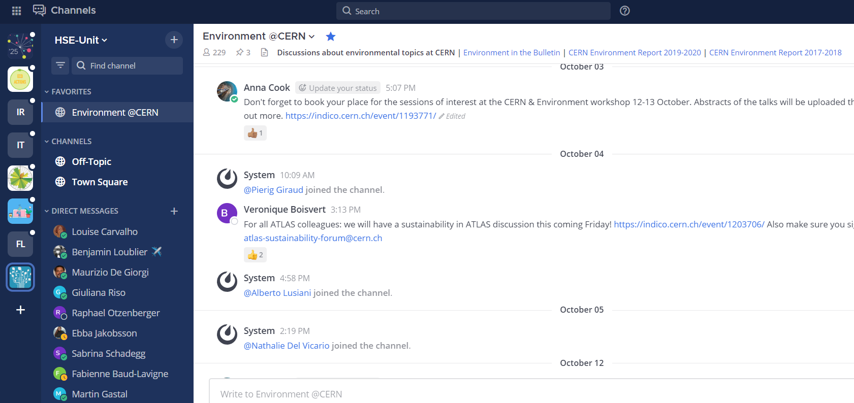
Community inputs: how?
Via Mattermost (social channel)
Email box: Environment.info@cern.ch
Gather energy ideas and feedback
Discuss in WG for follow up
Momentum from town hall meetings, seminars, workshops

Slide 30
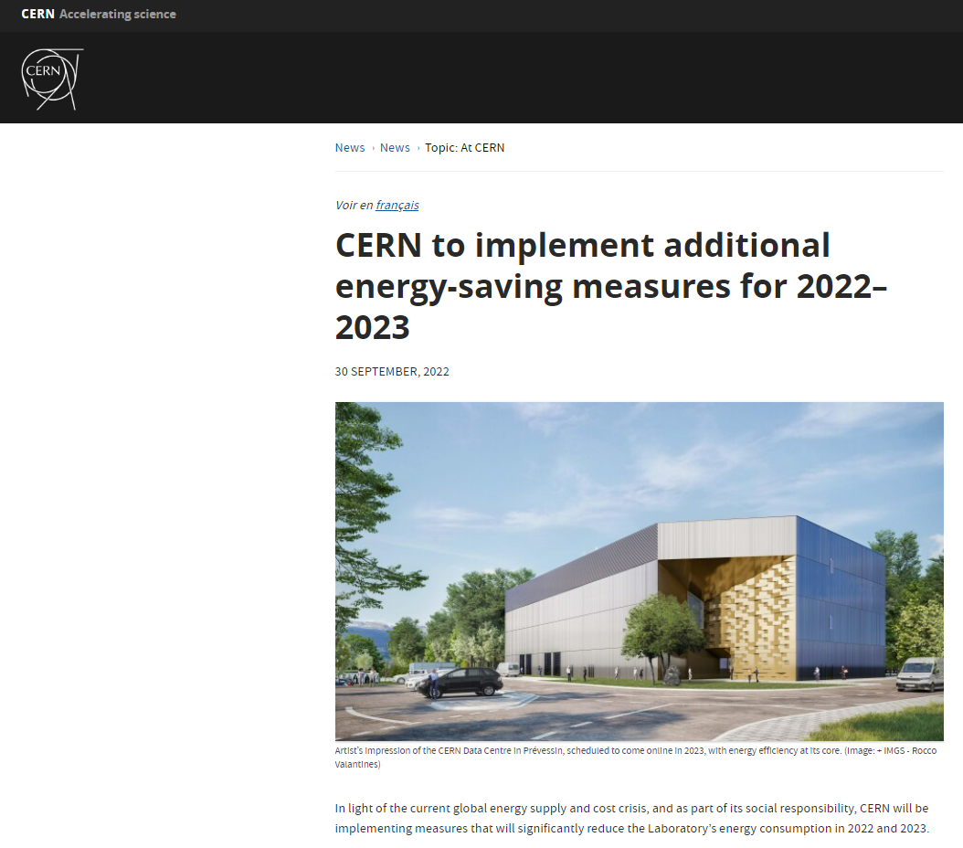
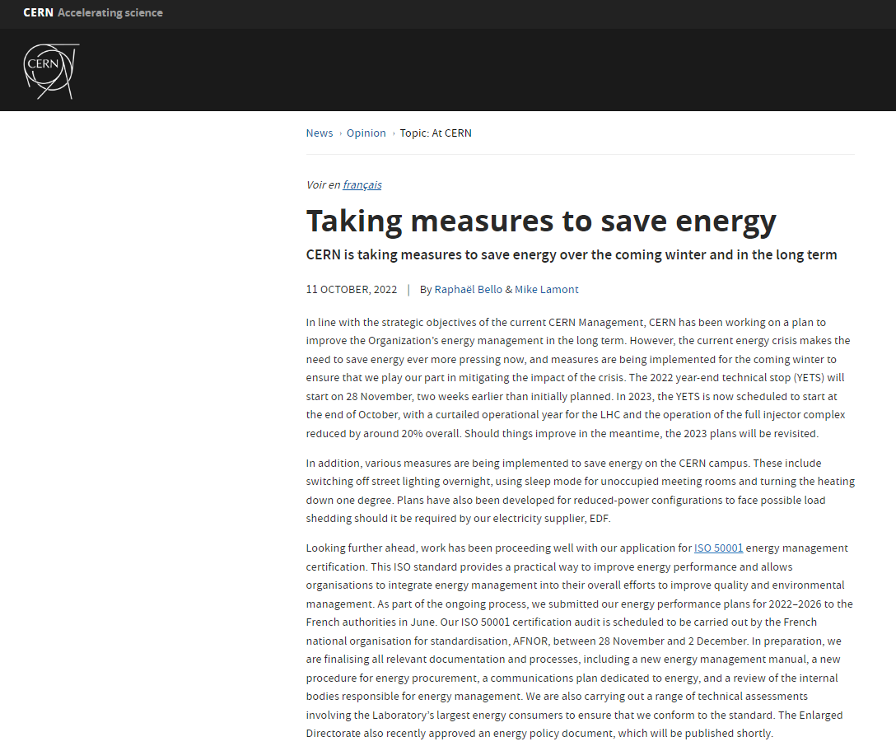
Communications to date – some examples

Slide 31
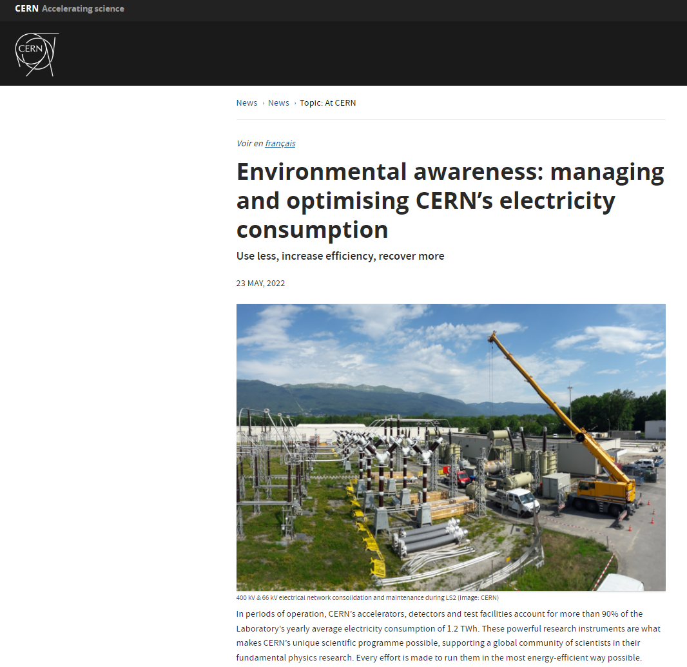
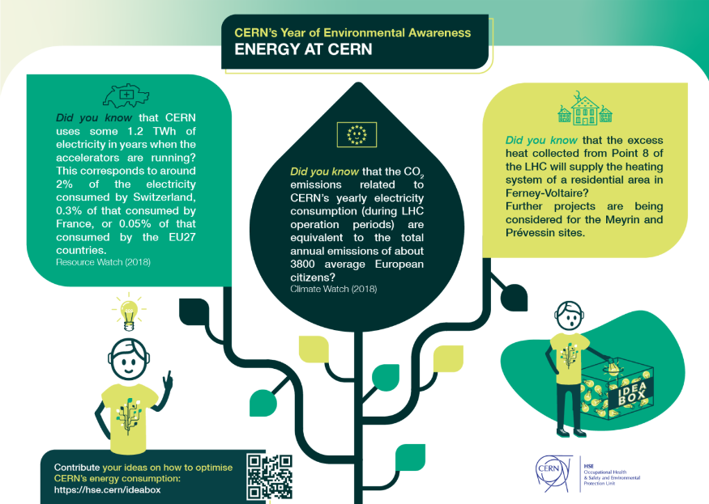
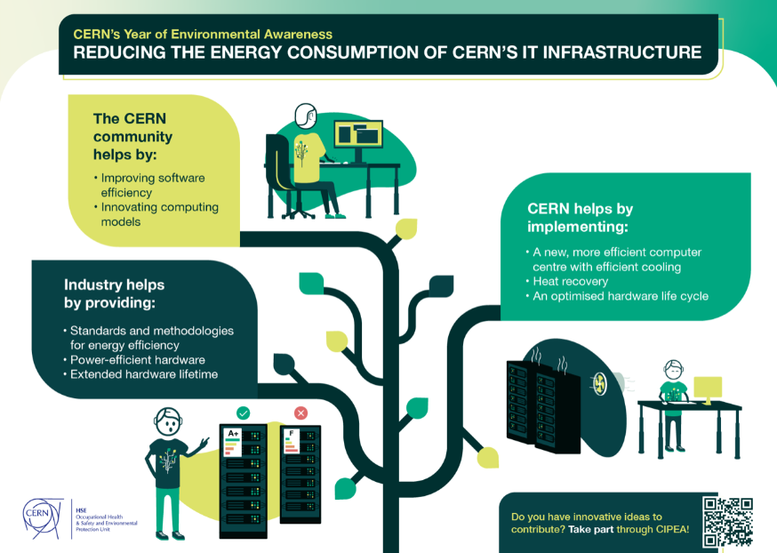
Communications to date – some examples

Slide 32
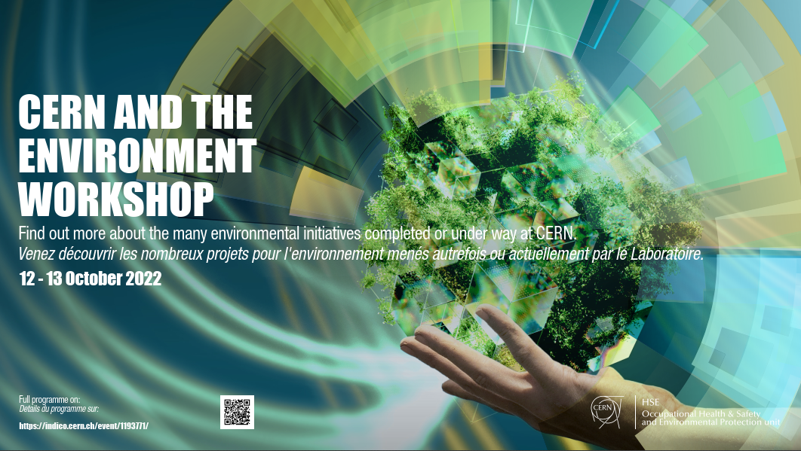
Communications to date – some examples
Opened with a dedicated session on Energy management
Overview of energy management at CERN
Campus Energy: situation, perspectives and savings foreseen for next winter
Electricity: plans for this autumn, next winter and beyond
Energy performance plan: towards ISO 50001

Slide 33
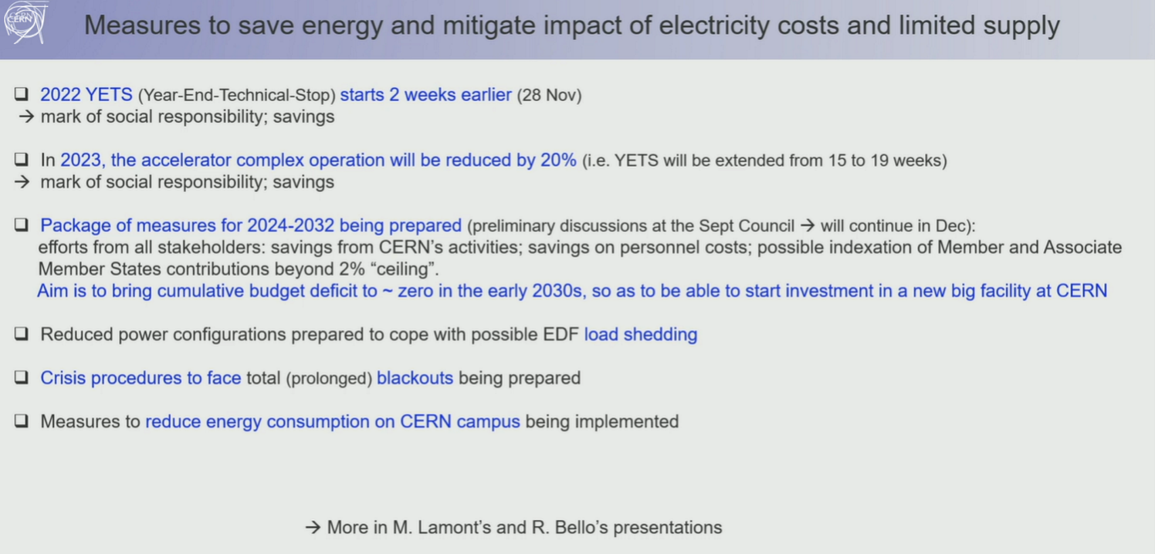
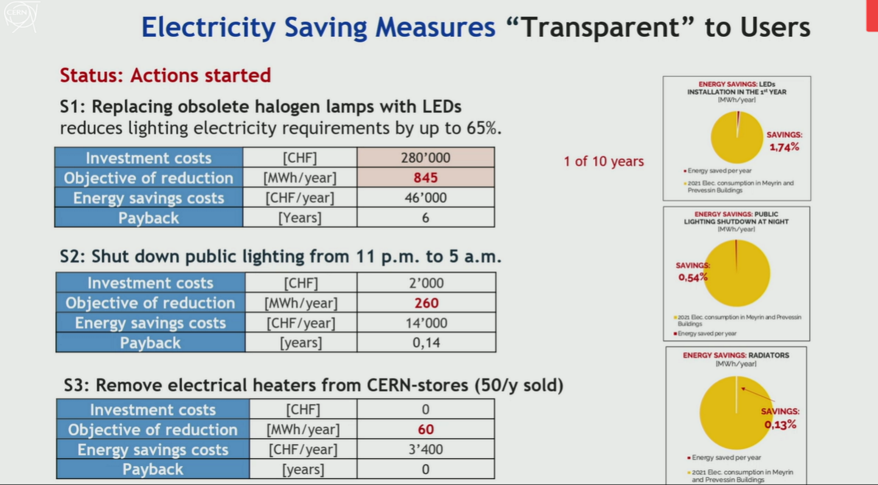
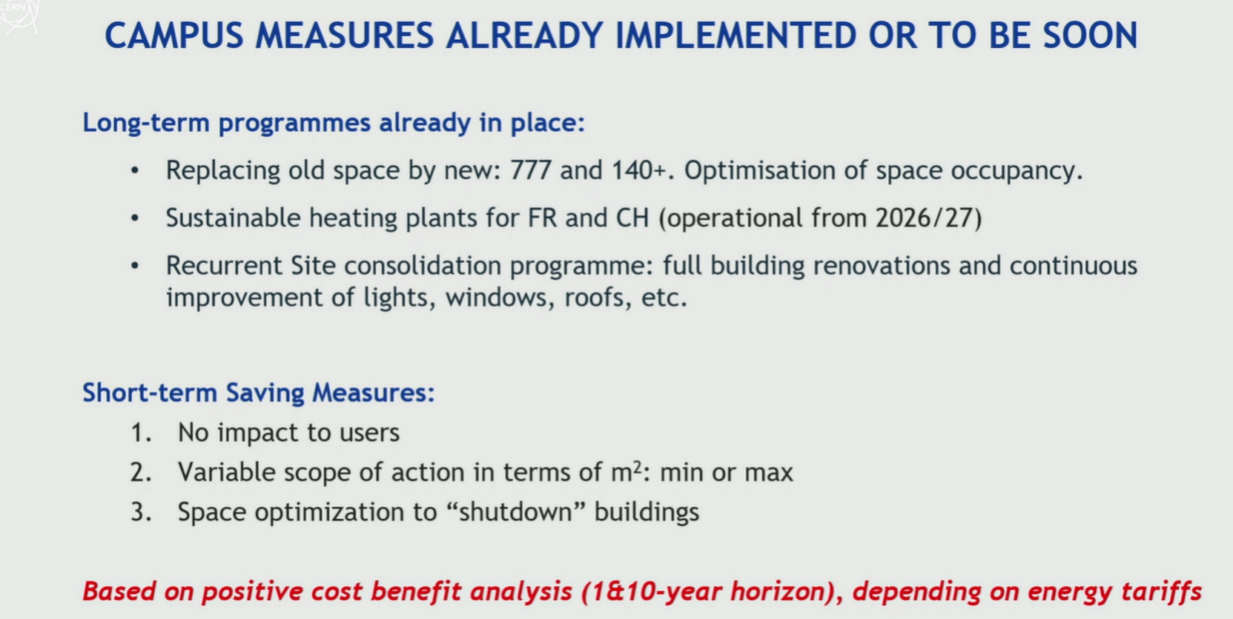
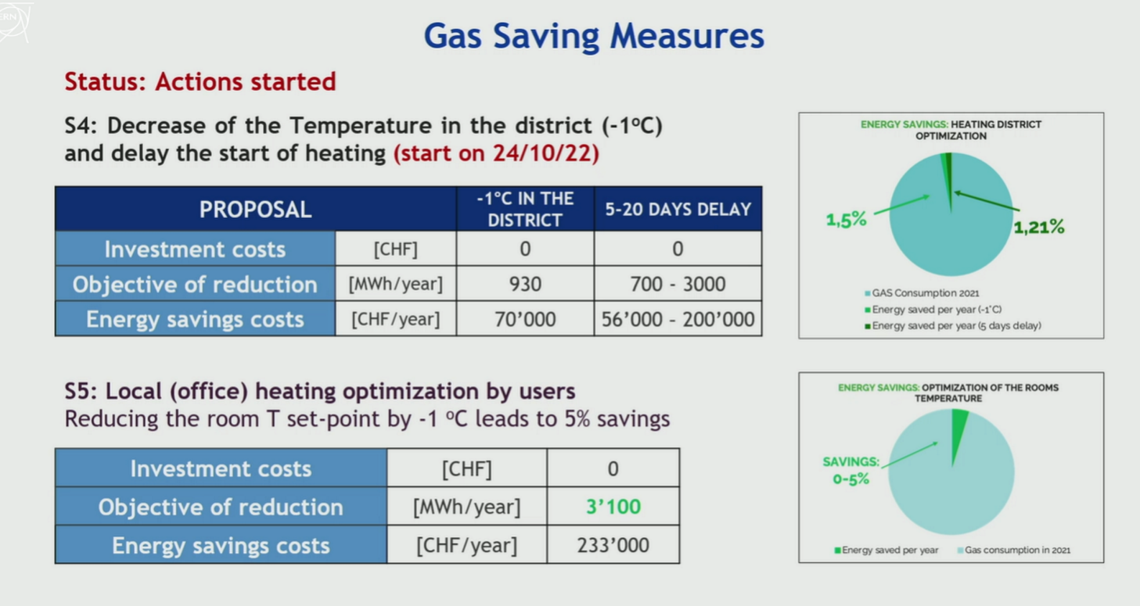
Directorate Town Hall 17 October 2022

Slide 34

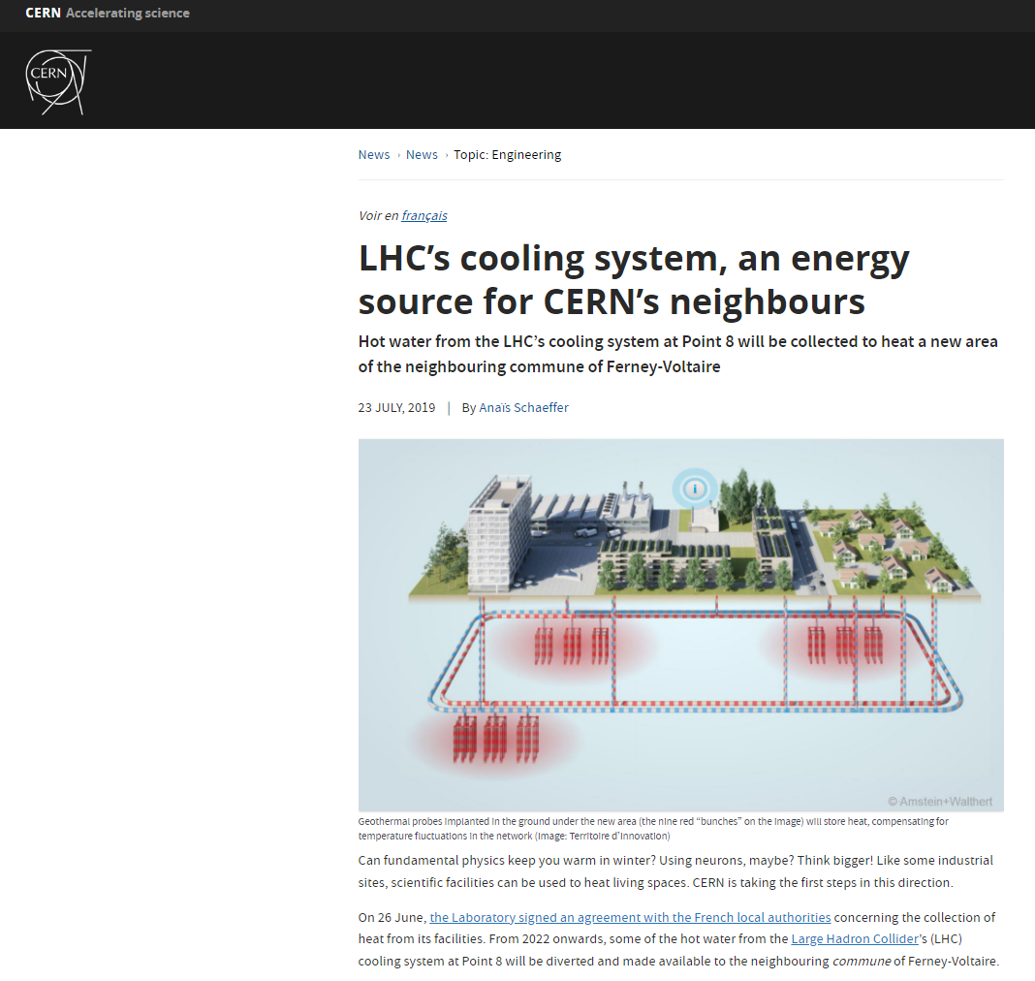
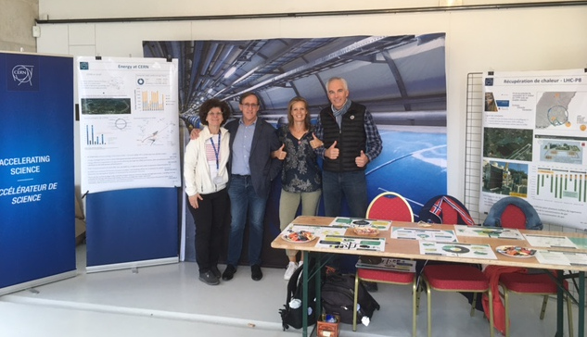
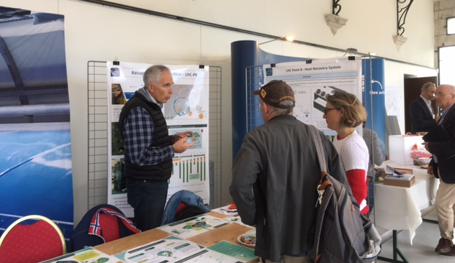
Communications to date – some examples

Slide 35
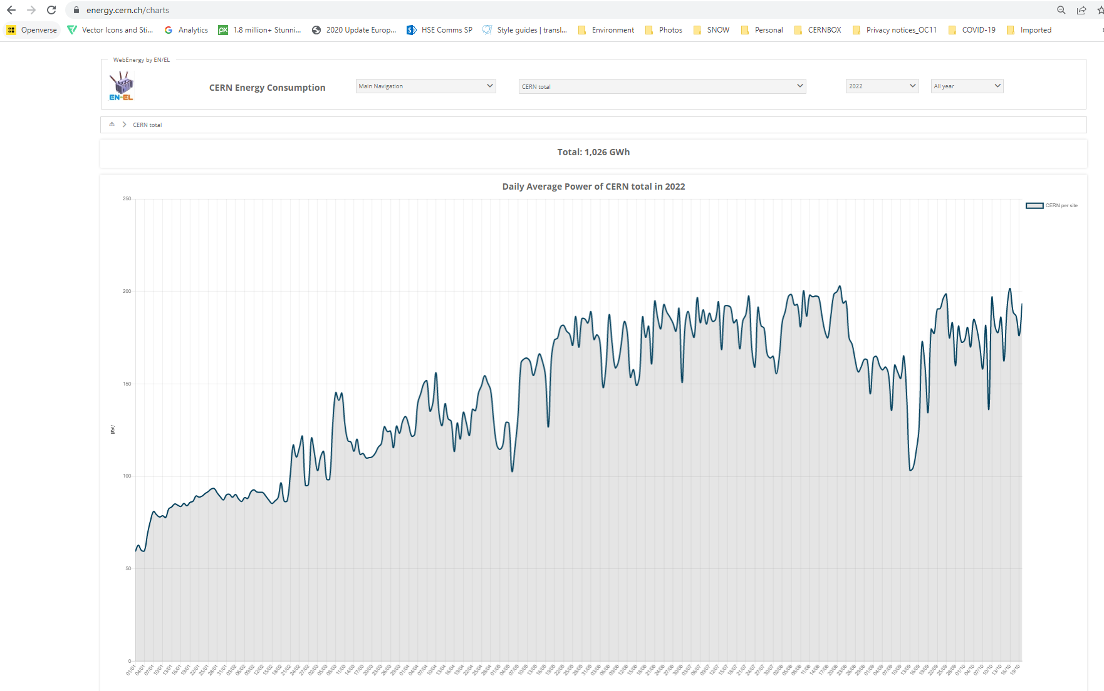
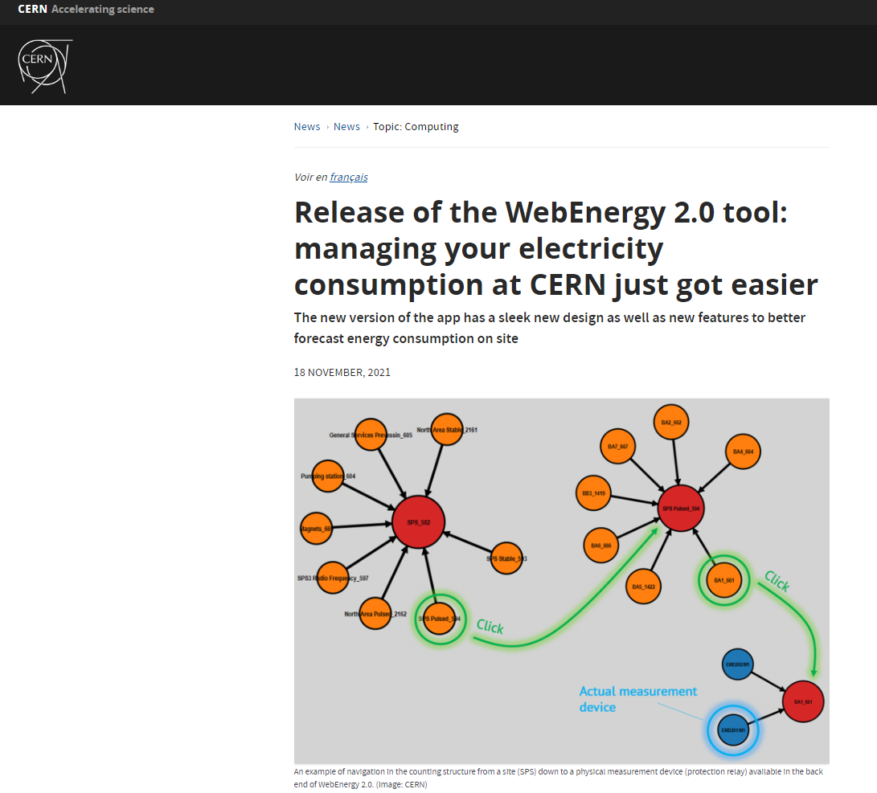
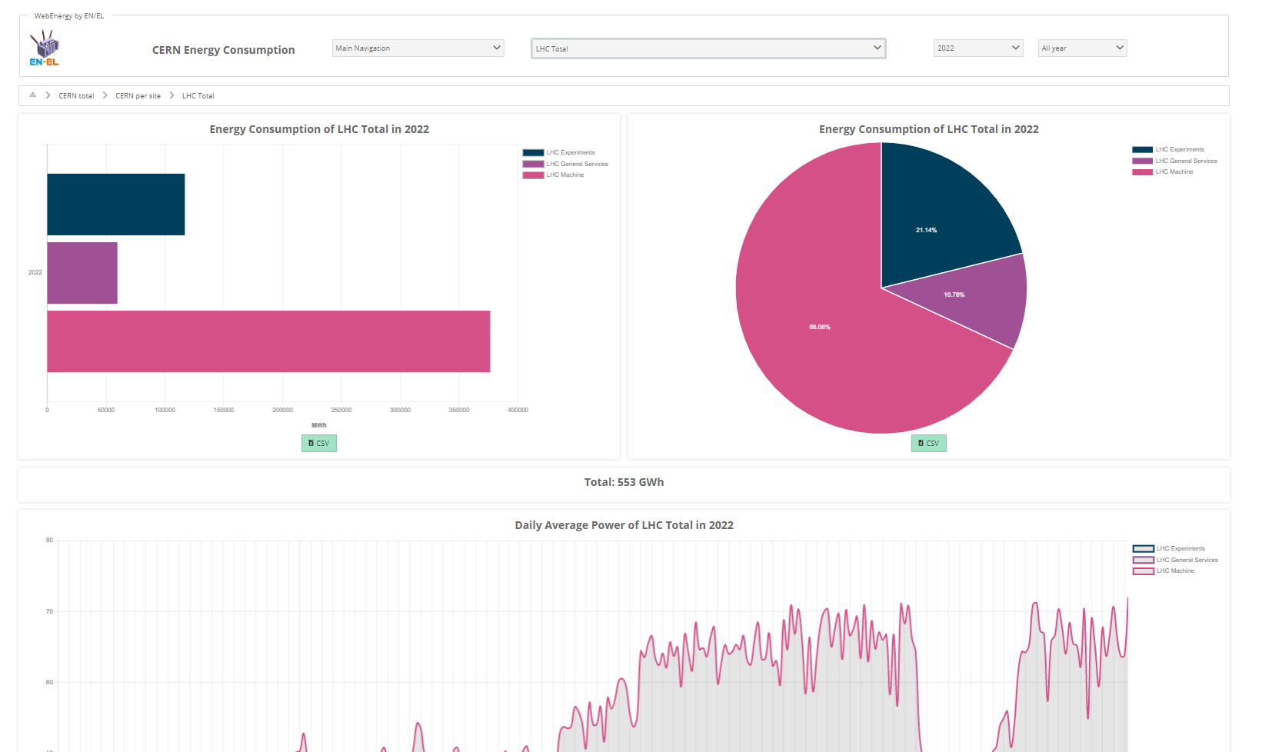
Webenergy

Slide 36
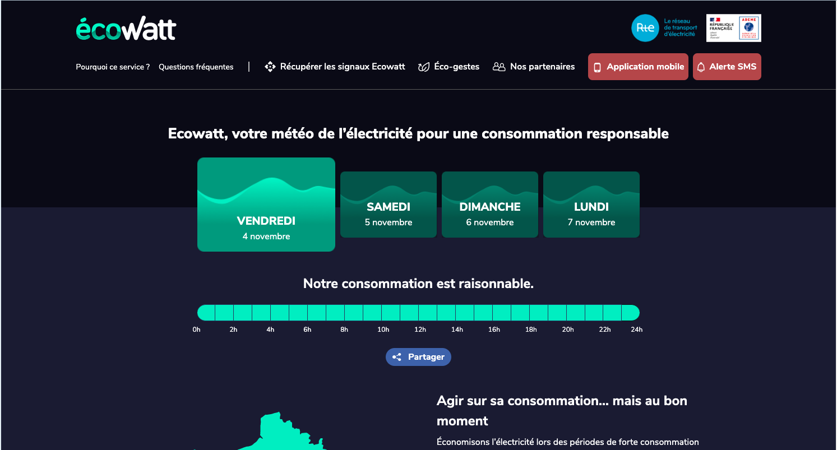
monecowatt.fr

Slide 37
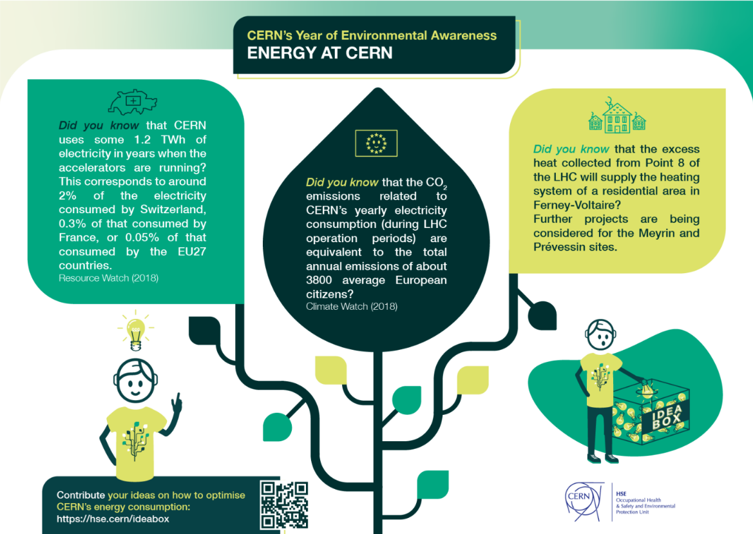
Campaigns: IDEABOX example
Initiative launched in the context of the ‘CERN Year of environmental Awareness’.
Infographic published on 2 June in the CERN bulletin following the article about CERN’s electricity consumption entitled:
«Environmental awareness: managing and optimising CERN’s electricity consumption. Use less, increase efficiency, recover more.”
Timeline: ran from 2 to 30 June 2022
Objective: to identify feasible ideas for CERN to optimise our energy consumption

Slide 38
Campaigns: IDEABOX example
Results:
42 ideas received, 39 identified for follow up further to first review by the HSE campaign team.
These were submitted for assessment of feasibility and applicability to a jury of 3 people :
The chair of the Energy Management Panel,
the Energy Coordinator,
the Infrastructure Section Leader (Site and Civil Engineering group)

Slide 39
Campaigns: IDEABOX example
Main feedback:
Lighting
Heating/cooling/heat recovery
Equipment energy efficiency and saving (including IT)
Responsible behaviour for saving energy
Some concerns (not directly related to energy):
Mobility
Water consumption

Slide 40
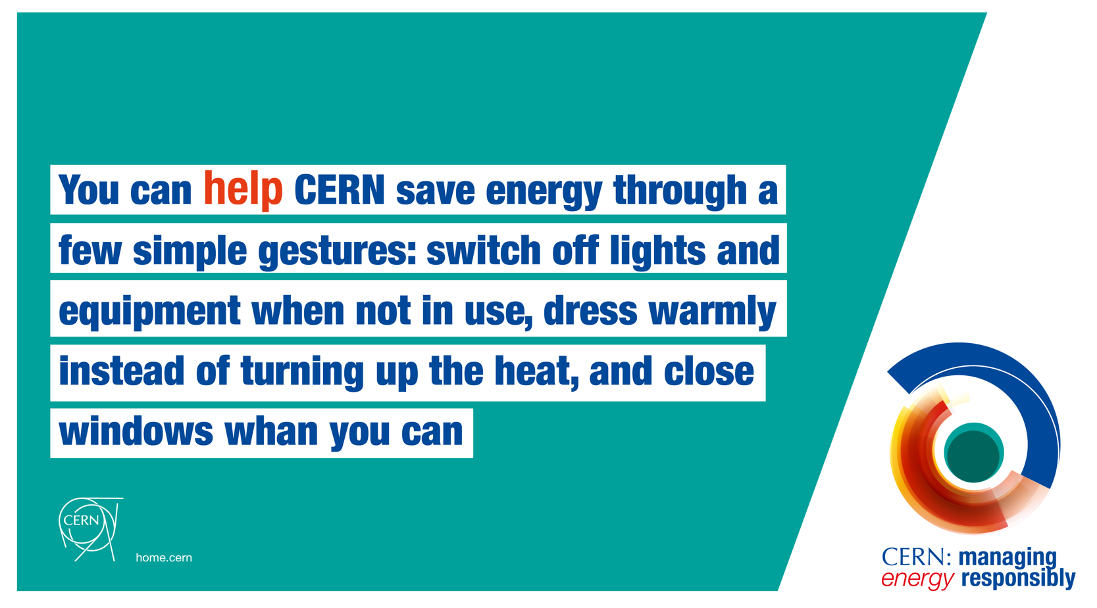
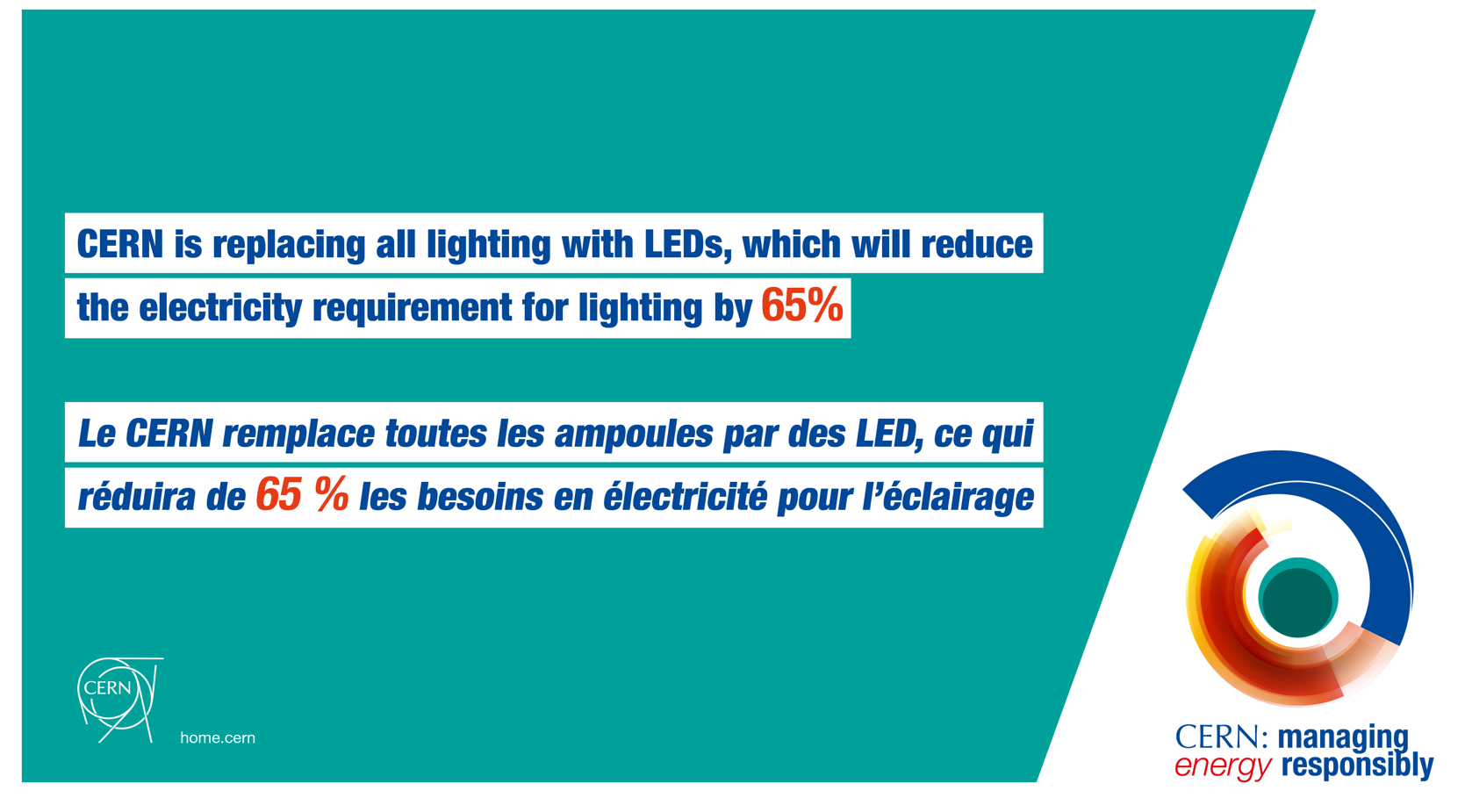
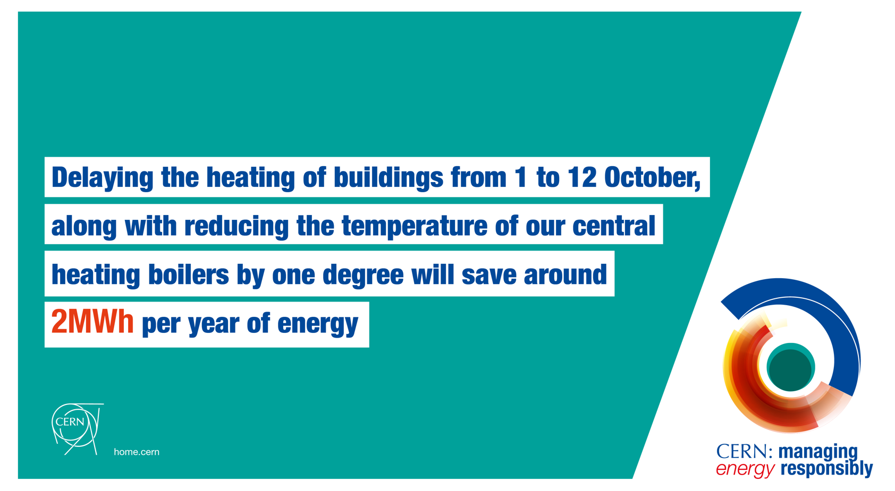

Coming soon
Informing the Community about winter measures and scenarios
Engaging with the Community to undertake simple gesture to contirbute to energy savings
Decicated energy webpage
And much more!

Slide 41
Thank you!
Any questions?

