Slide 1
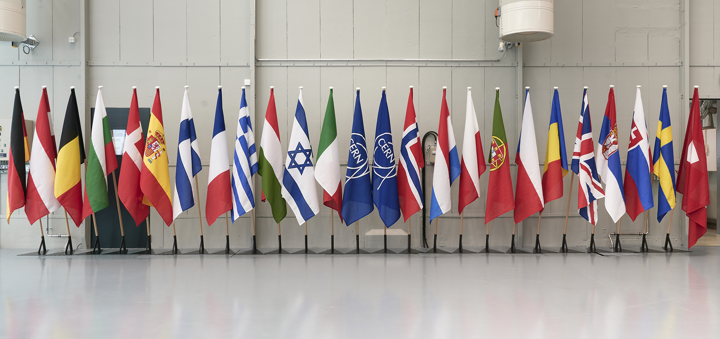
EPPCN council report and presentation UPDATE

Slide 2
What was planned this year (2022)
Written report:
EPPCN written report to be handed in to CERN Council in December
Therefore, country reports to Sophie by October (using template)
Oral presentation:
EPPCN oral presentation (10 – 20 min) to CERN Council in December
Focus on Higgs@10 report as a first example of joint activities in the implementation phase of the ESPPU communications strategy (‘follow up on roadmap’)

Slide 3
Things have changed (again)
Council Session moved from December 2022 to March 2023:
due to the unusually high number of items on the agenda of the Council’s December Session this year, the President’s Group has decided to defer the Restricted Council meeting dedicated to European Strategy matters, which had been scheduled to take place Friday 16 December, to 23 or 24 March 2023.

Slide 4
EPPCN council report and presentation 2022
Written report:
EPPCN written report to be handed in to CERN Council in March 2023
If you want to, you can send an updated country report to Sophie by January (covering the period up to December 2022)
Oral presentation:
EPPCN oral presentation (10–20 min) to CERN Council on 23/24 March 2023
Focus on Higgs@10 and RUN 3 as a first example of joint activities + progress of the new WGs on HL-LHC and Environment
Please send your Higgs@10 debriefs to Sophie by January, as input for presentation

