Slide 1
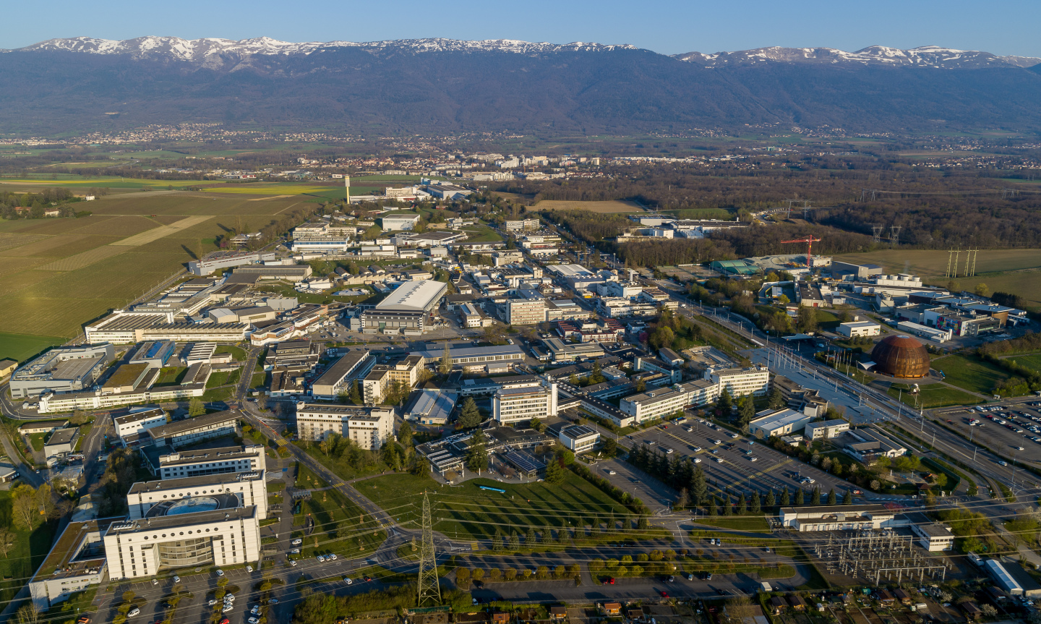
News from CERN
Ana Godinho (ECO, CERN)
32nd EPPCN Meeting | 24.11.2022

Slide 2
Since June 2022
Council meetings and ensuing communication
Higgs@10 and Run3
Media coverage
Sparks! – Future Technology for Health
CERN Science Gateway communications plan
CERN Science Gateway Inauguration Ceremony
Workshop on volunteers for education and outreach
Changes in IR-ECO

Slide 3
Communication after Council meetings
17 June
Council statement:
CERN Council declares its intention to terminate cooperation agreements with Russia and Belarus at their expiration dates in 2024
- Press release
- FAQ
- Media enquiries – mainly about implications for CERN’s research
- Email to personnel
30 September
Energy crisis: CERN to implement additional energy-saving measures for 2022–2023
- home.cern news + Social Media
- FAQ
- Media enquiries – CERN’s energy consumption and cost
- Email to personnel (news from Council)
Notes:
MRCH COUNCIL: New Council statement published on home.cern + Press release (Decision: suspension of participation in events with Russia, Belarus and JINR; suspension of CERN scientists in scientific committees; suspension of contracts to new users. Decision on ICA with Russia to be decided at June Council meeting)

Slide 4


Scientific symposium
In CERN Main Auditorium + EN and FR webcast
CERN Auditorium was oversubscribed …empty seats on the day
Peak online audience of approx. 1150
Public streaming at universities/institutes in at least 5 Member States
Live tweeting by CERN Courier -> increase in Courier followers on Twitter
Scientific community
CERN community
Media
Teachers and Students
Decision-makers

Slide 5

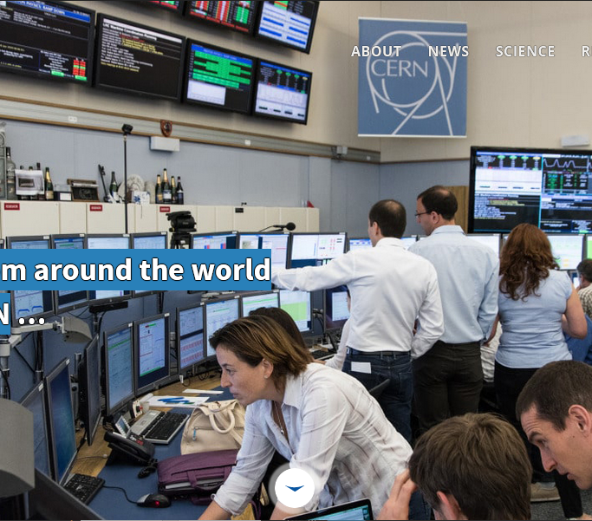
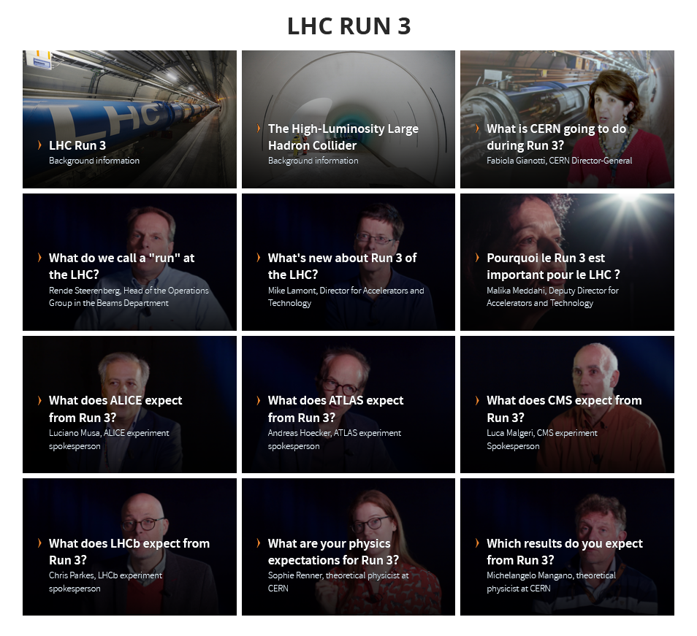
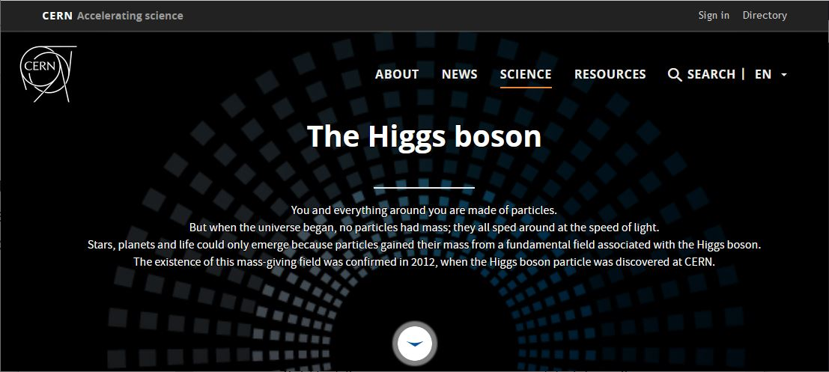
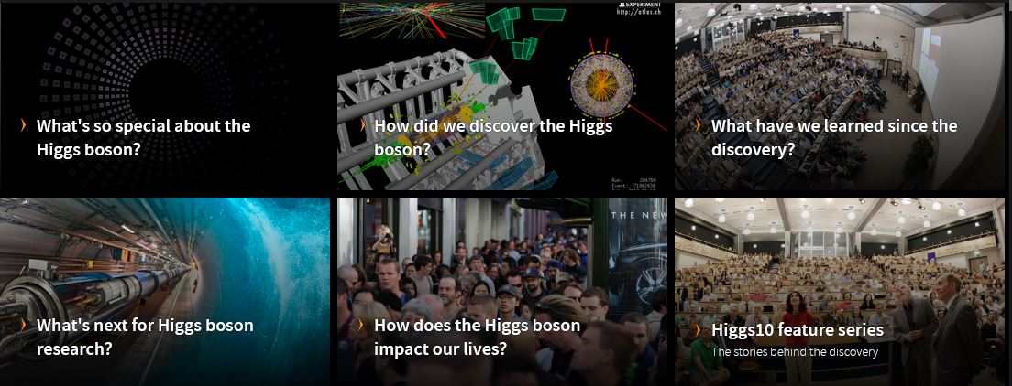
Home.cern
CERN community
General public
Teachers and Students
Media
Higgs boson “nuggets” - Five new pages of deeper Higgs boson content in EN and FR
Homepage: new banner imaging and messaging; countdowns
Digital media kits: backgrounders and videos for restart, Higgs@10 and Run3

Slide 6
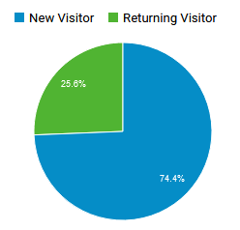

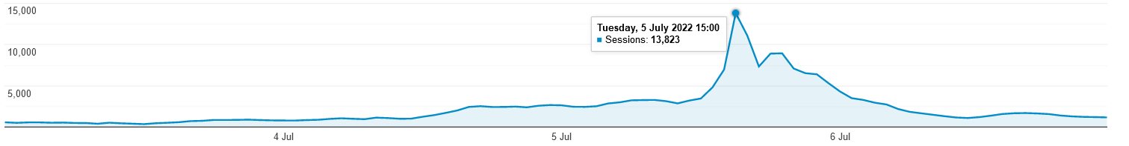
The impact on home.cern
7x increase in traffic to home.cern (peaking on 5 July)
75% of traffic were new visitors
Strong collaboration between IR web and IT Drupal infrastructure teams accommodated spike in traffic (peak of 18.5K simultaneous viewers)
Higgs@10 comms and outreach campaign – Kate Kahle

Slide 7
Social media: impact of three campaigns
355 posts
30,159,710 impressions
252,899 likes
17,885 mentions
Total 230,114 new followers on CERN channels

Slide 8
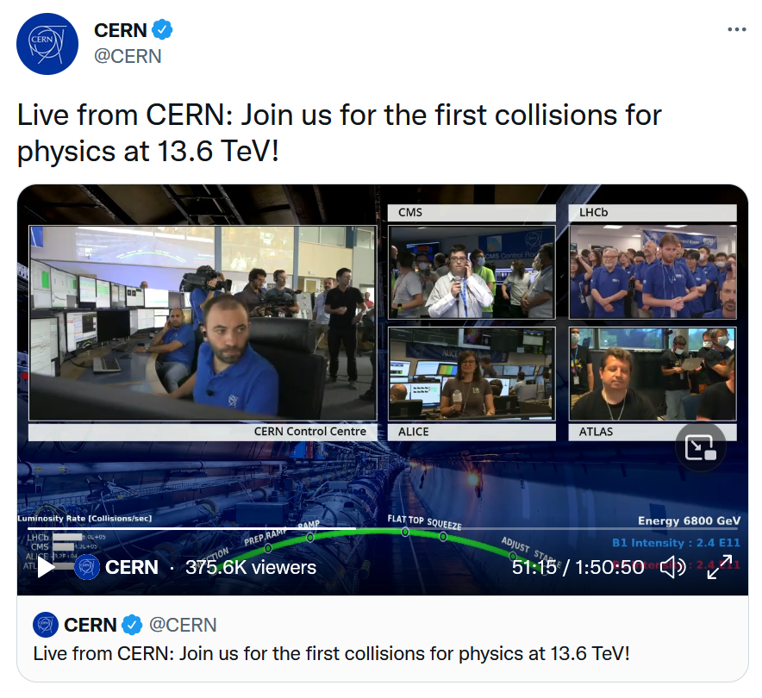
#LHCRun3 LIVE – 5 July 2022
Live for 1h50, with running commentary, from 4 LHC experiments + CCC (main hub) + data centre
Streamed on Facebook (CERN + 4 experiments), LinkedIn, Twitter, YouTube - Total of 13 platforms + CERN webcast + high quality Eurovision satellite
Commentary in 5 languages – EN, FR, IT, DE, ES. Moderation by 4 social media managers + 20 experts
Outcomes
  11,557,580 impressions (reach)
  4,732,869 views of the LIVE, inc. Reuters
  59,626 engagements (>27K comments and questions)
  75,737 concurrent viewers
  Hashtags caught trending in CH, FR, UK, US
Higgs@10 comms and outreach campaign - Paola Catapano, Jacques Fichet, Daniela António
Notes:
As an example, our peak concurrent viewers on YouTube was 64k. Usually it’s 200-400

Slide 9
Higgs@10 and Run 3: 6 897articles from 1Jun - 31July
Run3 live
Higgs10 Symposium
Council’s decision to terminate ICA’s with Russsia and Belarus
CELESTA satellite launch
Embargo lifted
Media briefing

Slide 10
Share of Higgs@10 media clippings across Member States with each Member States’ share of total Member States contributions

Slide 11
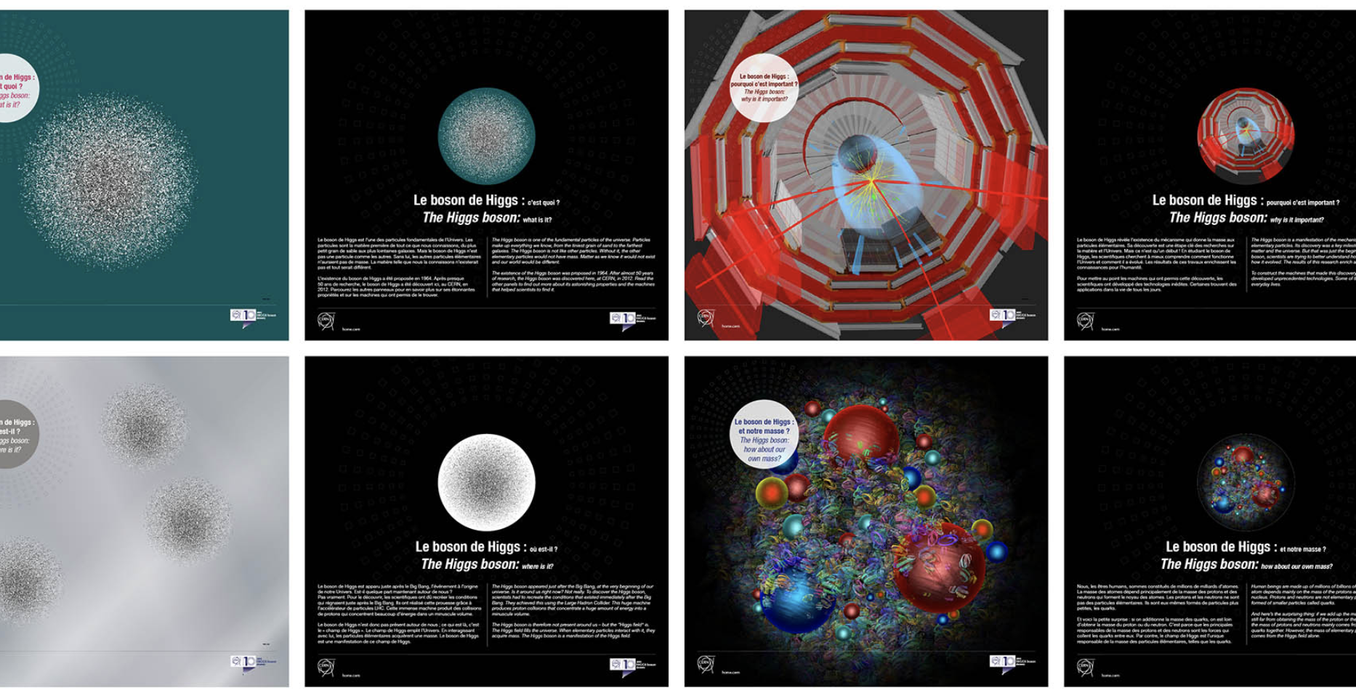
Exhibition
On Esplanade des Particules in French and English
10 panels in total: 5 Higgs-related +5 about current and future technologies (HL-LHC)
On the Esplanade des Particules (En and Fr)
In 6 additional languages, for Member States (via EPPCN)
Printed and used in 6 Member States (via EPPCN)
CERN community
Local communities
Media

Slide 12

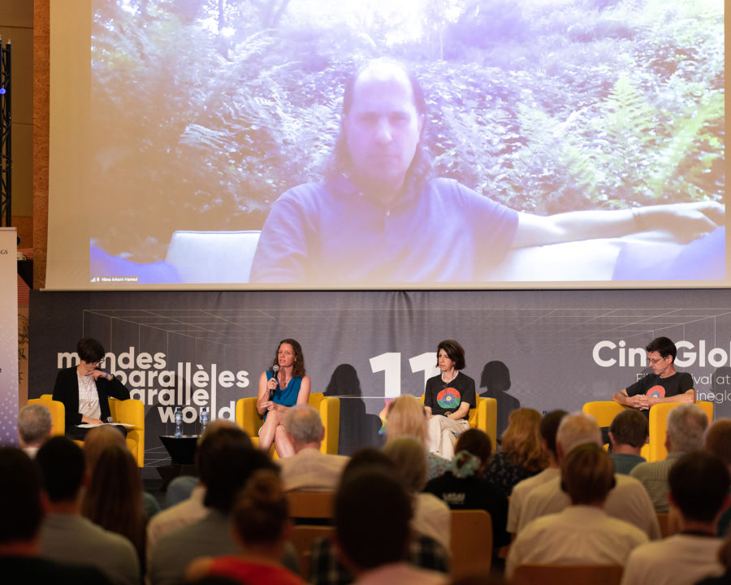
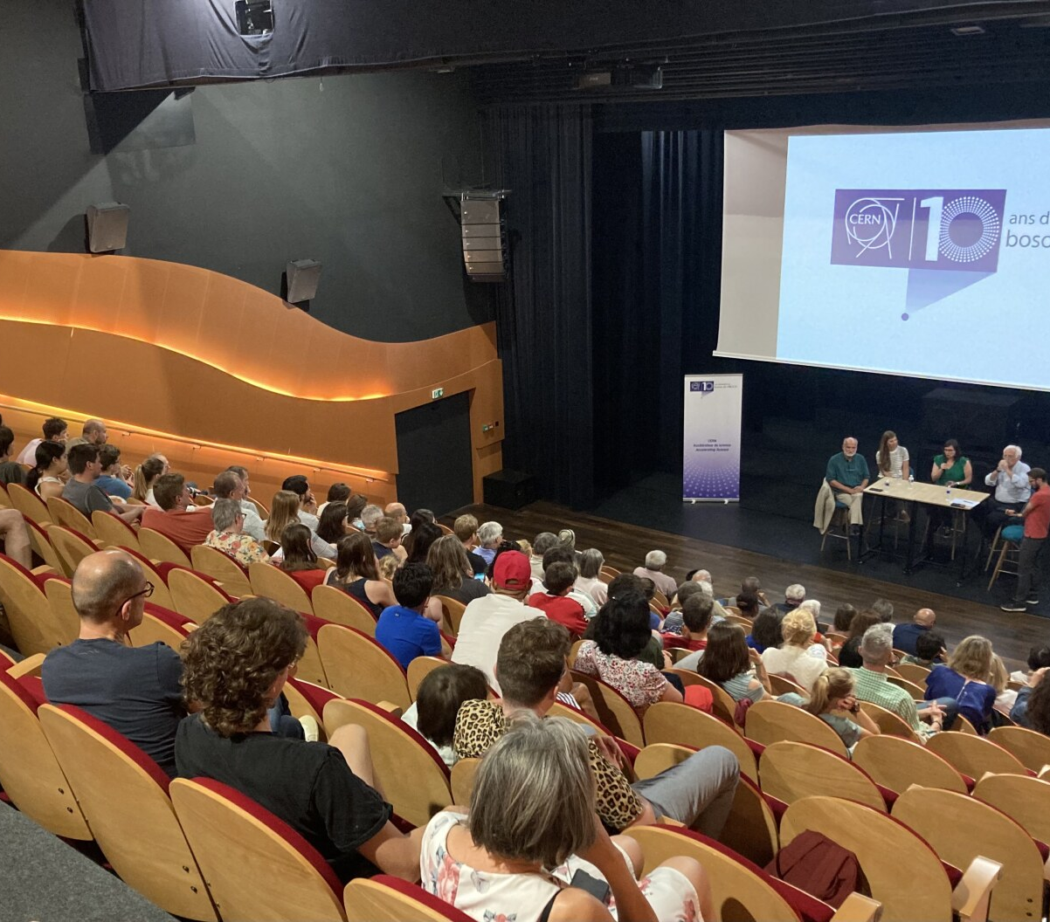
Public events
CERN community
Local communities
Media
Meyrin, St Genis, Saint Julien en Genevois (240 in audience)
“Particle Fever” screening + Q&A
Globe with webcast (186 in audience)
Higgs@10 comms and outreach campaign - Andrea Perez & Loraine Massarotti
Notes:
Well received by the locals who were happy with CERN coming to them
Good questions during the discussions (Big questions, Future of CERN, Environmental issues, FCC)
The event in Saint Genis triggered a collaboration with the Médiathèque for the Fête de la Science 2022

Slide 13

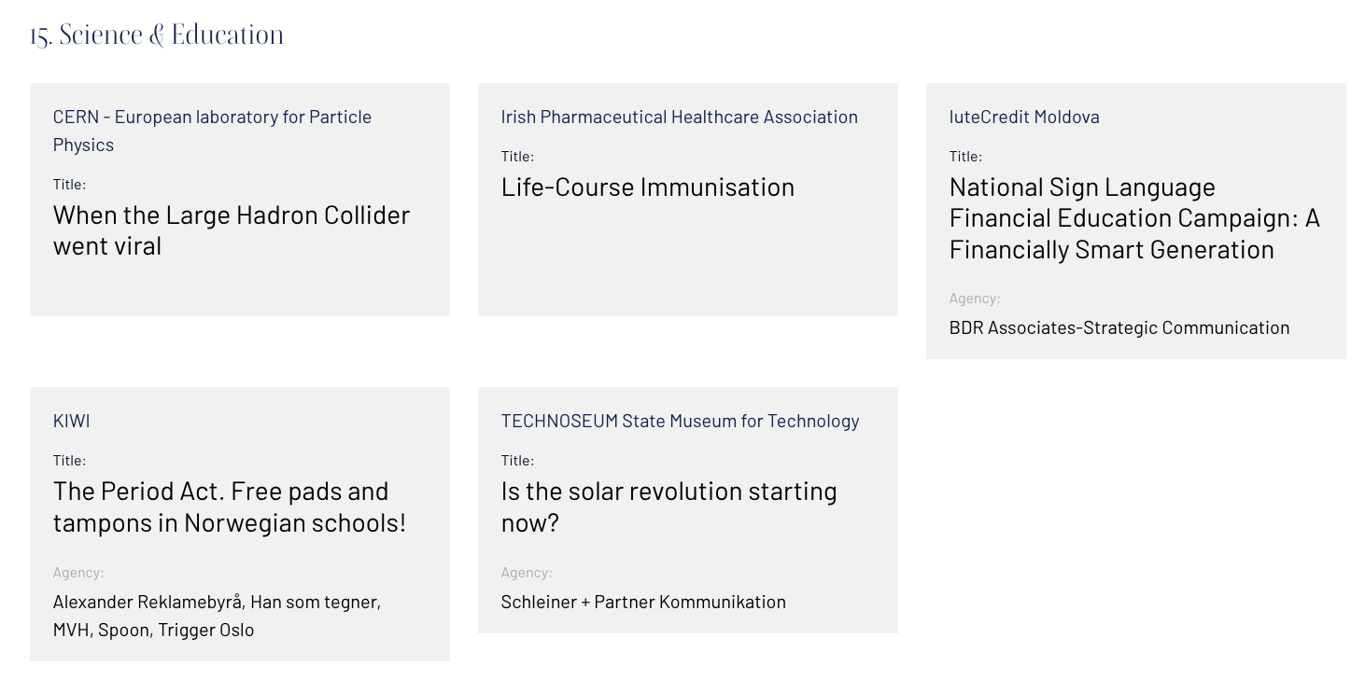
We made the shortlist for the European Excellence Awards 2022!
Thanks to Paola, for co-writing the proposal!

Slide 14
Media coverage - CERN
(1 June to 22 November 22)
Higgs10 and beginning of the LHC run 3.
Gemini South captures the brightest flash ever seen, CERN quoted as comparison
Daniel Whiteson (a Physicist who works at CERN) launches a special episode of his podcast
Council declares its intention to terminate cooperation agreements with Russia and Belarus.
Launch of CELESTA, the first CERN-driven satellite.
Energy-saving measures article published on home.cern.
Energy-crisis: media outlets recap what measures are decided by each institution.

Slide 15
CERN was mentioned in 9 819 clippings from 1 June to 22 November across Member States
Notes:
Total of 38 806 media clippings in 140 countries for this period.
Out of the 38 806 clippings, 27 509 originated either member states, associate member states or observer states (including 9 819 from member states only).
The USA had the most clippings, with 13 493, and Cyprus had the least with 16
The Press Office published 10 media updates and 2 press releases between June and November 2022

Slide 16
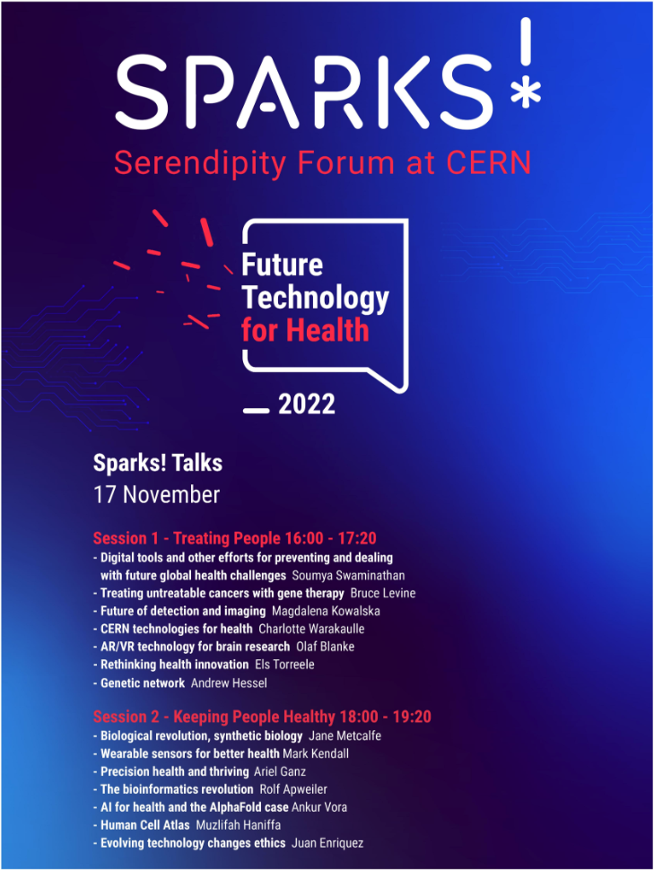
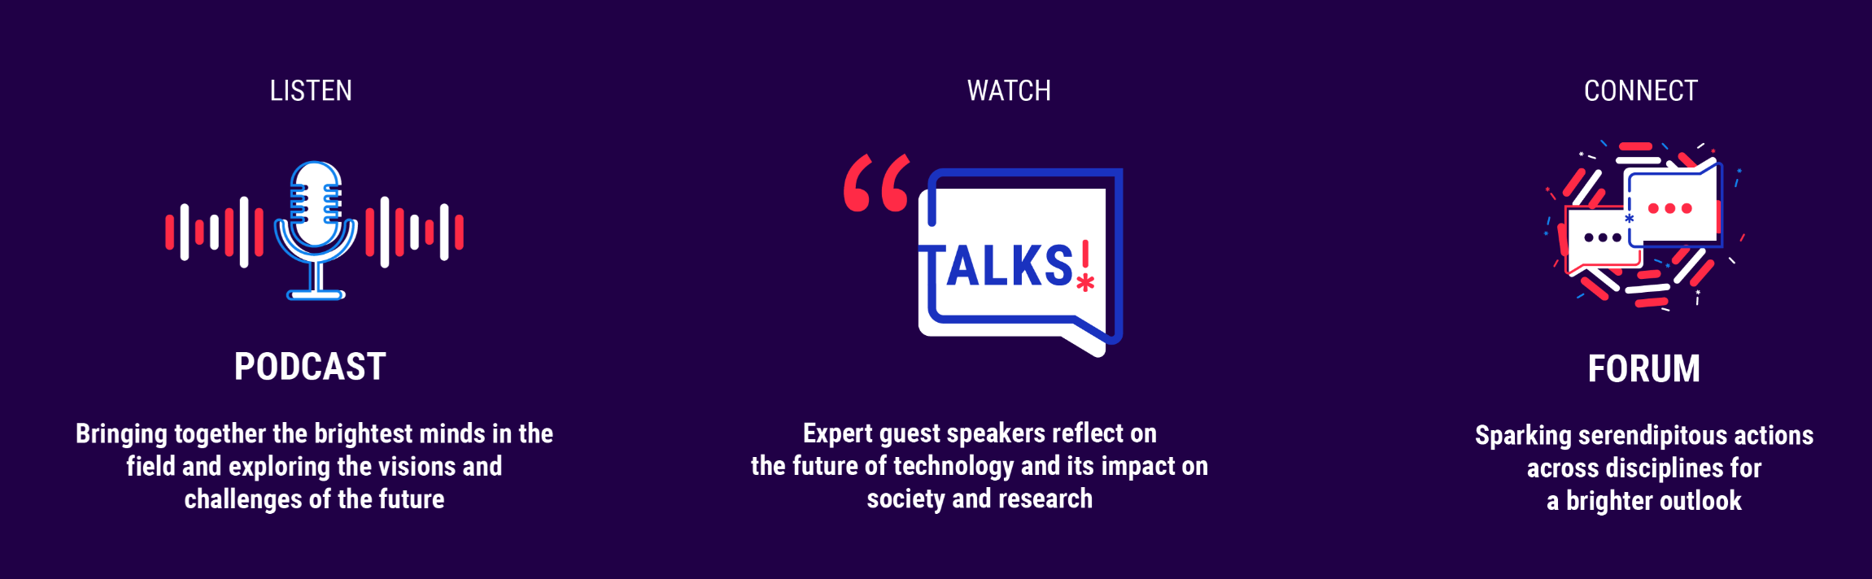
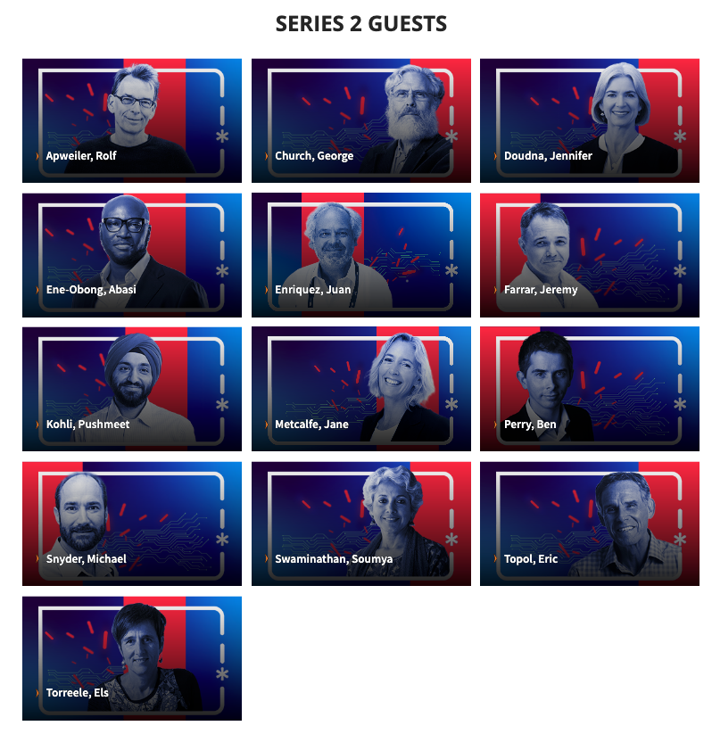
Still to to come:
Publication of individual talks
Publication of interviews with participants
CERN Yellow report
Frontiers for Young Minds paper
Measure new collaborations
Learn from the two editions to prepare 2023 edition -> in Science Gateway
Podcasts

Slide 17
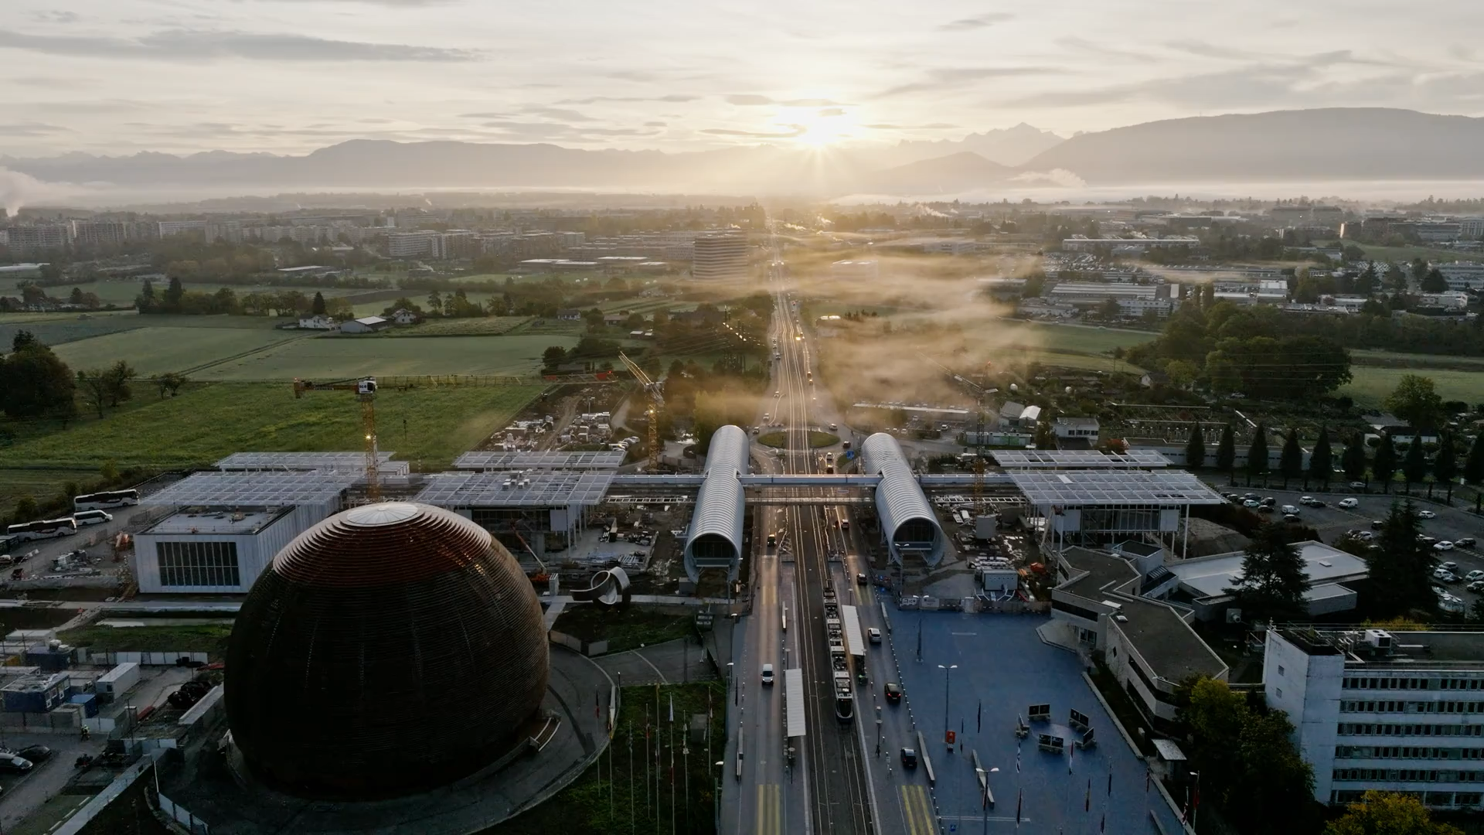

Slide 18
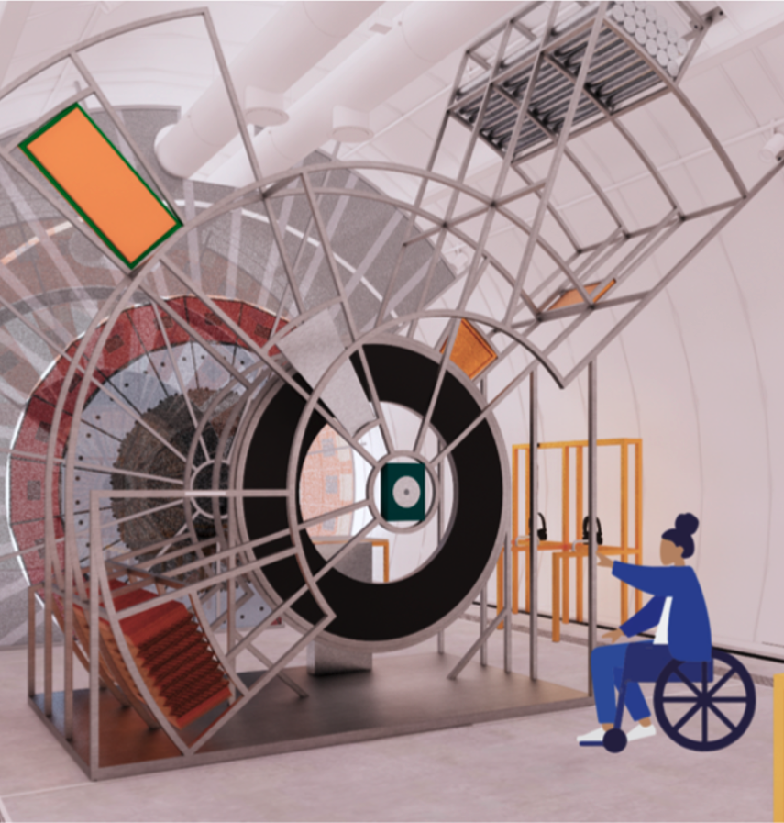
Communications plan
for the opening of Science Gateway
Construction and soft opening [July 2022 – May 2023]
Aims: build awareness; build support; build expectation for the opening
Preparing for the inauguration and opening [January – July 2023]
Aims: generate buzz and excitement; position SGW as a “must-see” attraction
After the opening [June 2023 – December 2023]
Aims: position SGW as a leading science centre; attract new audiences; establish key partnerships
Detailed communications objectives for each period are available here.

Slide 19
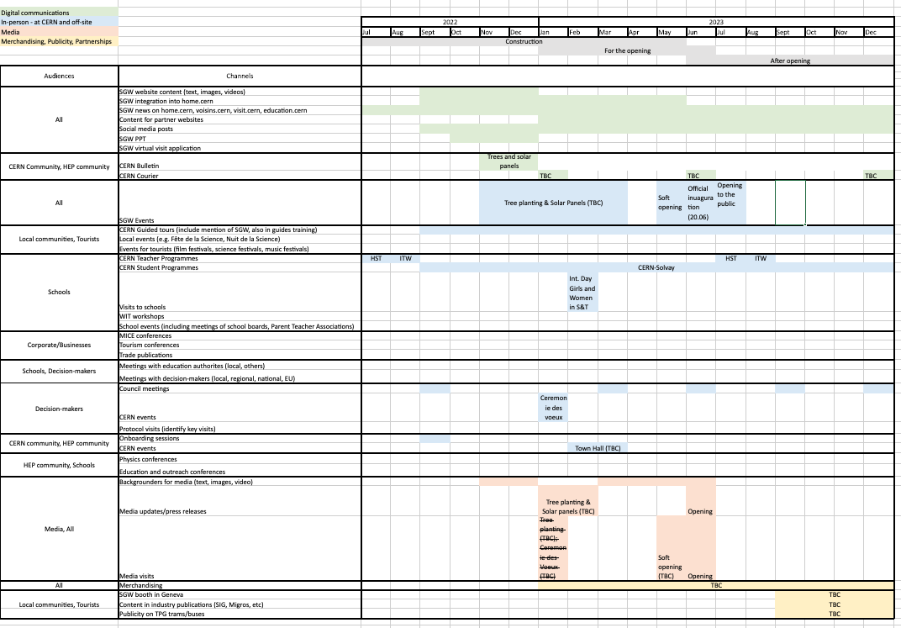
Under way:
SGW website structure and content
SGW news in Bulletin (e.g. trees and solar panels)
SGW news on home.cern & other websites
CERN-Solvay Education Programme
Meetings with tourism offices and corporate “clients”
Development of products for the SGW shop
Visual branding and design
Photography and video of the building site
#CERNScienceGateway
Inauguration ceremony (20 June)
Communications plan
for the opening of Science Gateway

Slide 20
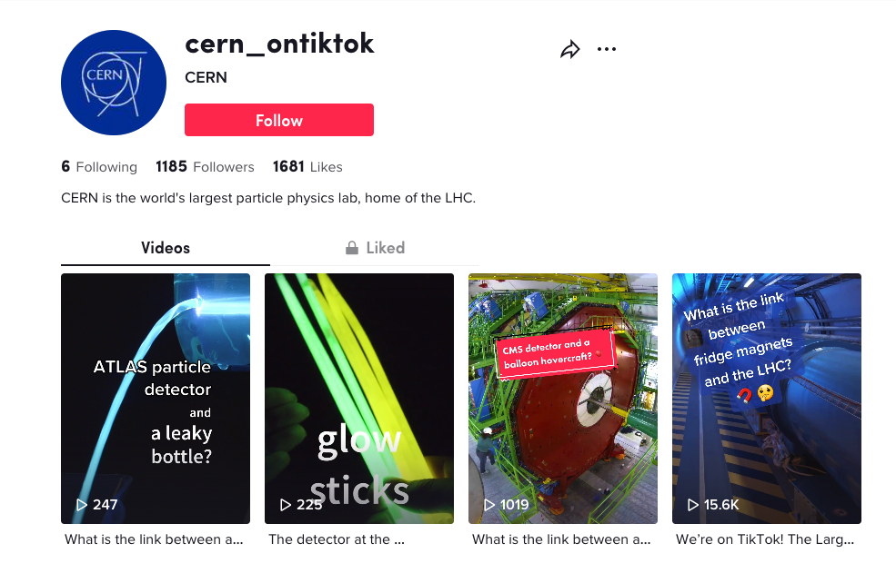
CERN-Solvay Education Programme
#CERNScienceGateway
level 1
Online social media educational videos
Reach: 10⁶ views per year via CERN channels
level 2
Online course for high-school students
level 3
On-site camp for high-school students at CERN
Reach: 10² participants in total from around the world
Goal: to develop interest in STEM
Goal: to build confidence & transform STEM interest
Goal: to trigger STEM interest
Reach: 10⁴ participants per year from around the world

Slide 21
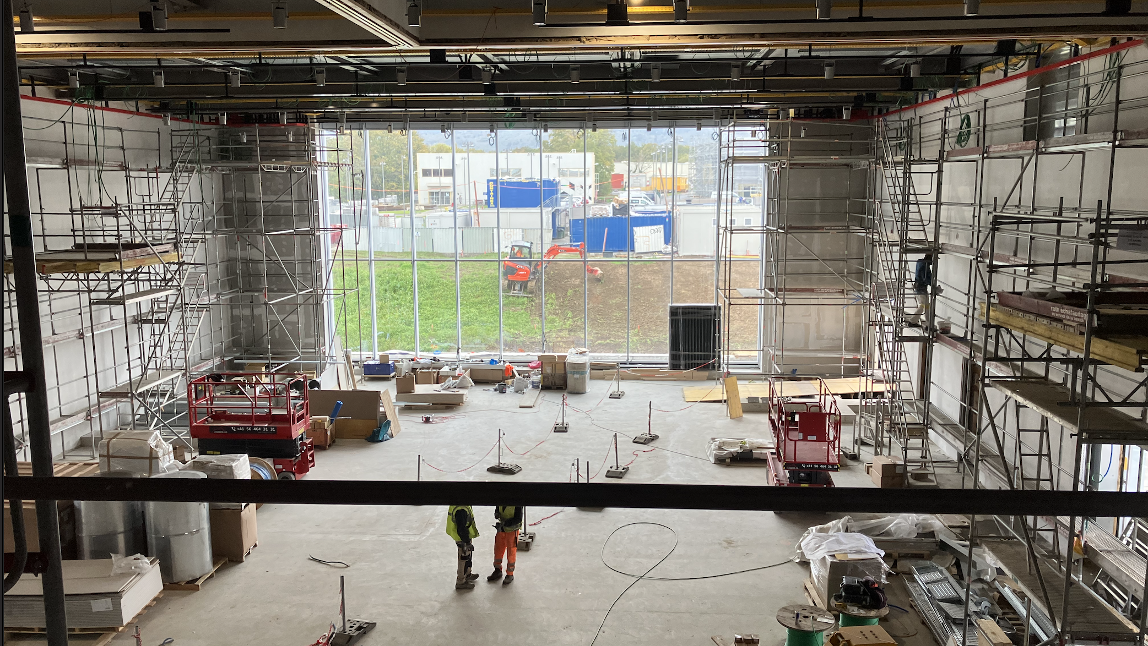
The Science Gateway inauguration ceremony - 20 June 2023
Challenges & Elements to incorporate
Finding the right balance:
    high-profile event that attracts attention to the incredible infrastructure and its programmes, with
    we operate in a context of budgetary pressure and global crisis.
Ensuring that the inauguration reflects the vision behind Science Gateway.
Accommodate wishes of donors within a CERN frame
800-900 guests
Use different spaces – include visits to and activities in exhibitions, labs, piazza
Strong presence of young people
Enable participation of relevant stakeholders - Member States!

Slide 22
Education and Outreach Volunteer Framework
A workshop to share best practices and learn from others (25 Nov)
 |  | TOPICS
 |  | Creating a culture | The team | Training
Recommendation strands | Structures – from governance to teams to individuals | Conclusions and/or Recommendations | Recommdndation
 | Approaches to ensure buy-in across the organization | Conclusions and/or Recommendations
 | Evaluation and Monitoring | Conclusions and/or Recommendations
Expected outcomes:
Conclusions and recommendations to inform setting up of a volunteer programme for education and outreach.
Participants:
Research labs – EMBL, EBI, XFEL, PSI
Science centres – UK National Space Centre, Physiscope, ESO Supernova, LEGO Foundation, SCMS-UNIL, Musée de la Main, Animascience
Industry - Novartis
Trainers, PES researchers
CERN – experienced guides, LHC experiments visit coordinators, HR L&D, senior staff involved in education and outreach
IR-ECO

Slide 23
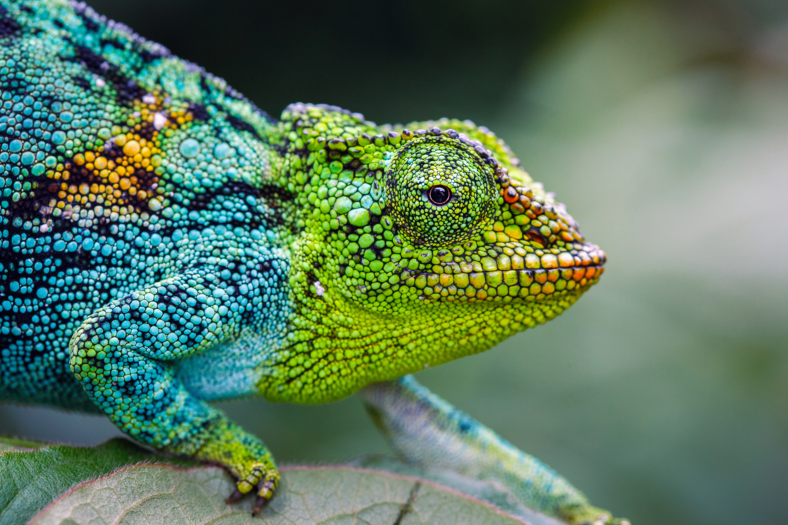
Changes in IR-ECO
Visits and Events Operations section will move to the SGW Business Unit (Jan 2023)
James Gillies will be retiring (summer 2023)
New section leader for Media and Digital Communication (Apr/May 2023)

