Slide 1




Annual report second year of PhD course
Matteo Magherini
Tutor: Alessandro Rossi

Slide 2
Overview
CMS outer tracker upgrade for high luminosity
  Anatomy of tracker modules for upgrade
  DAQ for CMS HiLumi modules
MUonE experiment test and deployment
  Physics case
  Measure
  Detector
  Data Acquisition
  Test beam results

Slide 3
CMS outer tracker upgrade for high luminosity

Slide 4
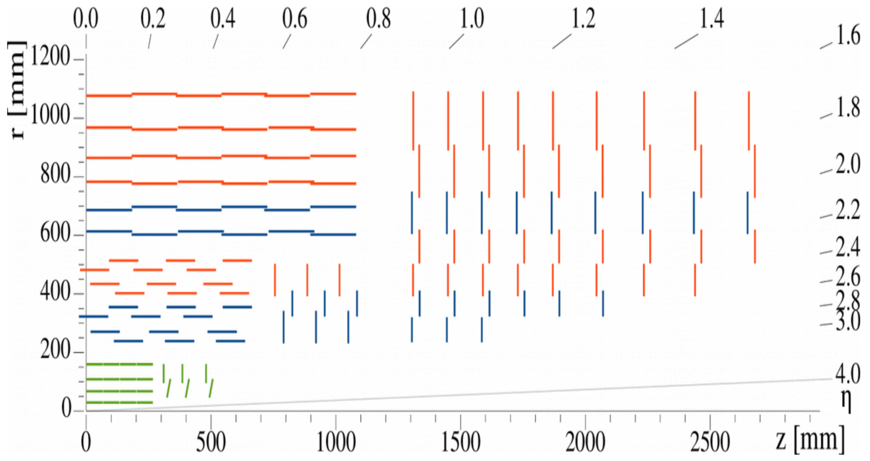
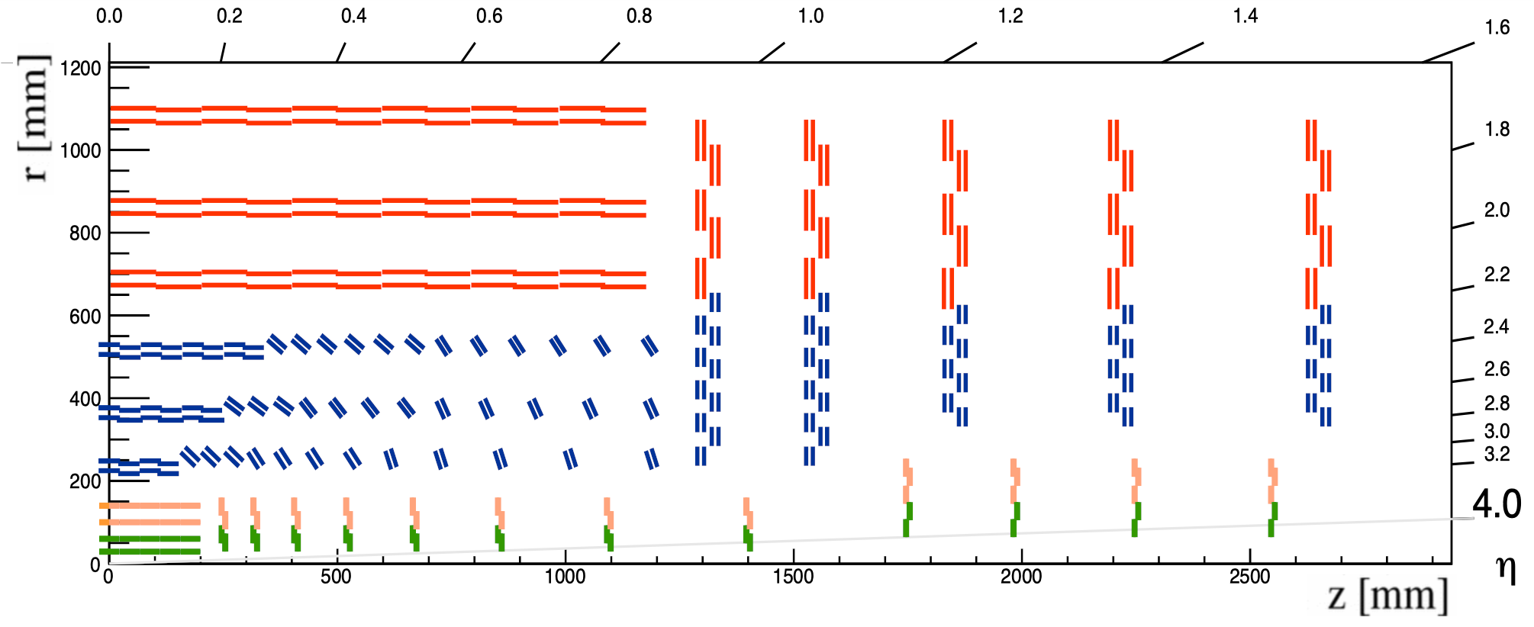
CMS outer tracker
Hi-Lumi upgrade of LHC after LS3 (~2026)
  Peak Luminosity ~7.5x10³⁴cm⁻²s⁻¹
  Expected Pile-up ~200
  Higher rates and radiation dose wrt Run3
  New Magnets (11T)
  Etc..
Necessary upgrade of current tracker:
  leakage current or full depletion voltage limitations → big part of current tracker will be inoperational
  Higher radiation level → upgraded tracker target: integrated luminosity of 3000 fb⁻¹
  Efficient tracking + Higher pileup → Increase of granularity needed
  Contribution to level-1 trigger → selection of interesting physics at the first trigger stage is extremely challenging at high luminosity
CMS Ph1 tracker
CMS Ph2 tracker

Slide 5
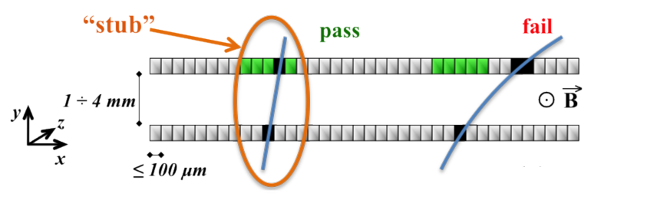
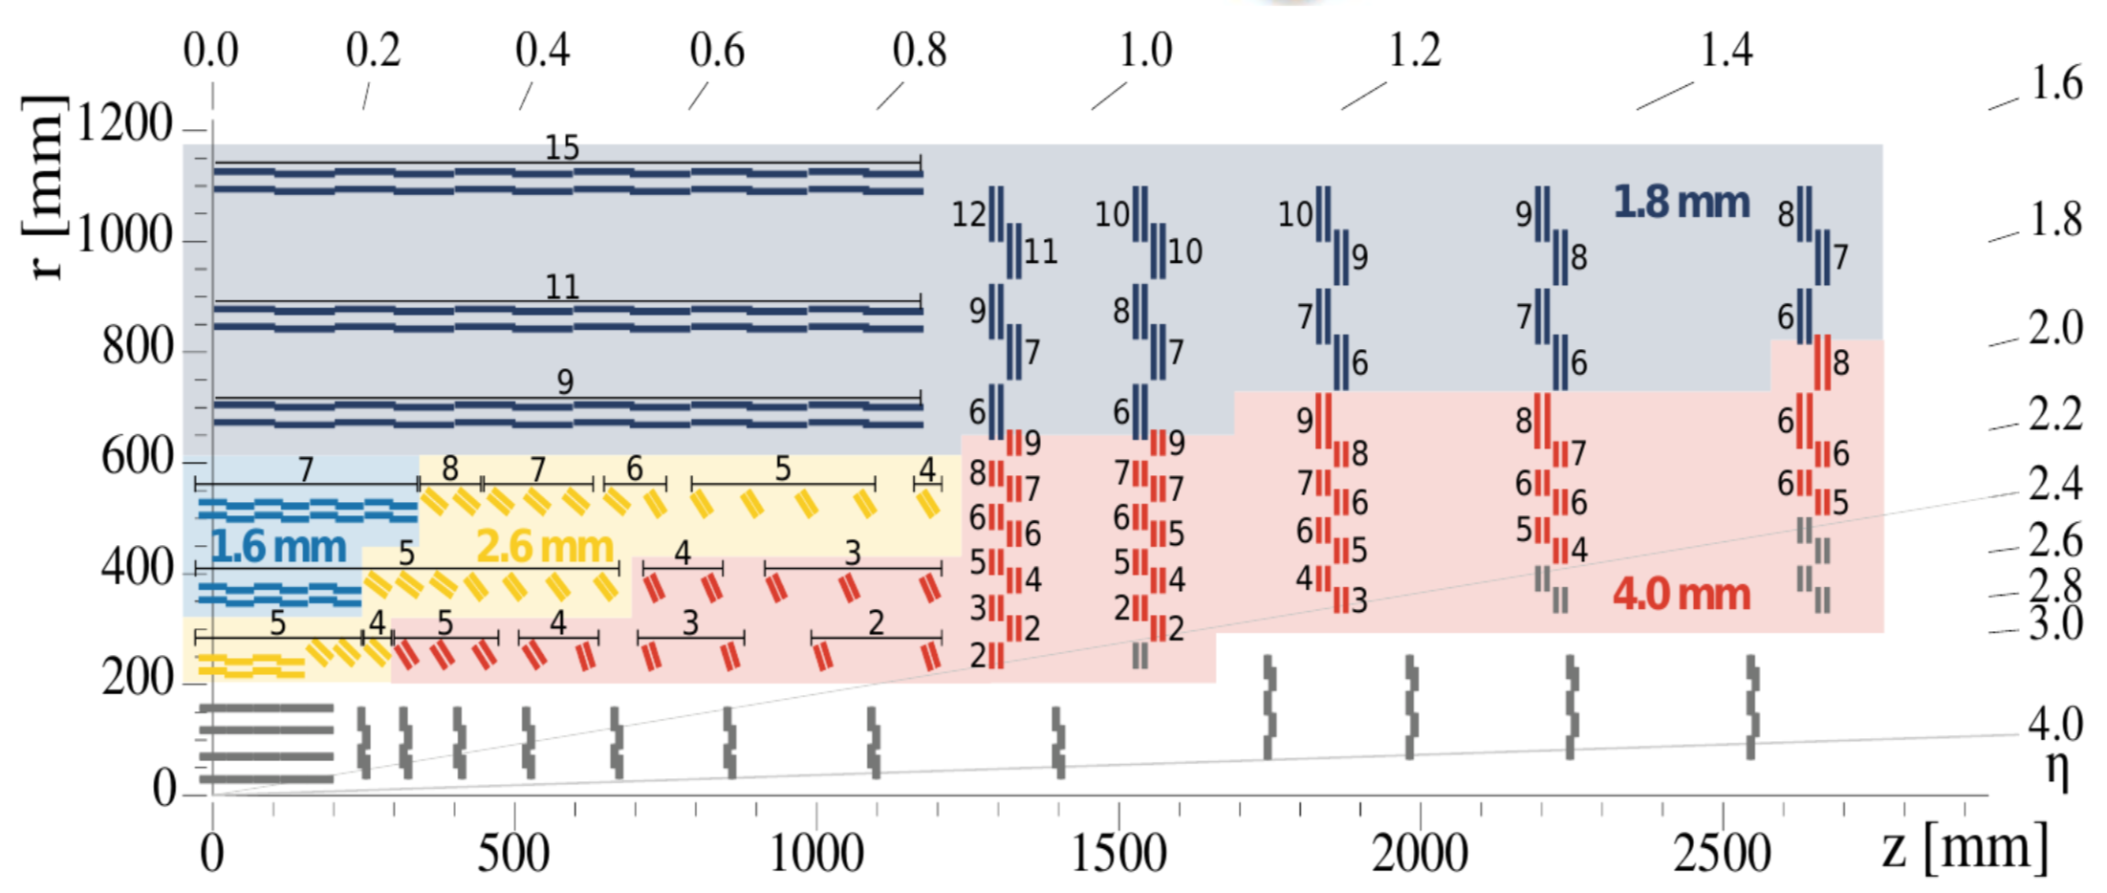
CMS outer tracker
HL-LHC → higher collision rate→ Most of charged particles have low p_{T} → p_{T} selection at readout level in order to reduce the L1 tracking input data size
pT modules
Two silicon sensors with small spacing in a module
Flex hybrid in order to get data from both sensors to one ASIC → Select track «stubs»
Different sensor spacing for different detector region
Tunable correlation windows
Inner Tracker

Slide 6
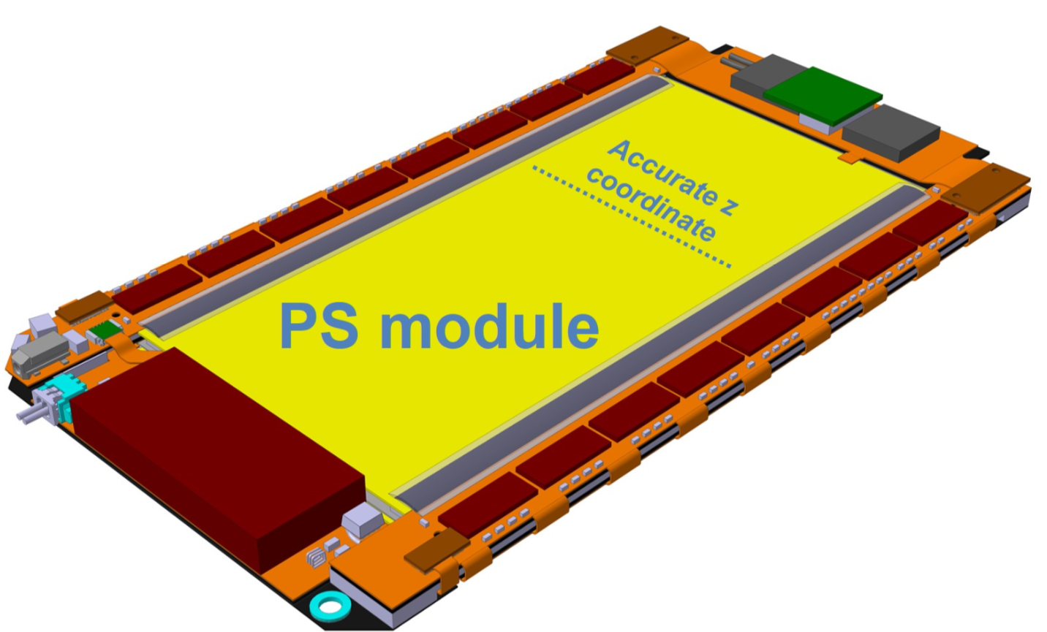
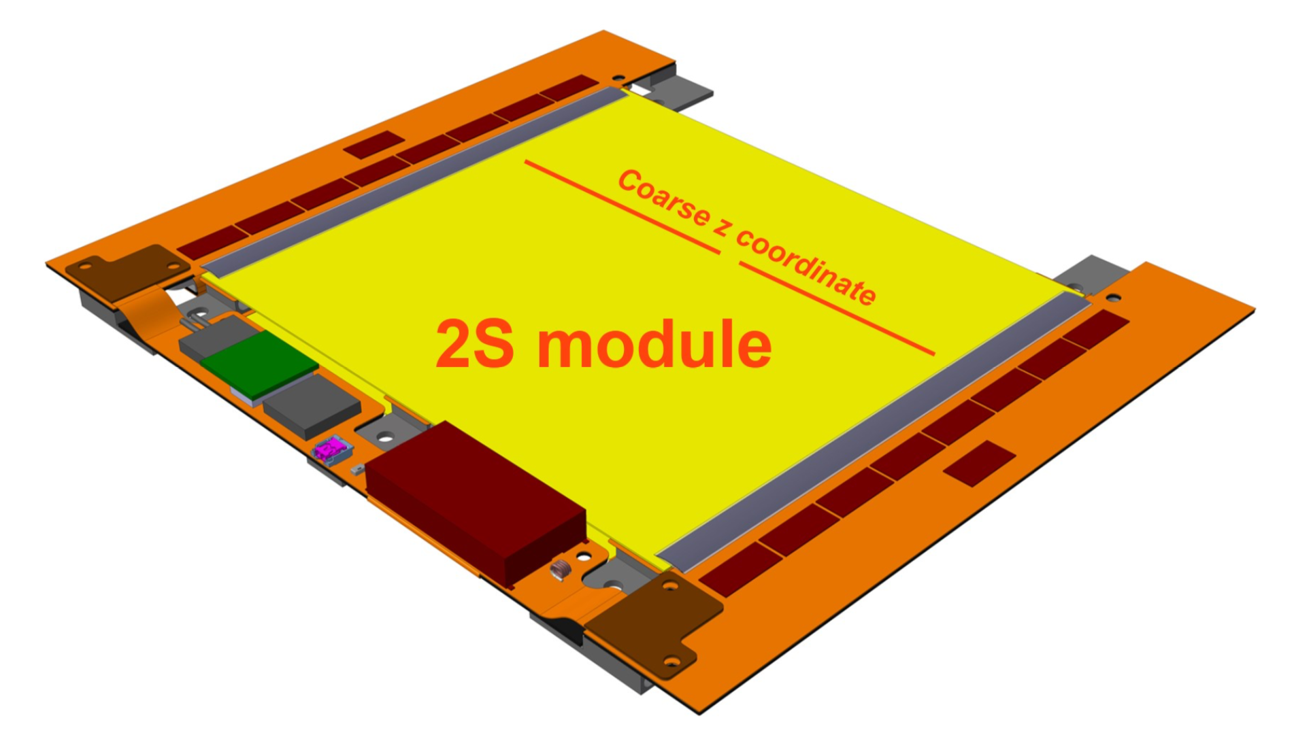
CMS outer tracker
PS Modules
  3 different spacing : 1.6mm & 2.6mm & 4mm
  One strip sensor: 2.5cm x 100μm strips
  One macro Pixel sensor : 1.5mm x 100μm pixels
  Sensor dimension 5cm x 10 cm
    two column of 960 strips
    32x960 pixels
2S Modules
  2 different spacing : 1.8mm & 4mm
  2 micro strip sensors with 5cm x 90μm strips
  Sensor dimension are 10cm x 10cm
    two column of 1016 strips

Slide 7
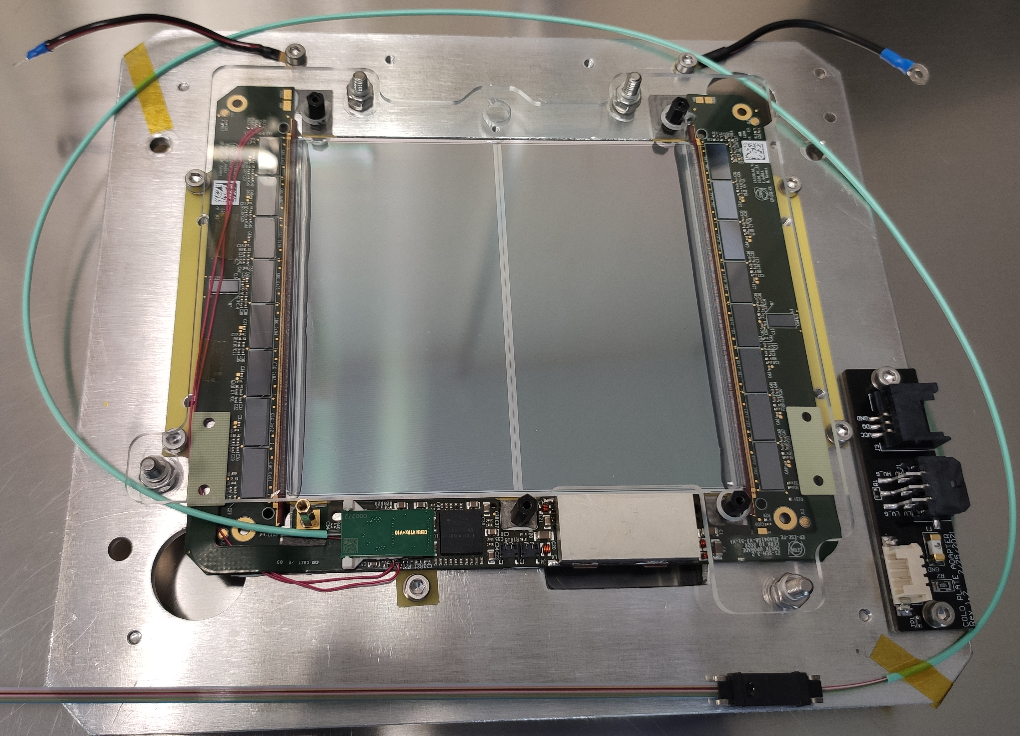
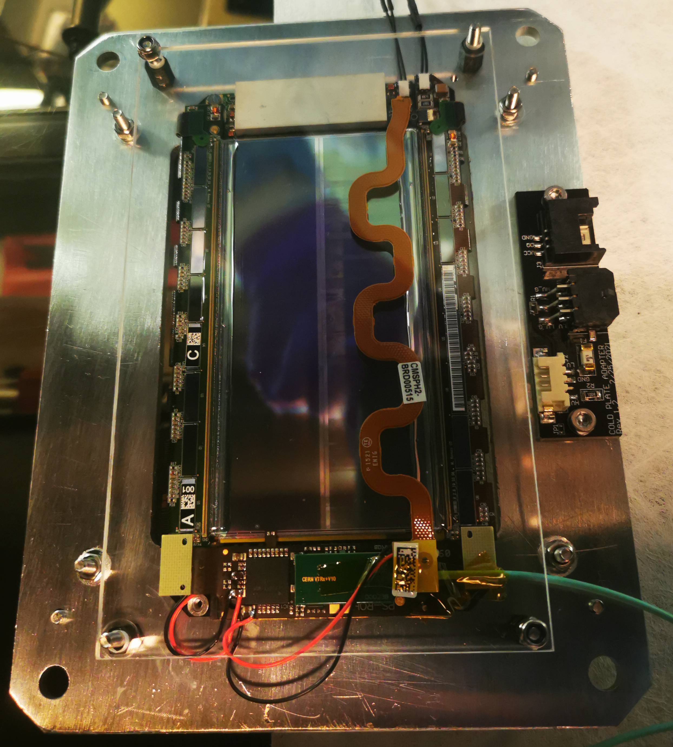
CMS outer tracker
PS Modules
  3 different spacing : 1.6mm & 2.6mm & 4mm
  One strip sensor: 2.5cm x 100μm strips
  One macro Pixel sensor : 1.5mm x 100μm pixels
  Sensor dimension 5cm x 10 cm
    two column of 960 strips
    32x960 pixels
2S Modules
  2 different spacing : 1.8mm & 4mm
  2 micro strip sensors with 5cm x 90μm strips
  Sensor dimension are 10cm x 10cm
    two column of 1016 strips

Slide 8
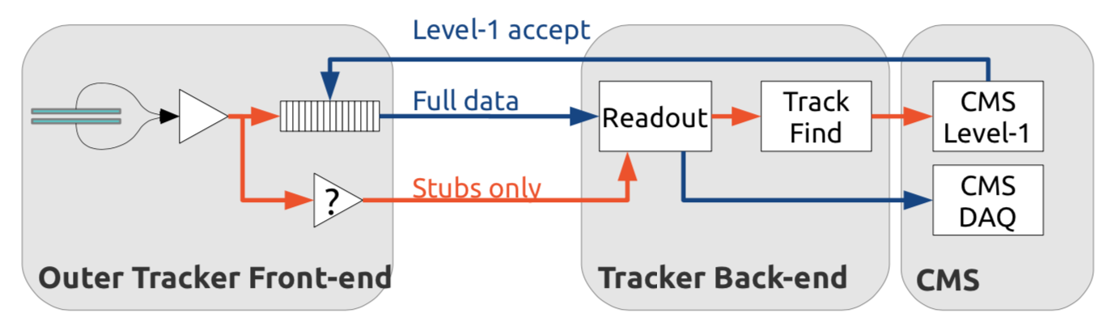
DAQ for CMS modules
Stubs: average position of the seed cluster + average position of the correlation cluster
  L1 trigger
  40 MHz readout
Hits: information on ALL the strips/pixel in a module (one bit per strip/pixel)
  Final DAQ
  750 kHz readout

Slide 9
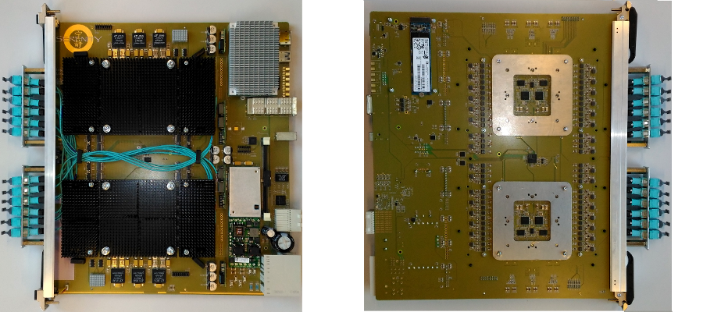
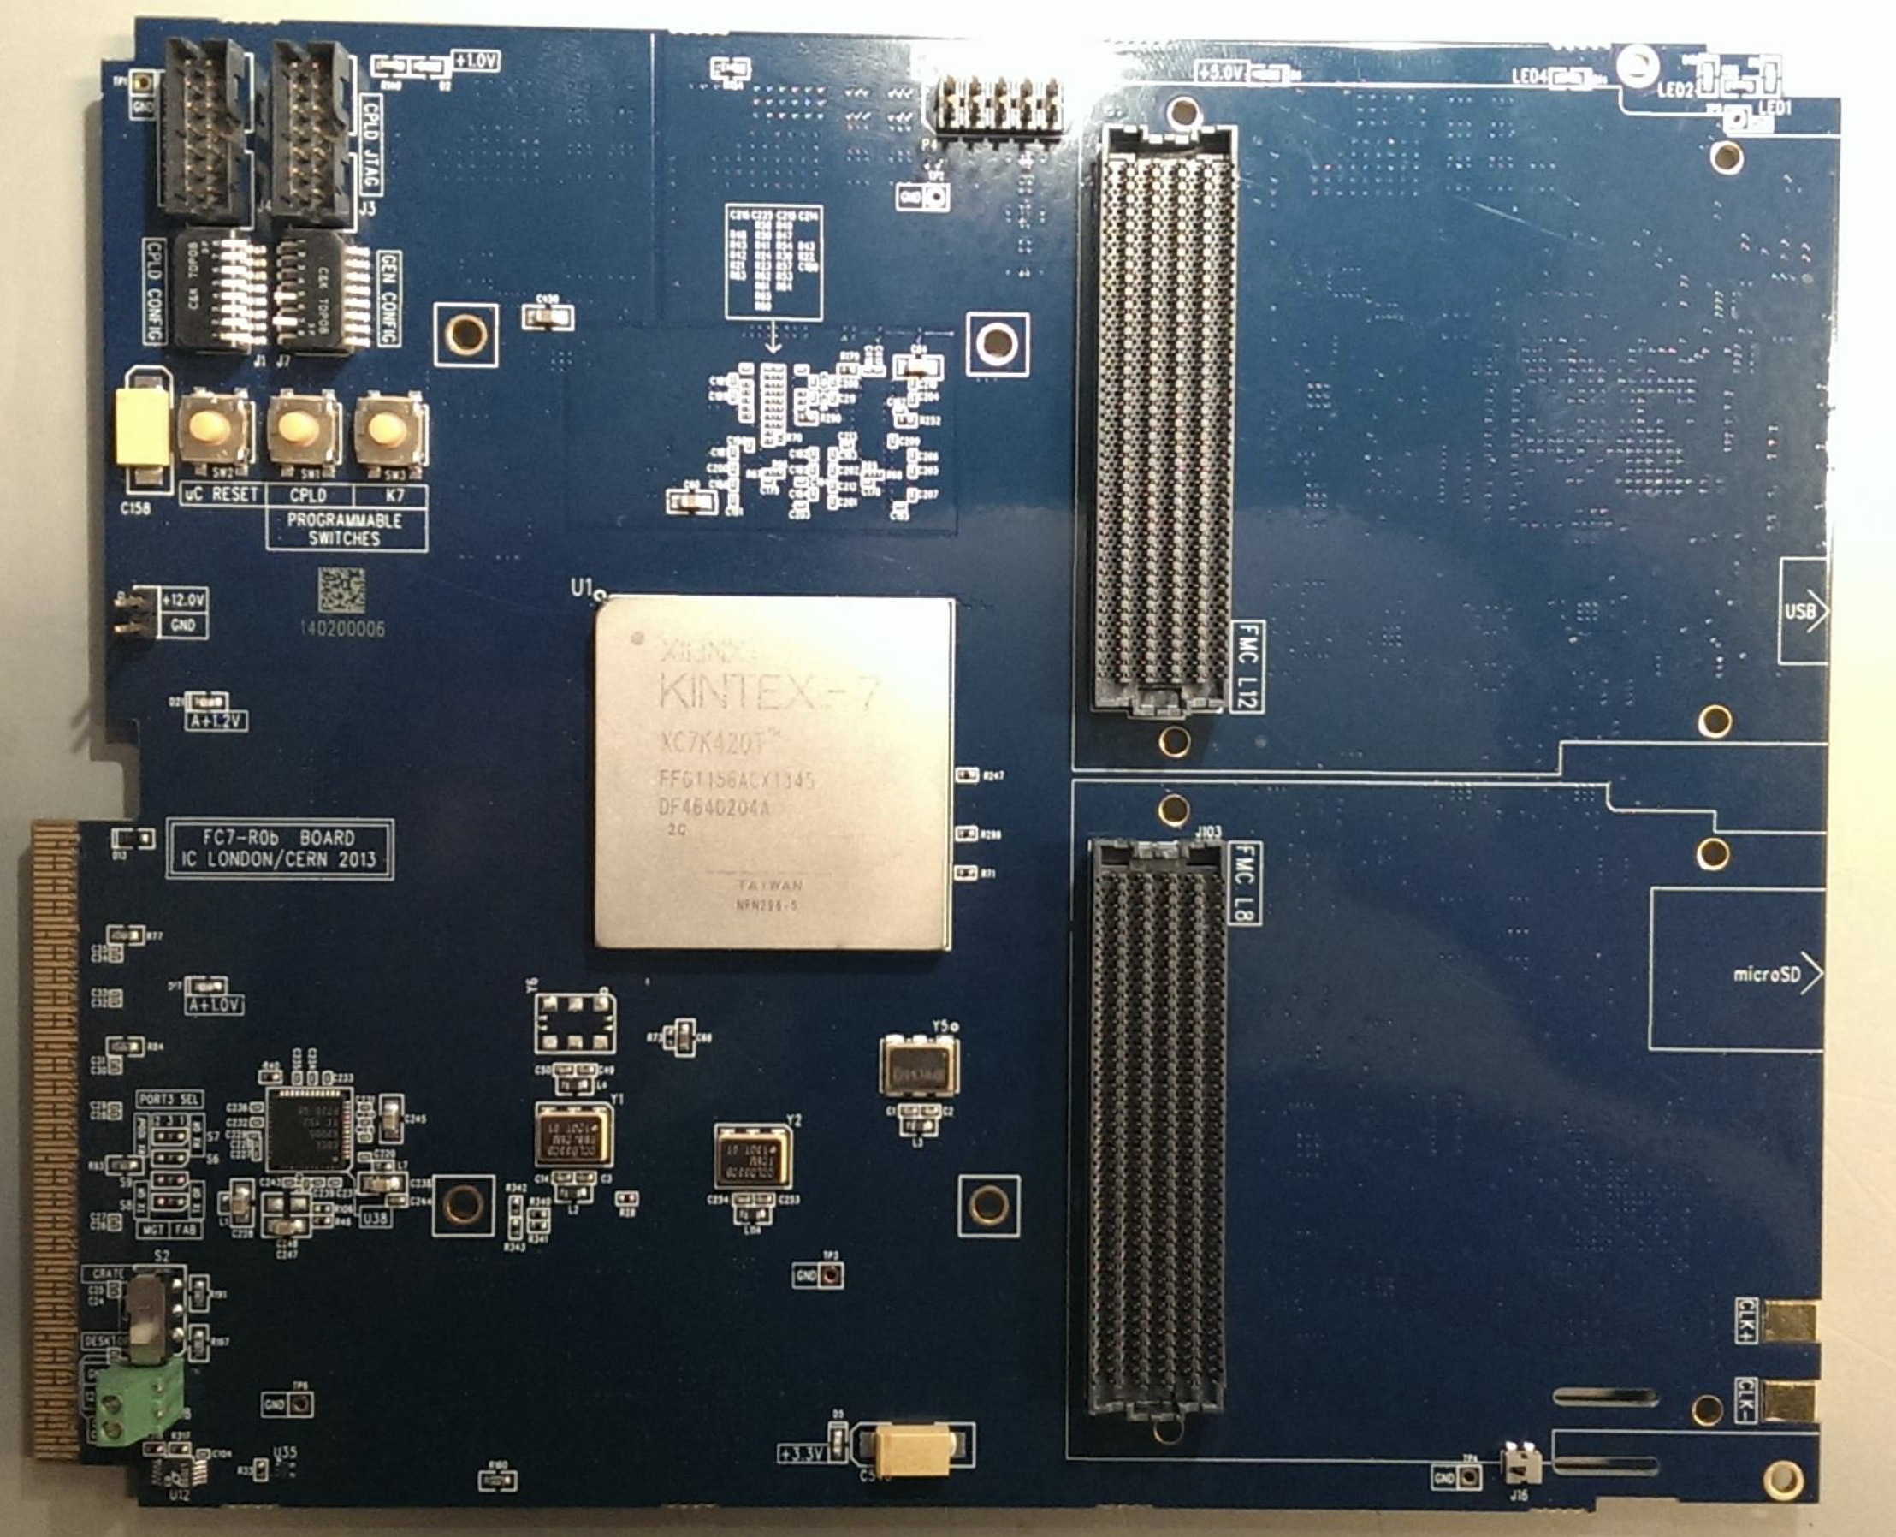
Involvement for DAQ chain
Passage from test system (uDTC) to final readout system (DTC)
  From readout via optical + IPBus + computation in resident CPU → optical + computation in FPGAs in the board
  Transition of the calibration software for 2S modules → calibration SW for PS has just been deployed on the test system, time to transition also that!

Slide 10
MUonE

Slide 11
MUonE Physics case - Introduction
Anomalous magnetic moment of a lepton as precison test for SM
  Can be (very) precisely calculated in SM framework
  But… it’s flavor dependent!
Electron
  g_{e}-2 determined with high precision
  Sensitivity to new particles limited by a ~(m/M)² factor
Muon
  Sensitivity to an higher mass region [GeV, TeV]
  State of art: 4σ discrepancy from SM prediction

Slide 12
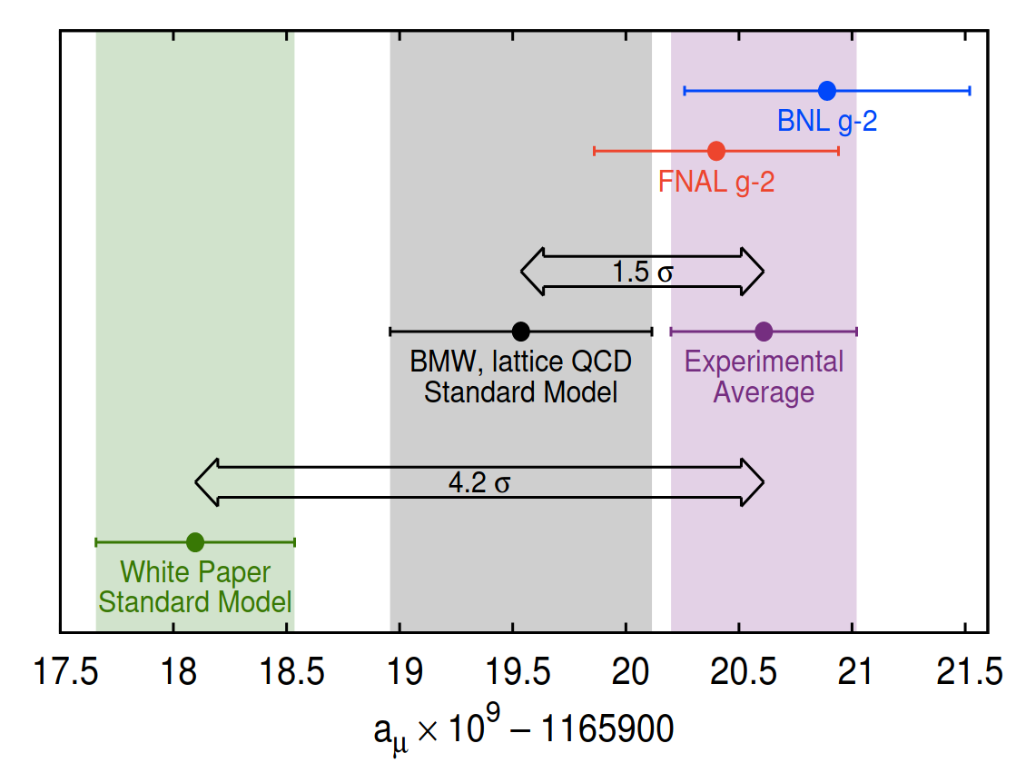
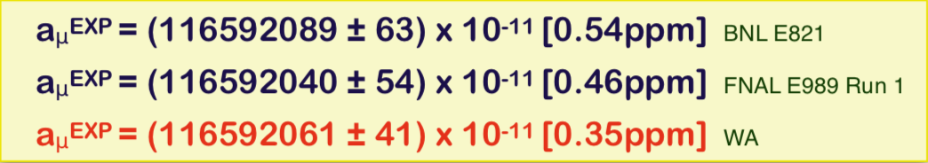
State of the art
FNAL g-2 Run1 results:

Slide 13
Present theoretical uncertainties

Slide 14
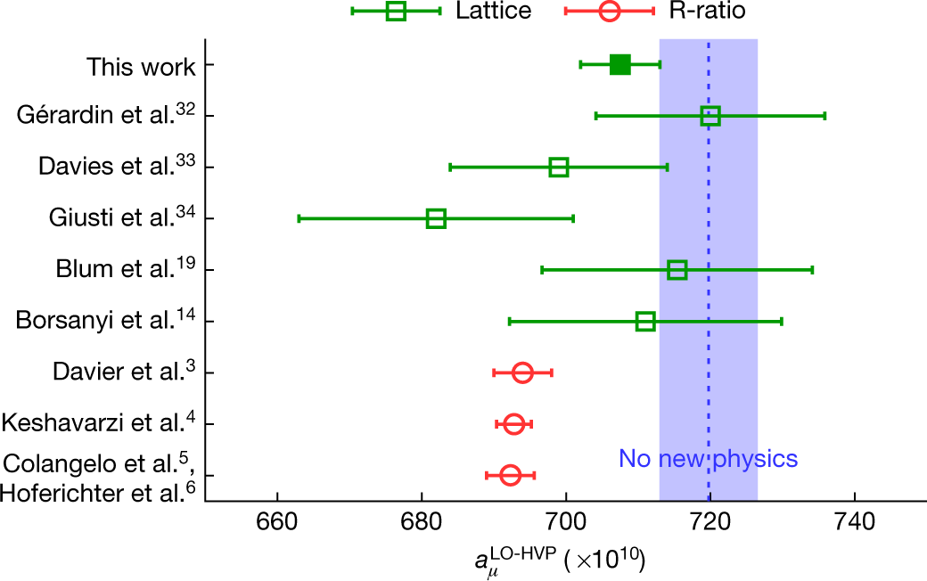
a_{μ}^{HLO}: LO Hadronic contribution
Traditionally computed via a dispersion integral using hadronic production cross sections in
electron-positron annihilation at low energies
QCD lactice calculation still not competitive
  …at least up to the FNAL g-2 results…
Borsanyi, S., Fodor, Z., Guenther, J.N. et al.
Leading hadronic contribution to the muon magnetic moment from lattice QCD - Nature 593, 51–55 (2021).

Slide 15
Measuring a_{μ}^{HLO} – how to
MUonE: high precision measurement of a_{μ}^{HLO}
  160 GeV μ beam on e⁻ target at CERN
Hadronic contribution to the effective electromagnetic coupling, ∆𝜶_{had}(q²) for space-like squared four-momentum transfers q² = t < 0, via scattering data

Slide 16
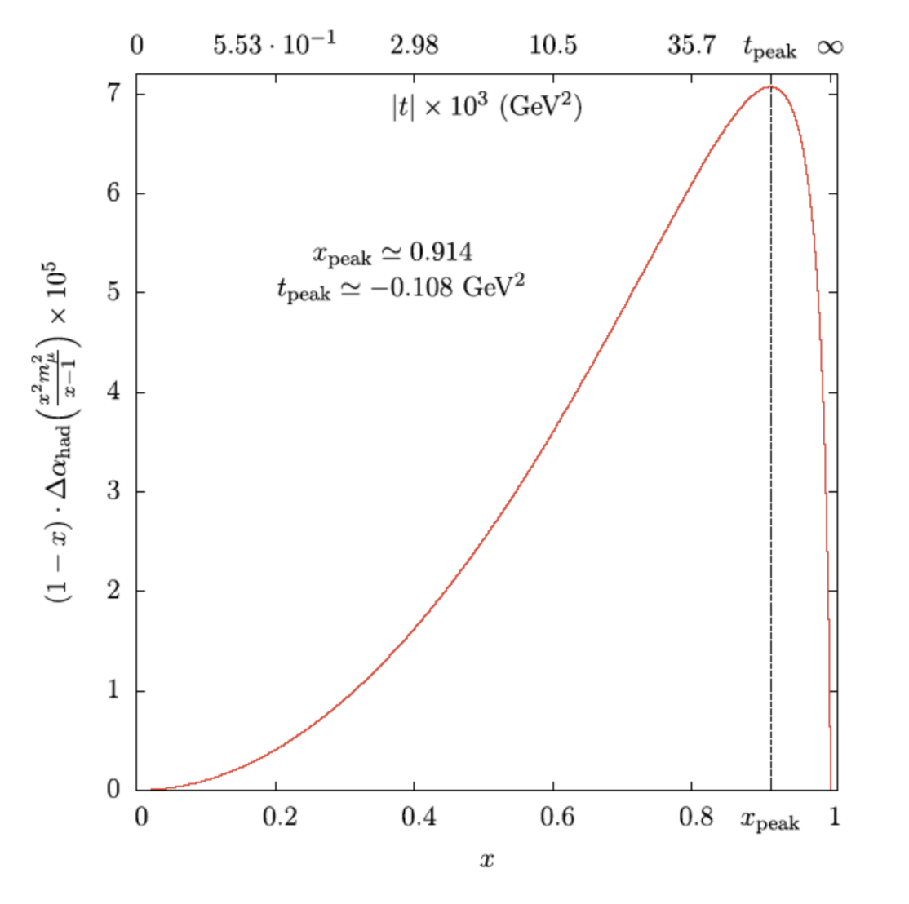
Measuring a_{μ}^{HLO}– how to
Experimental kinematic limit:
0 < -t < 0.161 GeV
or
  0< x <0.93
~87% of the area → extrapolated to 100% with functional model of Δα_{had} (t)

Slide 17
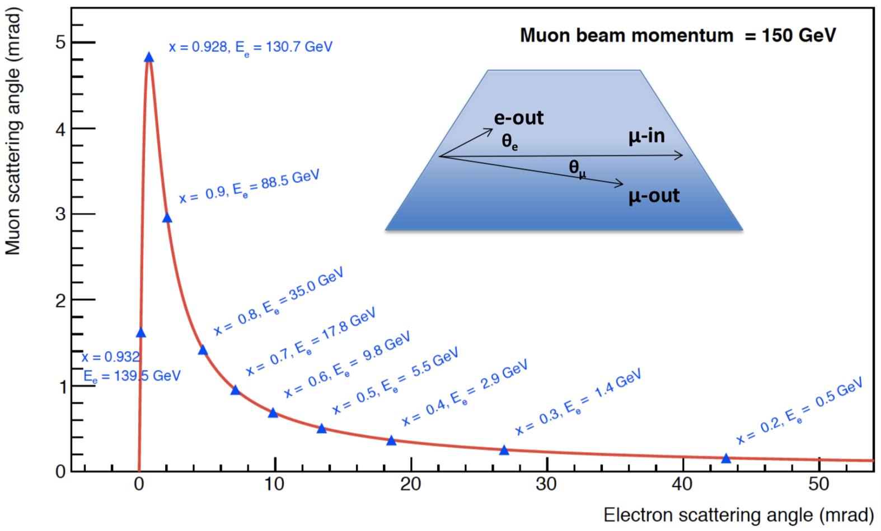
Measuring a_{μ}^{HLO}– key element
Measure of the scattering angles precise tracking and at high rate
Best solution: 2S modules from CMS

Slide 18
MUonE Detector
x 40
High Intensity μ
beam (160GeV)

Slide 19
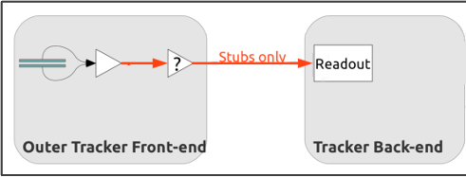
MUonE DAQ chain
CMS
MUonE

Slide 20
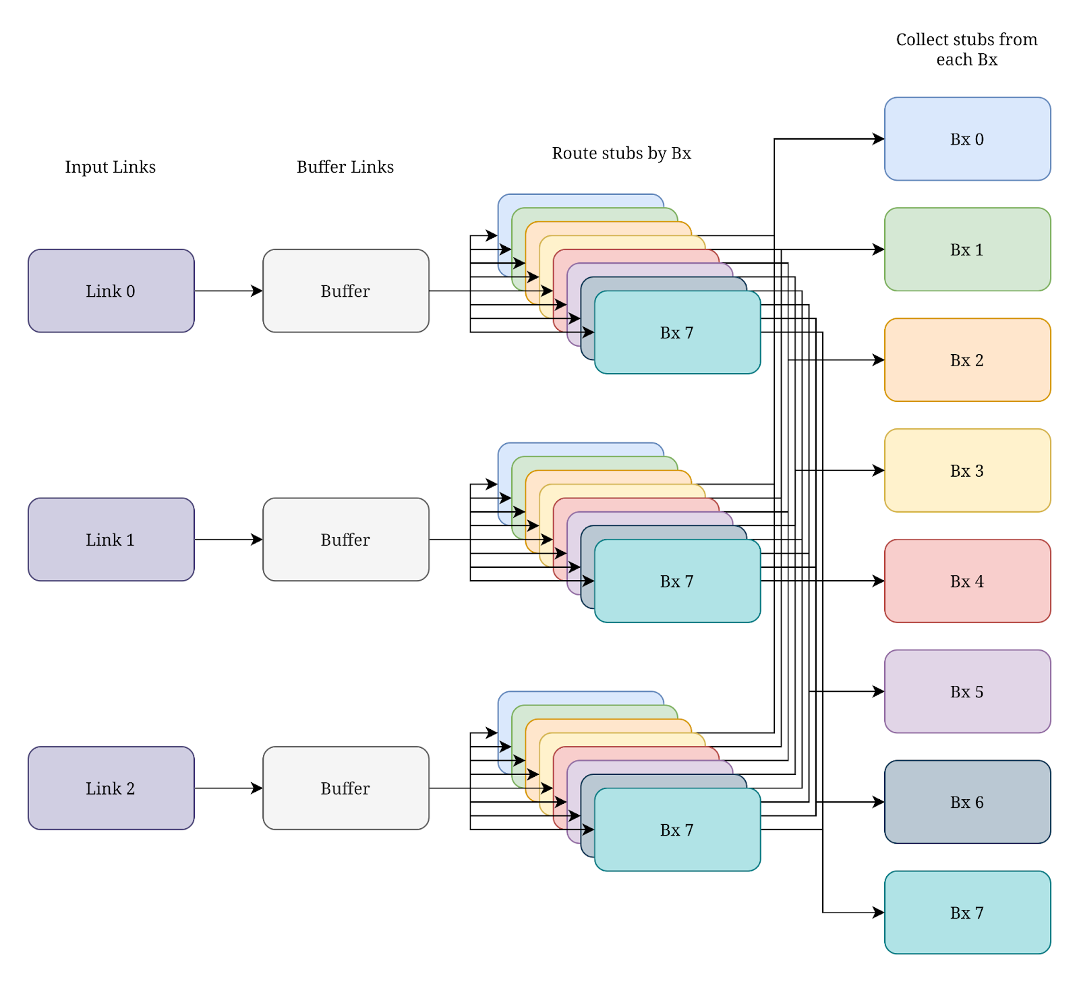
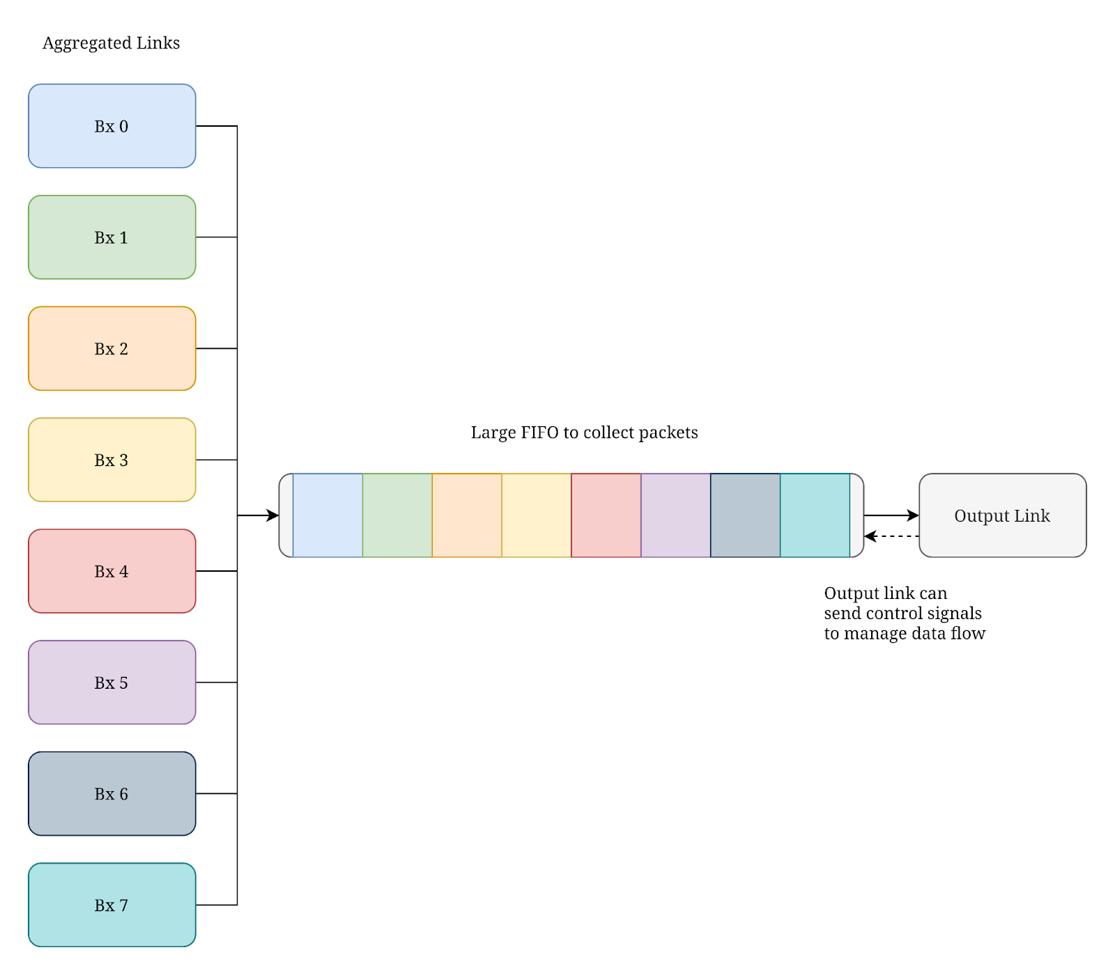
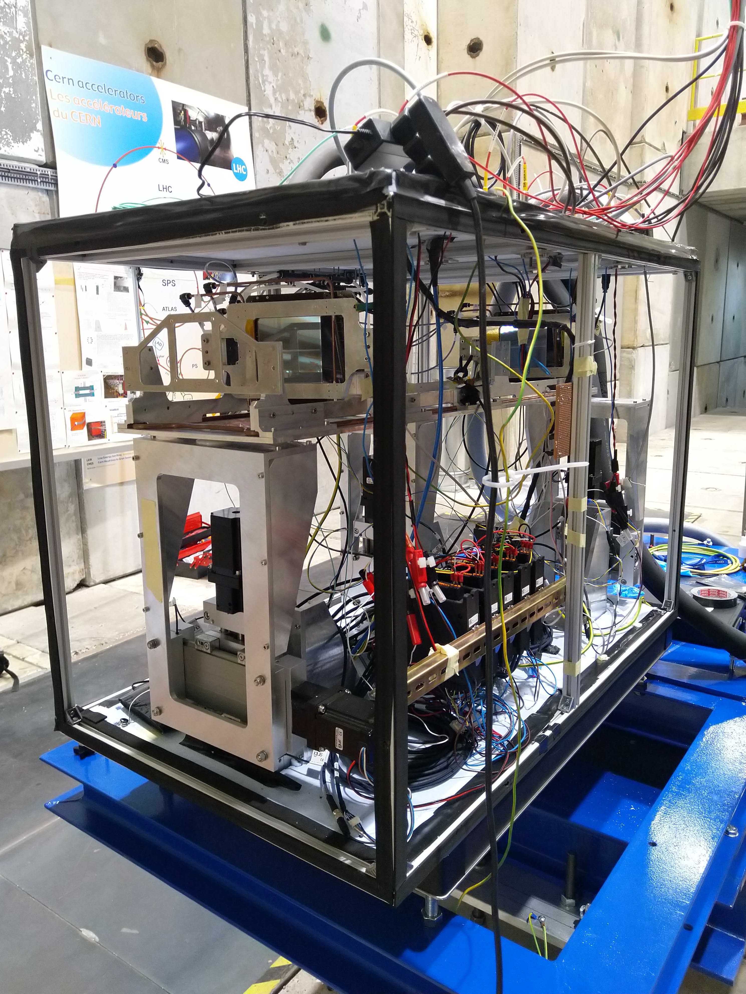

MUonE DAQ chain

Slide 21
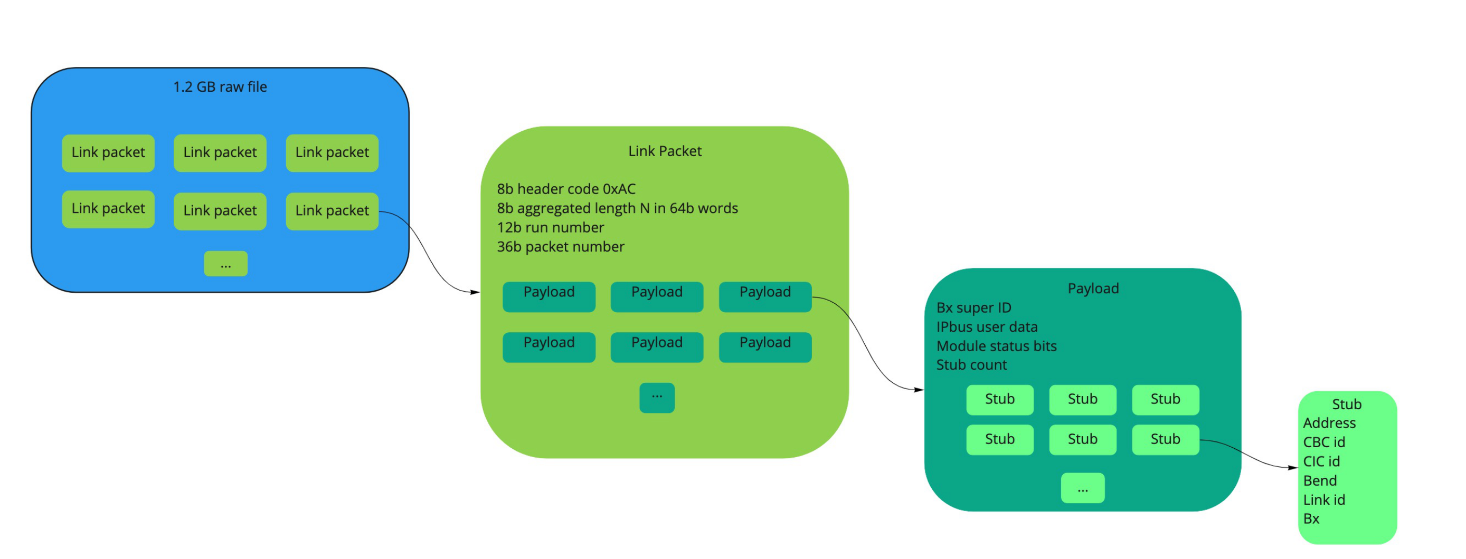
Data Structure from the 10 GB link
On the sink PC 1.2 GB raw files are saved
Raw files structure:
Decoding of raw data → different readable formats for analysers

Slide 22
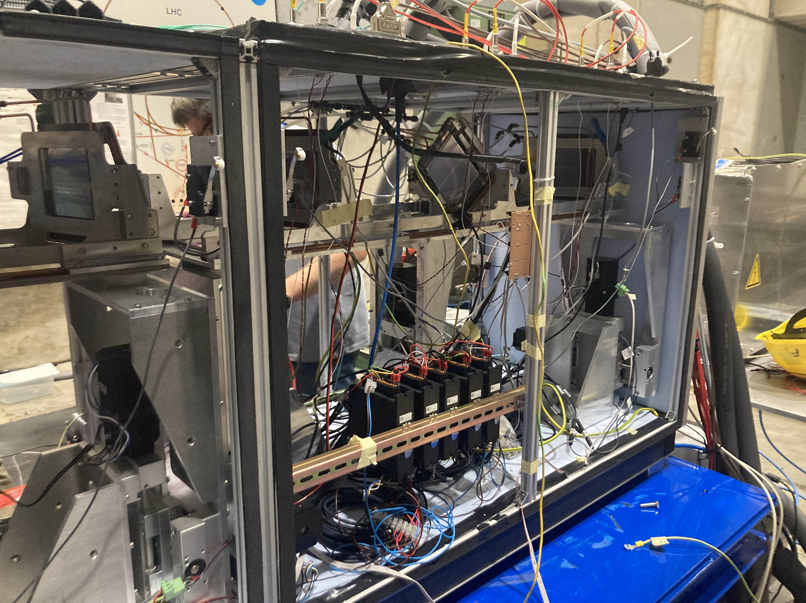
MUonE – 2022 test beam setup
*First time*: 6 modules readout at high intensity
One completely equipped station + target → first possibility to reconstruct tracks and study MUonE capabilities and resolution
Stress test for DAQ final system → 20 MHz muon beam ~ half of the expected rate in CMS for HiLumi

Slide 23
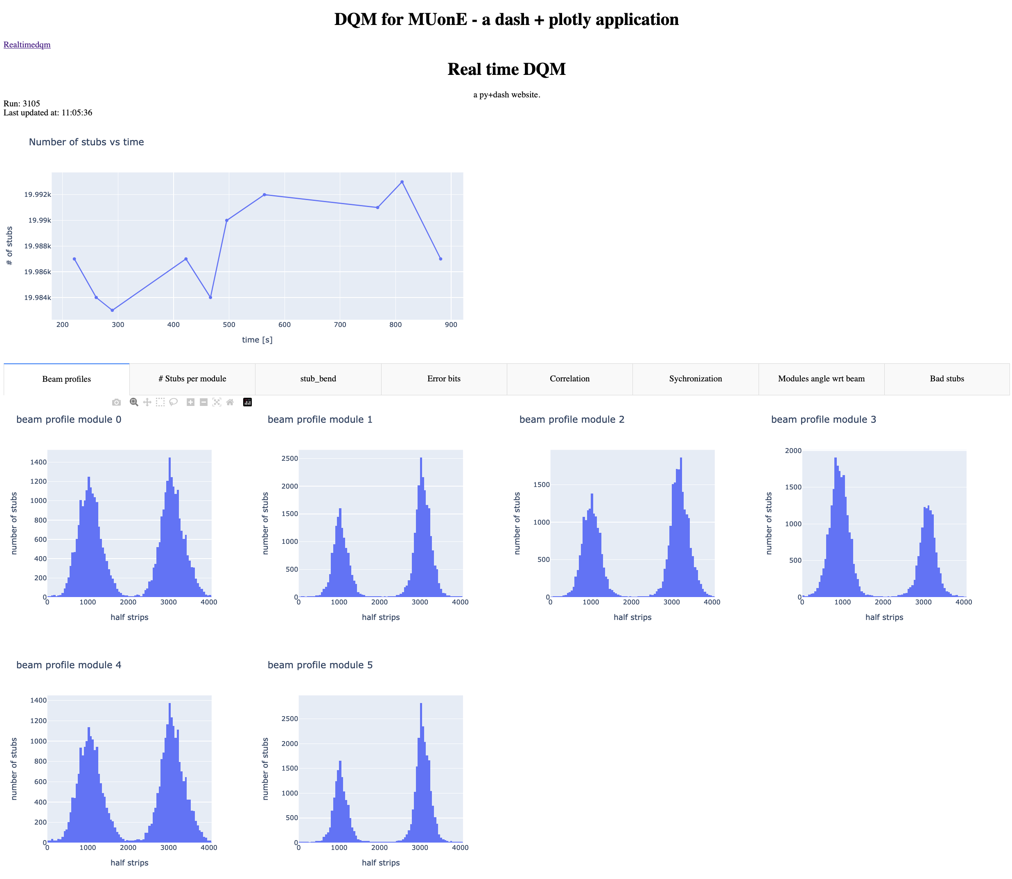
Data Quality Monitoring
Deployment of DQM tools:
  Fast
  Interactive
  Keeping track of both firmware errors and hardware conditions
  With an eye on scalability for the future
  In progress: adding fast reconstruction of tracks

Slide 24
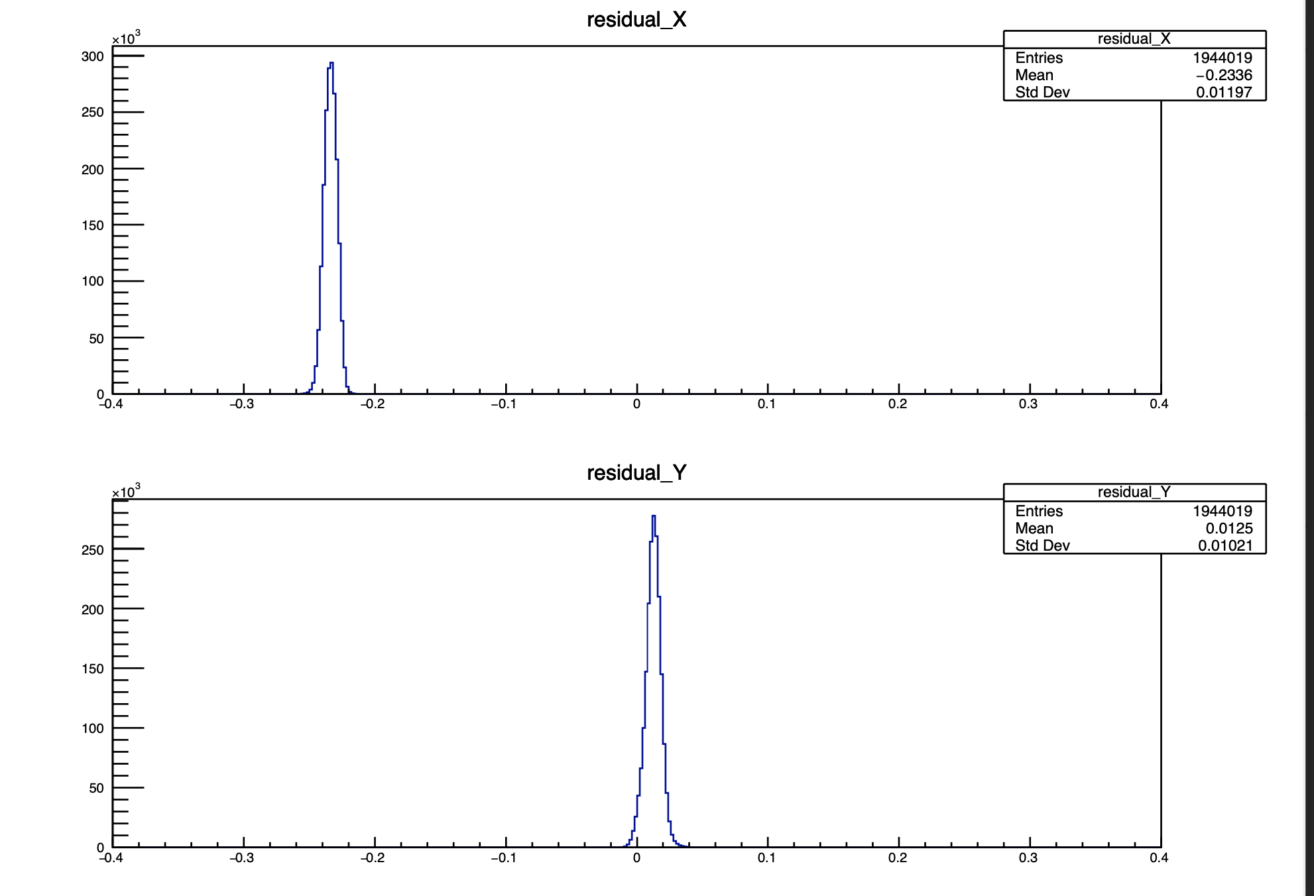
Offline analysis
Firsts results from tracking of this year TB – ended yesterday
First simple tracking with just a single particle passing through the detector → estimate of residuals
Results around what expected ~ 100 um resolution → preliminar! Alignment still to be done

Slide 25
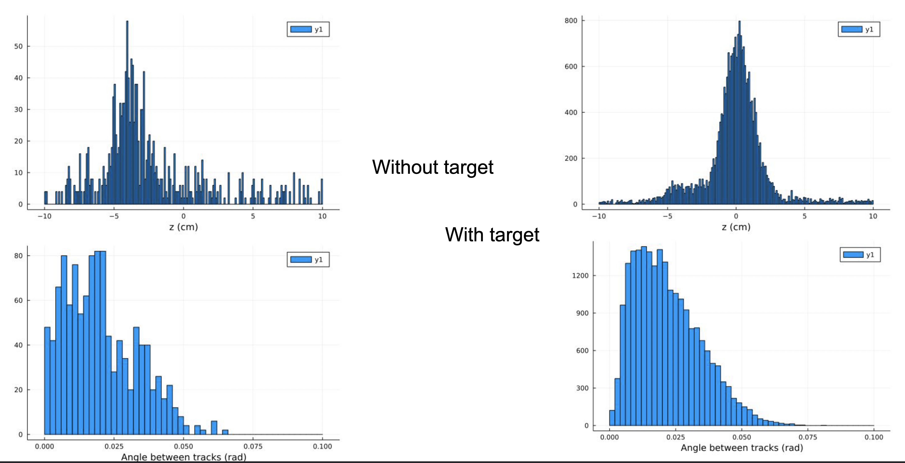
Offline analysis
Firsts results from tracking of this year TB – ended yesterday
First simple tracking with just a single particle passing through the detector → estimate of residuals
Results around what expected ~ 100 um resolution → preliminar! Alignment still to be done
First track reconstruction in 2D performed
Position of the interaction vertex with target

Slide 26
Offline analysis
Firsts results from tracking of this year TB – ended yesterday
First simple tracking with just a single particle passing through the detector → estimate of residuals
Results around what expected ~ 100 um resolution → preliminar! Alignment still to be done
First track reconstruction in 2D performed
You can recognize budget material
Position of the interaction vertex without target

Slide 27
Plans for the next year
Continuous work on passage from test DAQ system → final DAQ system. First step: transition of the whole calibration code for PS modules
Analysis on test beam dataset:
  Alignment of the modules – never done still with stubs data stream
  Studies on track reconstruction algorithms
  Estimate of MUonE capability, resolution and extrapolation to sensitivity of the whole experiment
  Characterization of CMS 2S modules
  Characterization of failures in high intensity for DAQ firmware

Slide 28
Backup

Slide 29
Educational activities
INFN School of Statistics 2022 [1]
Standard Model at the LHC 2022 [2]

Slide 30
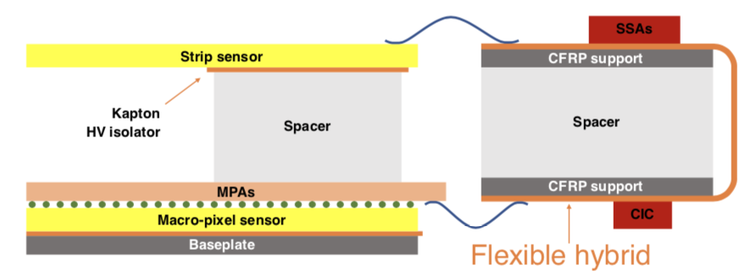
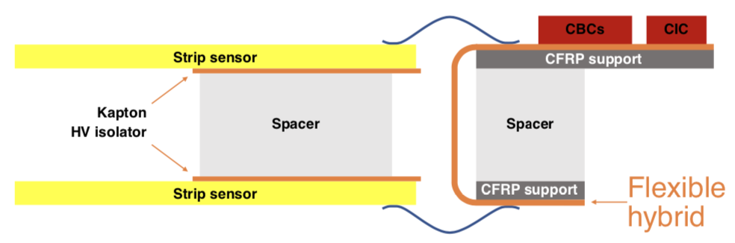
DAQ for CMS modules
Notes:
SSA -> short strip ASIC

Slide 31
Key element
The key elemet to achieve the precision required is the measure of the scattering angles
Experimental needs:
  PID to separate electron and muon → ECAL + μ-filter
  Precise tracking for angles → Tracker
  Electron energy measurement to add redoundancy and reduce systematics→ECAL

Slide 32
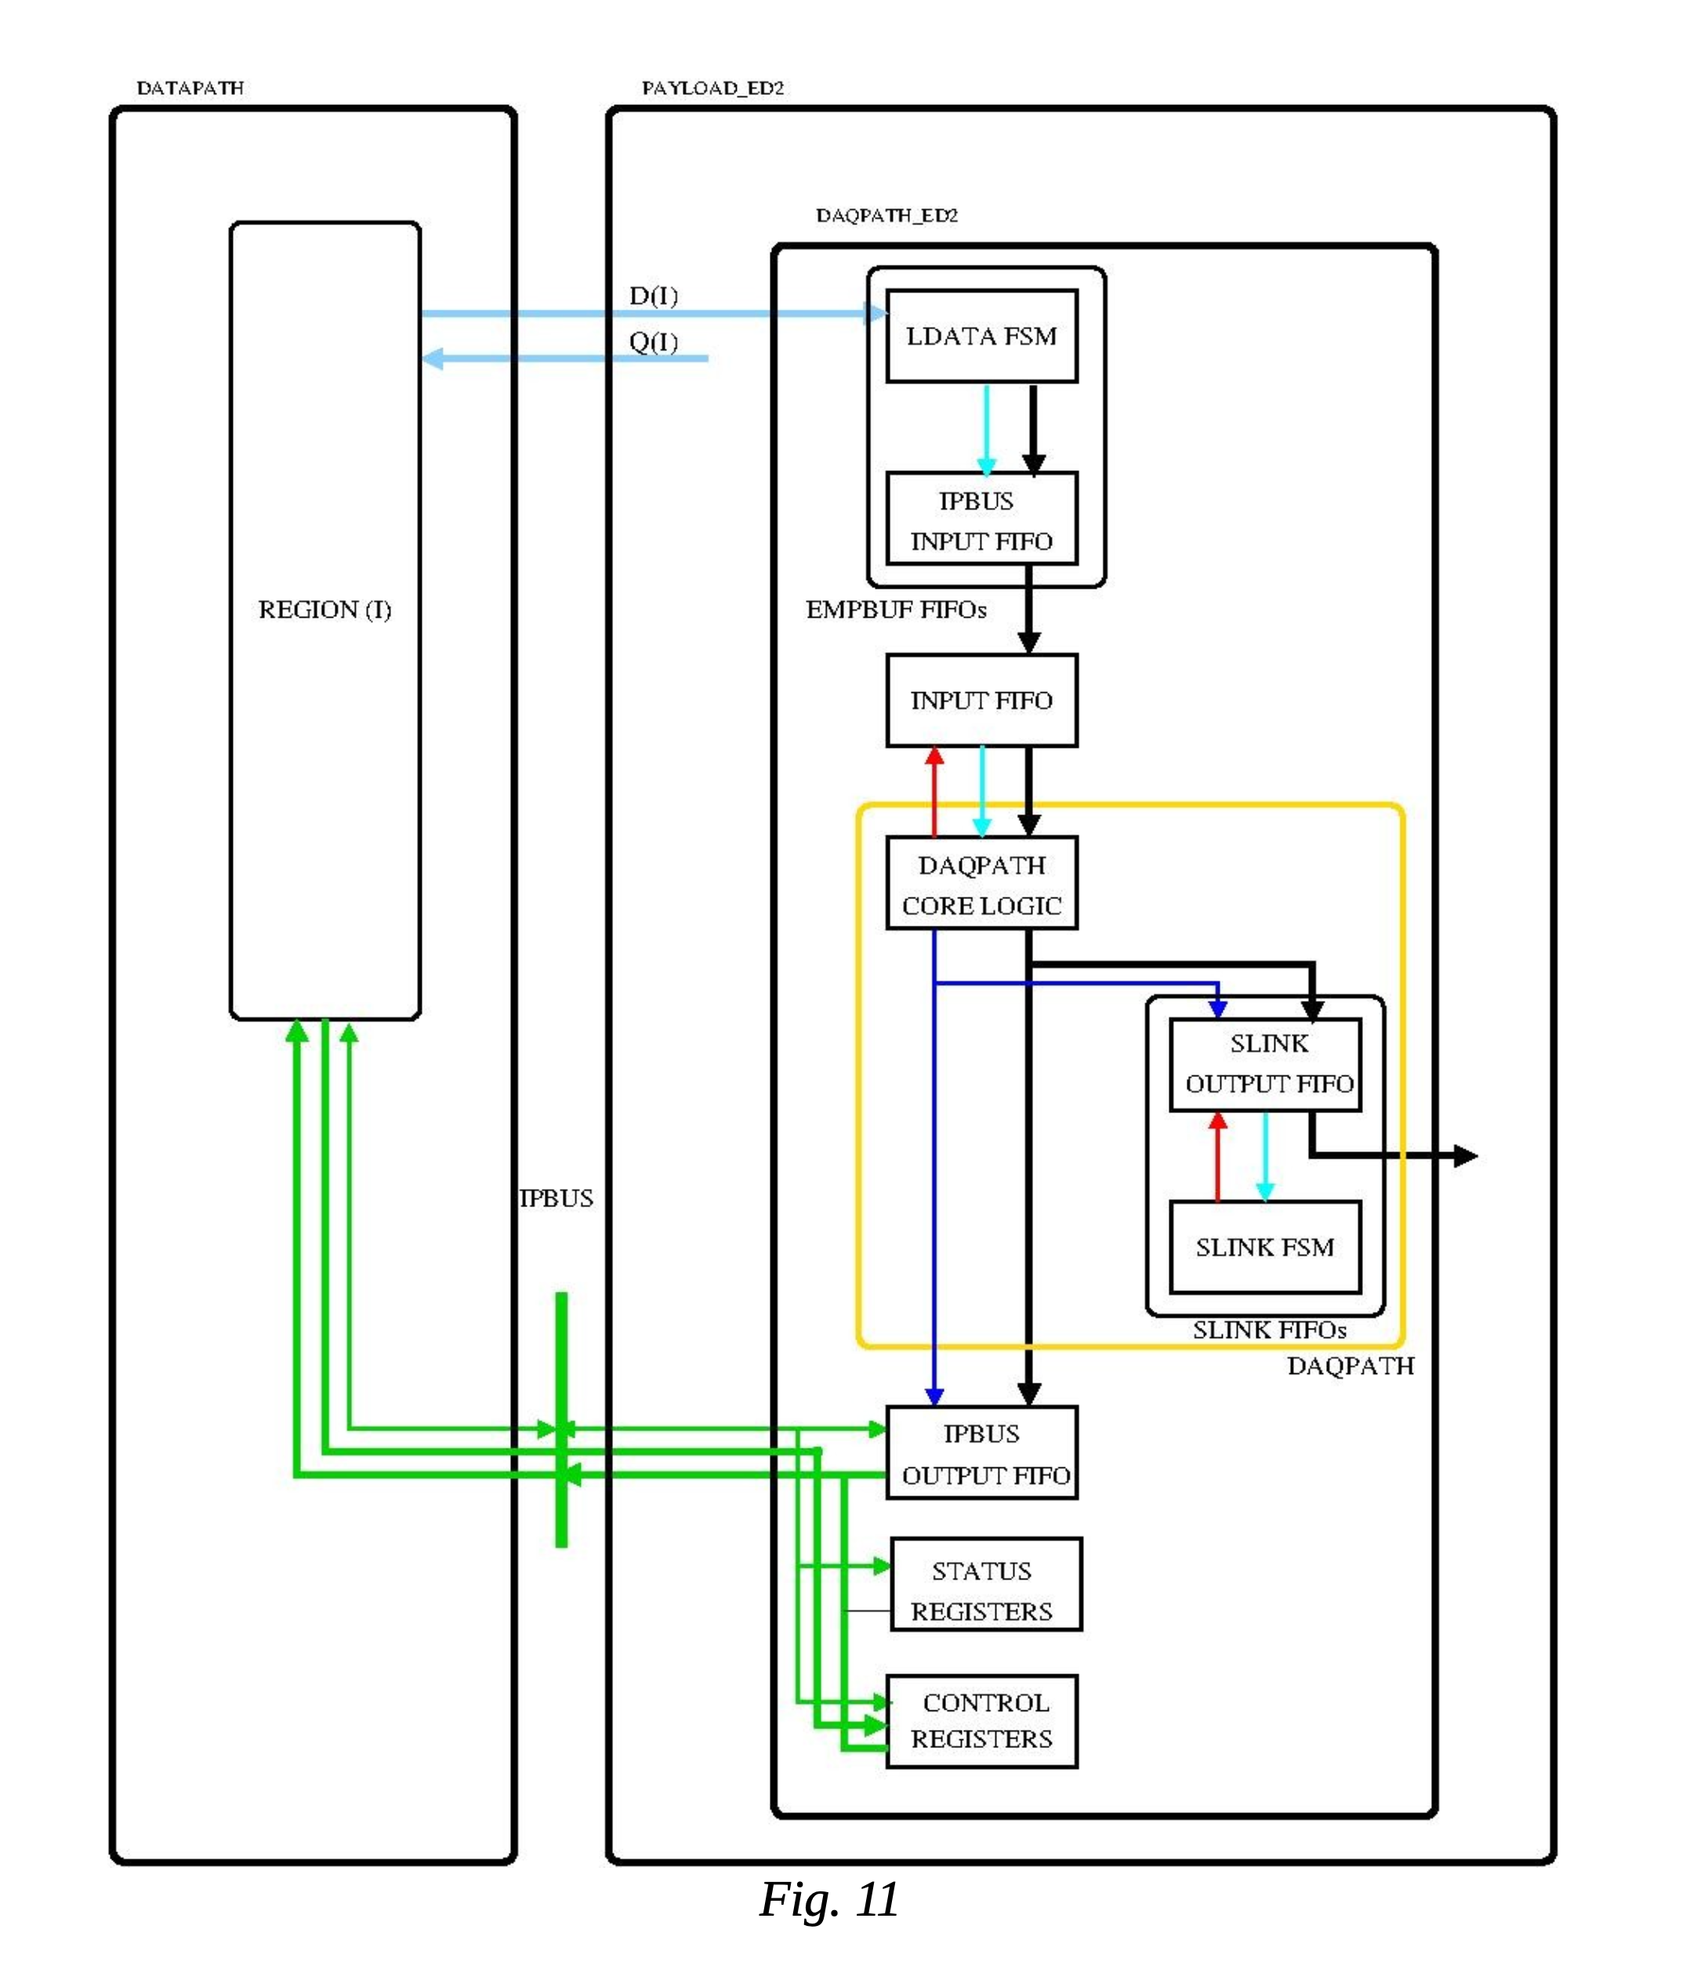
DAQPath inclusion and testing

Slide 33
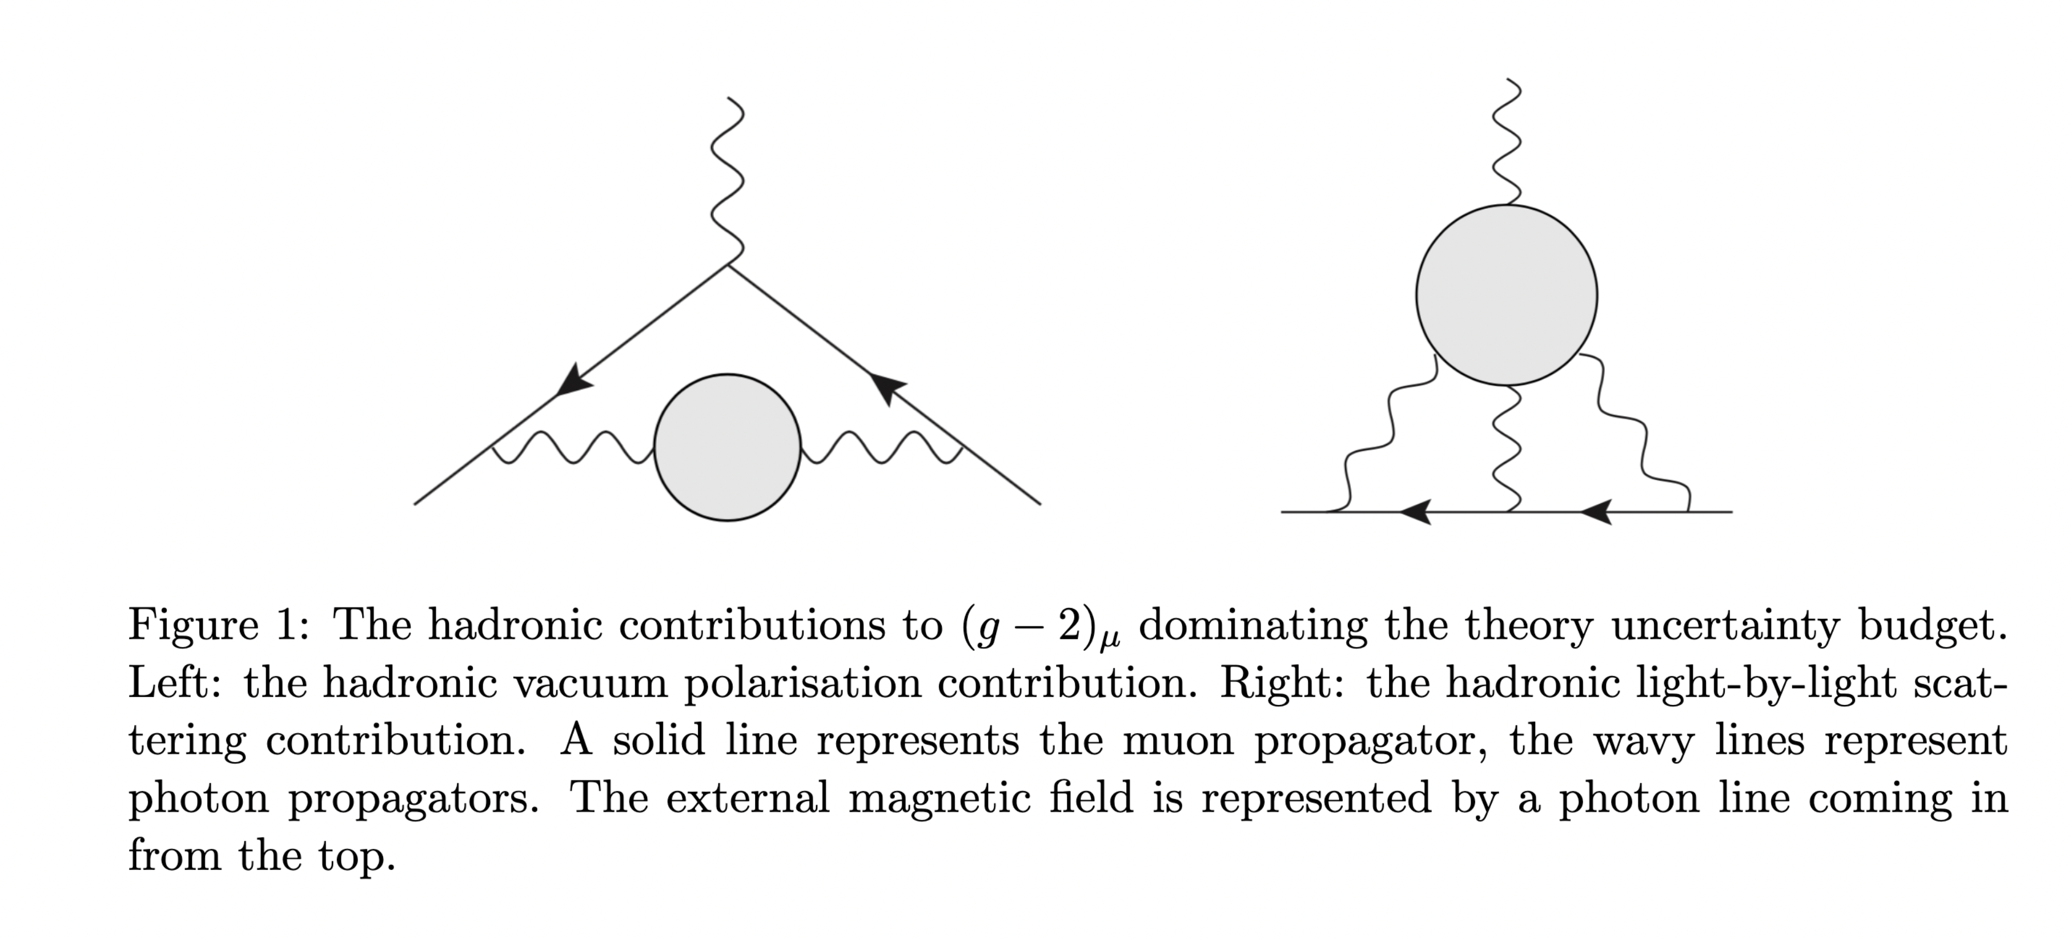
https://arxiv.org/pdf/1911.08123.pdf

