Slide 2
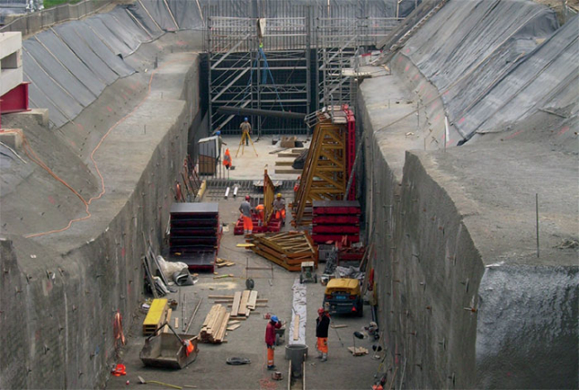
Linac4 – New Proton Source at CERN
Linac4 is 86 meters long and 12 meters underground
Linac4 is the new source of protons at CERN –Beams began to be produced in 2013 with the milestone energy of 160 MeV reached in 2016. It fully replaced Linac2 in December 2020.
Accelerates negative hydrogen ions (H-) to 160MeV which are then converted to protons and injected into the Proton Synchrotron Booster (PSB)
Machine is comprised of an ion source and four types of accelerating structure. Making up 26 RF cavities.
Linac4 is a 352MHz normal conducting Linac. It produces a 800 us long beam pulse every 1.2 s

Slide 3
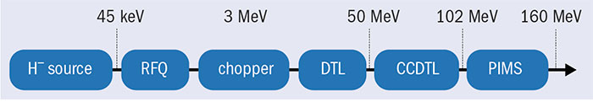
Accelerating Structures

Slide 4
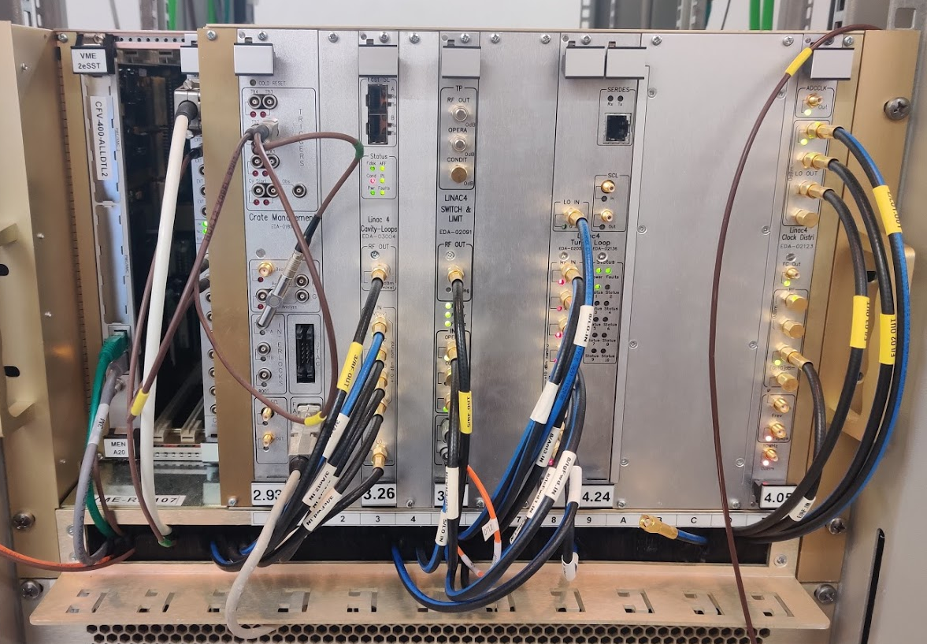
LLRF Hardware
Based on the LHC standard VME crates
There are 20 VME crates to control the 26 cavities
Each crate consist of
CavityLoops Module
TunerLoop module
Switch & Limit
ClockDistri
Front End
CTRV

Slide 5
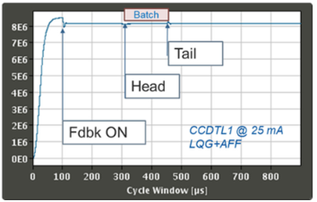
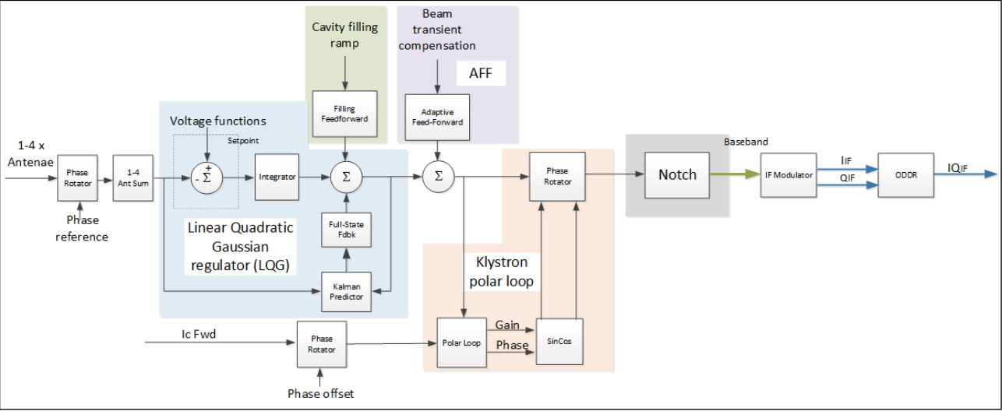
LLRF System
Specification was to keep the cavity voltage regulated to within 1% in amplitude and 1 degree in phase
This was achieved through the combination of a LQG regulator and adaptive feedforward

Slide 6
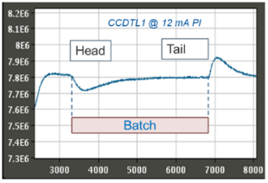
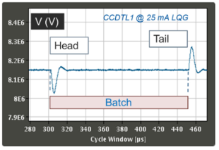
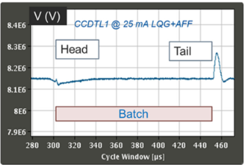
LLRF System
First firmware using a standard PI Controller
Upgraded firmware with LQG regulator
Combination of LQG regulator and Adaptive Feedforward

