Slide 1
SPS: MicroTCA LLRF and new power system
Arthur Spierer on behalf of the SPS LLRF and RF power teams
7 and 14 of October 2022

Slide 2
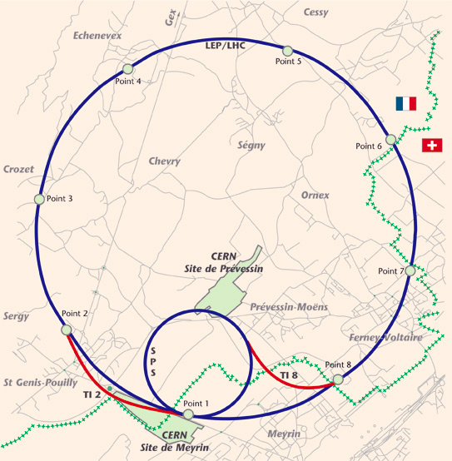
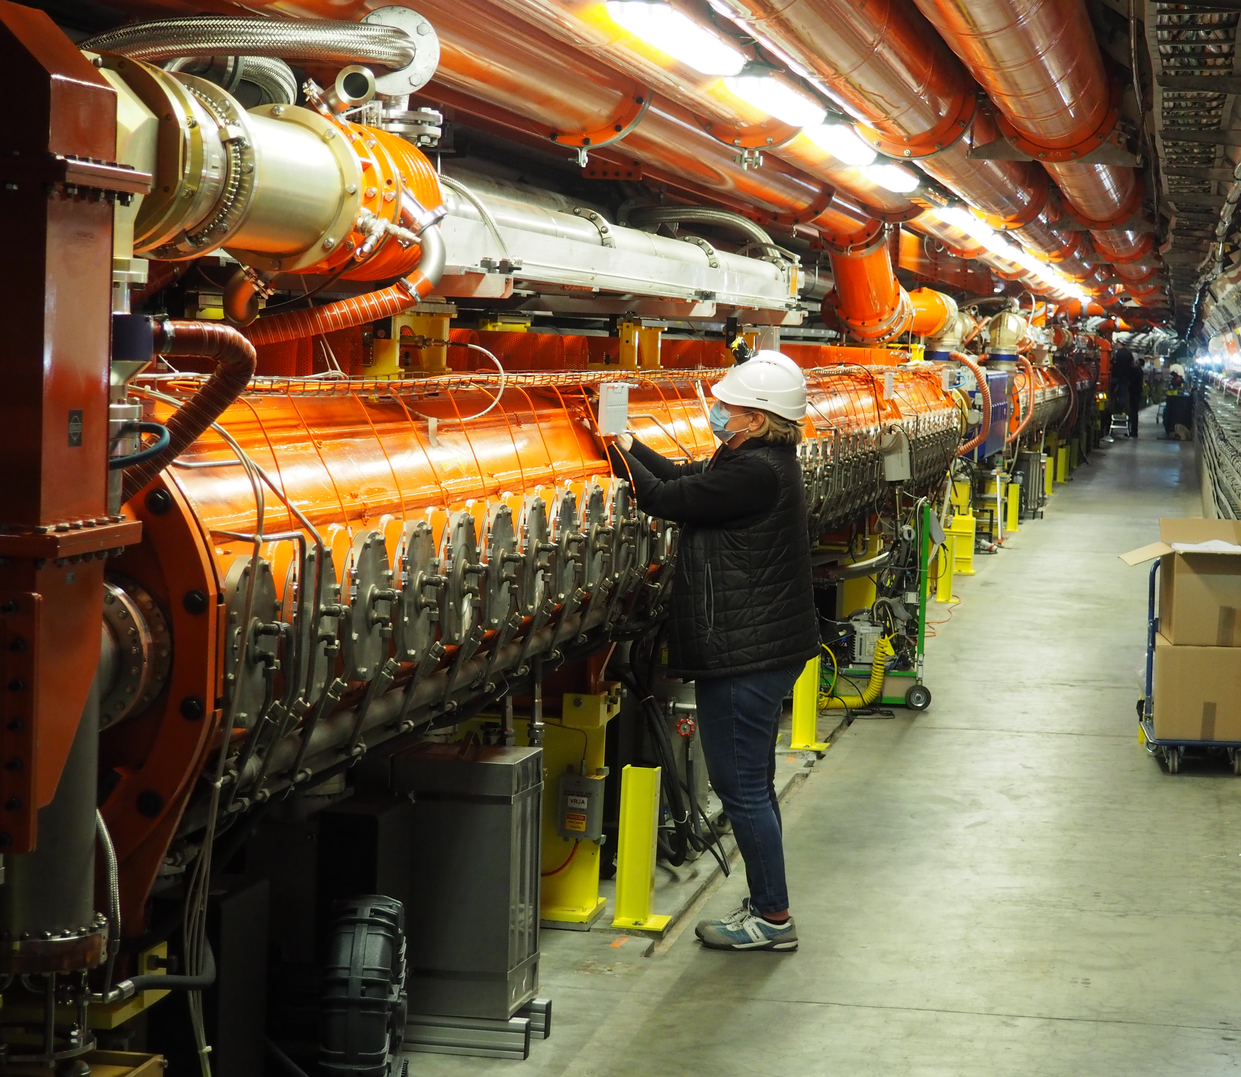
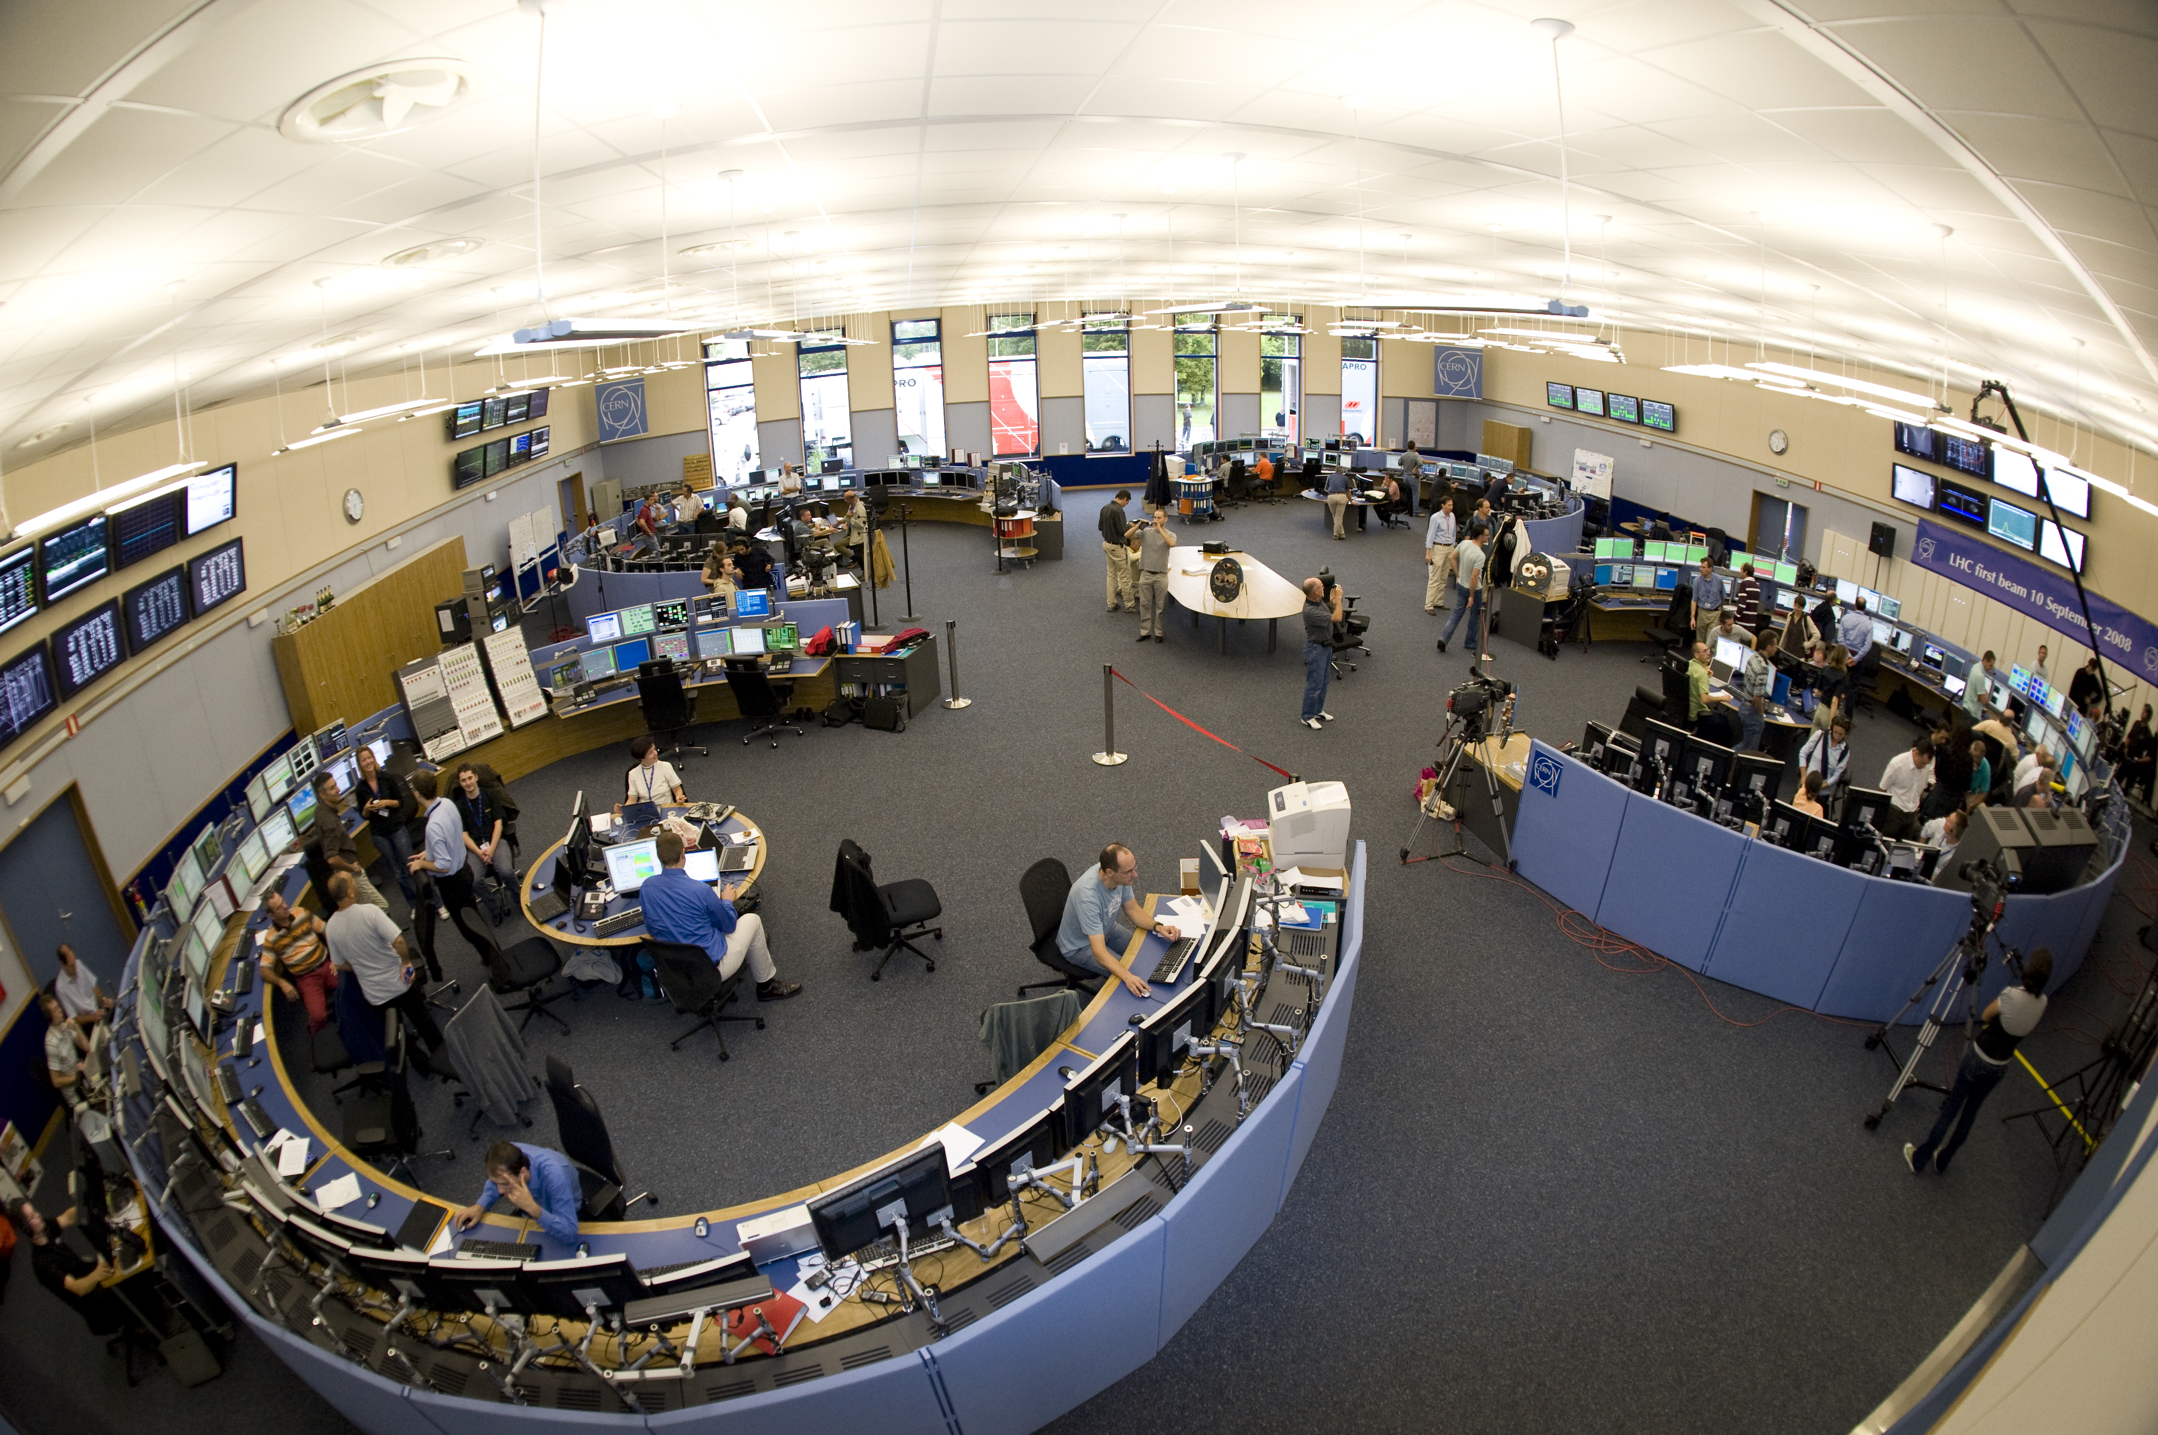
SPS: Super Proton Synchrotron
Injector for LHC and fixed target experiments
Visit of the LLRF Faraday cage and RF power amplifiers on the surface
Cern Control Center (CCC)
200 MHz travelling wave cavities
SPS/LHC map

Slide 3
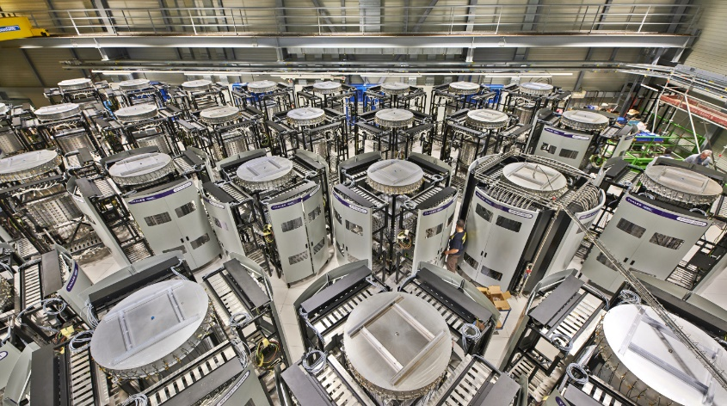
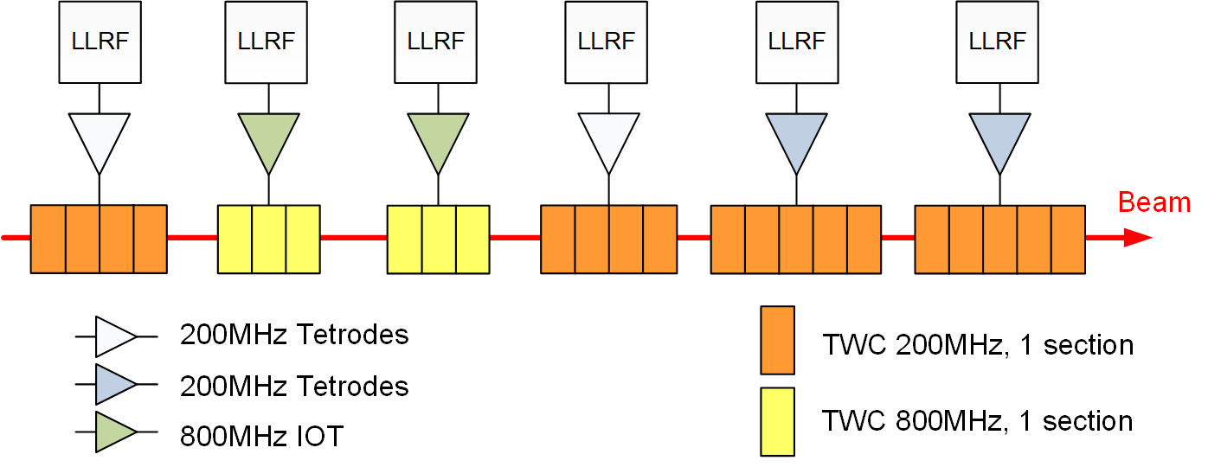
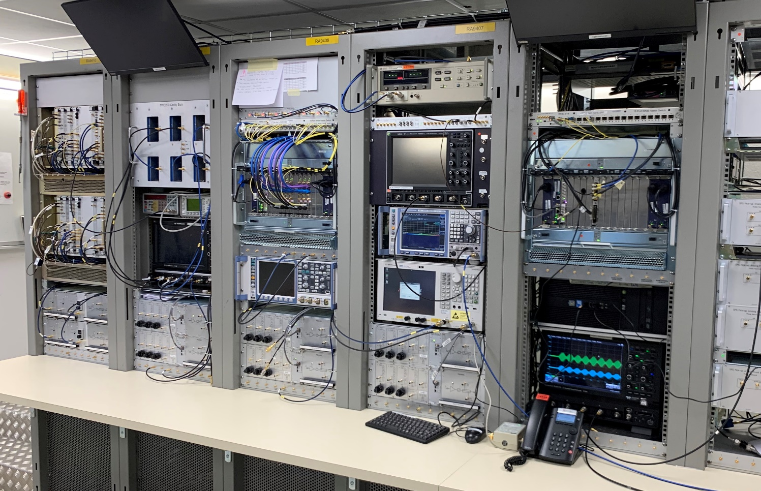
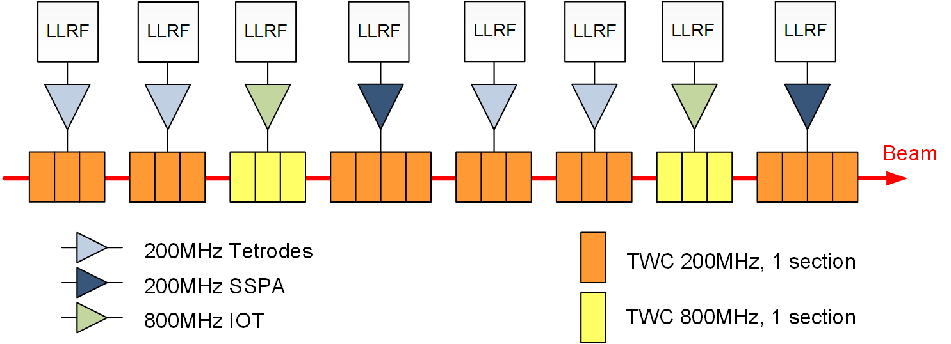
SPS RF Upgrade 2019-2020
Completely new RF system
  From 6 to 8 Cavities
  New 1.6MW solid-state amplifier systems
New digital LLRF
  MTCA for 200MHz Cavity-Controllers (RF feedback)
  MTCA for Beam Control
  (beam based loops)
SPS Solid-state amplifier system
image courtesy of G. Hagmann
SPS low-level RF system (MTCA)

Slide 4
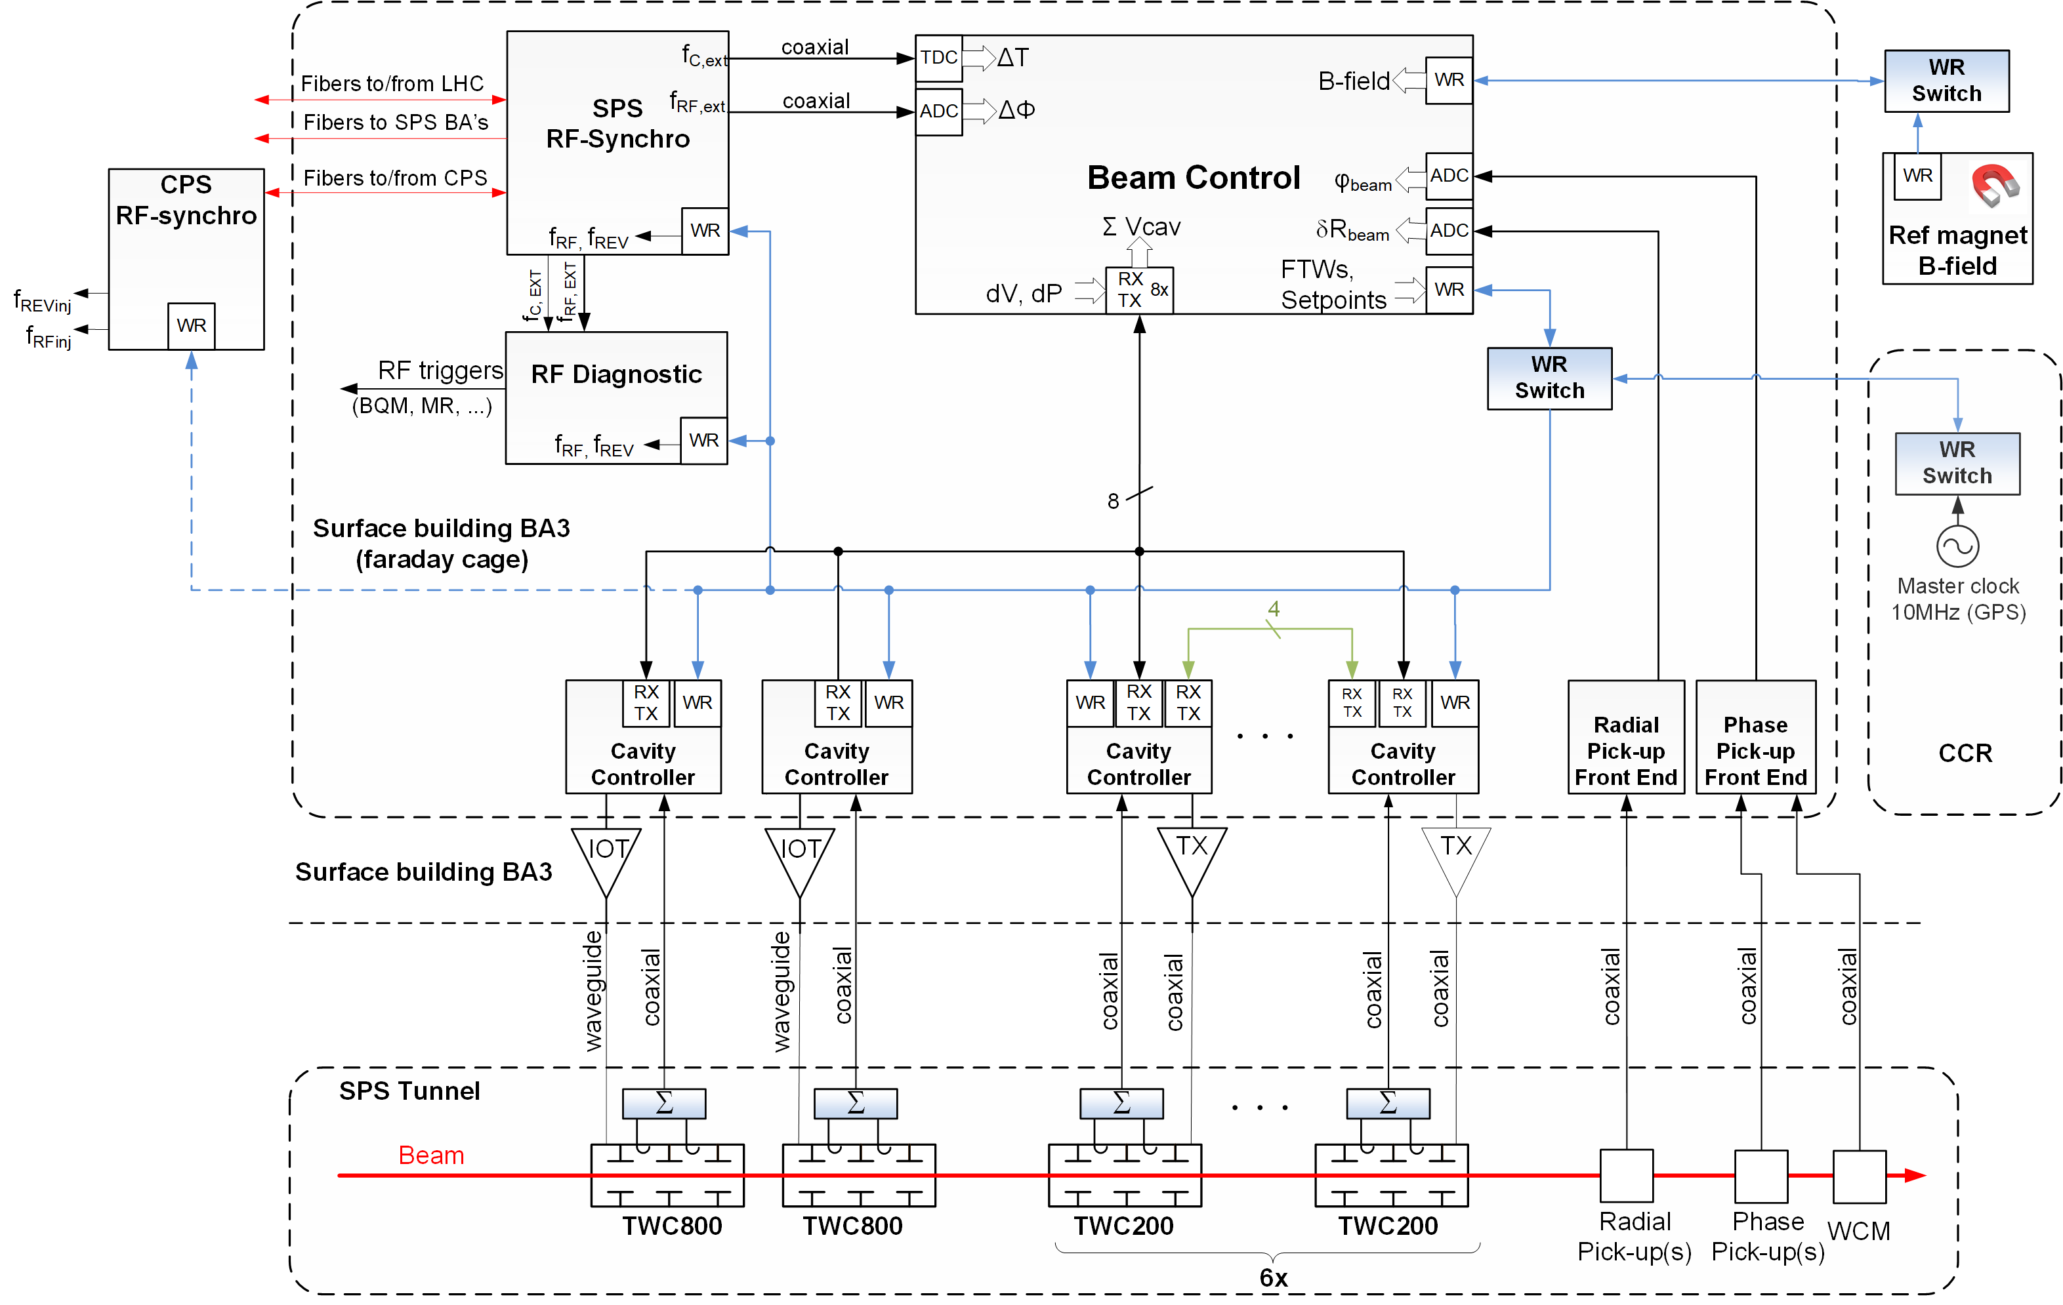
SPS LLRF Architecture
VME
MTCA
White-Rabbit network
  to broadcast frequency program and setpoints
  to synchronize clocks/RF
10 Gbits links to transmit cavity voltages and damper signals
Direct sampling at 125 Msps of the 200MHz RF
  Resampling to track sweeping RF
  Low noise clock generators
SPS low-level Architecture, image courtesy of G. Hagmann

Slide 5
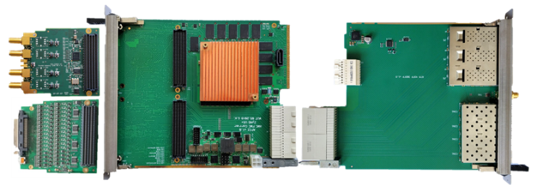
SPS LLRF Architecture
VME
MTCA
White-Rabbit network
  to broadcast frequency program and setpoints
  to synchronize clocks/RF
10 Gbits links to transmit cavity voltages and damper signals
Direct sampling at 125 Msps of the 200MHz RF
  Resampling to track sweeping RF
AFCZ MicroTCA FMC carrier
QSFP-SFP RTM
SIS8300-KU
DRTM_DS8VM1

Slide 6
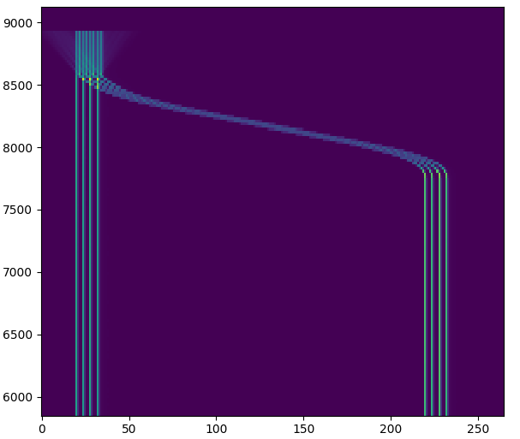
One example!
Lead ions slip-stacking
  Independent control of all cavities
  Amplitude and frequency modulation within the turn
  Control two beam in the machine!
Enjoy your visit!
8 bunches
50ns
Cycle time ->
4 bunches
100ns
4 bunches
100ns
Buckets (beam current transformer)

Slide 8
References
[1] Paper architecture

