Slide 1
RF check of the CC cavities and RF rotator
Ping Wang, Alexej Grudiev
30.09.2022

Slide 2
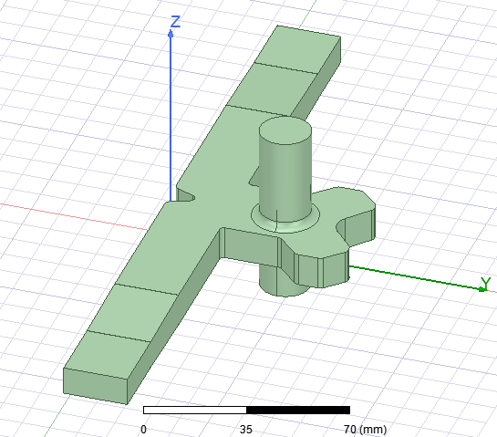
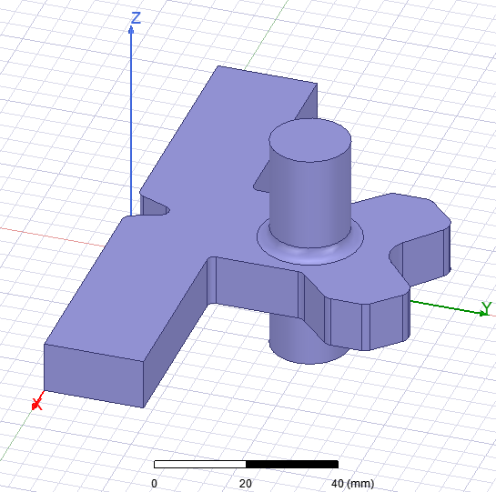
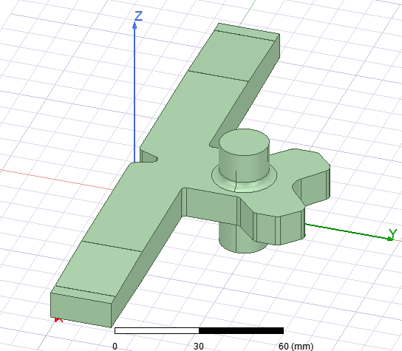
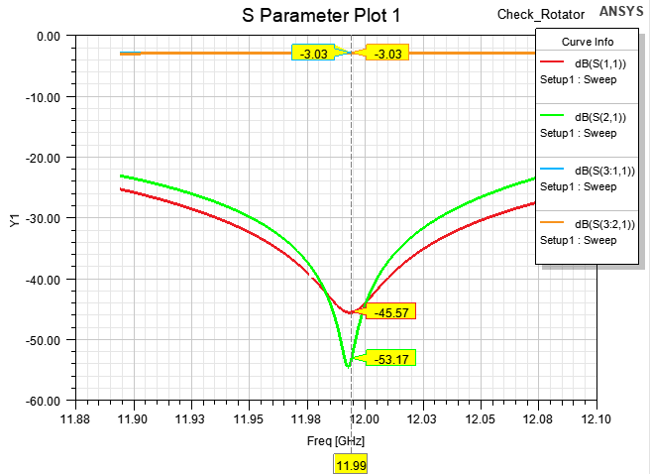
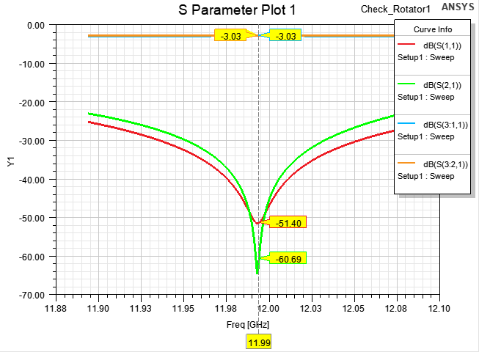
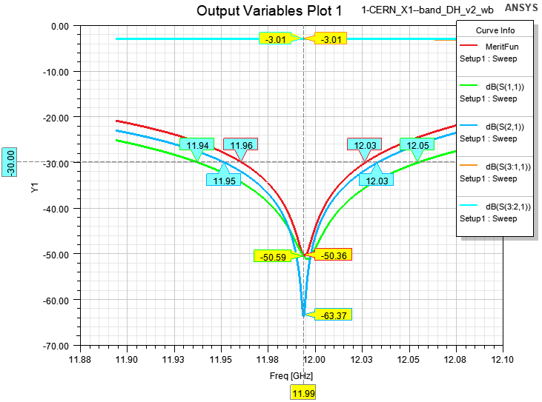
RF check of the RF rotator
Original model from mechanical model

Slide 3
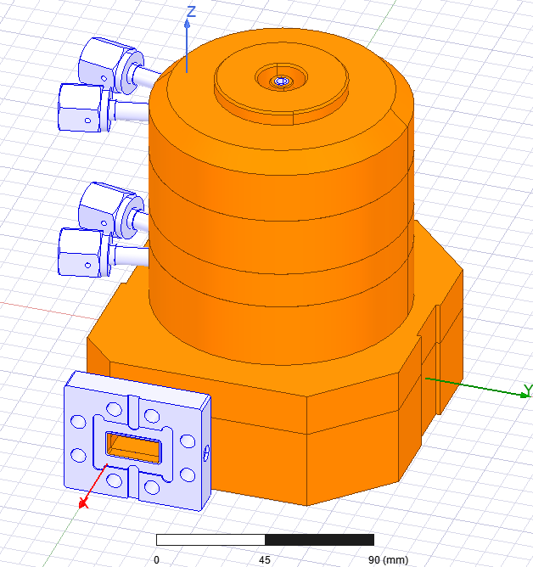
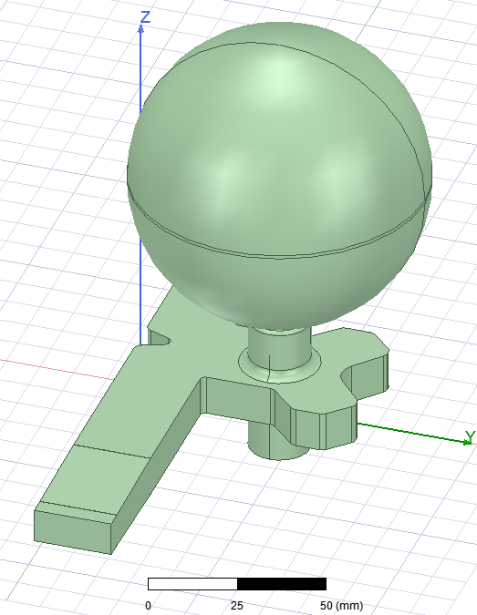
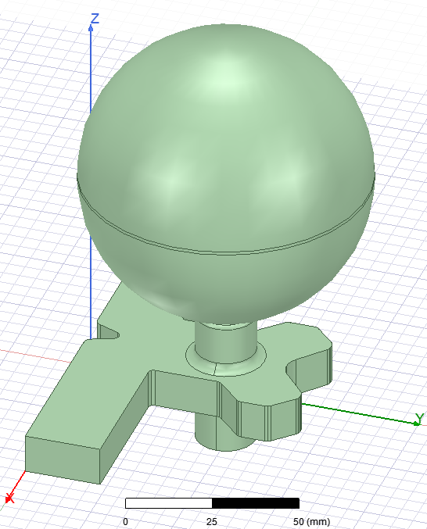
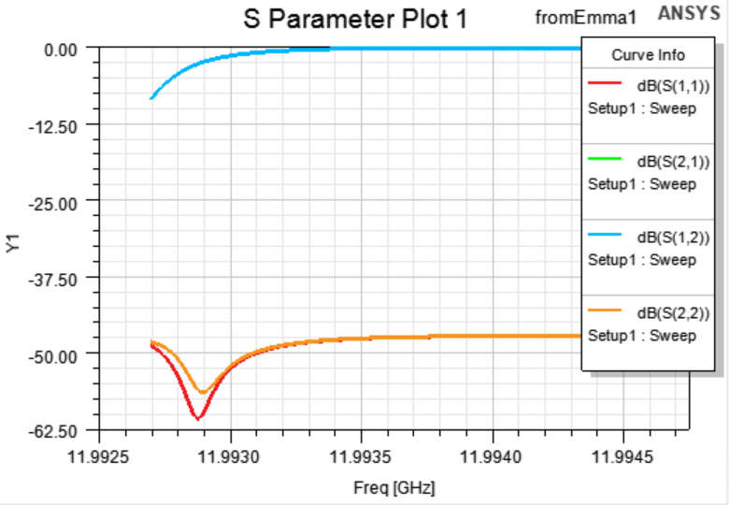
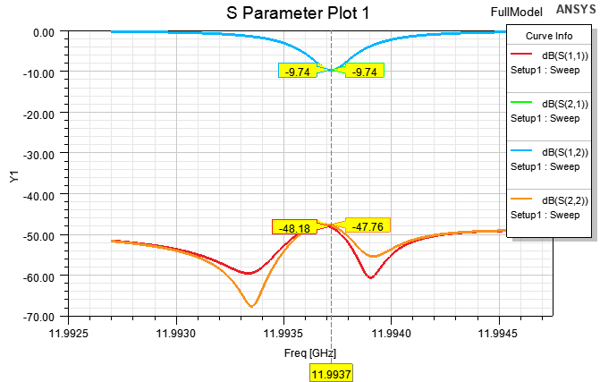
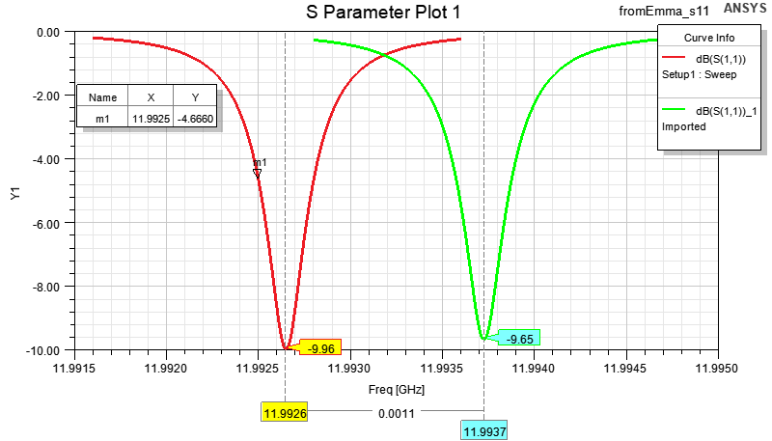
RF check of the spherical CC
Mechanical model
RF model
Frequency : No
Coupling factor: No
Rcav = 43.16 mm in mechanical model
Rcav = 43.156 mm in RF model
Mechanical quarter model
Mechanical full model
RF full model
RF quarter model

Slide 4
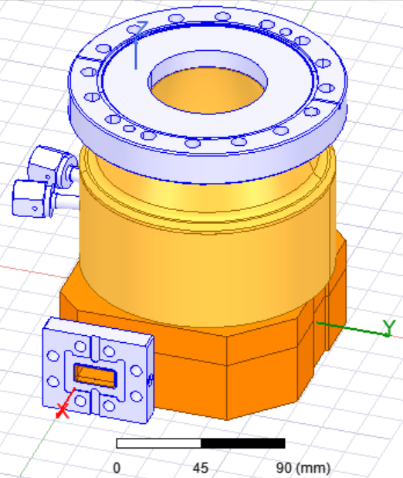
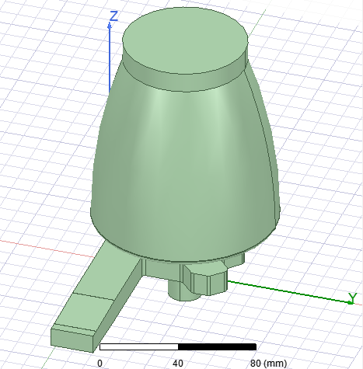
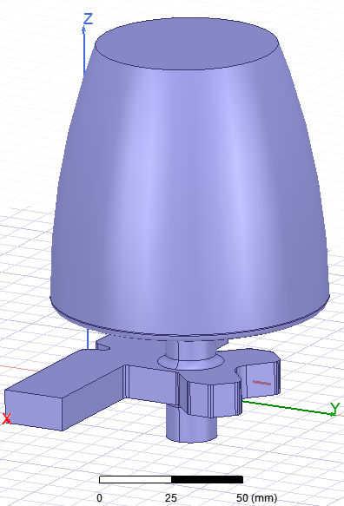
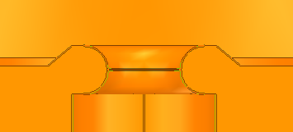
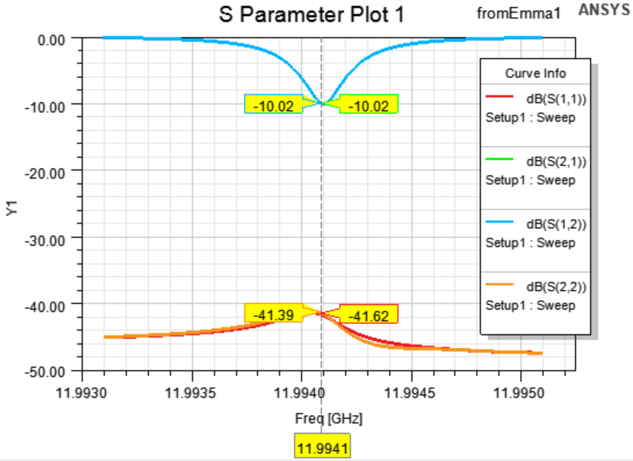
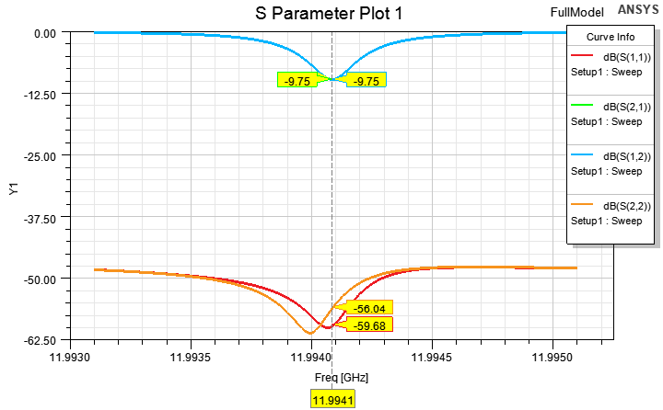
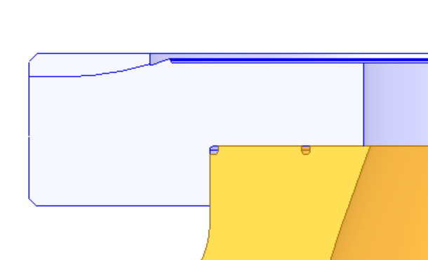
RF check of the bowl CC
Steel part is different (different RF model)
Frequency : Yes
Coupling factor: No
Mechanical model
RF model
Straight part is 0.2 mm in mechanical model (0.1 mm in RF model)
coup_h = 6.1 mm
Different diameters
Mechanical model
RF model

Slide 5
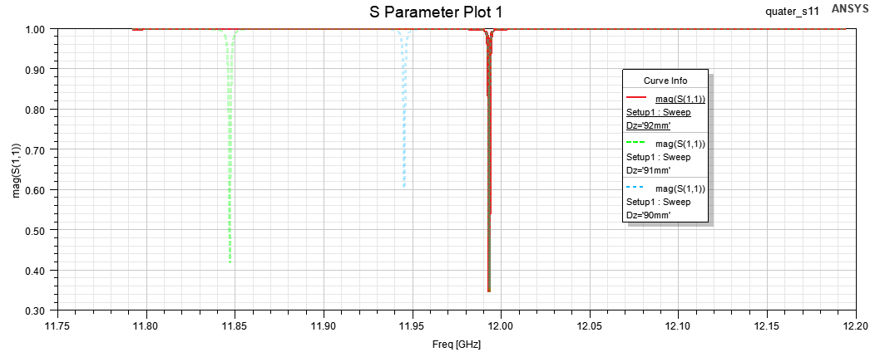
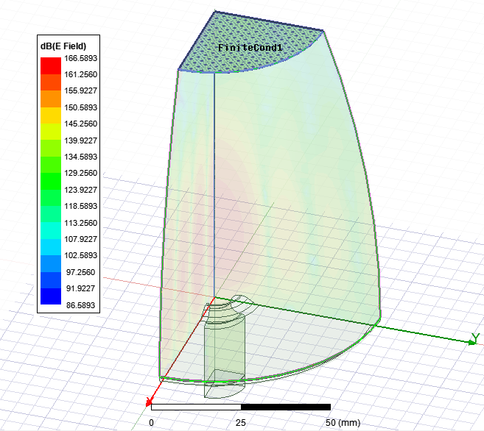
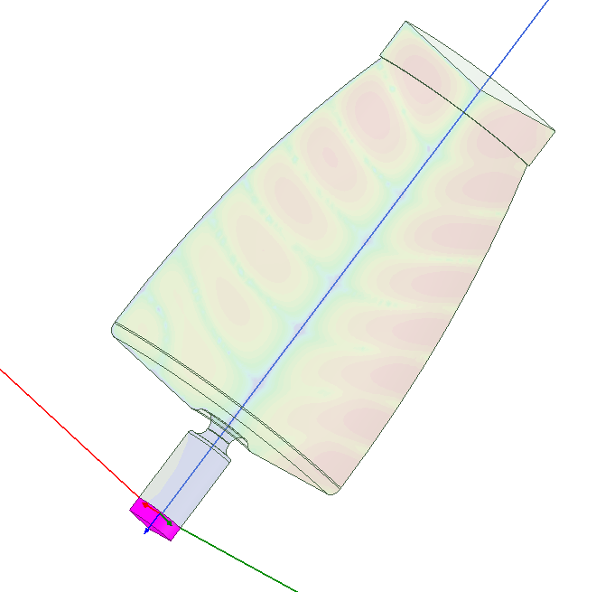
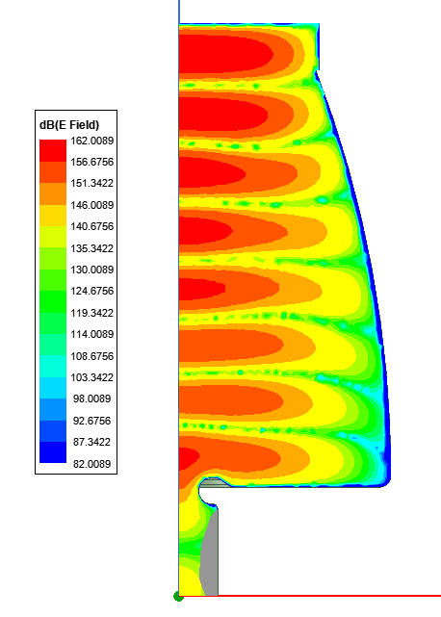
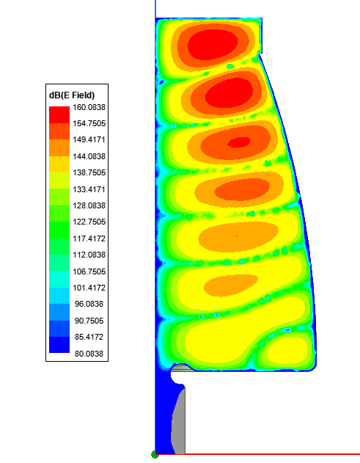

Mode separation of the bowl CC
The mode separation is only about 50 MHz @ Dz =90 mm, 150 MHz @ Dz =90 mm, Dz = 92 mm is much better
1100000 Siemens/m
11.9550 GHz
12.0483 GHz
Qe calculation

Slide 6
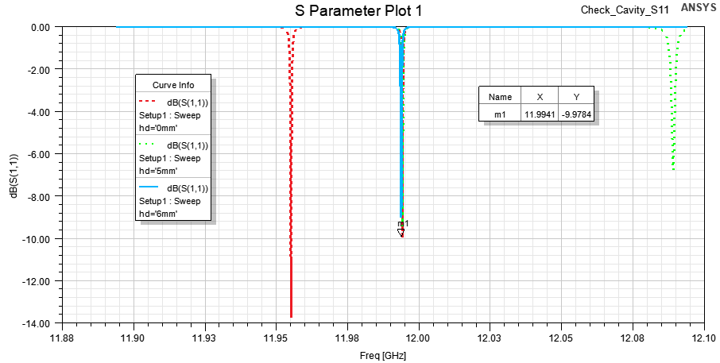
Mode separation of the bowl CC
hd

