Slide 1
EDMS documents

Slide 2
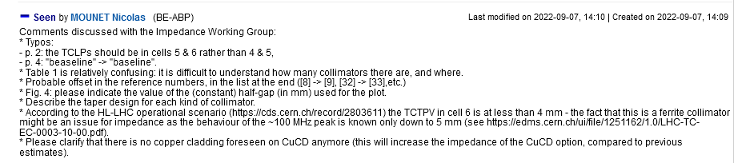
Functional Specification for the HL-LHC Tertiary Collimators 2519805 v.0.6 LHC-TC-ES-0011 v.0.6

Slide 3
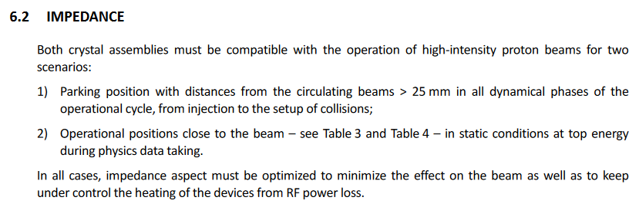
TCCS/TCCP] FUNCTIONAL AND OPERATIONAL CONDITIONS FOR THE DOUBLE-CRYSTAL SETUP IN THE LHC IR3 2742008 v.0.9
These specifications make perfect sense, but it is not clear that a technical solution exists to fulfill these specs with a satisfying level of certainty

Slide 4
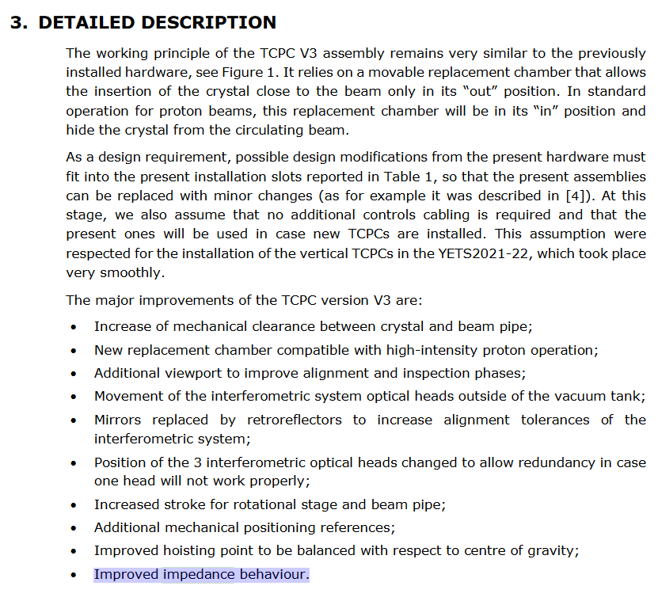
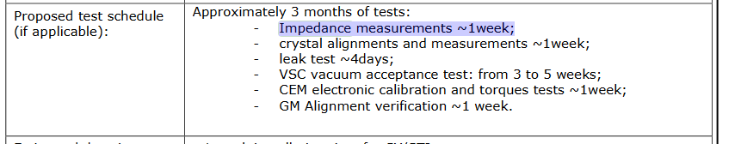
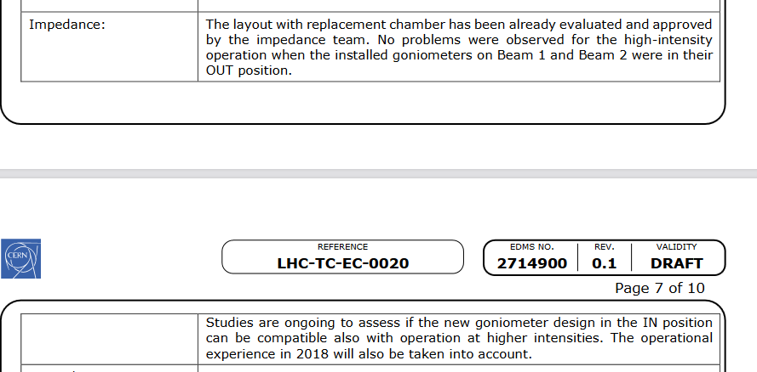
Upgrade Of The Crystal Collimation IR7 YETS 2022 2714900 v.0.1 LHC-TC-EC-0020 v.0.1
→proposal to accept
Is it true?

Slide 5
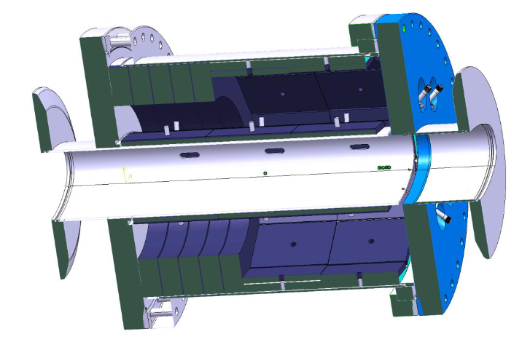
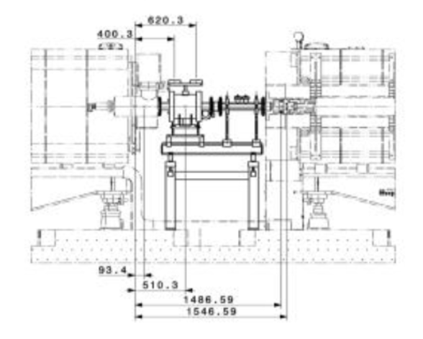
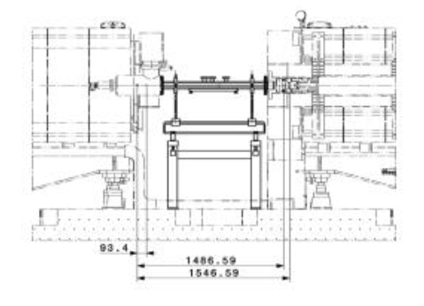
PS Beam Quality Monitor - Wall Current Monitor Installation in SS98 of PS Ring 2783725 v.0.1 PS-BCW-EC-0001 v.0.1

Slide 6
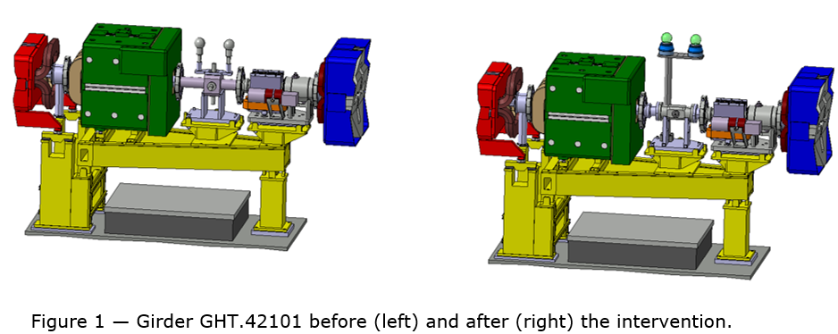
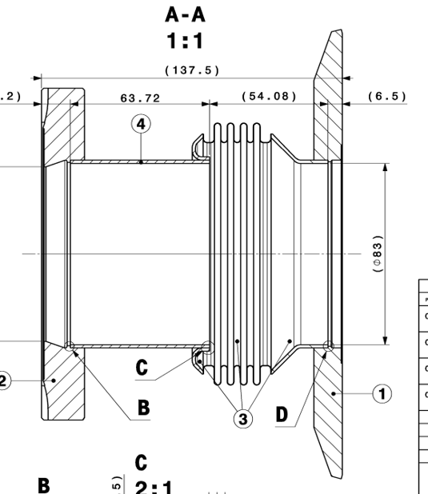
Installation of an Electro-Optical BPM in the SPS during YETS 2022-2023
→ No enameled flanges
→ the bellow geometry sounds a bit fishy

