Slide 1
Summary of low heating MKP-L impedance studies
M. Barnes, M. Beck, G. Rumolo, C. Zannini
Acknowledgments: F. Caspers, M. Diaz, L. Ducimetiere, V. Namora,
F. Pelloux, B. Salvant, Y. Sillanoli, P. Trubacova

Slide 2
Overview
Introduction
Benchmarks of impedance model and impedance optimization
Impedance measurements on the final assembly

Slide 3
Overview
Introduction
Benchmarks of impedance model and impedance optimization
Impedance measurements on the final assembly

Slide 4
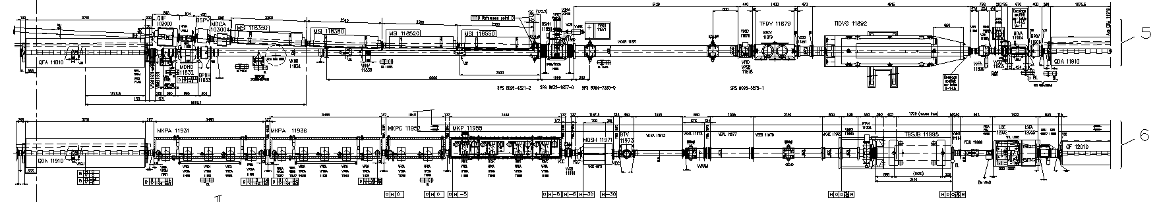
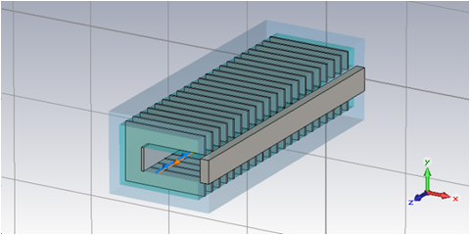
SPS injection kicker (MKPs)
MKP-S
MKP-L
#1
#2
#3
#4
Beam
Injection kickers are needed for beam injection in the SPS but unfortunately their contribution to the machine longitudinal and transverse impedance is relevant

Slide 5
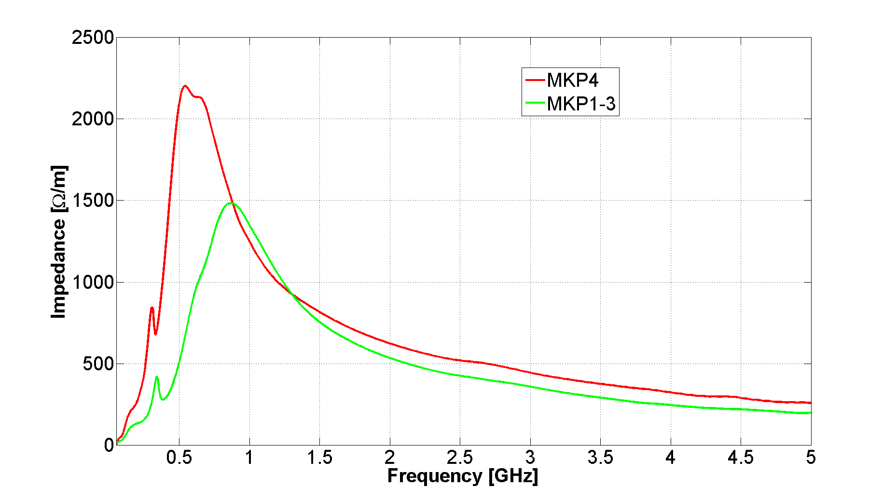
SPS injection kicker (MKPs)
Real part of the longitudinal impedance
MKPL
MKPS
MKP4 broadband kicker magnet resonance has lower frequency and higher peak value

Slide 6
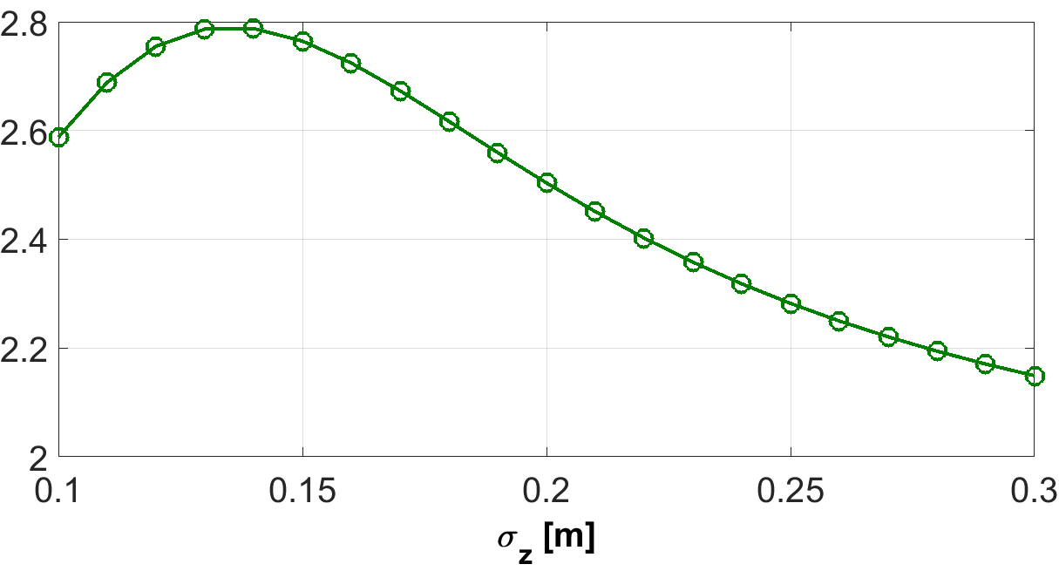
Power loss ratio between MKPL and MKPS
450 GeV (top energy)
26 GeV
(injection energy)
Notes:
Spiegarla meglio

Slide 7
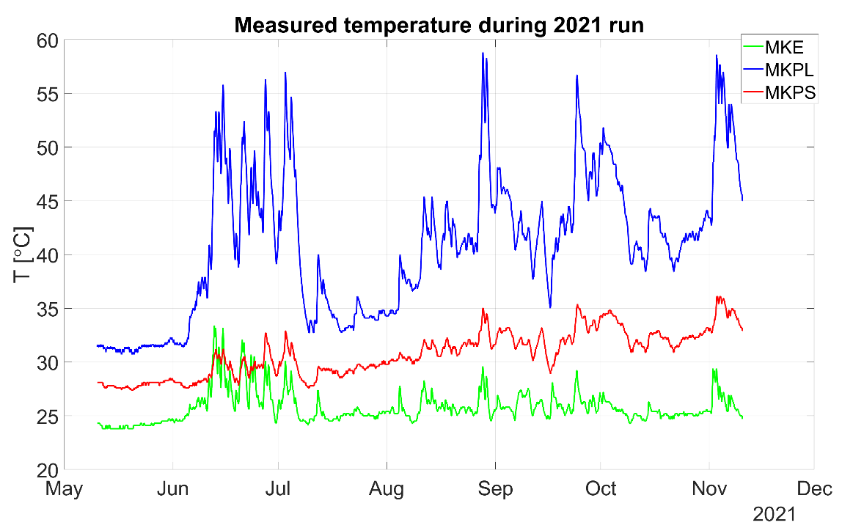
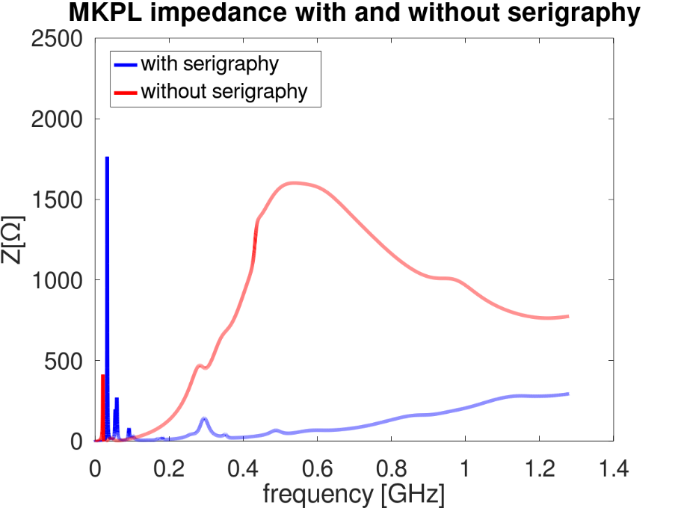
MKPL beam induced heating
scenario |  | trains | Injected p/b
scrubbing week | 2022 scrubbing | 4x72 | 2.00E+11
typical week | 2022 operation | 4x48 | 1.67E+11
 | 2022 MD | 4x72 | 2.22E+11
scrubbing week | 2023 scrubbing | 4x72 | 2.60E+11
typical week | 2023 operation | 4x48 | 2.00E+11
 | 2023 MD | 4x72 | 2.56E+11
typical week | 2024 operation | 4x48 | 2.00E+11
 | 2024 MD | 4x72 | 2.56E+11
Issue during the HV test of the low impedance prototype
Designed of the shielding to be modified: connection of the serigraphy to HV
Several impedance simulation and measurements performed
Installation foreseen during YETS 2022/2023

Slide 8
Overview
Introduction
Benchmarks of impedance model and impedance optimization
Impedance measurements on the final assembly

Slide 9
MKPL beam induced heating
A criticality of the MKPL at LIU intensities was predicted already in 2013 (slides)
First observation of heating during 2014 scrubbing run in good agreement with the expectation from the model
Possible mitigations of the MKP beam induced heating investigated from the beginning of 2015

Slide 10
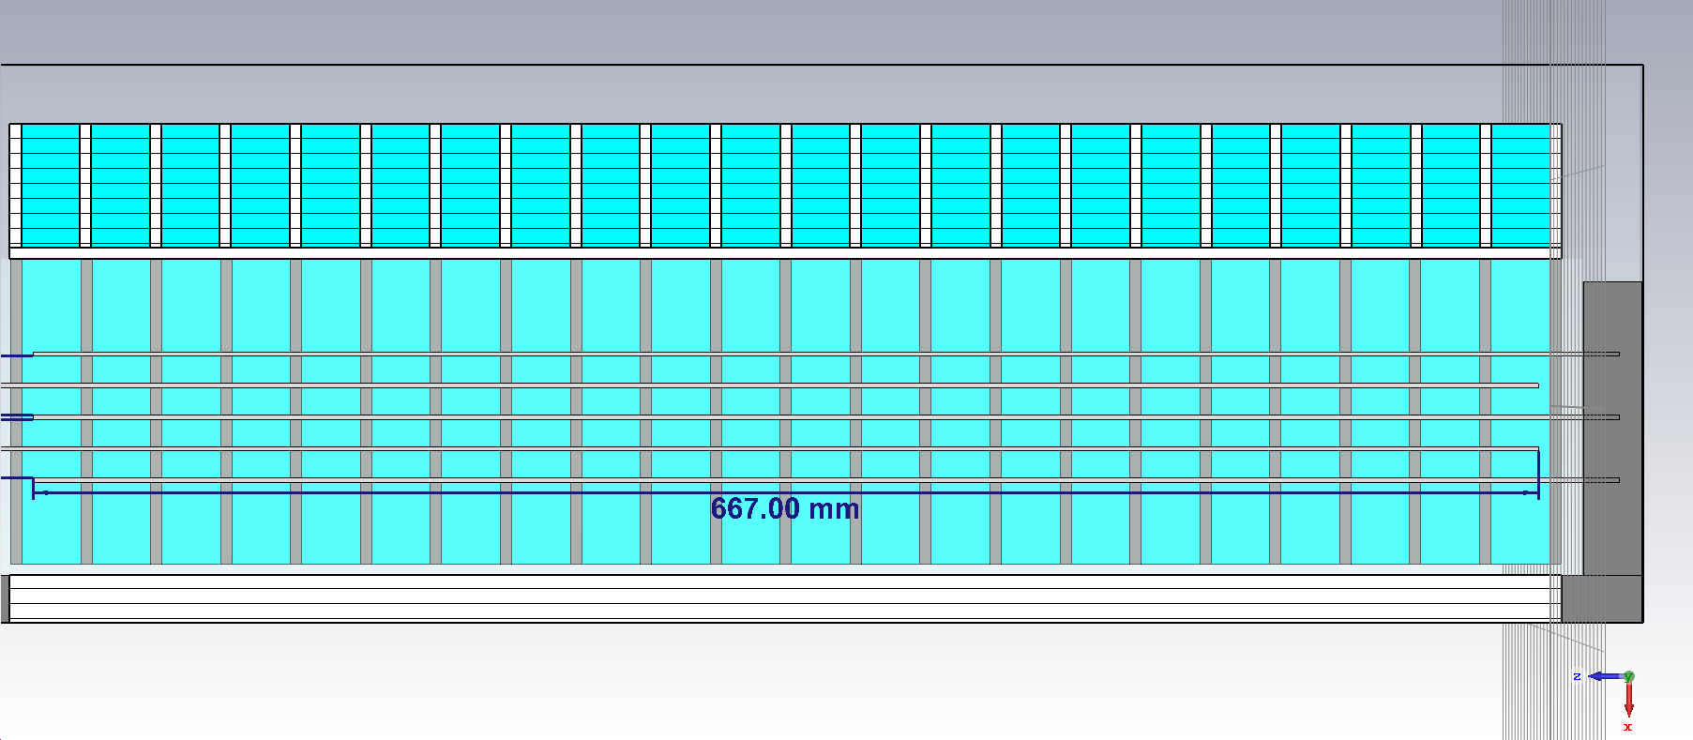
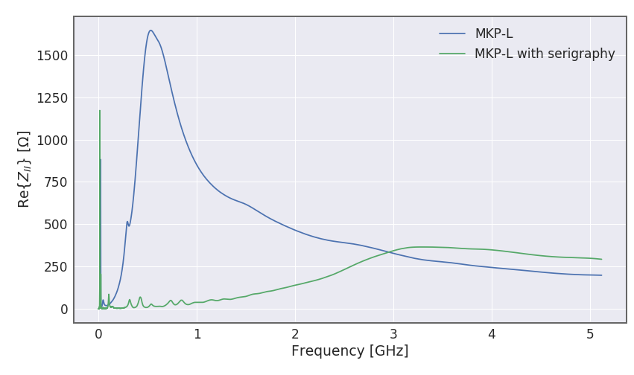
MKP impedance reduction
  Concept with longitudinal serigraphy exists (4, 5 and 6 stripes)
M. Beck
CERN-THESI015-374
Q20 | PL per LHC fill cycle
MKP-L | 874 W
MKP-S | 234 W
MKP-L ser. (6 stripes) | 28 W
MKP-L ser. (4 stripes) | 99 W

Slide 11
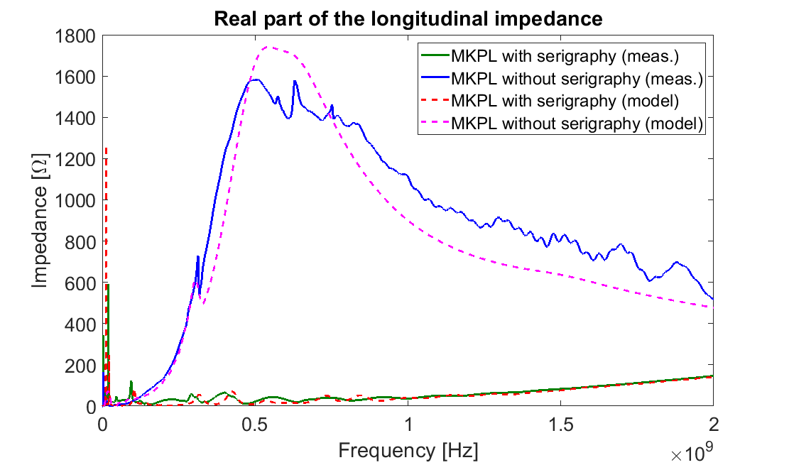
MKP impedance validation
Impedance validation with bench measurements in October 2020
Good agreement between simulation model and measurements

Slide 12
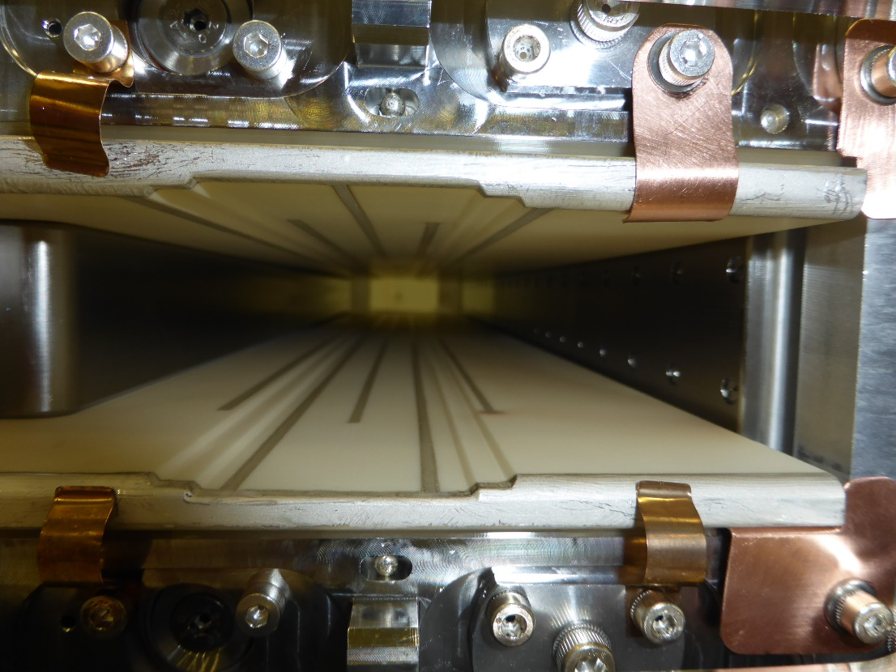
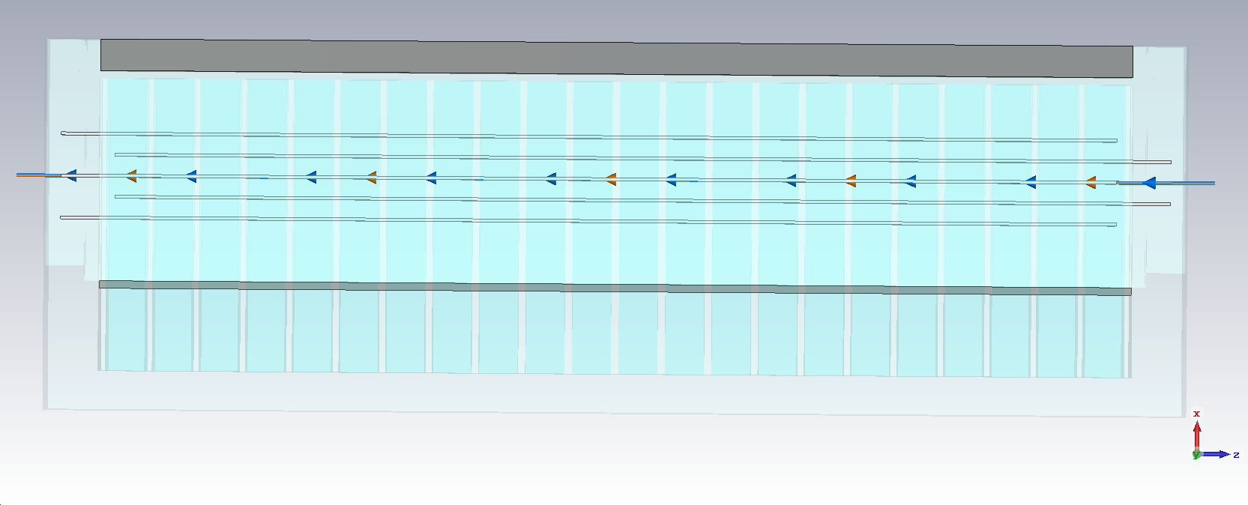
Issue experienced during HV test
Serigraphy finger closest to HV busbar shows most damage
Design solution were investigated to solve the issue
Ground conductor
HV conductor
Connection to HV of the serigraphy has been considered as the best solution of the sparking issue.
In the original design the serigraphy was grounded.

Slide 13
Design optimization
Initial low impedance MKPL model
Impedance/wake model from CST simulation (MKP-L with 5 stripes serigraphy)
Best trade-off between impedance and high voltage breakdown mitigation
Connection of serigraphy to HV, finger length optimization, only 4 fingers used ……

Slide 14
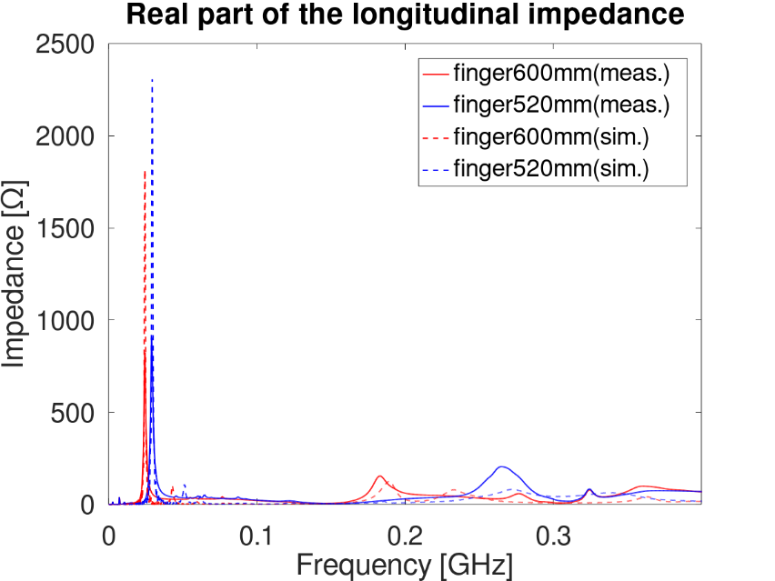

Design optimization
Impedance optimization: design constraints
To preserve kicker field quality
Aperture limitations
Ceramic robustness
$$ε_{r}$$
Strategy
Design the narrow resonance far away from dangerous spectrum lines
fdist
fL
Frequency increases with fdist and descreases with fL

Slide 15
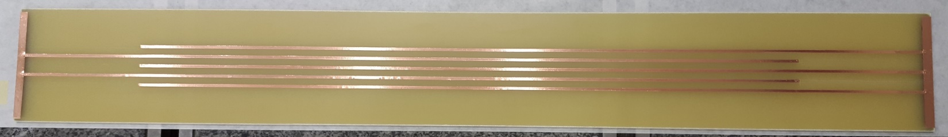
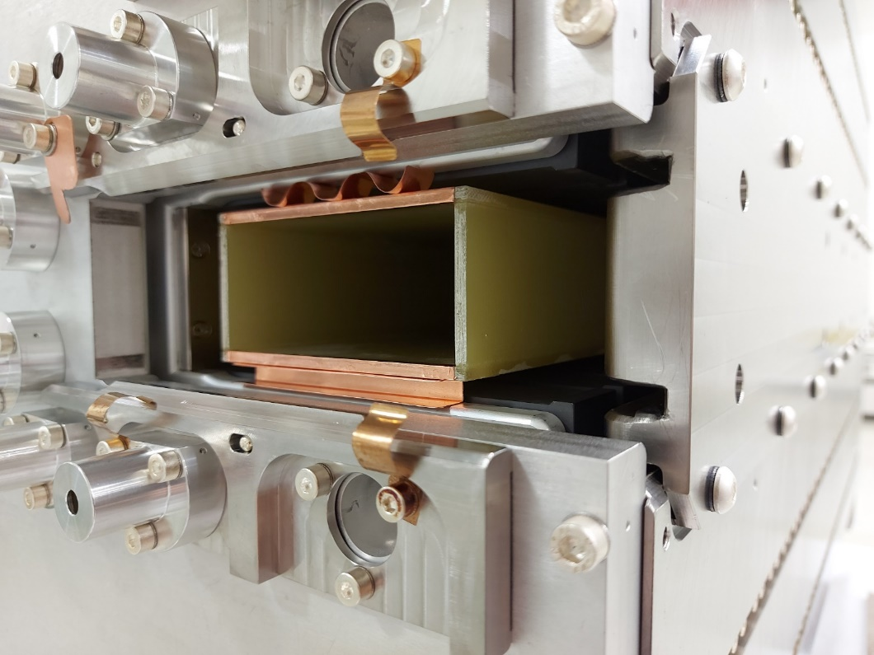
Design optimization: test on vetronite box
Low power measurements have been performed to benchmark the simulation model with serigraphy connected to HV
Serigraphy fingers on the outside part of the vetronite box (top and bottom)

Slide 16
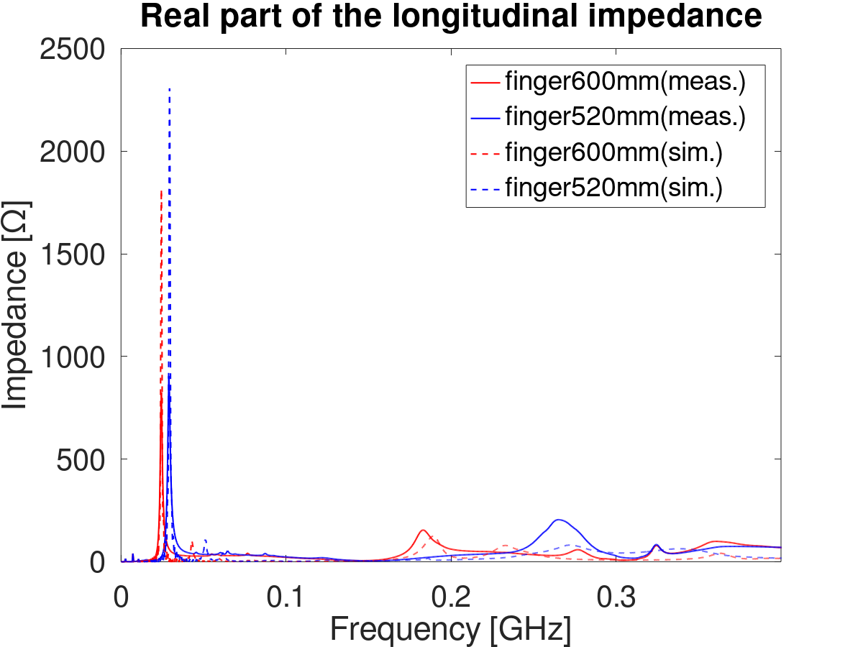
Design optimization: test on vetronite box
Details at the IWG#50 link
Measurements turned out to be very useful to improve the simulation model with serigraphy connected to HV
As for the serigraphy connected to ground also with serigraphy connected to HV the impedance is efficiently reduced

Slide 17
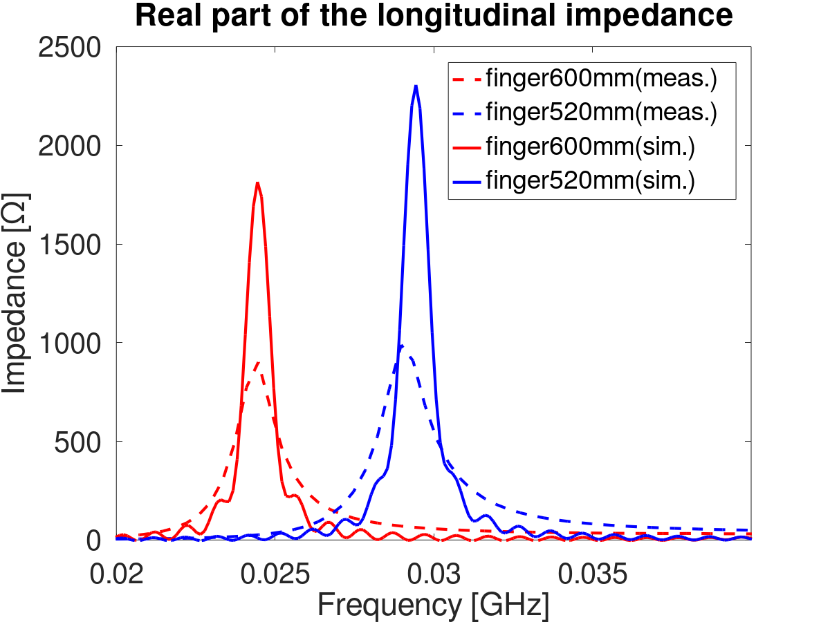
Design optimization: test on vetronite box
Details at the IWG#50 link
Measurements turned out to be very useful to improve the simulation model with serigraphy connected to HV
Good agreement in the frequency change versus finger length
Uncertainty on dielectric properties and alignment of the vetronite block
Frequency deviation between measurements and model is expected to be below 2 MHz

Slide 18
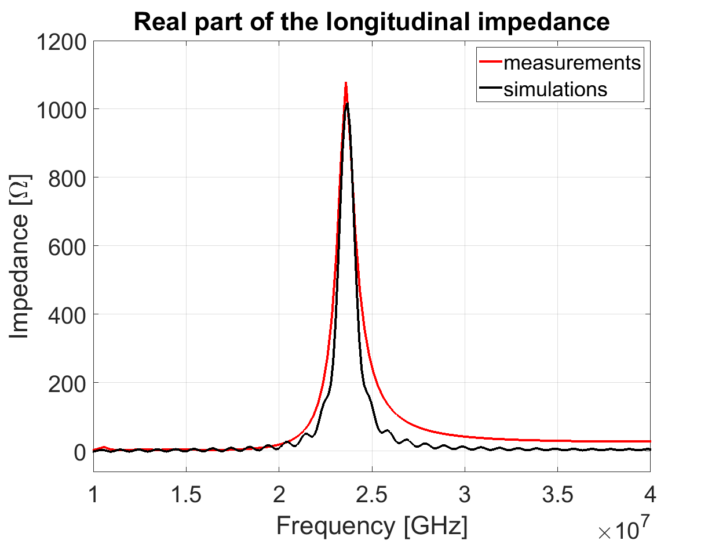
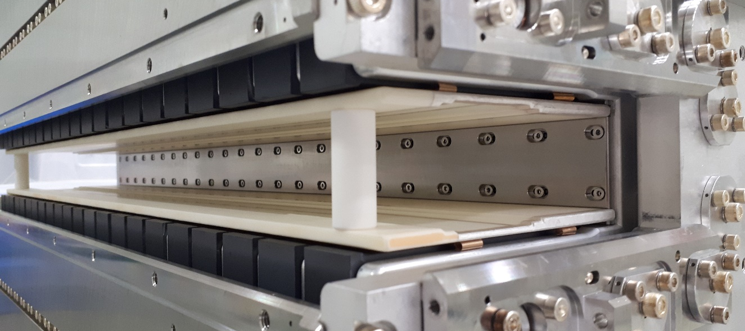
Comparing measurements and simulations:
Test on V3 serigraphy
Simulations performed with ε_{r}=9.9
A variation in the range 8.4-11.4 of ε_{r} will cause a ± 1 MHz variation in the frequency
HV busbar
[Hz]

Slide 19
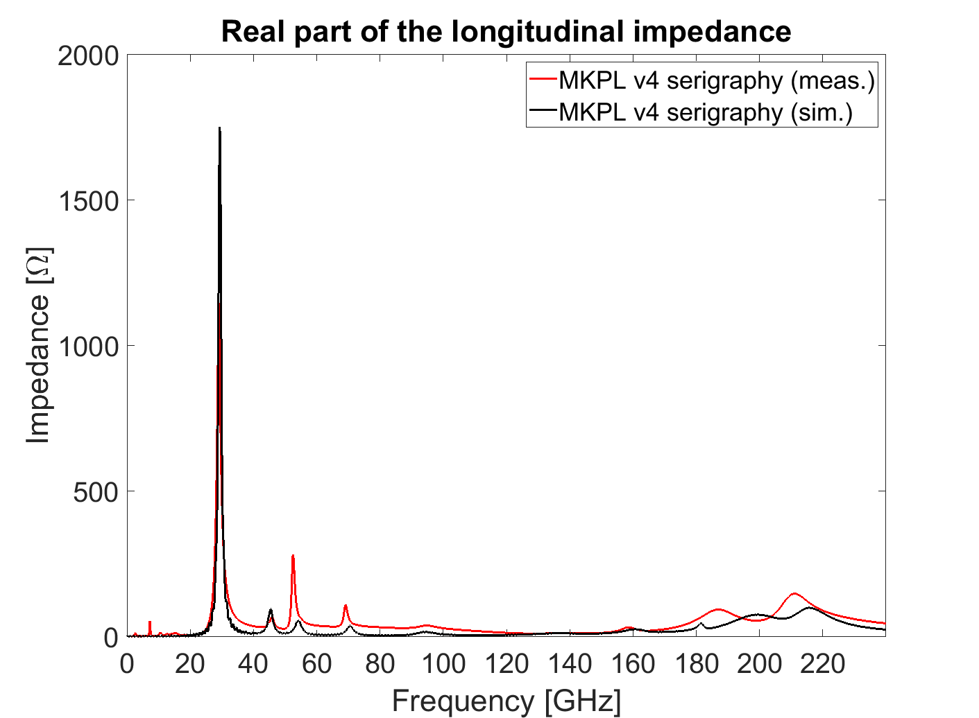
Comparing measurements and simulations:
Test on V4 serigraphy
Simulations performed with ε_{r}=9.9
A variation in the range 8.4-11.4 of ε_{r} will cause a ± 1 MHz variation in the frequency
Details on serigraphy versions
link
[MHz]

Slide 20
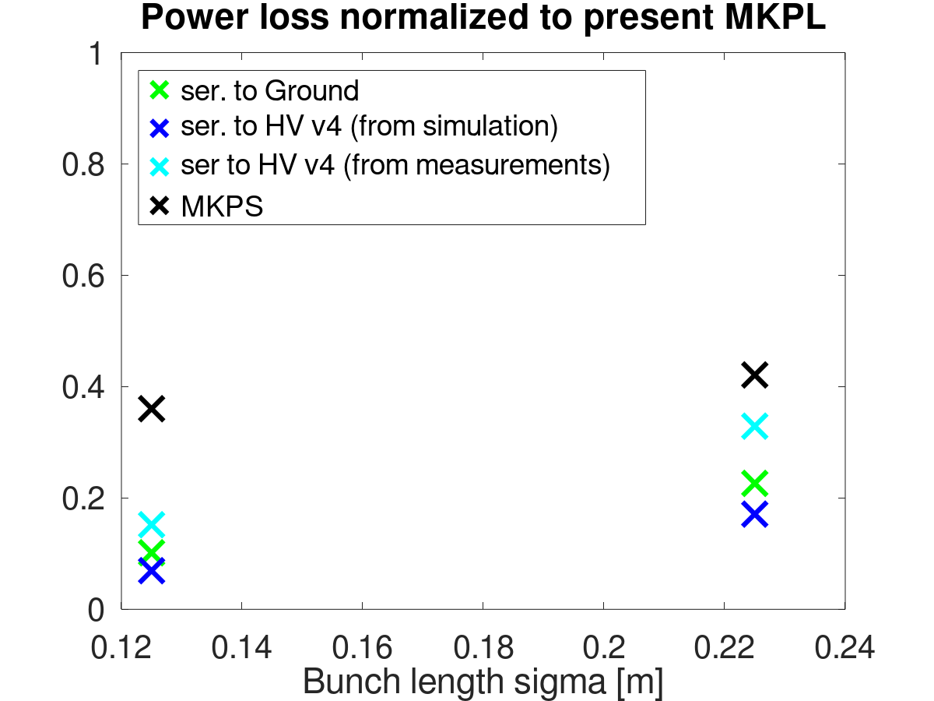
Beam induced power loss
Both from measurements and simulations the new MKPL is expected to exhibit a beam induced power loss significantly lower than the present MKPS

Slide 21
Overview
Introduction
Benchmarks of impedance model and impedance optimization
Impedance measurements on the final assembly

Slide 22
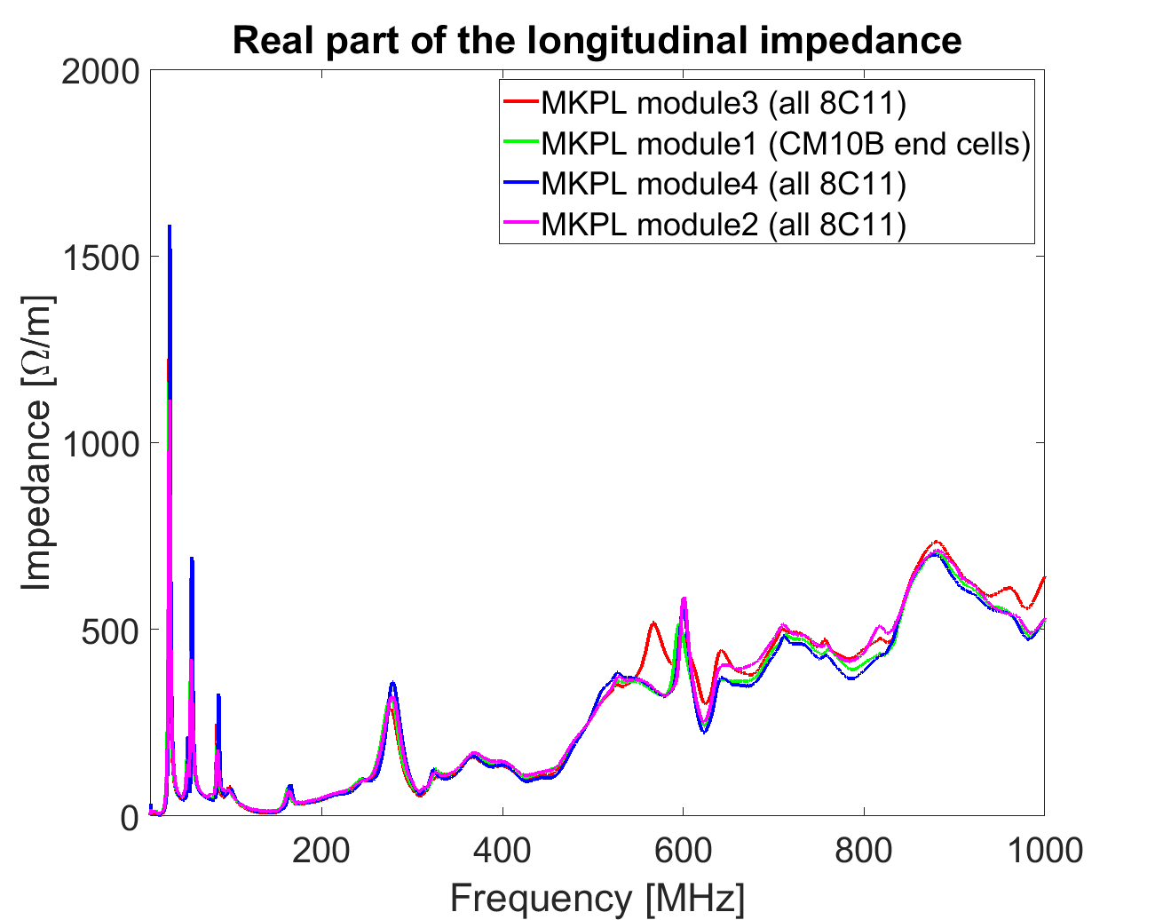
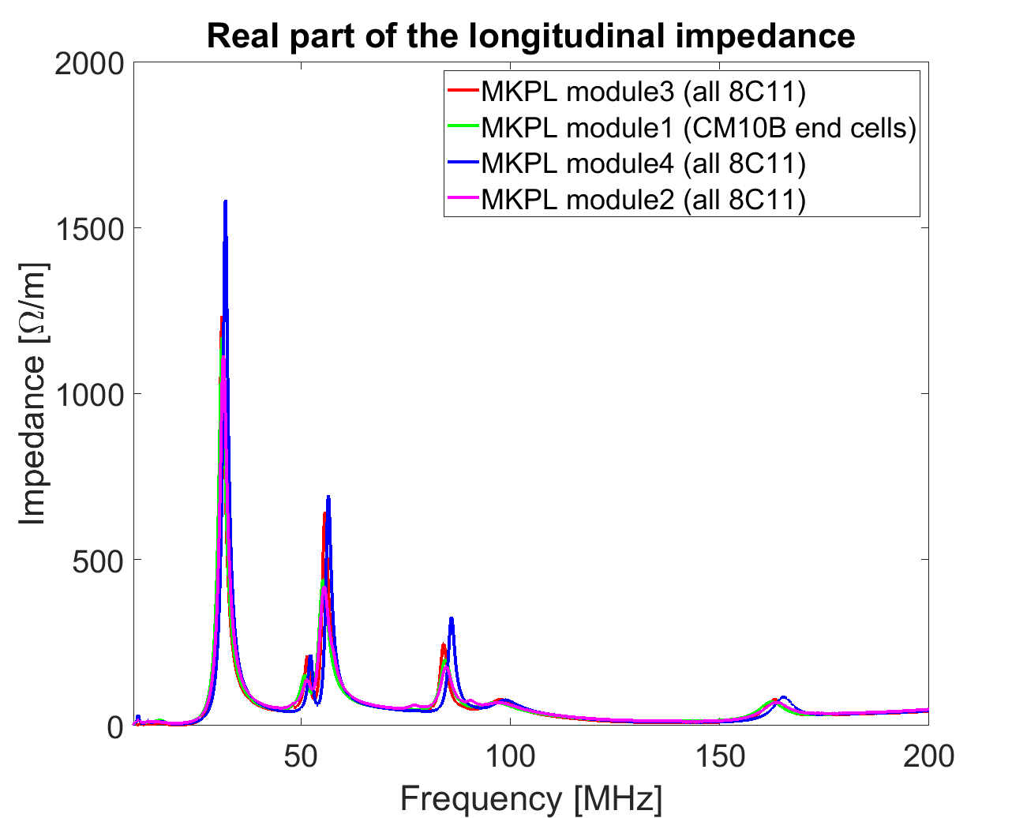
MKPL impedance measurements on the final assembly: all individual modules and full assembly

Slide 23
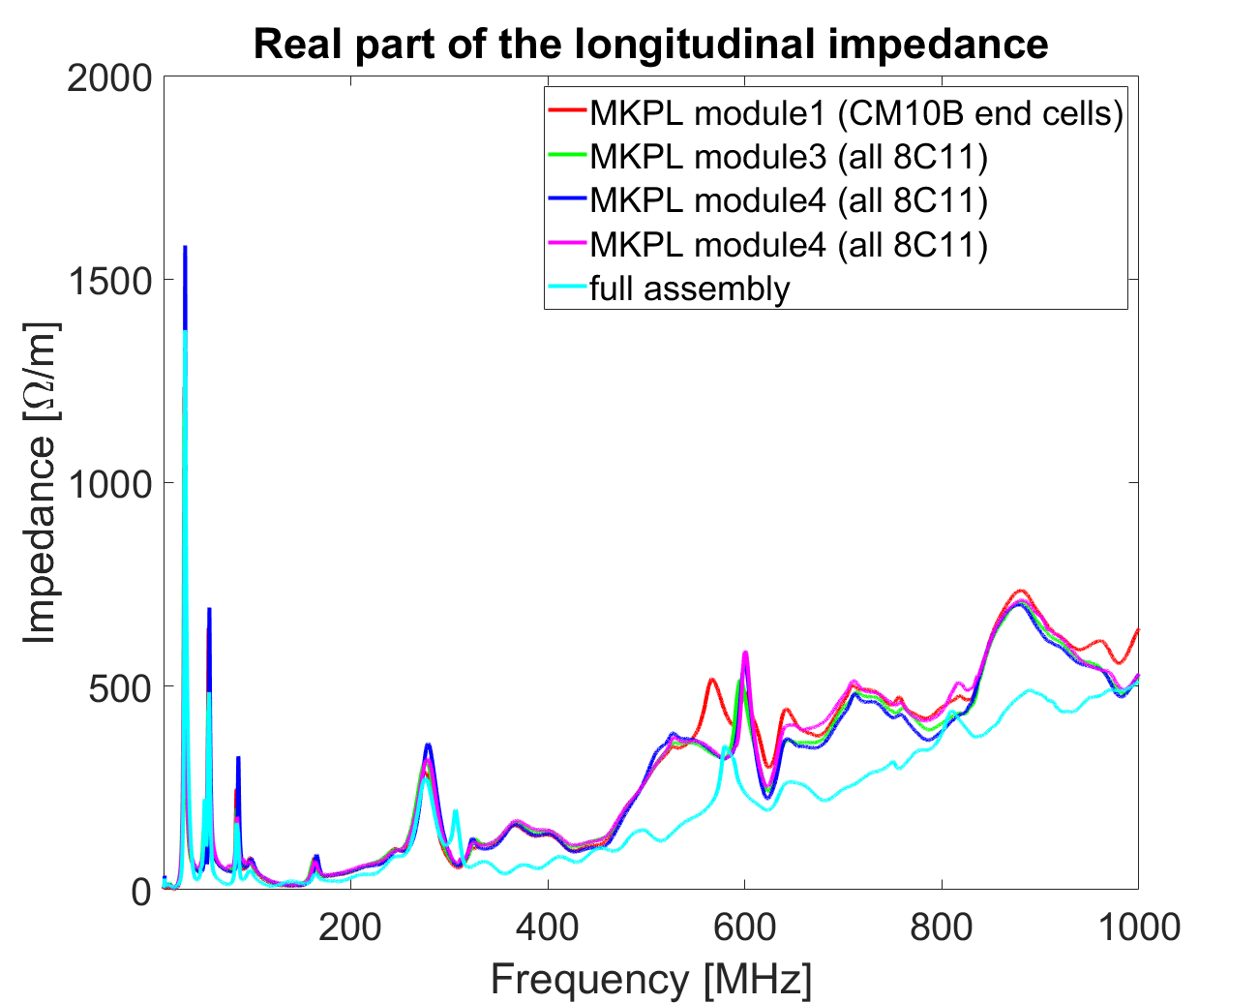
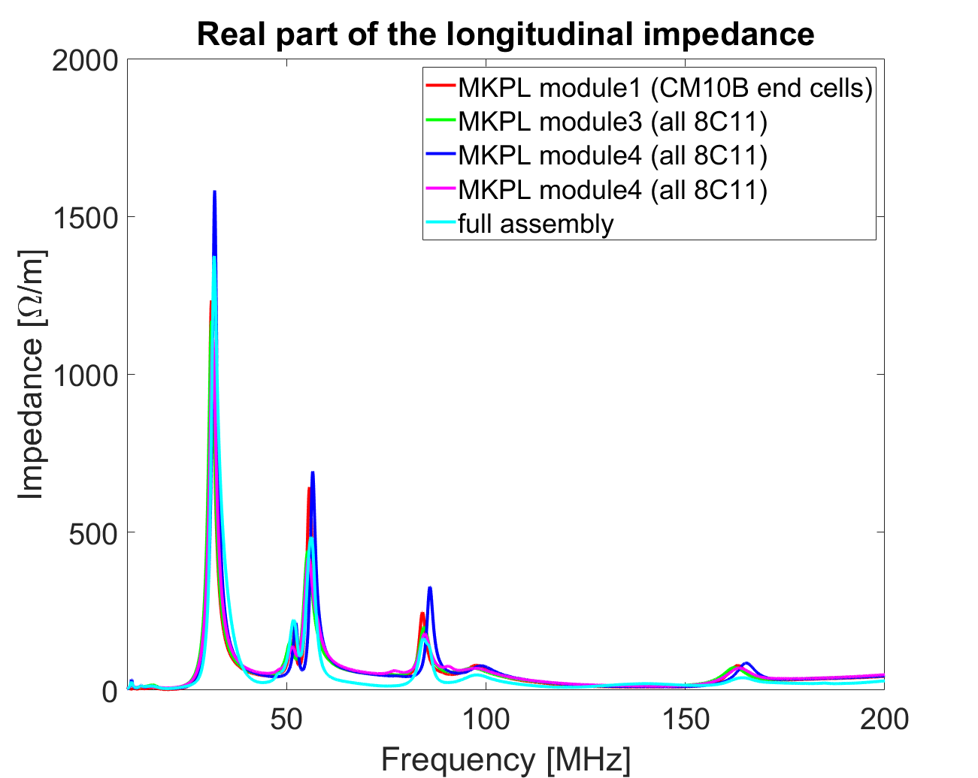
MKPL impedance measurements on the final assembly: all individual modules and full assembly

Slide 24
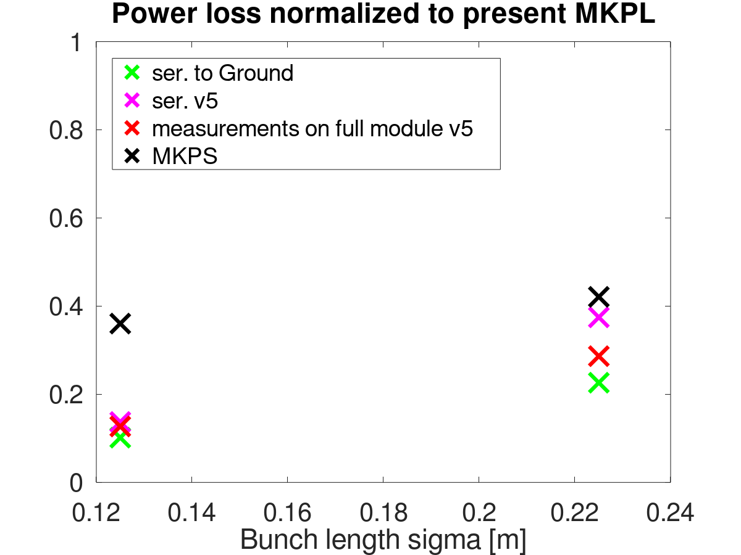
Beam induced power loss on the final assembly
Worst case on single module measurements
Both from measurements and simulations the new MKPL is expected to exhibit a beam induced power loss significantly lower than the present MKPS

Slide 25
Summary
The beam coupling impedance model of the MKPL can reproduce measurements observations with high degree of accuracy
  Uncertainty on first resonance frequency expected to be within 2 MHz
The design has been optimized to find a trade-off between kicker functionality and beam coupling impedance
  Serigraphy termination, number of serigraphy fingers, distance between fingers, finger lengths, ......
Longitudinal and transverse impedance measurements have been performed on the final assembly
  The new MKPL is expected to heat up less than the present MKPS
  Impact on beam stability to be studied on the final version (found to be negligible on initial version)

Slide 26
Thank you for the attention

Slide 27
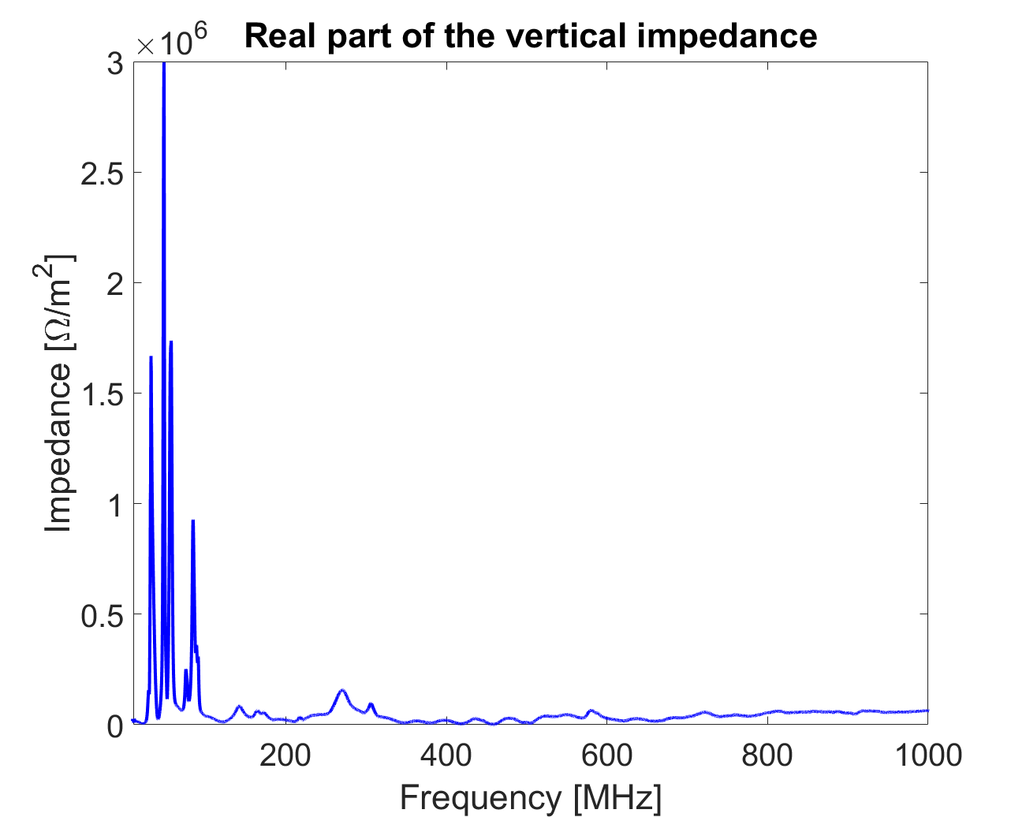
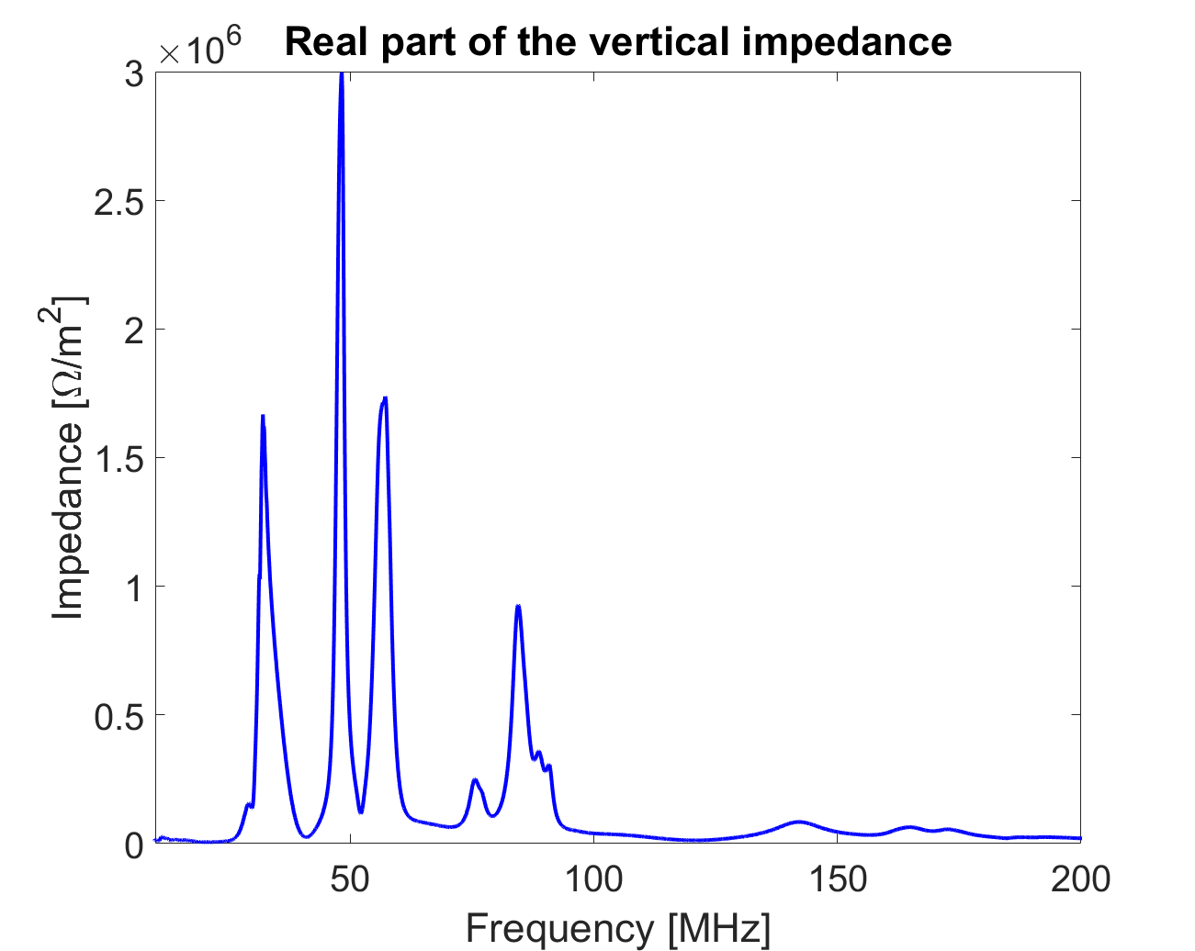
MKPL impedance measurements on the final assembly: transverse impedance
PRELIMINARY

Slide 28
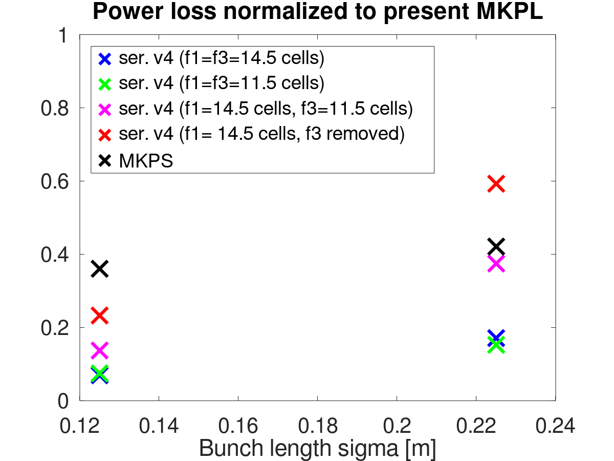
Beam induced power loss
Both from measurements and simulations the new MKPL is expected to exhibit a beam induced power loss significantly lower than the present MKPS

Slide 29
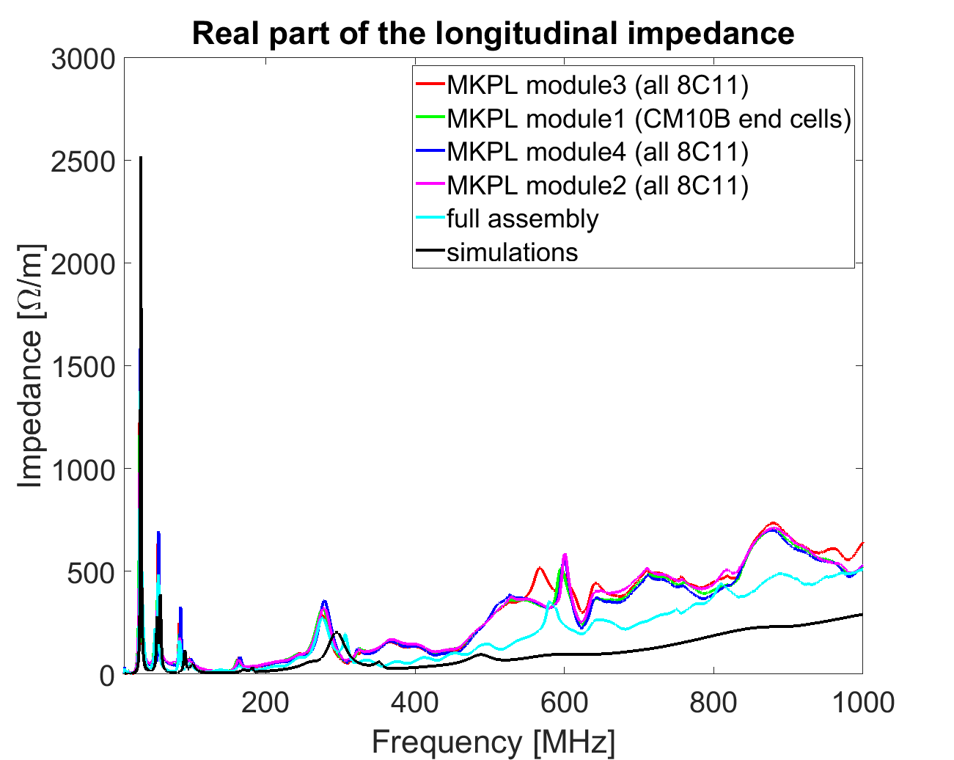
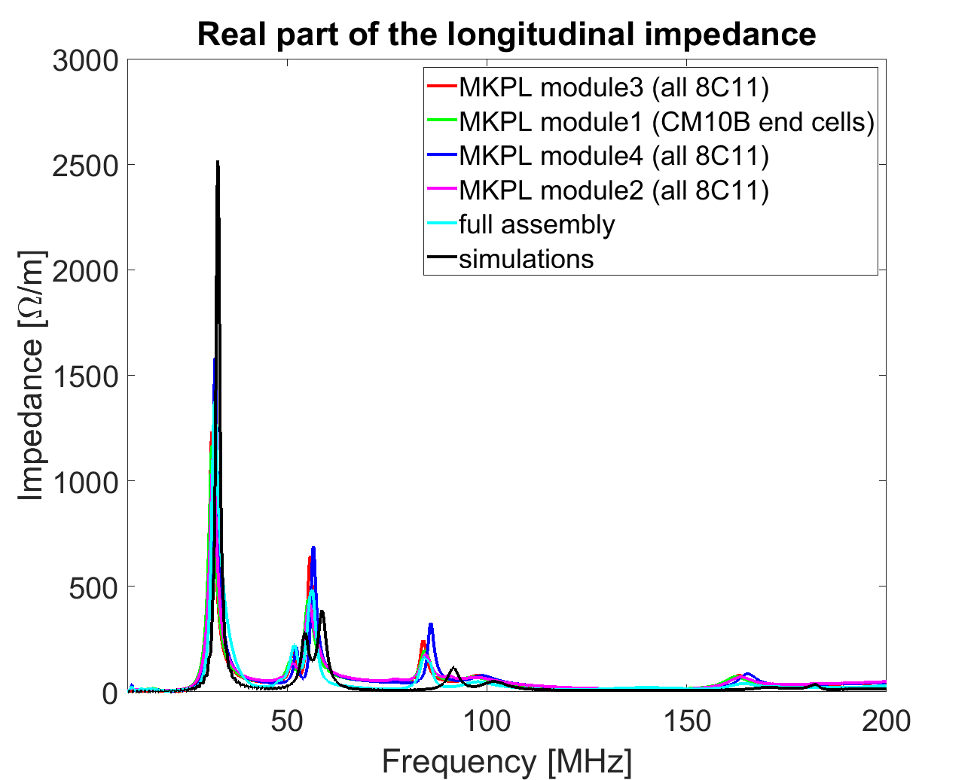
MKPL impedance measurements on the final assembly: all individual modules and full assembly

Slide 30
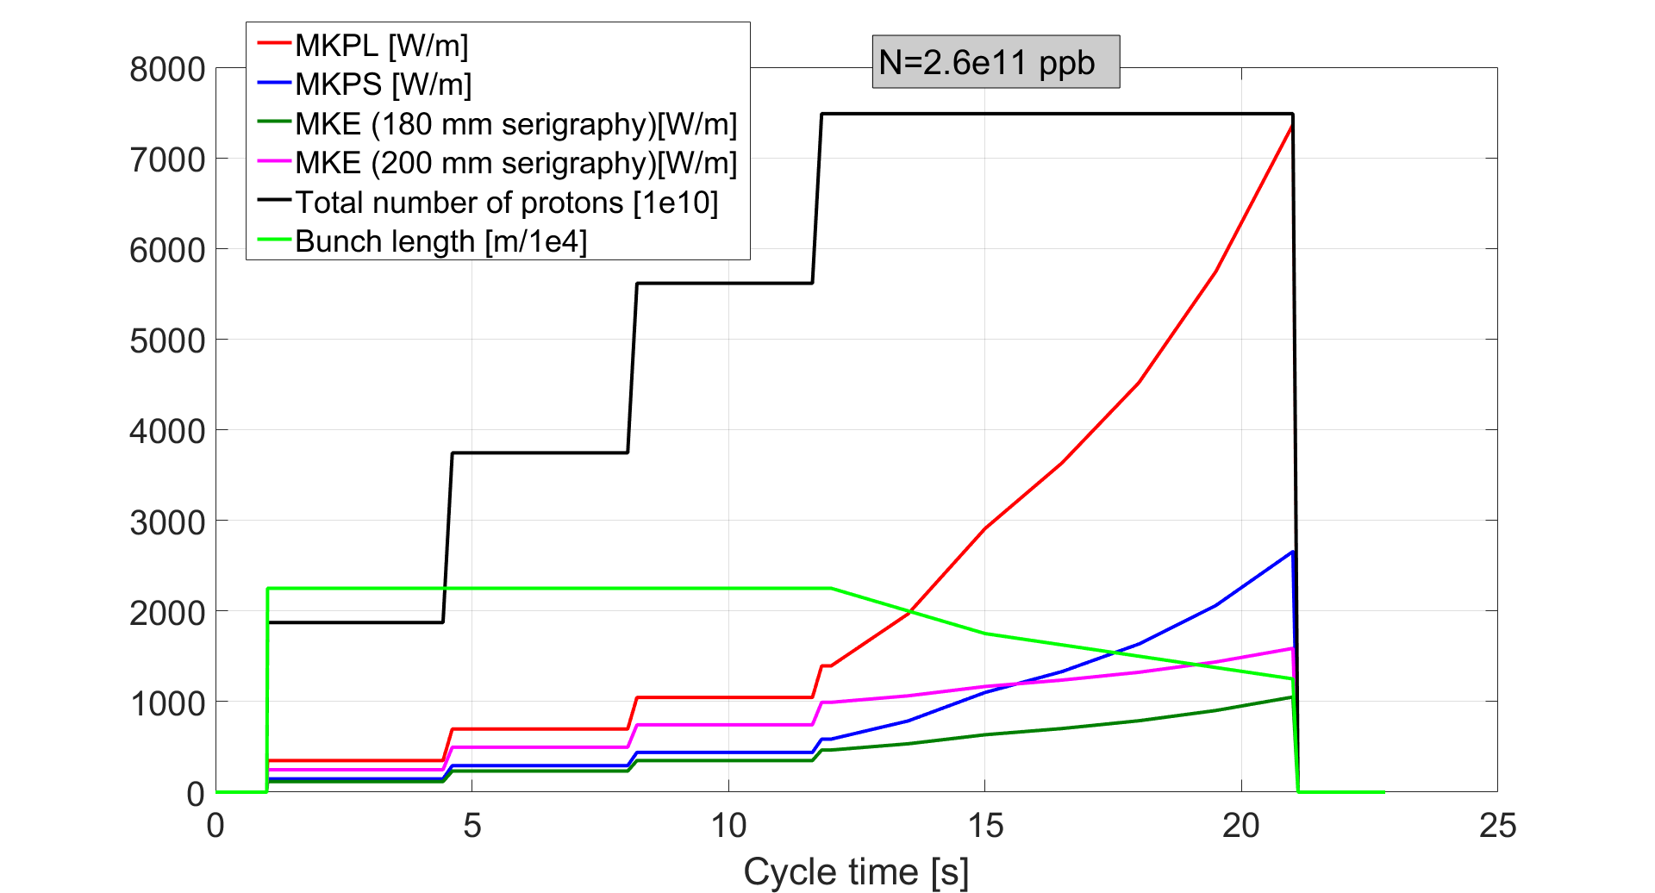
Power loss in kickers along cycle

