Slide 1
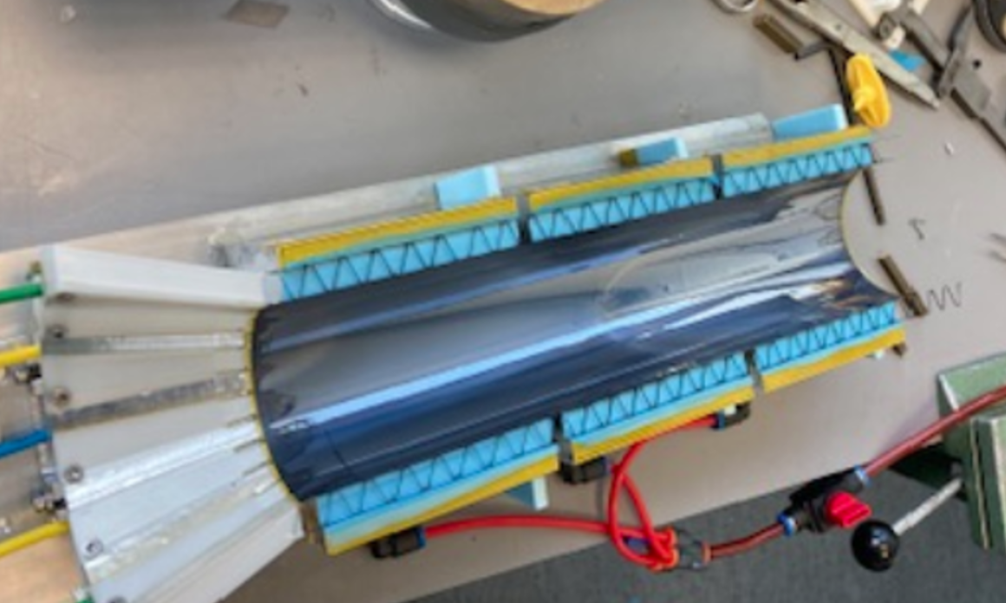
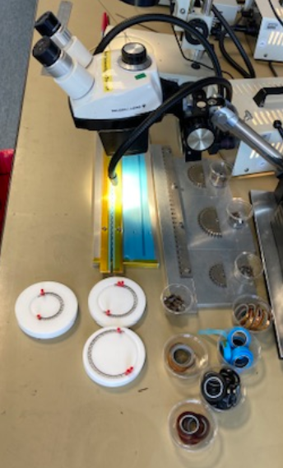
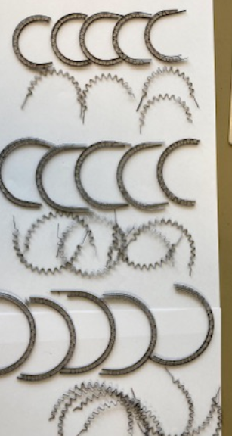
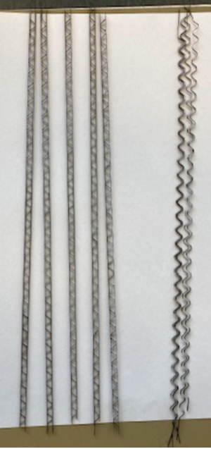
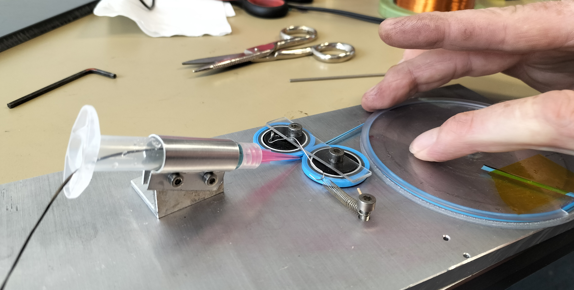
Demo concave mandrel assembly
We had delivery issues of carbon, finally could start preparing a couple weeks ago but also have some other projects now.
Hope to be ready in a 3-4 weeks (sorry)

Slide 2
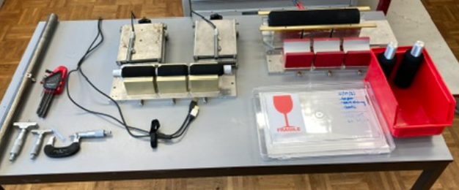
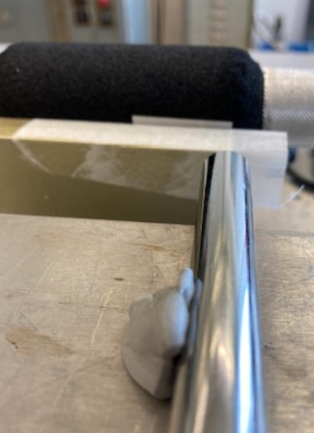
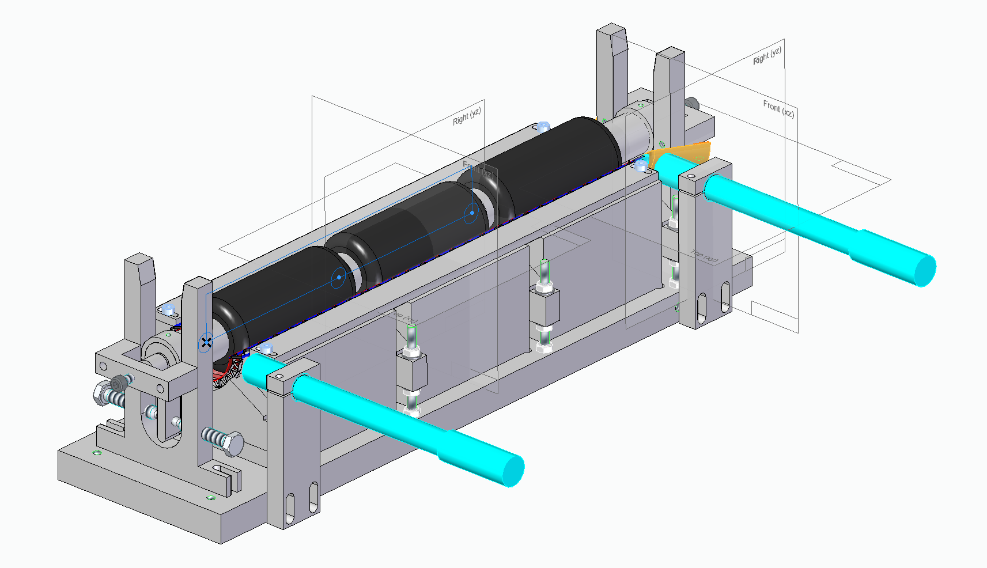
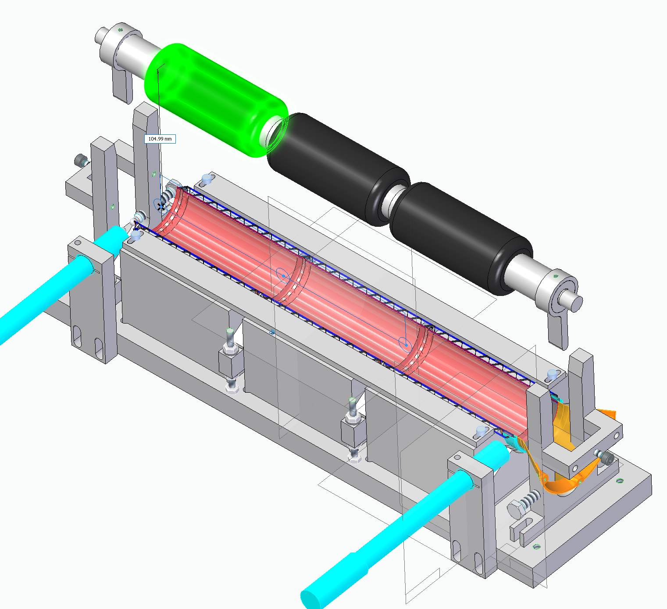
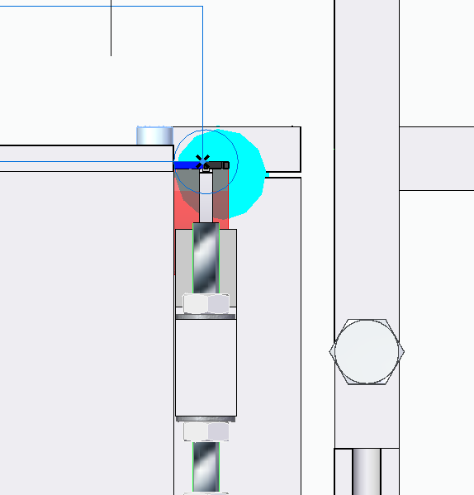
Main machining done , stil need to print parts , first alignment test looks oke but need a bit more testing/preparation.

Slide 3
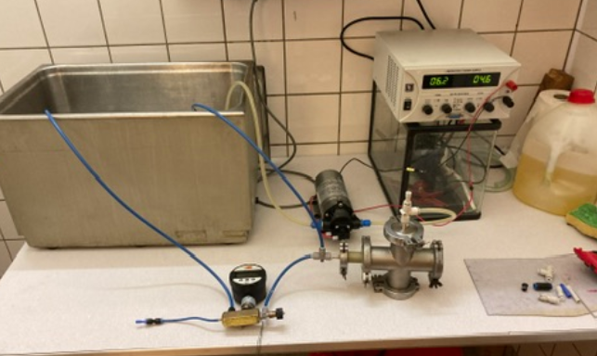
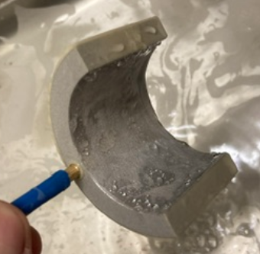
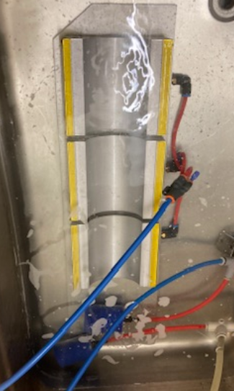
I had some doubt on lose particles from machining the mandrel. Contacted metaphor For advise.
Updated with a light polish with scotch bright then clean in a pressurized setup with ultrasonic cleaner.
Dry under air pressure in oven .

Slide 4
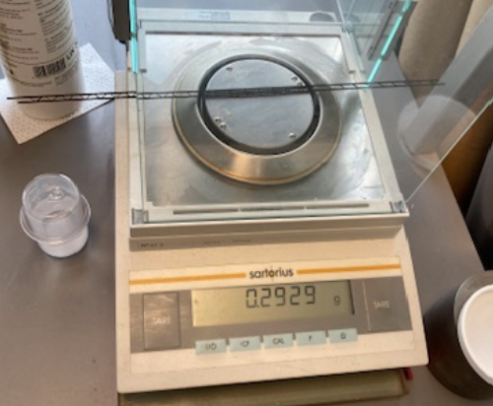
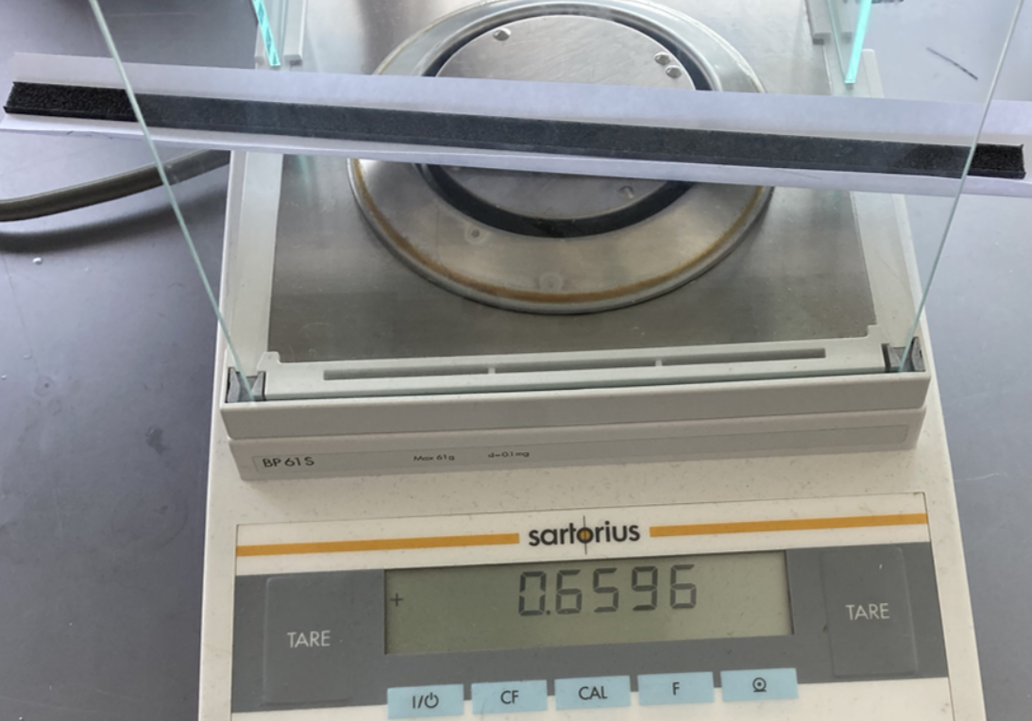
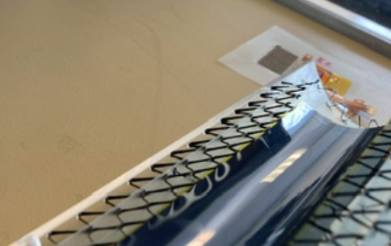
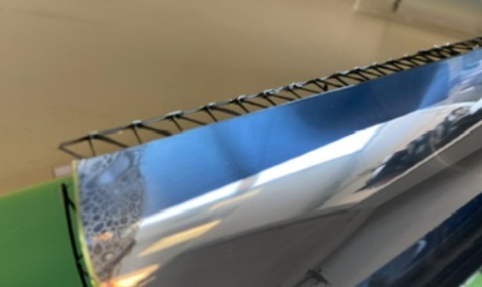
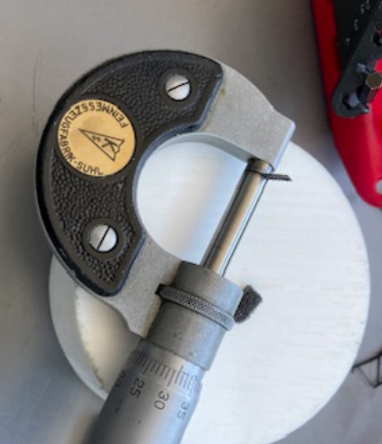
Short note on carbon foam v.s. fibre for mechanical support
 | Mechanical strength | mass | homogeneity | Ease of working | dimensions
Carbon foam | sufficient | Longerons Including glu aprox 0.66gr | Foam Oke but a lot mass seems to be in glu+flece, glue foam interface is irregular | Oke, but delicate +risk of lose particles | oke
Carbon fibre | Very good | 0.29gr with carbon strips | Less zigzag is aprox 0.07 gr and glue dots | easy | Oke
With added straight carbon bar 2x0.13mm oke on r30 Need to test on r24/18
Only zigzag bends out
Glue+flece on longeron 0.3mm

Slide 5
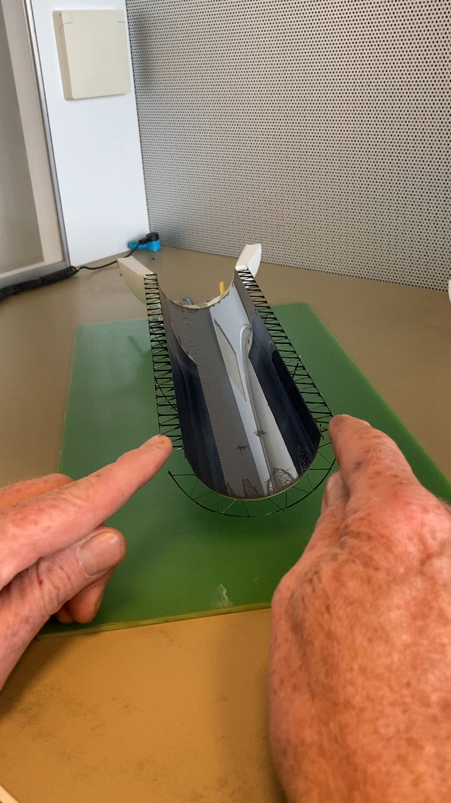
Short note on concave mandrel v.s. CERN setup
Concave mandrel:
-To be demonstrated
-need to assemble separate self supporting layers
+ seems easy to work with/no cutting of tape
? Bonding probably only on inside if bond after bend
CERN setup
+ most tested
+ can be used for separate layers or full assembly
-Cutting tape
? Bonding probably only on outside if bond after bend
On self supporting layers:
+ full testing before total assembly
-After comment of corrado I lookd a bit better at the total assembly
The torsional stiffness of singles layers is low can be improved with additional material but I think it would be hard to assure micron level Stability. Final assembly in a stiff carbon shell seems lower risk for dimensional stability.

Slide 6
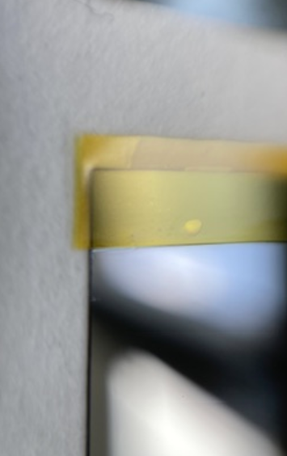
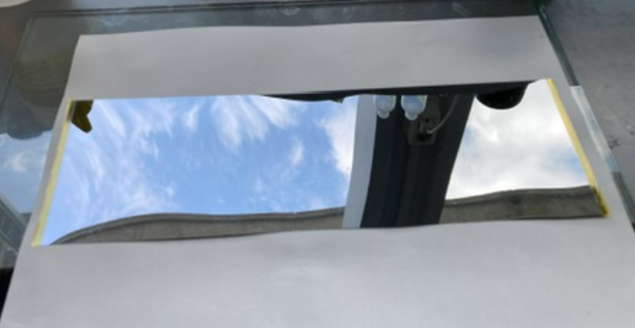
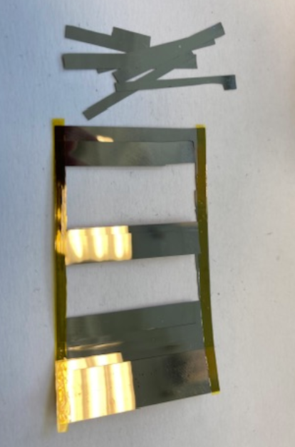
Note on breaking silicon,
As of now we seem to have a success rate of 1/3 with bending and we had at least one case of breaking
Weeks after assembly (utrecht)
I assume if we have silicon without edge defects we will have a better success rate. And at least in utrecht I seem
To have less failures with bending alpides (different dicing/grinding/metal layer’s ? )
On last R30 assembly i used a “cheat strip” of 30mu kapton glued to the edges which could be at least a intermediate
Solution (breadboard/engeneering modules )current im experimenting on scrap silicon it seems when mishandling
The silicon the fractures don’t start at the edge

Slide 7
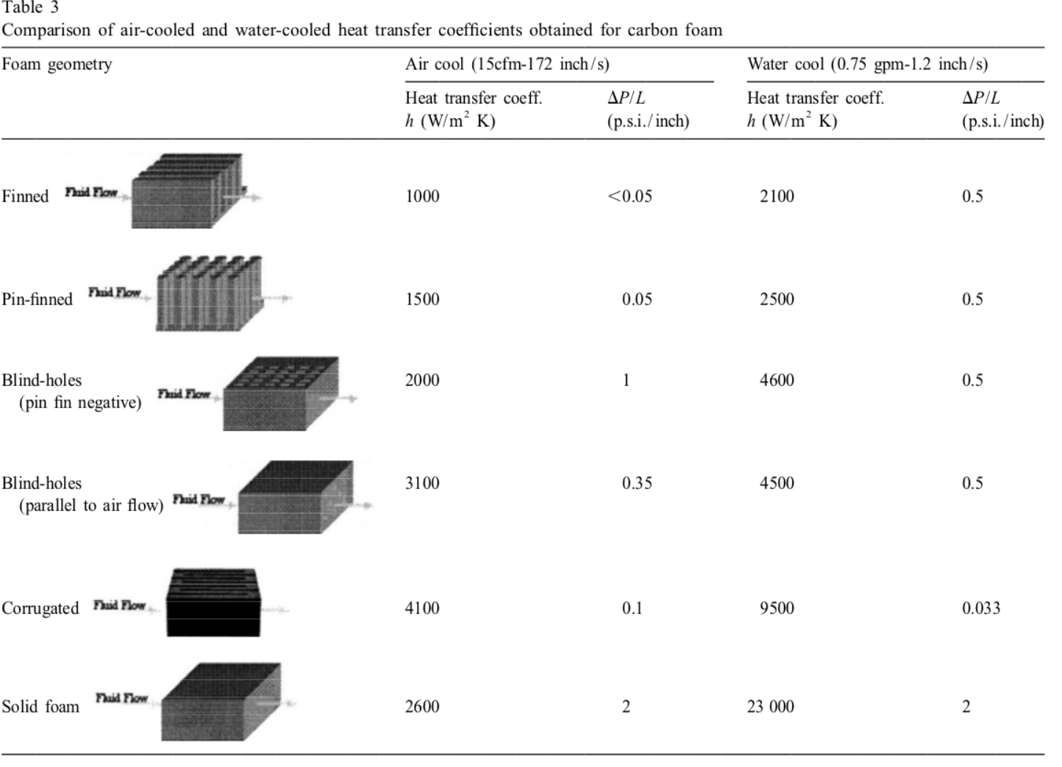
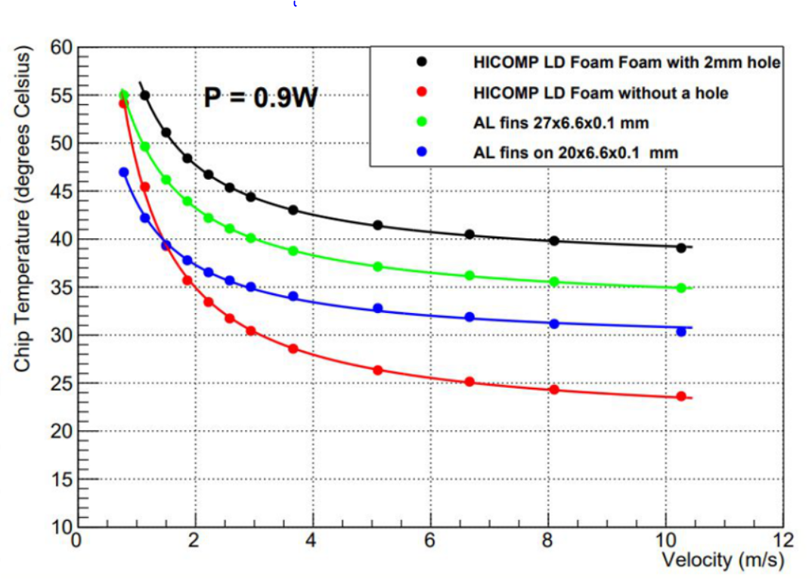
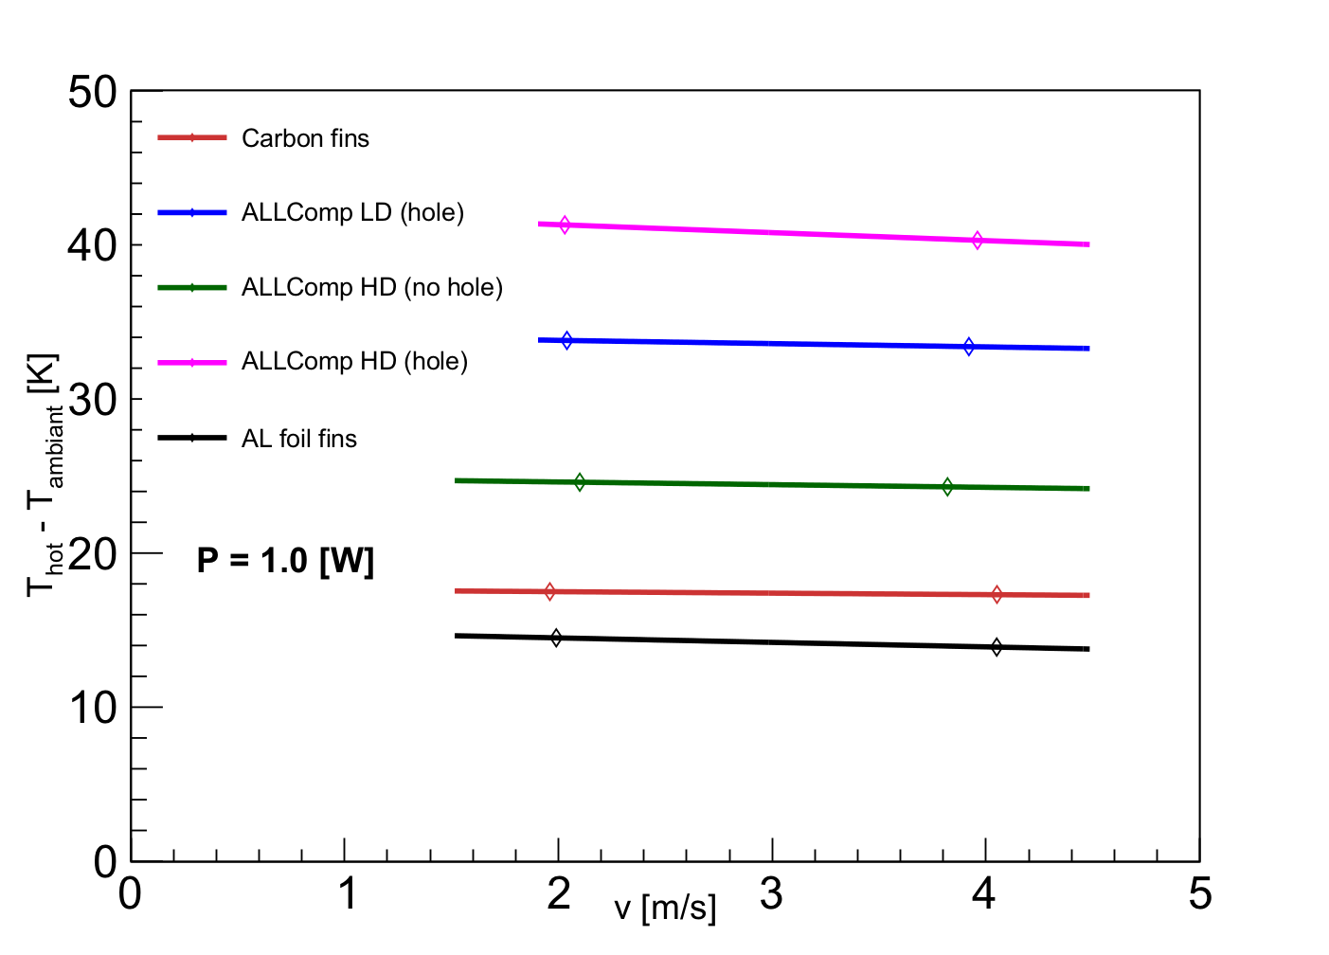
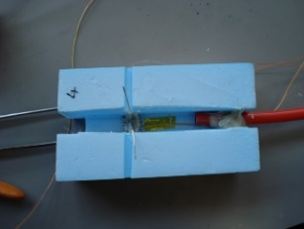
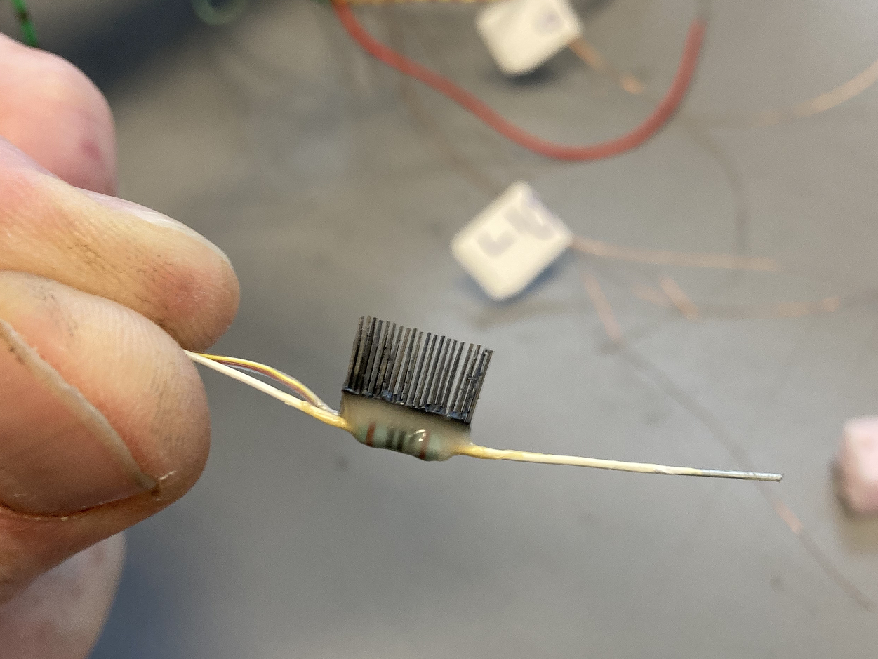
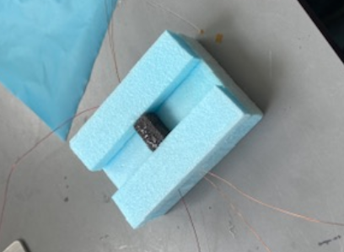
Cooling with carbon foam
rough comparison between Oak ridge and results here note its different foam different glue/solder e.t.c.
From :Carbon foams for thermal management Nidia C. Gallego*, James W. Klett
Carbon Materials Technology Group, Metals and Ceramics Division Oak Ridge National Laboratory, Oak Ridge, TN 37831, USA
A unique process for the fabrication of high-thermal-conductivity carbon foam was developed at Oak Ridge National
utrecht
Smd 2512 as heater
Round resistor as heater
Aprox 2080 W/m^2 K @4ms
Doubble at 10 ms !
Verry hard to make

Slide 8
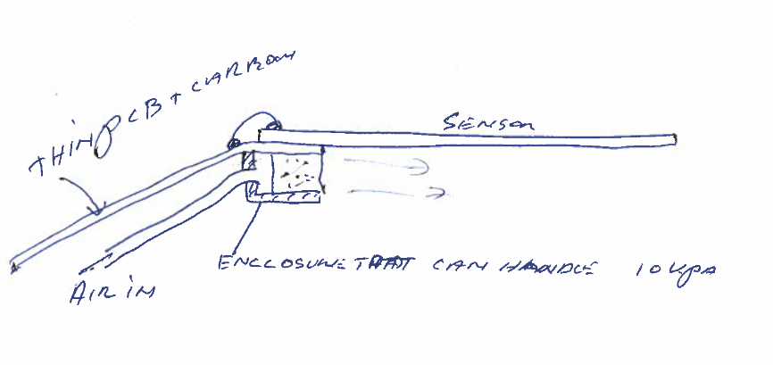
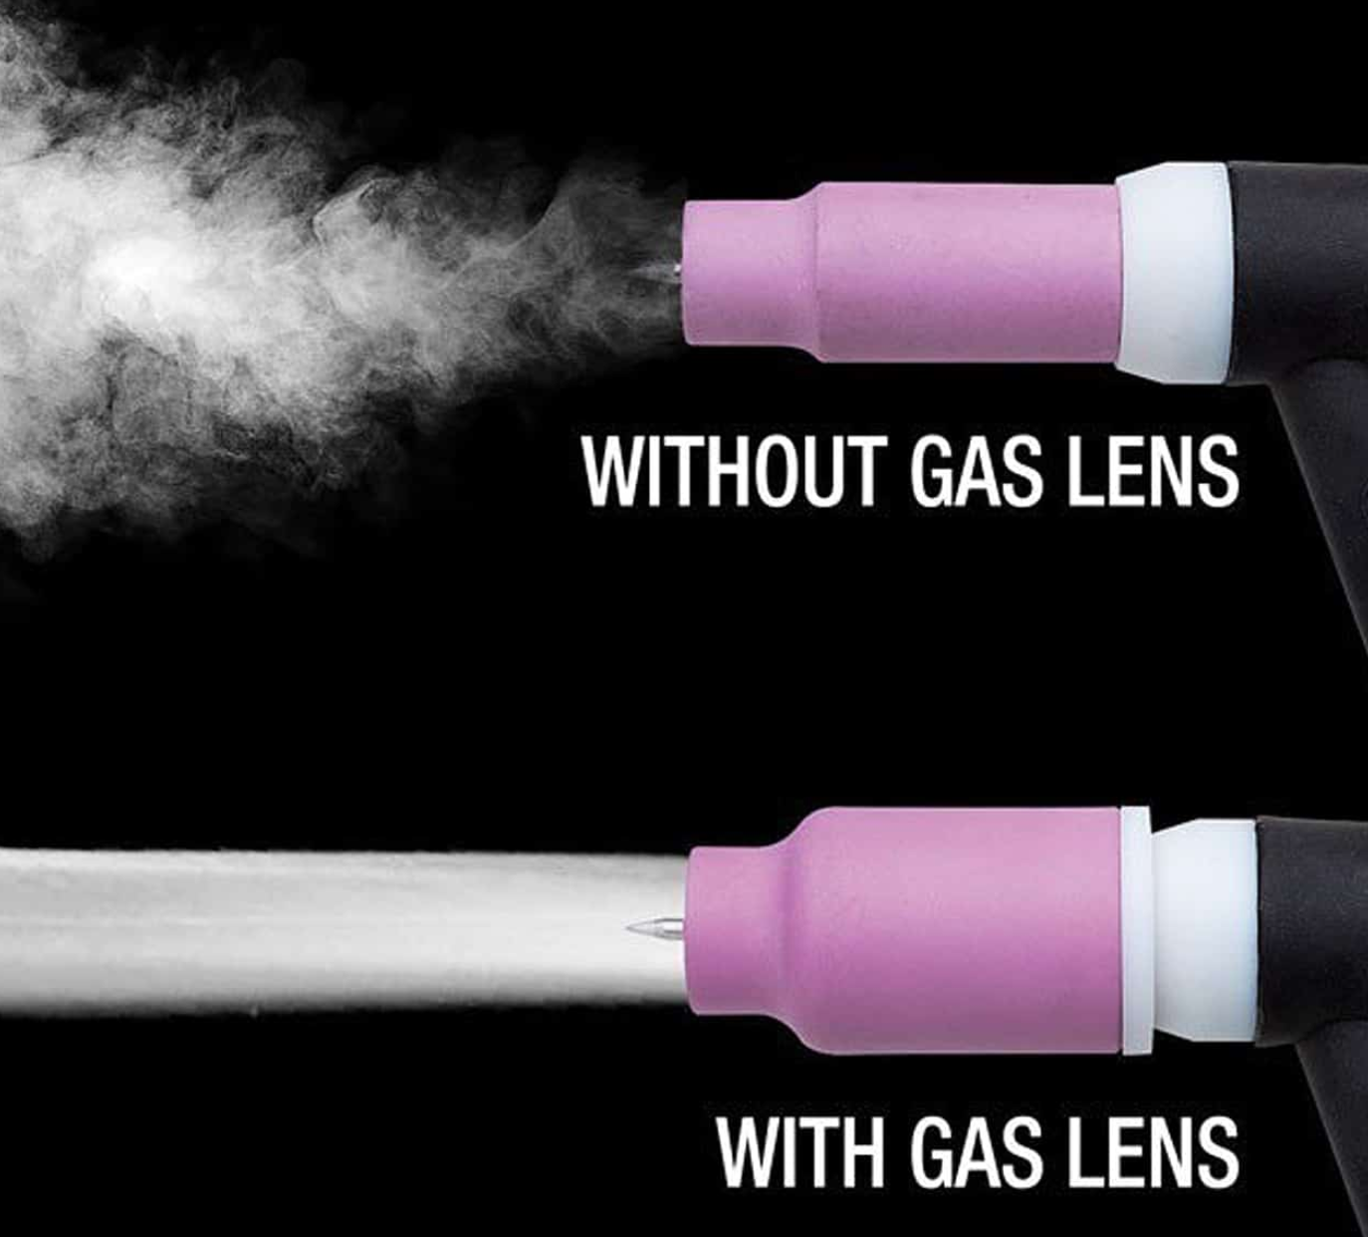
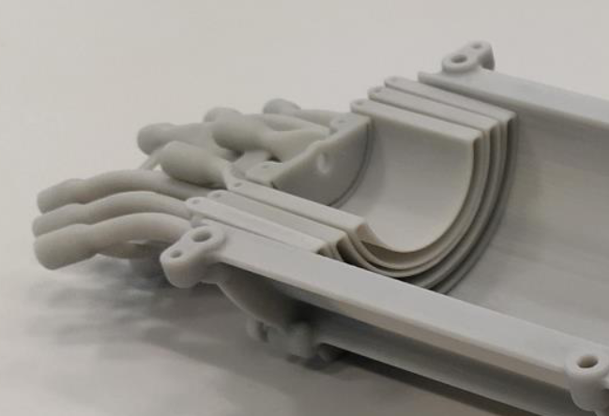
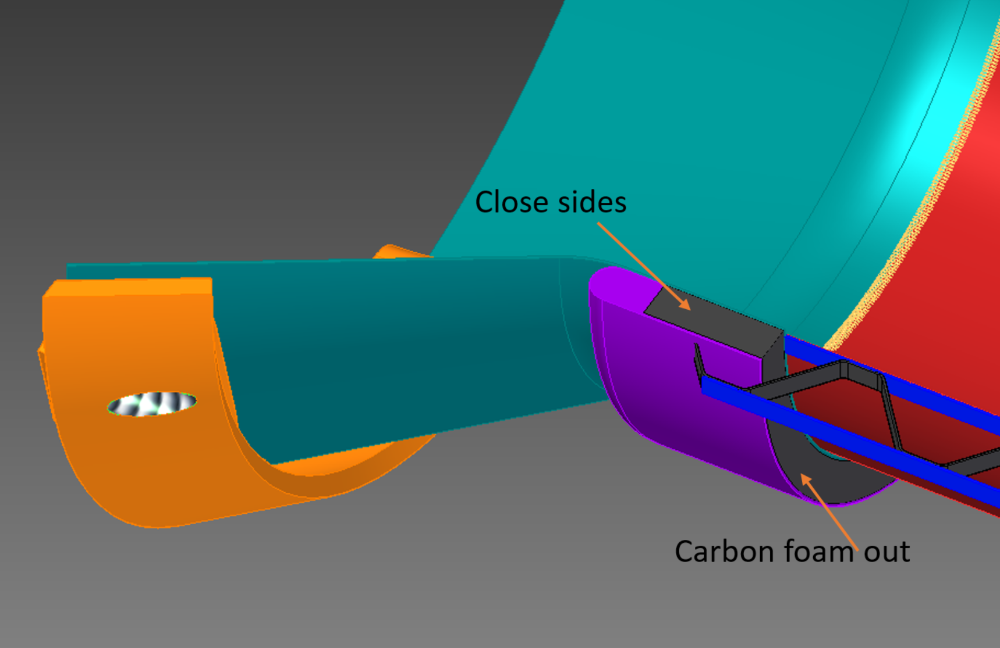
So it seems to perform well without hole and a relative large pressure drop
On pressure drop : as long as forces from pressure are confined to cooler the sensor “does not feel it”
From 20220809_gael.pdf
Note supply can be tubes/cones (like gael his desing) e.t.c

Slide 9
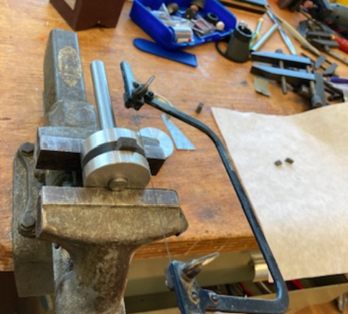
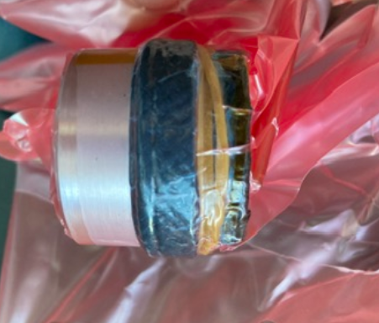
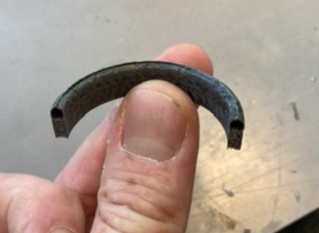
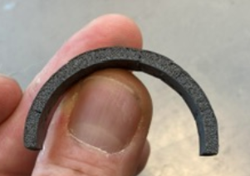
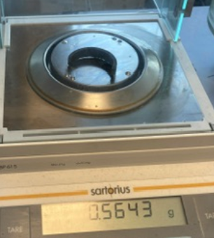
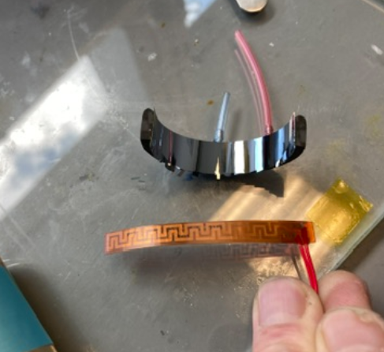
Can we build something like this ??
Folding 1 pice carbon was not easy next with two pices two steps
First inner layer + foam then closing from outside

Slide 10
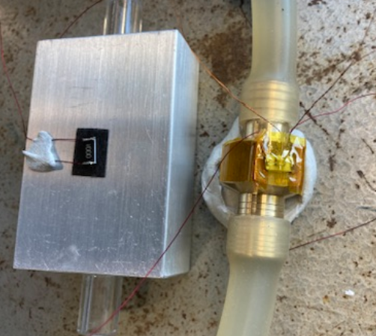
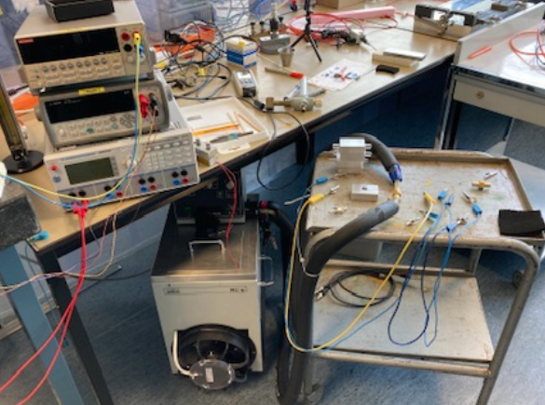
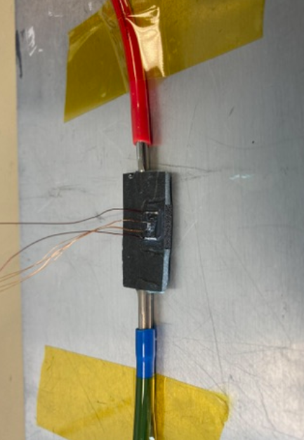
Hard to get a consistent gluing contact, researching now with small sections gluing under vacuum e.t.c.
2512 smd resistor as heater and 0603pt1000 sensor (researching small thermocouples inside) have two strategys
On is with carbon foam and air cooling second is simplified Thermal conductivity measurement
(ASTM D 5470, E1530, and E1461) to see what thermal conductive glue + carbon flece /fibre is doing
We have a bachelor student working on this now , we hope to find a consistent strategy and build a
Full layer in the coming months (BBM xxx?)

