Slide 1
MQXFB02 test plan discussion
F. Mangiarotti on behalf of the test team
2022.10.18

Slide 2
Summary of the test plan
At warm 2 weeks
  HV test
  Other electrical tests
  Pressure/Leak test
  SG & FOP tests
Cool down 3-4 days
  LT commis at 4.5 K
Preparation (1.9 K) 1 week
  HV tests
  Other electrical tests
  Magnetic measurements
  Protection Check
Power tests
  Training + 50 A/s
  VI measurements
  Splice measurements
  Magnetic measurements
  Fatigue tests (cycling)
Warm up
  RRR measurement
At warm, final
  HV test
  Other electrical tests

Slide 3
HV tests
 |  | Voltage [V] applied during 2 min in test bench
Polarity + | Polarity - | Warm initial | 1.9 K LHe | 100 K, 1.3 bar GHe | Warm Final | Imax [uA]
Coil-CLIQ-QH | Ground | 370 | 370/1100/1840 | 850 | 370 | 10
Coil-CLIQ | QH-Ground | 370 | 370/1100/1840 | 850 | 370 | 10
QH | Coil-CLIQ-Ground | 460 | 460/1300/2300 | 850 | 460 | 10
Cryogenic Heater | Ground |  | 675 |  |  | 70
TT821, TT822 | Ground |  | 25 |  |  | 2
Note: during the MQXFBP3 some inconsistencies were detected in the values for Coil vs QH-ground, which are now corrected. Values changed are in italics.

Slide 4
Other electrical tests
Coil, QH resistance measurement
Voltage taps continuity & resistance measurement
Frequency transfer function: full magnet, each coil, each coil pair; coils vs QH, coils vs Gnd, each QH to the other QHs
  Q to Mateusz, Ludovic, Susana: are coils vs QH, coils vs Gnd measurements interesting to have for all magnets?
    Indication of QH degradation (or not)
Capacitive discharge: full magnet, each coil, each coil pair
CLIQ leads resistance measurement
  Q to Emmanuele: is this measurement interesting?
    Once/twice per configuration

Slide 5
Pressure/Leak test
16 bar in the cold mass
16 bar in the thermal screen?
  OK, it can go to 25 bar
Q for Herve, Michael: do we need to validate the leak rate of the SG and FOP feedthrough?
  SG validated, FOP only leak, good to monitor during CD – to be confirmed if possible

Slide 6
Cool down
Expected duration: ~3 days
Q to Remi, Gabriella, Nicolas: how long do we need to commission the level sensor in the cold mass?
  Important to keep the time slot – 1 h if all ok, otherwise ~days
Q to Herve, Michael: do we need leak rate measurements to validate SG/FOP feedthrough?

Slide 7
Preparation at 1.9 K
Magnetic measurements: test at 2 kA and 8 kA
  Q to Susana, Lucio: can we remove the 2 kA test? OK
  Q to Susana, Lucio: is this interesting to keep for the series? Yes for virgin magnets
Protection checks
  QH, CLIQ triggers without current
  Single QH triggers at 2.9, 3.1 kA
  CLIQ trigger at 3.3 kA (QH delayed)
  Full protection trigger at 8.1 kA
Low current splice measurement: proposed to be removed, keeping the full current test – any objections? NO

Slide 8
Power tests at 1.9 K
Training at 20 A/s to 16.53 kA
Endurance: 8-12 h at 16.23 kA -- OK
Ramp rate studies: 50 A/s
  Baseline but option to sacrifice: 100, 150, 200 A/s with a change of the PC settings
VI measurements: 30 min plateau at 14 kA, then 5 min plateaus every 100 A with 1 A/s ramps
Magnetic measurements (+ splice measurements):
  With rotating shaft: stair-step, machine cycles, ramp rate
  With stretched wire: nominal field, angle and magnetic center
Current cycles: from 8.1 to 16.23 kA and back, at 50 A/s (target: 300)
Q: other tests?

Slide 9
Power tests at 4.5 K
Training verification at 20 A/s to 16.53 kA
Endurance: 8-12 h at 16.23 kA
Ramp rate studies: 50 A/s
  Baseline but option to sacrifice : 100, 150, 200 A/s with a change of the PC settings
VI measurements: 30 min plateau at 13 kA, then 5 min plateaus every 100 A with 1 A/s ramps (to be adapted)
Magnetic measurements (only B02) (+ splice measurements):
  With rotating shaft: stair-step, machine cycles, ramp rate
  With stretched wire: nominal field, angle and magnetic center
Current cycles: from 8.1 to 16.23 kA and back, at 50 A/s
Q: other tests?

Slide 10
Duration – CD1
Week 44 31.10-4.11 | Week 45 7-11.11 | Week 46 14-18.11 | Week 47 21-25.11 | Week 48 28.11-2.12 | Week 49 5-9.12 | Week 50 12-16.12
Reception: 31.10 Mechanical setup Warm initial tests Cool down start: 11.11 |  | LT149 commis. Electrical tests Protection check | Tests 1.9 K: Training Endurance RR studies VI, MM | Tests 4.5 K: Training RR studies VI 1.9 K: Current cycles | Tests 1.9 K: Current cycles Verification: RR, VI Final tests Warm up starts: 9.12 | Latest warmup day: 13.12 8 am Cryo plant stops on 14.12
Risks of delays:
Delivery
Cool down – ideally over the weekend, otherwise up to +1 week
Unexpected issues – can easily add 1-2 weeks
Note: the tests in week 49 could be done in the second cool down

Slide 11
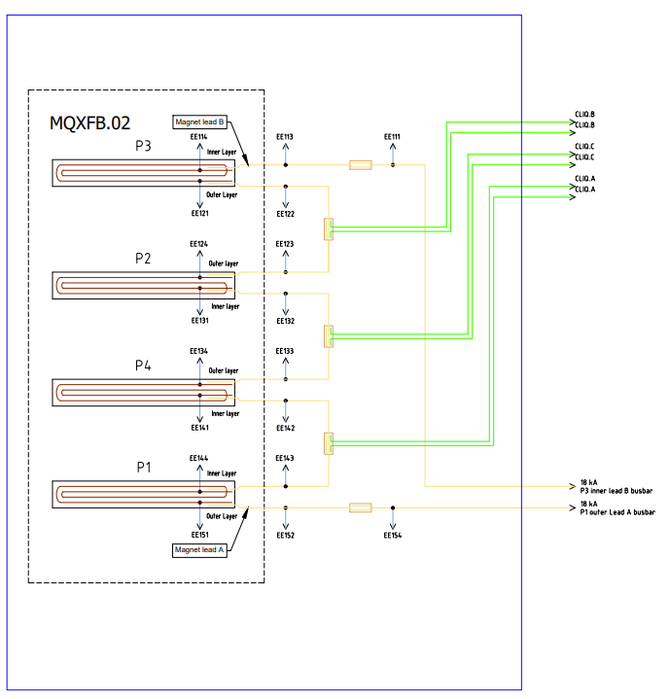
Potential special tests
Trimmed powering
  In case one coil is limited, we could power the other three at higher current
  Tested in BP2, “improved” by having double CLIQ leads between each coil pair
  All required equipment available between EPC and MSC-TM

