Slide 1
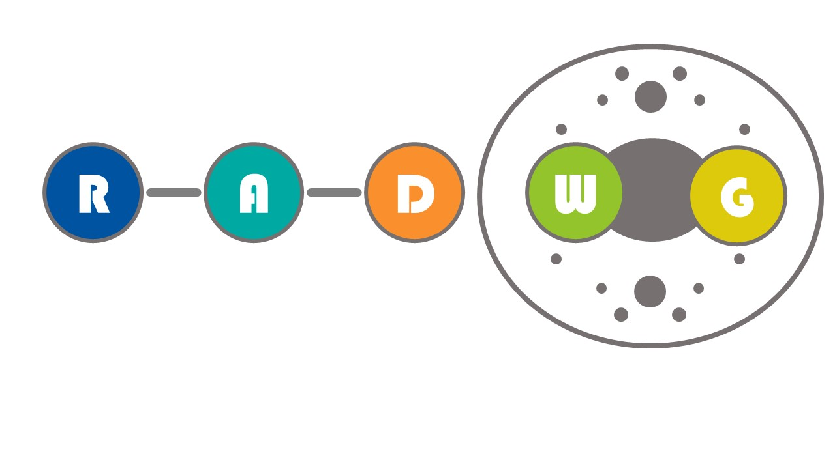
RADWG Workshop (05/10/22)
Salvatore Danzeca BE-CEM-EPR
Manoel Barros Marin SY-BI-BP
on behalf of the RADWG

Slide 2
AGENDA
Introduction
Activities Overview by Rudy Ferraro
LHC Oxygen level sensor (EN-AA-AS) by Andrea Lippiello et al.
CMS Muon DT On detector (EP-UCM) by Cristina Fernandez Bedoya
Open Questions

Slide 3

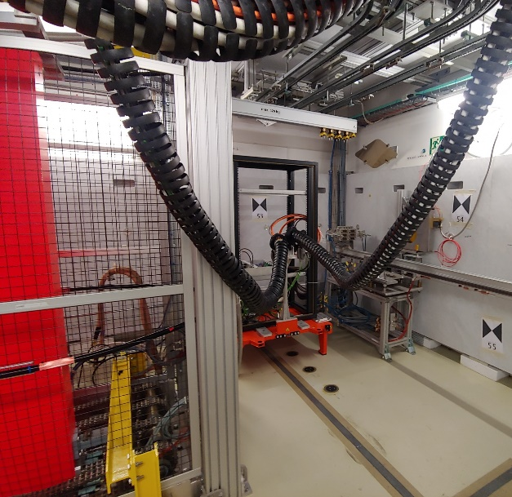
CHARM 2022
  1 slot = 1 Week
  6 slots remaining
  All slots are fully booked
    10 users booked until end of the year

Slide 4

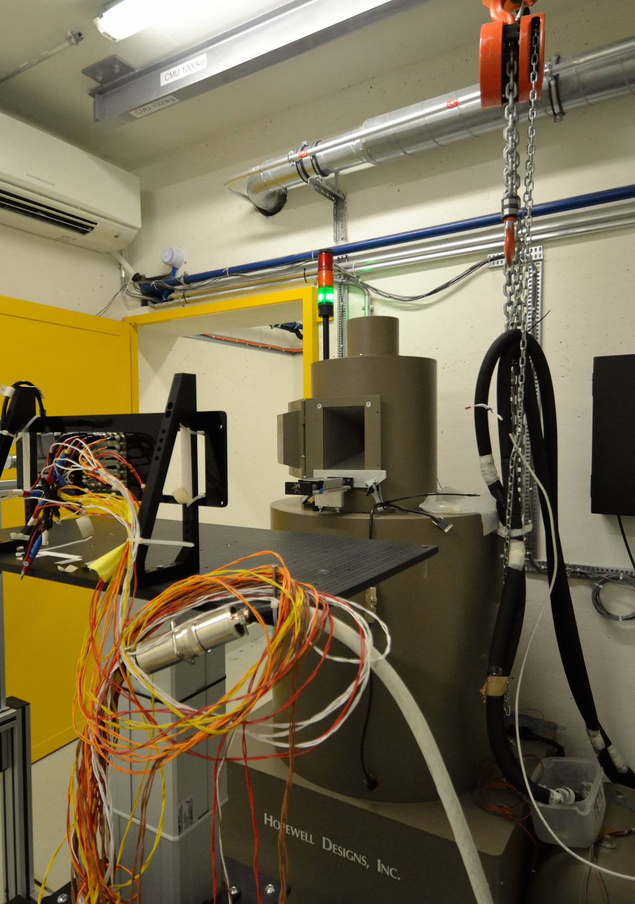
⁶⁰Co facility @ CERN
The CC60 facility has been maintained
First commissioning done yesterday (04/10/22)
User run start from next week
  Technical meeting will be organised next week

Slide 5
Radiation-Tolerant Power Supply Survey
Goal: Review the current situation regarding the use of low voltage power supplies under radiation within the ATS with the objective to identify standardization opportunities
Scope:
  All types of low-voltage supplies under radiation
    Linear/switched, AC/DC, and DC/DC , Homemade/COTS
It should be filled per each project
Result to be presented at the RADWG on Wednesday 12 October (please, fill it before that date).
Link to survey: https://limesurvey.web.cern.ch/569923?lang=en

Slide 6
THANK YOU

