Slide 1



Speeding up Madgraph5_aMC@NLO
through data parallelism:
CPU vectorization and GPUs
Compute Accelerator Forum, CERN, 8th February 2022
https://indico.cern.ch/event/1207838
Andrea Valassi (CERN IT)
With contributions from and many thanks to the whole madgraph4gpu development team!

Slide 2
(TRAILER – SPOILER ALERT!)
THE 4-SLIDE VERSION

Slide 3
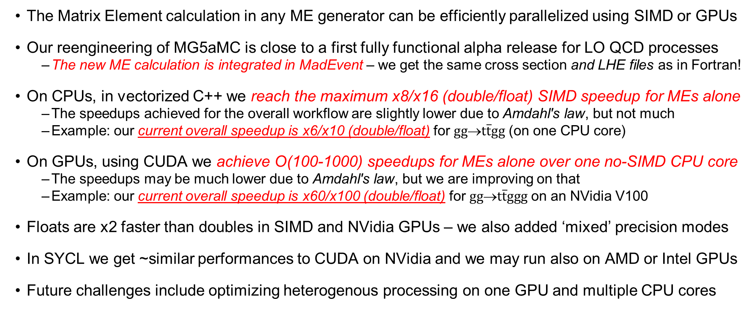
The 4-slide version! – Executive summary for the impatient
SPOILER
ALERT!
The Matrix Element calculation in any ME generator can be efficiently parallelized using SIMD or GPUs
Our reengineering of MG5aMC is close to a first fully functional alpha release for LO QCD processes
  The new ME calculation is integrated in MadEvent – we get the same cross section and LHE files as in Fortran!
On CPUs, in vectorized C++ we reach the maximum x8/x16 (double/float) SIMD speedup for MEs alone
  The speedups achieved for the overall workflow are slightly lower due to Amdahl's law, but not much
  Example: our current overall speedup is x6/x10 (double/float) for $gg$→$t\overline{t}gg$ (on one CPU core)
On GPUs, using CUDA we achieve O(100-1000) speedups for MEs alone over one no-SIMD CPU core
  The speedups may be much lower due to Amdahl's law, but we are improving on that
  Example: our current overall speedup is x60/x100 (double/float) for $gg$→$t\overline{t}ggg$ on an NVidia V100
Floats are x2 faster than doubles in SIMD and NVidia GPUs – we also added ‘mixed’ precision modes
In SYCL we get ~similar performances to CUDA on NVidia and we may run also on AMD or Intel GPUs
Future challenges include optimizing heterogenous processing on one GPU and multiple CPU cores

Slide 4
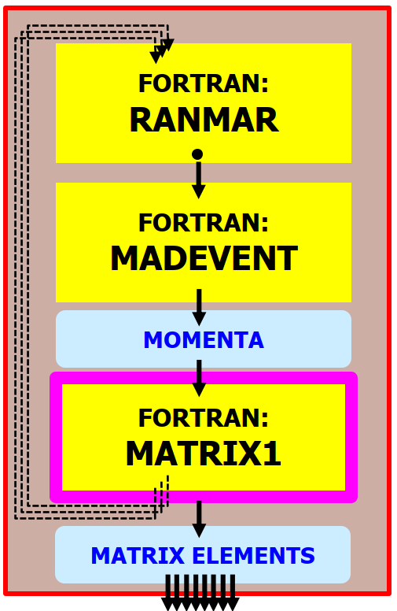
MG5aMC: old and new architecture designs
OLD MADEVENT
(NOW: LHC PROD)
SINGLE-EVENT API
Then we modified the existing
all-Fortran MadEvent
into a multi-event framework
and we injected the new MEs into it
First we developed
the new ME engines
in standalone applications
1. STANDALONE
(TOY APPLICATIONS)
MULTI-EVENT API
2. NEW MADEVENT
(GOAL: LHC PROD)
MULTI-EVENT API
CUDA/C++ or PFs:
cuRAND
FORTRAN:
RANMAR
FORTRAN:
RANMAR
(Amdahl...)
SCALAR:
NEW BOTTLENECK?
PARALLEL:
MUCH FASTER!
MATRIX ELEMENT: CPU BOTTLENECK IN OLD MADEVENT
CUDA/C++ or PFs:
RAMBO
FORTRAN:
MADEVENT
FORTRAN:
MADEVENT
MOMENTA
MOMENTA
MOMENTA
CUDA/C++ or PFs:
MEKERNELS
FORTRAN:
MATRIX1
CUDA/C++ or PFs:
MEKERNELS
MATRIX ELEMENTS
MATRIX ELEMENTS
MATRIX ELEMENTS

Slide 5
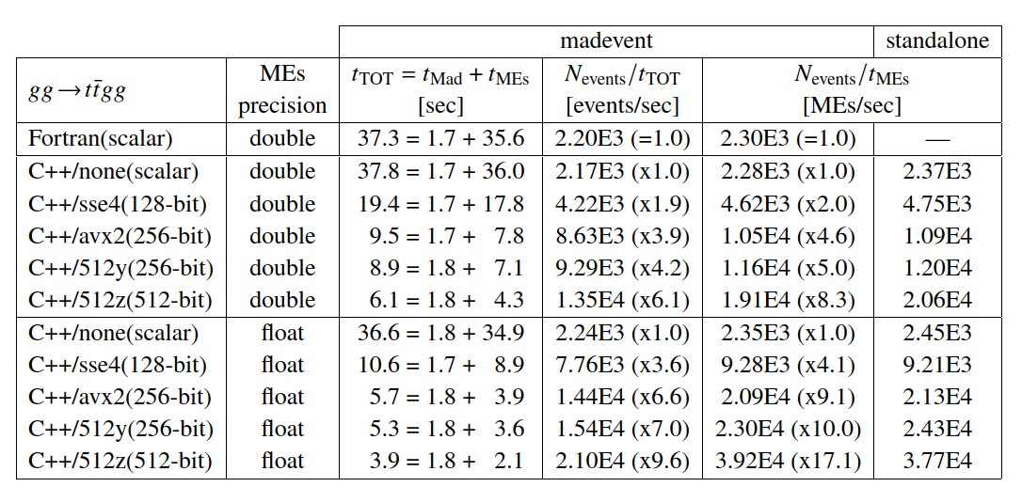
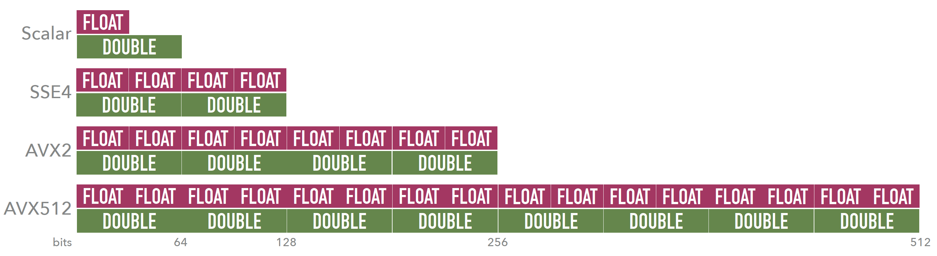
MadEvent with vectorized C++ for $gg$→$t\overline{t}gg$ (on a single CPU core)
ACAT2022
512y = AVX512, ymm registers
512z = AVX512, zmm registers
The latter is only better on
nodes with 2 FMA units
(here an Intel Gold 6148)
ME speedup ~ x8 (double) and x16 (float) over scalar Fortran
Our ME engine reaches the maximum theoretical SIMD speedup!
Overall speedup so far~ x6 (double) and x10 (float) over scalar Fortran (Amdahl’s law)

Slide 6
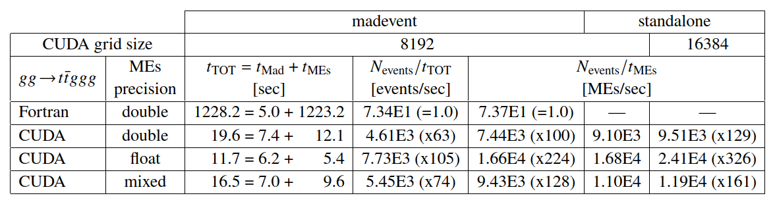
MadEvent/CUDA for $gg$→$t\overline{t}ggg$
ACAT2022
We are lucky! The more complex the physics process, the lower the relative overhead from the scalar Fortran MadEvent - here only 0.5%
Amdahl’s law limits the overall speedup to x200 (parallelizable p=0.5%), and we achieve x60 (double) or x100 (float) in the overall speedup!

Slide 7
THE LONG VERSION
(project evolution, physics, software details...)

Slide 8
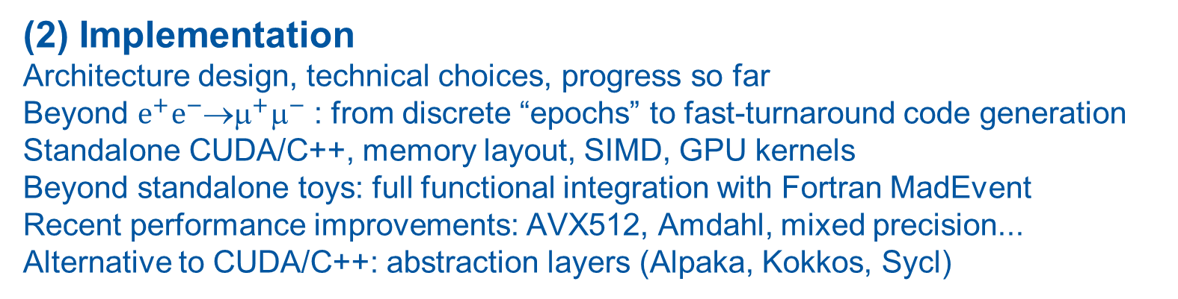
The (very) long version! – Outline
(3) Outlook
Towards the upcoming first LO alpha release
WIP, plans, ideas for more speed and features
Multithreading and heterogeneous strategies
More compilers, more CPU and GPU architectures
Beyond LO: loops and NLO
Event-by-event reweighting
Faster smaller kernels, faster builds
Tensor cores, cuBLAS
Other ME generators? Parton showers?
(1) Inception
Motivation, overview, how it all started
Why speed up MC generators?
Why Madgraph5_aMC@NLO (MG5aMC)?
Why GPUs and vectorization?
Q4
Q1
Q2
Q3
Q4
2020
2021
2022
Q1
Q2
Q3
Q4
Q1
Q2
Q3
Q4
2018
2019
2023
2024
Q1
Q2
Q3
Q4
Q1
Q2
Q3
Q4
Q1
Q2
Q3
Q4
(2) Implementation
Architecture design, technical choices, progress so far
Beyond $e^{+}e^{−}$→$^{+}^{−}$ : from discrete “epochs” to fast-turnaround code generation
Standalone CUDA/C++, memory layout, SIMD, GPU kernels
Beyond standalone toys: full functional integration with Fortran MadEvent
Recent performance improvements: AVX512, Amdahl, mixed precision...
Alternative to CUDA/C++: abstraction layers (Alpaka, Kokkos, Sycl)

Slide 9
(1) Inception: motivation, overview, how it all started
Apr 2020: HSF Generator WG review paper v1
May 2020: start of LHCC review of HL-LHC Software and Computing
Mar 2019: HSF/OSG/WLCG “HOW” workshop JLAB
review of KEK GPU work on MG5AMC
Sep 2020: HSF generator WG presentation to LHCC
Nov 2018: HSF Generator Workshop
Q4
Q1
Q2
Q3
Q4
2020
2021
2022
2018
2019
2023
2024
Q1
Q2
Q3
Q1 2020: start of madgraph4gpu project (Stefan Roiser, Olivier Mattelaer, AV)
Feb 2020: Stefan’s first commits on gitlab, first standalone cuda/C++ executable
The work on generators triggered by the HSF and the LHCC review created many opportunities
  A heightened sensitivity to the need to modernize and speed up HEP software (including generators)
  A breakdown of the computational anatomy of ME event generators and of the ways they can be improved
  A review of previous work on porting Madgraph5_aMC@NLO to GPUs (2008-2013, mainly at KEK)
  An opportunity for theorists, experimentalists and software engineers to meet and start collaborating...

Slide 10
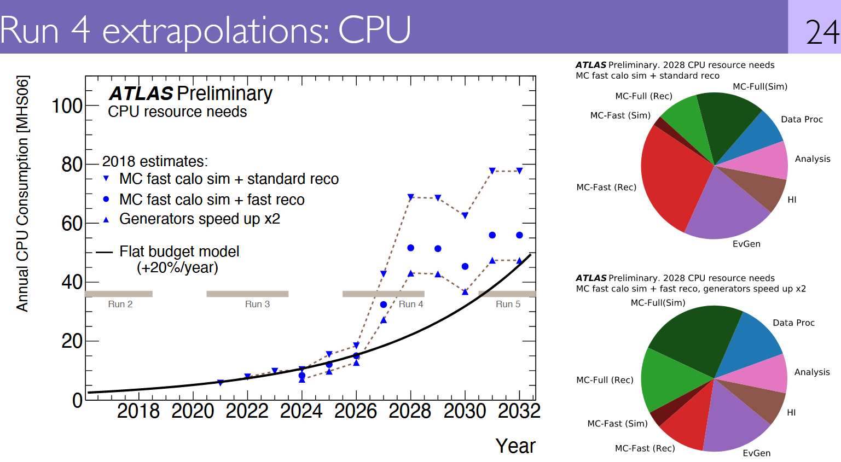
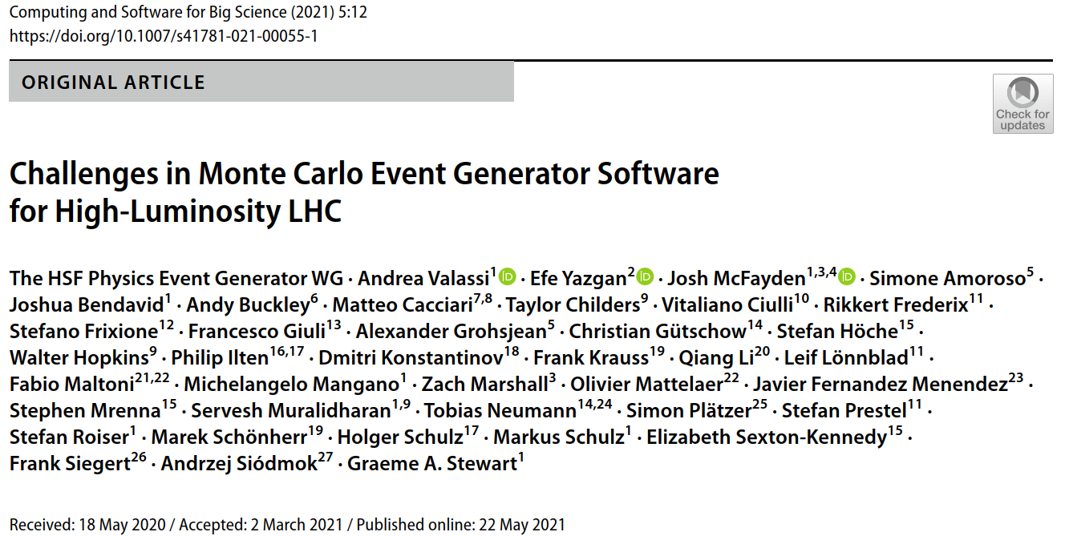

Motivation 1: Monte Carlo Event Generators in WLCG computing
HL-LHC computing needs are predicted to outpace resource growth: need R&D to improve software
MC generators are essential for HL-LHC physics and use ~5-20% of ATLAS/CMS WLCG CPU budgets
  Speeding them up helps address the resource gap and may allow more complex (N)NLO multi-jet simulations
Challenges and opportunities to improve MC software have been discussed in the HSF generator WG
  See the WG review paper prepared for the LHCC review in 2020: https://doi.org/10.1007/s41781-021-00055-1
WLCG meeting with LHCC referees, Feb. 2020
This plot is probably obsolete by now!
Sherpa speedups >>2 were reported at ACAT

Slide 11
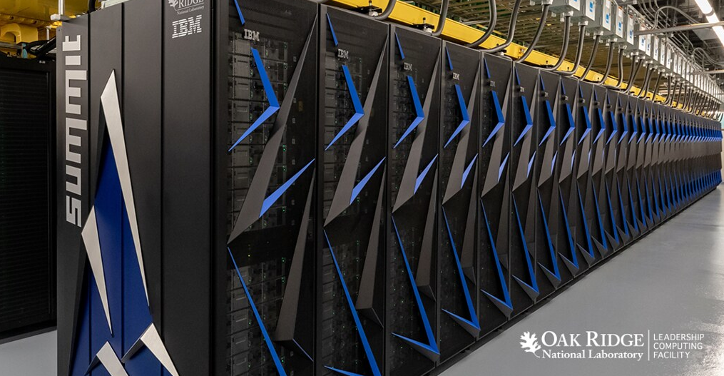
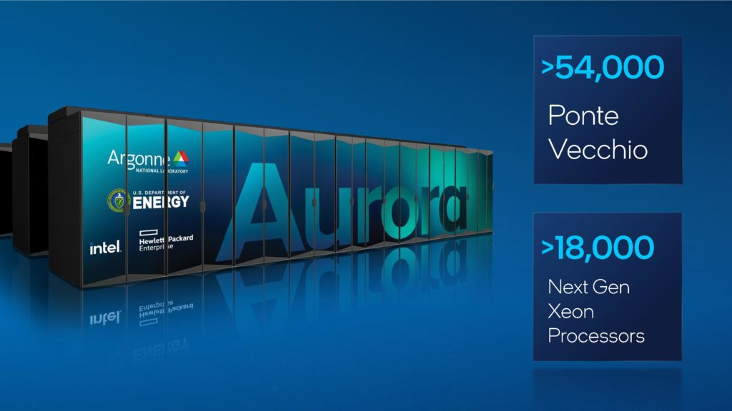

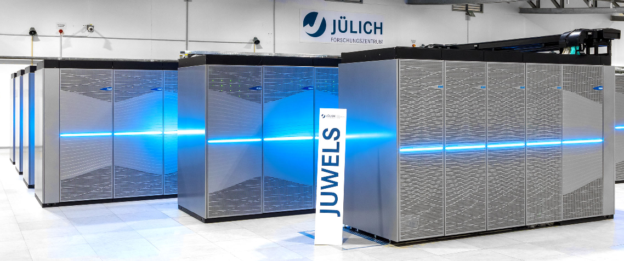
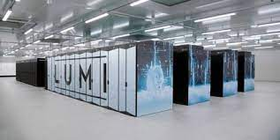
Motivation 2: GPUs and vector CPUs are underexploited in HEP
GPUs provide most of the compute power in recent HPCs (e.g. Summit: 95%)
  Supercomputers at HPC centers are already heavily used by the LHC experiments on an “opportunistic” basis
  But only a small share of HEP software workloads can run on GPUs today
Most WLCG CPUs support wide vector registers (SSE4.2, AVX2 or above)
  But only a small share of HEP software workloads efficiently exploit CPU vectorization today
These architectures are best suited to lockstep processing with limited branching... as in MC generators!
  MC generators are ideal candidates to exploit data parallelism in GPUs (SIMT) and vector CPUs (SIMD)!
  In this talk I will describe how we achieved this for Madgraph5_aMC@NLO (via event-level data parallelism)
Summit: NVidia V100 GPUs
Aurora: Intel Xe GPUs
Leonardo: NVidia A100 GPUs
Juwels: NVidia A100 GPUs
LUMI: AMD MI250X GPUs

Slide 12
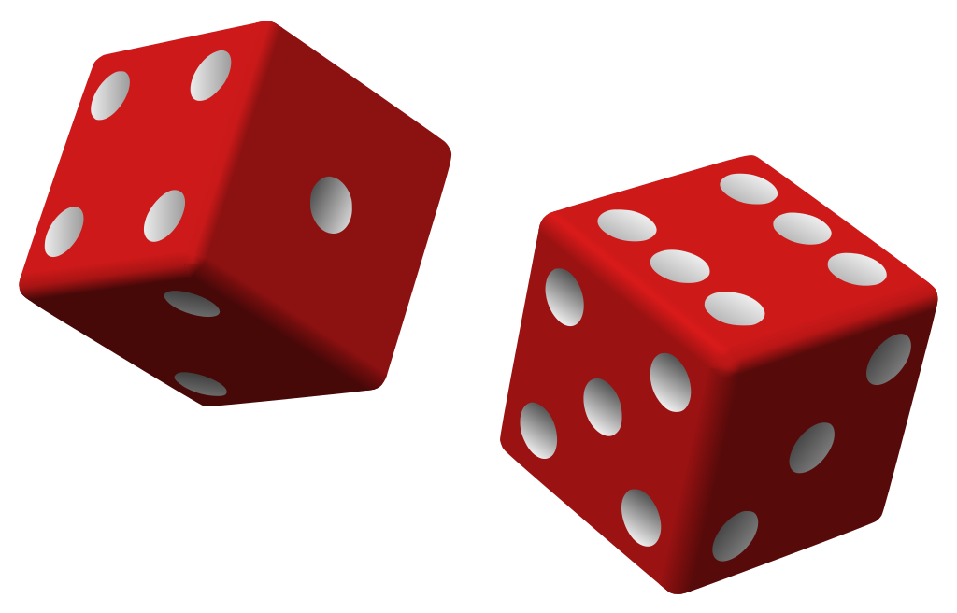
What is a MC ME generator? A simplified computational anatomy
Monte Carlo sampling: randomly generate and process
MANY different events (“phase space points”)
This can be parallelized (SIMT/SIMD and multithreading)
For each event:
1.
Output: random numbers
2.
Input: random numbers
Output: particle 4-momenta
3.
Input: particle 4-momenta
Output: Matrix Element (ME)
CPU BOTTLENECK
(NB: “Matrix Element” is an
element of the scattering matrix... not a linear algebra concept!)
MC MATRIX ELEMENT GENERATOR (e.g. MG5aMC)
PSEUDO RANDOM
NUMBERS
PHASE SPACE
SAMPLING
SHOWERING AND HADRONIZATION GENERATORS
(e.g. PYTHIA)
+ optional event cuts
MATRIX ELEMENT
CALCULATION
PARTON SHOWERS
PHASE SPACE
SAMPLING OPTIMISATION
WEIGHTED EVENTS {EVT_i , W_i}
HADRONISATION
AND DECAY
MONTE CARLO
INTEGRATION
MONTE CARLO
UNWEIGHTING
PARTICLE FILTERING
CROSS-SECTIONS etc...
(AVG W_i, MAX W_i)
UNWEIGHTED EVENTS {EVT_i , W_i=1}
DETECTOR SIMULATION
(GEANT4)
(FOR LATER!) Physics output: cross-section and LHE event file

Slide 13
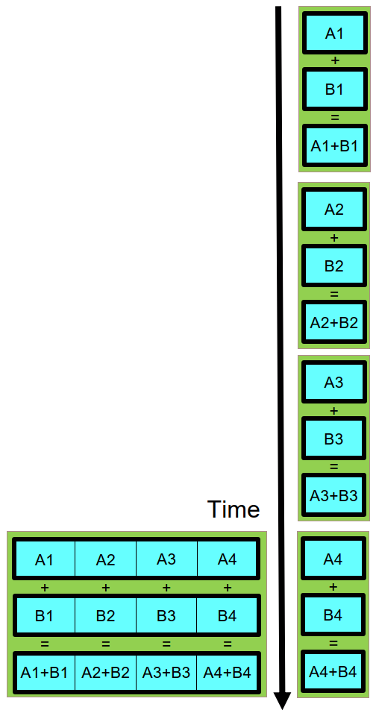
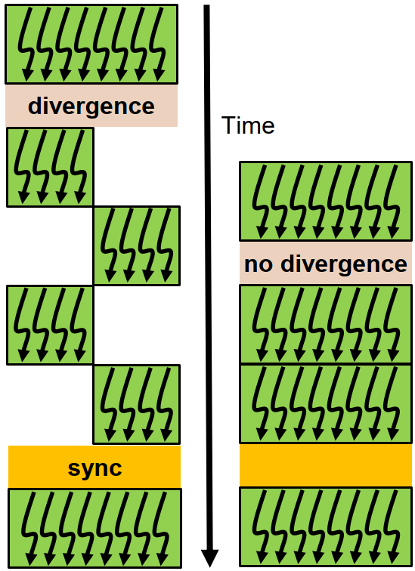
MG5aMC data parallelism: design for lockstep processing!
In MC generators, the same function is used to compute the Matrix Element for many different events
  ANY matrix element generator is a good fit for lockstep processing on GPUs (SIMT) and vector CPUs (SIMD)
  Data parallelism strategy in madgraph4gpu is event-level parallelism (many events = many phase space points)
PSEUDO RANDOM
NUMBERS
PHASE SPACE
SAMPLING
See the NVidia Volta whitepaper
MOMENTA
GPU SIMT
MATRIX ELEMENT
CALCULATION
CPU SIMD
MATRIX ELEMENTS
GPU SIMT (Single Instruction Multiple Threads)
Lockstep: all threads in a warp follow the same branch
Minimum parallelism: 32 threads in a warp (NVidia)
CPU SIMD (Single Instruction Multiple Data)
Lockstep: same op for all data in a vector register
Minimum parallelism: 2 to 16 (SSE/AVX2/AVX512...)

Slide 14
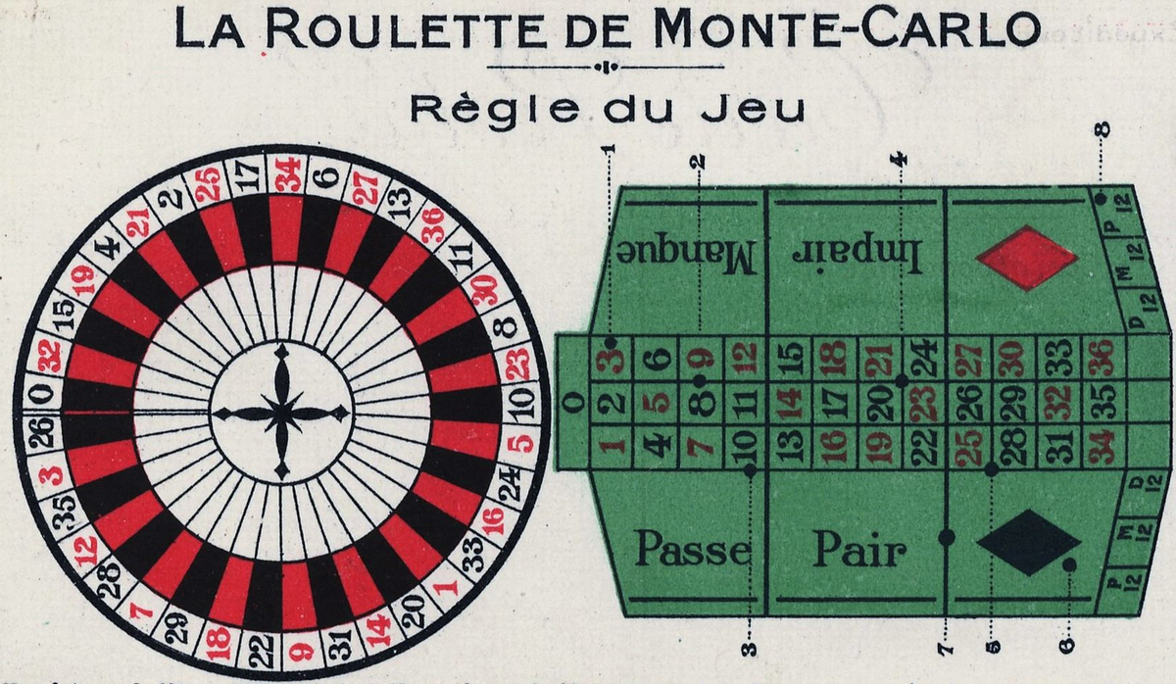


Lockstep? MC generators (lucky!) vs MC detector simulation (unlucky)
Monte Carlo methods are based on drawing (pseudo-)random numbers: a dice throw
From a software workflow point of view, these are used in two rather different cases:
Data parallelism (NB: MULTI-EVENT API !)
MC SAMPLING
ME event generators* (before ME calculation):
MC integration (cross sections)
MC generation (event samples)
INPUT
INPUT
MC DECISIONS
Detector simulation (Geant4)
Particle/matter interaction (when? how?)
Particle decays (when?)
Event generators*
(after ME calculation):
MC unweighting (keep/reject) Parton showers (PS)
Fragmentation and decays
SAME CALCULATION
ON DIFFERENT DATA!
DECISION
DIFFERENT CALCULATIONS
ON DIFFERENT DATA!
OUTPUT
OUTPUT
Lockstep processing
Good for SIMT/SIMD
Stochastic branching
Bad for SIMT/SIMD
*NB: the CPU-intensive ME calculation comes before PS, fragmentation, detector simulation

Slide 15
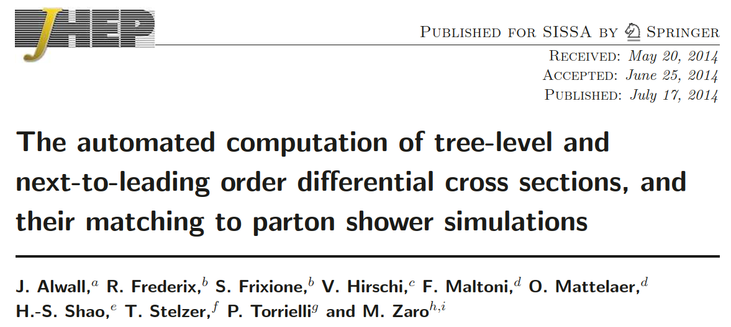
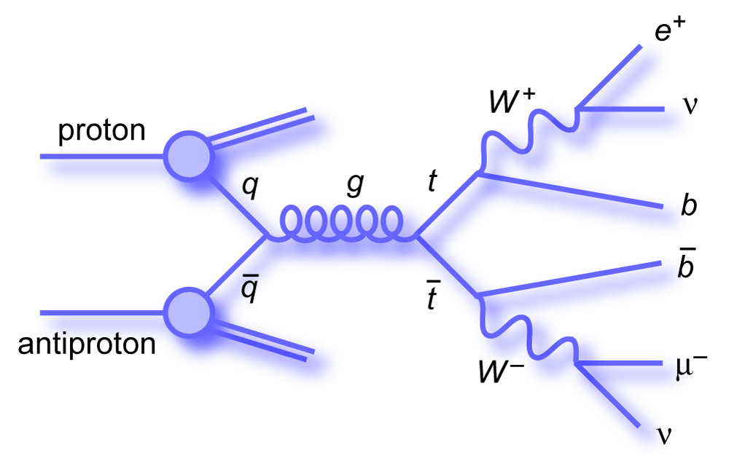

Madgraph5_aMC@NLO (MG5aMC)
One of the workhorses for event generation in ATLAS and CMS!
MG5aMC production version is in Fortran
  Software outer shell: Madevent (random sampling, integration and event generation + I/O, multi-jet merging...)
  Software inner core: Matrix Element (ME) calculation code, automatically generated for each physics process
    Matrix Element calculations take 95%+ of the CPU time for complex processes (e.g. $gg$→$t\overline{t}ggg$)
    And ME calculations are precisely one component that can be “easily” accelerated on GPUs and on vector CPUs...
Code repository recently moved from bazaar launchpad to https://github.com/mg5amcnlo/mg5amcnlo
https://doi.org/10.1007/JHEP07(2014)079

Slide 16
MG5aMC and the madgraph4gpu project
madgraph4gpu: speed up Matrix Element calculation in MG5aMC on GPUs and vector CPUs
  Code repository, CI tests, issue tracker: https://github.com/madgraph5/madgraph4gpu
  Development meetings every two weeks:
Collaboration of theoretical/experimental physicists with software engineers, born in HSF generator WG
  Initial core team since Q1 2020: Stefan Roiser – project leader, AV (CERN), Olivier Mattelaer (Louvain)
  Many other collaborators have joined over time and contributed to coding, testing and/or meeting discussions
    Currently active (alphabetical order): Taylor Childers, Walter Hopkins, Nathan Nichols (Argonne), Stephan Hageboeck, Jorgen Teig, Zenny Wettersten (CERN), Josh McFayden (Sussex), Carl Vuosalo (Wisconsin)
    Past collaborators: Tyler Burch, Smita Darmora (Argonne), Taran Singhania (Bangalore), Vince Pascuzzi (Berkeley), Laurence Field, Andreas Reepschlaeger, David Smith (CERN)
Why MG5aMC and not another MC generator for our GPU port?
  The reason is not that earlier ports of MG5aMC to GPUs exist (HOW talk): we are not leveraging on this work!
    KEK developments in 2008-2013, based on old version of MG5aMC’s ME library were never released for production use
  The main reason we focused on MG5aMC is the active involvement of Olivier (MG5aMC code developer)!
    This is also one of the main reason our collaboration is making good progress!
    Need a good mix of technical expertise and domain-specific knowledge, either alone would not be enough...
  NB: many of the design ideas we describe are applicable to other generators...

Slide 17
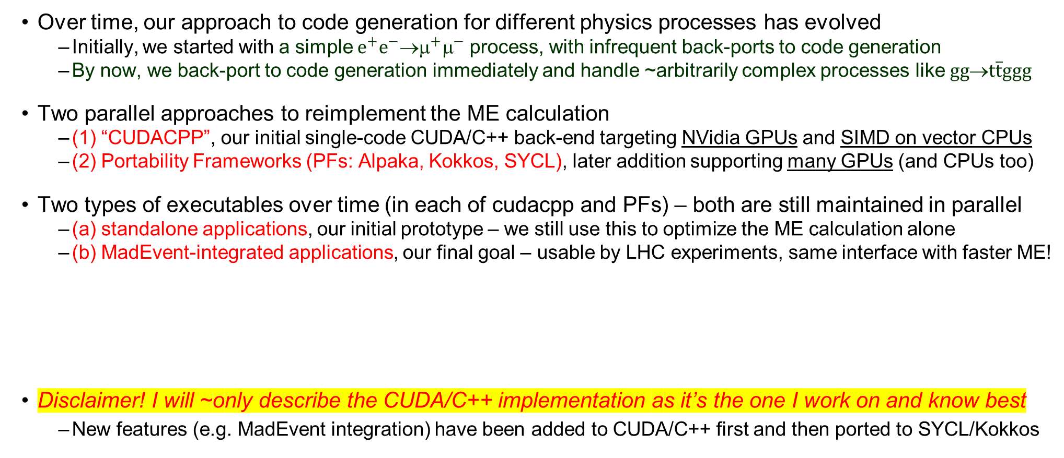
Guide to the next slides – a few steps/alternatives in development
Over time, our approach to code generation for different physics processes has evolved
  Initially, we started with a simple $e^{+}e^{−}$→$^{+}^{−}$ process, with infrequent back-ports to code generation
  By now, we back-port to code generation immediately and handle ~arbitrarily complex processes like $gg$→$t\overline{t}ggg$
Two parallel approaches to reimplement the ME calculation
  (1) “CUDACPP”, our initial single-code CUDA/C++ back-end targeting NVidia GPUs and SIMD on vector CPUs
  (2) Portability Frameworks (PFs: Alpaka, Kokkos, SYCL), later addition supporting many GPUs (and CPUs too)
Two types of executables over time (in each of cudacpp and PFs) – both are still maintained in parallel
  (a) standalone applications, our initial prototype – we still use this to optimize the ME calculation alone
  (b) MadEvent-integrated applications, our final goal – usable by LHC experiments, same interface with faster ME!
Disclaimer! I will ~only describe the CUDA/C++ implementation as it’s the one I work on and know best
  New features (e.g. MadEvent integration) have been added to CUDA/C++ first and then ported to SYCL/Kokkos

Slide 18
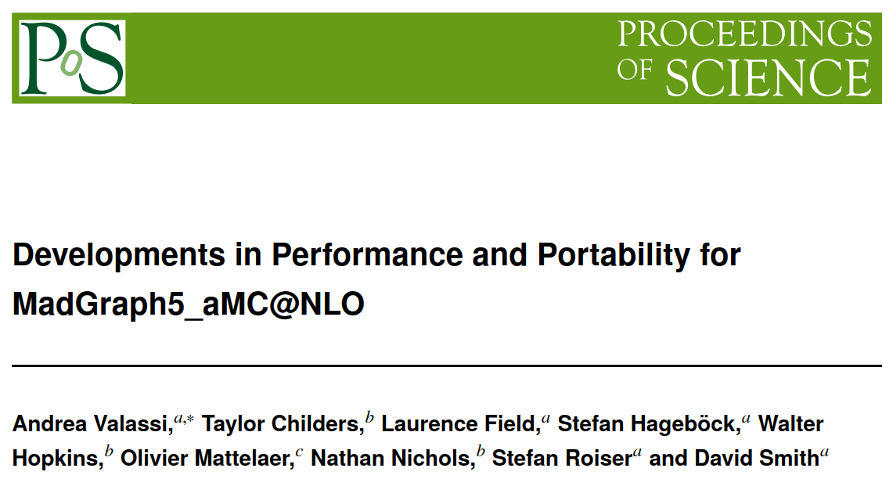
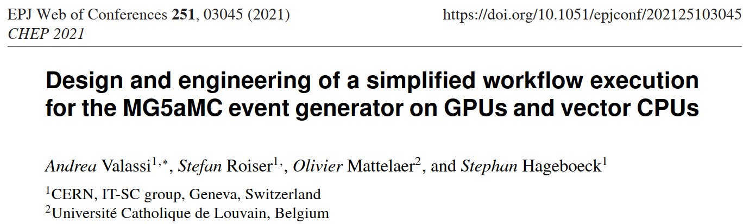


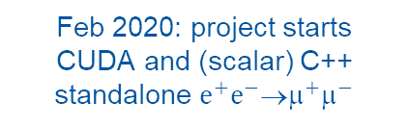

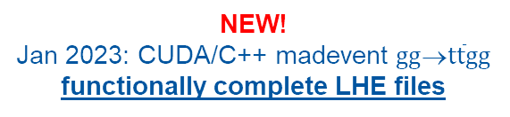
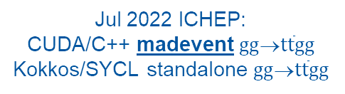
(2) Implementation: design, technical details, progress so far
Oct 2022 ACAT: CUDA/C++ madevent $gg$→$t\overline{t}gg$
performance studies (Amdahl, MT, heterogeneous)
Jul 2022 ICHEP:
CUDA/C++ madevent $gg$→$t\overline{t}gg$
Kokkos/SYCL standalone $gg$→$t\overline{t}gg$
PoS(ICHEP2022)212
NEW!
Jan 2023: CUDA/C++ madevent $gg$→$t\overline{t}gg$ functionally complete LHE files
https://doi.org/10.22323/1.414.0212
Oct 2021: full code generation
CUDA/C++ standalone $gg$→$t\overline{t}gg$
2020
2021
2022
Q1
2018
2019
2023
2024
Q1
Q2
Q3
Q4
Q1
Q2
Q3
Q4
Q1
Q2
Q3
Q4
Feb 2020: project starts
CUDA and (scalar) C++
standalone $e^{+}e^{−}$→$^{+}^{−}$
Jun 2021 vCHEP:
CUDA/C++ standalone $e^{+}e^{−}$→$^{+}^{−}$
Dec 2020: C++ vectorization
https://doi.org/10.1051/epjconf/202125103045
Disclaimer - again! Above and in the rest of this talk I focus on the CUDA/C++ implementation

Slide 19
CUDA/C++: a single source code approach (so far...)
The main difference between our CPU (C++) and GPU (CUDA) implementations is the following
  on the CPU, all computations and all memory access takes place on the host
  on the GPU, it is necessary to distinguish computations and memory accesses on the host and on the device
Within the GPU code, the amount of code that is specific to NVidia/CUDA is minimal
  Memory allocations (cudaMalloc), encapsulated within host/device buffer classes
  Kernel executions (<<<...>>>), encapsulated within very few specific classes
  A few specific types or features (thrust::complex, curand, cuBLAS), also encapsulated in specific classes
The rest of the code is (at least formally – see example later) ~identical for C++ and CUDA!
  There are almost more differences between scalar and vector C++ code...
Therefore, we presently use a single source code approach for CUDA/C++ (with #ifdef __CUDA__)
  We might review this later on – as it sometimes imposes slightly unnatural choices, and may hinder readability
  But so far it has allowed us to make rapid progress for both CUDA and C++ in parallel!

Slide 20
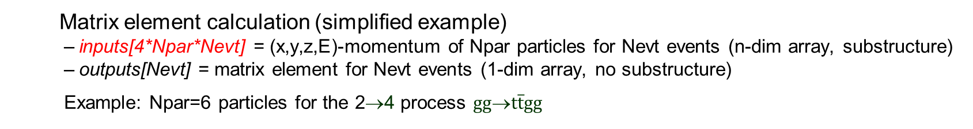
Memory layouts – AOS, SOA, AOSOA
MOMENTA
CUDA/C++:
MEKERNELS
Matrix element calculation (simplified example)
  inputs[4*Npar*Nevt] = (x,y,z,E)-momentum of Npar particles for Nevt events (n-dim array, substructure)
  outputs[Nevt] = matrix element for Nevt events (1-dim array, no substructure)
  Example: Npar=6 particles for the 2→4 process $gg$→$t\overline{t}gg$
MATRIX ELEMENTS
We have experimented with three possible memory layouts for momenta
(1) Array-of-Structures AOS: momenta[Nevt][Npar][4]
(2) Structure-of-Arrays SOA: momenta[Npar][4][Nevt]
(3) AOSOA: momenta[Npag][Npar][4][Nepp] with Nevt = Npag (“pages”) * Nepp (“events per page”)
We are using AOSOA’s as the current default – but this is still largely configurable
For CPU vectorization, AOSOAs (or SOAs) are absolutely mandatory!
  We use an AOSOA with Nepp equal to the SIMD vector size NeppV – and an aligned malloc is needed too!
  For performance comparison we also build a no-SIMD mode with Nepp=1, which is effectively an AOS
For GPUs (1 event per thread), AOSOAs are faster (fewer memory accesses) but not strictly necessary
  We use Nepp=4(8) for doubles(floats) so that each page is 32 bytes (the “sector” size, or L2 cache line size)
  For a given number of “requests”, AOS uses 4 times more “sectors” (transactions) than AOSOA with Nepp=4
Coding for SIMD is more complex than coding for GPUs...

Slide 21
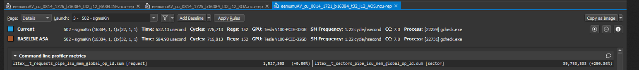
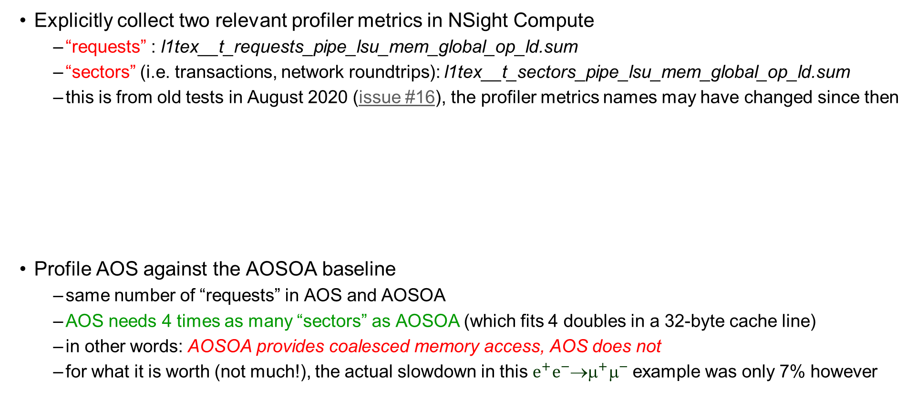
Monitoring GPU memory access – NSight Compute
Explicitly collect two relevant profiler metrics in NSight Compute
  “requests” : l1tex__t_requests_pipe_lsu_mem_global_op_ld.sum
  “sectors” (i.e. transactions, network roundtrips): l1tex__t_sectors_pipe_lsu_mem_global_op_ld.sum
  this is from old tests in August 2020 (issue #16), the profiler metrics names may have changed since then
Profile AOS against the AOSOA baseline
  same number of “requests” in AOS and AOSOA
  AOS needs 4 times as many “sectors” as AOSOA (which fits 4 doubles in a 32-byte cache line)
  in other words: AOSOA provides coalesced memory access, AOS does not
  for what it is worth (not much!), the actual slowdown in this $e^{+}e^{−}$→$^{+}^{−}$example was only 7% however

Slide 22
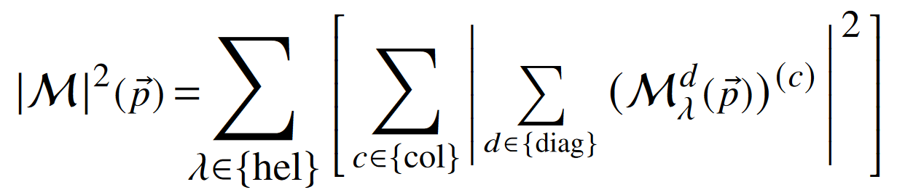
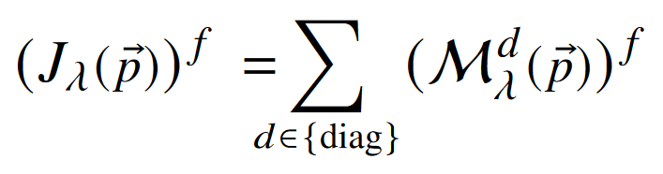

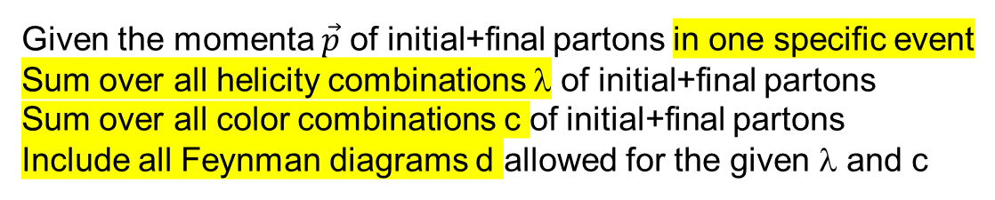
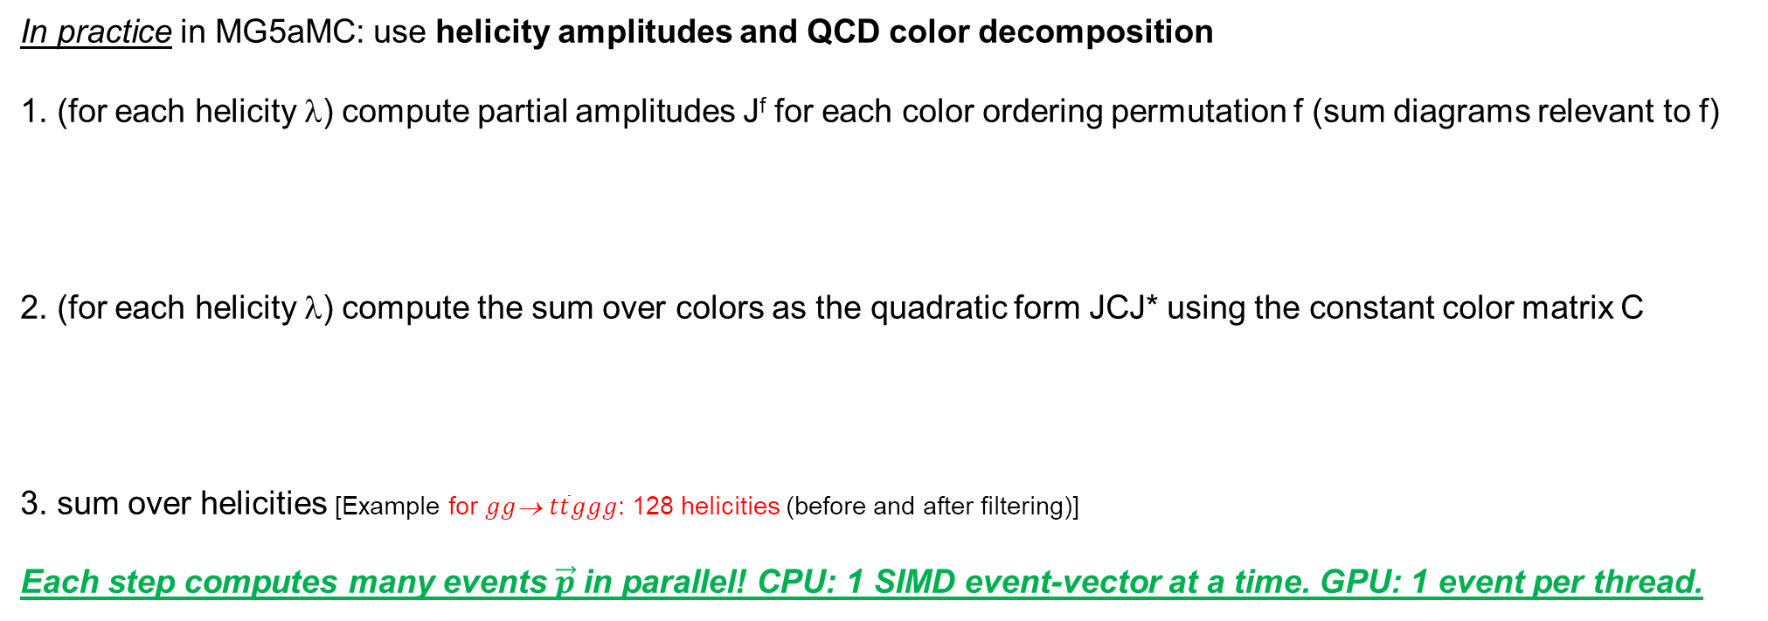
Inside the ME calculation: Feynman diagrams, colors, helicities
Given the momenta $\vec{p}$ of initial+final partons in one specific event
Sum over all helicity combinations λ of initial+final partons
Sum over all color combinations c of initial+final partons
Include all Feynman diagrams d allowed for the given λ and c
In practice in MG5aMC: use helicity amplitudes and QCD color decomposition
1. (for each helicity λ) compute partial amplitudes J^{f} for each color ordering permutation f (sum diagrams relevant to f)
2. (for each helicity λ) compute the sum over colors as the quadratic form JCJ* using the constant color matrix C
3. sum over helicities [Example for $gg$→ $t\overline{t}ggg$: 128 helicities (before and after filtering)]
Each step computes many events $\vec{p}$in parallel! CPU: 1 SIMD event-vector at a time. GPU: 1 event per thread.
Example for $gg$→ $t\overline{t}ggg$: 1240 Feynman diagrams (using helicity amplitudes)
This takes ~40% of the CPU time for this process
Example for $gg$→ $t\overline{t}ggg$: 120 color ordering permutations, 120x120 matrix
This takes ~60% of the CPU time for this process

Slide 23
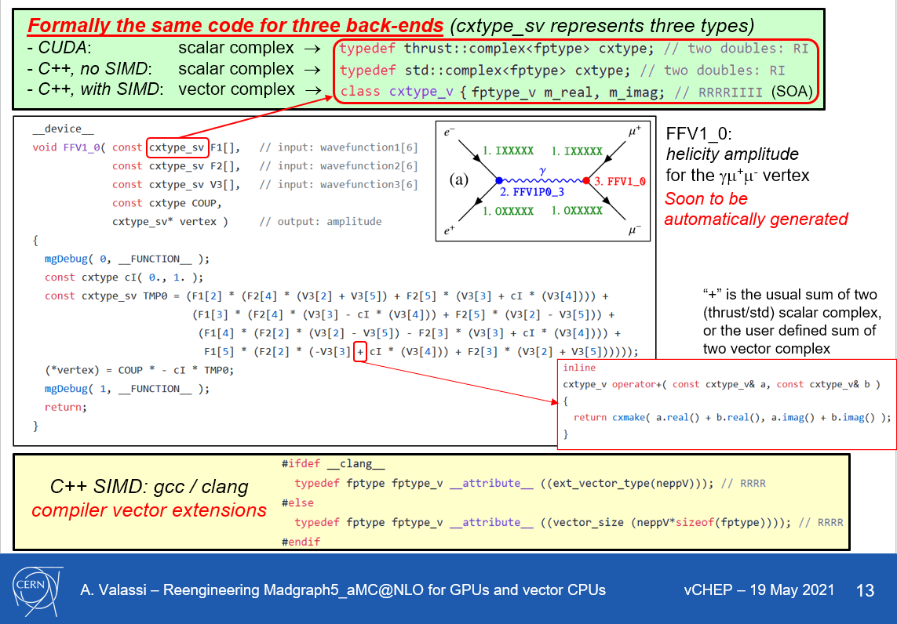
Helicity amplitudes – same code in CUDA and in vectorized C++
Old slide! The new code is different, the idea is the same!
Formally the same code for CUDA and scalar/vector C++
  hide type behind a typedef
  add a few missing operators
SIMD in CUDA/C++ uses compiler vector extensions!
Flexible design: being reused also for vectorized SYCL!
Automatically generated!

Slide 24
C++ vectorization – why choose Compiler Vector Extensions?
Portable – available in gcc, clang, icpx (from clang) with minimal differences
  Do not require any external libraries or tools (VC, VCL, VecCore, xSIMD, UME::SIMD, or SYCL...)
Powerful, but easy to use
  No need to debug auto-vectorization when it does not vectorize
  As powerful as intrinsics, but much easier to write (higher-level abstractions)
Intuitive – CVEs force you to think in terms of vector types!
Minor disadvantage – no vector complex type out of the box
  But it was easy to write it in our case (RRRRIIII memory layout) as we only need + - × ÷
  A few extensions for Boolean vector masks were needed, too
One technical detail: we malloc a standard (aligned!) fptype* and reinterpret_cast as fptype_v*...
HUGE THANKS TO SEBASTIEN PONCE for his Practical Vectorization lectures mentioning CVEs!

Slide 25
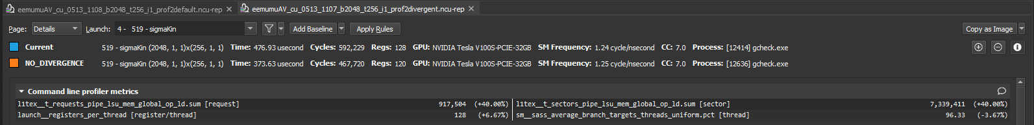
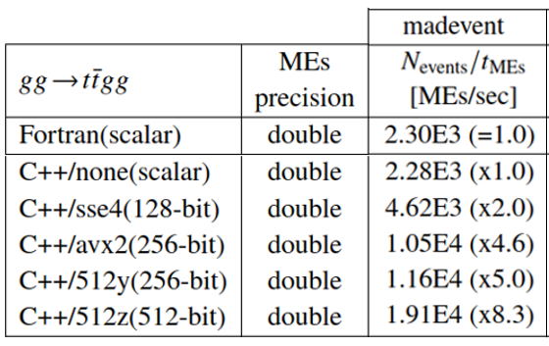

Monitoring lockstep – GPU NSight compute, CPU disassemble
GPU: explicitly collect one profiler metric in NSight Compute
  “branch efficiency” : sm__sass_average_branch_targets_threads_uniform.pct
  old test (May 2021 issue #25) comparing two code bases: no-divergence baseline has 100% efficiency, alternative with minor forced divergence has 96% efficiency (and is 20% slower)
CPU: the best lockstep metric IMO is the speedup over a no-SIMD case (reach theoretical maximum!)
  but is also useful to disassemble the object using objdump and categorize SIMD intrinsics symbols...
# Symbols in .o | SSE4.2 (xmm) | AVX2 (ymm) | AVX512 (ymm) | AVX512 (zmm)
Build type
Scalar | 4534 | 0 | 0 | 0
SSE4.2 | 12916 | 0 | 0 | 0
AVX2 | 0 | 10630 | 0 | 0
256-bit AVX512 | 0 | 10366 | 12 | 0
512-bit AVX512 | 0 | 1267 | 60 | 9910
ACAT2022
4a90ec2 $gg$→$t\overline{t}gg$

Slide 26
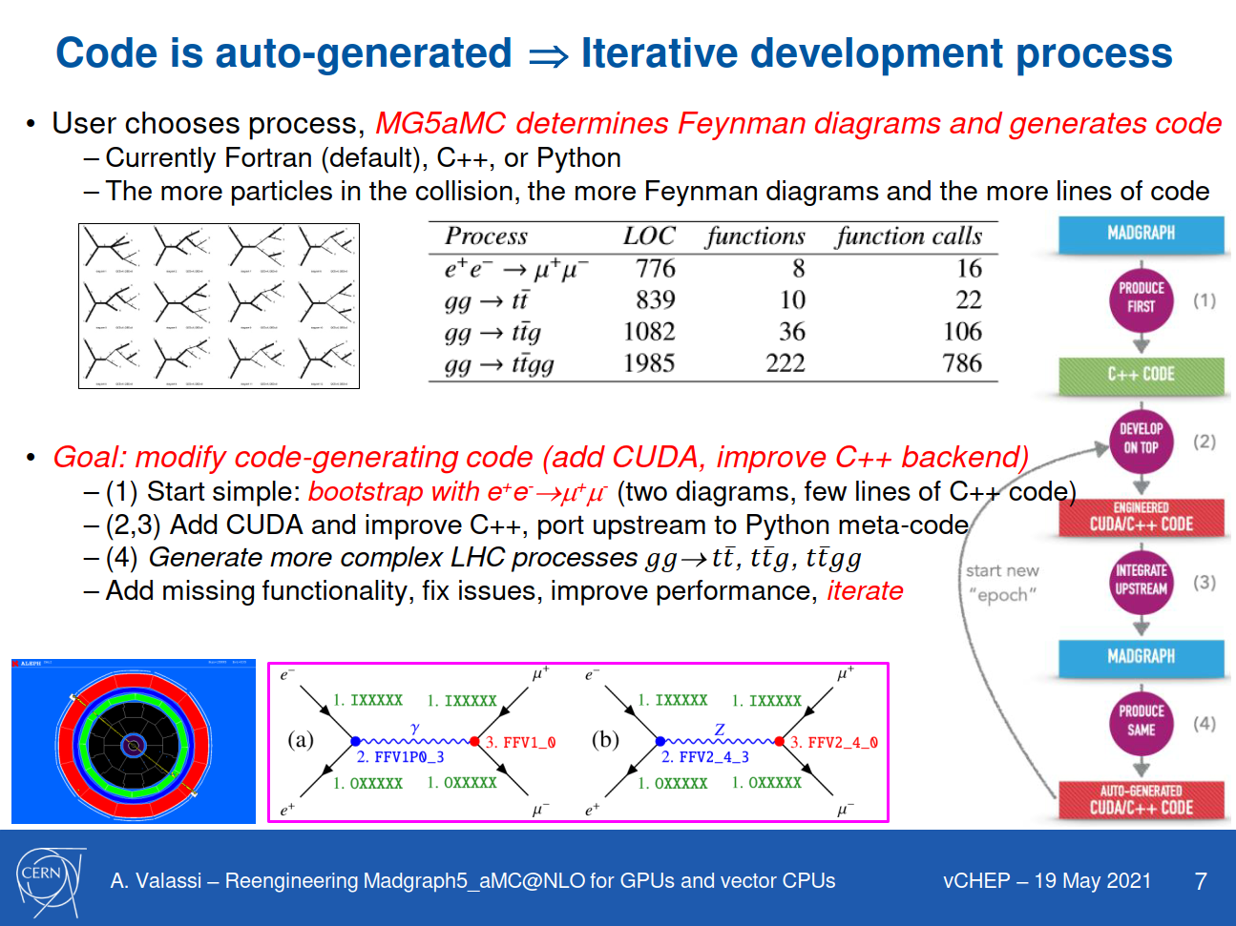
Code generation: how did we bootstrap the project?

Slide 27
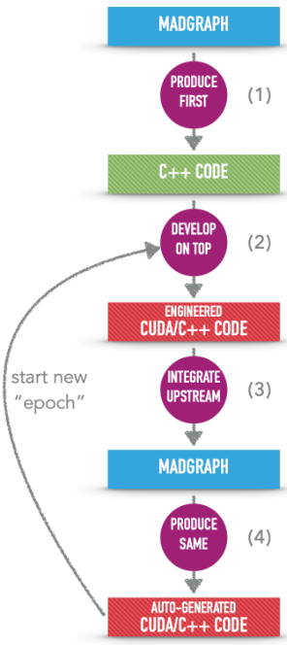
Code generation: from many “epochs” to a single evolving “epoch”
... and beyond
OLD MODEL
(2020- early 2021)
(1) MG5AMC Python framework, Fortran templates:
“upstream” https://github.com/mg5amcnlo/mg5amcnlo
(2) CUDACPP plugin, post-generation patches,
generated CUDA/C++ physics processes:
our https://github.com/madgraph5/madgraph4gpu
Code generation infrastructure
- Python framework and “cudacpp” plugin
- Fortran, C++, CUDA templates
- Post-generation patches (temporary...)
WIP to-do before a release: full port from madgraph4gpu to mg5amcnlo (remove post-generation Fortran patches, add CUDACPP upstream)
(3) re-generate
Automatically generated code
- Fortran framework (Madevent)
- CUDA/C++ Matrix Elements
NEW MODEL
(since end 2021)
(1) develop on top of auto-generated code
(2) backport immediately to code generation infrastructure

Slide 28
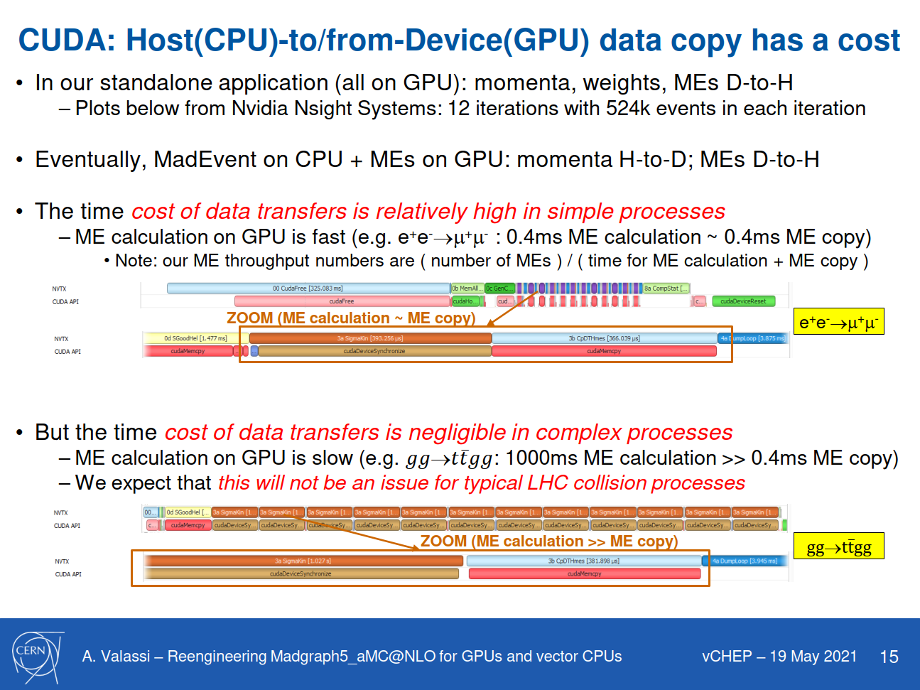
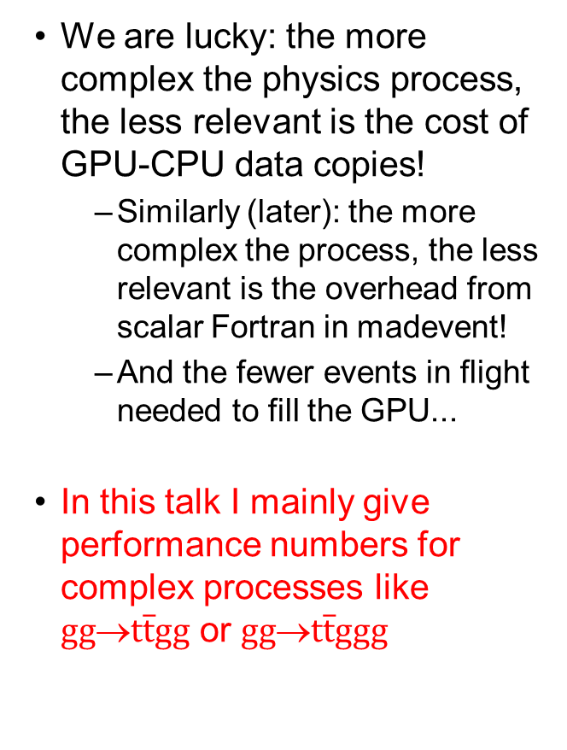

Why focus on complex processes? Compute >> memory!
We are lucky: the more complex the physics process, the less relevant is the cost of GPU-CPU data copies!
  Similarly (later): the more complex the process, the less relevant is the overhead from scalar Fortran in madevent!
  And the fewer events in flight needed to fill the GPU...
In this talk I mainly give performance numbers for complex processes like $gg$→$t\overline{t}gg$ or $gg$→$t\overline{t}ggg$
e⁺e⁻→μ⁺μ⁻
$gg$→$t\overline{t}gg$

Slide 29
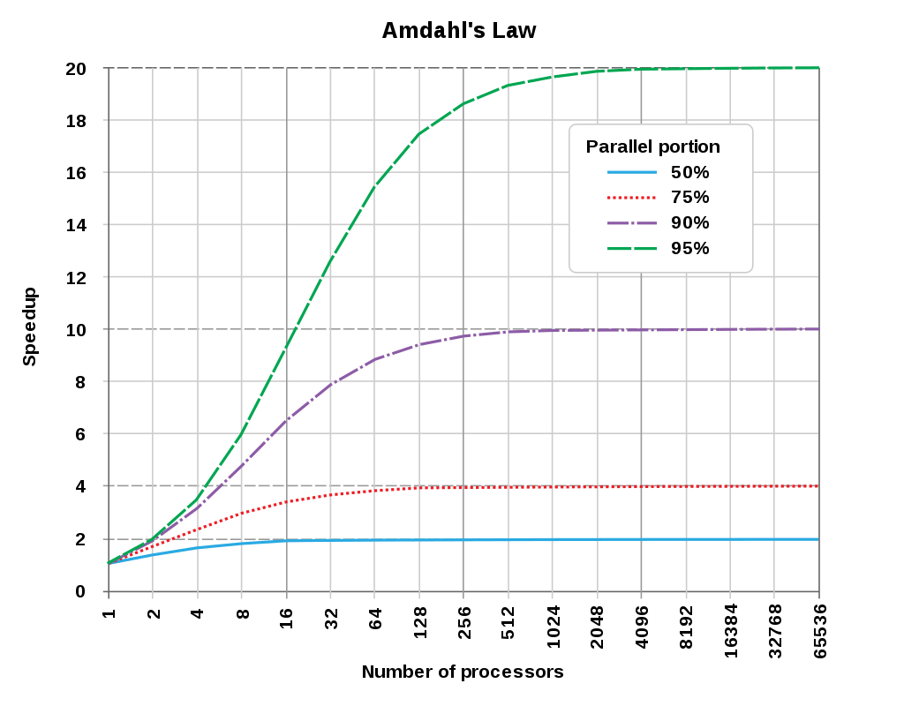

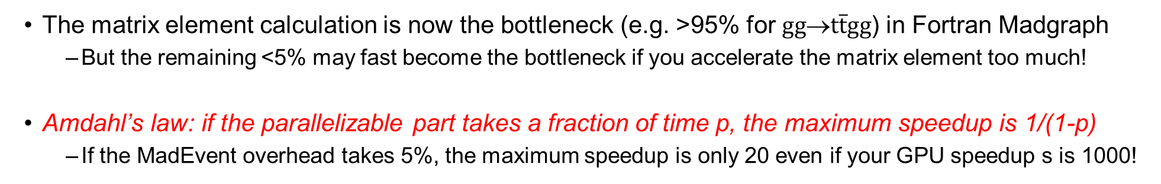
Amdahl’s law
The matrix element calculation is now the bottleneck (e.g. >95% for $gg$→$t\overline{t}gg$) in Fortran Madgraph
  But the remaining <5% may fast become the bottleneck if you accelerate the matrix element too much!
Amdahl’s law: if the parallelizable part takes a fraction of time p, the maximum speedup is 1/(1-p)
  If the MadEvent overhead takes 5%, the maximum speedup is only 20 even if your GPU speedup s is 1000!
https://en.wikipedia.org/wiki/Amdahl%27s_law

Slide 30
MG5aMC: old and new architecture designs
OLD MADEVENT
(NOW: LHC PROD)
SINGLE-EVENT API
Then we modified the existing
all-Fortran MadEvent
into a multi-event framework
and we injected the new MEs into it
First we developed
the new ME engines
in standalone applications
1. STANDALONE
(TOY APPLICATIONS)
MULTI-EVENT API
2. NEW MADEVENT
(GOAL: LHC PROD)
MULTI-EVENT API
CUDA/C++ or PFs:
cuRAND
FORTRAN:
RANMAR
FORTRAN:
RANMAR
(Amdahl...)
SCALAR:
NEW BOTTLENECK?
PARALLEL:
MUCH FASTER!
MATRIX ELEMENT: CPU BOTTLENECK IN OLD MADEVENT
CUDA/C++ or PFs:
RAMBO
FORTRAN:
MADEVENT
FORTRAN:
MADEVENT
MOMENTA
MOMENTA
MOMENTA
CUDA/C++ or PFs:
MEKERNELS
FORTRAN:
MATRIX1
CUDA/C++ or PFs:
MEKERNELS
MATRIX ELEMENTS
MATRIX ELEMENTS
MATRIX ELEMENTS

Slide 31
MadEvent with vectorized C++ for $gg$→$t\overline{t}gg$ (on a single CPU core)
ACAT2022
512y = AVX512, ymm registers
512z = AVX512, zmm registers
The latter is only better on
nodes with 2 FMA units
(here an Intel Gold 6148)
ME speedup ~ x8 (double) and x16 (float) over scalar Fortran
Our ME engine reaches the maximum theoretical SIMD speedup!
Overall speedup so far~ x6 (double) and x10 (float) over scalar Fortran (Amdahl’s law)

Slide 32
Floating point precision
Previous slide: our vectorized C++ on CPUs is 2x faster in single-precision than in double-precision
  In a 512-bit register you fit 16 (4-byte) floats but only 8 (8-byte) doubles
Next slides: our CUDA implementation on V100 GPUs is also 2x faster for floats than for doubles
  On data-center NVidia GPUs (e.g. V100 or A100), you have twice as many FLOPs in float as in double
  Note that lower-end GPUs (e.g. T4) have almost no double-precision FLOPs...
But single-point precision is not enough for physics: numerical instabilities (e.g. in Feynman diagrams)
  It would be useful to study if these instabilities can be worked around – anyone interested? ☺
  Alternative: we prototyped a “mixed-precision” calculation (double for Feynman, float for color matrix...)

Slide 33
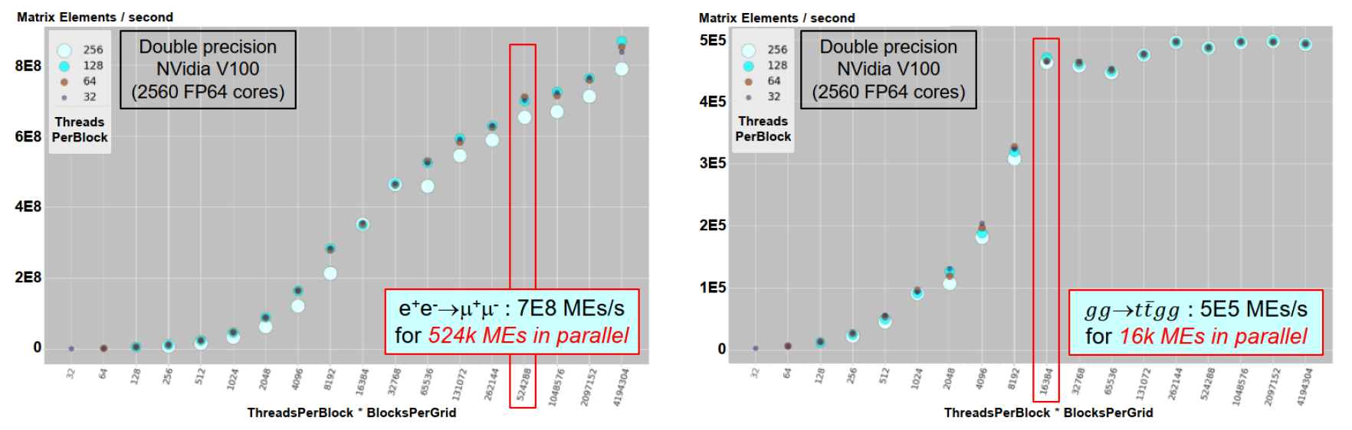
Filling the GPU – minimum number of threads (events in flight)
https://doi.org/10.1051/epjconf/202125103045 (vCHEP 2021)
We are lucky, again: the more complex the process, the fewer the events in flight needed to fill the GPU
But even 16k events is a lot: it results in imbalanced phase space sampling, and high RAM in Fortran
  Eventually, maybe: one helicity per kernel (fewer events in flight, spread each event across many kernels)?
  Eventually, maybe: many CPU cores/processes in parallel (fewer events in flight per CPU core/process)?
  Eventually, maybe: different channels in parallel (fewer events in flight in a single channel)?

Slide 34
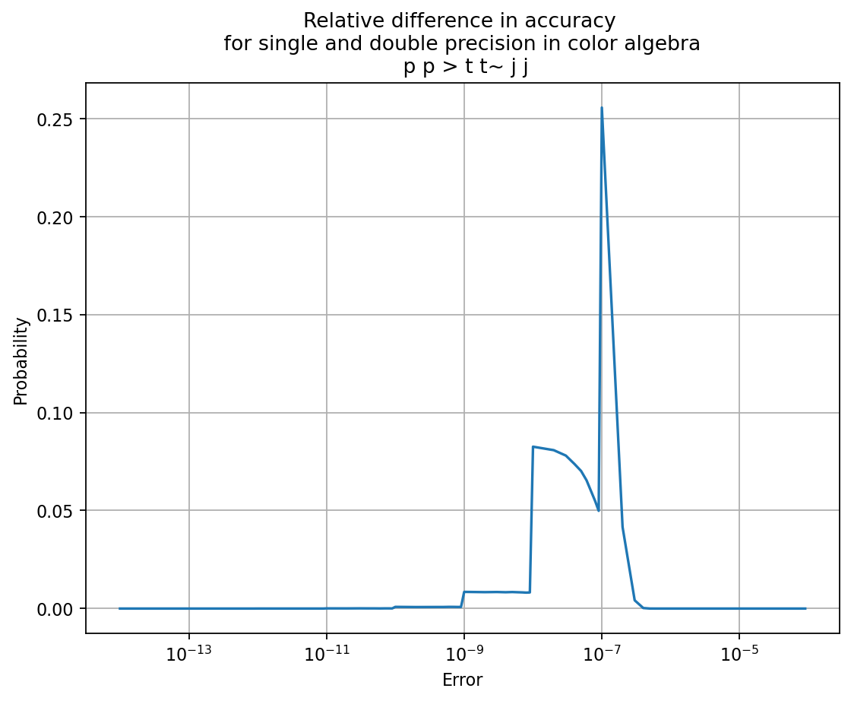
MadEvent/CUDA for $gg$→$t\overline{t}ggg$
ACAT2022
We are lucky! The more complex the physics process, the lower the relative overhead from the scalar Fortran MadEvent - here only 0.5%
Amdahl’s law limits the overall speedup to x200 (parallelizable p=0.5%), and we achieve x60 (double) or x100 (float) in the overall speedup!
In addition: prototype a “mixed” floating point precision
  Double precision for Feynman diagrams, single precision for the “color algebra” (JCJ*)
  Overall performance is in between single and double precision
    NB: relative importance of color algebra is higher for more complex processes (lucky again!)
  Physics precision ~ E-6 should be OK for production (float everywhere faster but less precise)

Slide 35

All MadEvent functionalities have been integrated over time
Most of these required some changes to the input/output API of our Fortran-to-CUDA/C++ “Bridge”
Helicity filtering – at initialization time, compute the allowed combinations of particle helicities
  This is computed in CUDA/C++ using the same criteria as in Fortran
“Multi-channel” – single-diagram enhancement of ME output
  This is the specificity of the MadEvent sampling algorithm (Maltoni Stelzer 2003)
Event-by-event running QCD coupling constants α_{s}(Q²)
  The scale is currently computed in Fortran from momenta and passed to the CUDA/C++ for each event
Event-by-event choice of helicity and color in LHE files
  Pass two additional random numbers per event from Fortran to CUDA/C++, retrieve helicity and color
  NEW (January 2023)! This was the last big missing physics functionality (showstopper to a release)
    We now get the same cross section AND the same LHE files (within numerical precision) in Fortran and CUDA/C++

Slide 36
The road to an alpha release (Q1-Q2 2023)
Complete the back-port of code generation from madgraph4gpu to mg5amcnlo upstream
  Including extra cross-checks that the LHE color IDs are those required for parton showers
Make the CUDA/C++ madevent executable consistent with the Madgraph “launch” infrastructure
  Modify the names and input parameters of the madevent executable
  Ensure consistency in the handling of physics parameter card files
  Ensure consistency of packaging and builds with the “launch” infrastructure
  Provide and document user hooks for new configurable options (SIMD mode, GPU vector size...)
  Tune some reasonable defaults for out-of-the-box SIMD modes and GPU grid sizes
  Test that a Madgraph “launch” works out-of-the-box for one of our current processes like ggttgg
Test and fix any bugs in pp collisions, including pdf integration
  Iterate on a few other physics processes, e.g. including Susy
Stay tuned! ☺
  We will be happy to help your experiment in the integration!
  NB This will use a new Fortran version too (multi-event API), need statistical validation...

Slide 37









CUDACPP MEs
PF MEs
95% common code + a few #ifdef's for CUDA vs C++
Designed for NVidia GPUs (so far: will add HIP/AMD)
  Full feature support, e.g. tensor cores, streams, graphs
Designed upfront for SIMD speedups on vector CPUs
WIP on CPU multithreading and heterogeneous modes
Write code once for many CPU/GPU vendors
Support NVidia, AMD and Intel GPUs out-of-the-box
  Limited support for vendor-specific features
SIMD added via SYCL in Jan 2023, analysing results
CPU multithreading out of the box
For the moment: we plan to continue development in parallel using both approaches – comparisons are very useful!
Two goals: not only production releases, but also aim to provide useful feedback to HEP about usability of PFs

Slide 38
CUDACPP vs. Portability Frameworks – recap
CUDAPP (our initial implementation) is where we add new features first
The SYCL implementation of MG5aMC is now almost at the same level, the KOKKOS one somewhat behind
The ALPAKA implementation of MG5aMC is no longer maintained
Backend | ME code generation | Standalone application | Actively maintained | MadEvent application | Latest dev code base
CUDACPP | ✓ | ✓ | ✓ | ✓ | ✓
SYCL | ✓ | ✓ | ✓ | ✓ | ~ ✓
KOKKOS | ✓ | ✓ | ~ ✓ | WIP | WIP
ALPAKA (CUPLA) | ✓ | ✓ | ✗ | ✗ | ✗

Slide 39
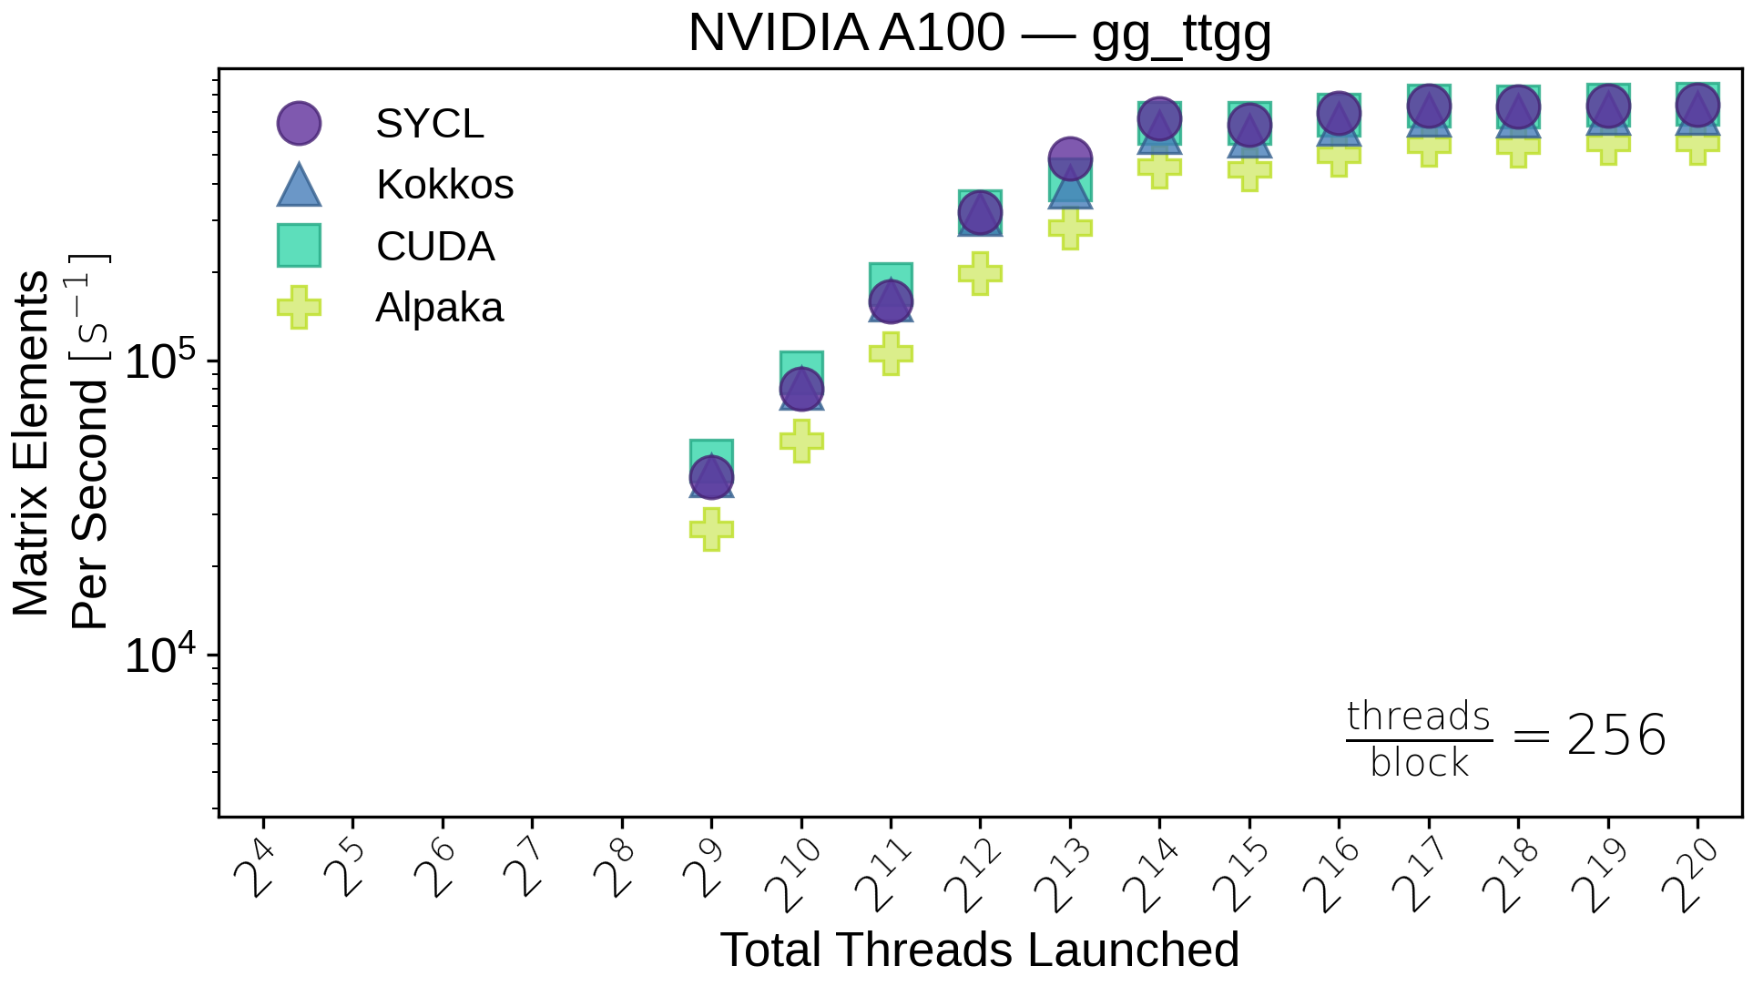
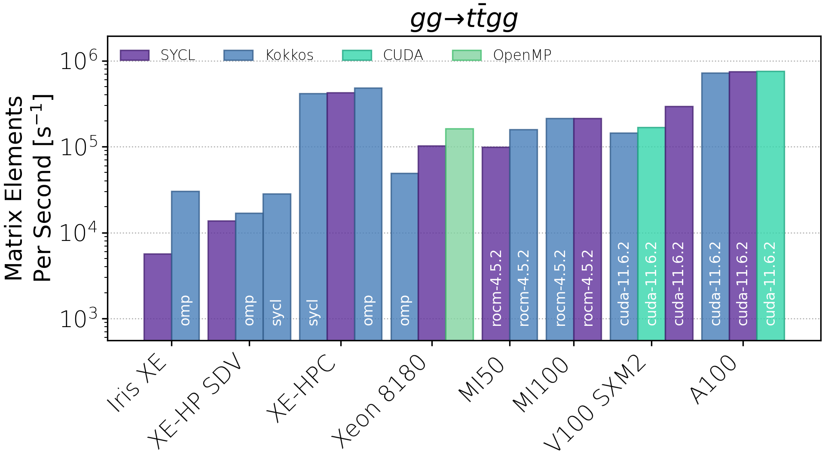
CUDACPP vs PFs - GPU ME throughputs (standalone application)
Variable GPU-grid size (throughput scan)
Fixed GPU-grid size (throughput plateau)
INTEL
AMD
NVIDIA
(gg_ttgg) 16k
The performances of the SYCL and Kokkos implementations of MG5aMC seem comparable to direct CUDA
  Further comparisons are in progress, performance scales differently with more jets for different backends (next slide)
SYCL and Kokkos run out of the box also on AMD and Intel GPUs
  They also run out of the box on CPUs (performance under investigation)
Xe-HP is a software development vehicle for functional testing only - currently used at Argonne and other customer sites to prepare their code for future Intel data centre GPUs
XE-HPC is an early implementation of the Aurora GPU

Slide 40
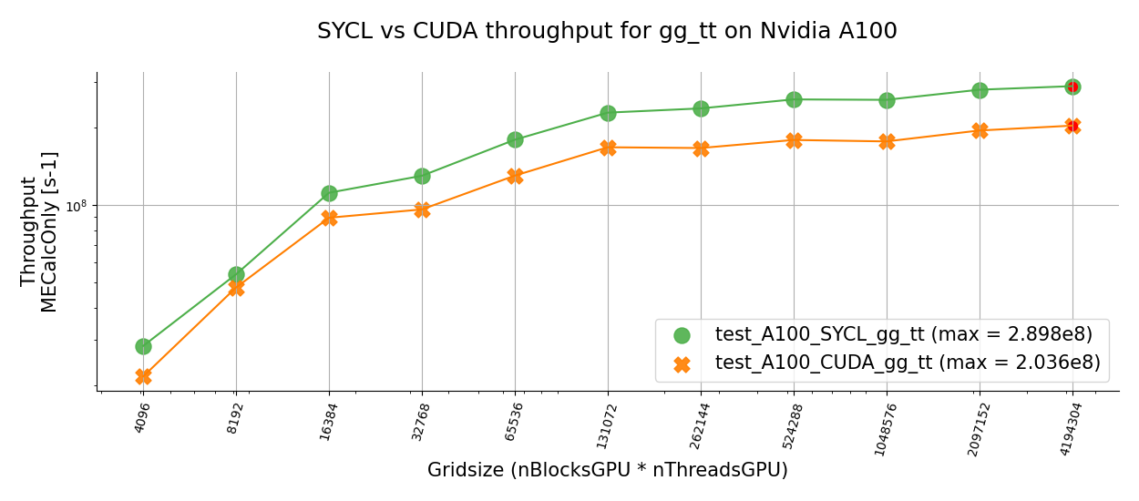
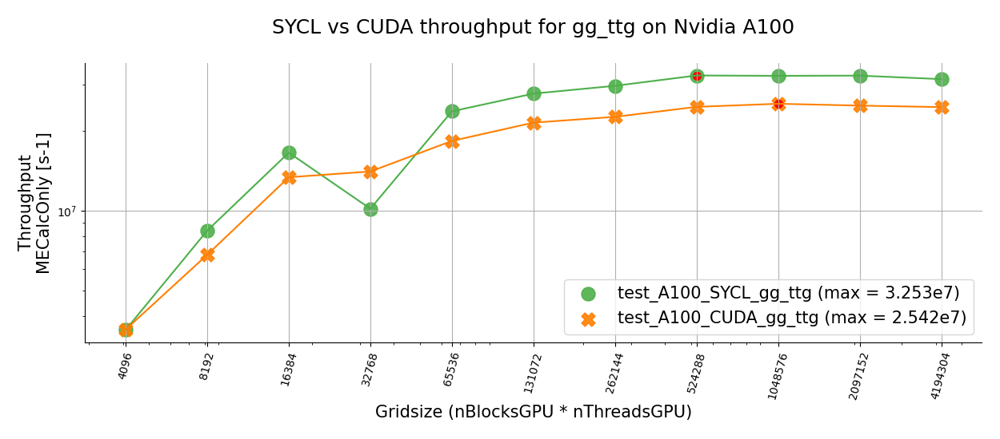
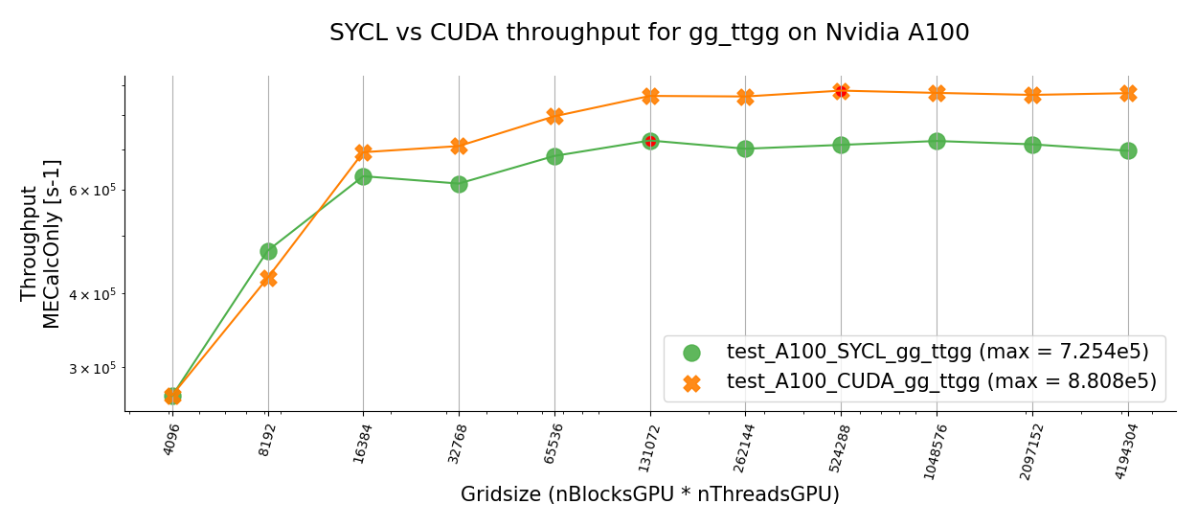
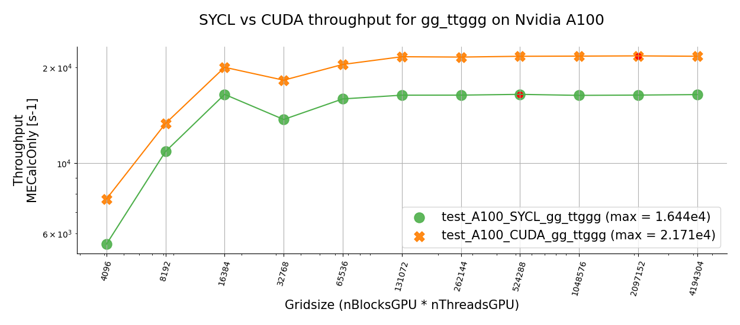




CUDA vs SYCL on NVidia A100
PRELIMINARY!
N. Nichols, T. Childers (SYCL)
J. Teig (tests/plots)
CUDA < SYCL
$gg$→$t\overline{t}$
SYCL and CUDA implementations have ~similar performances but
  SYCL seems better for less complex processes
  CUDA seems better for more complex processes
These are very recent results, which are still being digested (WIP!)
  It will be very interesting to understand more in detail what goes on
We plan to also compare more systematically the CUDACPP and SYCL performances on CPUs (vectorization, multi-core), but it will take time and optimization tweaks... WIP!
CUDA < SYCL
$gg$→$t\overline{t}g$
CUDA > SYCL
$gg$→$t\overline{t}gg$
CUDA > SYCL
$gg$→$t\overline{t}ggg$

Slide 41
(3) Outlook: WIP, plans, ideas for more speed and features
Q1-Q2 alpha release?...
2020
2021
2022
Q1
Q2
Q3
Q4
Q1
Q2
Q3
Q4
2018
2019
2023
2024
Q3
Q4
From Q3 2022: Zenny’s PhD work
(reweighting, NLO...)
Sep 2022 HEPscore
benchmarking workshop
Sep 2022 Lugano hackathon
(sub-event-level parallelism...)

Slide 42
Benchmarking – Madgraph and the HEP-SCORE project
HEPscore: the new HEP benchmark for compute resources, replacing HepSpec06
  Based on reproducible HEP workloads (GEN, SIM, DIGI, REC...) within docker containers
  The first version HEPscore23 should become production in April 2023 for (x86 and ARM) CPUs
The aim is to benchmark a fully loaded server: all CPU cores, and eventually all associated GPUs
  (and ideally measure how well an application is doing compared to the theoretical power of the server...)
  fill all CPU cores by a combination of application multi-threading and/or several identical copies/processes
A first container based on our Madgraph-on-GPU has been prepared
  Very useful because it gives the same physics results on CPU and GPU: may compare them to each other!
  And eventually may be used to evaluate heterogeneous processing on CPU+GPU...
The plots on the next slides are based on this HEPscore container: several identical copies/processes
  (A multi-threaded CUDACPP version exists but not optimized yet – SYCL and Kokkos also provide MT)

Slide 43
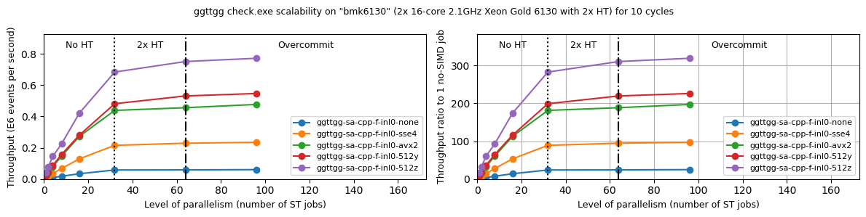


ME throughput in C++ for $gg$→$t\overline{t}gg$ (on all the cores of a CPU)
gg→$t\overline{t}$gg
(float)
gg→$t\overline{t}$gg
(float)
Previous tables for SIMD speedups on C++ were for a single CPU core
Large SIMD speedups are also confirmed when all CPU cores are used
  AVX512/zmm speedup of x16 over no-SIMD for a single core slightly decreases to ~x12 on a full node (clock slowdown?)
  Overall speedup on 32 physical cores (over no-SIMD on 1 core) is around 280 (maximum would be 16x32=512)
  Aggregate MEs throughput from many identical processes using the standalone application (HEP-workload Docker container)

Slide 44


Some ideas for heterogeneous processing
Nvidia V100 GPU
Silver 4216 4-core CPU
Throughput variation as a function of GPU grid size (#blocks * #threads)
This is the number of events processed in parallel in one cycle
To further reduce the relative overhead of the scalar Fortran MadEvent - parallelize it on many CPU cores?
Blue curve: one single CPU process using the GPU
  For gg→$t\overline{t}$gg, you need at least ~16k events to reach the throughput plateau
Yellow, Green, Red curves: 2, 4, 8 CPU processes using the GPU at the same time
  Fewer events in each GPU grid are needed to reach the plateau if several CPU processes use the GPU
  The total Fortran RAM would remain the same, but the CPU time in the Fortran overhead would be reduced
  (Why total throughput increases beyond the nCPU=1 plateau is not understood yet!...)

Slide 45
Lockstep beyond event-level parallelism
Efficient data parallelism (lockstep processing) requires the same function computed for different data
  This is true in MG5AMC at the event level (different events i.e. different phase space points)
  But it is also true at the sub-event level (different helicities within the same event)
We are evaluating the move to a different data parallelism strategy on GPUs
  Currently: one event (sum over all helicities) per GPU thread
  In the future: one helicity of one event per GPU thread?
Advantages:
  You can fill the GPU with much fewer “events in flight” – more balanced sampling/integration in MadEvent
  This is a prerequisite for moving the color matrix to externally-launched cuBLAS and tensor cores
  This is also a prerequisite if we want to evaluate much smaller kernels
    From all Feynman diagrams in one kernel to one Feynman diagram per kernel?
    Which might decrease register pressure and increase kernel occupancy, but would require more global memory access

Slide 46

NLO, loops
MC@NLO: https://doi.org/10.1088/1126-6708/2002/06/029
Matching NLO QCD and parton showers (avoid double counting)
Z. Wettersten (+ OM, SR, AV, R. Schoefbeck)
Marco Zaro – https://cp3.irmp.ucl.ac.be/projects/madgraph/wiki/Pavia2015
So far we have only worked on LO QCD processes!
NLO QCD processes are more computationally intensive
  They have more Feynman diagrams
  But especially they have loop diagrams!
  And, a matching procedure (MC@NLO) must be applied
We should be able to compute Born and Real emission contributions in our vectorized C++ and CUDA
  We should also be able to handle NLO matching using the current MadEvent based infrastructure
  The main challenge will be understanding the computational impact of loops (Amdahl)?
B, V, R: matrix elements
MC: parton shower
S and H events: two separate sets of events (different matrix elements)
Integral = S+H is positive – but individual events can have negative weights

Slide 47




Reweighting
Z. Wettersten (+ OM, SR, AV, R. Schoefbeck)
1. Generate signal sample at θ_{ref}, with w_{i}(θ_{ref})=1
(By definition, background does not depend on θ)
2. Full detector simulation
(MC truth event properties x_{i}^{(true)} → observed event properties x_{i})
3. Reweight each event by matrix element ratio
Old technique, renewed interest!
Advantages of reweighting: savings in computing costs (no detector simulation), fewer statistical fluctuations
In practice for MG5AMC: read in an LHE file, add weights, write back the modified LHE file
  Will use the new matrix element engine in CUDA/C++
  For further details and a status report: Zenny’s upcoming poster at CHEP 2023!
Theoretical and technical challenges
  NLO reweighting (see O. Mattelaer, https://arxiv.org/abs/1607.00763)
  Coverage of phase space in the new parameter set
  Reweighting for a given event-by-event helicity and color

Slide 48



Reweighting and weight derivatives in parameter estimation
AV
Weight derivative: event-by-event sensitivity to the measured parameter
First: makes it possible to determine the limit error with an ideal detector, and how much (0 to 1) we do worse
  with a given luminosity of FCC, what is the best theoretically achievable measurement on this parameter?
Second: can be used as a basis for an “improved optimal observable” ML method
Knowing one’s limits: maximum achievable
information with an ideal detector
- Ideal acceptance, select all signal events S_{sel}=S_{tot}
- Ideal resolution, measured γ_{i} is that from MC truth
(implies ideal rejection of background events, γ_{i}=0)
Data observable
event properties x_{i}^{(DATA)}
Fit WDR regressor
q_{i}^{(DATA)} = q( x_{i}^{(DATA)} )
q_{i}^{(MC)} = q( x_{i}^{(MC)} )
Weight Derivative
Regression
γ_{i}^{(MC truth)} ~ q( x_{i}^{(MC)} )
https://doi.org/10.1051/epjconf/202024506038
https://zenodo.org/record/3715951

Slide 49
Beyond Madgraph
ANY matrix element event generator is a perfect fit for vectorization and GPUs!
  Opportunities for 100% lockstep processing at the event-level and event the sub-event level
  Had some discussions with the Sherpa team about vectorization...
Beyond matrix element event generators: are parton showers a good fit for vectorization and GPUs?
  More stochastic branching than in ME event generators
  But the calculations before/after each PS splitting are the same? Would just need some basketization...
  Some discussions a few months ago with the Pythia team on possible collaborations

Slide 50
Acknowledgements
We gratefully acknowledge the computing resources provided by the Joint Laboratory for System Evaluation at Argonne National Laboratory, the Jülich Supercomputing Centre at Forschungszentrum Jülich, the Super Computing Applications and Innovation department at CINECA, and the EuroHPC Joint Undertaking at CSC’s Kajaani data centre
Many thanks from me and the whole team to:
  Our CERN IT colleagues (especially Ricardo Rocha and Ulrich Schwickerath) for their help with GPU nodes!
  Sebastien Ponce, Hadrien Grasland, Steve Lantz, Marco Clemencic for their suggestions on vectorization
  Igor Vorobtsov and Klaus-Dieter Oertel for useful discussions on vectorization on Intel CPUs
  The organizers and our mentors at the Sheffield 2020 and Lugano 2022 GPU hackathons
  Domenico Giordano and the HEPiX benchmarking WG
  The organizers of this Compute Accelerator Forum
  The HSF event generator WG
  The original authors of Madgraph5_aMC@NLO
Many thanks from me personally to the whole madgraph4gpu team for the great collaboration! ☺

Slide 51
Executive summary for the impatient Conclusions!
The Matrix Element calculation in any ME generator can be efficiently parallelized using SIMD or GPUs
Our reengineering of MG5aMC is close to a first fully functional alpha release for LO QCD processes
  The new ME calculation is integrated in MadEvent – we get the same cross section and LHE files as in Fortran!
On CPUs, in vectorized C++ we reach the maximum x8/x16 (double/float) SIMD speedup for MEs alone
  The speedups achieved for the overall workflow are slightly lower due to Amdahl's law, but not much
  Example: our current overall speedup is x6/x10 (double/float) for $gg$→$t\overline{t}gg$ (on one CPU core)
On GPUs, using CUDA we achieve O(100-1000) speedups for MEs alone over one no-SIMD CPU core
  The speedups may be much lower due to Amdahl's law, but we are improving on that
  Example: our current overall speedup is x60/x100 (double/float) for $gg$→$t\overline{t}ggg$ on an NVidia V100
Floats are x2 faster than doubles in SIMD and NVidia GPUs – we also added ‘mixed’ precision modes
In SYCL we get ~similar performances to CUDA on NVidia and we may run also on AMD or Intel GPUs
Future challenges include optimizing heterogenous processing on one GPU and multiple CPU cores

Slide 52
BACKUP SLIDES

Slide 53
Functional tests – CI, standalone, madevent
Functional tests in the CI
  Starting from some hardcoded momenta, reproduce some hardcoded matrix elements (within precision)
  A few different processes, architectures, all in double-float-mixed precision
Functional tests for standalone tests
  Always use the same random seeds, visually check that results do not change in logs
Functional tests for madevent
  Compute cross sections and generate LHE event files in Fortran
  Then do the same in CUDA/C++ and compare results (within precision)
  Note: for floats, the tolerance for allowed differences is now very generous...

Slide 54
Build challenges and issues
The build times increase enormously as you add more final state gluons
  Many more diagrams...
    ...but also the result of some whole-program link time optimization? (we disable RDC in CUDA)
  This may improve if/when we go to smaller kernels
  We use ccache to ease the pain
    Conversely, ninja would probably not help as we have few very large compilation units, not many small ones
We currently build separately for our five SIMD modes
  Eventually we might move to a “fat binary” approach with dynamic choice of the best implementation

Slide 55
A FEW OLD SLIDES

Slide 56

MadEvent/C++ for $gg$→$t\overline{t}ggg$ (on a single core)
ACAT2022
Lower overhead of scalar MadEvent in $gg$→$t\overline{t}ggg$ than in $gg$→$t\overline{t}gg$ : higher overall throughput speedup x13!
Mixed floating-point precision (single precision color algebra) is 5-10% better than double

Slide 57

https://doi.org/10.5281/zenodo.4028834

Slide 58

https://doi.org/10.5281/zenodo.4028834

Slide 59


Slide 60


Portability Frameworks (PFs)
(2) Second line of development: MEs on PFs
PFs allow writing algorithms once and running on many architectures with some hardware-specific optimizations
CUDA code can only run on NVidia GPUs, while Kokkos, Alpaka, and Sycl[Intel] codes can run on most hardware
In “cudacpp”, #ifdef directives separate code branches for GPU and CPU code during compilation (but these are very few: only kernel launching and memory access, not MEs)
With PFs, the algorithm is typically the same, but the compilation occurs once per architecture type
PFs often use templating to handle data types and hardware configuration and function lambdas or pointers for passing kernels (the cudacpp plugin has many of these, too)
PFs still require user to think about “host” vs “device”
“cudacpp” example of compiler directives
For GPU
For CPU
Kokkos example of Templating & lambda
Kokkos example of Memory Management

