Slide 1
LHC YETS 22-23 Updates
14th October 2022
EN-ACE-OSS
TREX meeting

Slide 2
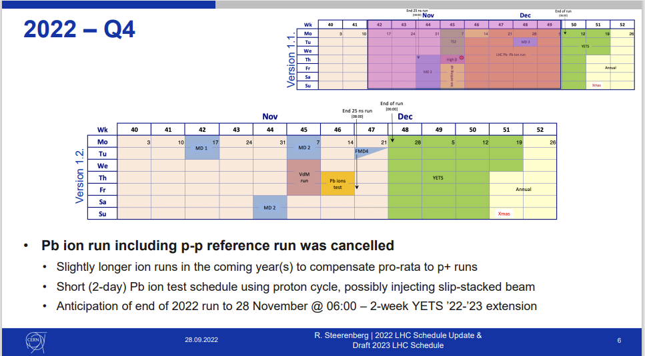
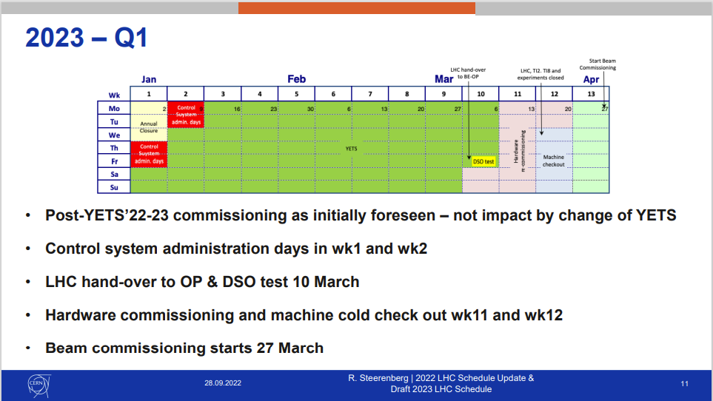
RUN 2022 - 2023 changes LMC 28th September 2022
Courtesy Rende Steerenberg
2022 LHC Schedule Update & Draft 2023 LHC SChedule
2022-10-07

Slide 3
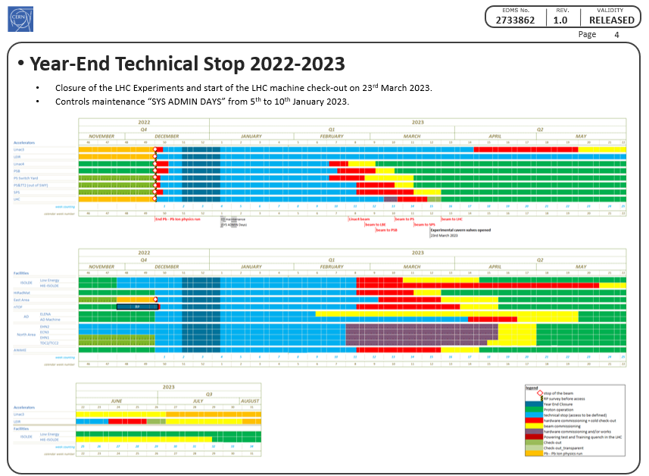
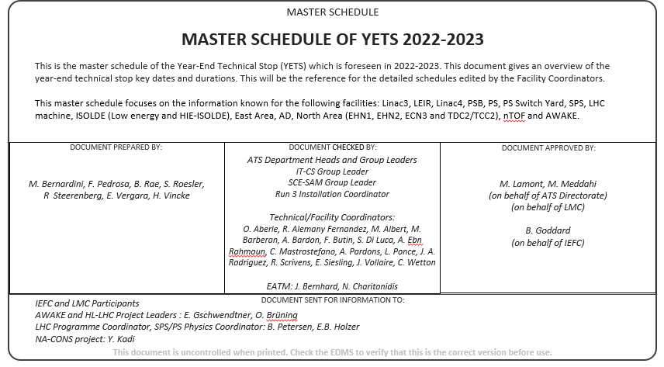
Master Schedule in EDMS ACC-PM-MS-0006 (Released 9th September 2022)
OBSOLETE
3

Slide 4
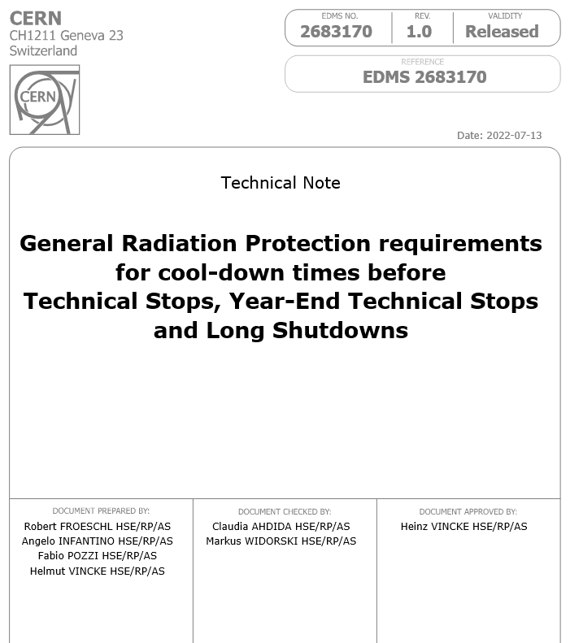
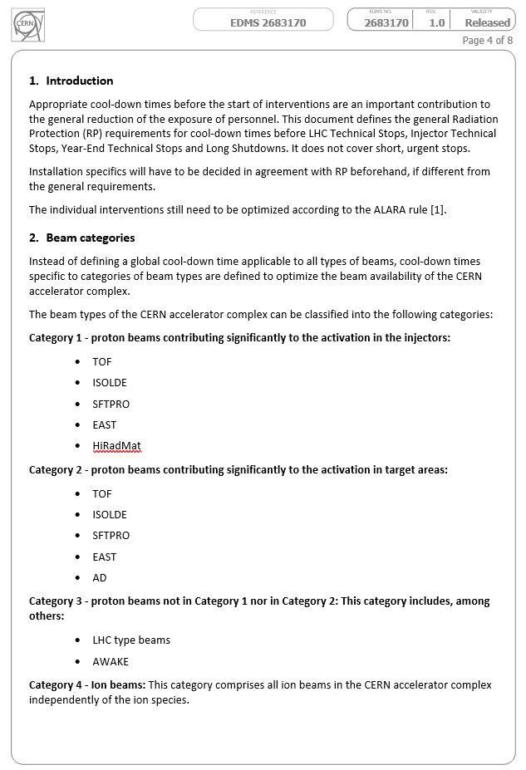
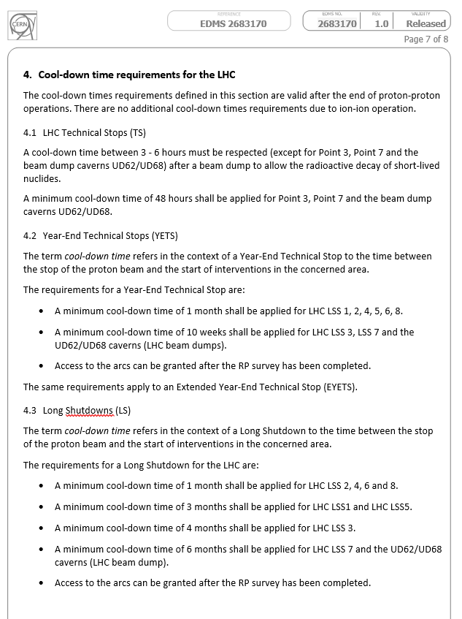
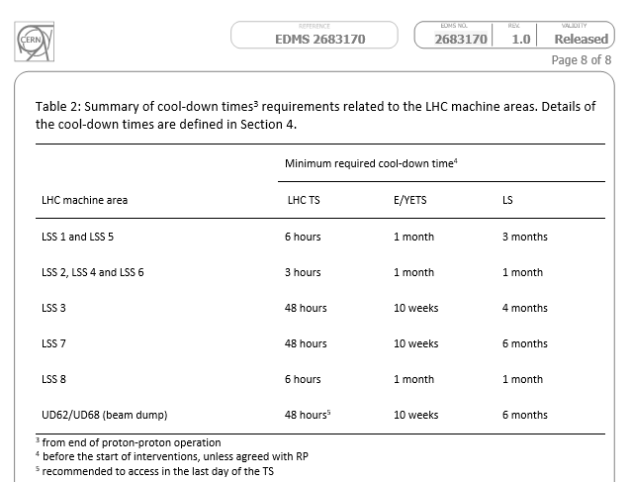
RP Guidelines – NO LHC ION RUN
https://edms.cern.ch/document/2683170/1

Slide 5
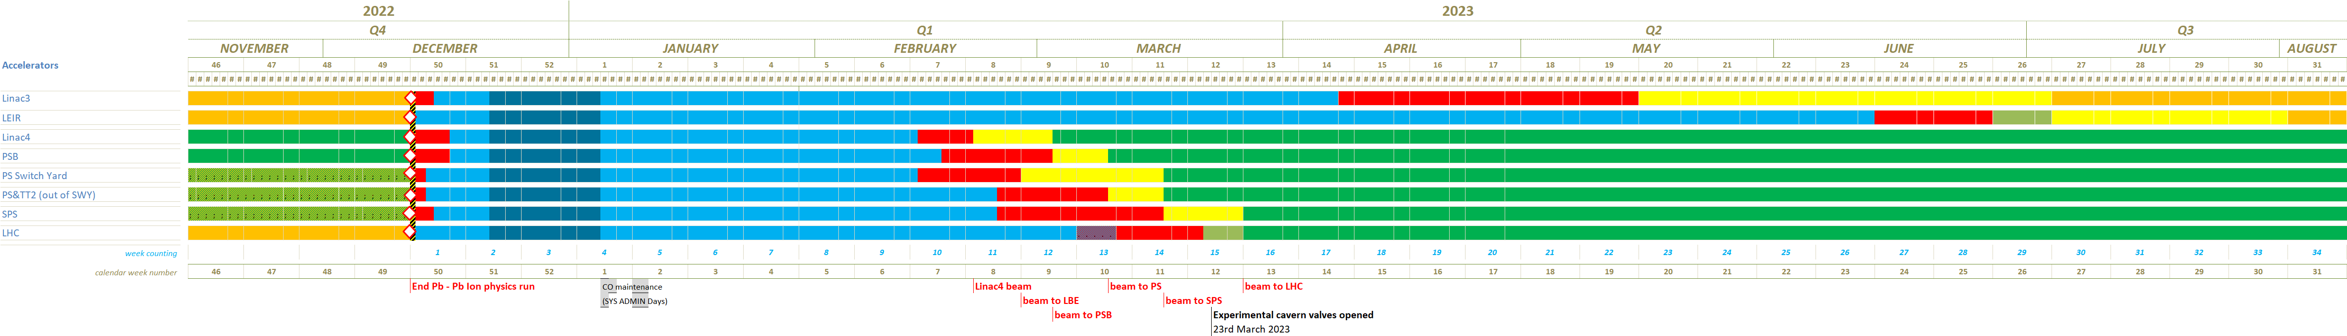
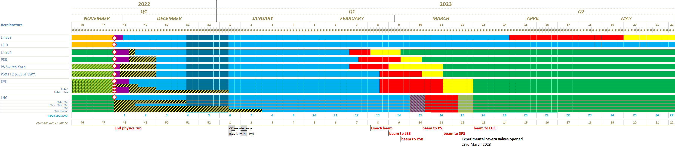
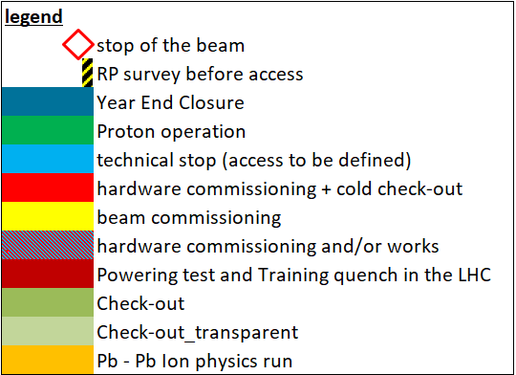
LHC & Injectors YETS 2022/23 Master Schedule ACC-PM-MS-006
  YETS extension of two weeks starting from the 28th of November 2022 for all the accelerators complex.
  This major change does not impact the end of the YETS 2022-23.
  No LHC ion run foreseen at the end of 2022 and NO TS2 for the LHC.
  The RP Cool-Down during the Ion Run are now included in the YETS 2022-23 period.
  The restart schedule for the LINAC 3 and LEIR has been optimized but is not yet finalised.
OBSOLETE
NEW
2022-10-07

Slide 6

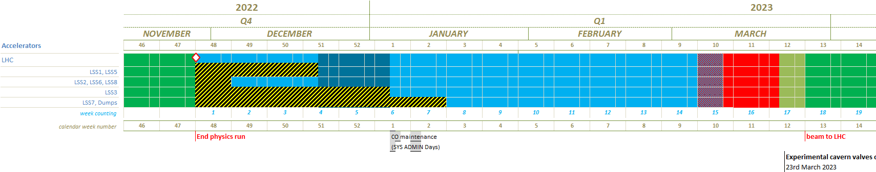
LHC YETS 2022/23 Master Schedule ACC-PM-MS-006
OBSOLETE
NEW
NEW
2022-10-07

Slide 7
Access dates: LHC YETS 22_23
Location | Accès «libres» dans les LSS à partir du : | Accès «libres» dans les arcs à partir du :
LSS1 L&R | 22/12/22 | /
UJ14 / UJ16 (arcs) | / | 28/11/22 (14h00 et 15h00)
LSS2 L&R | 30/11/22 ou 05/12/22 (en fonction des résultats des surveys RP ?) | /
UJ23 / UJ27 (arcs) | / | 28/11/22 (11h00 et 12h30)
LSS3 | 05/01/23 | /
LSS4 L&R | Accès libres le 28/11/22 à partir de 10h30
UJ43 / UJ47 | Accès libres le 28/11/22 à partir de 10h30
LSS5 L&R | 22/12/22
UJ56 / UL55 | / | 28/11/22 (14h00 et 15h00)
LSS6 | 30/11/22 ou 05/12/22 (en fonction des résultats des surveys RP ?) | /
UJ63 / UJ67 | / | 28/11/22(10h30)
Dumps UD62 et 68 | Accès possible avec RP à partir de 16/01/23 | /
LSS7 L&R | Accès possible avec RP à partir du 16/01/23 | /
LSS8 | 30/11/22 ou 05/12/22 (en fonction des résultats des surveys RP ?) | /
UJ83 / UJ87 |  | 28/11/22 (12h00 et 10h30)
General Radiation Protection requirements for cool-down times before Technical Stops, Year-End Technical Stops and Long Shutdowns (EDMS 2683170)
7

Slide 8
YETS 22-23 - Main information
For social responsibility and economic reasons : YETS 22-23 → + 2 wks for all machines
LHC : from 15 to 17 weeks (beam to beam) → Starting date 28th November 2022, NO changes on the end date.
  Beam to Beam: From 12th December 28th November 2022 to 27th March 2023
  Works: From 12th December 28th November 2022 to 10th March 2023 (handover with BE-OP)
  Machine Check-out from 22nd March to 26th March 2023 included
  Experiments valves open 23rd March 2023
  Beam on 27th March 2023
Strategy:
  No additional activities wrt previous Schedule (Hardware commissioning period not extended)
  Keep the current schedule for electrical tests and CV maintenance (except P3 and P7)
  Anticipate Cryo emptying @20K (and 4.5K for S. 78 & 81), Electrical lockouts

Slide 9
Electrical AUG tests during YETS 22-23
ELG-GENNET-TD-0001
Under Approval
Complex | Electrical test | Date
all CERN sites | Auto-transfert | 25th 26th 27th January 2023 (W4)
 | Normal Secours (N/S) | 11th January 2023 (6 a.m. to 6.10 am) (W2)
Meyrin site | AUG Adm. Zone Meyrin | 4th January 2023 (W1)
 | AUG PS & PSB | 14th & 15th January 2023 (W2)
 | AUG West area | 4th February 2023 (W5)
Prévessin site | AUG Adm. Zone Prevessin | 18th March 2023 (W11)
 | AUG North area (BA80-BA81-BA82) | 14th & 15th February 2023 (W7)
SPS | AUG SPS1 | 18th January 2023 (W3)
 | AUG SPS2 | 13th February 2023 (W7)
 | AUG SPS3 | 19th January 2023 (W3)
 | AUG SPS4 + AWAKE | 8th February 2023 (W6)
 | AUG SPS5 | 19th December 2022 (W50)
 | AUG SPS6 | 7th February 2023 (W6)
 | AUG SPS7 | 16th December 2022 (W50)
LHC | AUG LHC1 (including HL) + ATLAS | 5th January 2023 (W1)
 | AUG LHC18 + SM18 | 20th February 2023 (W8)
 | AUG LHC2 + ALICE | 31st January 2023 (W5)
 | AUG LHC3 + LHC3Z | 28th February 2023 (W9)
 | AUG LHC4 | 17th January 2023 (W3)
 | AUG LHC5 (including HL) + CMS | 20th December 2022 (W51) 13th December 2022 (W50)
 | AUG LHC6 | 2nd February 2023 (W5)
 | AUG LHC7 | 21st February 2023 (W8)
 | AUG LHC8 + LHCb | 10th January 2023 (W2)
9

Slide 10
EN-CV & TE-CRG maintenance
 | Point | Week | Start | Finish
EN-CV | LHC1 | 50, 51, 52, 1 | 12/12/2022 | 08/01/2023
 | LHC1.8 | 8, 9 , 10 | 21/02/2023 | 13/03/2023
 | LHC2 | 5, 6 , 7 | 30/01/2023 | 16/02/2023
 | LHC3.3 | 48 | 12/12/2022 | 16/12/2022
 | LHC4 | 2, 3, 4 | 09/01/2023 | 26/01/2023
 | LHC5 | 50, 51, 52, 1 | 12/12/2022 | 08/01/2023
 | LHC6 | 5, 6 , 7 | 30/01/2023 | 16/02/2023
 | LHC7 | 49 | 20/02/2023 | 24/02/2023
 | LHC8 | 2, 3, 4 | 09/01/2023 | 26/01/2023
 | Point | Week | Start | Finish
TE-CRG → NO CHANGES | LHC1.8 | 1, 2, 3, 4 | 05/01/2023 | 25/01/2023
 | LHC2 | 4, 5, 6, 7 | 23/01/2023 | 16/02/2023
 | LHC4 | 1, 2, 3, 4 4, 5, 6, 7 | 05/01/2023 27/01/2023 | 26/01/202317/02/2023
 | LHC6 | 1, 2, 3, 4 4, 5, 6, 7 | 05/01/2023 27/01/2023 | 26/01/202316/02/2023
 | LHC8 | 1, 2, 3, 4 4, 5, 6, 7 | 05/01/2023 27/01/2023 | 26/01/202317/02/2023

Slide 11
YETS 22-23 - General information
Sector 78 and 81 will be kept at 4.5K
All the ITs will be at 20K
Work in the IT areas → contact Delphine LETANT-DELRIEUX for a cryogenic risk assessment and authorisation
Work/transport near magnets @ cold → contact Delphine LETANT-DELRIEUX for a Work Authorisation
Electrical LHC status: electrical lock out of all main circuits (excluding 60 A)
Electrical lock out request → via IMPACT
Transport request → via IMPACT and EDH (48h in advance)
IMPACT: intervention period « YETS-LHC-2022-23 » (The IMPACTs will be validated only after the baseline approval in November/December 2022)
INDICO: https://indico.cern.ch/category/15160/

Slide 12
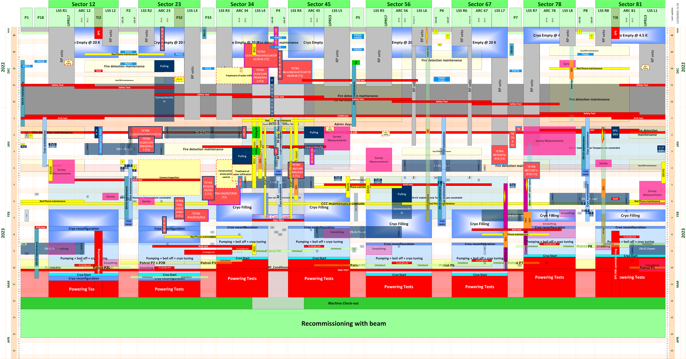
→ New YETS 22-23 LHC In Work LHC-PM-MS-0021 v.0.1
VERSION 2022-09-26

Slide 13
Inputs needed from LHC tunnel Experiments
List and short description of the activities to be performed during YETS 2022-2023
Constraints generated by the activities
Logistics aspects
Safety aspects
Support needed
Services and utilities requested for the activities and for the test phases
Inputs needed before end next week 42
YETS 22-23 Baseline to be presented at LMC ~9th November

Slide 14
Inputs received from LHC tunnel Experiments
MOeDAL
Assembly MAPP detector at UA83 → periodically through the entire YETS, possibly 8-10 weeks total time
Survey needed after assembly → 1 day
Constraints → block the transport corridor during short times while moving equipment around

Slide 15
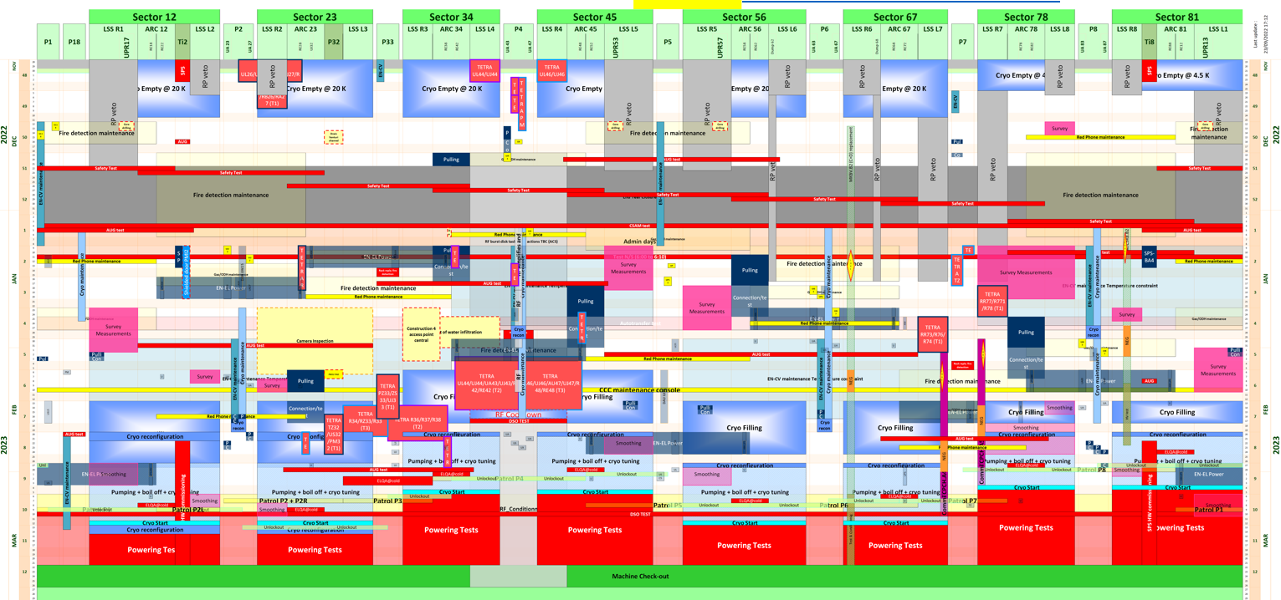
NEXT MILESTONES
Linear Schedule BASELINE @ LMC (~9th November →TBC)
Future meetings
Coordination meeting W43 – 25th October
  HSE (RP, OHS & FRS) (TBC)
Coordination meeting W44 & 45 – 1st November & 8th November
  Review schedule and actions
Coordination meeting W46 – 15th November
  Presentation of the YETS baseline
Coordination meeting W47 – 22nd November
  Review schedule and actions
Coordination meeting W48 – 29th November
  28th November → YETS starts
  YETS activities follow up

Slide 17
RP Guidelines – NO ION RUN
https://edms.cern.ch/document/2683170/1

Slide 18
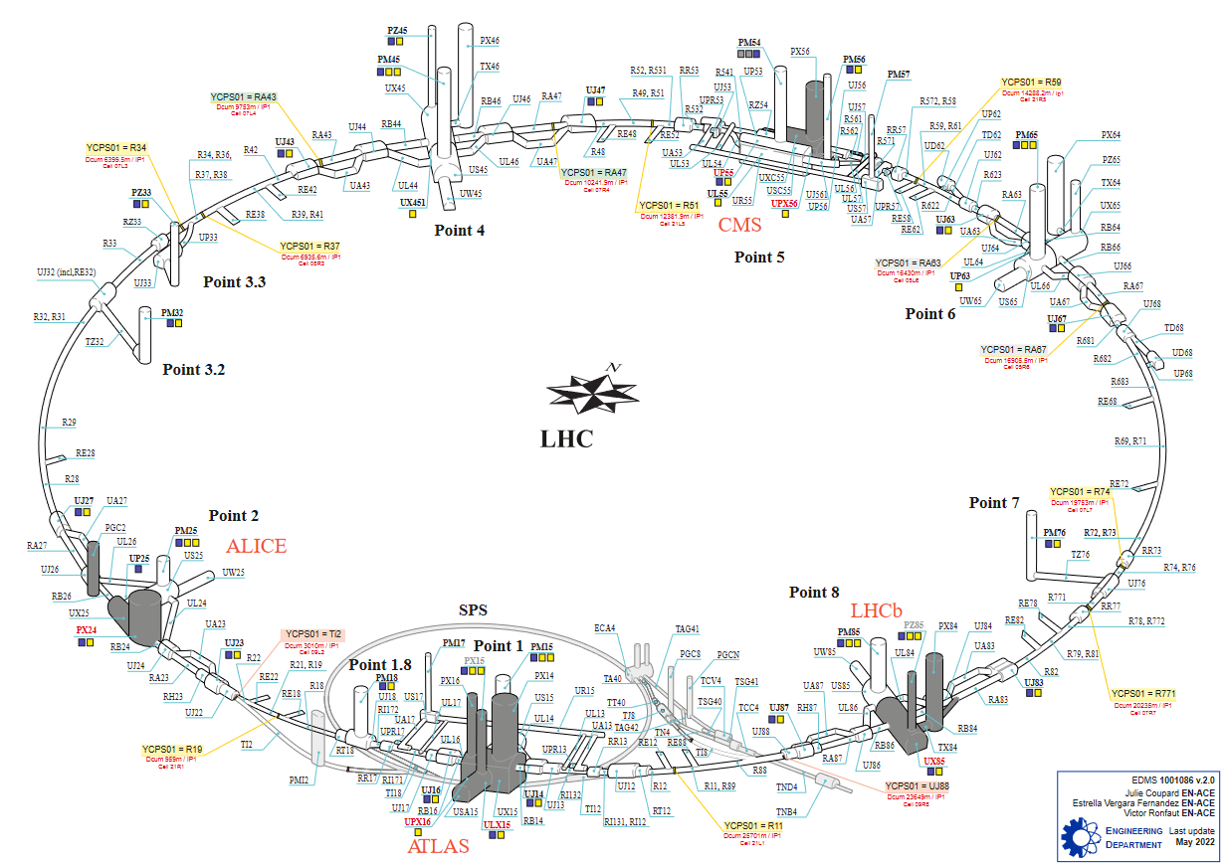
LHC underground and access system – EDMS 1001086

