Slide 1





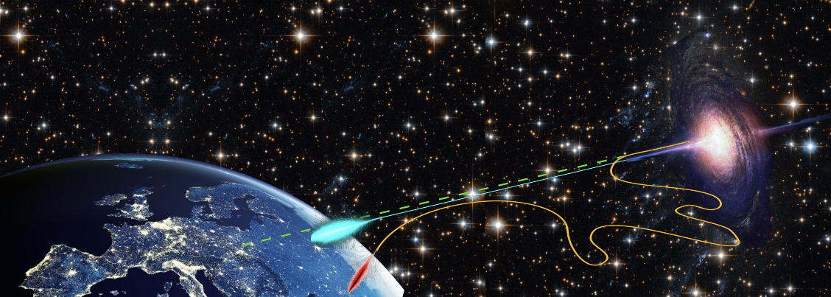



A SiPM based camera for the Terzina telescope on board the NUSES space mission
L. Burmistrov, M.Heller, T. Montaruli, C. Trimarelli, Jan Swakon (for IFJ PAN proton facility)
(on behalf of NUSES collaboration)
rr
Outline:
The NUSES mission.
Intro.
The Terzina telescope
SiPM intro.
Simulation of the instrument
Radiation hardness
Annealing

Slide 2
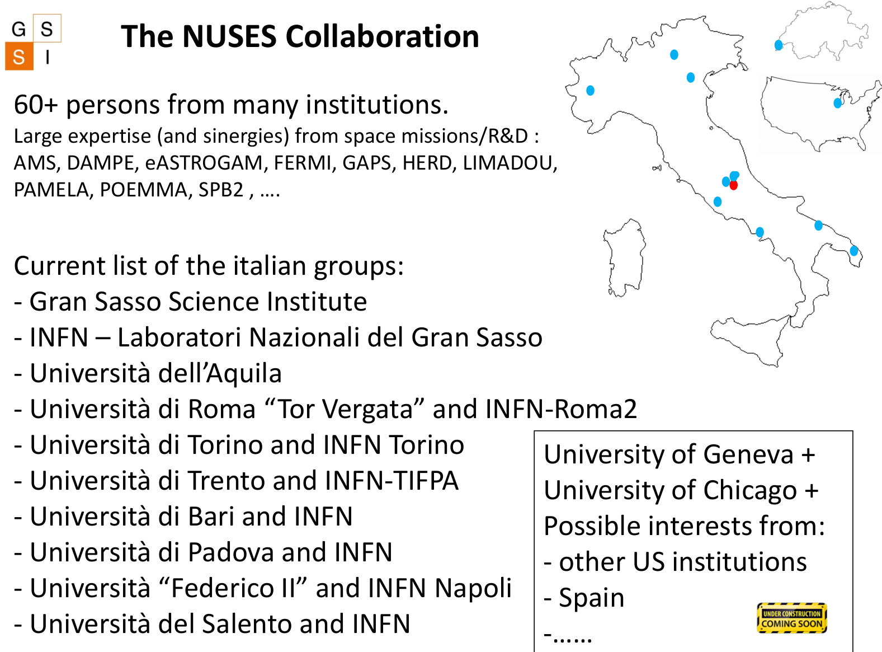
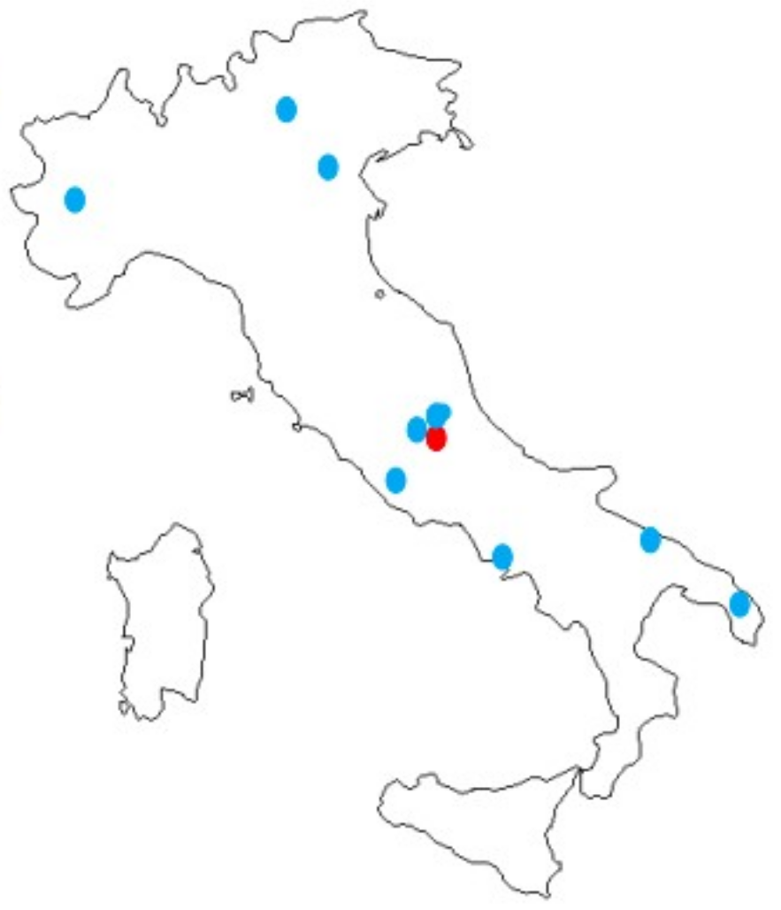
GSSI is leading the mission
This map some time ago

Slide 3
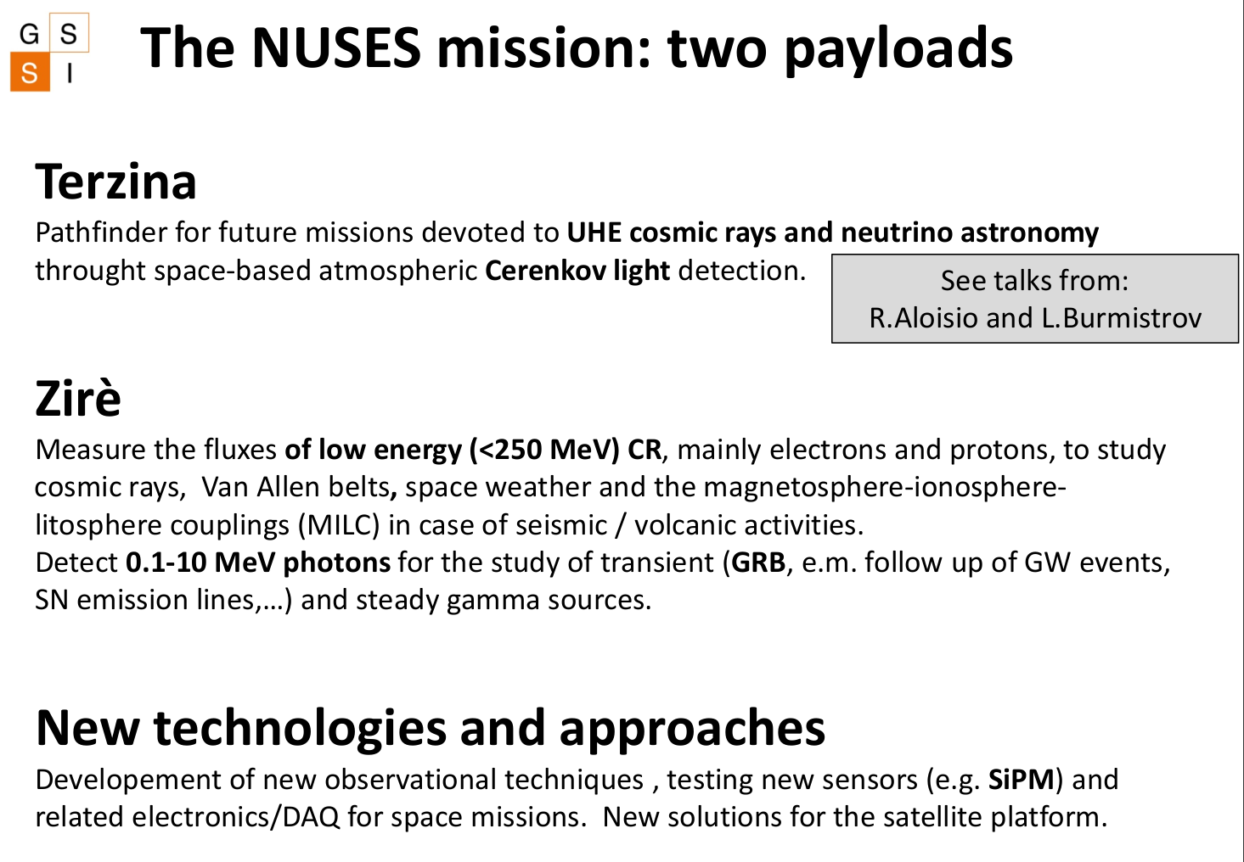
See talks from :
Ivan De Mitri
Riccardo Nicolaidis
Poster by : Pillera (zirè-FTK)
See talks from :
Andrea Di Salvo

Slide 4
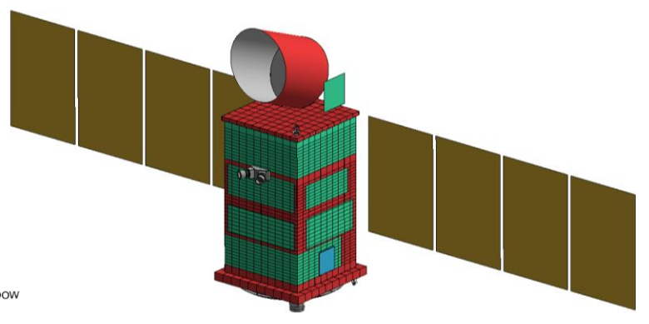
The NUSES mission composed of two payloads.
ZIRE`
Two main components :
ZIRE
TERZINA
TERZINA
Telescope
60 x 60 x 50 cm³
TERZINA weight < 30 kg
60 cm
60 cm
50 cm
TERZINA
Demonstrator of Cherenkov light detection produced by Extensive Air Showers
First measurement of showers with Cherenkov light from space (E>100PeV)
Proves the technology for detecting Earth skimming muon and tau neutrinos
Measure the background conditions
Further Development of SiPM technology for space
ZIRE`
Monitors the fluxes of low energy cosmic rays (< 250 MeV),
Electrons and protons to study Van Allen radiation belts
Space weather and the magnetosphere-ionosphere-litosphere couplings
And much more ….

Slide 5
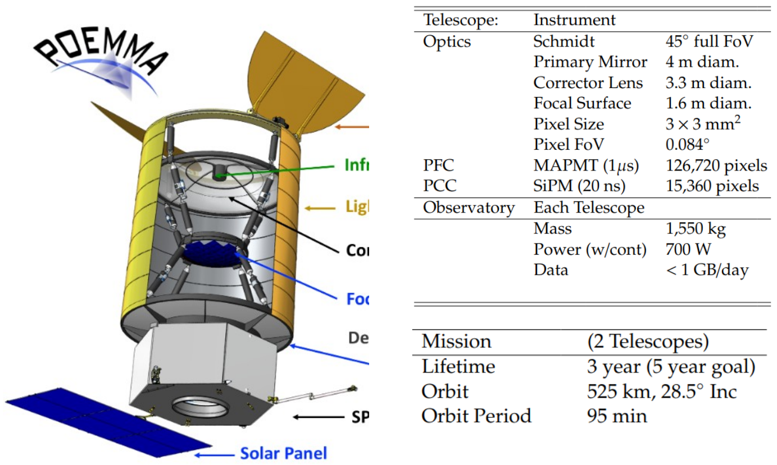
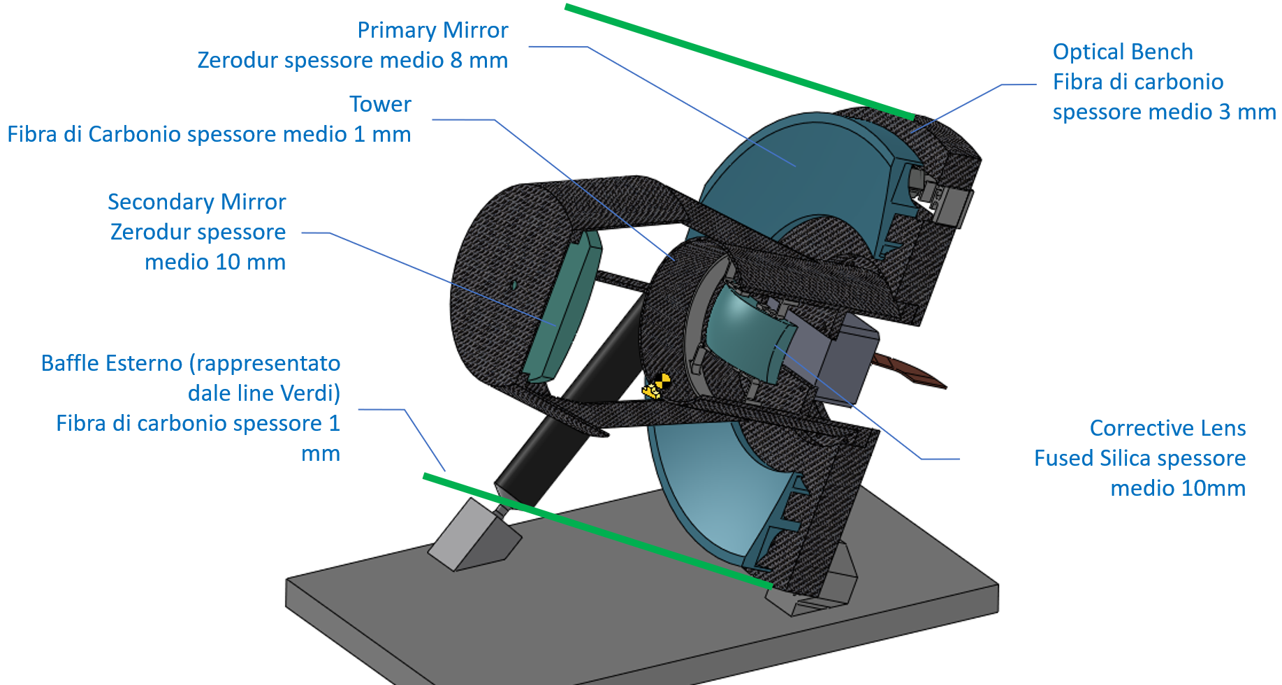
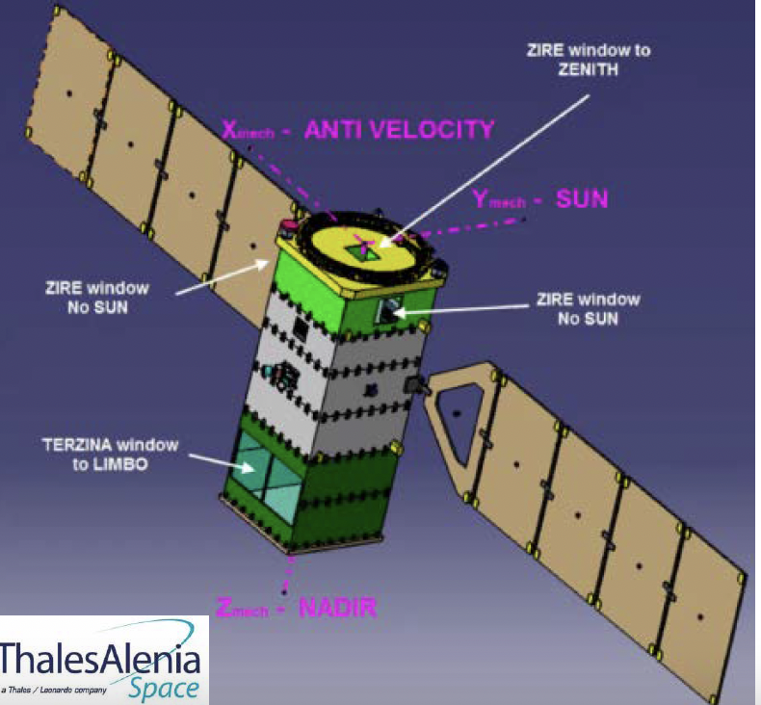
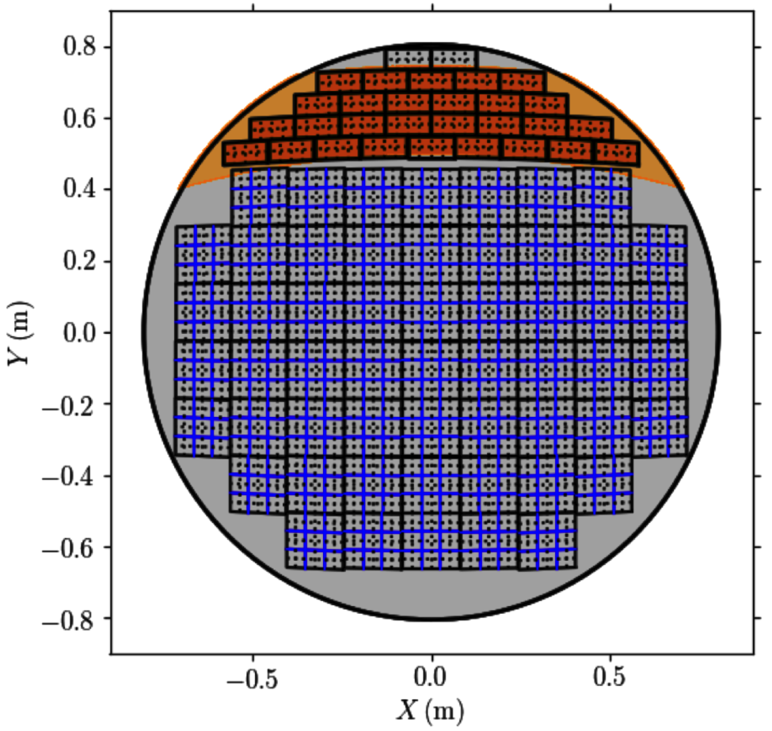
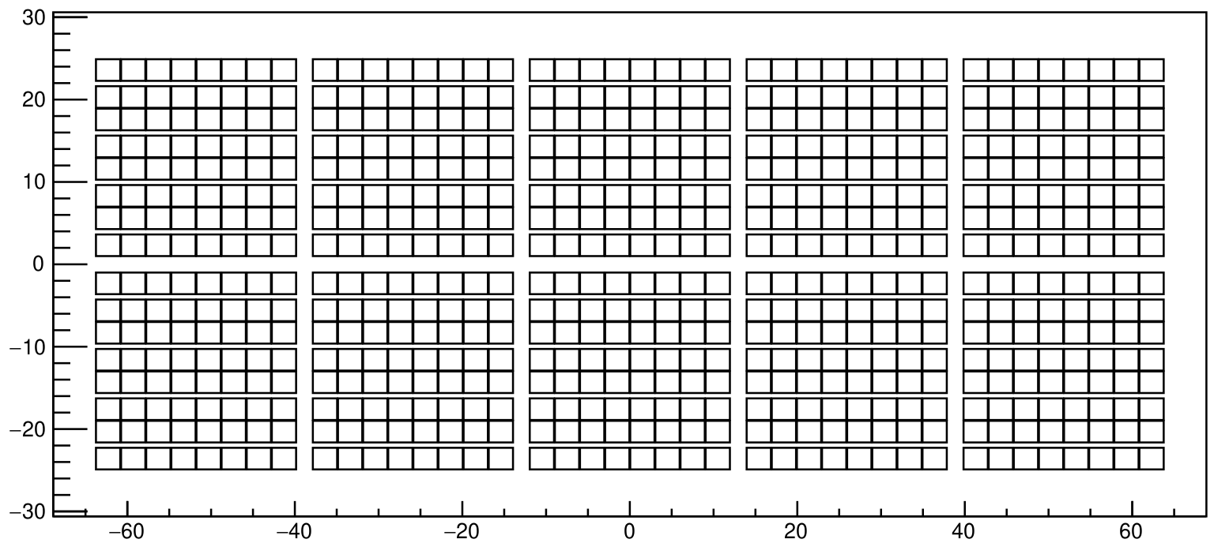
Camera vs POEMMA
Probe
POEMMA Telescope
primary mirror daim.: 4m
TERZINA Telescope
primary mirror daim.: 0.4m
SiPM part
(Detection of Cherenkov light)
TERZINA SiPM photo detection plane
y (mm)
x (mm)
~ 12 x 6 cm²
arxiv:2008.04984v2
POEMMA
John F. Krizmanic

Slide 6
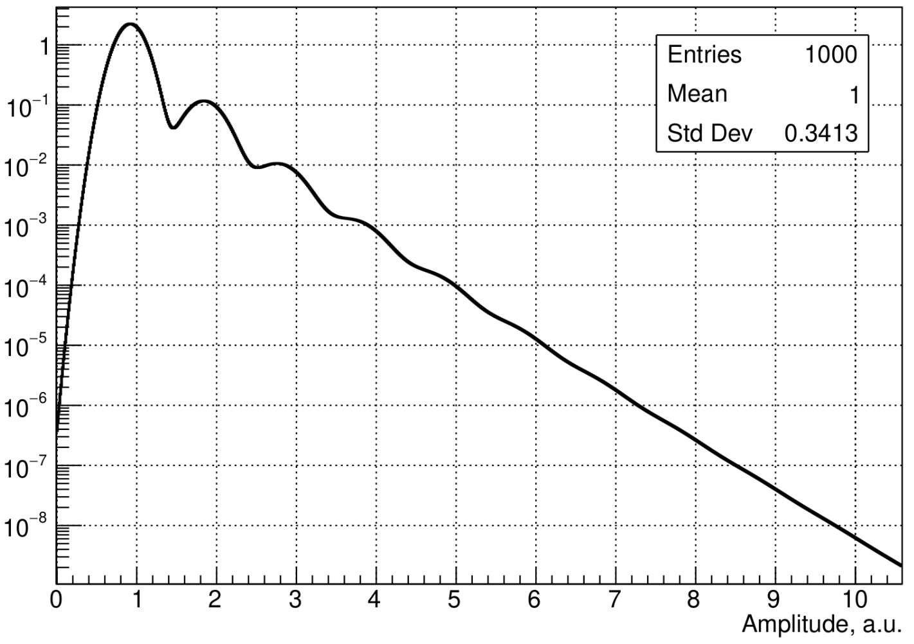
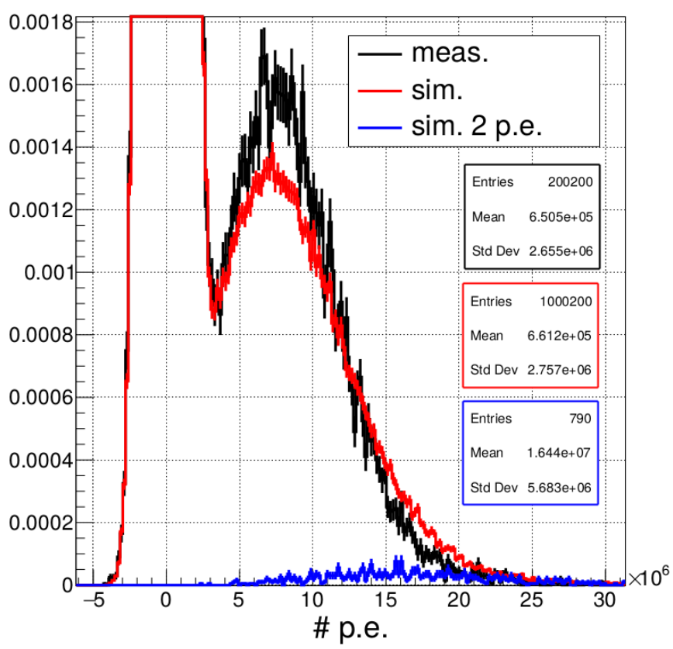
SiPM vs ma-PMT (PMT)
Operation voltage <100 V ~1000V
Currents ~1 muA ~100 muA
Power per cm² ~mW ~0.1W
Weight per cm² of sensitive area ~10 g ~100g
Total integrated charge infinite 200 Q
Time resolution <100 ps < 1 ns
Special resolution ~1 mm ~10 mm
Photo detection efficiency @ 400 nm > 50 % < 50 %
PMT
Variation with temperature very sensitive low
Need of pre-amplifier/PMT gain 0.1 mV 5 mV
Radiation resistance low good
Single photon response PMT vs SiPM
Change sharing between anodes.
Large variation of the response defined by secondary emission
Prompt cross-talk within one channel
SiPM
PMT

Slide 7
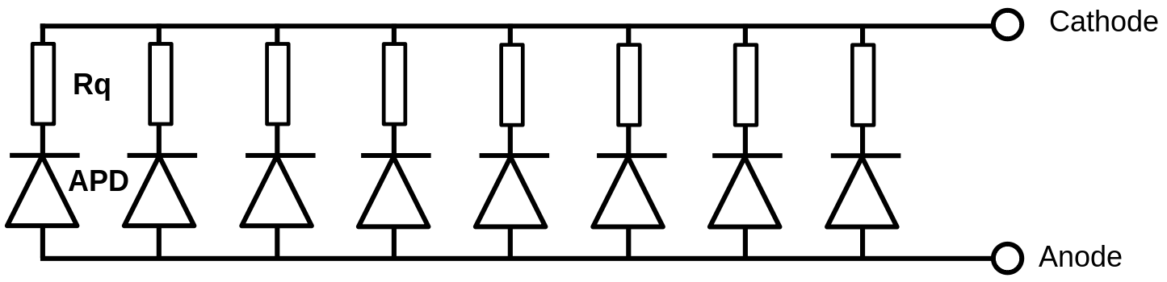
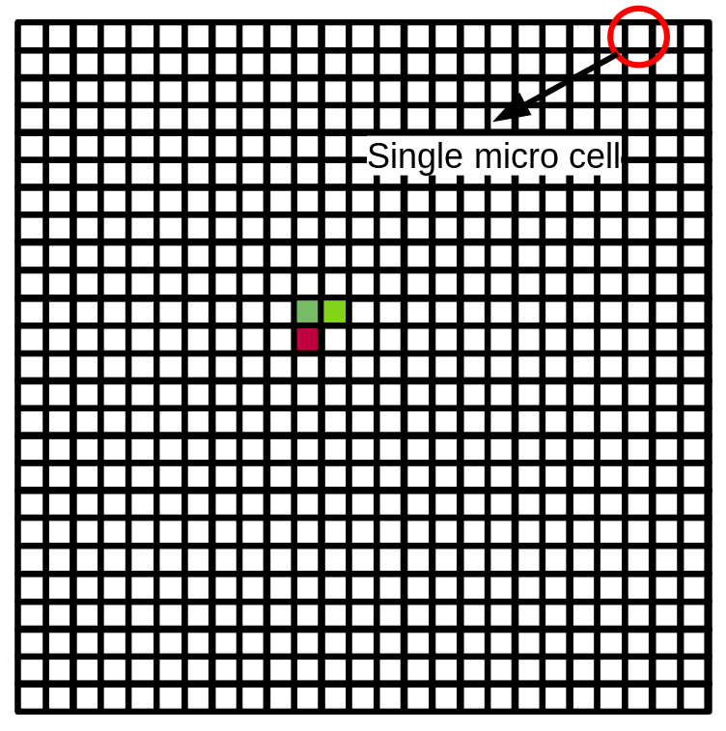
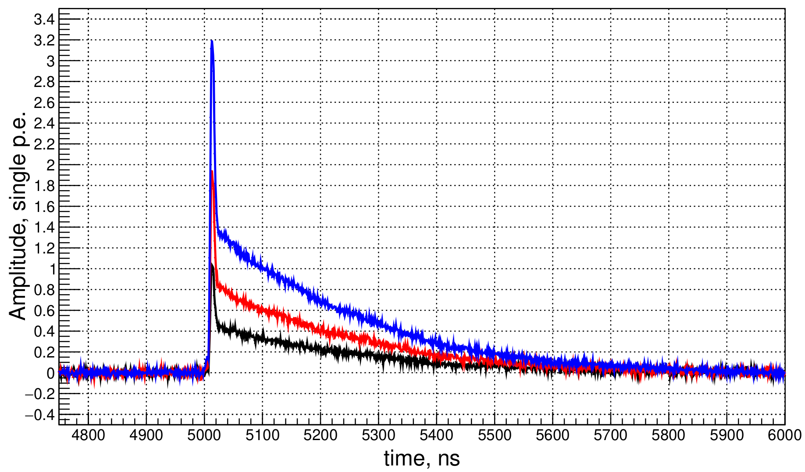
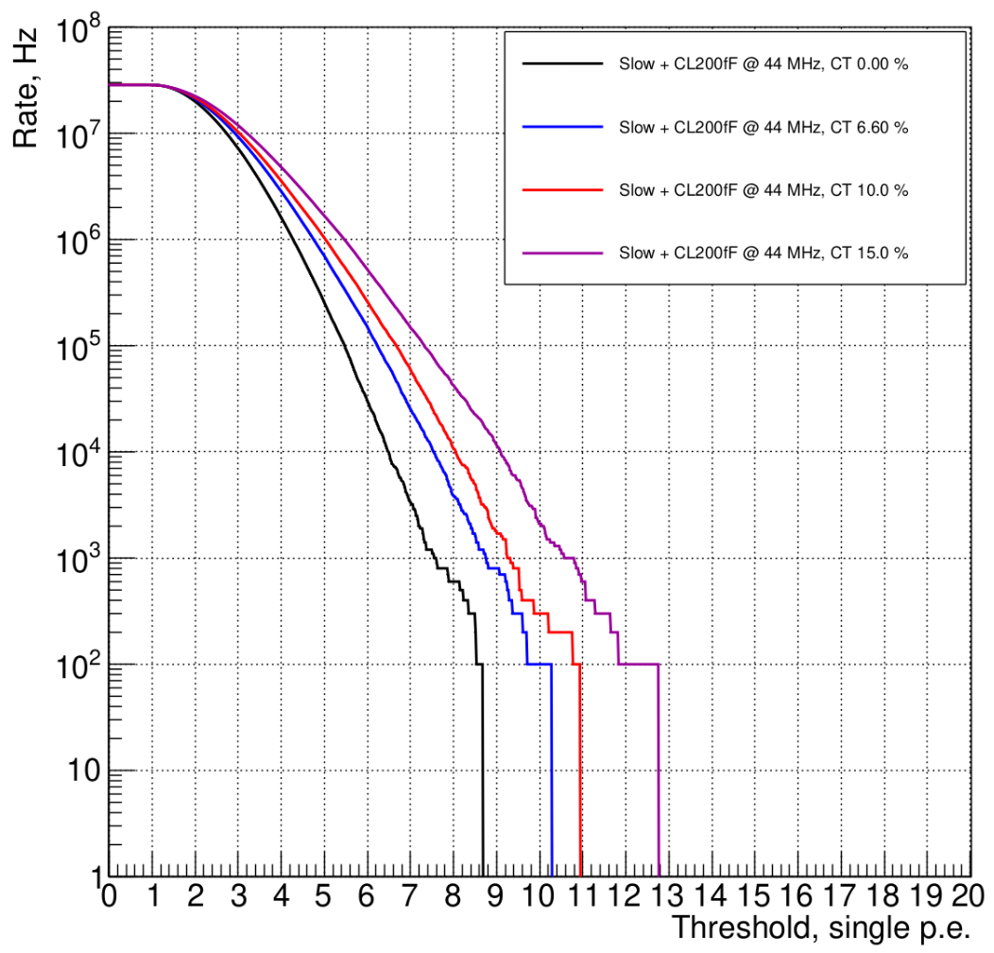
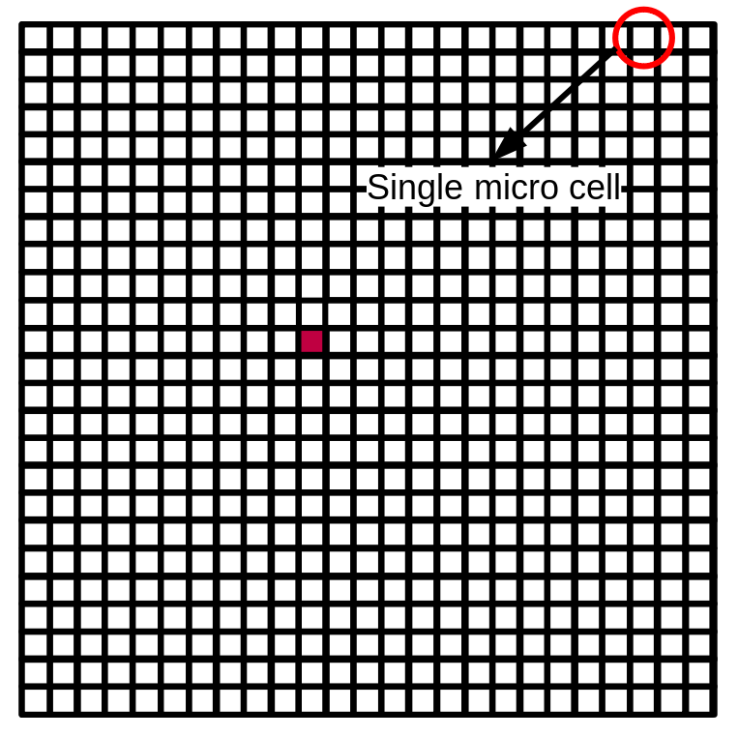
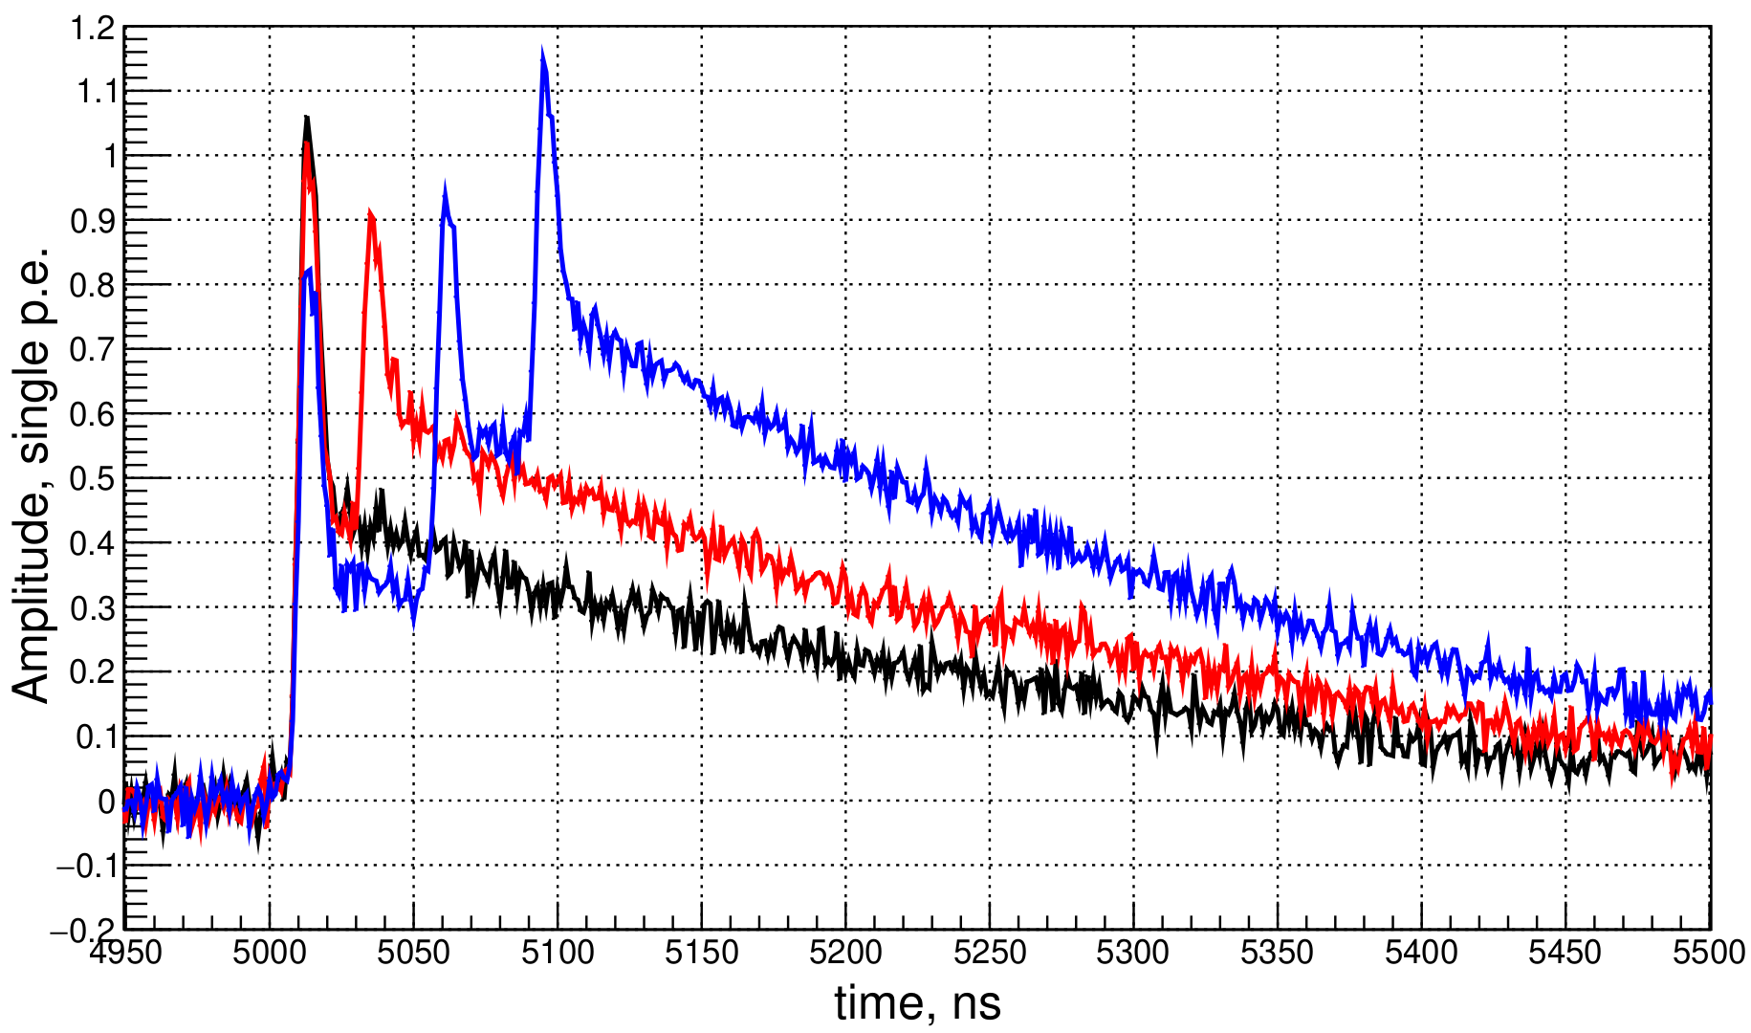
SiPM all the cells are connected in parallel
Parametric SiPM simulation
In simulation we include as well :
Gain variation, electronic noise, pre-amplifier, ADC.
Prompt cross talk.
After pulsing
Delayed crosstalk imposed in other pixels is not simulated.

Slide 8
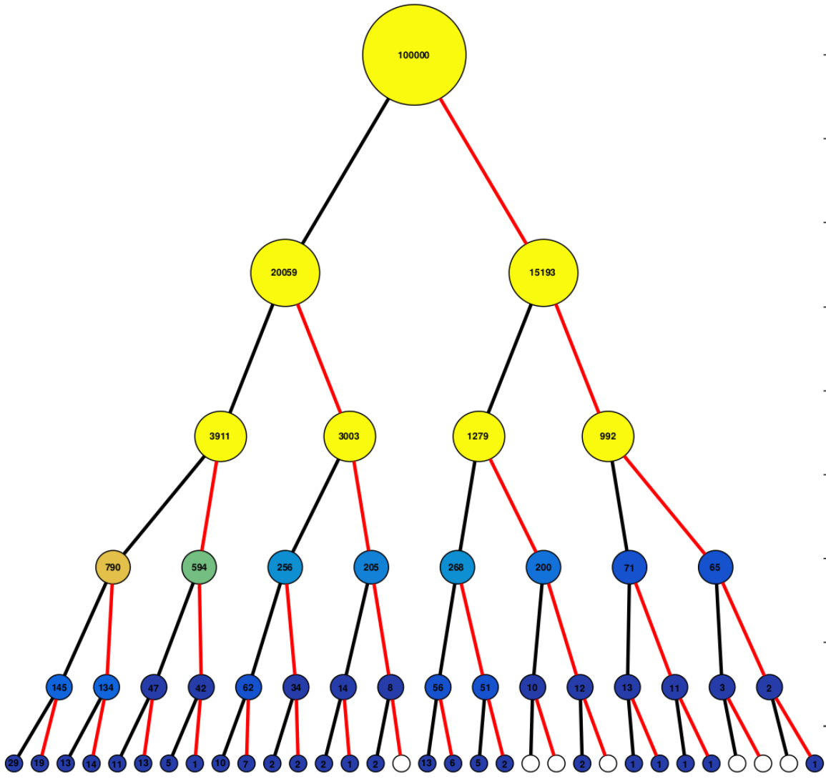
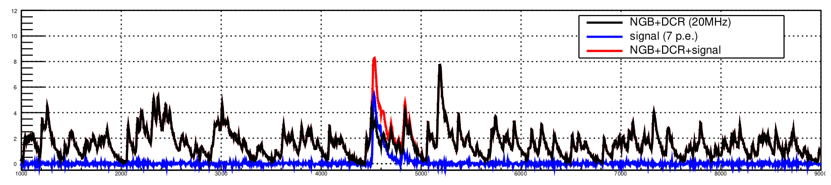
Single p.e. avalanche tree
Initial p.e.
Trial parameters for generator testing:
Probability of the cross talk is set to 0.2
Probability of the after-pulse is set to 0.15
And after pulse decay time 15 ns.
Crosstalk
After pulse
Recurrent process
Clearly saturated due to cell recovery time
Cross
Talk
Single
Photo electron
p.e.
After
pulse
Final result waveform.

Slide 9
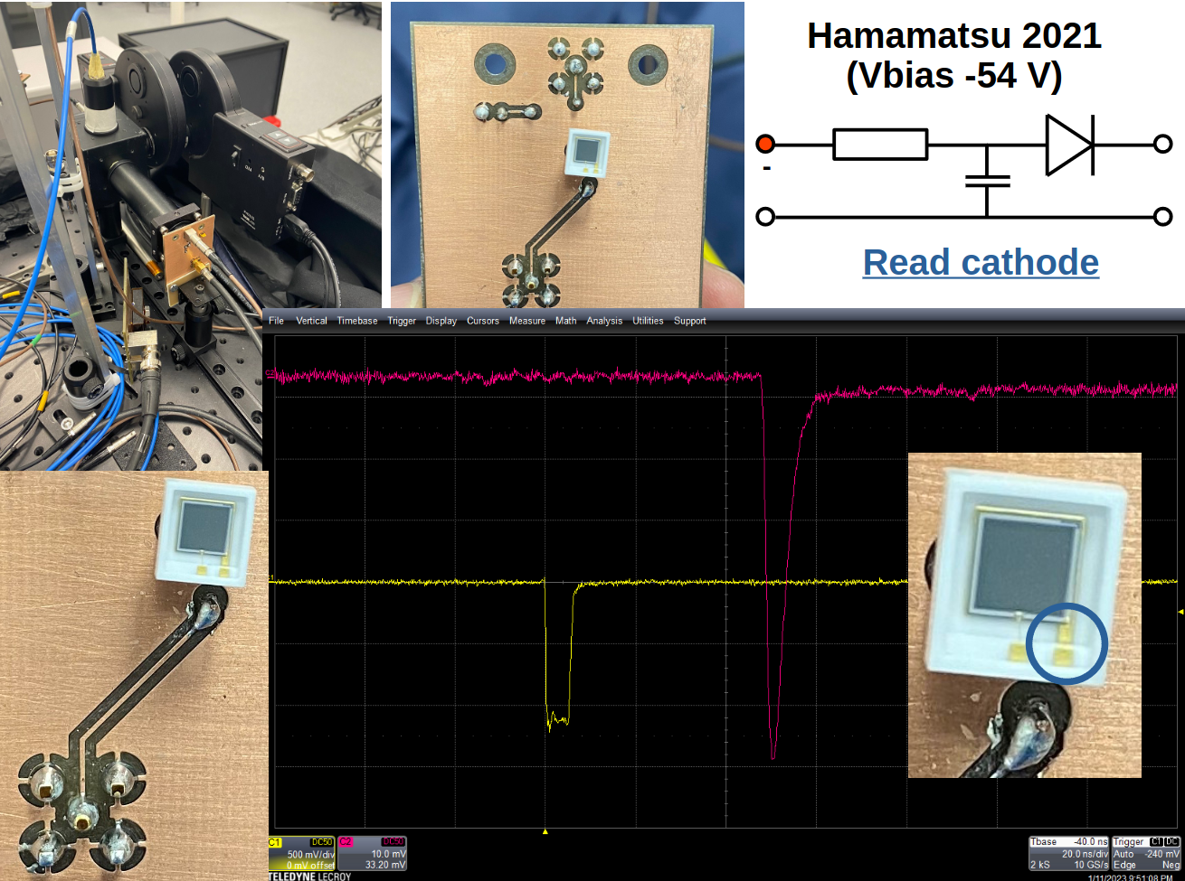
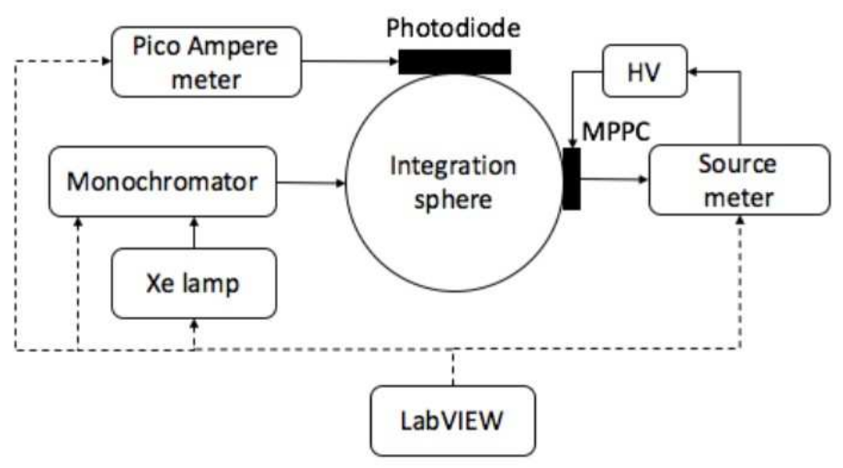
Experimental setup
S

Slide 10
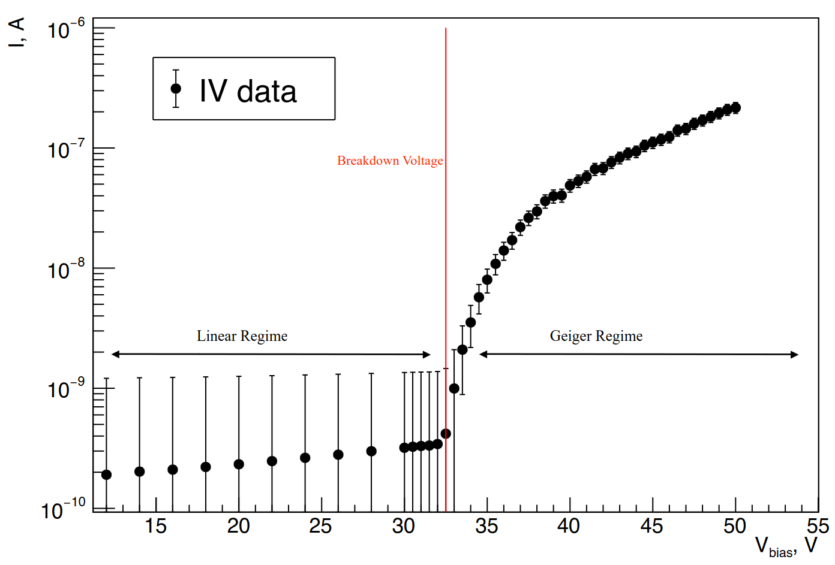
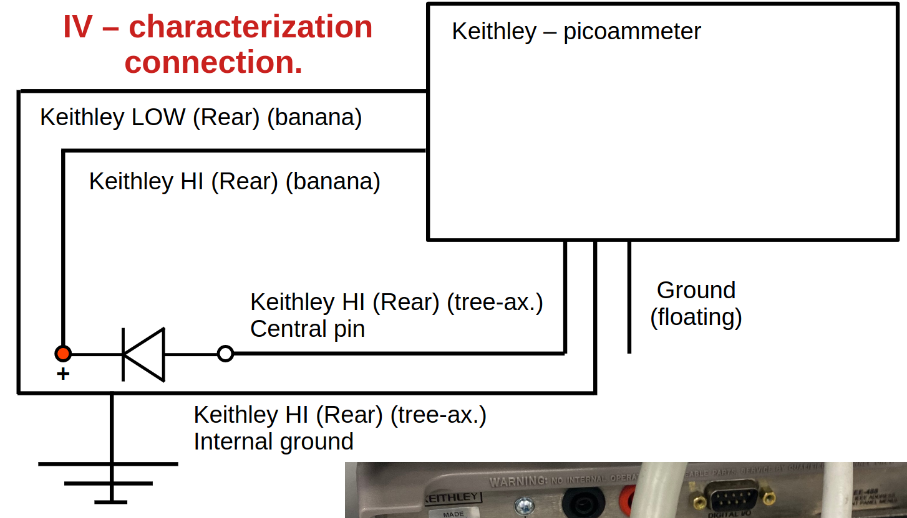
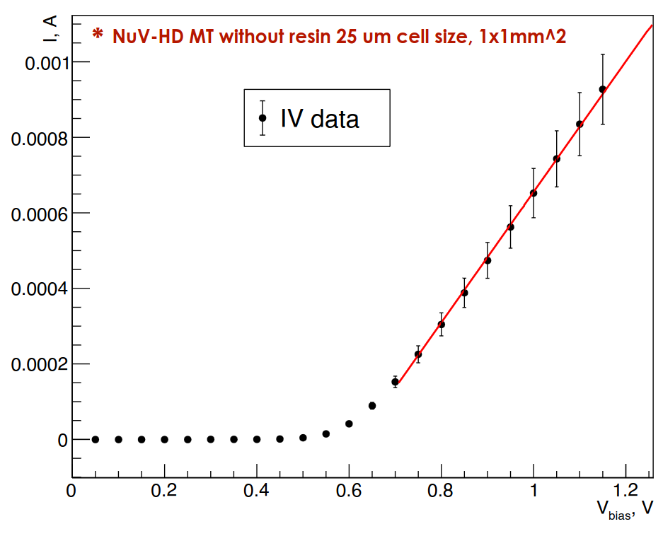
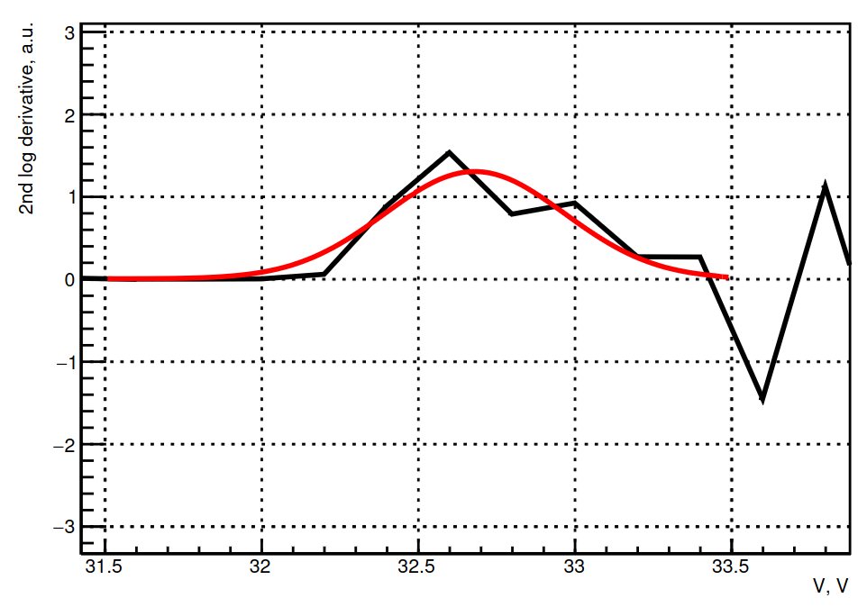
SiPM characterization : V _{break down} (V_{bd})
Break down voltage – defines when SiPM start to detect light. It is a function of a temperature.
V_{bd}
V_{bd} calculated with :
Second log derivative
Forward biasing.
Measure the quenching resistor

Slide 11
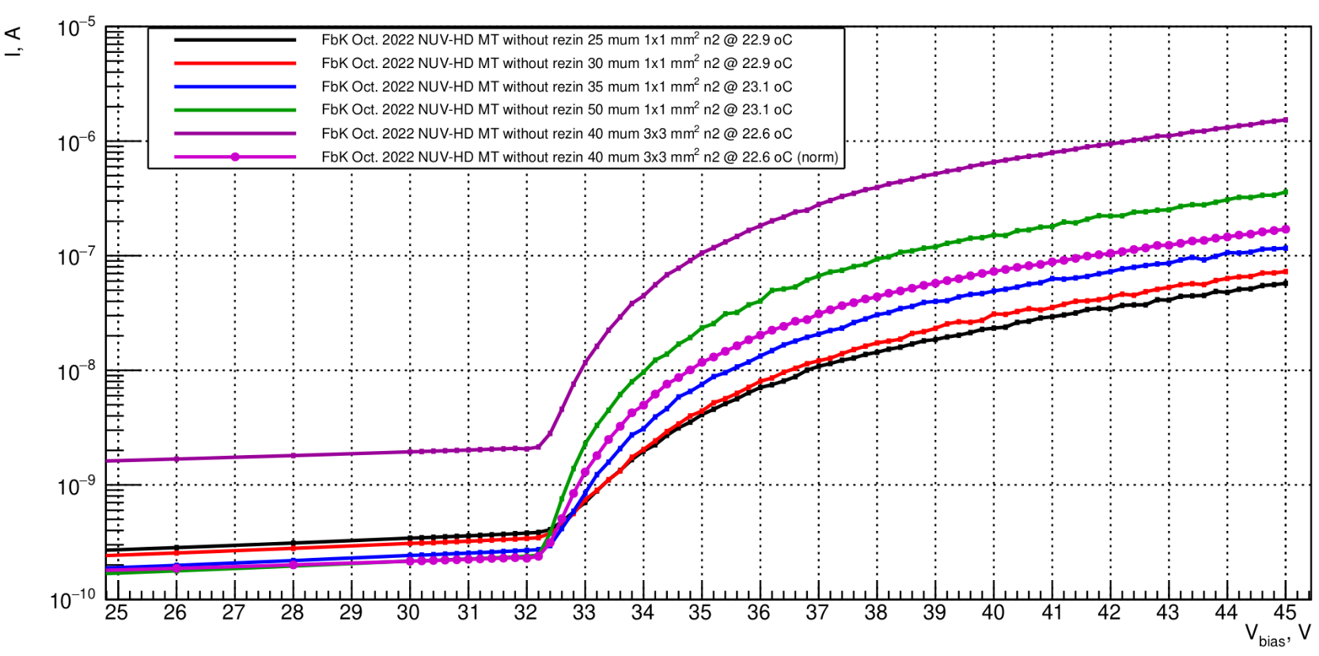
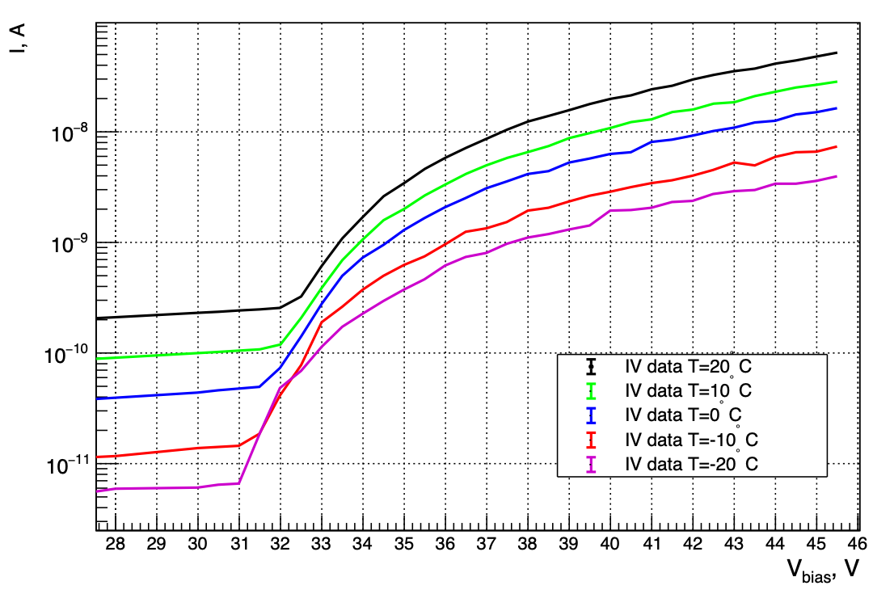
SiPM characterization : IV curves for different mu-cell sizes.
Cell size
Current at same V
V_{bd} as a function temperature
Temperature
V_{bd}
~32.6 V (20°C)
~31.2 V (-20°C)
Temperature coefficient is 33mV/ºC

Slide 12
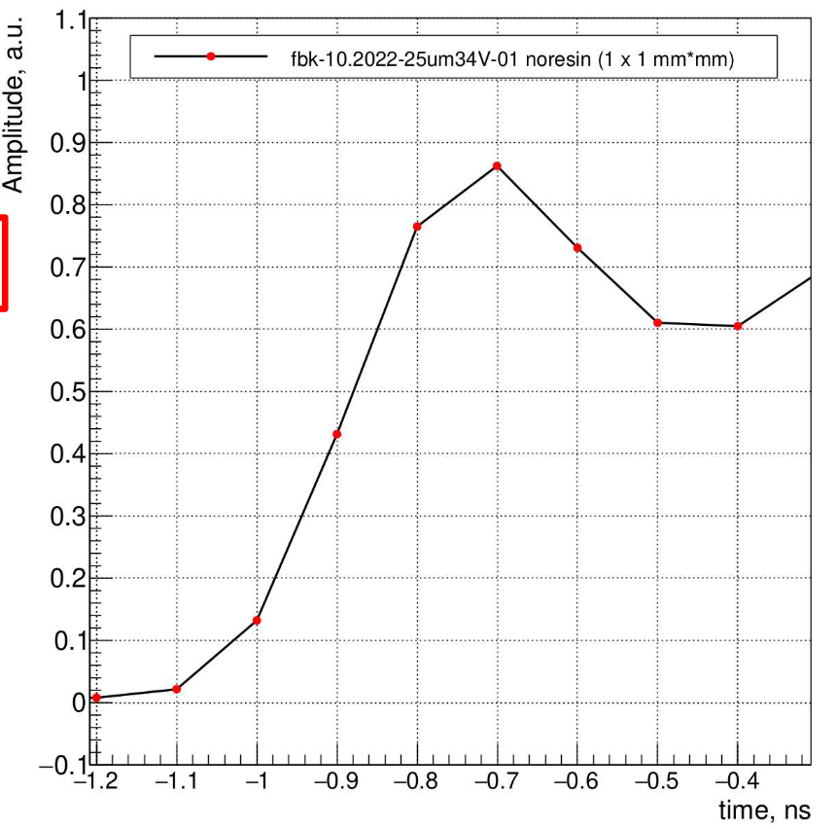
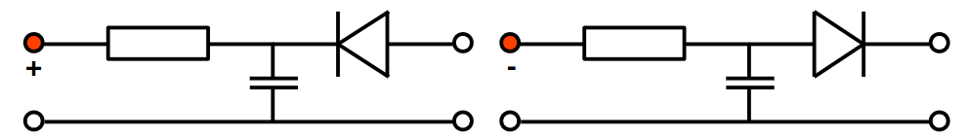
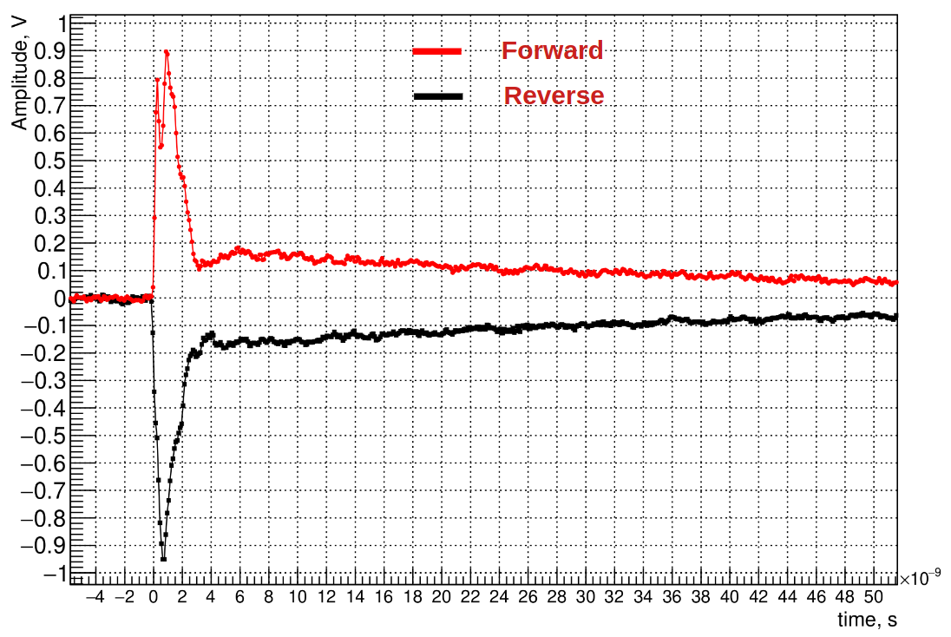
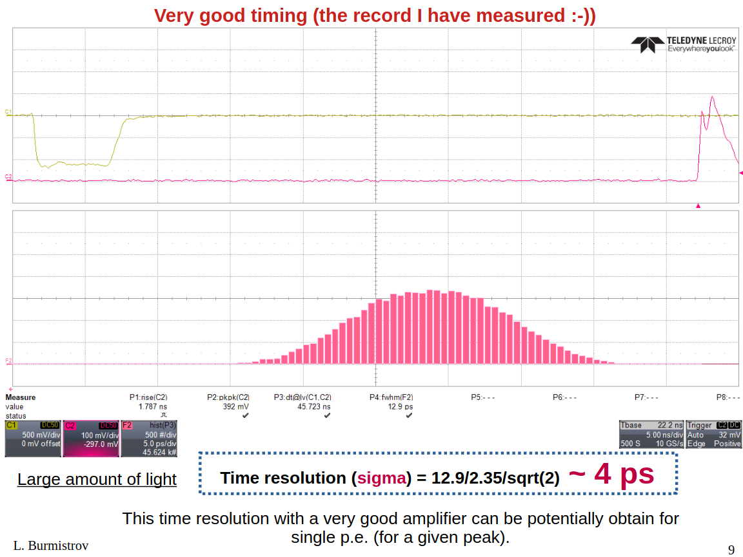
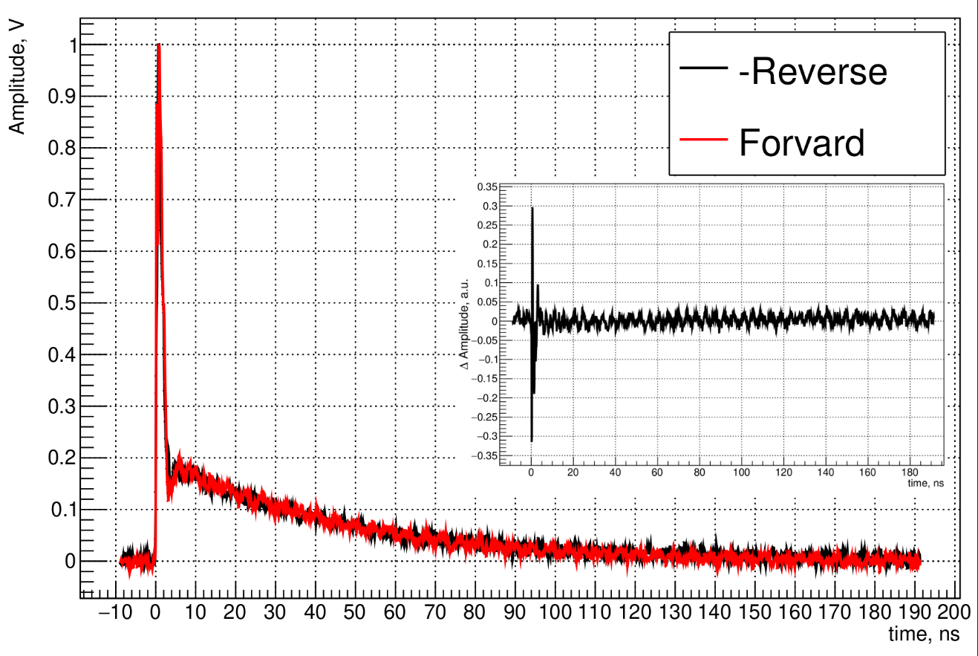
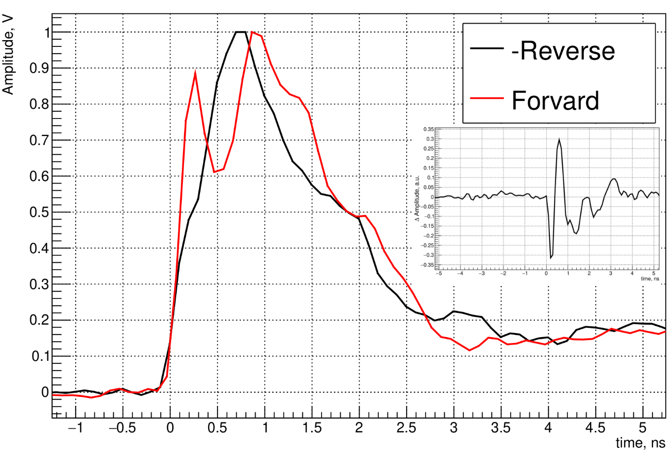
SiPM characterization : response on very large number of photons from laser (~10 ps).
“Forward” (positive)
Reverse (negative)
Rise time of the
signal is 200 ps !!!
Reverse (neg.)
“Forward” (pos.)

Slide 13
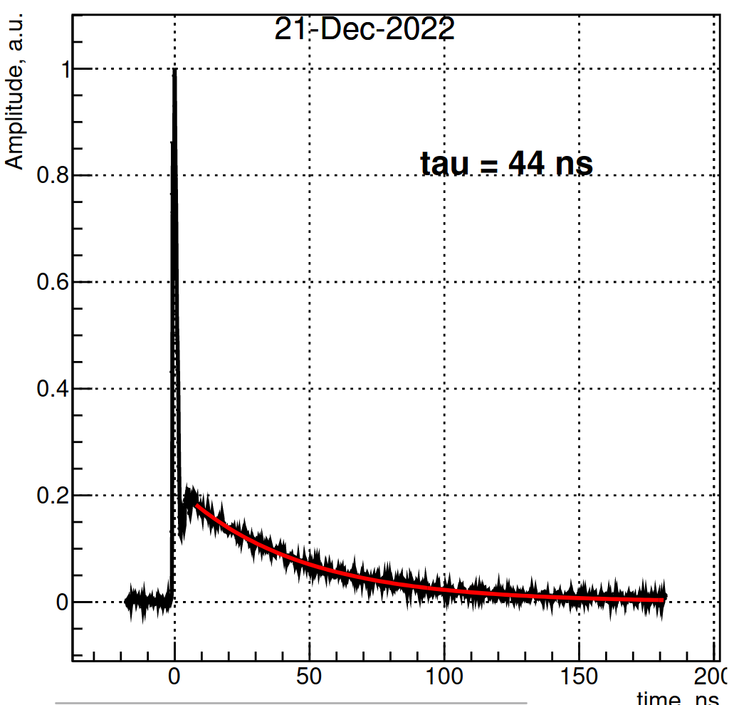
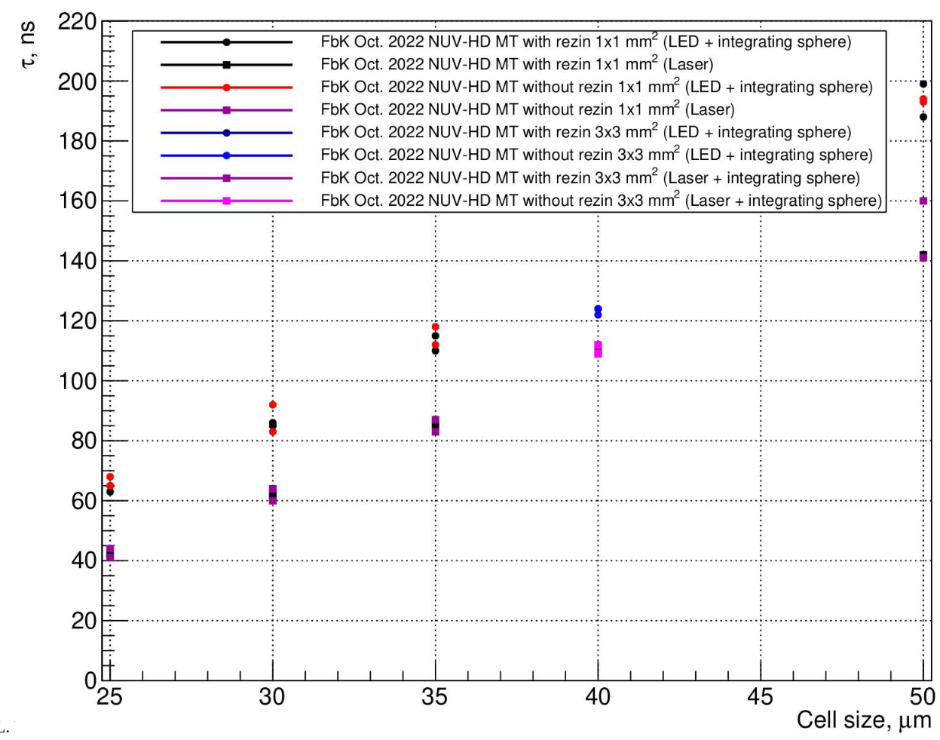
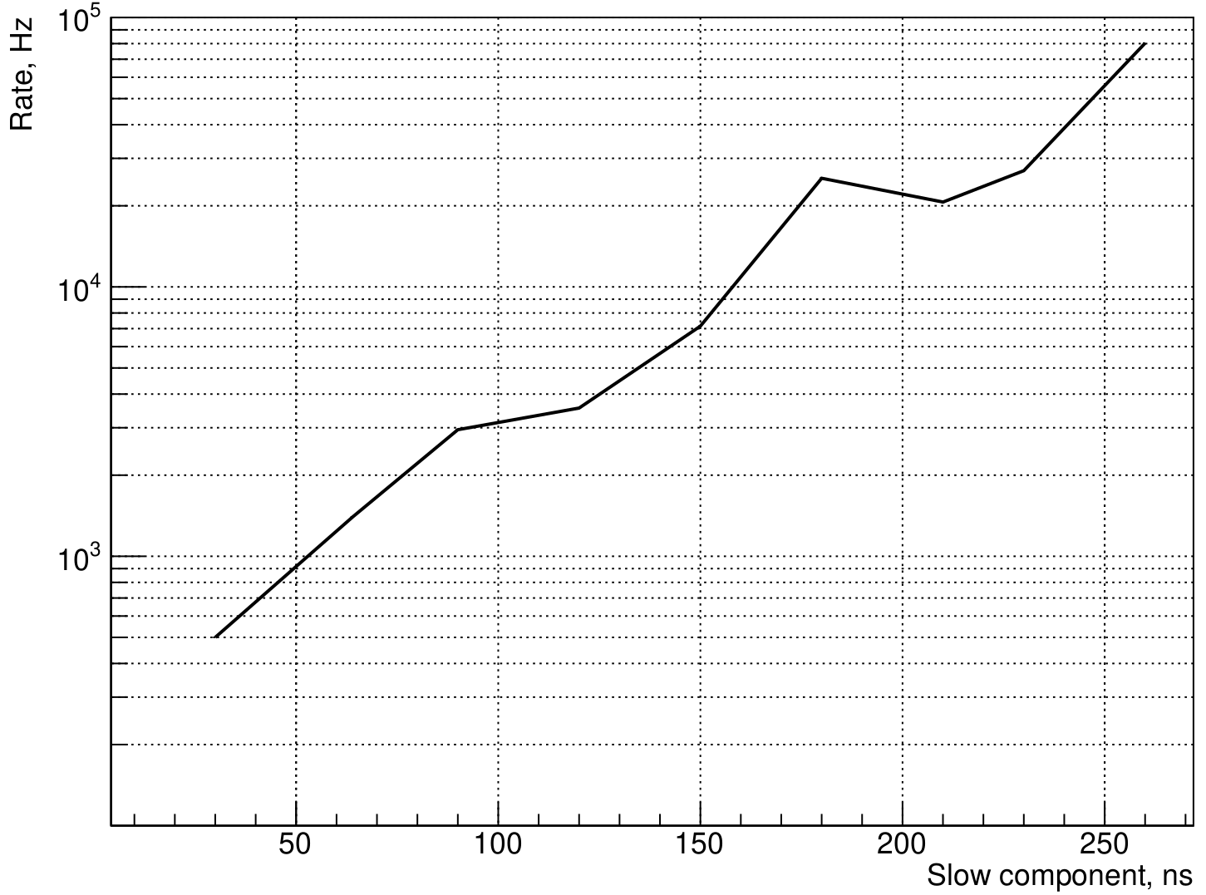
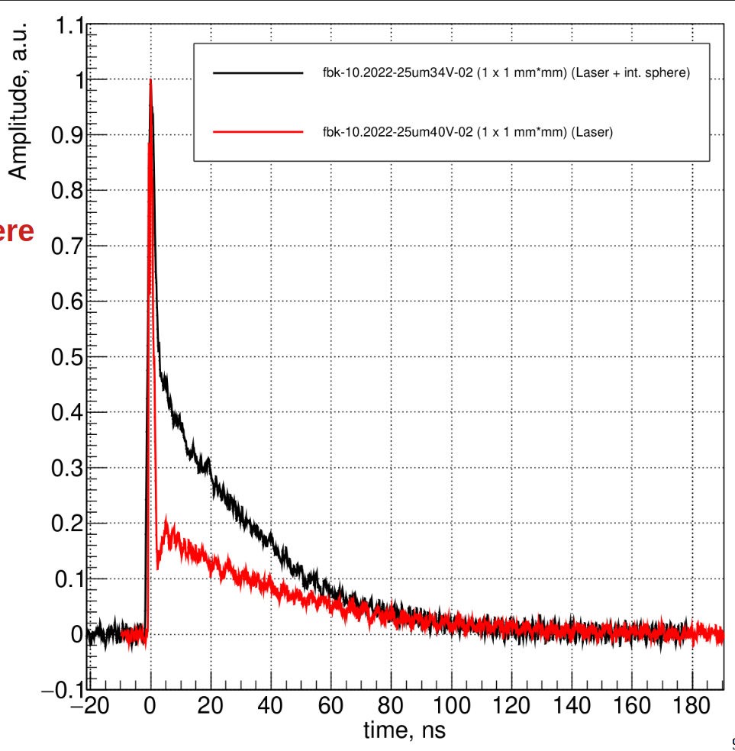
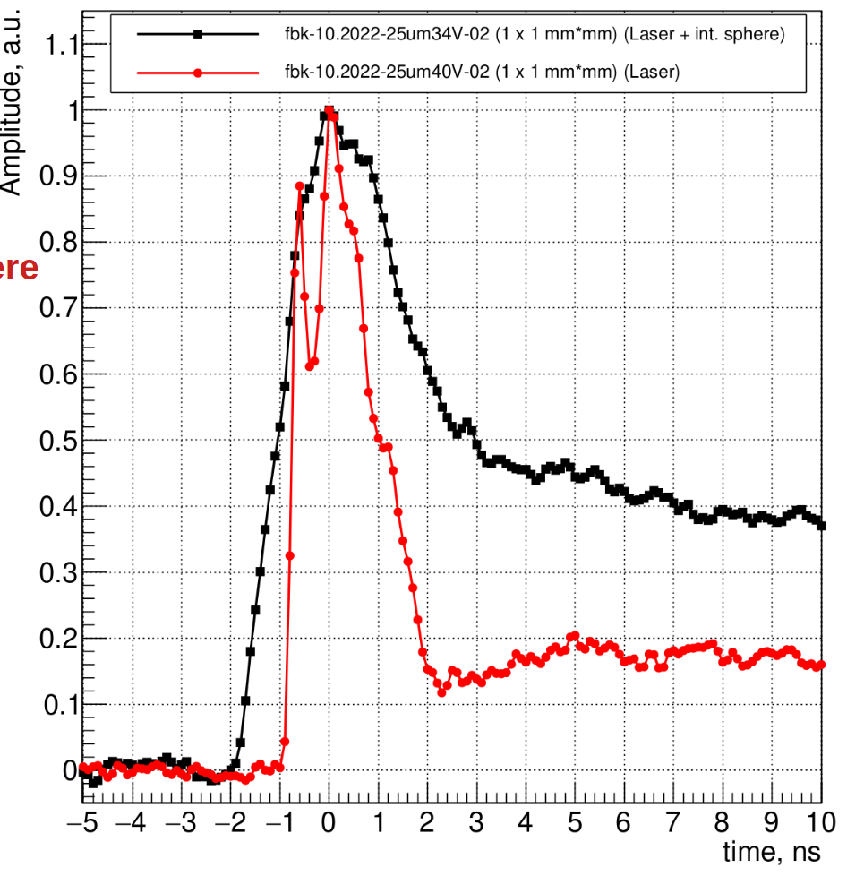
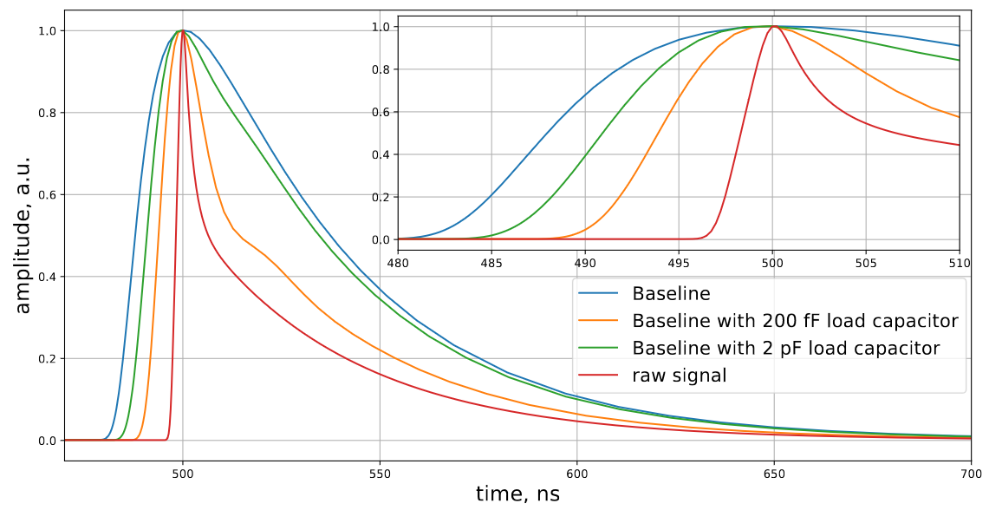
SiPM characterization : decay time of the slow component. Preamplifier optimization.
Normalized single p.e. shape after amplification.
Zoom
Laser vs
Laser + int. sphere

Slide 14
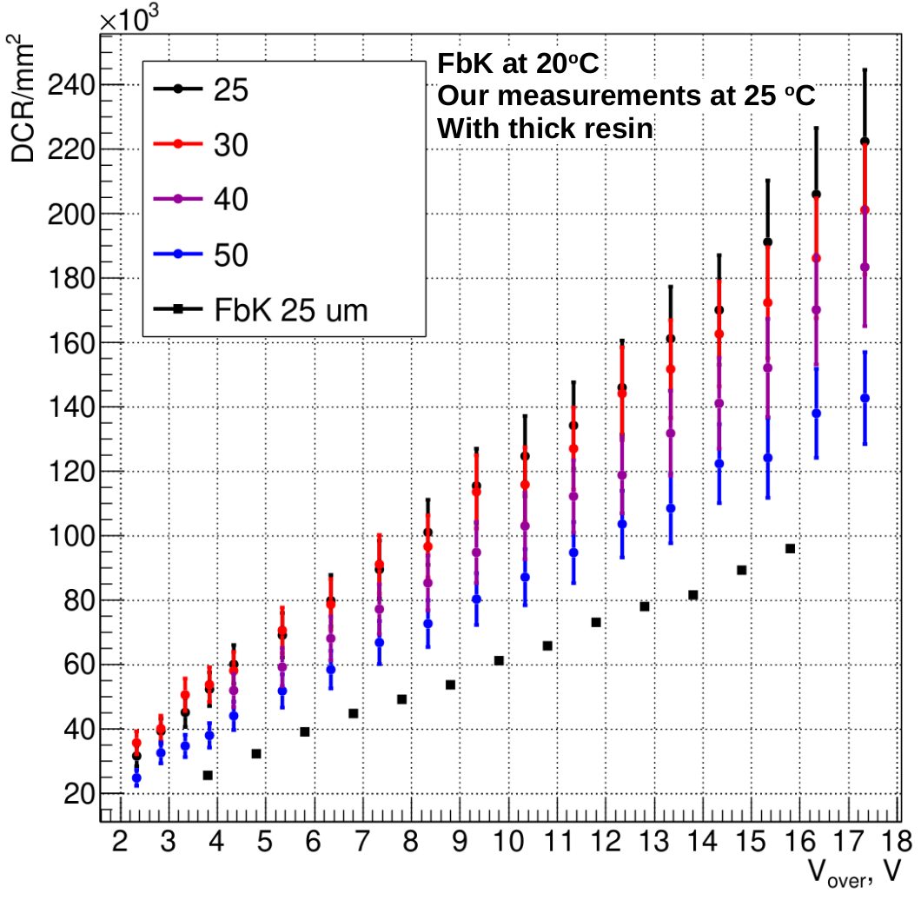
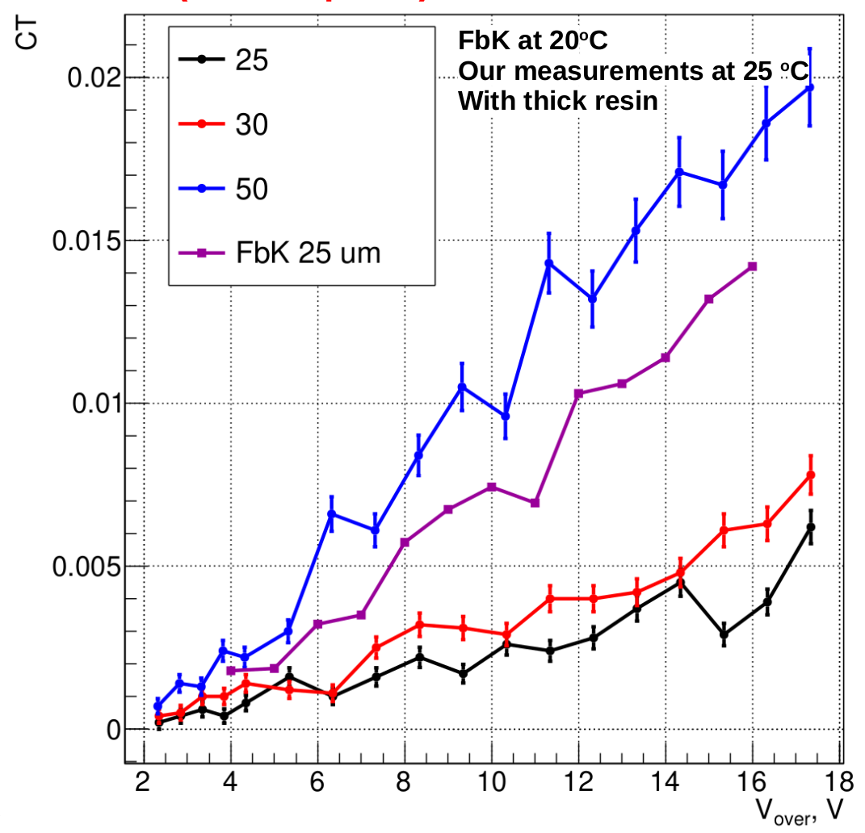
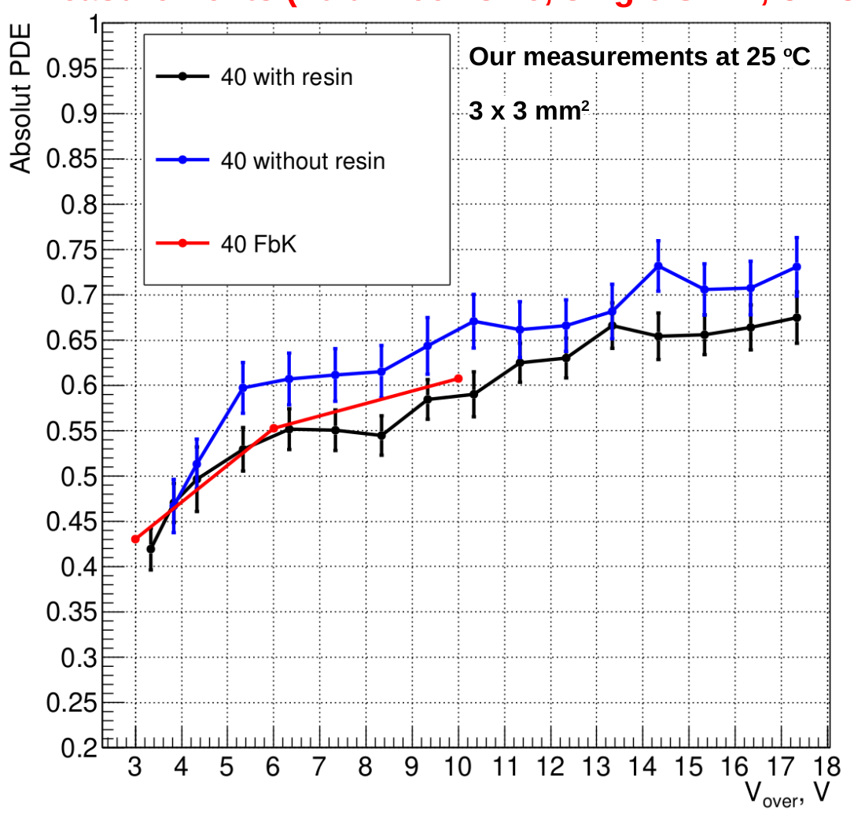
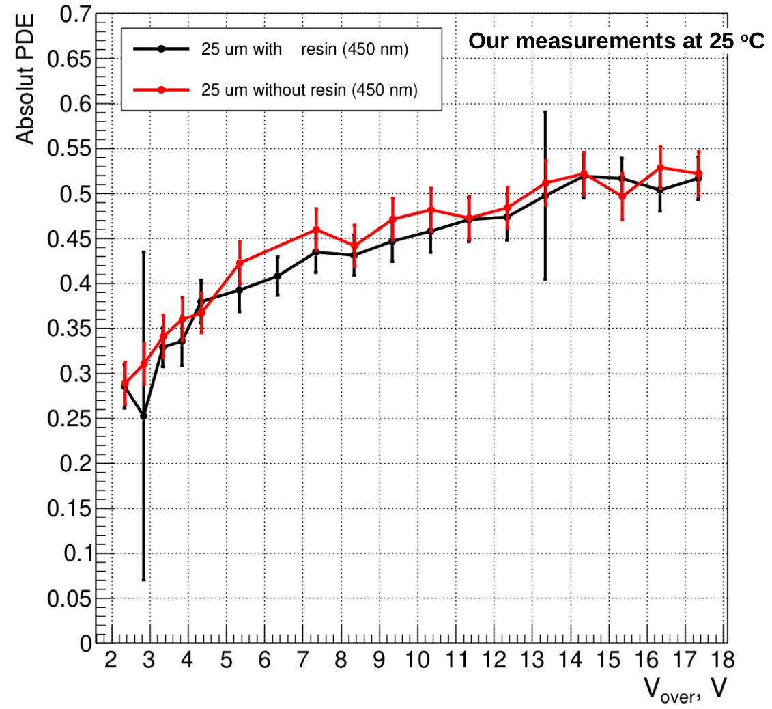
SiPM characterization : DCR (dark current rate), (CT) optical cross-talk, PDE(photo detection eff.)

Slide 15
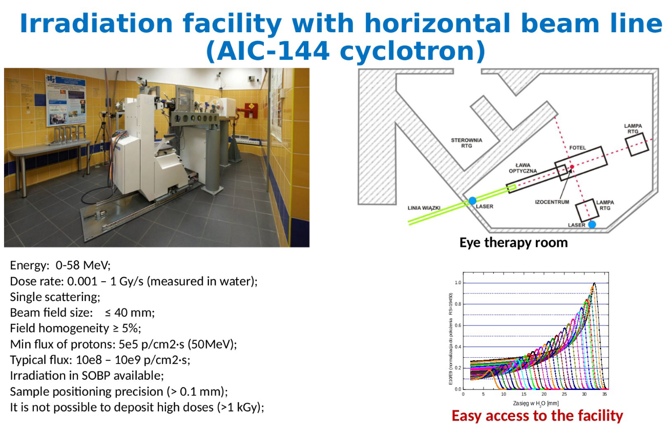
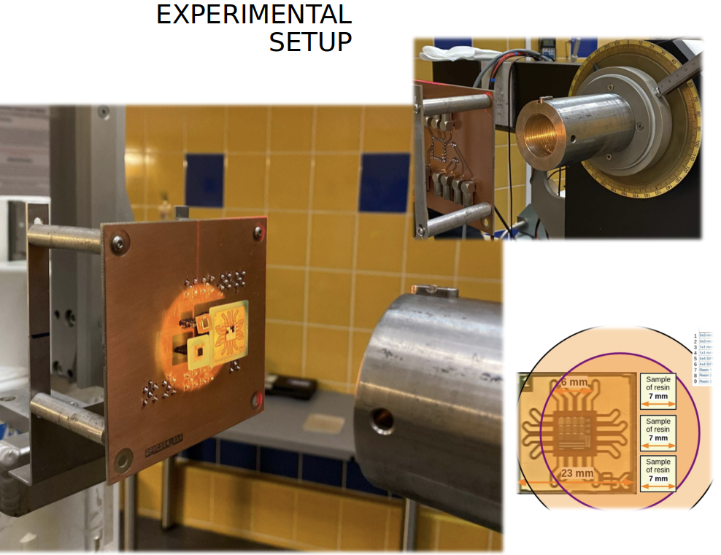
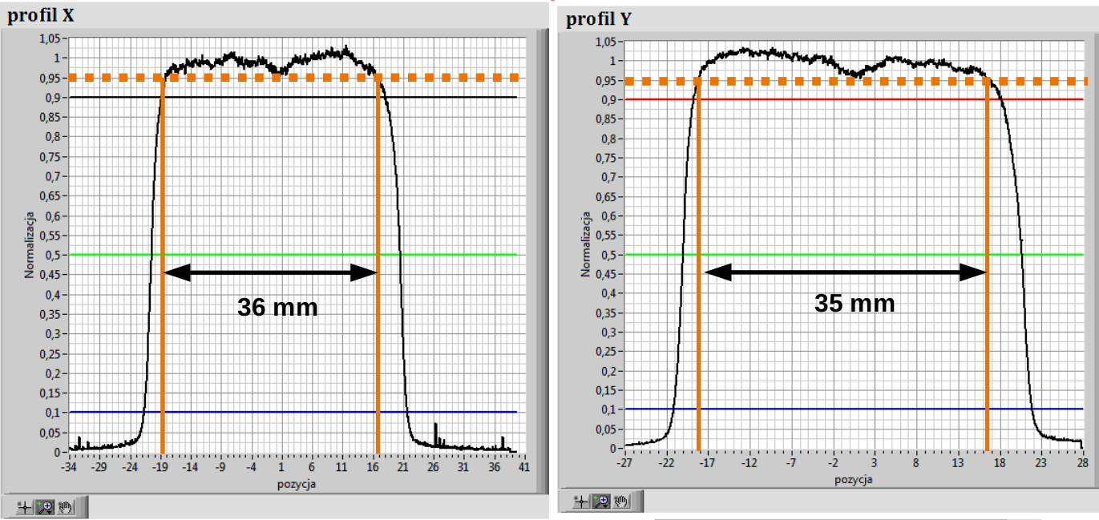
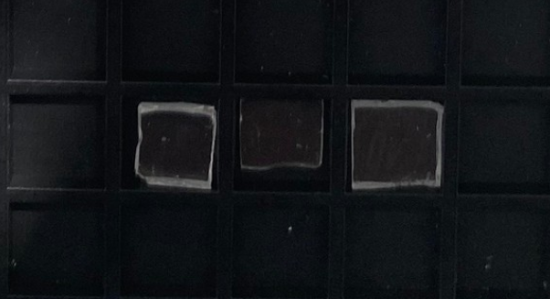
https://web.infn.it/EURO-LABS/
https://www.ifj.edu.pl/
Acknowledgments: IFJ-PAN and Jan Swakon (responsible for proton irradiation campaign).
Resin samples

Slide 16
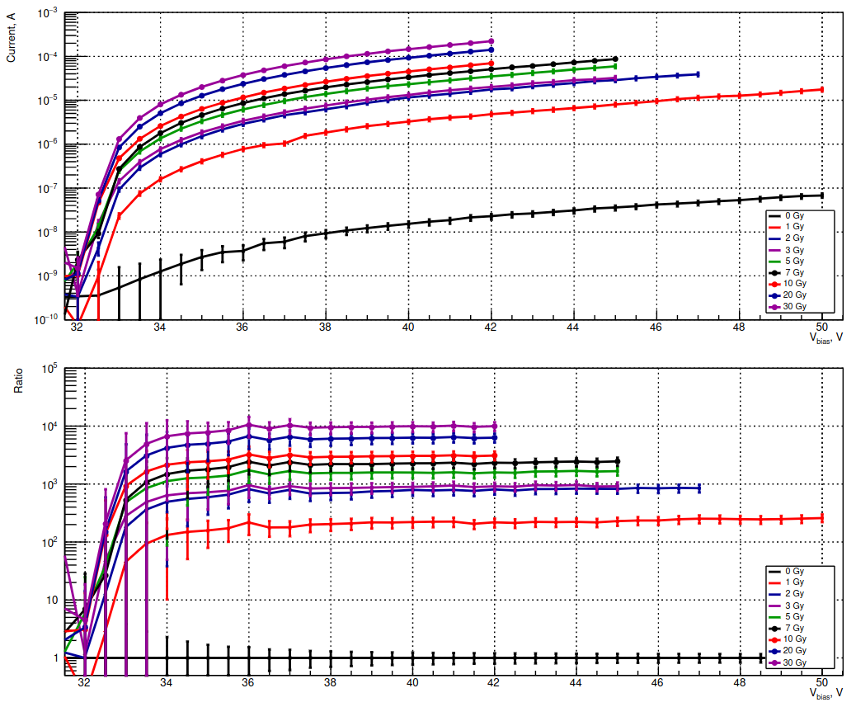
IV measurements after each irradiation step
IV_PCB1_S3_25um_wores_ch01_K2400_n1

Slide 17
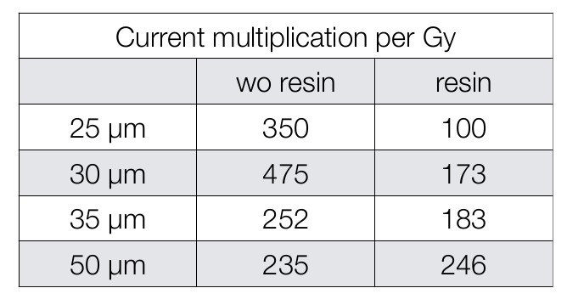


Results after irradiation test
We observe linear increase of the DCR with irradiation dose.
We observe linear increase of the DCR with irradiation dose.
Standard characterization of the SiPM is impossible after irradiation.
The PDE measurements can be done only with large number of photons, as a consequence large systematical are expected for this measurements.
30 % of the expected dose are coming from protons.
We “simulate” 10 years on the orbit (planed mission duration is 3 years).
No optical degradation of the resin samples have been observed.
No change of the quenching resistor has been observed.
No change of the V_{bd} behavior as a function of temperature measured.

Slide 18



Annealing at 40 ºC
The irradiated samples are stored at -20 ºC
to avoid room temperature annealing.
We use the climatic chamber for temperature control.
Dry air
Measurements IV measurements were done every 2-5 hours (excluding nights).
Climatic box, where we can vary the temperature from -20 to 80 ºC

Slide 19





How much light do we produce in the photo sensor window
Amplitude 237 mV @ 10⁶ amplification
Imaging the Fe ion

Slide 20




Bare SiPM or SiPM with thin window ?
Thikness of the protective window 400 – 40 mum
Can we make it thinner ? 10 mum ?
Can we completely remove it ?
Window
Perpendicular track at maximum will produce 4 p.e. equivalent signal
If the bare surface is not planar very thin resin can form micro-lenses need to have additional R&D.
Mu-cell operates in geiger mode
This effect can be vanished by removing the window :-) ...

Slide 21


Conclusions
SiPM are promising photo sensors to be used for space base experiments.
We present full chain of different activities for Terzina telescope on board the NUSES space mission.
We present the parametric simulation of the SiPM used in the full simulation chain.
We characterize SiPM with different mu-cell sizes with and without resin.
The radiation test with 50 MeV protons up to 30 Gy integrated dose (corresponds to 10 years on the orbit).
SiPM annealing at 40 ºC has been studied.

Slide 22
Backup

Slide 23
Cathode
Rq
APD
Anode

