Slide 1



Expected radiation dose
to the triplets/D1
Francesco Cerutti
1st Meeting of the LHC Triplet Task Force 2022 October 14th

Slide 2
OUTLINE
Radiation origin and measurements
Dose in the ATLAS and CMS triplet coils: a recap
Assumptions
Forecast
The separation dipole (warm D1), the Matching Section and the Dispersion Suppressor
LHCb
Ion operation (ALICE)

Slide 3
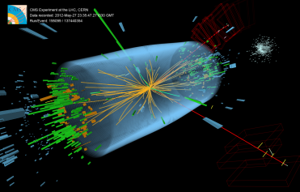

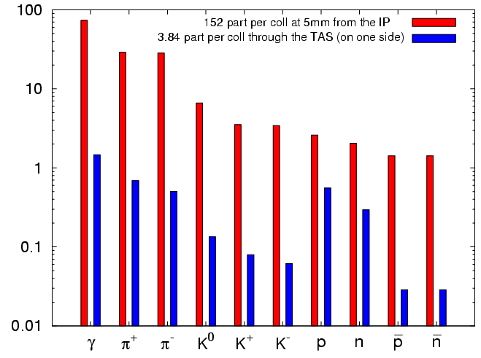

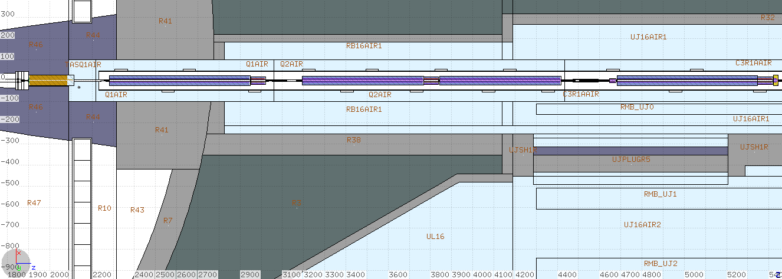
THE RADIATION SOURCE
7 TeV p + 7 TeV p
with 7.5 10⁻¹⁰
Higgs bosons
proton-proton inelastic reaction
@ 10³⁴ cm⁻² s⁻¹ , i.e. 8.5 10⁸ s⁻¹ inelastic collision rate
950 W towards each (L&R) side
150 W absorbed in the TAS absorber
650 W going through the TAS
of which
150 W absorbed in the triplet
cold magnets
with 6.5 TeV beams (80mb) ~125 W (magnet end uncertainties) prediction at 10³⁴ cm⁻² s⁻¹
vs 115-135 W measurements (TE-CRG-OP) in the triplet cold mass

Slide 4
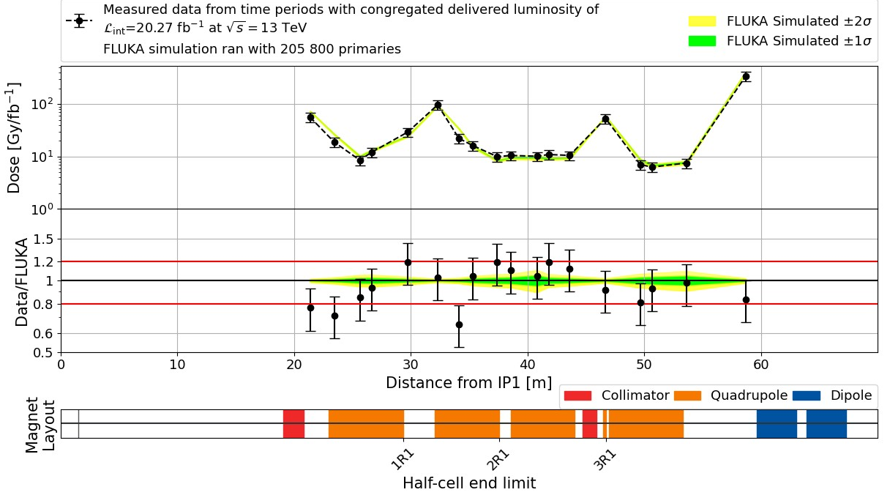
BLM VALIDATION
2018
6.5 TeV beams
[D. Prelipcean, in Phys. Rev. AB 25, 091001 (2022)]

Slide 5
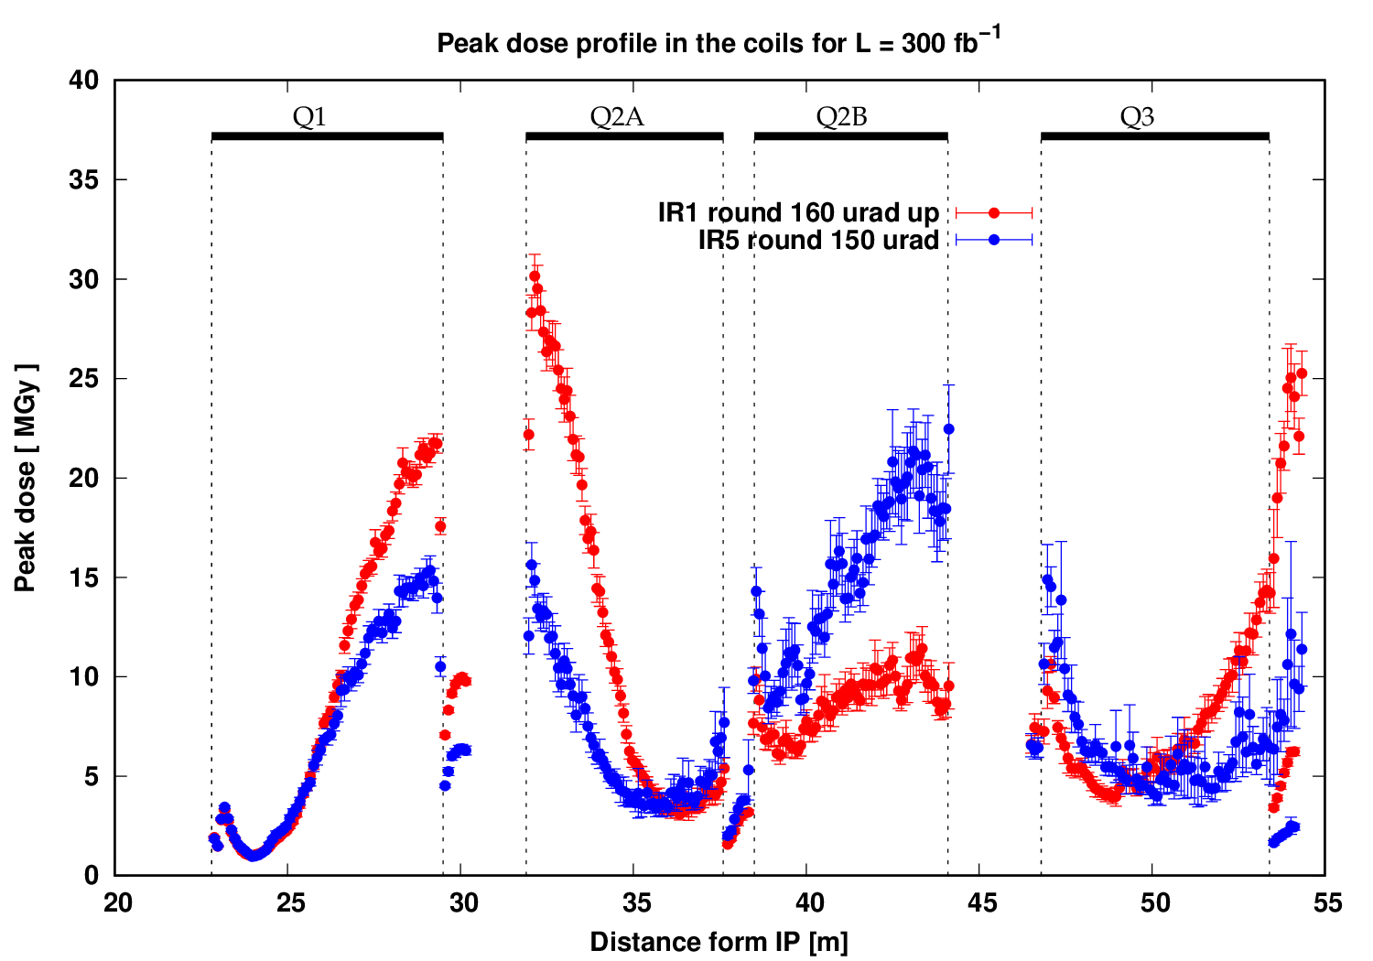
THE DOSE IN THE COILS [I]
p-p @√s=14 TeV
85 mb inel xs
correctors:
MCBX: larger aperture
MQSX: coils off mid planes
MC S/T X & MC O/OS/SS X
Dose distribution is not constant

Slide 6
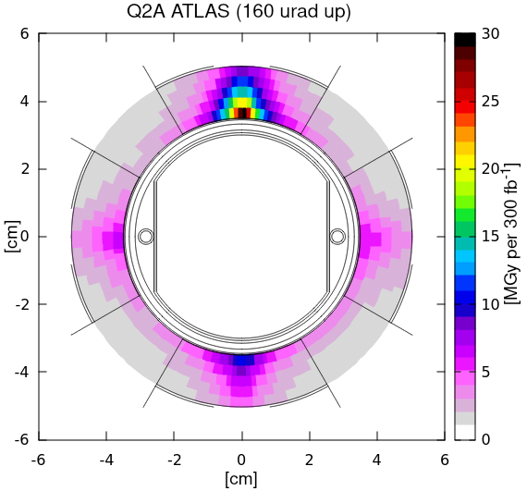
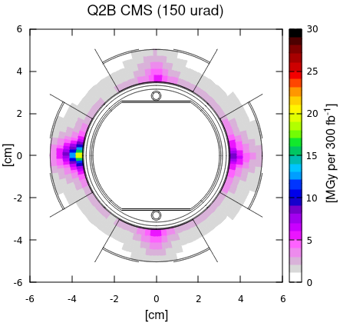
THE DOSE IN THE COILS [II]
p-p @√s=14 TeV
85 mb inel xs
x
x
regular inversion of the crossing angle polarity in ATLAS [LMC #225, 2015 Jul 8th]

Slide 7
THE DOSE IN THE COILS [III]
The peak dose values here reported are obtained with a resolution of about 3 mm in radius, 2° in azimuthal angle and 10 cm along the magnet length, namely averaging over a volume of less than 0.4 cm³ in the triplet quadrupole coils.
As for uncertainty management, in the related case of quench limit (mW/cm³), a safety factor of 3 was taken at design between the expected quench limit and the simulated peak power density (averaged over the whole radial thickness of the coils). On the contrary, no safety factor was taken for long term damage.

Slide 8
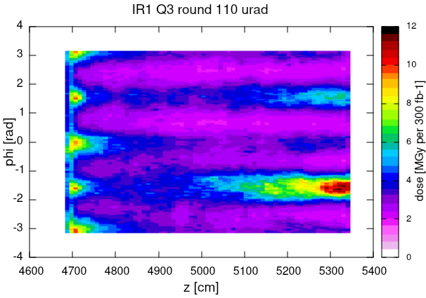
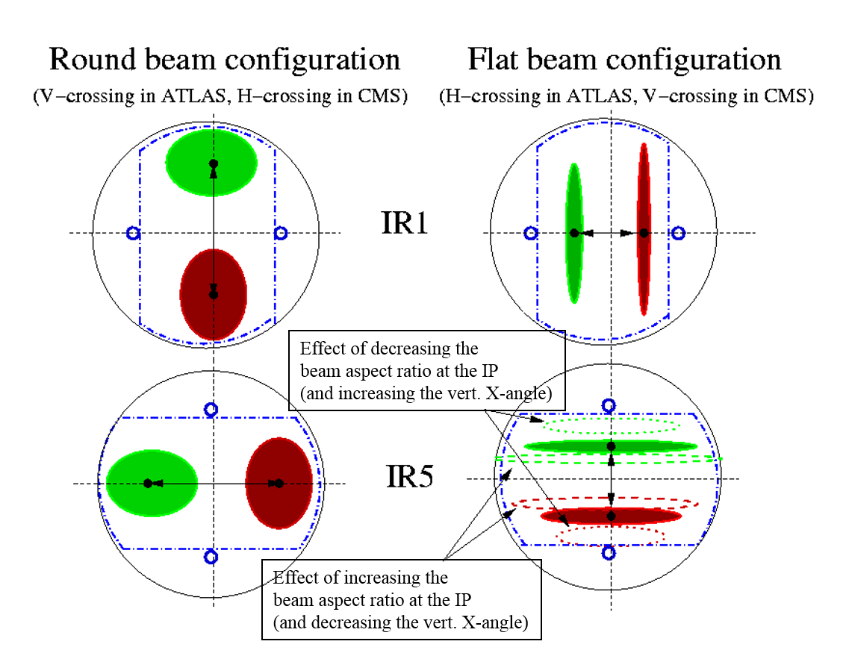
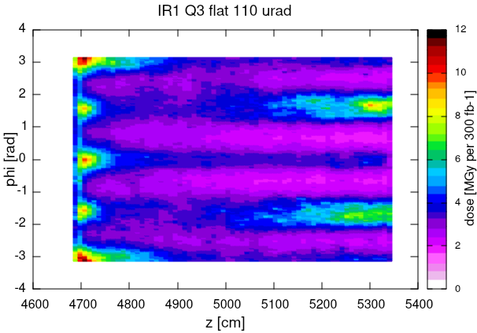
p-p @√s=14 TeV
85 mb inel xs
A MULTIDIMENSIONAL
PROBLEM
π/2
Relevant parameters:
beam energy
crossing plane
vertical crossing angle sign
crossing angle value
beam screen orientation
x
π
0
3π/2
Independence from b*,
i.e. beam divergence and luminous region size
not considered for Run 3
(substantial benefit only in IR5 thanks to the polarity inversion
and lower crossing angle)
π/2
π
x
0
3π/2
Each configuration has to be weighted
with the respective integrated lumi

Slide 9
RUN 3 SCENARIO
 | up to now | 2022 | 2023 | 2024 | 2025 | reaching
beam energy [TeV] |  | 6.8 |  |  | 6.8
integrated lumi [fb⁻¹] | 190 | 35 | 85 | 85 | 85 OR 42.5 + 42.5 | 480
lumi averaged half cross. angle [urad] |  | -156 (-160) | -149 (-160) | +149 (+160) | +149 / +149 -149 (+160) / (+160) (-160)

Slide 10
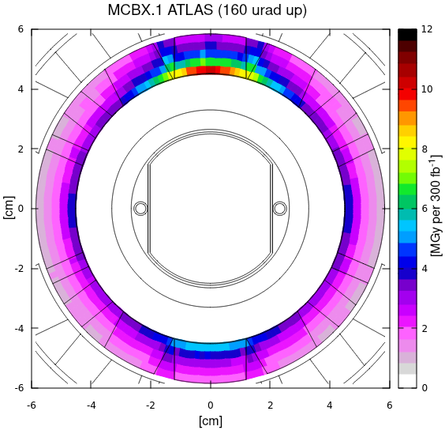
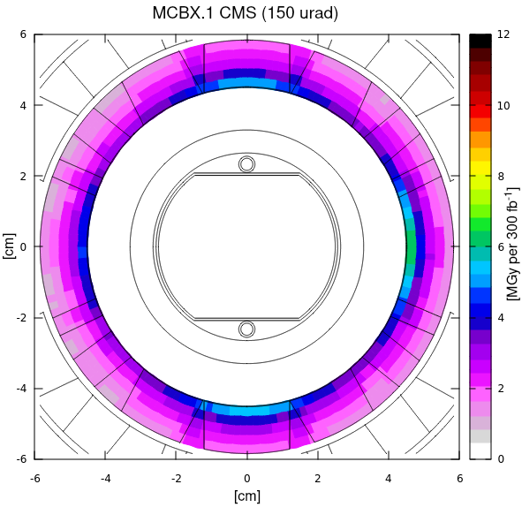
MCBX1
Dose on the external coil layer (that provides the horizontal kick) is not shown but remains below 4 MGy per 300 fb⁻¹
As for the internal coil layer (that provides the vertical kick), the coil region is in the vertical plane, where the peak lies
 | up to now | up to 2024 end
integrated lumi [fb⁻¹] | 190 | 395
IR1 up [MGy] | 4 | 8.5 (8.5)
IR1 down [MGy] | 3.5 | 8.5 (8.5)
IR5 up [MGy] | 2.5 | 6
IR5 down [MGy] | 2.5 | 6
IR5 outward [MGy] | 3 | 7 (7.5)
In case of horizontal crossing (CMS), the peak lies outside the coil region
p-p @√s=14 TeV
85 mb inel xs

Slide 11
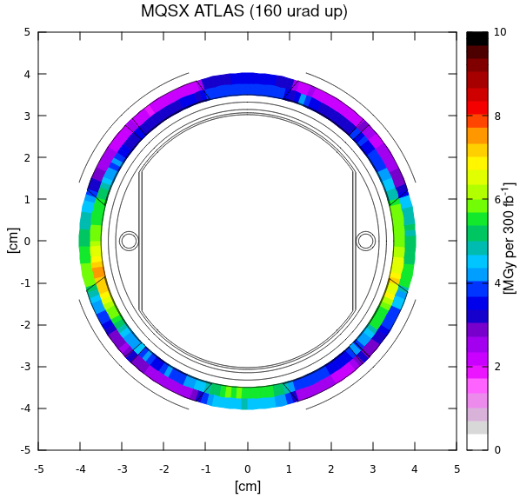
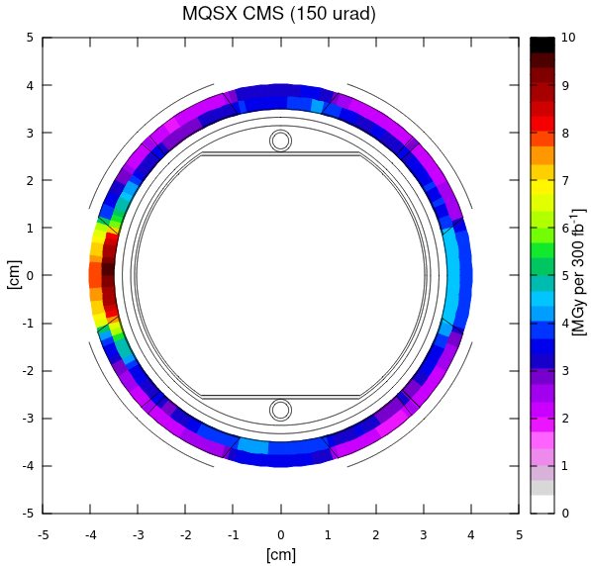
MQSX
p-p @√s=14 TeV
85 mb inel xs
 | up to now | up to 2024 end
integrated lumi [fb⁻¹] | 190 | 395
IR1 up [MGy] | 3 | 7 (7)
IR1 down [MGy] | 3.5 | 7.5 (7.5)
IR5 inward [MGy] | 3.5 | 8 (8)
In case of horizontal crossing (CMS), the peak lies outside the coil region

Slide 12
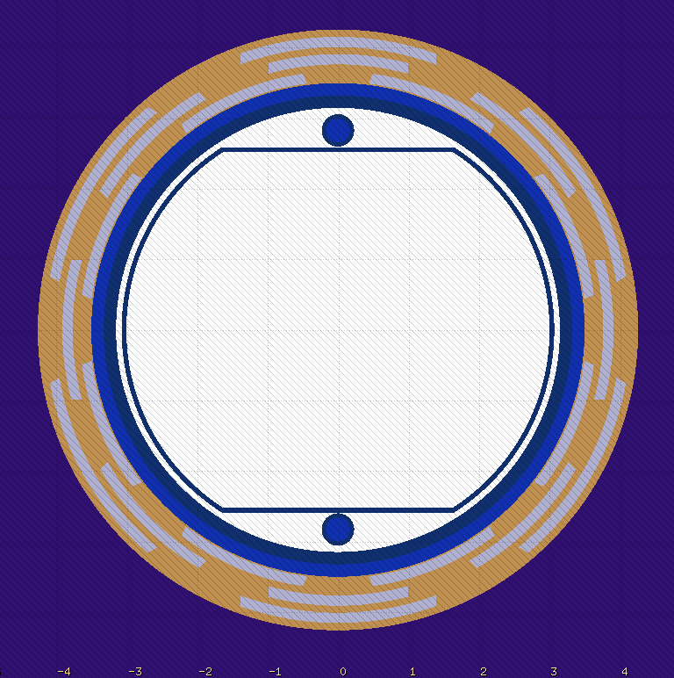
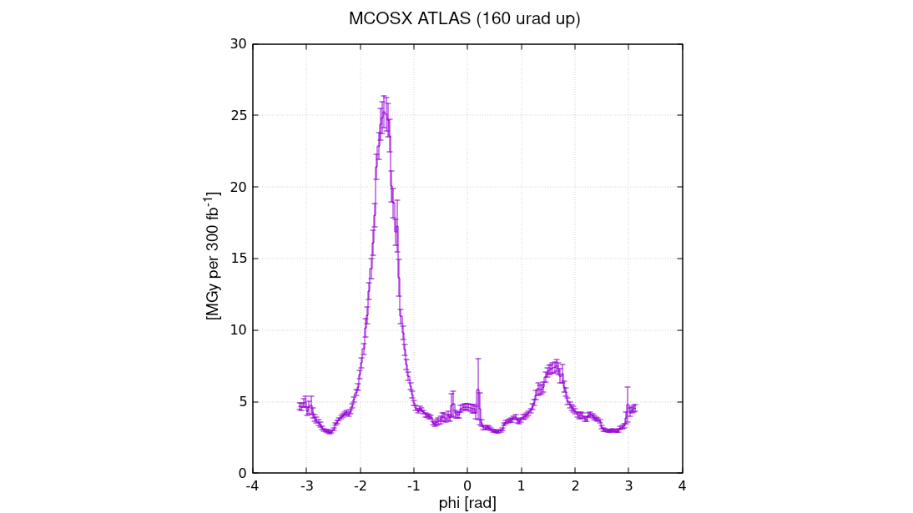
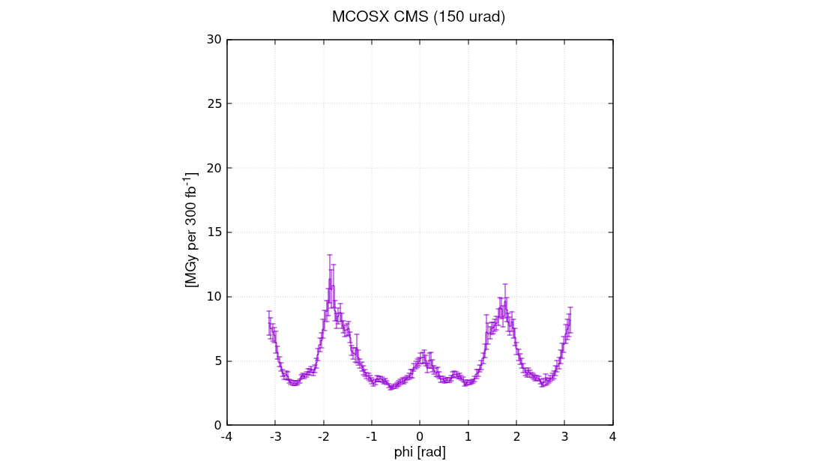
MCOSX3
inner layer
In IR1, the peak dose on the skew octupole coils is expected to have already challenged the reference limit
 | up to now
integrated lumi [fb⁻¹] | 190
IR1 up [MGy] | 5.5
IR1 down [MGy] | 7.5
IR5 up [MGy] | 4
IR5 down [MGy] | 4
IR5 inward [MGy] | 3
up to 2024 end
395
14.5 (15)
15 (15)
9
9
7 (7.5)
phi = p/2
phi = ± p
phi = 0
phi = - p/2
The peaks lie outside the coil region
p-p @√s=14 TeV
85 mb inel xs

Slide 13
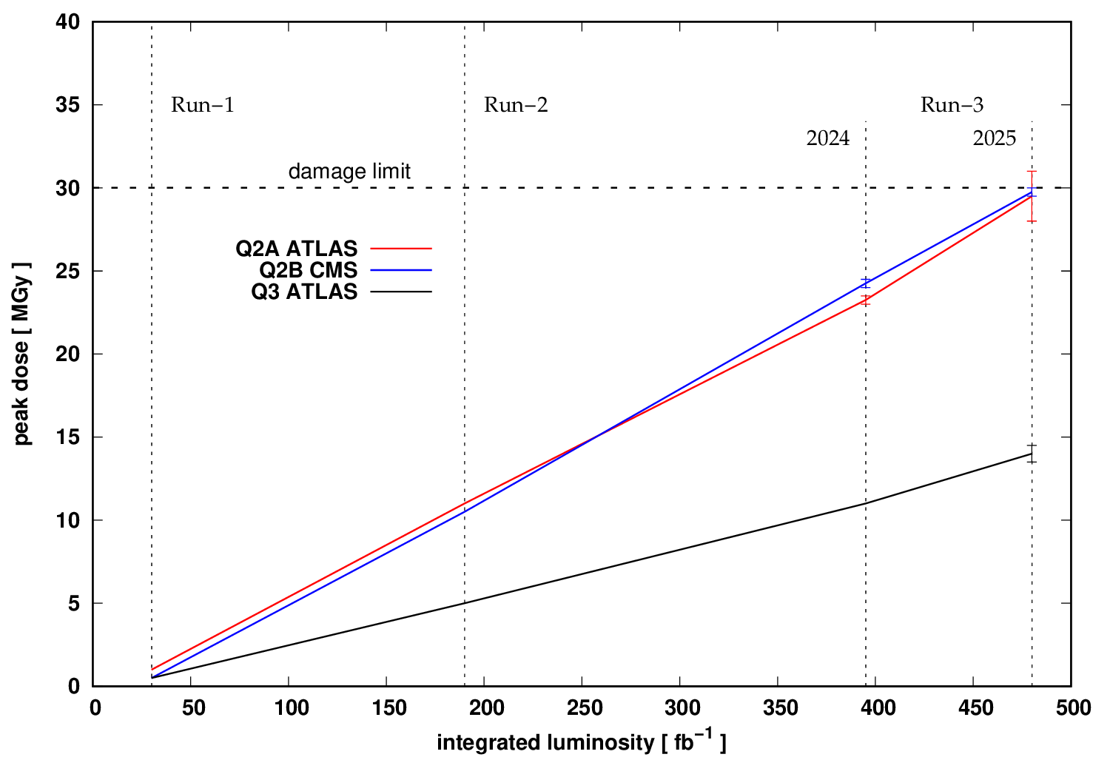
IN SUMMARY: MAIN QUADRUPOLES
error bars reflect the margin given by the crossing angle variation along the fill and mostly
the IR1 polarity inversion in the middle of 2025

Slide 14
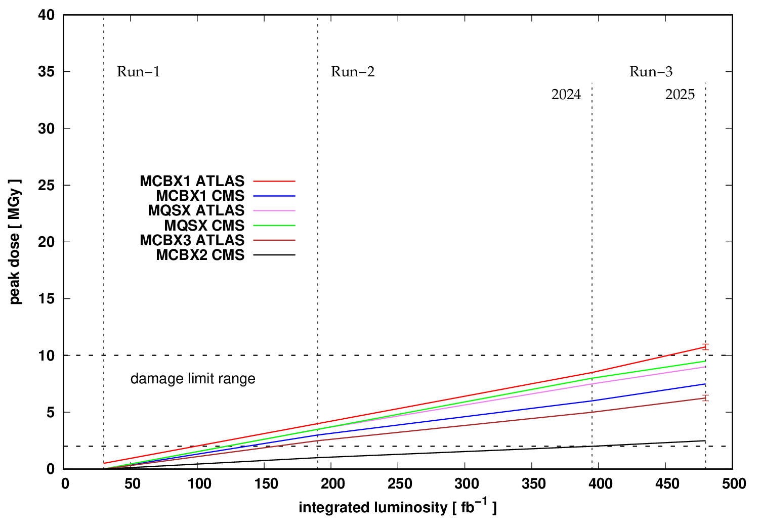
IN SUMMARY: MCBX & MQSX
error bars reflect the margin given by the crossing angle variation along the fill and mostly
the IR1 polarity inversion in the middle of 2025

Slide 15
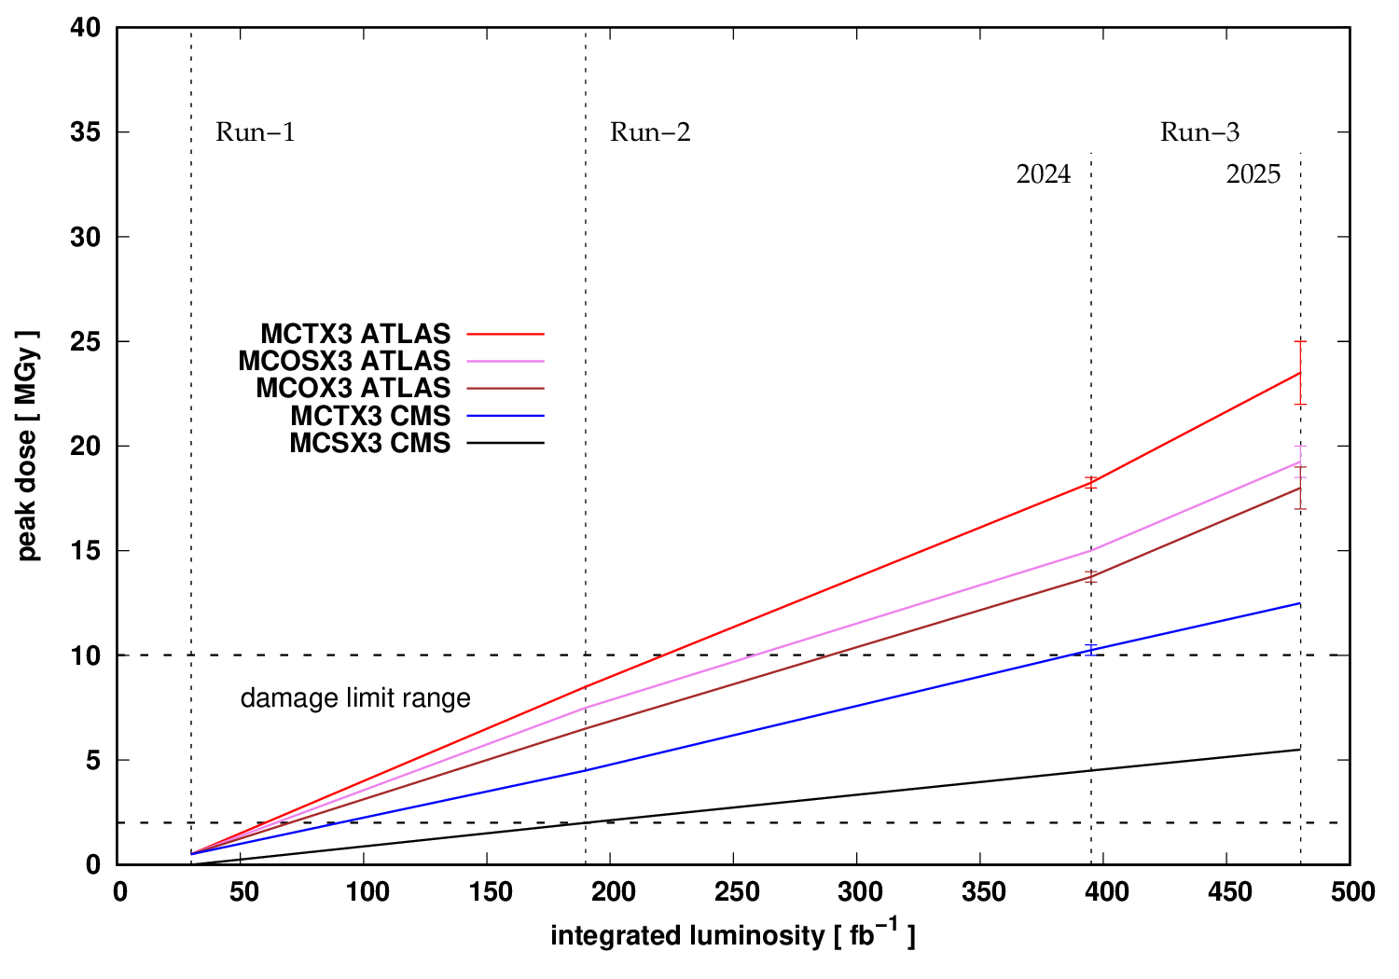
IN SUMMARY: HIGHER ORDER CORRECTORS
error bars reflect the margin given by the crossing angle variation along the fill and mostly
the IR1 polarity inversion in the middle of 2025

Slide 16
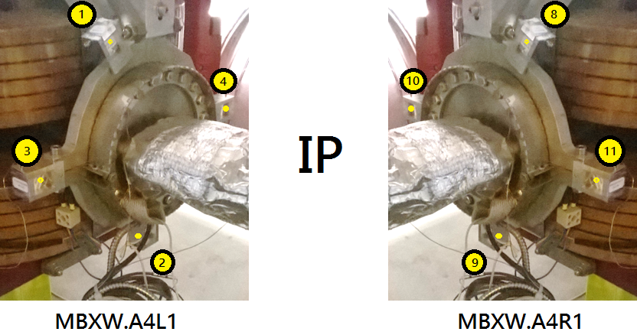
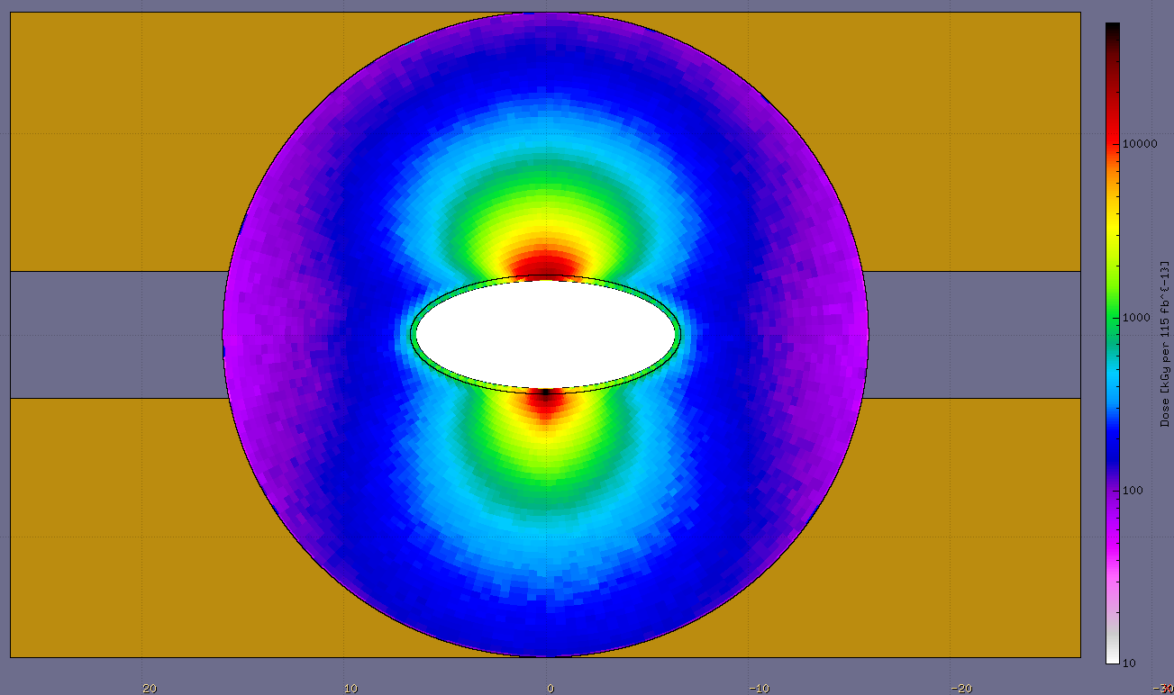
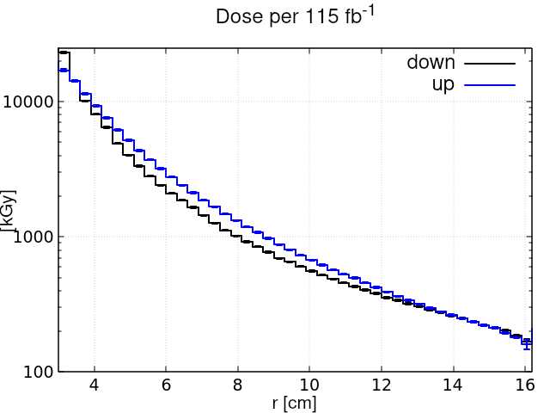
WHAT ABOUT THE D1? [I]
[Inigo Sancho Fernandez et al. ]
2017+2018 DOSE (KGy per 115 fb⁻¹)
1: 40 8: 50 120-135 (!)
2: 45 9: 90 (!) 160-175 (!)
3: 50 11: 55 50-70
4: 70 10: 15 (!) 50-70
(!) data asymmetry
(!) simulation overestimation
ATLAS
8
50 MGy
peak in the front coil
10
11
dosimeter
location
10 kGy
9

Slide 17
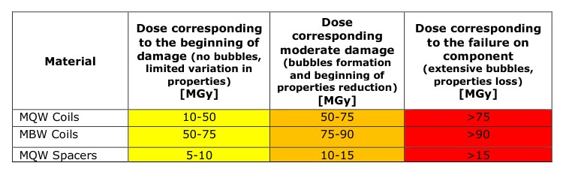
WHAT ABOUT THE D1? [II]
MBXW.A4 | up to now | up to 2024 end | + 2025 (as 2023/2024)
integrated lumi [fb⁻¹] | 190 | 395 | 480
IR1 [MGy] | 30 | 70 | 85
[Paolo Fessia, LMC #309, 2017 Jun 28th]
Shield installation under consideration

Slide 18
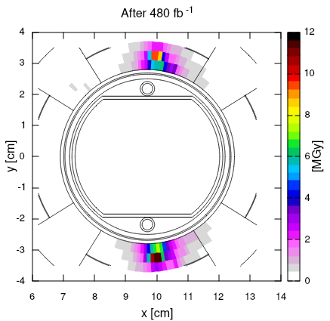
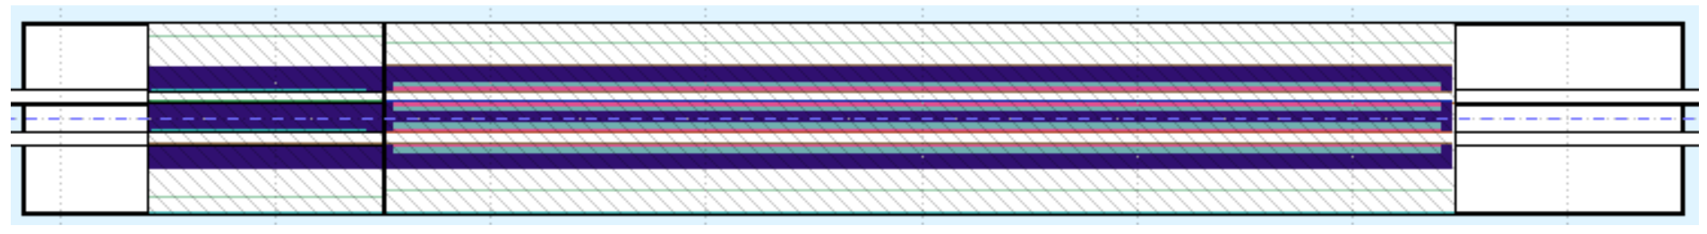
THE REST OF THE INSERTION …
The highest peak dose is expected to be reached on the IP side of the Q5 assembly in IR5 (CMS):
with TCL4 @ 19 σ
up to ~10 MGy in the quadrupole on the right side, with quite some sensitivity to TCL4 collimator half-gap (from 1 to 11 MGy as opening from 14 to 19 σ);
for the weaker MCBC corrector on the left side, this peak is outside the coil region
R5.B1
MQML5/6 MCBC MQML 5/6 MCBC
IP5
… AND THE DS
The second peak is in the half cell 9 corrector on the left side of ATLAS and CMS: almost 2 MGy after 480 fb⁻¹

Slide 19
SUMMARY
The regular inversion of the crossing angle polarity in ATLAS allows to accumulate a total of about 400 fb⁻¹ without exceeding – apart from systematic uncertainties – the 30 MGy reference limit for the main quadrupoles. The β* levelling at non constant (minimal) crossing angle offers a few percent additional margin.
An additional Run-III year (with 85 fb⁻¹ more), bringing the total integrated luminosity close to 500 fb⁻¹, would lead to reaching the above dose limit. In this case, the change of polarity in ATLAS mid 2025 (after achieving half of the annual lumi) is recommended.
Assuming a limit of 6 MGy for the corrector magnets in the triplet, this is expected to be reached in the four MCBX.1 and four MQSX by the end of 2024 and (largely) surpassed by then in the octupoles and dodecapoles (around ATLAS).
The most impacted D1 module (MBXW.A4 left and right of ATLAS) is expected to be locally subject to mild damage by the end of 2024, rising to moderate damage after an additional year.
For the weak points in the MS and DS (MCBC correctors), timely solutions are planned for HL-LHC.

Slide 20
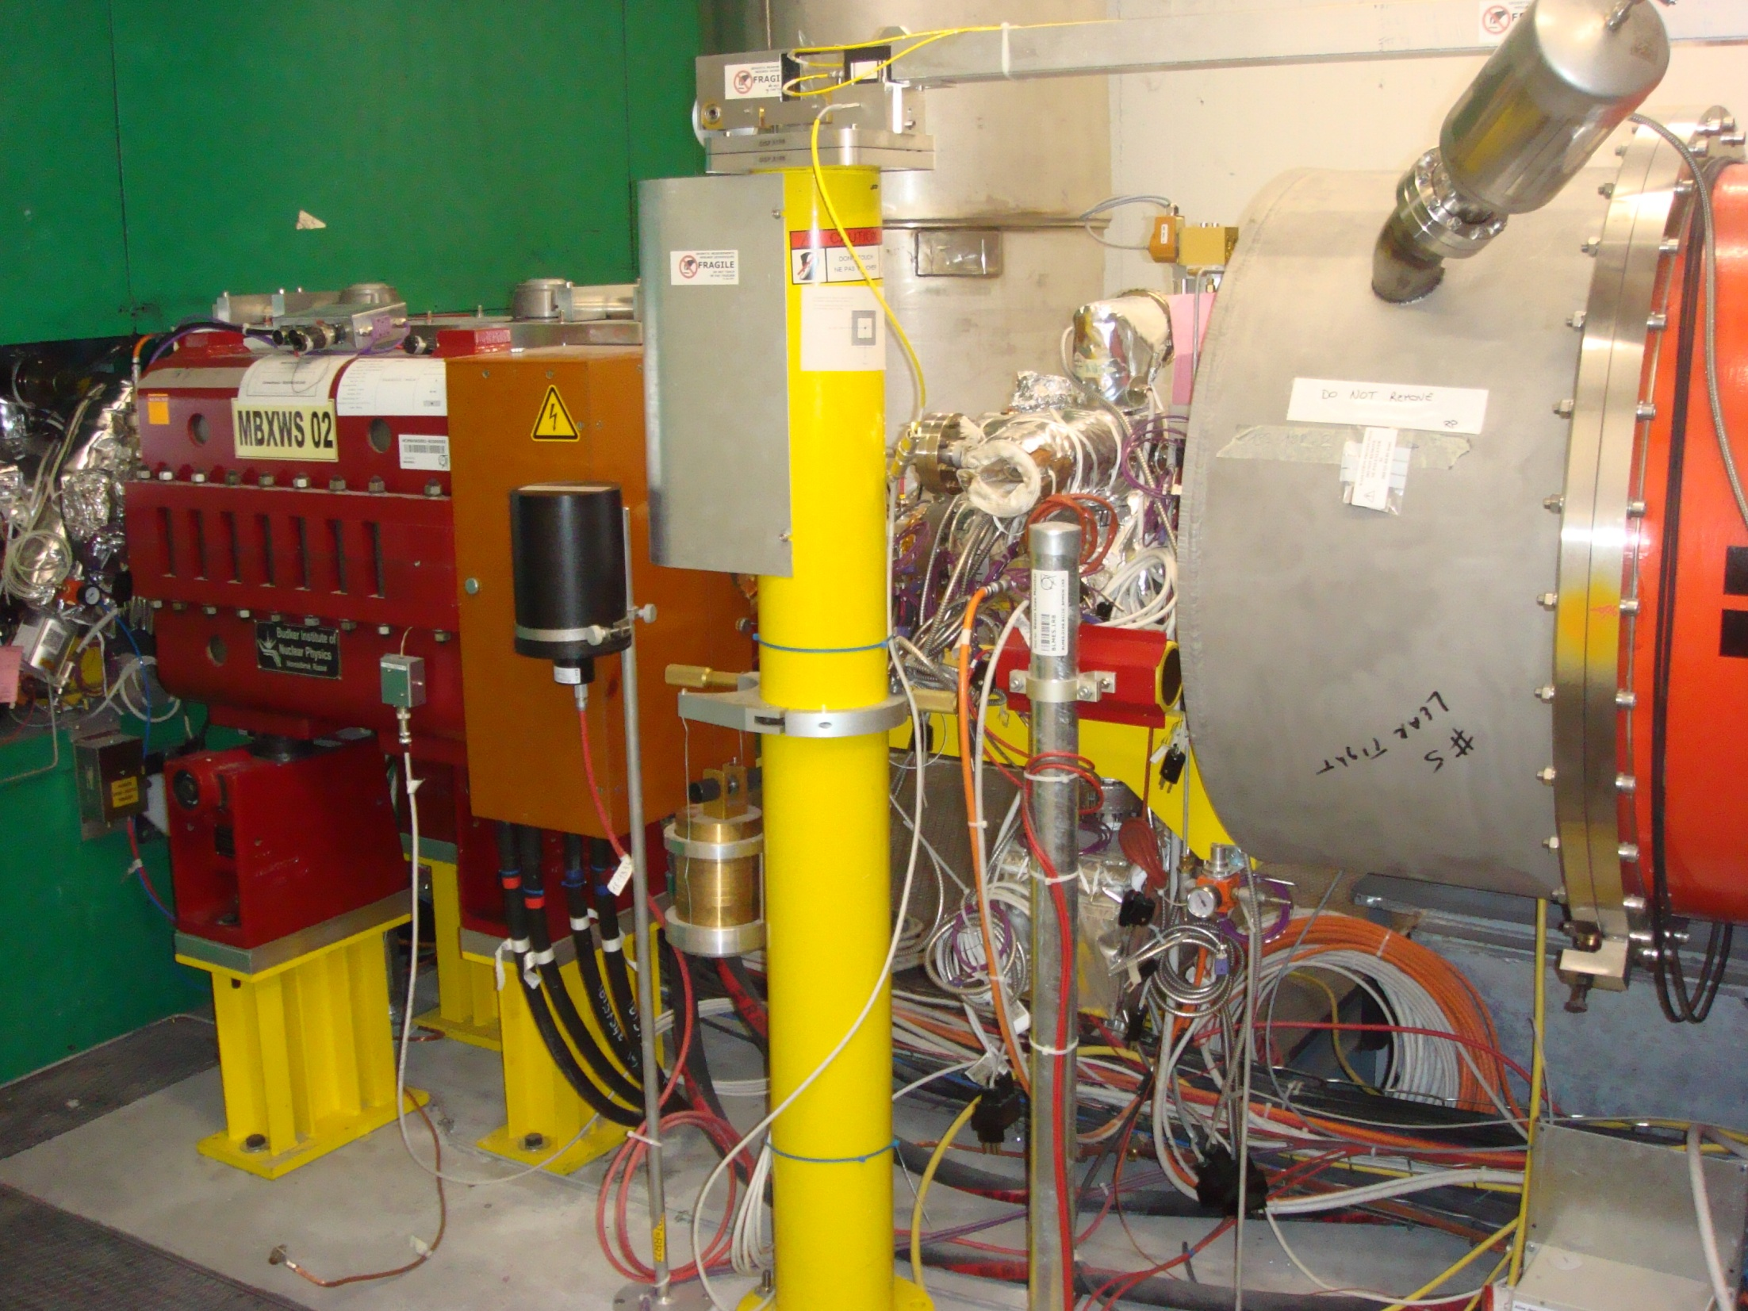
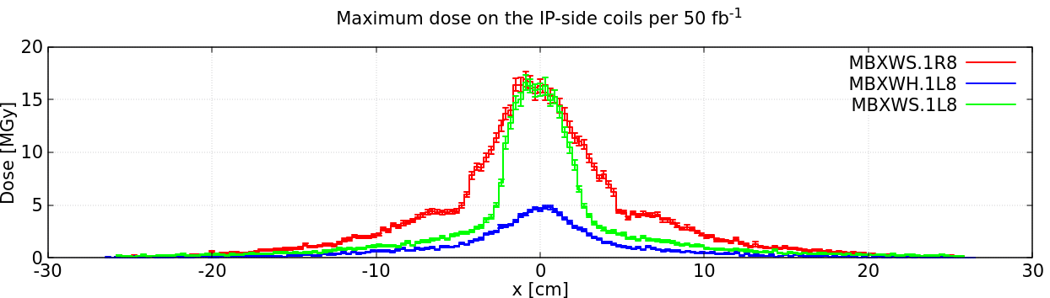
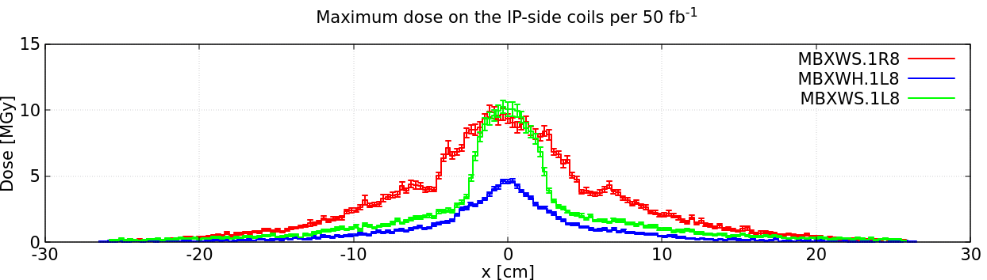
IR8
After a 28 fb⁻¹ Run 3, a cumulated dose of about 6 MGy is expected to be reached in the Q1.1R8 coils.
In parallel, the front coils of the short compensators would reach 10-12 MGy. The installation of tungsten shields, as already implemented in IR7, looks like an advisable measure for an YETS.
R8
UPPER
IP front coils
LOWER
7 TeV beams
+200 μrad V (ext)

Slide 21
BLM VALIDATION
2018
6.5 TeV beams
D1
Q3
Q2
Q1
LHCb
[A. Ciccotelli, submitted to Phys. Rev. AB]

Slide 22
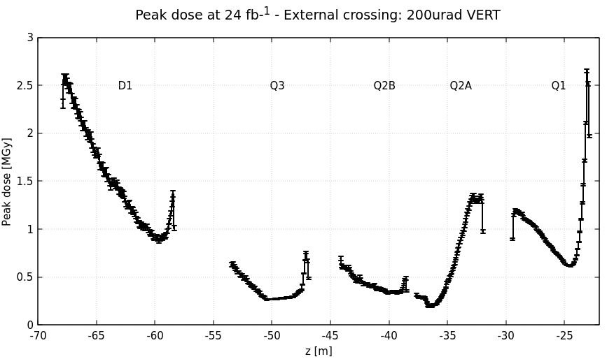
THE DOSE IN THE COLD COILS [I]
2023-2025 (@ √s=13.6 TeV)
most exposed
(high order) correctors

Slide 23
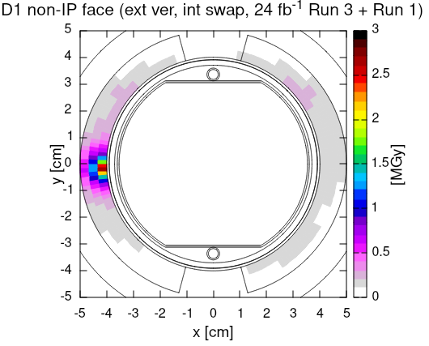
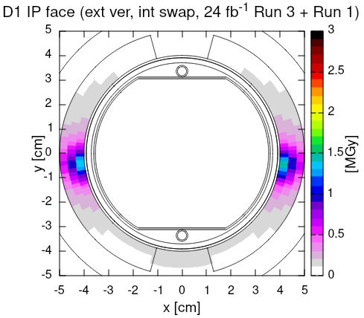
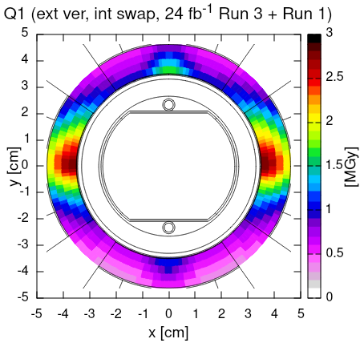
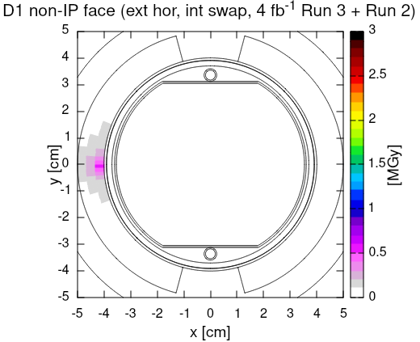
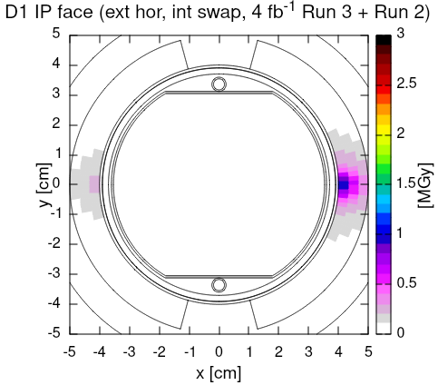
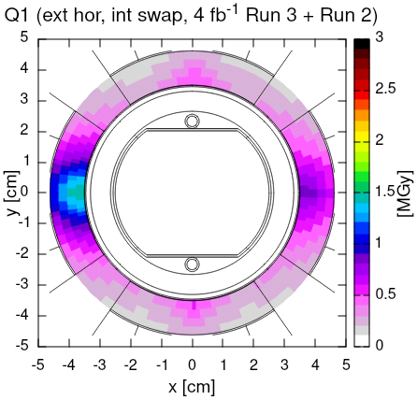
THE DOSE IN THE COLD COILS [II]
3 PEAK DOSE [MGy] 2.5 4.5 (~6 on 1R8)
by the end of Run 3 (+2025)

Slide 24
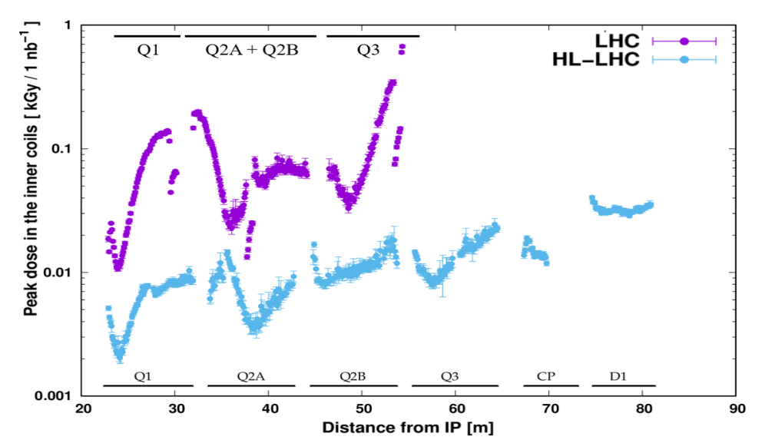
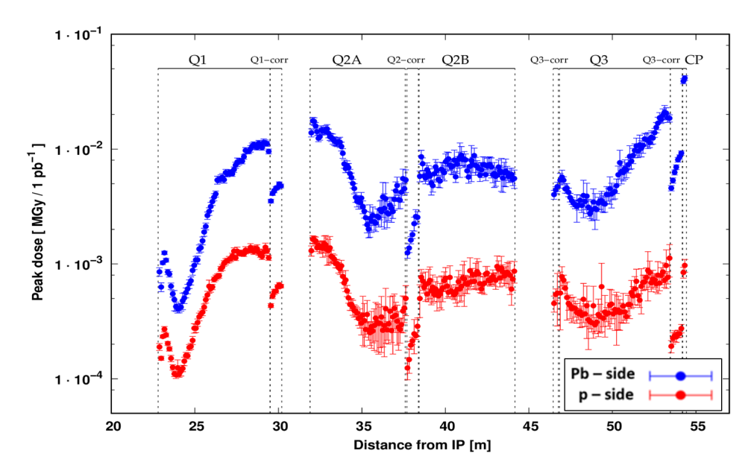
IONS → IR2
p-Pb in ATLAS
6.5 Z TeV beams (√s_{NN} = 8.16 TeV)
-140 urad vertical crossing
Pb-Pb in ATLAS
6.37 Z TeV beams (√s_{NN} = 5.02 TeV)
+160 urad vertical crossing
in the coils
[M. Sabaté-Gilarte, doi:10.18429/JACoW-IPAC2021-WEXA06]

Slide 25
BACKUP

Slide 26
Q1 UP TO NOW
[see 10th LHC Run-III Configuration Meeting, 2019 Mar 1st, https://indico.cern.ch/event/796630]
 | Run-I | 2015 | 2016 | 2017 | 2018 | up to now
beam energy [TeV] | 3.5 / 4 | 6.5
integrated lumi [fb⁻¹] | 30 | 5 | 40 | 50 | 65 | 190
lumi averaged half cross. angle [urad] | -145 | -205 | -180 | +135 | +144
IR1 up [MGy] | 0.3 | 0.2 | 1.3 | 3.0 | 4.0 | 8.5
IR1 down [MGy] | 0.7 | 0.3 | 2.6 | 1.6 | 2.0 | 7
IR5 up [MGy] | 0.4 | 0.2 | 1.5 | 1.9 | 2.5 | 6.5
IR5 down [MGy] | 0.4 | 0.2 | 1.5 | 1.9 | 2.5 | 6.5
IR5 outward [MGy] | 0.5 | 0.2 | 1.9 | 2.1 | 2.8 | 7.5
assuming here
an inelastic xs (including diffractive) rising from 73 mb to 81 mb for E_{beam} increasing from 3.5 TeV to 6.8 TeV
and a peak dose dependence, as established from the calculation of some configurations at different energies, as (E_{beam})^{3/2}

Slide 27
Q1 AFTER Run-III
 | up to now | 2022 | 2023 | 2024 | up to 2024 end
beam energy [TeV] |  | 6.8
integrated lumi [fb⁻¹] | 190 | 35 | 85 | 85 | 395
lumi averaged half cross. angle [urad] |  | -156 (-160) | -149 (-160) | +149 (+160)
IR1 up [MGy] | 8.5 | 1.2 | 2.9 | 5.6 (5.7) | 18.5 (18.5)
IR1 down [MGy] | 7 | 2.3 (2.4) | 5.6 (5.7) | 2.9 | 18 (18)
IR5 up [MGy] | 6.5 | 1.4 | 3.5 | 3.5 | 15
IR5 down [MGy] | 6.5 | 1.4 | 3.5 | 3.5 | 15
IR5 outward [MGy] | 7.5 | 1.7 (1.7) | 4.0 (4.1) | 4.0 (4.1) | 17 (17.5)
assuming here
an inelastic xs (including diffractive) rising from 73 mb to 81 mb for E_{beam} increasing from 3.5 TeV to 6.8 TeV
and a peak dose dependence, as established from the calculation of some configurations at different energies, as (E_{beam})^{3/2}

Slide 28
Q2A
 | up to now | up to 2024 end
integrated lumi [fb⁻¹] | 190 | 395
IR1 up [MGy] | 11 | 23 (23.5)
IR1 down [MGy] | 9 | 23 (23.5)
IR5 up [MGy] | 4.5 | 10.5
IR5 down [MGy] | 4.5 | 10.5
IR5 outward [MGy] | 7.5 | 17.5 (17.5)
AND Q2B
 | up to now | up to 2024 end
integrated lumi [fb⁻¹] | 190 | 395
IR1 up [MGy] | 4.5 | 10.5 (10.5)
IR1 down [MGy] | 5 | 10.5 (10.5)
IR1 inward [MGy] | 5.5 | 12
IR5 inward [MGy] | 10.5 | 24 (24.5)

Slide 29
MCBX2
 | up to now | up to 2024 end
integrated lumi [fb⁻¹] | 190 | 395
IR1 up [MGy] | 1.5 | 3 (3.5)
IR1 down [MGy] | 1.5 | 3.5 (3.5)
IR1 inward [MGy] | 1 | 3
IR5 up [MGy] | 1 | 2
IR5 down [MGy] | 1 | 2
IR5 inward [MGy] | 2 | 4 (4)

Slide 30
Q3
 | up to now | up to 2024 end
integrated lumi [fb⁻¹] | 190 | 395
IR1 up non-IP [MGy] | 4.5 | 11 (11)
IR1 down non-IP [MGy] | 5 | 11 (11)
IR1 inward [MGy] | 4.5 | 10
IR1 up IP [MGy] | 4.5 | 10 (10)
IR1 down IP [MGy] | 4.5 | 10 (10)
IR5 inward [MGy] | 7.5 | 16.5 (17)
AND MCBX3
 | up to now | up to 2024 end
integrated lumi [fb⁻¹] | 190 | 395
IR1 up [MGy] | 2 | 4.5 (5)
IR1 down [MGy] | 2.5 | 5 (5)
IR5 up IP [MGy] | 1 | 3
IR5 down IP [MGy] | 1 | 3
IR5 inward [MGy] | 1 | 3 (3)

Slide 31
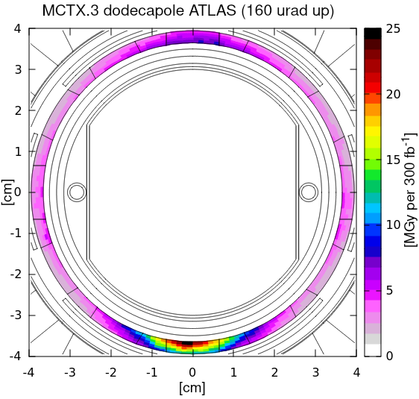
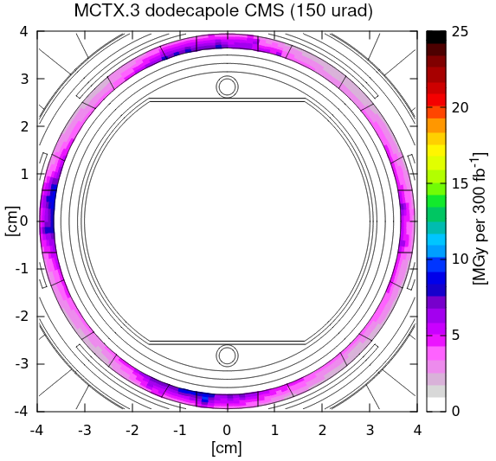
MCTX3
In IR1, the peak dose on the dodecapole coils is expected to have already challenged the reference limit
 | up to now | up to 2024 end
integrated lumi [fb⁻¹] | 190 | 395
IR1 up [MGy] | 7 | 18 (18.5)
IR1 down [MGy] | 8.5 | 18 (18.5)
IR5 up IP [MGy] | 4.5 | 10
IR5 down IP [MGy] | 4.5 | 10
IR5 inward [MGy] | 4.5 | 10 (10.5)
p-p @√s=14 TeV
85 mb inel xs

Slide 32
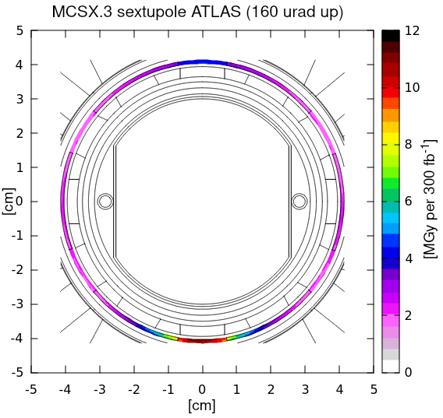
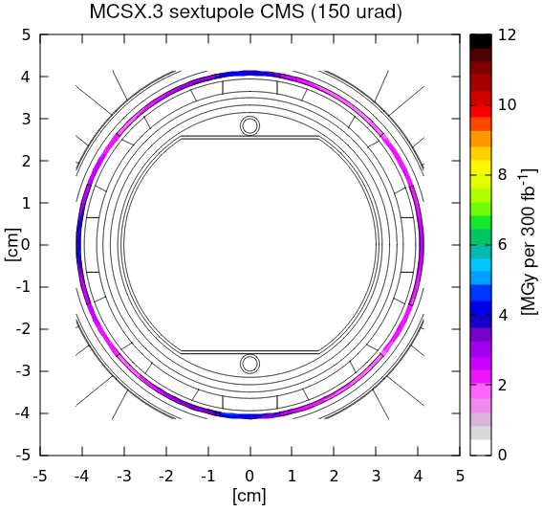
MCSX3
p-p @√s=14 TeV
85 mb inel xs
 | up to now
integrated lumi [fb⁻¹] | 190
IR1 up [MGy] | 2.5
IR1 down [MGy] | 3
IR5 up [MGy] | 1.5
IR5 down [MGy] | 1.5
IR5 inward [MGy] | 2
up to 2024 end
395
6 (6)
6 (6)
4
4
4.5 (4.5)
In case of vertical crossing (ATLAS), the peak lies outside the coil region

Slide 33
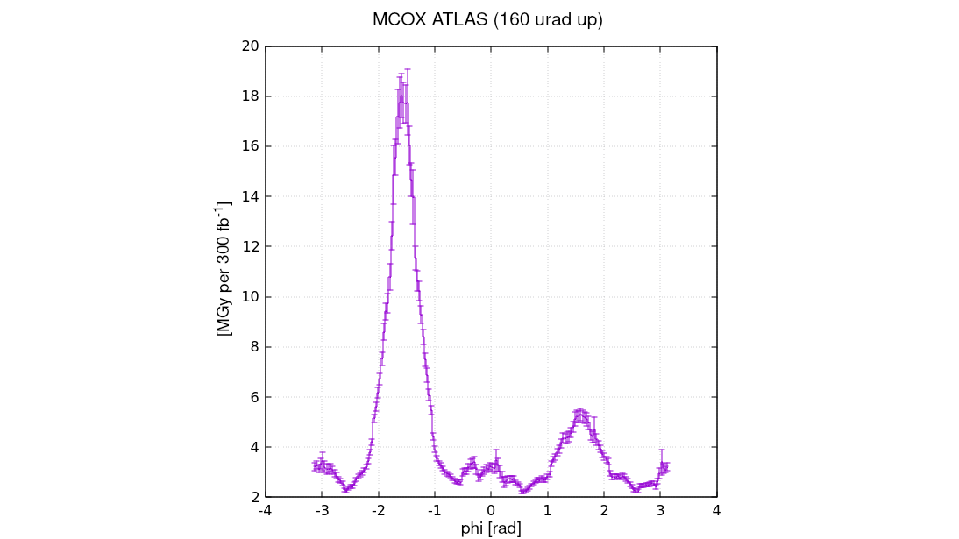
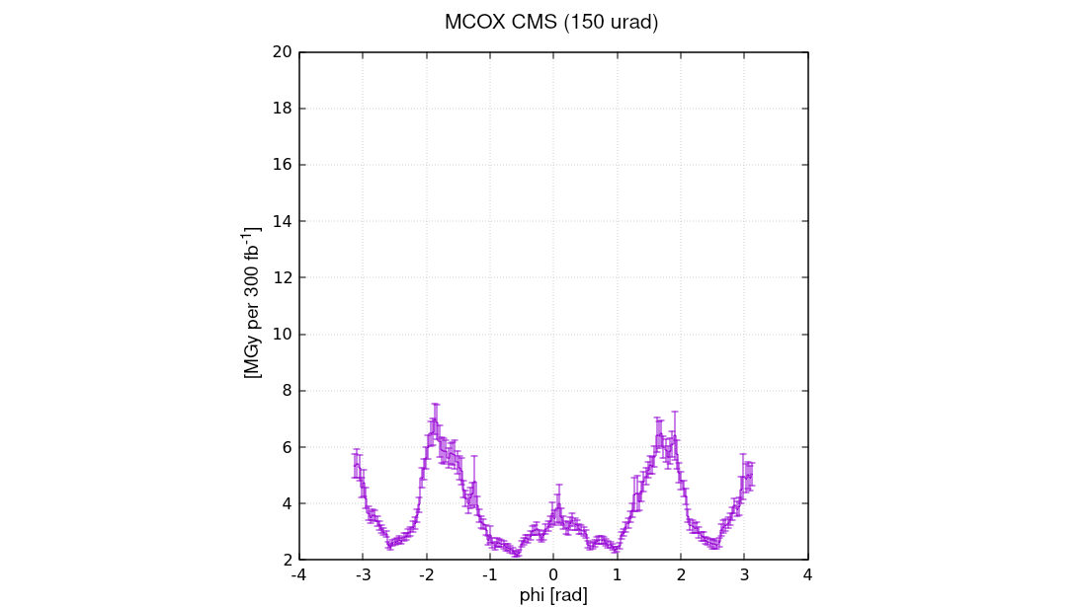
MCOX3
middle layer
 | up to now
integrated lumi [fb⁻¹] | 190
IR1 up [MGy] | 5.5
IR1 down [MGy] | 6.5
IR5 up [MGy] | 3.5
IR5 down [MGy] | 3.5
IR5 inward [MGy] | 2.5
up to 2024 end
395
13.5 (14)
13.5 (14)
8
8
6 (6)
phi = p/2
phi = ± p
phi = 0
phi = - p/2
p-p @√s=14 TeV
85 mb inel xs

Slide 34
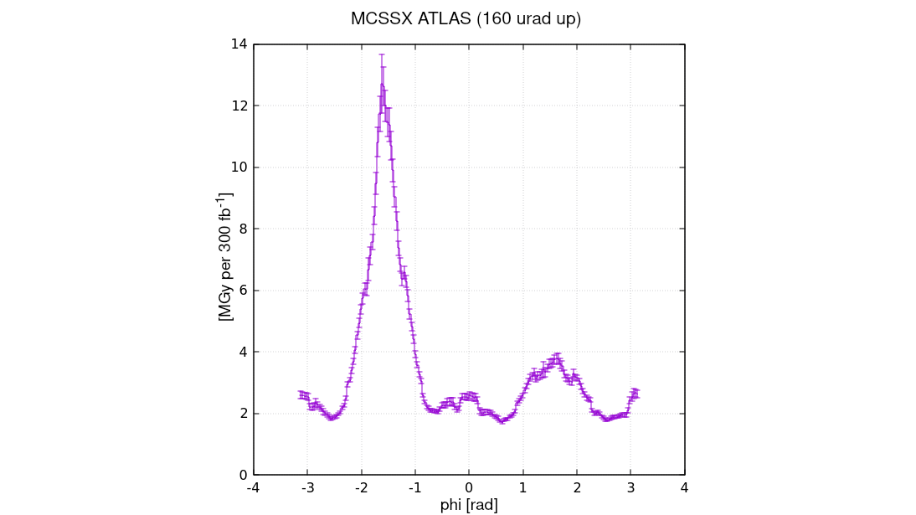
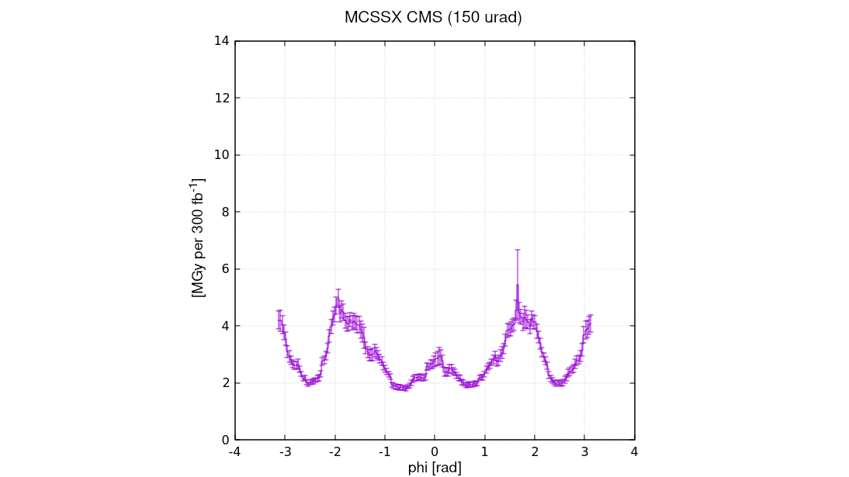
MCSSX3
outer layer
 | up to now
integrated lumi [fb⁻¹] | 190
IR1 up [MGy] | 3.5
IR1 down [MGy] | 4.5
IR5 up [MGy] | 2
IR5 down [MGy] | 2
IR5 inward [MGy] | 1.5
up to 2024 end
395
9 (9)
9 (9)
5
5
4 (4)
phi = p/2
phi = ± p
phi = 0
phi = - p/2
p-p @√s=14 TeV
85 mb inel xs

Slide 35
IN SUMMARY: MAIN QUADRUPOLES [I]
 | with variable angle (with fixed angle) | + 2025 (as 2023/2024)
MAIN QUADRUPOLE | PEAK DOSE [MGy]
 | after 395 fb⁻¹ | after 480 fb⁻¹
Q1 IR1 | 18.5 (18.5) | 23.5 (24) / * 22.5 (23)
Q1 IR5 | 17 (17.5) | 21 (21.5)
Q2A IR1 | 23 (23.5) | 30.5 (31) / * 28 (29)
Q2A IR5 | 17.5 (17.5) | 21.5 (21.5)
Q2B IR1 | 12 | 15
Q2B IR5 | 24 (24.5) | 29.5 (30)
Q3 IR1 | 11 (11) | 14.5 (14.5) / * 13.5 (13.5)
Q3 IR5 | 16.5 (17) | 20.5 (21)
* assuming IR1 polarity inversion in the middle of 2025

Slide 36
IN SUMMARY: MCBX & MQSX [I]
 | with variable angle (with fixed angle) | + 2025 (as 2023/2024)
CORRECTOR MAGNET | PEAK DOSE [MGy]
 | after 395 fb⁻¹ | after 480 fb⁻¹
MCBX1 IR1 | 8.5 (8.5) | 11 (11) / * 10.5 (10.5)
MCBX1 IR5 | 6 | 7.5
MCBX2 IR1 | 3.5 (3.5) | 4 (4) / * 4 (4)
MCBX2 IR5 | 2 | 2.5
MQSX IR1 | 7.5 (7.5) | 9 (9) / * 9 (9)
MQSX IR5 | 8 (8) | 9.5 (9.5)
MCBX3 IR1 | 5 (5) | 6 (6.5) / * 6 (6)
MCBX3 IR5 | 3 | 3.5
* assuming IR1 polarity inversion in the middle of 2025

Slide 37
IN SUMMARY: HIGHER ORDER CORRECTORS [I]
 | with variable angle (with fixed angle) | + 2025 (as 2023/2024)
CORRECTOR MAGNET | PEAK DOSE [MGy]
 | after 395 fb⁻¹ | after 480 fb⁻¹
MCSX3 IR1 | 6 (6) | 8 (8) / * 7.5 (7.5)
MCSX3 IR5 | 4.5 (4.5) | 5.5 (5.5)
MCTX3 IR1 | 18 (18.5) | 24 (25) / * 22 (23)
MCTX3 IR5 | 10 (10.5) | 12.5 (12.5)
MCSSX3 IR1 | 9 (9) | 12 (12) / * 11 (11)
MCSSX3 IR5 | 5 | 6
MCOX3 IR1 | 13.5 (14) | 18.5 (19) / * 17 (17.5)
MCOX3 IR5 | 8 | 9.5
MCOSX3 IR1 | 15 (15) | 19.5 (20) / * 18.5 (18.5)
MCOSX3 IR5 | 9 | 11
* assuming IR1 polarity inversion in the middle of 2025

