Slide 1
The PH/ESE µTCA evaluation project a (short) status update
Markus Joos
CERN

Slide 2
Equipment purchased
Manufacturer | Type
Schroff | 6-slot MTCA.4 shelf (type: 11850-019)
Kontron | Kontron AM4904 MCH (with PCIe GEN2 switch )
Kontron | Kontron AM5030 processor AMC
Elma | Elma AMC load module (ref.: 031716; single width full size)
ESD | ADIO-24 AMC
Vadatech | 12 slot µTCA shelf (ref.: VT892-112-000-000)
Vadatech | 792W power module (ref.: UTC010-200-000-010)
NAT | MCH (with PCIe GEN2 switch; NAT-MCH-Base12-GbE-SSCH-TCTCXO-PCIEx48). So far only GEN1 switch received

Slide 3
Problems encountered
Almost all of the commercial MCH/AMC modules that we have purchased caused some trouble
  Some IPMI commands not properly implemented
    This causes interoperability issues
  F/W updates required
    Products are not fully debugged
  Repairs required
    One shelve had to be sent back for repair
    One MCH has a H/W problem
The quality of the documentation and the user-friendliness of the S/W tools varies a lot

Slide 4
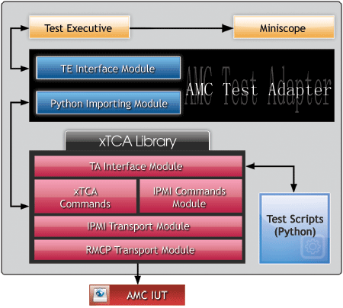
Polaris AMC tester
(http://www.polarisnetworks.net/amc.html)
This is a S/W product for Windows
It can test AMC modules and carrier managers
  All testable rules of the AMC / MCH standard are implemented (according to Polaris)
  Support for MTCA.4 will be added if there is enough demand
  User can add tests via scripting language
  Polaris offer additional tools for µTCA and ATCA
It communicates with the device under test via Ethernet
For all AMCs (commercial and CERN design) tested we got about the same picture:
  1/3 of the tests: OK
  1/3 of the tests: Failed to pass
  1/3 of the tests: Skipped (by operator or due to previous errors)
Polaris is aware of our results and promised to fix the issues that we have identified
The 28k$ question: Is it worth the money?

Slide 5
Next steps
Finish the work on the:
  MMC S/W
  MMC tester
  AMC load module
    First 2 boards built, more to be manufactured
    First look at PSUs: Parameters within spec.
    RTM not yet ready (MMC S/W missing)
Focus on evaluation of data transfer performance (via PCIe) once an AMC with PCIe is available
Resume work on PCIe hot-plug (has anyone of you got any experience?)
In case we purchase the AMC tester: Re-test the AMCs/MCHs and discuss the results with the manufacturers

