Slide 1




Study of the hybrid controller electronics for the nano-stabilisation of mechanical vibrations of CLIC quadrupoles
P. Fernández Carmona, K. Artoos , C. Collette**, M. Esposito, M. Guinchard, S. Janssens*, A. Kuzmin, and R. Morón Ballester
* PhD student ULB-CERN
* * Associate ULB
http://clic-stability.web.cern.ch/clic-stability
The research leading to these results has received funding from the European Commission under the FP7 Research Infrastructures project EuCARD

Slide 2





Collaboration
CERN is collaborating on the stabilization of accelerator components with the following institutes:
Active Structures Laboratory
Department of Mechanical Engineering and Robotics
Université Libre de Bruxelles (ULB), Belgium
Institut de Recherche sur les lois Fondamentales de l'Univers
CEA (Commissariat à l'énergy atomique) Saclay, France
Laboratories in Annecy (France) working on VIbration STAbilisation

Slide 3
Outline
CLIC stabilisation system
Design constraints
Hybrid controller
Stabilisation results
Future work and conclusions

Slide 4
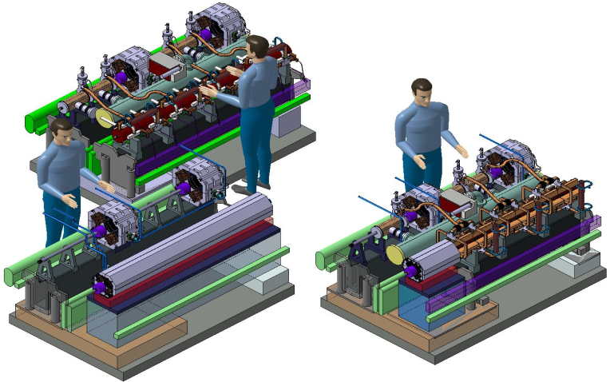
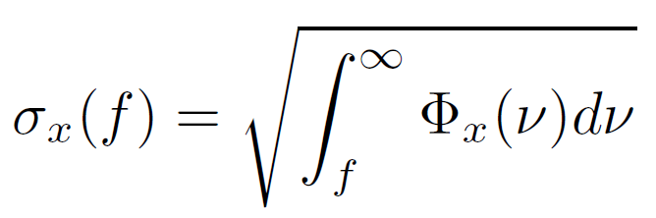
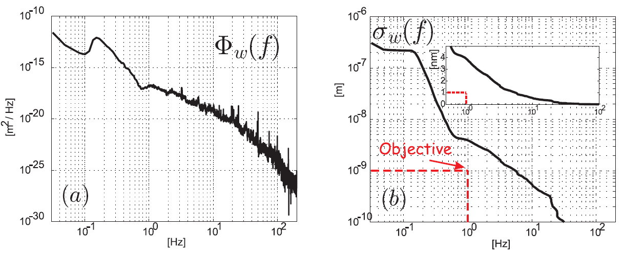
Requirements
3992 CLIC Main Beam Quadrupoles:
Four types :
Mass: ~ 100 to 400 kg
Length: 500 to 2000 mm
A. Samoshkin
Nano-positioning
Stability (magnetic axis):
Type 4: 2m, 400 kg
Type 1: 0.5 m, 100 kg
 | Main beam quadrupoles
Vertical | 1.5 nm > 1 Hz
Lateral | 5 nm > 1 Hz

Slide 5
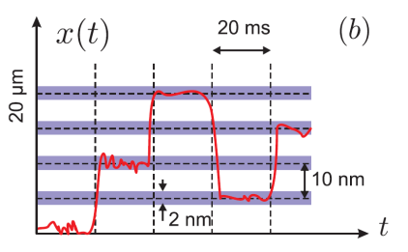
Additional objectives
« Nano-positioning» proposal
Modify position quadrupole in between pulses (~ 5 ms)
Range ± 5 μm, increments 10 to 50 nm, precision ± 1nm
In addition/ alternative dipole correctors
Increases time to next realignment with cams

Slide 6
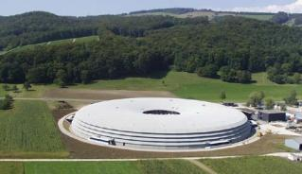
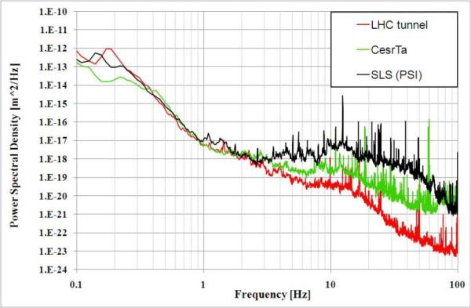
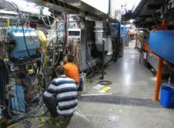
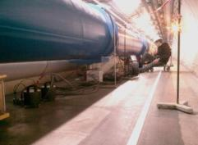
Characterisation vibration sources
Ground motion: seismic motion + technical noise transmitted through ground
Direct vibration forces on magnet: water cooling, ventilation, interconnects,…
SLS
CesrTA
LHC
M. Sylte, M. Guinchard, A. Kuzmin, A. Slaathaug
Notes:
CESR -> Cornell Electron Storage Ring. New York
SLS -> Swiss Light Source

Slide 7
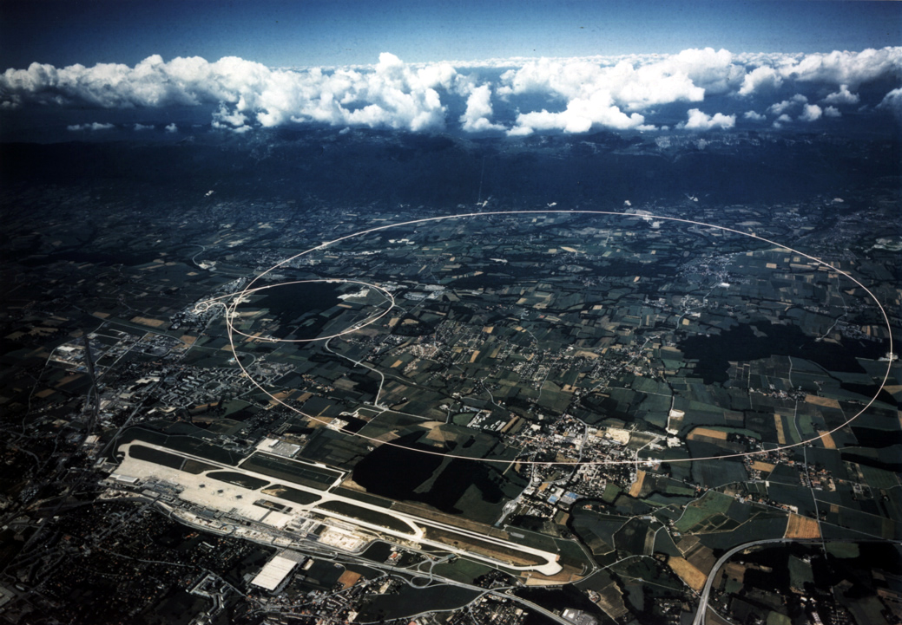
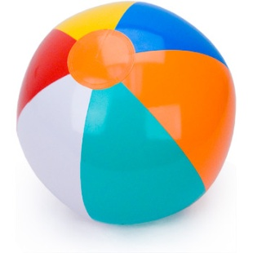
Need for stabilisation
20 cm
8.6 Km
CLIC beam size
1 nm vertical (1σ)
40 nm horizontal
LHC beam size
Ep [TeV} | σ [µm]
3.5 | 44.8
5 2 | 37.5
5 1 | 26.5
7.5 | 15.3

Slide 8
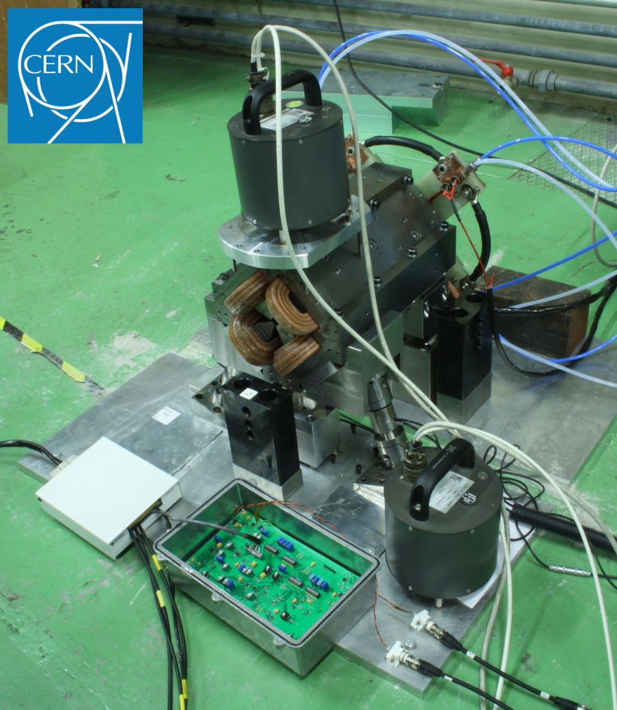
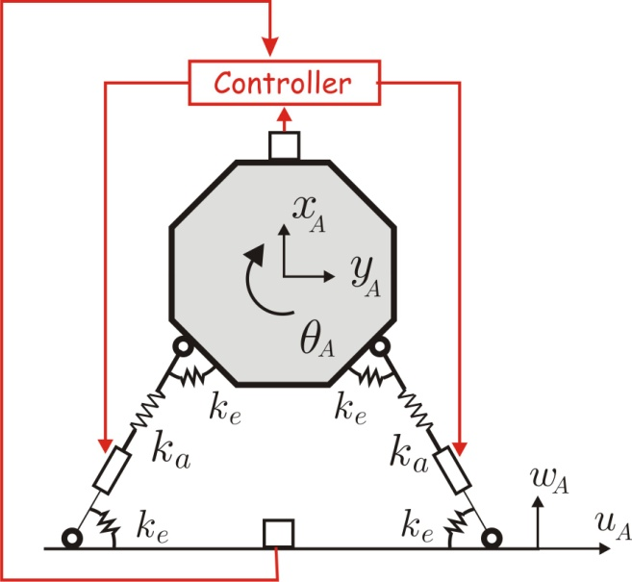
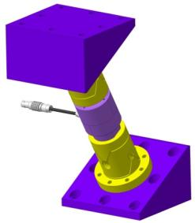
Stabilization strategy
Velocity sensors
Signal processing
&
Control loop
Communication with central control
Output actuators displacement

Slide 9
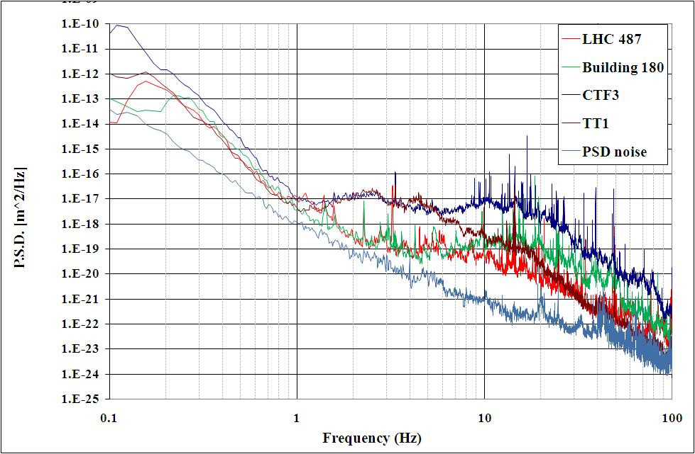
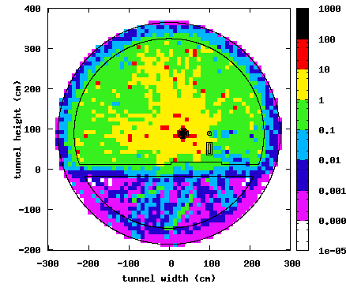
Design constraints for the electronics I
Inputs:
  Resolution 2 µV
  Dynamic range 60 dB
  Bandwidth 0.1-100 Hz
Output:
  Dynamic range 140 dB
Resistance to radiation
  Shielding, location
Cost (~4000 magnets to be stabilized)
Power restrictions (cooling)
Gy
Courtesy S. Mallows
MB 9 GeV

Slide 10
Design constraints for the electronics II
Latency (stability limit)
  Need for local control
Electromagnetic compatibility
  Shielded + twisted pairs
  Short sensor cables
Control loop delay | Stabilization performance
43μs | 100%
80 μs | 90%
90 μs | 80%
100 μs | 60%
130 μs | 30%
Component | Delay
ADC | 8 µs
Electro-optic transducer | 100 ns
Optic fiber transmission | 5 µs/Km
Opto-electric transducer | 120 ns
DAC | 3 µs
Actuator (20nm single step) | 1 µs
Typical catalog delay values for the components
Local controller

Slide 11
Hybrid controller
Digital implementation
Analogue implementation
Advantages
  Flexibility
  Easy reuse of IP
  Noise only added at ADC and DAC
Disadvantages
  Single events upsets
  Higher latency
Advantages
  Minimum latency
  Simplicity
  Less radiation effects expected
Disadvantages
  Fixed configuration

Slide 12
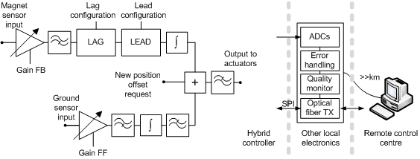
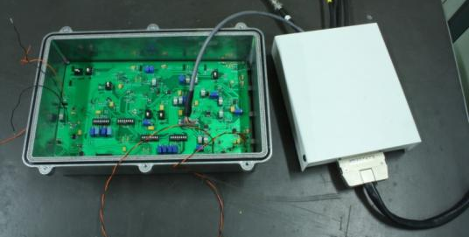
Architecture
Local electronics
ADCs digitize signals
For remote monitoring
Communication to remote control center with optical fiber
2 analogue chains
+ positioning offset
Hybrid stabilization and
positioning controller
SPI
Local electronics to interface
controller with remote control

Slide 13
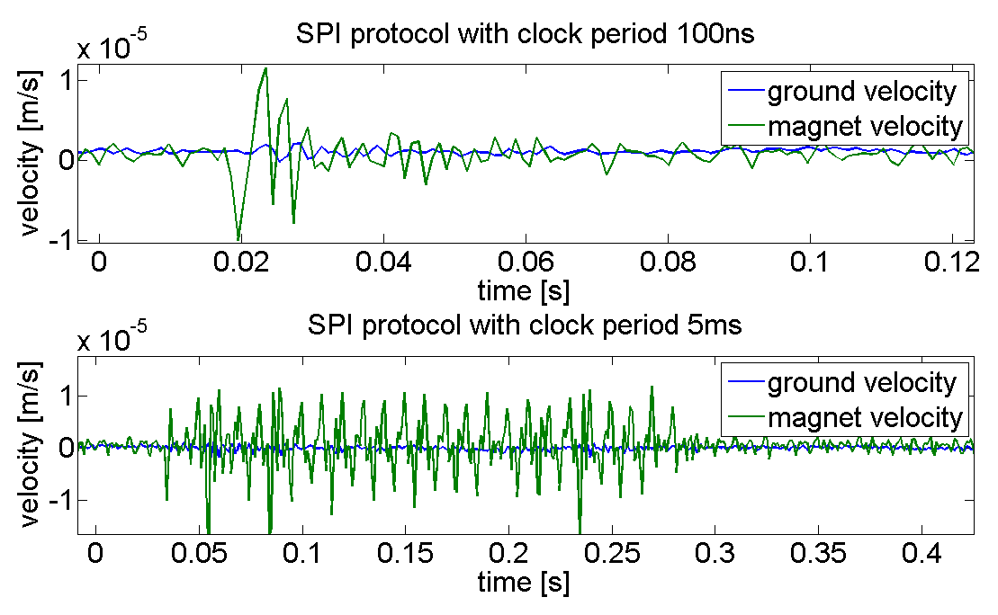
Configurable parameters
Changed according to vibration changes
Digital potentiometers used
Controlled via a serial peripheral interface SPI port
Change induces vibrations:
  Signal crosstalk
  Resistor settling time
No change while beam on
Includes registers and memories sensitive to SEU
  Detectable and non permanent
Configurable parameters
Gain Feedforward
Gain Feedback
Lag pole and zero frequencies
Lead pole and zero frequencies
Output offset (positioning)
Feedforward low pass filter frequency

Slide 14
Circuit details
Draws about 2 W
Differential inputs,110 dB CMR
10 bit digital potentiometers
250x150 mm printed circuit board
Low 1/f noise components
Local digital electronics implemented with National Instruments PXI running LabView real time

Slide 15
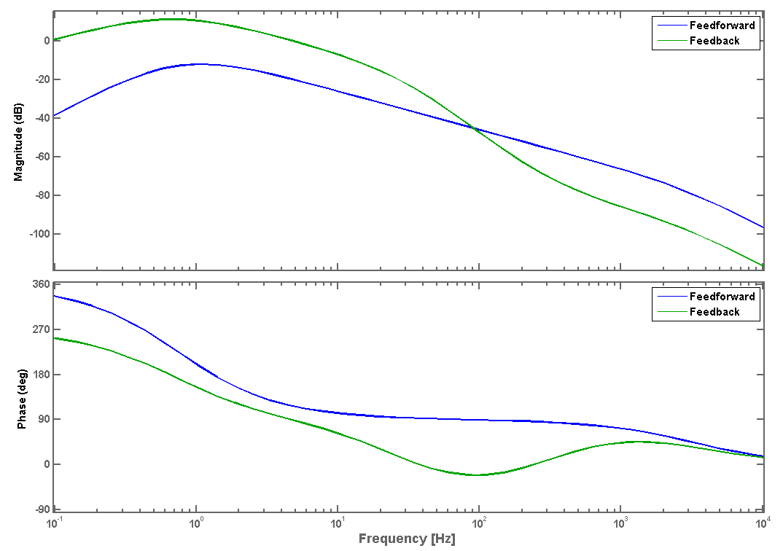
Frequency characterization
HP filter
Lag zero
Lag pole
LP filter

Slide 16
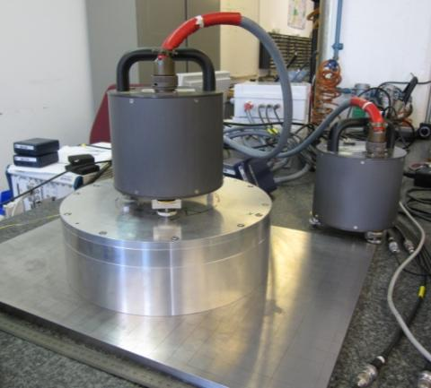
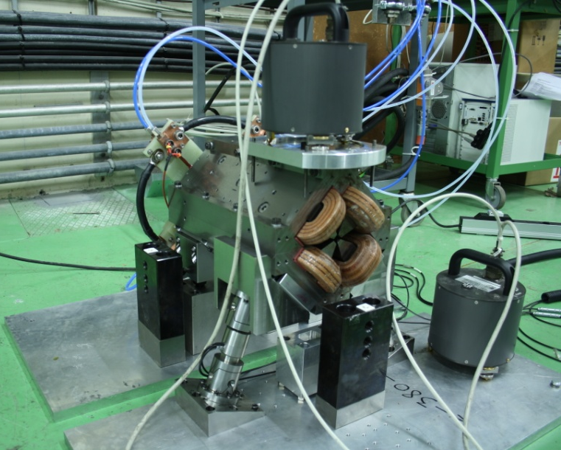
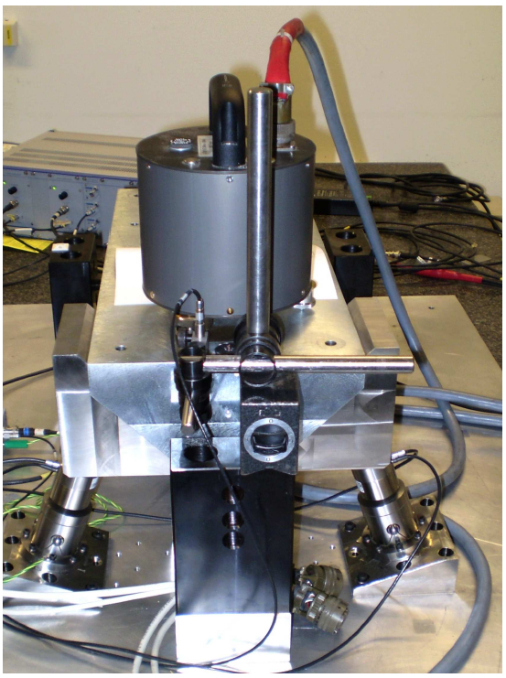
Testbenches
1 d.o.f.
(membrane)
2 d.o.f.
(tripod)
Type 1 Water-cooled magnet

Slide 17
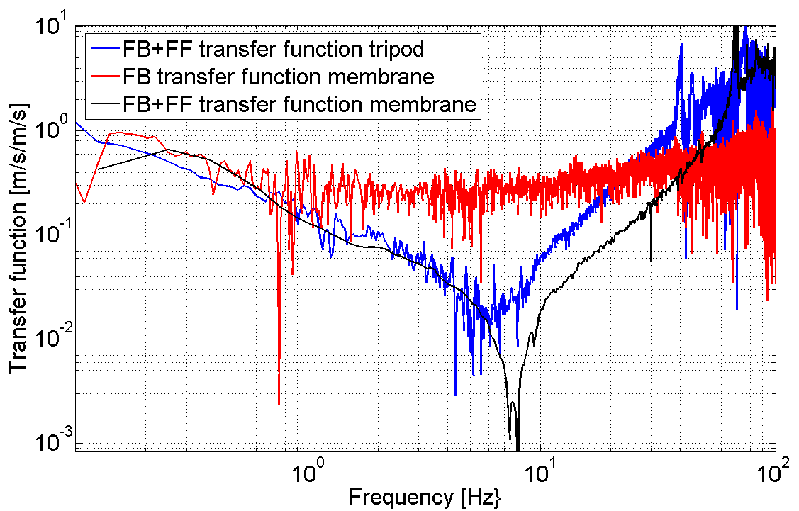
Stabilization results
Membrane
Wide BW
High attenuation
Tripod

Slide 18
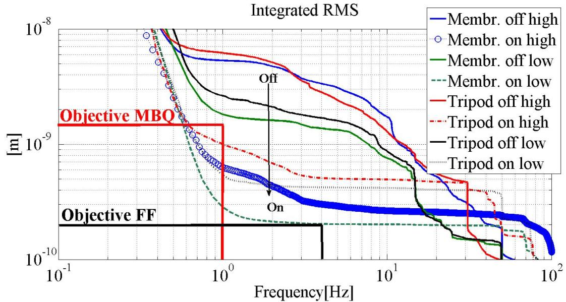
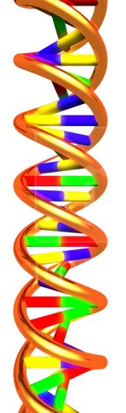
Stabilization results
5x lower
than
requirements
1&2
Results with low and high vibration background
Best result 0.3 nm on membrane, 0.5 nm on tripod at 1 Hz
2 nm

Slide 19
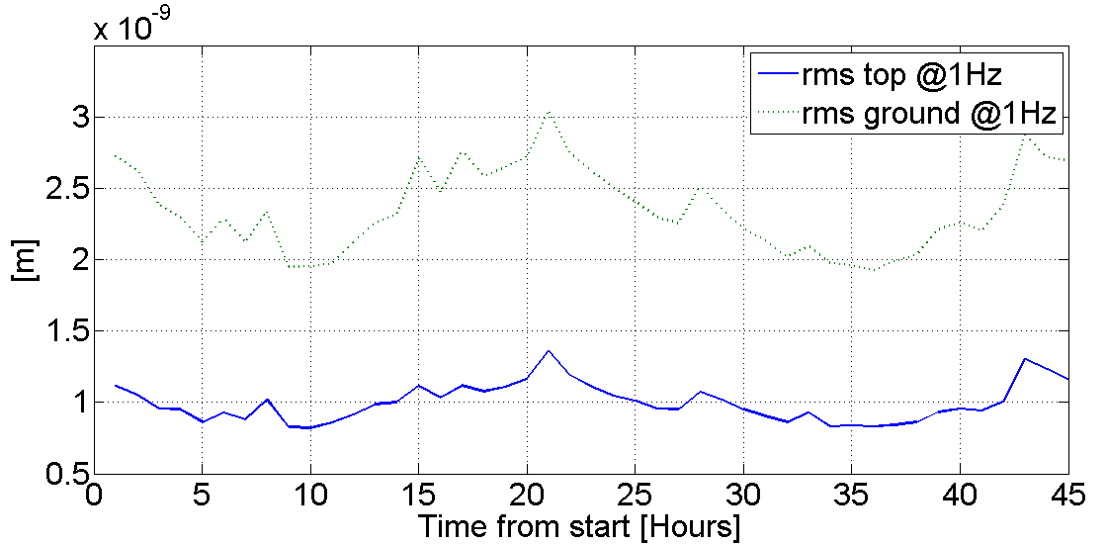
Stabilization results
Temperature stable within 0.5 degrees
    Test with temperature change in preparation
Objective
achieved

Slide 20
Future work
Implement ADC digitization for remote monitoring
Test effects of radiation and improve hardness
Design mechanical encasing and shielding
Increase positioning range to full ± 5 μm
Test simultaneous vertical and horizontal stabilization on powered and water cooled type1 magnet

Slide 21
Conclusions
Latency limitations force stabilization control local
A hybrid controller has been chosen for:
  Low latency
  Remote configurable
  Better expected tolerance to radiation
  Cost and space
Feasibility demonstrated:
  0.3 nm r.m.s. 5x better than original requirements
  Stability kept during several days
  Interferences due to remote configuration not harmful
Well established work plan and future work

Slide 22
Publications
COLLETTE C., FERNANDEZ-CARMONA P., JANSSENS S., ARTOOS K., GUINCHARD M., HAUVILLER C., Inertial sensors for low frequency seismic vibration measurement, Bulletin of the Seismological Society of America (in preparation 2011).
COLLETTE C., FERNANDEZ-CARMONA P., JANSSENS S., ARTOOS K., GUINCHARD M., HAUVILLER C., Nano-Motion Control of Heavy Quadrupoles for Future Particle Colliders: An Experimental Validation, Nuclear instruments and methods in physics research section A (submitted in 2011).
K. ARTOOS, C. COLLETTE, M. ESPOSITO, P. FERNANDEZ CARMONA, M. GUINCHARD, C. HAUVILLER, S. JANSSENS, A. KUZMIN, R. LEUXE, R. MORÓN BALLESTER, Status of a study of stabilization and fine positioning of clic quadrupoles to the nanometre level, IPAC 2011
K. ARTOOS, C. COLLETTE, M. ESPOSITO, P. FERNANDEZ CARMONA, M. GUINCHARD, S. JANSSENS, R. LEUXE, M. MODENA, R. MORÓN BALLESTER, M. STRUIK, Modal analysis and measurement of water cooling induced vibrations on a clic main beam quadrupole prototype, IPAC 2011
S. JANSSENS , K. ARTOOS, C. COLLETTE,M. ESPOSITO, P. FERNANDEZ-CARMONA,M. GUINCHARD, C. HAUVILLER, A. KUZMIN, R. LEUXE, J. PFINGSTNER, D. SCHULTE, J. SNUVERINK, System control for the clic main beam quadrupole stabilization and nano-positioning, IPAC 2011

Slide 23
Publications
S.M. JANSSENS, K. ARTOOS, C.G.R.L. COLLETTE, M. ESPOSITO, P. FERNANDEZ CARMONA, M. GUINCHARD, C. HAUVILLER, A.M. KUZMIN, R. LEUXE, R. MORON BALLESTER, Stabilization and Positioning of CLIC Quadrupole Magnets with sub-Nanometre Resolution, ICALEPCS 2011
COLLETTE C., ARTOOS K., KUZMIN A., SYLTE M., GUINCHARD M. and HAUVILLER C., Active quadrupole stabilization for future linear particle colliders, Nuclear instruments and methods in physics research section A, vol.621 (1-3) pp.71-78 (2010).
COLLETTE C., ARTOOS K., GUINCHARD M. and HAUVILLER C., Seismic response of linear accelerators, Physical reviews special topics – accelerators and beams vol.13 pp. 072801 (2010).
ARTOOS K., COLLETTE C., GUINCHARD M., JANSSENS S., KUZMIN A. and HAUVILLER C., Compatibility and integration of a CLIC quadrupole nano-stabilization and positioning system in a large accelerator environment, IEEE International Particle Accelerator Conference IPAC10, 23-25 May 2010 (Kyoto, Japan).
ARTOOS K., COLLETTE C., GUINCHARD M., JANSSENS S., LACKNER F. and HAUVILLER C., Stabilisation and fine positioning to the nanometer level of the CLIC Main beam quadrupoles, IEEE International Particle Accelerator Conference IPAC10, 23-25 May 2010 (Kyoto, Japan).

Slide 24
Publications
COLLETTE C., ARTOOS K., JANSSENS S. and HAUVILLER C., Hard mounts for quadrupole nano-positioning in a linear collider, 12th International Conference on New Actuators ACTUATOR2010, 14-16 May 2010 (Bremen, Germany).
COLLETTE C., JANSSENS S., ARTOOS K. and HAUVILLER C., Active vibration isolation of high precision machine (keynote lecture), 6th International Conference on Mechanical Engineering Design of Synchrotron Radiation Equipment and Instrumentation (MEDSI 2010), 14 July 2010 (Oxford, United Kingdom).
COLLETTE C., JANSSENS S., ARTOOS K., GUINCHARD M. and HAUVILLER C., CLIC quadrupole stabilization and nano-positioning, International Conference on Noise and Vibration Engineering (ISMA2010), 20-22 September 2010 (Leuven, Belgique).
JANSSENS S., COLLETTE C., ARTOOS K., GUINCHARD M. and HAUVILLER C., A sensitiviy analysis for the stabilization of the CLIC main beam quadrupoles, Conference on Uncertainty in Structural Dynamics, 20-22 September 2010 (Leuven, Belgique).
FERNANDEZ-CARMONA P., COLLETTE C., JANSSENS S., ARTOOS K., GUINCHARD M., KUZMIN A., SLAATHAUG A., HAUVILLER C., Study of the electronics architecture for the mechanical stabilization of the quadrupoles of the CLIC linear accelerator, Topical Workshop on Electronics for Particle Physics TWEPP 2010, 20-24 September 2010 (Aachen, Germany).

