Slide 1
VCSEL Reliability and Development of Robust Arrays
Advantages and disadvantages of VCSELs
Reliability theory
Diagnostic techniques for VCSEL Failure Analysis
ATLAS experience VCSEL failures
  Review failure rates for different systems
Solutions
Summary VCSEL reliability & ATLAS outlook

Slide 2
Advantages of VCSELs
Low thresholds ➔ low power consumption
Circular beam ➔ easier to couple to fibres
~ 10,000 VCSELs on wafer. Test at wafer level ➔ only package good devices ➔
saves costs (compared to
edge emitters)
Oxide implant provides current confinement & waveguide ➔ lower threshold current

Slide 3
Problems with VCSELs
Difficult to make reliable semiconductor lasers because minority carrier concentrations and recombination rates 100s times higher than in Si ICs
  Minority carriers cause defects to grow and kill laser ➔ need to start with nearly perfect device
Resources available to companies making lasers (~10M$) << silicon ICs (~10B$)
GaAs used for 850 nm VCSELs, allows
Dark Line Defects to grow (unlike InGaAsP in EEL)
Difficult but not impossible to make reliable VCSELs
Many trade-offs for speed/reliability e.g. oxide aperture, drive current …

Slide 4
Reliability Theory
Distinguish different failure times
  Infant mortalities
  Maverick failures
  End of life (wear out) failures
Need diagnostic tools to identify causes failures
Failures
1
2
3
Time

Slide 5
Physics of Failure Modes
GaAs lasers sensitive to growth of Dark Line Defects
  Defects act as centres for non-radiative transfers
  DLDs can come from substrate defects or damage:
  Electro Static Discharge/Electrical over Stress
  Mechanical, eg wafer handling, dicing or wire bonding
DLDs
  grow rapidly in active region from carrier recombination at trap sites
  away from active region grow slowly by spontaneous emission ➔ e h pairs ➔ DLDs grow towards the active area
  Slow growth of damage can be undetected, followed by rapid death

Slide 6
Wearout Failures
No change in active regions for devices that have degraded in long term aging tests
Current shunting hypothesis:
  Dopants are passivated by complexes with H
  Pushes current away from centre of device ➔ increases laser threshold and lowers efficiency
  Not directly proven

Slide 7
Some Diagnostic Techniques
(see backup for more)
Electroluminescence (EL)
  Image emitting area when laser operated below threshold
  Sensitive to Dark Line Defects
  Can improve resolution with filters
    Select λ=50 nm below emission wavelength reduces number of “bounces” photons make in cavity
  More information in shape of line scans
  Examples from ATLAS VCSEL failures next slide

Slide 8
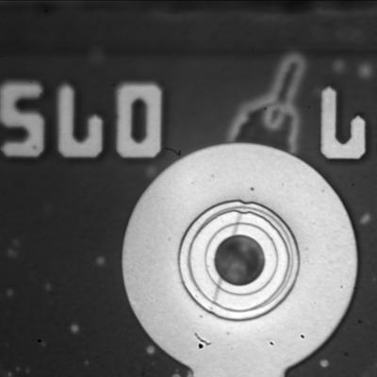
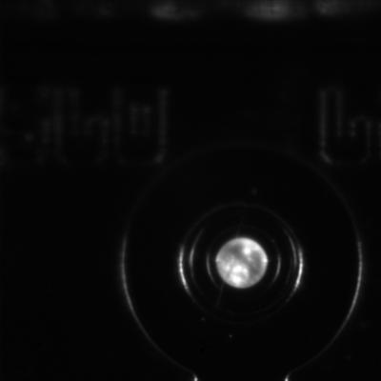
Electroluminescence for Failed VCSEL
(ATLAS LAr Otx)
Overlay: Optical and Emission
Low Level Emission Image
Possible scratch on surface
Speckled emission pattern
Analysis by Sandia

Slide 9
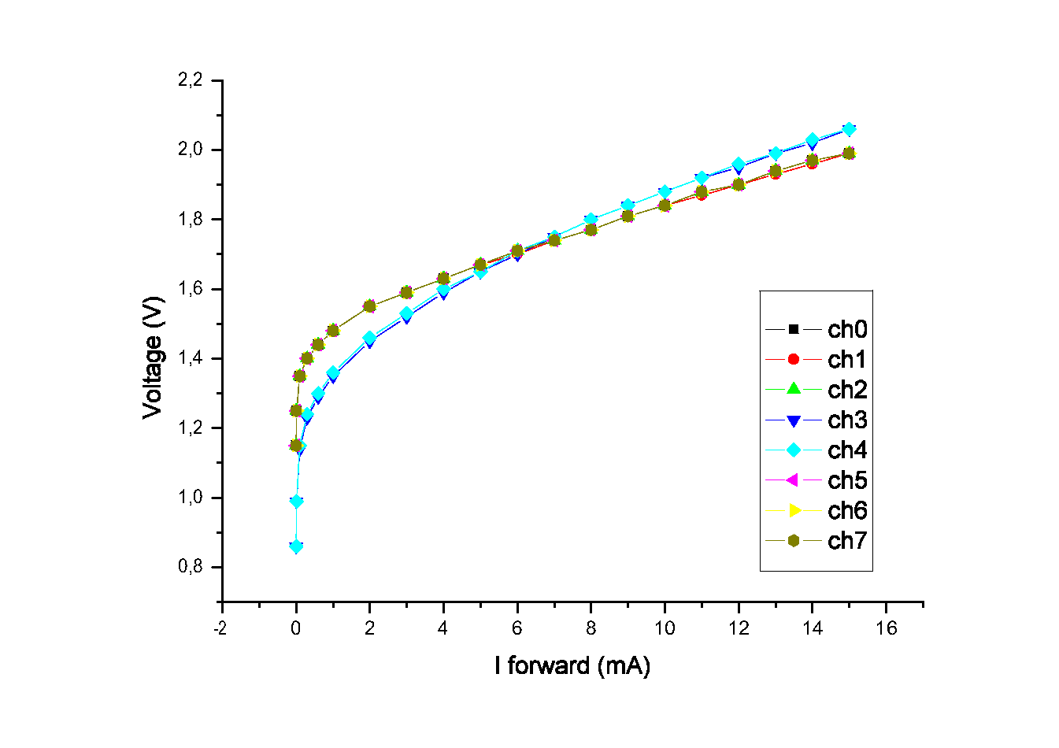
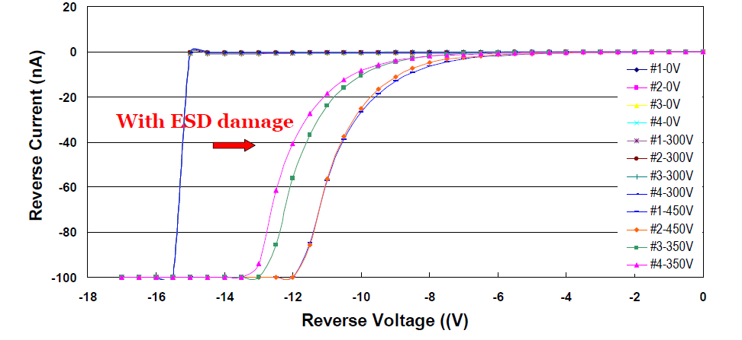
IV Curves
Forward IV
  One dead channel clearly shifted IV
  General feature for any dead VCSEL
Reverse IV
  Reverse leakage below breakdown >> after low level ESD
  More sensitive to low level (300V) ESD
Truelight VCSEL array
1 dead channel
V
I (mA)

Slide 10
Electron Beam Induced Current (EBIC)
Add sensitive amplifier to Scanning Electron Microscope and measure current as e beam is scanned
e beam generates e h pairs ➔ measure current
Damaged areas (eg DLDs) have carrier recombination at defects ➔ trap e and holes ➔ reduce current
SEM Voltage determines depth of primary beam
More information from scans with forward and reverse bias
  Depletion region extends into n and p regions
Not normally used for VCSELs because scatter from contact metal degrades resolution but …

Slide 11
EBIC comparison working & Failed channels TL VCSEL array
Working
Dead
All taken with same SEM settings: 10KV spot 5 (roughly same mag 4700X and 5000x)
Original Image LUTs stretched to accentuate EBIC changes across VCSELs
Only Ch 10 shows distinct EBIC minima (dark spots) within the emission region
Ch 06 & 08 show some inhomogeneity but no distinct minima
Small dark speckles are surface topography
Analysis by EAG

Slide 12
Transmission Electron Microscopy (TEM)
Plan view TEM can image full area of active region over narrow range in depth
X-section TEM
  Can see defects in different layers
  Requires sample preparation: FIB to produce ~ 1um thick sample ➔ requires localisation of defects with other techniques eg EBIC or EL (or luck)
  ATLAS examples in next slides

Slide 13
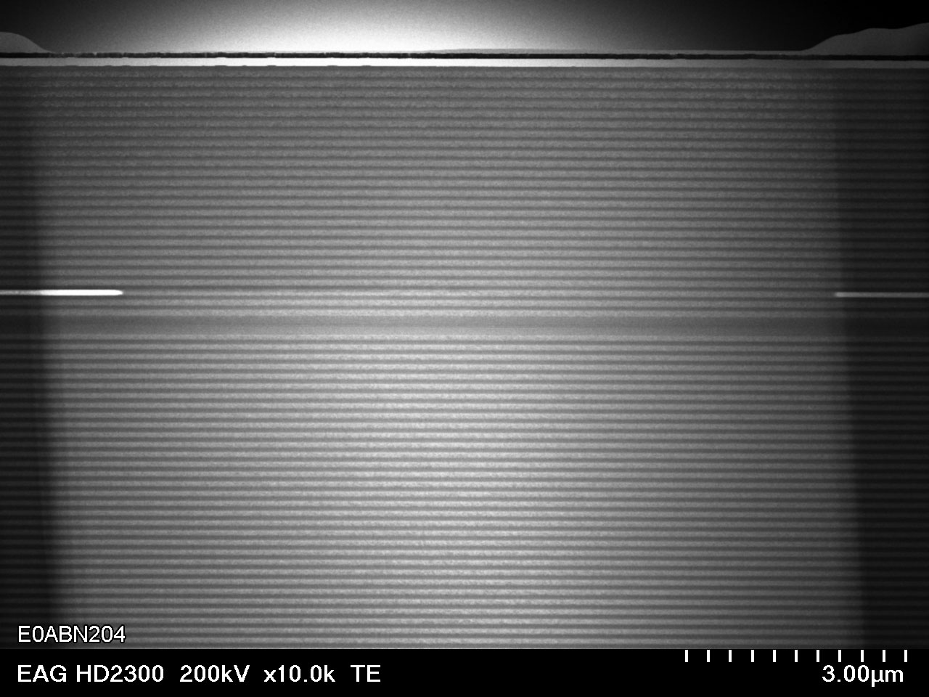
STEM Unused Channel
TL VCSEL array after FIB cut
Top DBR
oxide
MQW
(active region)
Bottom DBR
Analysis by EAG

Slide 14
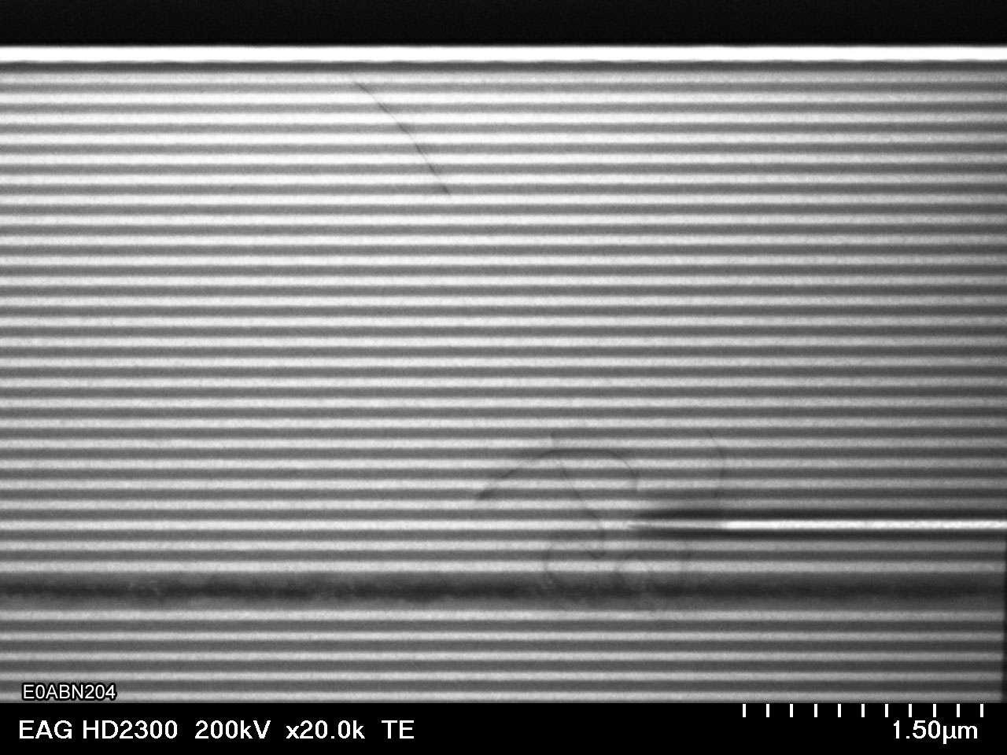
STEM Failed Channel
TL VCSEL array after FIB cut
DBR
Defects at edge of Oxide ➔ DBR ➔ active MQW region
Oxide
MQW
Analysis by EAG

Slide 15
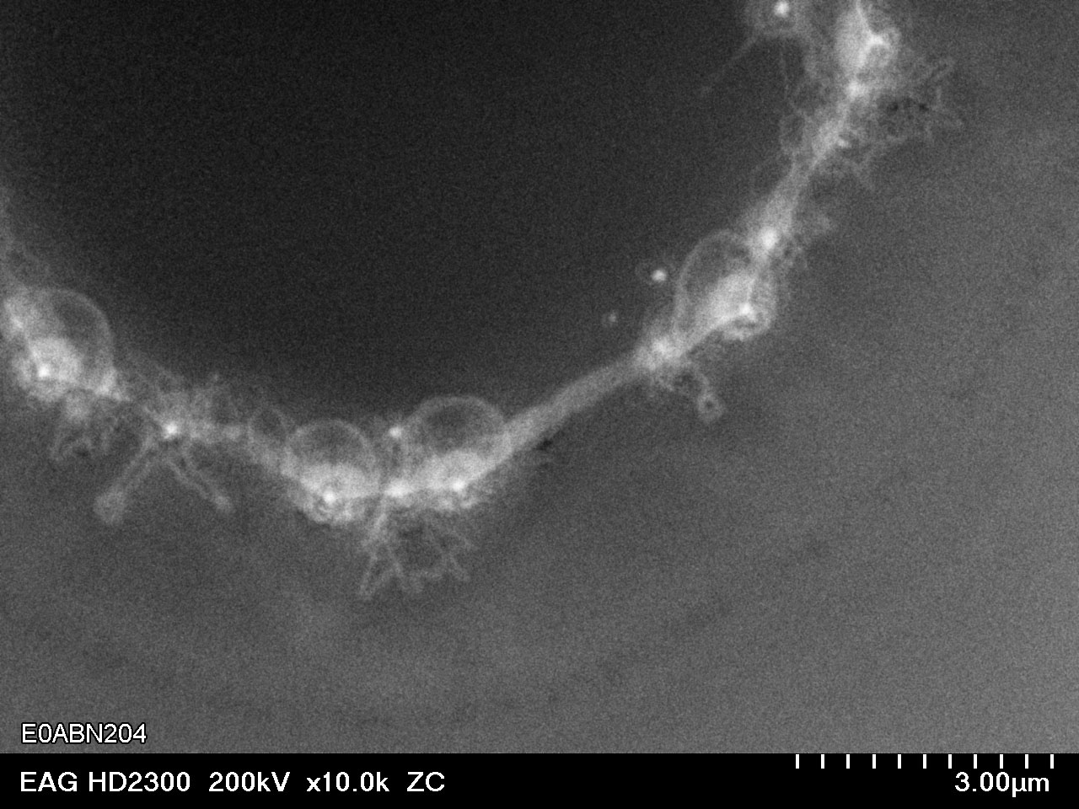
Used Working Channel
Plan View SEM
Dislocations starting to form on edge of aperture
Analysis by EAG

Slide 16
Optical Spectrum Analysis (OSA)
Powerful diagnostic technique used extensively by ATLAS
  In-situ, non-destructive
  Can detect very early signs of damage
VCSEL spectra show multiple transverse modes (single longitudinal mode)
Loss of higher order modes gives early indication of damage long before power decreases

Slide 17
VCSEL Spectrum
VCSELs single longitudinal mode but multiple transverse modes
Many weak higher order modes visible
  Loss of higher order modes is early warning
  Need to define width: use width @ peak -30dBm

Slide 18
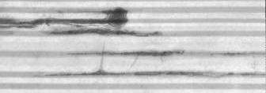
Warning
Sometimes possible to uniquely diagnose cause of failure, e.g. ESD or mechanical damage
But despite having array of beautiful diagnostic techniques available it is often not possible to uniquely determine causes of failures
Fused quantum wells
500V HBM ESD event

Slide 19
Accelerated Aging Tests (1)
Require lifetimes ~ 10 years ➔ need accelerated aging tests to validate designs
Measure Mean Time To Failure at several elevated temperature/current and use Arrehnius equation for Acceleration Factor from (I₂,T₂) to (I₁,T₁) Activation energy: E_{A}

Slide 20
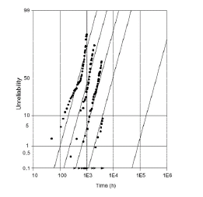
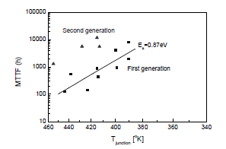
Accelerated Aging Tests (2)
Failures versus time
Acceleration Model
Fit MTTF vs T: extrapolation from elevated I & T to operating conditions
  Assumes one dominant failure mechanism
Log-normal fits to data at fixed I and T ➔ MTTF
  T= 150,130,110 & 90C
ULM VCSELs
50
Failure (%)
Emcore VCSELs
Time (h)

Slide 21
VCSEL Reliability in ATLAS
Detector | VCSEL type | Manufacturer | Package | Hermetic/ atmos | Number | Failures
Pixel on-det. | Oxide 8-way Array | True-Light | Custom Ac. Sinica | No/dry | 312 | 1 suspect channel
SCT on-det. | Proton implant | True-Light | Custom Ac. Sinica | No/dry | ~8200 | ~1% mainly infant mortalities
SCT/Pixel off-det. | Oxide 12-way Array | True-Light | Custom Ac. Sinica | No/lab RH | ~650 272+376 | MTTF ~ 1 year
TRT | Oxide | AOC (Finisar) | LC | Yes/lab RH | 768 | None
LAr | Oxide | True-Light | Custom Ac. Sinica | Yes/lab RH | ~1600 | ~1-2 / month before 2011
Tiles | Proton implant | True-Light | Custom Ac. Sinica | Yes/lab RH | 512 | None
MDT | Oxide | AOC (Finisar) | LC | Yes/lab RH | ~1200 | None
RPC | Oxide | Avago | MT-RJ | Yes/lab RH | ~512 | Was ~1/month
TGC | Oxide | Infineon | LC | Yes/lab RH | ~200 | None
CSC | Oxide | Stratos | SC | Yes/lab RH | ~160 | None
S-Link | Oxide | Infineon | SFP | Yes/lab RH | ~1600 | ≤6 since 2006

Slide 22
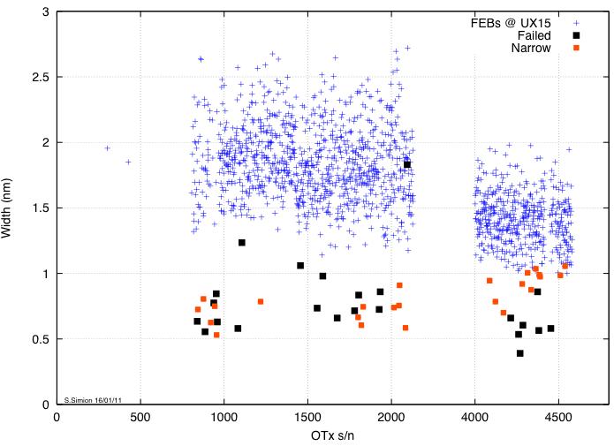
ATLAS LAr
OSA revealed two populations
Failed devices nearly all show narrow spectral widths
Width (nm)
Remaining devices with narrow widths removed during 2011 shutdown
No failures seen since
Serial number

Slide 23
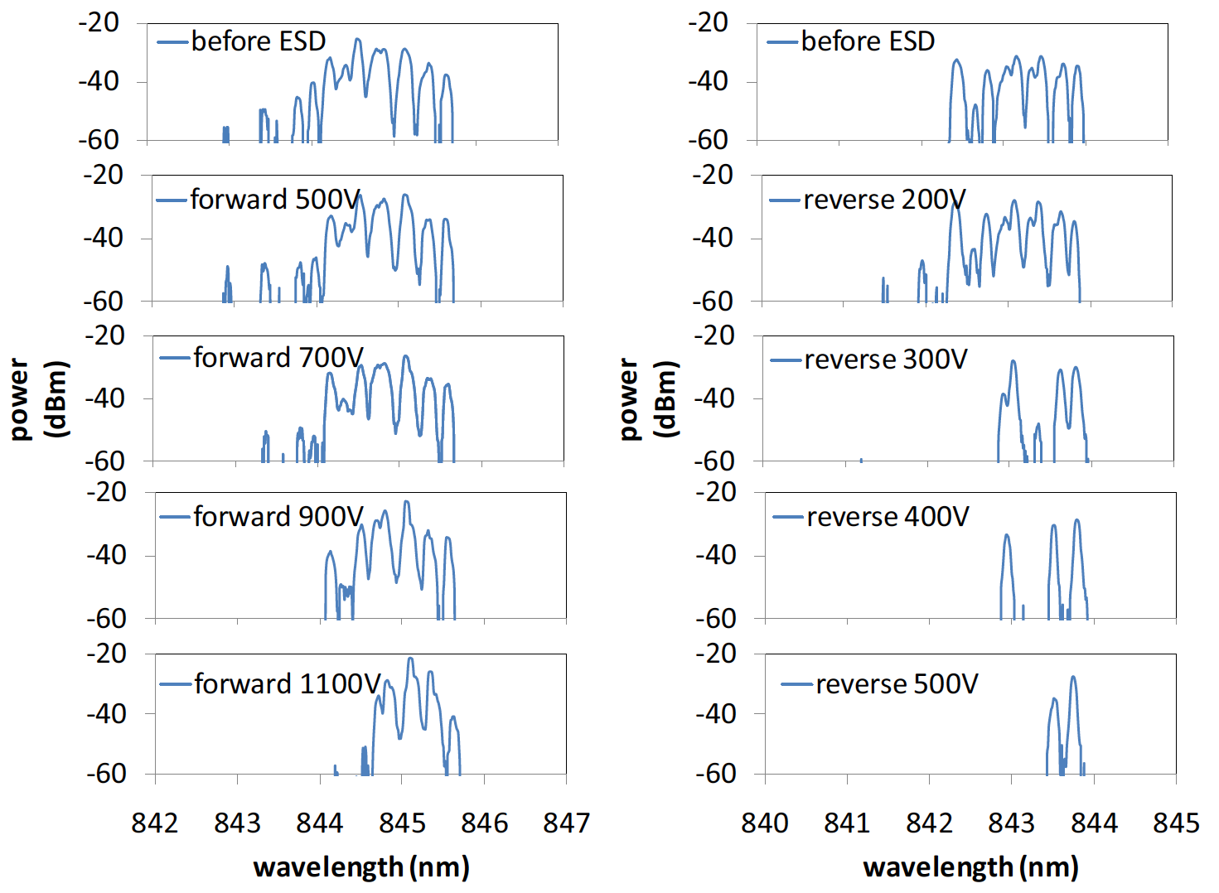
Possible Causes (1)
ESD
  VCSELs known to have very low ESD thresholds
  ESD most common cause of field failures for VCSELs
  Controlled low level ESD pulses can cause a decrease in spectral widths

Slide 24
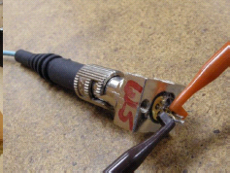
Possible Causes (2)
Humidity (TO can should be hermetic but suspect some damage during assembly)
Deliberately opened TO can
  Operation of VCSEL in lab environment with RH ~ 55% shows decrease in spectral width

Slide 25
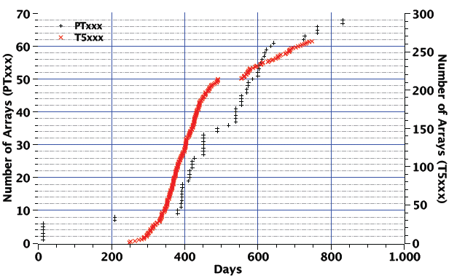
Pixel & SCT TXs
End of life failures experienced after ~ 6 months
ESD suspected during assembly ➔ all devices replaced with greatly improved ESD precautions
Lifetimes improved but still << 10 years required for ATLAS operation
Original production
Improved ESD Precuations

Slide 26
Humidity Hypothesis
Single channel VCSELs usually packaged in hermetic TO cans
Very difficult to package arrays in hermetic packages
Reliability of first arrays in damp environments was poor (lifetimes ~ 100 hours at 85C/85% RH)
Electrolytic corrosion hypothesis:
  Moisture depletes As in oxide layer ➔ excess Ga ➔ point defects which grow toward active area

Slide 27
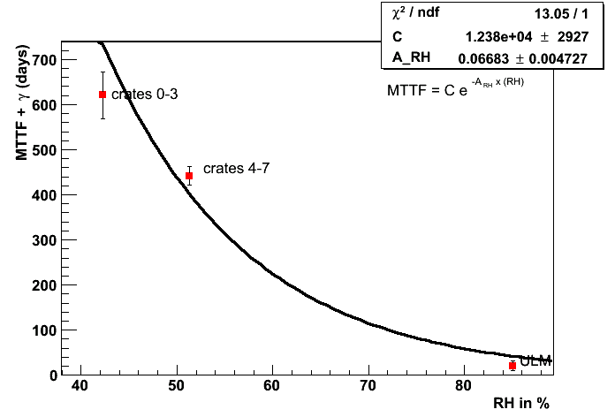
RH and Lifetime Correlation
Use (accidental) fact that RH was different for some SCT crates
Weibull fits to failures Mean Time To Failure
Correlation with RH similar to that reported in literature

Slide 28
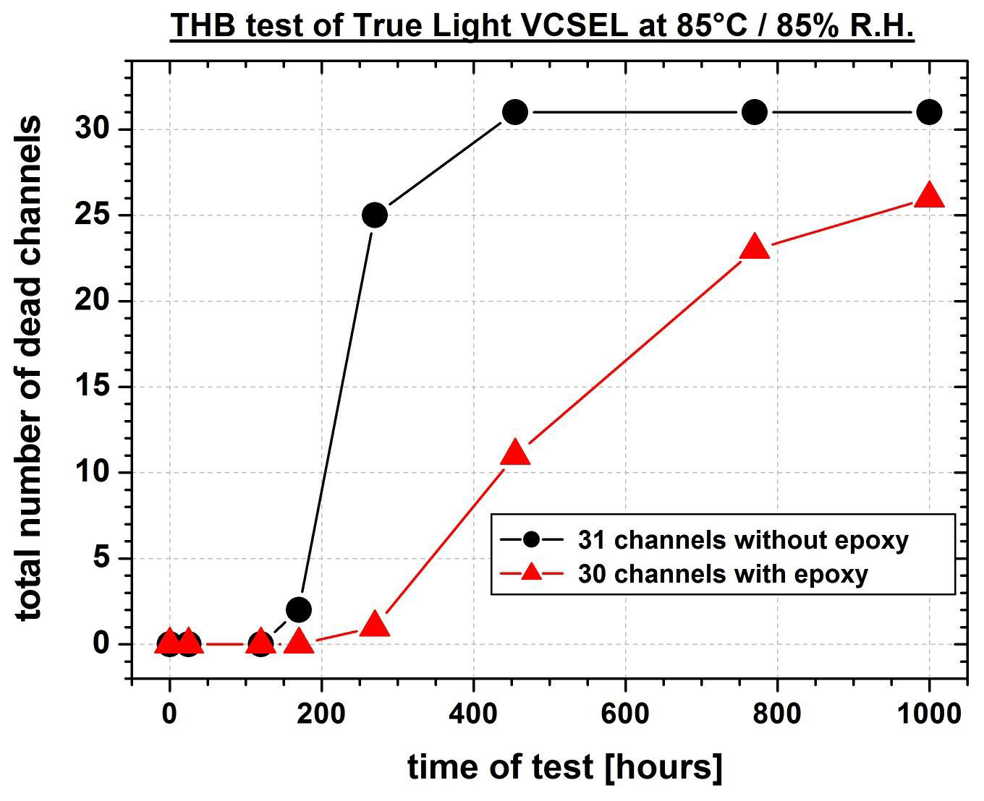
Accelerated Aging Tests
Very short MTTF
Epoxy only delays humidity entering VCSEL

Slide 29
Humidity Tests
85/85 test is extreme, so how do we know that humidity is the main cause of death?
Use OSA to look at spectral narrowing for
  TX VCSELs in dry N₂
  TX VCSELs in lab RH air

Slide 30
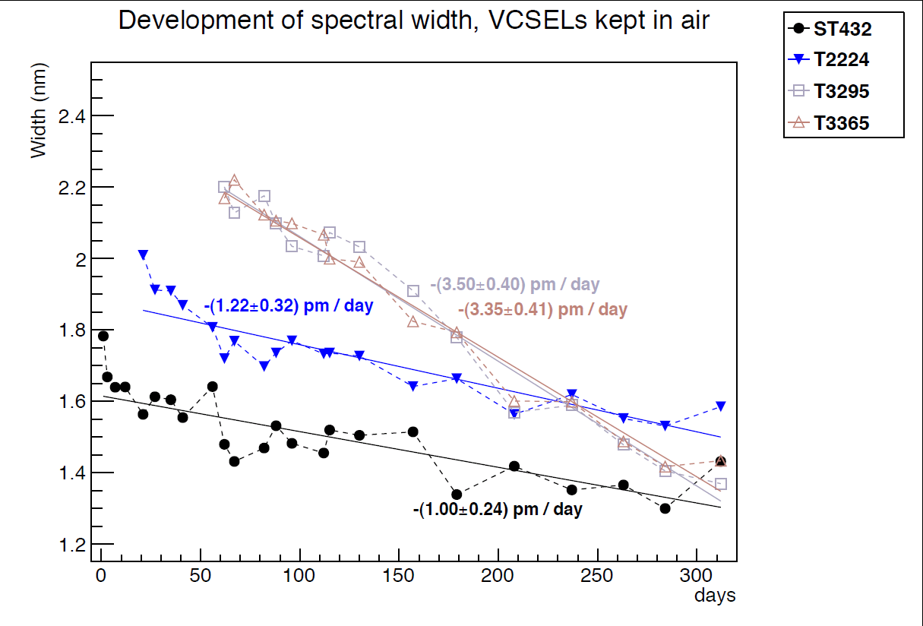
Widths clearly decreasing

Slide 31
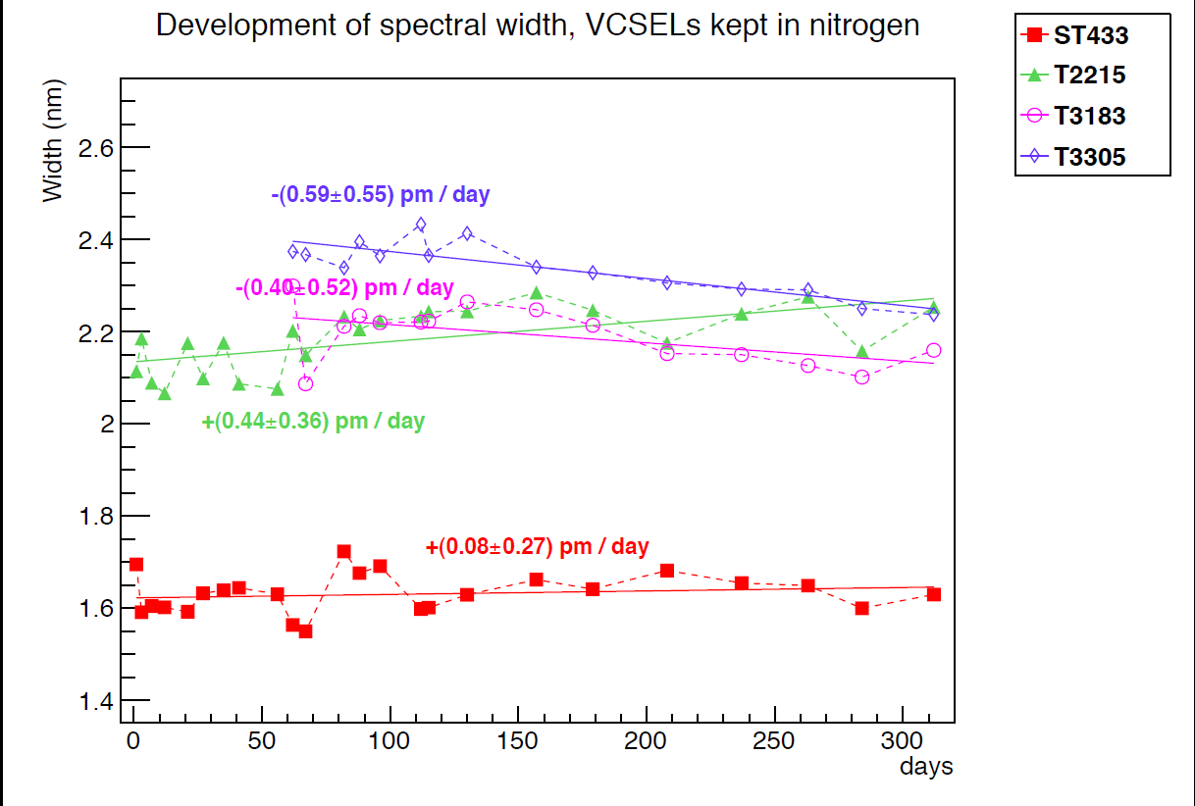
Widths ~ constant

Slide 32
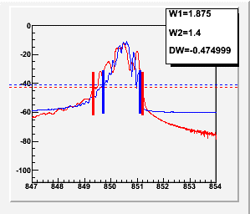
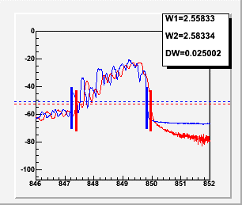
Example Spectra
Air ~ 50% RH
  Loss of higher order modes visible
Dry N₂
  Higher order modes very similar

Slide 33
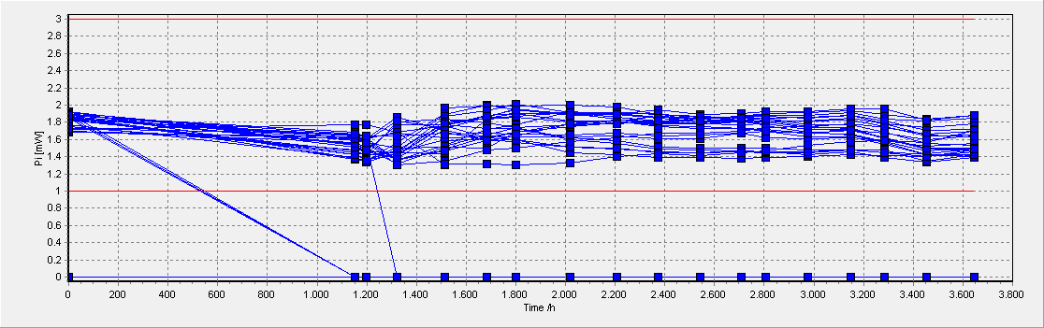
Pixel On-detector VCSEL
Same Truelight VCSEL array/MT package as for the SCT/Pixel off-detector arrays which are failing
But inside detector very low RH
Accelerated aging tests for Truelight arrays at low RH: no deaths for 24 channels, T=85C, I=10 mA , 2100 hours ➔ lower limit on lifetime = 49 years
Optical Power (mW)
Electrical disconnects
Time (h)

Slide 34
Solutions for Humidity Problems
Some manufacturers claim to make VCSELs that are reliable in high RH
  Details commercially sensitive but principle measure is blocking holes used for steam to grow oxide layer with a dielectric layer
AOC and ULM have made VCSELs that pass 1000 hours of 85C/85% RH ➔ should be ok for 10 years operation in normal lab environment

Slide 35
Reliability Tests
Bare AOC arrays
I=8 mA DC, 85C/85% RH
No deaths for 31 channels after 3200 hours
AOC arrays packaged by CSIST
  I=10mA DC, 70C/85% RH, 60 channels used
  No significant change in spectral widths for 2000 hours
Initial increase when T increased from 20C to 70C

Slide 36
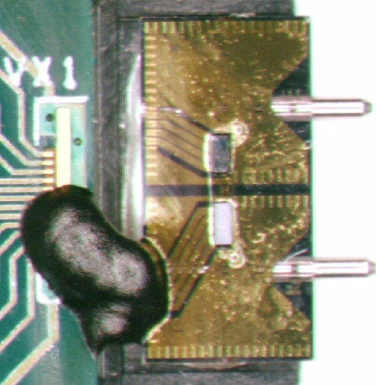
iFlame
Semi-hermetic package
  Small form-factor ➔ compatible with ATLAS SCT/Pixel TX PCBs
Uses ULM (ViS) VCSEL which also passes 1000 hours of 85C/85% RH
We will repeat lifetime tests with OSA
4 channel TRx
ATLAS 12x in production

Slide 37
VCSEL Reliability Summary
Manufacturers have succeeded in making reliable VCSELs but beware of sensitivity to environmental factors
  Mechanical
  Thermal
  ESD/EoS
  Humidity
OSA powerful diagnostic technique
Some manufacturers have improved moisture protection ➔ can use these VCSEL arrays in non-hermetic packages

Slide 38
ATLAS Outlook
LAr Calorimeter:
  replaced suspect channels in last winter shutdown
  No VCSEL deaths in 2011
  Backup schemes available if required (uses redundancy)
SCT/Pixel off-detector TXs
  All devices being replaced with two solutions:
    AOC packaged by CSIST
    ULM(ViS) VCSELs packaged in iFlame

Slide 39
Institutes Involved
  Academia Sinica
  Bergische Universität Wuppertal
  Columbia University, Nevis Laboratories
  Laboratoire de l'Accelérateur Linéaire d'Orsay (IN2P3-LAL)
  Lawrence Berkeley National Laboratory
  Ohio State University
  Organisation Européenne pour la Recherche Nucléaire (CERN)
  Oxford University
  Science and Technology Facilities Council, Rutherford Appleton Laboratory
  Southern Methodist University
  University of California, Santa Cruz
  Università degli Studi di Genova
  Universität Siegen

Slide 40
Backup Slides

Slide 41
Other Diagnostic Techniques
TIVA
CL

Slide 42
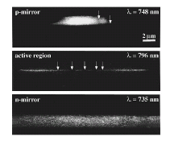
Cathode Luminescence
Light generated in SEM (cf EBIC)
Light emerges from all layers that have a direct bandgap
Defects create non-radiative traps ➔ images dark in these regions
Bandpass filter can resolve one feature
Arrows indicate dark line defects

Slide 43
Thermally Induced Voltage Analysis
Laser Scanning Microscopy
  If photon energy > bandgap ➔ e/h pairs cf EBIC
  If photon energy< bandgap ➔ local change in T creates local changes in resistance
  Constant current source supplies bias that results in voltage variation with resistance changes
  Scan surface and measure R (use constant current source)

Slide 44
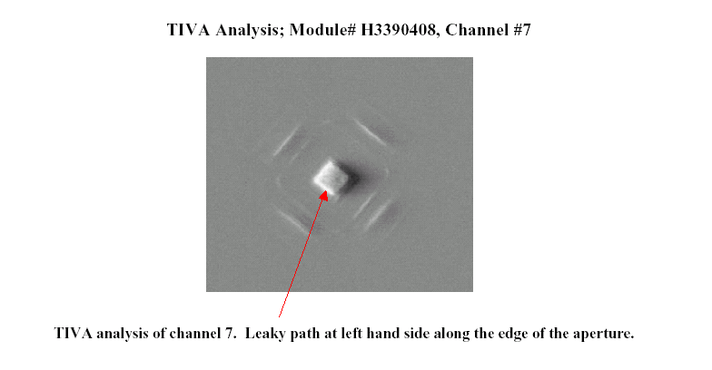
TIVA Example (Agilent)

Slide 45
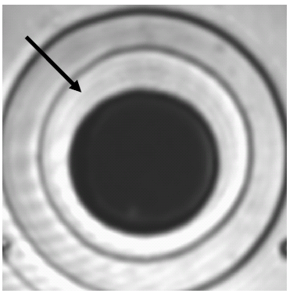
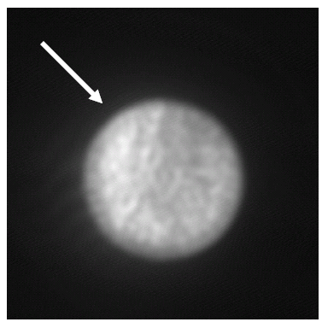
TIVA LAr OTx
Optical image
TIVA @ 10 nA
Dark lines and spots believed to be defects in MQW

Slide 46
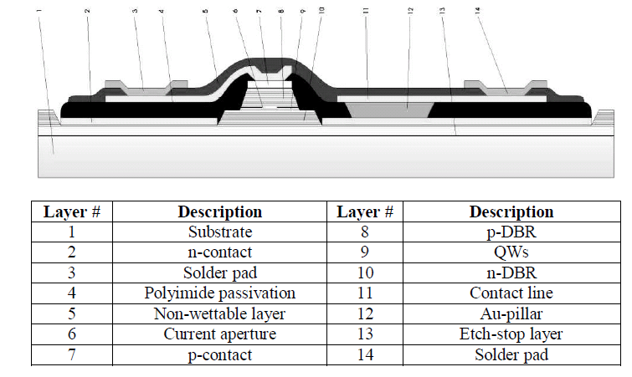
U-L-M VCSEL

Slide 47
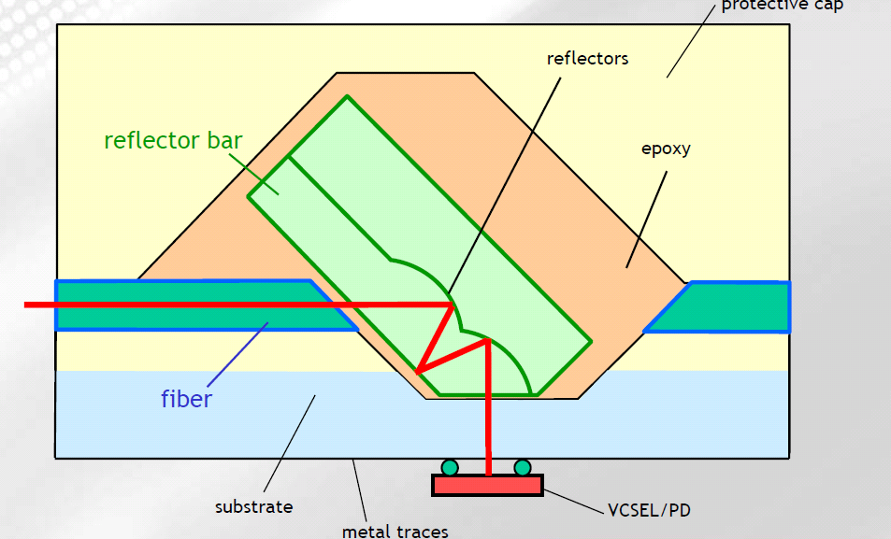
iFlame

Slide 48
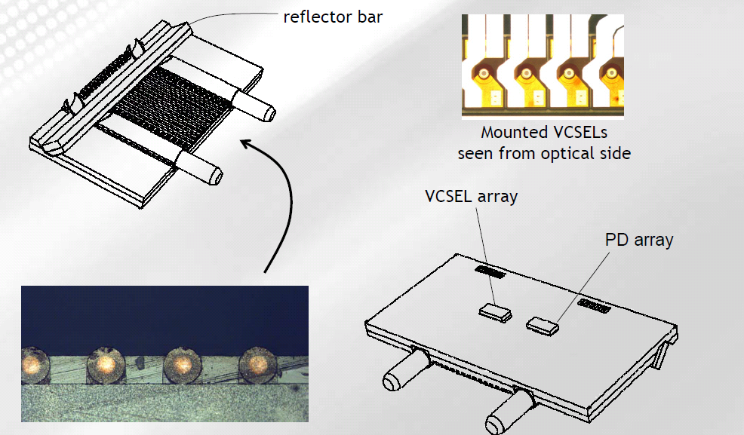
iFlame

Slide 49
IV Analysis
Forward IV curve changes with VCSEL death because device dominated by non-radiative rather than radiative recombination
  Simple indicator of VCSEL death but doesn’t tell you anything about the cause
Reverse IV curve
  Dead devices can show large increases in reverse current below breakdown voltage
  Very sensitive to low level ESD but can’t prove ESD

Slide 50
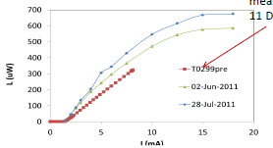
LAr OTx: exposed to RH
LI curves develop kinks: indication of damage

Slide 51
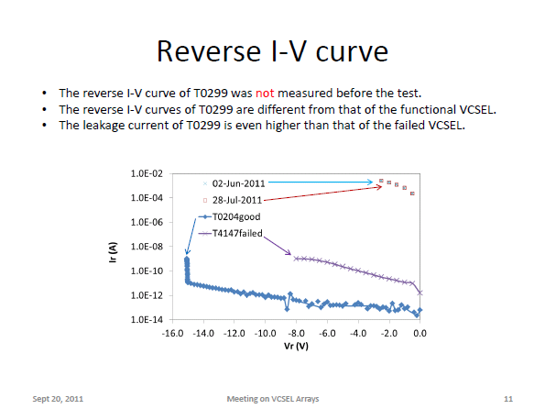
LAr OTx

Slide 52
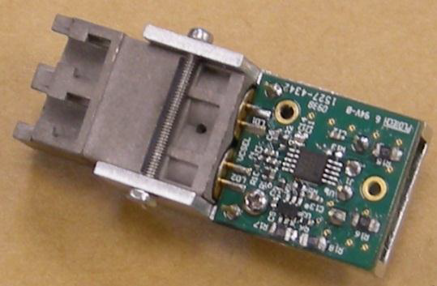
LAr OTx Backup
Dual channel for redundancy
48 VCSELs (Part# HFE4192-582 from Finisar)

Slide 53
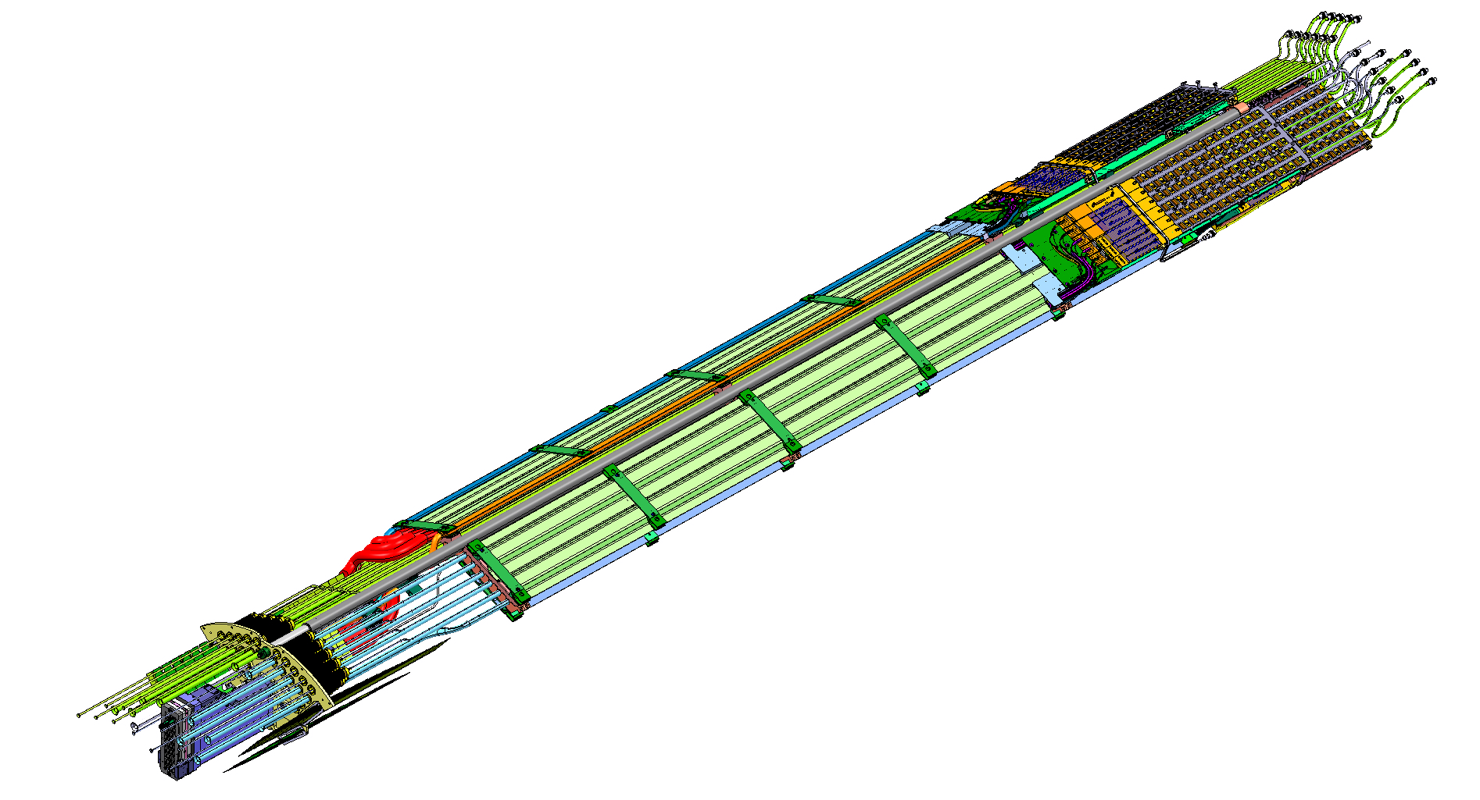
Pixel On-Detector
Monitoring a special sample of ∼40 on-detector lasing pixel links associated w/ disabled modules. An average of 15 bright months accumulated so far with one suspected failure (Sept 2009)
Backup option
  Project underway to fabricate new service panels
  If needed, would be installed during 2013 shutdown.
  Electrical readout (LVDS driven by e-boards) to a more accessible region on detector, where VCSELs would then be employed.
  Similar accessibility as LAr FEBs.

Slide 54
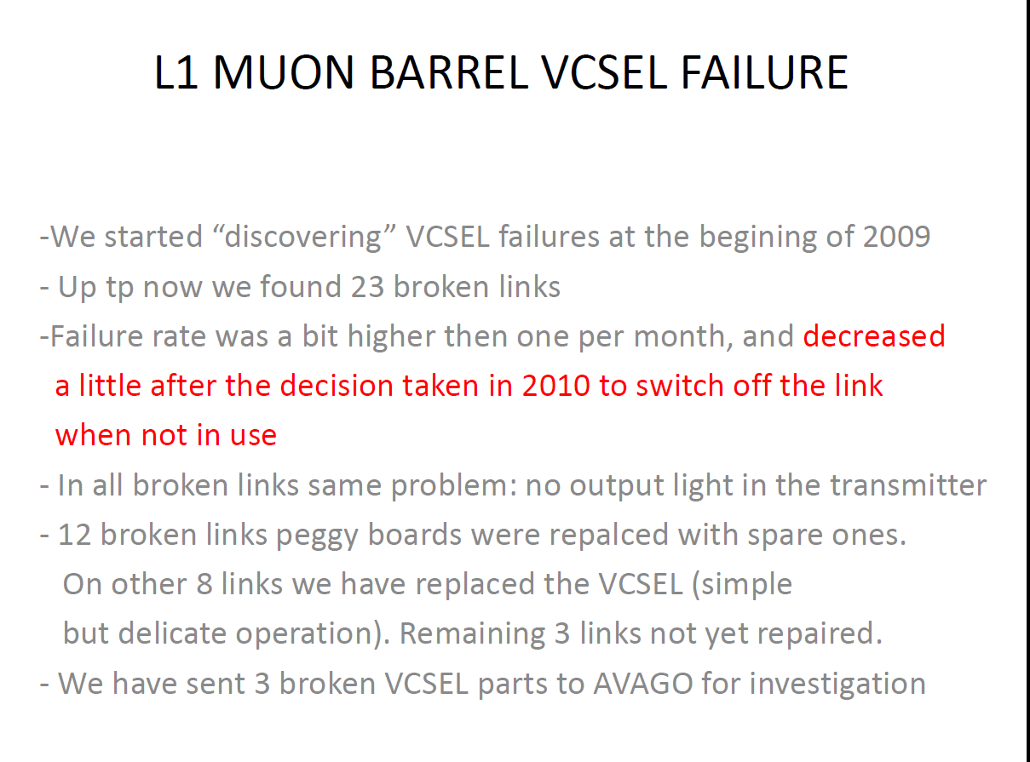

Slide 55
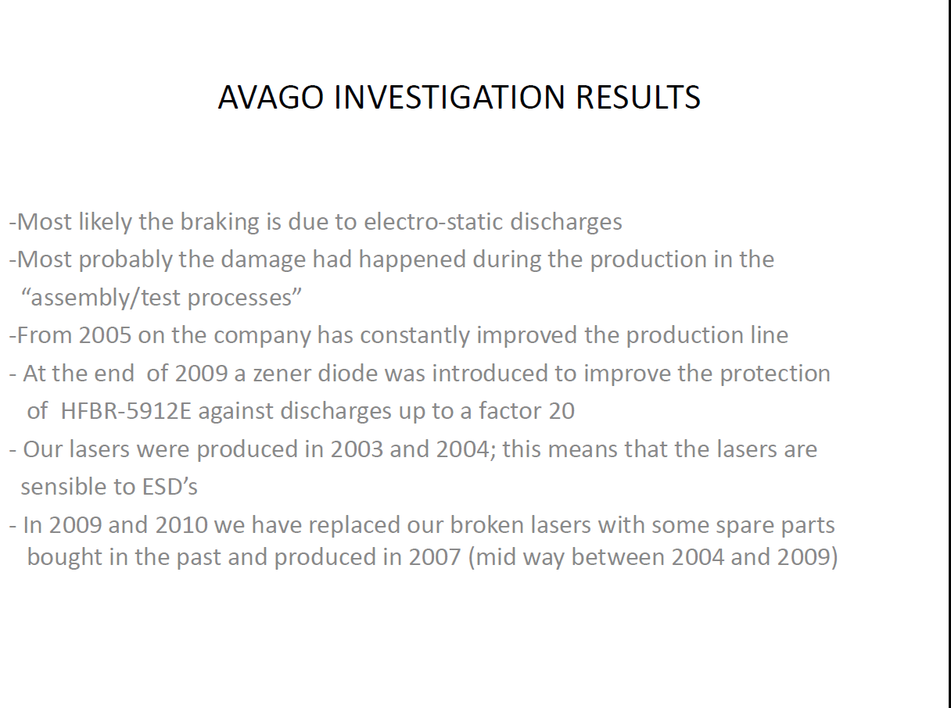

Slide 56
Dark Line Defects
For high radiance devices operated at high current densities, the dominant degradation process is the inhomogeneous development of crystal defects acting as centers for non-radiative recombinations
These defects, which occur also in semiconductor lasers, can
be seen under high magnification as dark lines and are therefore often called Dark Line Defects (DLD).
The development of DLDs is due to the growth of dislocation networks by a
climb mechanism under absorption or emission of point defects, apparently using the energy released under forward bias by non-radiative recombinations The growth and propagation of DLDs starts at initially present material impurities or crystal defects and, by increasing the non-radiative current, decreases the light output of the LED or laser at a fixed forward current. The rate of growth increases with current density and temperature, but seems to be also enhanced by mechanical stress, e.g. due to diode assembly or dicing-induced strain

Slide 57
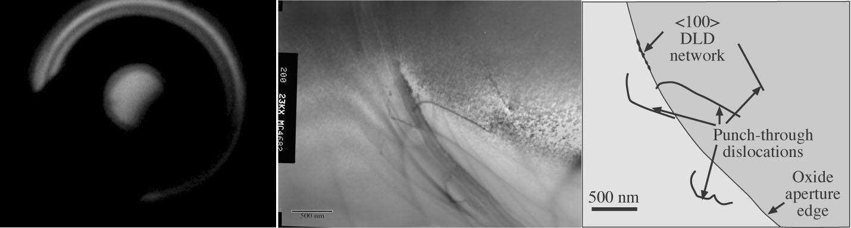
Dark Line Defects
Field return: suspected ESD
Figure 6: EL image of customer return (left) shows a small dark spot to the left, as well as a larger DLD network to the right. A planview
TEM image of the small dark spot shows “punched-out” dislocations which are usually signs of ESD breakdown.

Slide 58
(Some) VCSEL Design Trade-offs
Lower diameter oxide aperture
  Increases current density for fixed current ➔ lowers laser threshold
  Increases speed
  Increases electrical and thermal resistance ➔ lower reliability.
  Lowers ESD threshold
Optimise for one T:
cavity wavelength match gain peak wavelength at one T₀.
  Different CTE for DBR mirror and MQW active region ➔ laser threshold increases with (T-T₀)²
Mirror DBR reflectivity increase
  Decreases slope efficiency
  Decreases threshold

Slide 59
Manufacturer’s QA
Wafer level parameter measurements
  Threshold current
  Slope efficiency
  Series resistance
Allows rejection of suspect wafers
Wafer level burn-in: AOC
  In principle avoids need for burn-in after packaging.

