Slide 1

M. C. Esteban
EMC studies for CMS tracker upgrade
Status & Plans

Slide 2
OUTLINE
1. Introduction – Motivation
2. EMC project for tracker upgrade.
3. Working Packages
  Status & Plans
  Future works
4. Conclusions

Slide 3
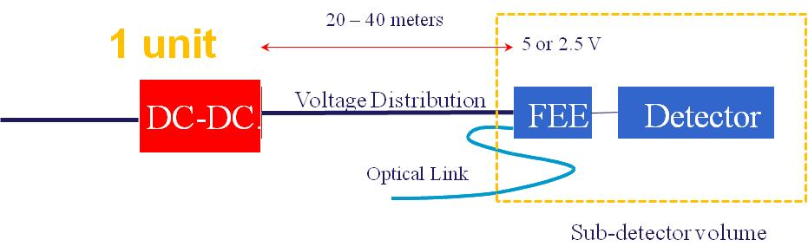
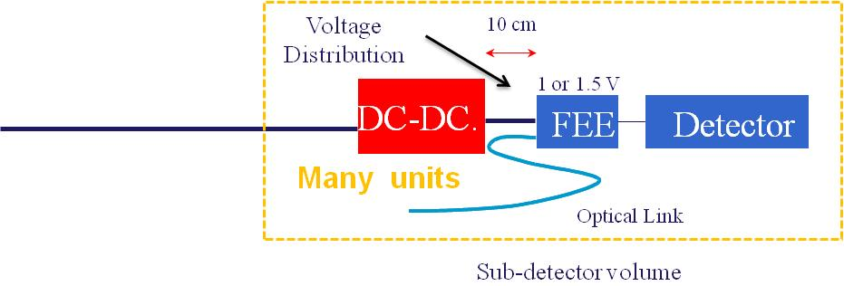
1. Introduction - Motivation
Today
Upgrade
New FEE requirements forces to install DC-DC converters close to FEE (inside sub-detector modules).
  The high current demanded by each power channel
However DC-DC converters are a very noise source
  It is necessary to minimize the noise coupling between FEE – DC-DC units
  It is necessary to minimize the total noise inside sub-detector volume
A large R&D effort is planned and taking place to develop a DC-DC switching converter to operate under high magnetic field with low noise emissions inside tracker volume
  GREAT effort form CERN & Aachen

Slide 4
2. EMC project-upgrade
EMC immunity studies for CMS tracker upgrade - 9.04
  IFCA & ITA – Approved by CMS MB on November 2009
    First stage of the EMC strategy – long term strategy for CMS
The project is founded by Spanish agencies and ITA
  3 year project
  Project members:
    Instituto de Física de Cantabria (CSIC-UC)
    Instituto Tecnológico de Aragón (G. Aragón)
    Centro Nacional de Microelectrónica Barcelona (CSIC
The main goal of the project is:
  To define preliminary rules to ensure the integration of main components (Detector, FEE, Power network and DC-DC )
  To define design strategies that allow increasing the immunity of the Detector-FEE unit – Robust FEE designs to EMI phenomena

Slide 5
3. Working packages – Status & Plans
The project has started in 2010
It is divided in four working packages
  WP 1: Power network impedance characterization
  WP 2: Noise propagation effects in power network
  WP 3: Noise immunity test in FEE prototypes
  WP 4: Validation of EM immune OFS for temperature, magnetic field and strain: Effect on overall EM noise
Strong collaborations with other groups is planned
  FERMILAB – M. Johnson- B. Copper
  Aachen –K. Klein
  CERN-F. Faccio

Slide 6
3. Working packages – Status & Plans
WP 1: Power network impedance characterization
  The aim of WP1 is to define and characterize the impedances connected to the DC-DC power converter
    It defines the noise (conducted and radiated) levels emitted by the DC-DC power converters AT SYSTEM LEVEL
    Characterization of the electromagnetic environment
      Impedances ( FEE & Power Bus)
      Multiple units
  Simulation of effect to impedances connected to the DC-DC power converter-TWEPP 2010
  First measurement on ITA facilities with a ITA DC-DC power converter prototype – May 2011

Slide 7
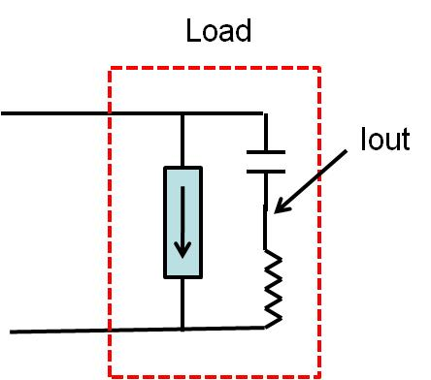
3. Working packages – Status & Plans
Simulations
Measurements

Slide 8
3. Working packages – Status & Plans
Preliminary results
  Strong dependence of DM noise emissions respect
      Input & output Impedance
      Granularity
  Strong dependence of CM noise emissions respect
      Stray capacitance Impedance
      Input voltage
A test set up has been developed to estimate noise emissions in real scenario – System Level
  Previous studies have shown that the impedance connected to the DC-DC has strong impact in noise emission
  It represents the low impedances connected to the DC-DC
  It has to be prepared to work between up to 100 MHz .

Slide 9
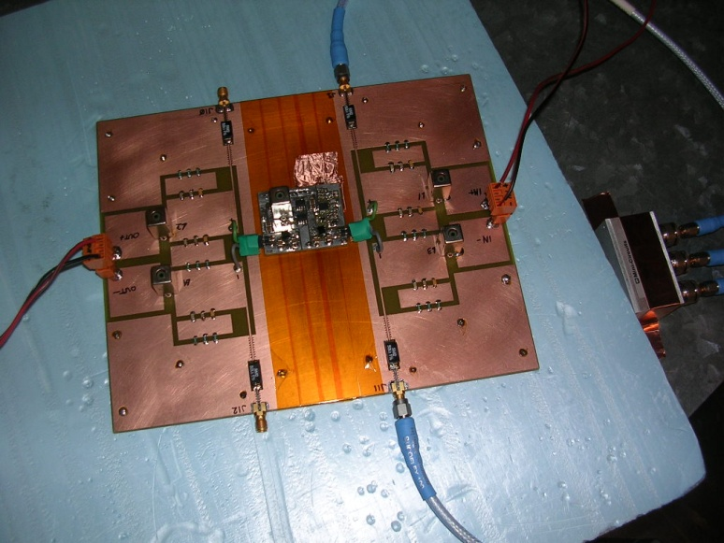
3. Working packages – Status & Plans
DC-DC
Test board
ports
The impedance effect have more or less impact depending on DC-DC layout & size
  It is planned to repeat these tests with Aachen´s converter

Slide 10
3. Working packages – Status & Plans
WP 2: Noise propagation effects in power network
  The aim of WP2 is to define the key points that allow designing the power network to minimize the effects of noise currents generated by DC-DC converter.
    Effects of noise emission of carbon fiber
    Shielding effectiveness to carbon fiber
    DC-DC layout effects (conducted and radiated)
    Cables – Ability to radiate
  This WP is carrying out in two stages:
    Simulations models
      Transmission line models - MATLAB code (finished)
    Real conducted and radiated test (Anechoic chambers)
      Radiated noise from DC-DC prototype
      Noise distribution on DC-DC prototype

Slide 11
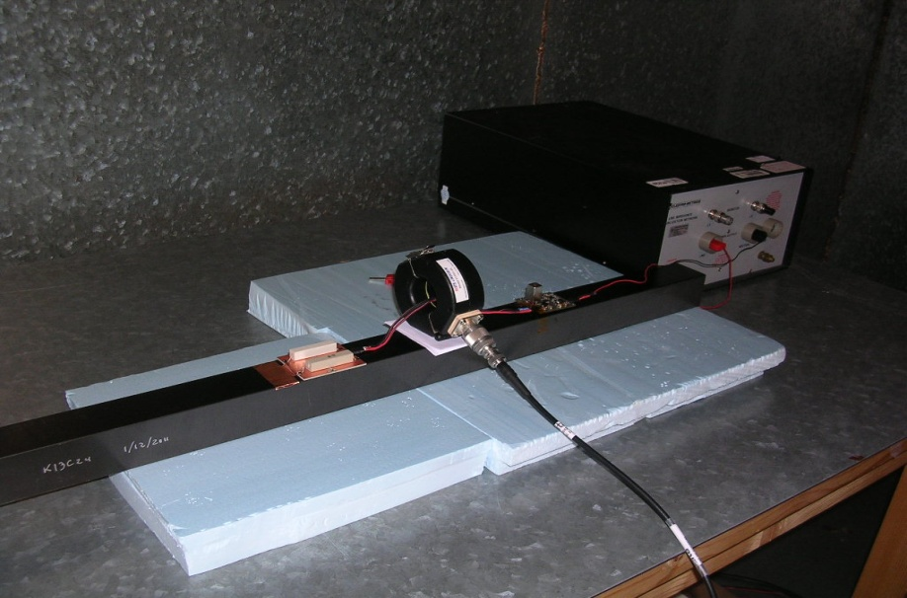
3. Working packages – Status & Plans
WP 2: Effects of noise emission of carbon fiber
LISN
OUTPUT
Isolation
DC-DC
Load
To spectrum
analyzer
CF structure: Double-stack
Results for ITA prototype
They are similar to the ones measured with System test board
INPUT

Slide 12
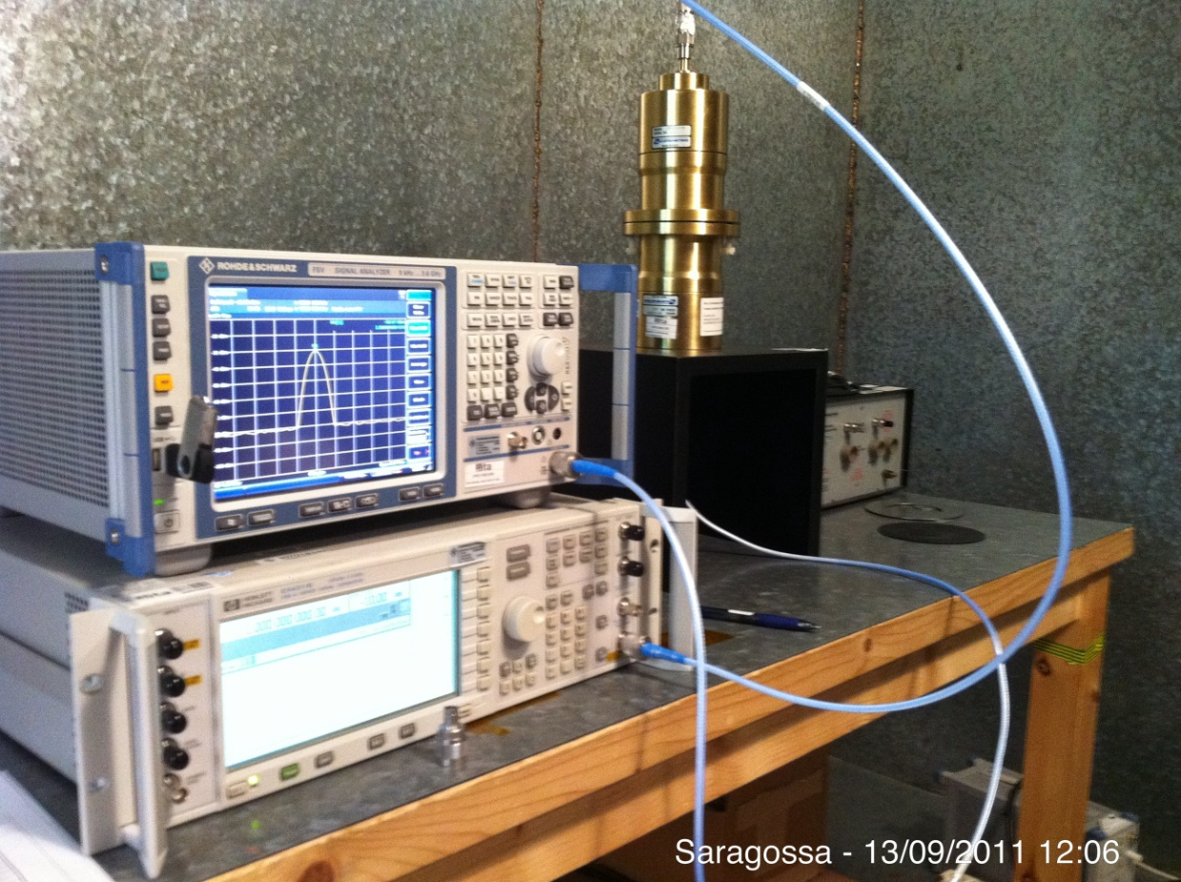
3. Working packages – Status & Plans
WP2. Shielding effectiveness test of carbon fiber
The carbon fiber is used in the development of double-stack structure.

Slide 13
3. Working packages – Status & Plans
Shielding effectiveness test to carbon fiber
  Sample 1: Carbon fiber
  Sample 2: copper insertion on carbon fiber
SHIELDING EFFECTIVENES | SE dB | ATEN. | %
POOR | 20 | 10:1 | 90%
 | 40 | 100:1 | 99%
 | 60 | 1000:1 | 99,90%
 | 80 | 10000:1 | 99,99%
EXCELENT | 100 | 100000:1 | 100,00%
  They may be use as DC-DC converter shield
    More studies are required – Copper ground

Slide 14
3. Working packages – Status & Plans
WP 3: Noise immunity test in FEE prototypes
  The aim WP3 is to define the FEE immunity on prototypes:
    Impact of integration strategies in the overall design.
      Conducted immunity test
      Radiated immunity test (ITA facilities).
  Some preliminary work has been done during 2009
    Analysis of coupling mechanism in old tracker
      Already presented in TWEPP 2009 & Tracker upgrade meetings (H field at pitch adapter)
  Future plans – two options
    Test FEE prototypes of new Tracker system
    Test old FEE in new topologies
  These tests are planned for 2012
  We expect to collaborate with other groups

Slide 15
3. Working packages – Status & Plans
WP 4: Validation of EM immune OFS for temperature, magnetic field and strain: Effect on overall EM noise
  The purpose of WP4 seeks out the implementation of OFS to substitutes previous measuring systems based on cooper cables.
    Different methods for attaching the fibres to carbon composites supports
    Architectures for sensor distribution network
    EMC factor measurement (Copper Vs FOS)
  Main FOS activities
    Complete the market survey.
    Proposal of fiber routing for CMS upgraded tracker
    Testing of standalone fibers (irradiation).
    CF test structures with bonded or embedded fibers.
    Mechanical expansion and compression test under several thermal and humidity conditions.
    Experimental validation of OFS vs. electrical expansion gauges.
    Comparison with FEA simulations

Slide 16
3. Working packages – Future works-
Long & detailed tests campaign planned for next months
  1.- Conducted emission test to DC-DC Aachen converter
  2.- Radiated emission test (ITA and Aachen)
  Magnetic emission test to DC-DC converter.
  Electric emission test to DC-DC converter.
  Magnetic and electric emission test to DC-DC converter on double-stack carbon fiber developed by FERMILAB:
    On double-stack carbon fiber
    Inner double-stack carbon fiber
    On double-stack structure not grounded, grounded one side, grounded two sides, grounded at the middle of the structure
  3.- Multiple DC-DC converter test
  It is planned to install 4 o 5 DC-DC converters on the CF structure. Radiated and conducted emission test.

Slide 17
3. Working packages – Future works
4.- Radiated emission test
Radiated emission test will be performed inside of the semi-anechoic chamber.
Near and far field will be measured.
The electromagnetic field will be measured using electric antenna (30 MHz to 1 GHz) and magnetic antenna (9kHz to 30 MHz) for near and far field.
Radiated emissions test to different components to power system distribution, they will carry out with current probe and antenna:
    Unshielding twisted cables
    Shielding twisted cables
    Radiated emissions on power distribution board

Slide 18
4. Conclusions
EMC Tracker upgrade project is on going.
This project is well founded by Spanish R&D program and ITA
The project is divided in 4 WP
WP1, WP2 & WP4 has started
  WP1 focused on impedance effects on noise emission is finished
  WP2 focused on power network issues- on going
  WP3 is planned
  WP4 focused on development of high immunity systems is on going

