Slide 1
TWEPP 2011
The ALICE trigger
Marián Krivda
On behalf of Trigger Project in the ALICE collaboration

Slide 2
Overview
Description of Central Trigger Processor (CTP) in ALICE experiment
Performance – SMAQ plots, DQM
Use of classes for beam gas correction
Configuration of CTP using Alice Configuration Tool (ACT)
Clock phase measurement and adjustment using CORDE board
Optical scope
Firmware Upgrade
CTP Upgrade plan

Slide 3
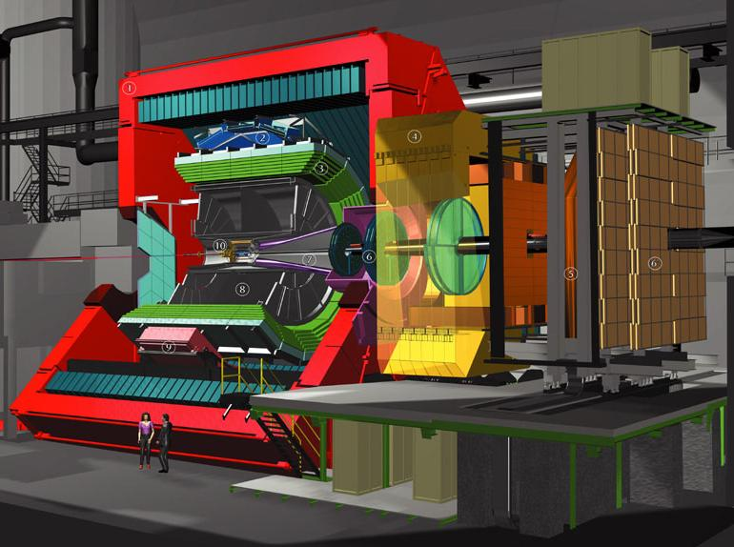
ALICE experiment
CENTRAL TRACKER
Silicon pixel, Silicon Drifts,
Silicon Microstrips, TPC, TRD,
TOF
FORWARD DETECTORS
T0, V0, FMD, PMD
SPECIAL DETECTORS
ACORDE, PHOS, EMCAL,
HMPID
DIMUON TRACKER
Absorber, Tracking chambers
Trigger chambers

Slide 4
System parameters for ALICE Trigger
3 HW trigger levels:
    L0 inputs to CTP up to 800 ns, time for making decision 100 ns, time for delivery to detectors up to 300 ns, together is max. 1.2 μs from interaction;
    L1 inputs to CTP up to 6.1 μs; time for making decision 100 ns, together is max. 6.5 μs from interaction;
    L2 delivered to detectors 105 μs from interaction.
60 trigger inputs
    L0 24; L1 24; L2 12.
Up to 24 detectors
6 independent partitions (clusters)
50 classes
4 past/future protection circuits
Interaction record - a list of all the bunch-crossings in which the Interaction signal has been detected; also for past-future protection check and pattern recognition
Rare event handling

Slide 5
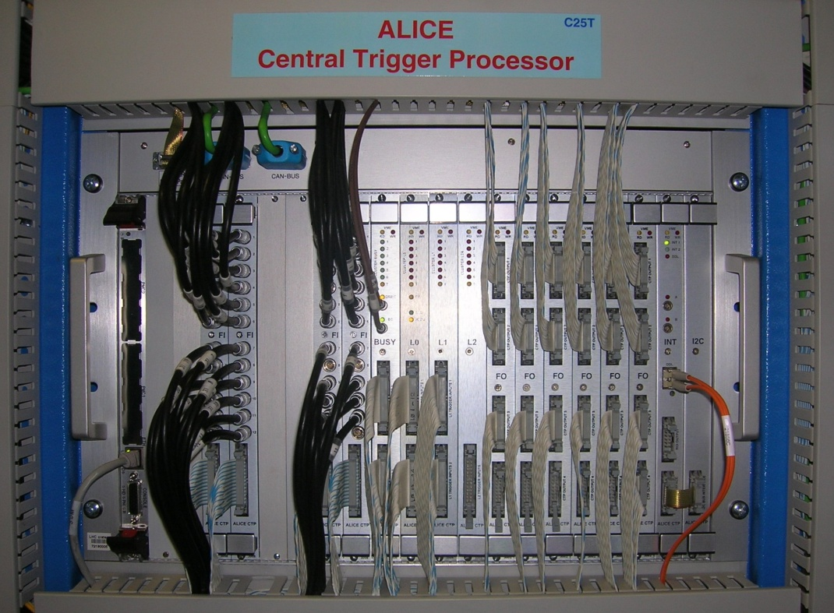
Alice trigger system
Central Trigger Processor (CTP):
receives trigger detector inputs, makes decision
Local Trigger Unit (LTU):
interface between CTP and readout detectors
Trigger and Time Control (TTC):
transmits LHC clock and delivers trigger signals to detectors
Due to short time for L0 latency the CTP is in the experimental cavern
6U VME boards
  L0, L1, L2 boards
  BUSY board
  FO boards
  INT board
  I2C board
LVDS Trigger inputs
Outputs are sent to Local Trigger Units (LTUs) where conversion to output format occurs

Slide 6
Classes and clusters
50 classes
Classes define requested physics i.e. which trigger inputs must be active for making decision
Cluster inside classes define which detectors will receive trigger decision
Past-future protection inside classes define number of interaction in time interval
Rare event handling

Slide 7
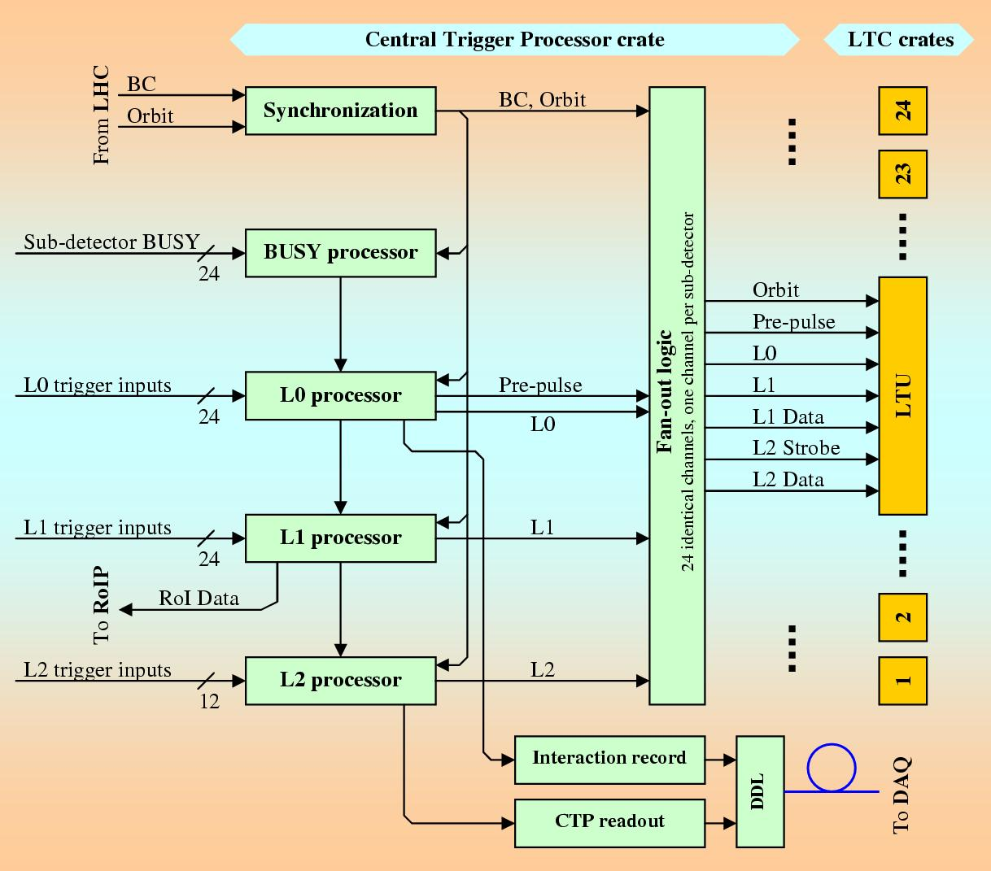
Interaction record (INT1,INT2) and CTP readout
Each BC is generated INT1 and INT2 (INT is LUT from first 4 trigger inputs)
After each L2 trigger is generated CTP readout
INT and CTP readout are sent to DAQ

Slide 8
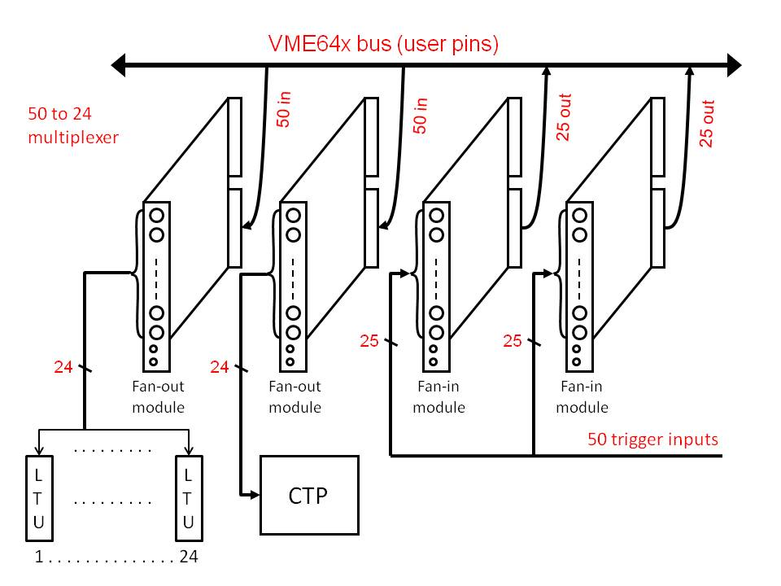
L0 trigger input switch
In order to handle more L0 trigger inputs the L0 trigger input multiplexer 50:24 has been made from available Faninout boards

Slide 9
SsM data Acquisition (SMAQ)
L0 inputs
SSM
1048576 BCs, 32 bits = 26.2ms = 294 orbits
~1 sec
CPU
SSM filling is started by any L0 input, usually by 0MSL - the one with the lowest rate in proton runs
Important signals:
  0BPA/C - beam presence (BPTX)
  0VBA, 0VBC, 0SMB, 0SMH - collision detection
  0MSL - single muon detection
Goals:
Check whether correct BC masks is loaded
Check alignment of L0 inputs
Diagnostics of timing problems

Slide 10
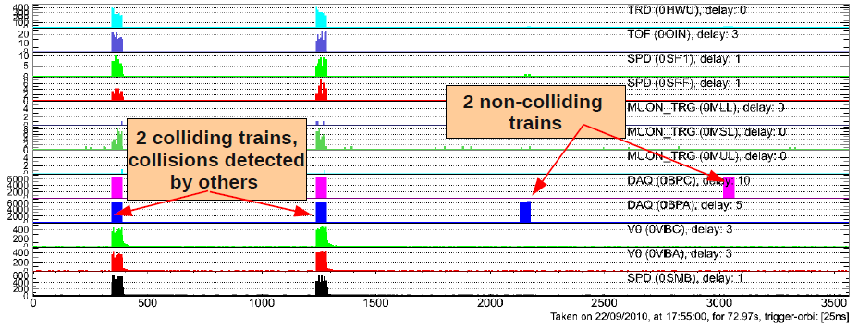
Performance – SMAQ plots
Full ORBIT SMAQ
Looking at BPTX signals (0BPC and 0BPA) we can determine where are collisions

Slide 11
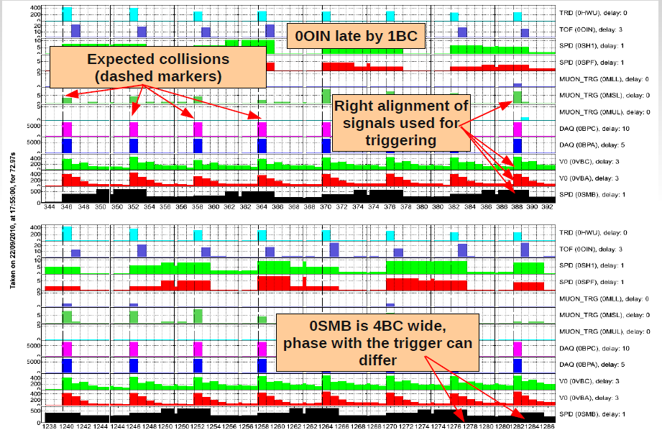
SMAQ zoomed plots
50

Slide 12
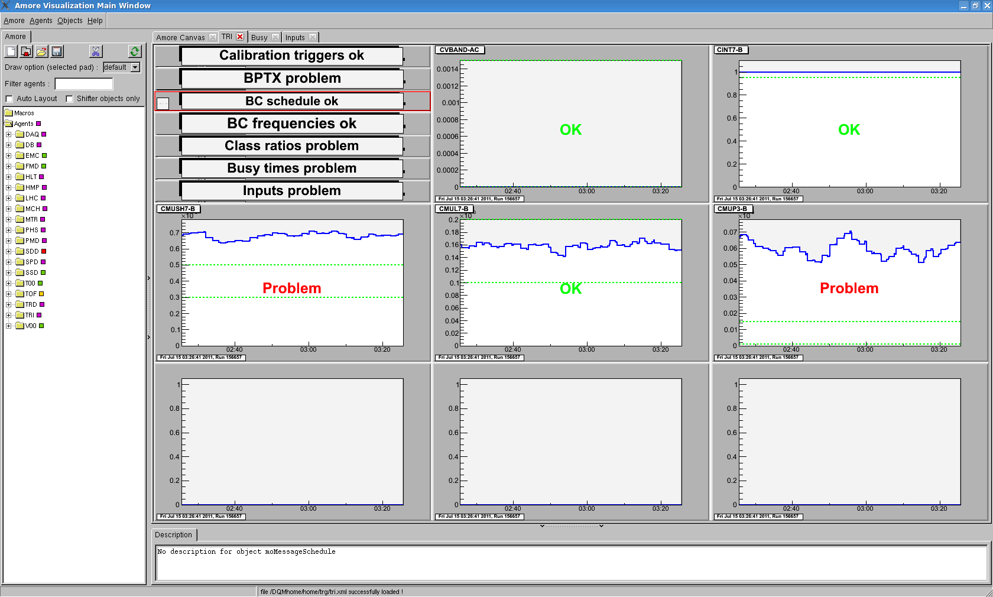
CTP Data Quality Monitor
Possibility to set thresholds
Monitoring of CAL triggers, BUSY times, BC schedule, trigger input rates, class rates, cluster rates.

Slide 13
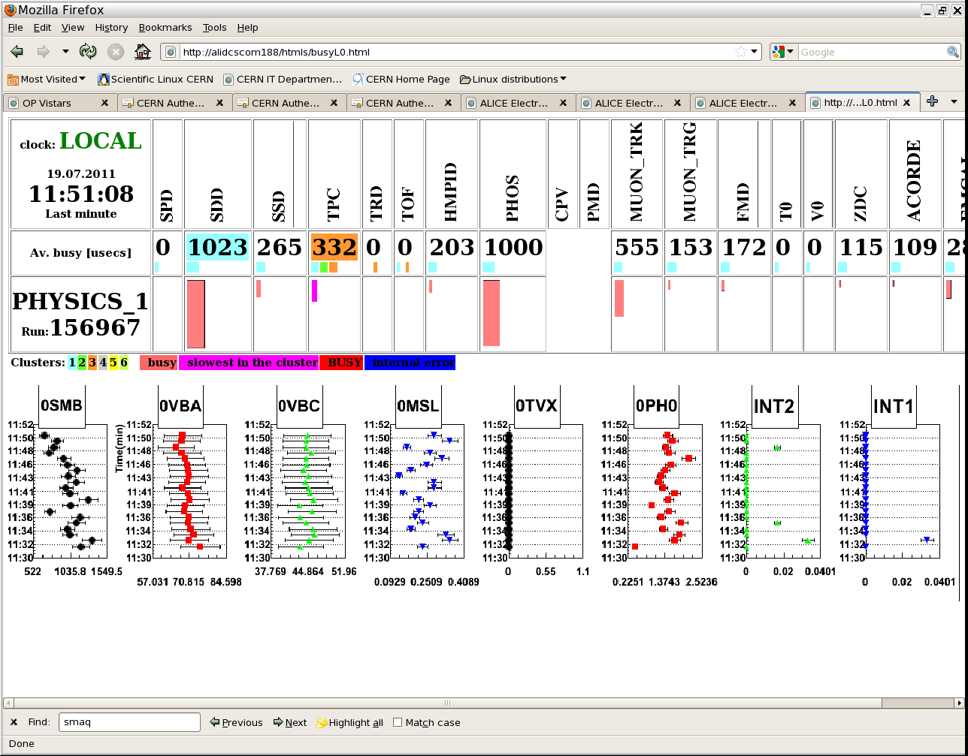
Online screen

Slide 14
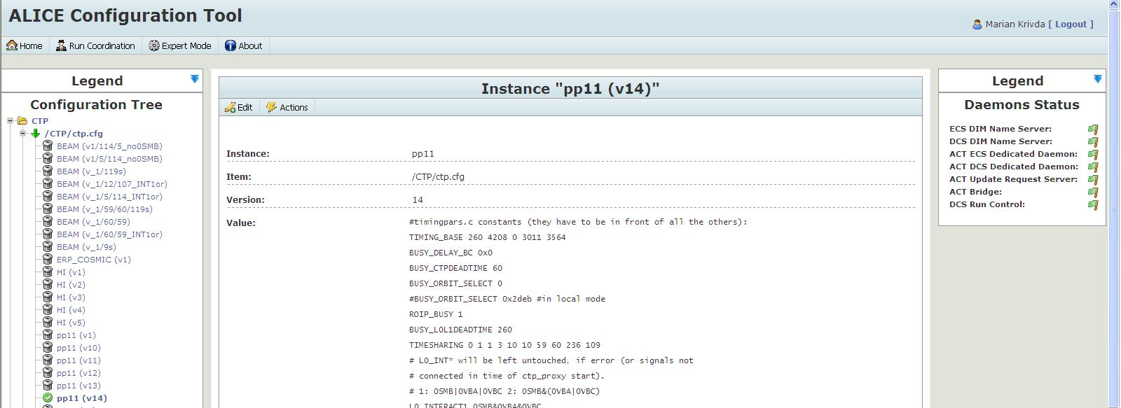
Configuration of Alice experiment using Alice Configuration Tool (ACT)
ACT provides sets of reference files ensuring that the ALICE experiment - including the CTP - can be configured for standard tasks without the presence of experts. Reduces dramatically the number of people on shift.
Configuration is done by a shift leader when necessary (a change in CTP inputs, new filling scheme, ...)

Slide 15
Configuration of CTP using ACT
After choosing a correct configuration files in ACT the following action are done
  Downloads CTP configuration files from ACT to local files
  Configure CTP and L0 multiplexer(50:24)
  Restart CTP
ACT
LOCAL
L0 switch
CTP
Options in ACT:
  L0 switch: 24 from 50 L0 trigger inputs
  Bunch Crossing mask (BC Mask): CTP can choose in which bunches in ORBIT to allow triggers
  Downscaling: CTP can reduce trigger rate of classes with high rate (downscale factor – DS, assigning group of classes (CG) time windows)
  Filter: disabling of faulty detector from trigger and readout logic
  ……

Slide 16
Use of classes for background correction
Each class has associated BC mask:
  B - colliding BCs
  AC - BCs with bunches from A or C
  E - BCs without bunch
  D - cosmic during beam in empty BCs
  I - isolated BCs i.e. colliding BCs separated by min. 100 BCs
In offline we are able to select Beam, Beam-Gas-A, Beam-Gas-C and Empty versions of the trigger

Slide 17
Clock phase adjustment using CORDE board
CTP
RF RX
RF RX
CORDE
RF2TTC
Fan-out
Fan-out
Fan-out
2
2
MAIN_BC
MAIN_ORB
LTU1
2
BC1
ORBIT1
ORBIT2
LTU19
BC1,
BC2
after fine
adjustment
ORB1,
ORB2
BC1,
BC2
ORBIT2
Oscilloscope
ORBIT1
BC1
Clock is measured by BPTX and adjusted at the begging of each run with clock steps of 50 ps
Separated CLK and ORBIT for BPTX measurement
BPTXA
BPTXC
2
ORBIT1
BPIM
2
BC1

Slide 18
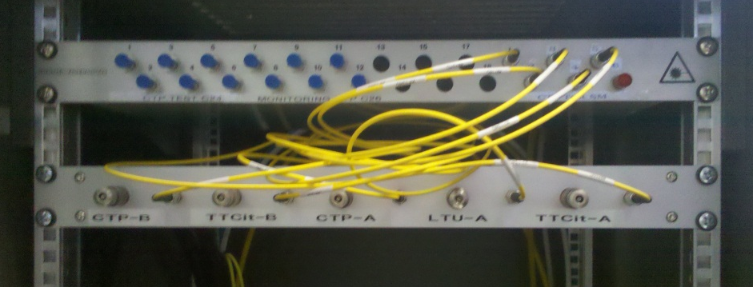
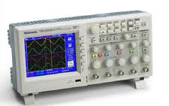
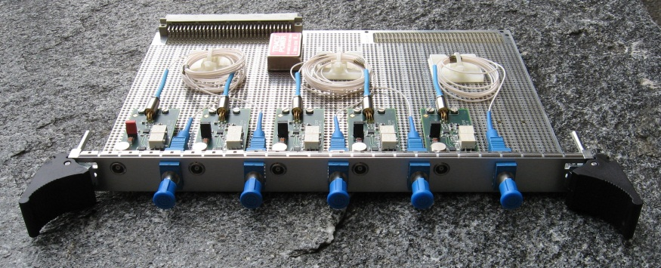
Optical scope
~120 m
surface
cavern
El. to optical and optical to el. conversion
Monitoring of frequency of signals in the cavern

Slide 19
Firmware Upgrade (L0 board)
BC mask moved from VETO logic to TRIGGER logic
2 new L0_functions using memory bits inside FPGA (2 LUTs, first 12-inputs and second 12-inputs) => logical OR of outputs of 2 LTUs)
8 new BC masks i.e. 12 BC masks available
Possibility to use negation for all classes
1
LUT
Cass
bit 27
12
OR
13
LUT
24

Slide 20
Firmware Upgrade
(INT board and LTU board)
Added timing option for interaction record to be sent to DAQ every 2 sec.
Changed synchronization of ORBIT counters as L2 trigger time extended to 105 µs
L2 delay extended to 13-bits
Rate interlock units changed from ~0.82ms to ~0.1ms
Rate period increases from 8 to 11 bits
Added input for external ORBIT

Slide 21
Possible CTP Upgrade
Trigger input multiplexer (50:24) directly on L0 board – upgrade of L0 board with more trigger inputs and bigger FPGA
Implement GBT on LTU board
Add more Interaction records – firmware upgrade on L0 and INT board
SMAQ plot for L1 inputs

Slide 22
Summary
Possibility to chose 24 from 50 L0 trigger inputs using L0 trigger switch
SMAQ plots and CTP DQM available to check correct performance
CTP is possible configure automatically from ACT at the begging of each run
Very sophisticated management of triggers into classes with associated BC masks
CORDE board used to adjust seasonal clock shift in steps of 50 ps
Optical scope available to check signals in the cavern
Several firmware upgrades done for new requirements
Possible CTP upgrade plans under discussion

