Slide 1


Cryogenic Electronics for Very Large Liquid Argon Neutrino and Nucleon Decay Detectors
Veljko Radeka
BNL
Acknowledgements:
BNL: G. De Geronimo, S. Li, H. Chen, C. Thorn, B. Yu, A. D’Andragora, S. Rescia
FNAL: G. Deptuch, R. Yarema
Georgia Tech: J. Cressler
TWEPP 2011, Vienna, Sept. 26-30

Slide 2
ν
Outline:
Solar neutrino deficit and neutrino oscillations
Giant Lar facility dreams and plans
TPC and signal formation
Giant TPCs readout challenge and essential block diagram
CMOS properties vs temperature
CMOS lifetime and electronics reliability
ASIC design
ASIC results
Summary and future developments

Slide 3
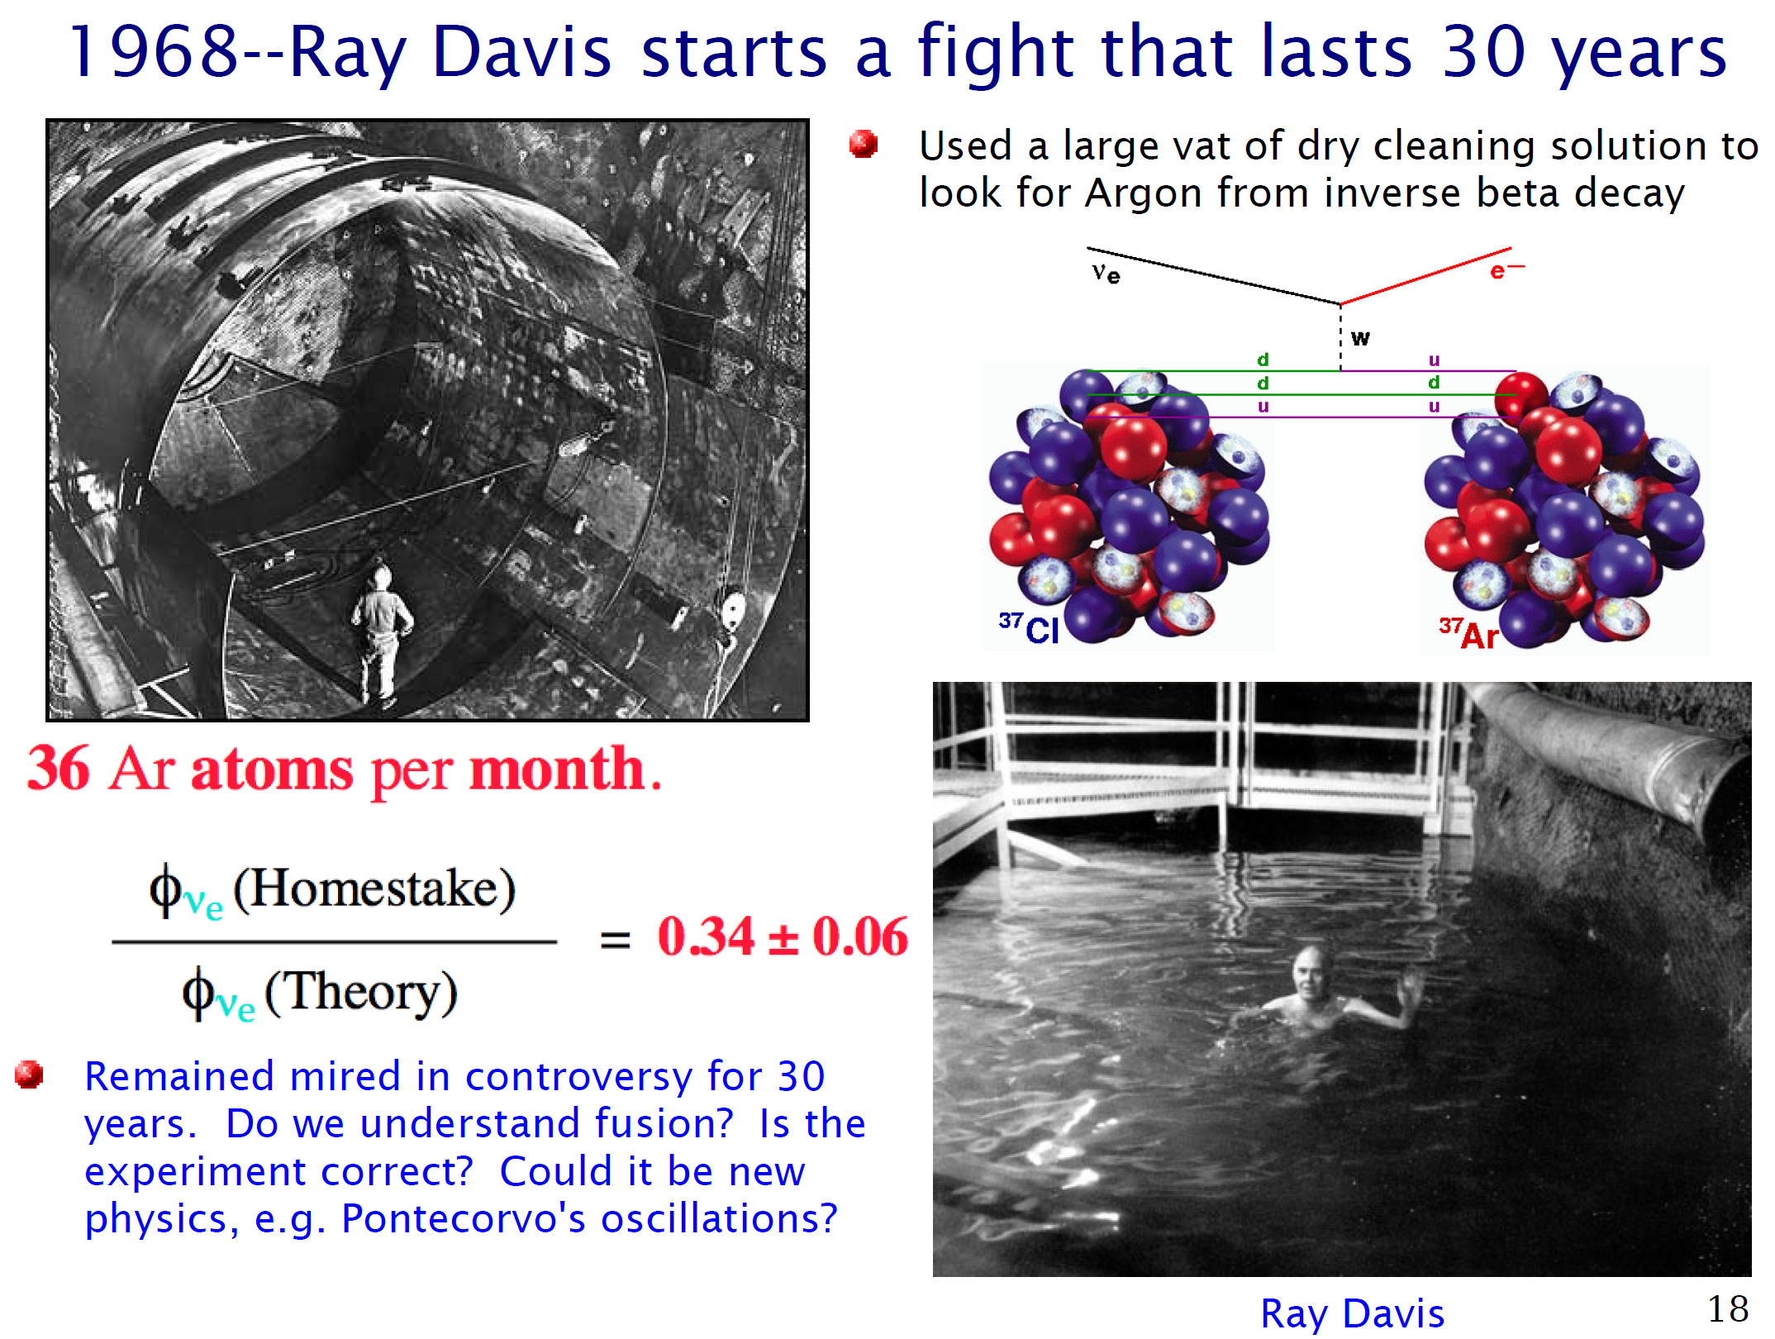

Slide 4
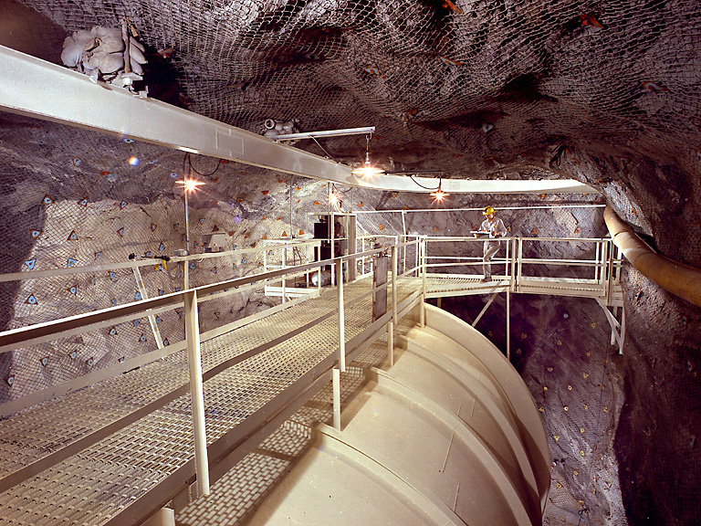
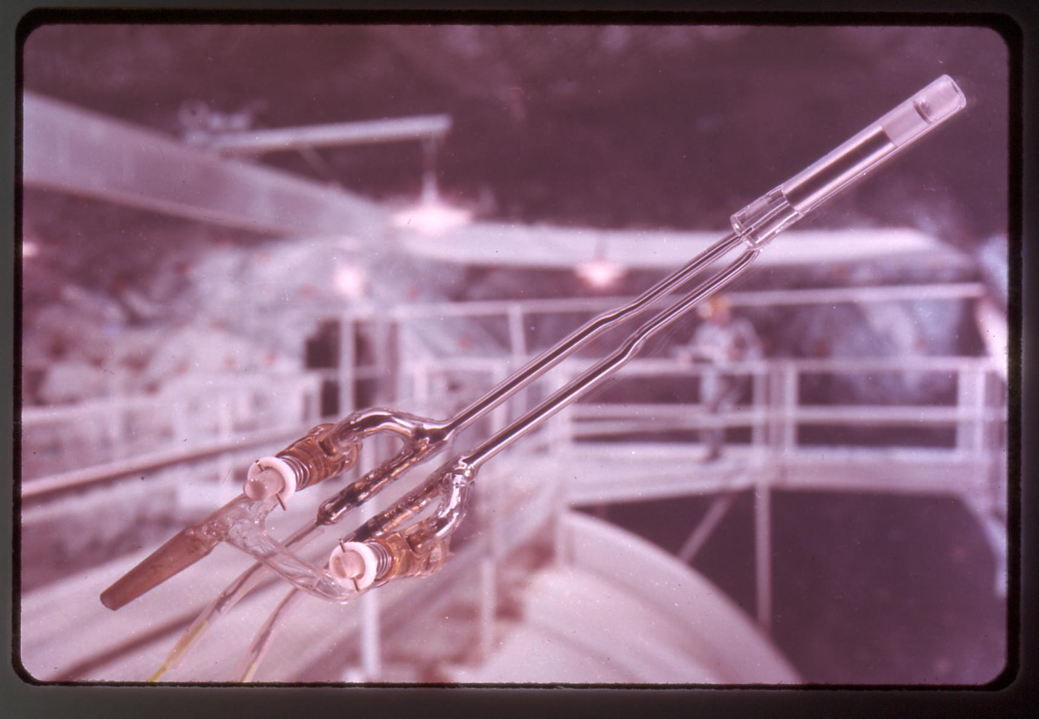
The C₂Cl₄ Tank (~400m³) - Homestake exp., 1478m below the surface
Gas proportional counter used to count ³⁷Ar decays by detecting 2.8 keV Auger electrons
~20 atoms of ³⁷Ar extracted from 2.2x10³⁰ atoms of ³⁷Cl

Slide 5
Neutrinos and the Sun
The source of the Sun’s energy is fusion of 4 hydrogen atoms to make a helium atom
Each time this reaction occurs, 2 (electron) neutrinos (ν) are released
1.8 × 10³⁹ neutrinos per second come from the center of the sun and here on Earth, ~100 billion pass through your fingernail (1 cm²) every second
For an average size person, an atom in the body will capture a neutrino every 70 years
Davis’ result (relative to the Standard Solar Model prediction): ~1/3
This was the only experiment for over two decades searching for solar neutrinos. It opened up a new field of particle and astrophysics …

Slide 6
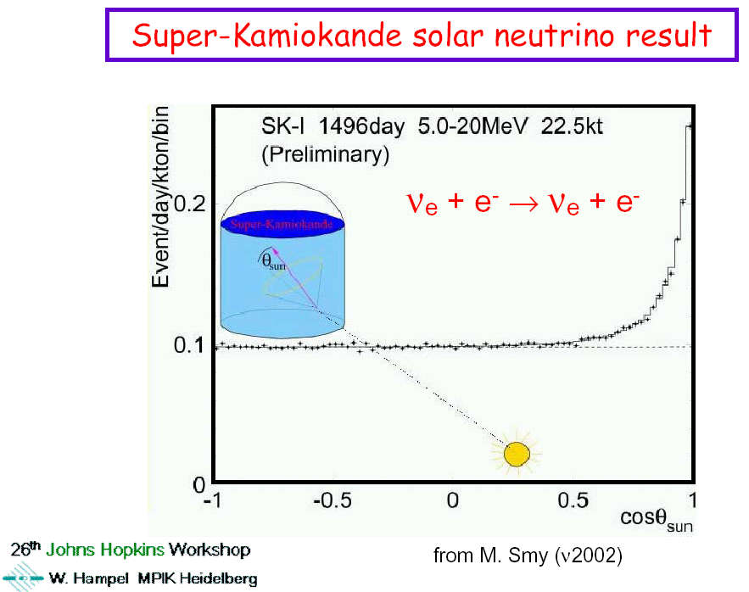

Slide 7
Resolution of Solar ν Deficit (2002)
SNO – Sudbury: Deep Underground: 6,000 mwe
Heavy water (D₂O)
Detect ν_{e} : charged current (CC)
elastic scatter (ES)
Also ν_{μ,} ν_{τ} : neutral current (NC)
ν_{e} n → e⁻ p CC
ν_{e} e⁻ → ν_{e} e ES
ν_{e} ν_{e}
ν_{μ} d → ν_{μ} d NC
ν_{τ} ν_{τ}
Result : ~1/3 ν_{e}
~ 2/3 (ν_{μ} + ν_{τ})
Total flux agrees with that expected from the sun (predicted by J. Bahcall 3 decades earlier)
{
}
{
}
Neutrino oscillations

Slide 8
Outline:
Solar neutrino deficit and neutrino oscillations
Giant facility plans (and dreams!) - to study neutrino oscillations, nucleon decay, supernova neutrinos …
TPC and signal formation
Giant TPCs readout challenge and essential block diagram
CMOS properties vs temperature
CMOS lifetime and electronics reliability
ASIC design
ASIC results
Summary and future developments

Slide 9
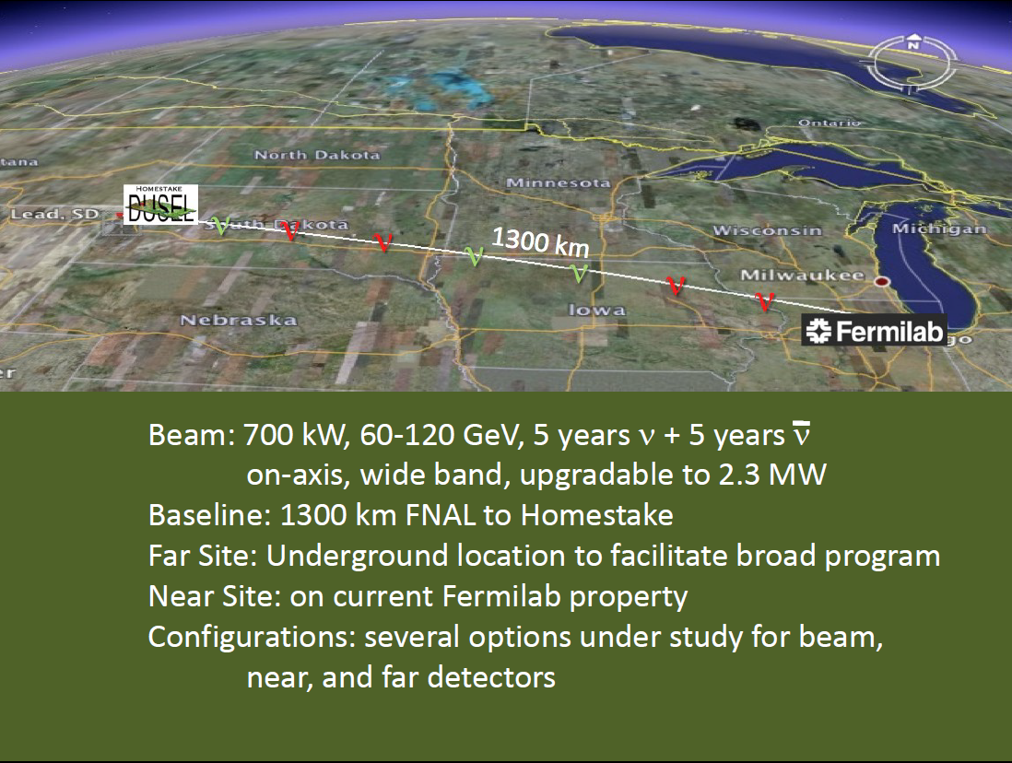

Slide 10
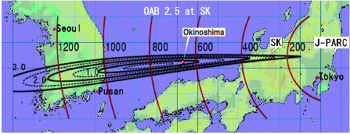
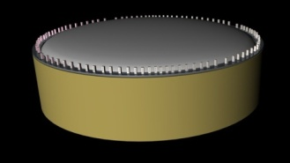
J-PARC to Okinoshima
arXiv:0804.2111
Distance = 658 km
Off-axis angle = 0.76º (2.5º @ SK)
100 kton liquid Argon
10
➙ Good coverage of 1st & 2nd oscillation maximum

Slide 11
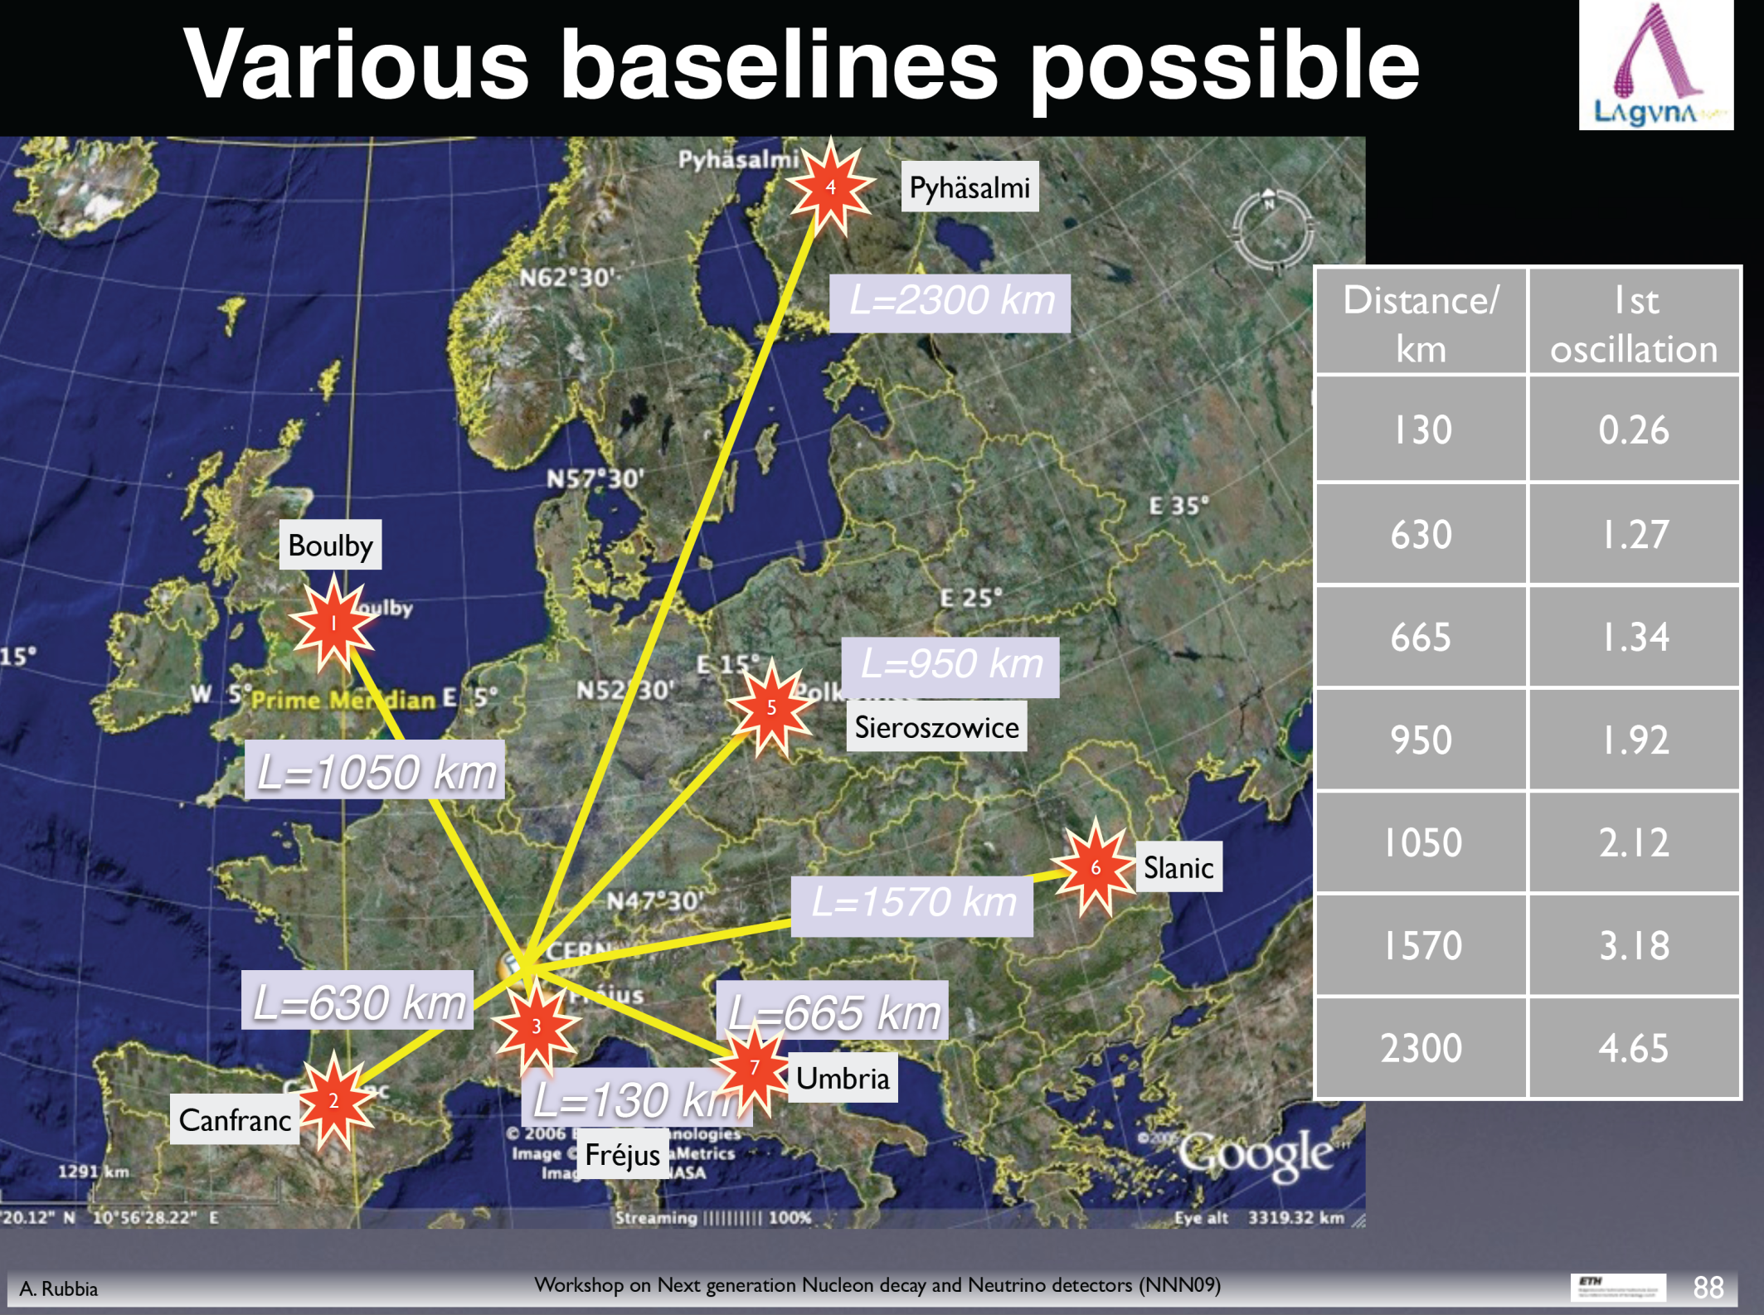

Slide 12
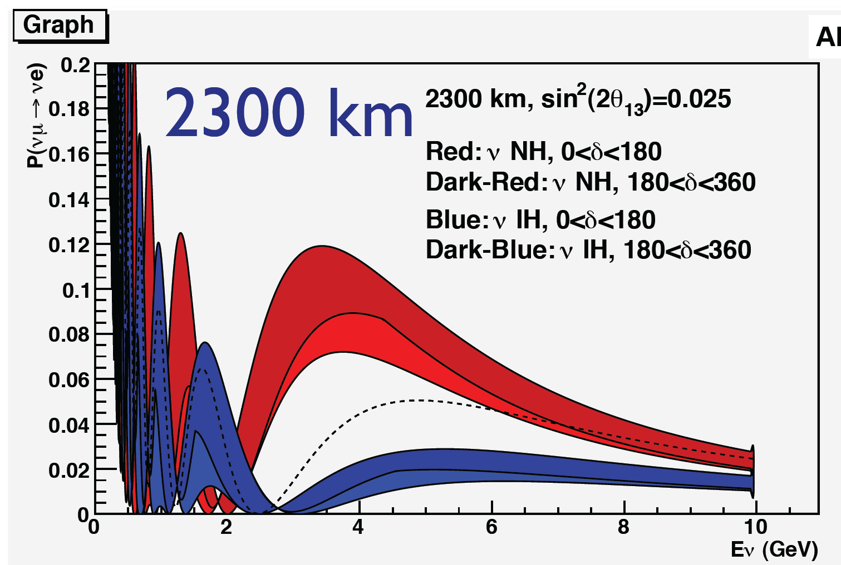
Probability of neutrino oscillations vs neutrino energy
From: A. Rubbia, GLA2011

Slide 13
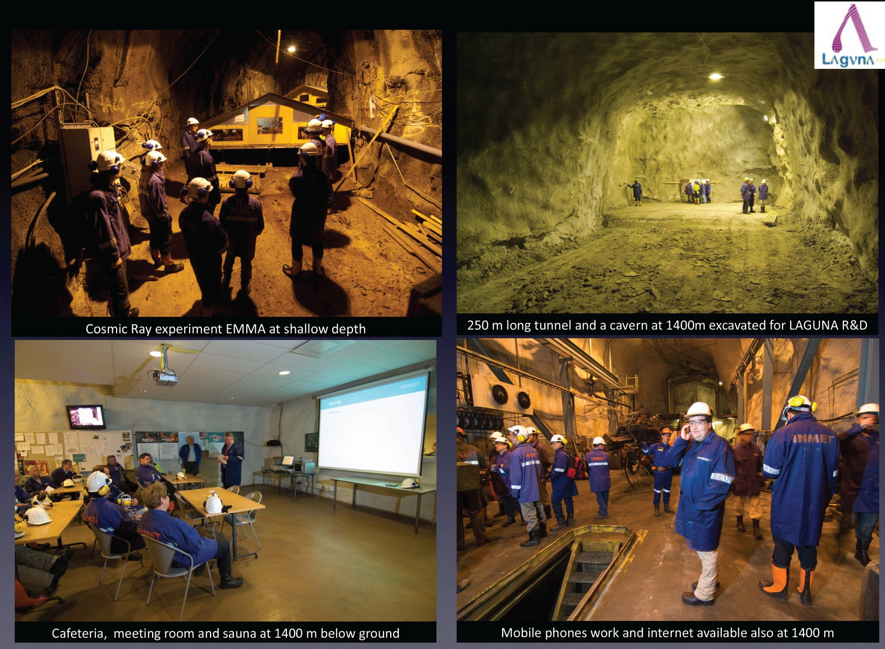

Slide 14
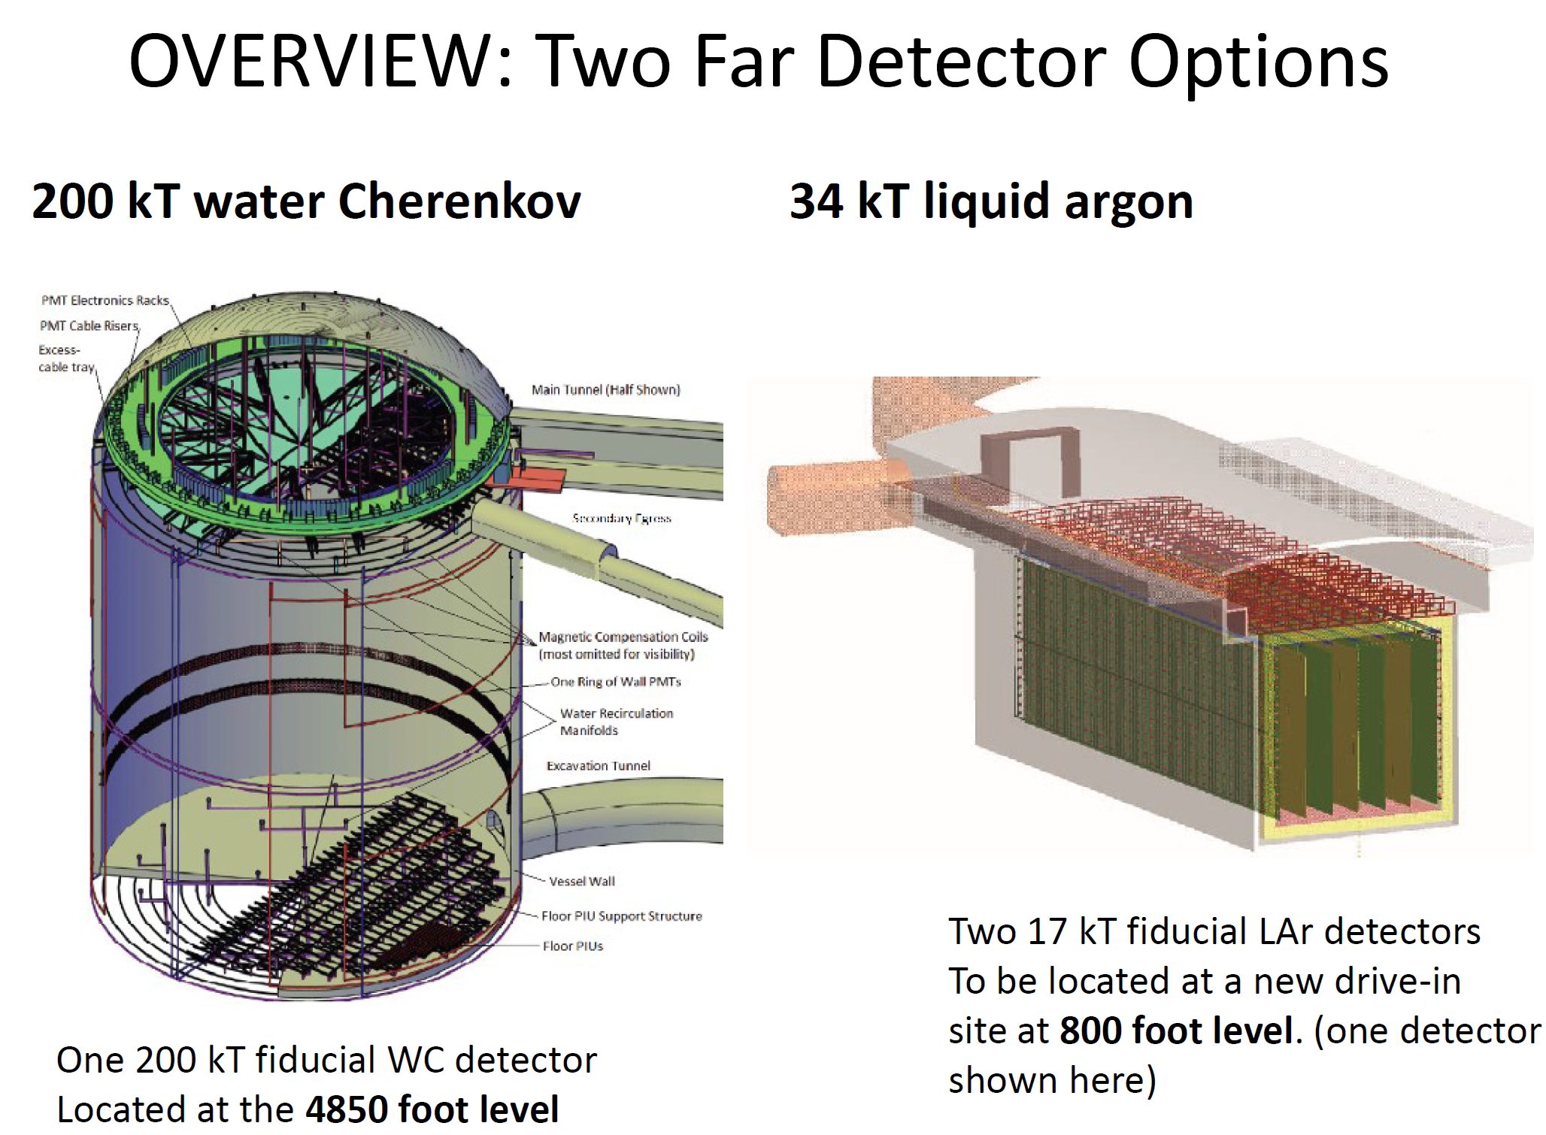
for LBNE

Slide 15
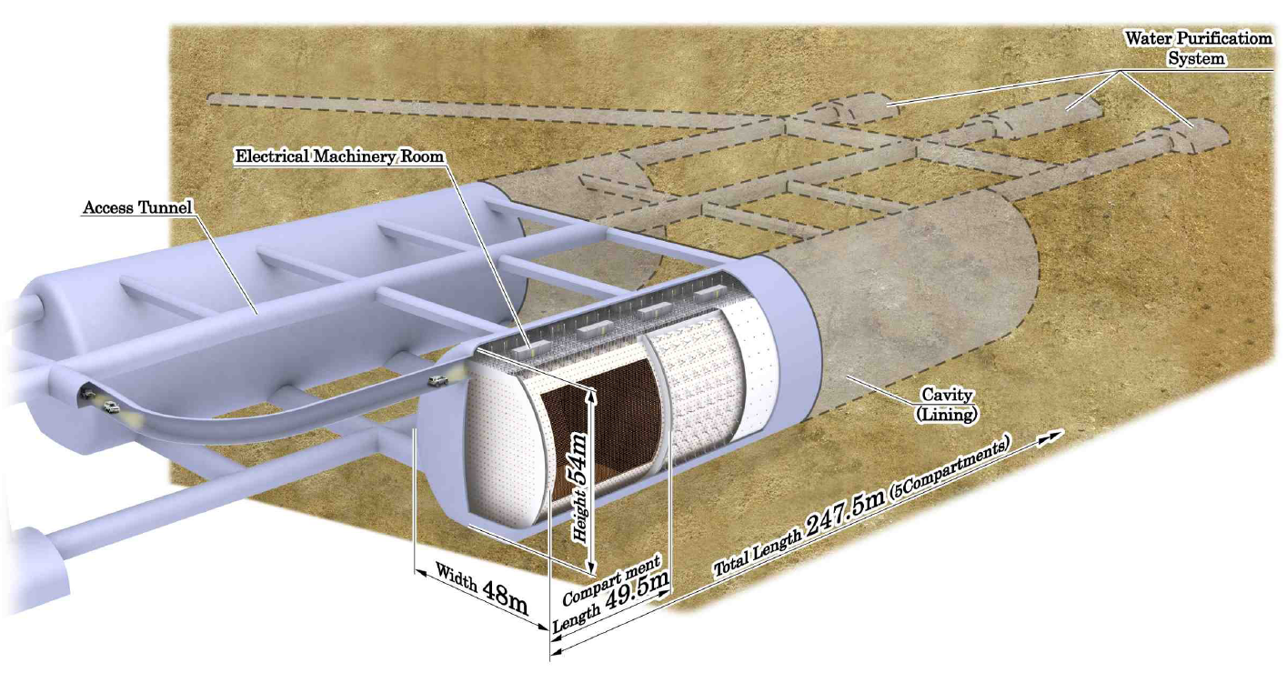
Hyper-K (~20xS-K)
Total (fiducial) vol. ~0.99(0.56) Mton H₂O
From the Letter of Intent, Sept 2011
~99 k 20” + 25 k 8” PMs

Slide 16
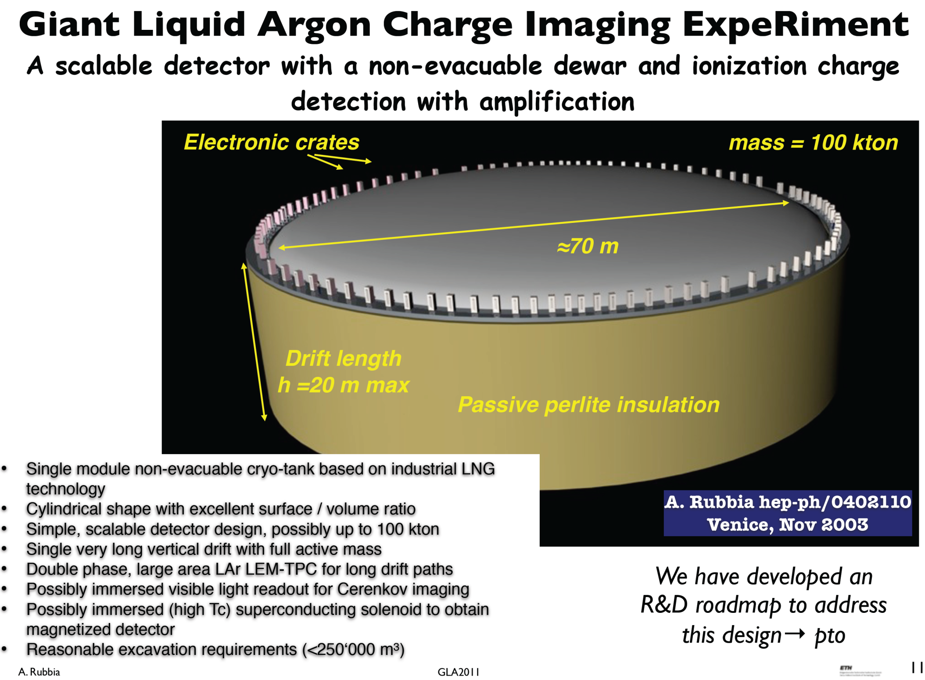

Slide 17
Outline:
Solar neutrino deficit and neutrino oscillations
Giant Lar facility plans (and dreams!)
TPC and signal formation
Giant TPCs readout challenge and essential block diagram
CMOS properties vs temperature
CMOS lifetime and electronics reliability
ASIC design
ASIC results
Summary and future developments

Slide 18
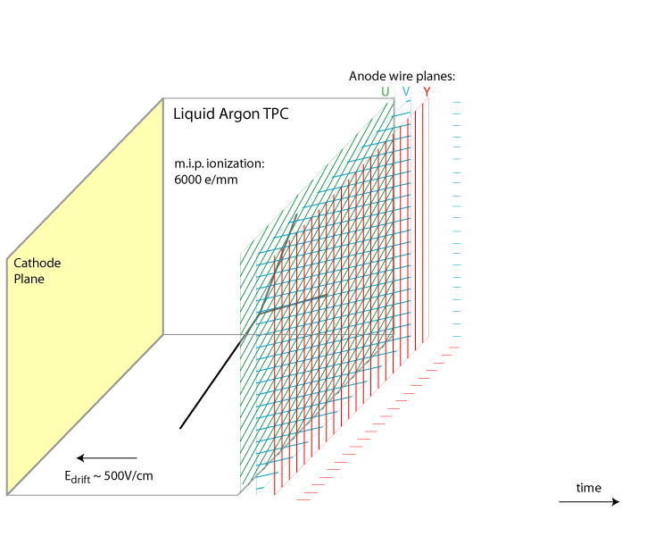
How Does a LArTPC Work
Sense (anode) wires (up to ~ 10m long):
~14-31 kwires/kton
  up to 200 pF/wire
  collecting (Y)
  non-collecting (U,V)
charge sensitivity
  range ~300 fC
  ENC < 1,000 e⁻
sample/buffer events
  ADC 10-12-bit, 1-2 MS/s
  3,000 deep buffer
digital multiplexing
  128:1 to1024:1 two-three stages
  power constraint
  ~ 10 mW /wire
operation in LAr
  > 30 years
dE/dx of 1 MIP: 2.1MeV/cm
First proposed by C. Rubbia, 1977
time

Slide 19
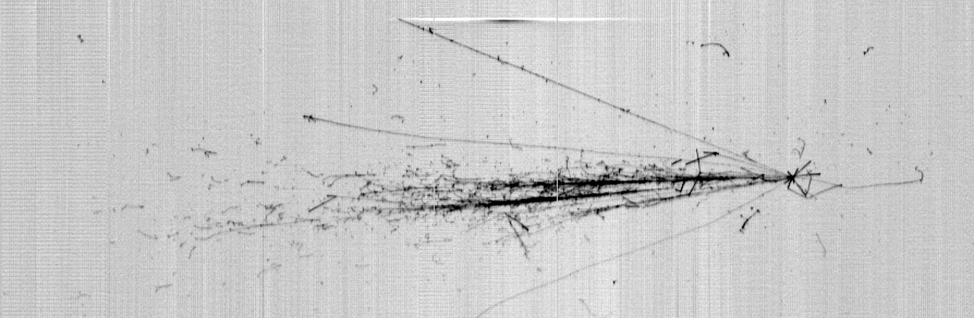
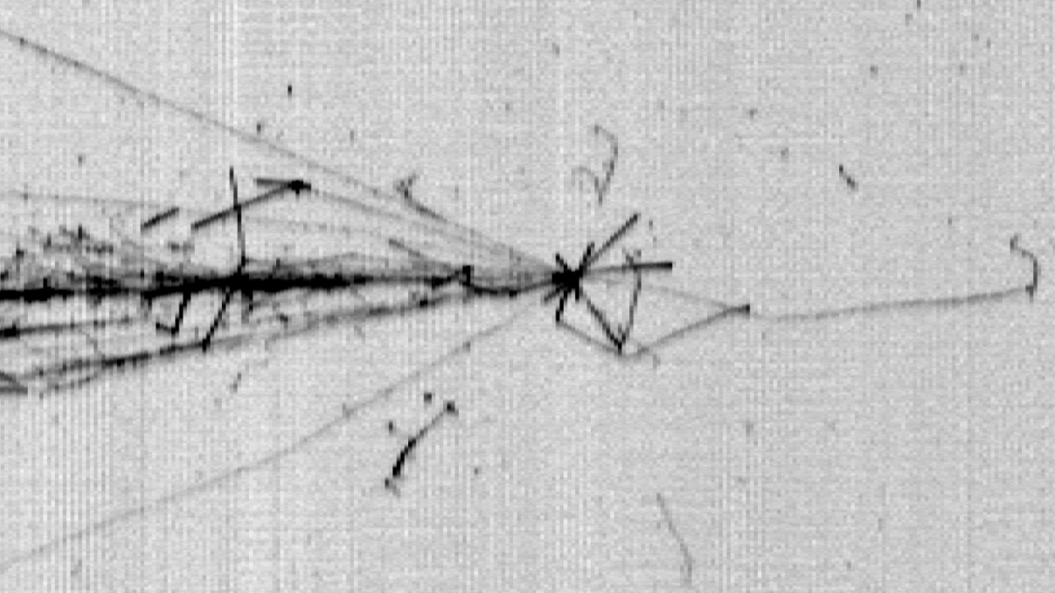
First CNGS neutrino interaction in ICARUS T600
Collection view
Drift time coordinate (1.4 m)
Wire coordinate (8 m)
CNGS ν beam direction
ν_{μ} CC
A. Guglielmi

Slide 20
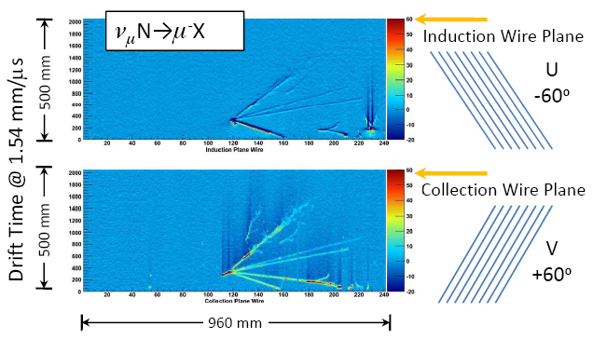
Advantages of LAr TPCs
Neutrino interactions recorded in the small LAr TPC at FNAL: ArgoNeut
Full 3D event reconstruction
  sub-mm position resolution
dE/dx for particle ID
  e/γ separation >90%
Low energy threshold <5 MeV
Scalable to multi‐kiloton size
Optimized TPC geometry
Low noise electronics
Multiplexed readout
High LAr purity

Slide 21
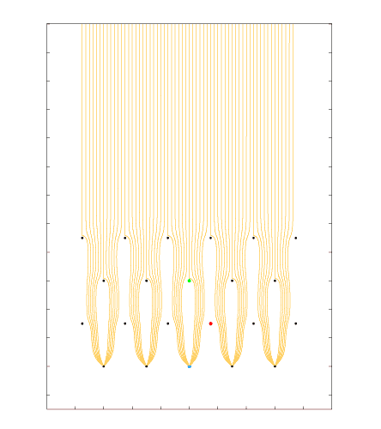
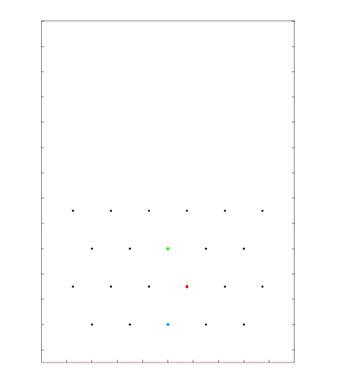
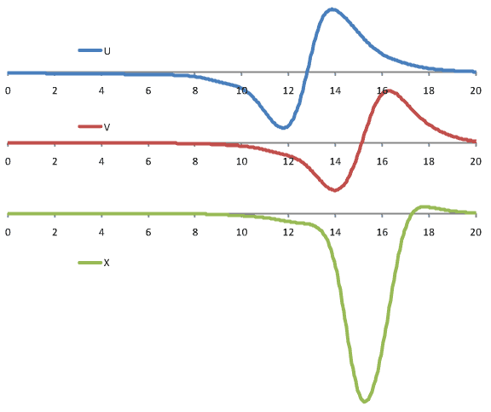
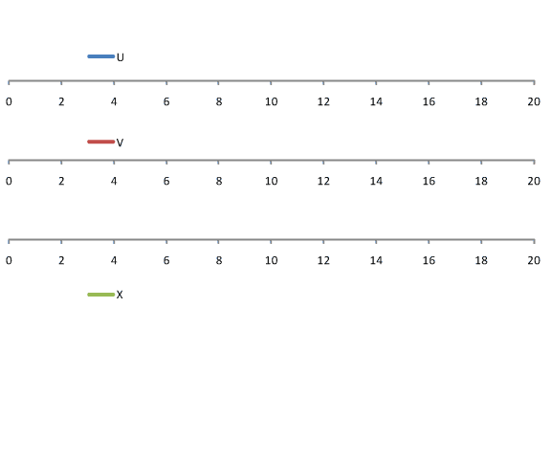
Signal Formation: Induced Signals from a Track Segment
[µs]
LBNE style wire arrangement: 3 instrumented wire planes + 1 grid plane
Raw current waveforms convolved with a 0.5µs gaussian (~1/2 drift length) to mimic diffusion

Slide 22
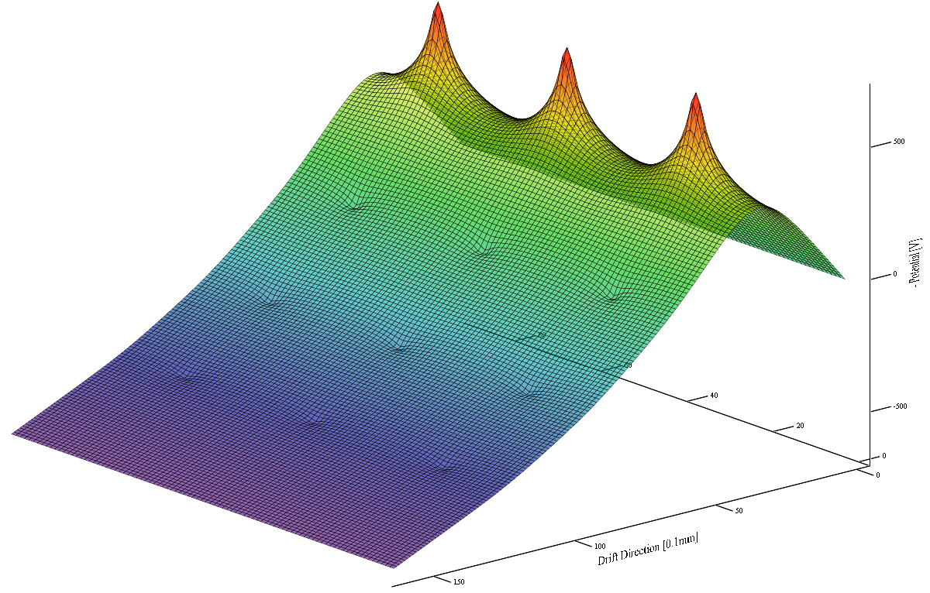
Potential Distribution Near the Wires
Bias Voltages for 3mm pitch:
V_{G} = -480V
V_{U} = -280V
V_{V} = 0
V_{X} = +700V
For 5mm wire pitch:
V_{G} = -690V
V_{U} = -385V
V_{V} = 0
V_{X} = +900V

Slide 23
Anode Plane Assembly (APA) modular TPC in a large cryostat
~5 APAs/kton, ~4.5mm wire pitch, 3.8m drift , 2560 wires/APA
U, V, Y wires
APAs are structural and electrical units containing all sense wires and readout electronics. They can be tested in LN2 , stored and transported in shipping containers.
7 m
LAr
front-end electronics
~ 2560-3840 channels/APA
2.5 m

Slide 24
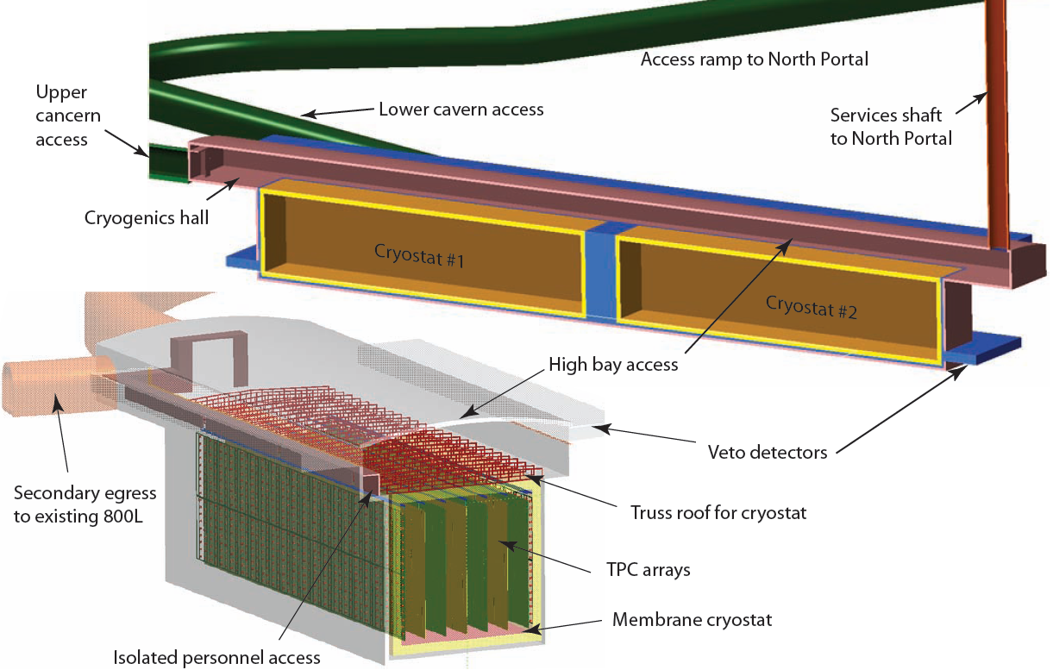

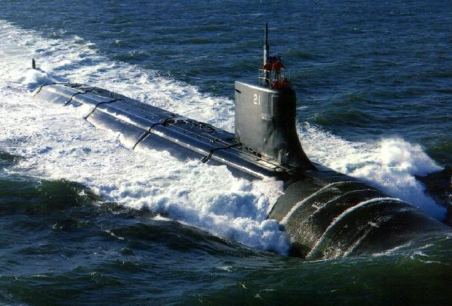
LAr40 Conceptual Design at 800L

Slide 25
Outline:
Solar neutrino deficit and neutrino oscillations
Giant Lar facility plans (and dreams!)
TPC and signal formation
Giant TPCs readout challenge and essential block diagram
CMOS properties vs temperature
CMOS lifetime and electronics reliability
ASIC design
ASIC results
Summary and future developments

Slide 26
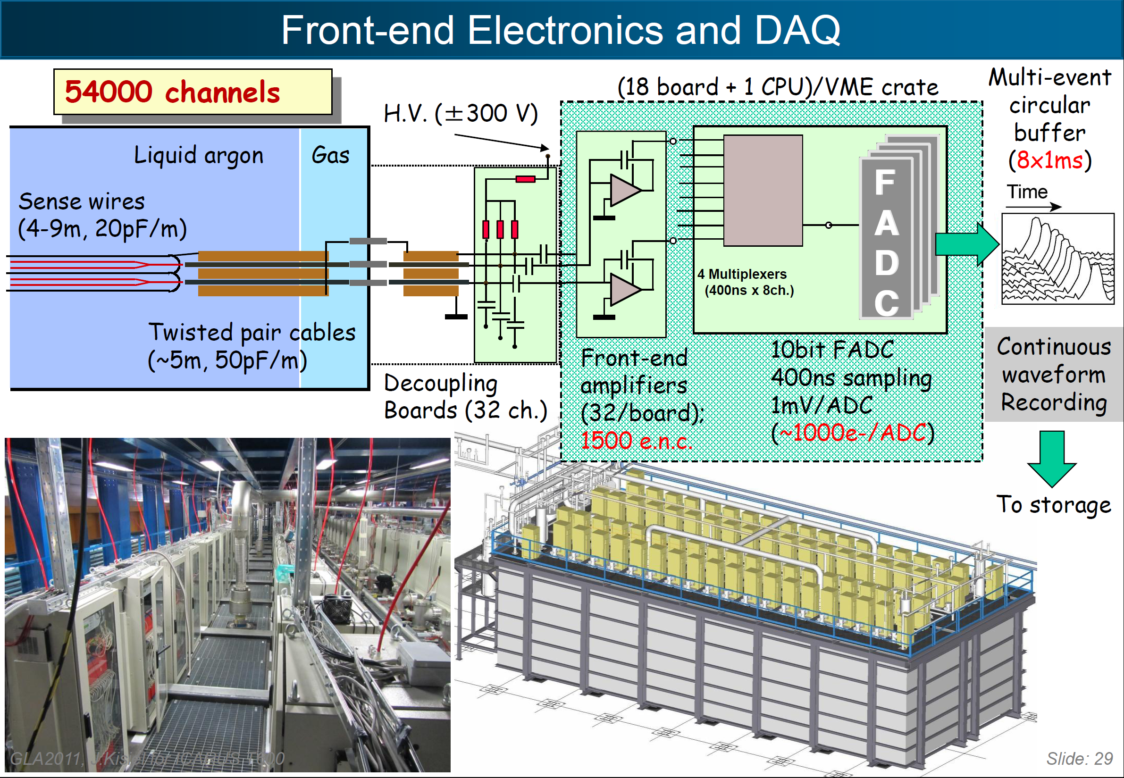
ICARUS 600 ton LAr TPC (pioneered by C. Rubbia)

Slide 27
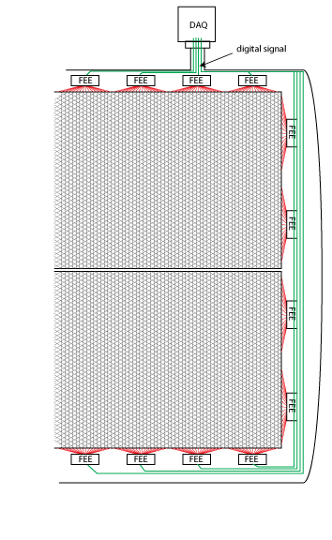
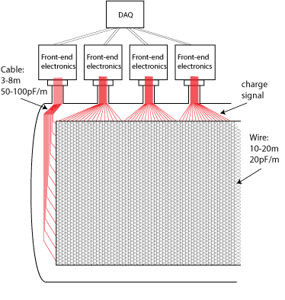
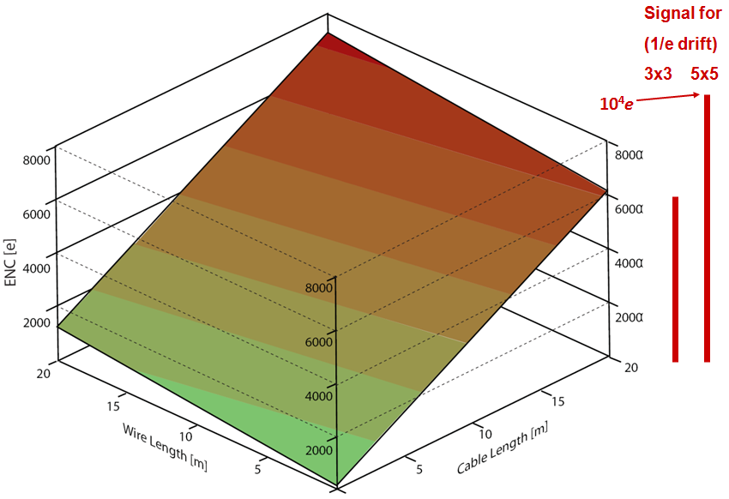
Key Technology in Building Large Scale LArTPC: Cold Electronics
A typical readout configuration with warm electronics: long cables connect the sense wires to the FEE, resulting in large electronics noise. To reduce the cable length, one has to implement cold feedthroughs below the liquid level, which increases the cryostat complexity.
Having front-end electronics in the cryostat, close to the wire electrodes yields the best SNR
Highly multiplexed circuits with fewer digital output lines not only greatly reduce the number of cryostat penetrations, but also give the designers of both the TPC and the cryostat the freedom to choose the optimum configurations
Noise (ENC) vs Sense Wire and Signal Cable Length - in relation to MIP Signal for 3x3 and 5x5 mm Wire Spacing
Stacked detectors for large cryostats
27

Slide 28
Readout Electronics Outline for very large TPCs
Cavern
to
DAQ
ADC
3000 x12 bit
16 channel mixed signal
LAr Cryostat
s
per channel
Front End ASIC (x8)
s
e
r
r
e
. . .
p
f
?
Charge amplifier + filter
. . .
p
. . .
f
. . .
u
16:1
8 Mb/s
. . .
u
?
Charge calibration
. . .
S
. . .
. . .
B
. . .
. . .
o
?
ADC
. . .
r
Nx Redundancy
. . .
. . .
e
. . .
. . .
Z
?
Zero-suppression
?
Buffering
?
Token passing bus
30:1
N:N
?
Register programmable
3840 (2304) wires/APA
s
h
240 Mb/s
g
u
8:1
o
r
h
t
Nx Redundancy
d
e
e
F
CM or LV differential
30:1
N:N
digital signaling
1 Mb/s
240 Mb/s
Optical
or
128 ch FE MB
Copper
. . .
Driver
128 ch FE MB
One APA

Slide 29
Outline:
Solar neutrino deficit and neutrino oscillations
Giant Lar facility plans (and dreams!)
TPC and signal formation
Giant TPCs readout challenge and essential block diagram
CMOS properties vs temperature
CMOS lifetime and electronics reliability
ASIC design
ASIC results
Summary and future developments

Slide 30
CMOS static characteristics vs T
g_{m}/I_{D}
Transconductance//drain current
At 77-89K, charge carrier mobility in silicon increases, thermal fluctuations decrease with kT/e, resulting in a higher gain, higher g_{m} /I, higher speed and lower noise.

Slide 31
CMOS Noise Spectral Density vs T
1.3nV/Hz^{1/2}
0.65nV/Hz^{1/2}
TSMC 180nm: Noise lower by a factor of 2 at 77K across the spectrum for PMOS, only white for NMOS ; (1/f further reduced at longer L)

Slide 32
Outline:
Solar neutrino deficit and neutrino oscillations
Giant Lar facility plans (and dreams!)
TPC and signal formation
Giant TPCs readout challenge and essential block diagram
CMOS properties vs temperature
CMOS lifetime and electronics reliability
ASIC design
ASIC results
Summary and future developments

Slide 33
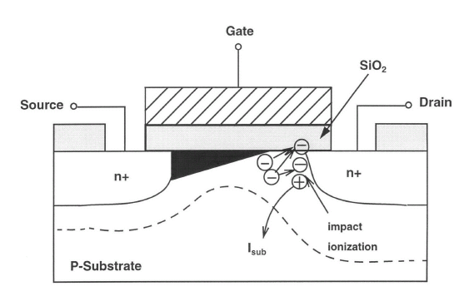
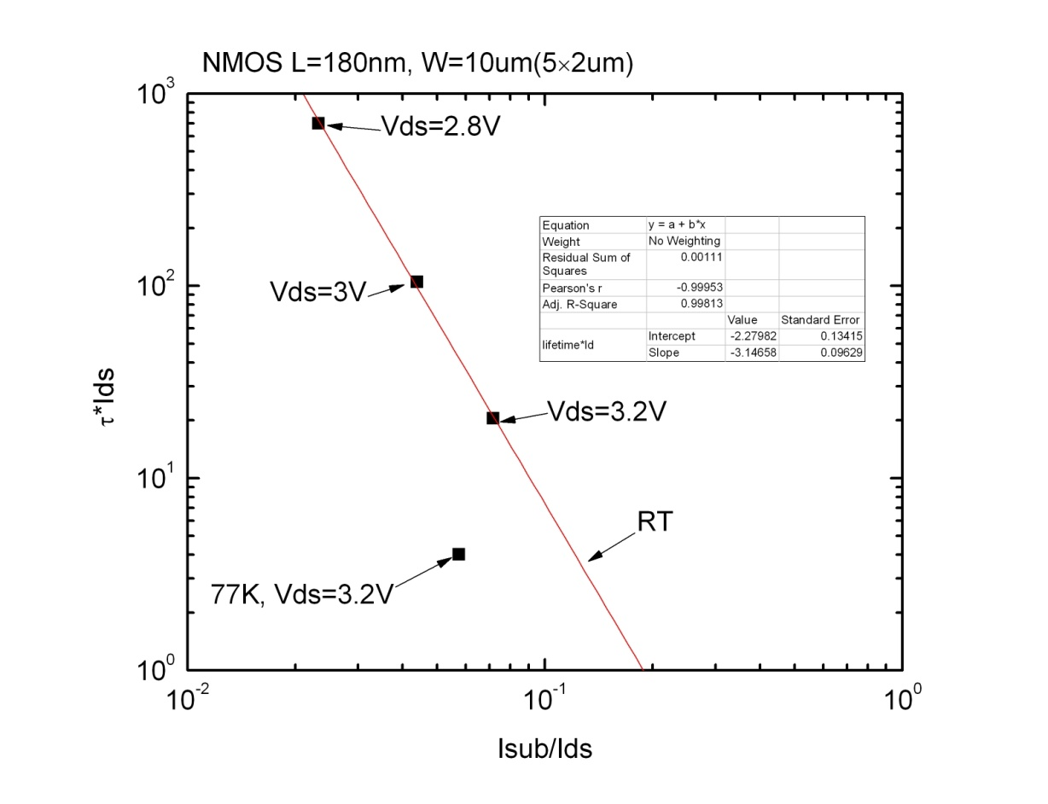
Impact Ionization and CMOS Lifetime
Chemistry slows down at 89K.
What is left of aging processes?
Impact ionization . Creation of interface states by (some) hot electrons causes a decrease in mobility, transconductance (gain), f_{t} , and a threshold shift.
This limits the effective lifetime of the device at any temperature (defined in industry as 10% decrease in transconductance g_{m}).
Accelerated lifetime testing is performed by stressing the device, at increased drain-source voltages and by measuring the substrate current (a very sensitive quantitative indicator) .
“Stress plot”

Slide 34
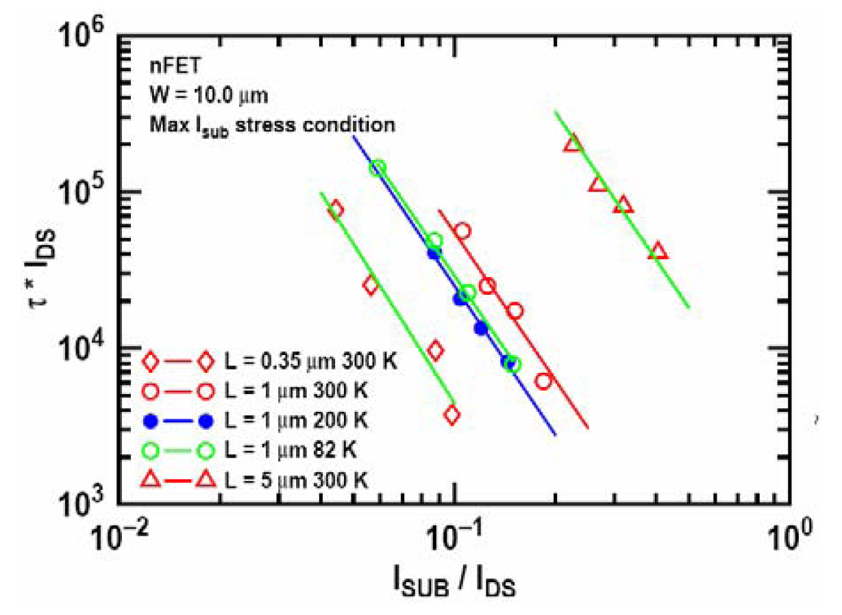
J. Cressler, et al. (Georgia Tech ) measurements confirming:

Slide 35
NMOS 180nm TSMC lifetime vs Vds (preliminary)
1.8V
V_{DS}=1.6V
3.2, 3.0, 2.8V

Slide 36
Designing CMOS for low power = long lifetime
Lifetime ≈ 1/(current density)
Additional conservative guidelines:
V_{DD}-10%,
L>1.5 L_{min}
Digital: + clock frequency <<
ring oscillator frequency
Life time testing region
Design region (approx.) for low power and long lifetime at 77K (moderate inversion)

Slide 37
Outline:
Solar neutrino deficit and neutrino oscillations
Giant Lar facility plans (and dreams!)
TPC and signal formation
Giant TPCs readout challenge and essential block diagram
CMOS properties vs temperature
CMOS lifetime and electronics reliability
ASIC design
ASIC results
Summary and future developments

Slide 38
Analog ASIC
16 channels
charge amplifier, high-order anti-aliasing filter
programmable gain: 4.7, 7.8, 14, 25 mV/fC
(charge 55, 100, 180, 300 fC)
programmable filter
(peaking time 0.5, 1, 2, 3 µs)
programmable collection/non-collection mode (baseline 200, 800 mV)
programmable dc/ac coupling (100µs)
band-gap referenced biasing
temperature sensor (~ 3mV/°C)
136 registers with digital interface
5.5 mW/channel (input MOSFET 3.9 mW)
single MOSFET test structures
~ 15,000 MOSFETs
designed for room and cryogenic operation
technology CMOS 0.18 µm, 1.8 V

Slide 39
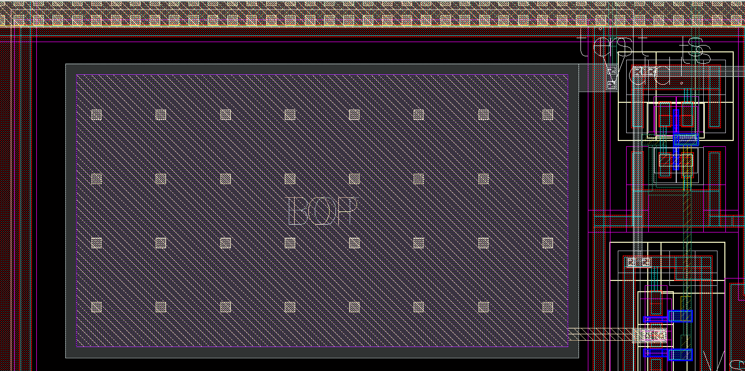
Cold Electronics ASIC - Front-End Detail and Calibration Scheme
N₁ = 20 N₂ = 3, 5, 9, 16
C_{INJ} ≈ 180 fF
Integrated injection capacitance (10 x 18 µm²)
Measured with high-precision external capacitance
Integrated pulse generators on ASICs Charge sensitivity calibration of entire TPC during assembly, cooling and operation

Slide 40
Outline:
Solar neutrino deficit and neutrino oscillations
Giant Lar facility plans (and dreams!)
TPC and signal formation
Giant TPCs readout challenge and essential block diagram
CMOS properties vs temperature
CMOS lifetime and electronics reliability
ASIC design
ASIC results
Summary and future developments

Slide 41
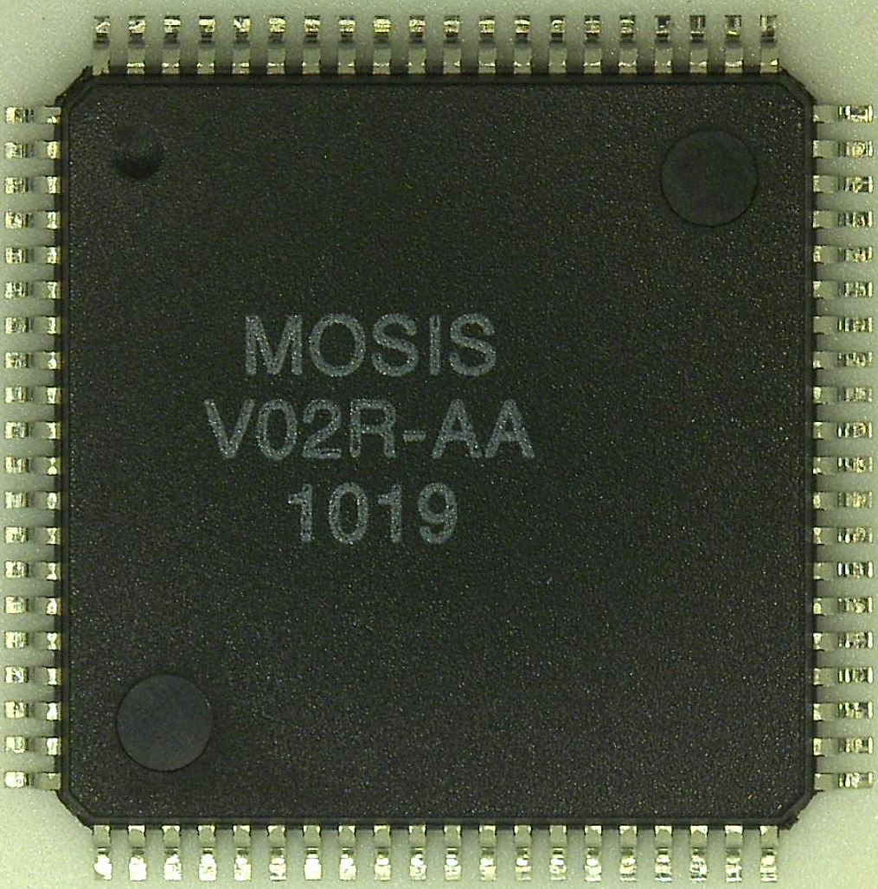
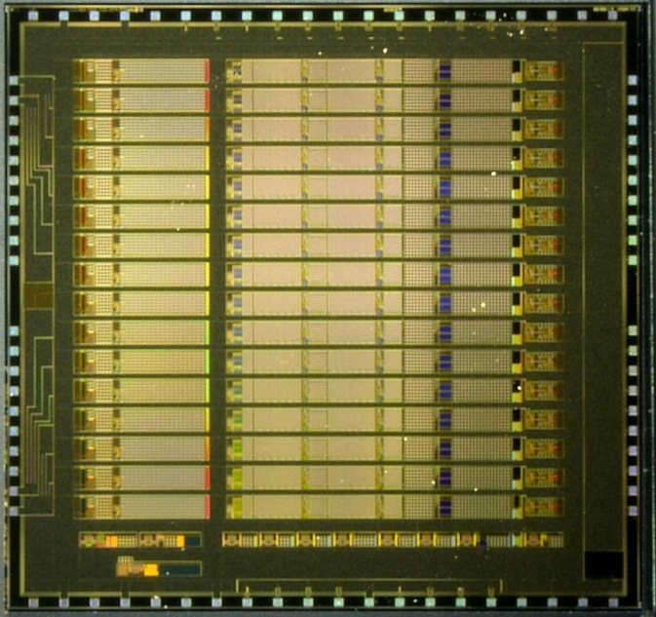
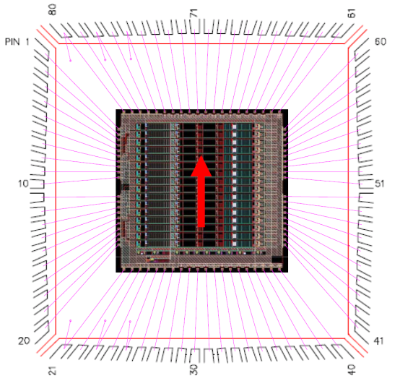
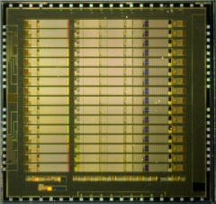
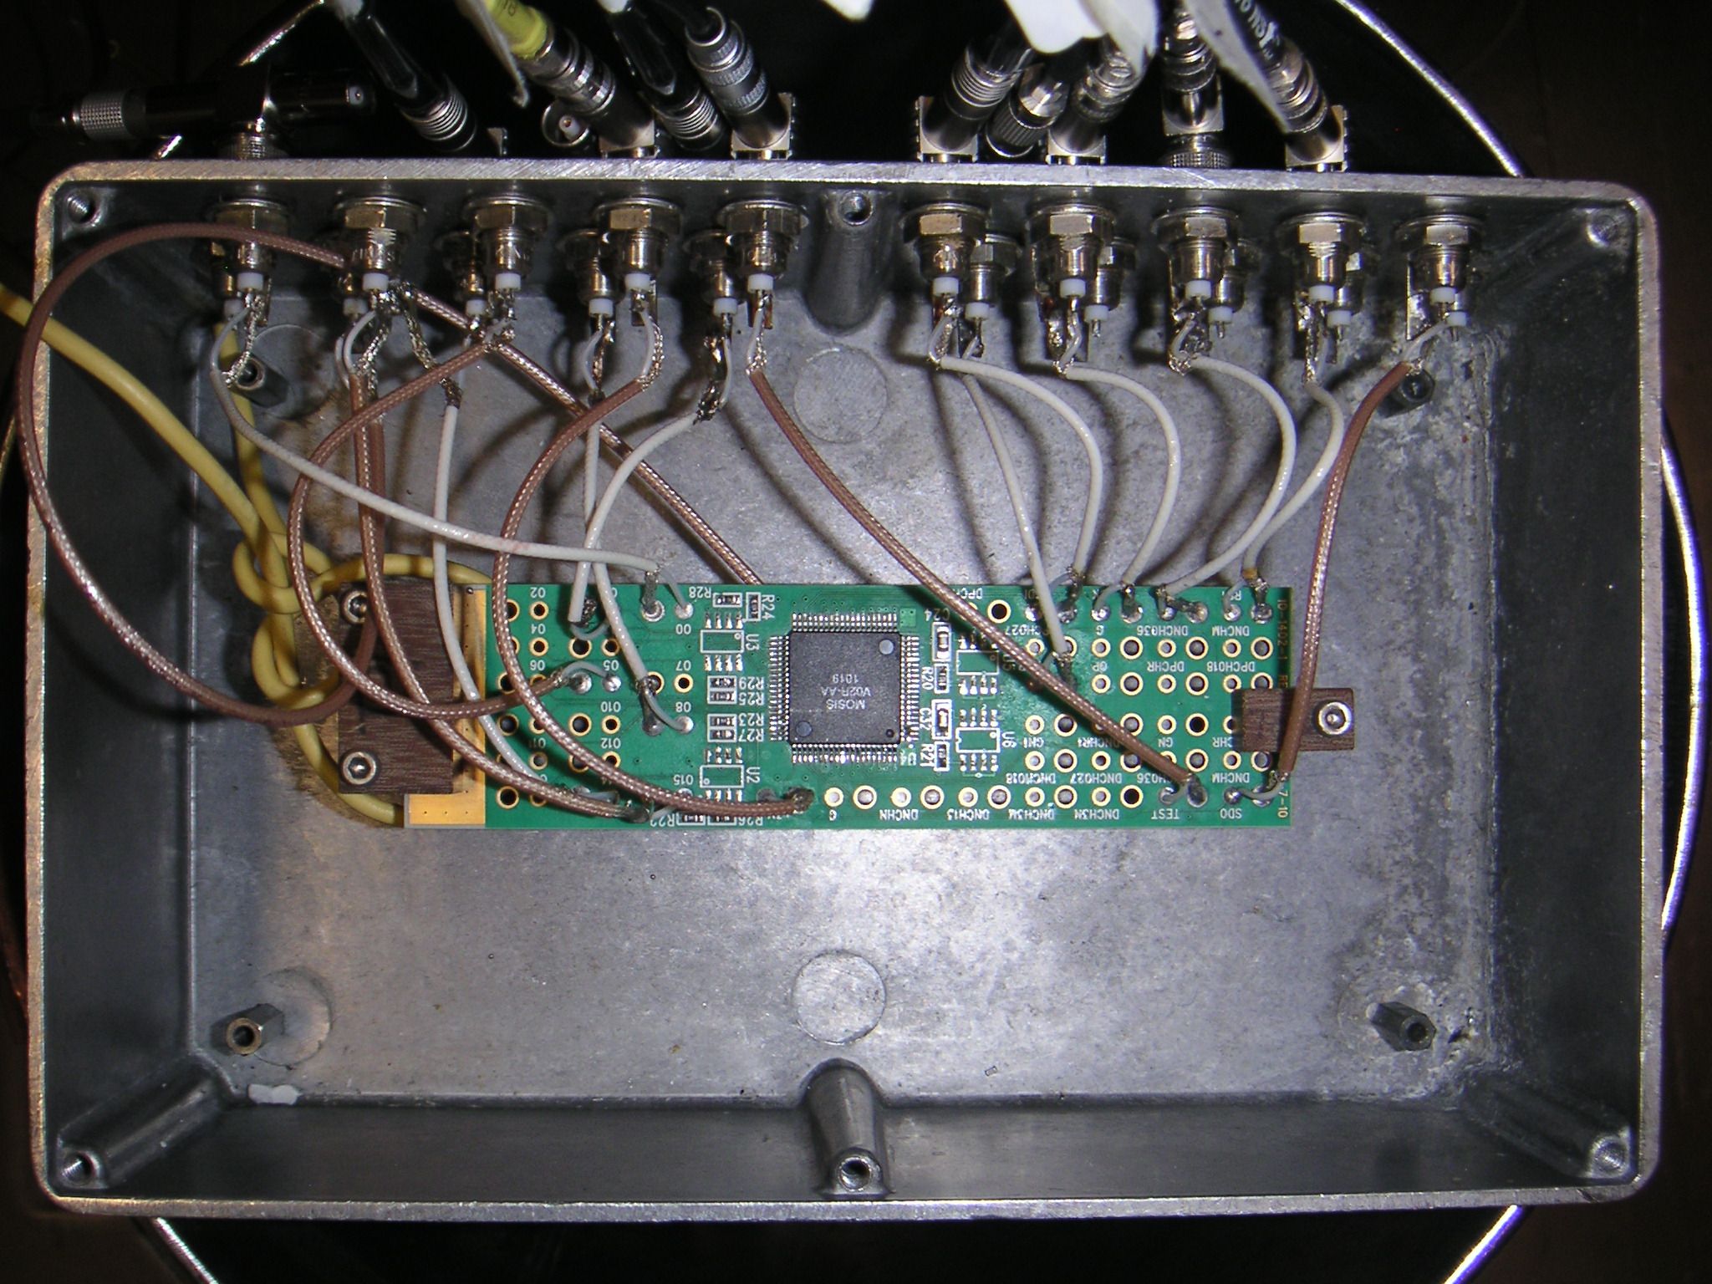
Analog ASIC: Die and Packaging, Temperature Cycling
Package Photo
Die Photo
5.7 mm
14.0 mm
6.0 mm
14.0 mm
(cavity 10.5 mm)
Test Fixture
Cycled (abruptly, by pouring LN over the fixture in a dewar) from 300K to 77K more than 30 times
No failure occurred

Slide 42
Cold CMOS: Results from FE ASIC (1st prototype cycle)
Noise gets better at 77K (220pF det. Capacitance):
Signal after preamp+shaper changes little with temperature:
Integrated charge calibration capacitance - little change with temperature
Measured with high-precision external capacitance

Slide 43
Noise vs T in CMOS:
Existing ASIC, 0.25 µm (not designed for Lar)
ENC vs. T (Cd=100pF, 0.5µs peaking time)
ENC [e rms]
T [K]
CMOS in LAr has less than half the (white) noise as that at room temperature, higher mobility and higher transconductance/current ratio
Notes:
43
43

Slide 44
Signal Measurements: programmable gain, peak time and baseline
Bandgap Reference:
variation ≈ 1.8 %
Temperature Sensor:
~ 2.86 mV / °K
Programmable gain, peaking time and baseline
Maximum charge 55, 100, 180, 300 fC

Slide 45
Input transistor ENC optimization
From: G. De Geronimo

Slide 46
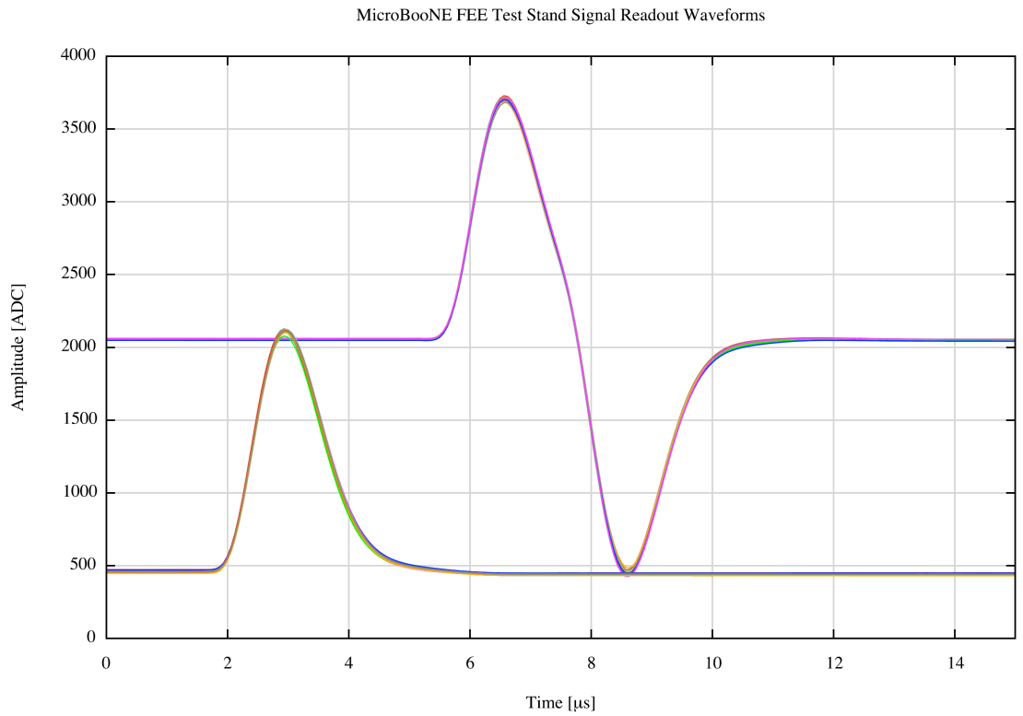
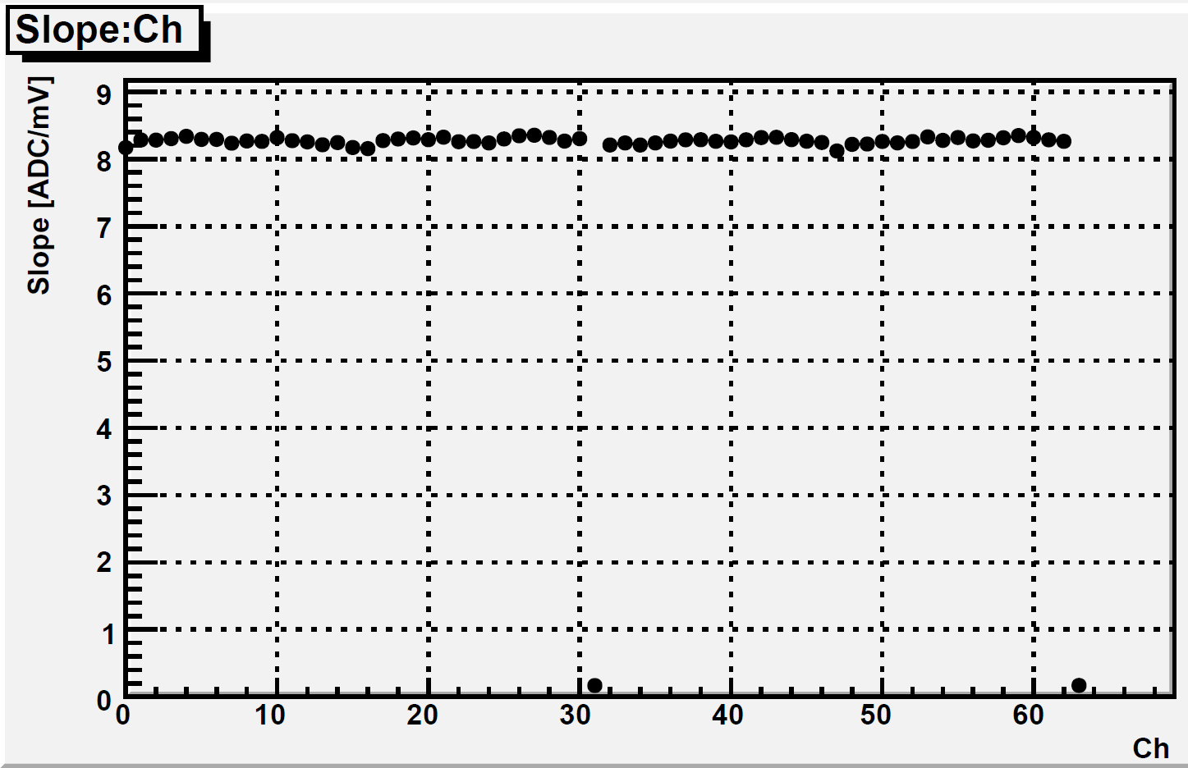
Analog ASIC: gain and waveform uniformity
31 signals overlapped
Four ASICs, 4x16 channels
(one lead of the 32-channel cable not connected)
Residuals from a linear fit < 0.3%
Crosstalk < 0.3%
These measurements performed with enire MicroBooNE signal chain:
Analog ASIC+cold cable+ +intermediate amplifier+ADC
The ASIC will be used in MicroBooNE , ~150(75) ton LAr TPC

Slide 47
Outline:
Solar neutrino deficit and neutrino oscillations
Giant Lar facility plans (and dreams!)
TPC and signal formation
Giant TPCs readout challenge and essential block diagram
CMOS properties vs temperature
CMOS lifetime and electronics reliability
ASIC design
ASIC results
Summary and future developments

Slide 48
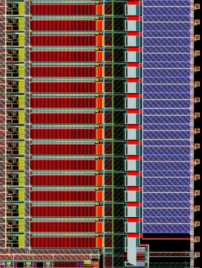

Front-End ASIC with 16:1 digital multiplexing
16 channels
charge amplifier (progr. gain)
high-order filter (progr. time constant)
ac/dc, progr. baseline
test capacitor, channel mask
ADC (12-bit, 2 MS/s)
compression, progr. discrimination
multiplexing and digital buffering
LV or CM digital interface
pulse generator, analog monitor
temperature sensor
estimated size ~ 6 x 8 mm²
estimated power ~ 10 mW/channel

Slide 49
Summary and Future Work
CMOS performs better at cryogenic temperatures
CMOS technologies verified to work at 77K: IBM SiGe (Gergia Tech for Lunar Project), Chartered (FNAL) and TSMC (BNL); FPGAs (SMU, BNL); widest choice for a large project
Defined and predictable design for 77-300K range
Low-noise at cryogenic T demonstrated
  ENC < 1,000 e⁻ at 200pF ~5mW/ch.
  characterization and modeling of CMOS 180nm
Low power design consistent with long lifetime
Future work
  Optimum technology node wrt dynamic range, noise, power
  Merge separately developed ADC, zero-suppression & buffering

Slide 50
Backup slides

Slide 51
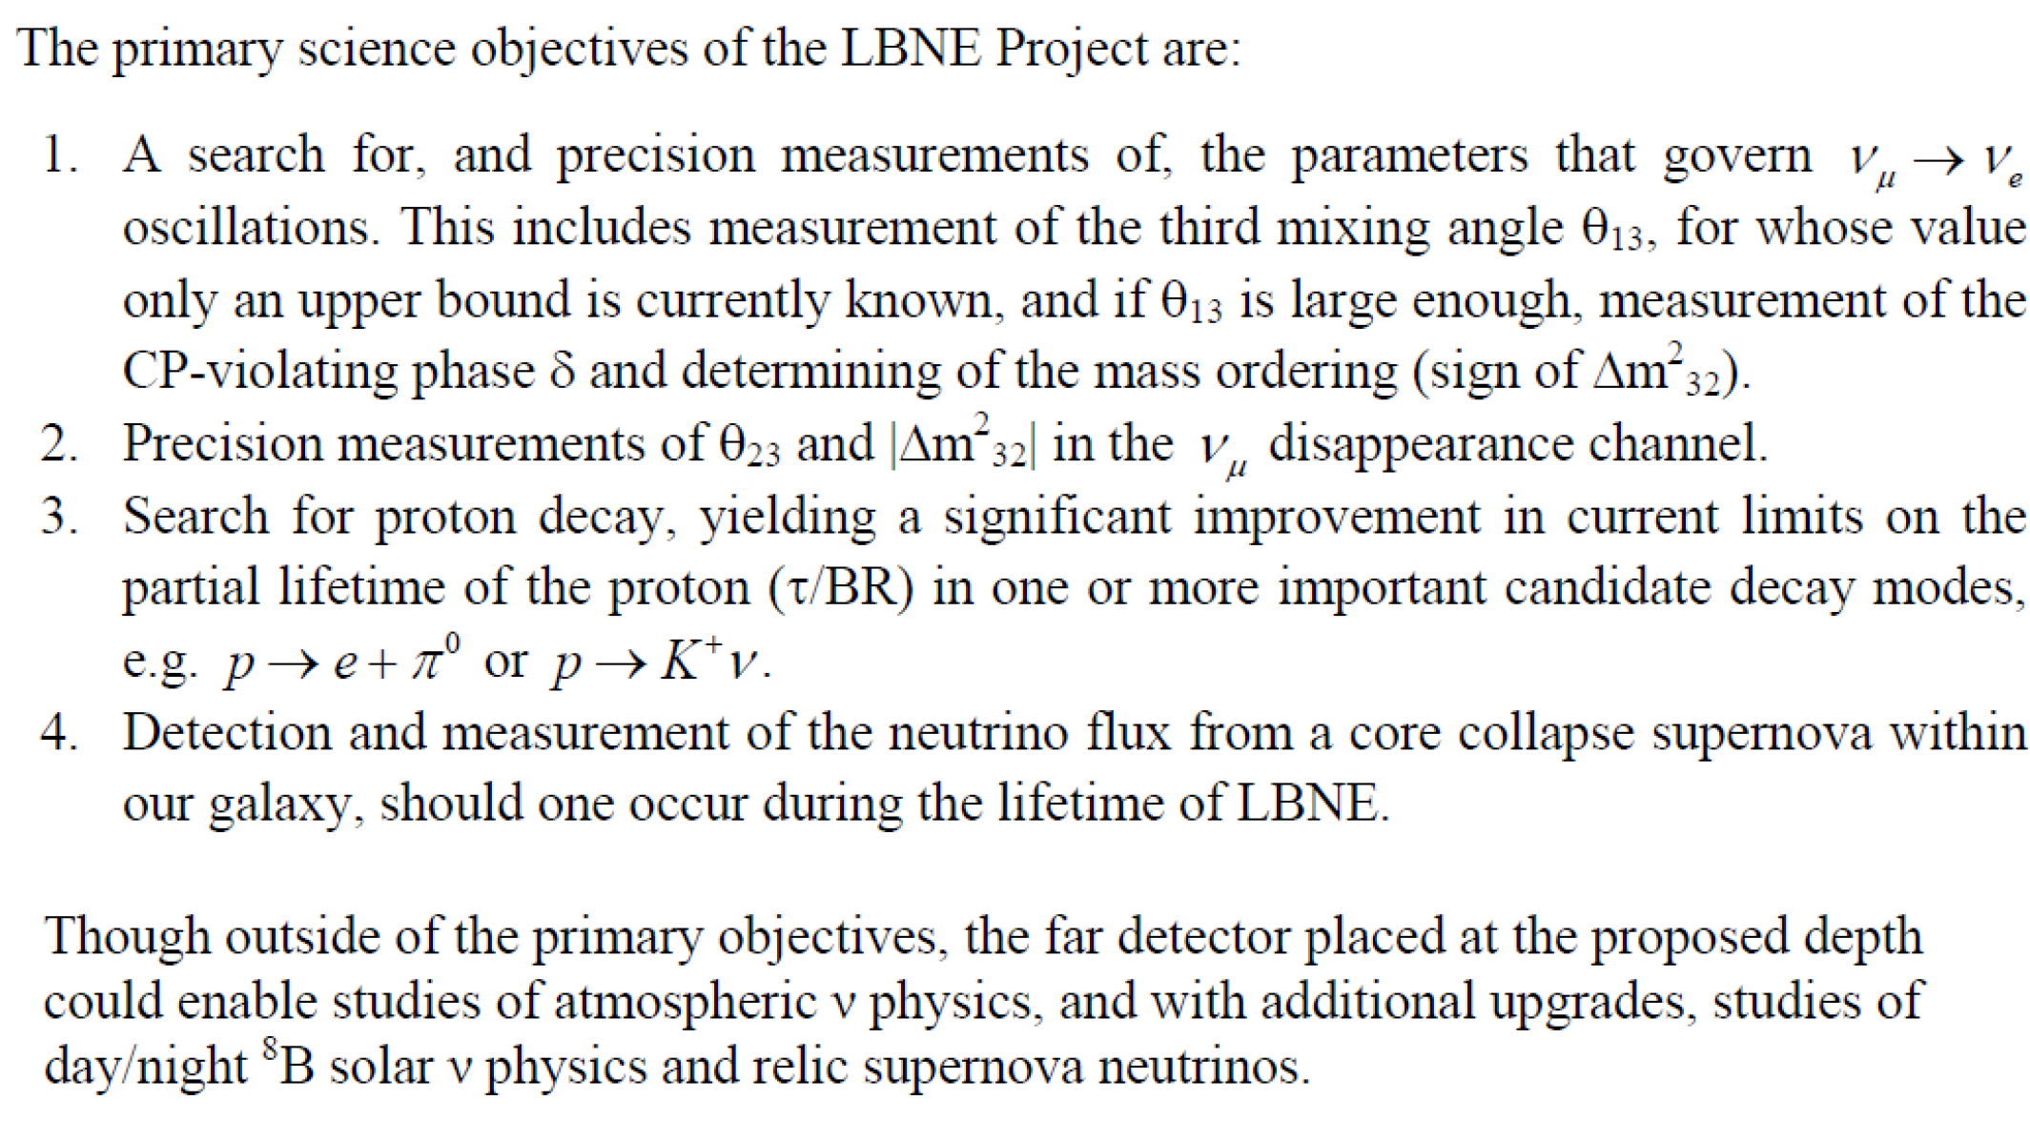

Slide 52
Track Waveforms on the Wires
LBNE style wire arrangement: 3 instrumented wire plane + 1 grid plane
Raw current waveforms convolved with a 0.5µs gaussian (~1/2 drift length) to mimic diffusion
Current waveforms from a 0° track
Current waveforms from a 45° track
Collection plane signal gives direct measurement of dE/dx
Drift time [µs]
Drift time [µs]

Slide 53
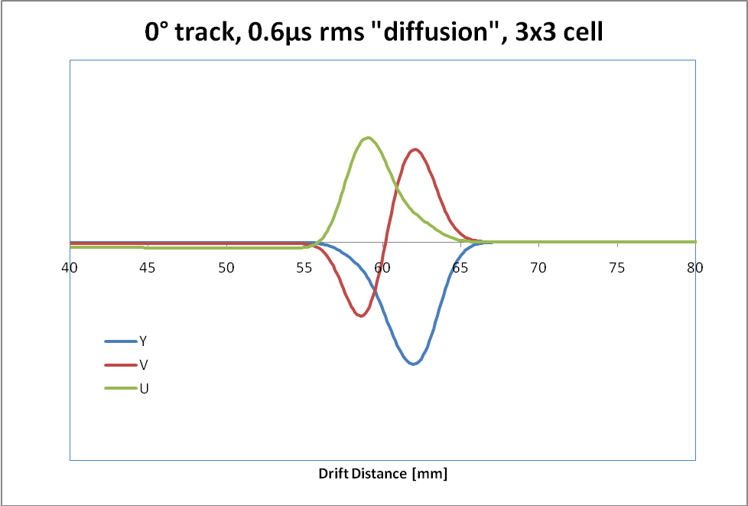
Signals in LAr TPC
Charge signal:
Induced Current Waveforms on 3 Sense Wire Planes:
A 3mm MIP track should create 210keV/mm x 3mm /23.6eV/e = 4.3fC.
After a 1/3 initial recombination loss: ~2.8fC
Assume the drift path to equal the charge life time, reducing the signal to 1/e≈0.368.
The expected signal for 3mm wire spacing is then ≈1fC=6250 e, … and for 5mm, ≈10⁴ e, for the “collection signal”.
The induction signals are smaller
The time scale of TPC signals is determined by the wire plane spacing and electron drift velocity, (~1.5 mm/µs at 500 V/cm).
Sampling rate ≤ 2 Ms/s
53

Slide 54
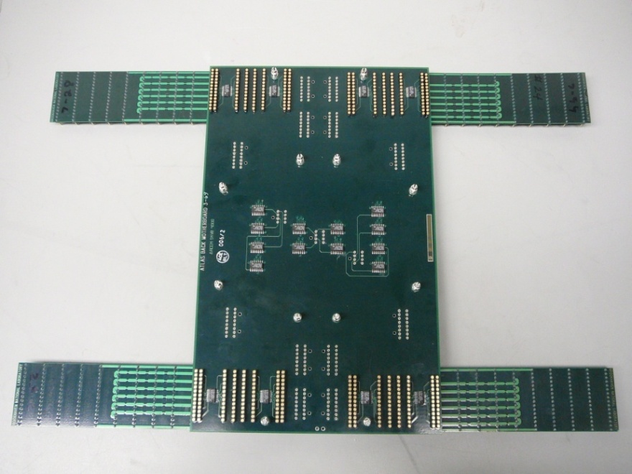
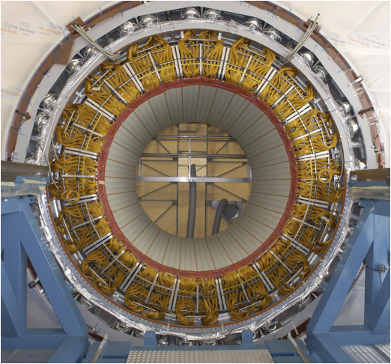
Reliability of Cold Electronics (1) wrt thermal contraction-expansion
PCB and Cold Electronics in ATLAS:
EMB Mid/Back MB+SB Assembly
ATLAS LAr Calorimeter
  182,468 readout channels
EM Barrel Mother Board and Summing Board
  EMB has ~110,000 detector channels read out by 896x128-ch FEBs
  960 Mother Boards (MB)
  7,168 Summing Boards (SB)
  20,480 resistor network chips, 0.1%
  ~110,000 protection diodes on MBs/SBs
EM Barrel Calorimeter has been cold since 2004
  Operation: 7 years so far
  MB/SB will remain in operation without upgrade for super LHC
  ‘Inoperative’ channels <0.5%, as of 05/10/2011
  Dead channels in the cryostat ~0.02% since 2008
EMB Wheel C

Slide 55
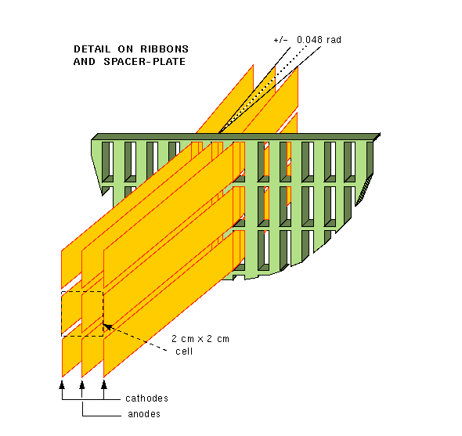
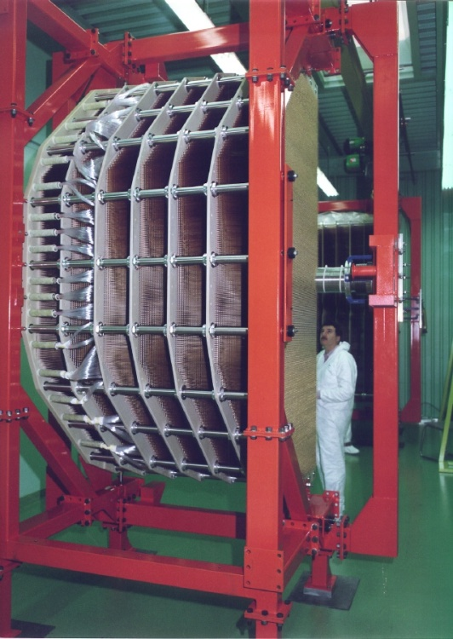
Reliability of Cold Electronics (2)
Cryogenic front-end based on JFETs –NA48-NA62
  Liquid Krypton calorimeter
  JFET preamplifiers in LKr: 13,212 channels
  Operated at very high voltage
    Tested up to 7kV, operated in 3kV
  Failures
    ~50 because of an HV accident in 1998
    ~25 cold electronics failures after 1998, < 0.2%
    The last failure recorded was more than 3 years ago
  Always kept at LKr temperature since 1998
  Operation
    13 years so far
    Plan to run until 2015, expected to be in operation for 17 years

Slide 56
ENC vs power in the input cascode

Slide 57
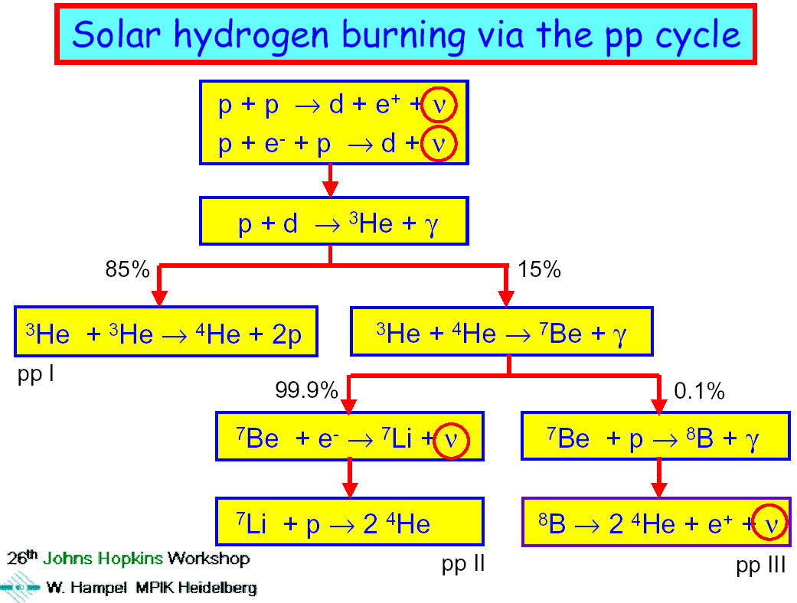
Appendix 2

Slide 58
