Slide 1
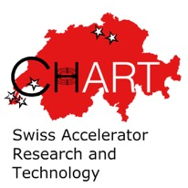
Accelerator Magnet R&D in CHART
D. M. Araujo, B. Auchmann, A. Brem, M. Daly, M. Duda, R. Felder, C. Hug, O. Kirby,
J. Kosse, T. Michlmayr, G. Montenero, H. G. Rodrigues, G. Rolando, S. Sanfilippo, S. Sidorov,
D. Sotnikov with support from CERN, ETHZ, FNAL, LBNL, Tokamak Energy Ltd, UniGE, uTwente
02.03.2023 – Magnet Seminar
Work supported by the Swiss State Secretariat for Education, Research and Innovation SERI.

Slide 2
Overview
CHART and HFM
CHART1: Canted Dipole 1 (CD1)
CHART2:
  MagDev Lab
  Technology R&D and Stress-management
  Technology Solenoid, Pcubed
  HTS4
  HTS HFM
MagXX family of CHART projects

Slide 3
Overview
CHART and HFM
CHART1: Canted Dipole 1 (CD1)
CHART2:
  MagDev Lab
  Technology R&D and Stress-management
  Technology Solenoid, Pcubed
  HTS4
  HTS HFM
MagXX family of CHART projects

Slide 4
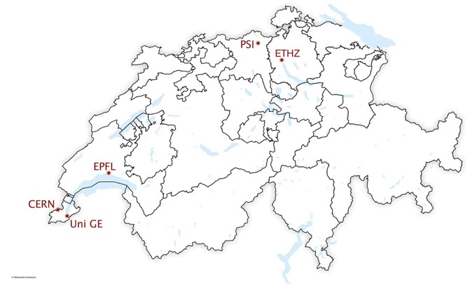




CHART – What, Who, How?
“CHART, the Swiss Center for Accelerator Research and Technology, was founded to support the future oriented accelerator project Future Circular Collider (FCC) at CERN and the development of advanced accelerator concepts in Switzerland beyond the existing technology. […] The high field magnet R&D has strong synergies with PSI projects […]”
[Application for support of the Swiss Accelerator Research and Technology Initiative, 2018]
http://chart.ch

Slide 5



CHART – What, Who, How?
Members:
CHART Council: approves projects and receives reports.
CHART Executive Board: implements and reports on progress.
Funding: For a given research period, CHART members pledge funds and apply jointly for additional funding from SERI and ETH Council.
  CERN’s pledge is the biggest individual amount and makes up 37%
  of the overall CHART2 envelope (2019-2024).
  Projects are defined in CHART Project Proposals and, if they receive CERN funding, addenda with the FCC Feasibility Study or the HFM Programme.
Notes:
Implications of the national effort:
Only in a national effort can multiple institutes as well as national funding agencies be persuaded to set aside funds – most of these resources would be lost otherwise.
Projects with academic experts can be hard to set up when complementary funding is required. In CHART, the complementary funds are pre-allocated.
Geographic vicinity eases collaboration, but the national character does not preclude (at all) international collaboration, as many of the following slides will illustrate.
Multiple lines of funding come with multiple lines of accountability and reporting (local instititue, CHART Council and SERI, HFM Programme).

Slide 6
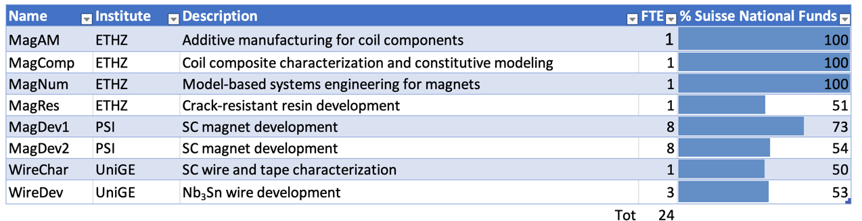


CHART – What, Who How?
Topics and FTEs of ongoing HFM projects in CHART:
FCC Feasibility Study and other CHART projects:
  FCC / LHC Lumi
  FCCee Beam Dynamics Simulation
  FCChh Stability
  FCCEe SPIN POL
  FCCee Lumi
  Muon Collider Feasibility Studies
  FCCee Injector
  FCC Geodesy
  FCCee CPES – cryogenic power supply development (1 FTE)
  FCCee HTS4 – HTS Short Straight Section Demo for FCCee (4 FTE)
  HTS Bulk Undulator – bulk REBCO undulator technology (2 FTE)
  FCC Geology 3D Model

Slide 7




CHART HFM Strategic Guidelines
Provide relevant input to the next ESPPU.
Aim for meaningful innovation.
Fast-track key technology R&D with academia and industry.
Use fast-turnaround minimum viable products as innovation funnel.
Where required, invest in infrastructure early to maximize its impact.
Increase the cross-linking among CHART members to reach full potential as a distributed research network.
Ensure optimal communication, coordination, and collaboration within CHART, with CERN, and the HFM Programme.
Realize synergies for PSI’s scientific and medical programs.

Slide 8

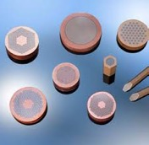
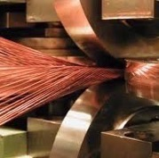
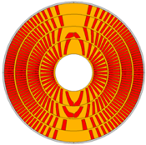
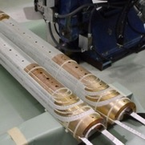
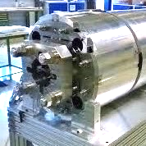
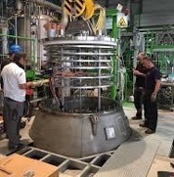

CHART Acc. Magnets – Technology Pillars
MagDev1
MagDev2
FCCee Injector
FCCee HTS4
WireChar
WireDev
Strand / Tape
LTS/HTS conductor R&D, Characterization
Cable
Rutherford / Roebel production
Magnet Design
FCC-hh / HE-LHC conceptual and technical
Coil Manufacturing
Nb3Sn and HTS coils
Mechanical Assembly
Mechanical loading
Testing
LTS and HTS magnet tests
INJECTION
Notes:
UniGE has experience in rod-type internal tin wire manufacturing

Slide 9


CHART Acc. Mag. – Enabling Technology R&D
X-ray tomography
Billet manufacturing
Strand / Tape
LTS and HTS strand/tape
R&D, Procurement, QA
Cable
Rutherford / Roebel production
Magnet Design
FCC-hh / HE-LHC conceptual and technical
Coil Manufacturing
Nb3Sn and HTS coils
Mechanical Assembly
Mechanical loading
Testing
LTS and HTS magnet tests
INJECTION
Notes:
Grenoble, synchrotron and HMF
CERN
Manufacturing infrastructure
Modeling wire to cable performance

Slide 10


CHART Acc. Mag. – Enabling Technology R&D
MagNum
MagComp
Model-Based Systems Engineering,
Multi-scale modeling
Strand / Tape
LTS and HTS strand/tape
R&D, Procurement, QA
Cable
Rutherford / Roebel production
Magnet Design
FCC-hh / HE-LHC conceptual and technical
Coil Manufacturing
Nb3Sn and HTS coils
Mechanical Assembly
Mechanical loading
Testing
LTS and HTS magnet tests
INJECTION
Notes:
Grenoble, synchrotron and HMF
CERN
Manufacturing infrastructure
Modeling wire to cable performance

Slide 11

CHART Acc. Mag. – Enabling Technology R&D
MagRes
MagComp
Polymer R&D
Insulation and composite R&D
REBCO NI Coil Technology
Strand / Tape
LTS and HTS strand/tape
R&D, Procurement, QA
Cable
Rutherford / Roebel production
Magnet Design
FCC-hh / HE-LHC conceptual and technical
Coil Manufacturing
Nb3Sn and HTS coils
Mechanical Assembly
Mechanical loading
Testing
LTS and HTS magnet tests
INJECTION

Slide 12

CHART Acc. Mag. – Enabling Technology R&D
MagAM
Additive manufacturing
Coil interfaces
Lab 4.0
Strand / Tape
LTS and HTS strand/tape
R&D, Procurement, QA
Cable
Rutherford / Roebel production
Magnet Design
FCC-hh / HE-LHC conceptual and technical
Coil Manufacturing
Nb3Sn and HTS coils
Mechanical Assembly
Mechanical loading
Testing
LTS and HTS magnet tests
INJECTION

Slide 13



CHART Acc. Mag. – Enabling Technology R&D
FCCee CPES
Powered sample tests in background field
Quench Protection
Signal Analysis
Cryogenic Powering
Strand / Tape
LTS and HTS strand/tape
R&D, Procurement, QA
Cable
Rutherford / Roebel production
Magnet Design
FCC-hh / HE-LHC conceptual and technical
Coil Manufacturing
Nb3Sn and HTS coils
Mechanical Assembly
Mechanical loading
Testing
LTS and HTS magnet tests
INJECTION

Slide 14
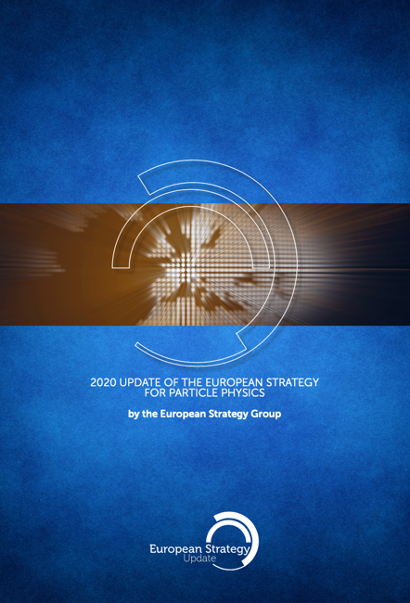
2020 Update of the European Strategy for Particle Physics
  “Europe, together with its international partners, should investigate the technical and financial feasibility of a future hadron collider at CERN with a centre-of-mass energy of at least 100 TeV and with an electron-positron Higgs and electroweak factory as a possible first stage. “
  “The technologies under consideration include high-field magnets, high-temperature superconductors, plasma wakefield acceleration and other high-gradient accelerating structures, bright muon beams, energy recovery linacs.
  The European particle physics community must intensify accelerator R&D and sustain it with adequate resources. A roadmap should prioritise the technology, taking into account synergies with international partners and other communities such as photon and neutron sources, fusion energy and industry. Deliverables for this decade should be defined in a timely fashion and coordinated among CERN and national laboratories and institutes.“
http://cds.cern.ch/record/2721370

Slide 15
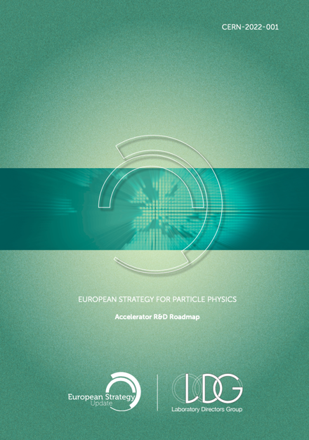

LDG Roadmap for HFM R&D
Accelerator R&D Roadmap published in Jan 2022.
  https://arxiv.org/abs/2201.07895
Input for CHART Roadmap and HFM Programme

Slide 16
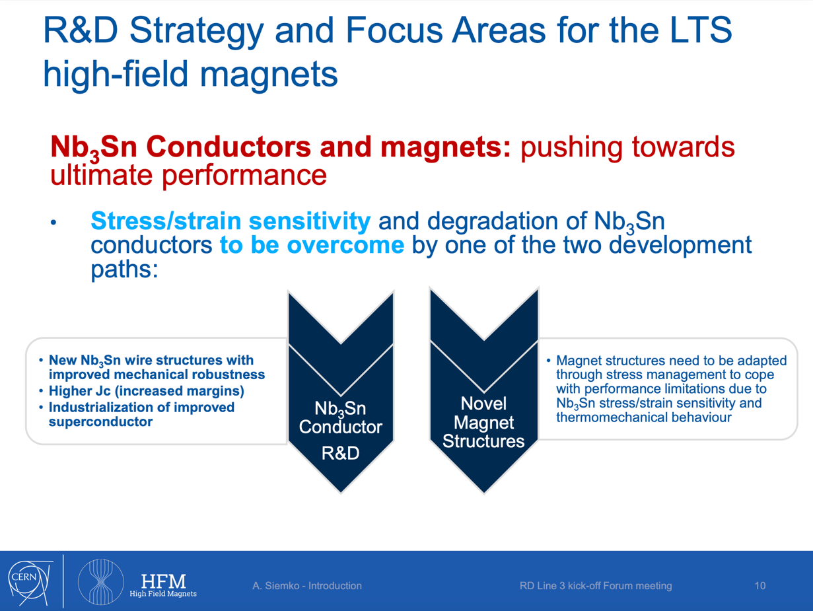
From A. Siemko, Intro to HFM RD3 Meeting

Slide 17
Overview
CHART and HFM
CHART1: Canted Dipole 1 (CD1)
CHART2:
  MagDev Lab
  Technology R&D and Stress-management
  Technology Solenoid, Pcubed
  HTS4
  HTS HFM
MagXX family of CHART projects

Slide 18
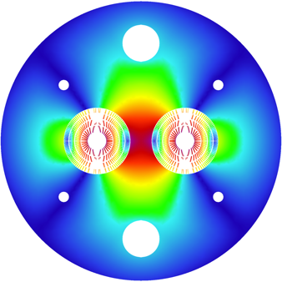
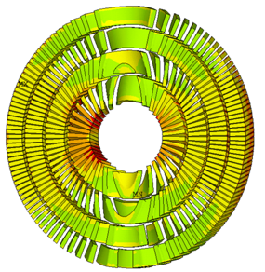
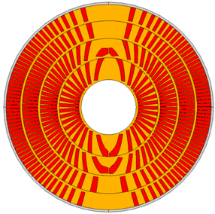
CHART1 Goals
CHART1 goals (mid-2016 to mid-2019) :
  the design of an optimised 16 T Canted Cosine Theta (CCT) dipole magnet,
  as an option for the FCC hadron collider main magnet;
  the development (design and prototype) of a high-field dipole
  magnet with CCT technology; and
[B. Auchmann et al., Electromechanical Design of a 16-T CCT Twin-Aperture Dipole for FCC, IEEE Trans. on Appl. SC 28 (April, 2018) no. 3.]
[M. Benedikt et al., FCC Conceptual Design Report, Vol. 3 – The Hadron Collider (FCC-hh), pp. 50-52, submitted to Eur. Phys. J. ST, (December 2018).]

Slide 19
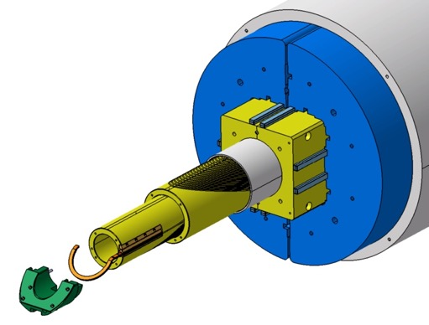
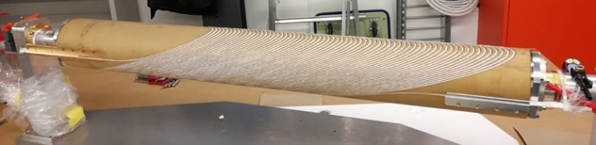
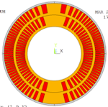
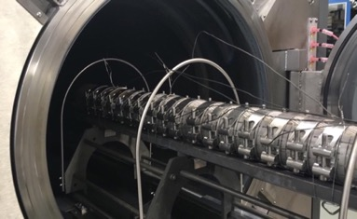
CHART1 Goals
CHART1 goals (mid-2016 to mid-2019):
  the design of an optimised 16 T Canted Cosine Theta (CCT) dipole magnet,
  as an option for the FCC hadron collider main magnet;
  the development (design and prototype) of a high-field dipole
  magnet with CCT technology (February 2017 – October 2019)
[G. Montenero et al., Coil Manufacturing Process of the First 1-m-Long Canted-Cosine-Theta (CCT) Model Magnet at PSI, IEEE Trans. on App. SC., Vol 29(5), 2019.]
[G. Montenero et al., Mechanical Structure for the PSI Canted-Cosine-Theta (CCT) Magnet Program, IEEE Trans. on Appl. SC., Vol 28(3), 2018.]

Slide 20
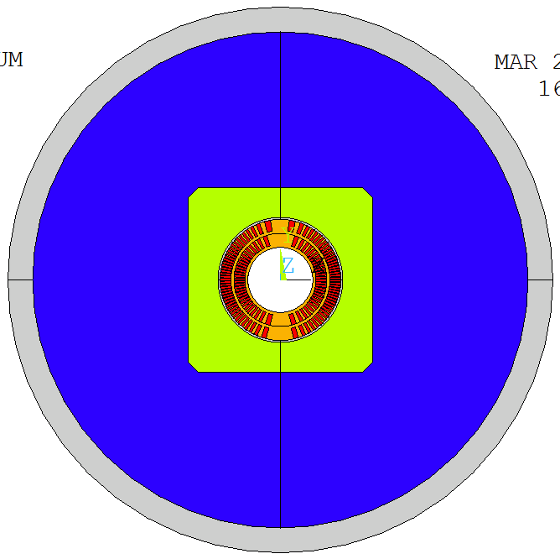
Mechanical Structure
Bladder and Key technology chosen for tuneability and relative simplicity.
  Closed and pre-loaded pad gap for maximum-rigidity cage around coils.
  Aluminum bronze pads to match coil differential contraction.
Closed pad gap
Bladder locations
Vertical and horizontal keys
Al shell 25 mm
Protective Al shell 5 mm
Vertically split Al-bronze pad
Vertically split yoke, OR 250 mm
Al-bronze former
Open yoke gap
Notes:
show loading concept via reaction forces

Slide 21
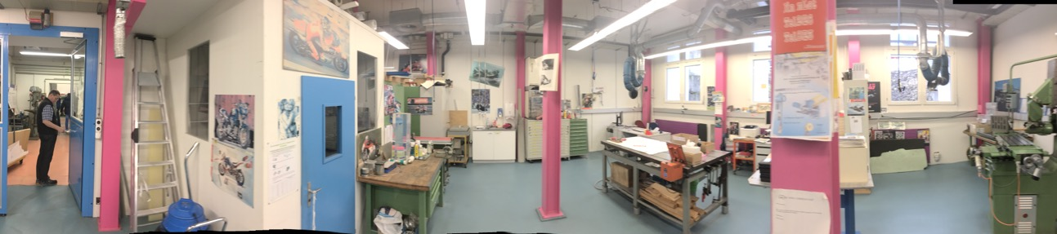
CHART1 MagDev Lab

Slide 22
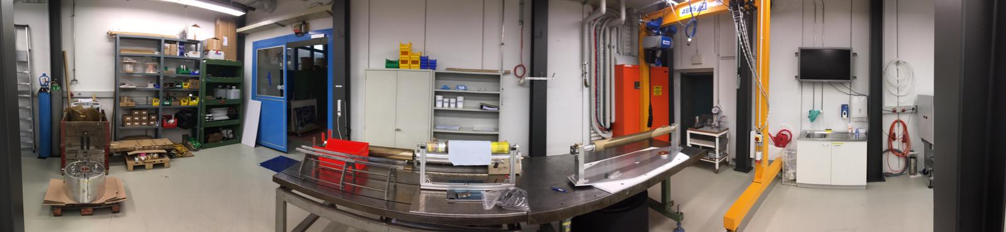
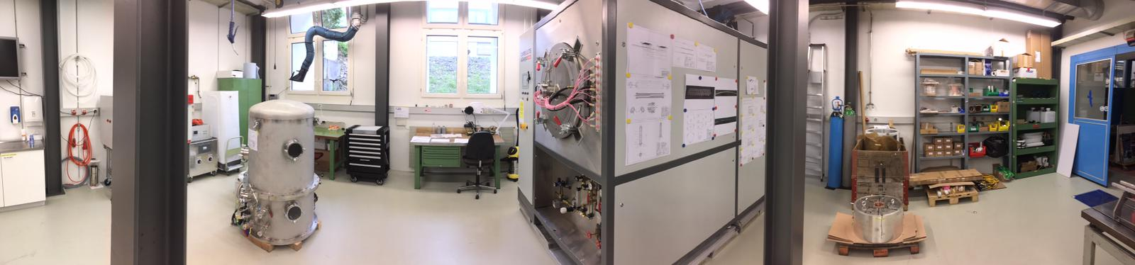
CHART1 MagDev Lab
90 m² laboratory refurbished, equipped, commissioned for construction of CD1
06/2017-06/2018.
Production-readiness review (http://indico.psi.ch/event/cd1prr).
Portal crane
Storage
Winding table
4-m winding/instrum/assembly bench
Vacuum Impregnation
Coil reaction

Slide 23
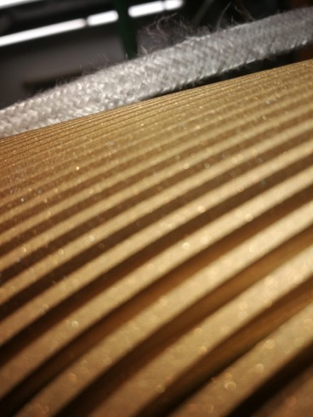
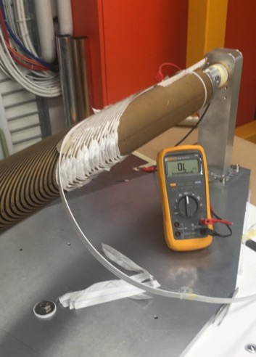
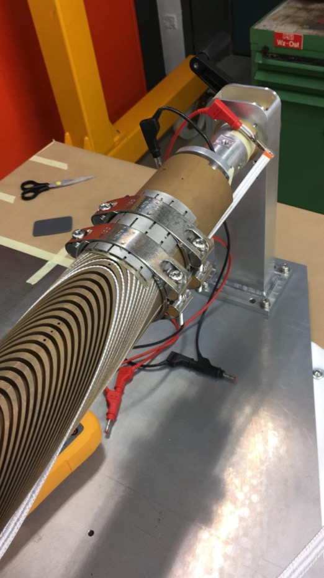
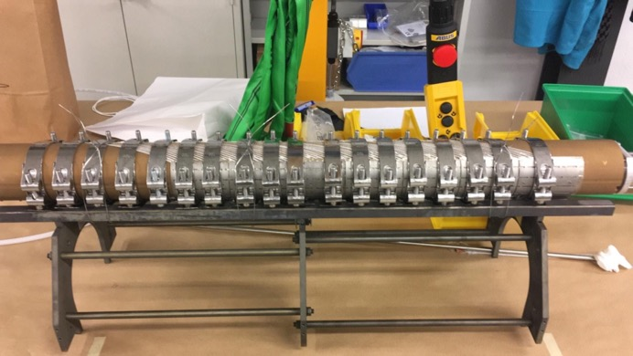
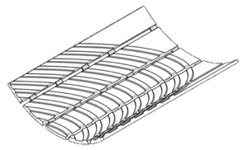
CD1 Winding and Insulation Issues

Slide 24
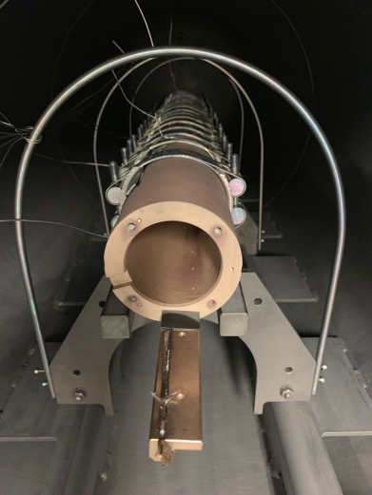
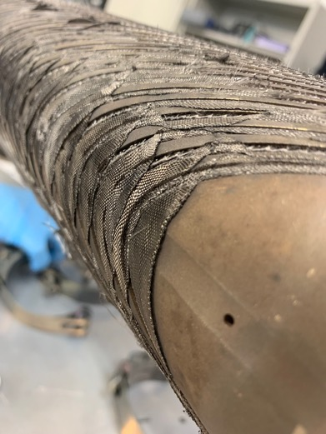
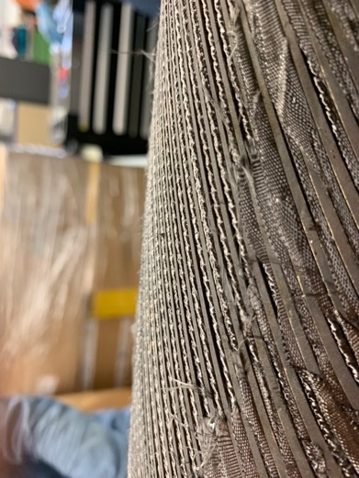
CD1 IL Former after Heat Treatment
Insulation has turned resistive (1-3 Ω mandrel to cable).
Cable clamping caused mandrel deformation by +/- 1.5 mm in central section.

Slide 25
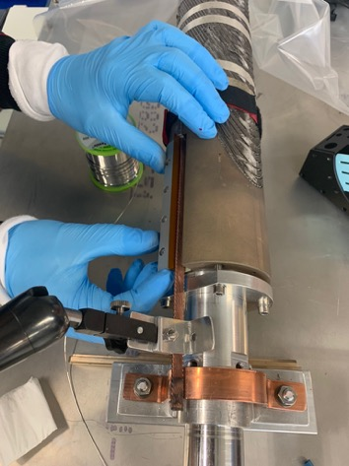
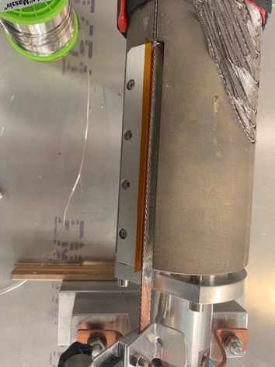
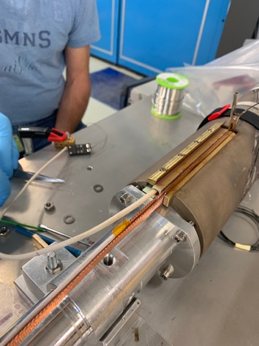
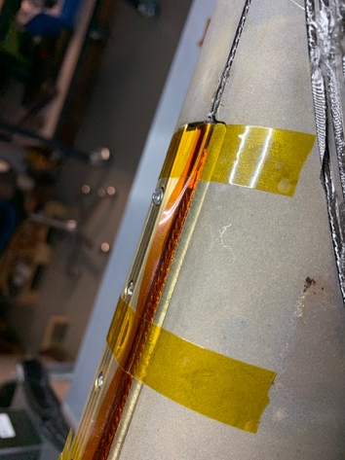
IL Splicing an Instrumentation
Splicing followed closely the LBNL procedure.
Repeated trials led to a smooth operation. Visually, all looks good.
IL has only two v-taps in the winding, and two more on each splice.

Slide 26
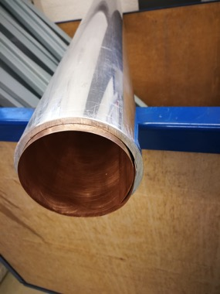
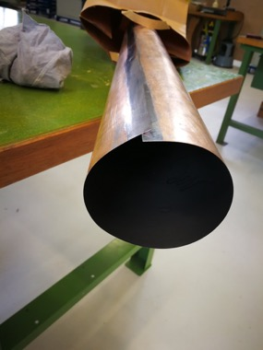
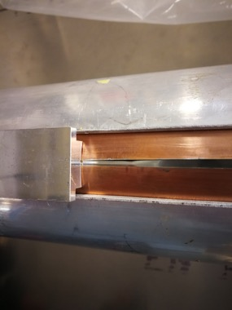
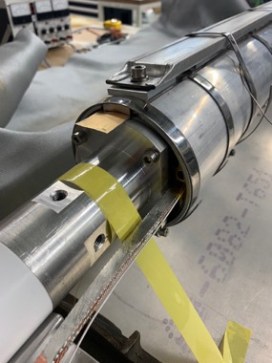
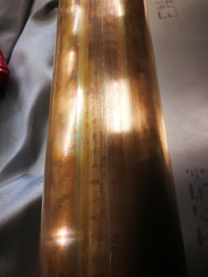
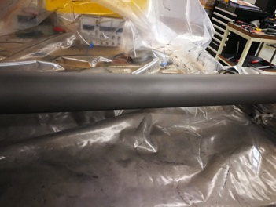
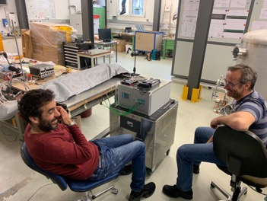
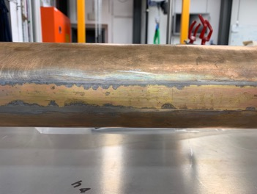
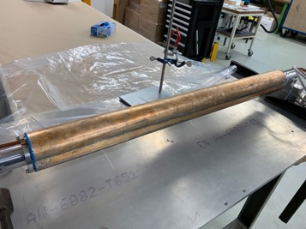
IL/OL Sliding Planes
Sliding planes installation without incidents.
Need to improve heating towards the extremities (coil mounting acts as heat sink).

Slide 27
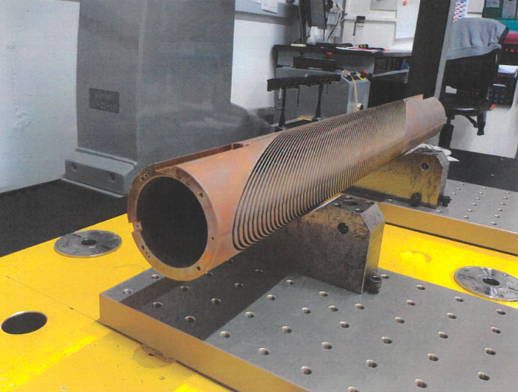
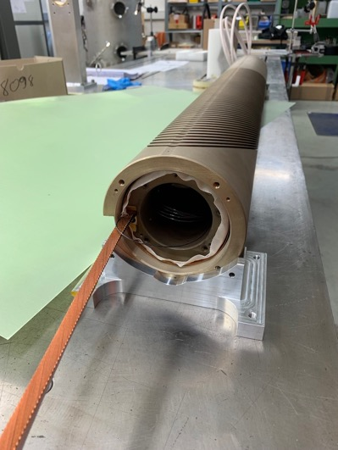
Re-machining OL
Outer-layer spar was reduced from 3 mm to 2 mm.
QA shows minimal distortion of the former.
Test-assembly successful.

Slide 28
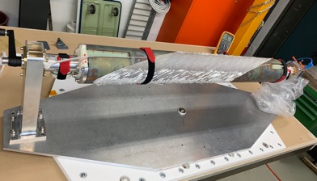
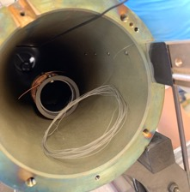
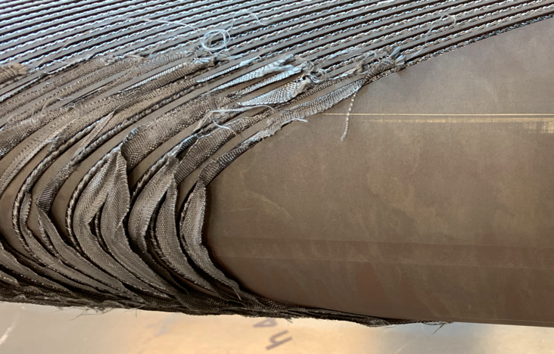
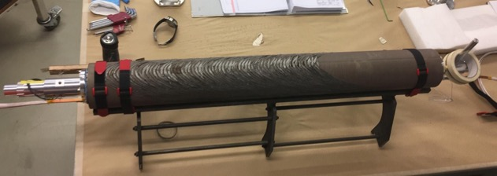
OL Winding and Reaction
Winding without incidents. Glass-ribbon reinforcement on pole surfaces
provided good insulation.
Pre-reaction, the cable was below the former OD everywhere.
Resistance cable/former was again ~3 Ω. There is no distinct weakness, but all glass braid has turned resistive.
After reaction, numerous turns, especially towards the ends, stuck out from the mandrel OD by as much as 0.7 mm.

Slide 29


Splicing and Instrumentation OL
OL splicing was carried out without incidents. Visual inspection is good.
OL is equipped with 5 v-taps and a spot heater, as well as 2 v-taps per splice.

Slide 30






Coil Assembly
OL wrapped in glass ribbon.
IL and OL aligned by Al block.
G10 shims between IL and OL
to avoid axial slipping.
Teflon mesh between Al shell
and coil.

Slide 31







Impregnation
Following mostly the LBNL
impregnation scheme,
adjusted for our thin Al shell,
and using a peristaltic pump
to slow down injection.

Slide 32






Intra-layer Splicing and Assembly in Pads
Intra-layer splicing produced a
cable stack slightly wider than
anticipated.
Visual inspection looks good.
Wrapping imp. coil with two
layers 125-µm-thick Kapton
and assembly inside pads
proved difficult.
Pads-to-Al-shell insulation tested up to 800 V.

Slide 33




Mechanical Assembly – Loading
Assembly went “as advertised”.
The yoke halves are sprayed with Steel-It, inserted, and locked into the Al shell.
The yokes are turned and lifted on the table.
The pads are inserted and loaded with nominal shims.
The keys entered at the predicted bladder pressure of 100 bar for vertical and
350 bar for horizontal keys.
The strain gauges equally tracked very well with simulations.
Horizontal loading took only 1 hour.

Slide 34







Loading and Strain Gauges

Slide 35



CD1 Complete
A wonderful team effort came to an end.
Without the incredible openness and generosity of LBNL colleagues
we could not have reached this milestone!

Slide 36



Test of CCT5 at LBNL
 | CD1 | CCT5
ID | 63.6 mm | 90 mm
Spar | 3/2 mm | 7.4/3 mm
Layer interface | Sliding plane | Bend & Shim
Mechanical structure | Bladder & Key | ID Spar and Al shell
Resin | FSU Mix 61 | FSU Mix 61
CCT5 was tested before CD1 was complete.
It has many of the same design features.
Long training was explained by
  De-bonding of cables from channel walls
  And cracks in the glass-epoxy insulation.
CD1
Courtesy D. Arbelaez, LBNL.

Slide 37





Record Field after a Long Delay
October 2019, the CD1 magnet was finalized and shipped to LBNL, Berkeley, US, for testing.
An Odyssey began:
The magnet was blocked for 3 months in US customs and the transport crate was heavily damaged by a fork lift.
COVID delayed the start of testing by 6 months.
After several ramps, the LBNL test station had technical problems. The repair grew into an upgrade project.
After the return of the test station, the PSI magnet lost in priority over other delayed LBNL projects.
Upon invitation by CERN, the magnet was shipped there and arrived in November 2021.
A dangerous electrical incident at CERN interrupted all testing at CERN for several months.
Upon resumption of testing, HiLumi magnets received priority.
CD1 was eventually tested at CERN in November 2022.
It reached 10.1 T in the bore at 94% of Iss at 1.9 K; 9.9 T and 100% of Iss at 4.5 K..
Courtesy F. Mangiarotti (CERN) and M. Daly (PSI).
Bottom line: Stress-management works –
no conductor degradation from handling, assembly, powering, cycling.

Slide 38

BOX Data (see below) for Iss Determination

Slide 39

CD1 and CCT4/5
Courtesy F. Mangiarotti (CERN), D. Arbelaez (LBNL), M. Daly (PSI).

Slide 40
CD1 CLIQ Tests
Safely assess CLIQ efficiency
on short CCT magnet.
Numerous voltage and capacitance values
tested at increasing current values.
10
8
6
Current [kA]
CLIQ settings
200V; 40 mF
EE = 200ms
4
2
0
- 0.05
0
0.05
- 0.1
- 0.15
- 0.2
Time [s]
Courtesy F. Mangiarotti

Slide 41

CD1 Spot Heater Test
Outer Layer
All tests at 4.5 K
Circuit: 10 mF capacitor
charged to:
  27 V (8 kA and above)
  35 V (6 kA)
  45 V (4 kA)
10.5 Ohm resistance
2.2 2.3
I [kA] | t_{100mV} [ms]
4 | 310
6 | 100*
8 | 32
10 | 15
12 | 7.0
14 | 4.1
16 | 2.3
Courtesy F. Mangiarotti

Slide 42
Overview
CHART and HFM
CHART1: Canted Dipole 1 (CD1)
CHART2:
  MagDev Lab
  Technology R&D and Stress-management
  Technology Solenoid, Pcubed
  HTS4
  HTS HFM
MagXX family of CHART projects

Slide 43


MagDev Laboratory
New extension to building WLHA
next to SLS2.0.
Hand-over in August 2020.
Infrastructure (hall and equipment)
was excluded from cost-sharing
with CERN.

Slide 44

MagDev Laboratory Layout
3D Scanning
Heat treatment
HTS winding
Re-reeler
Impregnation
Storage
Instrumentation
LTS winding
Loading / Assembly
Autoclave 10 bar, 250ºC to arrive April 2022. For the time being no loading press.

Slide 45









MagDev and HTS4 Team
Douglas Araujo
Engineer LTS
Henrique Rodrigues
Technician ReBCO
Dmitry Sotnikovs
Engineer HFM ReBCO
Michael Daly
Engineer LTS
Jaap Kosse
Engineer HTS4 ReBCO
Christoph Hug
Technician LTS
Design
Materials
Processes
Oliver Kirby
Internship LTS
André Brem
Material Scientist
Thomas Michlmayr
CAD, Technical Design
Instrumentation, Protection, Testing

Slide 46

MagDev1
BigBOX constr.
and test
Pcubed
concept. design
Clean reaction

Slide 47






BOX Program
Pictures by M. Daly, S. Sidorov, S. Otten
BOX (BOnding eXperiment) program with uTwente has shown a wide variety of results,
from complete conductor degradation (no impregnation) to substantial training (epoxy) to
no-training (wax, Stycast), with 18 BOX samples successfully manufactured and tested to date.
Notes:
LBNL is preparing a wax impregnated subscale CCT magnet

Slide 48



BOX Program Sections
Cleaner BOXes perform better.
Weak CTD101K (5x lower K1c)
outperforms standard CTD101K.
Terribly processed filled CTD101K
by far outperforms standard CTD101K.
K1c alone cannot predict performance.
  Tg (glass transition) and Tc (curing)
  may be equally important.

Slide 49




Accoustic data taken on all BOX samples

Slide 50




PostMortem Analysis
Quantify defects after wire-saw cutting and polishing.
Cracks
Voids
Surface defects (de-bonding)
[Courtesy of O. Kirby, M. Daly.]

Slide 51


PostMortem Analysis - First 7 Data sets
Channel 9
Channel 9
Channel 9
Wire OD 7-8
Wire OD 7-8
Wire OD 7-8
Voids 0-3
Voids 0-3
Voids 0-3
Low K1c
CTD101k
MY750
Mix61
Cracks 4-6
Cracks 4-6
Cracks 4-6
Channel 9
Channel 9
Wire OD 7-8
Voids 0-3
Wire OD 7-8
Voids 0-3
CTD101k
CTD101k
Cracks 4-6
Cracks 4-6
Channel 9
Channel 9
Wire OD 7-8
Voids 0-3
Wire OD 7-8
Voids 0-3
Stycast
Sedimentation
Cracks 4-6
Cracks 4-6

Slide 52





BOX Compression
Successful systems can be characterized and benchmarked against CTD101-K in U Twente’s transverse-compression setup.
CTD 101-K measurements reproduce previous results
of Twente U-shaped samples.
Paraffin wax’s lower modulus and yield increase degradation.
Courtesy M. Daly
Courtesy S. Ott et al.

Slide 53



Wax Sub-scale Layer tested at LBNL
All data courtesy of D. Arbelaez for the LBNL CCT program.
  Sub_2: epoxy in inner and outer, inner with thin spar
  Sub_3, epoxy in inner and outer, inner with thick spar
  Sub_5, wax in inner, epoxy in outer, outer layer re-used from sub_3
Wax inner layer did not show any training quenches.
Also Stycast will be investigated.
The wax-impregnated Sushi by Wigner institute (HU) is being prepared for testing.

Slide 54

CCT4FCC Pros and Cons
Design:
  Mechanical support of each turn
  → reduced coil stress and avoidance of stress-induced degradation.
  Easy field quality (on paper).
  Ideally suited for LTS/HTS hybrid magnets due to easy stacking of heterogeneous layers.
  Simpler external mechanical structure → more iron between the apertures and better magnetic separation → less cross-talk.
  Hope to fix training: getting one turn “right”, the entire magnet would work; no discontinuities towards the end regions
Fabrication:
  Simple and safe coil-manufacturing process; little tooling needed; coil always protected by former.
Instrumentation and protection:
  Efficient CLIQ protection as every turn is a high-field turn.
  Co-winding of instrumentation (fibers, wires, etc.) is supposedly easy.
Design:
  Every turn must be glued to metal surfaces; delamination would preclude good performance.
  Reduced efficiency by winding angle, rib thickness, and spar thickness.
  Check FQ variation along z-axis due to lack of control on turn position.
  Some axial strain on cable in every turn.
  No radial pre-compression possible.
Fabrication:
  Tricky winding on small ID with wide cable.
  Difficult to obtain reliable insulation.
  Difficult to keep cable in groove on small IDs.
  Interplay between former and cable during reaction.
Instrumentation and protection
  No heater protection possible.
Scaleup:
  Involved former manufacturing; cost and time consuming; difficult to scale to 15 m.
  Difficult assembly and alignment for long magnets – assembly gaps reduce performance.

Slide 55



Alternatives to CCT – Low-Pre-Stress CT
Initially, the plan was to abandon stress management due to the training.
A Low-Pre-Stress Cosine Theta configuration was studied in collaboration with G. Vallone (LBNL).
2D studies looked promising:
  A standard cos-theta coil inside a rigid structure of optimized thermal contraction for little pre-stress after cool-down.
  2-layer coils like 11-T saw peak stresses on coil OD, little stress-enhancement on ID midplane.
  4-layer coil results showed strong dependence on wedge position in the outer layers.
  Recall: FNAL 15-T magnet has no wedges in the outer layers. Hence they plan to use SM-CT to enhance outer-layer stiffness.
3D studies revealed problems:
  The additional motion of a low-pre-stress configuration leads to prohibitive stress concentrations.
  Possibly low transverse pre-stress should be combined with conventional axial loading.
New 3-D coil-end generator (G. Vallone) is available from this work.
Courtesy G. Vallone
http://indico.psi.ch/e/magdev1review

Slide 56


Stress Managed Alternatives to CCT
Following wax and later Stycast BOX results, the focus shifted back to stress management.
SM CT (Cosine Theta) and SM CC (Common Coil) were studied, using FNAL 15 T cable/strands.
HF cable (28 x 1.0 mm ) Layers 1 and 2
LF cable (40 x 0.7 mm)
HF cable (28 x 1.0 mm ) Layer 1 and pole coils
LF-1 cable (40 x 0.7 mm) Layer 2
LF-2 cable (30 x 0.7 mm) Layers 3 and 4
1
2
Pole coil
3
4
1
2
3
Same scale, 50 mm aperture
4
Conductor area (1/4) = 2709.3 mm2 (+ 10.8 % conductor)
Conductor area (1/4) = 2445.4 mm2
Courtesy of D. M. Araujo – images for illustration purposes only; these are snapshots of comparative
design studies – not fully optimized designs.

Slide 57





Stress-Managed Common Coil Option
Advantages:
  Synergies with HTS program.
  Individual-layer impregnation with low-field splices.
  In preliminary study, less conductor than SM CT option.
  Easier axial mechanics.
  Potential route to react&wind.
Disadvantages
  More difficult transverse mechanics.
  More difficult to wind into slots.
SEQV Max 146 MPa
SEQV Max 910 MPa
Preliminary study at 14.5 T
Courtesy of D. M. Araujo – images for illustration purposes only; these are snapshots of comparative
design studies – not fully optimized designs.

Slide 58






BigBOX
Brookhaven DCC17 magnet provides 9.2 T field.
A 13-turn Nb3Sn hardway-bend racetrack coil will
see ~120 MPa with ~25% margin on one straight section.
This corresponds to the most strenuous operating
condition expected for a stress-managed coil.
BigBOX was delivered 06/2022.
Test expected soon ...
Courtesy of D. M. Araujo

Slide 59





Materials R&D
Elimination of pyrolyzed organic residues.
  Combustion in vacuum above 580ºC
  for highest efficiency.
  Minimum oxygen injection, controlled
  through CO, CO2 sensors and electrical
  measurements.
  RRR tests show 8% reduction.
  BOX test for super-clean surfaces will
  follow. Cable-stability test needed.
Spray/dip-coating and glazing
process with heat-resistant
insulating paint.
Low K1c CTD101K.
No-bond epoxy/wax blend.
Courtesy A. Brem.

Slide 60






Materials R&D
Cryogenic tribology with BAM Berlin.
Wax characterization at ETHZ.
Filled-wax/epoxy process development
  Particle functionalizing, dispersion.
  Vacuum bag filling.
  VPI for the most reliable impregnation
  process.
Courtesy A. Brem.

Slide 61
Outlook
2023-2024 will see the sub-scale program, that shall tune and validate manufacturing processes and
discover major design issues
(3-4 magnet tests).
2024-2026 will see the ultimate-
field program (at lest 1 magnet test).
Material sample and powered-sample
R&D will continue in support of large- scale magnets.
Collaboration remains a center-piece of our methodology. CHART collaborations, close exchanges with the CIEMAT’s common-coil program, and open exchanges and cooperation throughout the HFM Programme will remain a priority.
Materials and Composite Samples (not powered)
Powered Samples and Mechanical Models
Sub-scale Magnets
2023-2024
2024-2026
Short Magnets
Ultimate Field (14…16T)
Long Magnets Ultimate Field Magnets
(14…16 T)

Slide 62
Overview
CHART and HFM
CHART1: Canted Dipole 1 (CD1)
CHART2:
  MagDev Lab
  Technology R&D and Stress-management
  HTS Technology Solenoid, Pcubed
  HTS4
  HTS HFM
MagXX family of CHART projects

Slide 63



4-Stack Technology Solenoid in the
Cryogen-Free Test Station
Successful test in cryogen-free test station of 4-pancake HTS NI solenoid, built in-house at PSI and using licensed Tokamak Energy Ltd technology.
Coil reached 18.2 T in the center,
20.3 T on the conductor at the
maximum current of the power
converter of 2 kA.
thermal
connectors
radiation shield
top plate
Diameter: 100 mm
Aperture: 50 mm
SC type: ReBCO
# tapes: 2
# turns: 2 x 170
SC length: 2 x 49 m
2nd cryocooler
20K coldhead
1st cryocooler
4K coldhead
Cu leads
HTS leads
Stack of 4 NI HTS
coils with thermal/
electrical connectors
Courtesy of M. Duda, J. Kosse, H. Rodrigues

Slide 64

4-Stack Technology Solenoid in the
Cryogen-Free Test Station
Gained experience with NI coils.
Thermal runaway as consequence of bad electro-
thermal contact (indium contact sheet was re-used).
Axial contacting plates needed to be re-soldered.
No SC degradation observed.
A B C D
0-A:
fast ramp up with 1 A/s
voltage over coils increasing because of current radial path
A-B:
slower ramp up with 0.2 A/s to stabilize coils voltage increase
B-C:
2 kA 3h plateau
coils voltage decreasing because of current redistribution
field is increasing – not reaching plateau
C-D:
slow ramp down with 0.5 A/s to avoid quench back
slow ramp
down with
0.5 A/s only
current
2 kA 3h
coils voltage
1.6 mV
over 4 coils
~800 nohm
18.2 T
field
Courtesy of M. Duda

Slide 65


FCCee Injector Study:P³ (PSI
Positron Production)
15 K conduction-cooling
HTS NI target solenoid, to demonstrate
high-yield positron source concept
  stable DC operation,
  high thermal conduction due to solder
  impregnation to extract heat
  deposited in coils,
  radiation robustness due to
  absence of insulators.
Manufacturing Q3’23-Q2’24
Experiment at PSI’s SwissFEL 2025/26
5 coils from 12 mm ReBCO
target
Solid-state (Pb)
thermal buffer
15 T in 72 mm warm bore
21 T on conductor
Coil diameter | 122 mm inner, 219 mm outer
Stored energy | 331 kJ
Operating current | 1.17 kA
Charging constant | 11 hours
Courtesy J. Kosse, T. Michlmayr, H. Rodrigues

Slide 66








Solder Impregnation Technology
Fluxed Winding
Soldering from top
Fluxed-Hot-winding
Pre-tinned tape
Fluxed winding
Pre-tinned tape
Bath soldering in
vacuum
Removable mandrel
Fluxed winding
Pre-tinned tape
Bath soldering in vacuum
Removable mandrel
Tightening during soldering
Rosin Flux
200 Celsius
+ 30 min cycle
Rosin Flux
200 Celsius
~ 25 min cycle
GSP-2533 Flux
210 Celsius
~ 3 min cycle / ~ 5 mbar
GSP-2533 Flux
220 Celsius
~ 3 min cycle / ~ 5 mbar
Problems:
Dry patches inside
Time
Problems:
Small empty voids
Time
Problems:
Unequally spaced turns
Problems:
Tbs
Courtesy of H. Rodrigues (PSI)

Slide 67
HTS for HFM
How to make cable for HTS accelerator magnets (e.g (15 m long, 16+ T, 4.2-20 K)?
  How to deal with ramp losses?
  How to guarantee sufficient integral field quality?
  How to protect the magnets?
Material development for
insulated tape stack.
Numerical studies for transient
effects in cross-section.
Insulated tape-stack cable manufacturing.
Technology racetracks.
Hybrid configuration of SM-CC beyond 2025.
Ultimately HTS-only SM-CC.
Close technical exchange with MSC has started.
Materials and Numerical Design Studies
Powered Cable Samples
Technology Racetrack Coils
Q4’24
Short Hybrid HTS/LTS
Magnets (15…17 T)
Short All-HTS Magnets
(16…20 T)
(4.2…20 K)

Slide 68


HTS4: HTS short straight sections for FCC-ee
By using HTS sextupoles and quadrupoles instead of the RT baseline, HTS4 aims to:
Reduce energy consumption from up to 80 MW (43 MW in CDR) to <10 MW
Increase dipole filling factor
Enhance optics flexibility
Challenges:
Accelerator-grade field quality with HTS
Balance cooling power with conductor volume
High-reliability cryocooler-based operation
Low heat-load powering
Mitigation of radiation issues on electronics
Sub-scale coils and 1-m prototype module to be constructed and tested at PSI
CCT variant courtesy M. Koratzinos

Slide 69

MagDev2 (2023-2024) Under Preparation
HFM
RD4
RD3
RD2
Application to SERI for support of CHART 2025-2028 under preparation.

Slide 70
Overview
CHART and HFM
CHART1: Canted Dipole 1 (CD1)
CHART2:
  MagDev Lab
  Technology R&D and Stress-management
  HTS Technology Solenoid, Pcubed
  HTS4
  HTS HFM
MagXX family of CHART projects

Slide 71



D-MAT SMG:
MagRes
Development of fracture-tough resins.
Best-in-class K1c with multi-hour pot-life.
Made from readily available components.
Courtesy P. Studer and Prof. T. Tervoort

Slide 72





ETHZ D-MAVT/pd|z and inspire AG:
MagAM
Enhanced functionality in coil
components through design for
Additive Manufacturing
  Interpenetrating Phase Layers
  for improved bonding.
  Compliant endspacers.
  Locally tunable modulus for.
Courtesy P. Beutler

Slide 73

D-ITET IEF:
MagNum
Enhanced reproducibility, traceability, and sustainability through Model-Based Systems Engineering for accelerator magnets.
pyMBSE package and a bundle of standard tools and best practices are now supported and maintained by MSC group.
Pilot projects under way at CERN, ETHZ, LBNL, and PSI.
Courtesy M. Maciejewski

Slide 74


D-MAT SMG:
MagComp
Started in December 2022, MagComp will attempt to
  mechanically characterize 10-stacks
  produced at PSI with different epoxies/waxes.
  perform detailed subscale modeling.
  extract 3D anisotropic elasto-plastic
  constitutive relations.
  link with related efforts through HFM RD4.
Courtesy D. Araujo, X. Kong

Slide 75

D-ITET PES:
FCCee CPES
In support of FCCee HTS4,
CPES develops a cryogenic
power supply which, in its
first iteration, may reduce
heat load to the cryo-cooler
by 50%.
CPES development follows
specifications provided by
CERN power-supply specialists.
The CPES unit may incorporate
magnet protection functionality.
Cold-testing and integration
studies at PSI cryogen-free
test station.
Courtesy J. Huber

Slide 76
Conclusion
CHART supports the goals of the HFM Programme and carries out magnet development for FCCee.
The MagDev laboratory is fully operational with a dedicated and focused team.
We aim to build a Nb3Sn ultimate-field demonstrator by 2026.
We believe that the stress-managed approach to be a unique contribution to the HFM community’s effort and improve the overall risk-balance.
Our HTS program supports FCCee, creates synergies for PSI, and its HFM activity is designed for full synergy with the LTS program.
Coordination, communication, and collaboration are key for gettting the most out of the CHART network and for being a constructive partner in HFM.
We are grateful for support throughout the community, in particular CERN, FNAL, LBNL, uTwente!
The challenges are real and ieads are plentyful – it is an exciting time to do magnet R&D! We are looking forward to our exchanges in the HFM R&D Fora!

Slide 77
Spare Slides

Slide 78
Fast-Turnaround R&D Programme as an Innovation Funnel
HFM R&D has suffered from slow turnaround and late feedback on technological choices.
“We propose to structure the magnet R&D as a succession of meaningful fast-turnaround demonstrations, ranging from non-powered material […] samples […] towards ultimate specifications. In this way, new technologies can be tested under realistic conditions at the earliest possible stage, the smallest relevant scale and cost, and the fastest pace.“
Materials and Composite Samples (not powered)
HTS Samples and Technology
Powered Samples and Mechanical Models
HTS Design Studies
(LTS/HTS hybrid , all-HTS)
Sub-scale Magnets
Short Magnets at Intermediate Field
(11…12T)
Sub-scale HTS Magnets
Hybrid LTS/HTS R&D Magnets
(4.2 K)
All-HTS
R&D Magnets
(4.2…20 K)
Short Ultimate Magnets (14…16T)
Long Robust Magnets (11…12T)
HTS Demonstrator Magnets
(16…20 T)
Long Robust
Ultimate Magnets
(14…16 T)
Examples of multi-scale demonstrators for LTS and
HTS magnet R&D, adapted from Figs. 2.11 and 2.12.

Slide 79

Non-contained Wax in U-Shaped Sample at uTwente

Slide 80

[Copper Development Organization, Guide to Nickel Aluminium Bronze for Engineers, 2019]

Slide 81
CD1 Protection: Energy Extraction & CLIQ
CLIQ 300V 10 mF
Assess protection of CD1 with EE only and, CLIQ with a EE delay.
Based on Jiani’s PhD Thesis.
Typically, EE tested and triggered at lower currents and extraction (MIITs) calculated.
CLIQ assessed by triggering at lower currents to gauge max current in inner coil.
Significantly lower quench integral than expected.
CLIQ tests have larger quench integral because we added some energy extraction delay.

Slide 82
CD1 Protection: Energy Extraction & CLIQ
Assess protection of CD1 with EE only and, CLIQ with a EE delay.
Based on Jiani’s PhD Thesis.
Typically, EE tested and triggered at lower currents and extraction (MIITs) calculated.
CLIQ assessed by triggering at lower currents to gauge max current in inner coil.
Significantly lower quench integral than expected.
CLIQ tests have larger quench integral because we added some energy extraction delay.

Slide 83

Resistance to Mandrel
CD1, after reaction and impregnation, had a resistance of approx. 3 Ohms to the mandrel.
Coil to mandrel resistance greatly improves when cold.
This transition was noticed for each thermal cycle.

Slide 84


RRR measurements
Fast and uniform transition
RRR (293/20) values:
  All magnet: 270 +- 6
  Outer layer: 290 +- 10
  Inner layer: 250 +- 10

Slide 85

CD1: Splice Resistance

