Slide 1
Project Objectives Review
& Partner Roles
Sandro Rossi
Coordinator
First Reporting Period Meeting – Wien (Austria), December 12th-13th, 2022

Slide 2
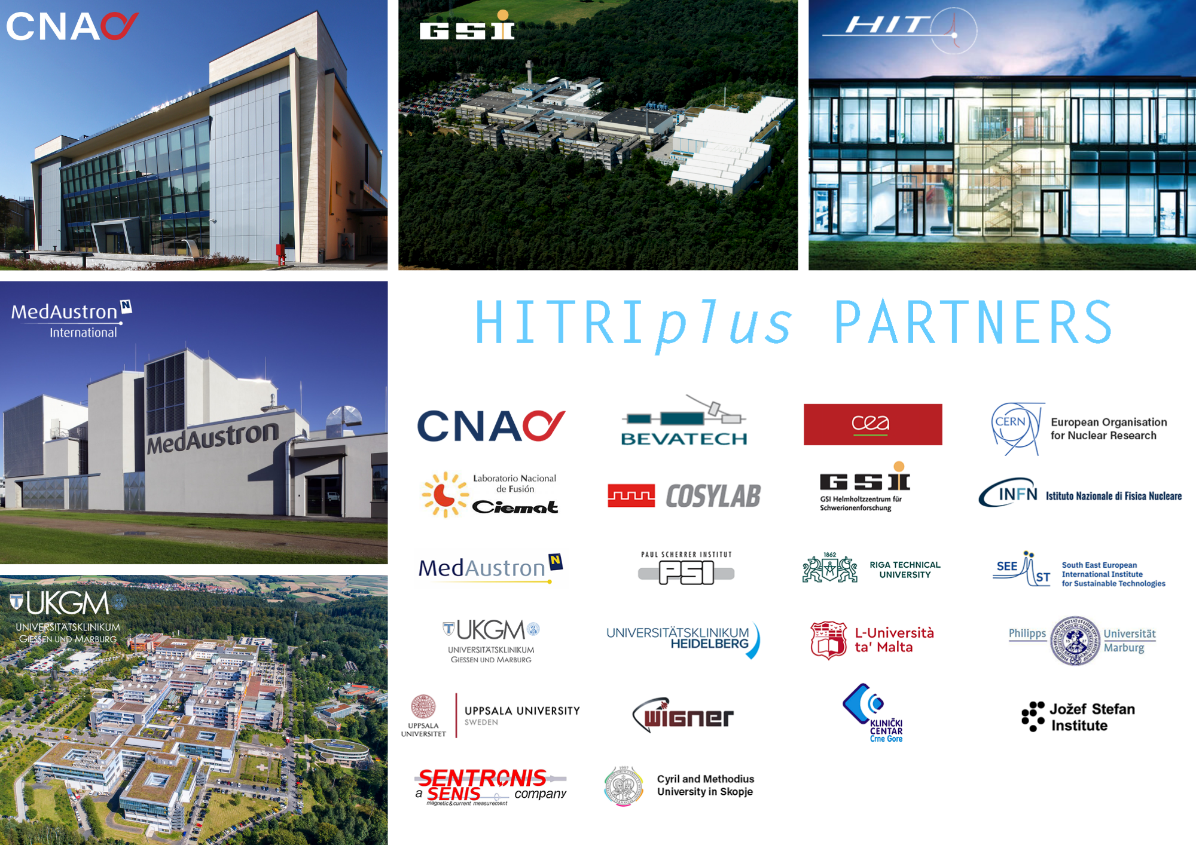
22 Institutes - 14 EU Countries
(4 CIRT centres, 10 research institutions, 5 universities, 3 SMEs)
4 years Project: 1st April 2021 – 31st March 2025

Slide 3
HITRIplus Objectives
1. To integrate, open up and broaden the leading European Research Infrastructure for the treatment of cancer with beams of ions, ranging from helium to carbon and to heavier ions.
2. To coordinate and strengthen the research programmes on heavy ion therapy of different European institutions, by promoting synergies, collaborations, innovation, knowledge transfer, new initiatives and sharing of tools and data.
3. To develop in a joint and coordinated way novel technologies to improve the accelerators and their ancillary systems that provide particle beams to this scientific community. These technologies will improve the present generation of facilities and will be the foundation for a next generation European design for ion therapy facilities.
4. To establish a European multidisciplinary community for heavy ion therapy research, aiming at improving treatment strategies and modalities by connecting physics and engineering with medicine, biology and biophysics, and to extend this community towards emerging European regions, addressing in particular new initiatives in South East Europe.
5. To define the main technical features and the scientific programme of a future pan-European Research Infrastructure for medical and radiobiological research with heavy ion beams, to be built in South East Europe or in another European region.

Slide 4
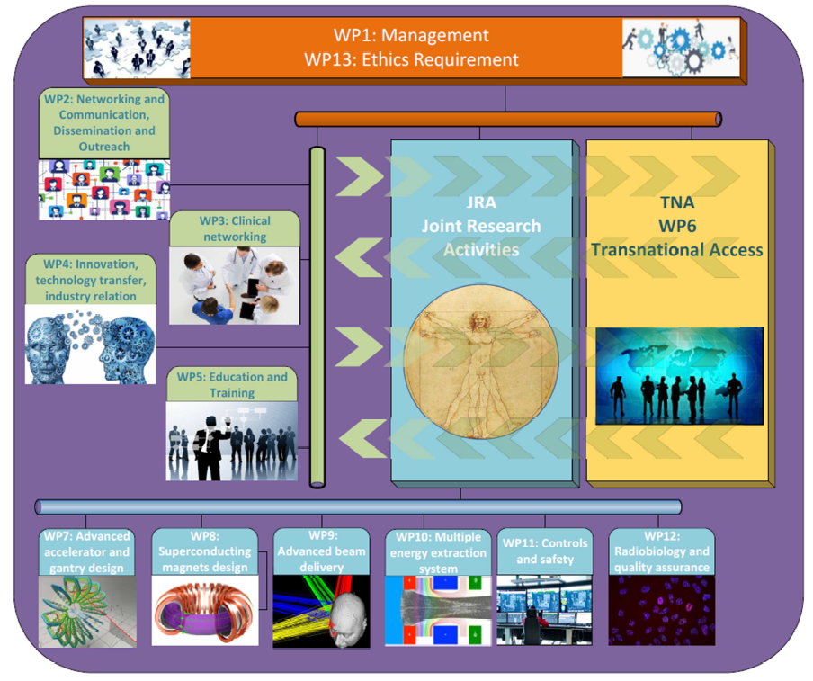
Notes:
Maximum

Slide 5
General Assembly
SEEIIST (Chair)
1 representative per Party
PROJECT MANAGEMENT
(WP1+WP13)
External Scientific Advisory Board
Advisory Board for ethical/legal/industrial issues
Coordinator
Sandro Rossi (CNAO)
Deputy Coordinator
Maurizio Vretenar (CERN)
Central Project Office
Technical Project Board (coordinator + pillar coordinators)
NA: M. Dosanjh (SEEIIST) – TNA: M. Durante (GSI) – JRA: M. Vretenar (CERN)
E. De Matteis
M. Cecovski

Slide 6
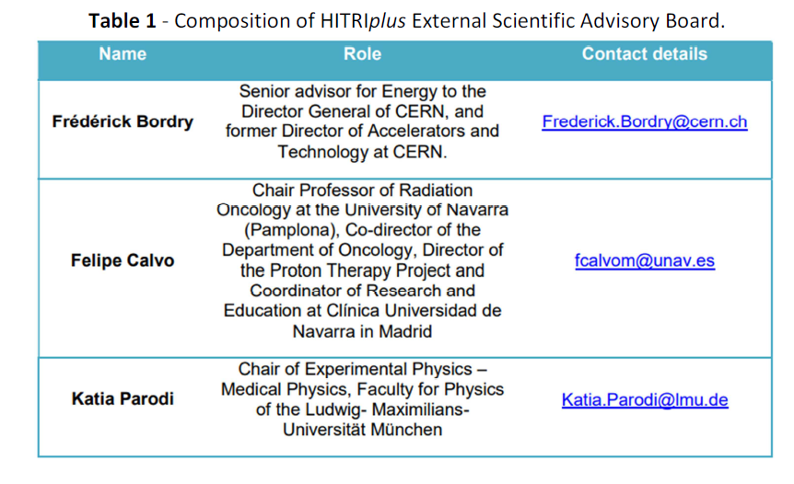
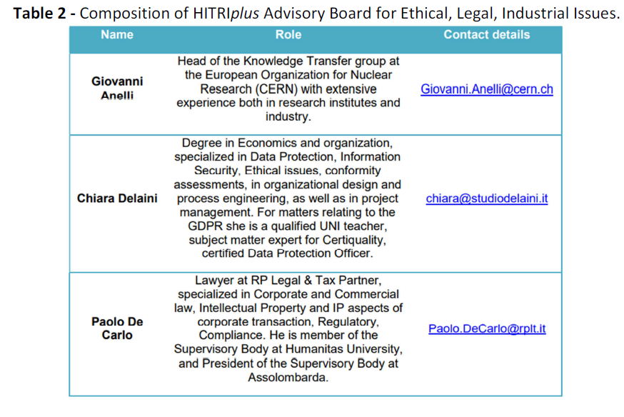
GA, ESAB, ABELII

Slide 7
Meetings so far …
WorkPackage Leaders Meeting:
June 16, 2021
Technical Project Board meeting:
April 9, 2021
June 30, 2021
July 29, 2021
September 29, 2021
October 27, 2021
November 25, 2021
January 18, 2022
February 10, 2022
March 22, 2022
April 27, 2022
June 23, 2022
July 28, 2022
October 25, 2022
November 22, 2022
GA meetings:
(19 March 2021)
June 21, 2021
December 7, 2021
May 18, 2022
Project meetings:
April 13, 2021 (Kick off meeting)
December 7, 2021
May 17-18, 2022 (CNAO, Pavia)
ABELII Meetings:
November 16, 2021
May 18, 2022
TNA and ESAB meeting:
- April 28, 2022
WP4, TPB and ABELII meeting:
- April 13, 2022
ESAB, TPB, Sigrum Meeting on Gantry:
- Sept 28, 2022
https://indico.cern.ch/category/13549/

Slide 8
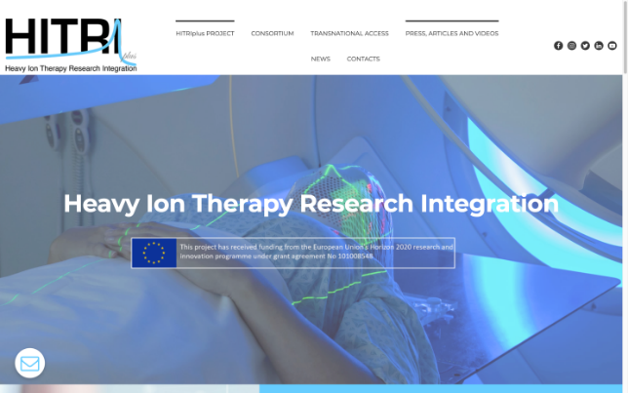
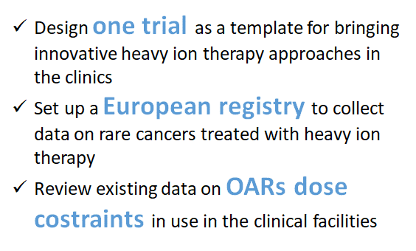
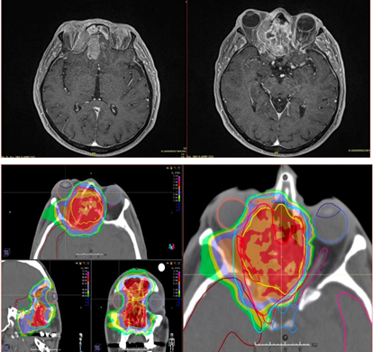
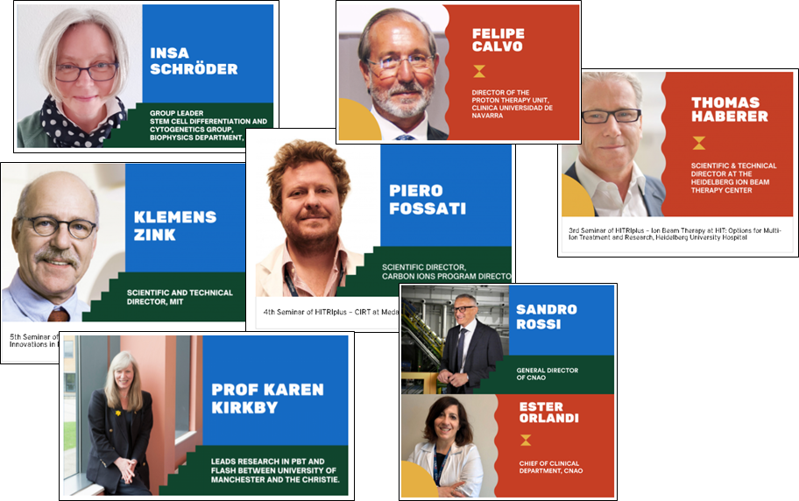
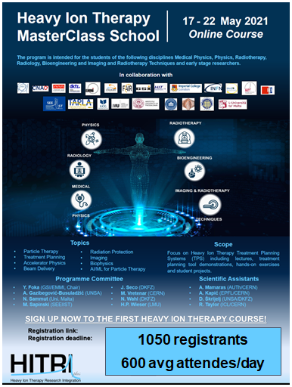

WP2
WP3
HITRIplus
NA
WP5
WP4

Slide 9
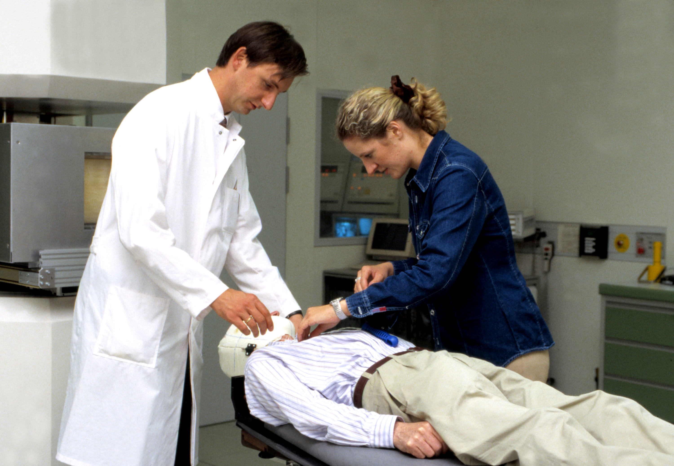
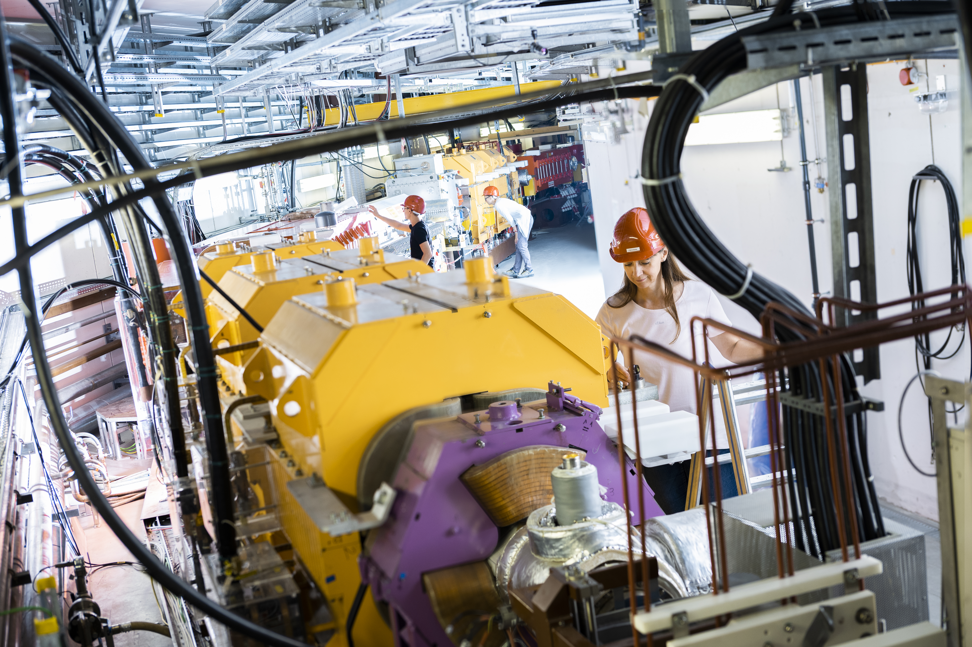
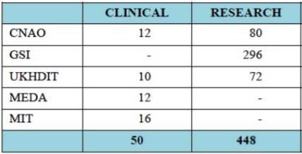
WP6: Transnational Access
The Clinical Access gives the opportunity to clinicians/medical physicists/technicians referring patients to the hadrontherapy facilities to personally follow patient’s treatment and follow up.
The Research Access will attract universities, research centres, and hospitals, which will connect all the groups to perform research activities with carbon ion beams. Industrial partners are also encouraged to take part in the research programme, to be involved in the development of new clinical procedures and new medical devices.
111 hours of research
+
3 applications for clinical

Slide 10
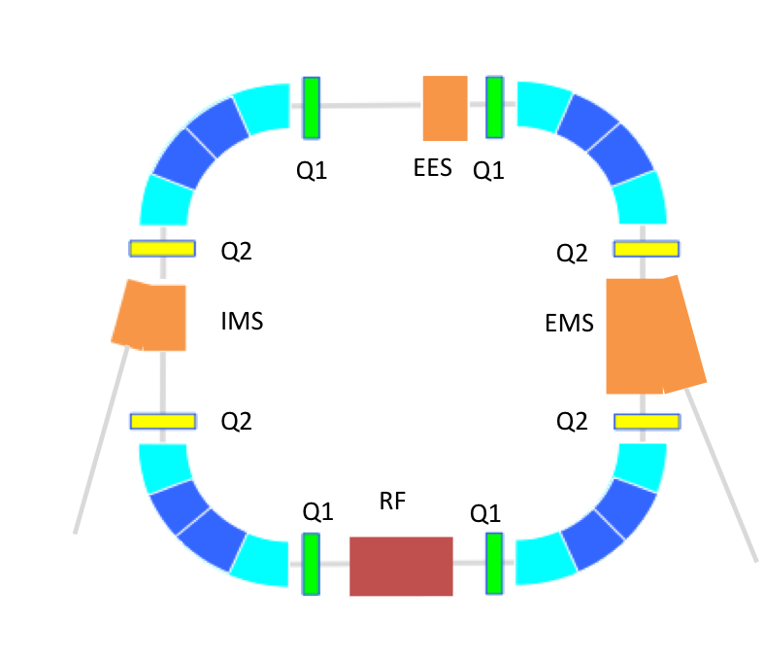
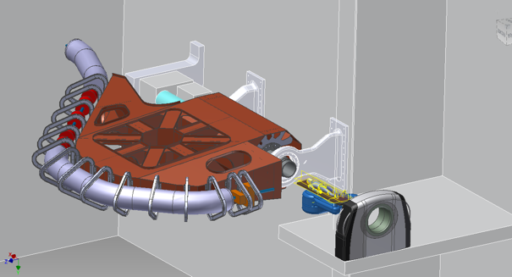
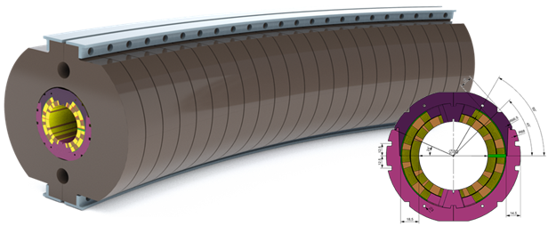
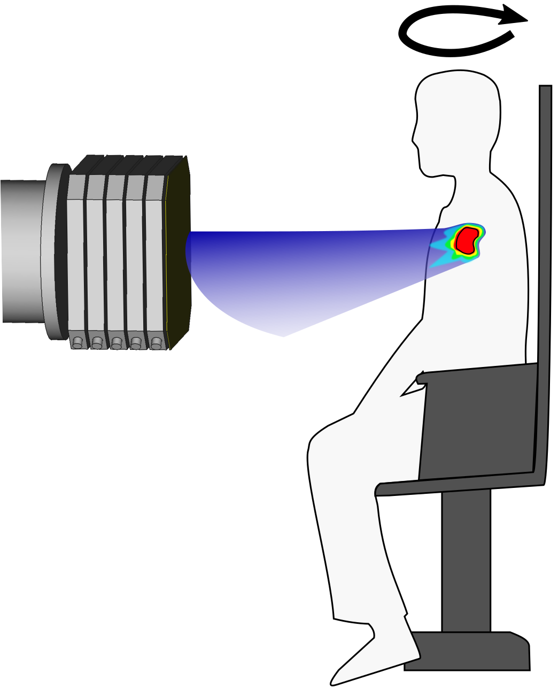
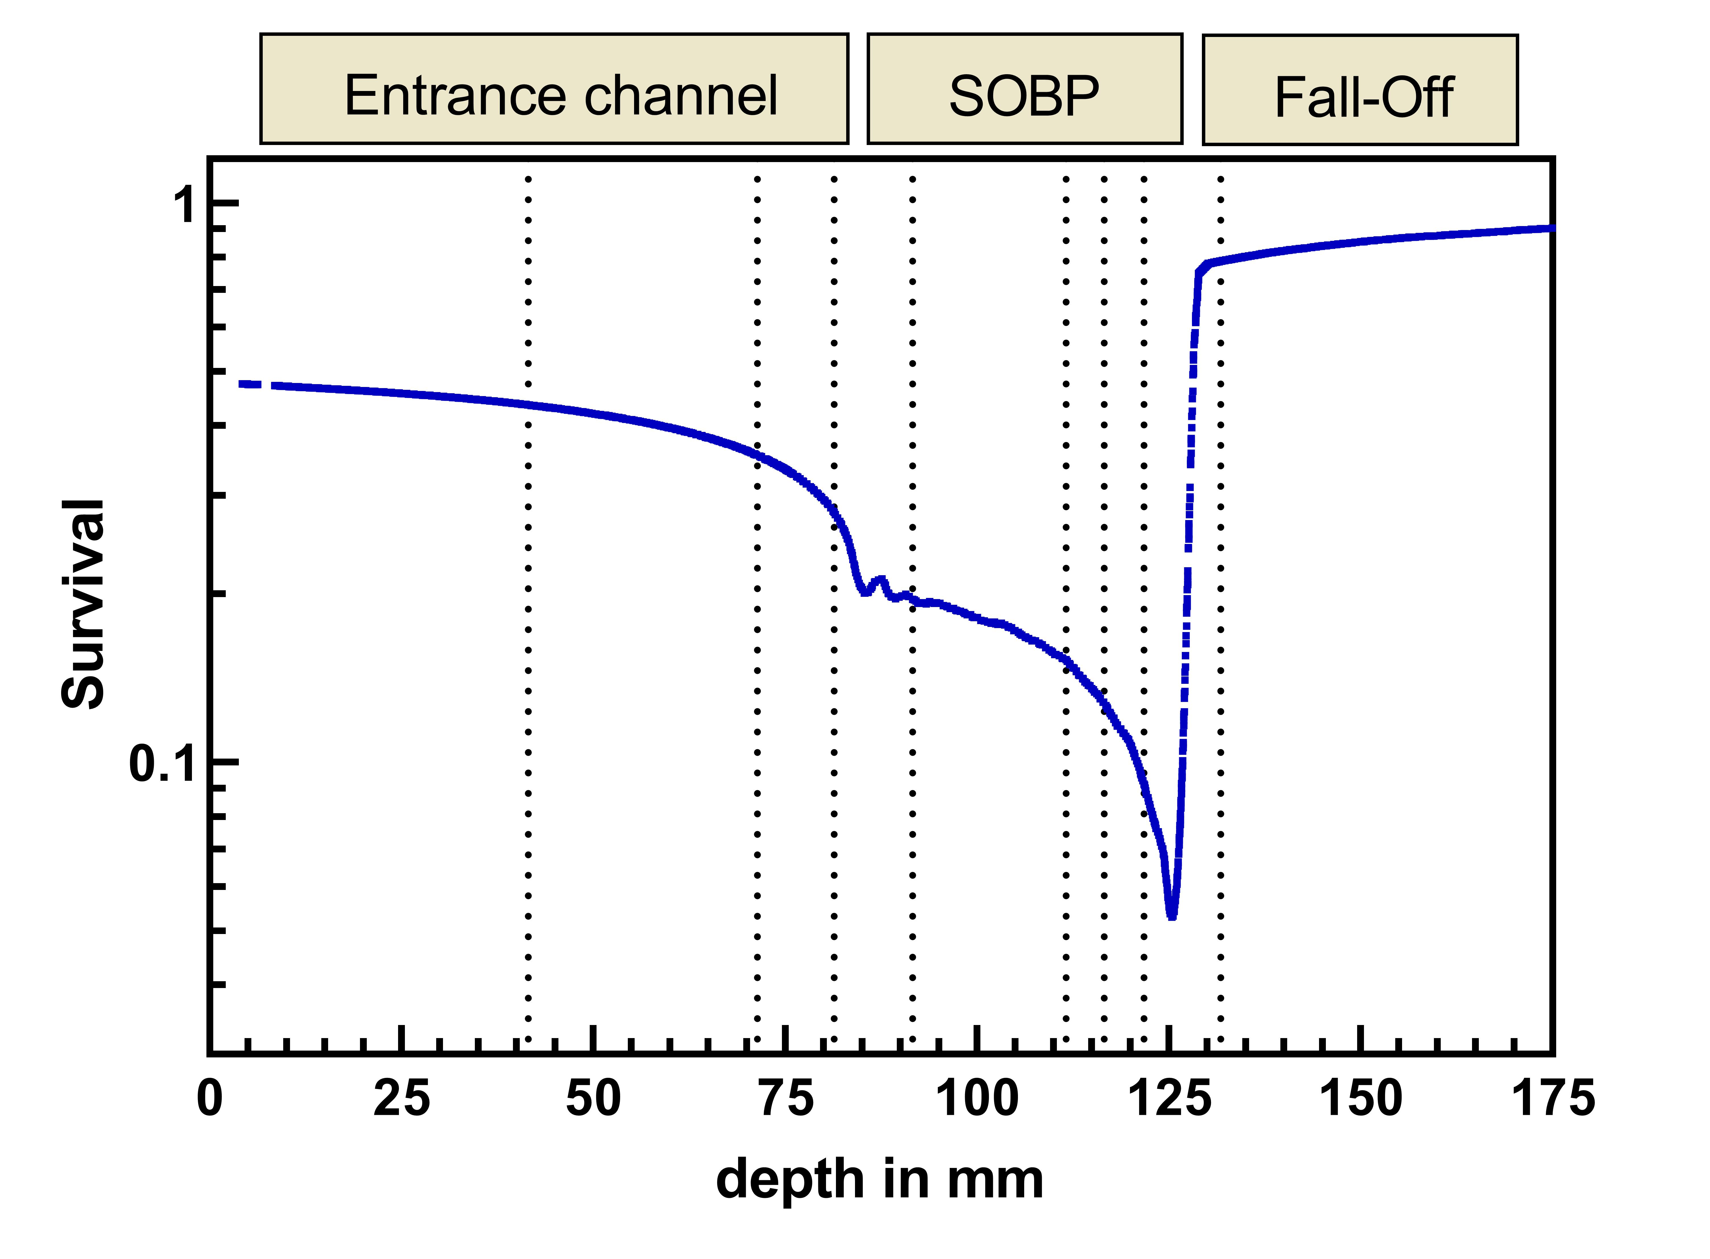
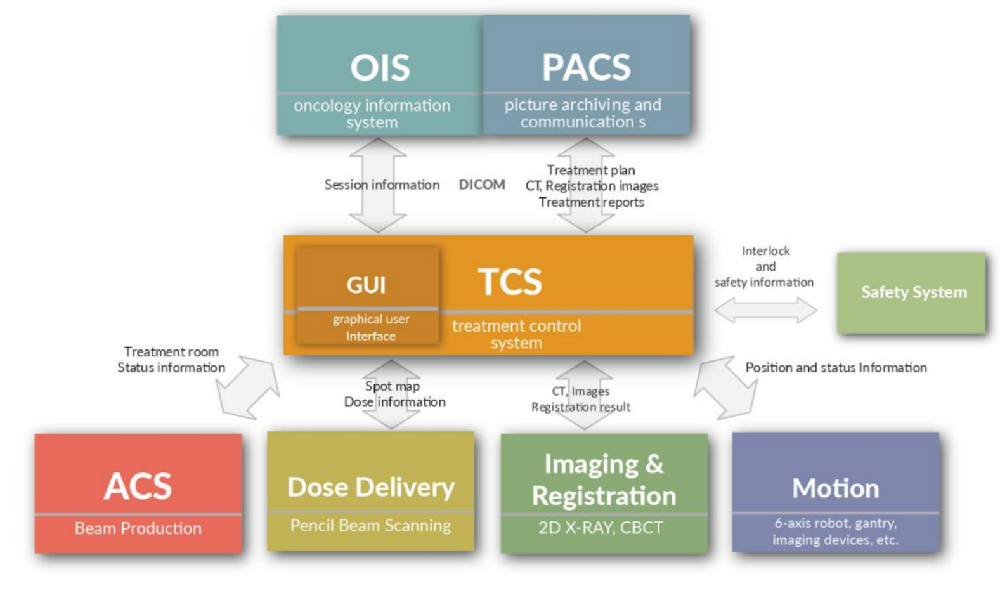
WP8
WP7
HITRIplus
JRA
WP9
WP12
WP11
WP10

Slide 11
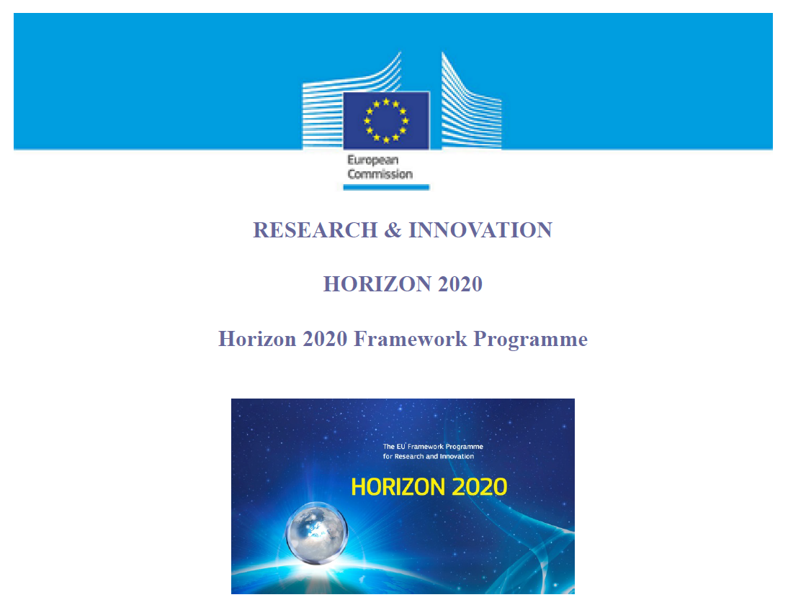
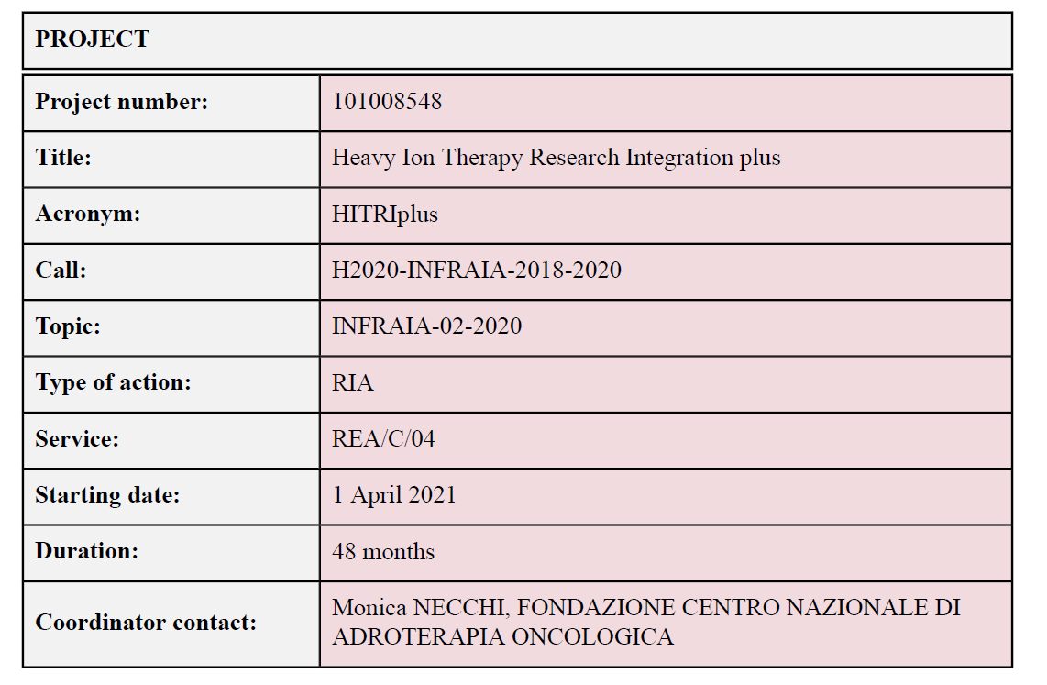
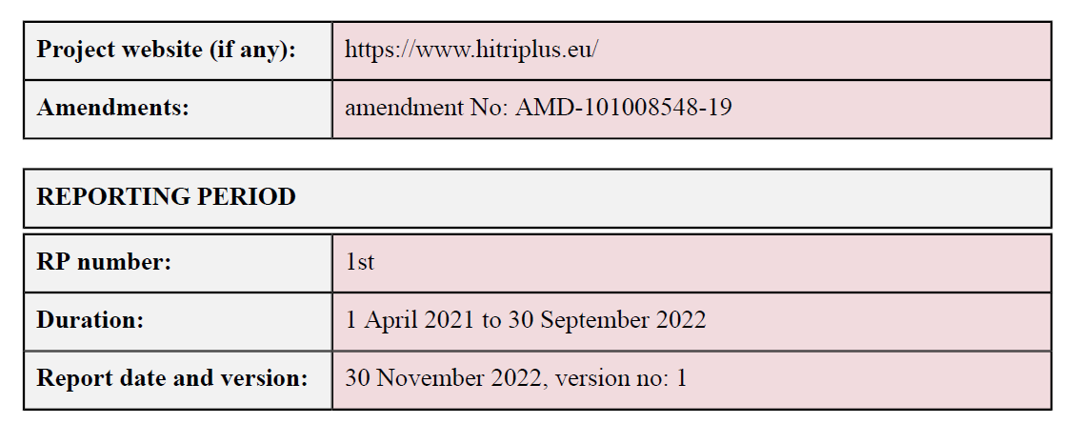

Slide 12

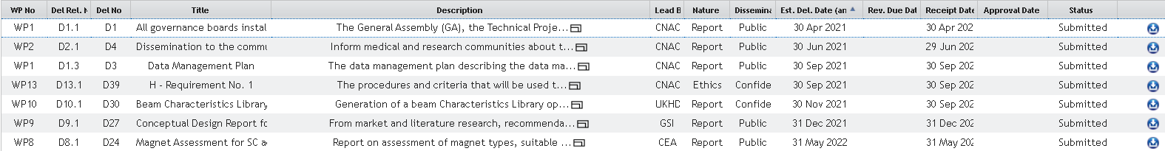
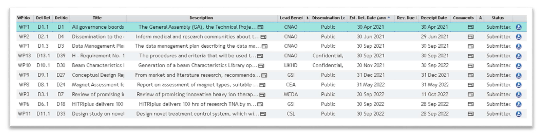
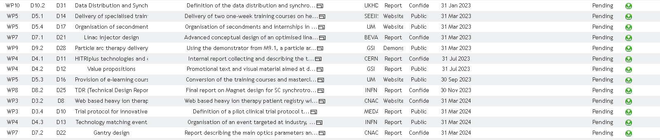
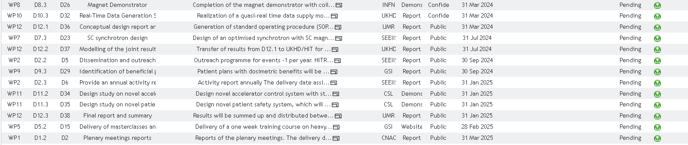
Deliverables
10/10 Deliverables completed

Slide 13
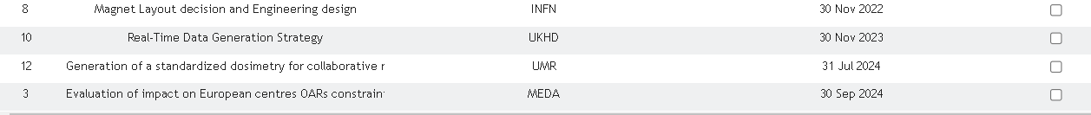
Milestones
10/10 Milestones completed

Slide 14
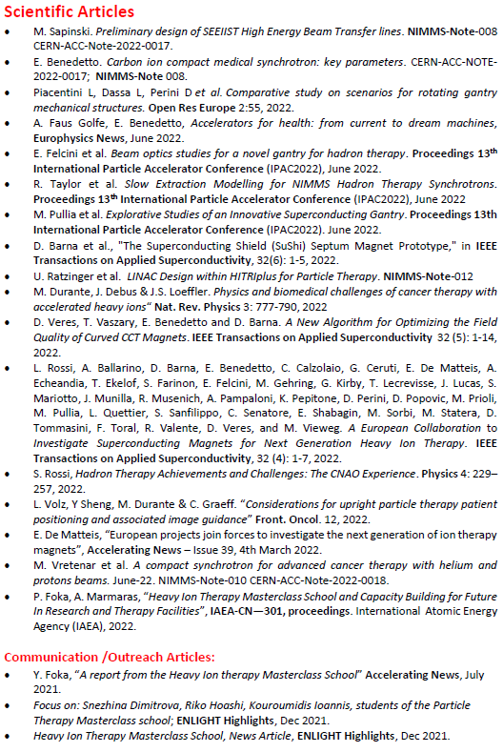
Scientific publications
(20 articles)

Slide 15
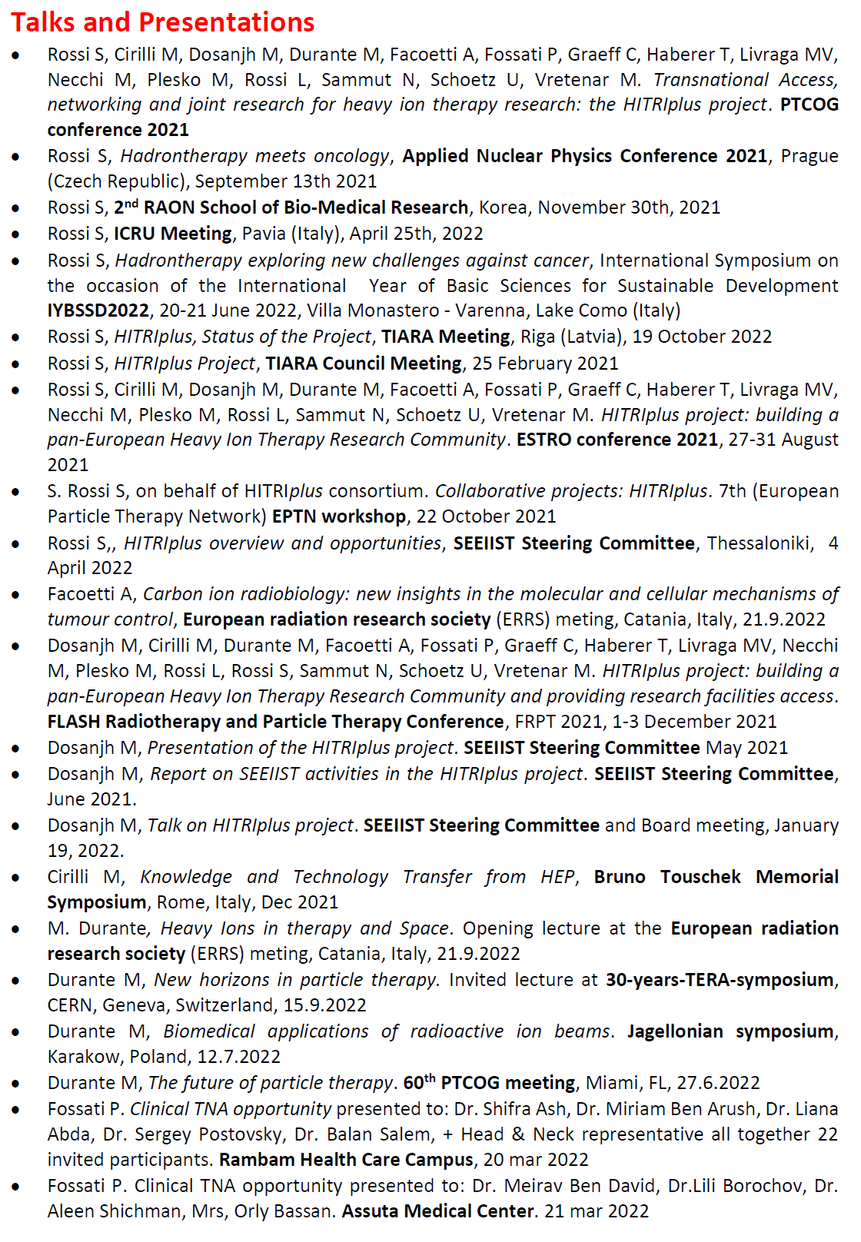
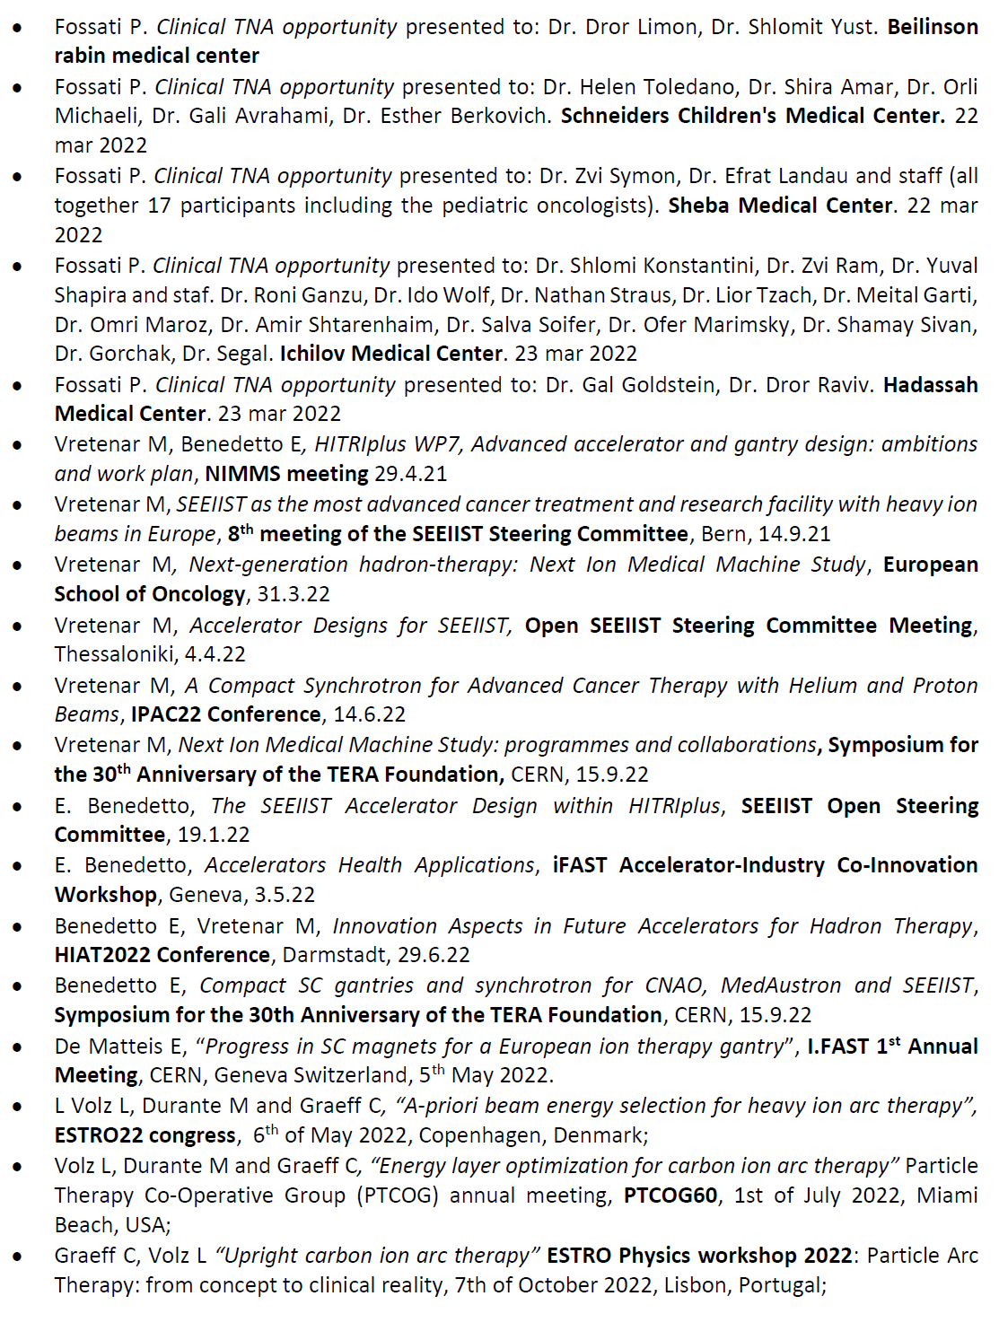
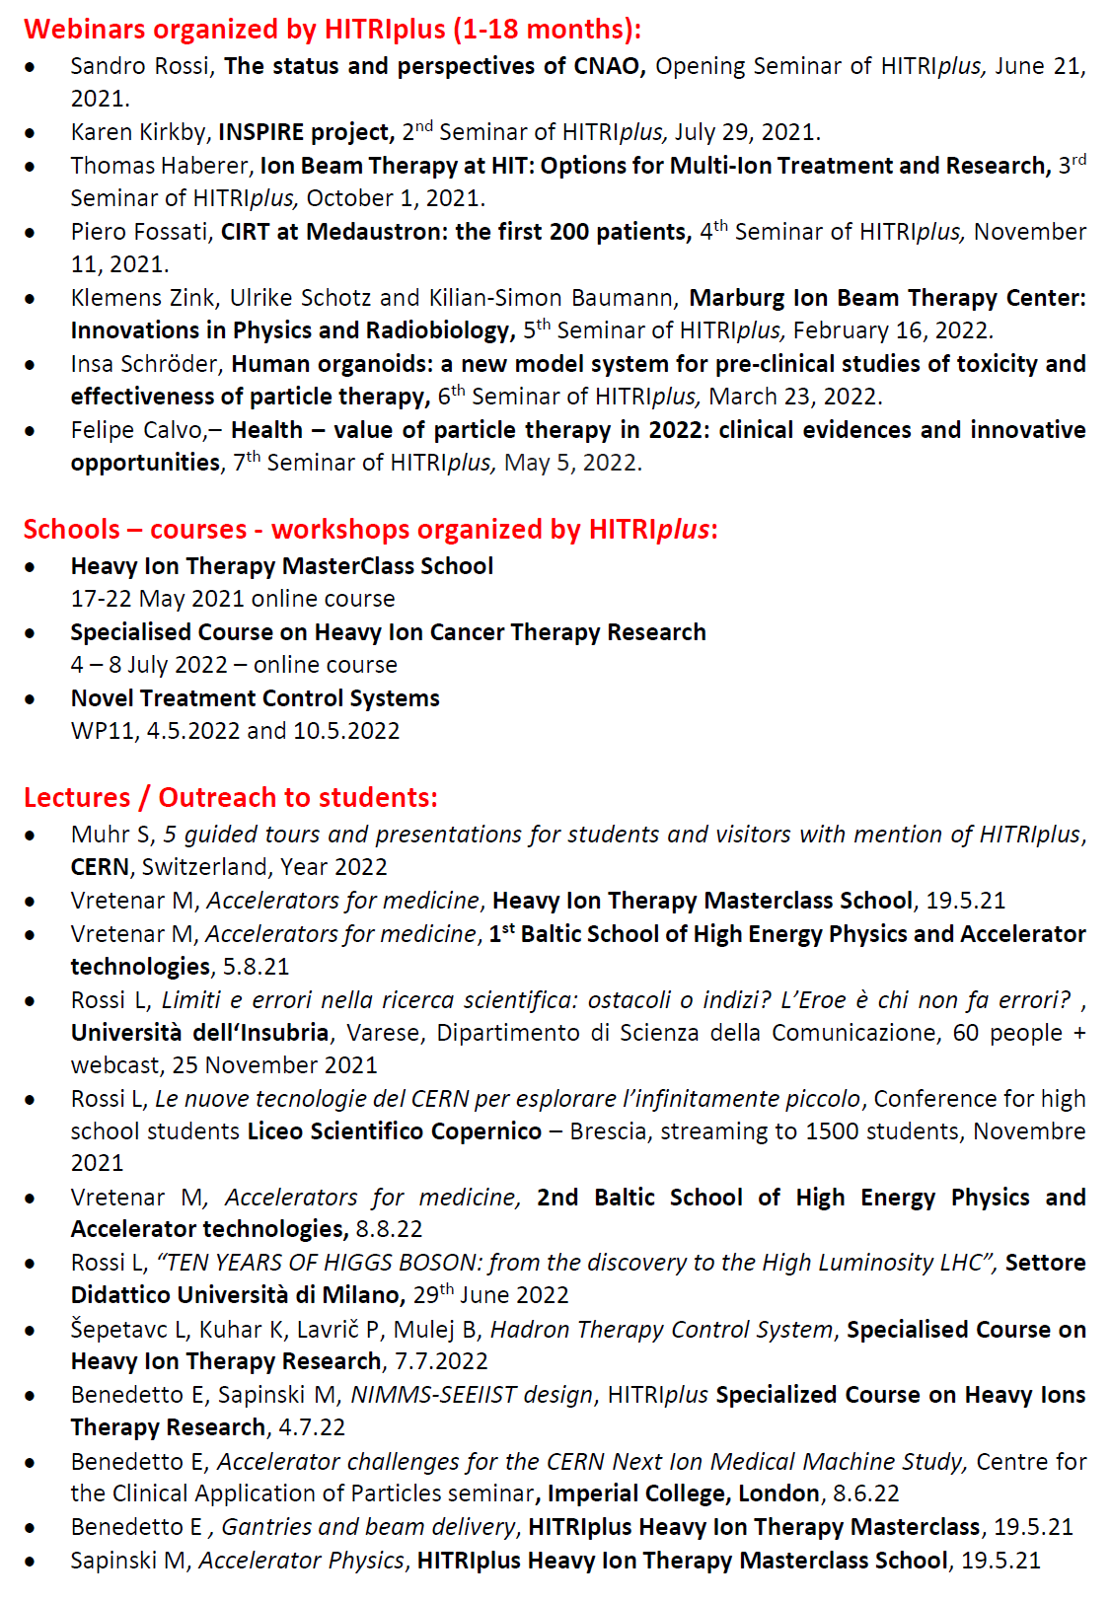
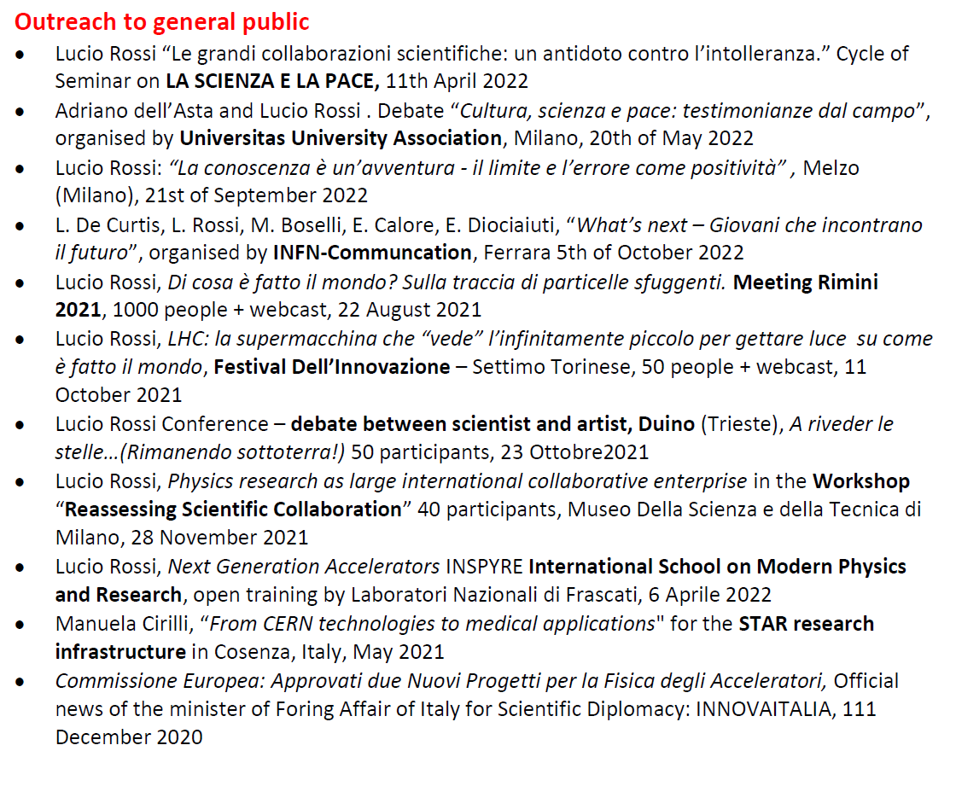
Talks
(41 speeches)
Webinars
(7 events)
Schools
(3 courses)
Lectures
(23 events)

Slide 16
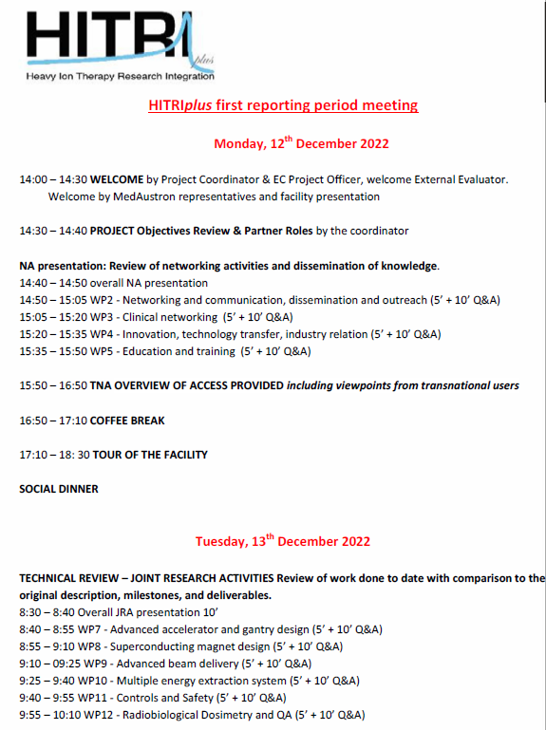
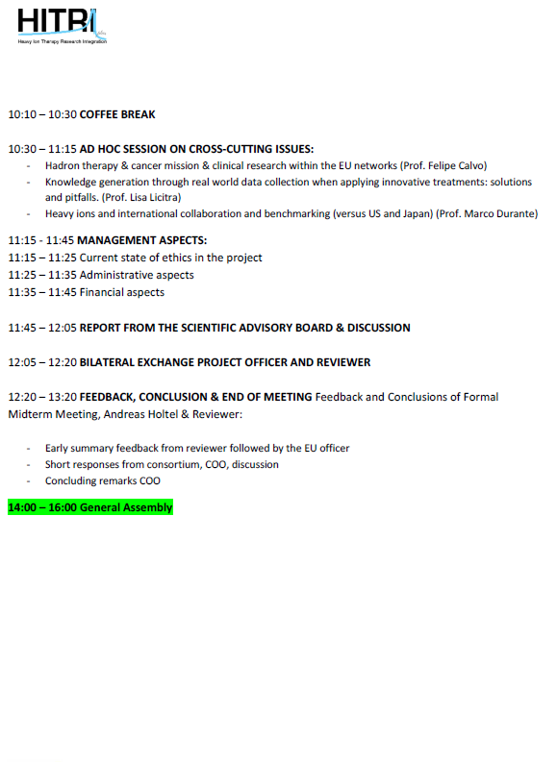
First Review Meeting (18 mo)
12-13 December 2022
MedAustron – Wiener Neustadt

Slide 17

THANK YOU!
https://www.hitriplus.eu/

