Slide 1
WP3 NA
Piero Fossati

Slide 2
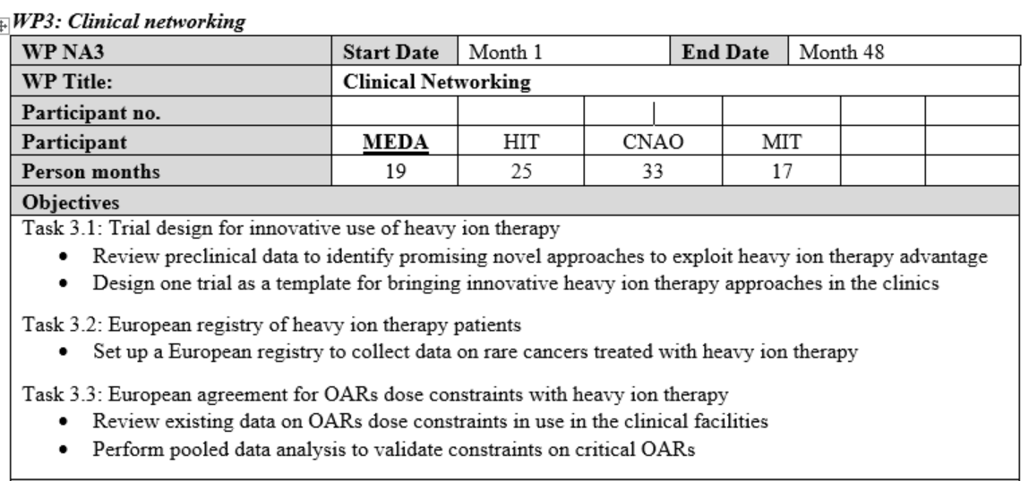

Slide 3
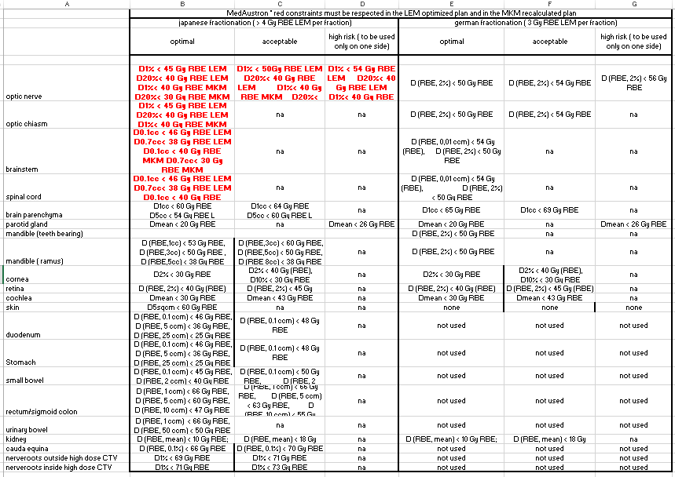
Task 3.3

Slide 4
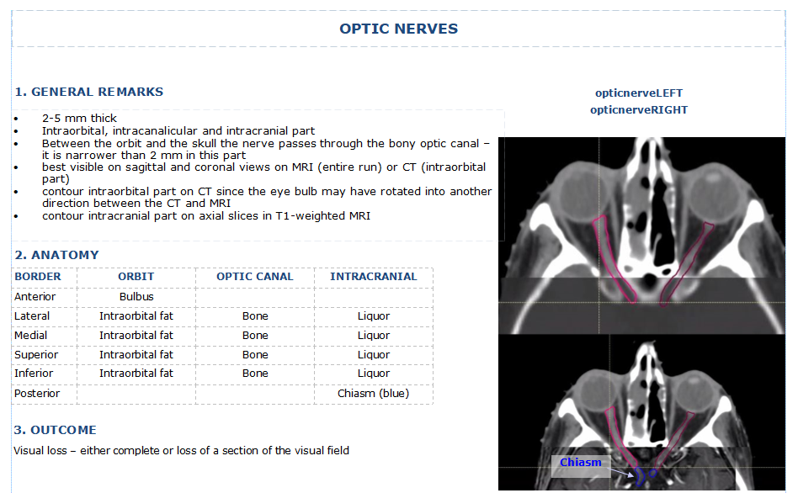

Slide 5
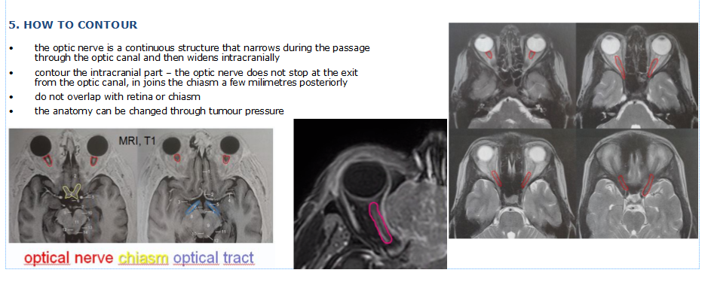

Slide 6
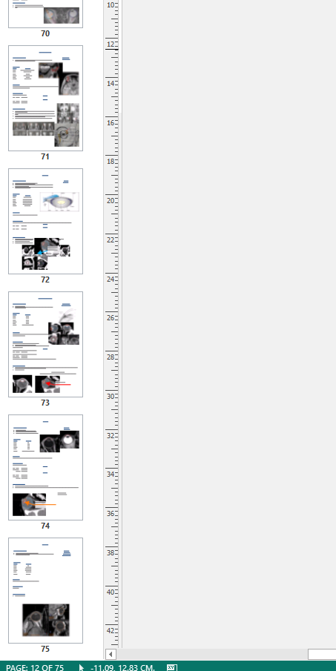
Draft of contouring guidelines for OARs will be circulated among WP participants

Slide 7
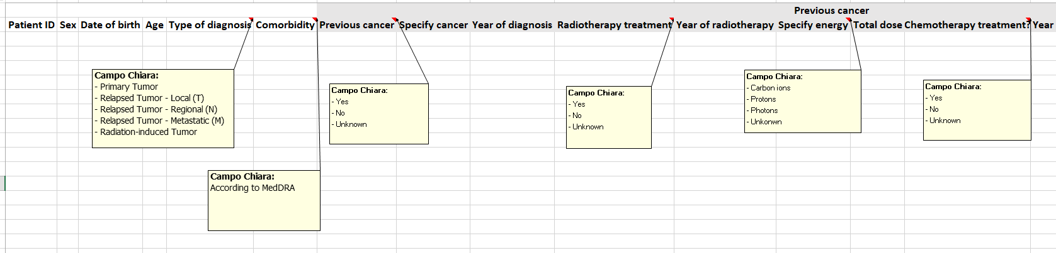
Task 3.2

Slide 8
Task 3.1
1: Hypoxia and reoxygenation
2: Synergistic effect of CIRT and immunotherapy
3: LET based optimization

Slide 9
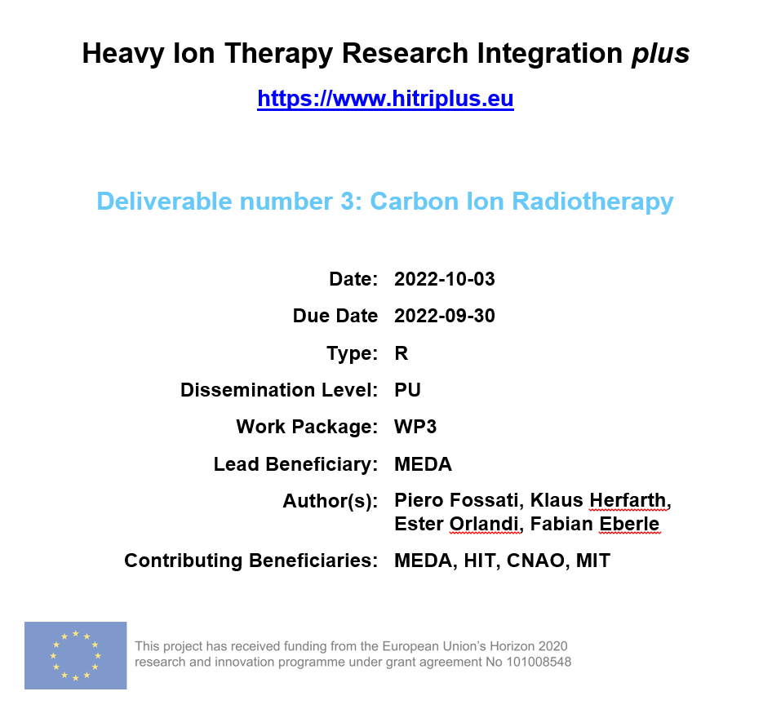

Slide 10
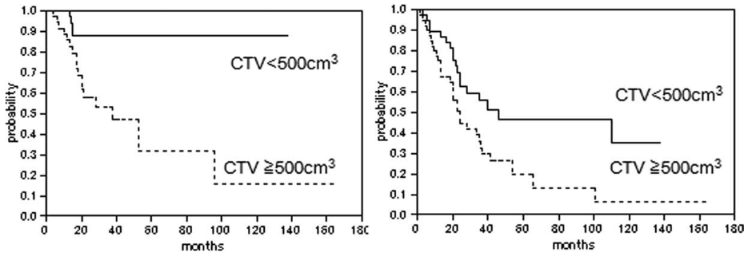

Inferior clinical outcomes in large tumors
A. Matsunobu et al. 2012
Y. Demizu et al. 2017
M. Osama et al. 2018
T. Bostel et al. 2020
Unresectable Osteosarcoma of the trunk treated with CIRT
Clinical target volume (<500 cm³ vs. ≥500 cm³):
Significantly associated with 5-year LC
  88% vs 31%
Significantly associated with 5-year OS:
  46% vs 19%
5-year LC
5-year OS
CIRT: Carbon Ion Radiotherapy; LC: Local Control; OS: Overall Survival

Slide 11
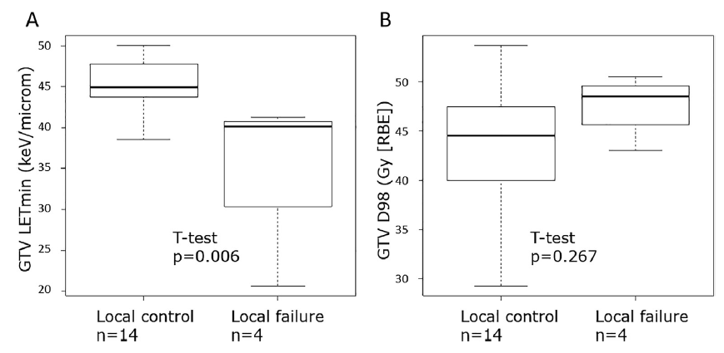
Recent studies
Y. Hagiwara et al. 2020
  Influence of dose-averaged linear energy transfer on tumour control after carbon-ion radiation therapy for pancreatic cancer
S. Matsumoto et al. 2020
  Unresectable chondrosarcomas treated with carbon ion radiotherapy: Relationship between dose-averaged linear energy transfer and local recurrence
S. Molinelli et al. 2021
  How LEM-based RBE and dose-averaged LET affected clinical outcomes of sacral chordoma patients treated with carbon ion radiotherapy
Influence of LET_{d} on tumor control
Significant association of high LET_{d,min}(≥44 keV/µm) in the GTV with better 18-month LC
  100% vs. 34.3%
LET_{d}: Dose averaged Linear Energy Transfer; LET_{d, min}: Minimum dose averaged Linear Energy Transfer; LC: Local Control
Notes:
Tumor type: locally advanced pancreateic cancer To eliminate the influence of cold spots within GTV on dose coverage, they evaluated the GTV D98 and Dmin:
No statistical significant difference in GTV D98 and Dmin between patients with LC and patients with local failure
They found that median values of all LET_{d} parameters within GTV were below 50 keV/um (which is far from the optimum LET of ≥80-100 keV/um)
→ might be one factor contributing to higher local recurrences
A general conclusion:
LC could be improved with the delivery of optimal LET_{d} through CIRT in unresectable LAPC (locally advanced pancreatic cancer)

Slide 12
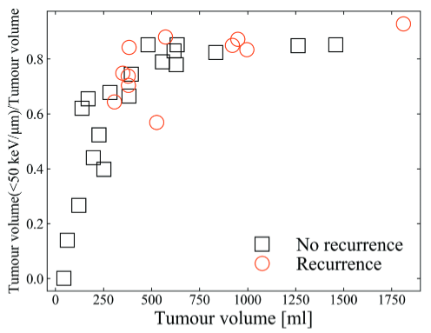
Recent studies
Y. Hagiwara et al. 2020
  Influence of dose-averaged linear energy transfer on tumour control after carbon-ion radiation therapy for pancreatic cancer
S. Matsumoto et al. 2020
  Unresectable chondrosarcomas treated with carbon ion radiotherapy: Relationship between dose-averaged linear energy transfer and local recurrence
S. Molinelli et al. 2021
  How LEM-based RBE and dose-averaged LET affected clinical outcomes of sacral chordoma patients treated with carbon ion radiotherapy
Significant correlation of V_{50 keV/µm} with tumor volume
  V_{50 keV/µm}: The ratio of the volume in the PTV receiving less than 50 keV/µm to the entire volume of the PTV
PTV: Planning Target Volume
Notes:
Tumor type: Unresectable chondrosarcoma /Patient treated at NIRS (QST) from 2000-2012 (No rec: 19; rec: 11) / Chiba, Japan NIRS
Why 50 keV/um:
in a previous study (Furusawa, Tinganelli) it was shown that for carbons, the OER begins to decline from 50 keV/um
@50 keV/um: OER is 2
@100 keV/um: OER is 1
Plot outcome:
No recurrence: ranged from 0.0-0.85
Recurrence: ranged from 0.56-0.92
→ No recurrence was observed in cases where V50 was less than 0.56
A general conclusion of the study was:
The LET_{d} within the PTV may be associated with LC in chondrosarcomas

Slide 13
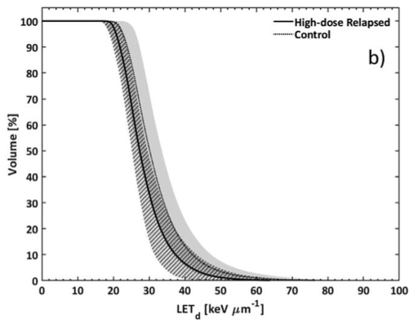
Recent studies
Y. Hagiwara et al. 2020
  Influence of dose-averaged linear energy transfer on tumour control after carbon-ion radiation therapy for pancreatic cancer
S. Matsumoto et al. 2020
  Unresectable chondrosarcomas treated with carbon ion radiotherapy: Relationship between dose-averaged linear energy transfer and local recurrence
S. Molinelli et al. 2021
  How LEM-based RBE and dose-averaged LET affected clinical outcomes of sacral chordoma patients treated with carbon ion radiotherapy
All LET_{d} evaluators obtained from the CTV_{HD} (boost) were higher than the CTV_{LD}
LET_{d|50%} of the CTV_{HD} was significantly higher for the control group
LET_{d}: dose averaged Linear Energy Transfer; LET_{d|50%}: Median LET_{d}; CTV_{HD}: Clinical Target Volume high dose; CTV_{LD}: Clinical Target Volume low dose
Notes:
Tumor type: sacral chordoma / CNAO / 26 local failure (progressive disease); 13 High dose relapsed (and not due to underdosage to protect OAR); 24 Control /FRoG
Other Outcomes:
A common aspect of the LET_{d} distribution: lower values of all evaluators obtained from the 9 Fxs with respect to the boost
Volume of CTV_{LD}>CTV_{HD} → dose is mostly delivered by the plateau of high energy beams
The median LET_{d} of the CTV_{HD} was significantly higher for the control group
Figure:
The figure reports the average CTV_{HD} LET_{d} volume histograms of the two studied patient
Solid line: high-dose relapsed group
Dotted line: control cases
Shadowed areas: ±1 standard deviation
Figure outcome:
Enhanced LVH of the Control group
Tumor volume is covered with a higher LET_{d}
Their conclusion:
A combined multi model RBE- and LET-based optimization could plaz a kez role in the enhancement of the therapeutic ratio of CIRT

Slide 14
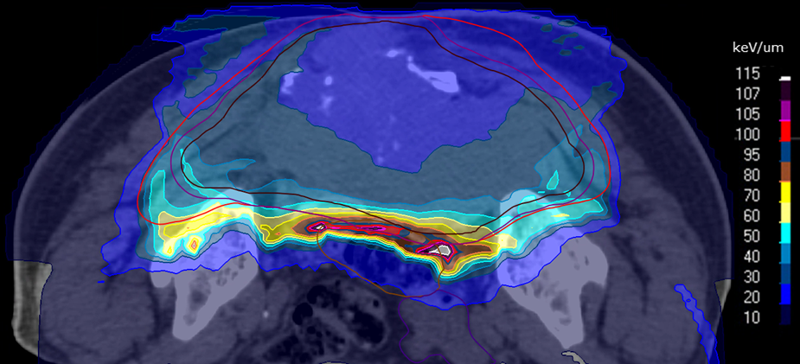
LET_{d}/High-LET-dose in large targets
LET_{d}
Sacral chordoma
  PTV1: 1954.5 cm³
  PTV2: 1305.7 cm³
Sequential dose prescription
  RBE-weighted dose per fraction:
    PTV1: 9 fx; 4.6 Gy (RBE)/fx
    PTV2: 7 fx; 4.6 Gy (RBE)/fx
Beam arrangement:
  T-shape (2 horizontal + 1 vertical)
PTV: Planning Target Volume; RBE: Relative Biological Effectiveness; fx: Fraction
Notes:
Additional Info:
PTV1:
Near min LET_{d}: 25.0 keV/um
Median LET_{d}: 32.5 keV/um
Near max LET_{d}: 67.3 keV/um

Slide 15
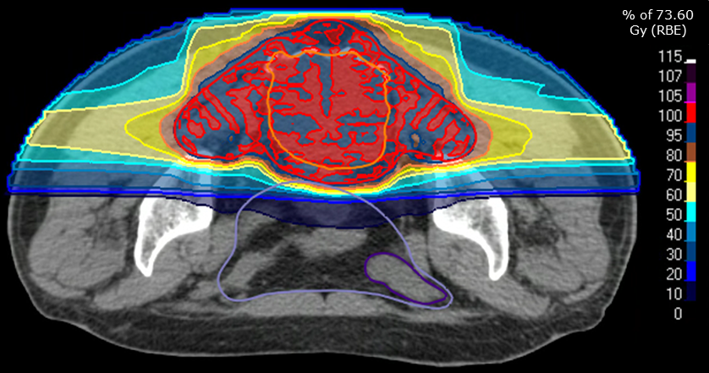
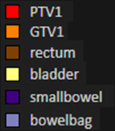
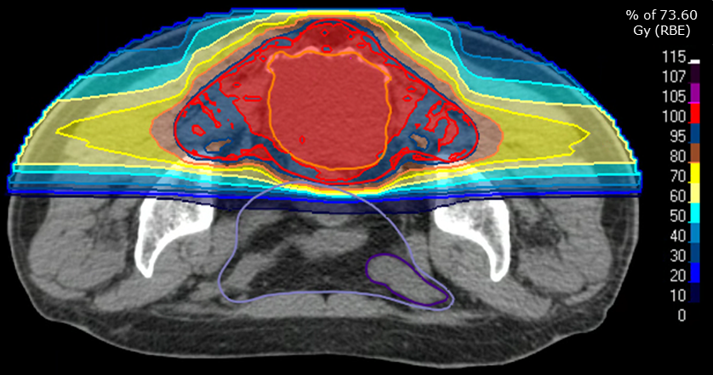
LET-based optimization
Sacral chordoma
  PTV1: 1244.3 cm³
  PTV2: 656.7 cm³
Sequential dose prescription
  RBE-weighted dose per fraction:
    PTV1: 9 fx; 4.6 Gy (RBE)/fx
    PTV2: 7 fx; 4.6 Gy (RBE)/fx
Beam arrangement:
  T-shape (2 horizontal + 1 vertical)
Comparing the:
  RBE-weighted dose distribution
  LET_{d} distribution
  DVHs & LVHs
Original plan
Optimized plan
PTV: Planning Target Volume; GTV: Gross Tumor Volume; RBE: Relative Biological Effectiveness; fx: Fraction; DVH: Dose Volume Histogram; LVH: LET_{d} Volume Histogram
Notes:
Figure: RBE-weighted dose distribution
Normalized to the prescribed dose
Prescription type: Median dose (D50%)
Price to be paid in order to achieve a better high-Let-dose distribution:
Higher dose at the entrance
Less uniformity in terms of RBE-weighted dose in the target
(especially in the GTV, for which we used the optimization objective)
Additional info:
Objective: Min Dirty Dose; GTV1; 15 Gy (PHY) at LETd 40 keV/um

Slide 16
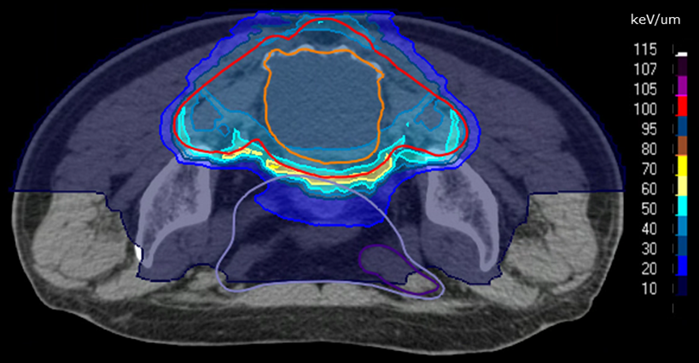
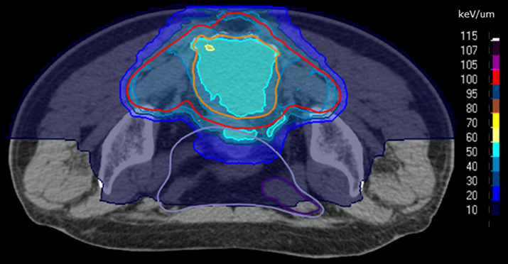
LET-based optimization
Sacral chordoma
  PTV1: 1244.3 cm³
  PTV2: 656.7 cm³
Sequential dose prescription
  RBE-weighted dose per fraction:
    PTV1: 9 fx; 4.6 Gy (RBE)/fx
    PTV2: 7 fx; 4.6 Gy (RBE)/fx
Beam arrangement:
  T-shape (2 horizontal + 1 vertical)
Comparing the:
  RBE-weighted dose distribution
  LET_{d} distribution
  DVHs & LVHs
Original plan
Optimized plan
PTV: Planning Target Volume; GTV: Gross Tumor Volume; RBE: Relative Biological Effectiveness; fx: Fraction; DVH: Dose Volume Histogram; LVH: LET_{d} Volume Histogram
Notes:
Figure: LET_{d} distribution
Color table: Absolute values
What can be achieved by LET-based optimization:
Higher LET_{d} in the central region of the target (GTV)
We see that the majority of the GTV is covered with 50 keV/um
Additional info (please see attachment 2):
GTV1:
Near min LET_{d} [keV/um]: 30.1 → 44.1
Median LET_{d} [keV/um]: 33.2 → 54.1
Near max LET_{d} [keV/um]: 43.4 → 59.5
Rectum:
All LET_{d} evaluators were slightly lower compared to the original plan

Slide 17
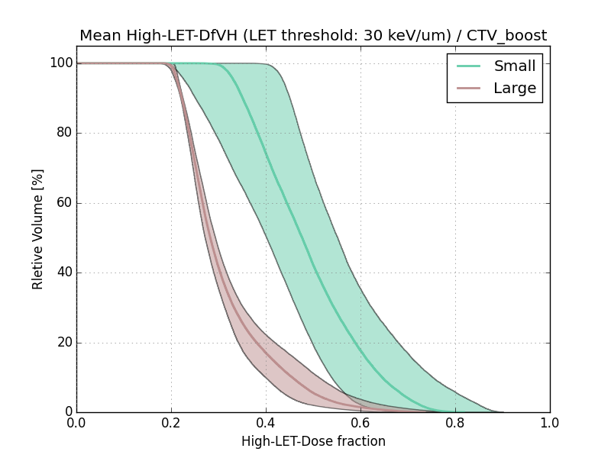
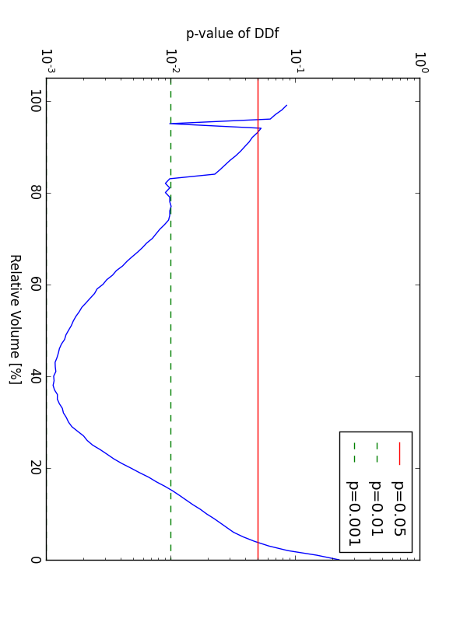
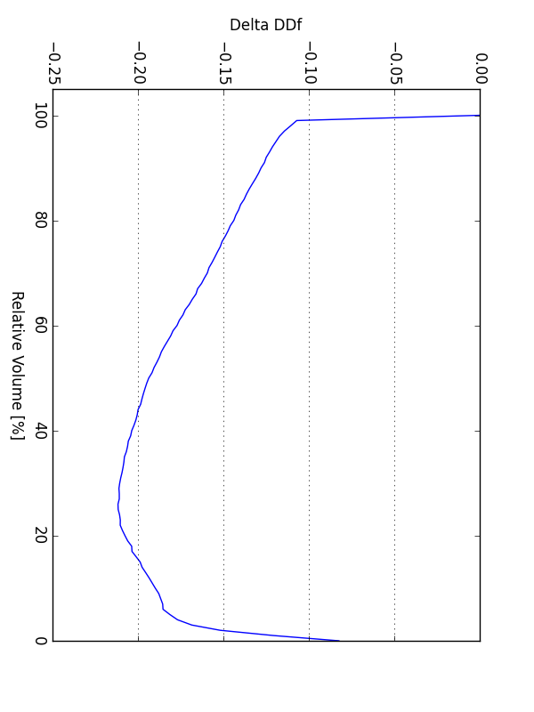
p-value
Delta high-LET-Dose-fraction
Mean DD_{r}VH ± one standard deviation
Notes:
Check at each point if data have normal distribution [Shapiro_wilk]
If YES: comparison via t-test
If NO: comparison via Mann-Whitney U test

Slide 18
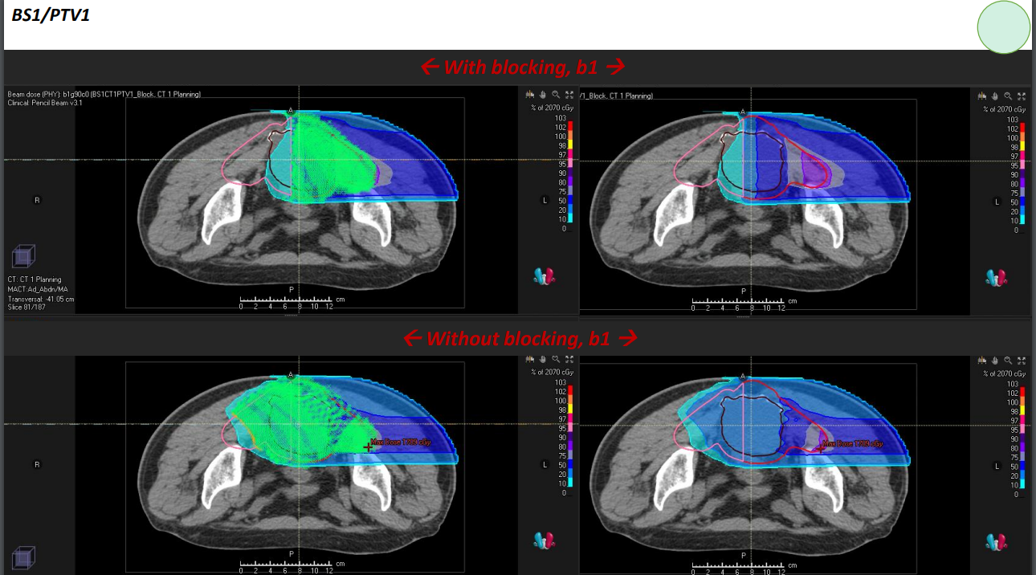

Slide 19
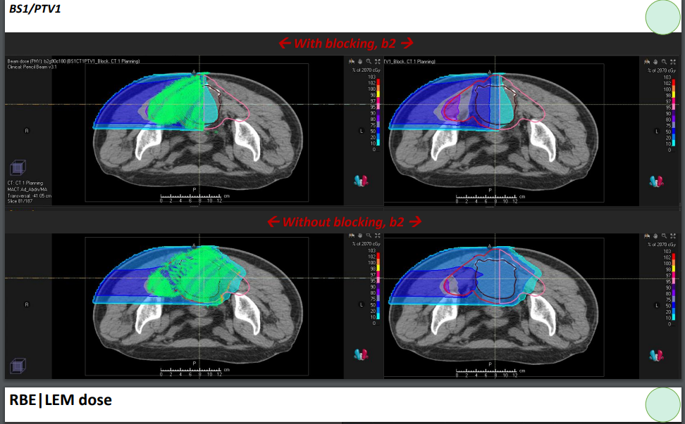

Slide 20
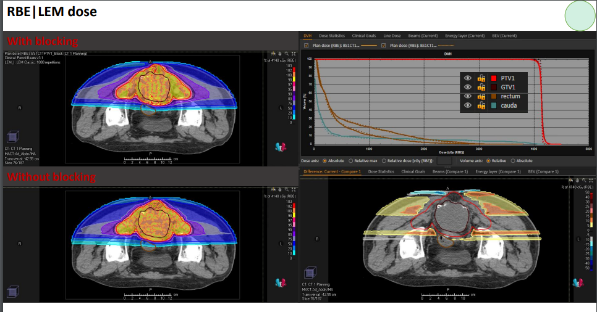

Slide 21
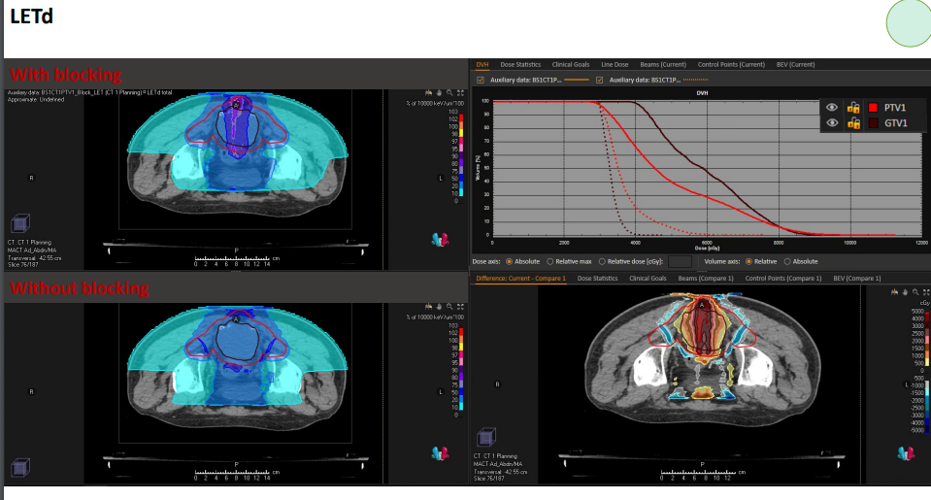

Slide 22
