Slide 1



WP5
Education and Training
12th December 2022
1

Slide 2
Objectives
- Educate and provide hands-on experience to a new generation of researchers
- Allow them to optimally access and exploit the European research infrastructures
- Students, postdocs, technical staff, early stage researchers from multidisciplinary background and not involved in the field, oncology practitioners
- Specialised courses
- Secondments and internships so that they become
facility users and learn best practice
WP5 – Education & Training
2

Slide 3
Tasks & Deliverables
Task | Deliverable | Lead | Due Date | % Completed | Status
5.1 | Delivery of Specialised Training Courses | SEEIIST | M24 | 50% | Late (few months)
5.2 | Delivery of Masterclasses and train-the-trainer masterclasses | GSI | M47 | 95% | Early
5.3 | Provision of e-learning courses | UM | M30 | 66% | On Track
5.4 | Organisation of secondments and internships: calendar of events | UM | M24 | 80% | Late (few days)
M5.1 | Specialised Courses and Masterclass Definition | SEEIIST | M18 | 100% | Submitted
WP5 – Education & Training
3

Slide 4
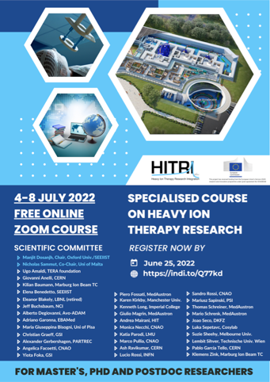
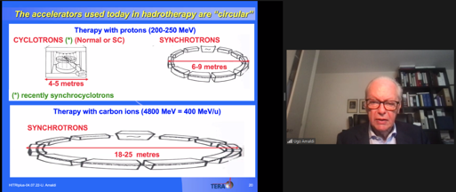
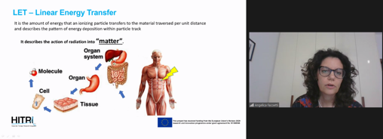
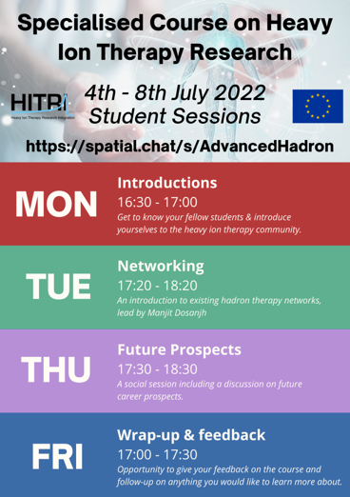
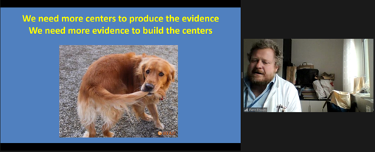
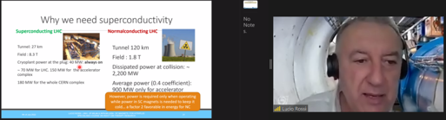
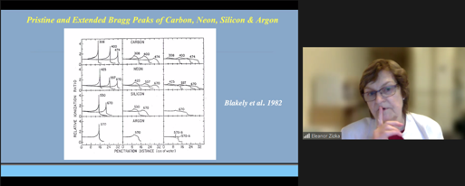
Task 5.1 – Specialised Courses
- Led by SEEIIST
- Two schools of 1 week long - medical physics held on 4th to 8th July 2022
- clinical aspects planned for Q2 2023
WP5 – Education & Training
6

Slide 5
Task 5.1 – Specialised Courses
- 1st course - led by SEEIIST (Manjit Dosanjh)
- held online limited to 60 participants to maximise student interaction
- targeting advanced masters, Ph.D., postdocs and researchers from close fields
- 36 faculty members, 35 hours of material, 600 YouTube channel views during the week
- accelerators, magnet tech, biophysics, clinical aspects, radiobiology, treatment planning, simulations, dosimetry, moving targets, arc delivery, imaging, gantry design, beam dynamics, business development, entrepreneurship, certification
- 44 students obtained attendance certificate
- included train the trainer session
- students from 30 countries + 8 through nationality (44 EU, 11 third countries, 4 Balkan, 1 Ukraine)
WP5 – Education & Training
6

Slide 6
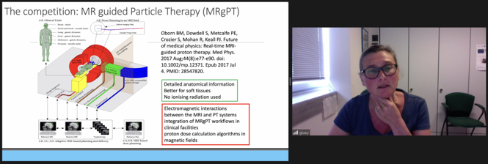
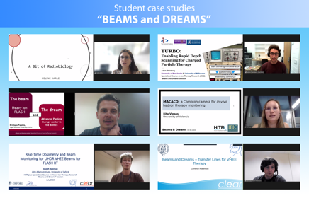
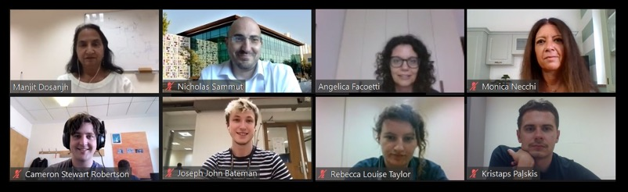
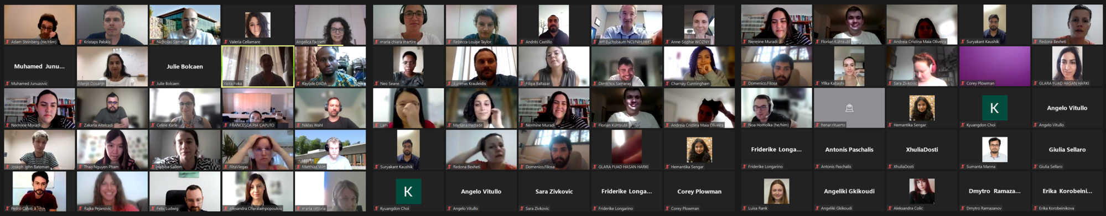
Task 5.1 – Specialised Courses
WP5 – Education & Training
6

Slide 7
Task 5.2 – Masterclass School
- led by GSI – Yiota Foka
- Online 17th - 22nd May 2021
- Report & tracer study underway
- 36 lecturers (15 female)
- undergrads, masters, PhDs postdocs, researchers from close fields
- 1050 registrants
- 992 attended at some point – average of 600 per day (50% from EU, 12% from Balkan region)
- 158 attendance certificates awarded
- 33 hours of engagement time
WP5 – Education & Training
7

Slide 8
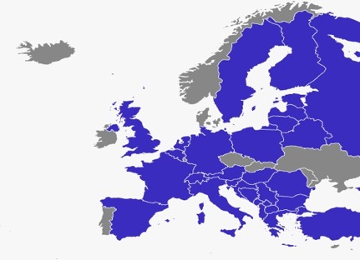
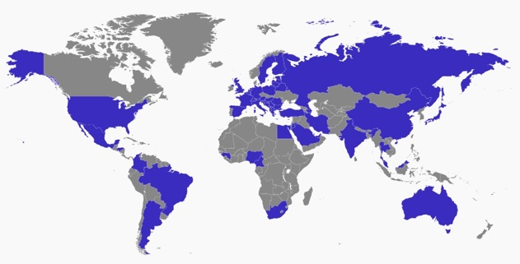
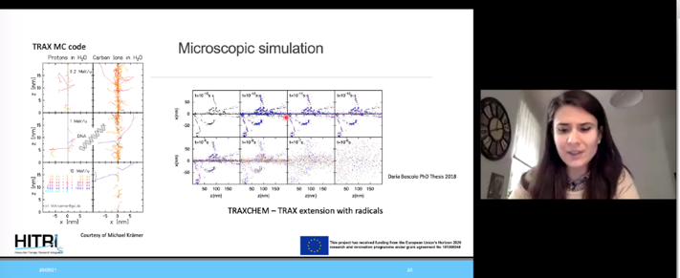
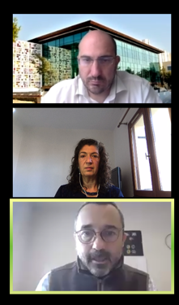
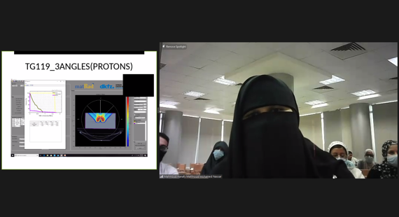
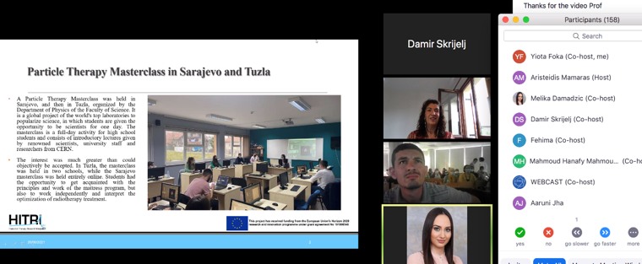
Task 5.2 – Masterclass School
WP5 – Education & Training
7

Slide 9
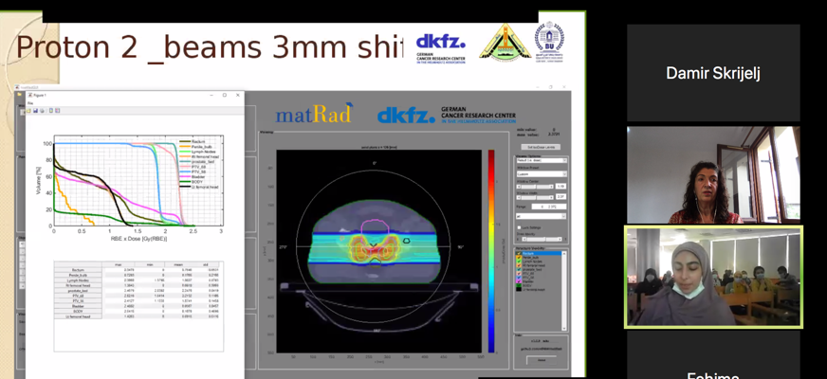
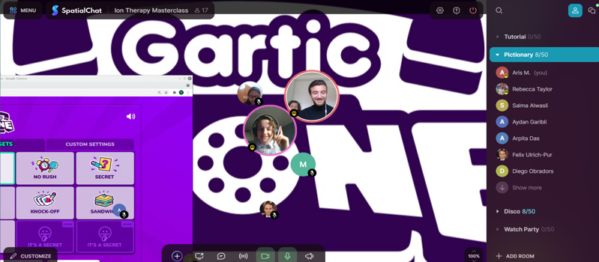
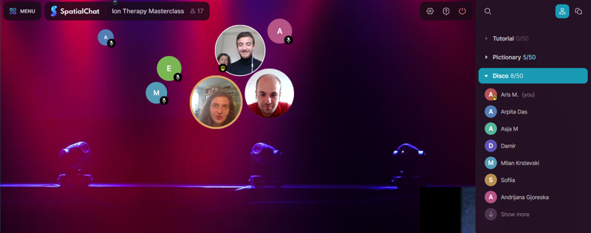
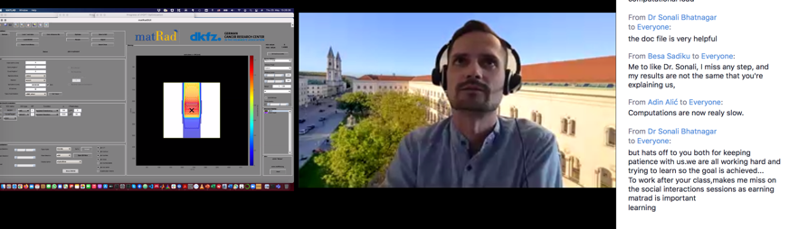
Task 5.2 – Masterclass School
WP5 – Education & Training
7

Slide 10
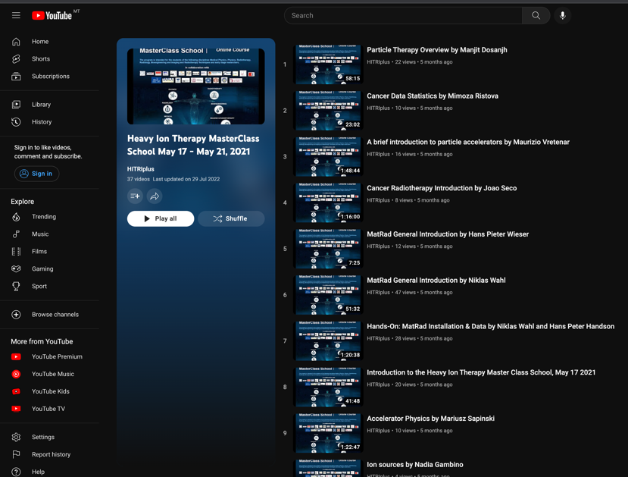
Task 5.3 – e-learning Material
- led by UM
- conversion of task 5.1 and 5.2 into e-learning courses
- Task 5.1 1st specialised school recorded and made available online (1605 views to date)
- Task 5.2 masterclass school recorded and made available online (425 views to date)
- Still to do – editing of all recordings, recording and publishing 2nd specialised school
WP5 – Education & Training
9

Slide 11
Task 5.4 – Secondments & Internships
- UM in collaboration with CNAO
- 8 opportunities available
- €2000/month for internships; €3000/month for secondments
- 56 applications (40 form EU or Balkan states)
- 25 eligible applications
- 2 internships offered ; Microdosimetry, Accelerator Physics
- 3 secondments offered; Radiation Oncology, Medical Physics, Radiotherapy
- 59 weeks in total
- countries represented: Italy/Palestine, Turkey, Albania, Romania
- 1 final secondment left to take place in Q1 2023
WP5 – Education & Training
10

Slide 12
Milestone 5.1 – Courses and Masterclass Definition
- Led by UM
- scoping the content and level of current courses in particle therapy
- identifying content that can be adapted to focus on heavy ion therapy
- singling out gaps related to heavy ion therapy
- drawing up a syllabus based on a number of discussions with experts and specialists in the field
- report was submitted in M18
WP5 – Education & Training
10

Slide 13
Plans for the Future
- Task 5.1 - Specialised Course in Clinical Aspects of Heavy Ion Therapy Research
- Reporting
- Task 5.2 - Reporting
- Task 5.3 - Recording Specialised Course
- Editing and Polishing all Videos
- Reporting
- Task 5.4 - Last Secondment
- Reporting
WP5 – Education & Training
10

Slide 14
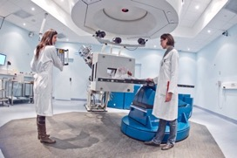
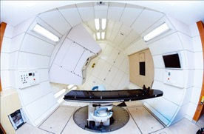
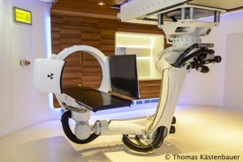
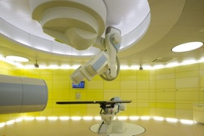
WP5 – Education & Training
12

