Slide 1
WP6: Transnational Access
Prof. Marco durante, Ph.d.
Dr. konrad lehmann, ph.d.
GSI helmholtzzentrum für schwerionenforschung

Slide 2
Main objectives and goals
WP6 is dedicated to providing Trans-National Access (TNA / TA) to research rooms in Heavy Ion centres in Europe. Main objectives are:
• Manage the provision of access to beam time allocation across TA providers
• Review the TNA proposals
• Perform TNA for selected project
• Facilitate the modality of access for the users
• Describe possible research activities in TNA
• Involving TNA users from the SEE research community
• Select and support the experiments for TNA
• Support new users with little background in Heavy Ion Therapy to undertake experiment

Slide 3
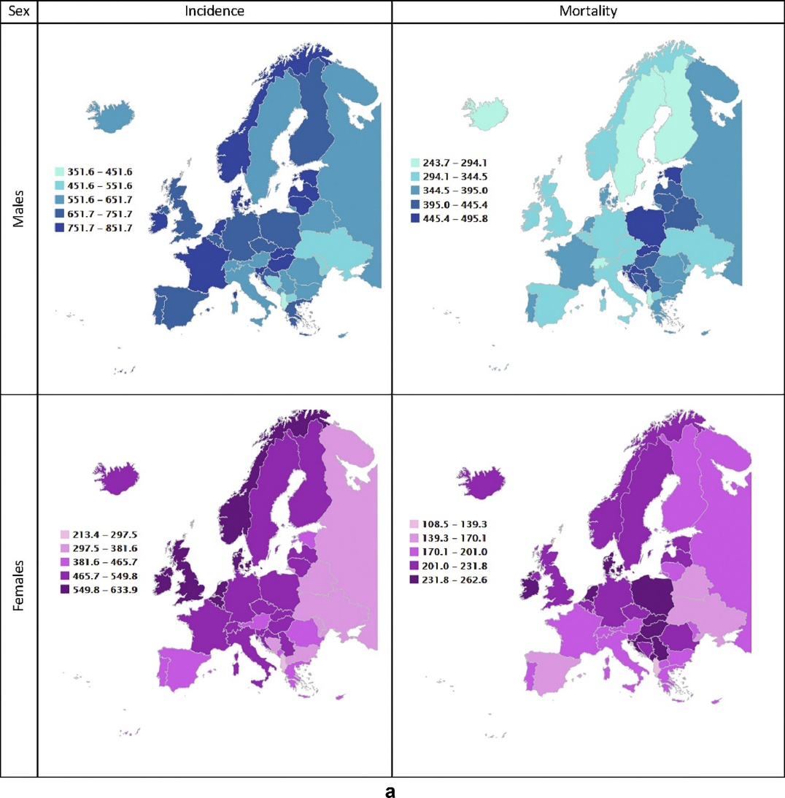
Cancer: countries that suffer, countries that treat
Cancer incidence in the Balkan region is on average European level, but mortalitiy is exceedingly high. (Dyba T et al. 2021, https://doi.org/10.1016/j.ejca.2021.07.039)
In Hungary, Poland and Romania, head and neck cancer results in a total of 9729 annual deaths and 157,328 years of potential life lost (Bencina et al. 2022, https://doi.org/10.1016/j.jcpo.2022.100366).
Radiotherapy centres capable of hadron irradiation are only found in a few central European countries, which (incidentally?) have a low cancer mortality among males.
Hence: Necessity for TNA
Notes:
I made that point also in the report: TNA is important to provide patients and researchers from countries without an accelerator with the opportunity to use one.
The last remark refers to the panel top right. The bright vertical area from Germany through Sicily is really quite striking.

Slide 4
Support through HITRI and Outreach to New Users
Problems for small countries:
resource limitations
lack of sufficiently large patient cohorts
lack of knowledge about technology
lack of qualified personnel
HITRI+ heavy ion centres
Notes:
Old slide a bit updated. Can be deleted.

Slide 5




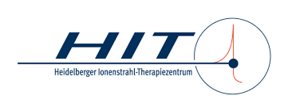
Contributors to TNA
Research
Clinic
 | Res. [h] | Clin. [h] | Total
CNAO | 80 | 12 | 92
GSI | 296 | - | 296
UKHD/HIT | 72 | 10 | 82
MEDA | - | 12 | 12
MIT | - | 16 | 16
 | 448 | 50 | 498

Slide 6
Tasks in Months 1-18
Task 6.1 and 6.2 Provision of Access, Review of Proposals, Modality of Access
Task 6.3: Specific TA to clinical activities
Task 6.4 and 6.5: Outreach to new users, SEE involvement

Slide 7
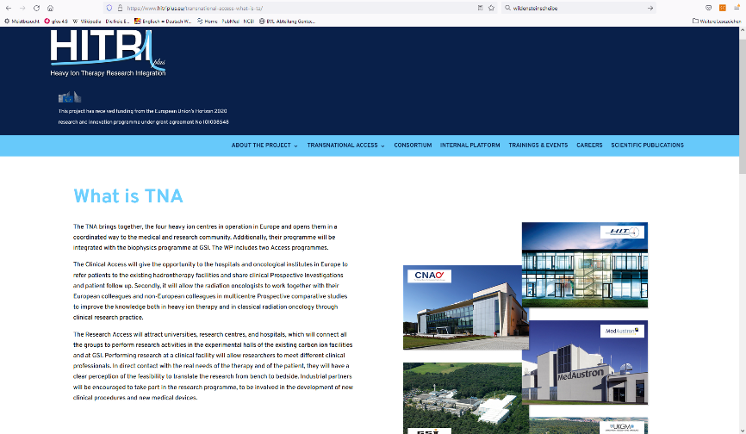
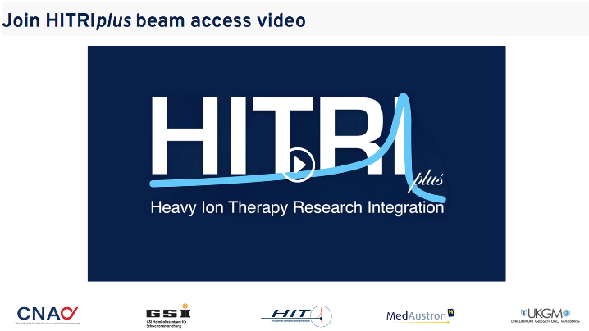
Task 6.1 and 6.2 Provision of Access, Review of Proposals, Modality of Access
WP6 provides access to clinicians and researchers from other countries.
This applies to member states and associated countries, but up to 20% of TNA can be given to other countries.
Information and contact via the HITRI+ web page.

Slide 8
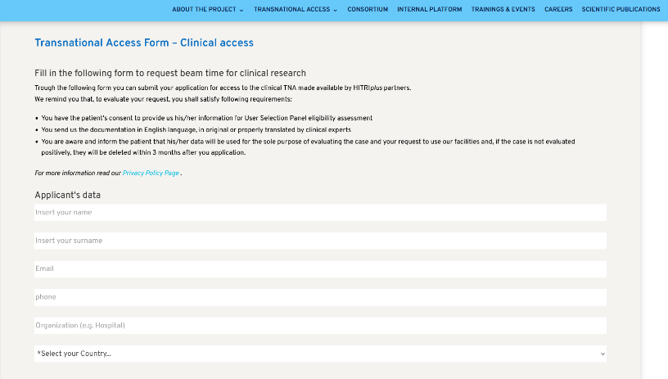
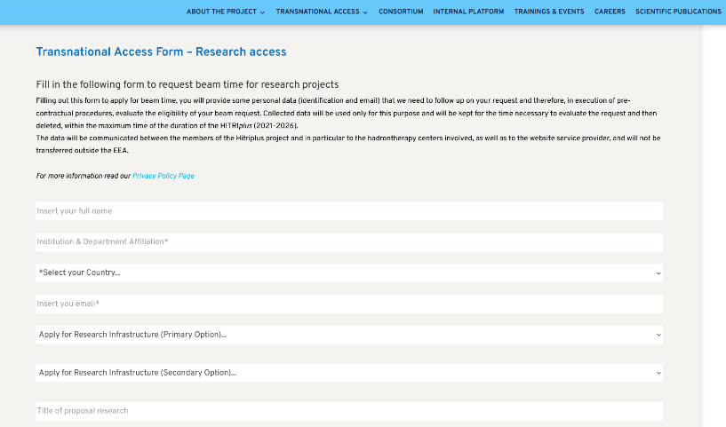
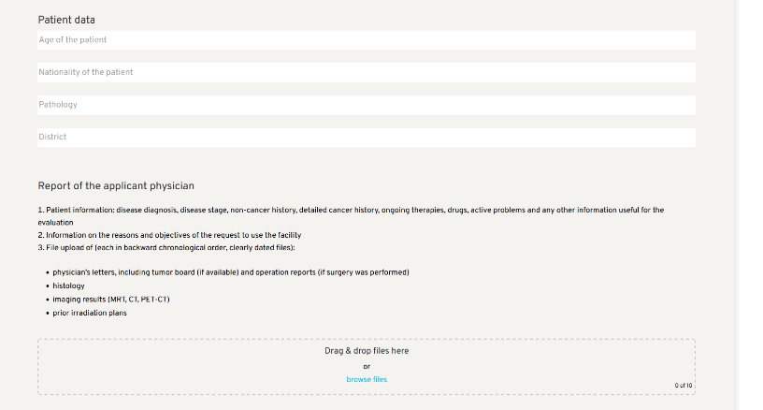
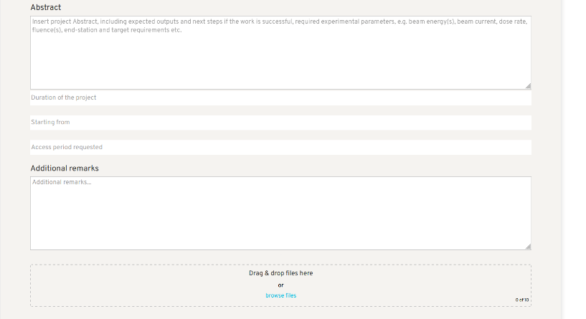
Task 6.1 and 6.2 Provision of Access, Review of Proposals, Modality of Access
A TNA page has been set up on the HITRI+ website: https://www.hitriplus.eu/transnational-access-what-is-ta/
Apply for TNA via HITRIplus webpage
  Clinical access: https://www.hitriplus.eu/transnational-access-ca/
  Research access: https://www.hitriplus.eu/transnational-access-ra/
  Applications are directly forwarded to the respective USP
  Encrypted files are uploaded to the HITRI+ Google workspace and only accessible to the USP members.
Apply for beam access to facility
File form and receipts for reimbursement
Report after the experiment

Slide 9
Task 6.1 and 6.2 Provision of Access, Review of Proposals, Modality of Access
Two USPs have been established:
Research:
Marco Pullia (CNAO)
Marco Durante (GSI)
Katia Parodi (LMU)
Takashi Shimokawa (NIRS)
Clinical:
Fabian Eberle (UKGM)
Ester Orlandi (CNAO)
Esther Troost (HZDR)
Tatsuya Ohno (GHMC)
All proposals have been subjected to the USPs, and a decision was reached within two weeks in all cases.

Slide 10
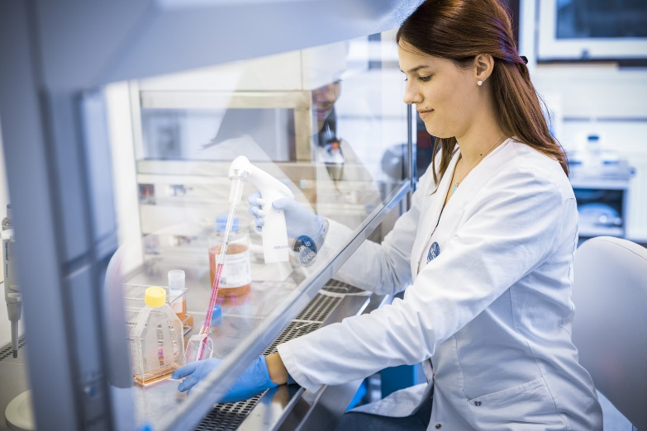
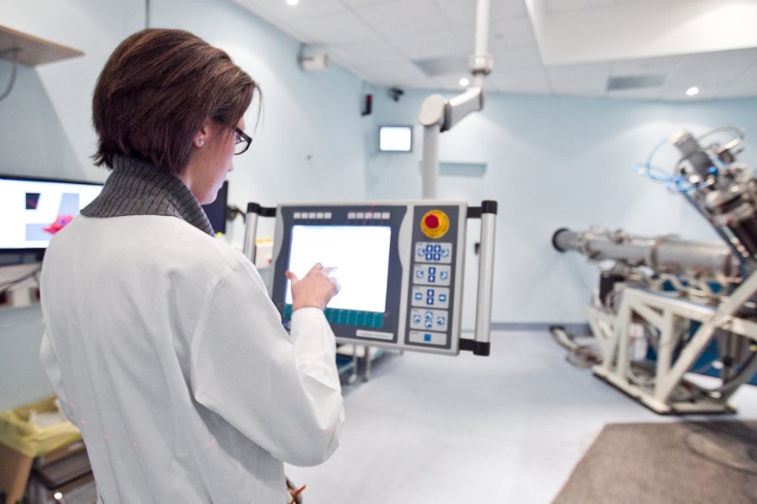
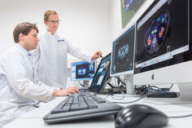

Deliverable 6.1: HITRIplus delivers 100 hrs of research TNA by month 18

Slide 11
Deliverable 6.1: HITRIplus delivers 100 hrs of research TNA by month 18
Applications to all three participating research centres have been received.
Applicants came from:
  Spain
  Italy
  France
  Germany
  Netherlands
  UK
Access has been granted to five groups for 107 hours.
Several further applications have been granted but not yet implemented.
Notes:
To demonstrate the broad geographical impact of WP6 in many European countries.

Slide 12
3. Research TNA applications
Applicant | Affiliation | Proposal title | h requested | h used | Host facility | Period
Carlos Guerrero | Centro Nacional de Aceleradores (CNA), 41092 Sevilla, Spain | Feasibility of real-time PET range verification in proton, He and C therapy using short-lived nuclides | 38 | 62 | HIT | Oct. 12/13, 25/26, Nov. 18-20, Dec. 15-17, 2021
Piergiorgio Cerello | INFN Turin, Italy | FragmentatiOn Of Target @ HIT (FOOT@HIT) | 24 | 24 | HIT | July 17-24, 2022
Katia Parodi | LMU München | SIRMIO (Small Animal Proton Irradiator for Research in Molecular Image-guided Radiation-Oncology) | 20 | 20 | CNAO | May 29 – June 1, 2022
Yolanda Prezado | Research Center-Orsay, Institut Curie, France | Spatially fractionated RT with Hadrons | 20 | 20 | GSI | May 28/29, 2022
Veronica de Micco | University of Naples Federico II, Department of Agricultural Sciences | Assessing radiosensitivity of higher plants and mechanisms for radioresistance at different phenological stages (RADIOPLANT) | 16 | 9 | GSI | April 2 & May 28, 2022
Marie Vanstalle | Institut Pluridisciplinaire Hubert Curien (IPHC), Strasbourg | Measurements of damages to biomolecules in solution induced by carbon ions and their secondary fragments | 24 | - | CNAO | Upcoming
Christophe Badie | UK Health Security Agency | Assessing space like radiation dose exposure and long-term risks in humans by using real-time differential gene expression sequencing analysis | 6 | - | GSI | Upcoming
Ilaria Rinaldi | MAASTRO Maastricht | Stopping power ratio measurements of electron density phantom | 5 | - | HIT | Upcoming
Ester Orlandi | CNAO | Commutative property in mixed X-ray plus C-ions clinical trials (COMIX) |  |  | GSI | Upcoming
Veronica de Micco | University of Naples Federico II, Department of Agricultural Sciences | Exploring the radioresistance and radiosensitivity mechanisms of edible plants (RadioPlant2) |  |  | GSI | Upcoming
Fernando Dominguez | Universidad de Santiago de Compostela, Spain | Silver atomic Quantum Clusters of five atoms (Ag5-AQCs), radiosensitizer for heavy-ion particle therapy. | 12 |  | GSI | Upcoming
Notes:
The animated bars highlight the two projects that are presented in more detail on the next slide. I chose FOOT, because it is your project, and Prezado, because she came to GSI.

Slide 13
TNA research projects: voice to the users!
Application by Piergiorgio Cerello:
  part of the large FOOT experiment
  measuring fragmentation cross sections of interest for particle therapy and radioprotection in space
  Measurements carried out at HIT focussed on charge changing fragmentation cross sections of 4He projectiles on C targets at beam energies of 200 MeV/u.
  The experiments were performed at HIT between July, 17th and July, 24th (54h).
Application by Veronica De Micco:
  Plants are more radioresistant than animals, due to their different structure and metabolism
  The severity of damage in higher plants depends on radiation type, exposure time (acute or chronic), dose, phenological stage and species
  Knowledge gaps: structure/function related mechanisms for radioresistance to validate the idea of exploiting ionizing radiation as a sort of stimulant factor for the production of high-nutritious plant-derived food
  Experiments at GSI/SIS18 on April 2 and May 28, 2022 (9 hrs)

Slide 14
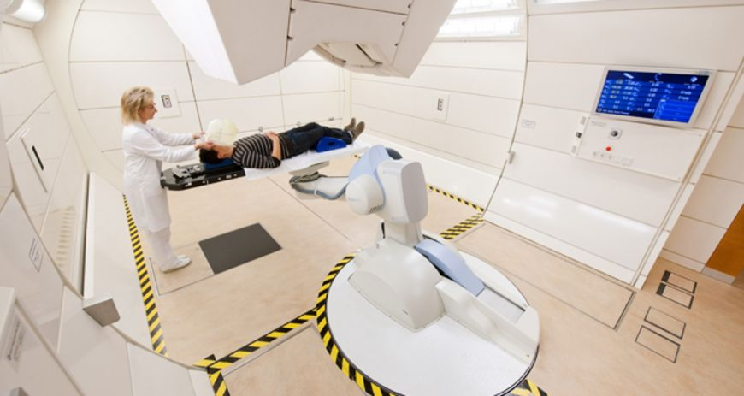
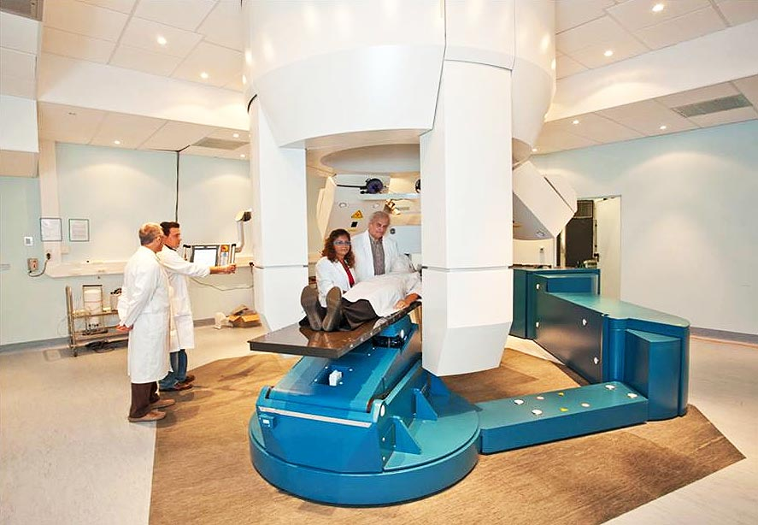
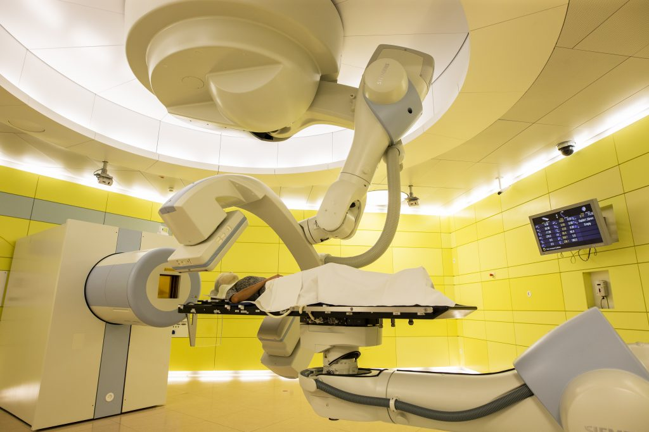
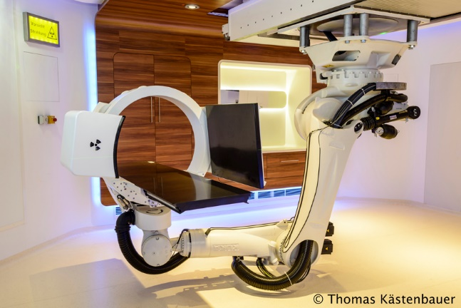
Task 6.3: Specific TA to clinical activities

Slide 15
Deliverable 6.1: Treatment of 10 patients with heavy ion therapy in TA by month 18
Four applications so far:
Greek patient 1 (Mrs. N.), female, to HIT (see next slide)
Brazilian patient, female, sacral chordoma. Accepted at CNAO, but joint consultations agreed on continuing conservative therapy for six months. Visit by treating physician to CNAO is scheduled.
Greek patient 2, female. Chordoma L5/S1 with recurrence after initial surgery. Stabilization screws and titanium bars flank the chordoma. => hadron irradiation impossible. Considered for immunotherapy.
Greek patient 3, female. Brain tumor. Suggested for photon or proton irradiation by treating physician. Hadron irradiation not currently adequate, therefore rejected by USP.

Slide 16
Greek patient Mrs. N.
female patient, 59y, diagnosed 2015 with high grade pleomorphic sarcoma of the right thigh. Relapse in 2020 with metastases.
tumor in the skull base with invasion of the sphenoidal bone
carbon irradiation therapy performed at HIT 25.5-15.6.2022 (17 fractions)
Joint follow-up supported by HITRI+ TNA (applied 13.6; approved 29.7).
tumor has completely disappeared
However: Most recently new metastases have been detected in the follow up

Slide 17
Deviation from deliverable & countermeasures
Deliverable: 10 patients; Treated: 3 patients
Potential reasons:
Travel restrictions due to pandemic.
Insufficient knowledge of method and opportunity.
Obstacles to communication: lack of counterparts for medical discussion.
Countermeasures taken:
Strategic meetings of the TPB and USP on April 28th & October 25th
Invitations to EPTN and EURACAN have been sent. Flyers have been distributed on IBC, ENLIGHT & MEDINET mailing lists, and on ESTRO, EFOMP & IEEE congresses.
Clinical TNA has been opened to physicians wishing to discuss the eligibility of a specific patient.
The designation of TNA contact persons by each clinical centre has been suggested and is currently under implementation.
Notes:
This can lead over to the next slide.

Slide 18
Task 6.4 and 6.5: Outreach to new users, SEE involvement
Video on TNA online
HITRI+ flyer has been distributed at all relevant scientific meetings.
TNA opportunity has been mentioned by organizers and beneficiaries on multiple occasions.
Type | Author(s), Title, References, Date
Article | Durante, M., Debus, J. & Loeffler, J.S. (2022) „Physics and biomedical challenges of cancer therapy with accelerated heavy ions“ Nat. Rev. Physics 3: 777-790
Article | Volz, L., Sheng, Y., Durante, M. & Graeff, C. (2022) „Considerations for upright particle therapy patient positioning and associated image guidance“ Front. Oncol. 12: 930850
Talk | M. Durante, Heavy ion therapy. Groundbreaking ceremony of the Mayo Clinics heavy ion facility, Jacksonville, FL, 12.10.2022
Talk | M. Durante, Heavy Ions in therapy and Space. Opening lecture at the European radiation research society (ERRS) meting, Catania, Italy, 21.9.2022
Talk | M. Durante, New horizons in particle therapy. Invited lecture at 30-years-TERA-symposium, CERN, Geneva, Switzerland, 15.9.2022
Talk | M. Durante, Biomedical applications of radioactive ion beams. Jagellonian symposium, Karakow, Poland, 12.7.2022
Talk | M. Durante, The future of particle therapy. 60th PTCOG meeting, Miami, FL, 27.6.2022
Talk | P. Fossati. Clinical TNA opportunity presented to: Dr. Shifra Ash, Dr. Miriam Ben Arush, Dr. Liana Abda, Dr. Sergey Postovsky, Dr. Balan Salem, + Head & Neck representative all together 22 invited participants. Rambam Health Care Campus, 20 mar 2022
Talk | P. Fossati. Clinical TNA opportunity presented to: Dr. Meirav Ben David, Dr.Lili Borochov, Dr. Aleen Shichman, Mrs, Orly Bassan. Assuta Medical Center. 21 mar 2022
Talk | P. Fossati. Clinical TNA opportunitypresented to: Dr. Helen Toledano, Dr. Shira Amar, Dr. Orli Michaeli, Dr. Gali Avrahami, Dr. Esther Berkovich Schneiders Children's Medical Center
Talk | P. Fossati. Clinical TNA opportunity presented to: Dr. Dror Limon, Dr. Shlomit Yust. Beilinson rabin medical center
Talk | P. Fossati. Clinical TNA opportunity presented to: Dr. Zvi Symon, Dr. Efrat Landau and staff (all together 17 participants including the pediatric oncologists). Sheba Medical Center. 22 mar 2022
Talk | P. Fossati. Clinical TNA opportunity presented to: Dr. Shlomi Konstantini, Dr. Zvi Ram, Dr. Yuval Shapira and staf. Dr. Roni Ganzu, Dr. Ido Wolf, Dr. Nathan Straus, Dr. Lior Tzach, Dr. Meital Garti, Dr. Omri Maroz, Dr. Amir Shtarenhaim, Dr. Salva Soifer, Dr. Ofer Marimsky, Dr. Shamay Sivan, Dr. Gorchak, Dr. Segal. Ichilov Medical Center. 23 mar 2022
Talk | P. Fossati. Clinical TNA opportunity presented to: Dr. Gal Goldstein, Dr. Dror Raviv. Hadassah Medical Center. 23 mar 2022

Slide 19

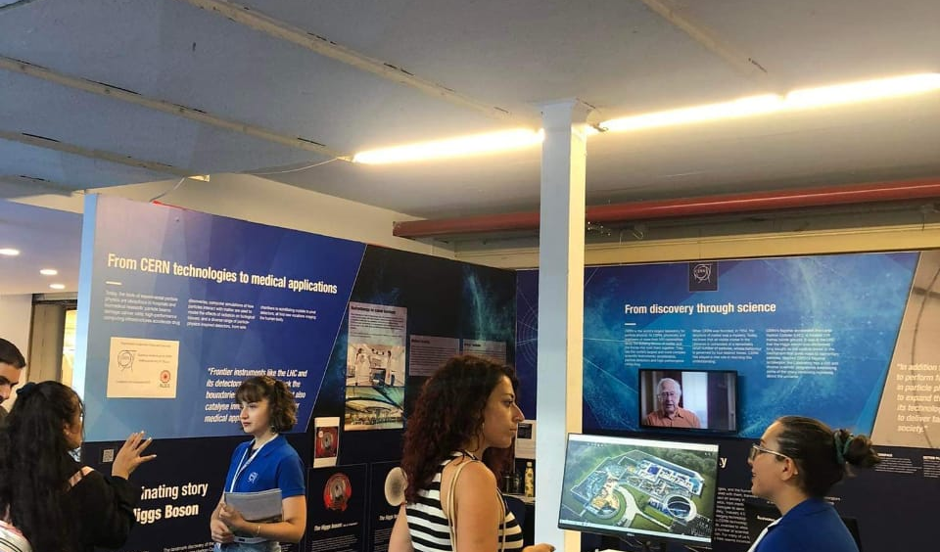
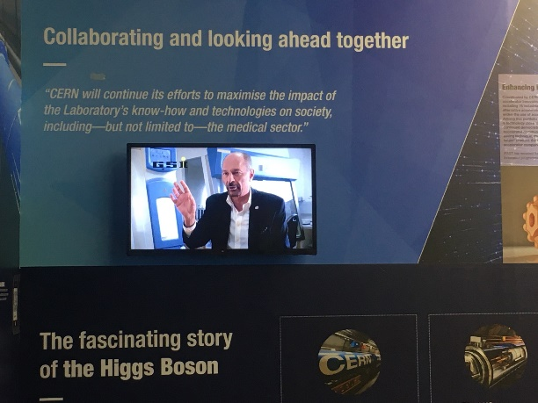
Task 6.4 and 6.5: Thessaloniki International Fair
HITRI+ was presented in the CERN booth at the Thessaloniki International Fair 2022 with the topic „Benefits for Society from Fundamental Research” from Sept. 10th- 18th.
The TNA video was shown non-stop, together with a link to a web page of Papageorgiou hospital explaining the procedure.

Slide 20
THANK YOU VERY MUCH!

