Slide 1
Introduction to Joint Research Activities
Maurizio vretenar, CERN (Pillar coordinator)
Vienna, 13 december 2022

Slide 2
The 6 JRA’s: a set of strategic directions to advance Heavy Ion Therapy
higher beam intensity, new accelerator designs
simplified beam delivery
Future Ion Therapy
improved controls and safety
improved beam injection/extraction
standardised tools and procedures
Superconducting accelerators
WP | Title | Coordinator | Goals
7 | Advanced accelerator and gantry design | M. Vretenar (CERN) | Develop technologies and designs for synchrotron, gantry
8 | Superconducting magnet design | L. Rossi (INFN) | Assessment and preliminary design of SC magnets
9 | Advanced beam delivery | C. Graeff (GSI) | Develop new patient chair and related arc therapy
10 | Multiple energy extraction system | T. Haberer (HIT) | Develop strategy and tools for multiple en. extraction
11 | Controls and Safety | M. Cekovski (Cosylab) | Design controls and safety for increased intensity
12 | Radiobiological Dosimetry and QA | U. Schötz (MIT) | Dosimetry standardization for radiobiological experiments

Slide 3
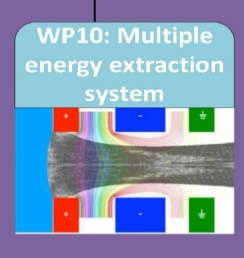
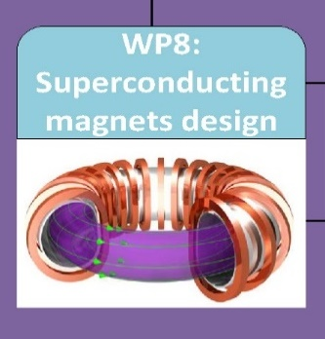
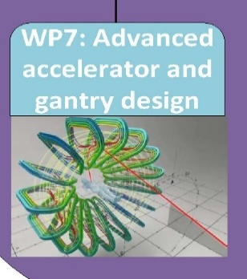

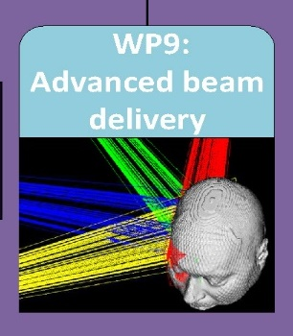
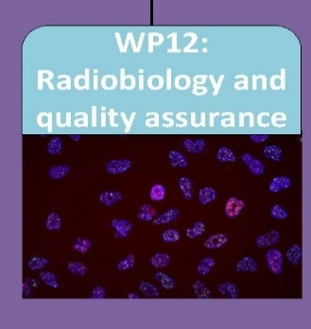
Interactions between the HITRIplus JRA’s
Improvements to present facilities
Improvements to radiobiological experiments
Improvements to future facilities
M.E. implementation in future facilities
field quality requirements
magnet parameters
adapting controls and safety to future systems

Slide 4
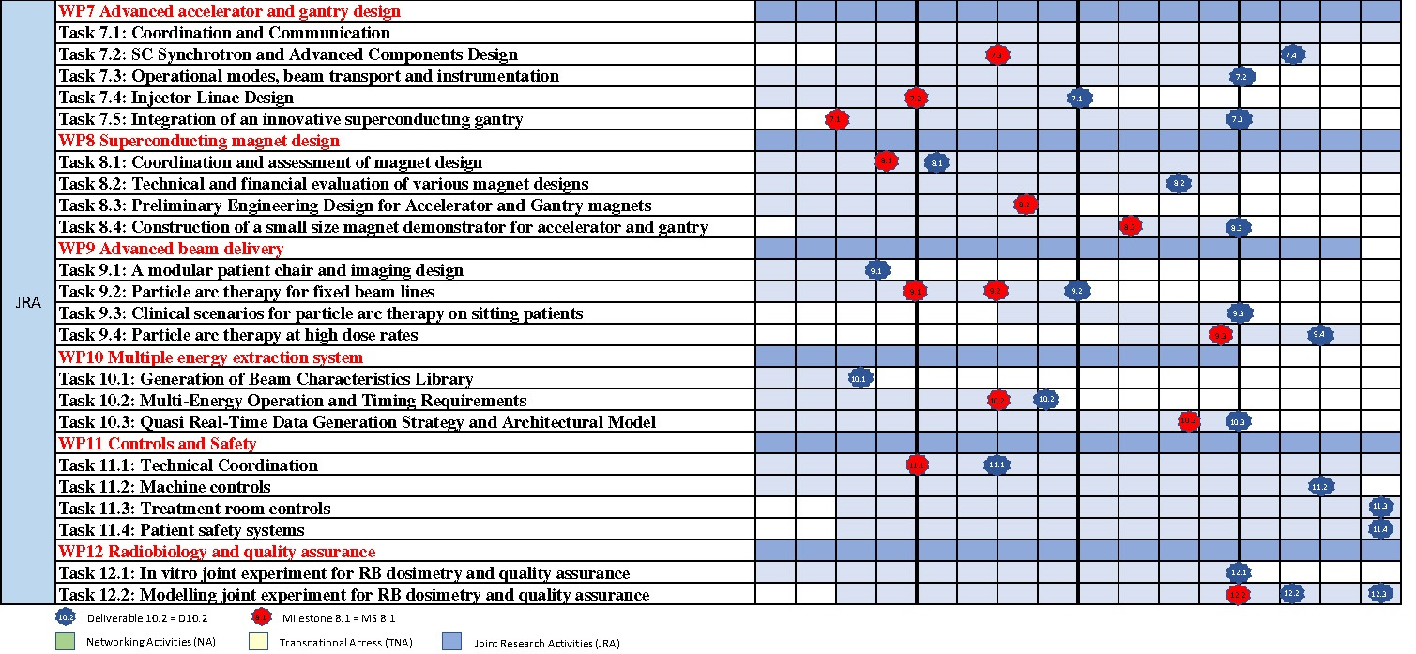
The JRA Work Programme
Y1 Y2 Y3 Y4
Scientific activity to be completed in:
3 years for WP8, WP10
3.5 years for WP7, WP9
4 years for WP11, WP12

Slide 5
Quick Overview Period 1 for HITRIplus JRAs
WP7: Milestone 7 (Linac and Gantry conceptual design, and SC synchrotron main parameters), baseline design ready for P2.
WP8: D8.1 (Magnet Assessment for SC accelerator and gantry).
WP9: D9.1 (Conceptual Design Report for a patient chair capable of rotating the patient around a vertical axis as well as a vertical in-room imaging system) and MS9 (Simulation environment for particle arc therapy).
WP10: D10.1 (Beam Characteristics Library).
WP11: Milestone 11 (Intermediate report on the state-of-the-art treatment room, accelerator control systems, and patient safety systems). D11.1 (Design study on novel treatment room control systems).
WP12: no contractual obligations.
Common issue to most of the JRA’s during P1 were delays due to problems in finding PhD students or expert personnel.

Slide 6
Thank you for your attention

