Slide 1
WP7 - Advanced accelerator and gantry design
Maurizio vretenar, CERN (WP coordinator)
Elena benedetto, SEEIIST ASSociation (deputy coordinator, task 7.2 leader)
Vienna, 13 december 2022

Slide 2
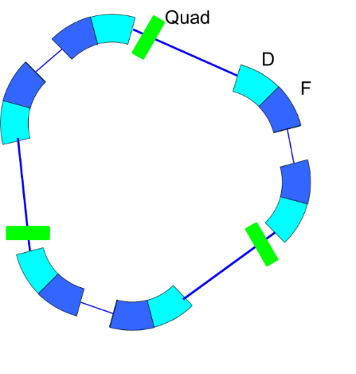
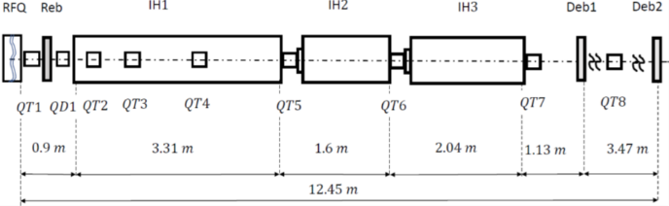
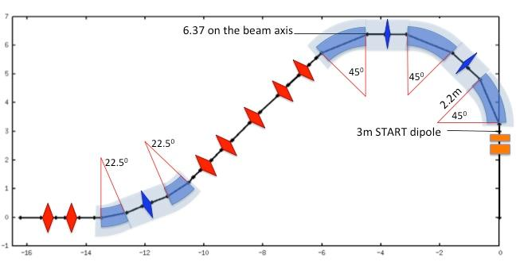
WP7 Main objectives and goals (from proposal)
• To design solutions to improve performance of the existing accelerators for heavy ion research and therapy: multiturn injection for higher beam intensity, improved extraction and beam transport – in particular for new FLASH therapy modality, and new linac injector for higher intensity and parallel production of isotopes for research and therapy.
• To combine these accelerator solutions with the superconducting (SC) magnets developed in WP8 to develop the conceptual design of a compact and innovative SC heavy ion synchrotron for cancer research capable of operating with multiple ion species. To propose a simplified version as the reference for a new generation of compact ion therapy accelerators to be built by European industry to address the global ion therapy market.
• To convert the most promising of the existing conceptual designs for superconducting gantries into a detailed technical design integrating all components including diagnostics and beam delivery, and prepare for a final industrialisation and production phase by European industry.

Slide 3
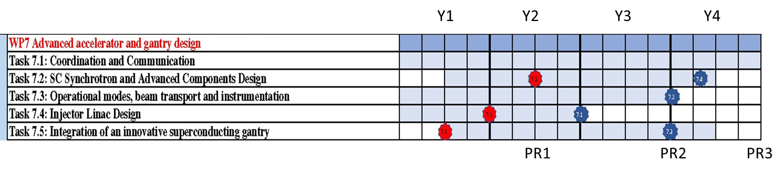
WP7 Work Plan and Consortium
7 partners (2 laboratories, 2 therapy centres, 1 research institution, 1 University, 1 SME), 6 countries
CERN: WP Coordination, contribution to synchrotron, gantry and linac design
SEEIIST: synchrotron design and beam transport, contribution to linac and gantry design
CNAO: gantry design, contribution to synchrotron and beam transport design
Bevatech GmbH: linac design
MedAustron: contribution to synchrotron, beam transport, and gantry design
Riga Technical University: gantry mechanical design
GSI: contribution to internal communication and coordination support

Slide 4
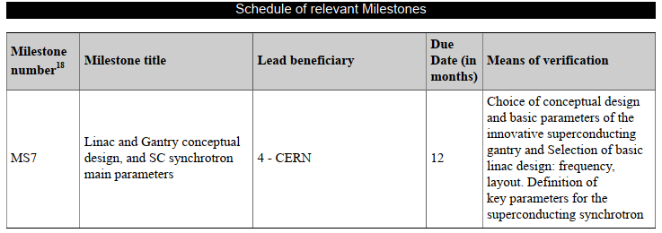
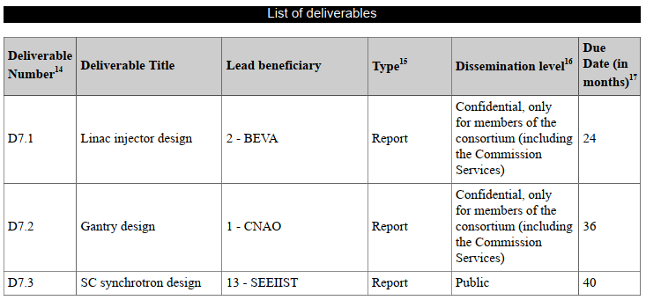
WP7 in Period 1: contractual obligations and status
In P1 only 1 Milestone (MS7): achieved on schedule.
Summarises the basic design choices in preparation for the 3 final deliverables foreseen between M24 (April 2023, linac) and M40 (August 2024, synchrotron).
Main issues during P1 are related to personnel:
Delay in finding a PhD student at CERN has delayed study one of the two linac options,
Loss of 1.5 senior experts at SEEIIST (replaced by 2 junior post-docs and a short-time senior expert) leads to some delay in the synchrotron design, still compatible with the final deliverable date.

Slide 5
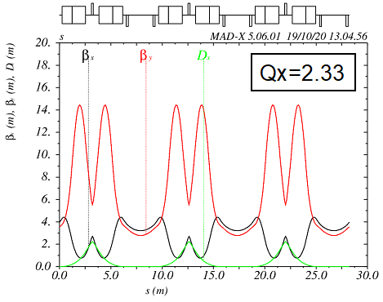
Task 7.2, 7.3 - SC Synchrotron and Components Design, Operational Modes, Beam Transport (SEEIIST, CERN, CNAO, MEDA)
Baseline: Triangular lattice, magnet parameters defined in collaboration with WP8
(common WP7/WP8 working group on field quality for curved magnets)
SC magnet requirements
Beam transport and instrumentation analysed, operational modes delayed waiting for expert personnel available.
Aperture (mm diameter) | 70-90
Bending radius (m) | 2.2
Bending angle | 60⁰
Minimum bending field (T) | 0.3
Maximum bending field (T) | 3
Gradient of the AG layer at top energy (T/m) | <6.6 (<1 m⁻²)
Integrated gradient of the SC magnet (T/m x m) | 10
Ramp rate (T/s) | 1
60deg magnets. Optics with zero dispersion in 3 straight sections (injection, extraction and the RF). No systematic resonance, lattice flexible thanks to the presence of small quadrupoles in straight section for working point adjustment. Quadrupole magnets carry additional coils for sextupole and for orbit correction.
FLASH-type extraction being analysed (PhD thesis based at CERN)

Slide 6
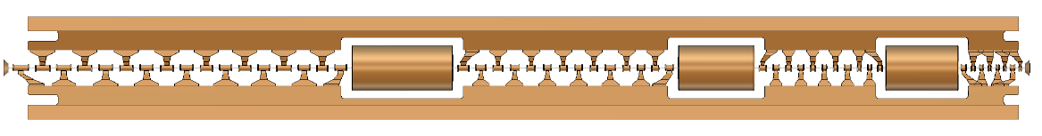
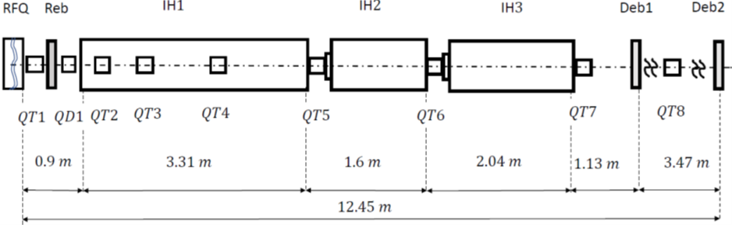
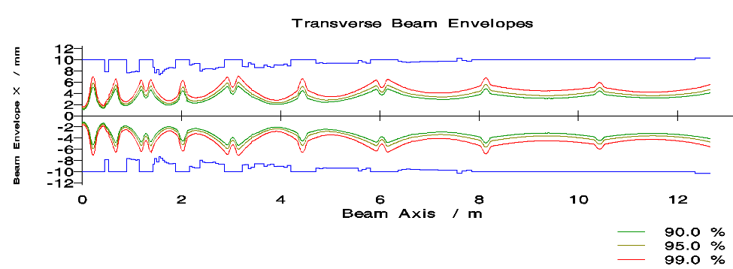
Task 7.4 - Injector Linac Design (BEVA, CERN, SEEIIST)
Baseline: 217 MHz injector linac based on IH-type structures
fully meets specifications, while design of the 352 MHz version is late because of late PhD start.
Deliverable D7.1 on schedule, will report on the 217 MHz baseline design presenting an alternative layout at 352 MHz (to be presented at IPAC Conference in May)
Multiple ion acceleration (12C4+, 4He2+, p)
Designed for production of radioisotopes in parallel with synchrotron injection

Slide 7
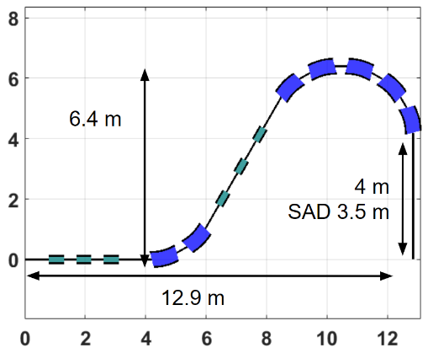
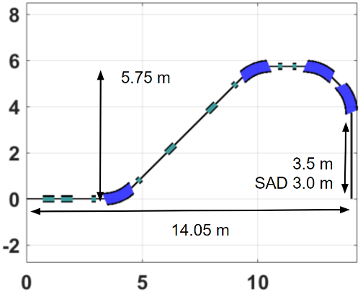
Task 7.5 - Integration of an innovative superconducting gantry: optics, mechanics, beam delivery (CNAO, CERN, SEEIIST, MEDA, RTU)
Selection of most promising gantry design done by a specially appointed committee in December 2020, which gave priority to SIGRUM rotational gantry for a realisation over the next 10 years.
Comparative analysis of 4 mechanical designs and 10 beam optics layouts, to converge on a baseline design:
360deg rotation mechanical design selected by the HITRIplus ESAC in December 2022 based on clinical considerations.
45 deg magnet configuration preferred because simpler and with similar acceptance as other solutions.

Slide 8
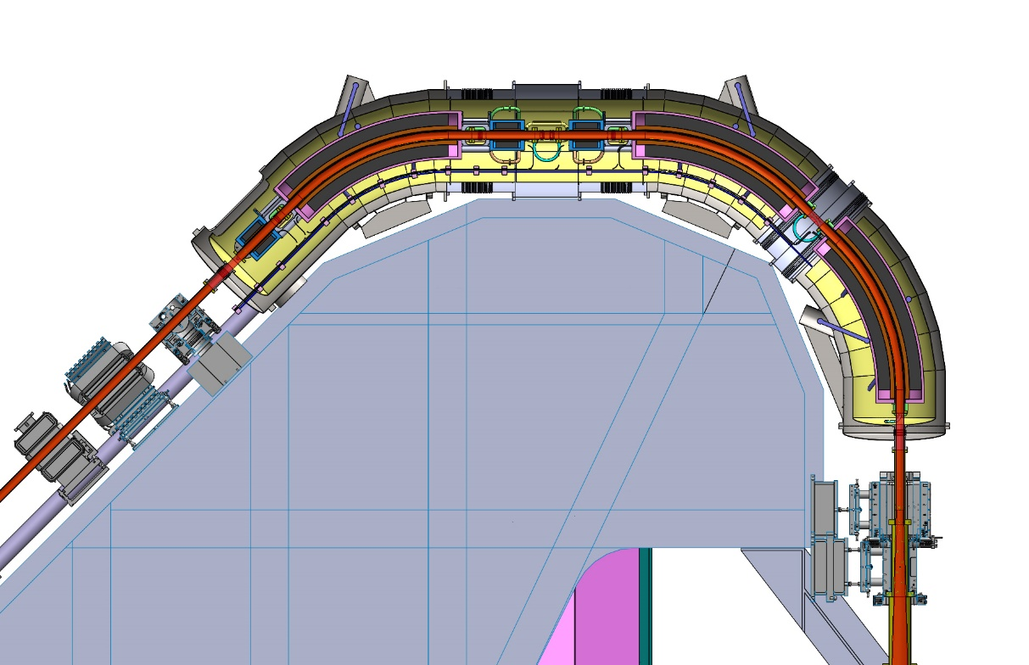
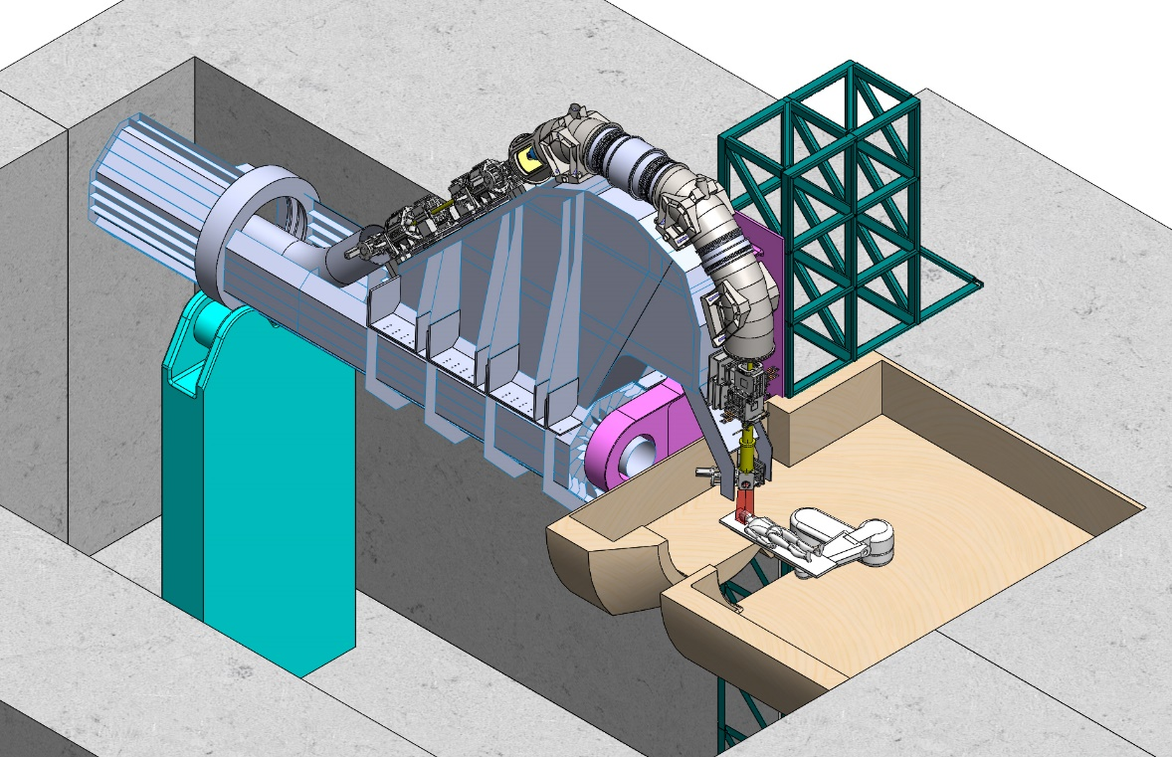
Gantry integration - status
Baseline: Full-rotation gantry made of 45 degrees cos-theta magnets

Slide 9
Planning for the next 6 months
Prepare for D7.1 on linac design: final refinement of the baseline 217 MHz IH design, complete the design of the Quasi-Alvarez (QA) alternative at 352 MHz (217 MHz IH was presented at Linac22 Conference in September 2022, 352 MHz QA will be presented at IPAC23 Conference in May.
Start the analysis of operational modes (treatment and research, beam timing and share)
Continue the analysis of the three most promising options of FLASH-type extraction and agree on a common set of parameters with the FLASH community.
After definition of the gantry baseline design, advance in the integration of the preferred design.

Slide 10
Thank you for your attention and thanks to all the WP7 colleagues:
SEEIIST: E. Benedetto, M. Sapinski, P. Grüebling, L. Garolfi, A. Vnuchenko
CNAO: M. Pullia, E. Felcini, G. Frisella, A. Mereghetti, M.G. Pullia, S. Savazzi
BEVA: U. Ratzinger, B. Koubek
RTU: L. Piacentini, T. Torims, A. Ratkus
MedAustron: C. Kurfürst, M. Pivi
GSI: Y. Foka
CERN: L. Dassa, D. Perini, L. Nikitovic

