Slide 1
WP9: Advanced beam delivery
C. Graeff
GSI Helmholtz Center for Heavy Ion Research

Slide 2
Overview
Task 9.1: A modular patient chair and imaging design
Task 9.2: Particle arc therapy for fixed beam lines
Task 9.3: Clinical scenarios for particle arc therapy on sitting patients
Task 9.4: Particle arc therapy at high dose rates
Milestones/deliverables:
Deliverable 9.1 (M9): Conceptual design report for a modular patient chair and vertical imaging
Deliverable 9.2 (M24): Particle arc therapy delivery to a small scale demonstrator of a rotational patient positioning system for gantry-free delivery with a position feedback integrated to the DDS
Deliverable 9.3 (M42): Patient identification and Experimental validation of arc therapy treatment plans through patient QA-like procedures
Milestone 9 (M18): Finished simulation environment for particle arc therapy

Slide 3
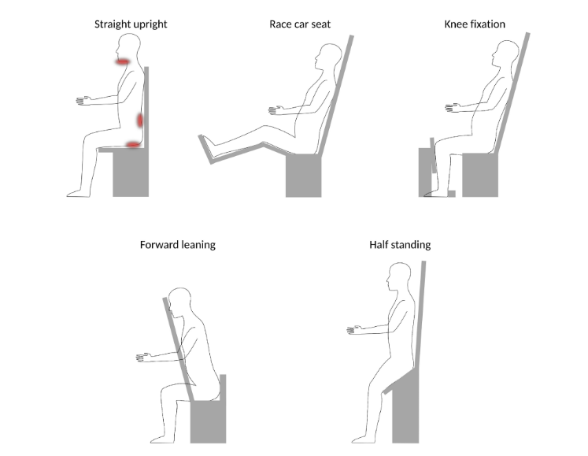
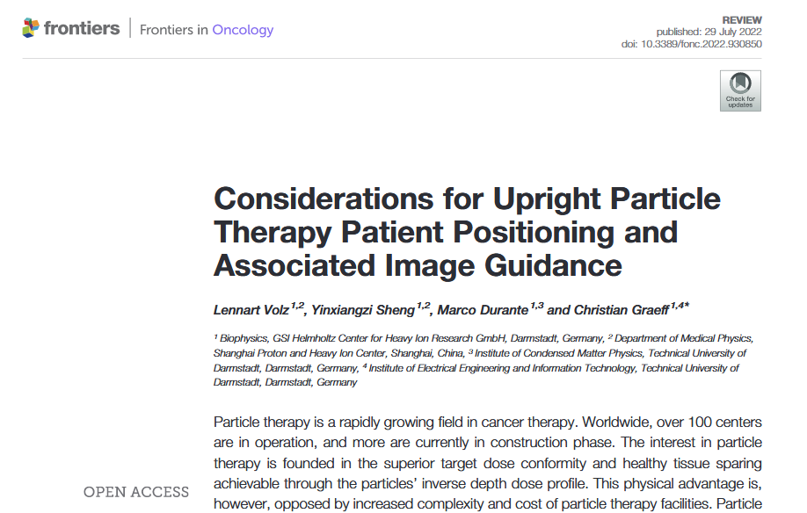
Task 9.1: A modular patient chair and imaging design
Deliverable 9.1: finished on time
  Discussed chair design, patient positioning and image guidance options
  Recommendations for early adopters
Conceptual design report published as open access review article in frontiers
- Volz, Sheng, Durante and Graeff (2022) Frontiers in Oncology

Slide 4
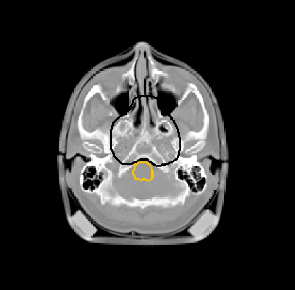
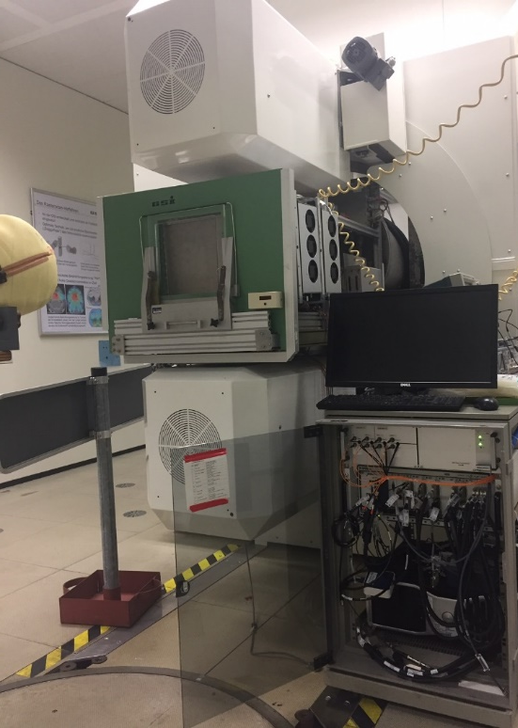

Task 9.2: Particle arc therapy for fixed beam line
Carbon arc TPS:
Small scale demonstrator:
Field setup
Beam nozzle
Pre-selection of energy band and spot positions
A-priori energy selection
Raster point setup
Iterative energy optimization
Dose delivery system
Rotating stage
Rob. bio. optimization and plan refinement
Notes:
In photon therapy, arc delivery of a continuously moving gantry enables the highest degree of flexibility and doseconformity. First studies on proton arc therapy show its feasibility at comparable or shorter delivery times andcomparable or better plan quality. In this task, a simulation environment for particle arc therapy will be developed toderive efficient treatment planning strategies. The resulting plans will consist of a large number of discrete beam angleswith a single energy each and will rely on the fast dose delivery capability as well as the feedback control of the chairrotation during delivery. A demonstrator rotational stage will be developed and interfaced to the DDS at GSI, to permit adynamic rotation for arc therapy (CNAO). Outside of the scope of this project, this stage will be usable also for precisionirradiation of orthotopic tumours in small animals (note: there will be no animal studies performed within the projectitself). The DDS itself will be modified to be able to deliver plans to a continuously rotating chair

Slide 5
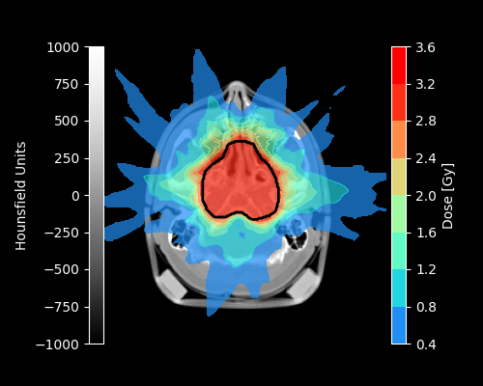
Simulation environment for carbon ion arc therapy
Environment in TRiP98 for robust biological dose optimization for heavy ion arcs
Supports both single and multiple targets
New energy layer optimization techniques for highest delivery efficiency
Setup tested on a cohort of H&N patients provided by the Shanghai Proton and Heavy Ion Center
4D (3D+patient rotation) delivery environment

Slide 6
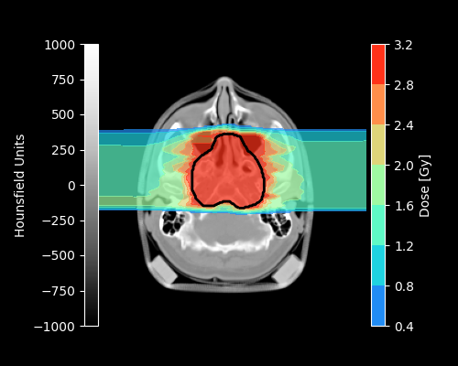
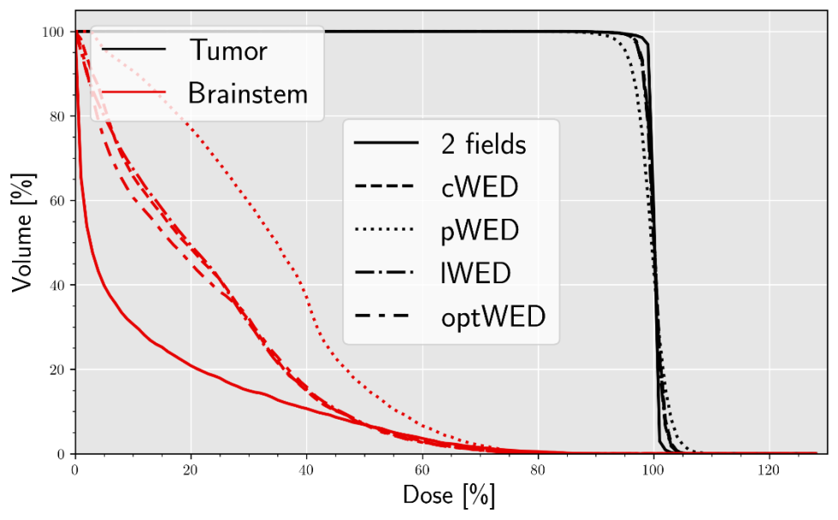
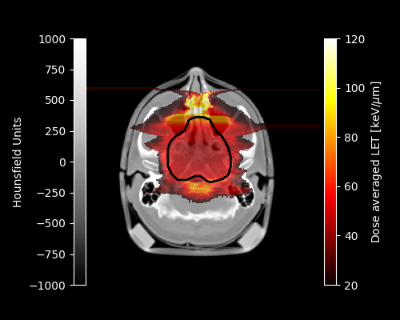
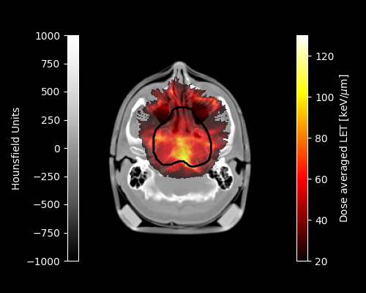
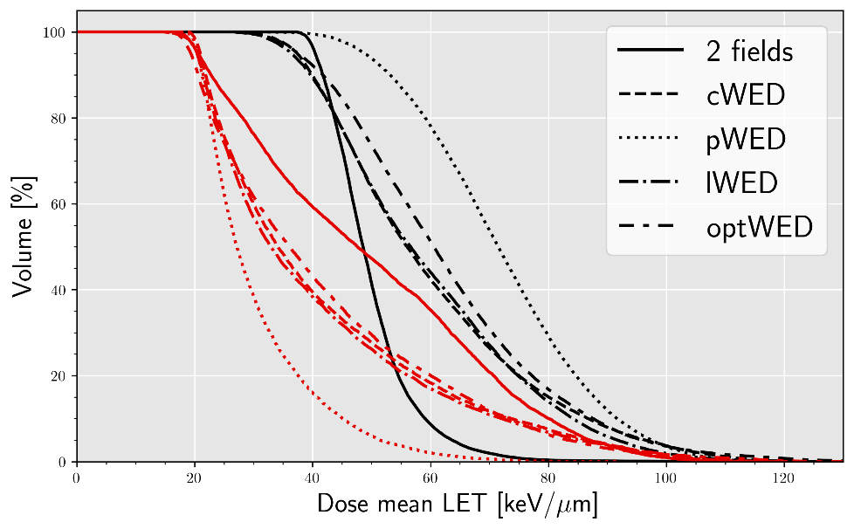
Carbon arc therapy versus 2 opposing fields: Dose and LET
2 Fields
Arc

Slide 7
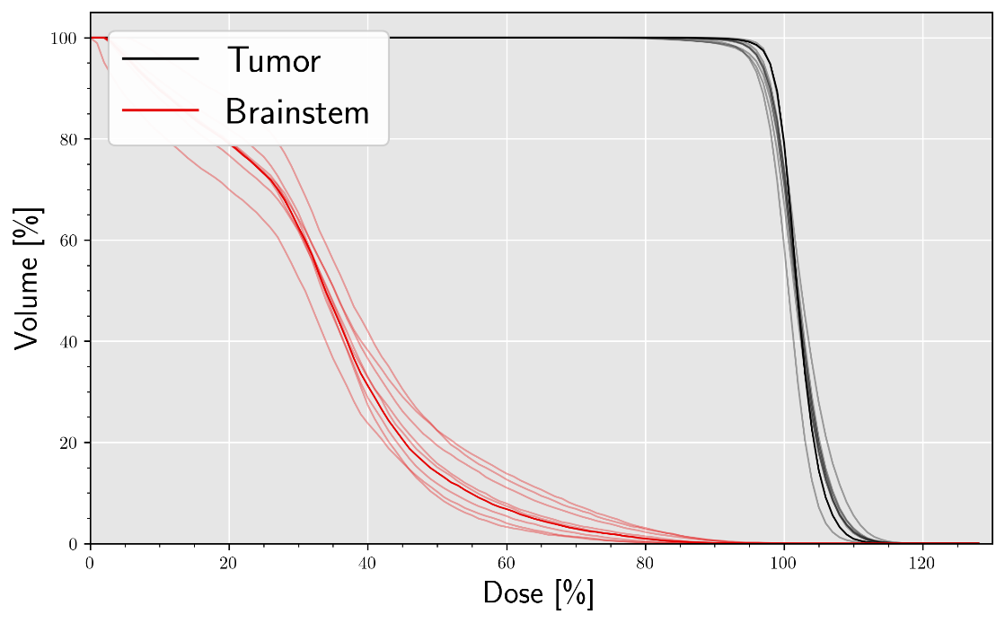
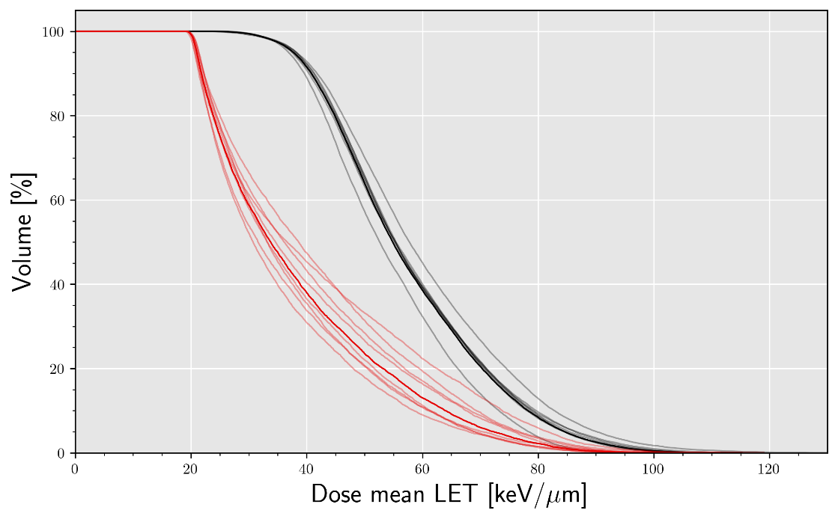
Robustness of carbon ion arc
Dose
LETd

Slide 8
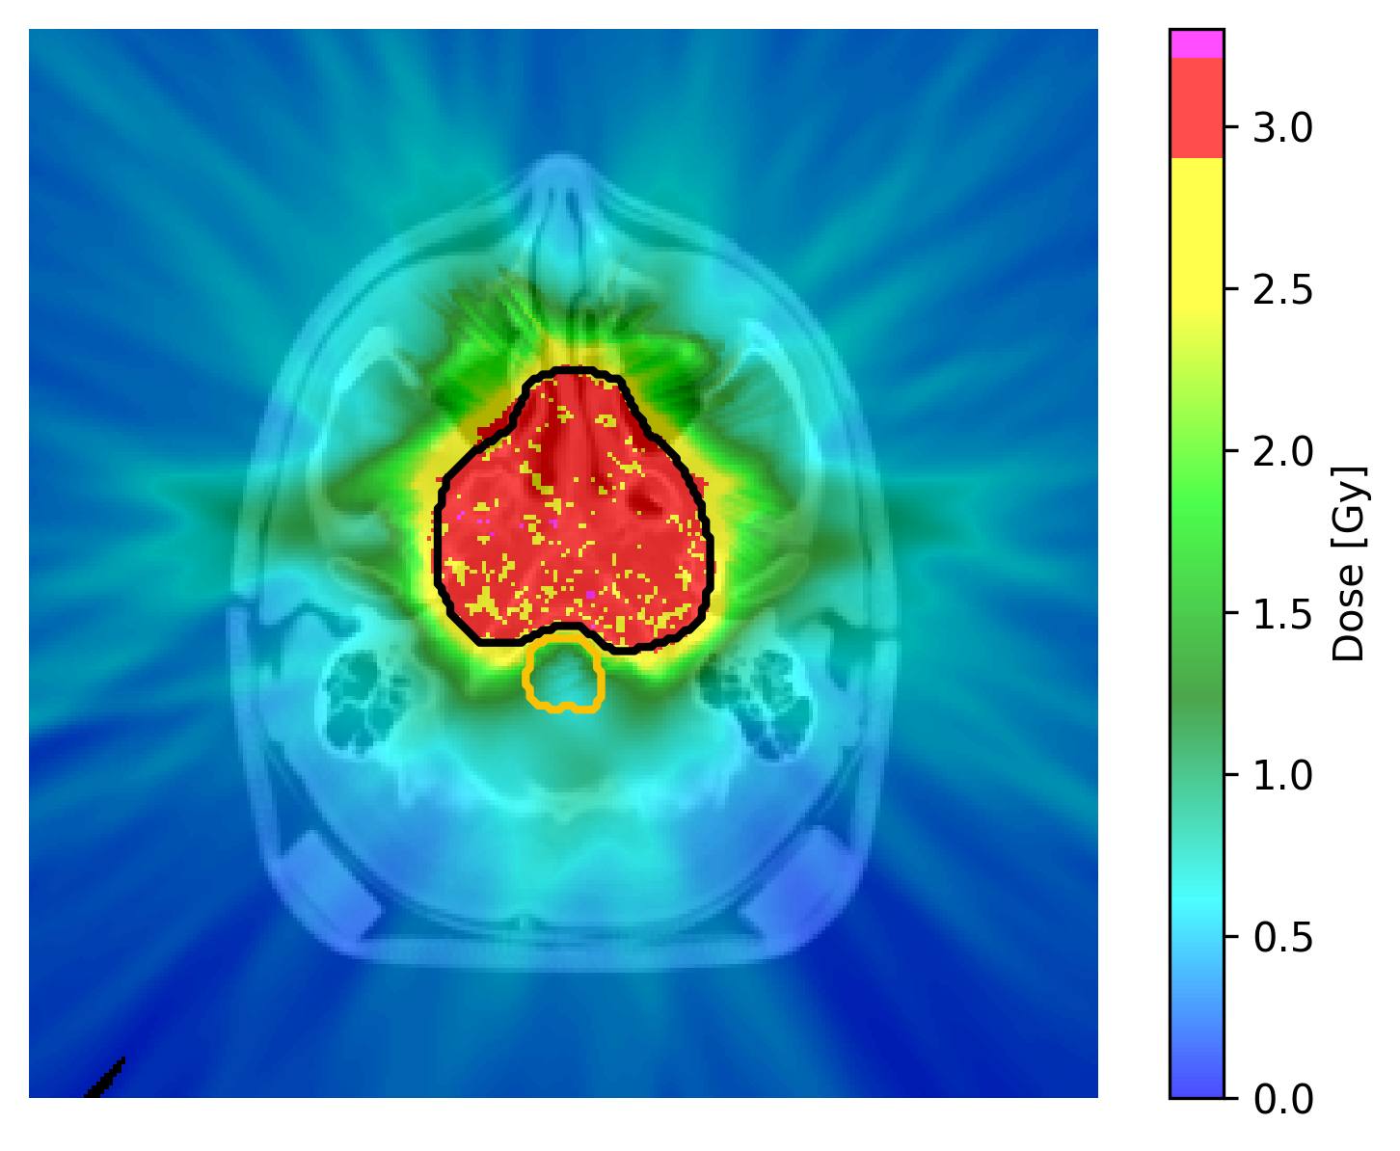
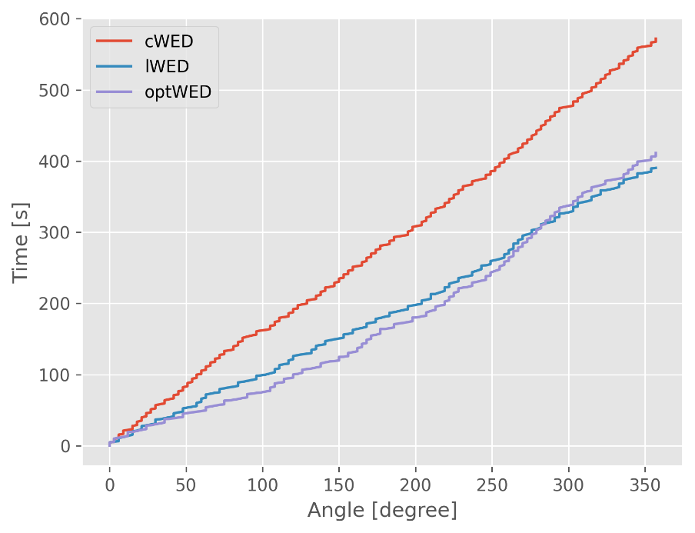
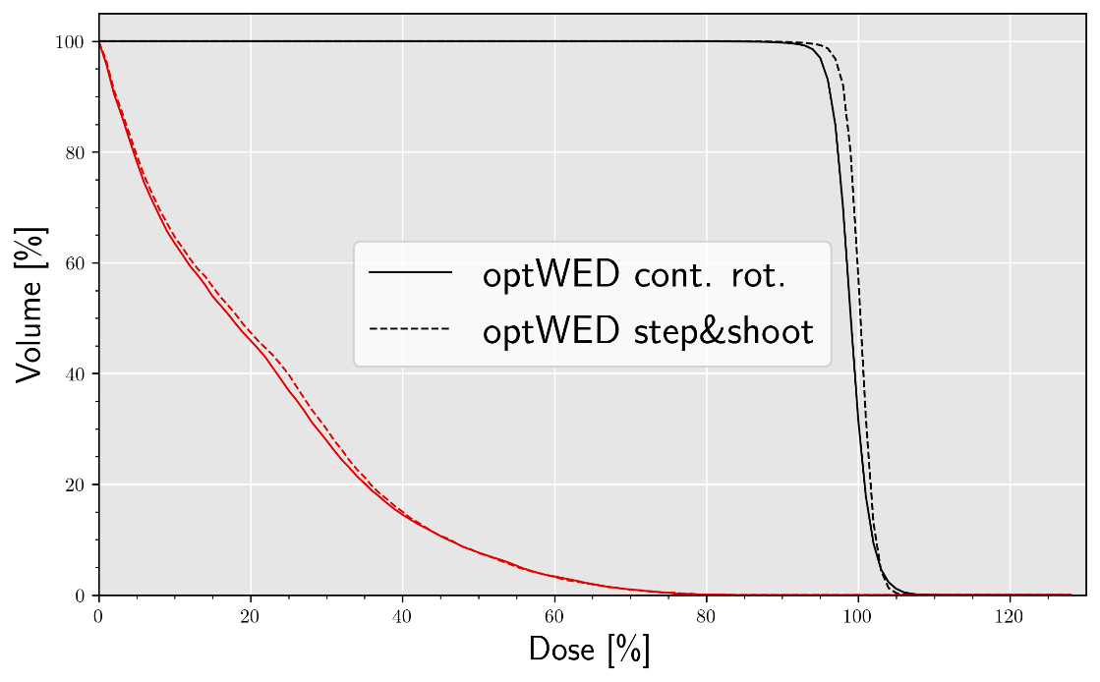
Arc therapy for fixed beamline with continuously rotating patient
Cont. rotating arc
Time progression
DVH comparison
30% lower treatment duration with suitable energy selection strategy

Slide 9
Small scale demonstrator
Small rotational stage connected to CNAO DDS
Infrastructure for stage rotation based on arc progression being set up
First tests using DDS and simulated accelerator environment planned for early next year
On track for deliverable deadline in March 2023

Slide 10
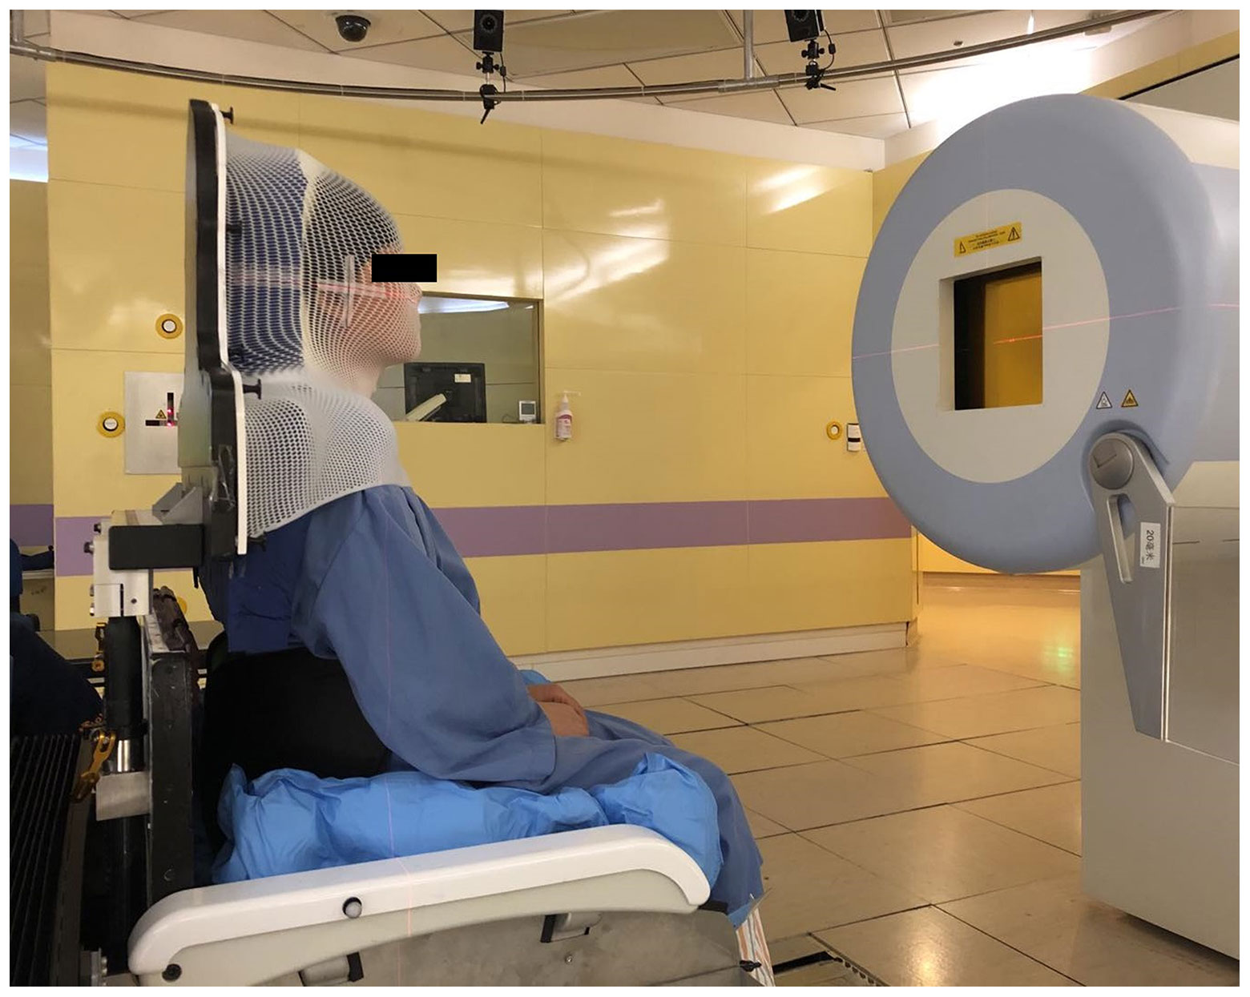
Task 9.3: Clinical scenarios for particle arc therapy on sitting patients
Acquired cohort of 23 H&N patients from Shanghai Proton and Heavy Ion Therapy Center
Study on the way investigating clinical benefit of upright rotational arc therapy
Current collaboration with UPenn (Dr. Taoran Li) and Beaumont Hospitals Proton Center (Dr. Xianfeng Ding) on carbon arc therapy for patients with multiple brain metastases
Collaboration with Leo Cancer Care Ltd. for comparing upright and supine carbon therapy
Notes:
Based on the data gathered in 9.1 and the performance achieved in 9.2, a comprehensive set of simulations will beperformed to assess the potential clinical benefit and usability of particle arc therapy to sitting patients. This includestarget locations, such as brain, head-and-neck, thoracic or abdominal, as well as different treatment modalities. In a technically more challenging strategy, the Bragg Peak can be used in arc therapy as well, demanding for angle-dependentenergy changes. While strategies exist to reduce energy layers, fast energy changes will still pose a challenge to thetechnique. Moreover, range uncertainty for a sitting patient might be considerably higher, depending on the treatmentsite. An alternative could be to use the plateau of the beam in a shoot-through therapy, which would eliminate the need forenergy changes as well as most of the range dependence, but would also reduce the inherent benefit of particle therapy.This drawback could be overcome by combining arc therapy with strategies to reduce side effects, such as Flash therapy.

Slide 11
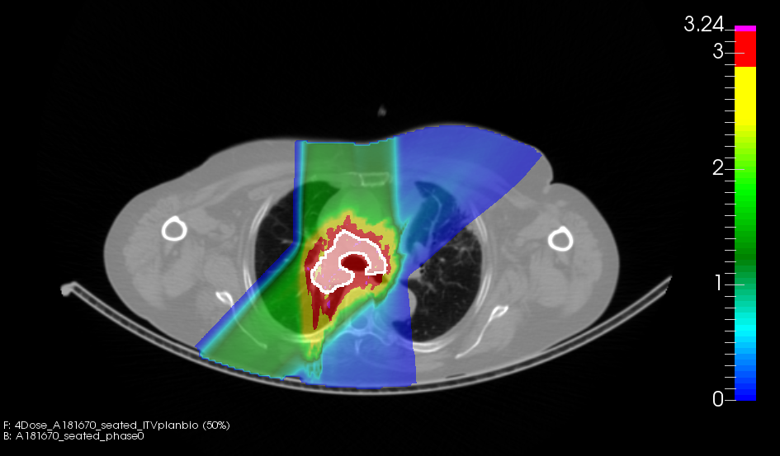
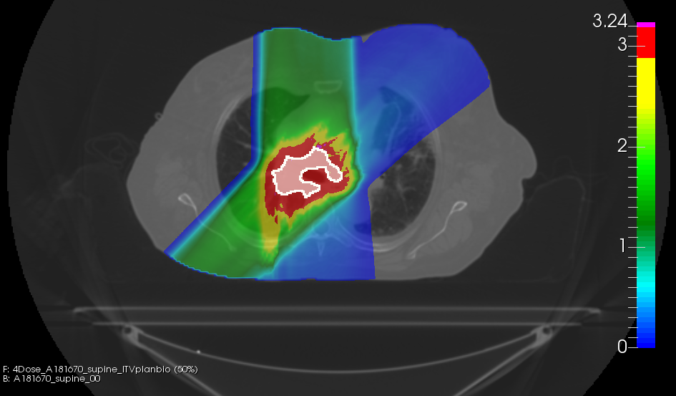
Comparison upright and supine therapy
SEATED
SUPINE
270°
270°
45°
45°
Work in progress

Slide 12
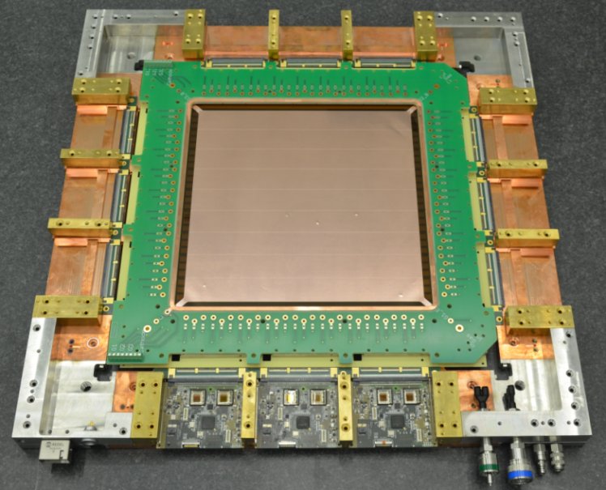
Task 9.4: Particle arc therapy at high dose rates
Investigate arc therapy at high dose rates (FLASH effect?)
Port GEM beam position monitor to DDS
  Fast TERA ADC chips connected to MWPC (different project)
  Sets the basic infrastructure for GEM detectors

Slide 13
Summary and contributions
Deliverables and milestones so far have been delivered on time
Well on track for next deliverable due in March 2024
Established international collaborations (SPHIC, UPenn, Beaumont Hospitals, Leo Cancer Care Ltd.)
Several dissemination activities:
  Open access review article Volz et al. (2022) Frontiers in Oncology
  Poster at ESTRO2022 (Task 9.2)
  Talk at PTCOG60 2022 (Task 9.2)
  Talk at ESTRO physics workshop 2022 (Task 9.2)
  2 manuscripts on Task 9.2 currently in preparation

Slide 14
THANK YOU

