Slide 1
WP 11 - Controls and Safety
Mariano Cecowski
@cosylab.com
Notes:
5 secs

Slide 2



WP 1: PARTNERS
- Cosylab JSC, Control System Laboratory, Slovenia – WP coordinator
- EBG MedAustron GmbH, Austria
- Institut “Jožef Stefan”, Slovenia
South East European International Institute for Sustainable Technologies (SEEIIST)
Notes:
10 secs

Slide 3
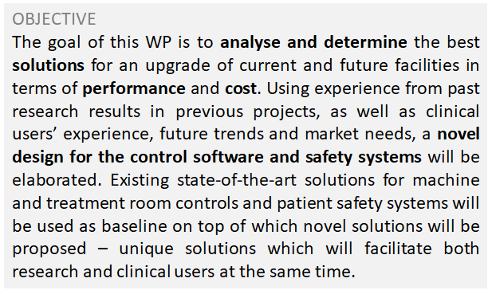
WP 11: Controls and Safety
WP Number: WP11
WP Title: JRA5 - Controls and Safety
Lead beneficiary: Cosylab
Start month: 1
End month: 48
Notes:
10 sec

Slide 4
WP 11: TASKS AND DELIVERABLES
Task 11.1: Technical Coordination (Cosylab)
Task 11.2: Machine controls (Cosylab, MedAustron, IJS)
  D11.1: Design study on novel accelerator control systems
Task 11.3: Treatment room controls (Cosylab, MedAustron)
  D11.2: Design study on novel treatment room control systems
Task 11.4: Patient safety systems (MedAustron, Cosylab)
  D11.3: Design study on novel patient safety systems
Notes:
10 secs

Slide 5
WP11 - Timeline (no deviations)
April 2021
  Start of the project
September 2022
  D11.1 Design study on novel treatment room control systems
March 2025
  End of the project
March 2022
  MS11 Intermediate report on the state-of-the-art treatment room, accelerator control systems, and patient safety systems.
January 2025
  D11.2 Design study on novel accelerator control systems
  D11.3 Design study on novel patient safety systems
Notes:
10 secs

Slide 6
Achievements in the first reporting period - M11
M11 Intermediate report on the state-of-the-art Treatment Room, Accelerator Control Systems, and Patient Safety Systems
Regulatory standards, components’ classification
General requirements for each of the systems
Analysis of their state-of-the-art
Examples of existing systems for each (from MDA and CSL)
Document disseminated during D11.1 Workshop
Notes:
30 secs

Slide 7
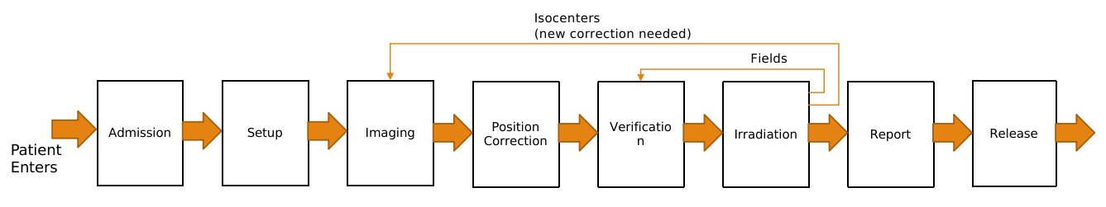
Achievements in the first reporting period - D11.1
D11.1 Design study on novel treatment room control systems
2 workshop sessions to gather innovative ideas (25+ experts)
Functional and non-functional requirements
Design approaches
Notes:
30 secs

Slide 8
Achievements in the reporting period - D11.1
Key findings to advance the Treatment Control Systems state-of-the-art:
Expected better integration between OIS/TCS/Imaging. Unified Workflow
Reduce time of patient in treatment room (e.g. prep/imaging room, automatic workflow steps, auto-patient verification)
Pre-treat Plan verification (e.g. deformable registration + dose calculation)
Multi-room, multi-modal operation (accelerator queue and setup)
Reduce commissioning time (tools:ad-hoc plans, configuration versioning)
Best practices for TCS designs for flexibility and resilience (e.g. decoupling)
Notes:
60 secs

Slide 9
WP11 - Timeline
April 2021
  Start of the project
September 2022
  D11.1 Design study on novel treatment room control systems
March 2025
  End of the project
March 2022
  MS11 Intermediate report on the state-of-the-art treatment room, accelerator control systems, and patient safety systems.
January 2025
  D11.2 Design study on novel accelerator control systems
  D11.3 Design study on novel patient safety systems
Notes:
10 secs

Slide 10
Plans for the next 6 months
No immediate deliverables.
Focus will be on gathering information for Accelerators and Patient Safety from other work packages, especially:
WP3: Promising innovative heavy ion therapy approaches
WP9: RPS Arc-therapy
WP10: Data Distribution and Synchrotron Timing
Additionally, we will focus on preparing dissemination material.
Notes:
30 secs

Slide 11
THANK YOU
mariano.cecowski@cosylab.com
Notes:
60 sec

