Slide 1

HITRIPlus
Knowledge generation through real world data collection when applying innovative treatments: solutions and pitfalls
Prof. Lisa LICITRA
Scientific Director CNAO

Slide 2
Background and Definitions
RCTs remain the highest standard of clinical evidence,
RWD generate knowledge from the vast clinical data aggregated in routine care.
RWD build on retrospective studies, filling gaps to supplement RCTs and generating research hypotheses
RWD can address a number of limitations of RCTs:
resource and time intensiveness;
issues with external generalizability,
narrow practice settings,
patient disparities in access
insufficient power to detect rare events or study uncommon diseases
RWD plays an important role in regulatory reviews but also have serious limitations attributable to bias and data quality.

Slide 3
Registry definition
A patient registry is an organized system that uses observational study methods to collect uniform data (clinical and other) to evaluate specified outcomes for a population defined by a particular disease, condition, or exposure, and that serves one or more predetermined scientific, clinical, or policy purposes
A registry database is a file (or files) derived from the registry.

Slide 4
Purposes of a cancer registry:
To fill knowledge gaps for regulatory decisions
1.by providing natural history data
2.information on standard of care
3.historical comparator cohort/external control arm in trials
4.long term safety and effectiveness data.

Slide 5
Data Standards: Ontologies, DB models…
Systematized Nomenclature of Medicine Clinical Terms (SNOMED-CT)
International Classification of Diseases (ICD)
Observational Medical Outcomes Partnership (OMOP) Common Data Model
Registry quality
Governance
Fundings
Sustainability

Slide 6


Slide 7
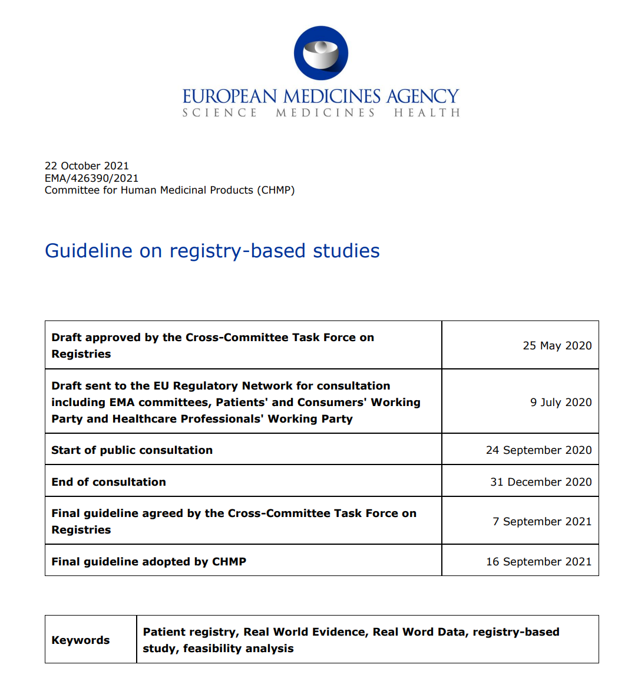
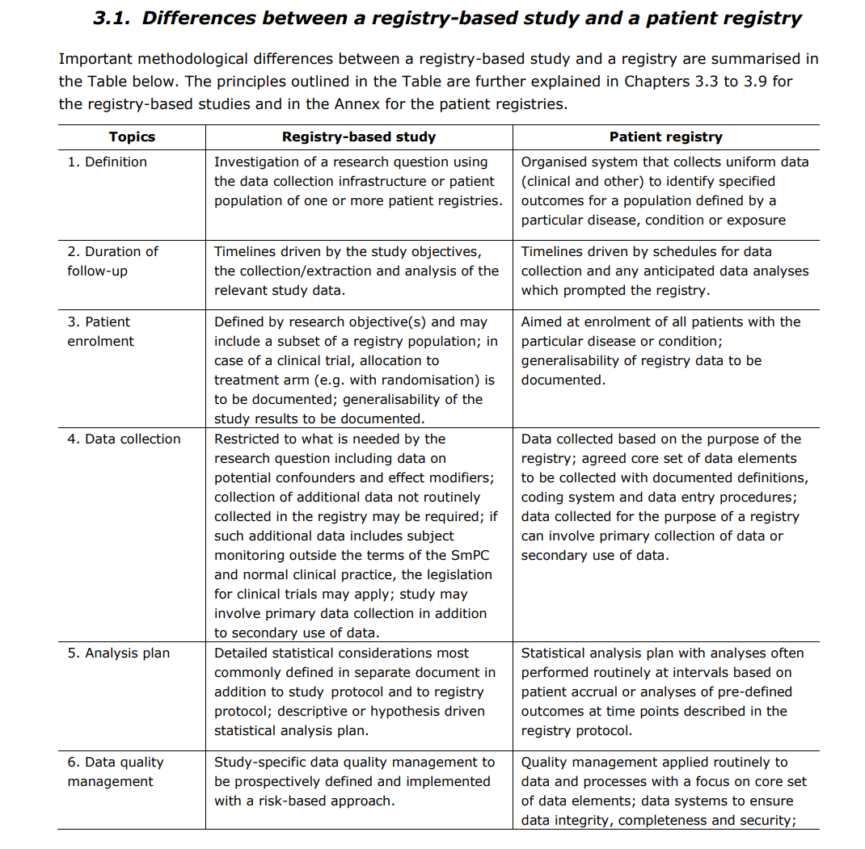

Slide 8
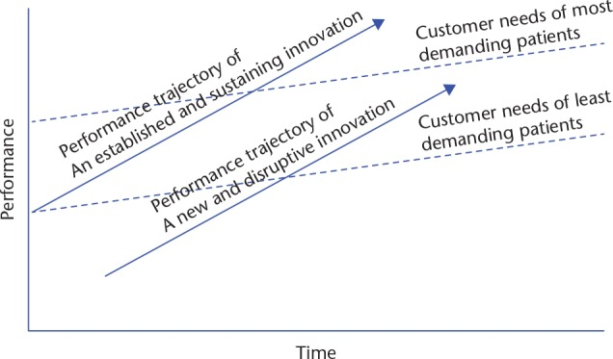
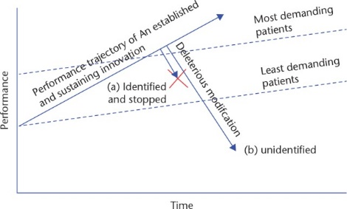
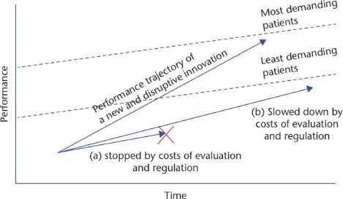

Slide 9
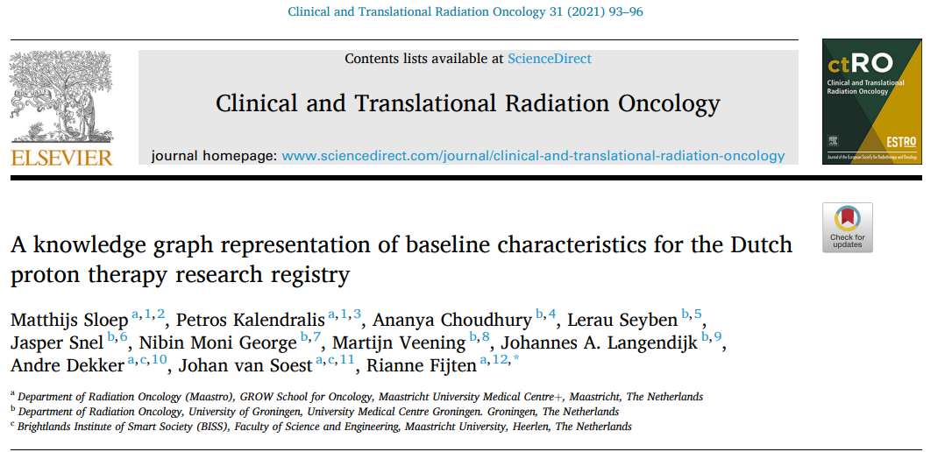
Ongoing experiences
Notes:
.

Slide 10

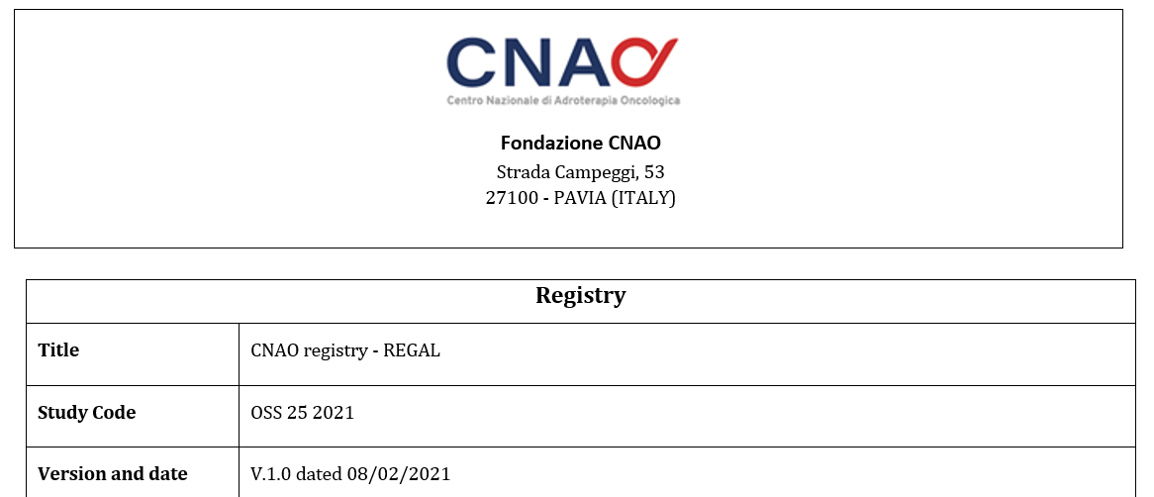
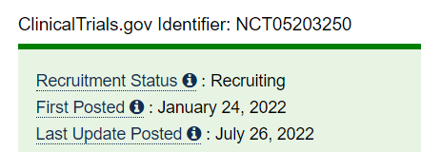

Slide 11
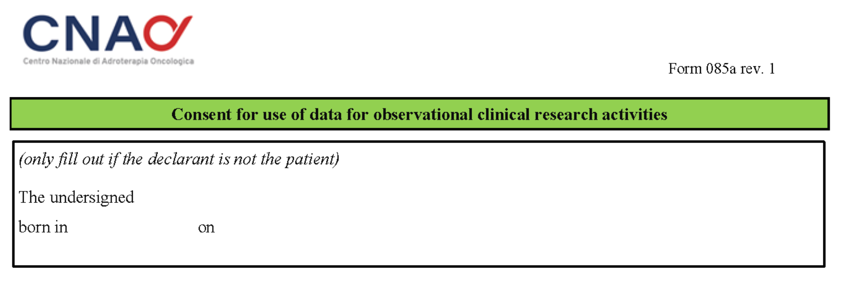
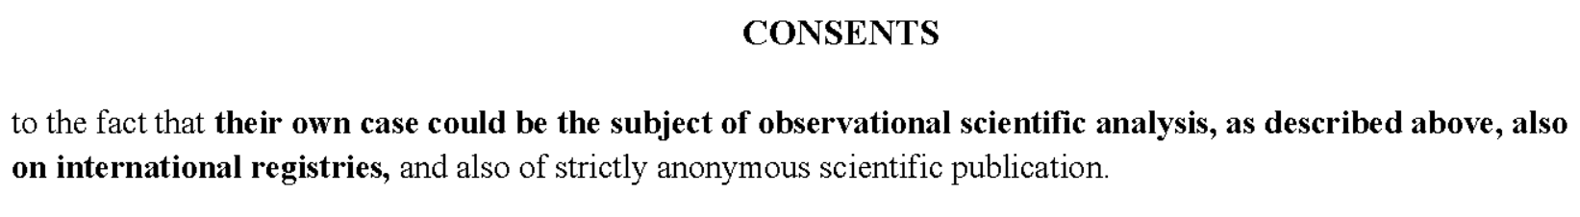

Slide 12
NUMBER OF FIELDS IN REGAL
Patient demographics
Comorbidities
Medical history
Diagnosis: primary and recurrent tumor
Treatment details
Availability of imaging pre and post treatment
Treatment response and tumor control
Toxicities
Concomitant medications
3
1
28
30
56
6
15
6
5

Slide 13
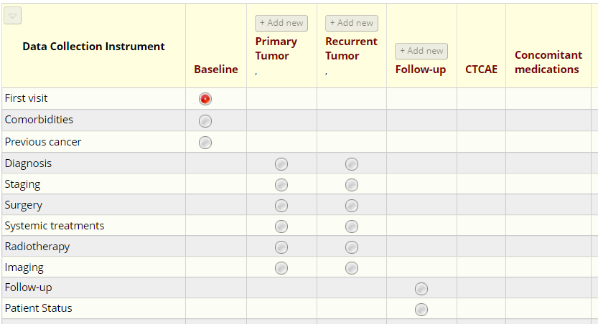

FIELDS IN REGAL

Slide 14
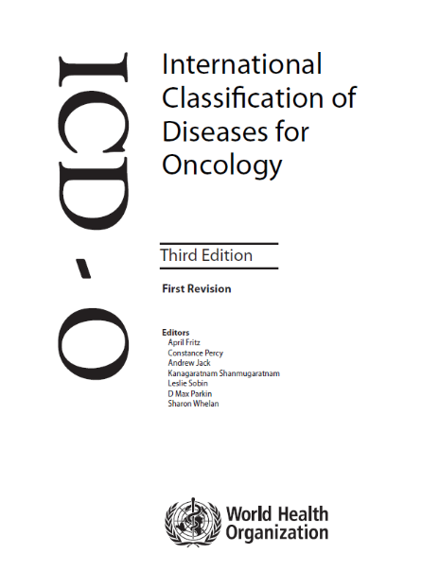
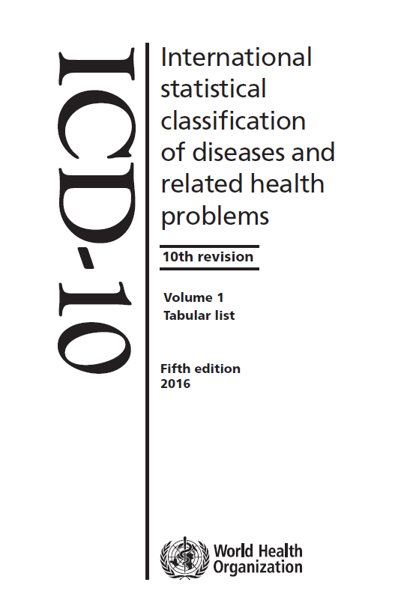
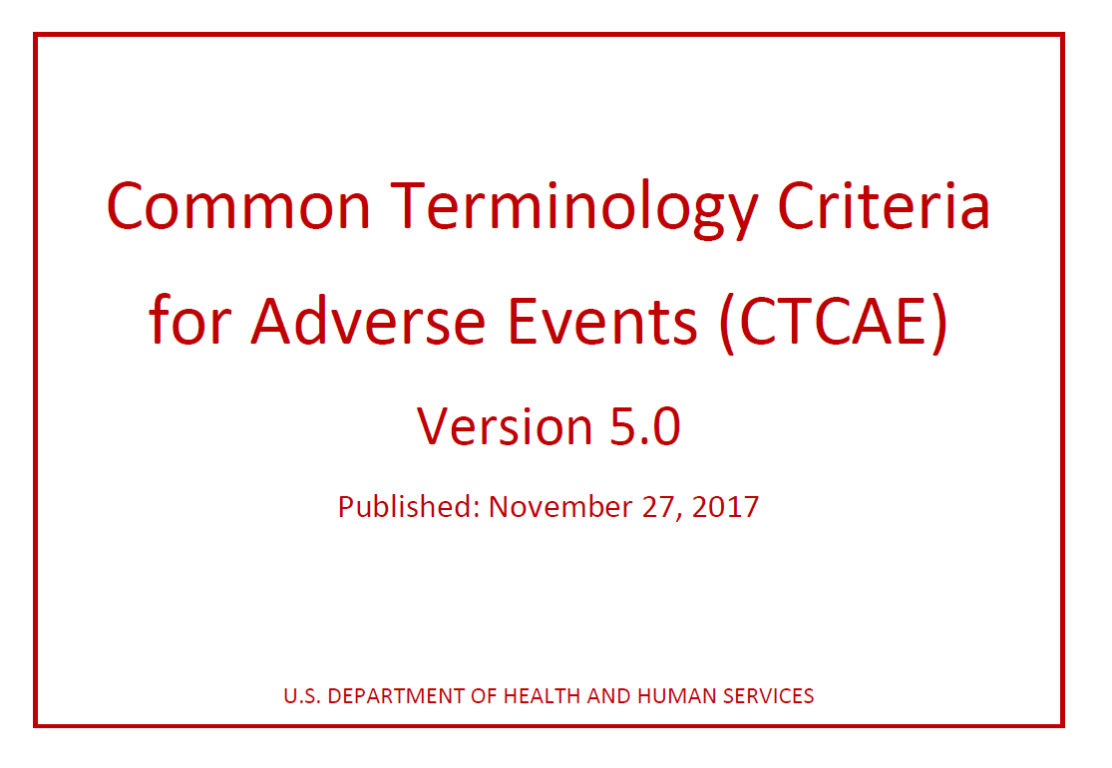


SEMANTICS IN REGAL
Histology and Topography
Diagnosis
Toxicities
Comorbidities
Concomitant Medications

Slide 15
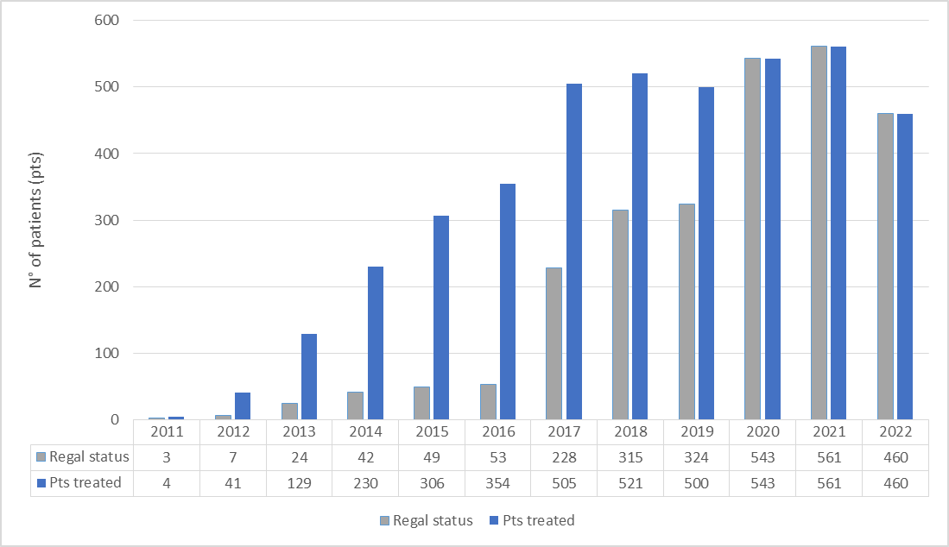
DATA Completion

Slide 16

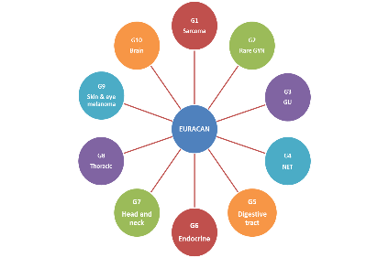


NATIONAL AND INTERNATIONAL REGISTRIES
AIOCC Italian Registry on
Head and Neck Carcinoma
Registry of the European Reference Network on Rare Adult Solid Cancer “EURACAN”
RARITY
AIR Study
Heavy Ion Therapy Research Integration plus
HITRIPlus
REGAL
  CNAO REGistry TriAL

Slide 17
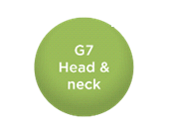
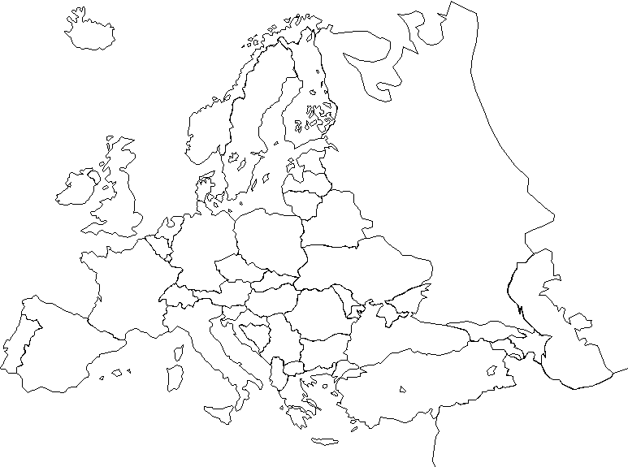


Exploiting and enlarging collaboration
EURACAN
Clinical data
Biological samples
Imaging
l
l
l
l
UK registry
l
l
l
l
l
l
l
l
l
l
l
l
l
l
l
l
l
l
l
l
l
l
l
l
l
l
l
l

Slide 18
Registry objectives
to help describe the natural history of rare head and neck cancers;
to evaluate factors that influence prognosis (e.g. mortality, survival, progression free survival and treatment response;
to assess treatments effectiveness (systemic, radiotherapy, surgery, target therapy, immunotherapy and possible combinations);
to measure indicators of quality of care (diagnostic and staging procedures, treatment strategies, follow-up etc.).

Slide 19

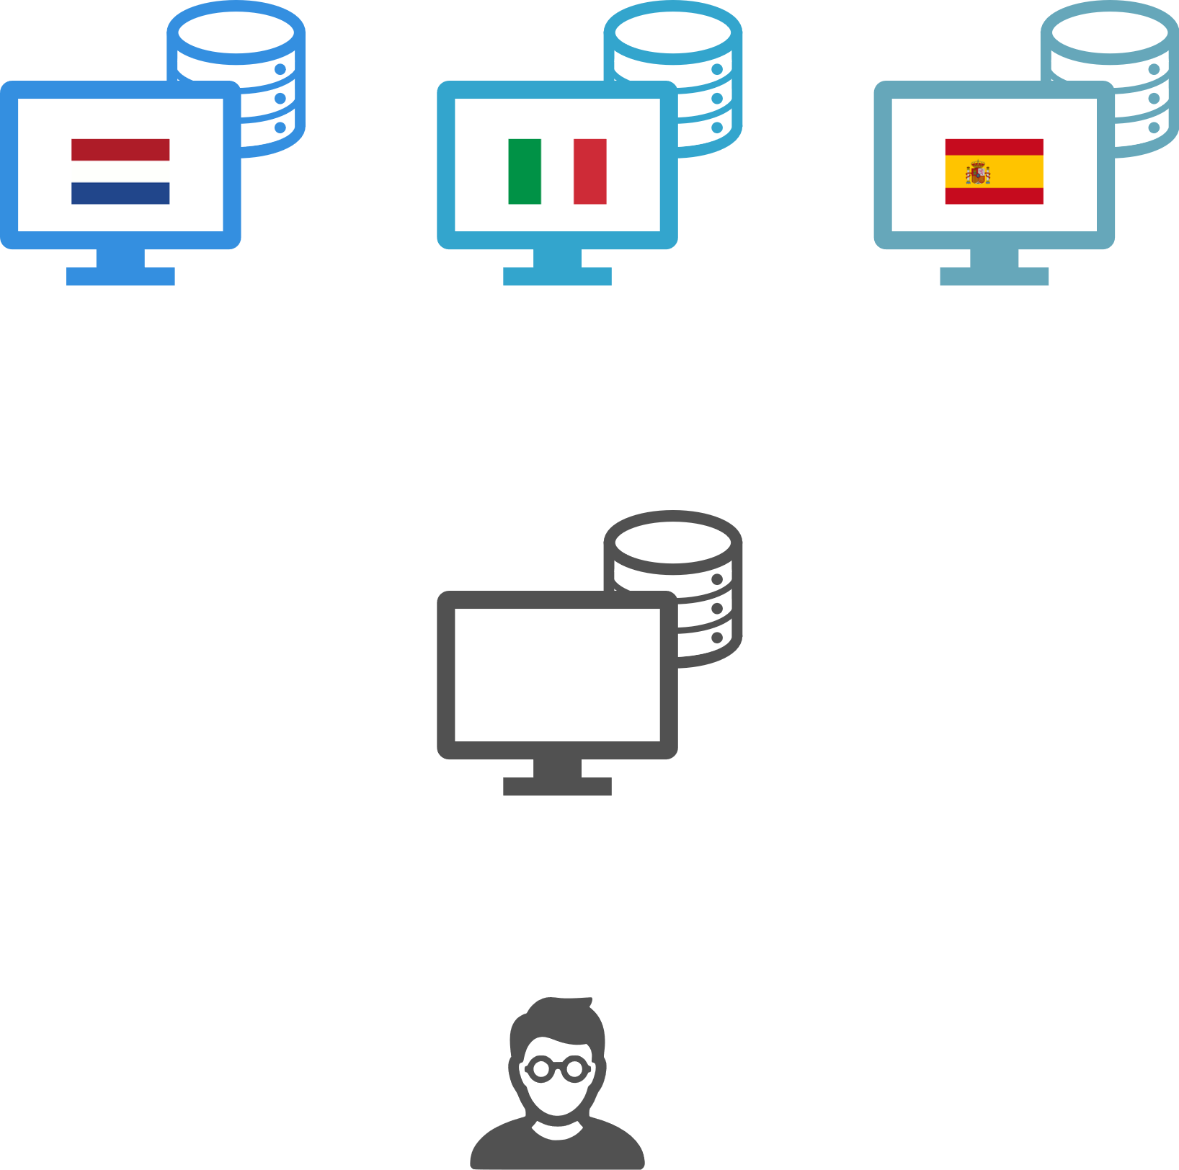
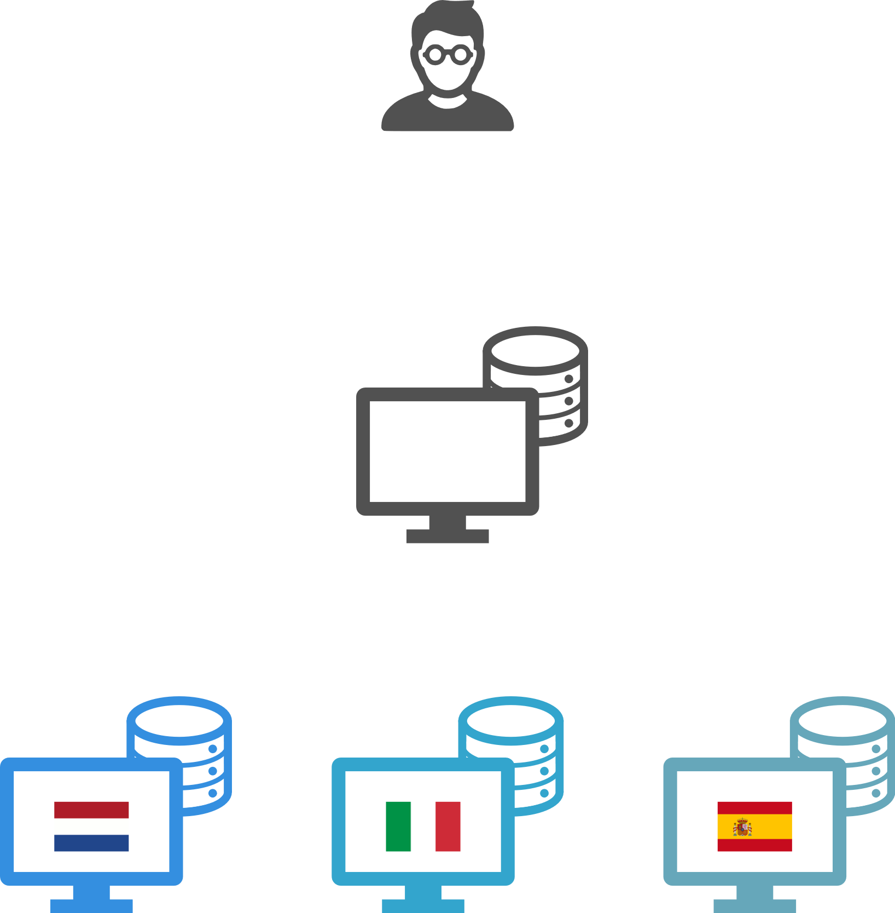
Registry Model
Performing an analysis across multiple decentralized data sources, without exchanging their data.
=
aggregated results
=
data
Centralized approach
Federated learning

Slide 20
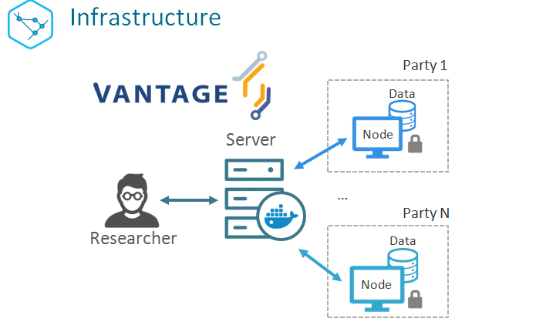

Notes:
:CNAO is developing its infrastracture in thsi way.

Slide 21
Progresses at november 2022
Protocol finalised (by EURACAN, ACC, AIOCC partners and “Global”)
Patient consent for data, for biological sample + patients informative finalised
  Protocol accepted by INT and by all ethic commitees of the Italian partners + Czech Republic
  Data transfer agreement signed with all Italian partners + Czech Republic (discussion on-going with the Netherlands)
  REDCap available in most of EURACAN partners and in all Italian partners
  Vantage6 installation manual ready (installation on going at the Italian centre)
  March 2022 training https://euracan.eu/registries/starter/rare-head-and-neck-cancer-registry/#training
  https://clinicaltrials.gov/ct2/results?recrs=ab&cond=Head+and+Neck+Cancer&term=Trama&cntry=&state=&city=&dist=
  Registry protocol submitted to PLOSone
April 2022: data collection started

Slide 22

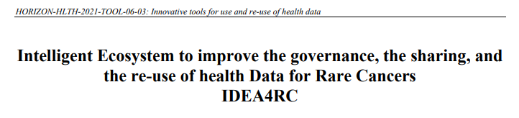
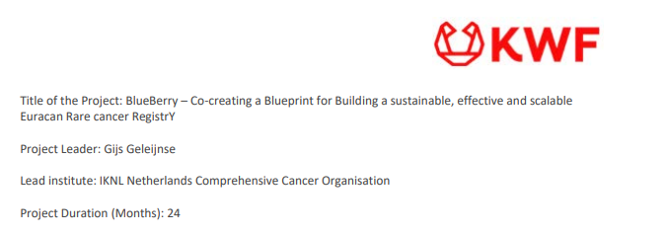




Registry sustainability
ERN Grant 2022-2023: Bridging Grant
Notes:
.

