Slide 1
Management Aspects:
Administrative Aspects
Angelica Facoetti (CNAO)
HITRIplus first reporting period meeting
Wien (Austria)
December 12th - 13th, 2022

Slide 2


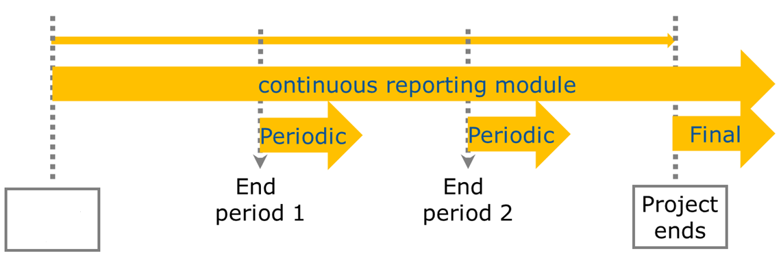
Project reporting obligations
Continuous Reporting (Deliverables, Milestones)
Periodic Reporting (60 days after end of reporting period)
Periodic technical report
Periodic financial report
Final Reporting
Final technical report
Final financial report
Article 19
of the GA
Article 20
of the GA
Month 48
1 April 2021
Month 18
Month 36
31 March 2025
Project starts
Project ends
30 September 2022
31 March 2024
All reporting done electronically through the Participant Portal.

Slide 3

Periodic reporting module – 1st period
Activated after the end of each reporting period
All beneficiaries complete their own Financial Statement and their contribution to the Technical Part of the Periodic Report.
Beneficiaries e-sign and submit their Financial Statements to the Coordinator.
The Coordinator approves the elements of the Periodic Report & submits to the EU Services.
EU services review the submitted Periodic Report and accept or reject it.
The PO/ FO may request additional documents/ justifications/ explanations
Approval and Payment

Slide 4
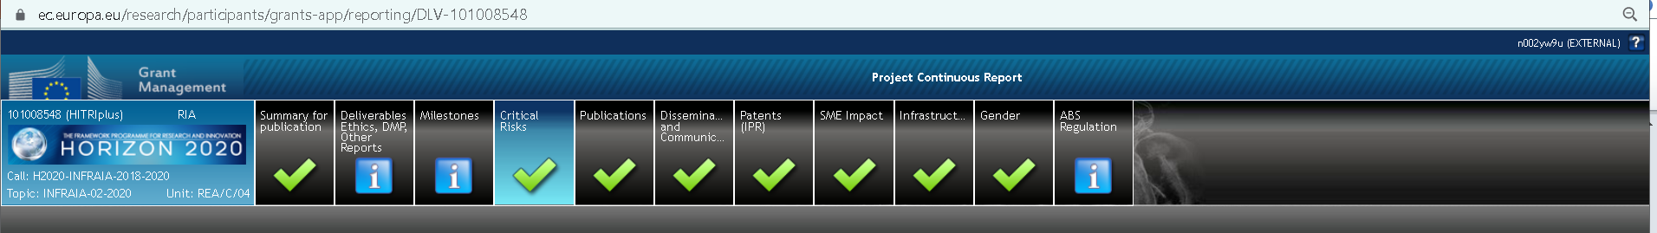
Continuous Reporting
The continuous reporting functionality is available as soon as the project starts to submit information about the progress of the project.
This includes:
deliverables
progress in achieving milestones
updates to the publishable summary
response to critical risks, publications, communications activities, IPRs.
All this information is automatically compiled to create part A of every technical periodic report.

Slide 5
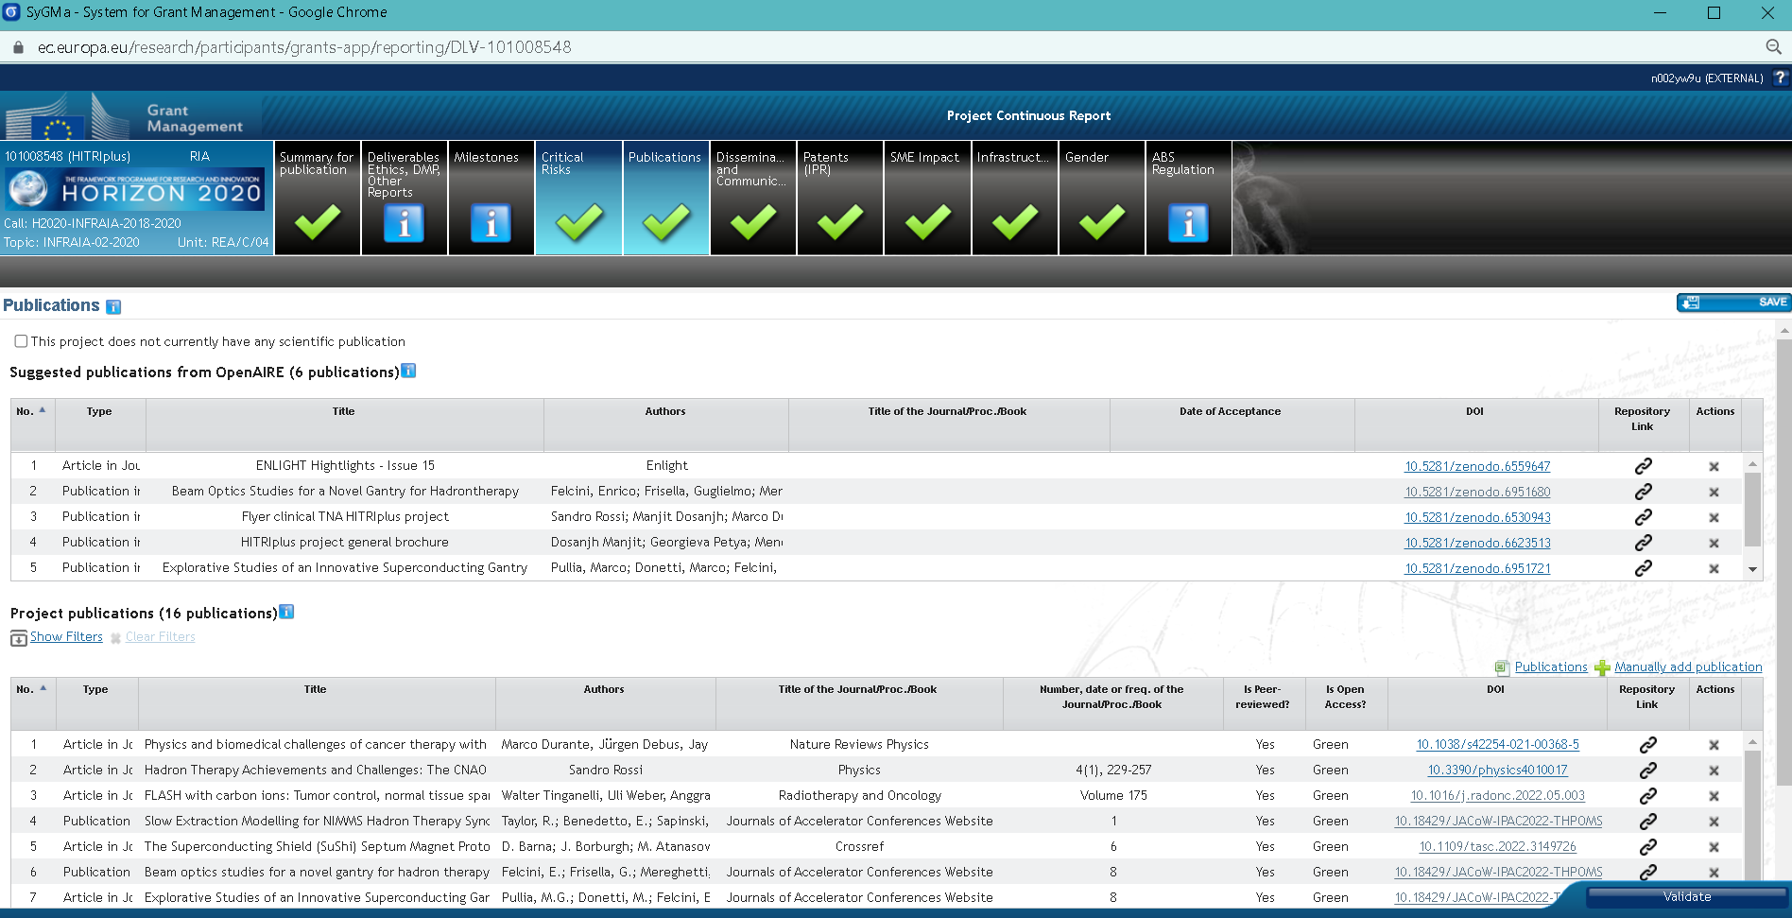

Slide 6
ZENODO (https://zenodo.org)
Zenodo is an open repository for all scholarship, enabling researchers from all disciplines to share and preserve their research outputs, regardless of size or format.
Zenodo makes scientific outputs of all kinds citable, shareable and discoverable for the long term.
All uploads get a Digital Object Identifier (DOI) to make them easily and uniquely citeable
Zenodo accepts any file format.
Zenodo allows you to link uploads to grants from more than 11 funders such as European Commission, National Science Foundation and Wellcome Trust. Zenodo is further integrated into reporting lines for research funded by the European Commission via OpenAIRE.

Slide 7
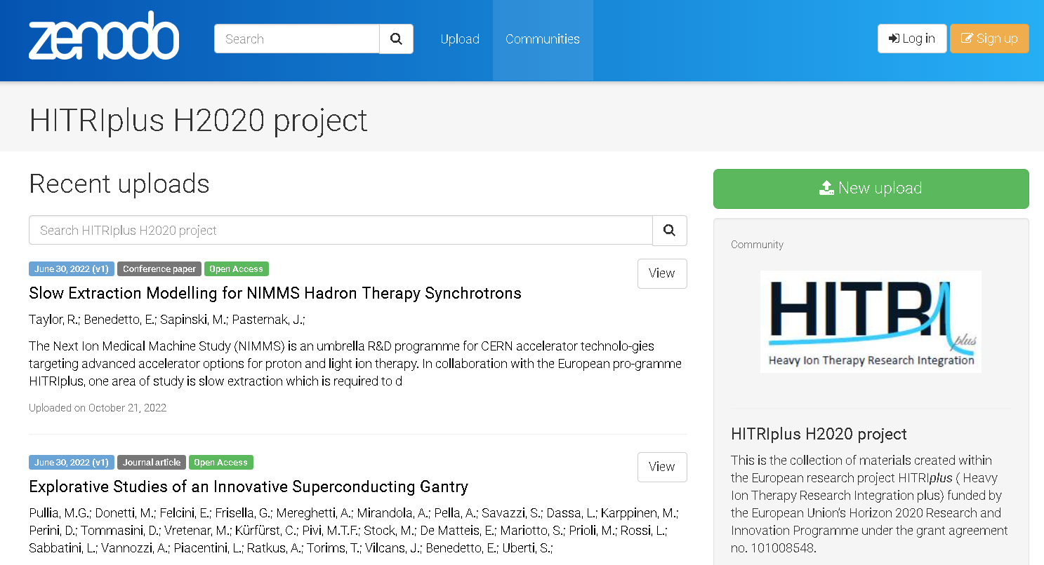
Zenodo is an open repository that makes scientific outputs of all kinds citable, shareable and discoverable for the long term. All uploads get a Digital Object Identifier (DOI) to make them easily and uniquely citeable. Any file format.
→ Zenodo is integrated into reporting lines for research funded by the European Commission via OpenAIRE.
https://zenodo.org/communities/hitriplus/?page=1&size=20

Slide 8
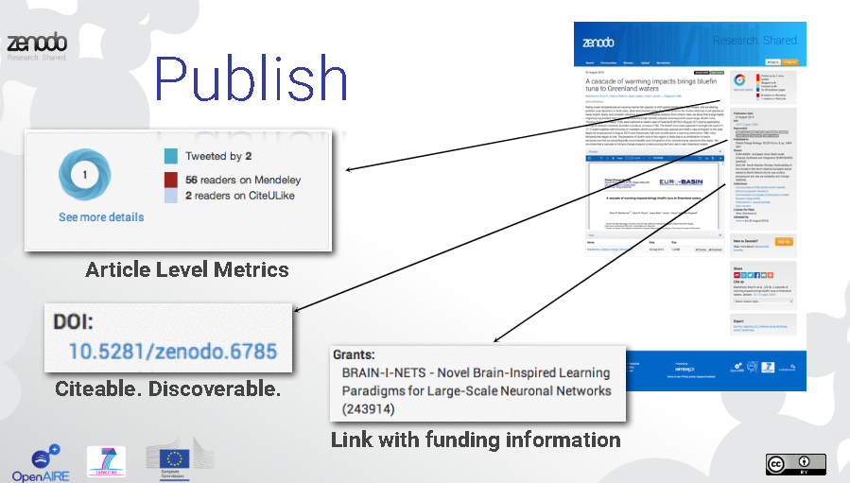

Slide 9

Pubblications
Manuscripts/deliverables must be submitted to the Editorial Board by the Work Package leader within 2 weeks before the deadline. Abstracts for congresses or meetings must be proposed at least 1 day before the deadline. Silent assent applies in the latter case. A dedicated folder for all approved documents is available at:
https://drive.google.com/drive/folders/0AB4EIR-vgifeUk9PVA
Please refer to our project as “HITRIplus”
ACKNOWLEDGEMENTS!!!!!
“This project/research/study was (partially) supported by the European Union’s Horizon 2020 research and innovation programme under grant agreement no. 101008548 (HITRIplus)”

Slide 10
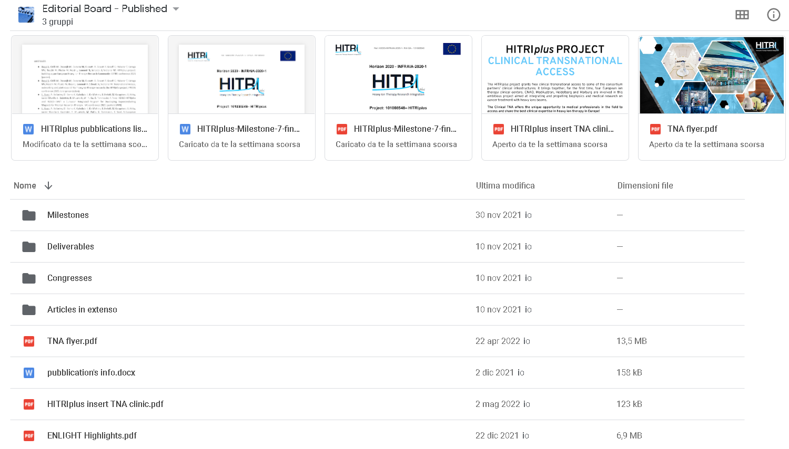
Google DRIVE
https://drive.google.com/drive/folders/0AB4EIR-vgifeUk9PVA

Slide 11
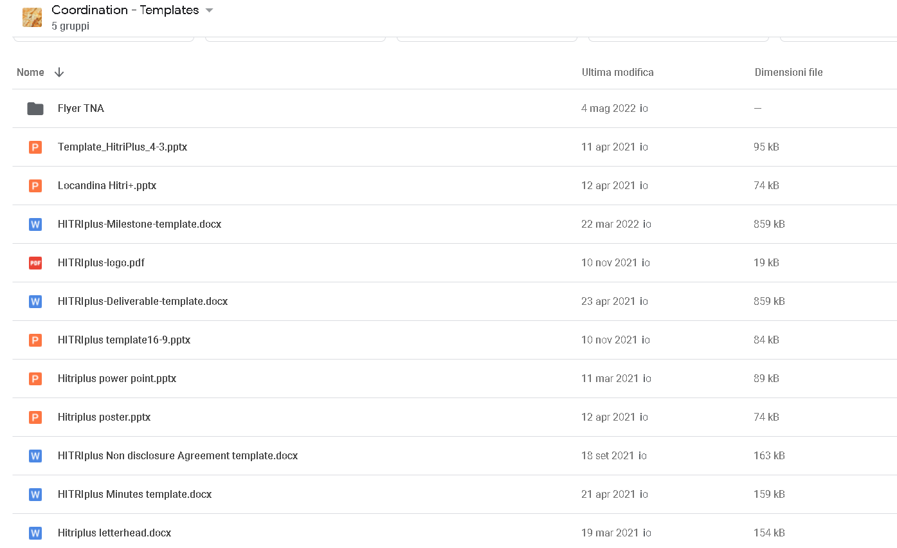
Google DRIVE
https://drive.google.com/drive/folders/0ACt1MlolAAr3Uk9PVA

Slide 12
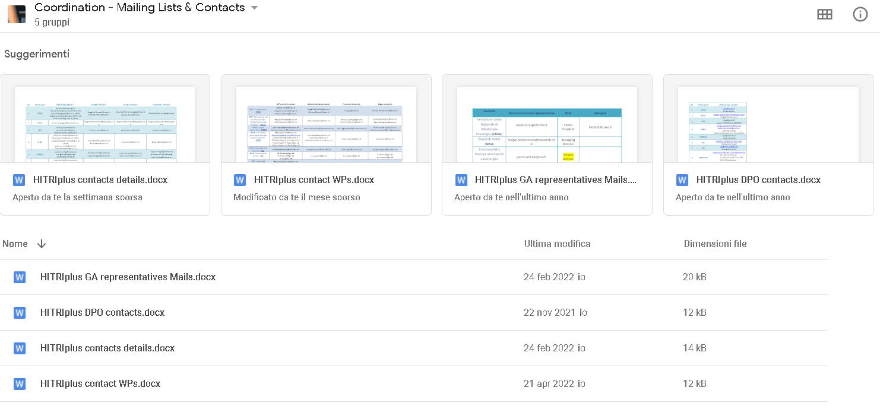
Google DRIVE
https://drive.google.com/drive/folders/0AL428rZQDgfTUk9PVA

Slide 13
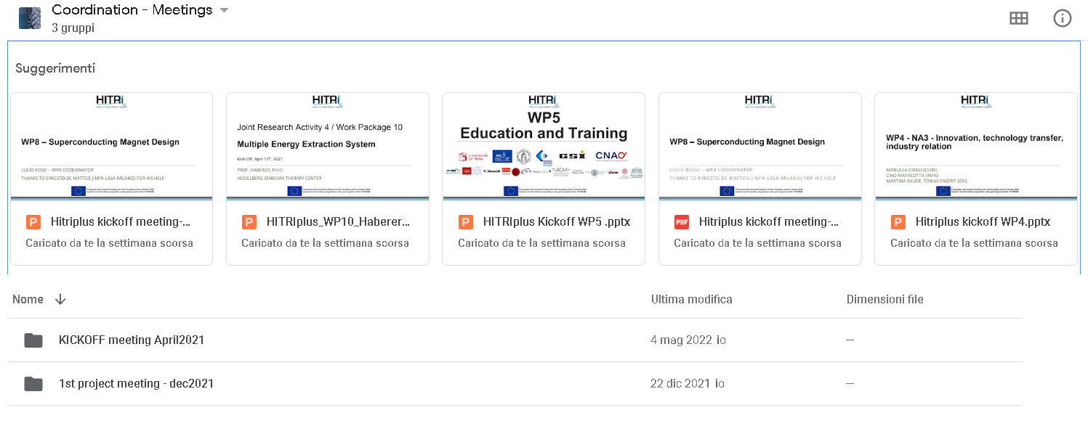
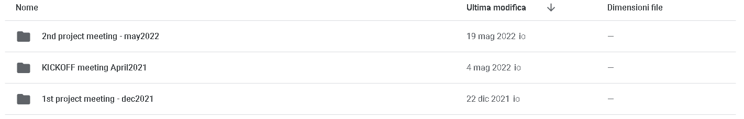
Google DRIVE
https://drive.google.com/drive/folders/0ALSC0vORENsdUk9PVA

Slide 14
Project reporting obligations
Continuous Reporting (Deliverables, Milestones)
Periodic Reporting (60 days after end of reporting period)
Periodic technical report
Periodic financial report
Final Reporting
Final technical report
Final financial report
Article 19
of the GA
Article 20
of the GA
Month 48
1 April 2021
Month 18
Month 36
31 March 2025
Project starts
Project ends
30 September 2022
31 March 2024
All reporting done electronically through the Participant Portal.

Slide 15
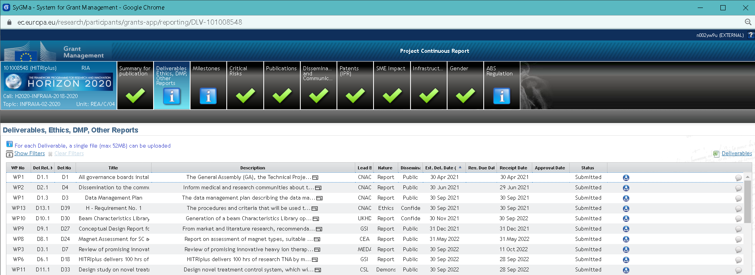
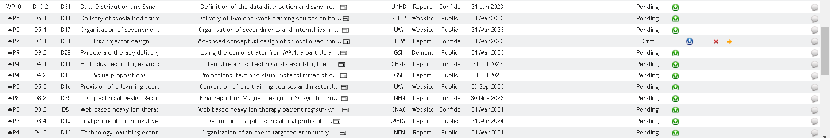
1° reporting period
2° reporting period

Slide 16
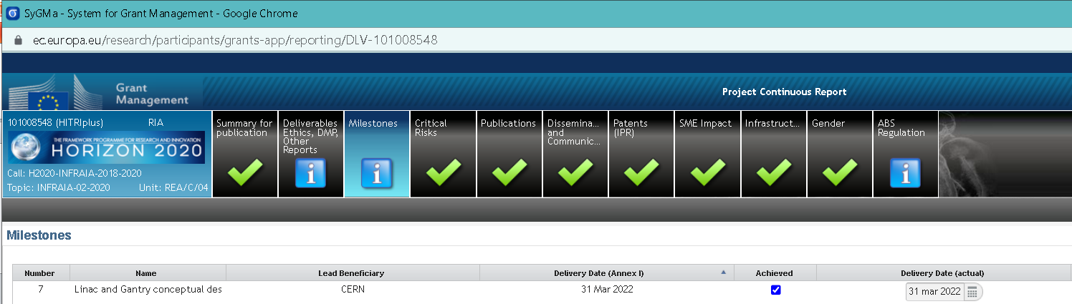
1° reporting period
2° reporting period

Slide 17
THANK YOU!!!

