Slide 1

Long-baseline Atom Interferometer Ambient Environmental Site Requirements
Jeremiah Mitchell
14 March 2023
Terrestrial Very-Long-Baseline atom Interferometry Workshop

Slide 2
Outline
Impact of ambient noise
Seismic
Atmospheric
Site selection

Slide 3
Ambient effects and phase shift
Consider effects which affect the propagation phase i.e. the wavefunction trajectories (Newtonian Noise, to be discussed later)
Time-dependent gravitational potential fluctuations sourced by density fluctuations
Notes:
w.r.t. single-photon clock atom interferometry, since kgT^2 is then associated with \Delta \phi_prop instead of laser phase

Slide 4
Local vibrations
Motion of floors and walls for mounting
Connection couples into shot-shot variations of phase shift
  Steering optics and mirrors for interaction lasers, optics and systems associated with the cold atom cloud production
Mitigated through damping, isolation, or decoupling
Actively tracked through auxiliary instrumentation
2021 Quantum Sci. Technol. 6 044003

Slide 5
Seismic waves
P-waves
  Longitudinal body waves
S-waves
  Transverse body waves
Rayleigh waves
  Surface waves in counter-elliptical motion
Love waves
  Horizontal surface waves

Slide 6
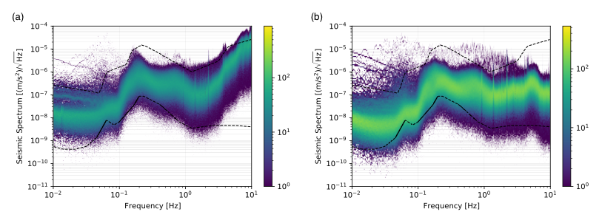
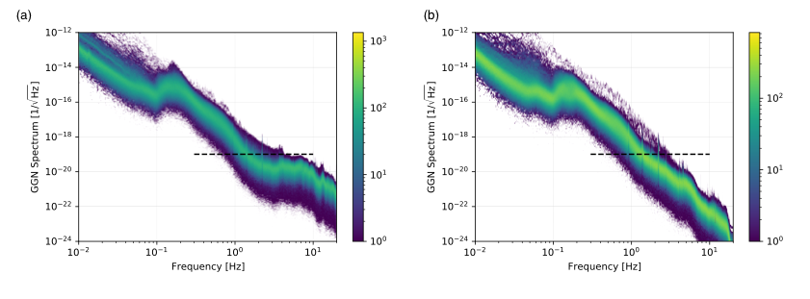
Seismic gravity gradient noise (GGN)
Coupling of test masses to gravitational potential perturbations
Present for test masses in vacuum and free-fall
Rayleigh waves dominant source close to surface
Cannot screen gravity
  Use density perturbation characteristics
2022 JINST 17 P01007
Notes:
- Rayleigh wave modes – only dominant in theory but not empirically proven
- Underground body waves do have an impact

Slide 7
Atmospheric gravity gradient noise
Any time-dependent density perturbation = GGN
Weather systems
Scale of these fluctuations and duration push into target frequency band (0.1 Hz, 10 Hz)
Worked out effects in terms of large-scale horizontal laser interferometers
Active investigation for atom interferometry
2008 Class. Quantum Grav. 25 125011

Slide 8

Infrasound (pressure wave) sourced
Infrasound in atmospheric boundary layer travels like waveguide
Reflection and absorption off ocean waves leads to Rayleigh surface waves
Reflection off land mass leads to standing fluctuations
$$δh∝1/f^{6}$$

Slide 9
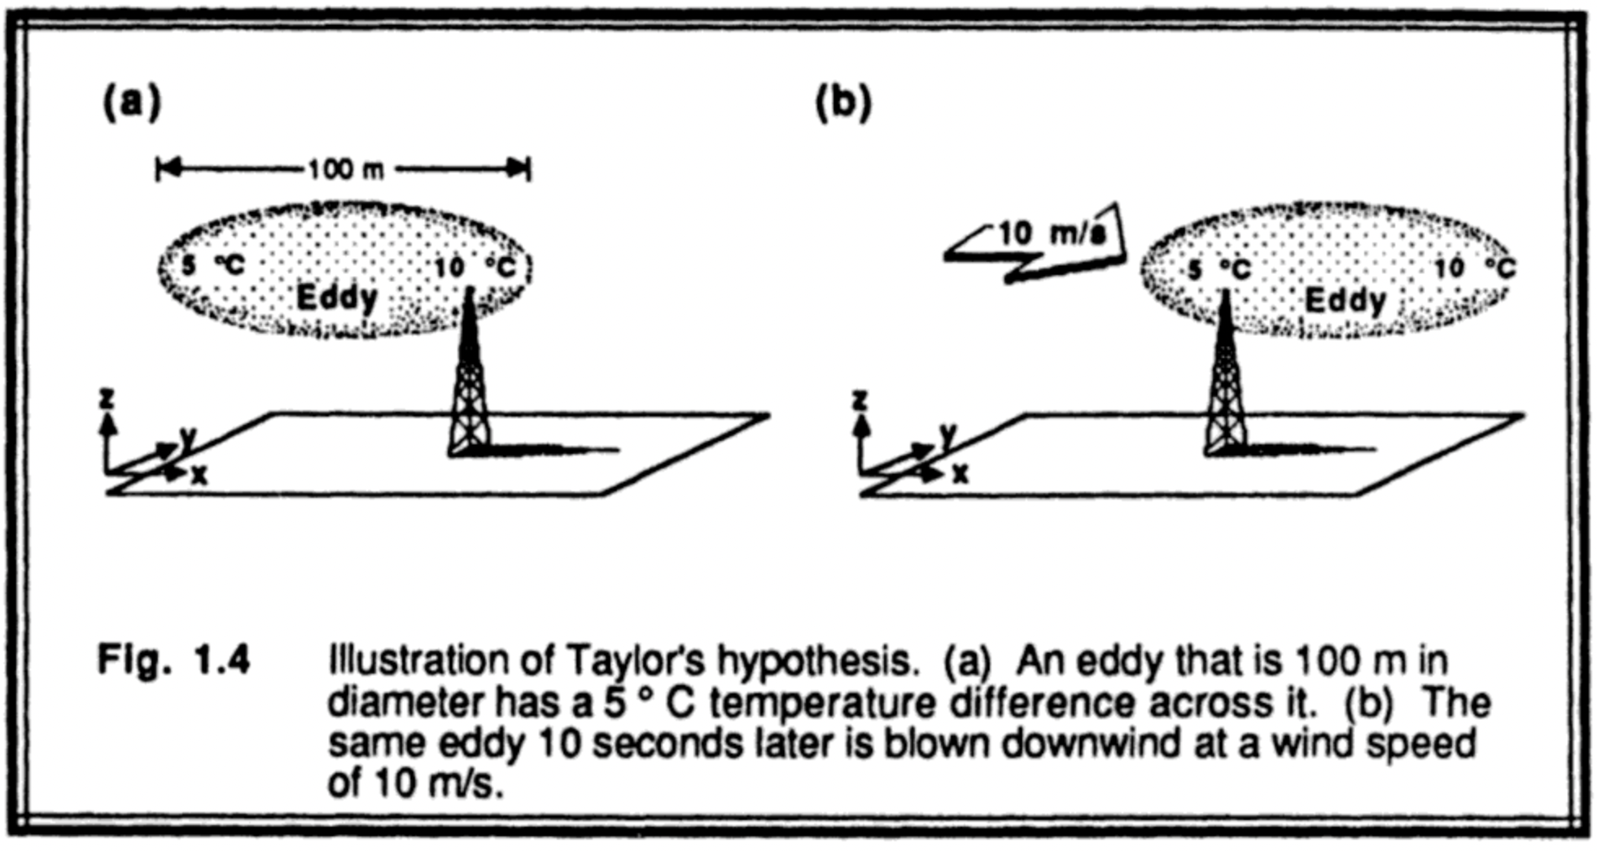
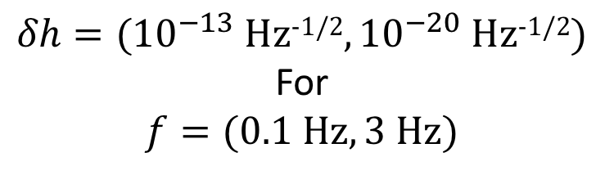
Advected temperature gradients
Taylor’s hypothesis of turbulence: eddies correspond to spatial gradients with an advection velocity
Characterized by temperature fluctuation spectrum
Not of much concern in higher frequency detection ranges
Leading atmospheric GGN for low frequencies
Stull, R. B. (1988). Springer Science & Business Media.
$$δh=({10}^{−13} \text{Hz}\text{−1/2},{10}^{−20} \text{Hz}\text{−1/2})$$
For
$$f=(0.1 \text{Hz}, 3 \text{Hz})$$
Notes:
Strain for horizontal configuration L=4km, v=20m/s at the surface

Slide 10
What does this mean for site selection?
Atmospheric effects → Go underground, monitor weather precisely, Large structures around detectors to increase distance between test mass and density fluctuation
Seismic effects → Find quiet site, stable seasonal variations, understand and quantify the power spectral densities, auxiliary instrumentation for monitoring

Slide 11
Summary
Ambient environmental noise in atom interferometers is highly site specific
One can attempt to find either quiet site i.e. low amplitude noise, or highly stable site where noise power can be well predicted
Mitigations include going underground, building large structures for shielding, active monitoring and feedback
  In-situ
  Auxiliary weather and seismic sensor arrays
Very active area of research with upcoming workshop between Earth sciences and Atom interferometry
Notes:
- Using correlations between AI measurements and sensor arrays, post processing, active feedback filtering via Weiner filters or Kalman filtering

Slide 12
Thanks
Kavli-Newton Trust
MAGIS-100 and AION collaborations

Slide 13
Backups

