Slide 1


A Vertical Atom Interferometer at
CERN LHC Point 4
Sergio Calatroni on behalf of the Feasibility Study Group
14.03.2023

Slide 2
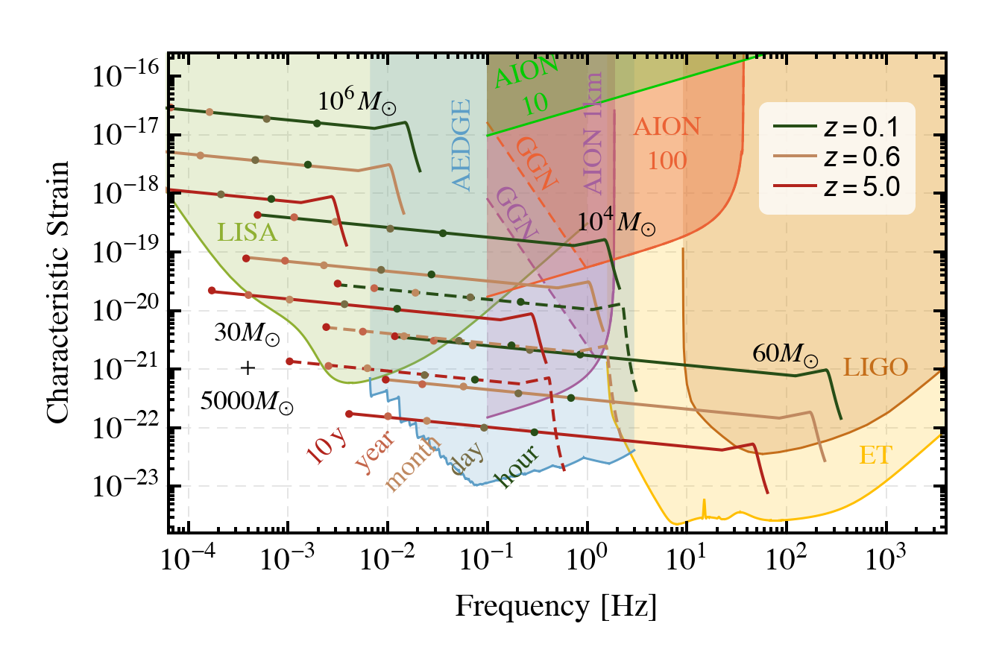
Motivation for atom interferometer

Slide 3
Motivation
Identify location for a vertical AI ~100 m deep at CERN
Site already part of a large international laboratory and experimental facility
Assess technical feasibility and impact from presence of LHC machine
Based on AION-100 technical requirements as guideline
“A Long-Baseline Atom Interferometer at CERN: Conceptual Feasibility Study”
CERN-PBC-REPORT-2023-002, https://cds.cern.ch/record/2851946

Slide 4
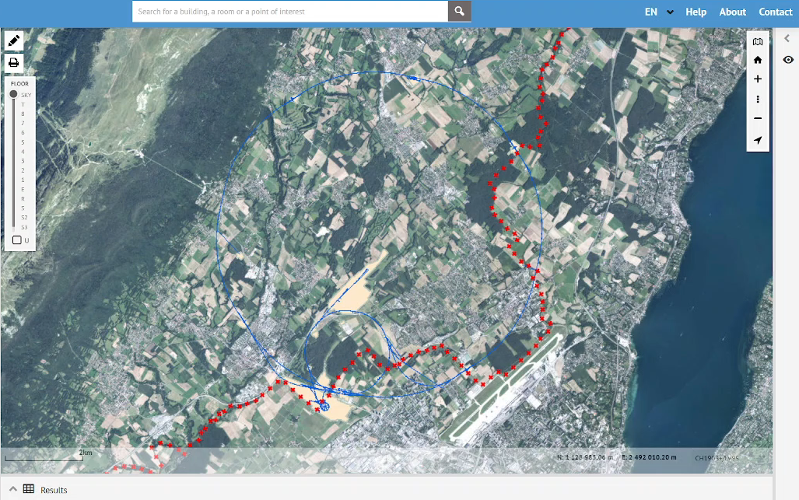
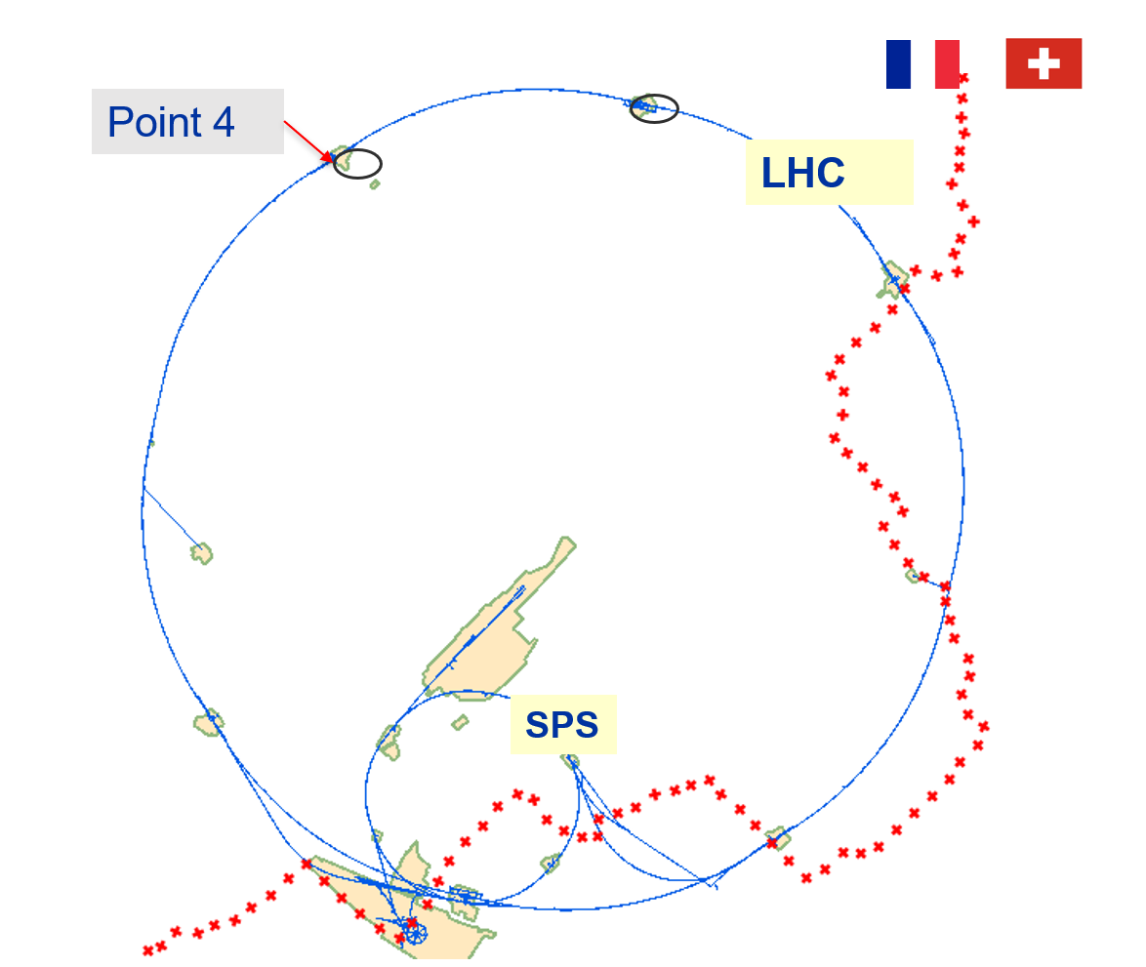
LHC Point 4

Slide 5
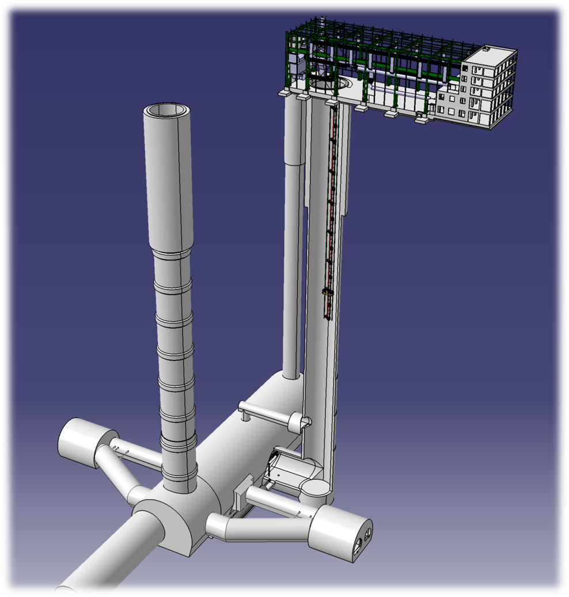
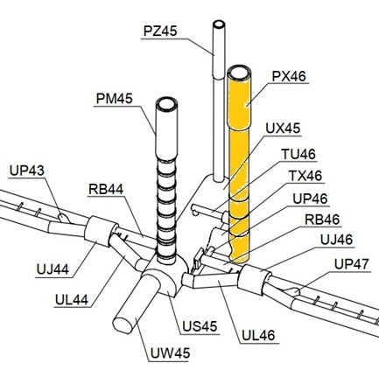
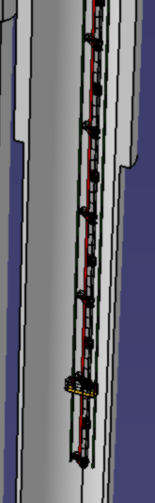
Selected location: PX46
Depth
143 m

Slide 6
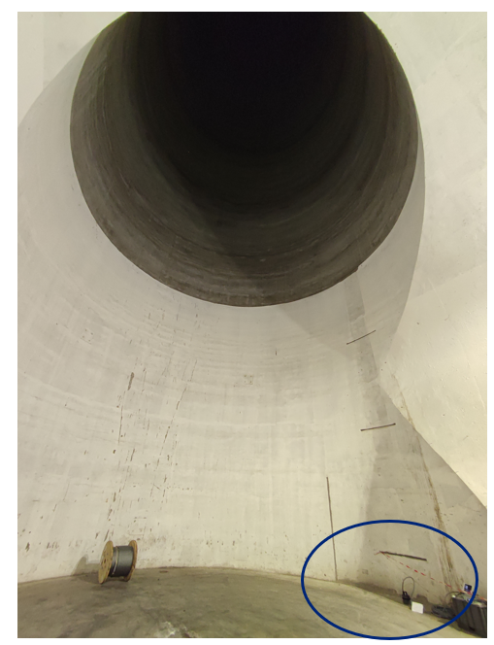
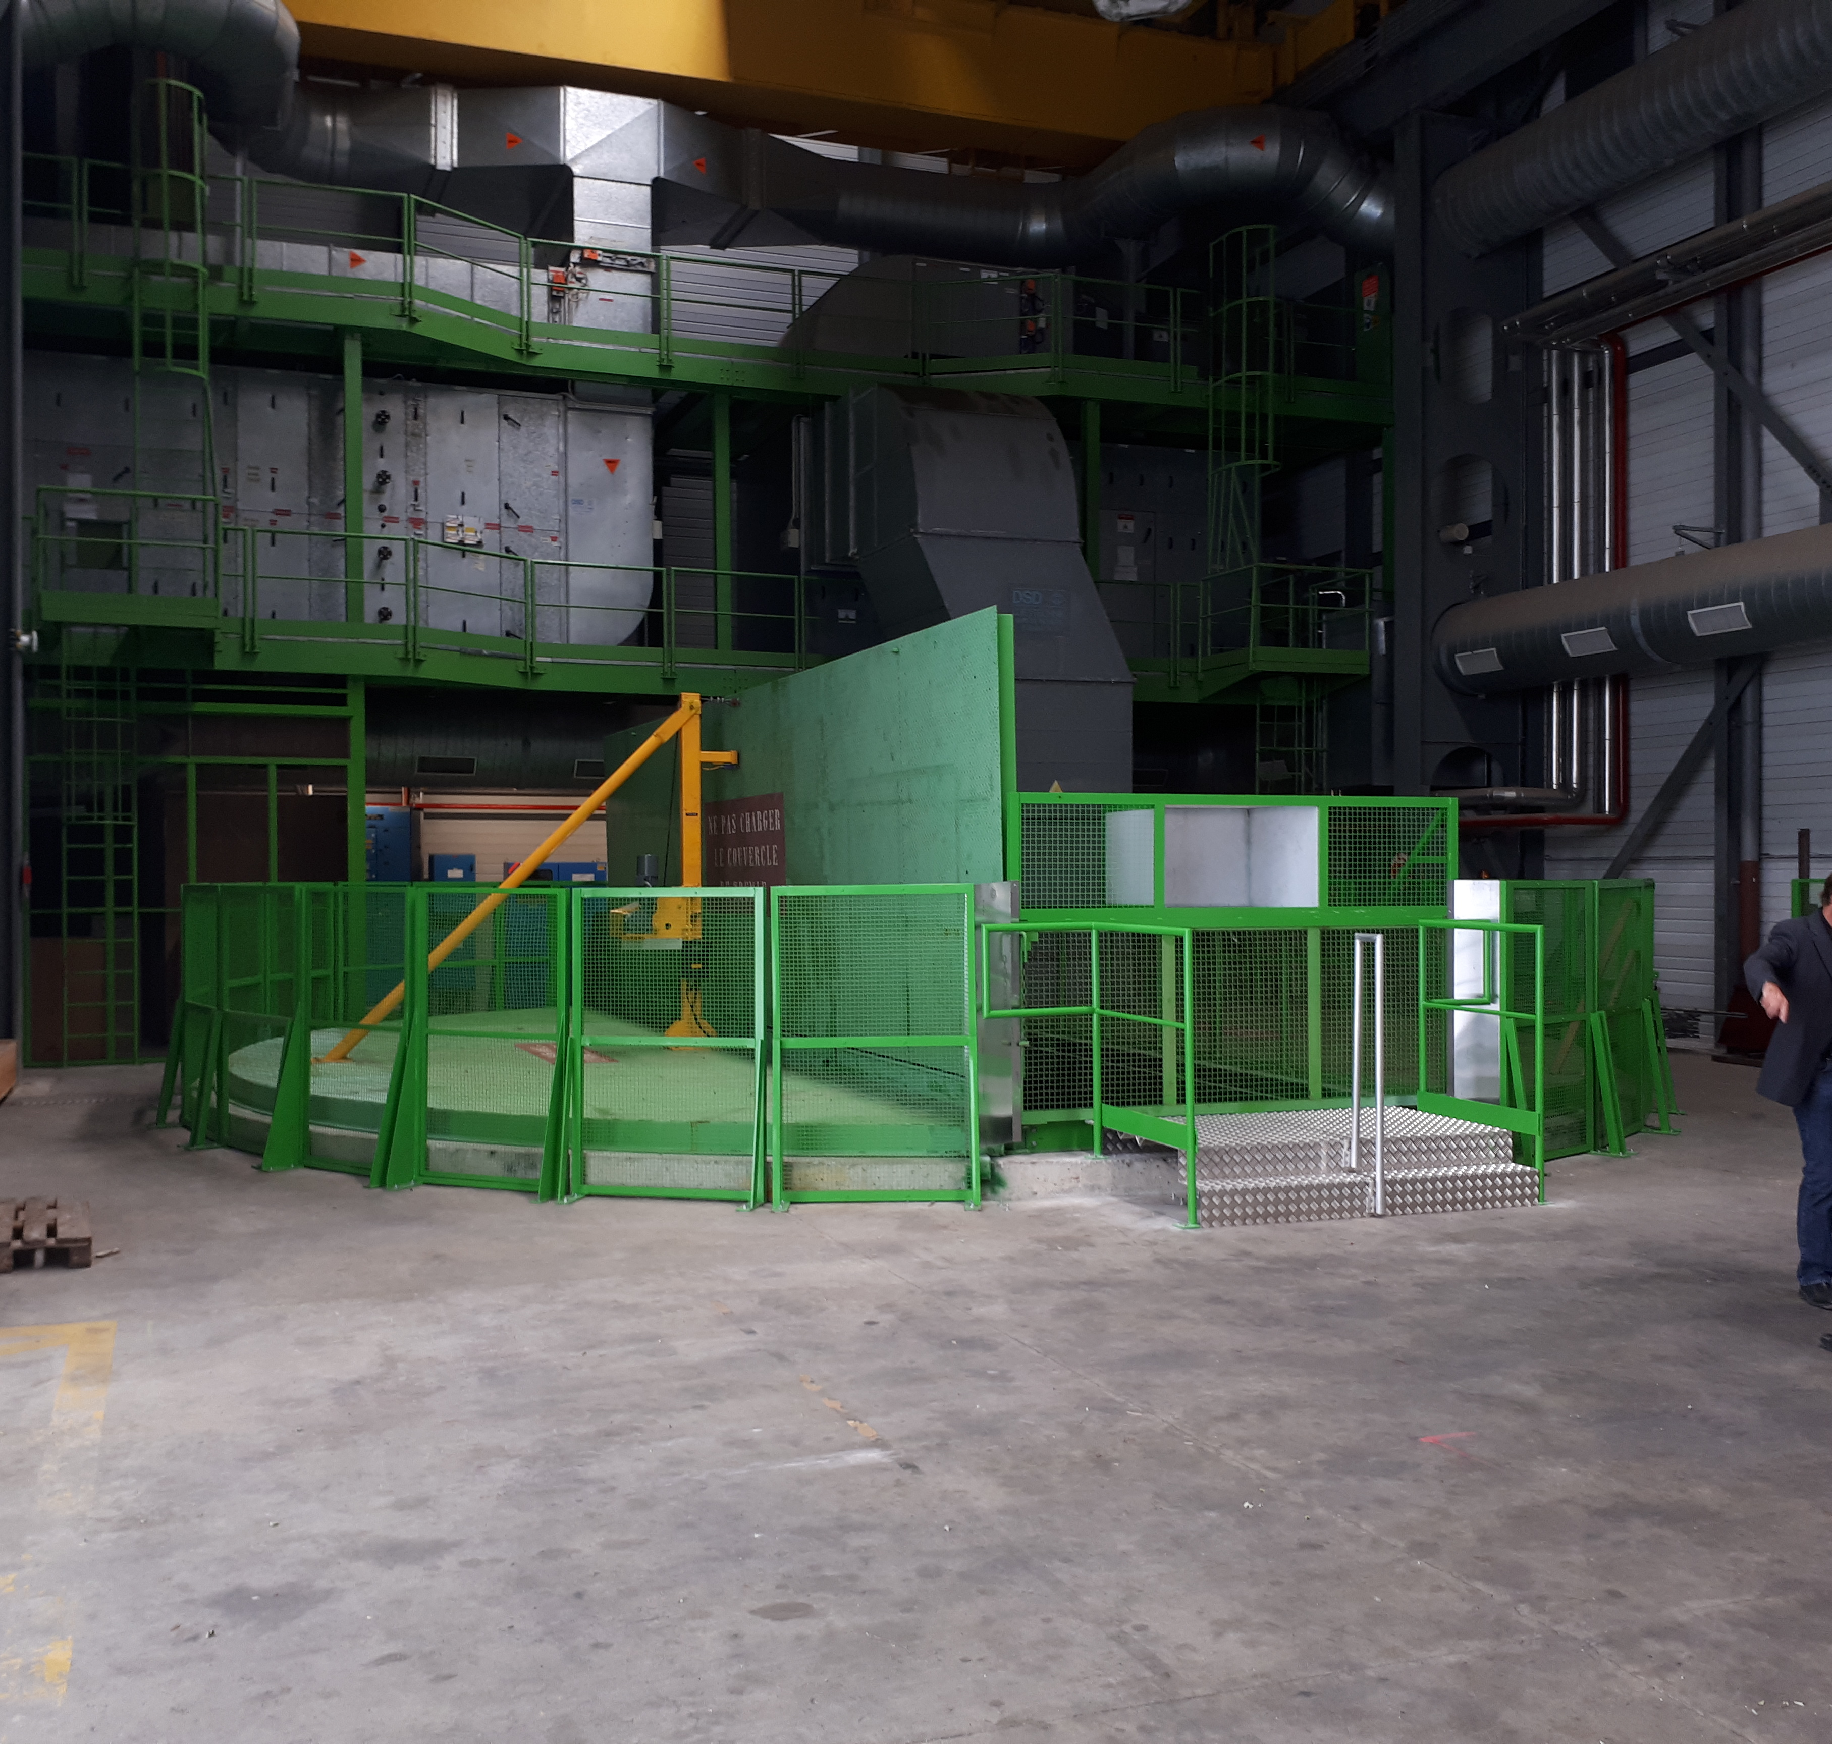
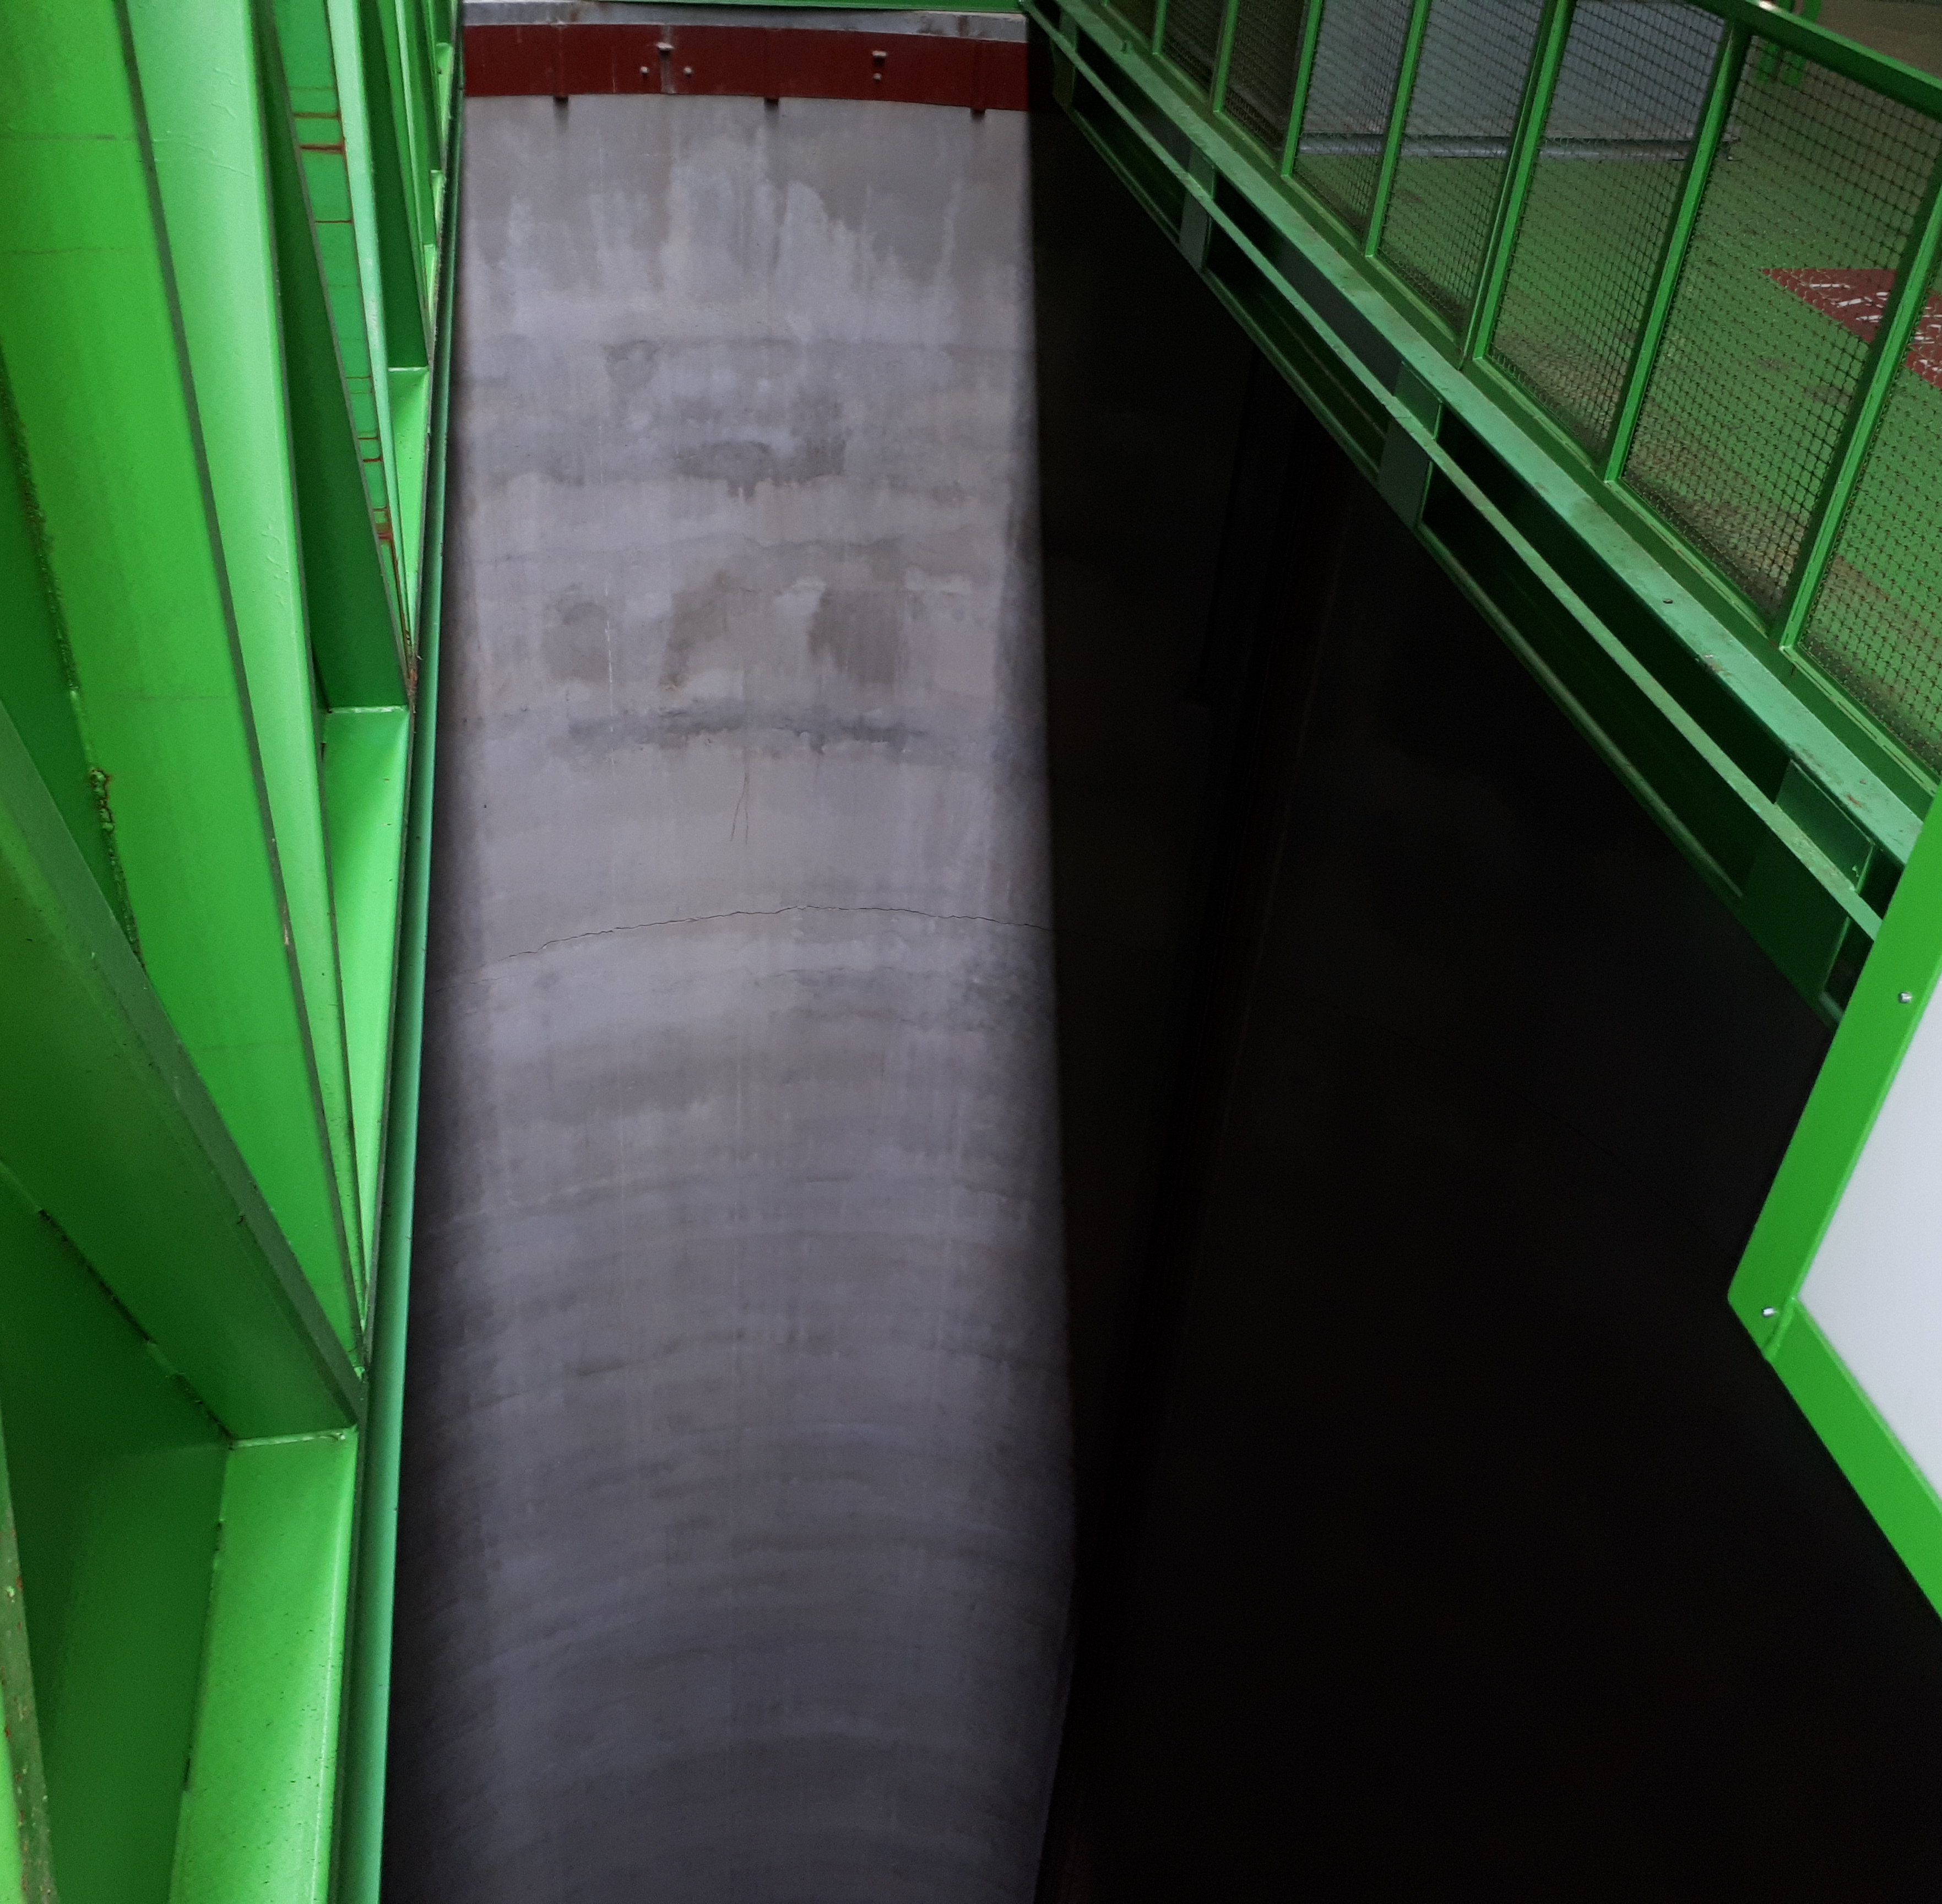
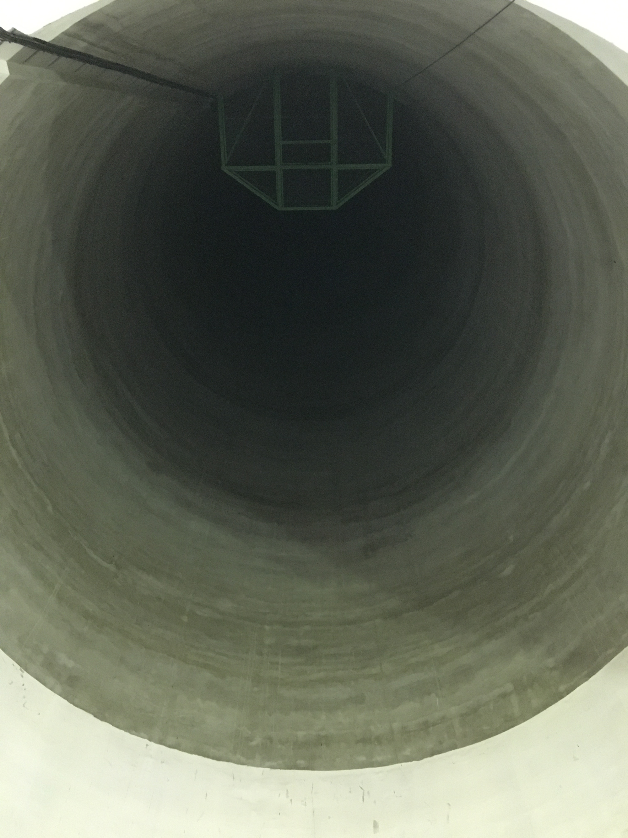
Selected location: PX46
View from below
Views at the surface

Slide 7
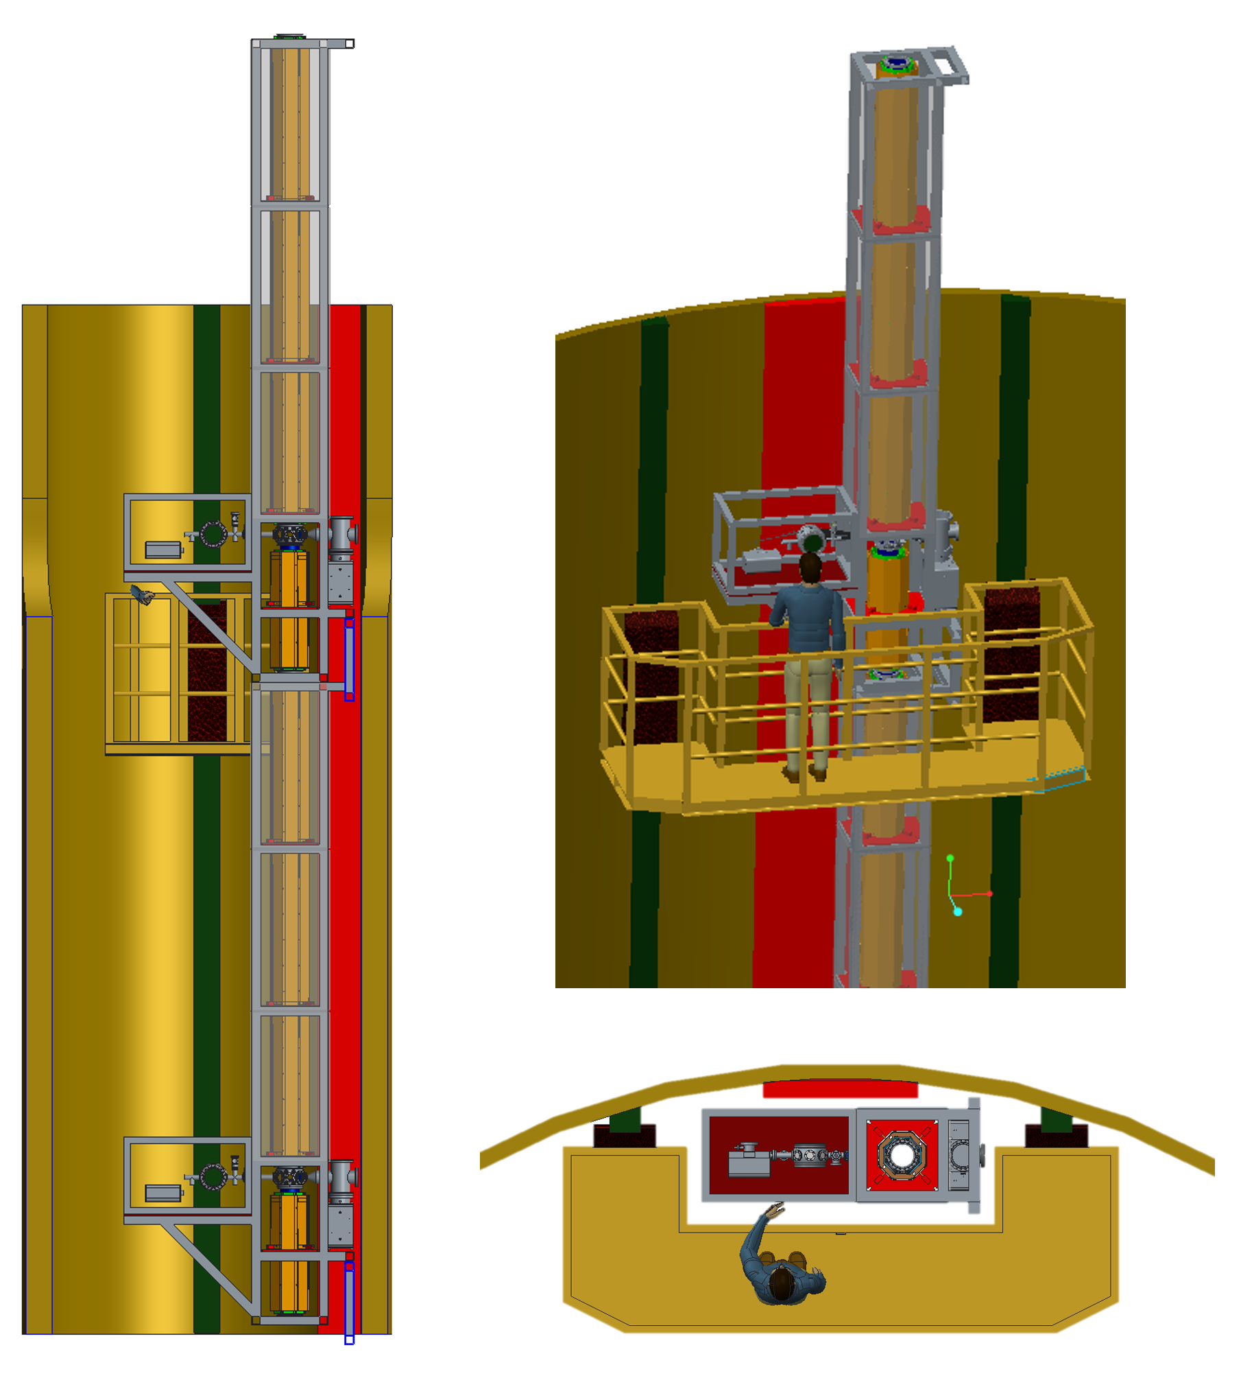
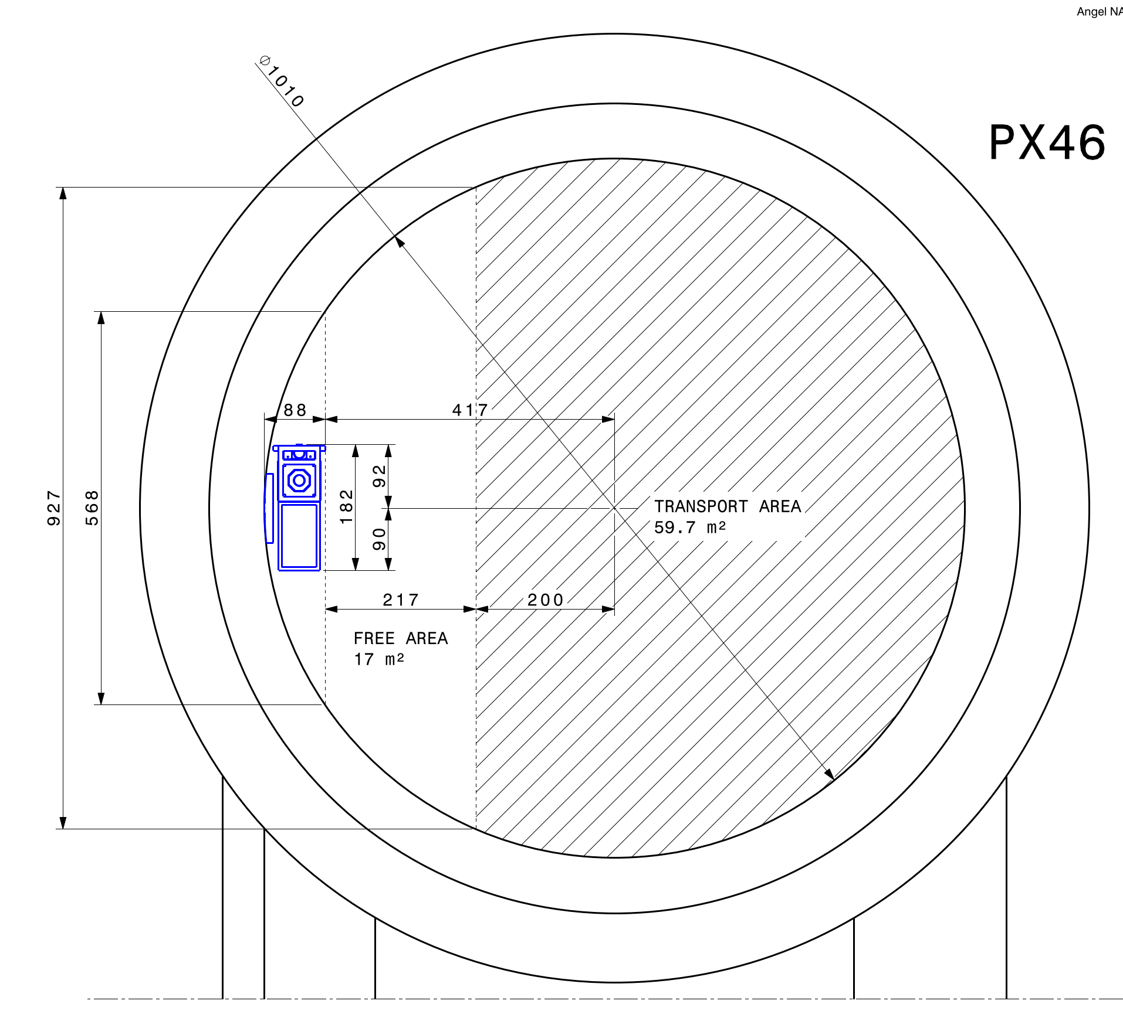
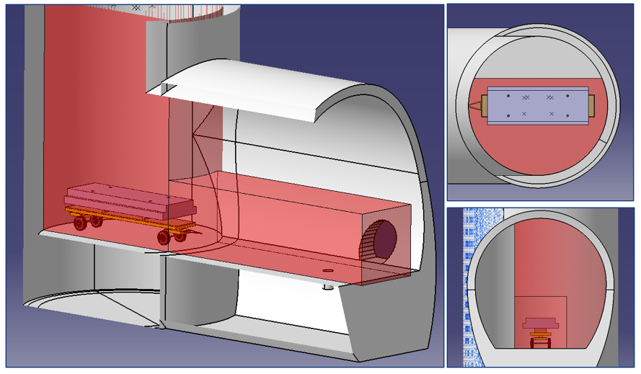
Transport of LHC components and proposed layout

Slide 8
Evaluation of PX46 as suitable site for an AI
Compatibility with technical requirements for an AI – influence of the LHC
  Vibrations, seismic noise and local geology
  EM noise
  Radiation protection
  Fire safety
  He release hazards
  Access control
Available infrastructure
  Electrical supply, network, etc.
  HVAC

Slide 9
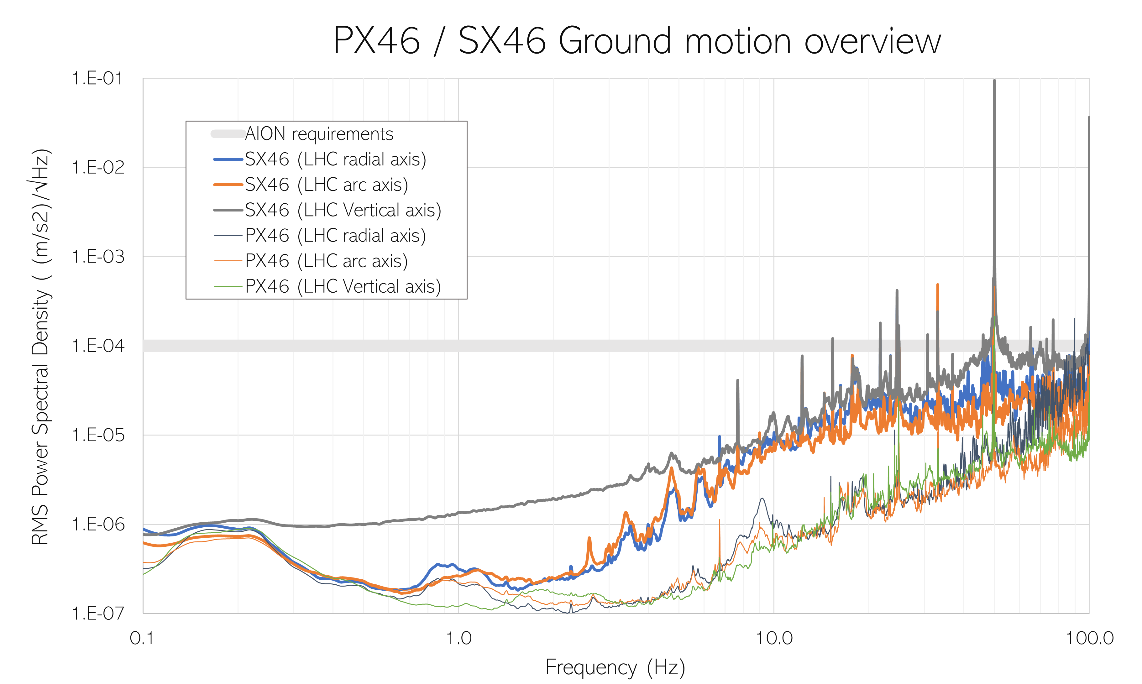
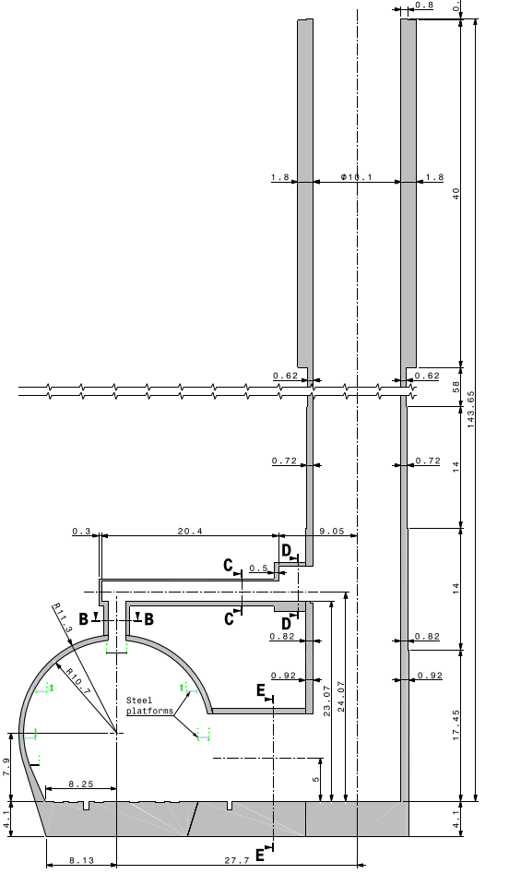
Vibrations and seismic noise
Measured at top of PX46
Cultural noise
Local seismicity
Measured at bottom of PX46
Ocean waves
RMS power spectral density (time block 64s, averaged over the worst day)
Measured values within acceptable limits

Slide 10
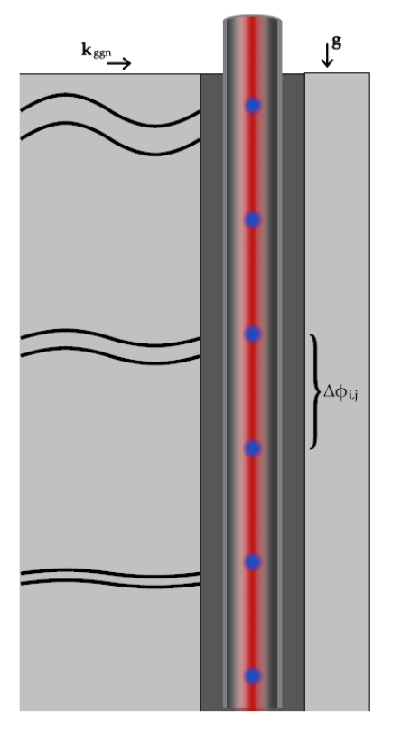
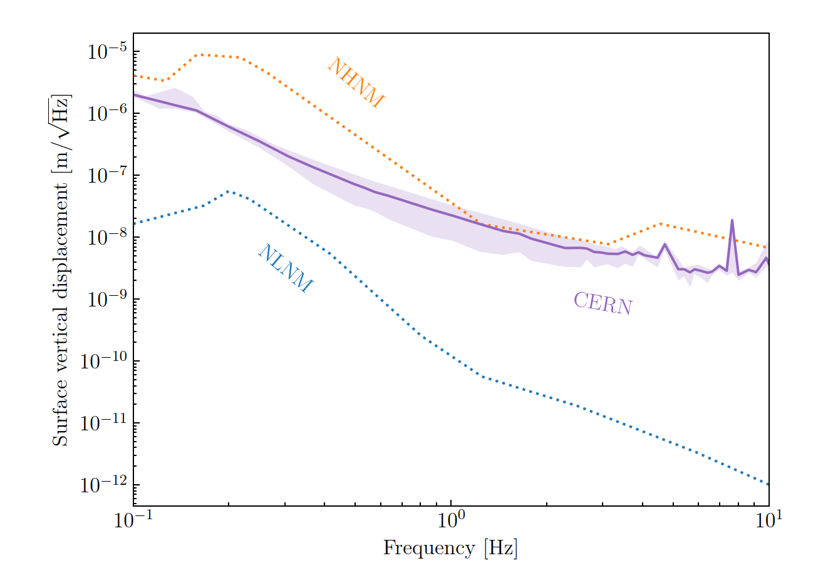
Effect of local geology: gravity gradient noise
Seismic gravity gradient noise (GGN): seismic waves disturb local mass distribution, cause oscillating gravity gradient that is a noise background (especially important at lower frequencies)
Calculated using RMS spectral density of surface vertical displacement measurements, the shaded band corresponds to the difference between the minimum and maximum daily measurements. Compared with the New High and Low Noise Models (NHNM and NLNM: USGS seismic models for hypothetical quiet and noisy sites).

Slide 11
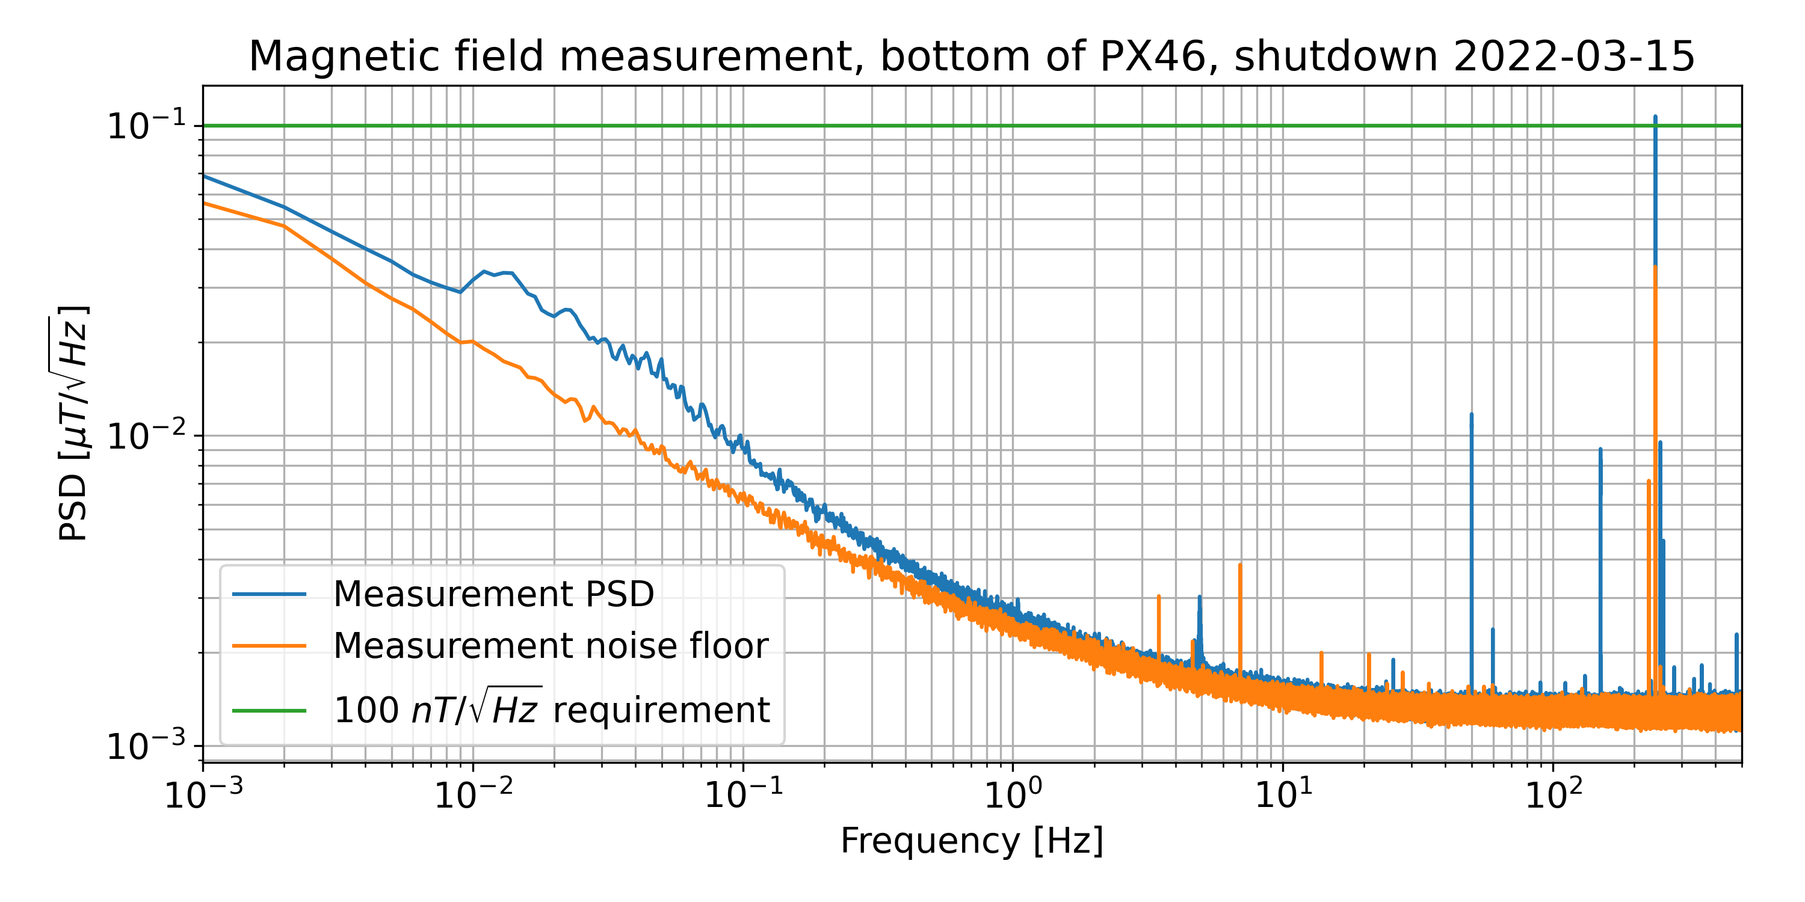
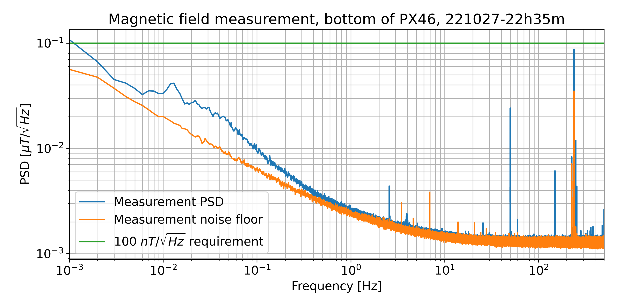
EM noise
Power spectral density low-frequency magnetic field measurement
Measured values within acceptable limits

Slide 12
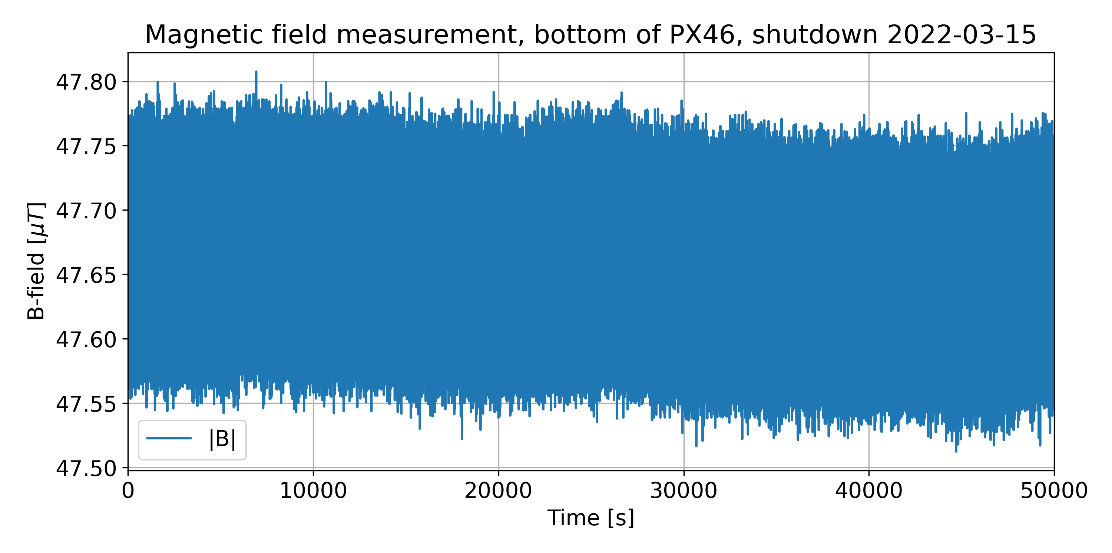
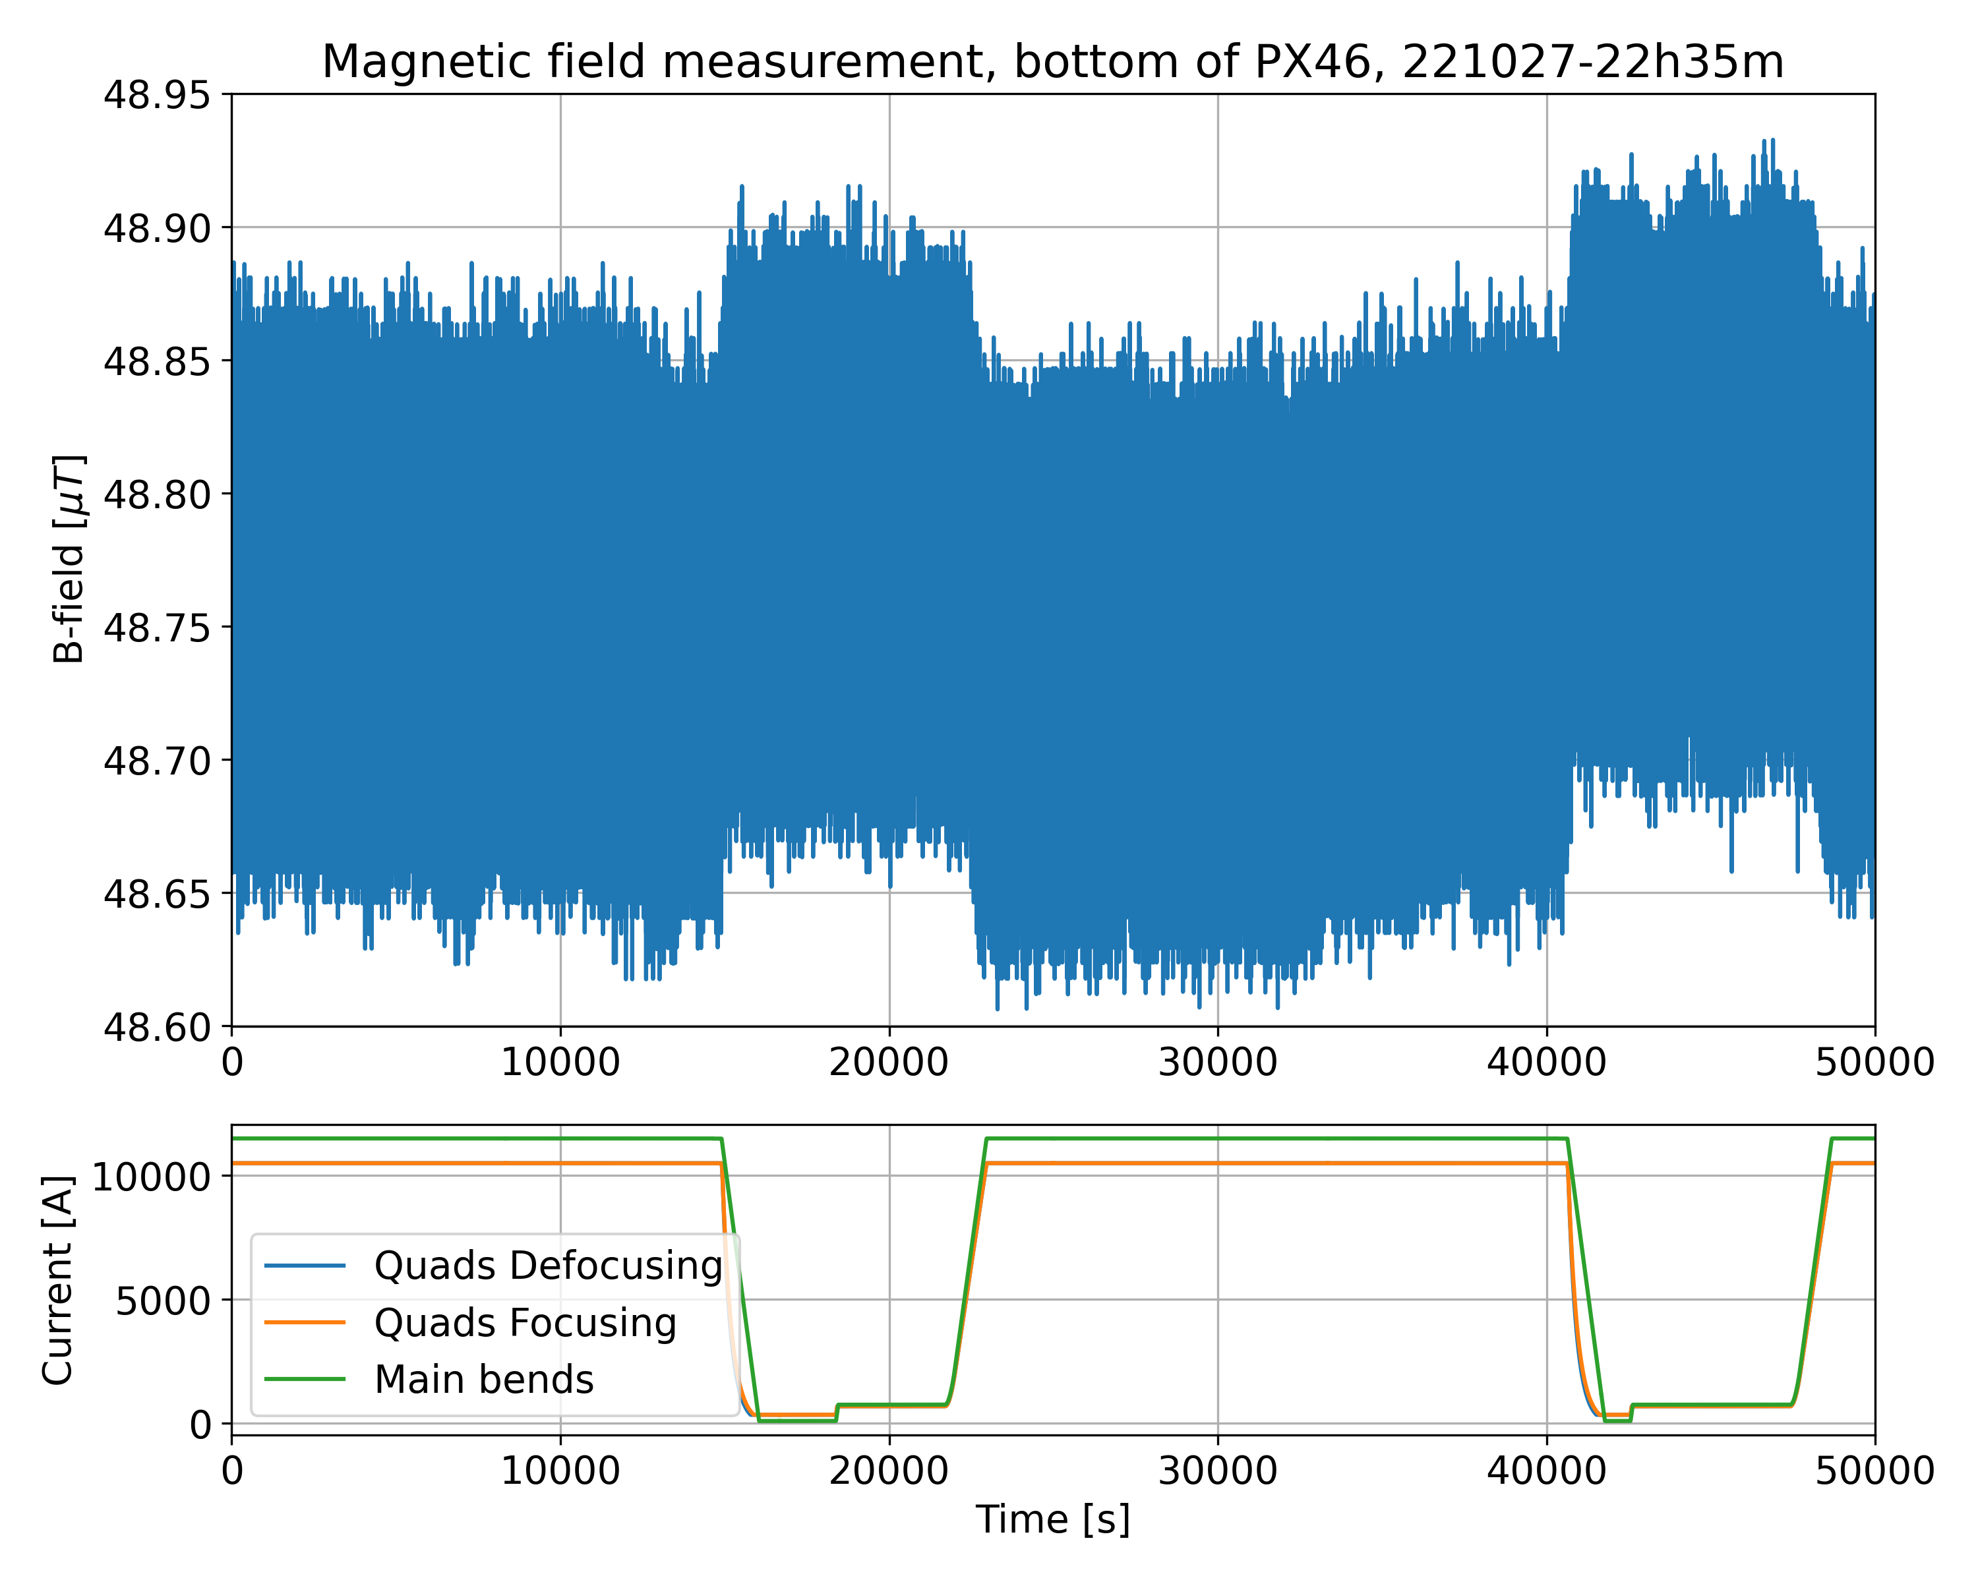
Effect of LHC magnets
50 nT
LHC shutdown
LHC beam on
Drift or steps in magnetic field of ≳50nT are a potential concern for the side-arms and the detector.
Measured values within acceptable limits

Slide 13
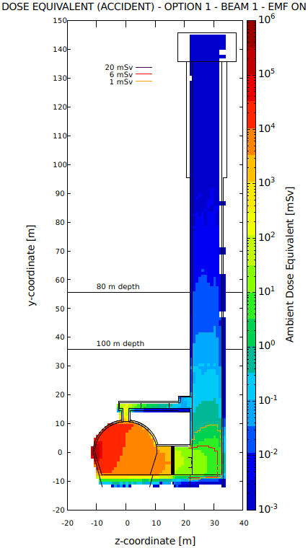
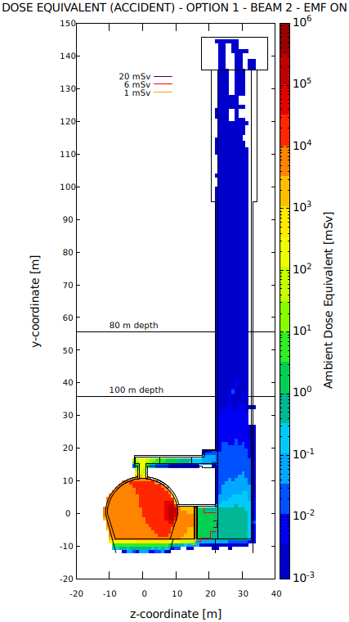
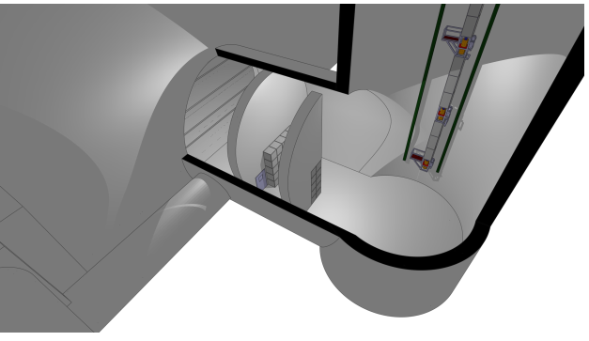
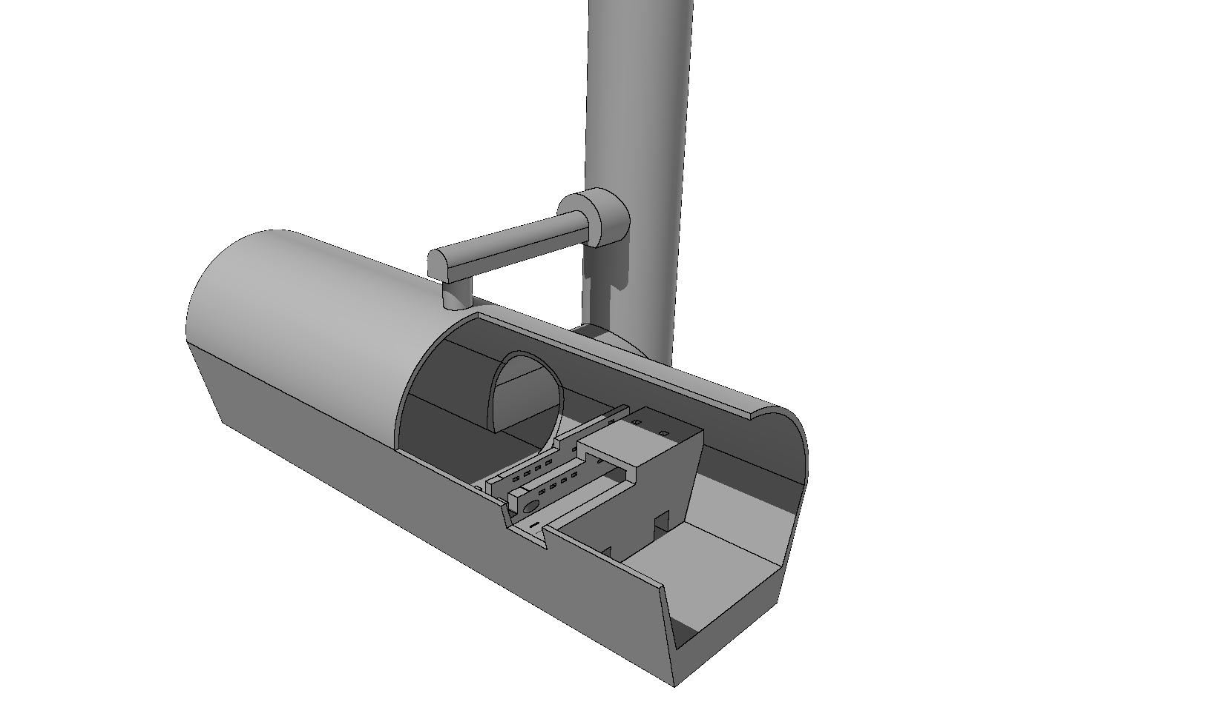
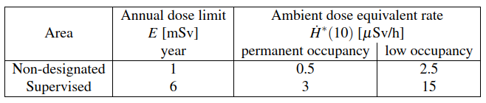
Radiation protection
Beam loss in RUX45 with 0.8 m shielding in TX46
LHC
Assuming 20% working time
No concern during normal LHC beam operations
In case of beam loss, radiation levels remain within acceptable limits (supervised area)
Thickness of shielding wall to be optimized

Slide 14
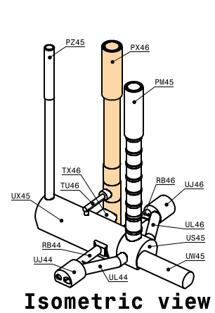
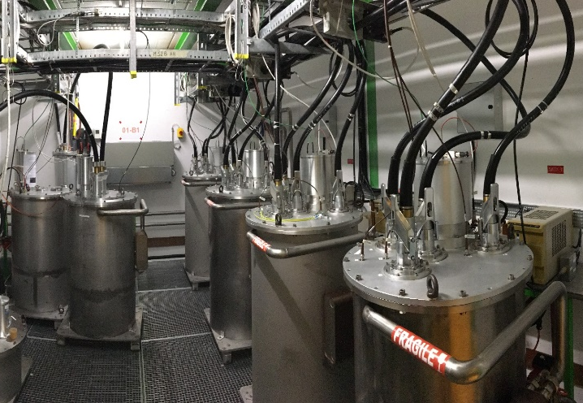
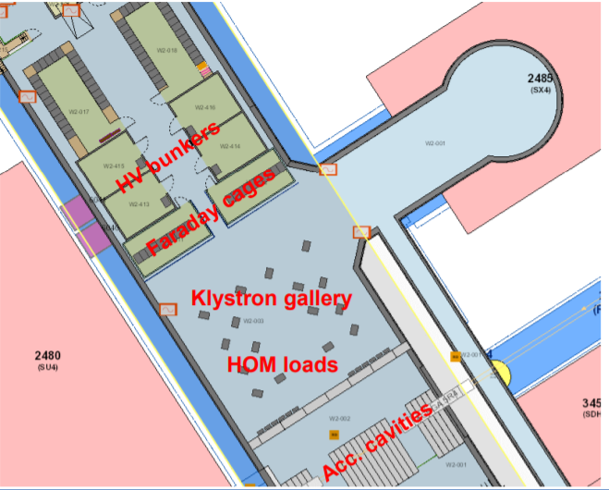
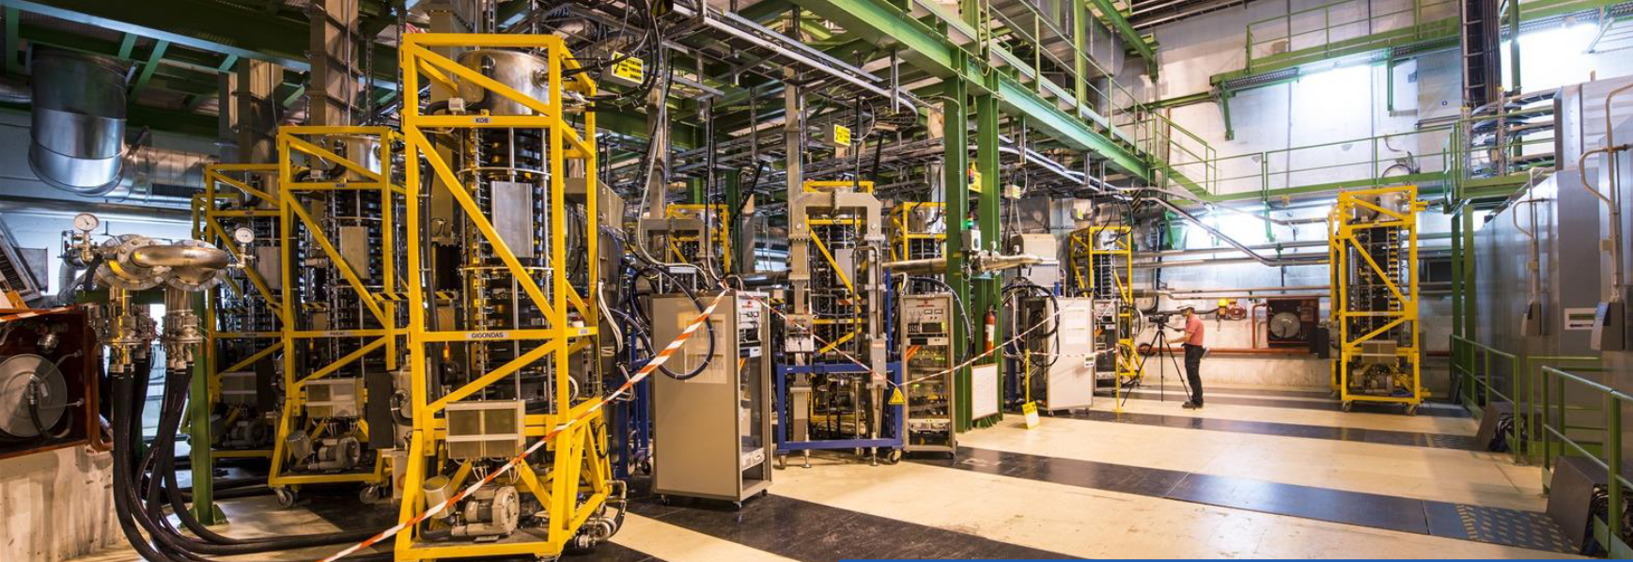
Fire safety
In case of a fire in UX45 (klystron gallery):
Smoke detection -> Alarms -> Evacuation with elevator in ~2 min via top of PX46
In case of systems failure: controlled descent in ~2 min to bottom of PX46 and exit via PM45 or PZ45

Slide 15
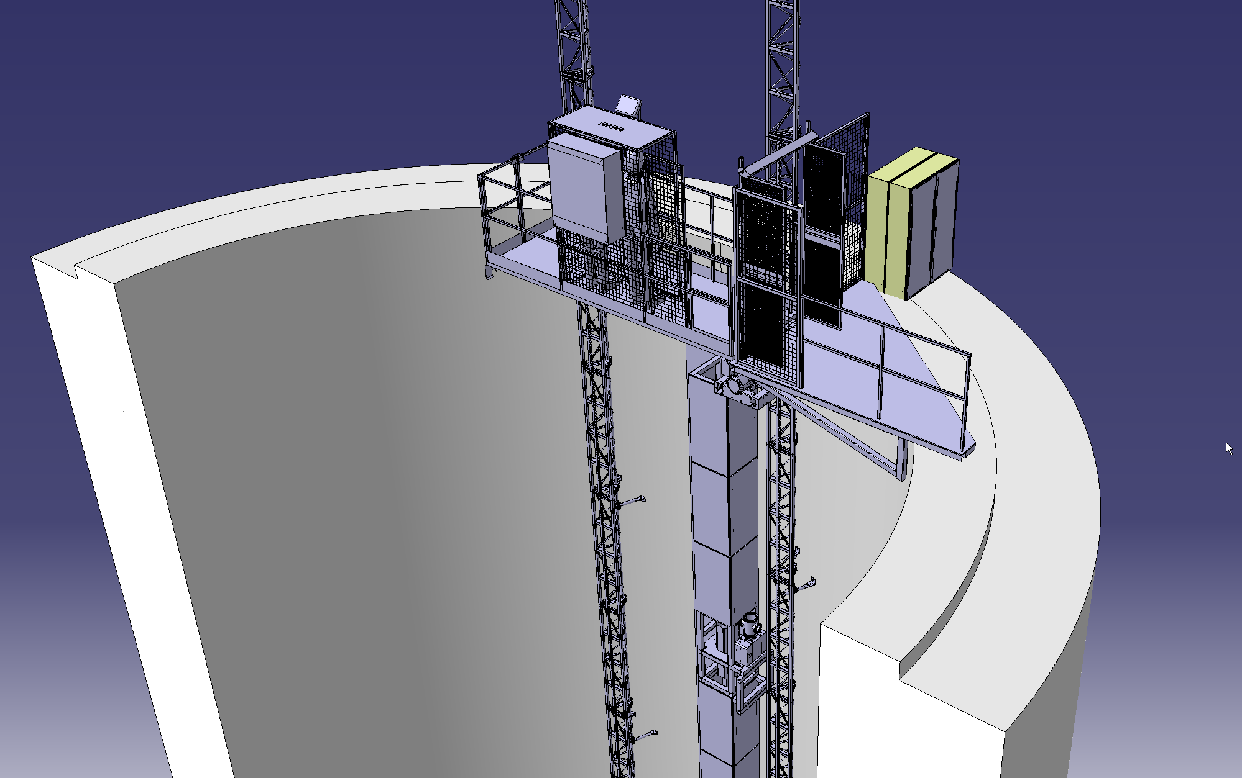
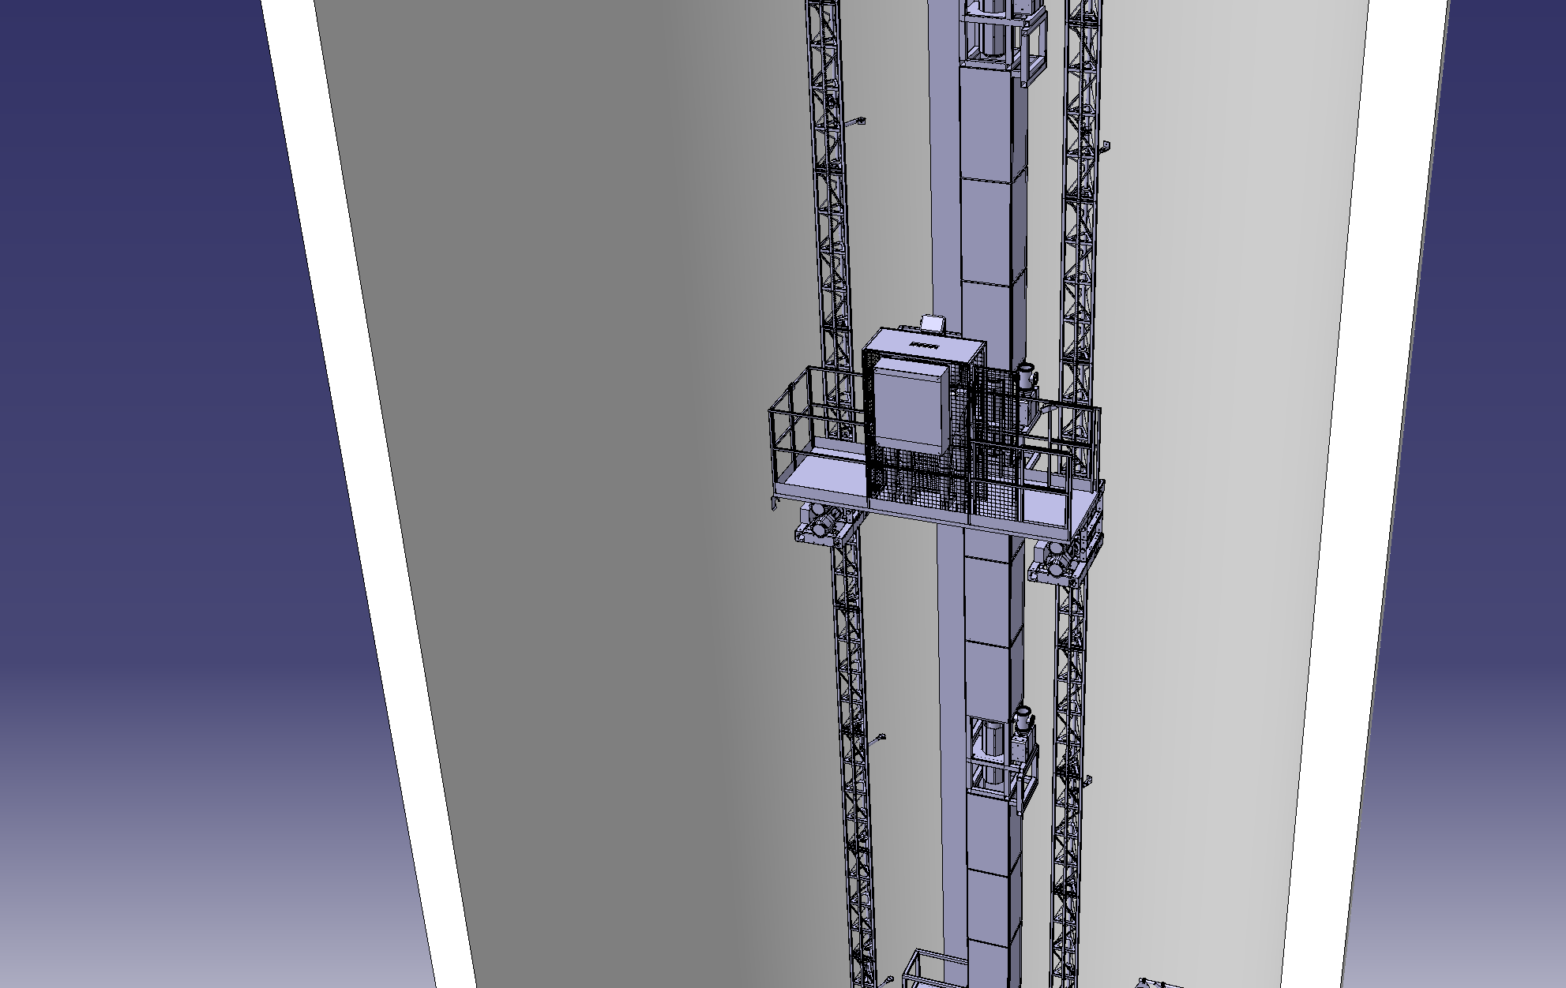
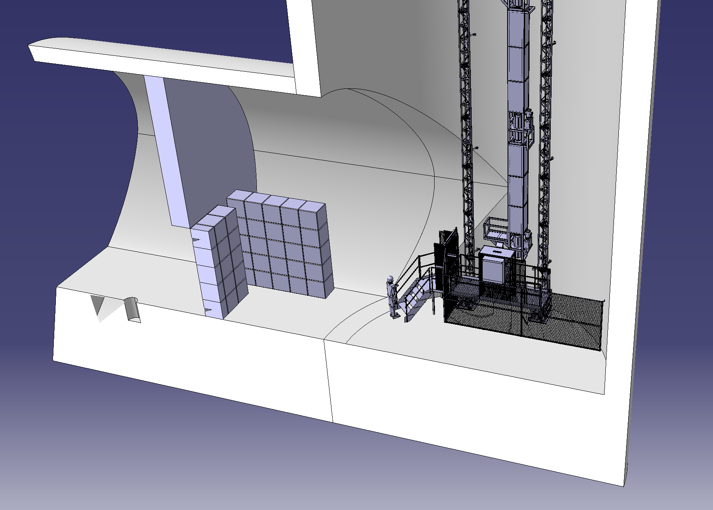
Elevator: from artist view to conceptual design
A design that complies with all requirements is technically feasible as demonstrated by an external consultant

Slide 16
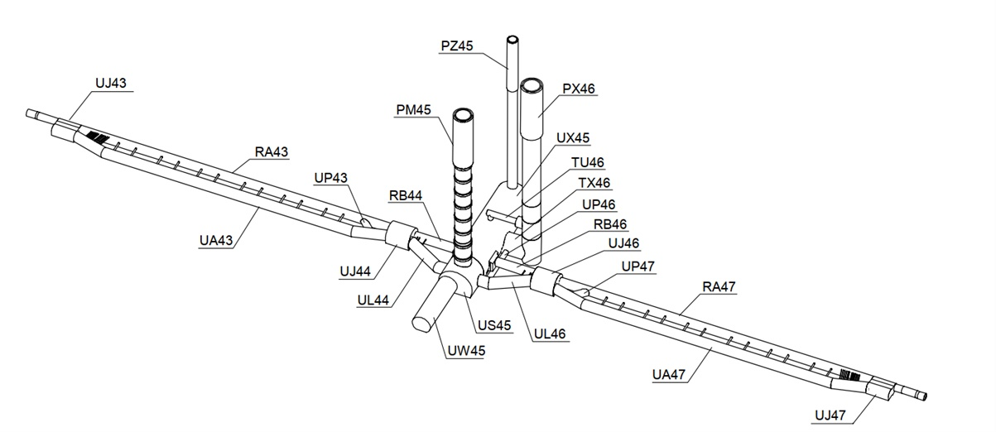
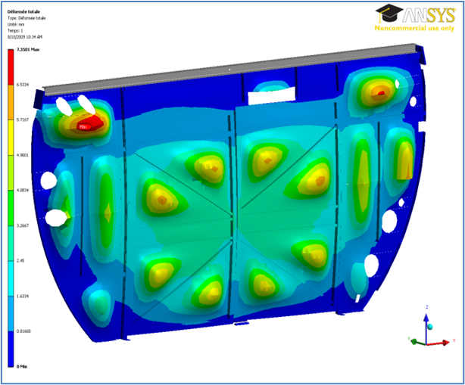
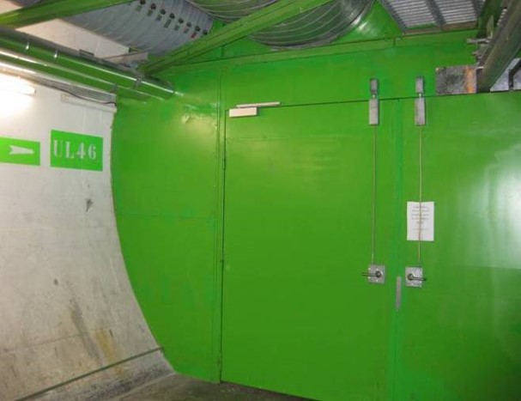
Helium release safety: LHC arcs
In case of major release from the LHC arcs,
He is evacuated via PM45 via a set of confinement doors
No hazard in PX46 from He release in the LHC arcs

Slide 17
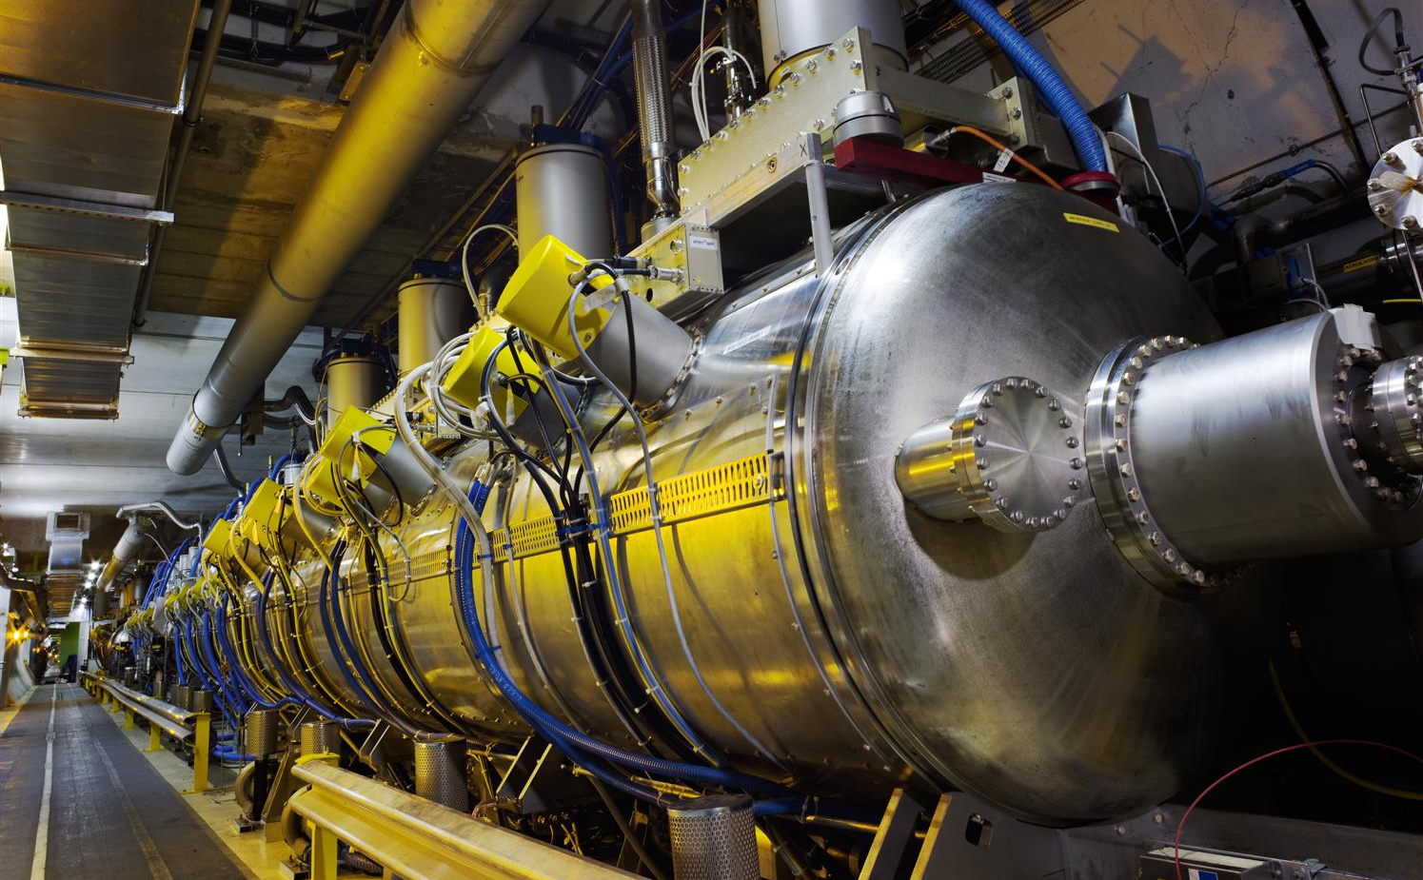
Helium release safety: RF cryomodules
RF cryomodules contain 320 x 4 liters of liquid He; in case of release it is evacuated via PX46
Flow restrained by the small openings ( RF waveguides)
970 m³ of gas compared to 18000 m³ of the cavern
(<~ 20%), oxygen deficiency hazard is limited
Recently measured: no change in O₂ % in TU46 due to He release from RF cryomodules

Slide 18
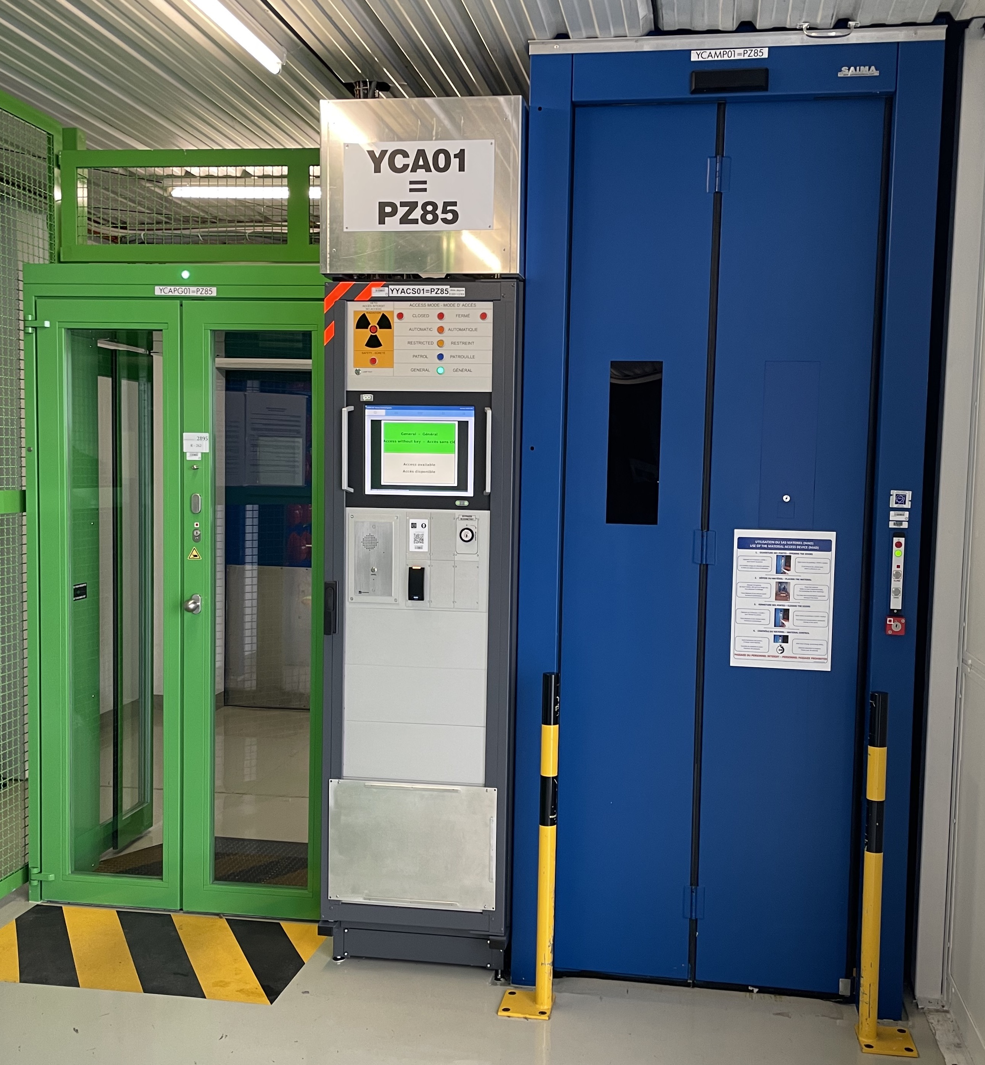
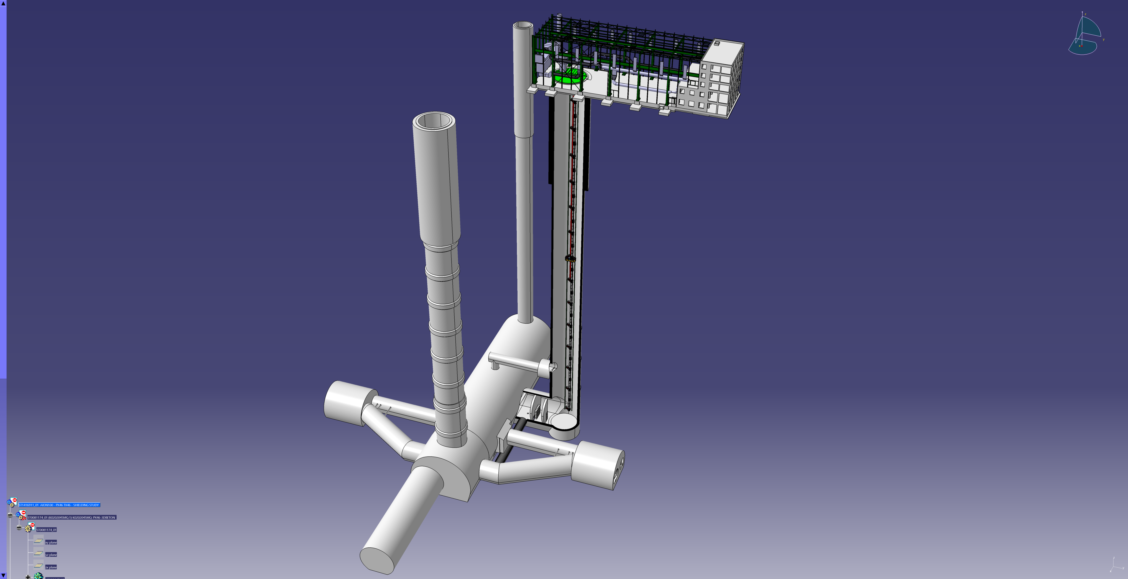
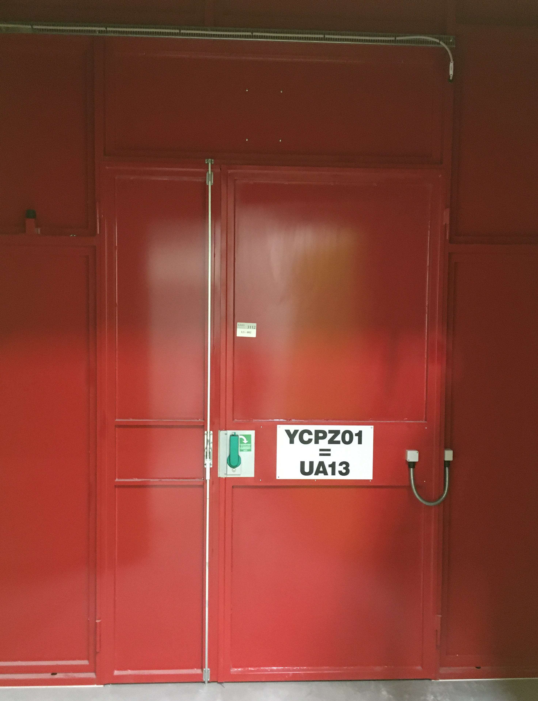
Access control
Standard LHC Access Control System (LACS) door.
Probably a lightweight solution could be installed at the top platform of PX46, since access to the AI will NOT be an access to the LHC.
Availability and use of oxygen-generating self-rescue masks to be assessed
End-of-zone door of the LHC Access Safety System (LASS), for emergency exit at the bottom of PX46
Red in color and including an emergency opening handle on both sides

Slide 19
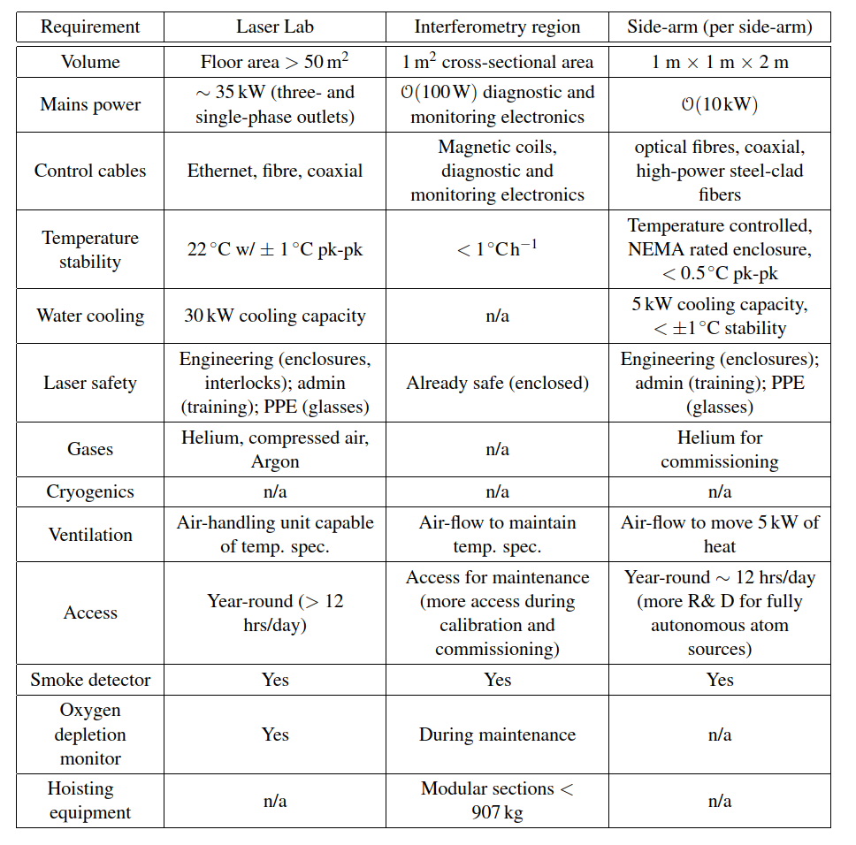
Technical requirements

Slide 20
Conclusions and perspectives
No showstoppers identified for installing an AI at LHC Point 4
  Environmental noise measurements comply with requirements of an AI
  Mitigation measures related to LHC environment identified (RP, helium, etc.)
  HVAC, electricity and other relevant services are available
Expected ~1.5 MCHF cost for making the site infrastructure available for an AI
CERN can propose PX46 at LHC point 4 as a candidate site for a vertical AI
Next steps
  Detailed technical design
  Creation of an experimental collaboration aimed at constructing and running the AI
Target installation of shielding wall, elevator and access control: LS3 or LS4

Slide 21
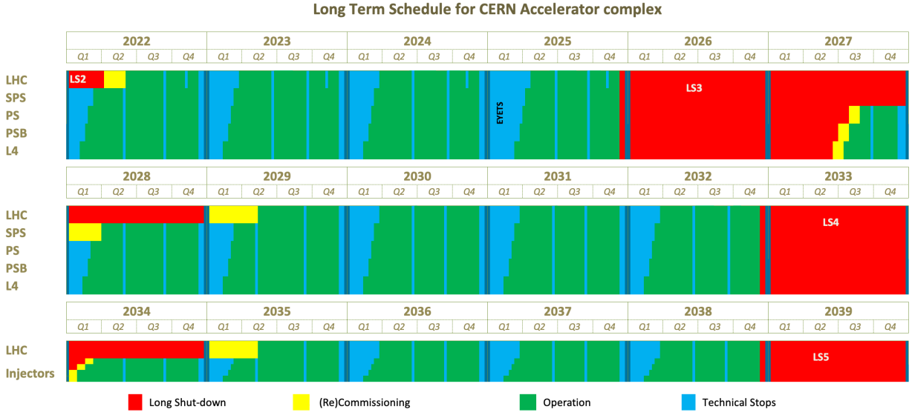
CERN accelerator complex master schedule

Slide 22
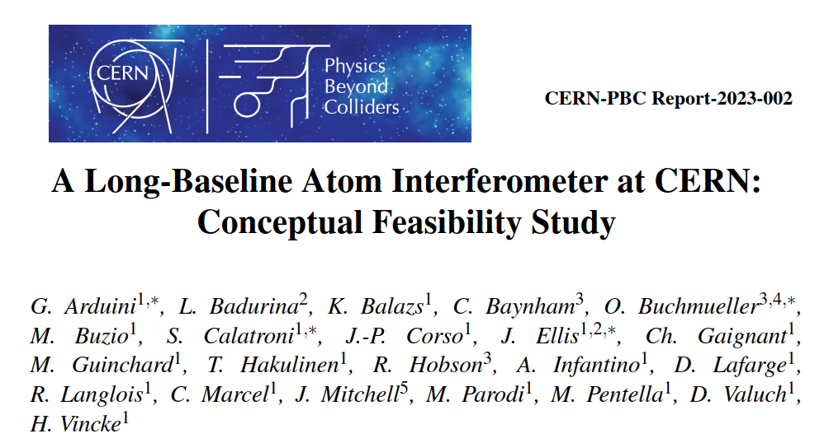
Acknowledgements

Slide 24
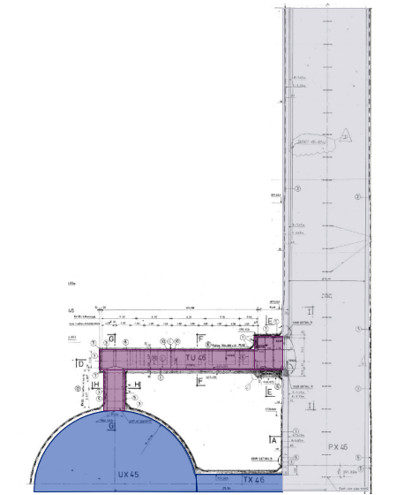
PX46 - Existing conditions: HVAC
  Ventilation
  Air extraction from the UX45 is done at the top of the cavern by unit located in TU46
  Extracted air is then directly supplied in PX46 (no ducts in PX46)
  In surface, a duct is connected to the cap to collect extracted air to main extraction unit in SX4
  Existing CV platform at 24m from the bottom of the shaft, openable inside from the TU46
  All ventilation units are stopped if a fire is detected
  Cooling
  Cooling system will be located on the surface and
  Water will be distributed to each side-arm
  Distribution piping will be installed along the full height of the experiment
Air extraction of UX45
Courtesy of R. Langlois

Slide 25
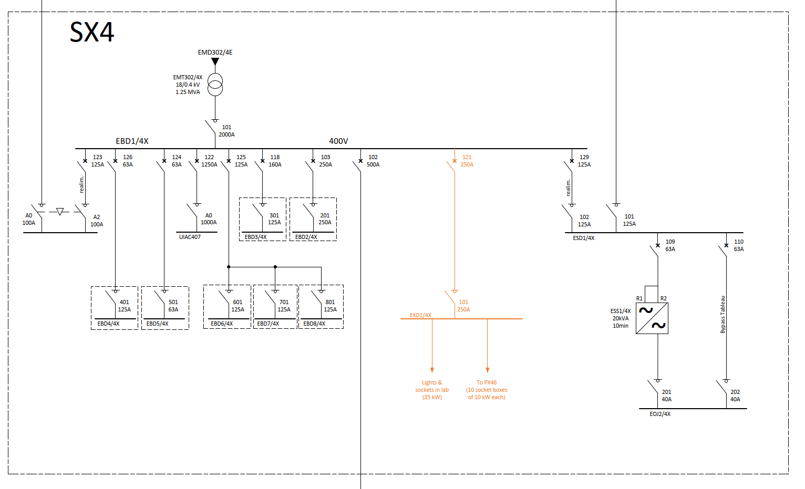
PX46 - Existing conditions: electricity
About 160 kW needed: interferometer + laser laboratory + elevator
About 1.25 MVA available at the transformer in SX4 in front of a present consumption of 85 kVA
As a consequence, no modifications of the electrical power distribution network are expected
New preliminary single line diagram of SX4, with the new feeder of EBD1/4X, the new switchboard EXD1/4X and its feeders in orange

