Slide 1

BGV design optimisation & performance study
Bernadette Kolbinger (CERN SY-BI-XEI)
Acknowledgements:
BGV team: H. Guerin, J. Storey
With input from: G. Breggliozzi, A. Galloro, D. Hynds, R. Kersevan, R. De Maria, J. Oliveira, R. Plackett, D. Prelipcean, T. Ramos Garcia, B. Salvant, G. Schneider, T. Lefevre, B. Salvant, A. Salzburger, H. Sandberg, R. Veness
Notes:
Overview of activities in last 2 years

Slide 2
Outline
Introduction: BGV performance
Simulation & reconstruction framework
Performance study, results & conclusions
Summary & outlook

Slide 3

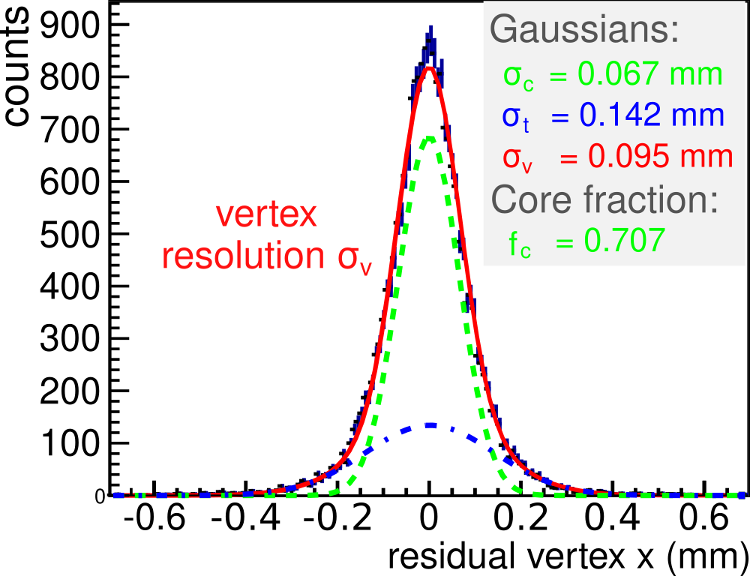
BGV performance – profile measurement
Method: deduce true beam profile from spatial distribution of reconstructed vertices.
Key performance measure = response function. Not easy to determine with high precision - keep its width (= vertex resolution) small!
Vertex response and resolution definitions:
  Compare the reconstructed vertex positions to the actual positions.
  Calculate residuals v_{x,reco} - v_{x,true} ➡ histogram ➡ response.
  In measurement - find another way (see later)!
sum of two Gaussians:
core + tail

Slide 4
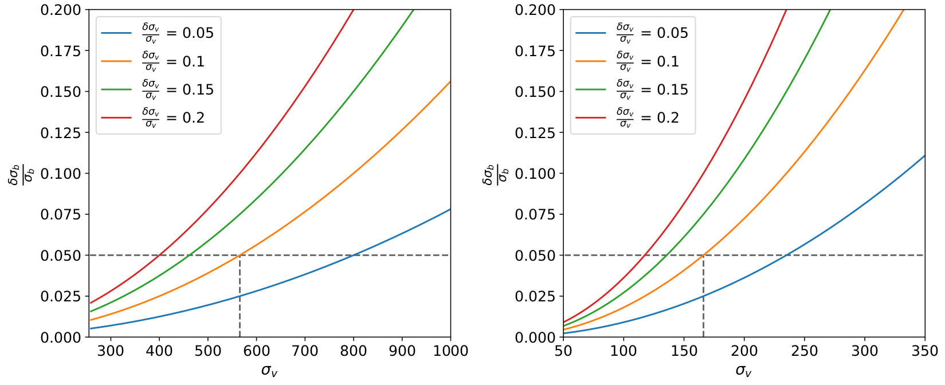
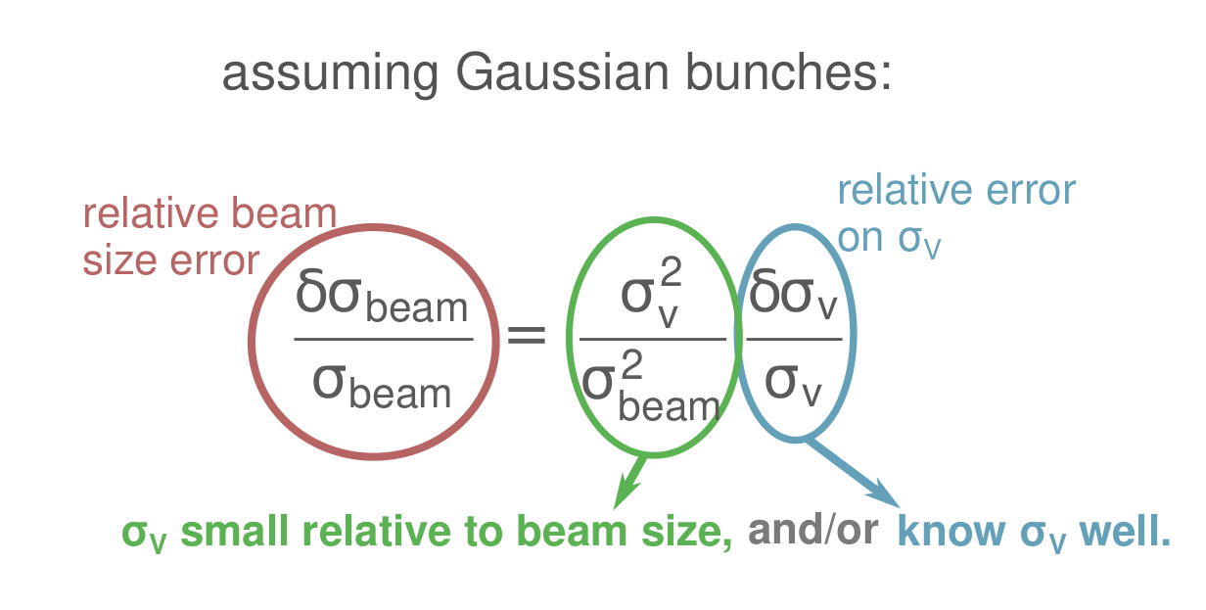
BGV performance –
Emittance measurement with relative accuracy ≤ 10 % (beam size ≤ 5%)
Relative accuracy = $$\frac{σ_{meas} - σ_{true}}{σ_{true}}$$
Certain accuracy goal needs a certain vertex resolution $$σ_{v}$$. How small?
  Depends on the beam size - the smaller the beam size, the higher the resolution needs to be.
  Depends also on how well we know the vertex resolution!
accuracy
precision
true value
mean
(see calculation)
Minimum beam size at BGV locations is 232 µm (7 TeV). Knowing the vertex resolution with 10 % accuracy ➡ need $$σ_{v}$$ $$≤$$ 164 µm.
Notes:
Vertex resolution is a measure of how far away we are from the truth vertex
beta-fct error assume 5 %, error propagation -> beam size 5 %

Slide 5
BGV performance –
Bunch-by-bunch measurements of beam size with ~1 % relative precision after ~1 min of accumulating data.
accuracy
Precision is determined by statistics!
How many interactions N do we accumulate in 1 min per bunch?
  (... that show a good enough vertex resolution?)
Assuming a Gaussian distribution G(µ,σ), the relative precision on σ is given by:
precision
true value
mean
12N - 2
[1%, 2%] relat. precision ➡ need [5000, 1250] recorded interactions.

Slide 6
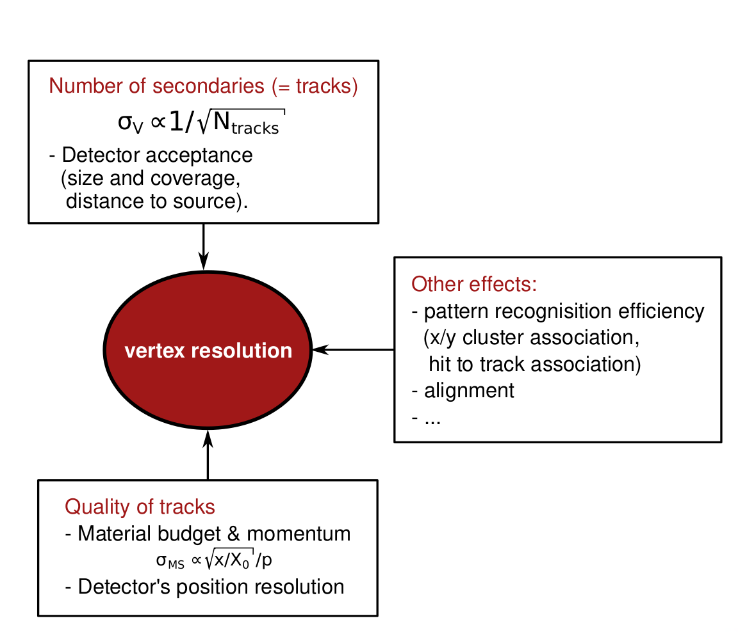
What impacts the vertex resolution?
distance detector-vertex
Notes:
Strategy:
Phase 1: generic BGV setup to ease navigation of extensive parameter space.
Efficiently identify impact of design parameters and provide first estimates of promising setup’s dimensions and identify promising technologies.
Phase 2: simulate specific detector technologies and detailed setup.
Conclusions:
Performance results point towards possibility of compact tracker with a high spatial resolution.
Promising candidate: compact Si pixel tracker with detector layers ~250 mm apart.
Localised gas target improves performance, but extended gas target is no show stopper.
(BGV talk at 2021 Hilumi Collaboration Meeting, IBIC paper 2021).
Furthermore: analysis framework that can be later adapted and used with measurements.

Slide 7
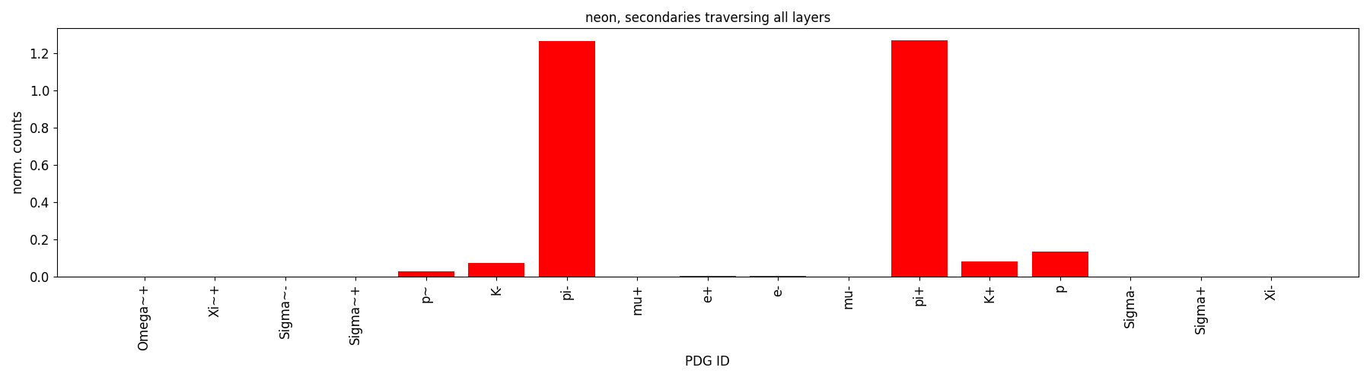
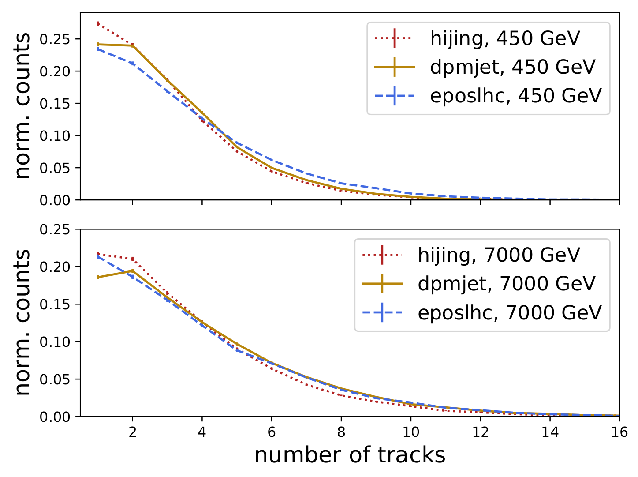
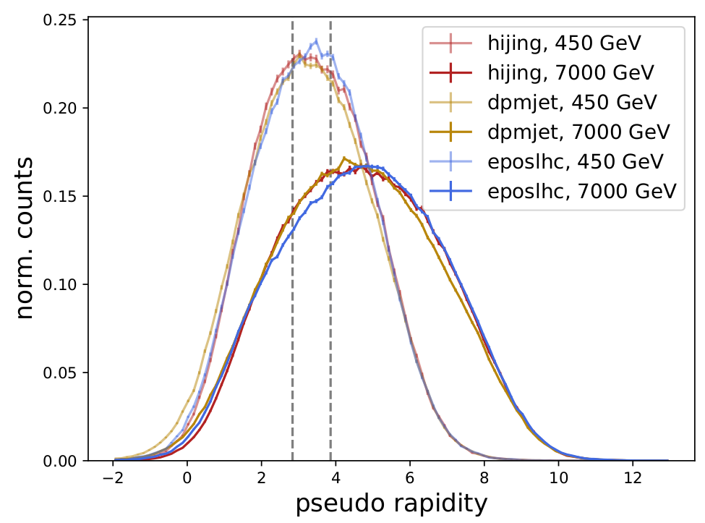
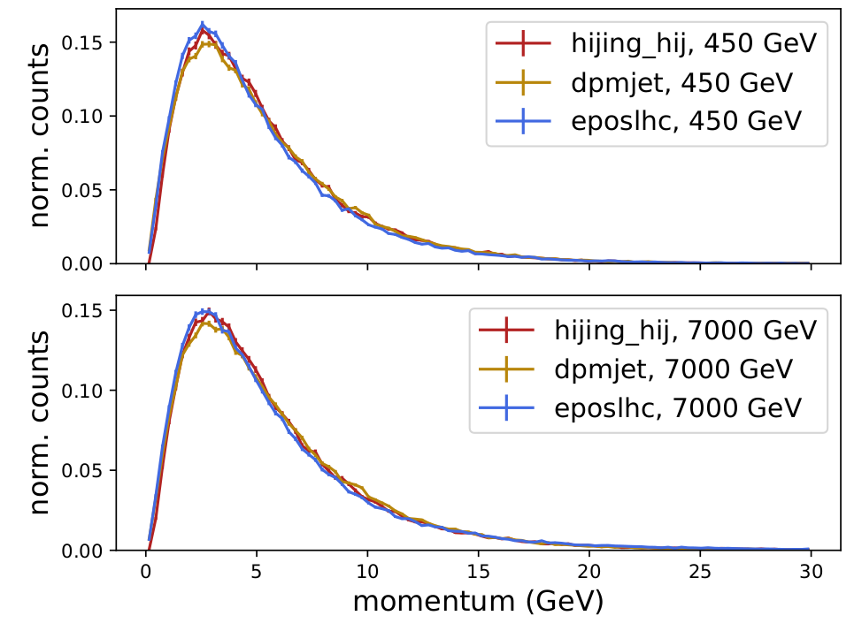
BGV - tracks, vertices & secondary properties
Infer beam profile from primary vertices of beam-gas interactions.
  Interaction rate is ~600 kHz (total, ~200 Hz per bunch).
  Recording single collisions, pile-up unlikely (one collision every 2 µs).
Secondary species: mostly pions.
No magnetic field - straight tracks.
Forward tracks with relatively
low momentum.
#tracks per event, traversing detector
$$η$$ of emerging
secondaries
|p| of tracks
traversing detector
Notes:
Event = single collision

Slide 8
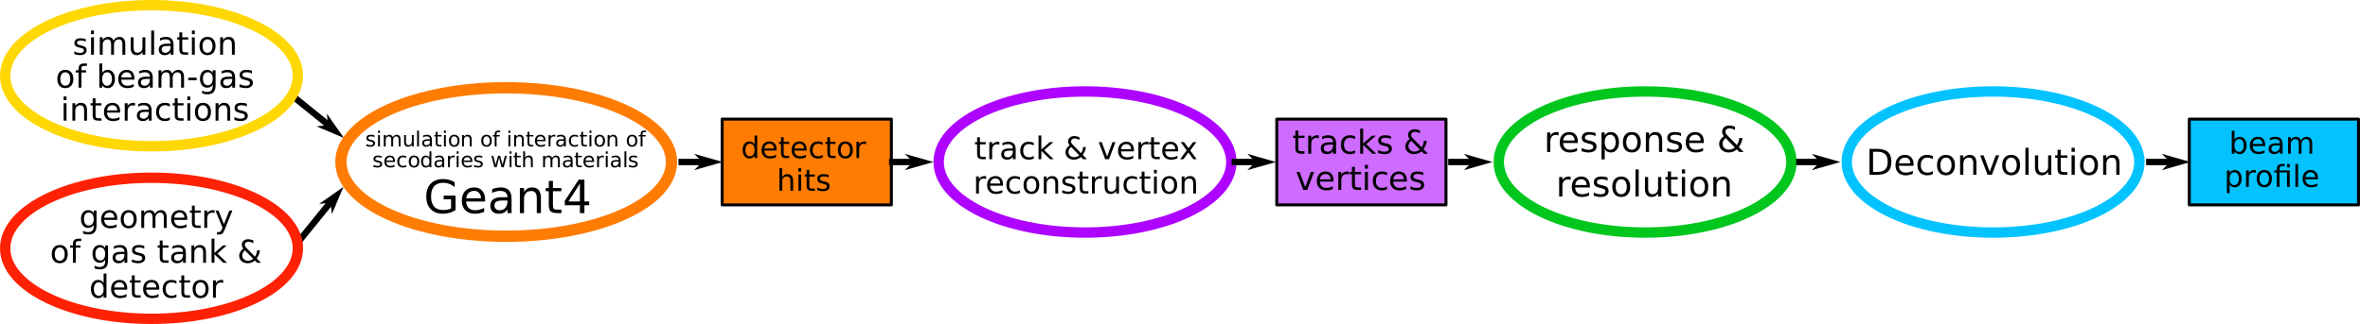
Performance study & optimisation
What are the requirements for BGV gas target and tracker, to:
  fulfilling performance specifications,
  within the boundary conditions of: feasibility of integrating it into the LHC?
answer with complete simulation study!
➡ simulation and reconstruction framework
Track reconstruction - fit found position measurements with a track model.
Use the fitted tracks to determine vertex.
Pattern recognition, alignment etc. ➡ see later presentation.
Two independent softwares developed:
Based on tracking tool-kit ACTS (A Common Tracking Software).
Custom reconstruction code.
Notes:
Strategy:
Phase 1: generic BGV setup to ease navigation of extensive parameter space.
Efficiently identify impact of design parameters and provide first estimates of promising setup’s dimensions and identify promising technologies.
Phase 2: simulate specific detector technologies and detailed setup.
Conclusions:
Performance results point towards possibility of compact tracker with a high spatial resolution.
Promising candidate: compact Si pixel tracker with detector layers ~250 mm apart.
Localised gas target improves performance, but extended gas target is no show stopper.
(BGV talk at 2021 Hilumi Collaboration Meeting, IBIC paper 2021).
Furthermore: analysis framework that can be later adapted and used with measurements.

Slide 9
Track and vertex reconstruction
Experimental independent tool-kit ACTS
(A Common Tracking Software).
  Intended for HL-LHC and future colliders.
  Community driven, under active development, with new features and improvements added constantly.
  Kalman track fitter and Billoir vertex fitter.
  Performant algorithms (modern C++):
    ~1ms per event (track & vertex fitting).
  Input:
    Additionally to (x,y,z) points, ACTS needs :
    Geometry & material description of setup.
    Particle momentum estimation.
  ACTS also has modules for: pattern recognition (cluster and track finding), digitisation.
  Adding momentum estimation on-going, more work necessary to make it work.
Custom reconstruction code:
  Tailored to BGV case, written in-house.
    Simple straight line track fit by $$χ$$² minimisation.
    Vertex found by clustering approach (back-up).
    Developed in python, then translated to C++.
    Performance (C++):
      ~1ms per event (track & vertex fitting).
  Input:
    (x,y,z) positions of the detector measurements.
  Cross check: both agree on their predictions on a promising detector candidate.
  Can be adapted and used with measurements.
Notes:
Well integrated and connected to ACTS team, part of github project and participation at developer meetings and workshops.
ACTS pros: developed by experts, intended to have long term maintenance.

Slide 10
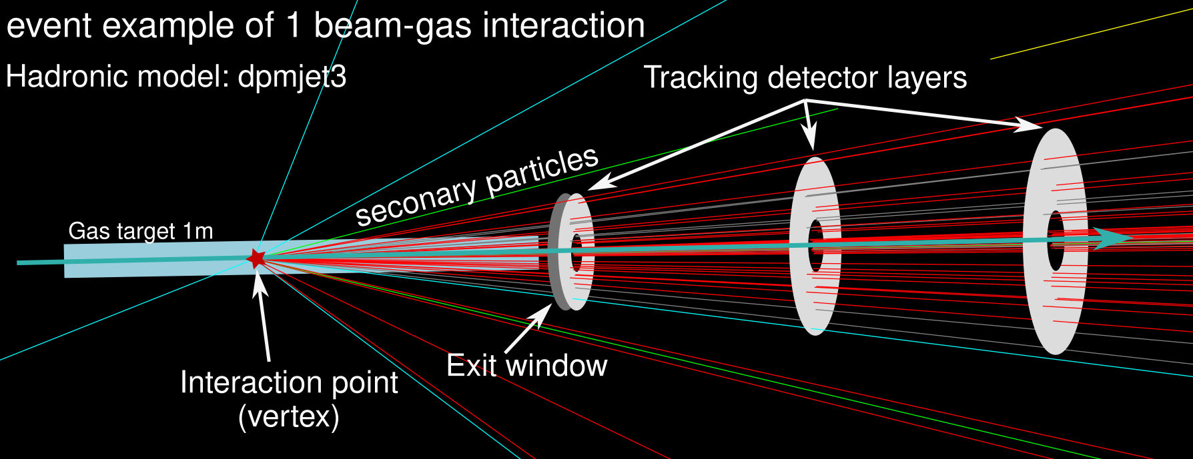
Performance study - overview
Initially: generic BGV setup to ease navigation of extensive parameter space.
Goal: efficiently identify impact of design parameters and provide first estimates of promising setup’s dimensions etc.
neon
fit residual with sum of two Gaussians: core + tail
Detector parameters studied:
  Material budget, size, separation,
  Spatial resolution (Gaussian smearing of simulated hits).
Gas target:
  Extent in z, distance to detector, gas species.
Evaluation of performance:
Compare reconstructed vertices to generator level vertices.
Determine response and vertex resolution (see also)
via residuals of vertex positions.
Notes:
Sigma v is weighted average of core and tail sigma

Slide 11
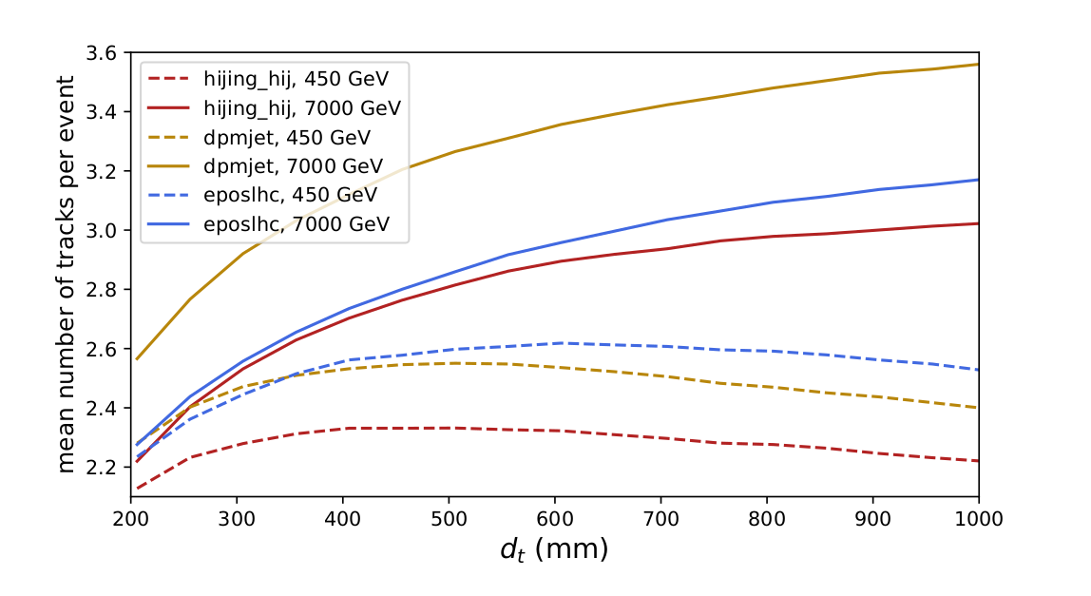
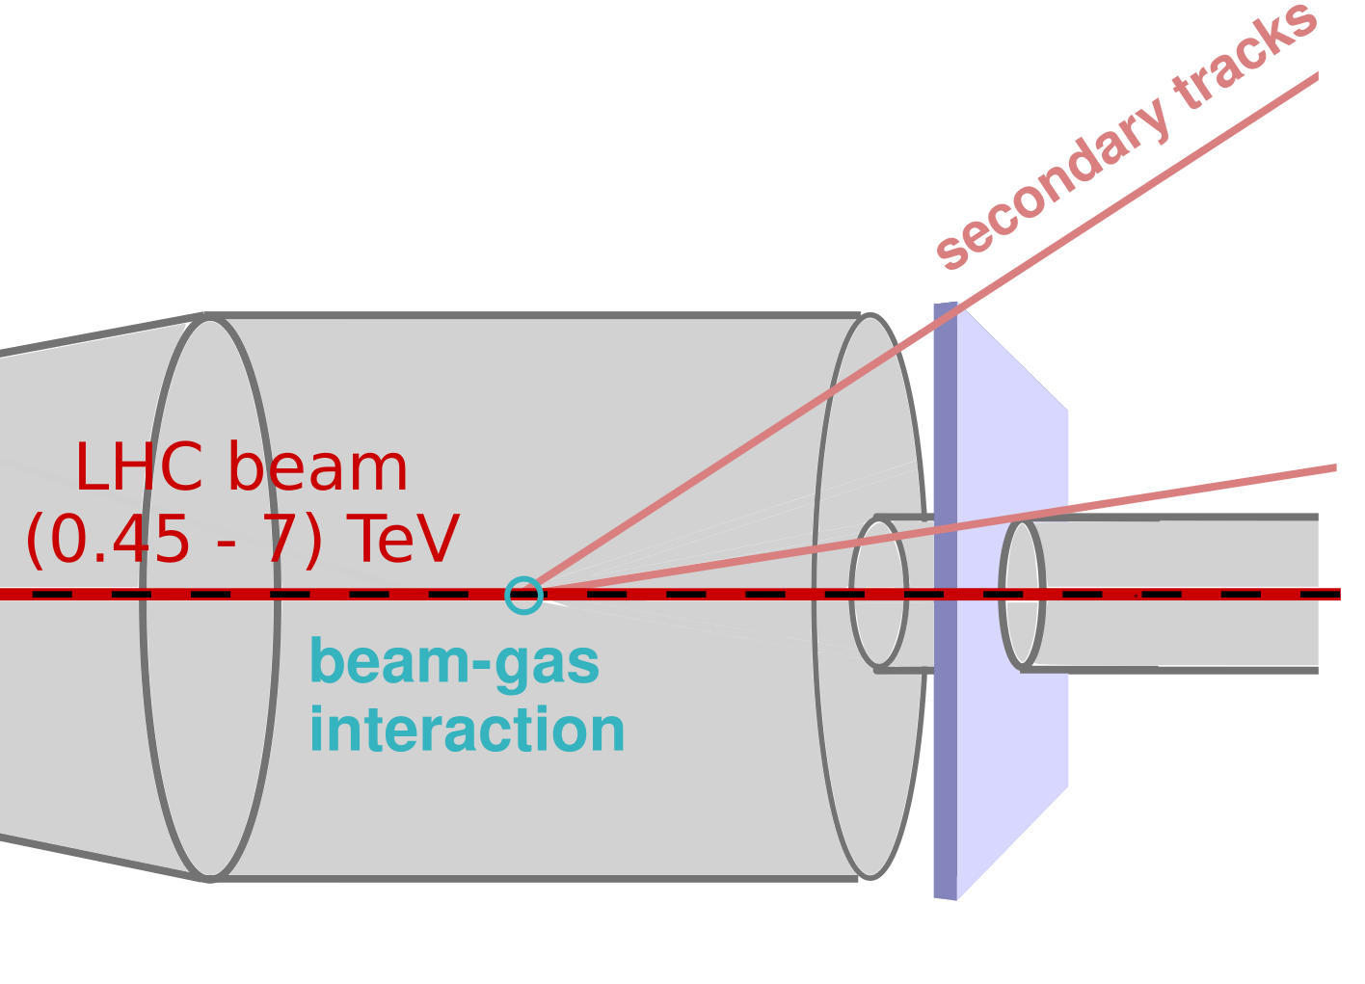
Distance source-detector
Need to get close to interaction (smaller extrapolation distance).
But not too close - tracks have a very shallow angle to beam axis!
Mean number of tracks per event in acceptance of first detector layer.
for different hadronic models and 450 GeV and 7 TeV.
130 mm
45 mm
d_{t}
mean number of tracks per event: 450 GeV data shows plateau at ~550 mm.

Slide 12
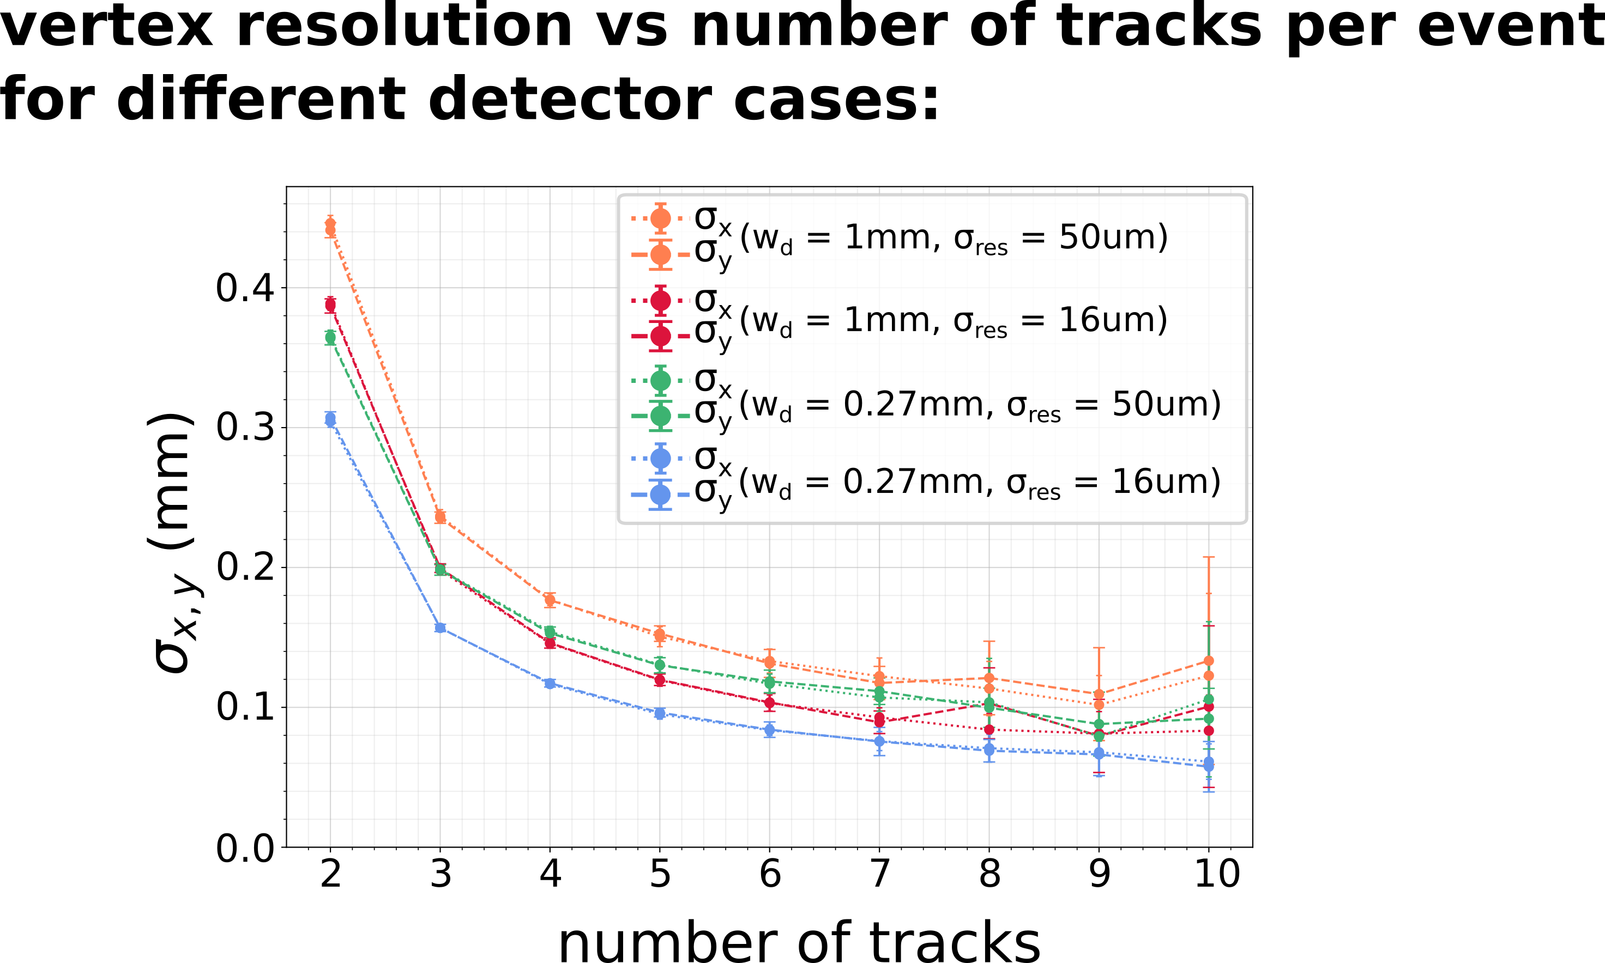
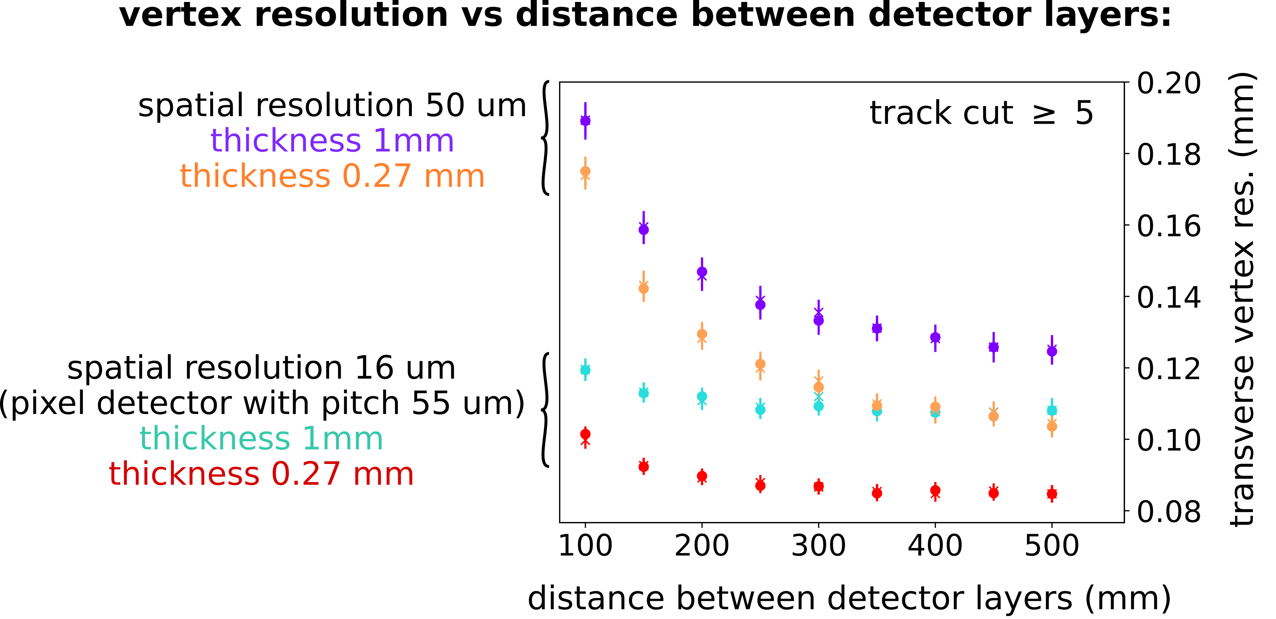
Results and conclusions of generic BGV study - detector
x/X₀ = 1 % per layer
x/X₀ = 0.30 % per layer
neon
x/X₀ = 1 % per layer
x/X₀ = 0.30 % per layer
For these results: 1 m long neon gas target, 450 GeV protons.
Performance results point towards possibility of a compact tracker with a high spatial resolution.
  The greater the distance between detector layers, the larger the detector area (solid angle!).
  Fits within space between the LHC beam pipes.
Notes:
Left plot conclusion: can except events with 5,6 tracks
Fits within space between beam pipes, no loss of solid angle – need to work around the second beam pipe

Slide 13
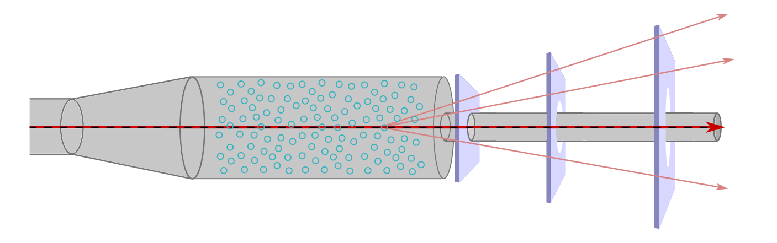
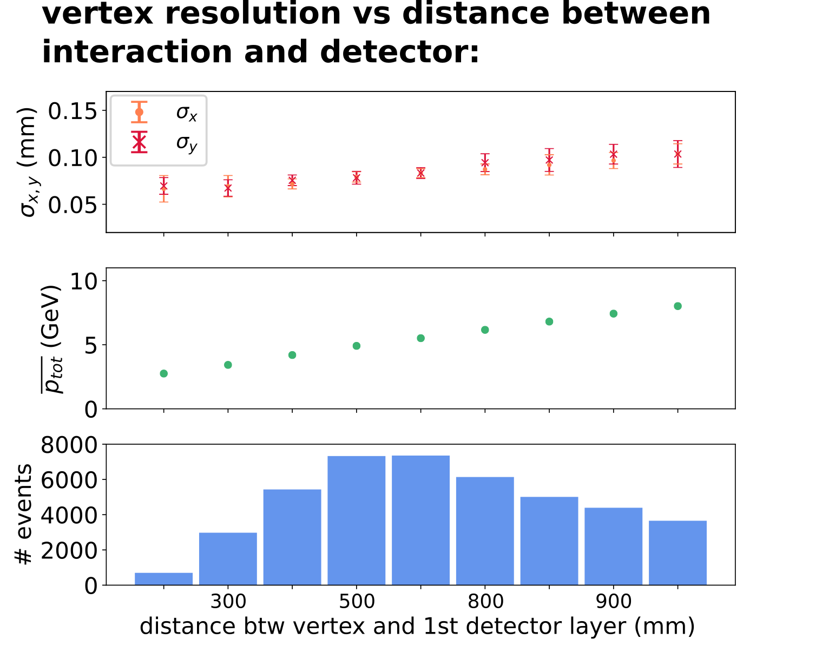
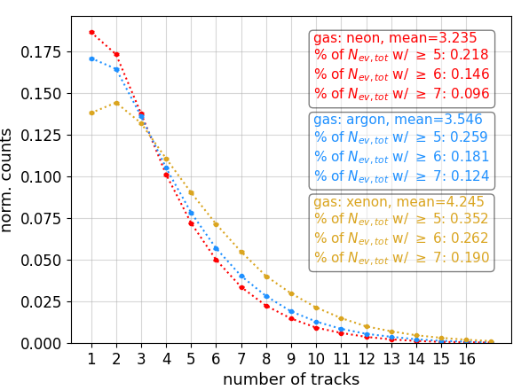
Results and conclusions of generic BGV study – gas target I
Neon gas target with 1 m extent in z:
  Not a showstopper.
  Simple system - gas injection system as already used by demonstrator BGV.
Higher A gas studied (e.g. argon, xenon):
  Higher cross section.
  Higher average number of tracks per collision.
  Possibility of running with a prop lower pressure. Larger percentage of the total number of collisions with N_{tracks} > N_{track,cut}.
neon
#tracks per event, traversing detector
Notes:
Performance wise not a showstopper.
to keep the radiation levels the same (prop lower pressure)

Slide 14
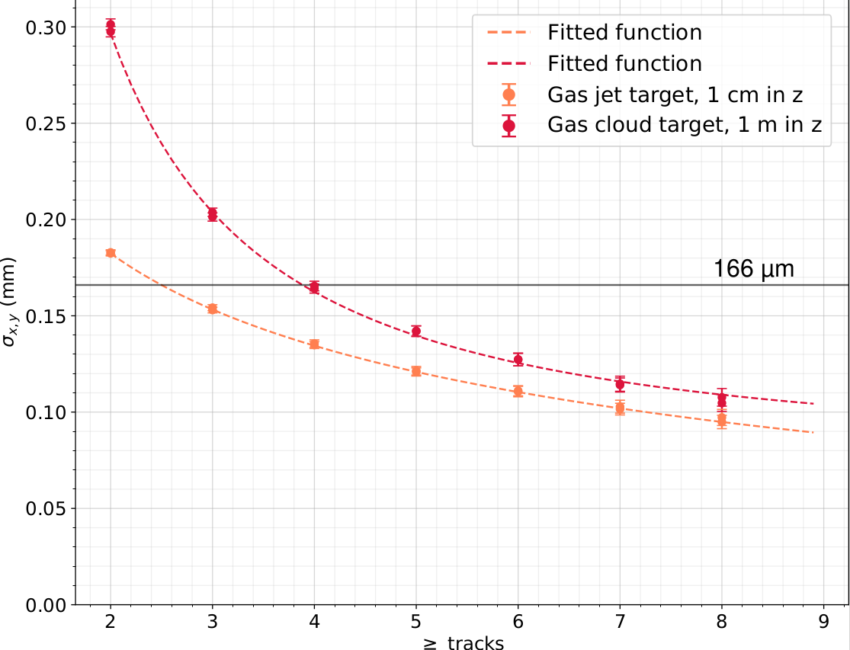
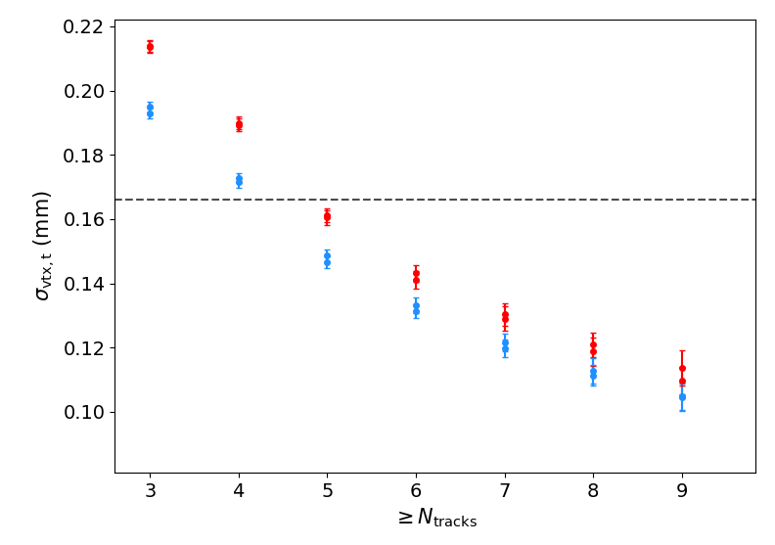
Results and conclusions of generic BGV study – gas target II
Gas jet target:
  Reducing extent of gas target in beam direction to ~1cm.
  Improved vertex resolution for events, especially with lower track numbers.
    Integrated pressure could potentially be reduced.
  Improved background rejection.
  Impact on cost and complexity.
neon
gas target 1 m
gas target 1 cm
neon
164 µm
164 µm
PRELIMINARY
ACTS reconstruction
(truth momentum)
Custom reconstruction

Slide 15
Summary & outlook
Development of a simulation frame work for extensive performance study - based on established tools, support from experts.
Two independent reconstruction tools developed.
Results point toward possibility of a compact tracker with high spatial resolution.
  Promising candidate: Si pixel tracker with detector layer ~250 mm apart.
Extended gas target not a show stopper – simplifies system, has already been successfully operated during Run 2 (BGV demonstrator).
Later today:
  Simulation study based on concept tracker design by Oxford.
  Alignment, pattern recognition.
  Measuring vertex resolution, deconvolution.
  Expected performance – precision on bunch width etc.
Thank you for your attention!

Slide 16
BACK UP

Slide 17
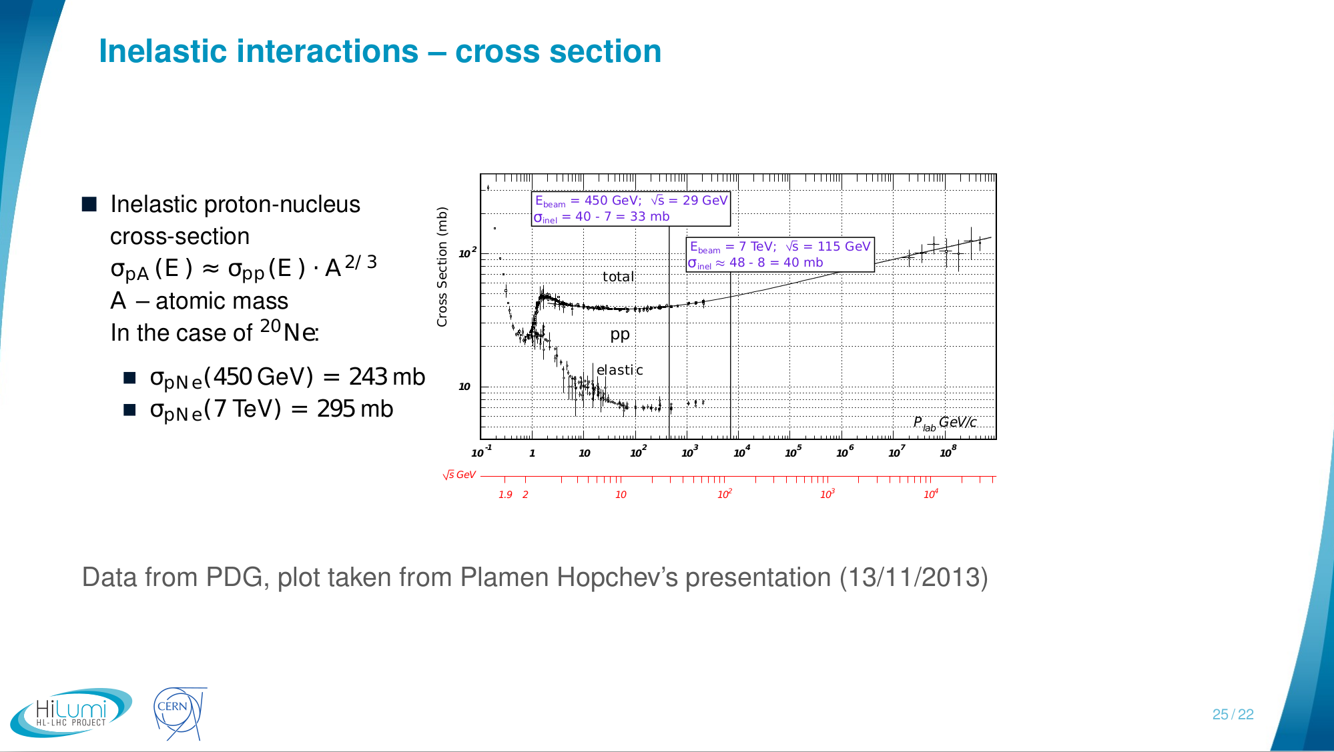

Inelastic collisions
Rate of inelastic collisions per bunch:
with the revolution frequency (11245 Hz), the number of protons per bunch N (2.2 x 10¹¹), the gas density $$ρ$$_{gas} and the gas width $$Δ$$z.

Slide 18
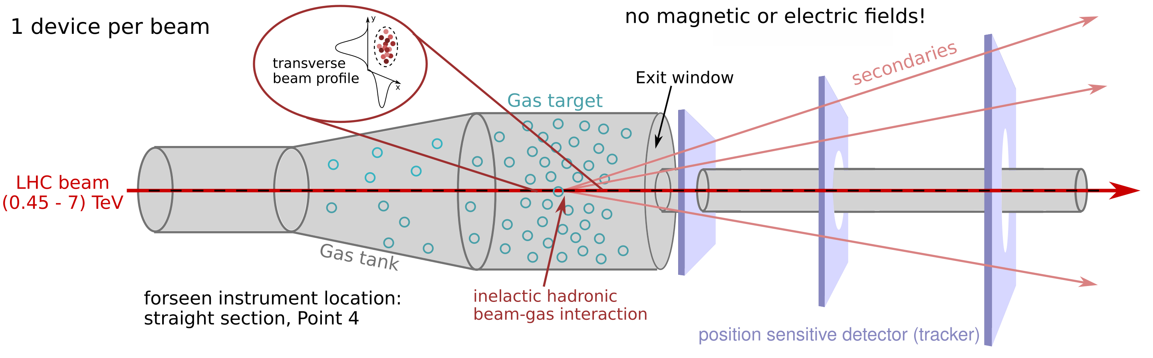
Introduction - principle
Noninvasive transverse beam profile monitor based on the reconstruction of vertices of inelastic hadronic beam-gas interactions - BGV (Beam Gas Vertex) monitor.
Provide continuous emittance and beam profile measurement throughout the LHC accelerator cycle (450 GeV to 7 TeV).
Consists of: a gas target, a forward tracking detector and computing resources dedicated to event reconstruction.

Slide 19
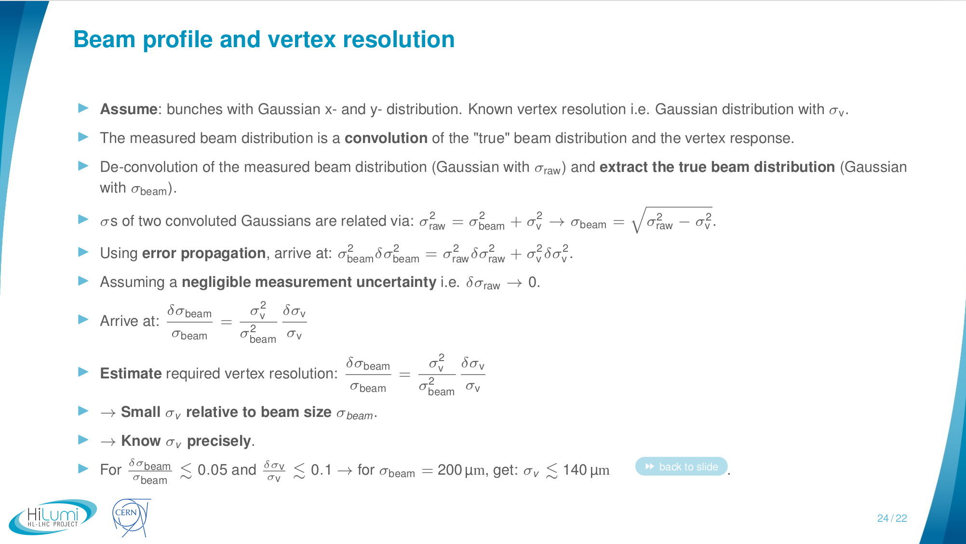

Slide 20
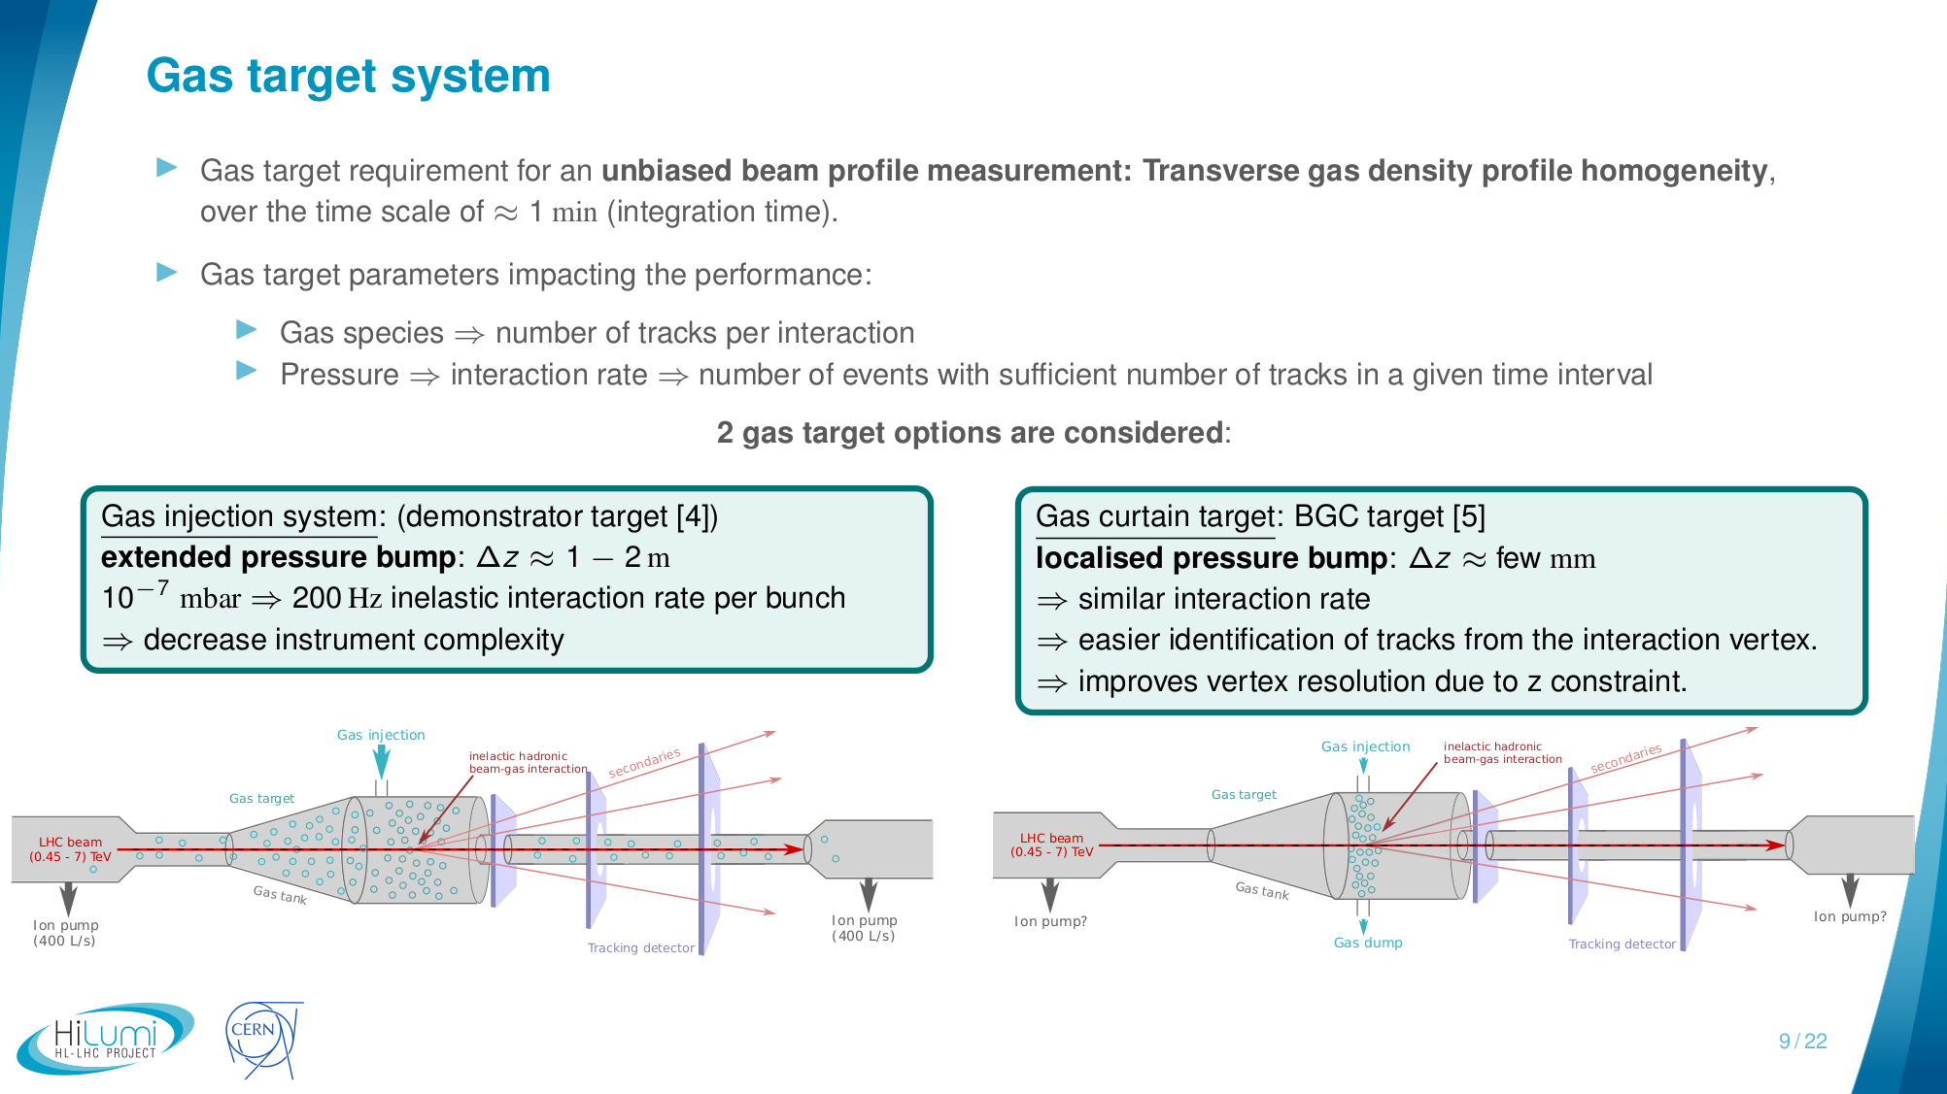

Slide 21
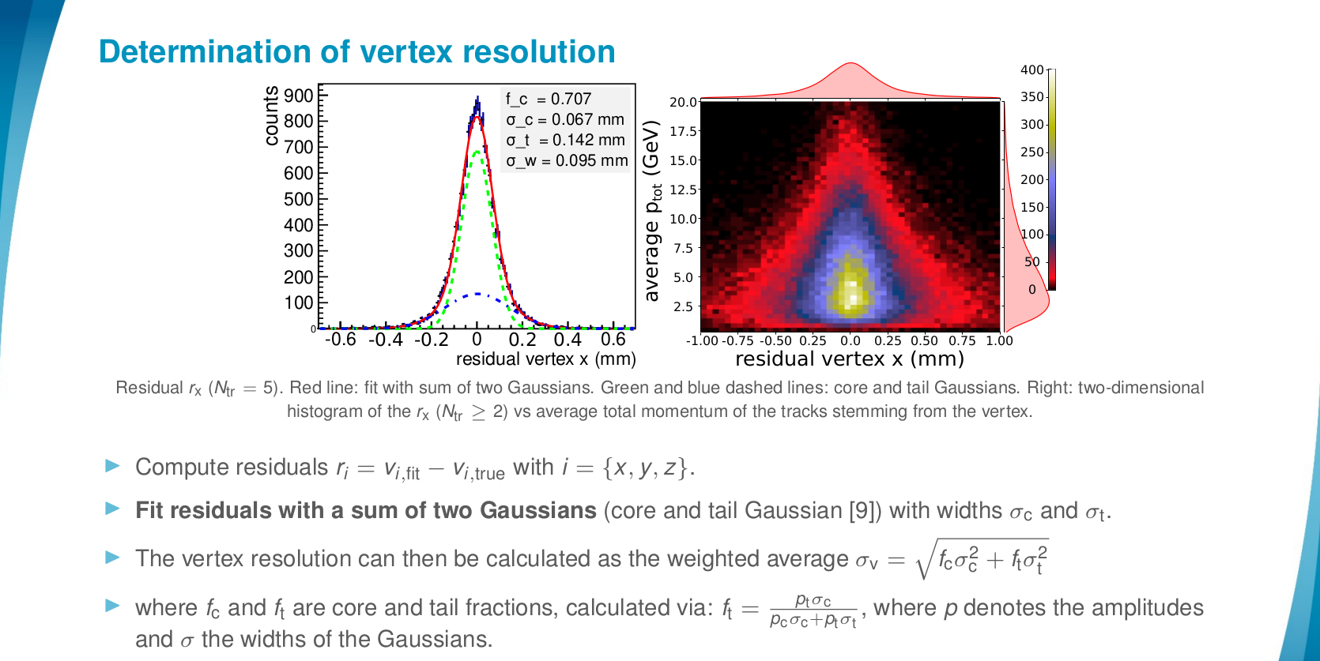

Slide 22
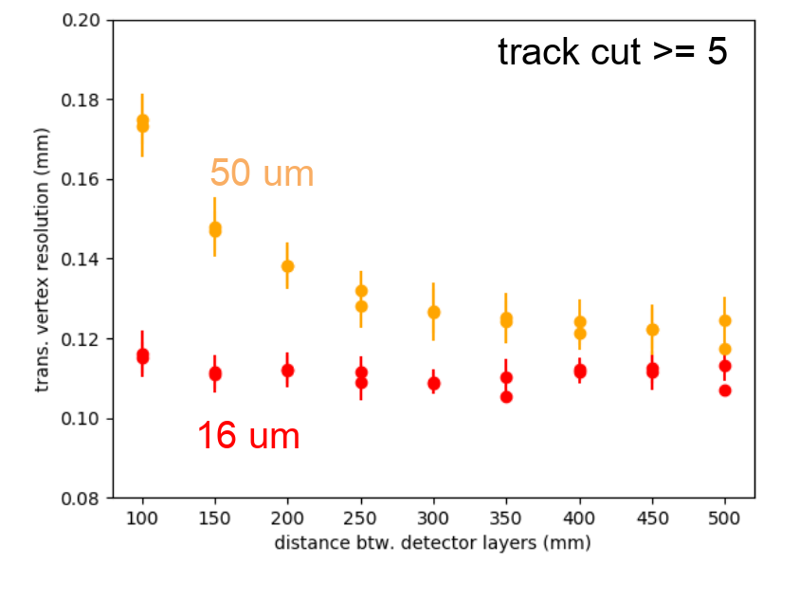
Cross-comparison of reco analyses

Slide 23
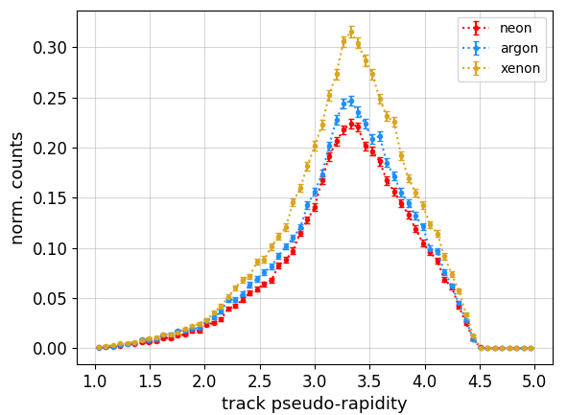
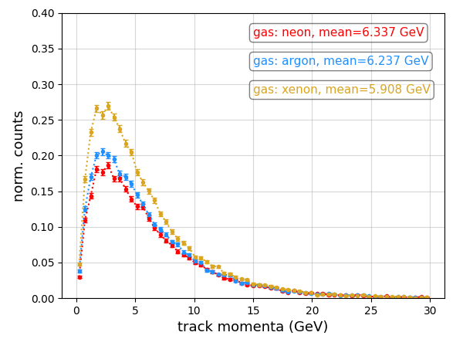
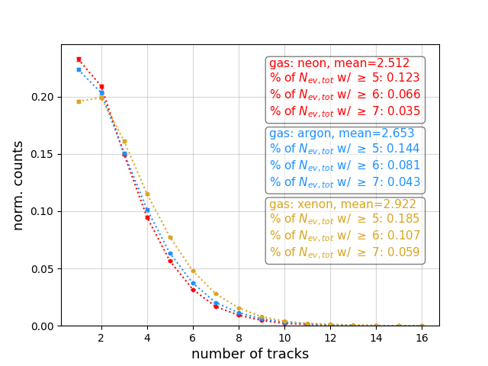
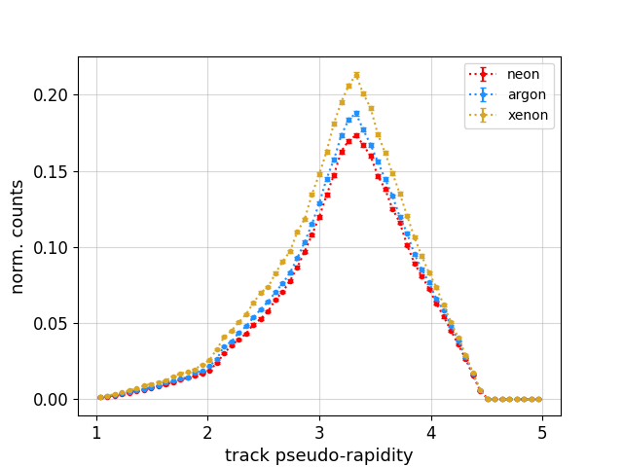
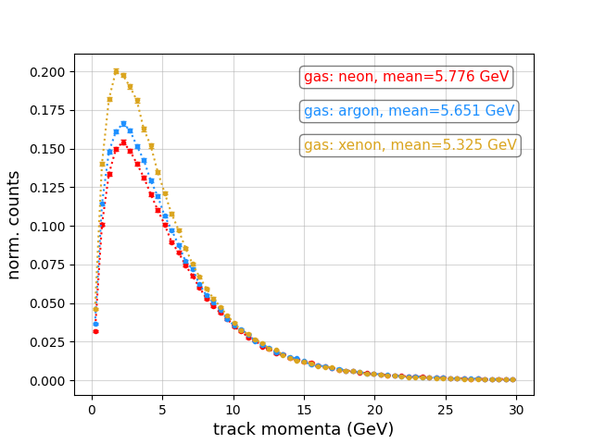
Secondary properties – protons on neon, argon, xenon
7 TeV protons on 1m extended gas target:
#tracks per event, traversing detector
$$η$$ of tracks traversing
detector
|p| of tracks
traversing detector
450 GeV protons on 1m extended gas target:

Slide 24
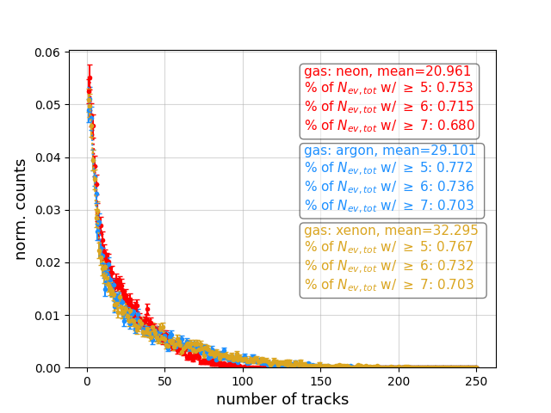
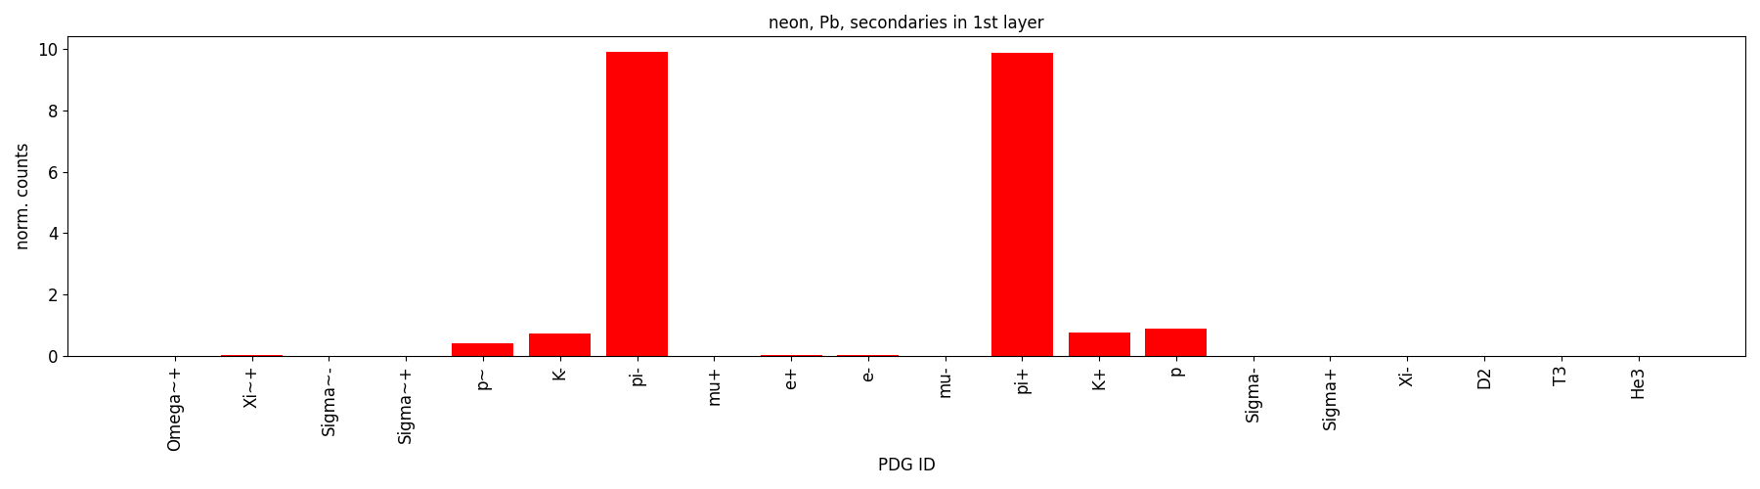
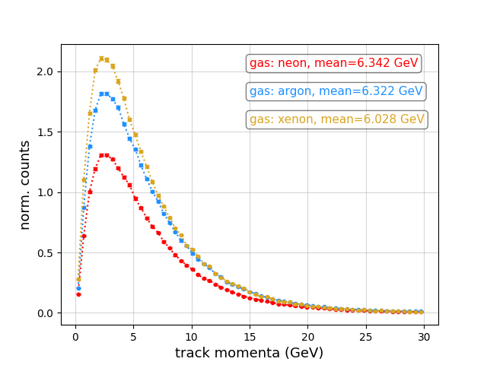
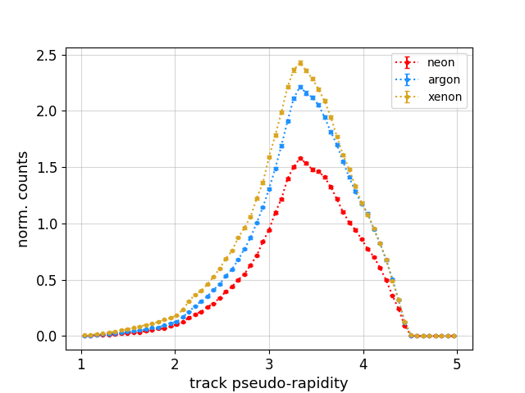
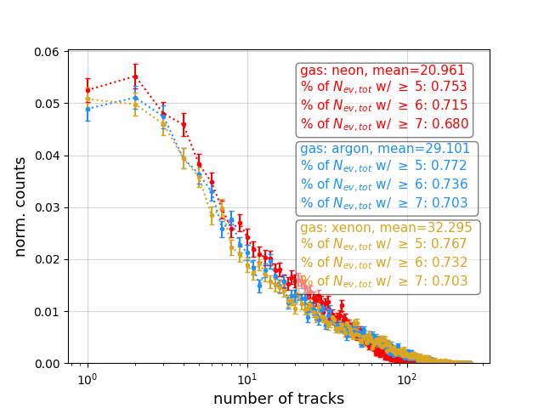
Pb-gas secondary properties
_{(log scale)}

Slide 25
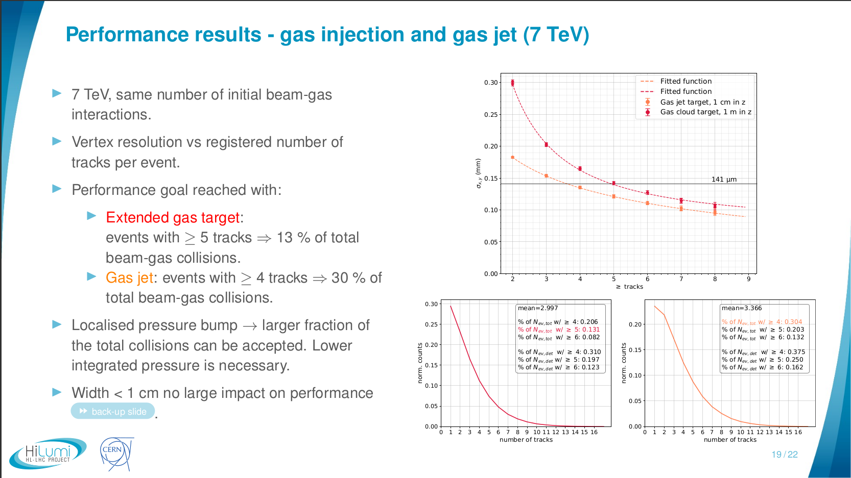
Gas curtain target - performance
slide from: BI/TB Meeting, March 2022
PRELIMINARY

Slide 26
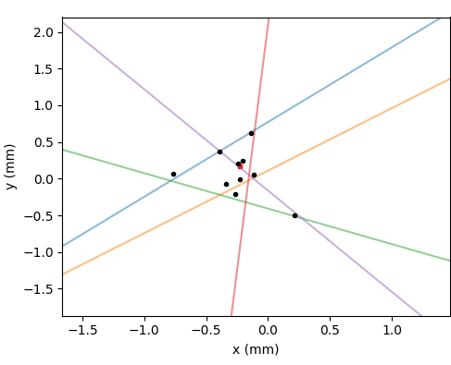
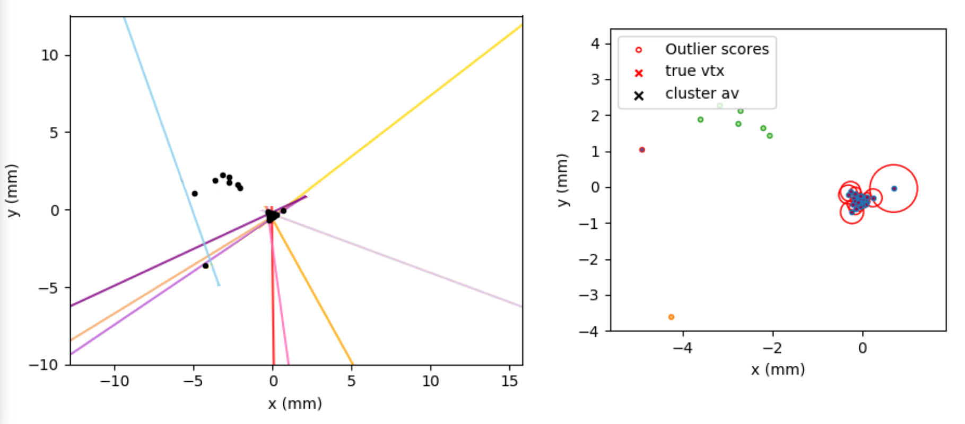
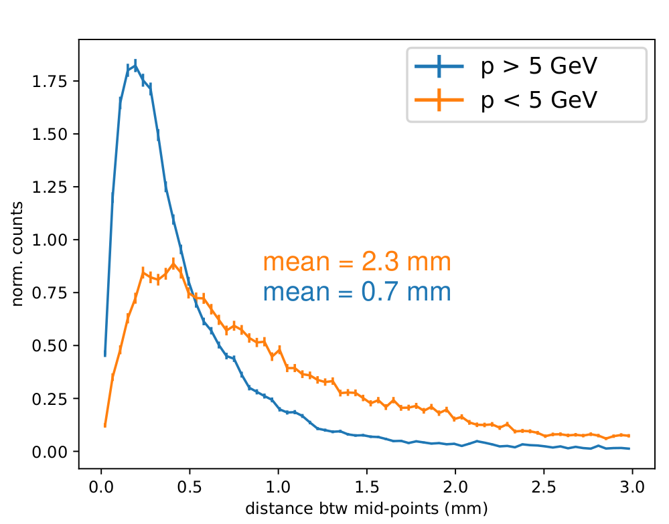
Custom vertexing
Calculate for track pairs:
  Points on both straight lines that are closest to each other,
  then calculate the point mid way.
Creates a mid-point “cloud” (black) – will yield $$\left({N_{tracks} \atop 2}\right)$$ mid-points in total.
Apply cluster finding to mid-points - exclude mid-points further away from centre of points.
Note: tracks with lower momentum show a wider spread of mid-points - by applying clustering, those points can be excluded.
Vertex is determined by calculating point, that minimises mid-point distances.
low momentum track
Notes:
Strategy:
Phase 1: generic BGV setup to ease navigation of extensive parameter space.
Efficiently identify impact of design parameters and provide first estimates of promising setup’s dimensions and identify promising technologies.
Phase 2: simulate specific detector technologies and detailed setup.
Conclusions:
Performance results point towards possibility of compact tracker with a high spatial resolution.
Promising candidate: compact Si pixel tracker with detector layers ~250 mm apart.
Localised gas target improves performance, but extended gas target is no show stopper.
(BGV talk at 2021 Hilumi Collaboration Meeting, IBIC paper 2021).
Furthermore: analysis framework that can be later adapted and used with measurements.

Slide 27
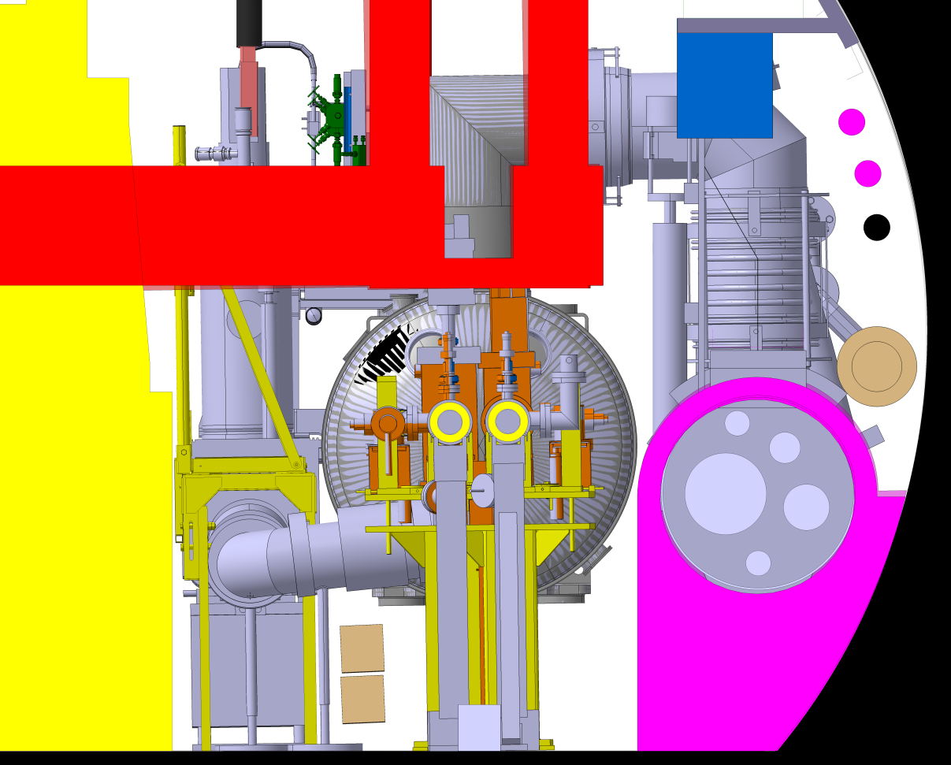
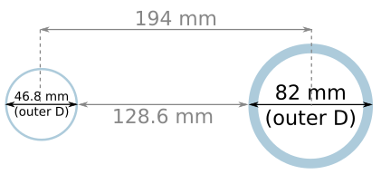
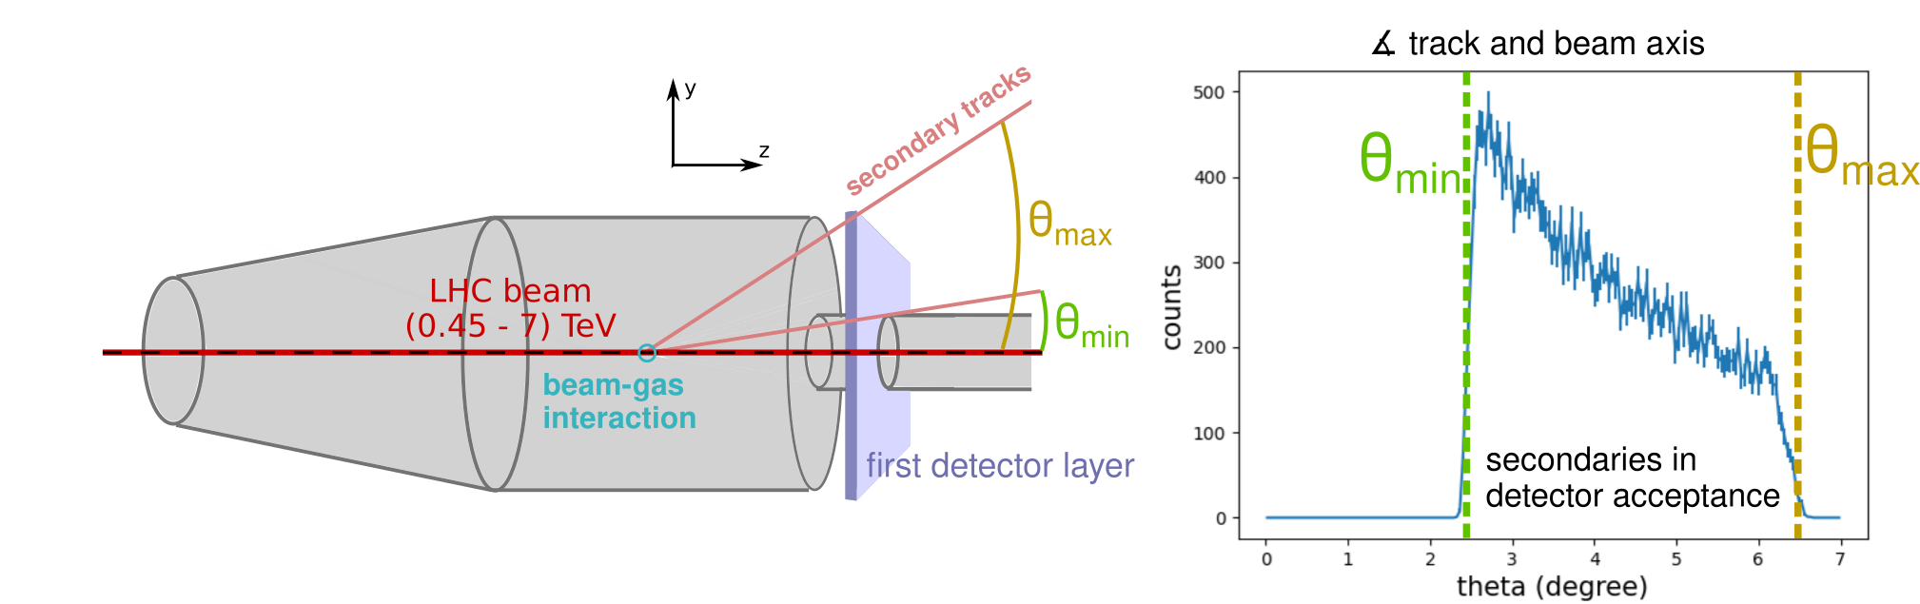
Detector space and placement
Tunnel cross section, location for BGV beam 1
Integrational space constraints (reserved areas in tunnel).
Allow access to beam pipes for e.g. baking prior to runs. Take into account for detector support.
Space constraint transversally due to second beam pipe:
survey space reservation
transport
space
reservation
447 mm
other LHC beam pipe
928 mm
436 mm
y
1100 mm
QRL space
reseveration
BGV detector beam pipe
x
y
picture provided
by J. Oliveira
x
Place detector layers transversally as close to beam axis as possible.
Size of 1st detector layer is determined by diameter of gas tank.

Slide 28
And why did the demonstrator have troubles?
Demonstrator conclusions:
Number and quality of identified tracks too low.
  Troubles with track recognition!
  Associating x- and y- position measurement of strip detector.
  Track finding efficiency 70%.
  High amount of fake tracks (30%).
Consequence: vertices could only be found for 50 % of events - average track number 2.
Notes:
Strategy:
Phase 1: generic BGV setup to ease navigation of extensive parameter space.
Efficiently identify impact of design parameters and provide first estimates of promising setup’s dimensions and identify promising technologies.
Phase 2: simulate specific detector technologies and detailed setup.
Conclusions:
Performance results point towards possibility of compact tracker with a high spatial resolution.
Promising candidate: compact Si pixel tracker with detector layers ~250 mm apart.
Localised gas target improves performance, but extended gas target is no show stopper.
(BGV talk at 2021 Hilumi Collaboration Meeting, IBIC paper 2021).
Furthermore: analysis framework that can be later adapted and used with measurements.

