Slide 1

BGV DAQ
H. Sandberg
Rehearsal for HL-LHC BGV Review
2022-10-12

Slide 2
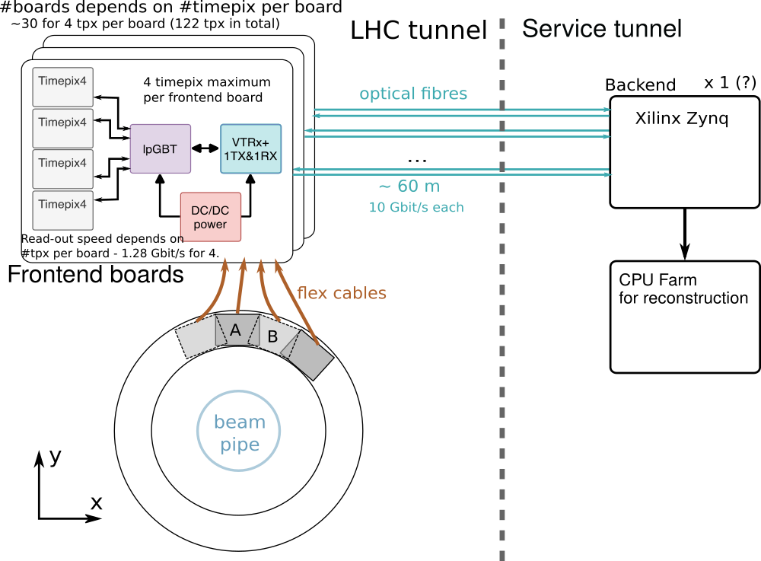
BGV DAQ - overview
Based on the pixel detector readout developed in the beam instrumentation group^{[1]}
4 parts:
  Detectors
  Front-end
  Back-end
  CPU farm
Components in the tunnel are radiation-hardened by design
Components outside the tunnel are off-the-shelf (COTS)
[1] https://edms.cern.ch/document/2666394

Slide 3
BGV DAQ - front-end
Current BI readout supports up to 4x Timepix3
  Designed for maximum data rate
This new BGV version is 122x Timepix4
  Similar but different detector
  Larger scale
The Timepix4’s in the BGV is expected to operate at a modest data rate
  Relaxes the requirements substantially
  BGV DAQ has been designed around this
One front-end board supports up to 4x Timepix4
  2 optical fibers per front-end (TX/RX)
Components from the latest generation of the GBT project^{[1]}
~30 front-ends needed in total
[1] https://espace.cern.ch/gbt-project/default.aspx

Slide 4
BGV DAQ - back-end
Current BI readout is using a system-on-chip (SoC)
  CPUs (software) and FPGA (gateware) on the same chip
  Xilinx Zynq UltraScale+ MPSoC
The processing can therefore be done in software or gateware
  Needs to be studied to take most advantage of each domain
~30 fiber links (TX & RX) in total
  There are MPSoC devices which can handle this
  Option to split into multiple MPSoC (e.g. one per detector plane)
The final processing is done on a CPU farm
  Size and configuration to-be-studied
  High-speed interface to MPSoC(s)

Slide 5
BGV DAQ - auxiliary
The following has to be considered also:
Powering scheme
  Digital system so high-efficiency supplies should be chosen
  Detector sensor biasing is a critical analog supply that should be protected
Cooling infrastructure (forced convection most likely enough for the readout)
Triggers and synchronization to LHC (White Rabbit, BST, etc.)
Single vs multi-mode fibers
  Only ~60m so multi-mode would open up for more options
  BI group has standardized on single-mode
Detector settings, calibration, equalization
  Important tasks that need to be carried out regularly during operation
  The need for any external test source should be identified early on to ensure it is included in the instrument

Slide 6
Questions and comments?

