Slide 1
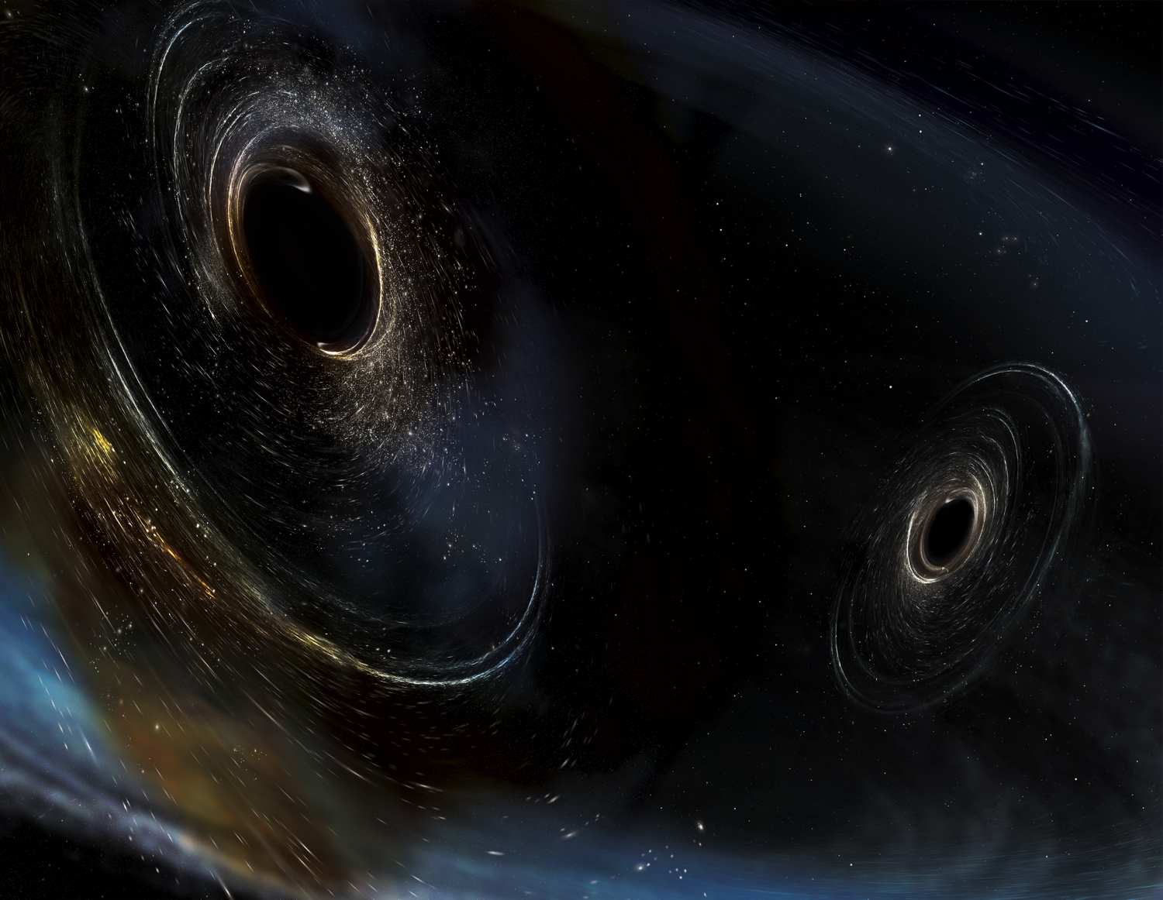

CE Beamtube Requirements, Plan and Status
Jon Feicht, LIGO Laboratory
California Institute of Technology
Image Credit: Aurore Simmonet/SSU

Slide 2
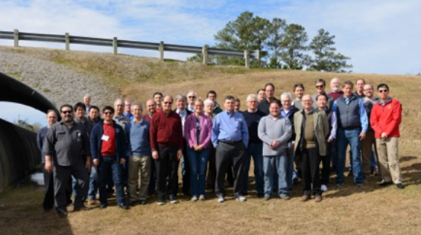
3rd Generation Gravitational Wave Detector
NSF vacuum workshop Jan 2019
Participants in the NSF Workshop on Large Ultrahigh Vacuum Systems for Frontier Scientific Instrumentation, LIGO Livingston, Jan. 28-31,2019
Attendee Affiliation
Curtis Baffes FNAL
Alex Chen FNAL
Paolo Chiggiato CERN
Bob Childs MIT PSFC
Dennis Coyne LIGO Caltech
Fred Dylla AIP (retired)
James Fedchak NIST
Jon Feicht LIGO Caltech
Joseph Giaime LIGO Livingston
Daniel Henkel Henkel Consulting
Hsiao-Chaun (Dick) Hseuh BNL
Albert Lazzarini LIGO Caltech
Yulin Li Cornell University
Yev Lushtak Cornell University
Enrico Maccallini SAES
Dennis Manos William & Mary
Scott McCormick LIGO Livingston
Gerardo Moreno LIGO Hanford
Dave Morrissey MSU
Tetsuro Nakamura MiraPro
John Noonan ANL
David Ottoway Adelaide University
Richard Oram LIGO Livingston
Harry Overmier LIGO Livingston
Antonio Pasqualetti Virgo
Matt Poelker Jefferson Lab
Tommaso Porcelli SAES
David Reitze LIGO Caltech
Fulvio Ricci Virgo
Chandra Romel LIGO Hanford
Yoshio Saito KAGRA
Bruce Strauss DOE
Tom Swain VAT
Ryutaro Takahashi KAGRA
Martin Tellalian McDermott
Takayuki Tomaru KEK
Rainer Weiss LIGO MIT
Michael Zucker LIGO MIT
3rd Generation Detector Vacuum System Design Workshop held in 2019.
Final report publicly available at https://dcc.ligo.org/LIGO-P1900072

Slide 3
Topics
2015 - Gravitational Wave Astronomy 1st Detection and Multi-Messenger event
Rational for building CE
Design Trade Space: Improving Detector Sensitivity
Scaling to 40 km beampipes
Beamtube Requirements
    Mechanical Design
    Vacuum Conditions
Outgassing Research
    Water and hydrogen
    Coatings
    LTREX chamber
Alternate Materials and Concepts
    Carbon Steel
    Nested (coaxial) System
Summary and Status

Slide 4
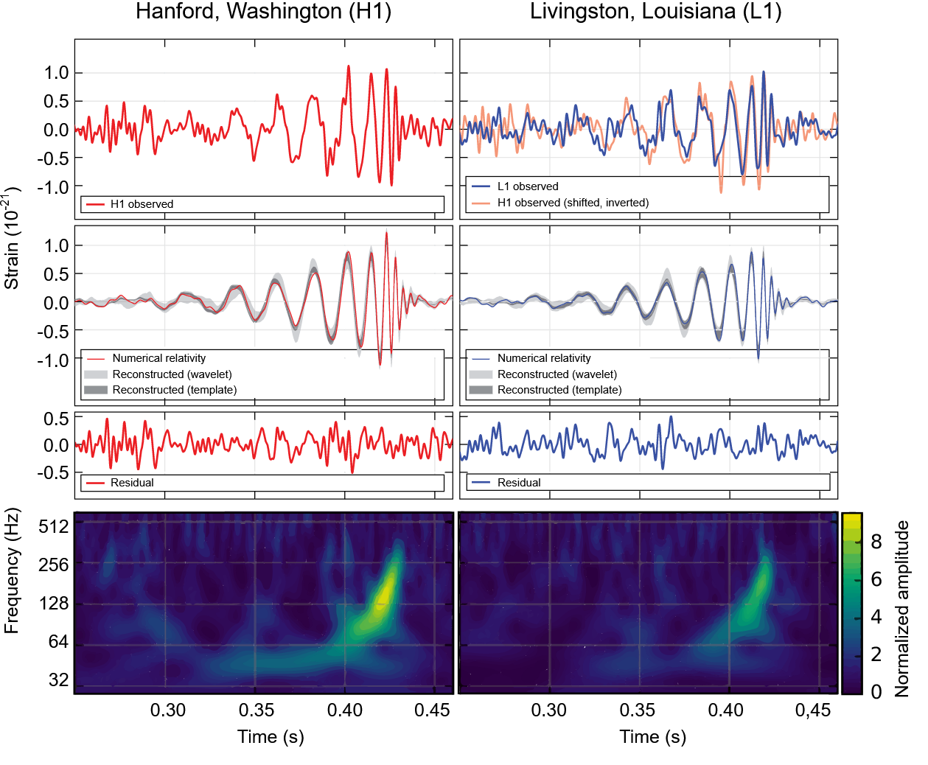
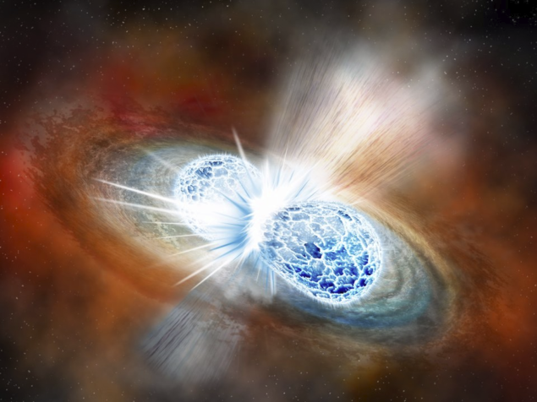
Gravitational Wave Astronomy
Predicted by general relativity- acceleration of mass.
Distortion of space-time “strain waves”. Measure 10⁻¹⁹ m change in LIGO arms.
First detection September 14th 2015- Black hole pair “inspiral”.
Neutron star pair- August 17 2017- First GW+EM signals “multi-messenger”.
GW150914
GW170817

Slide 5
Rational for CE ?
CE would be a “3rd generation” GW detector
  Major upgrade vs LIGO, 10x increase arm length 4 km -> 40 km
  10x increase in strain sensitivity (scales with L). See farther back in time.
  Larger “volume” of observation. Potential 1000x increase in detection frequency.
  Ground based detector similar to LIGO, leverages > 20 yrs. of operational experience.
  Minimal reliance on “new” technologies that may not become available.
  Minimal increase in noise sources, same overall design as LIGO.
CE Vacuum Workshop CERN March 2023

Slide 6
Trade Space-Increased GW Detector Sensitivity
  Increase length of arms-the current CE proposal (ΔL/L)
    Sensitivity scales with L .
    Noise sources stay approximately constant.
    Many cost drivers- land, materials, earthwork, site topology (30 m earth curvature), seismic.
    LISA: Move to space. “Free” vacuum, unlimited room, explore much lower frequencies. Trade is complexity and costs, mission life and redundancy. JWST cost $10B, a cost growth about 1000%, 15 years behind schedule. Add $1B to launch.
  Increase “N” number of arm transits (add path length and photon density)
    Optics reflectivity determines N, for LIGO about 200 trips, cavity finesse. Coatings about 15 ppm XMNS currently with ~10 ms arm storage time. Optical losses accumulate as N increases, also don’t want light storage time close to GW period, so this approach has limits.
    Reflective coatings are near state of the art, but also want coatings with lowest Brownian (thermal) noise possible …..significantly ”better” coatings under intense research, 2x improvement?
  Reduce noise sources-other options (thermal, seismic)
    Cryogenics- increased complexity, optics are now the vacuum pumps (cryofilms- optical scattering noise).
    Lower (vacuum) arm pressure –> lower forward scattering-reduced phase noise , XUHV not practical.
    Better suspensions (seismic), lower coating defects, larger or different test masses, scattering, etc. R&D.
  Increase laser/arm power (quantum noise)
    A-LIGO arm power goal 800 kW <10 mm beam. Optics damage threshold ? Lossy areas/defects in coating “burn”, increased radiation pressure, thermal lensing, shot noise, laser stability (need for length measurement).
    Molecular films and particles (scatter and ablation, vaporize dust particles (loss and scatter).
See https://dcc.cosmicexplorer.org/public/0163/P2100003/007/ce-horizon-study.pdf for a
discussion of trades associated with alternate CE detector designs
CE Vacuum Workshop CERN March 2023

Slide 7
Concentrate on arm length trade
40 km arms will add 10x strain sensitivity
    “See” cosmic events from 1st epoch of time.
    Measure strain < 10⁻²² ΔL 4X10⁻¹⁸m.
    Minimal new technology drivers (optics, coatings, etc.).
Vacuum system becomes technology and cost driver
    90M liter UHV system.
    Where to build and how to manage the 30 meter height change (earth curvature/40 km).
    Cost of SST (Cr, Ni) is volatile (surcharge, cost escalation risk). Alternate materials?
    Most requirements (diameter, vacuum levels, straightness are similar to the existing LIGO system.
    Can we bake such a large system?
A wave’s strength is measured by the strain induced in the detector,
We can calculate expected strain at Earth;
Existing interferometer arms are 4,000 meters long,

Slide 8
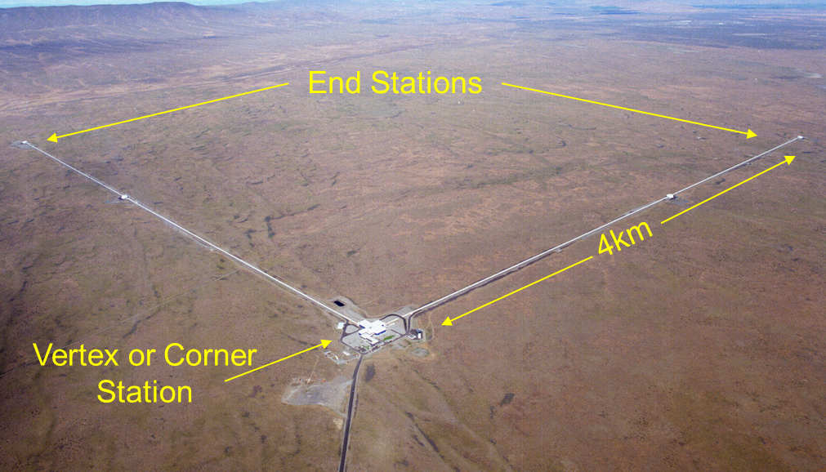
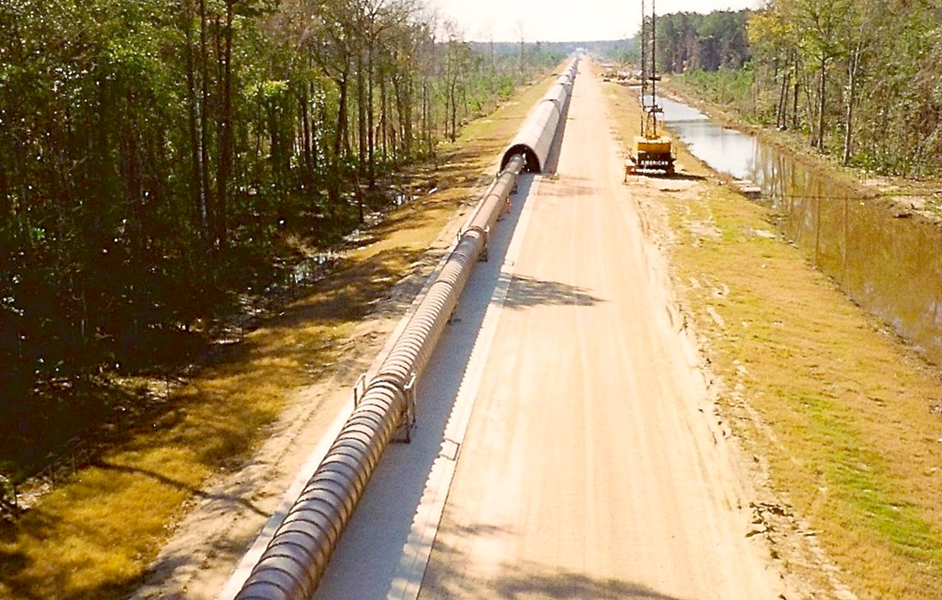
Scaling to 40 km
40 km system largest cost driver will be the the vacuum system
  Cost scaling: Beamtubes (8 km) were $76M (1994) estimated $700M in 2028.
  Chromium and nickel are commodities, price can be volatile. LIGO Contractor would not commit to FFP.
  Are there alternate materials?
  Can we eliminate the concrete enclosure?
  What about bakeout?
  We will assume an above-ground facility.
Proposed CE beamtube 80 km
  90M liter x10⁻⁹ Torr
  3e9 cm² of surface area
  500 km of welds
  30M kg of material (1.27 cm wall)
CE Vacuum Workshop CERN March 2023

Slide 9
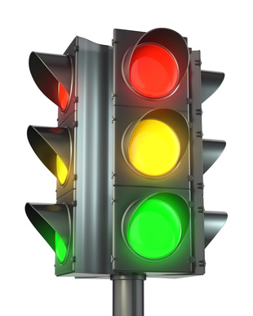
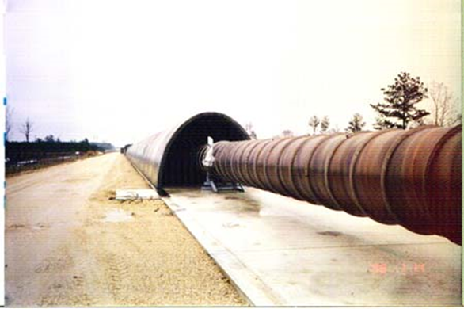
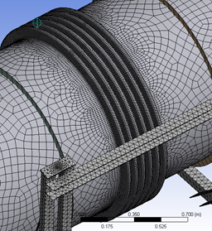
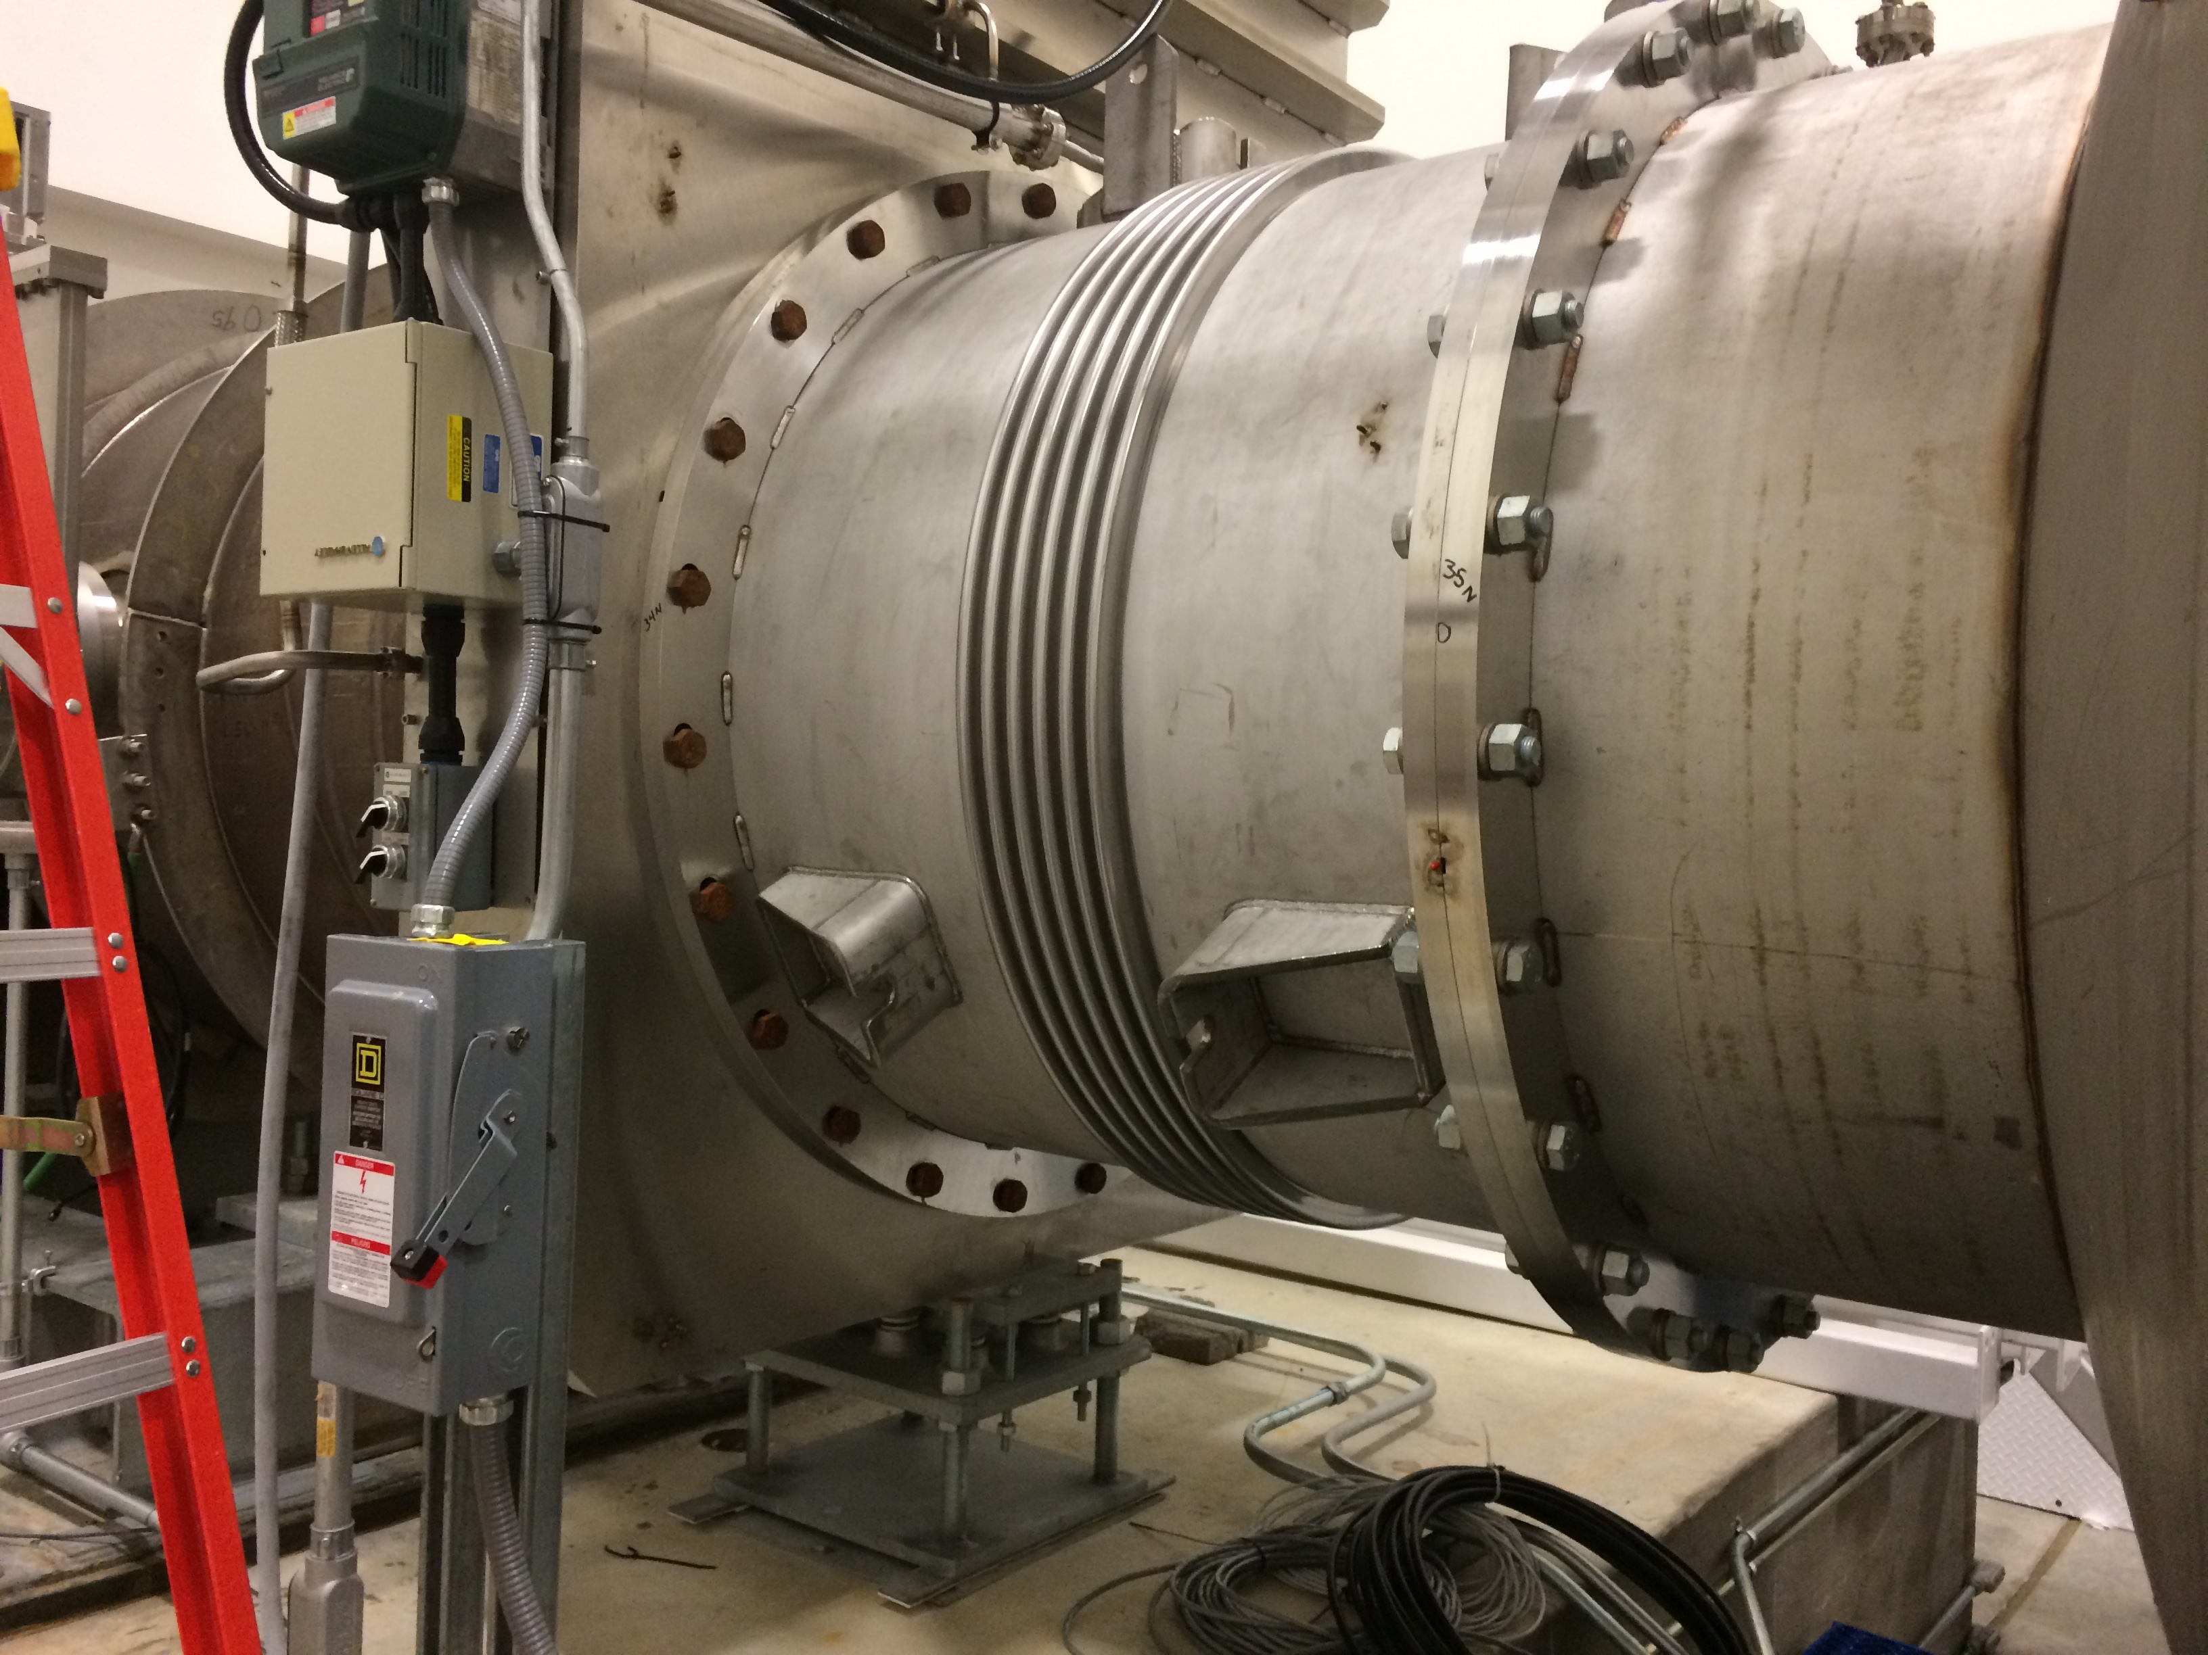
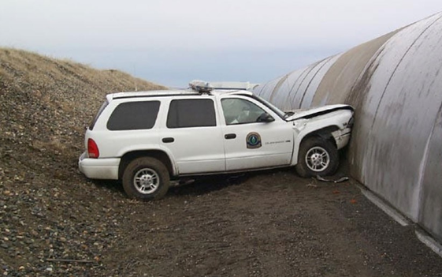
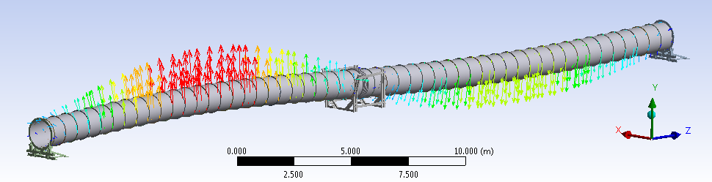
Beamtube requirements- Mechanical
  1.2 meter pipe-80 km total length (two arms)
  1 meter clear aperture through the arm (alignment, straightness)
    Straightness to 5 mm rms (beam transmission, diffraction). Differential GPS ~ 10mm/10km resolution? Concrete foundation.
    Arms orthogonal to 5 mrad (max sensitivity, antenna directivity).
    Low vibration (phase noise from scattered light). Low optical scatter surface, optical baffles. Seismic noise response.
    Modal analysis. Suspension systems: bellows, anchor points, no stick-slip, bowing. Stresses-cycle fatigue (particularly w/alt. materials like aluminum-also post weld).
    Bellows and anchor points to accommodate thermal expansion, atm. pressure, etc. Keep tube aligned. LIGO ΔL/temp ~3.5 meter.
    Flanges for large gate valves, pumps, etc. Need to be compatible with standard SST construction.
    Resist atm. pressure, buckling, vibrational modes, operational lifetime, etc. Support rings if thin wall or guard vac if nested.
    Enclosure required? Accidental or malicious damage, ballistics, wind noise or resonance (Aeolian), lightning, corrosion?
Beamtube materials costs (M’s of kg). Cost of Cr and Ni also heat treatment if using SST (H2).
Hydrofomed bellow and 48” GV
Modal analysis
Suspension and cover
CE Vacuum Workshop CERN March 2023

Slide 10
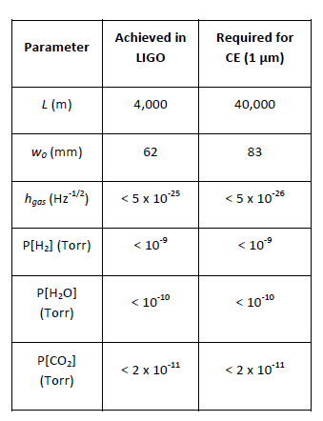
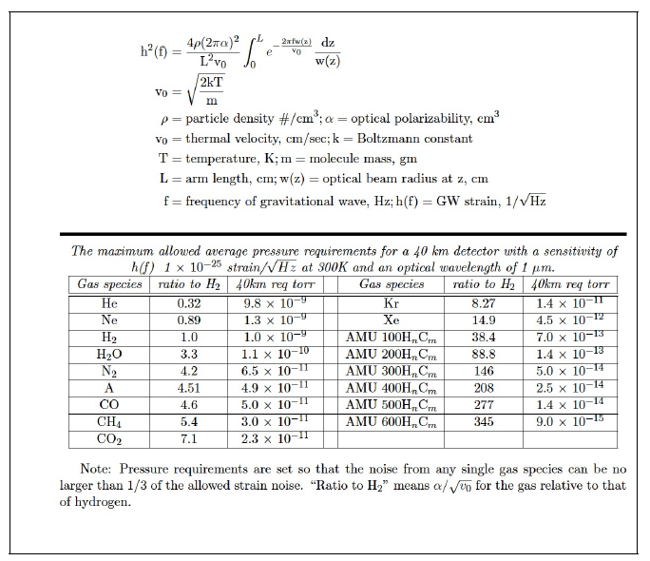
Beamtube requirements- Vacuum
Vacuum requirements similar to LIGO
  H2 1e13- Torr-liter/sec-cm².
  H2O 1e-16 Torr-liter/sec-cm².
  Low hydrocarbon flux.
  Leak rate < 1e-10 Torr-liter/sec He
Molecule size->polarization. Gas interaction scatter over path length. Phase noise, lowers h(f). Want both # density and amu low.
Hydrogen diffusion, SST or Aluminum or Steel.
Water expected to dominate spectrum.
Keeping HC pressure low. Cleaning w/low waste stream-> low VOCs, ODP, phosphates, etc. Keep parts clean post cleaning-how?
Bakeout required? Pumps, getters? Pump distribution? (no vibration)
Low reflectance at 1 µm (laser frequency) desirable. Scattered light noise.
Partial pressure requirements are similar to those achieved in LIGO
CE Vacuum Workshop CERN March 2023

Slide 11
Issue: Dealing with water outgassing
“Sojourn” time at room temperature vs energy*
E_{b} [kcal/mol] | E_{b} [eV] | τ_{a}
1.4 | 0.06 | 1.2 x 10⁻¹² s
3.5 | 0.16 | 5 x 10⁻¹¹ s
9.5 | 0.41 | 1.2 x 10⁻⁶ s
14.3 | 0.62 | 5.5 x0⁻³ s
19 | 0.83 | 15 s
21 | 0.93 | 15 min
23 | 0.98 | 2 h
24 | 1.04 | 8 x 10⁴ s ~ 1 d
28 | 1.24 | 2 x 10⁸ s ~ 10 years
35 | 1.55 | 7 x 10¹³ s ~ 20,000 years
Water is the problem.
Distribution of binding energies
Mid-range energies are the problem, high/low energies irrelevant.
Either raise T (bake) or lower binding energy
Coatings to lower energy?
Many in the collaboration are studying this.
physisorption
weak chemisorption
.
.
.
.
Water on SST ~ 1 eV
strong chemisorption
CE Vacuum Workshop CERN March 2023
*Excerpt from G. Vandoni, CERN

Slide 12
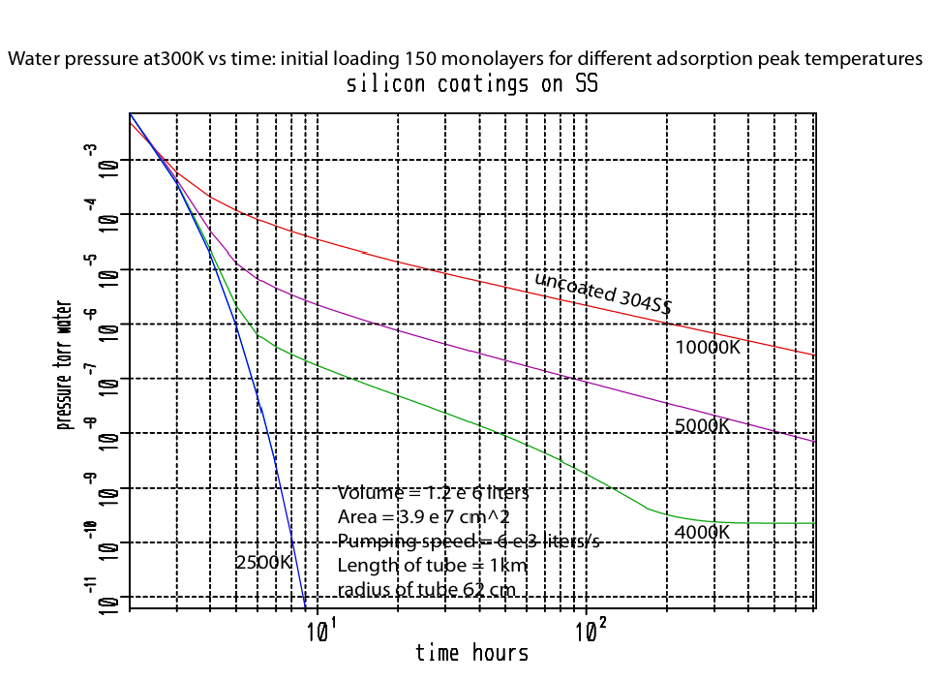
Pumpdown vs peak binding energy. Why coatings or other surface modifications could improve water desorption
The 1/t behavior of water pressure vs time. Typically wait >10⁶ sec at RT.
Water binding energy on SST is around 1eV (24 kcal/mol).
If a coating reduced the peak energy < 4000 or 5000 K, bakeout would be unnecessary.
Dubinin-Radushkevich Isotherm model shown (Weiss).
Low-temperature bakeout-both Hanford and Livingston often 40C ambient temperature “summer bakeout” helps.
Good p(t) models required.
A hydrophobic coating could make bakeout unnecessary
CE Vacuum Workshop CERN March 2023

Slide 13
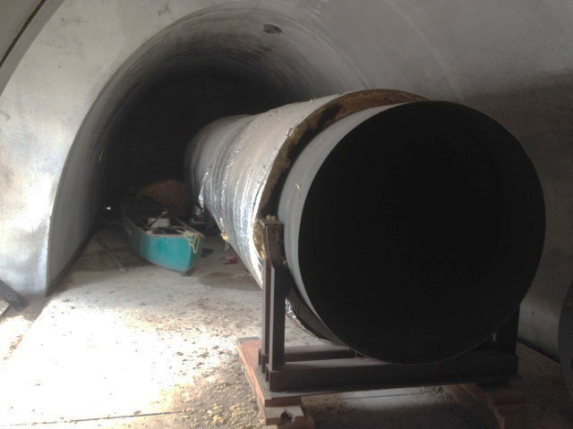
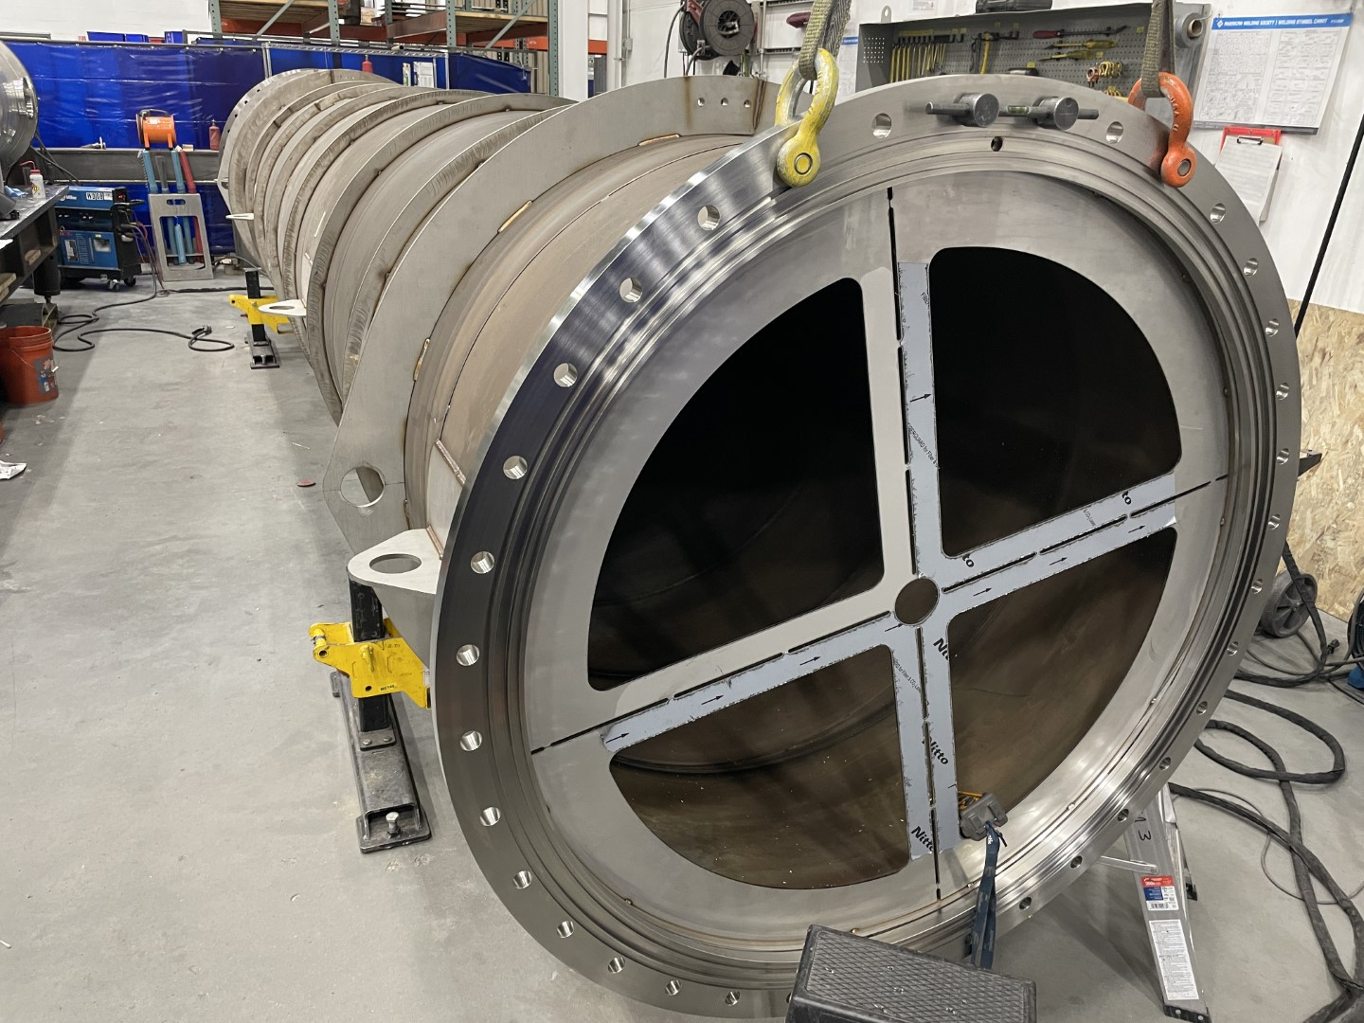
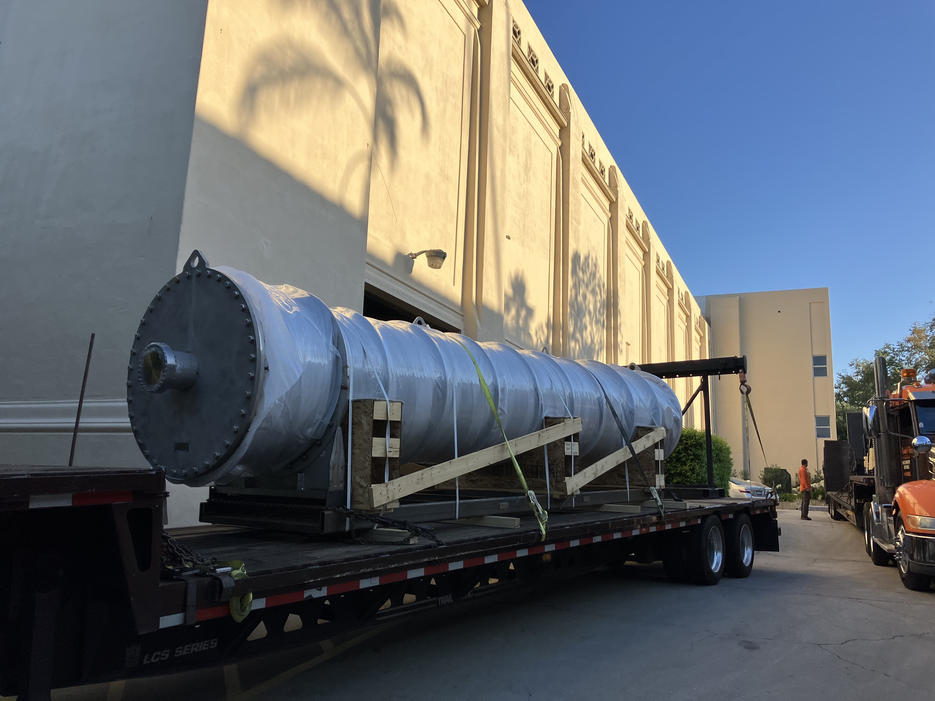
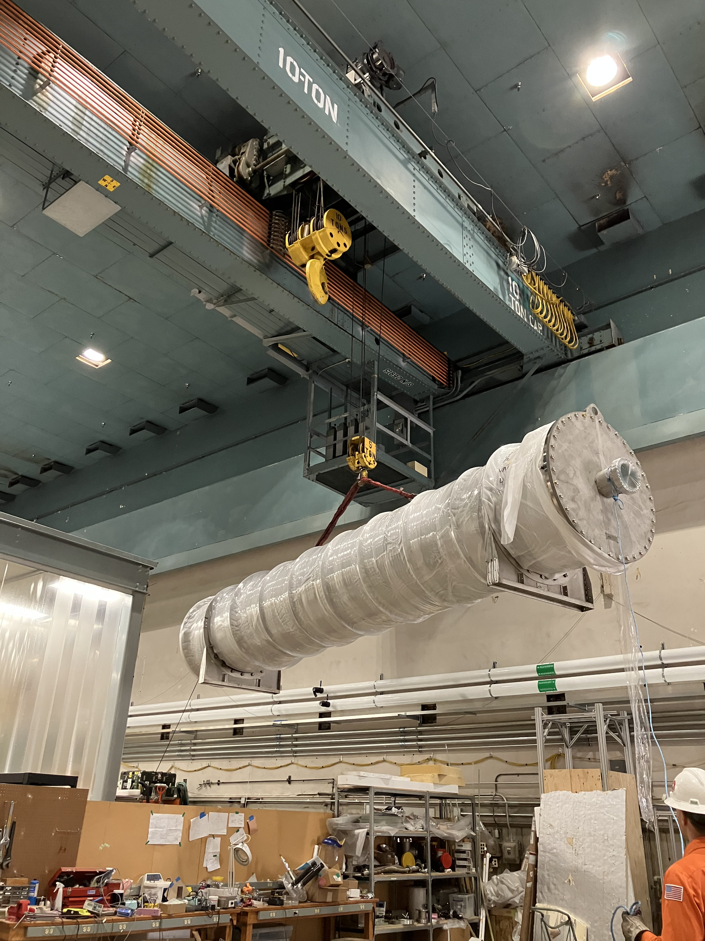
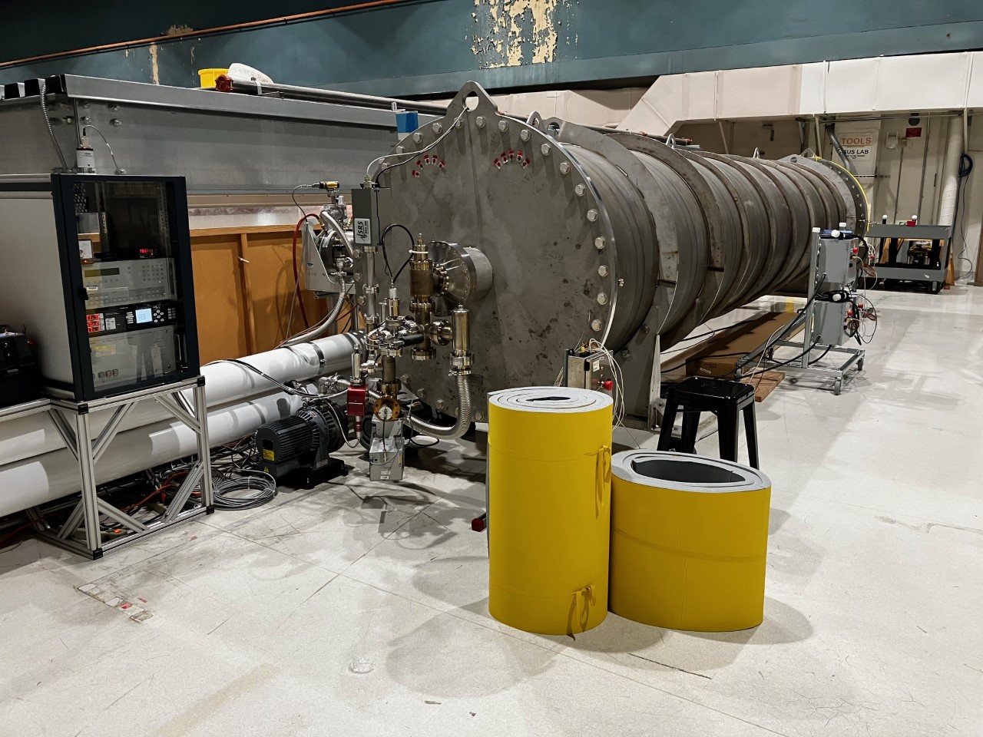
LTREX experiment: An outgassing system using a residual section of LIGO beamtube
8m section of beamtube in storage at LLO ~ 20 yr
Tube being converted into UHV vacuum system
Delivery to Caltech
1.1 x 7.5 meter section of residual LIGO beamtube that stored at LLO since site construction. Removed from storage, flanges and end caps installed. Differentially pumped o-ring flanges. Helium leak testing and UHV performance verified. Mild (non-acid) cleaning processed to preserve surface chemistry. Matches LIGO beamtube surface- same low hydrogen air baked SST.
Will be used for outgassing tests and dry-gas venting experiments and to verify isotherm models. Can we do a brief vent w/o rebake?
Scale-up of Vortex tabletop system.
Installation
CE Vacuum Workshop CERN March 2023
Currently under vacuum 8x10⁻⁹ Torr and being prepared for 150 C bakeout

Slide 14
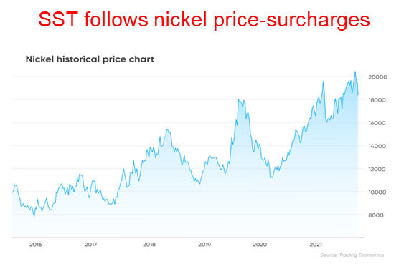
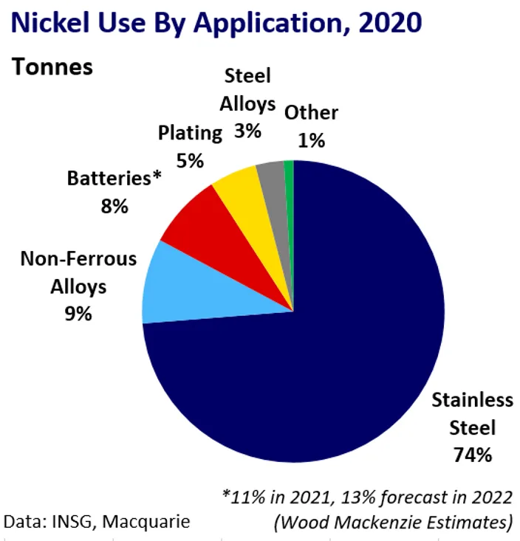
Alternate Construction methods
(how to beat the commodities market)
Cheaper materials, alternate construction methods and/or processing
  Ni is a commodity, used in SST, superalloys, also batteries including Li-ion, magnets, etc.
  SST typically sells with a market surcharge.
  Evaluate mild steel for beamtube (Park, et. al).
  Use a low temperature (or skip) bakeout (LIGO electrical costs were $1M/arm).
  Are there coatings that reduce water desorption time?
  Eliminate expense of concrete enclosure (BTE)?
  A 1-meter diameter vacuum valve costs $300k. Expect 1 valve/10km. Simplify?
  Nested system: use very thin inner wall, i.e. use less of the expensive stuff.
CE Vacuum Workshop CERN March 2023

Slide 15
Mild steel research summary
Hydrogen bulk content and diffusion rate verified.
Outgassing tests: CERN, NIST, others.
Mild steel pipe: Preliminary report complete (Henkel). Boutique mill can easily provide standard material, possibly tweak alloy if warranted.
Magnetite coating: Needs development: how to efficiently make coating, verify outgassing rate. Some preliminary results encouraging.
SST to mild steel transitions ~ 7 x 10⁻⁶m/m-C CTE mismatch. Will make numerous CFF connections to std. vacuum equipment. Need to evaluate and manage.
Scaling test of 20-40m beamtube, particularly induction heating test (LHO?)
Vacuum component vendors typically do not allow mild steel fabrication in their shops due to “free-iron” contamination of the SST parts.
CE Vacuum Workshop CERN March 2023

Slide 16
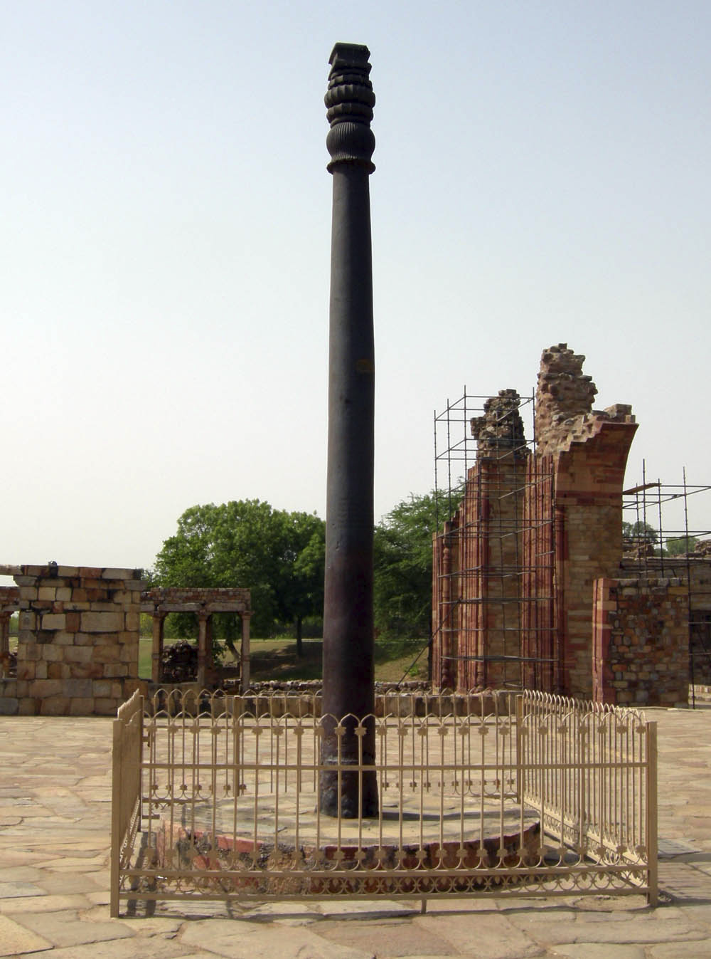
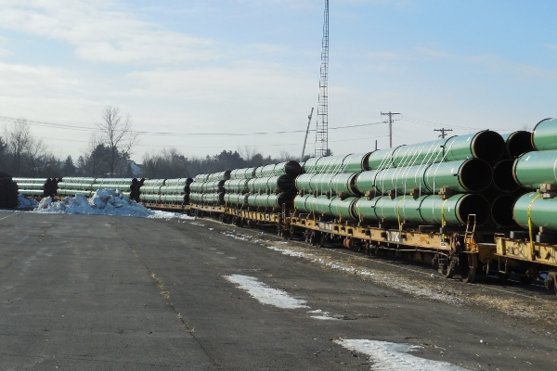
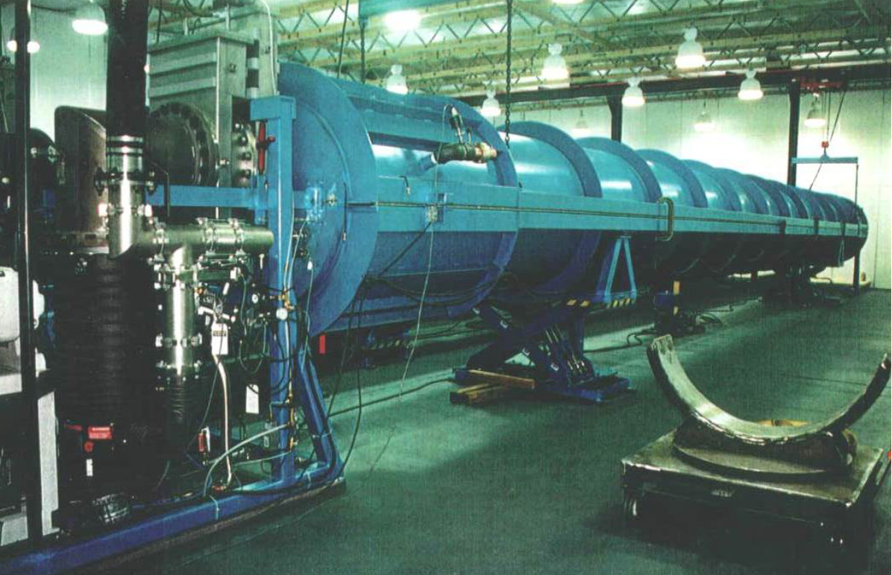
Carbon (mild) steel pipe
Gas/Petroleum pipeline
  Inexpensive- estimated saving $300M vs SST.
  Available- 80 km is actually “small” order.
  Shipped from factory with rail transport to site. (LIGO tube was made on-site).
  QA system in place (fuel gas pipeline safety-US DOT).
  No helium leak testing- revive LIGO leak test system?
  ½” thickness- 380 kg/m. Tube is stable to atm pressure, buckling, resistant to mechanical damage.
  No support rings needed. Suspension system (and cover) design TBD.
  Corrosion? (epoxy, but what happens if it covers a vacuum leak?)
  Magnetite (Fe3O4). Outgassing and optical scatter, mild corrosion protection.
  Other coatings?
Helium leak test system for 20m LIGO tubes
Iron pillar of Delhi
400 AD
FePO4 “Parkerized”
Coca-Cola
CE Vacuum Workshop CERN March 2023

Slide 17
Carbon steel pipe
Pipe factory
  Nominal ½” wall thickness. 48” diameter.
  Self supporting (no stiffening rings needed).
  Spiral welded (LIGO same).
  Low hydrogen outgassing.
  Surfaces options.
    Bare (corrosion ”bad rust”)?
    Silica (CVD process) ?
    Magentite (Fe₃O₄ ”good rust”)?
    External-epoxy coating. Outgassing?
    Magnetic, can be induction heated.
24m sections of spiral welded steel pipe.
This mill makes about 500km/year*
D. Henkel (invited talk 3/27@13:30) surveyed pipe mills
CE Vacuum Workshop CERN March 2023

Slide 18
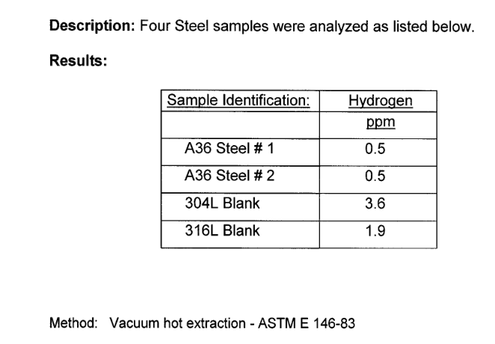
Hydrogen outgassing stainless steel vs carbon steel comparison
H2 diffusion from bulk
  Hydrogen dissolved in the metal when molten.
  t=0 concentration starts with the material manufacture
  SST requires vacuum degassing or air oxidation to reduce H2 diffusion
  LIGO beamtube SST was oxidized prior to rolling
Mild steel has extremely low intrinsic hydrogen
  Vacuum degassing lowers dissolved gas, mainly hydrogen
  Old textbook H2 values obsolete.
  Mild steel lower H2 diffusion than the best LIGO SST
  Verified low H2 concentration and diffusion rate
    Park et.al JVST A 26 (5) 2008
    NIST (Fedchak)
    CERN
H2 concentration A36 mild vs 304L stainless steel using vacuum hot-extraction testing method
Low intrinsic hydrogen in mild steel verified
CE Vacuum Workshop CERN March 2023

Slide 19
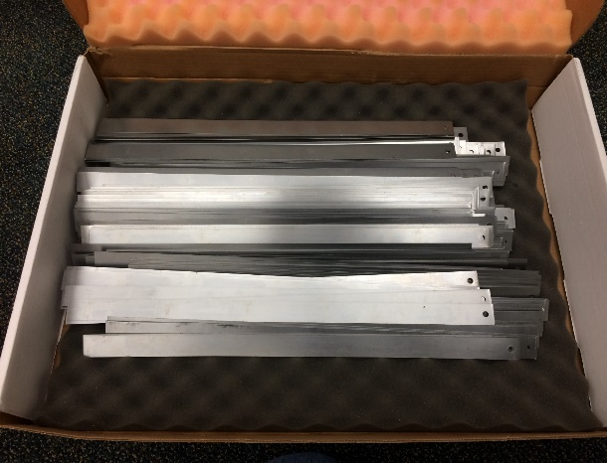
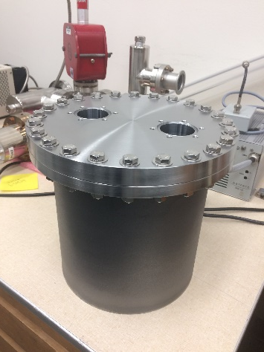
Silica coatings-Silane decomposition
CVD process.
Silane precursor SiH₄
Proprietary process.
CERN reports hydrogen uptake in the strips.
Does improve outgassing but at what cost/benefit?
Layer probably too thick (JRF).
Dust and particulates.
Practical on huge beamtube sections?
Above: Test strips ( mild steel and SST) coated with silica. Below: A36 steel test chamber was also coated. The chamber is at now at NIST.
Strips being prepared for Silane CVD coating
Si-based coating reduces outgassing ≤10x.
Helpful but CVD process too complex for this application
CE Vacuum Workshop CERN March 2023

Slide 20
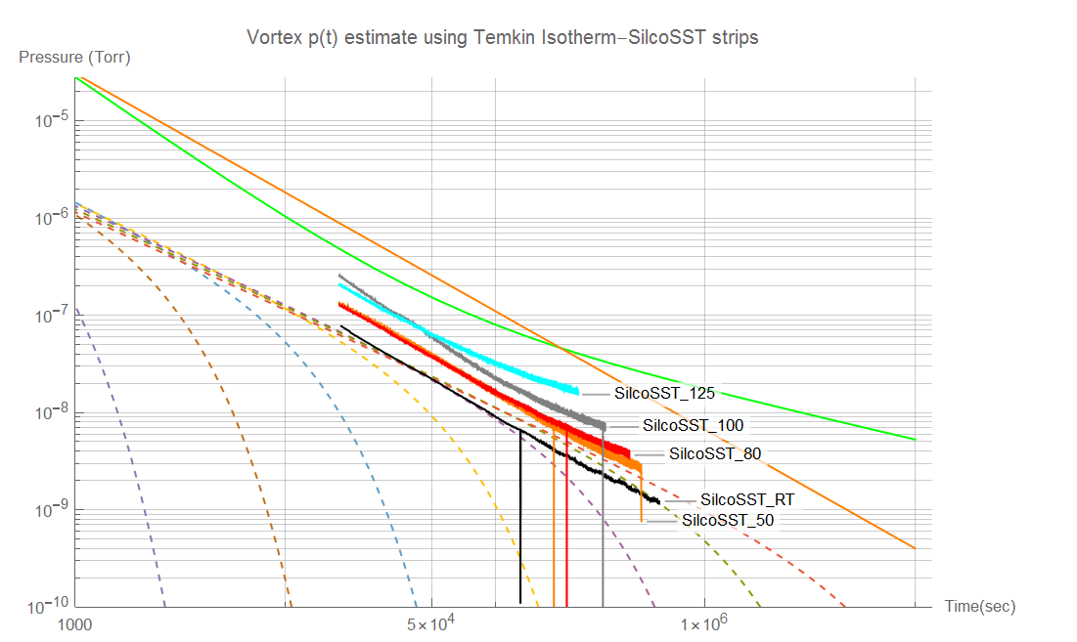
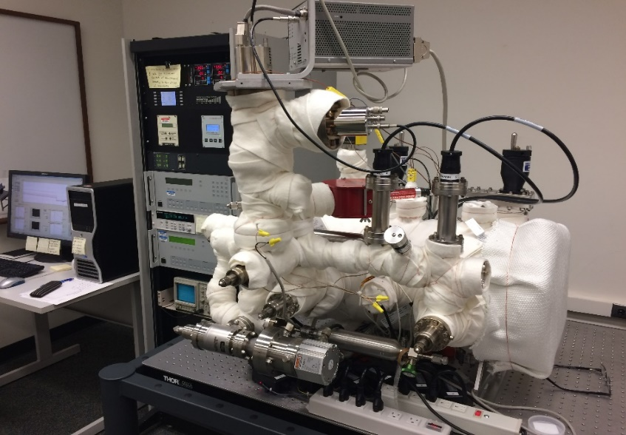
Thermal outgassing: Temkin Isotherm model E₀=10.6 kcal/mol, E₁=25kcal/mol . CIT benchtop system
Temkin Isotherm.
T=300K.
Dashed lines are p(t) at various energies.
Green, Orange lines are Li/Dylla* models for SST pumpdown, show 1/t behavior.
Still looks like stainless?
Possible explanation in Y2000 patent?
Vortex thermal outgassing system at CIT
* Minxu Li and H. F. Dylla , Journal of Vacuum Science & Technology A 12, 1772 (1994)
CE Vacuum Workshop CERN March 2023

Slide 21

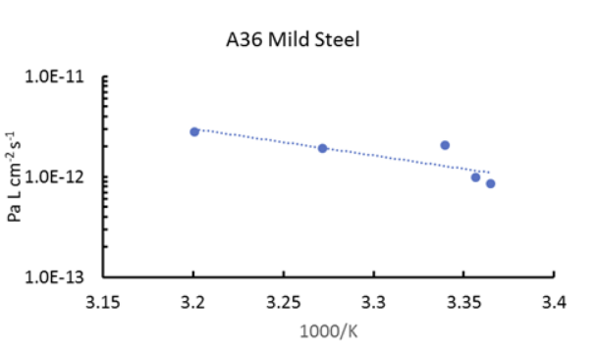
Outgassing tests at NIST
Mild-steel vacuum test chamber made from A36 mild steel. H2 outgassing measured by NIST using spinning rotor gauge. Technique described in J. Fedchak, JVST B 39, 024201 (2021).
Invited talk J. Fedchak 3/28 @ 09:00
CE Vacuum Workshop CERN March 2023

Slide 22
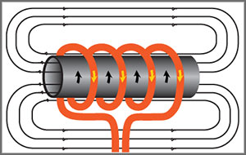
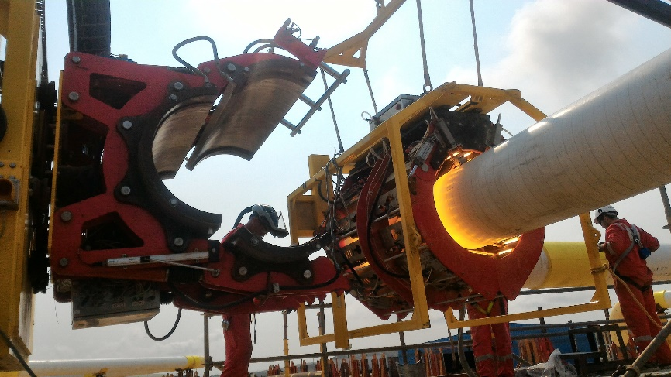
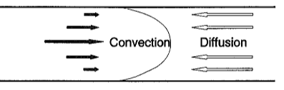
Traveling Bakeout System?
Thought experiment
  Heat pipe with traveling heater while flowing ultra-dry gas to prevent recontamination
  Temperature and flow rates?
  How to heat the pipe.
  Practicality?
RF Induction heating (the easy part)
  Eddy current and magnetic hysteresis loss.
  Works best on magnetic materials.
  10-30 kHz for pipe.
  Turn-key for pipeline heating.
  Purge with ultra-dry (< ppb) air.
  Low conductance so vacuum ineffective.
Now the hard part….
  Back-contamination with water vapor.
  Balance flow rate out with diffusion back in.
  Common technique in semiconductor gas systems.
  Flow rate may be unmanageable. Throttle ?.
  Active research. Model and scale tests.
CE Vacuum Workshop CERN March 2023

Slide 23
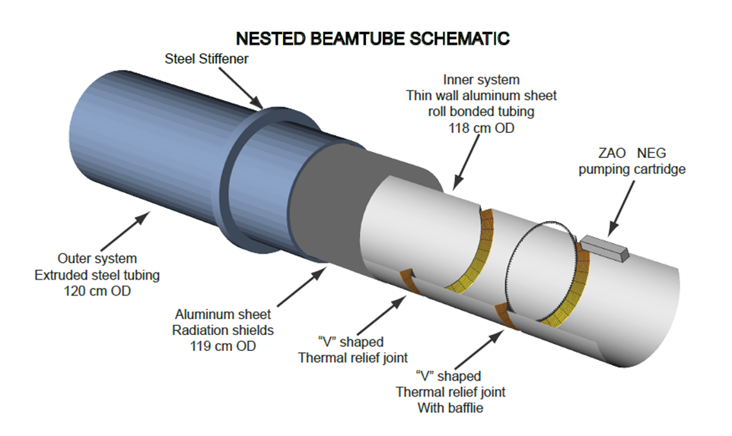
Nested System
Complex but has several unique features
  Steel outer pipe (thickness TBD) with thin (1/2 mm) aluminum inner pipe (could also be thin steel).
  Modest vacuum (10⁻⁴ Torr) in annular gap.
  Thin inner liner resistively heated to bake (same as LIGO).
  Aluminum is excellent vacuum material. Reflectivity at 1µ?
  Spiral formed and cold welded (new technology).
  Gap vacuum: Thermal insulation, crush of inner tube, allows some leaks in inner liner.
  Complex thermal/electrical isolation, valves need to be developed, unique feedthroughs and ports, manage 2x CTE mismatch between inner and outer systems.
  Updated design (May 2022) both tubes are steel.
  ZAO Getter pumps-require feedthroughs to heat. Water speed?
  Hide ZAO getter behind baffle.
Proposed by R. Weiss
CE Vacuum Workshop CERN March 2023

Slide 24
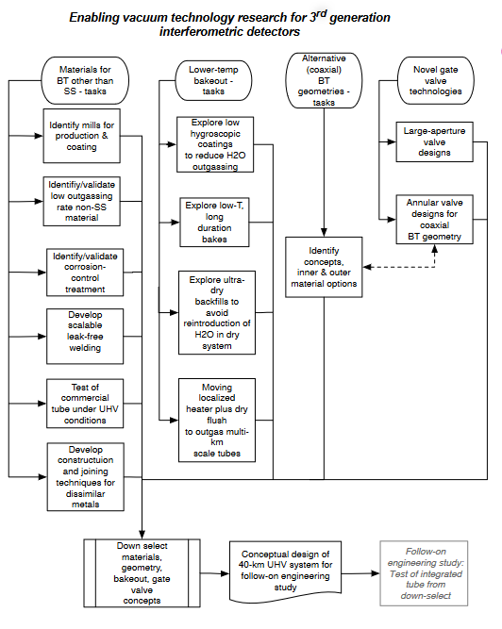
Summary
Tasks started
  Mild steel outgassing characterization.
  Hydrogen content A36 steel.
  Pipe mill inquiries and tube mfg. details.
  Silica coatings prepared, tested.
  Tube travelling heater/bake funded.
  LTREX experiments underway.
  Ultra-dry air benchtop tests started (Vortex).
  Coaxial alternate system conceptual design.
  Back-diffusion modelling.
Tasks needing effort
  Welding and joining methods-dissimilar metal.
  Alternate coatings.
  Gate valve(s)-design details.
  Coaxial system-design details.
CE Vacuum Workshop CERN March 2023

