Slide 1
Materials and their production processing for ET's beam pipes
A. T. Pérez Fontenla CERN EN-MME-MM
Beampipes for Gravitational Wave Telescopes 27 March 2023

Slide 2
Outline
Materials science at CERN: MM Section
ET pipes considerations
Specimens and pre-prototypes: work in progress
Pre-prototypes: quality assurance
Cost assessment

Slide 3
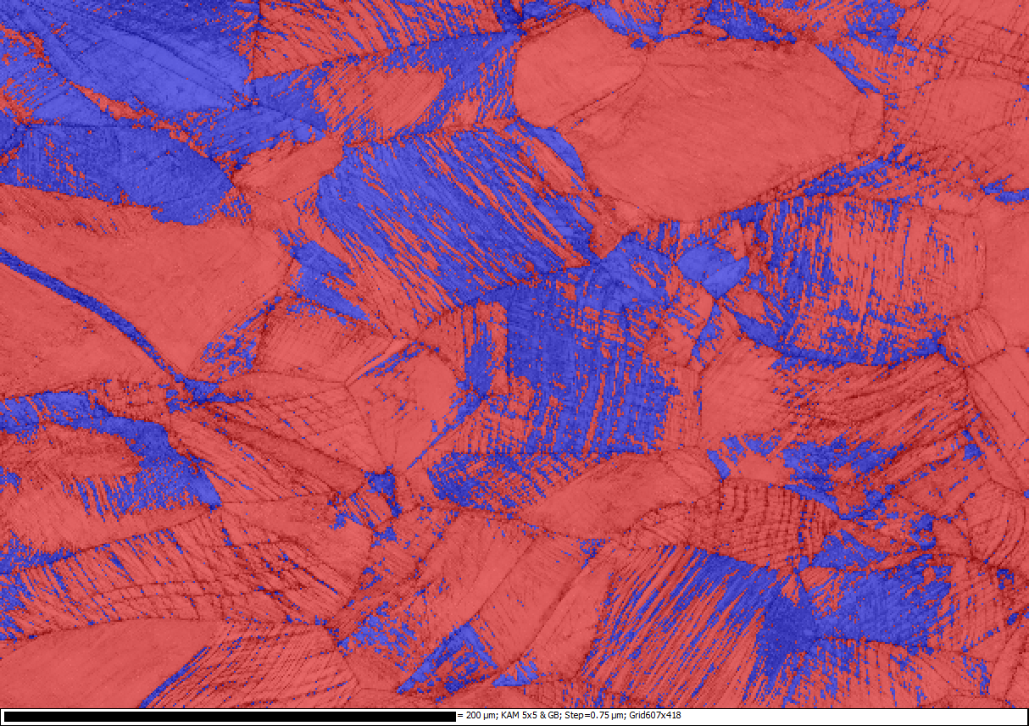
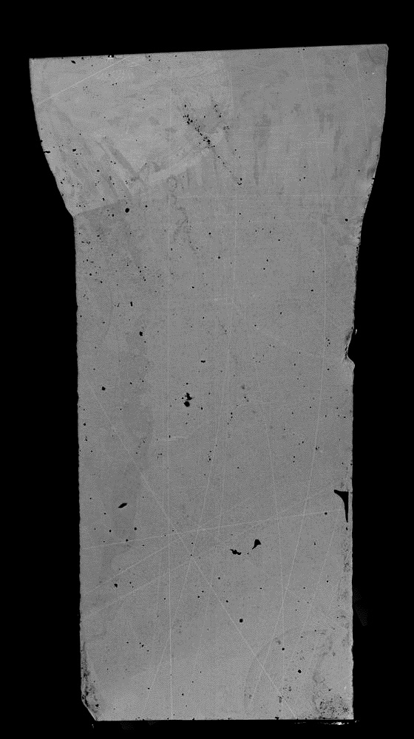

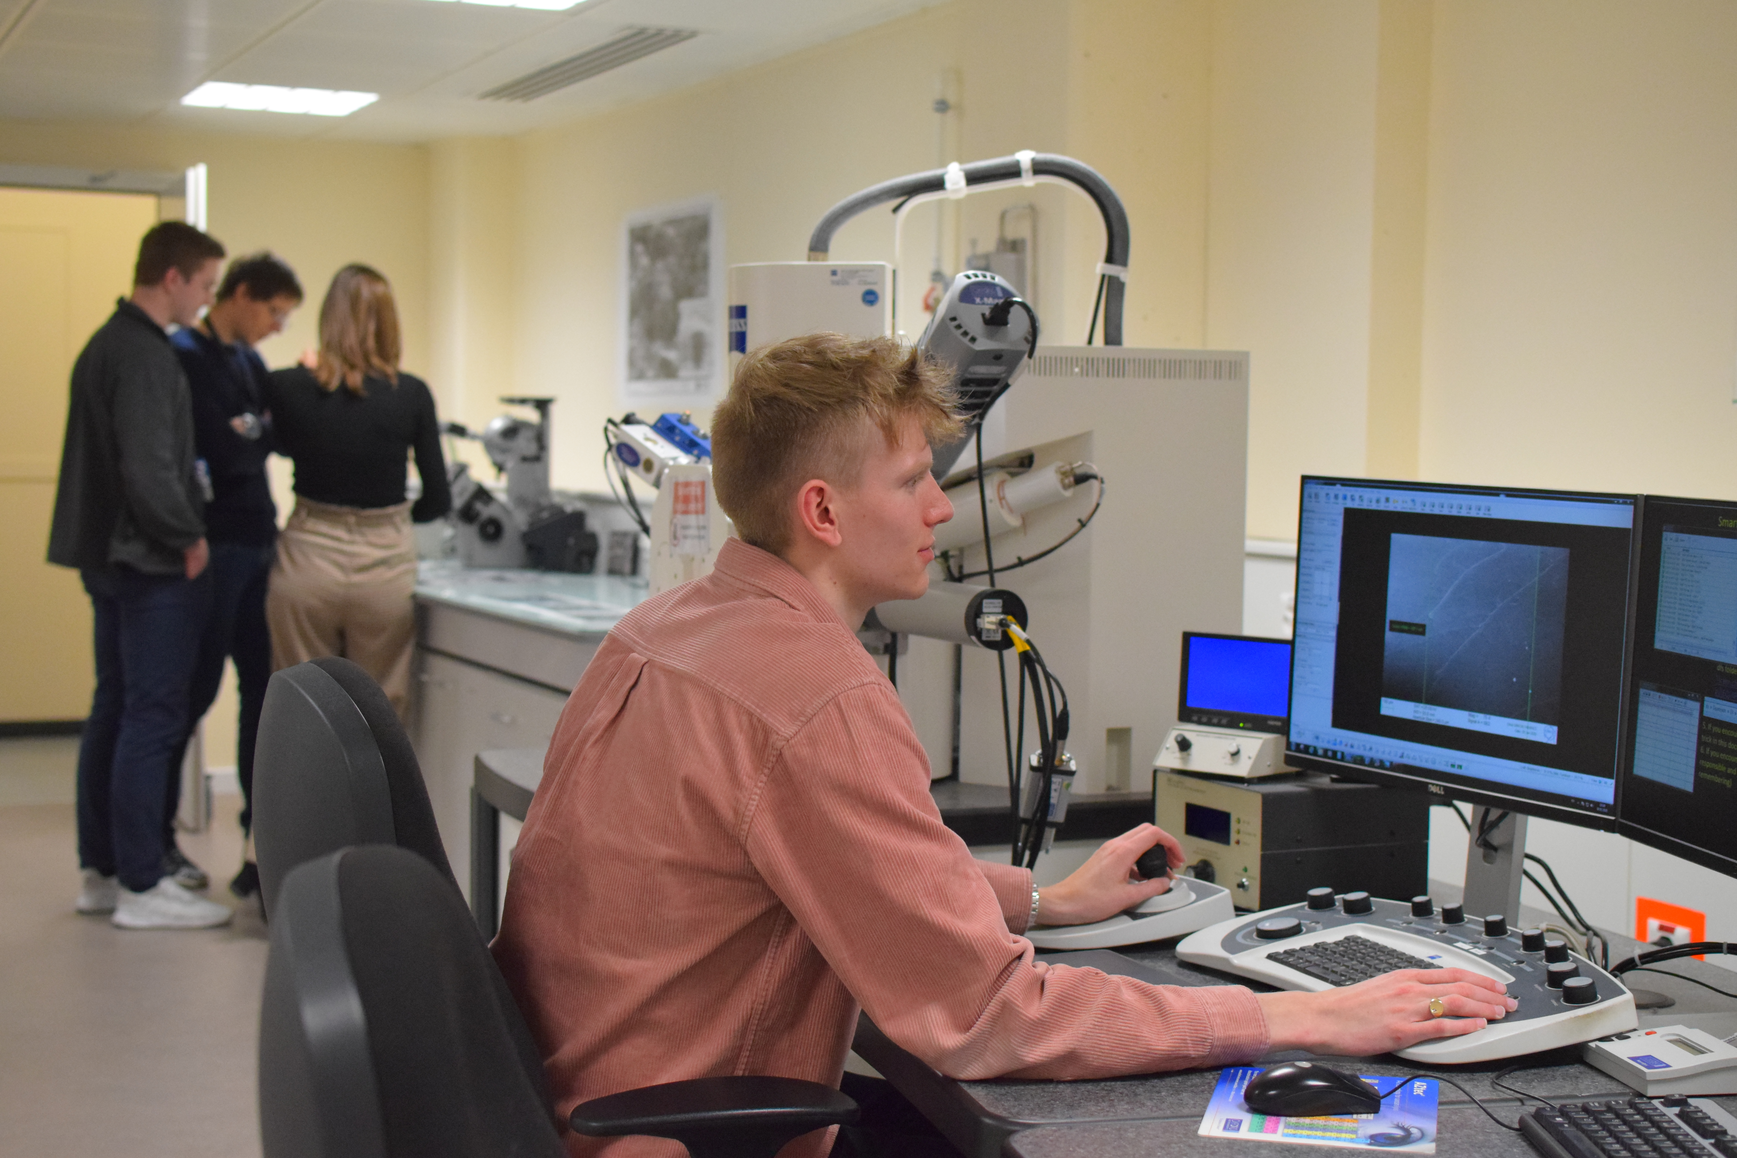
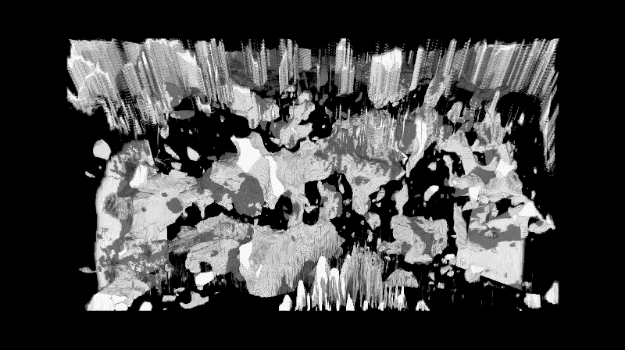
Materials science at CERN: MM Section
MM Section have an extensive experience in materials characterization and our equipment covers conventional and advanced techniques in microstructural and mechanical testing, dimensional control and NDT
OM, SEM, FIB-SEM, STEM, EDS, EBSD, APA, XRD, residual stress, hardness, tensile testing, fatigue, FT, nano-indentation, µCT, UT, RT…
UHV, magnets, cryogenics, irradiation zones…
Materials selection, technical specifications, researching, qualification, failure analysis…
Microscopy
EBSD Strain-induced martensite at 4K
304L23% deformation
316LN 32% deformation
FIB 3D tomography
2 mm
5 µm

Slide 4
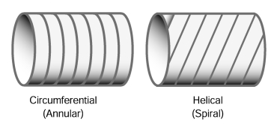
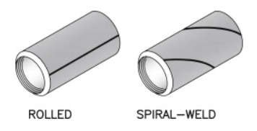
ET pipes considerations
120 km (3 arms x 10 km x 4 tubes)
UHV is requested in laser interferometers for GW detection
Large diameter to avoid interaction with the beam
Segment length depends on integration of optics, pumps…
Thickness to prevent tubes from buckling and collapsing
Thick walls + external stiffeners / Thin walls + corrugation
Forming into circular section from sheet or coil/strip
Welding: Longitudinal or spiral + circular
ET infrastructure a lifetime longer than 50 years...
Material requirements?
Fine and homogenous microstructure
Sufficient mechanical strength
High melting and boiling points
Adapted thermal expansion behaviour
Corrosion resistance
Favorable degassing properties
High gas tightness
Low intrinsic vapor pressure
Low foreign gas content
Clean surfaces
Circumferential
Spiral
S. Sgobba: Materials for high vacuum technology: an overview
Rolled and welded
Spiral-welded

Slide 5
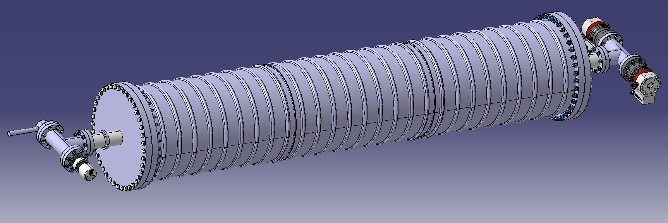
Specimens and pre-prototypes: work in progress
Materials analysis to complement fundamental vacuum studies
Interesting vacuum performance and industrially available
Three grades selected for the pre-prototypes manufacturing
Stainless Steel
Low C
Ferritic Bainitic Steel
Pure iron
AISI 304L
AISI 430
AISI 444
AISI 318LN
S315MC
ULC-IF
Ø 400 mm x L 2000 mm
Thickness < 1.5 mm
Corrugated solution
HR440Y580T-FB
ARMCO Gr.4

Slide 6
Specimens and pre-prototypes: work in progress
Materials analysis to complement fundamental vacuum studies
Interesting vacuum performance and industrially available
Three grades selected for the pre-prototypes manufacturing
Stainless Steel
Low C
Ferritic Bainitic Steel
Pure iron
AISI 304L
AISI 430
S315MC
Ø 400 mm x L 2000 mm
Thickness < 1.5 mm
Corrugated solution
 | Rm (MPa) | Rp₀₂ (MPa) | A (%) | HB
AISI 304L | ≥ 520* | ≥ 220* | ≥ 45* | ≤ 180*
AISI 430 | ≥ 450 482 | ≥ 205 349 | ≥ 22 30 | ≤ 183 140
S315MC | 390-510 425 | ≥ 315 391 | ≥ 20 28 | - 131
 | Structure | C | Mn | P | S | Si | Cr | Ni | N | Cu | Nb+Ti+V | Fe
AISI 304L | Austenitic | < 0.03 | ≤ 2.0 | ≤ 0.030* | ≤ 0.015* | ≤ 1.0 | 17.0-20.0* | 10.0-12.5 | 0.1 | - | - | balance
AISI 430 | Ferritic | < 0.12 0.044 | ≤ 1.0 0.32 | ≤ 0.040 0.027 | ≤ 0.030 0.001 | ≤ 1.0 0.370 | 16.0-18.0 16.05 | 0.75 0.22 | - 0.042 | - 0.070 | - - | balance
S315MC | Ferritic | ≤ 0.12 0.042 | ≤ 1.3 0.45 | ≤ 0.025 0.0055 | ≤ 0.020 0.0023 | ≤ 0.5 0.027 | - 0.05 | - 0.07 | - 0.007 | ≤ 0.22 0.17 | ≤ 0.22 0.0121 | balance
* CERN requirements

Slide 7
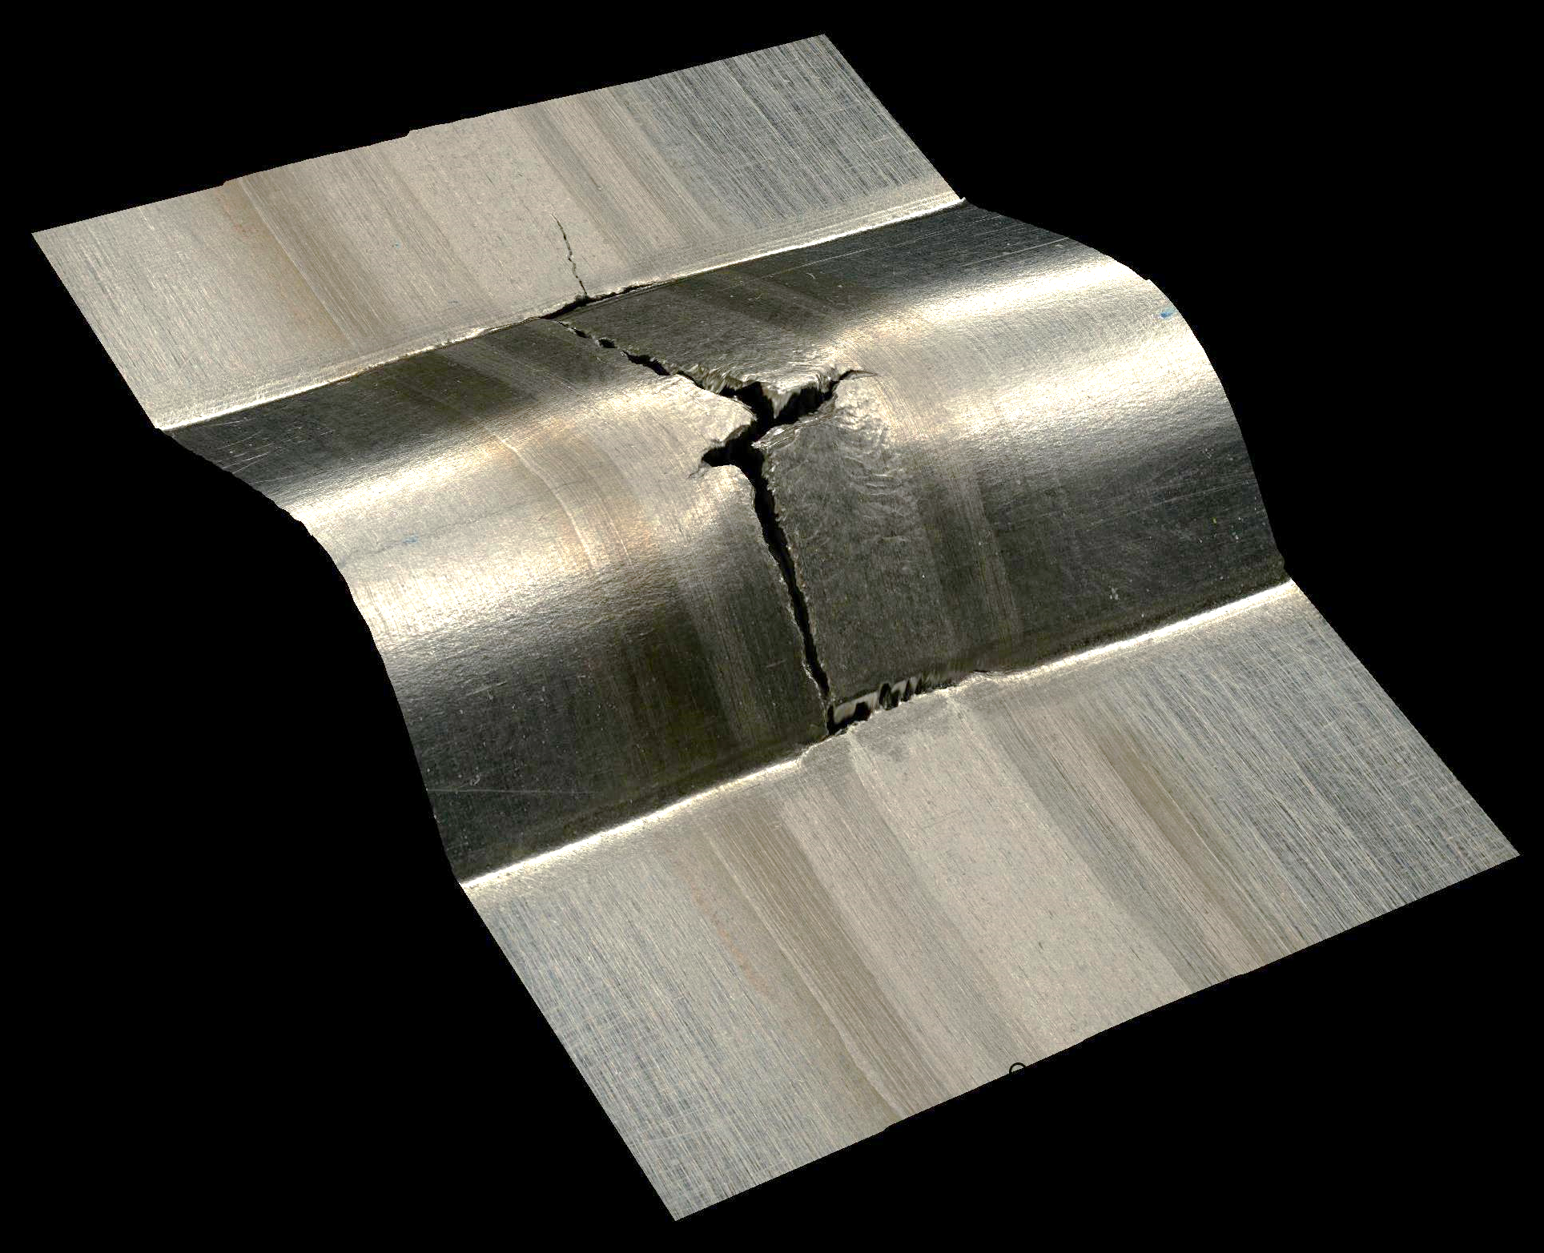
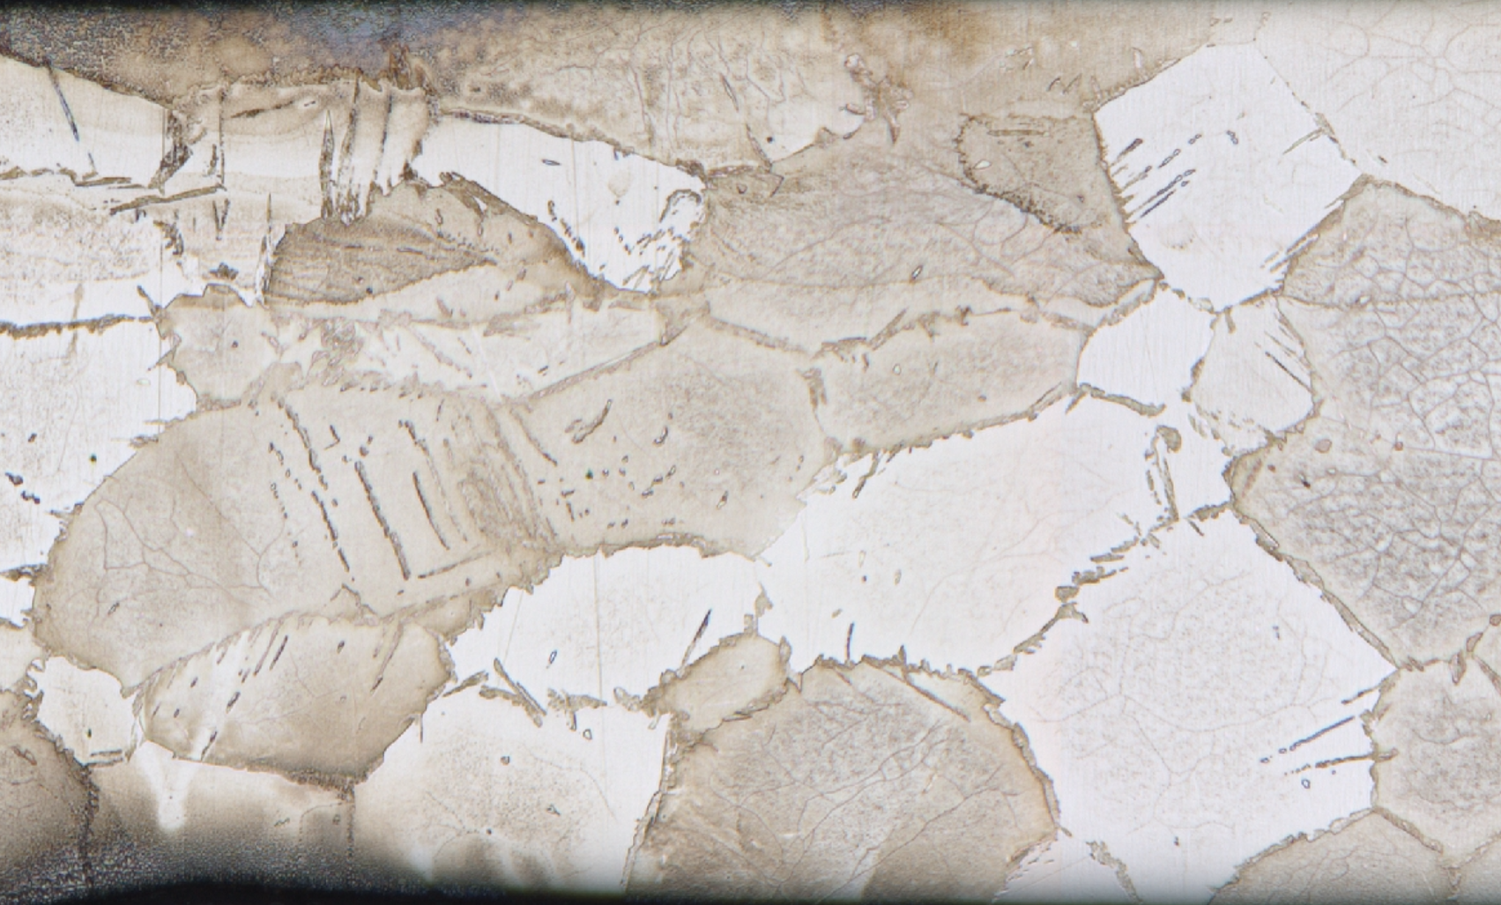
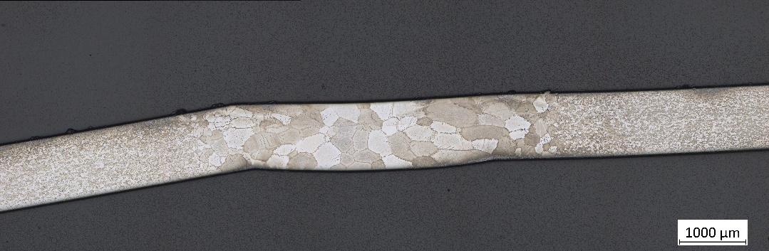
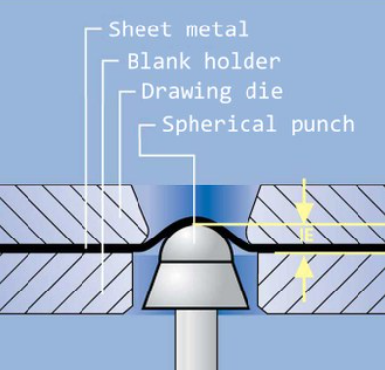
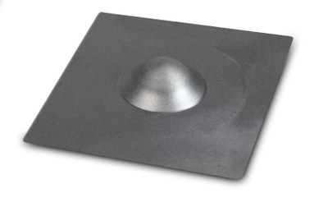
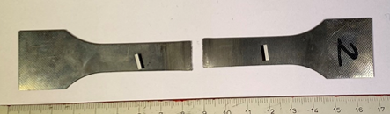
Pre-prototypes: quality assurance
AISI 430
weld
Two-phases microstructure: δ + intergranular M
Weld qualification according to CERN procedure for UHV:
Qualification plates prepared according ISO 15614-1
RT: procedure according to ISO 17636-2 and checked against ISO 10675-1 Level 1
Metallurgical examination
Mechanical testing
Additional tests on the weld qualification for ET project:
Erichsen cupping test (formability test)→ according to ASTM E643-09
Weld
BM
Martensite
Ferrite grains
1 mm
Images courtesy of M. Dakshinamurthy and L. Racaud
AISI 430 TIG autogenous weld (1st trial): The piece presented a major failure at the level of the longitudinal weld during corrugation operation
RT: The plate was not compliant due to the presence of isolated gas pores (Ø > 0.2 mm)
Metallurgical examinations:
  Grain coarsening → Weld grains are 10 times larger than in base material (BM)
  Martensite (M) is present in the fusion zone at the ferrite (δ) grain boundaries
Mechanical testing:
  Tensile test → Final failure occurred along the weld centreline in a completely brittle manner
  Micro-hardness → Important hardness increase at the fusion zone
Weld

Slide 8
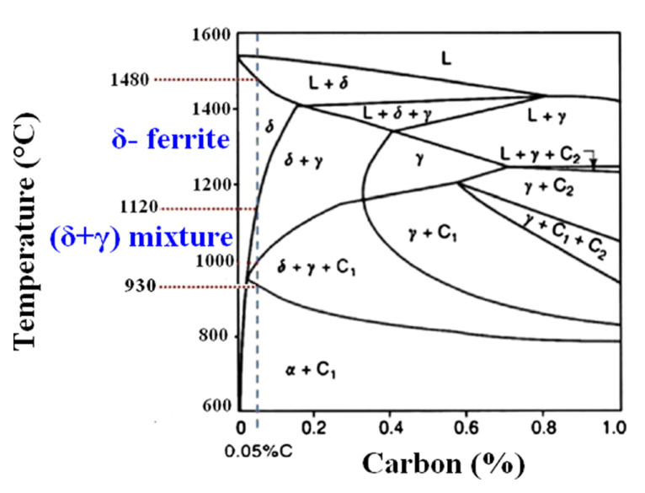
Pre-prototypes: quality assurance
In the pseudo-binary diagram for a Cr content of 17 wt. % and C within the 0.05 - 0.15 wt. % range (corresponding to the AISI 430), some austenite (γ) forms at elevated temperature along the δ-ferrite GB
This austenite transforms to M as the weld fusion zone cools to RT
The Kaltenhauser ferrite factor (K-factor) is commonly used to predict if the microstructure is fully ferritic but does not provide information regarding the amount of M that will be present
In our raw material the K-factor = 13.3 (17.0 is the minimum value determined by Kaltenhauser for AISI 430)
This factor is normally achieved by reducing C, adding ferrite stabilizing elements (Ti, Nb) or both
Other ferritic stainless steels can present better weldability
L → L + F → F → F + A
→ F + M
From Castro and Tricot
AISI 444 to be tested
How to improve weldability on AISI 430?
It is good practice in medium-Cr types to limit heat input to minimise grain growth and optimize the cooling rate to reduce the martensite presence preventing the degradation of the ductility and toughness at the weld region
The use of austenitic consumables → Weld qualification plate performed using TIG with 308L as filler metal is for the moment RT and PT compliant
Composition, heat input and cooling rate are characteristics of welding process and thickness
Feasibility and cost to be evaluated…

Slide 9
Cost assessment…in progress
Material selection will impact manufacturing strategy, installation and inspection plans but also future actions like service maintenance, or eventual reparations…and by hence the final cost of the project
The material cost per kg is not always the most important economic consideration. The final cost will be affected by other additional costs:
Installation Reparation
QC/QA
Material selection
Cleaning approach
Bake out cycle
Design
Welding method
Surface operation/ finishing
AISI 304L | ≈ 1.5 times more expensive than AISI 430
 | ≈ 4 times more expensive than S315MC
Leak detection
Inspectability
Insulation material

Slide 10
Cost assessment…in progress
Thickness
Supports
Format
Material selection will impact manufacturing strategy, installation and inspection plans but also future actions like service maintenance, or eventual reparations…and by hence the final cost of the project
The material cost per kg is not always the most important economic consideration. The final cost will be affected by other additional costs:
Higher strength materials allow reduced sections providing considerable savings in welding time, transport, handling…
Installation Reparation
QC/QA
Material selection
Cleaning approach
Bake out cycle
Design
Welding method
Surface operation/ finishing
AISI 304L | ≈ 1.5 times more expensive than AISI 430
 | ≈ 4 times more expensive than S315MC
Leak detection
Inspectability
Insulation material

Slide 11
Cost assessment…in progress
Thickness
Supports
Format
Material selection will impact manufacturing strategy, installation and inspection plans but also future actions like service maintenance, or eventual reparations…and by hence the final cost of the project
The material cost per kg is not always the most important economic consideration. The final cost will be affected by other additional costs:
Higher strength materials allow reduced sections providing considerable savings in welding time, transport, handling…
Particular finish may entail extra cost but if it eliminates processing steps, the higher initial cost may be justified
Installation Reparation
QC/QA
Material selection
Cleaning approach
Bake out cycle
Design
Welding method
Surface operation/ finishing
AISI 304L | ≈ 1.5 times more expensive than AISI 430
 | ≈ 4 times more expensive than S315MC
Corrosion
resistance
Leak detection
Inspectability
Insulation material

Slide 12
Cost assessment…in progress
Thickness
Supports
Format
Material selection will impact manufacturing strategy, installation and inspection plans but also future actions like service maintenance, or eventual reparations…and by hence the final cost of the project
The material cost per kg is not always the most important economic consideration. The final cost will be affected by other additional costs:
Higher strength materials allow reduced sections providing considerable savings in welding time, transport, handling…
Particular finish may entail extra cost but if it eliminates processing steps, the higher initial cost may be justified
Steel storing and handling could increase the project cost from 10 to 25% of the initial cost if facilities, taxes, insurance, deterioration, re-handling and re-inspection are considered…
The unit price of the raw material could be increased by a factor over ten between a material available from the shelf and a material specially produced → adequate material specification
Transport
Handling
Storage
Installation Reparation
QC/QA
Material selection
Cleaning approach
Bake out cycle
Design
Welding method
Surface operation/ finishing
AISI 304L | ≈ 1.5 times more expensive than AISI 430
 | ≈ 4 times more expensive than S315MC
Corrosion
resistance
Leak detection
Inspectability
Insulation material

Slide 13
Summary
Selection of the structural materials and the appropriate manufacturing process play a crucial role in a large vacuum system like the one in ET composed by several thousand of leak tight components to be integrated
The successful selection is closely related to obtaining a controlled microstructure and stable properties on the base material but also on the welds
Work is in progress: Specimens fundamental analysis and pre-prototypes manufacturing and qualification to evaluate the material performance and in parallel validate production routes for each material
Next steps: Complete the manufacturing of two additional chambers and start the cost assessment of each technical solution in close collaboration with the industrial partners

Slide 15
Welded pipes manufacturing:
Ingot/ slab production
Sheet/ coil production
Conditioning
Edge preparation
Marking
Coating
Sizing
Cutting
Straightening
Forming
Welding
Corrugation
Packaging
Storing
Shipping
Annealing
Cooling
NDT inspection
Testing (hydro, flattening…)
Visual and dimensional inspections
Tech. Spec.
Analysis
NDT inspection
Testing
NDT inspection
Crystal structure and composition
Microstructure and mech. properties
Material cleanliness and homogeneity
Leak tightness
Geometry and tolerances
Surface reflectance
Corrosion resistance

Slide 16
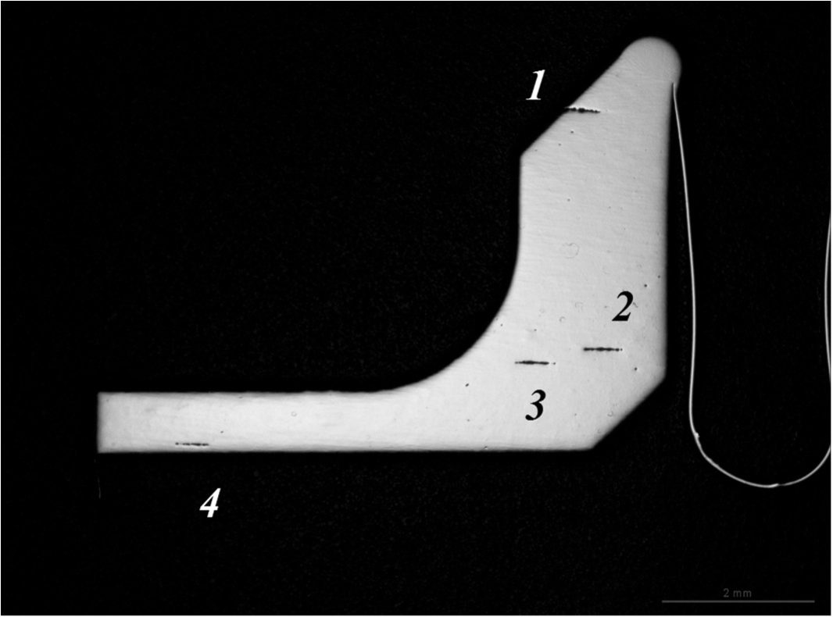
Materials for vacuum applications: CERN
Impose a maximum allowed content of non-metallic inclusions.
Since microscopical test methods for determining the inclusion content of steel are not intended for assessing exogenous macroinclusions, impose a steelmaking process. Stainless steels are primary melted in an electric furnace and decarburized through an Argon-Oxygen Decarburization (AOD) or Vacuum-Oxygen Decarburization (VOD). These processes, consisting of a single melting step, might not guarantee alone a sufficient homogeneity of the ingot. Imposing a remelting process such as VAR or ESR ensures the homogeneity of the material will be effectively influenced. In addition, remelting reduces the impurity and the microinclusion content of the final products, allows high density and a lack of macrosegregations with shrinkage cavities to be achieved [34].
3) Specify three-dimensionally, redundantly forged products [24]. Upsetting steps allow the alignment of the inclusions which are elongated by two-dimensional steps of previous forging or rolling to be broken, thus reducing the risk of leak through the thickness.
4) Specify products with a fine and homogenous grain size.
5) Impose a final separate solution annealing rather than allowing mill-annealing from a high temperature process, in order to facilitate the achievement of a controlled, homogeneous and non-segregated microstructure [33], more easily inspectable by Non-Destructive Testing (NDT), see point 7 hereafter.
6) Avoid breaking the fibre of the product by machining walls perpendicular to the direction of the material flow, such as in the example of Fig. 3.
7) Introduce NDT such as Ultrasonic Testing (UT) not only on the final product, but also on semifinished products resulting from intermediate steps of steel processing. NDT procedures and acceptance criteria should be the object of an agreement between supplier and customer.
Bellow end fitting machined from an AISI 316LN round bar, showing alignment of oversized (1,2,3) and thick (4) B type inclusions up to class 2, classified according to standard ASTM E45. CERN specification [23] imposes a class of inclusions at most 1 for type B inclusions and a half-class above this limit in up to 2% of the fields counted
Leak tightness is specially critical when it comes to thin wall components like bellows

