Slide 1
Topical Discussion T3:
Pumping system, valves sectorization and bakeout
Giuseppe Bregliozzi and Antonio Pasqualetti
March 28th, 2023

Slide 2
What’s on the menu today….
Passing thorough a possible layout to trigger discussion
Valves and sectorization
Bake-out and insulation system
Gauges and RGA
  Possible Agilent Presentation
Coffee break (30’)
Pumping system for H₂, CO, CO₂ and CH₄
  Roughing and turbo molecular pumping
  Final pumping system
    SAES Presentation
    Agilent Presentation
Tower Vacuum (If time allow)
Wrap-up -> Now
We did not have time to discuss it, but we got some “indirect” inputs
We did not have time to discuss it, unfortunately

Slide 3
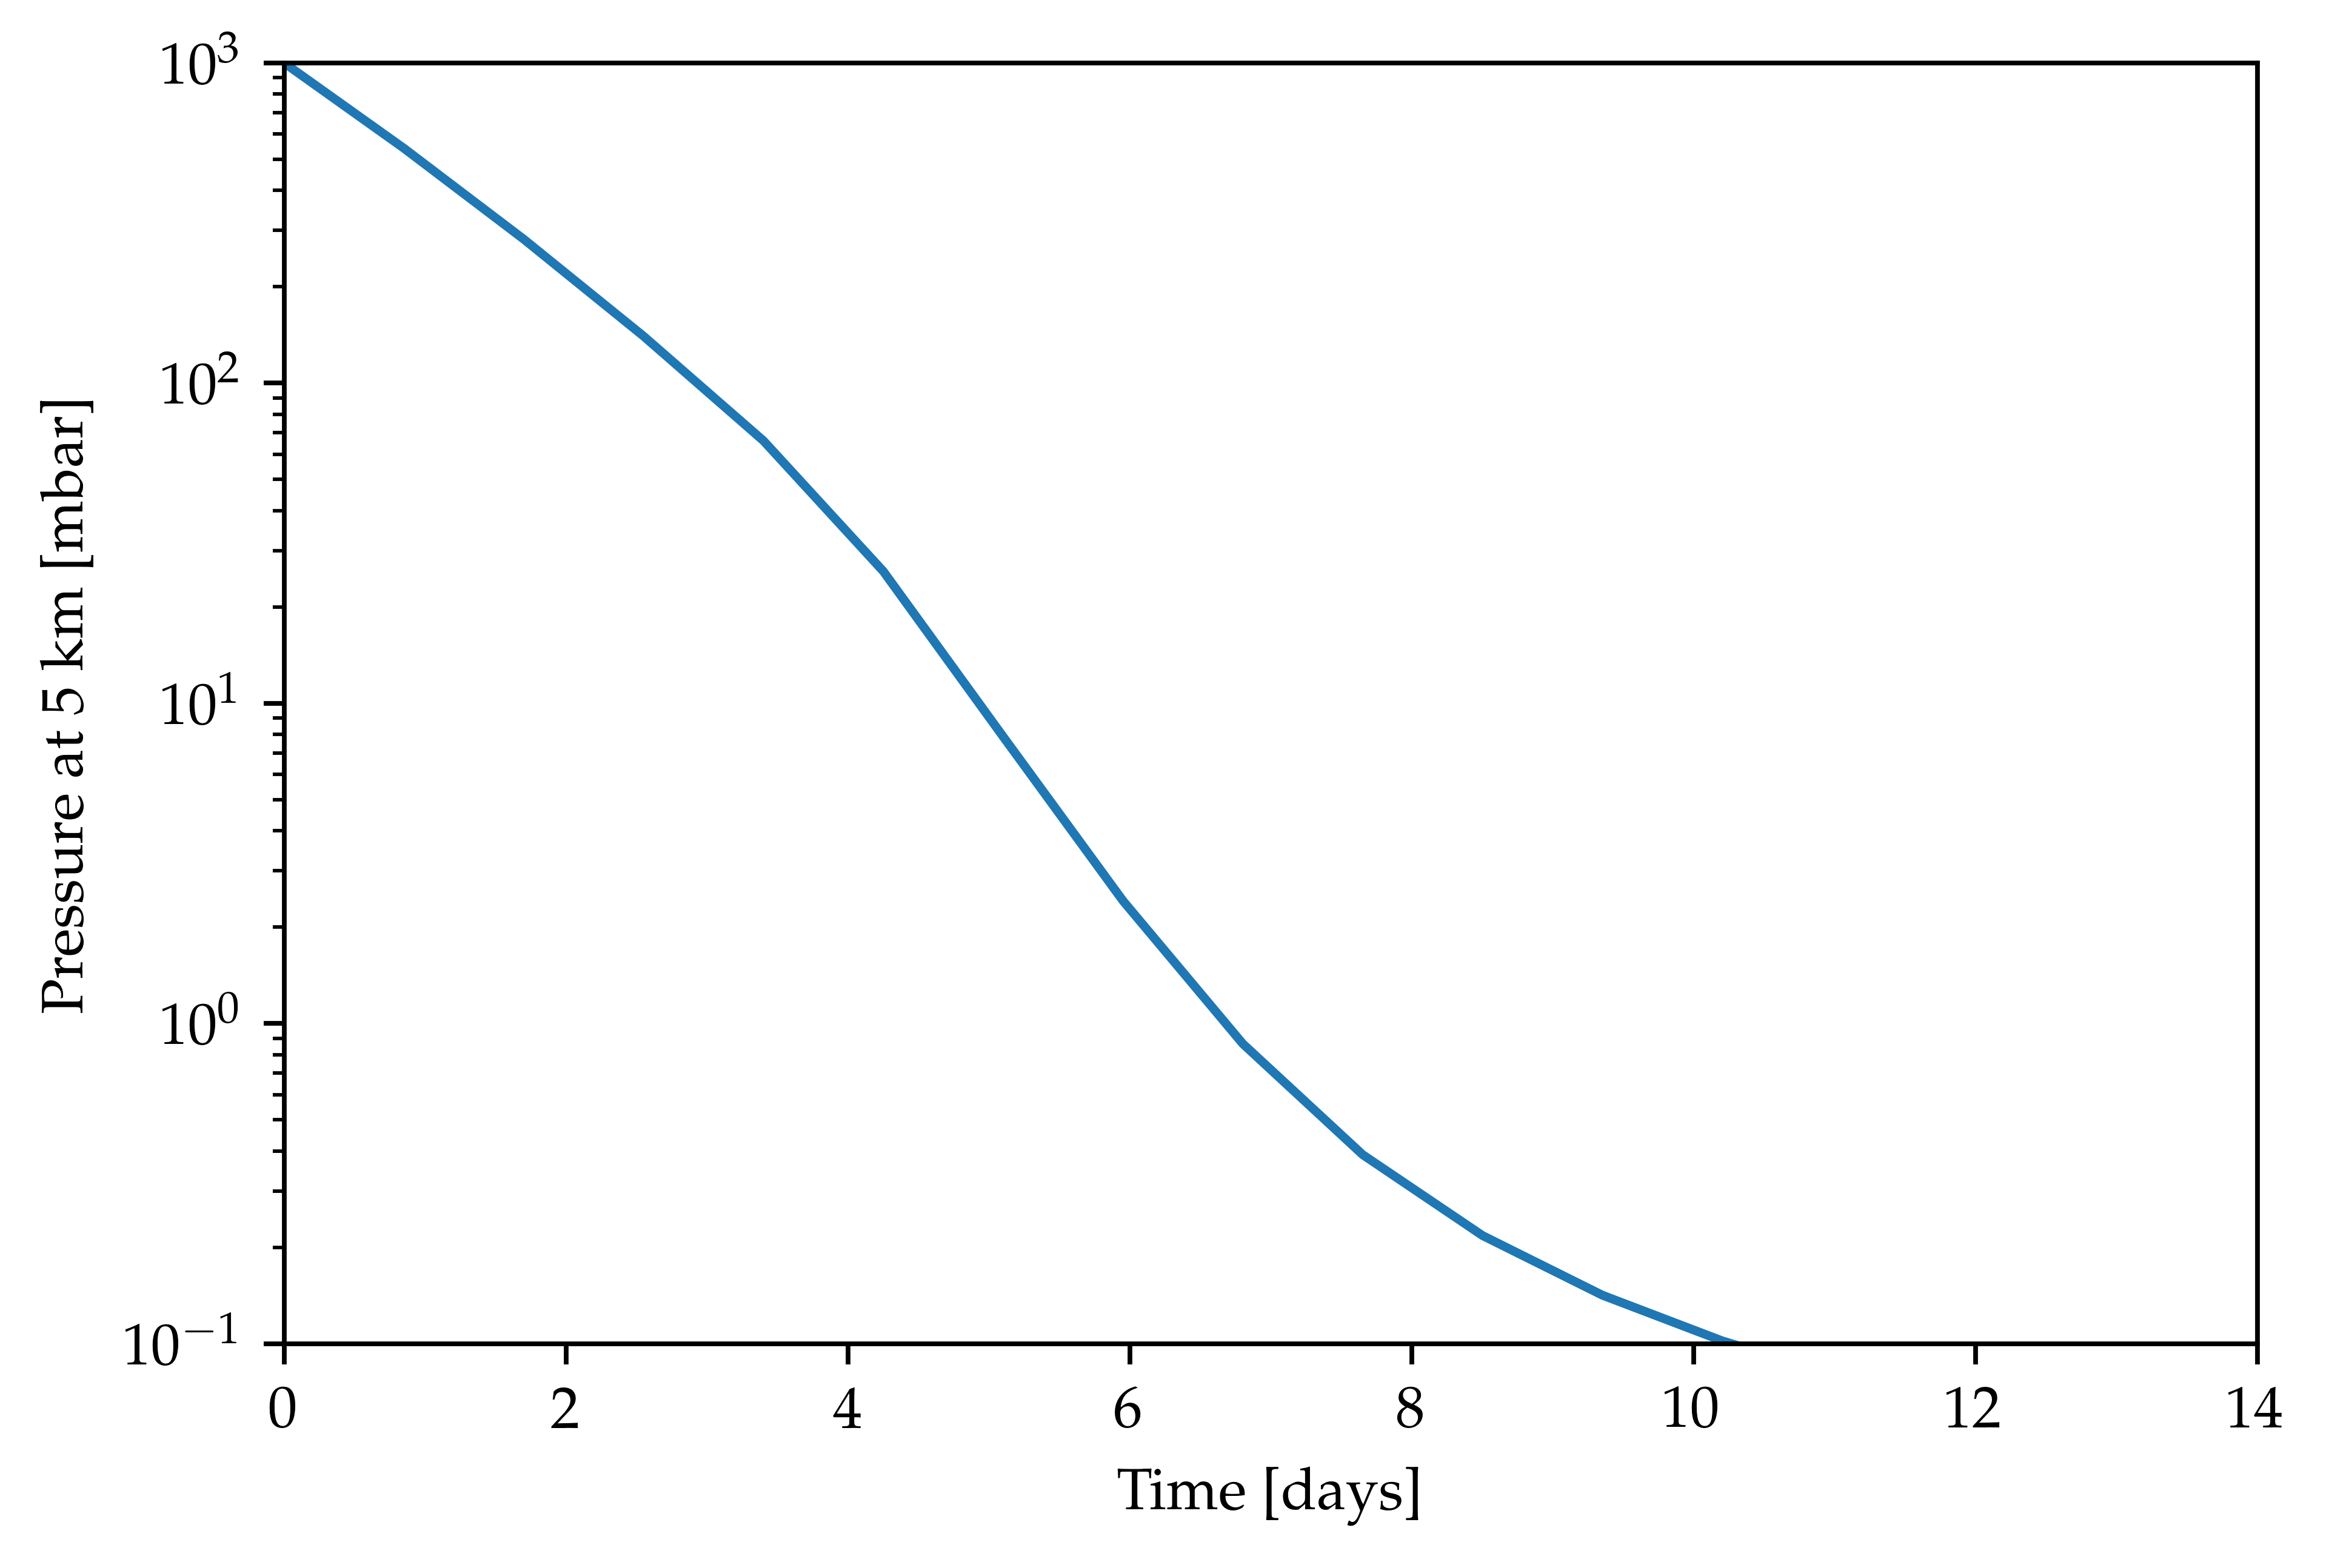
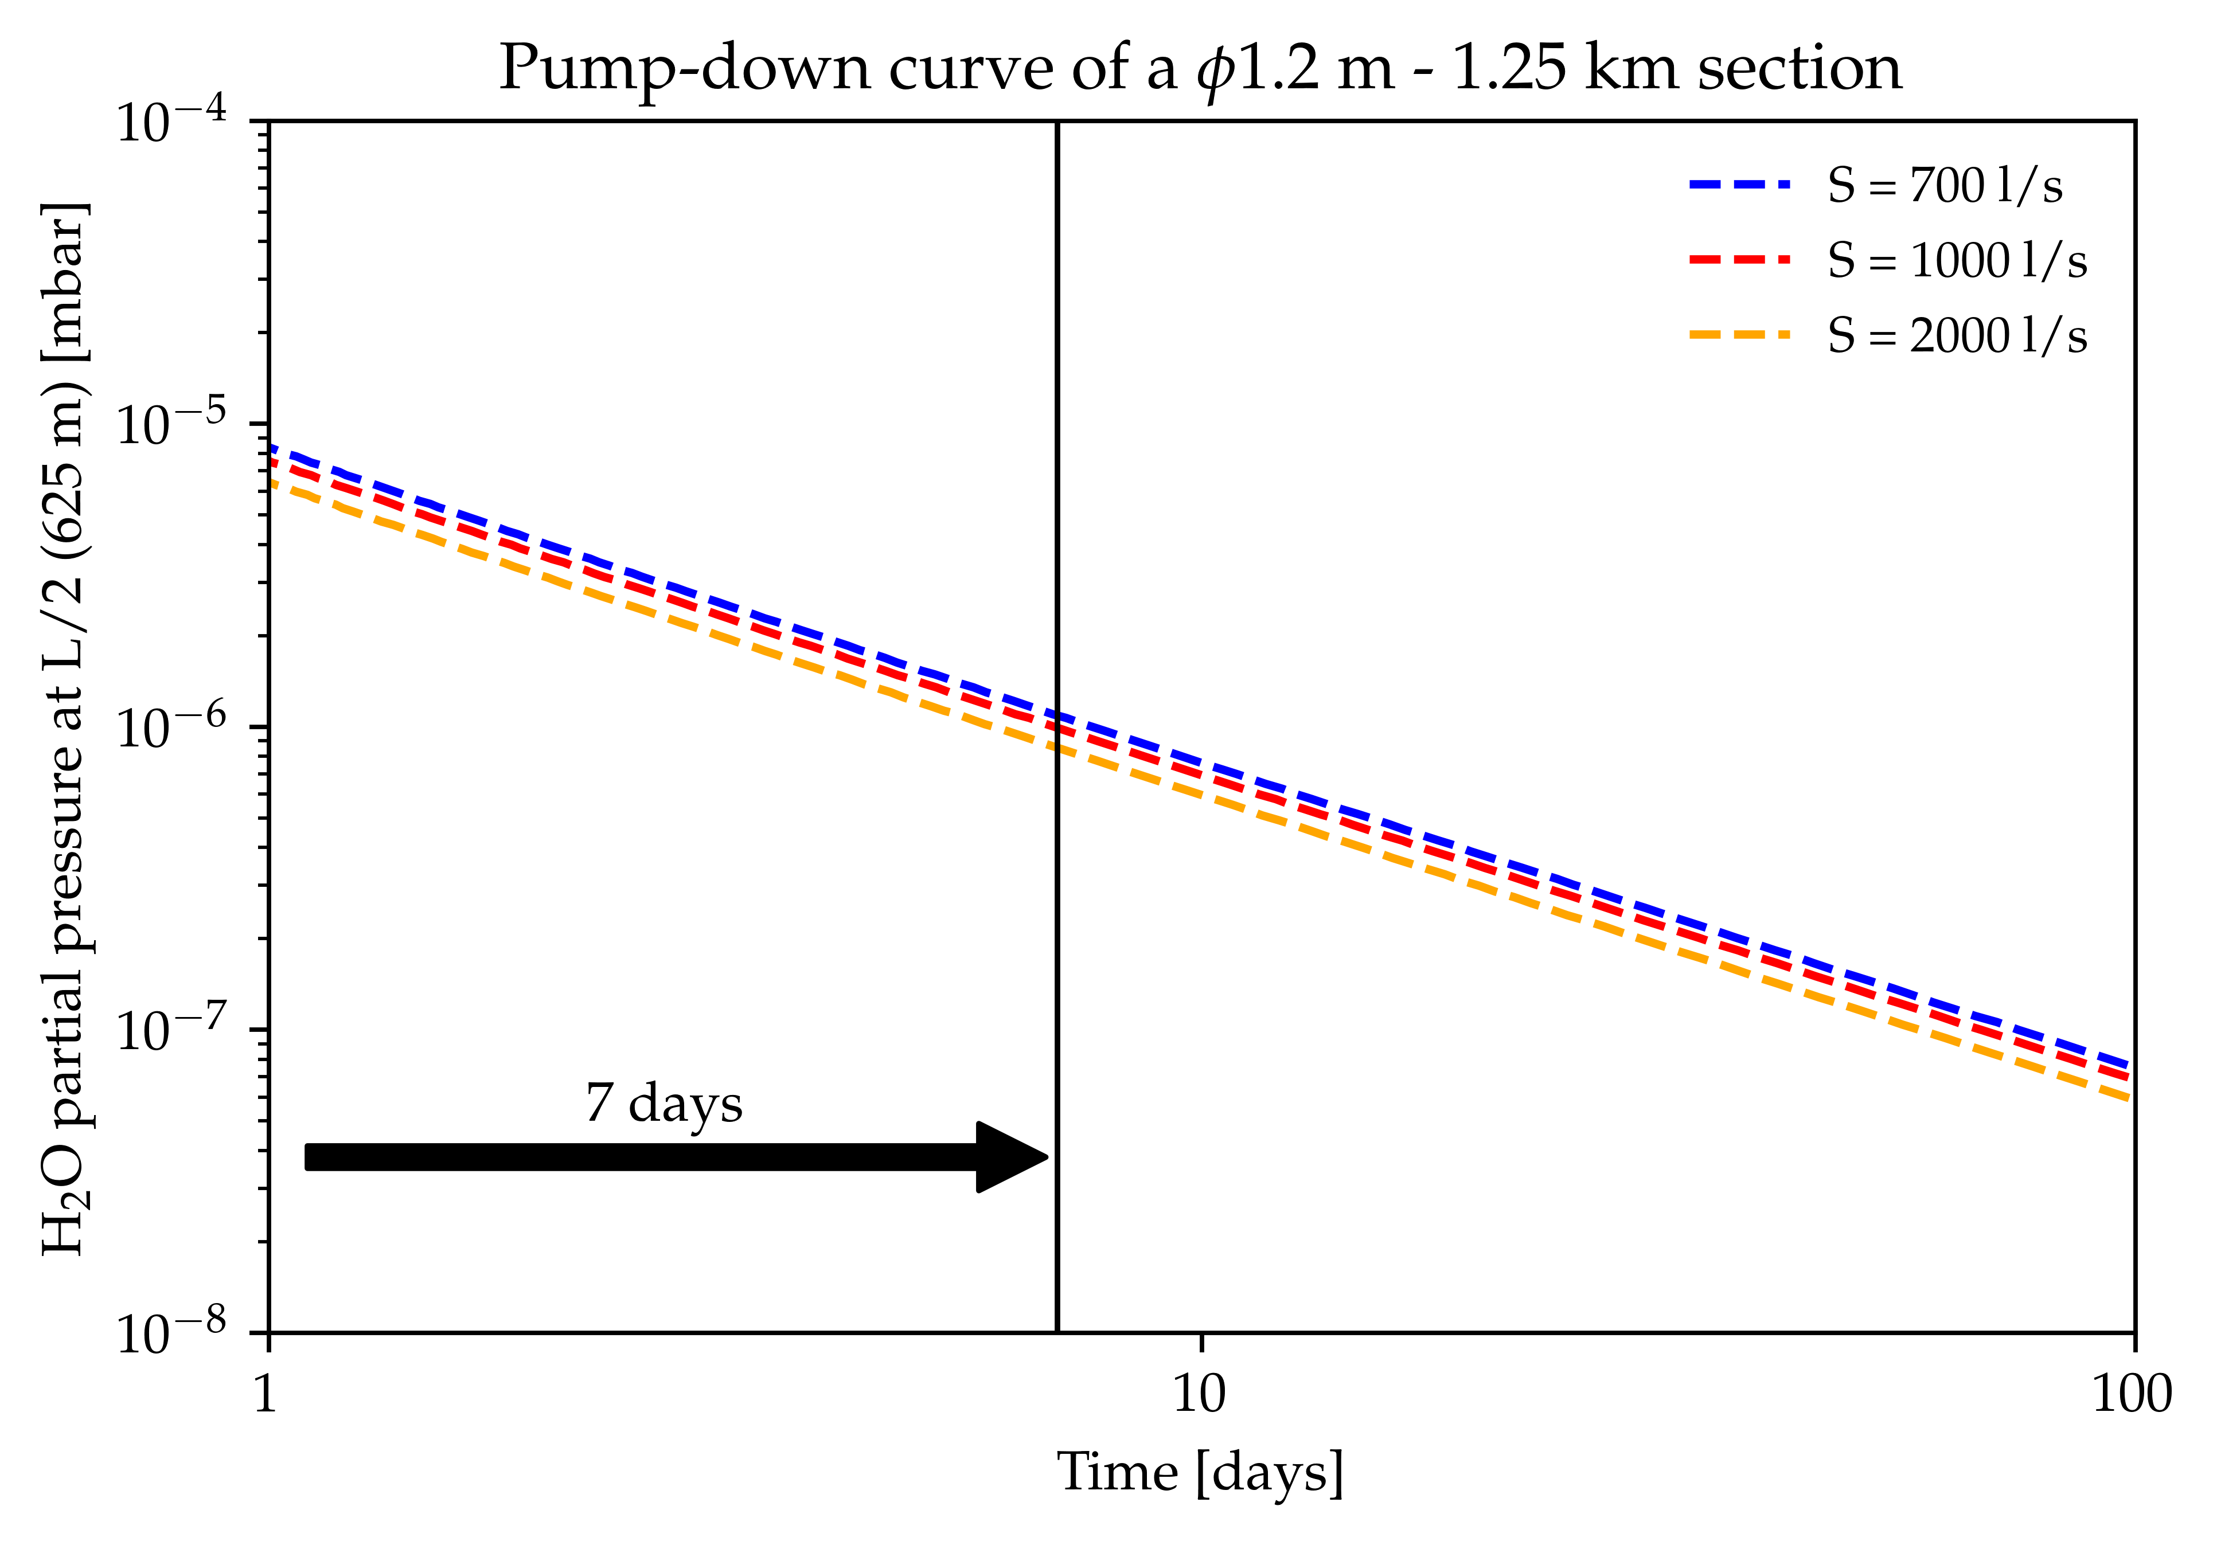
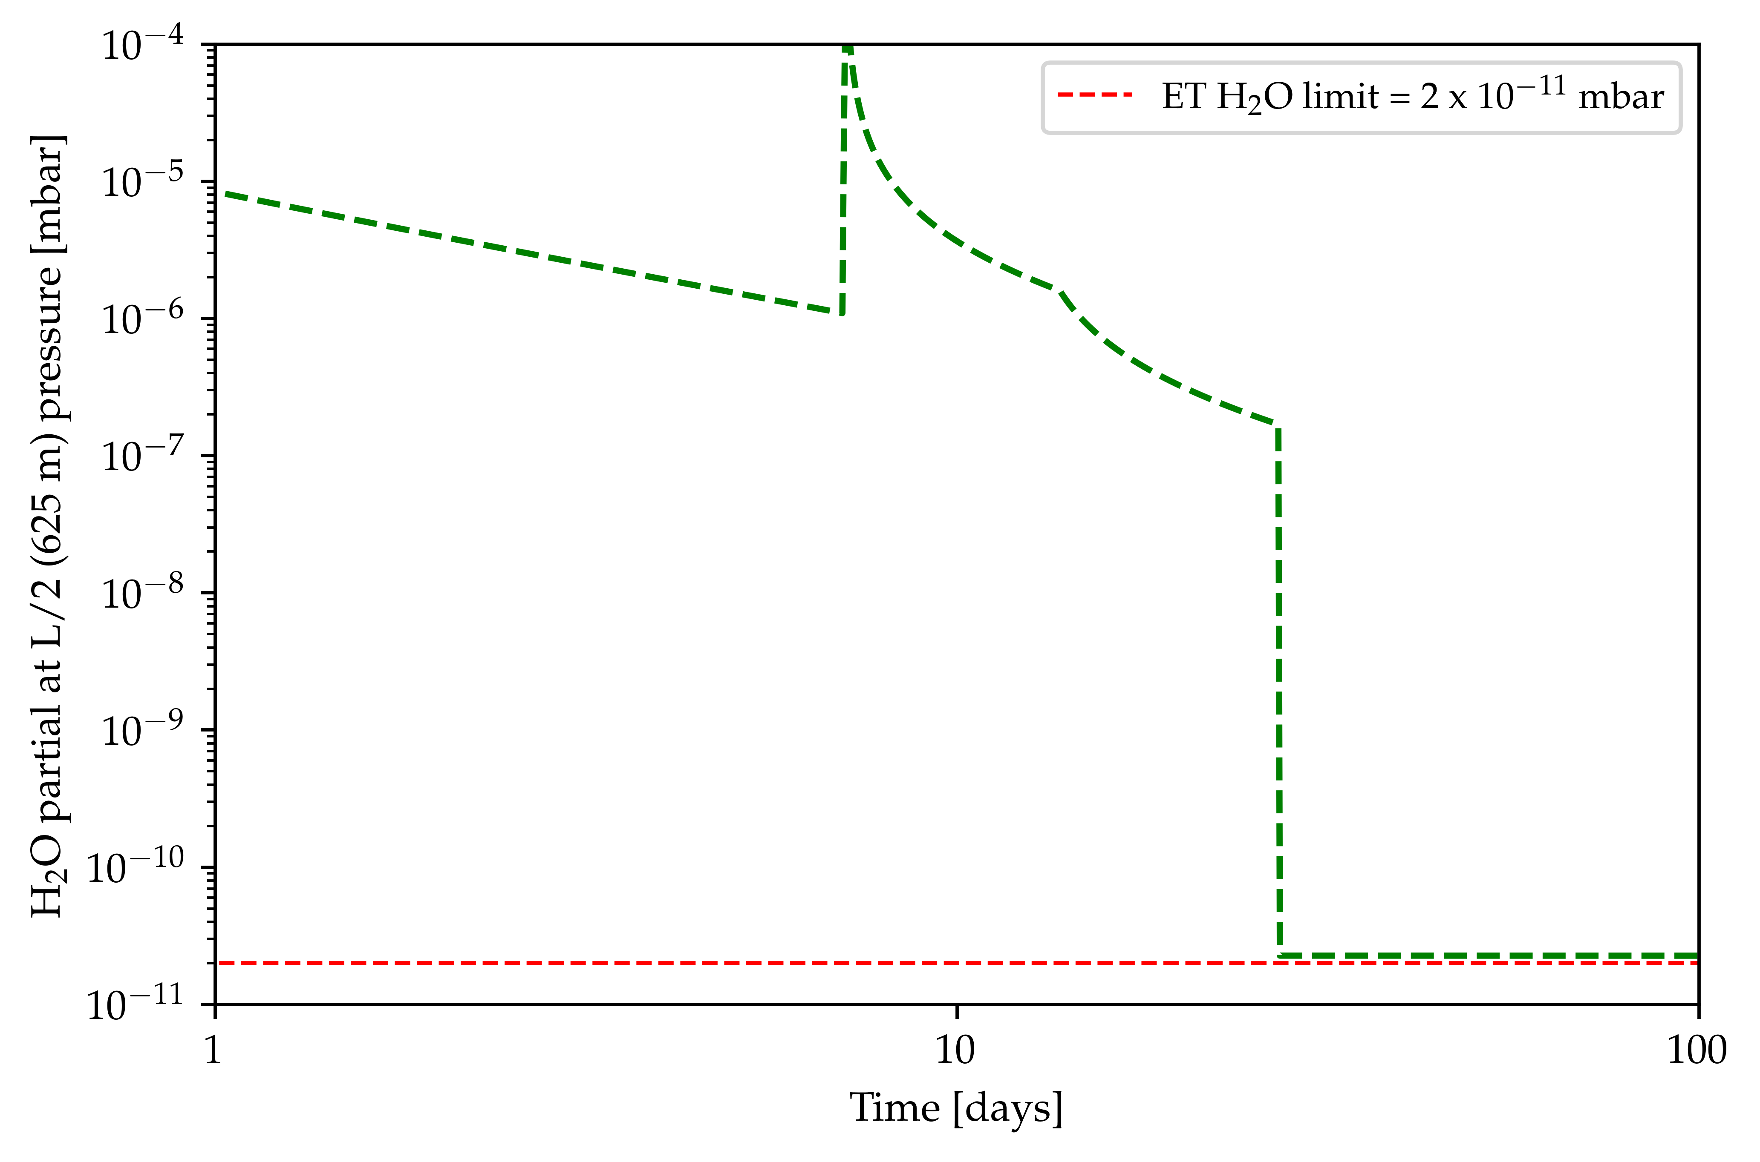
Simplified overview of pumping stages
P_{ET} (H₂O) = 2∙10⁻¹¹ mbar
1 – Rough pumping
2 – Intermediate pumping
3 Bakeout & Steady state
Bake-out start
NEG activation (after 1/3 bake-out duration)
8-10 days
5-7 days
20 days
About 5-6 weeks to fully commission 5km of beam pipes -> Furter optimization, mainly on the bakeout (P(H₂O) requirements, bakeout temperature, insulation thickness) could even reduce the time to ≈ 4 weeks (?)
Close to one year to commission all the vacuum system: Which parallel activities could be allowed in the tunnel?
From C.Scarcia presentation

Slide 4
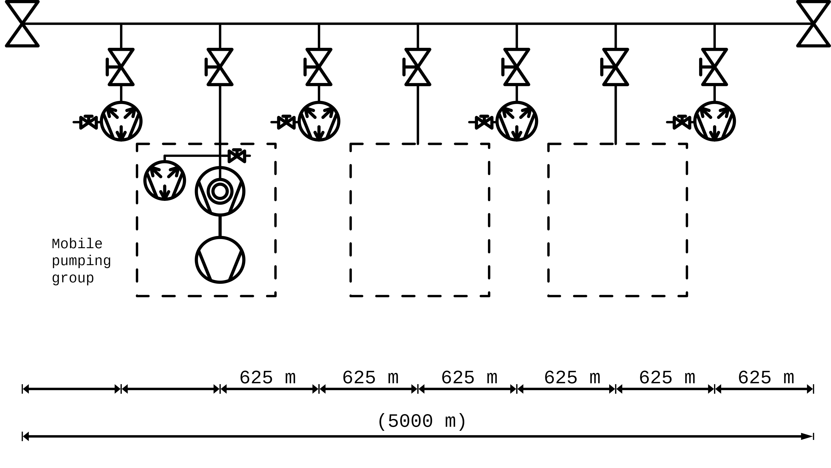



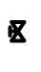
HV pumping: Mobile group to be used during the bakeout cycle
NEG at high temp during the BO
These NEG cartridges will be activated at ≈ 500°C and then kept at 200°C (about 40W needed) for the bakeout duration. This will ≈double the capacity and increase diffusion mainly for H₂O during this stage
From C.Scarcia presentation

Slide 5
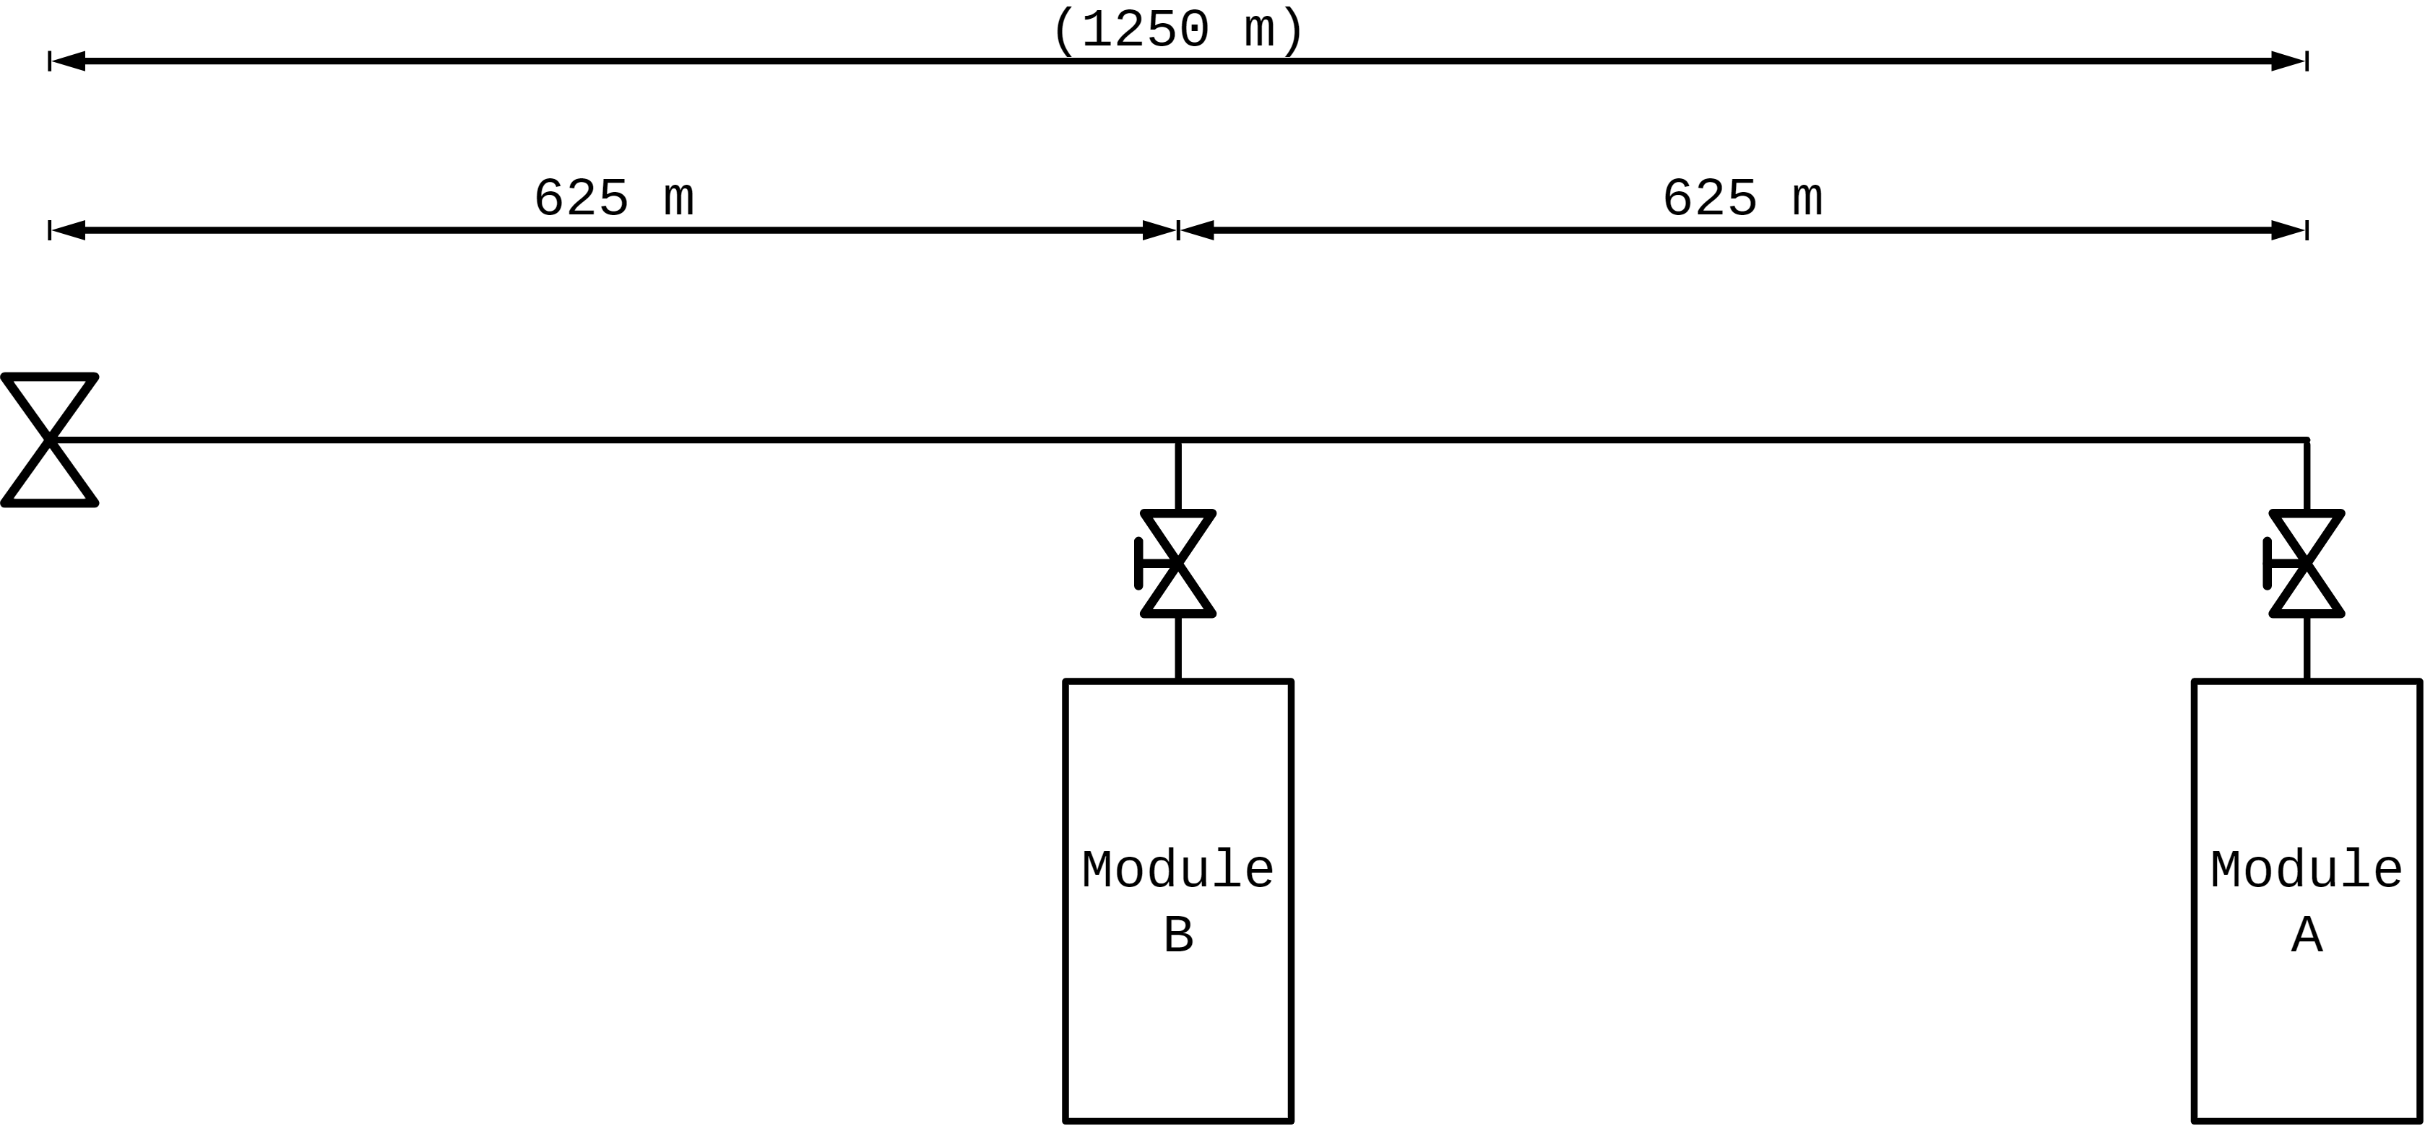
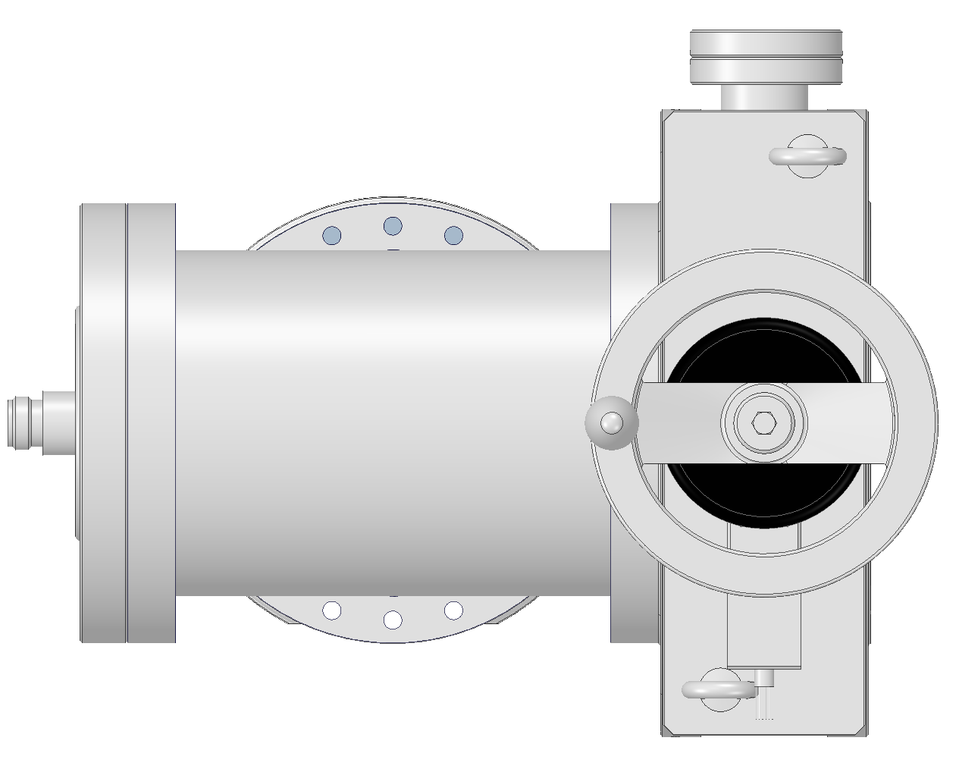
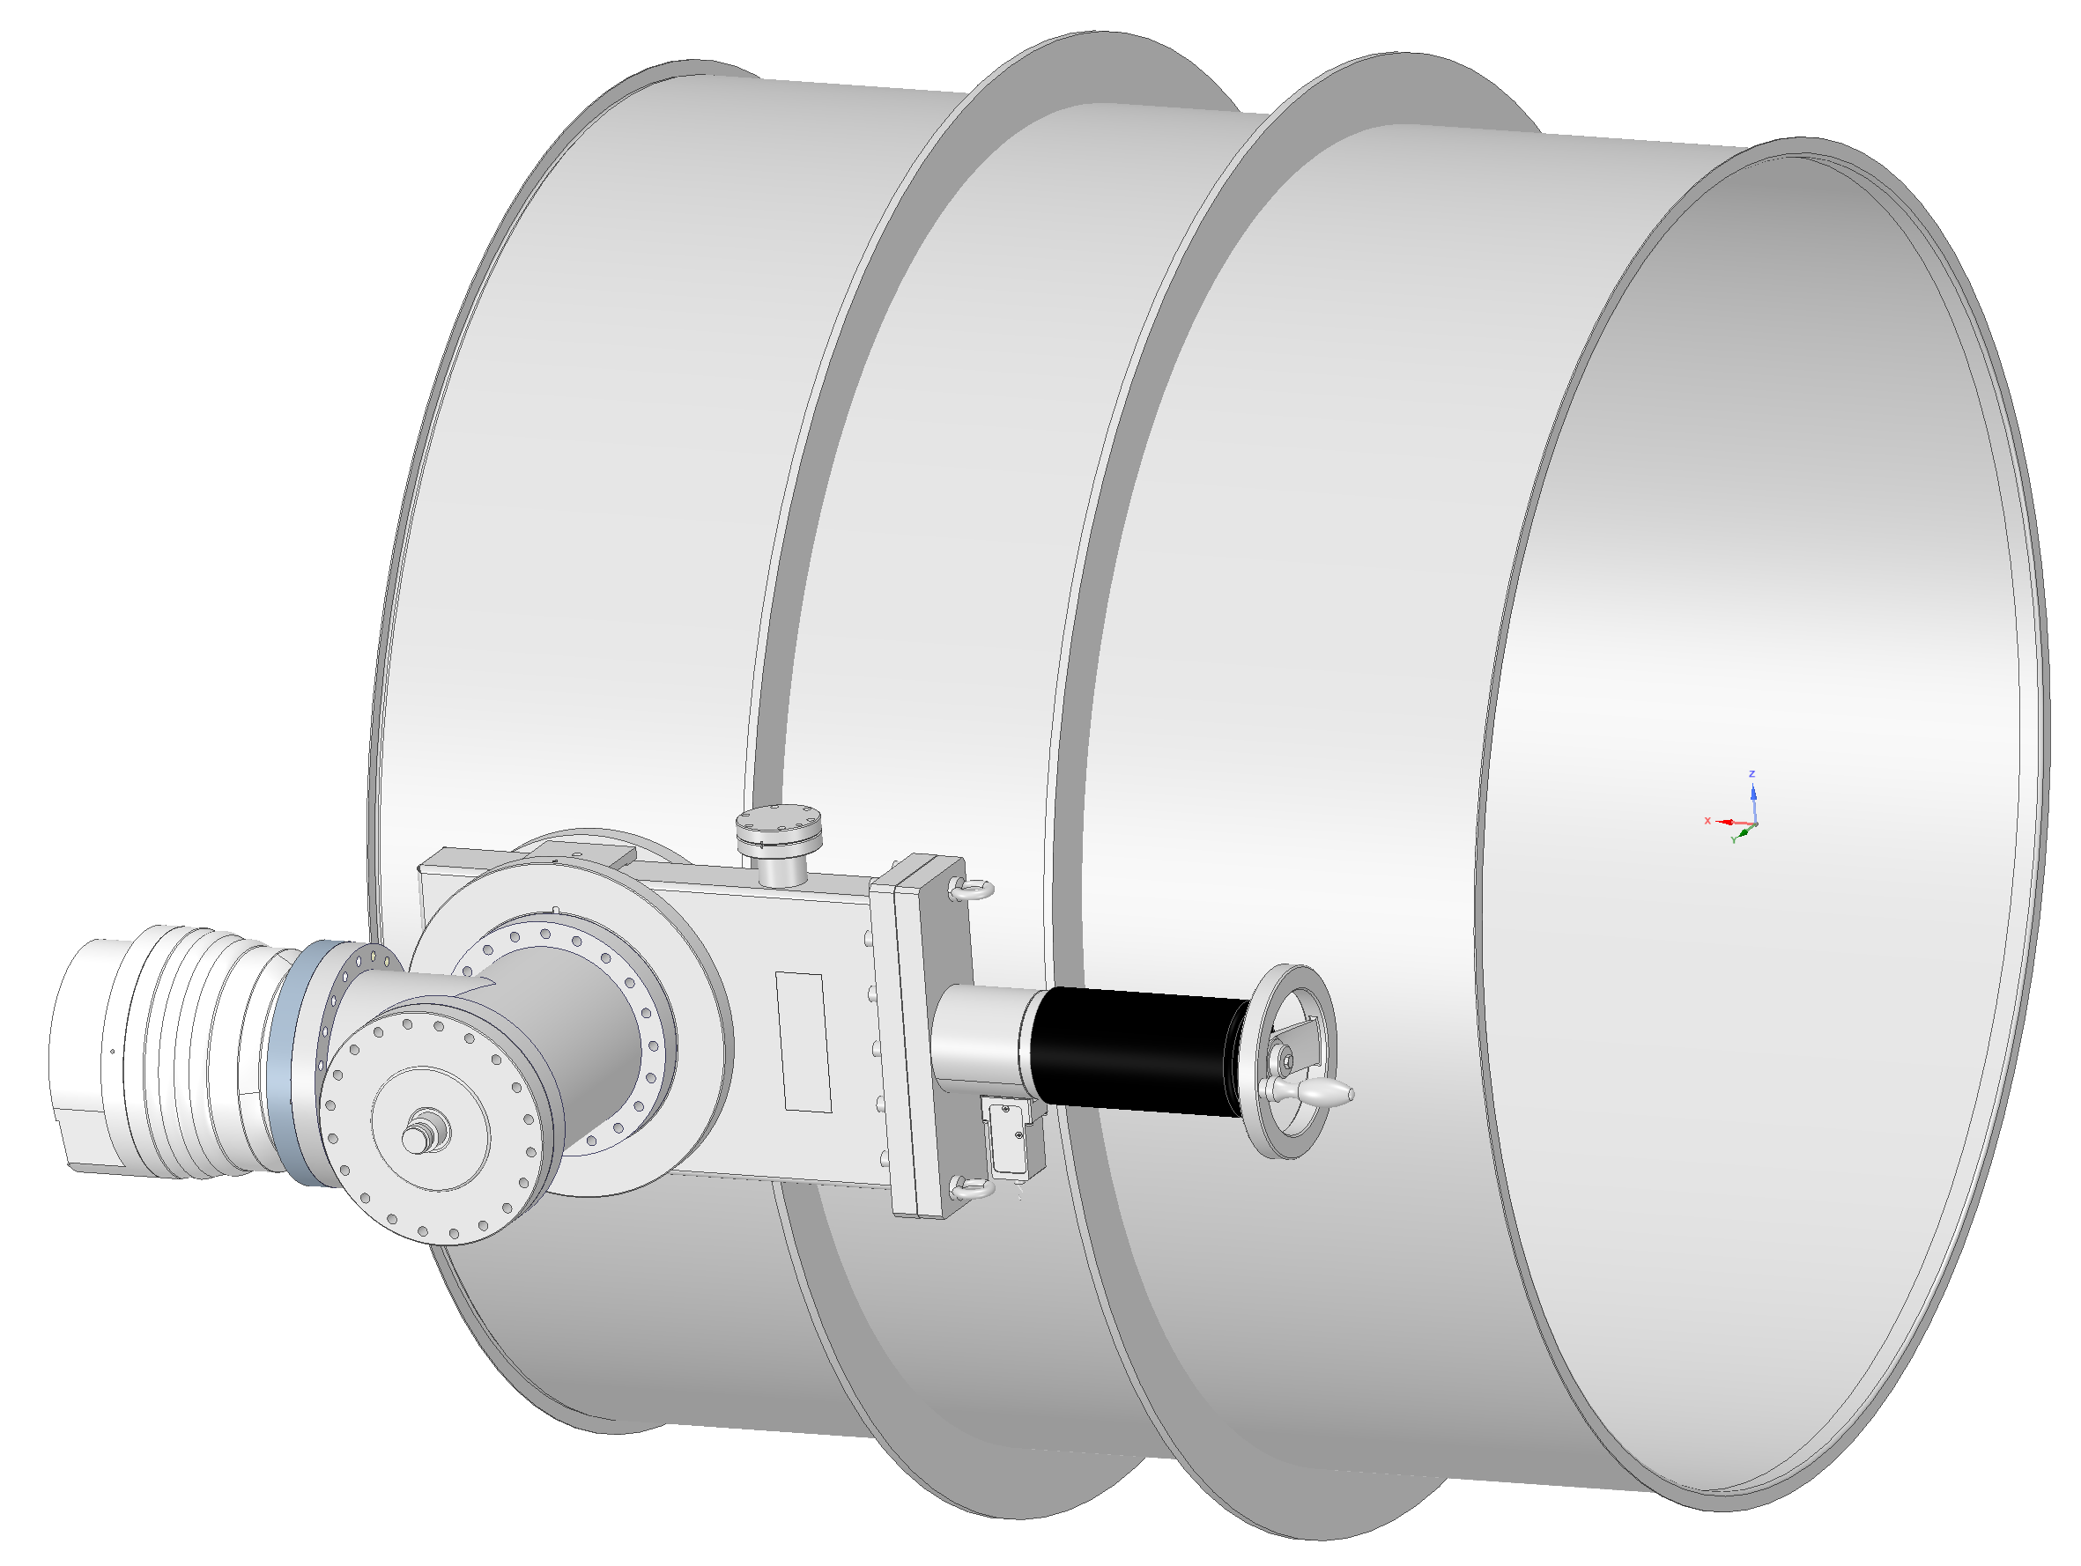
HV pumping: vacuum layout
NEG at high temp during the BO
Module A (mobile):
2000 ls⁻¹ NEG + 700 ls⁻¹ TMP
~39 cm
A more detailed design of the module with possibly an elbow need to be studies and integrated
From C.Scarcia presentation

Slide 6
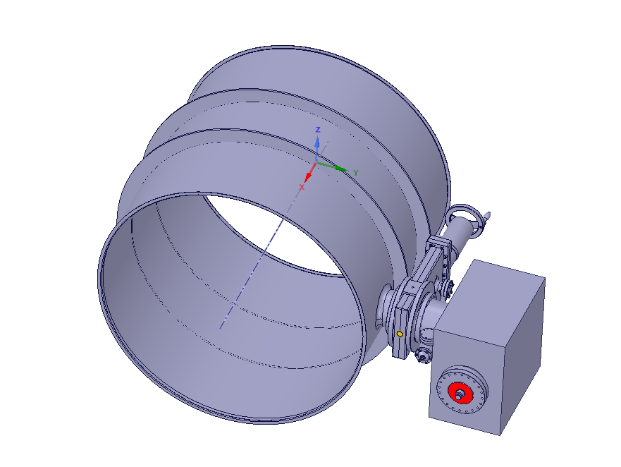
HV pumping: vacuum layout
Module C
Will replace the module A mobile turbo
2000 ls⁻¹ NEG + 500 ls⁻¹ Ion Pump
Gauge
C
Final configuration after bakeout
All metal valve for LD
From C.Scarcia presentation

Slide 7
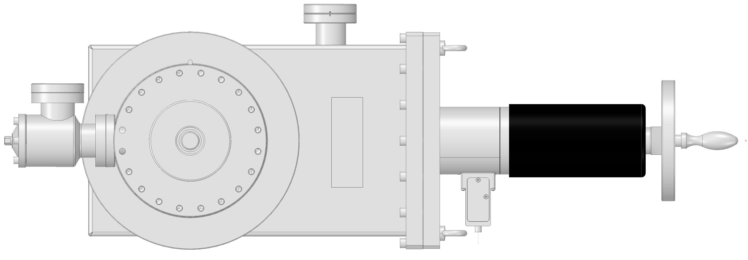
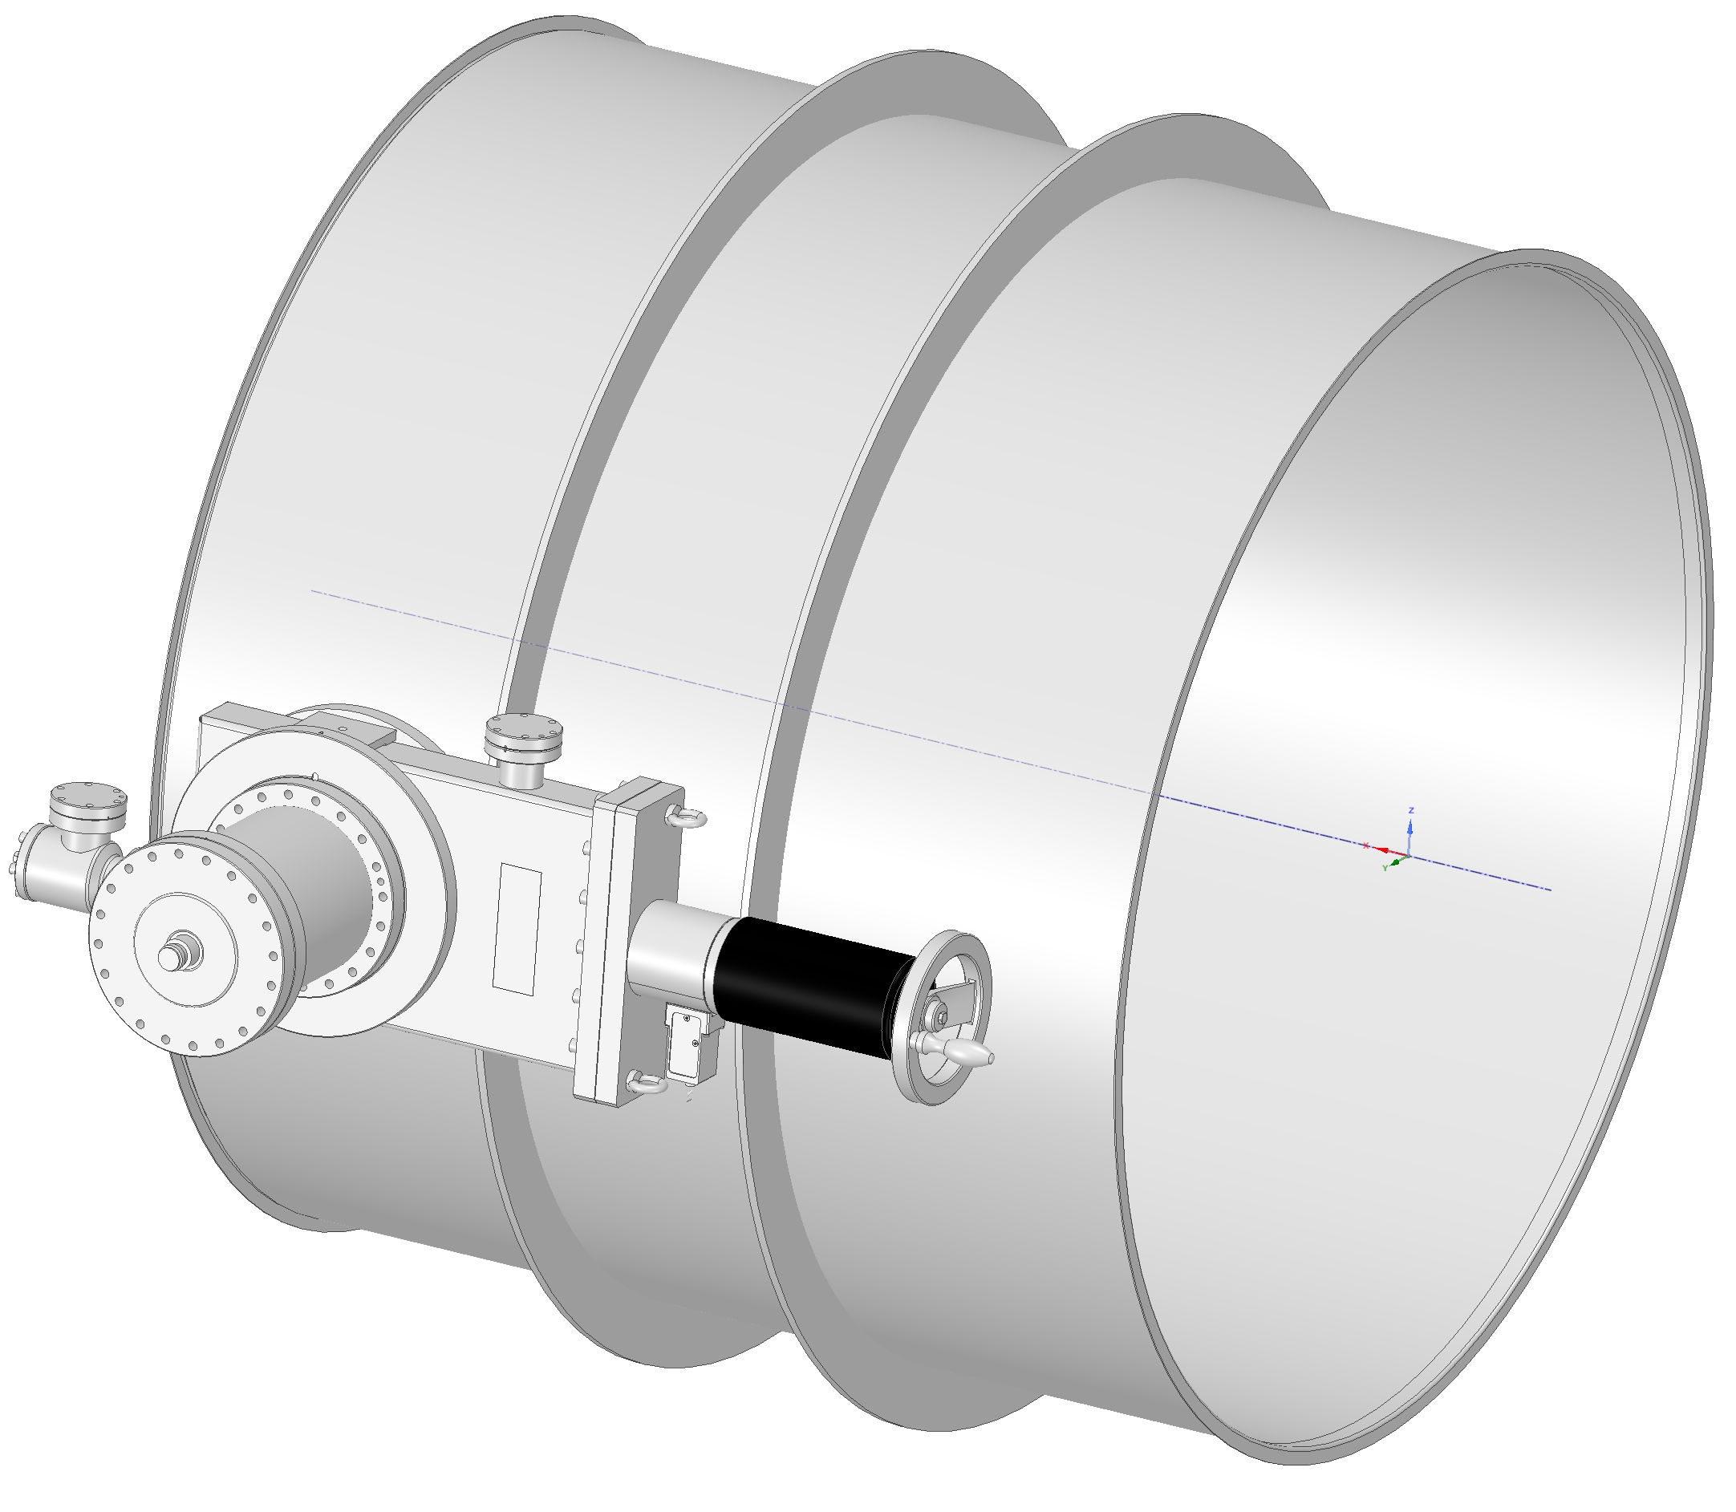
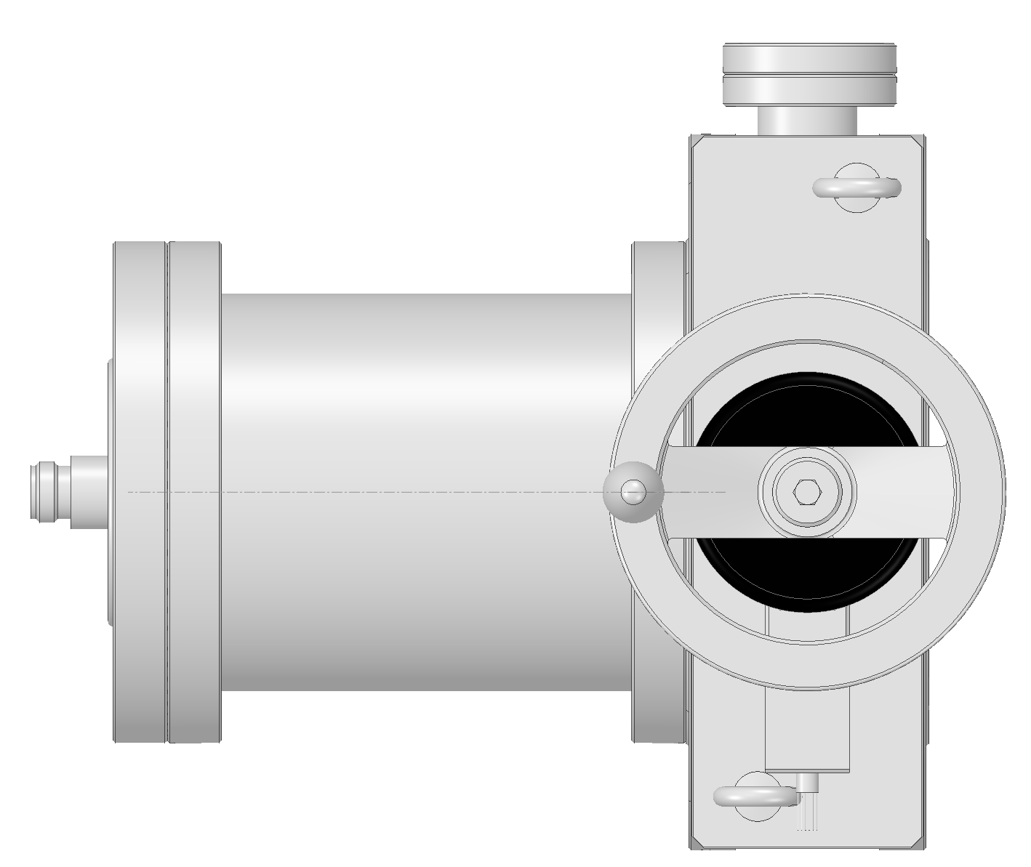
HV pumping: vacuum layout
Module B:
2000 ls⁻¹ NEG
NEG at high temp during the BO
~39 cm
From C.Scarcia presentation

Slide 8
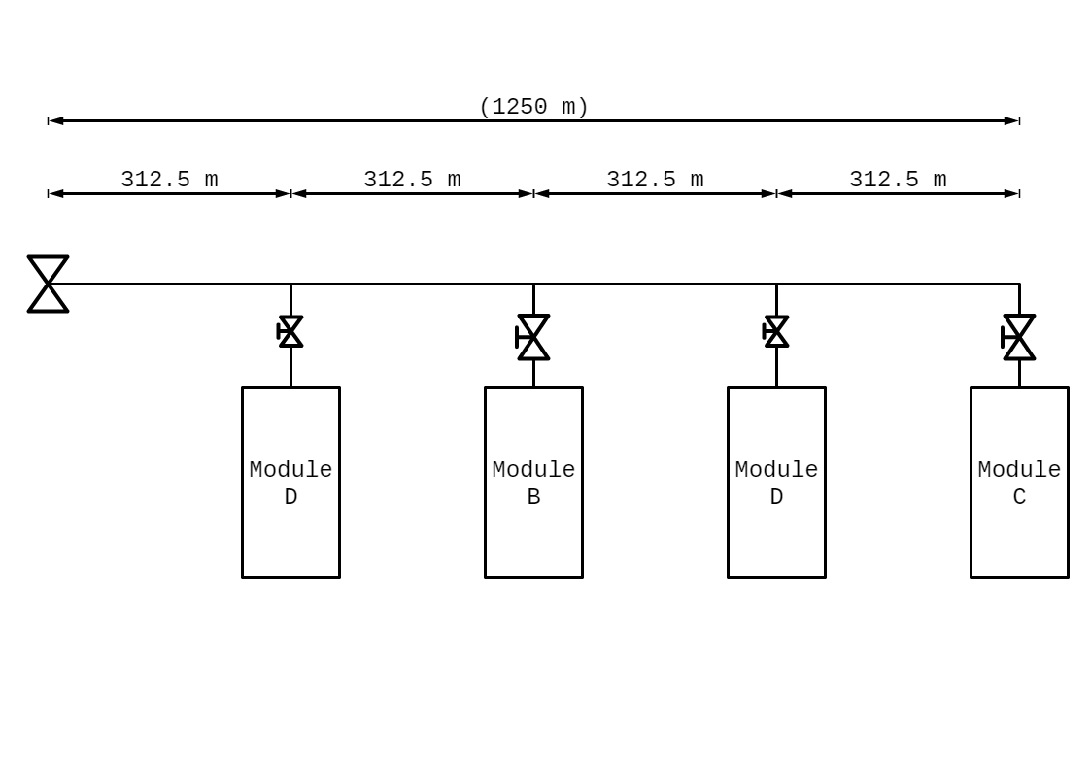
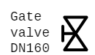
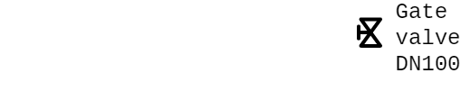
UHV pumping at RT: vacuum layout
Module D:
1000 ls⁻¹ NEG or similar
Final configuration after bakeout
~ 25 cm
From C.Scarcia presentation

Slide 9
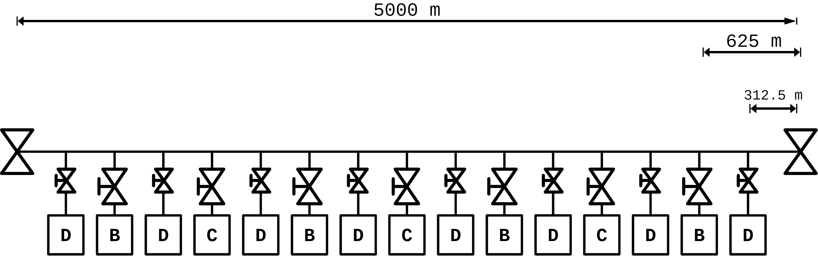
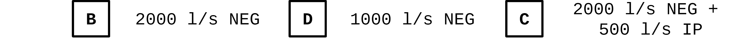
UHV pumping at RT: vacuum layout
Whenever possible the beampipe experts should try to finalize the design of the tunnel, which conditions the spaces and positions of the other elements of the system (cryosystems, towers, )
Very Important:
Need of power 220V on all the pumping station
Need of compressed air on all the pumping station
From intermediate phase
Working @ RT
Working @ High temperature
From C.Scarcia presentation

Slide 10
UHV pumping at RT: vacuum layout
Some further considerations
It was said that all the valves of the pumping modules should be electropneumatic with control system to increase reliability and remote intervention if needed
It was proposed to even add every 125m some additional angular metal valve/flanges to give the option in case of problems of:
  Add additional pumps Ti sublimation filaments on a “sleeping” mode”: See slide afterward
  To add some RGA if needed
  To perform more precise leak detection

Slide 11
UHV pumping at RT: vacuum layout
Some further considerations
The DN1250 gate valves should be installed horizontally to the beam line:
  In case of failure you will not block the aperture
They will need in any case some dedicated space for a “clean” installation in the tunnel with a design tent and gas flow
The DN1250 gate valves are a major concern in case of failure based on existing experience. It was proposed to possibly double at least the one at 5km and have a sort of buffer small sector that in case of need could be easily dismounted and allow access to the mechanism of the valve
  Need a list of risks and benefits. Also risks associated with the addition of the valves themselves (e.g. leaks ).
We should know if a DN1000 or even smaller is a real option at 5km because would decrease a lot the cost

Slide 12
Venting system & Leak test (or anticipate leaks problem)
It was proposed to use some purified dry air compressor
  LIGO experts suggest dry air @ 77K level with sort of purifying filters : Can we have some detailed information about that? Thanks
Leak test: during the installation, an overall check of 'total leak rate' shall be done by accumulation and may save some effort with the He LD procedure
  Also, more RGAs shall help for leak localization issues: At least 3 RGA combined with the routine check described below
  As a routine check an accumulation should be done to measure that the pressure level is conform and that no “hidden” air leak are present on the system
    Important to have a proper RGA signal and every 1-3 year a kind of calibration with an Argon calibrated leak should be done on the pumping ports to be sure we have a proper and precise signal

Slide 13
What’s on the menu today….
Bake-out and insulation system

Slide 14
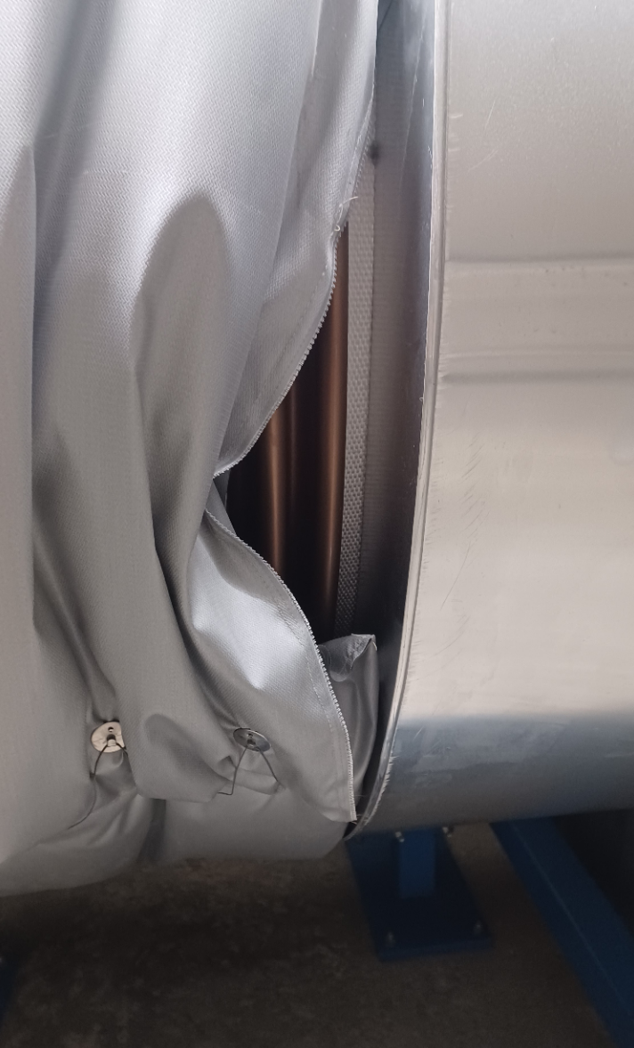
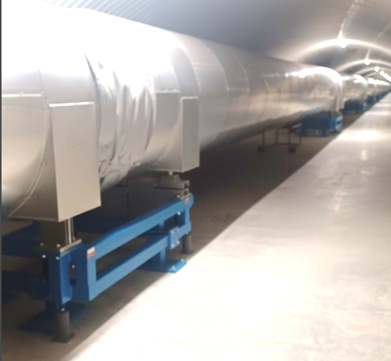
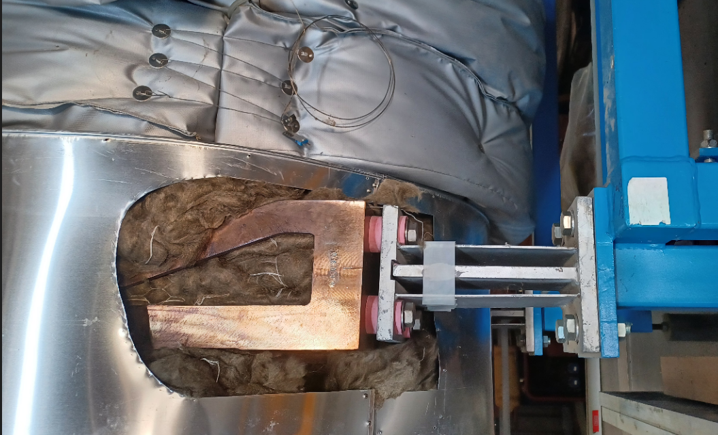
Bake-out via ‘Joule effect’
The support system of the beam pipe should take in consideration the need of bakeout
Some details
II. more heat generated in thinner sections (top/bottom unequal)
I. Electrical isolation of beampipe stands & covers

Slide 15
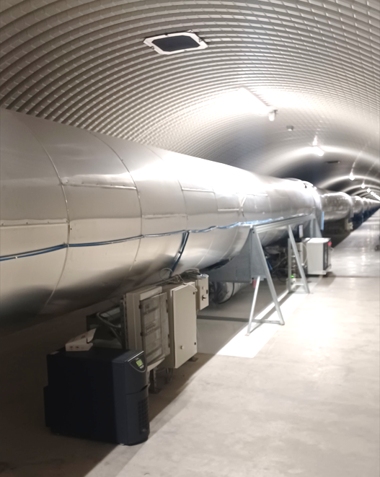
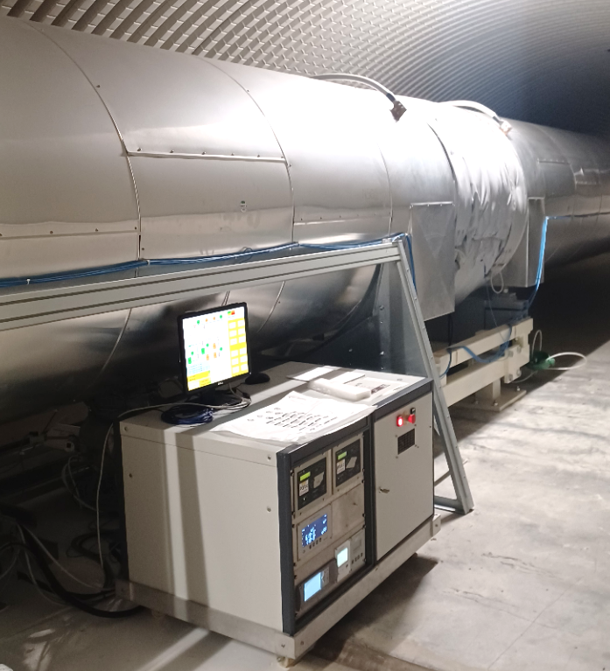
Bake-out via ‘direct Joule effect’
Some details
III. Pumping stations @ ≈ 0 V
to be designed on purpose

Slide 16
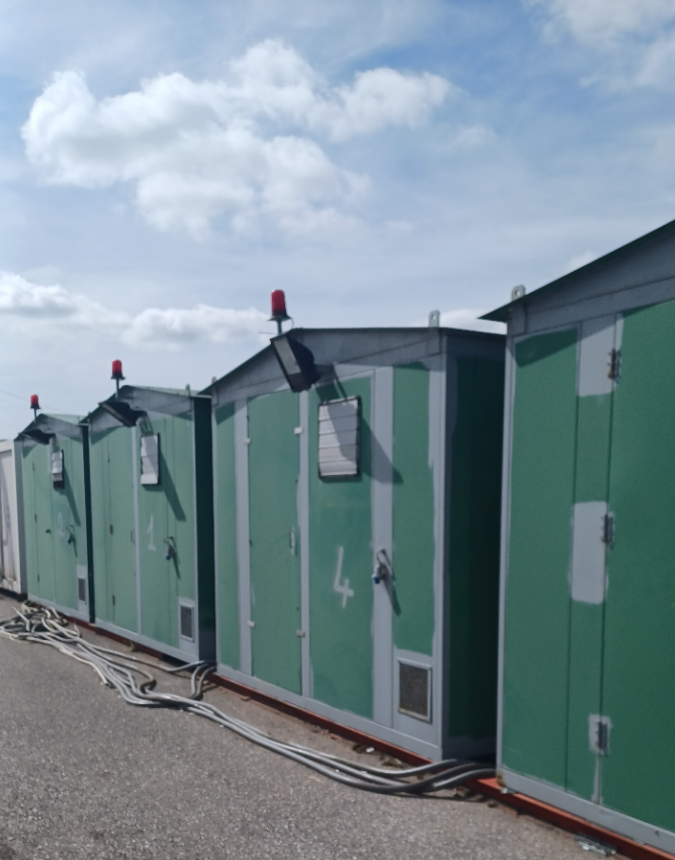
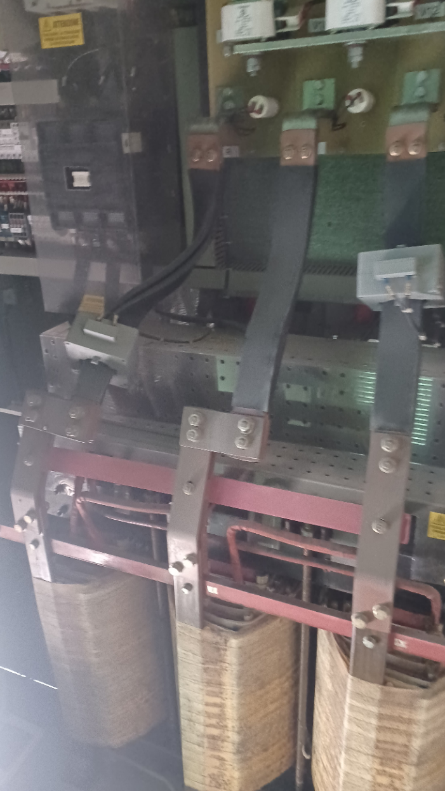
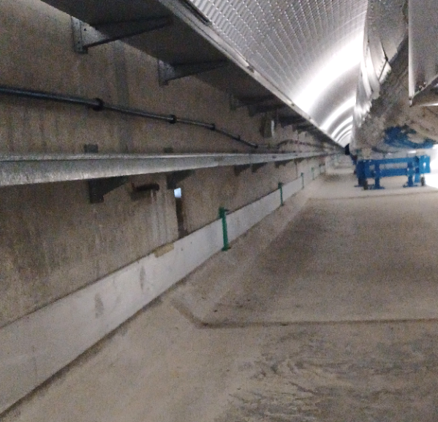
Bake-out via ‘direct Joule effect’
We need to study this in detail with the technology now available
Some details II
Like for GEO600 the return conductor could be the possible rail (If any) used to transport the tube section in position otherwise it should be integrated in the tunnel
not optimized wrt room use
IV. Return conductor
V. DC converters: room & cooling

Slide 17
Bake-out via ‘Joule effect’
It was done for 3km length, and it could be implemented for 5km. Longer sector length start to be very difficult from all point of view
Some details
VI. 60 V DC ‘limit’ (?) & safety aspects: possible impact on layout of bake-out pumping system

Slide 18
Insulation material & bakeout consideration
H₂O pressure requirements should be carefully defined because they could have an important impact on the bakeout temperature, insulation thickness and needed time for the bakeout
If HF or LF beam pipe have different requirements should be included already on the design because it could easier the full commissioning and installation: Possible different insulation thickness, different bakeout length, different pumping system, etc…
Heat to be exhausted during bakeout: forced ventilation sems not to be needed. Consequently, there seem to be no impacts with respect to sectorization. A real case of experience would be helpful. It is an important point that now needs to be defined in order to finalize the design.
Insulation: Easy to install and to de-install in case of leak
  Is it worth looking at a solution with dismountable insulation system: Gain on cost of material but more labor cost: TBD.
Are we searching an as much as possible dust free insulation?
  Mineral wool or glass fibers or aerogel insulation (etc..) will produce a lot of dust in the tunnel: Coactivates? Blocking point?
Notes:
All the following considerations are made for a sector.

Slide 19
Insulation material & bakeout consideration
Bakeout with joule effect is the only option at the moment, but needs to be developed in detail for the ET project and the CERN pilot sector
What if a major problem happening?
  Venting with dry air
  Exchange the part under air flux to limit retro-diffusion of water
  Use the “spare“ port with Ti sublimation to limit the bakeout of the exchanged part: Limited bakeout with standard heating tape to 100-150m already done at CERN and could save time and money in case of problem
    “Crazy” idea but it could/should work if analyzed in detail, on a small diameter and with NEG coated beam pipe already implemented at CERN and could be developed for ET: Safety FIRST!
Notes:
All the following considerations are made for a sector.

Slide 20
What’s on the menu today….
Pumping system

Slide 21
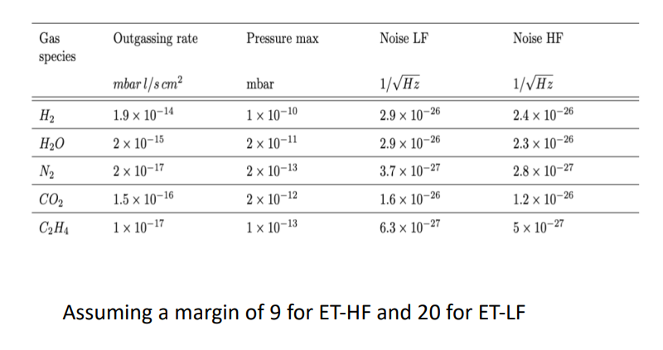
Pressure requirements for ET
Pressure requirements for ET
HF><LF?
Are these average value of pressure along 10km? On which length can you accept to a have higher pressure? What is the limit?
At first stage we consider the average pressure along the 10 km arm. To further optimise the analysis, we shall then consider the actual pressure profile in relation to the expected beam profile

Slide 22
Final pumping system for H₂ and CH₄
H₂
H₂
Turbo molecular pump
Maintenance
Vibration
Cryogenic pumps
Maintenance
Vibration
Ion pumps
Single local power supply
Weight
Sublimation pumps
Low cost
If well designed: High pumping speed and high capacity
No local controller and no power needs
High capacity and possible custom made design
Single local power supply
Control system: PLC
Single local power supply
Control system: PLC
Integration
Control system: PLC
NEG based pumps
Sublimation process very fats: few minutes
No local controller and could be easily remotely operated
Activation cycle relatively short (30-60 min)
Not possible to use during the bakeout phase
CH₄
CH₄
CH₄

Slide 23
NEG cartridge based pumps
Some consideration & Open questions
Custom made shape? What is the maximum pumping speed?
  External vs Internal solution
Capacity for different gases @ RT vs @ 200°C
Is there any problem of dust or particles production during the activation cycle?
Pro and cons of different solution: Cost vs Performance
  Why and when using the ZAO?
  Why not capacitor?
  Why not the NEG Strip

Slide 24
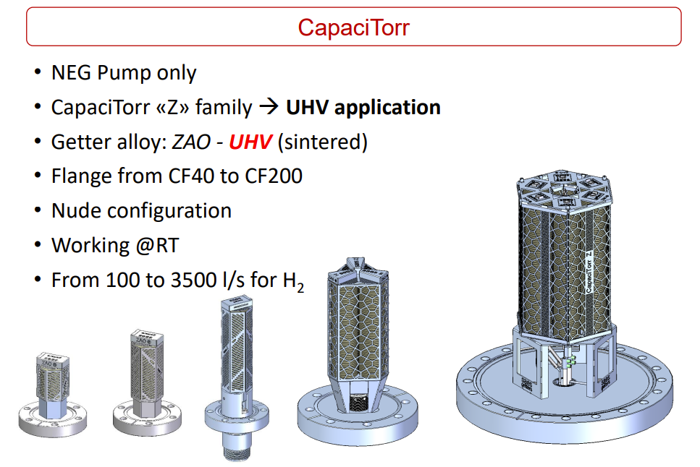
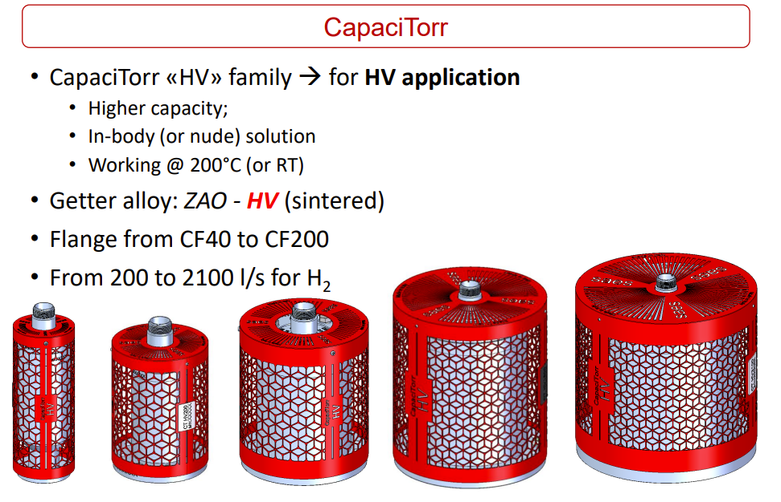
SAES presentation: External solution
Working @ RT
Working @ High temperature

Slide 25
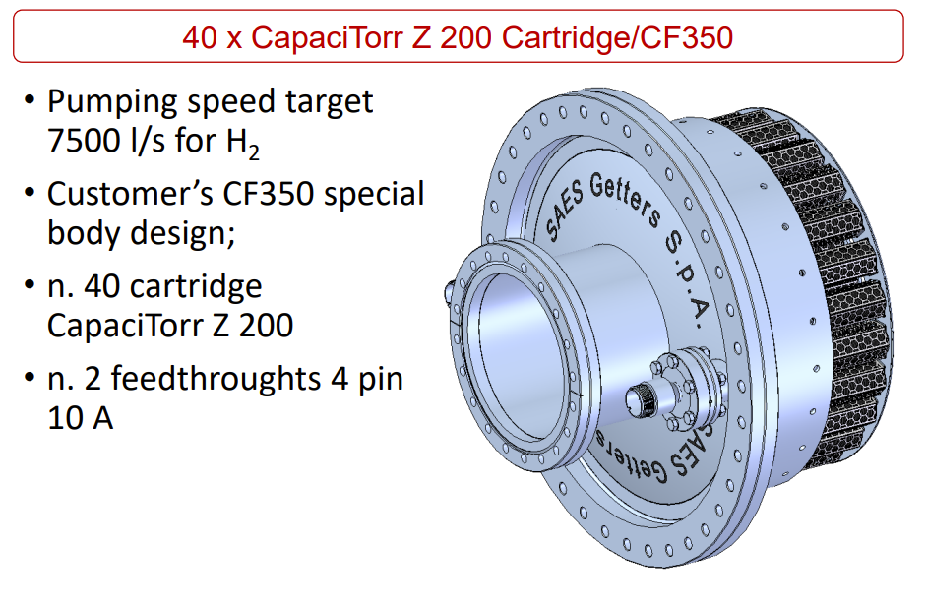
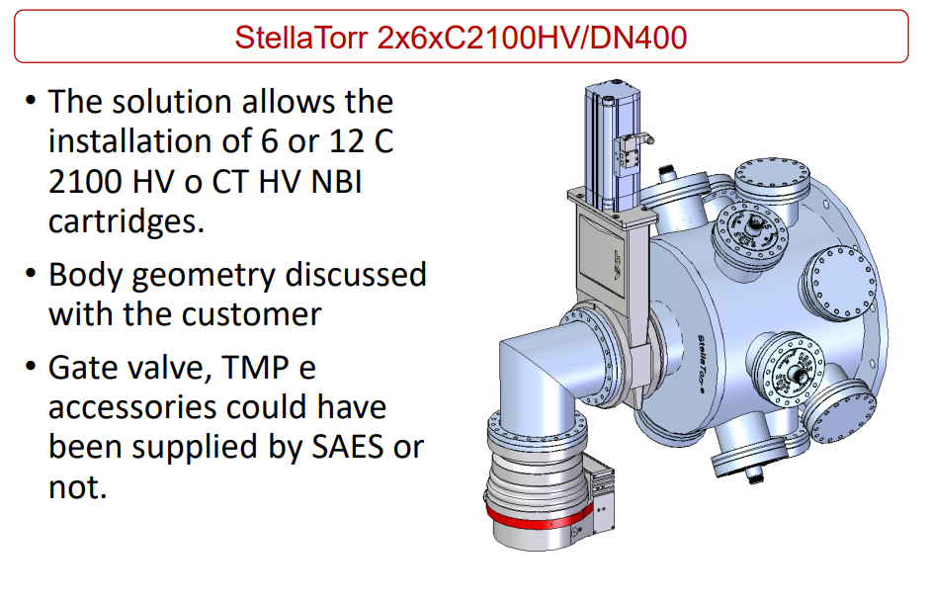
SAES presentation: External solution –Custom made

Slide 26
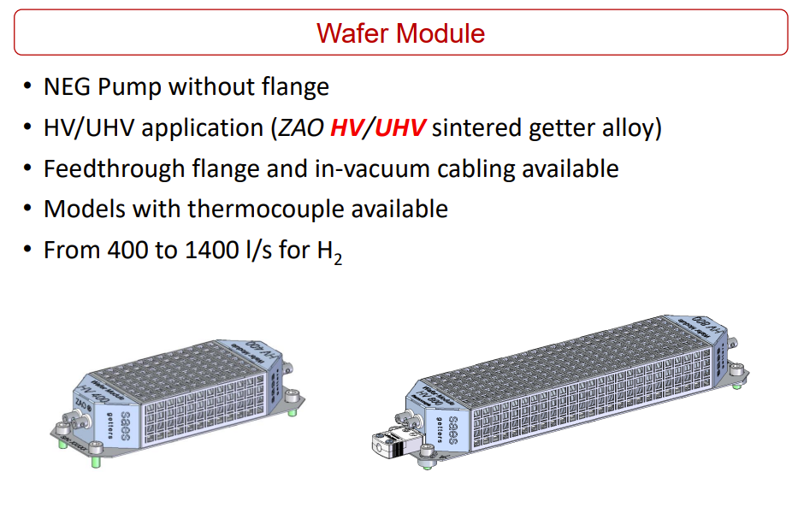
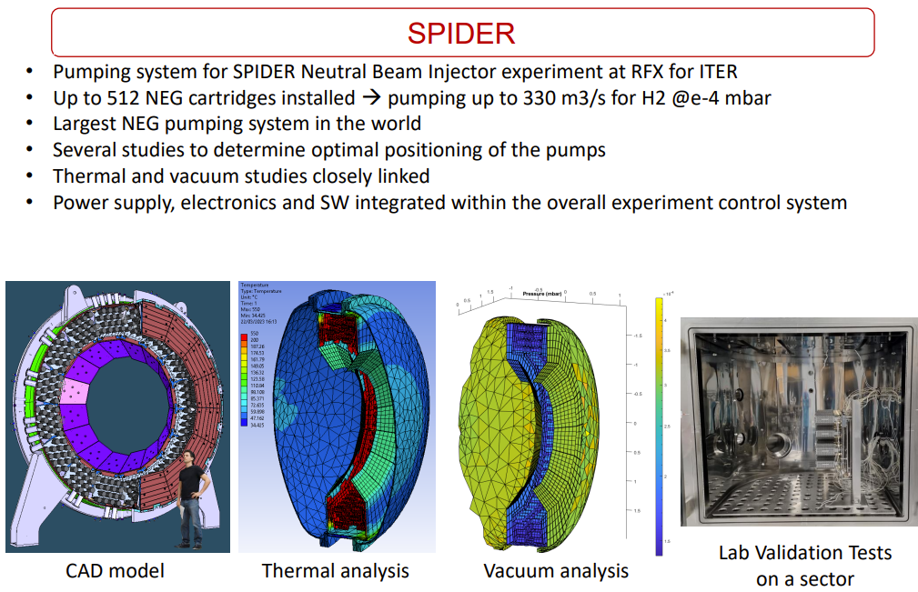
SAES presentation: Internal solution & Custom made

Slide 27
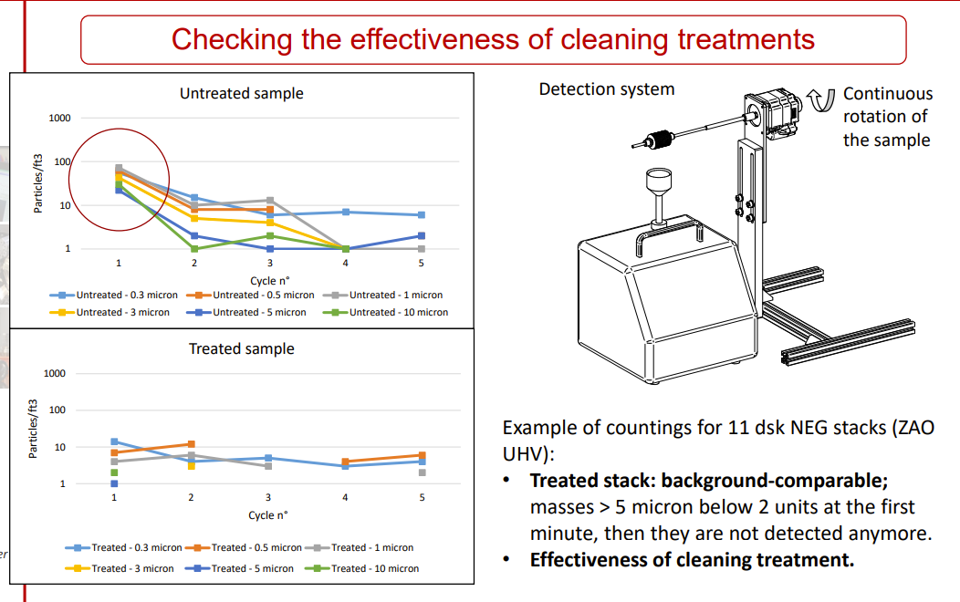
SAES presentation: Particle detection

Slide 28
Ion Pumps
Some consideration & Open questions
CH4 Pumping: How efficient at this pressure level?
  Internal vs external solution.
Powder and particle production? Can they migrate in the beam tube?
HV Feed through robustness? Can we drop the idea of the manual gate valve? Pro and cons
How many ion pumps can be piloted with a single power supply? Power and cable needs? Ethernat or Profibus connection?

Slide 29
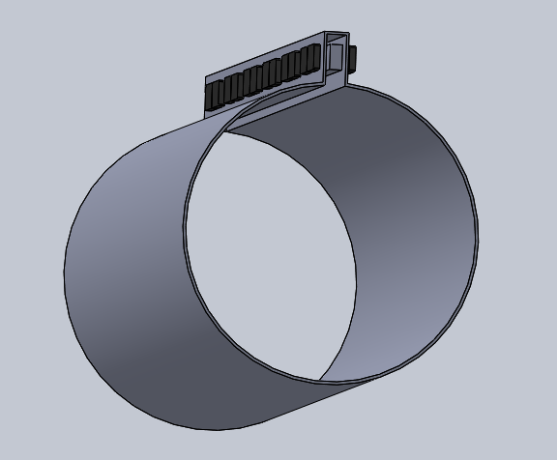
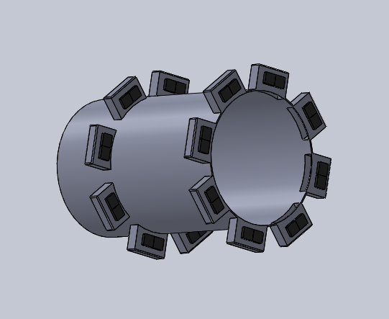
Agilent presentation: Internal solution & Custom made
Slot dimensions: 160mm x 130 mm x ???
160 mm Diameter increase
Overall dimensions, including magnets & Pole pieces
Slot dimensions: 160 x 130 X 300 mm
160 mm diameter increase
Overall dimensions, including magnets & Pole pieces

Slide 30
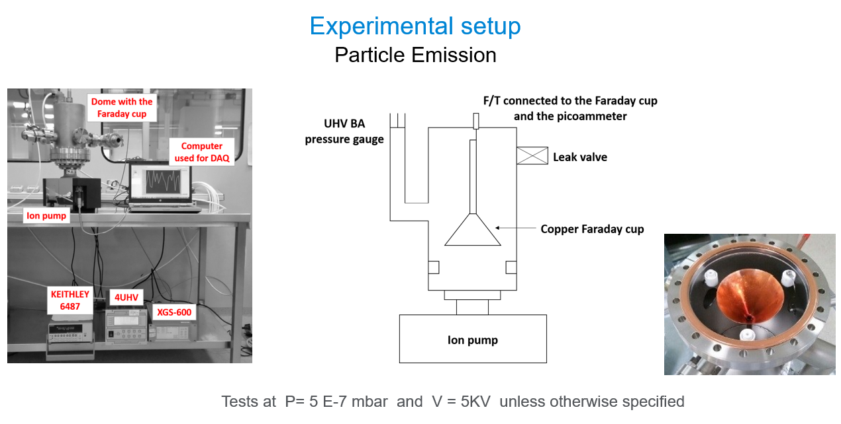
Agilent presentation: Particle emission

Slide 31
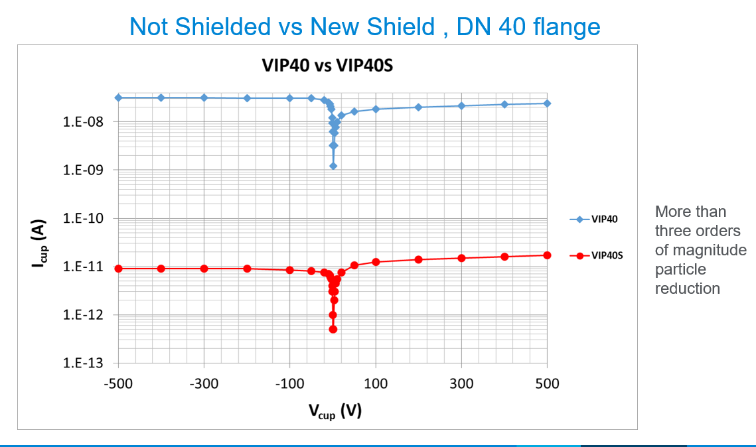
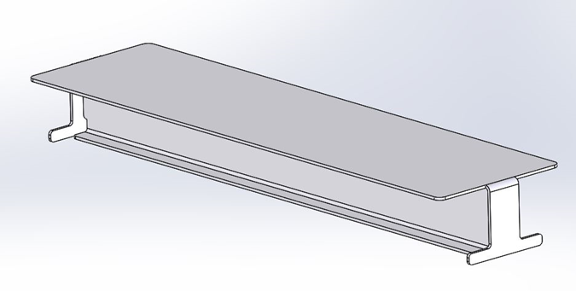
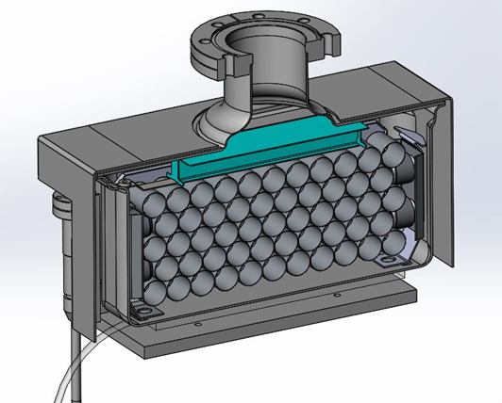
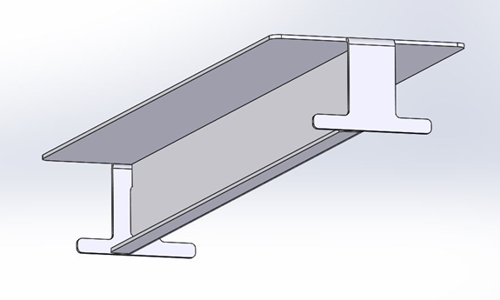
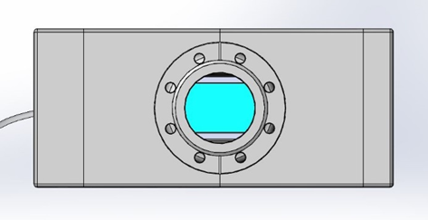
Agilent presentation: Particle emission
Loss of about 25% of pumping speed in case of shield
If installed with elbow most probably there is no need of shielding

Slide 32
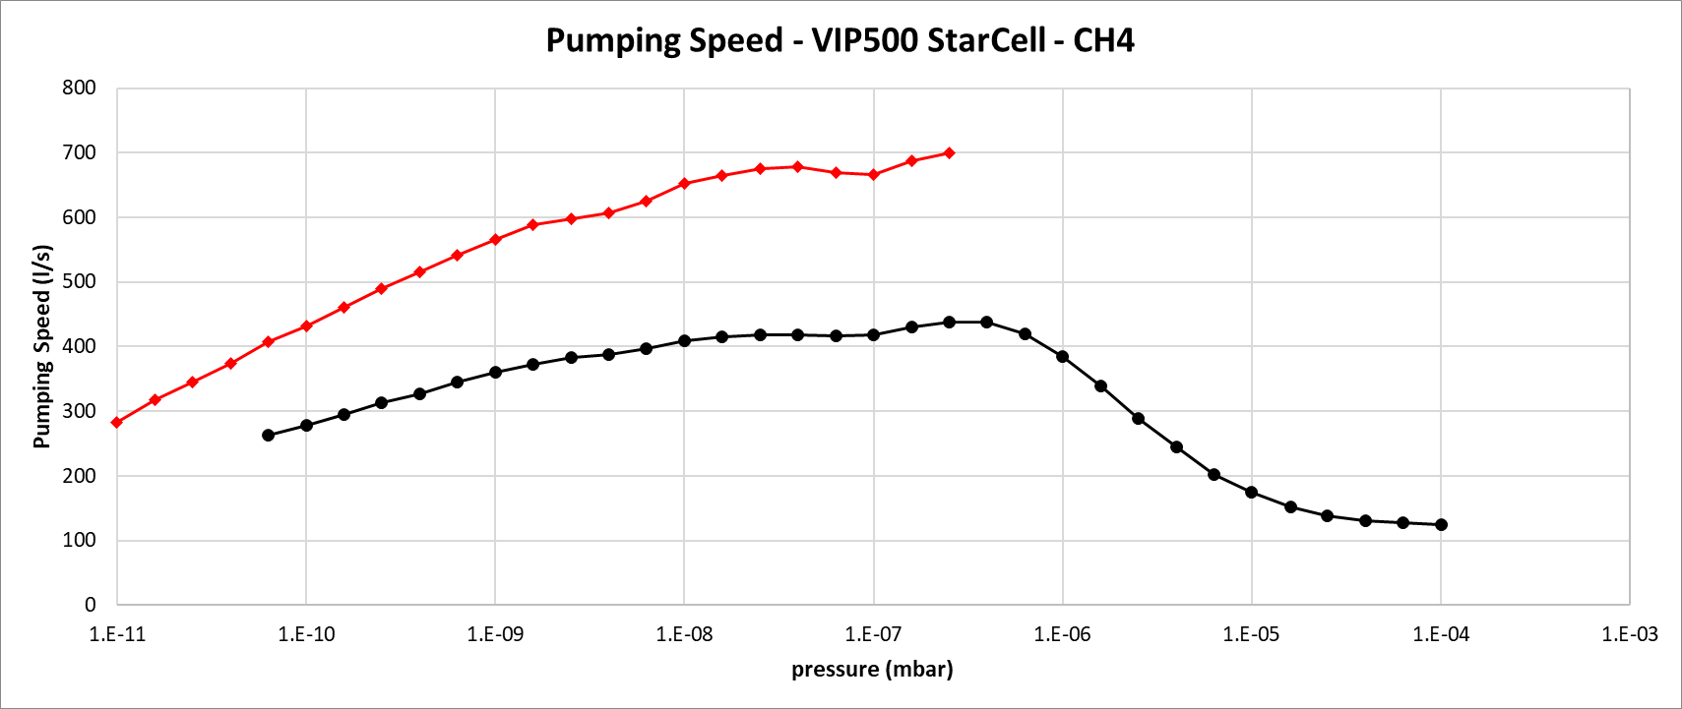
Agilent presentation: CH₄ Pumping
Methane «behaves» like a Noble Gas
Main pumping mechanism is CH4 ions bombarding the cathode , and then either implanted there ( unstable pumping ) or being neutralized and reflected , and embedded into the anode and covered by sputtered cathode material ( stable pumping )
StarCell performance best for CH4 , highest reflection rate
Phisycal burying , not chemical reaction
Ion pumps do crack Methane and Hydrogen and CHx are pumped as «getterable» gases
Overall efficiency almost comparable to the one for Nitrogen
Starcell is the best solution in any case

Slide 33
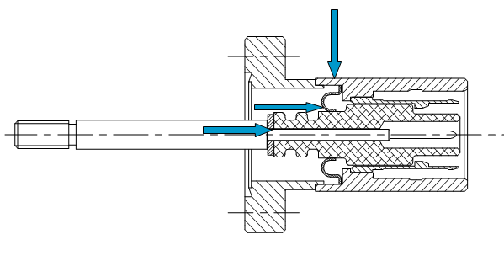
Agilent presentation:
Corrosion free ION Pumps HV Feedthrough
Corrosion free feedthrough
HV feedthrough and connector are subjected to corrosion
Transition metal to Kovar (or similar) to ceramic is critical
Temperature cycling , humidity , high electric field gradient may cause corrosion
Water vapor trapped in between the connector and the feedthrough may cause oxidation
Specific design to minimize air trapping and critical surface exposed to air (vacuum side brazing)
Vacuum Side Brazing for Corrosion Free

Slide 34
Gauges
Do not manged to properly discuss but we got some “indirect” inputs

Slide 35
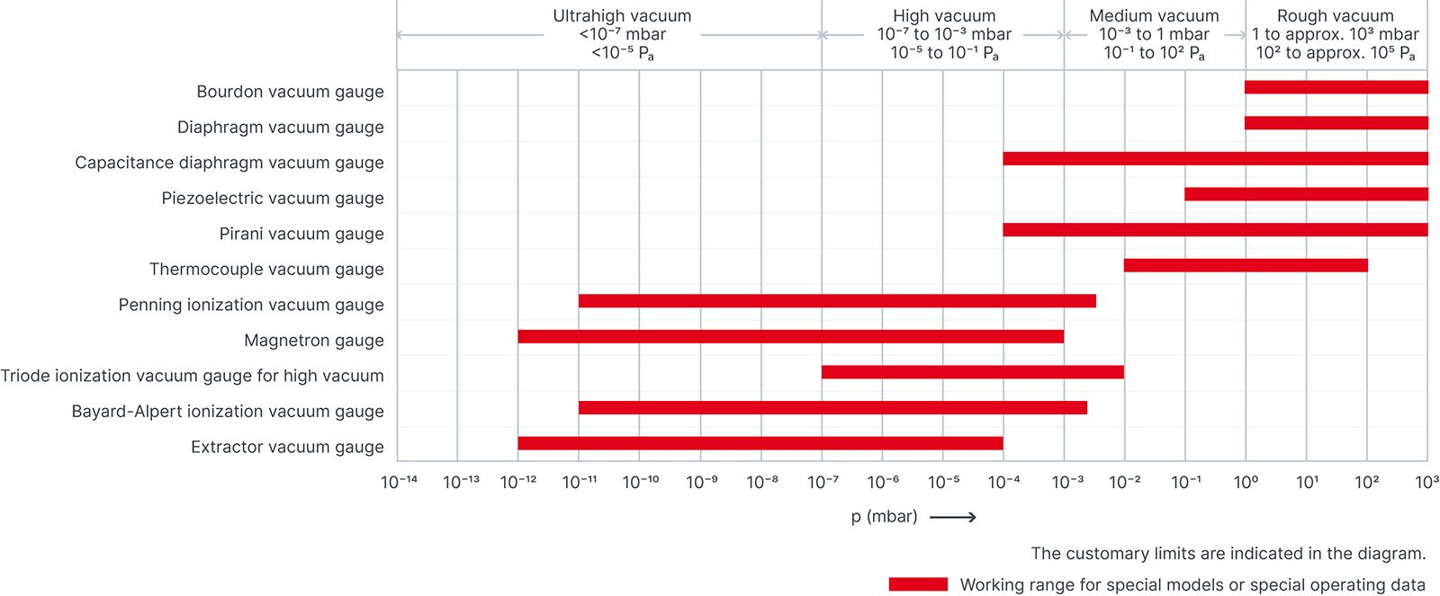
Which choice do we have for vacuum gauge?
Area of interest
FROM: https://diavac.co.jp/english/products/keisokuki/index.html

Slide 36
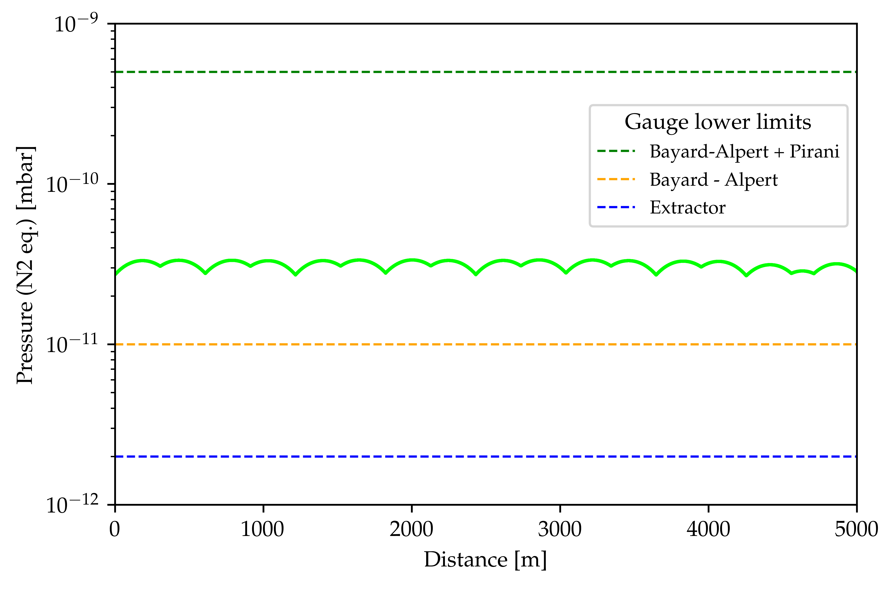
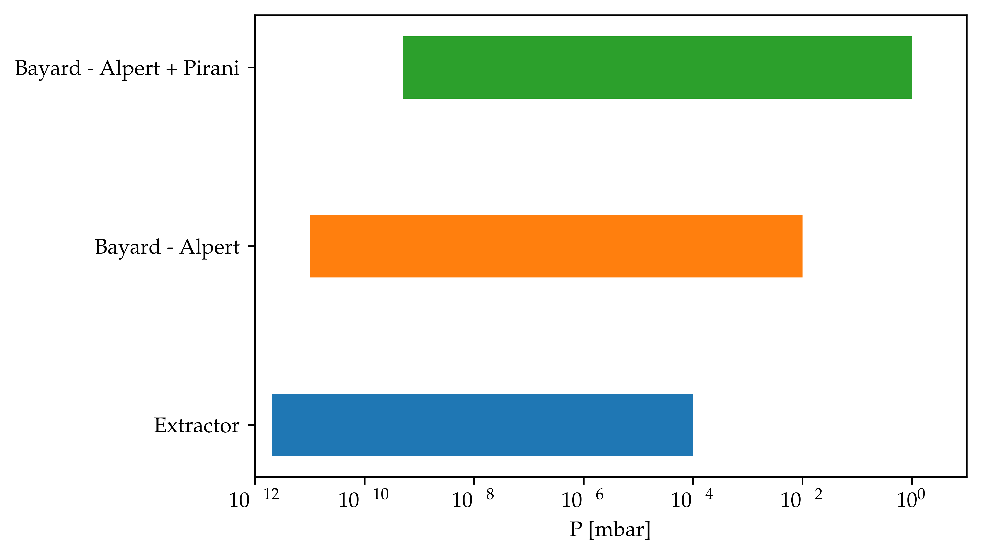
Pressure monitoring: total pressure profile vs. gauge limits
From the discussion it seems that BA gauge are the best option and should be analysed and its integration studies in details
  Installed on elbow or with shield to limit charged particles production
From C.Scarcia presentation

Slide 37
Thank you for your attention

