Slide 1
Beam Pipes for Gravitational Wave Telescopes
23-27 March 2023, Geneva.
Leak Detection: component production to system installation
Paul Cruikshank, TE-VSC, CERN
with inputs from P. Chiggiato, A. Grimaud, W. Maan, J. Perez Espinos, C. Scarcia, J. Somoza Ferreira

Slide 2
Outline
Introduction
Testing considerations & strategies
Testing without flanges
Cost (gu)estimates
Summary

Slide 3
Opening Remarks….
Good Leak Testing
(expensive, time consuming)
No
Good Leak Tightness
Doesn’t leak, or…..does leak
☺ ☹ $$
Yes
Good Engineering Practice
(design, manufacture, assembly, commissioning, QC)
Vacuum engineer must be involved in all steps
Good Leak Tightness
Gravitation Wave Telescopes are a new adventure for us ……… so please guide us as much as possible !

Slide 4
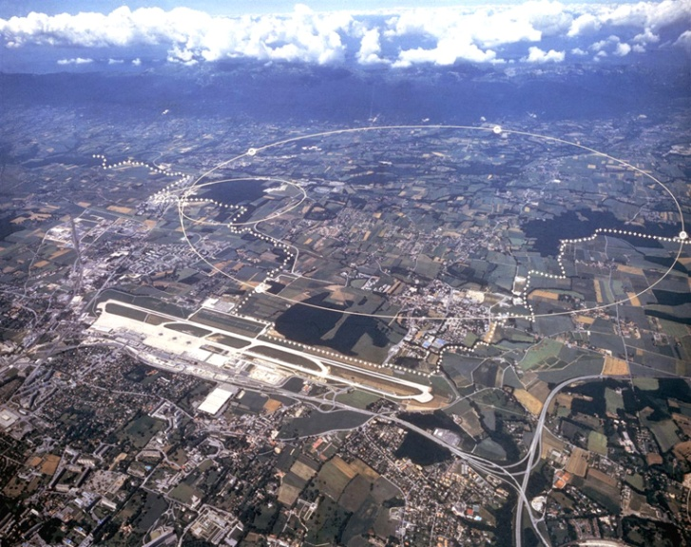
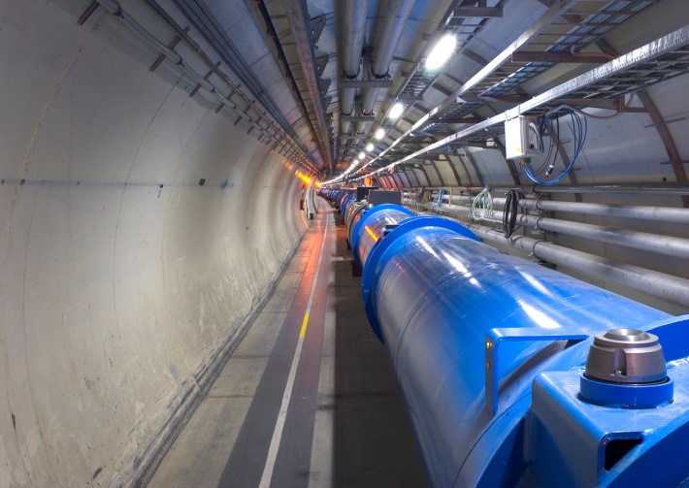
LHC Insulation Vacuum
A few numbers…..
Characteristic | Quantity for LHC machine & distribution line (QRL)
Insulation vacuum system length | 22,4 km & 25 km
Welds | ~ 200 000 ( > 60 000 in-situ)
Weld length | ~ 100 000 m
Elastomer joints | ~ 18000
Elastomer joint length | ~ 22 000 m
Multi-layer insulation | ~ 9 000 000 m² or 200 m²/m of cryostat
Vacuum subsectors | 234
Vacuum subsector length | 214 m (machine) & 428 m (QRL)
Vacuum subsector volume | ~ 80 m³
Fixed turbo pumps | 178
Nominal turbo pumping speed | 0,25 l/s/m of cryostat
Fixed vacuum gauges | 974
Mobile turbo pumping groups | 36
Mobile primary pumping groups | 36

Slide 5
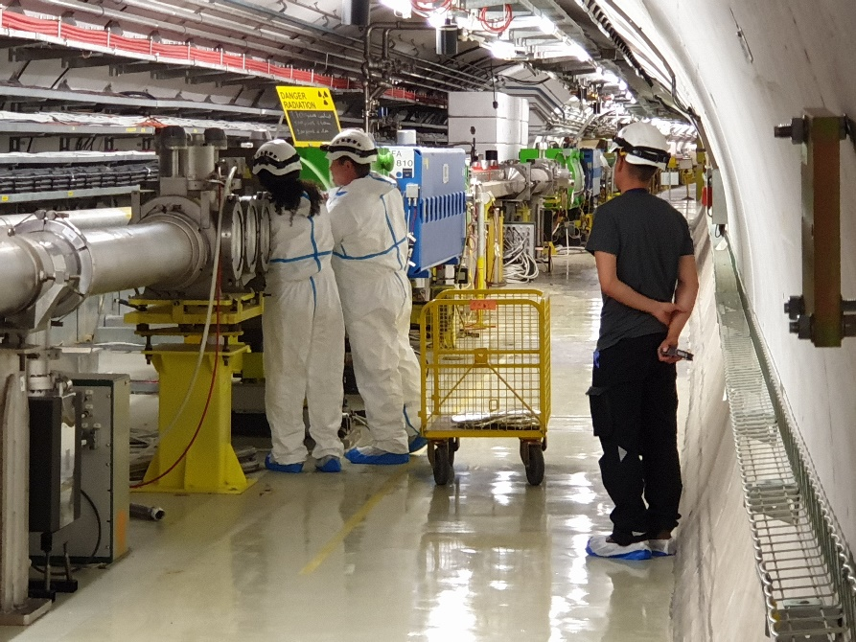
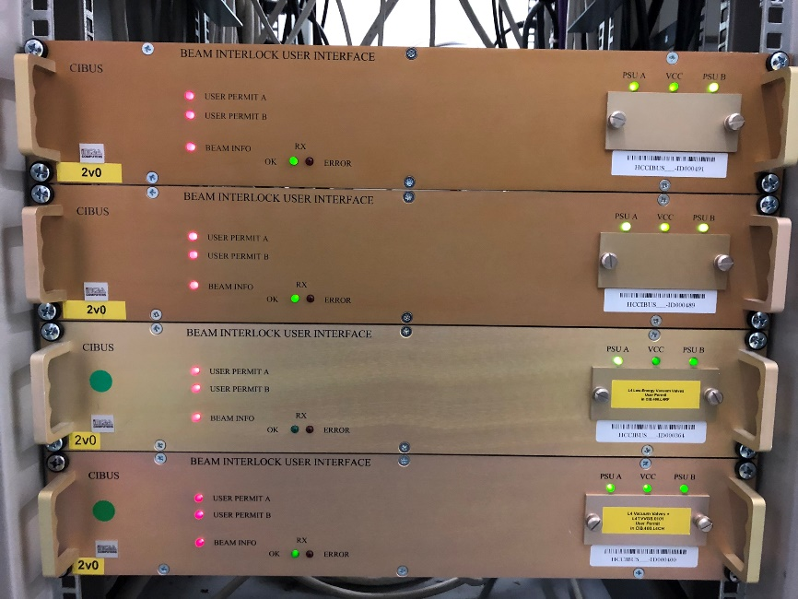
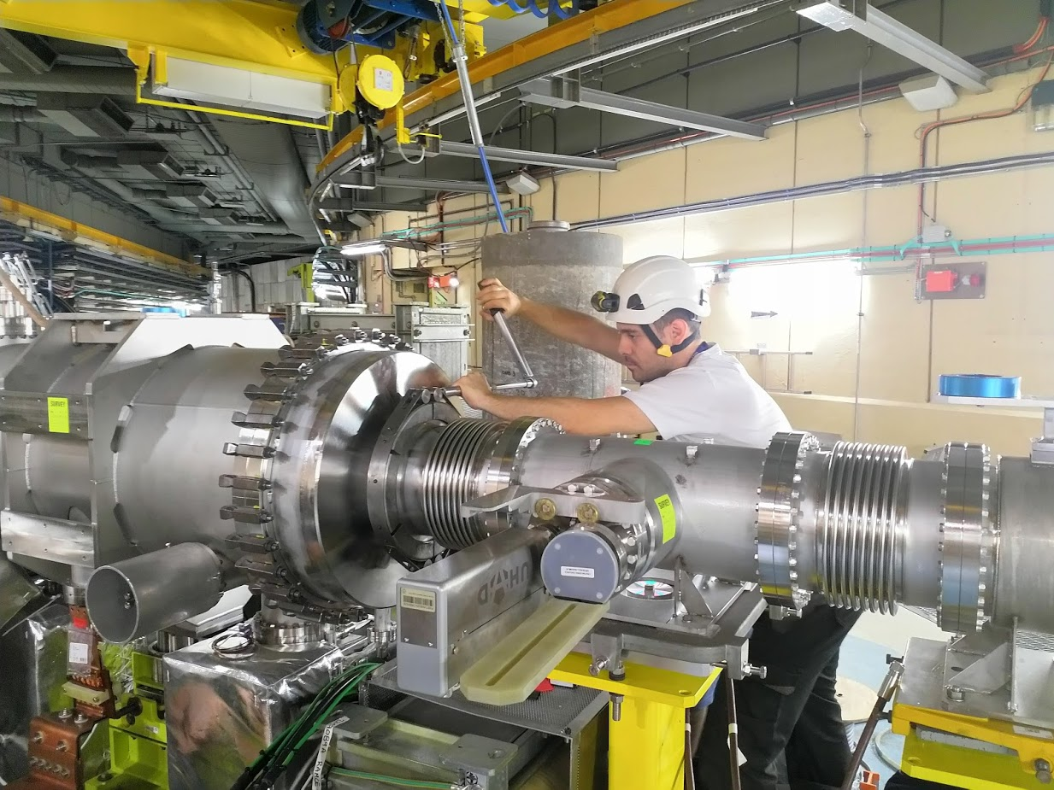
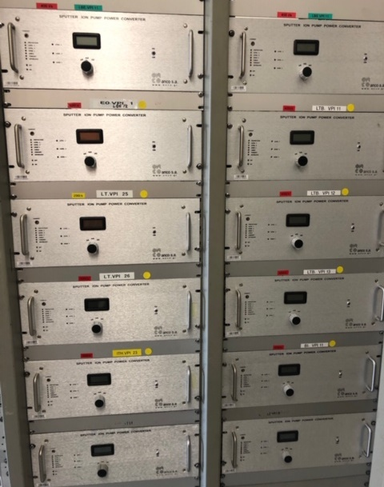
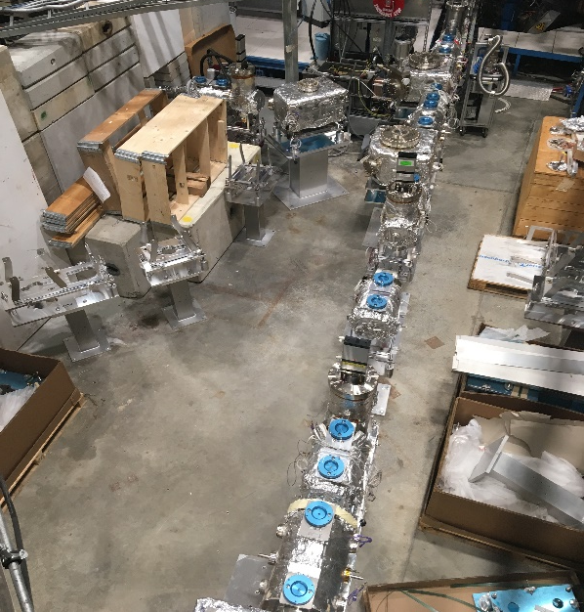
Vacuum of CERN’s accelerators

Slide 6
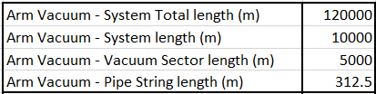
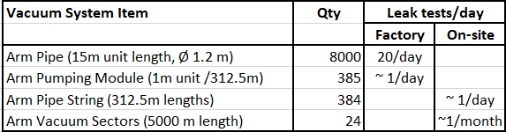
Typical ET Build Sequence
Components: Manufacture ‘Pipes’ & ‘Pumping Modules’
  Inspect, clean, condition?, helium leak test, vacuum characteristation?, wrap?, ….
Assemblies: Weld Pipes into x00 m ‘Strings’
  Inspect, clean?, pump, helium leak test new welds, ….
‘Vacuum Sector’: Weld ‘Pumping Modules’ between ‘Strings’
  Inspect, clean?, instrument, pump, helium leak test new welds & CF instr flanges, bake, global tests.
What leak test delivery rates to achieve ? I’ve assumed a 2 yr build period, ~ 400 working days.

Slide 7
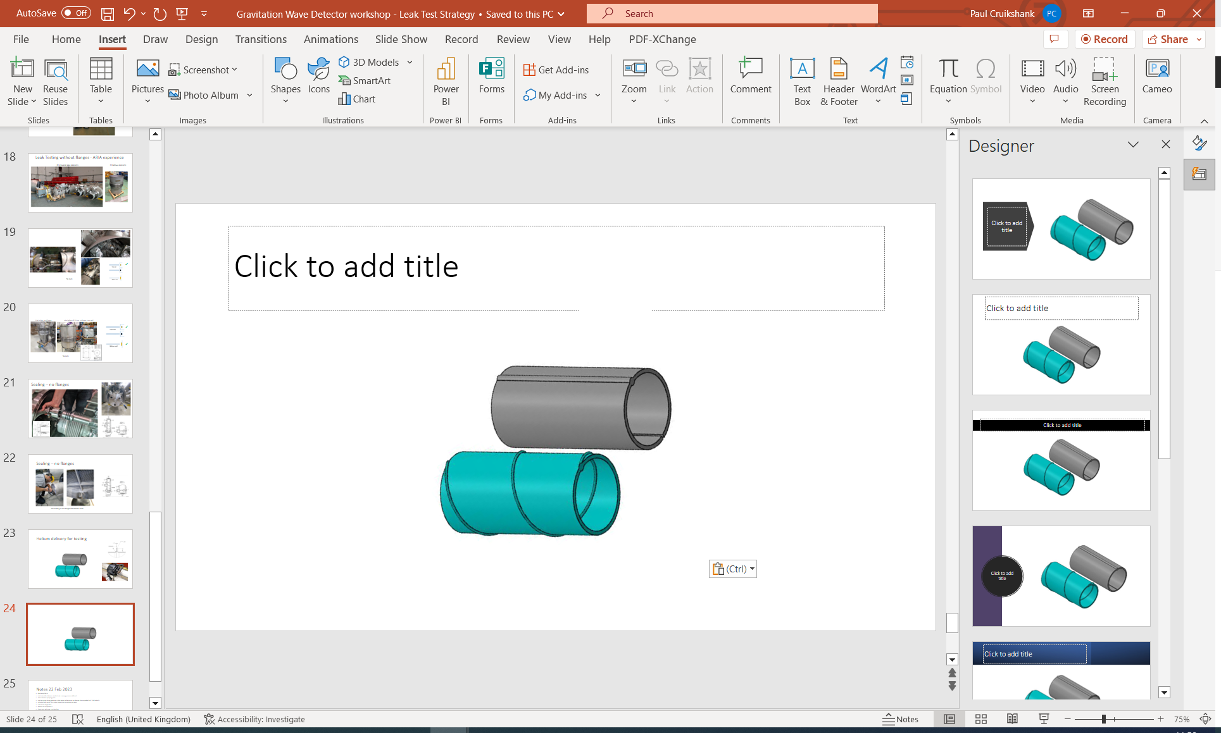
Leak Testing: What could leak ?
Ex-situ (components)
  15m Pipe
    longitudinal weld (spiral or straight)
    circumferential welds (if any)
    material through-wall defects (porosity, inclusions, damage, weld arc errors, ..)
  1 m Pumping Module
    welds, material defects, flange NC,…
In-situ ( x00 m Pipe Strings)
  Pipe to Pipe circumferential welds
  Degradation of validated components (transport, corrosion, etc)
In-situ (5 km Vacuum Sector)
  Pipe to Pumping Module circumferential welds
  Vacuum Instrumentation CF flange connections
Components:
under vacuum tests, external helium
20/day
1/day
Pipe Strings: Pipe to Pipe
(under vacuum tests, external helium)
1/week
Vacuum Sector: Pipe String to Pipe String
1/month

Slide 8
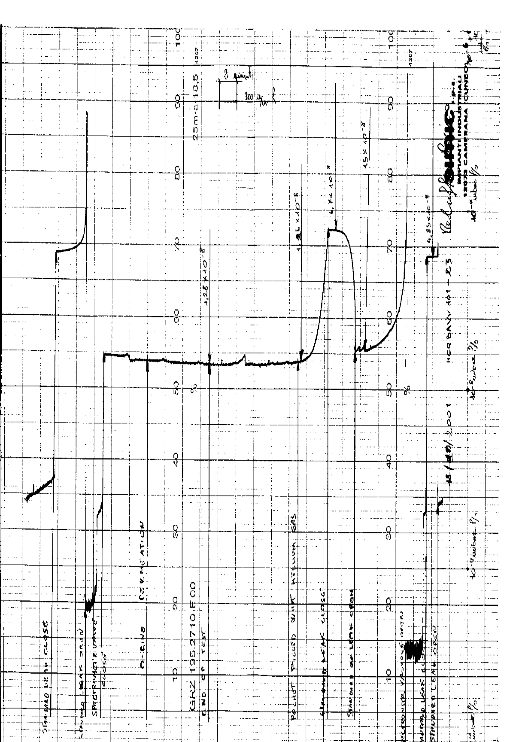
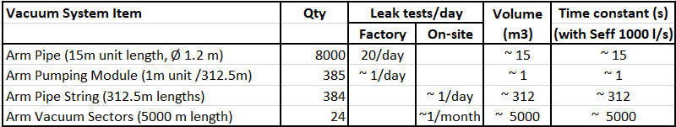
Leak Testing Considerations
Signal rise time
(& recovery time) needs to be considered
⇨ Assume manufacture/installation in 400 working days.
⇨ Use COTS vacuum equipment – mobile pumping groups, MSLD, etc.
Big infrastructure cost
& space needs
S_{eff} needs to be in
~ 10000 l/s range
Assume target tightness: 10 ⁻¹⁰ mbarl/s per component (yes?)

Slide 9
Leak Testing: Strategy Options
Leak Test Strategy | Fixed Costs (std tests) | Variable Costs (leaks)
‘Max’ Testing Strategy (classic, preventive approach) | Ex-situ: 100 % Component leak test ($$$), In-situ: 100 % Subsector leak test($$), In-situ: Vacuum Sector leak test ($), | NC localisation, repairs & retest ($) NC localisation, repairs & retest ($) NC localisation, repairs & retest ($)
‘Mid’ Testing Strategy | In-situ: 100 % Subsector leak test($$), In-situ: Vacuum Sector leak test ($), | NC localisation, repairs & retest ($$) NC localisation, repairs & retest ($)
‘Min’ Strategy (corrective approach) | In-situ: Vacuum Sector test ($) | NC localisation, repairs & retest ($$$)
Max, Mid or Min approach ?
Leak Test Strategy will depend on:
⇨ How many leak we expect to get (past experience from similar projects),
Fixed cost of 100% component test vs Variable costs of leak repairs in-situ
Solutions for in-situ leak localization
Solutions for in-situ leak repairs
Other constraints eg all 8000 Pipes need individual insulation/bakeout/vacuum characterizated before installation ?
Approach can be changed/tailored during execution……

Slide 10
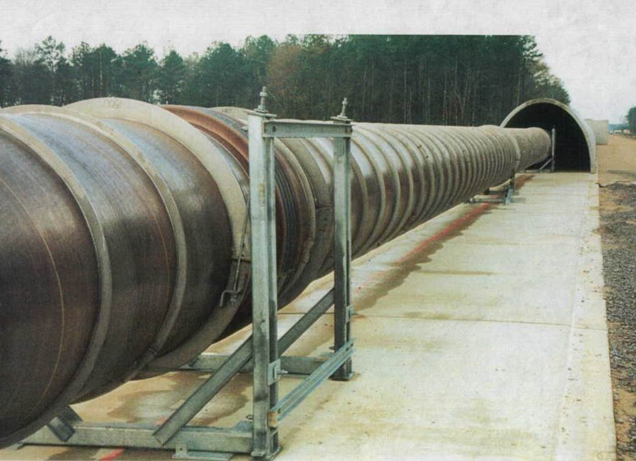
How many leaks ?
LIGO experience on 20 m Pipes (report P990023-00-B)
  Auto welding ⇨ visual inspection (plus x-ray or US ?) ⇨ manual weld repairs ⇨ leak test.
  No leaks on ~ 1000 tube/components. Statistics on in-situ leaks to be gathered
VIRGO experience
  Statistics on component & in-situ leaks to be gathered
LHC experience on insulation vacuum
  Zero leaks on spiral weld of dipole cryostats (~ 1350 units)
  Leaks of 1-5 ‰ welds in overall project ~ 200k welds (auto & manual)
    2d inclusions, Cu contamination, poor manual/auto execution, damage, etc.
  Some leaks only appear during or after cold thermal cycle
Applying LHC experience to ET Arm Vacuum (120 km)
  ~ 10000 ex-situ welds ⇨ qty of leaks: 10 – 50 range ( < 1 % of Pipes may leak)
  ~ 10000 in-situ welds ⇨ qty of leaks: 10 - 50 range ( < 1 leak / km)
Ex-situ Component welds: 8000 Pipes 400 Pump Modules
In-situ Assembly welds: 8000 Pipe-Pipe 800 Pipe-Pump Modules 400 CF flanges

Slide 11
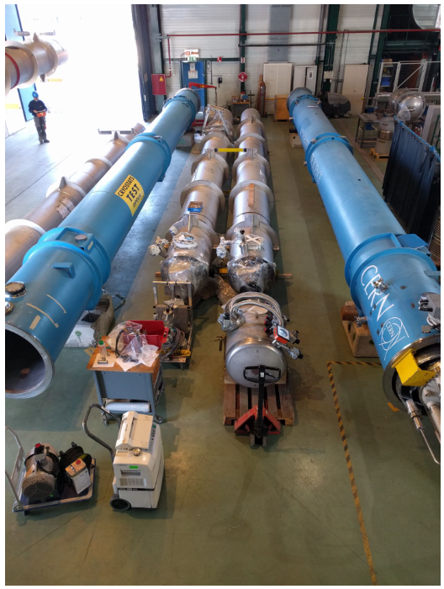
Vacuum Vessel Testing:
With/without flanges
ARIA Cryostats without flanges
LHC Cryostats with flanges

Slide 12
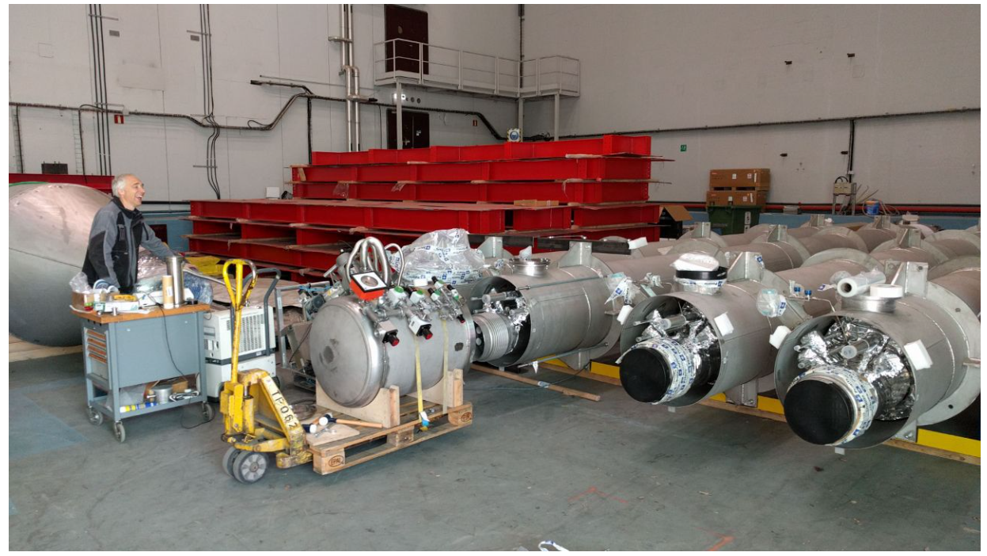
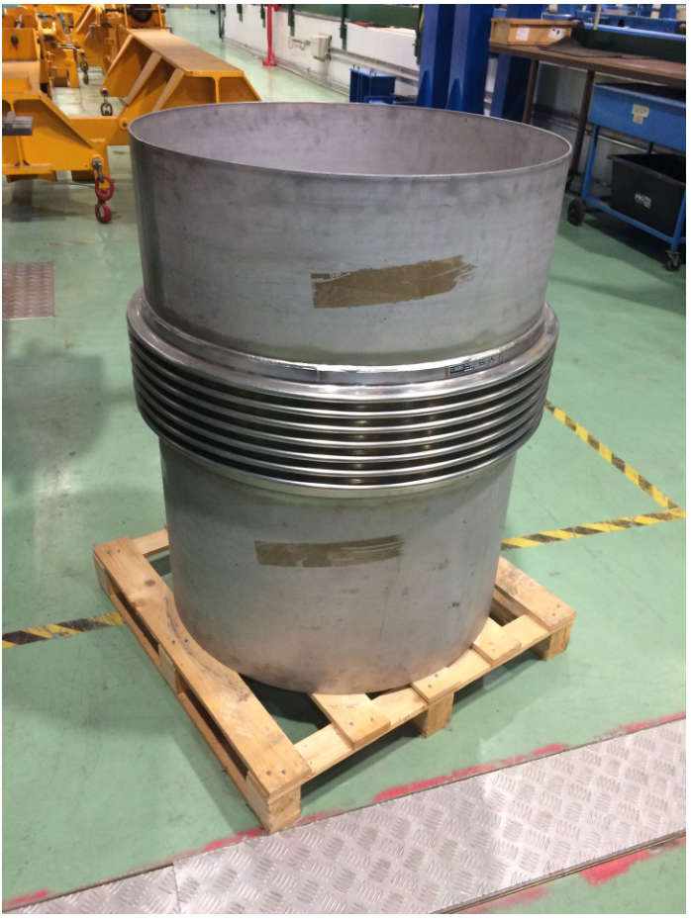
Leak Testing without flanges - ARIA experience
(300m tall Ar distillation column)
28 cryogenic pipe elements
29 bellows elements

Slide 13
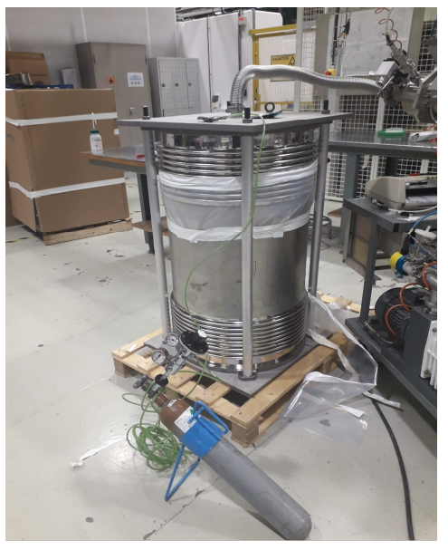
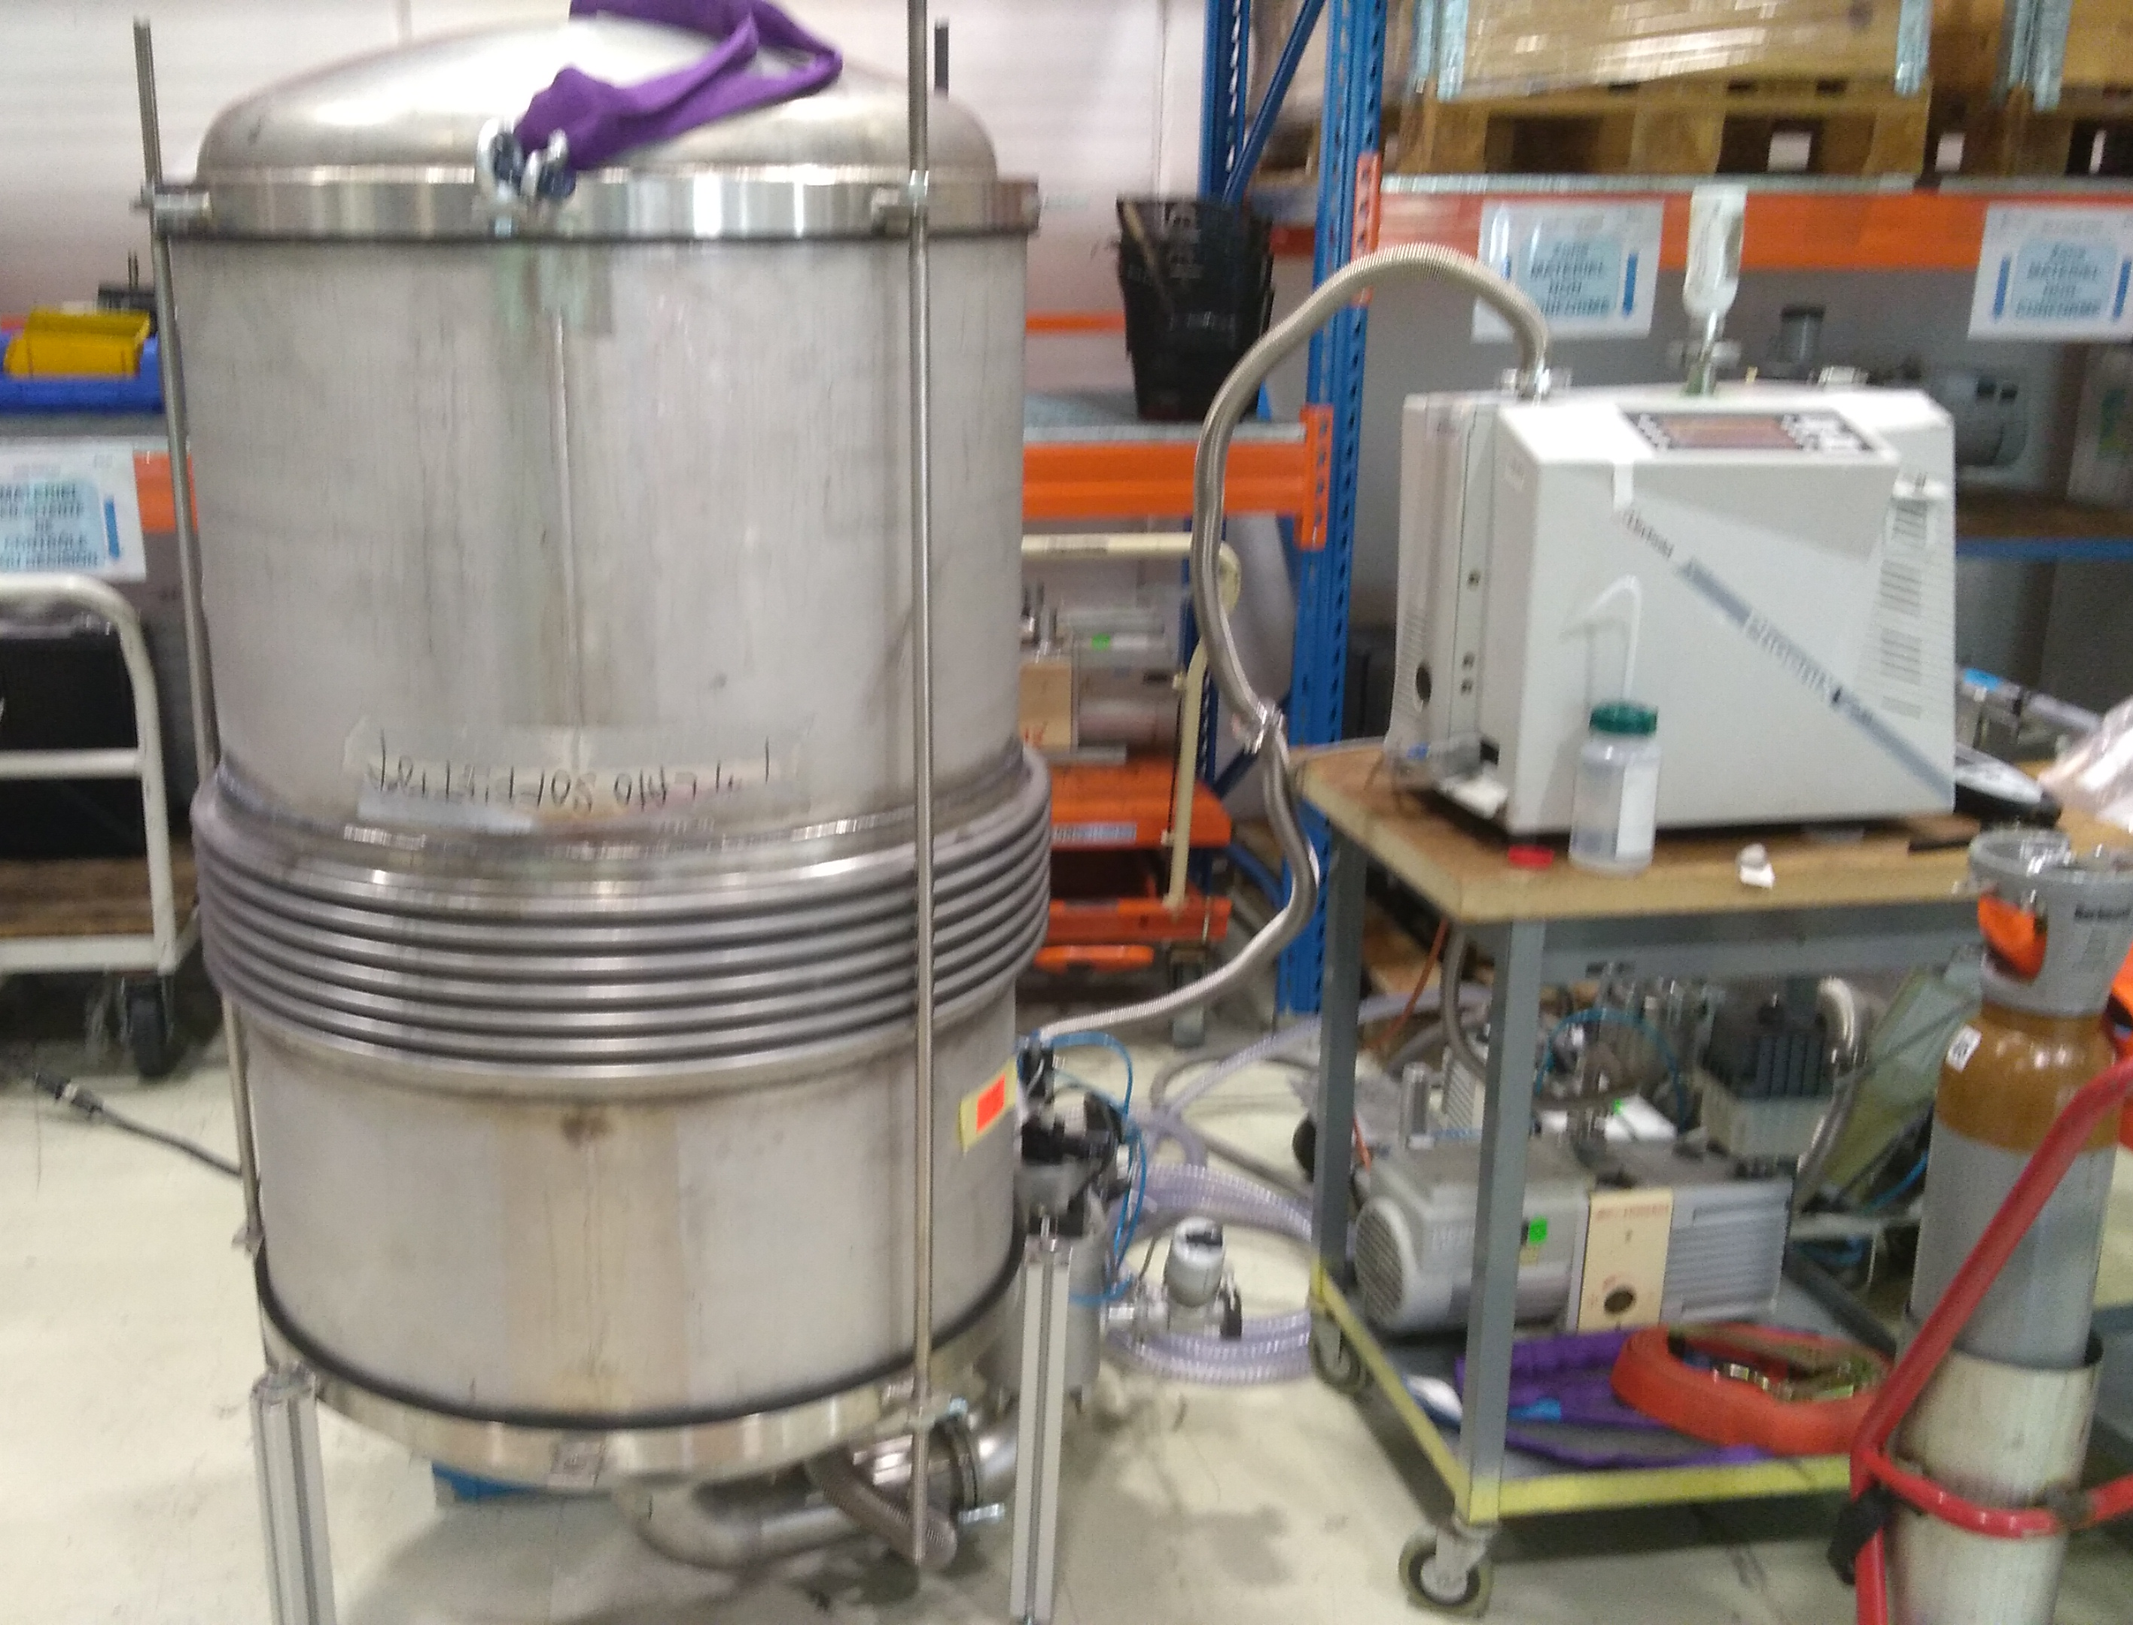
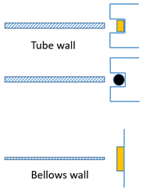
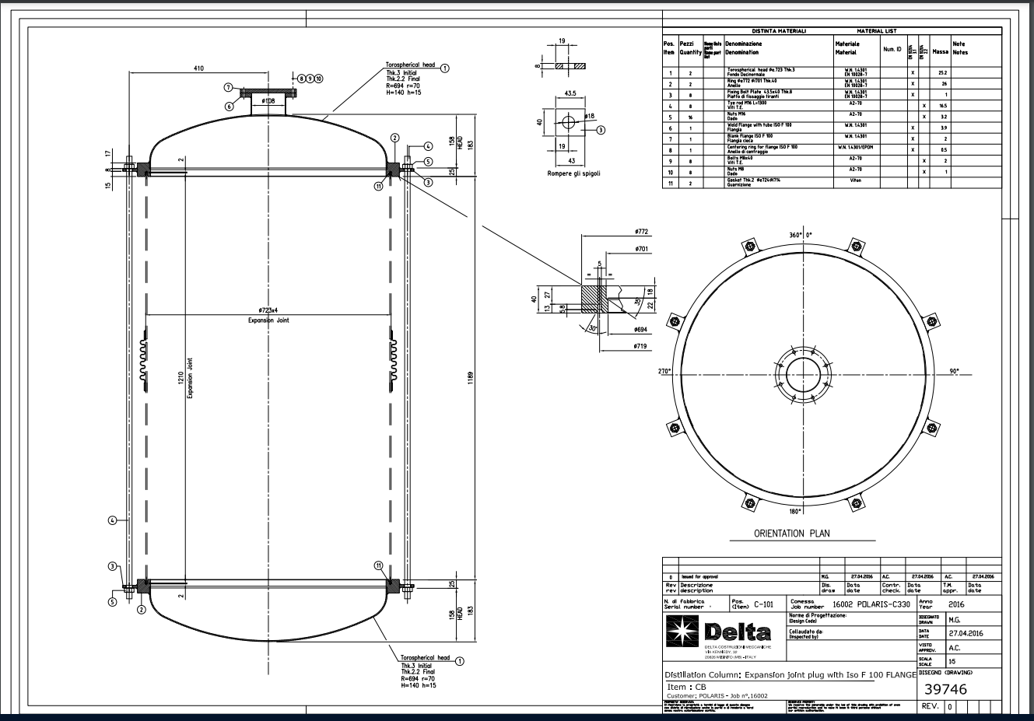
End Sealing without flanges
DCM bellow – end flanges
ARIA bellow – Ø723 mm, no flanges, 4 mm wall
✓
✓
Tie rods

Slide 14
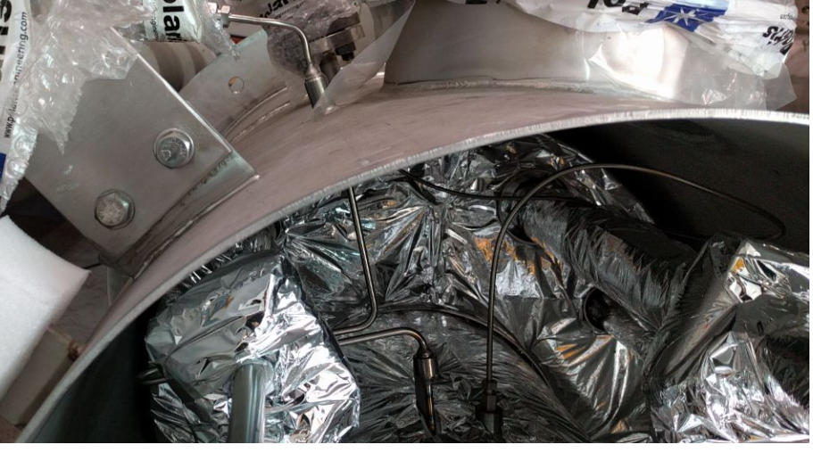
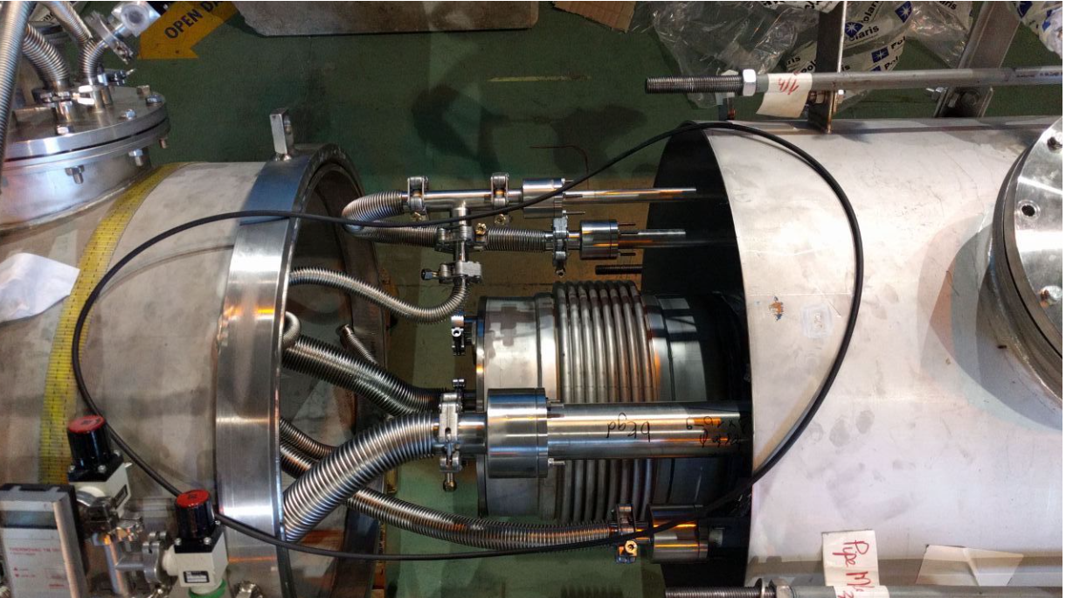
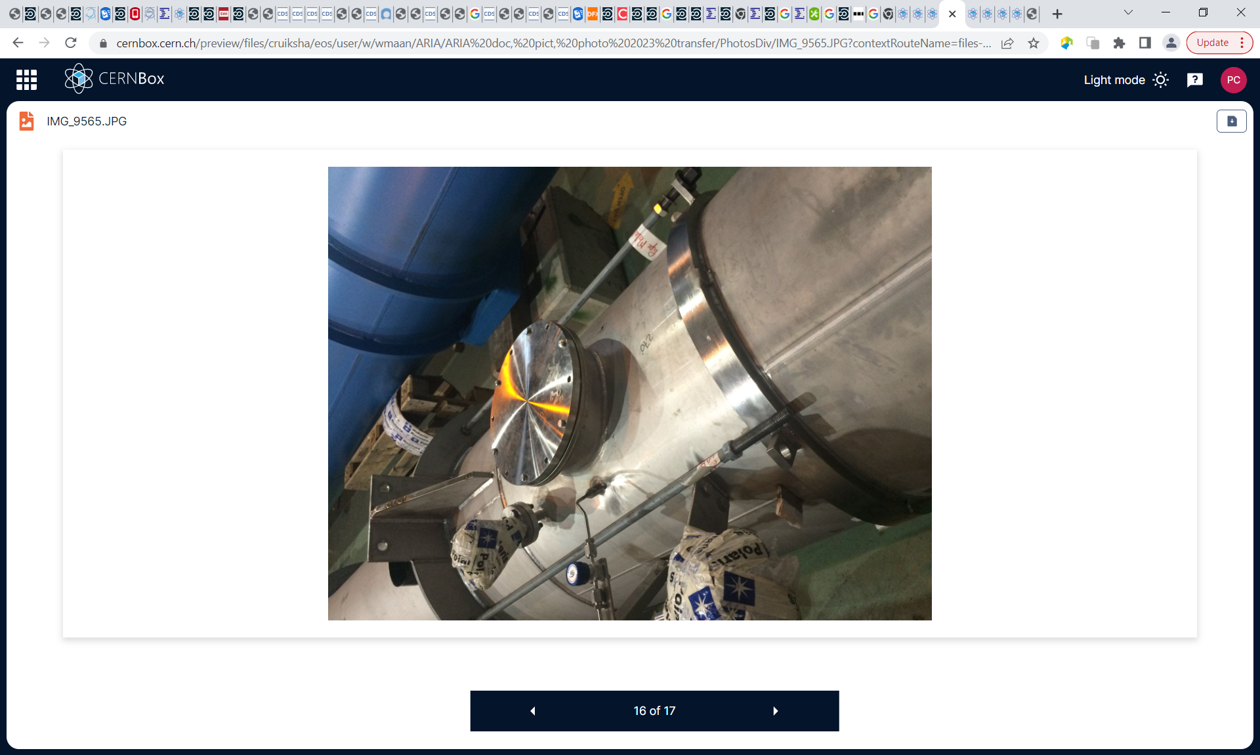
End sealing without flanges
4 mm wall
✓
Tie rods

Slide 15
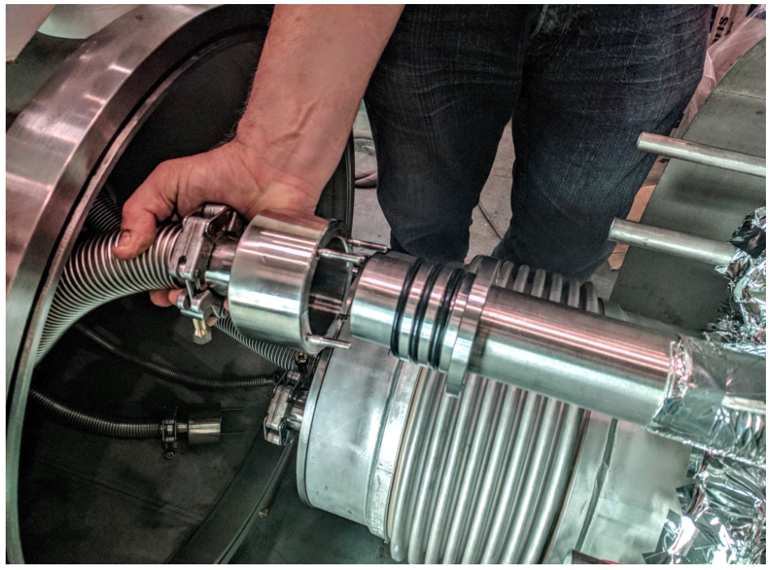
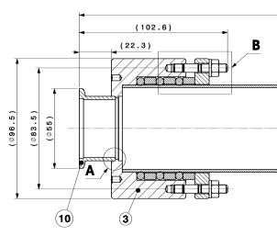
End Sealing – no flanges
Triplet o-rings to prevent
helium permeation

Slide 16
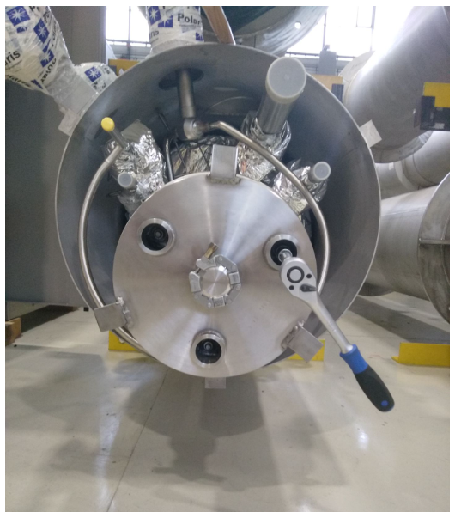
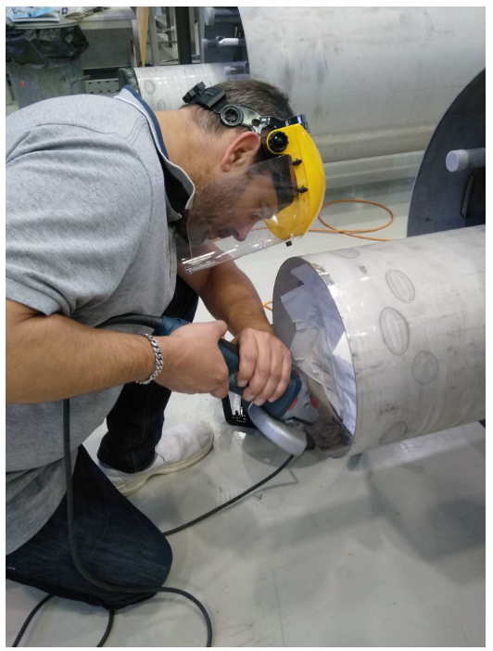
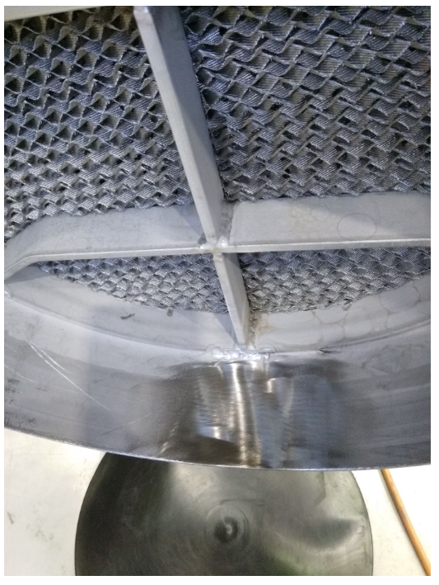
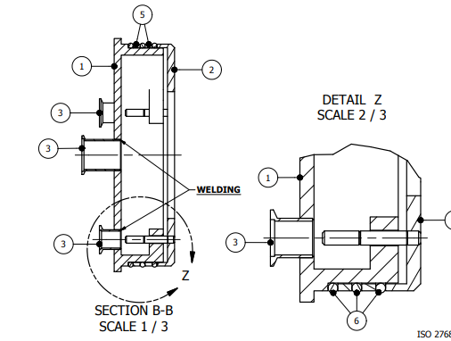
Sealing – no flanges
End plug sealing on internal tube surface
Smoothing of the longitudinal weld seam

Slide 17
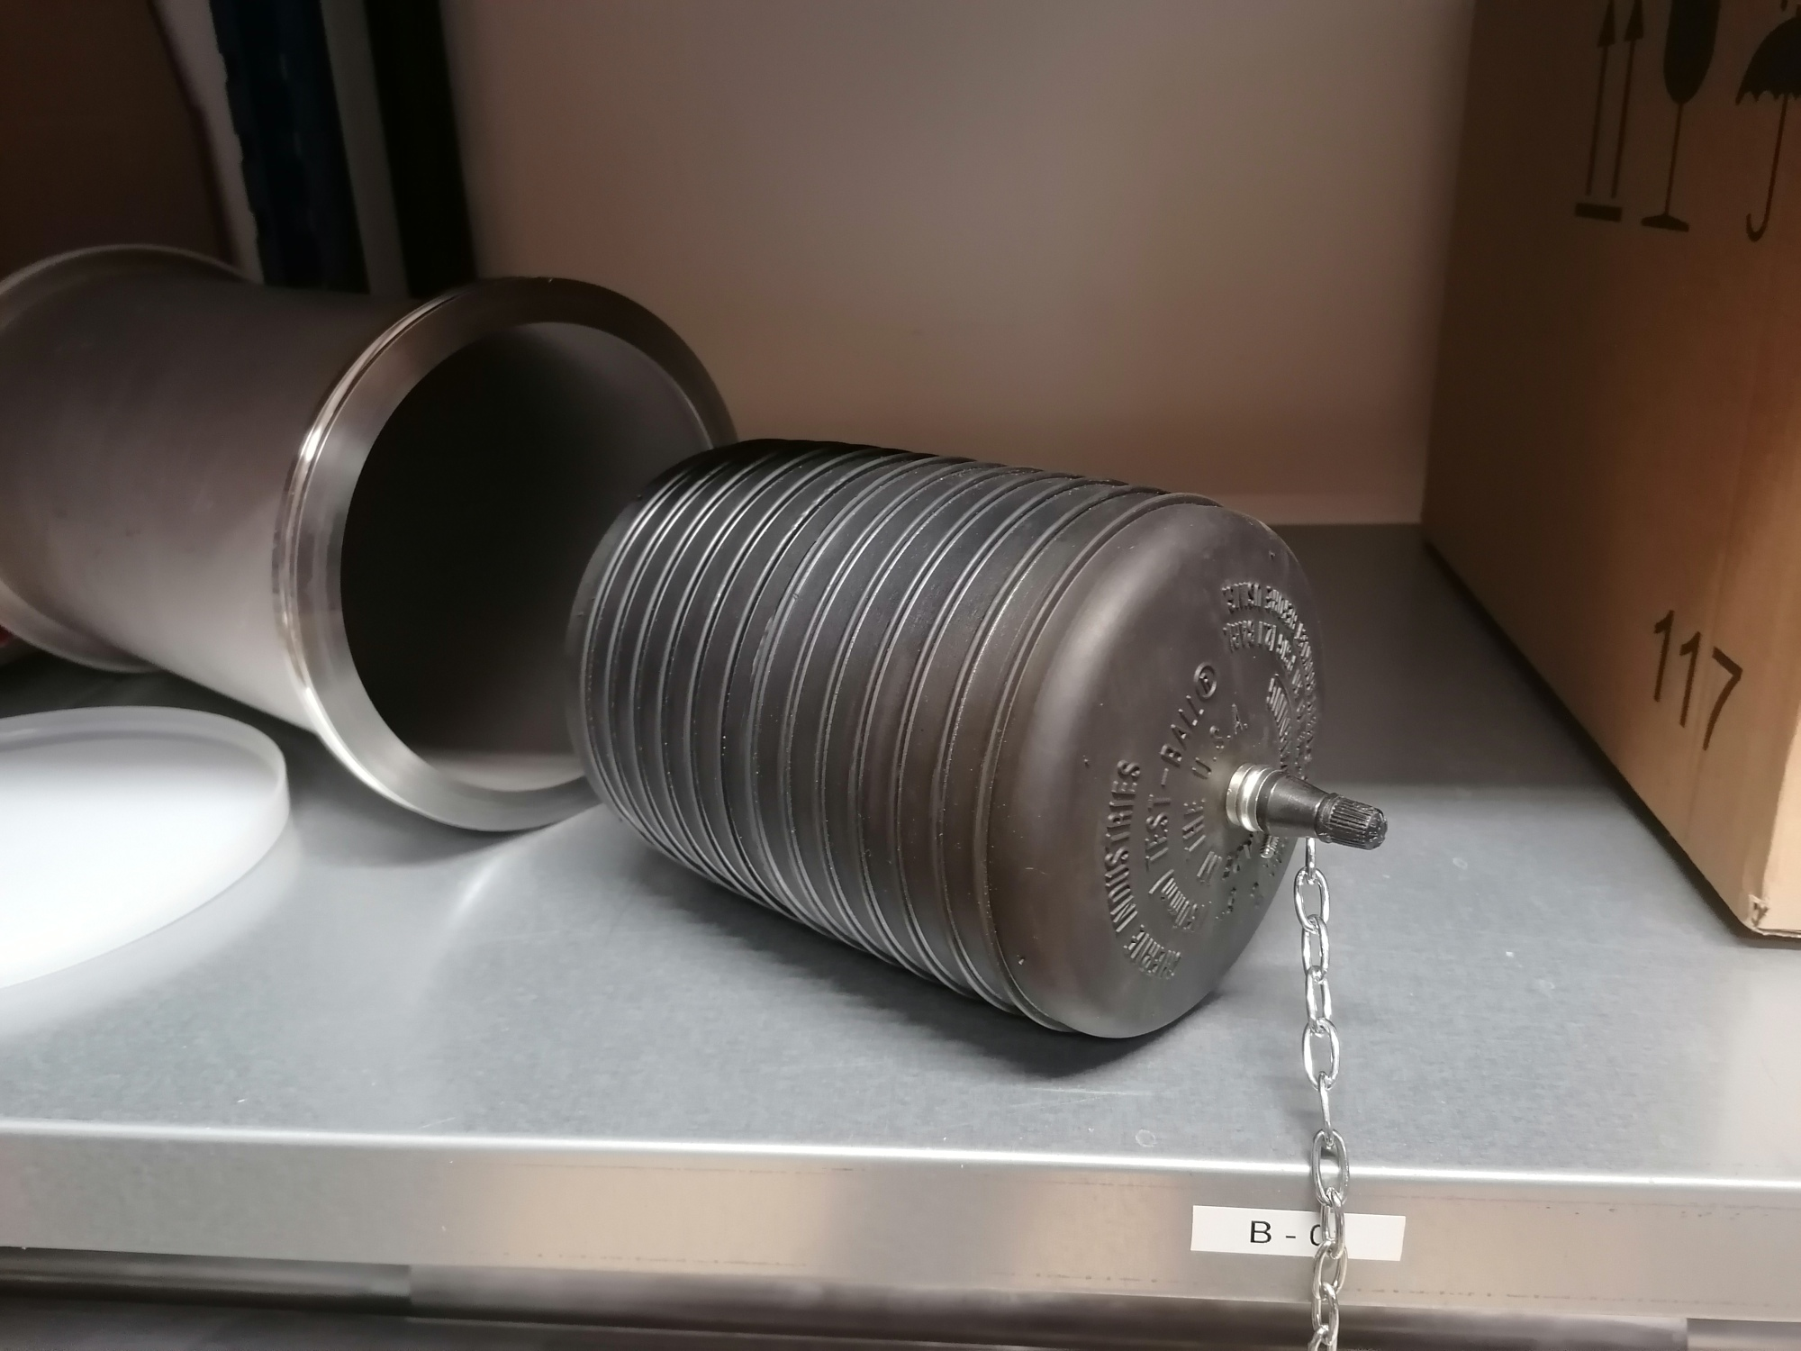
End Sealing – no flanges
Inflatable plug
solution

Slide 18
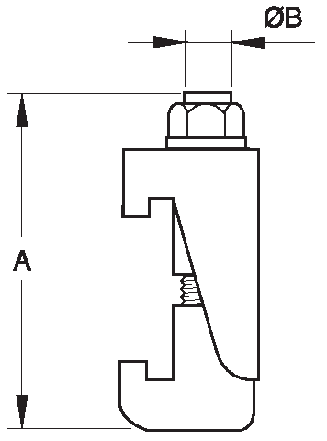
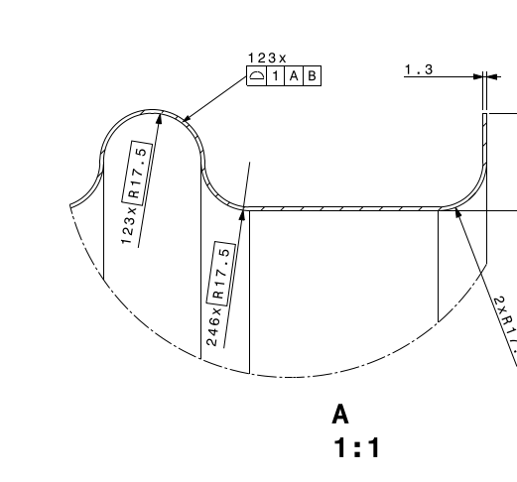
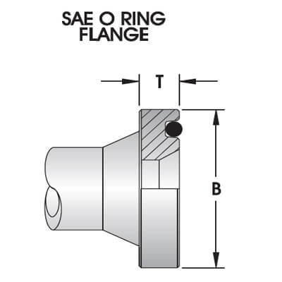
End Sealing – no flanges
Clamp
Corrugated PIPE
Backing
flange
Sealing
flange
Attention:
Needs appropriate surface finish of corrugated extremity

Slide 19
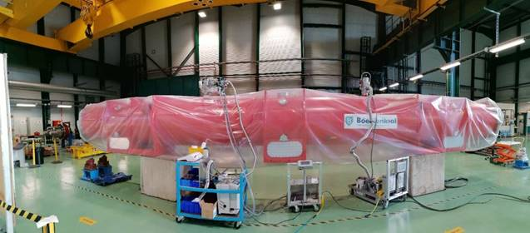
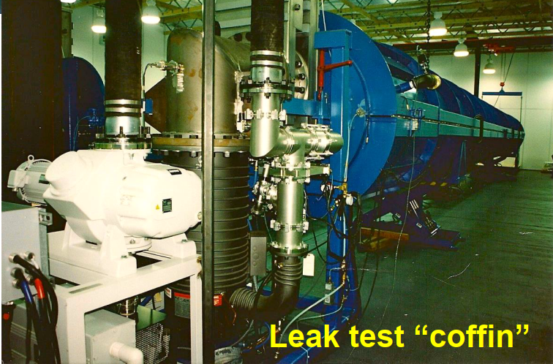
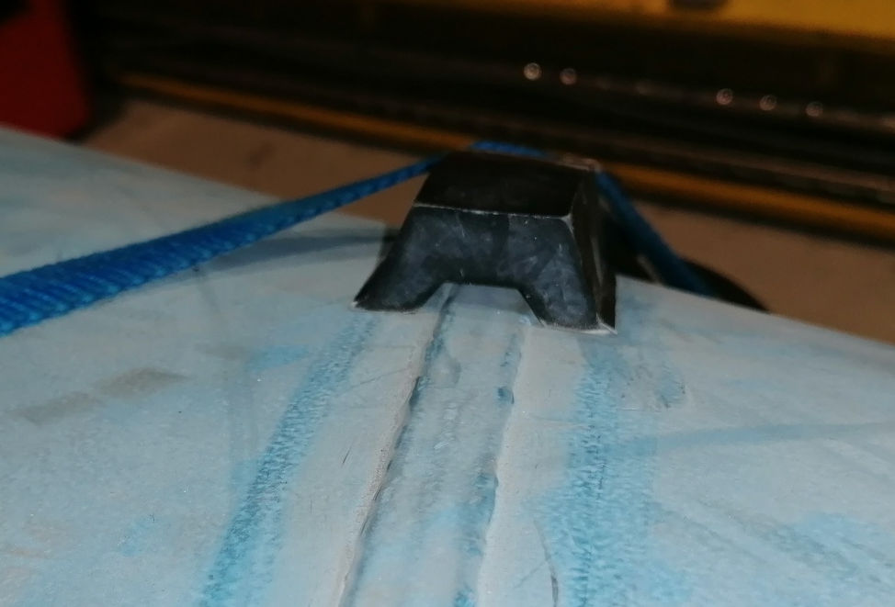
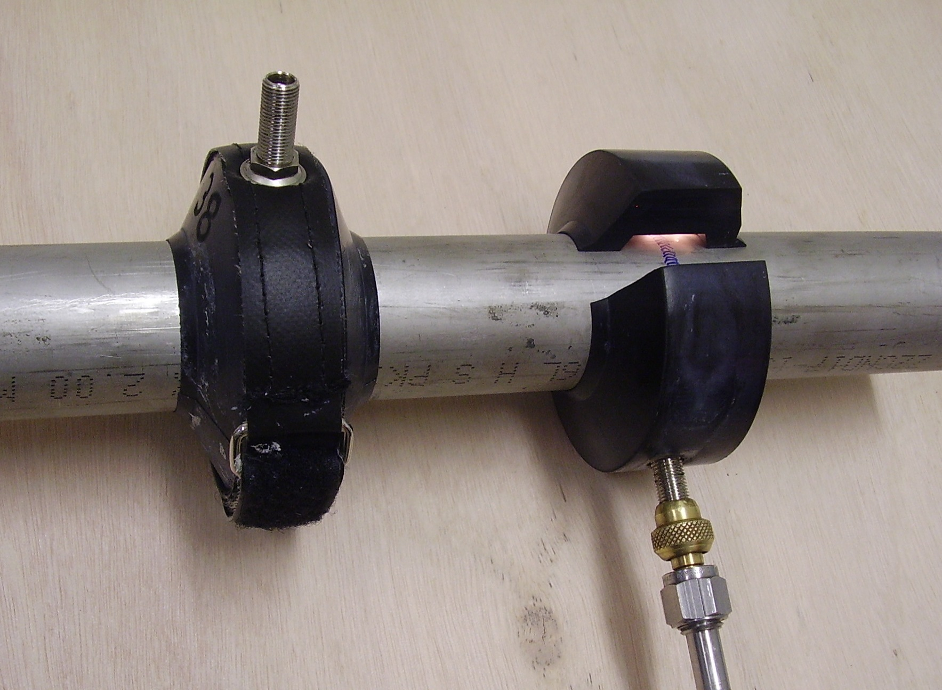
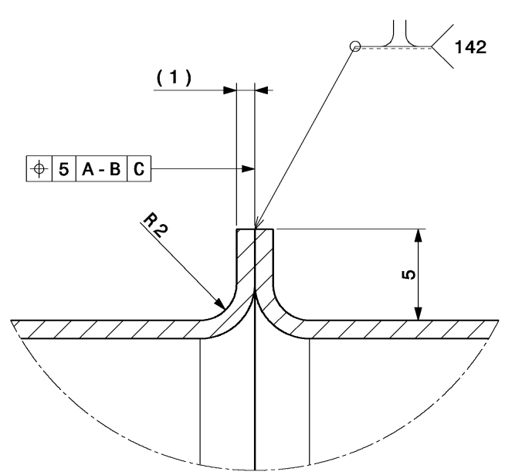
Helium delivery during ‘under vacuum’ testing ?
He delivery options:
Jet (not ideal for global test on large volumes)
Total immersion (ext pocket, ext secondary chamber)
  Large helium cost
  Rise in helium background in air
  Complex tooling to recovery helium
Local channel at weld to deliver external helium:
  At longitudinal weld (spiral or straight)
  At circumferential weld
External vacuum clamshell, internal helium
  At Pumping Module circumferential welds
  Helium (jet) delivery thro pumping port
Temporary channel
at the weld bead
Spiral
weld

Slide 20
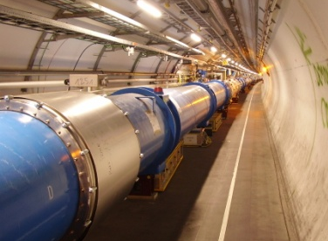
Leak localization in Pipe Strings
Method was used for leak localization in LHC internal helium circuits
Leak
position
‘Under vacuum’ leak test in molecular flow conditions:
2 identical turbo pumps at each extremity, plus leak detectors
Helium as tracer gas.
Measurements are made with system in equilibrium conditions.
Linear conductance of vacuum system, so C ∝ 1/L
For S >> C1 or C2: q1/q2 ∝ C1/C2 ∝ L2/L1
Ratio of He signal arriving at each detector is inversely proportional to its distance from the leak

Slide 21
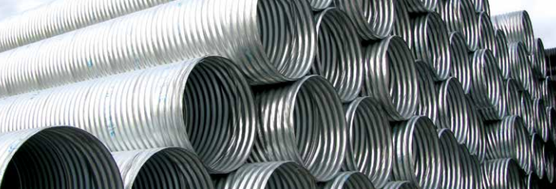
Leak Testing Costs - Pipes
Pipes (15m components)
  Equipment costs for 2 leak test benches
    2 benches 60k, 2 pumping systems 100k, 2 leak detectors 40k = 200 kCHF
    Dedicated facility of 150 m² @ 2 kCHF/m² = 300 kCHF
      (not including land purchase, in/out storage areas, handling, transport logistics, etc)
  Manpower
    2 vacuum technicians producing 2 leak tests/day = 0.5 kCHF/test
    2 vacuum technicians localizing 1 leak, repair and retest = 1 kCHF/NC repair & retest
  ⇨ 8000 Pipes in 4000 days (2 benches): 500 kCHF & 4000 kCHF (+ NC repair & retest)
  ⇨ 8000 Pipes in 400 days (20 benches x 0.5): 2500 kCHF & 2000 kCHF (+ NC repair & retest)
Effect of scaling & synergies
1 CHF = 1 Euro = 1 USD

Slide 22
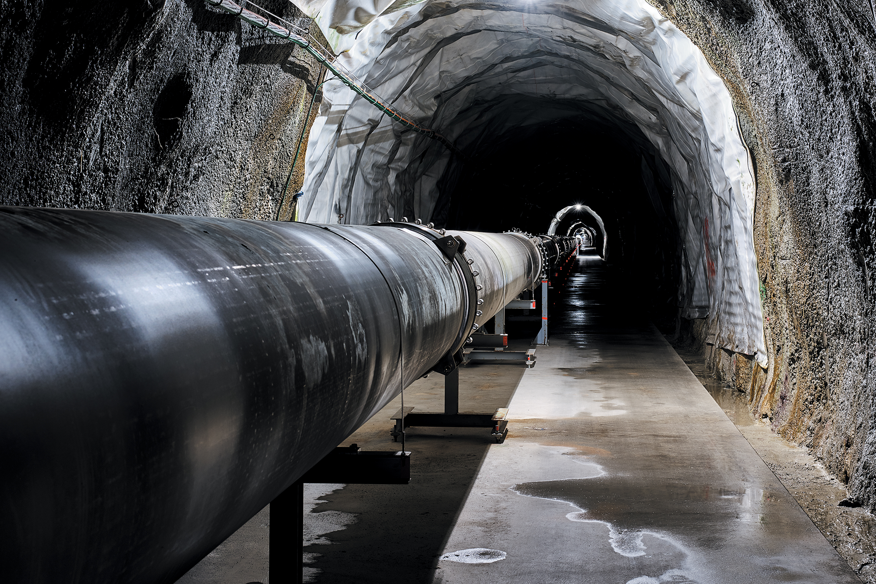
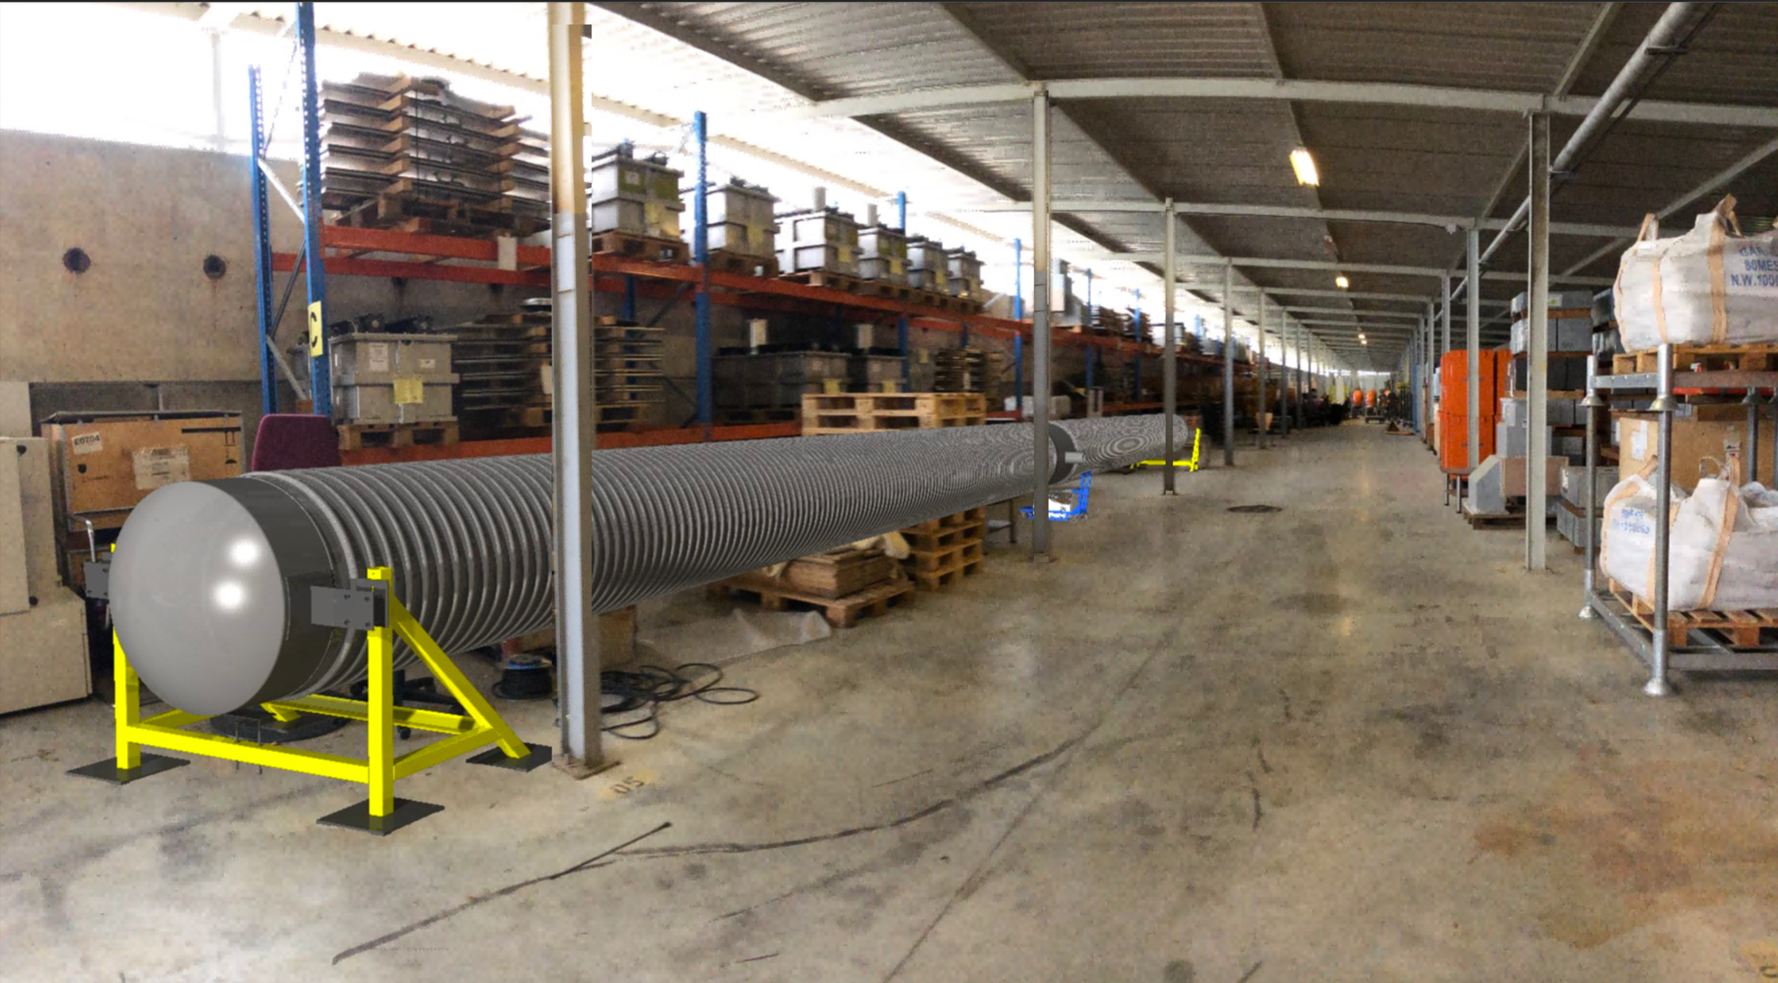
Leak Testing Costs: Pipe Strings
(
Pipe x 20
)
Pipes Strings (312 m)
  Equipment costs for 1 leak test setup:
    2 mobile end caps (20k) , 2 mobile fixed points (20k) = 40 kCHF
    1 mobile roughing (60k), 2 mobile 700 l/s turbos* (60k), 2 leak detectors (40k) = 160 kCHF
  Manpower
    2 technicians producing 1 leak test/week = 5 kCHF/test
    4 technicians localizing 1 leak, repair & retest = 10 kCHF/NC repair & retest
  ⇨ 400 Pipes Strings, 400 wks: 200 kCHF & 2000 kCHF (+ NC repair & retests)
  ⇨ 400 Pipes Strings, 80 wks (5 setups x 0.5): 500 kCHF & 1000 kCHF (+ NC repair & retests)
Effect of scaling & synergies
*check any double counting

Slide 23
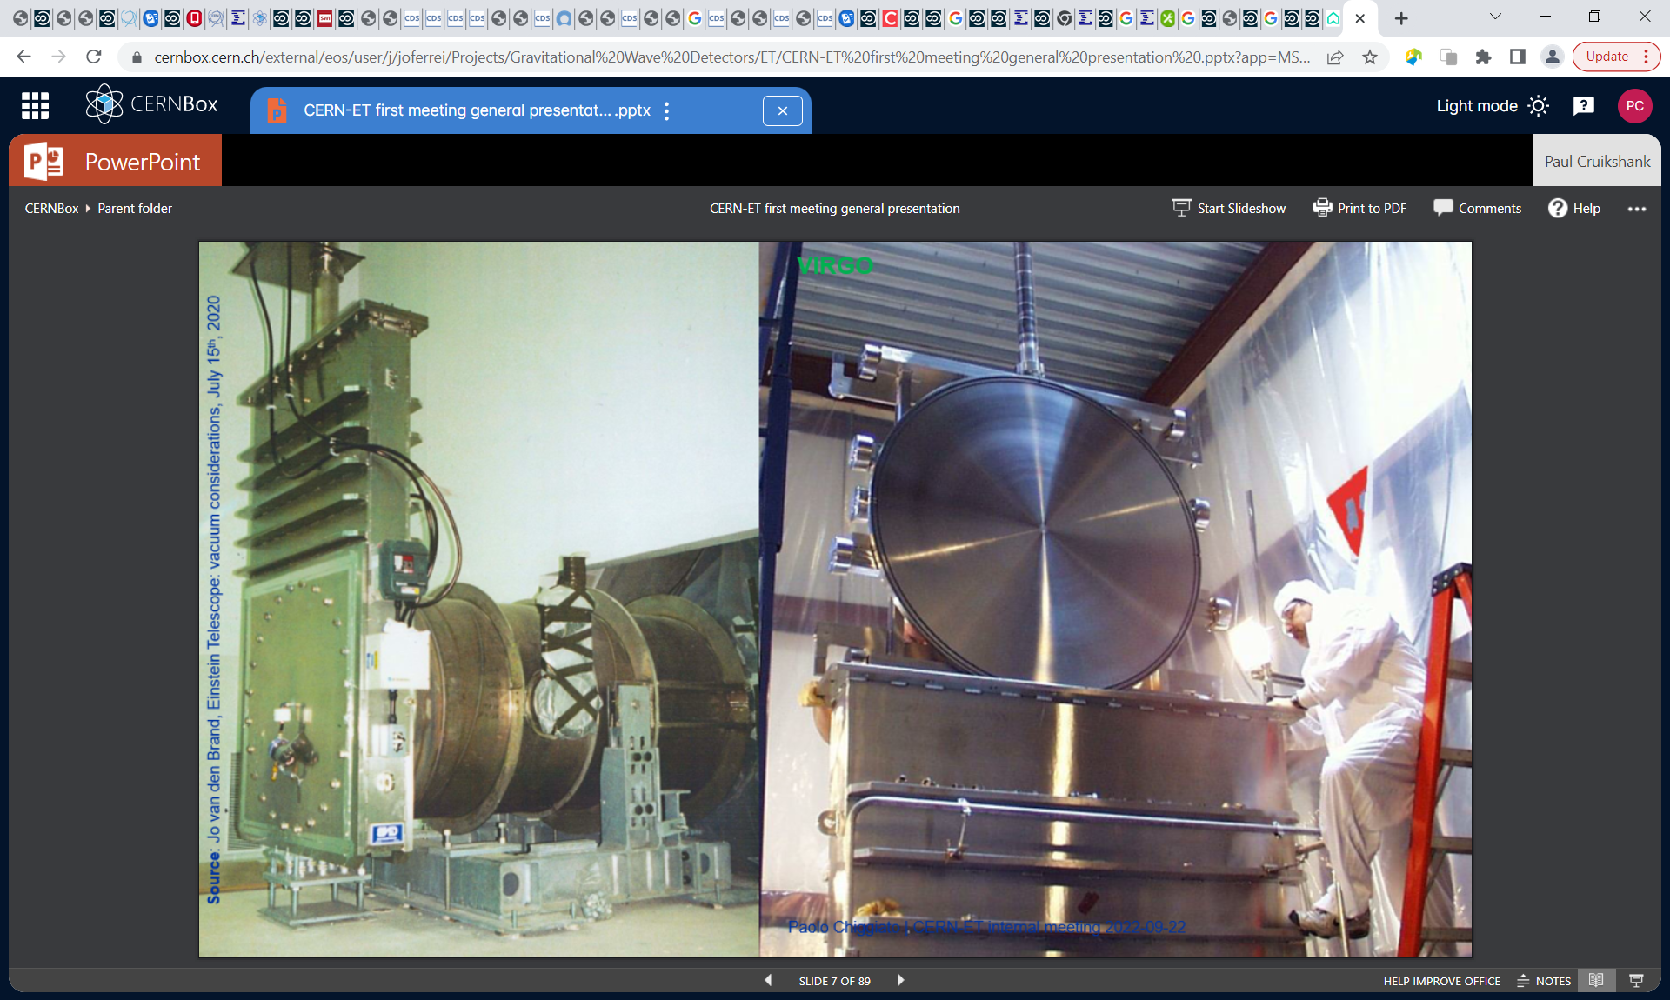
Leak Testing Costs – 5 km Vacuum Sectors
1 CHF = 1 Euro = 1 USD
Mid-Arm
Pipe Strings x 16
Pump Module x 15
Fixed Roughing x 1
Sector valve
Mobile turbo x 15
Sector valve
Pipe Strings (312 m)
  Equipment costs for 1 leak test setup
    1 fixed roughing unit (0 CHF)
    15 mobile 700 l/s turbos* (450 kCHF), 5 leak detectors (100 kCHF)
  Manpower
    2 technicians producing 1 leak test/month = 20 kCHF/test
    4 technicians localizing 1 leak, repair & retest = 40 kCHF/NC repair & retest
  ⇨ 24 Vacuum Sectors in 24 months: 550 kCHF & 480 kCHF (+ NC repair & retests)
*check any double counting

Slide 24
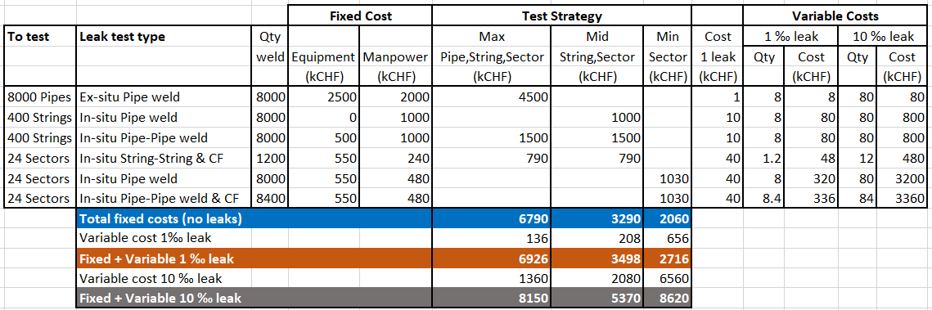
Leak Test Cost v Strategy v Leak Occurrence

Slide 25
Leak Test Cost v Strategy v Leak Occurrence
Max Strategy:
Low risk
Early warning of leak issues
Dominated by component testing costs
Min Strategy:
High risk (high confidence)
Dependent on low leak occurance
Potential minimum cost
Mid Strategy
Medium risk
Higher leak occurance can be tolerated wrt cost.
Can review strategy dependent on field results.

Slide 26
ET Leak Test Strategy – brainstorming !
⇨ assume leaks in low ‰ range by stringent control on material & welding quality
⇨ adopt ‘Mid’ strategy, but with some targeted checking of Pipes as components
Step 1 – Components, ex-situ
  Leak test first 100 Pipes (eliminate systematics)
  Leak test every 20th Pipe (avoid production deviations, cleanliness check, etc)
  Leak test every Pump Module
Step 2a - 312 m Pipe Strings, in-situ
  Pump & leak test longitudinal & circumferential Pipe welds
Step 2b - 5000 m Vacuum Sector, in-situ
  Clamshell test Pipe to Pumping Module welds
  Pump & leak test fully equipped Sector prior to bakeout
100 tests
~ 400 tests
~ 400 tests
6 % Pipes
~ 400 tests
24 tests

Slide 27
Summary
Good engineering is better than good leak detection.
We can build upon the leak testing experience (good & bad) from existing GWD and LHC type accelerators.
Standard leak testing equipment and methods can be applied, but care must be taken with large volumes.
Different leak testing strategies can be considered – each has its merits and drawbacks with respect to duration, cost, risk…..and we need to remain flexible based on return of experience.
Testing strategy will strongly depend on the Pipe manufacturing & installation techniques, together with our confidence level wrt to leak occurance
Solutions exist to close vacuum vessels without flanges.
Cost (gu)estimates should be considered as a starting point for discussions. Need to check double counting of vacuum equipment costs eg mobile pumping groups already included elsewhere.
There are no showstoppers, so “Let’s get to work………” on more brainstorming.

Slide 28
Thanks for your attention !

Slide 29
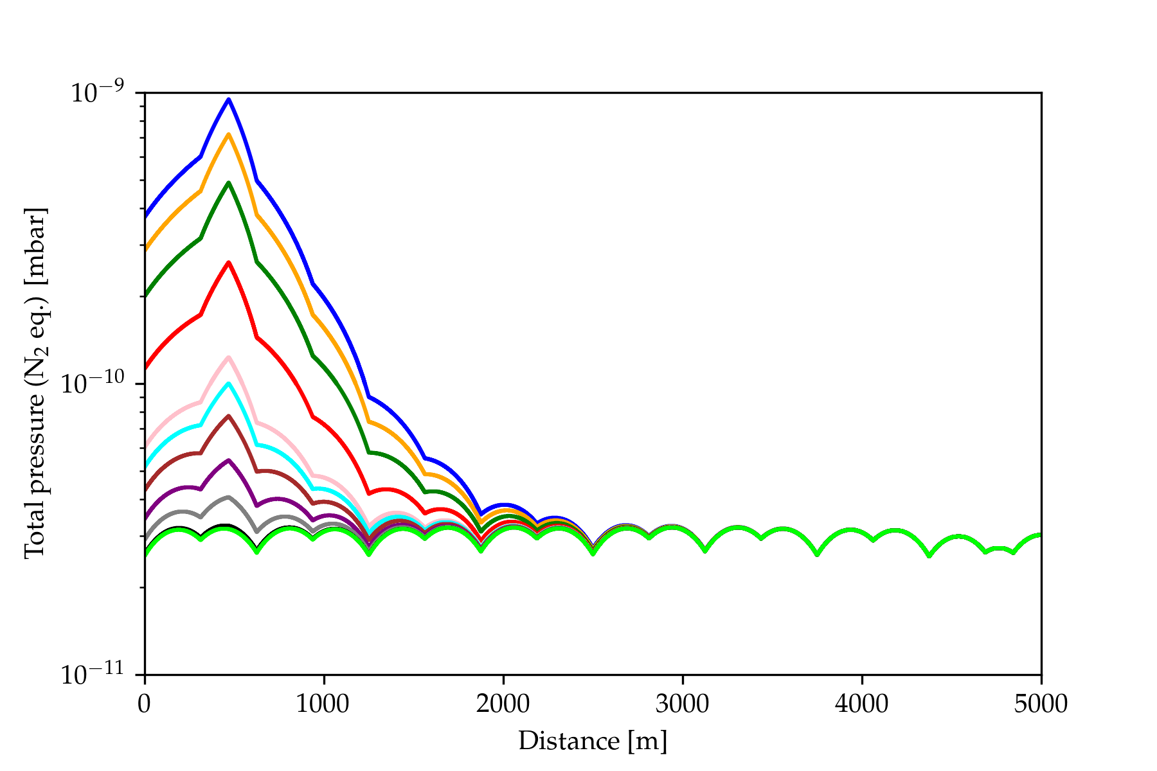
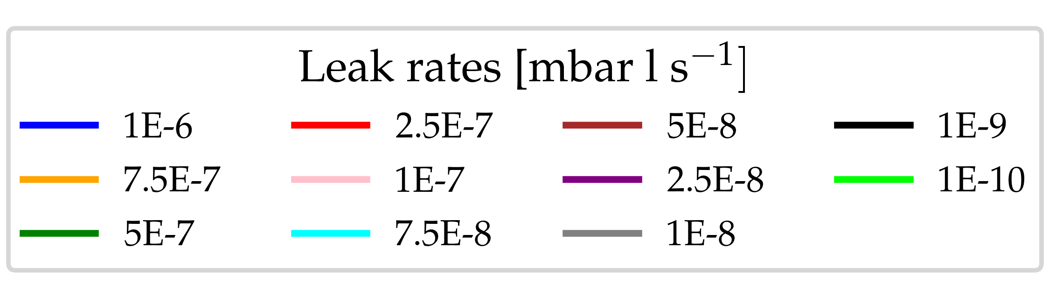
Air leak: impact on total pressure

Slide 30


Slide 31
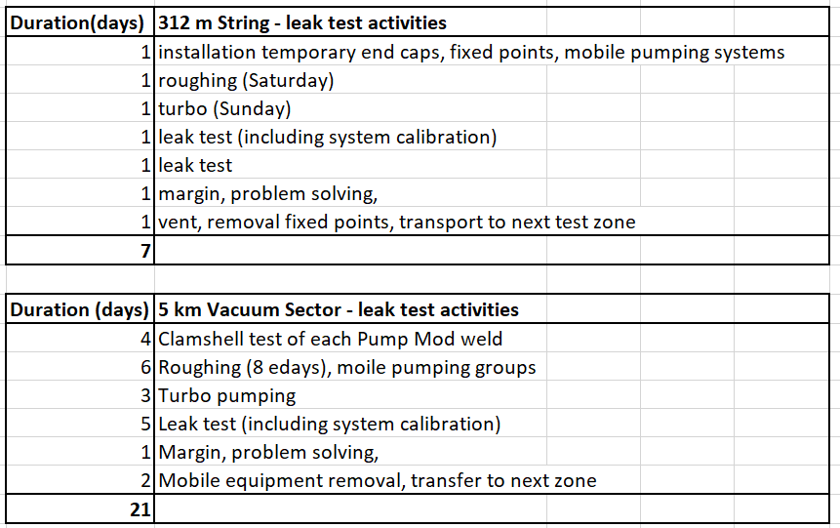

Slide 32
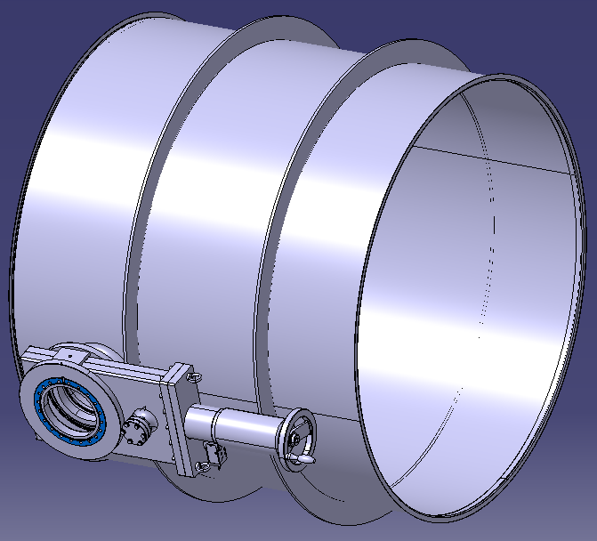
Leak Testing Cost Estimate – Pumping Modules
1 CHF = 1 Euro = 1 USD
Pumping Modules (1m components)
  Equipment costs for leak test bench
    1 bench 40k, 1 pumping system 40k, 1 leak detector 20k = 100 kCHF
  Manpower
    1 vacuum technician producing 1 leak test/day = 0.5 kCHF/test
  ⇨ 400 Pumping Modules in 400 days: 100 kCHF & 200 kCHF (+ 1% NC)

