Slide 1
Vacuum Control Systems
Gregory Pigny, TE/VSC, CERN

Slide 2
Outline
Vacuum layout
Racks and controllers
Tunnel networking – CERN example
Bake-out
Control HW cost estimation
Possible control architecture
Supervision layer

Slide 3
Vacuum layout
5 km
36 gate valves DN1250
216 gate valves DN150
168 gate valves DN100
384 angle valves DN40 (no control)
96 Sputter Ion Pumps (500 l/s)
384 NEG Pumps (1000 l/s and 2000 l/s)
  Local activation of the NEG pumps during bakeout
384 Gauges (Bayard-Alpert)
36 Residual Gas Analyzer (RGA)
V1
V2
V3
1250 m
D
B
D
C
NEG
1000 l/s
NEG
2000 l/s
NEG
1000 l/s
500 l/s
NEG
2000 l/s
312 m

Slide 4
Racks and controllers
5 km
LF
V1
V2
V3
HF
Left
Right
1250 m
One rack 5U at each sector valve position for all 4 lines
4 signal cables per rack (4 valves)
Tot 3*4*3/4= 9 racks
  36 signal cables
Mains 230VAC
  1x 10A for PLC
Ethernet socket
D
B
D
C
NEG
1000 l/s
NEG
2000 l/s
NEG
1000 l/s
500 l/s
NEG
2000 l/s
(~ 30cm)
312 m

Slide 5
Racks and controllers
5 km
LF
V1
V2
V3
HF
Left
Right
One rack 14U at each pumping port type C for all 4 lines
12 cables per rack (4 gauges, 4 Ion pumps, 4 gate valves)
Tot 4*4*3/4 = 12 racks
  144 signal cables
Mains 230VAC
  1x 10A for the rack + controllers
  1x 16A for NEG
  1x 16A for mobile pumping group
Ethernet socket
1250 m
D
B
D
C
NEG
1000 l/s
NEG
2000 l/s
NEG
1000 l/s
500 l/s
NEG
2000 l/s
312 m
(~ 60cm)

Slide 6
Racks and controllers
5 km
LF
V1
V2
V3
HF
Left
Right
1250 m
One rack 9U at each pumping port type B or D for all 4 lines
8 signal cables per rack (4 gauges, 4 valves)
Tot 4*4*3/4 = 36 racks
  288 signal cables
Mains 230VAC
  1x 10A for the rack + controllers
  1x 16A for NEG
  1x 16A for Mobile pumping group
Ethernet socket
D
B
D
C
NEG
1000 l/s
NEG
2000 l/s
NEG
1000 l/s
500 l/s
NEG
2000 l/s
312 m
(~ 50cm)

Slide 7
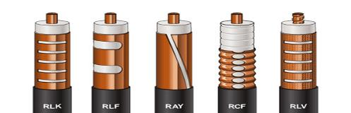

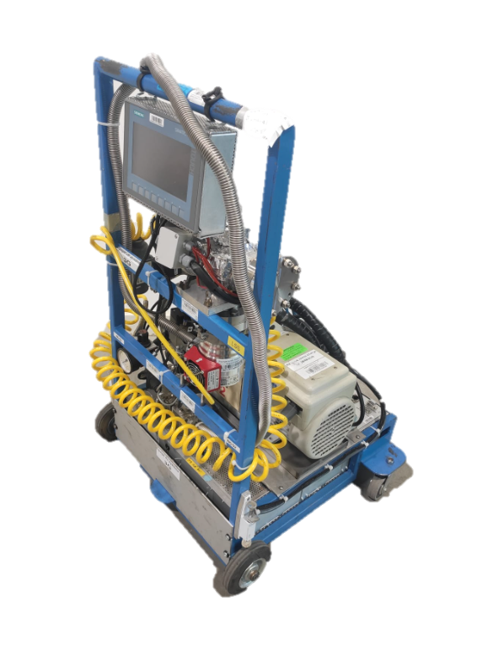
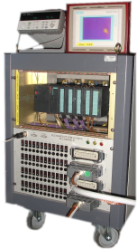

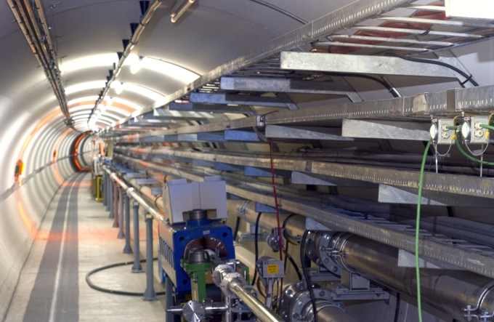
Tunnel networking- CERN example
Radiating cable:
    Only means to have mobile communications in tunnels for the fire brigade and other users:
      Safety: TETRA @400MHz (TErrestrial TRunked RAdio)
      Cellular : LTE (4G) @800MHz, UMTS (3G) @900MHz
        Cell phones, Laptop
        Remote inspection train on LHC monorail (TIM)
        Mobile vacuum equipment
    Too high losses for Wi-Fi (2.4/5GHz) over long distances
    Recently used for LoraWan (Long range Wide area network) in the LHC
      867-870 MHz (in Europe)
Holes
Longitudinal loss
Foam
Jacket
Coax cables

Slide 8
Bake-out
Stainless steel (304L) 1.3mm thick corrugated tube 1.2m
15 cm thick thermal insulation based on PU/phenolic foam (λ ~ 0.025 W.m⁻¹.K⁻¹, Q ~ 72 W/m)
R (ρ(100°C) ~ 8E-7 Ω.m) ~ 250 mΩ/km
Intensity ~ 540 A
  Smaller current and cross section
Voltage drop ~ 135 V/km
  Electrical hazard for circuit > 500m (> 60VDC)
Mild steel 3mm thick tube 1.2m
15 cm thick thermal insulation based on PU/phenolic foam (λ ~ 0.025 W.m⁻¹.K⁻¹, Q ~ 72 W/m)
R (ρ(100°C) ~ 2.7E-7 Ω.m) ~ 34 mΩ/km
Intensity ~ 1400 A
  Higher current and cross section
Voltage drop ~ 50 V/km
  Electrically safe for circuit < 1km (< 60VDC)
For personnel safety, potential of the chamber must be < 60VDC

Slide 9
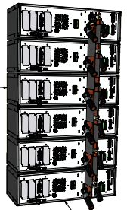
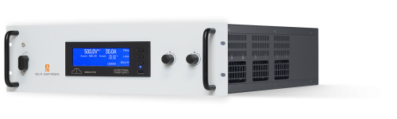
Bake-out
5 km
1250 m
V1
SS: 80V
MS: 30V
V2
540A
1400A
540A
1400A
DC current source
1080A
2800A
Chamber connected to earth every 1250 m
One current source every 1250m
Current source: // connection of several smaller PS
Temperature measurement: thermocouples (position? Qty?)
Current source controlled by PLC: temperature regulation?
Example of current source:
  6x SM70-CP-450 connected in // (2.8kA, 33V) in a mobile rack
  Main power (max): 6x15kW = 90kW per current source
  6x 3-phase sockets 32A / position
  Tot. max power for one sector: 4x90kW = 360kW

Slide 10

Bake-out
5 km
1250 m
V1
V2
DC current source
All equipment and cables (D, B) must be isolated from earth during bakeout to avoid current deviation to earth through cable shielding or wires connected to earth through their controllers
  NEG cartridges
  Vacuum gauges
Procedure and safety measures due to high current
625 m
625 m
D
B
D
A
NEG
1000 l/s
NEG
2000 l/s
NEG
1000 l/s
NEG
2000 l/s

Slide 11
Control hardware cost estimation
Power and IT infrastructure not considered
Bakeout control system not considered

Slide 12
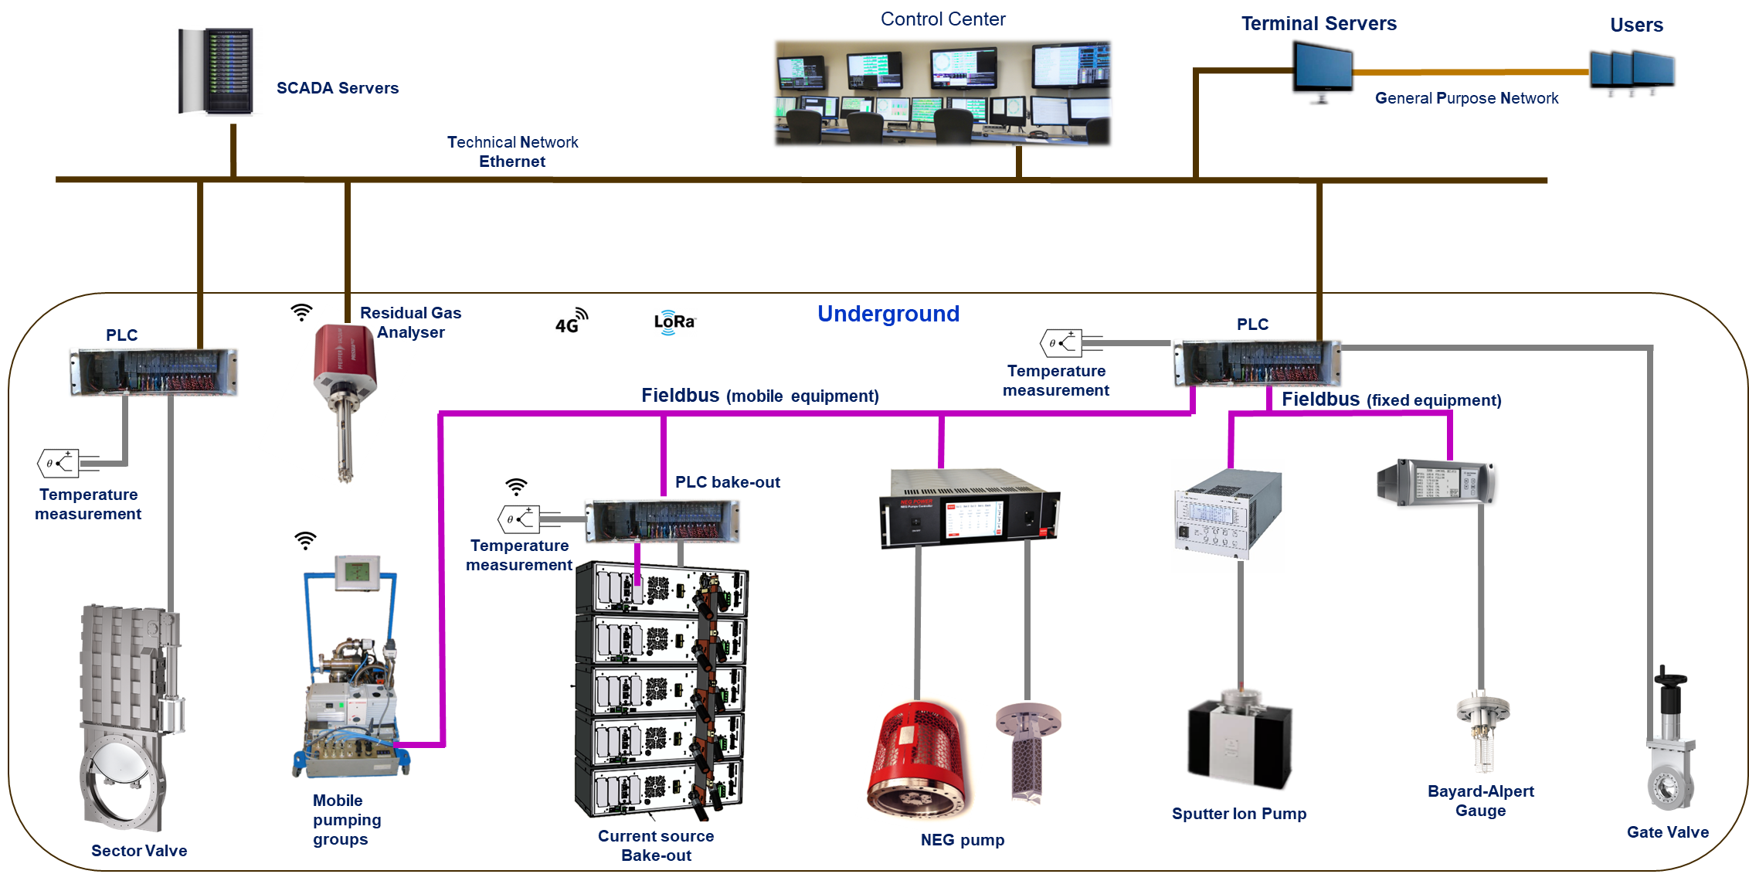
Possible Control Architecture
Supervison Layer
Control and field Layers

Slide 13
SCADA (Supervisory Control And Data Acquisition)
Communicates in “real-time” with controllers running the vacuum process
Present data to operators using a graphical user interface (GUI) in order to:
  Check the process
  React on alarms
  Interact with devices
Archives historical data
  Operators can check what happened in the past
CERN’s vacuum SCADA is based on WinCC-OA (Open Architecture) from Siemens
Other SCADAs exist:
  EPICS - Experimental Physics and Industrial Control System (www.aps.anl.gov/epics/)
  TANGO - (http://www.tango-controls.org/)
LAN
Mobile VPG
(S7-1200)

Slide 14
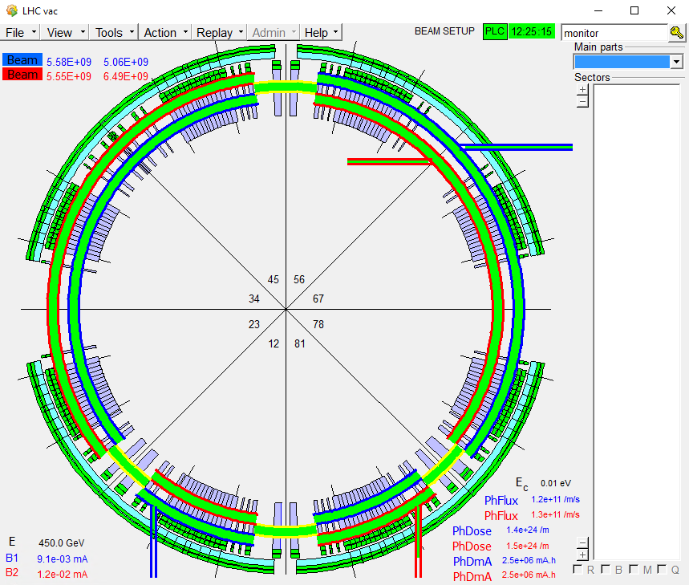
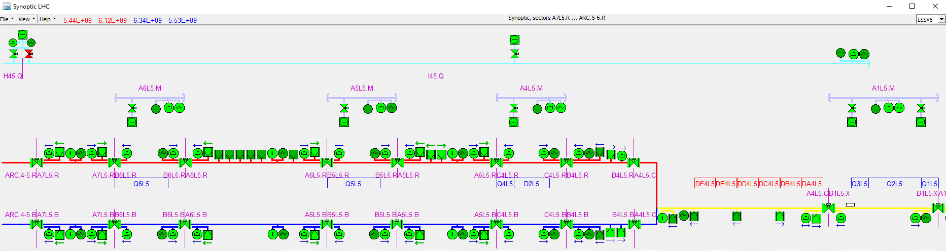
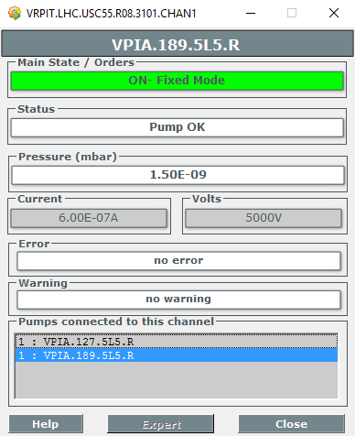
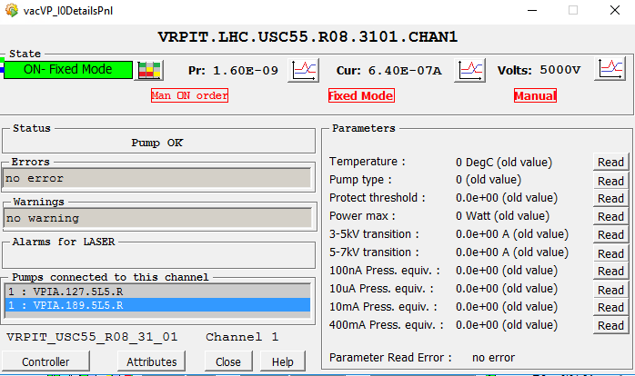
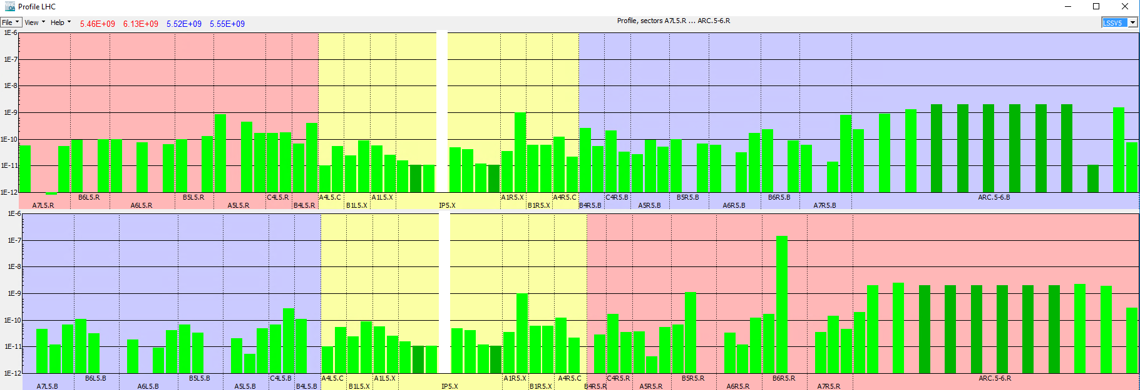
Examples of Vacuum SCADA panels and functionalities
Main View
Detailed Synoptic
Controller Panels
Pressure Profiles
Mobile VPG
(S7-1200)

Slide 15
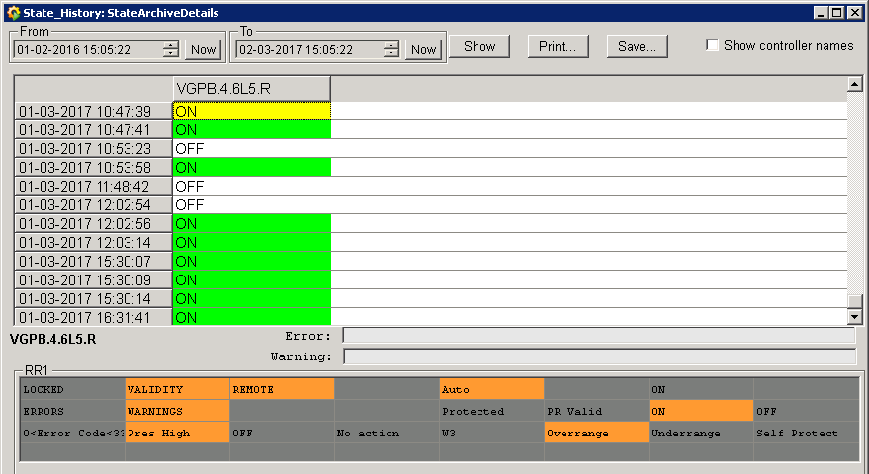
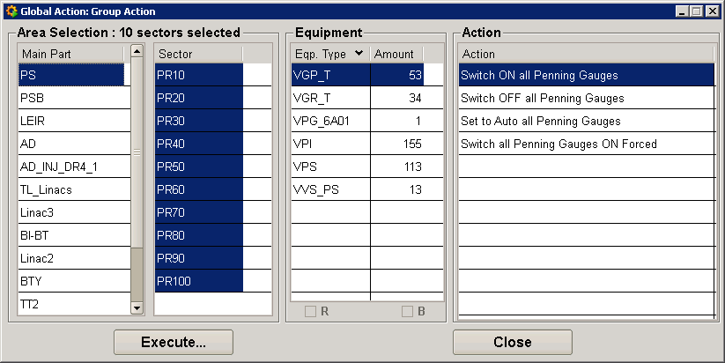
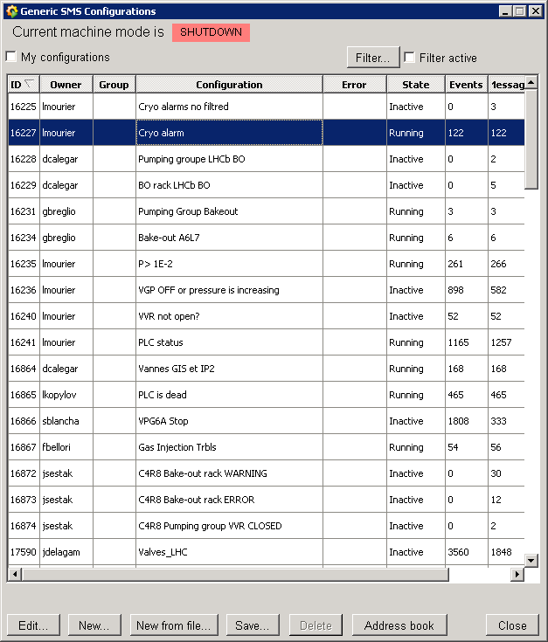
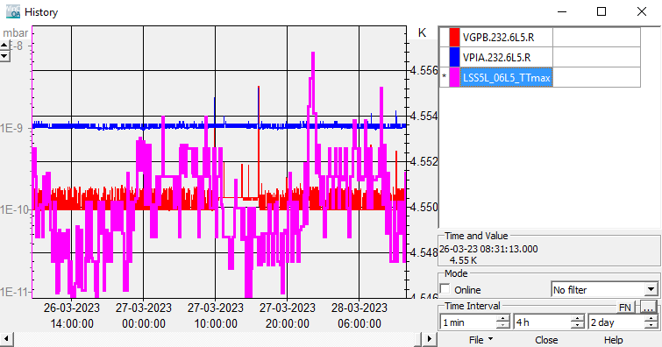
Examples of Vacuum SCADA panels and functionalities
Equipment State History
Global actions
SMS Notifications
Multi trend panel
Mobile VPG
(S7-1200)

Slide 16
Thank you for your attention

