Slide 1
ePump
(error PDF Update Method Package)
Carl Schmidt
Michigan State University
PRD98 (2018) 9, 094005 – CS, J. Pumplin, C.-P. Yuan
PRD99 (2019) 5, 054004 – C. Willis, R. Brock, D. Hayden, T.-J.Hou, CS, C.-P. Yuan
PRD100 (2019) 11, 114024 – T.-J.Hou, Z. Yu, S. Dulat, CS, C.-P. Yuan
Others…
10/7/2022

Slide 2
Why ePump?
  Global Analysis:
  What if we want to see the effects of new experiments Exp1’, Exp2’,…?
    Full global analysis code takes a long time to run.
    Requires detailed info of all other included experiments.
  ePump provides two tools: UpdatePDFs, OptimizePDFs
Exp1
Exp2
D₁(1),D₁(2)…
Error matrix
D₂(1),D₂(2)…
Error matrix
.....
Global
Analysis
Best fit PDFs (g,u,d,…)
Th1
Th2
Hessian Error PDFs (~56)
.....
T₁(1),T₁(2)…
T₂(1),T₂(2)…
PDFs
Minimize χ²

Slide 3
ePump: UpdatePDFs
  Only requires new experiments Exp1’, Exp2’ (or pseudo-data).
    Old experimental info is contained in Error PDFs
  Only requires theory predictions calculated with current best-fit/error PDFs
    With these input, it runs fast, ~few seconds on MacBook Pro
Exp1’
Exp2’
D’₁(1),D’₁(2)…
Error matrix
D₂(1),D₂(2)…
Error matrix
Updated Best fit PDFs (g,u,d,…)
Updated Error PDFs (~56)
Th1’
Th2’
UpdatePDFs
T’₁(1),T’₁(2)…
T’₂(1),T’₂(2)…
Using current best-fit/error PDFs
Updated Theory Predictions
T’_{a}(1),…
Current Best fit PDFs (g,u,d,…)
Current Error PDFs (~56)

Slide 4
Hessian Updating
  PDF parametrization : (parameters )
    best-fit: , error PDFs:
  Updated Chi-square function :
  Hessian approximation :
  (T = tolerance parameter)
  with
  Minimize to find new best fit:
  with
Paukkunen and Zurita, JHEP 1412 (2014) 100

Slide 5
Updated PDF set
  New best-fit PDF :
  New error PDFs :
  where and are the eigenvalues and eigenvectors of matrix
  Extensions :
    Best choices for within the linear approximation
    Dynamical tolerances :
    Inclusion of diagonal quadratic terms in expansion of
    Direct update of other observables :
  ,
Xfitter “Hessian profiling” has similar functionality, but less flexible in choice of tolerances (as used by CT, MMHT)

Slide 6
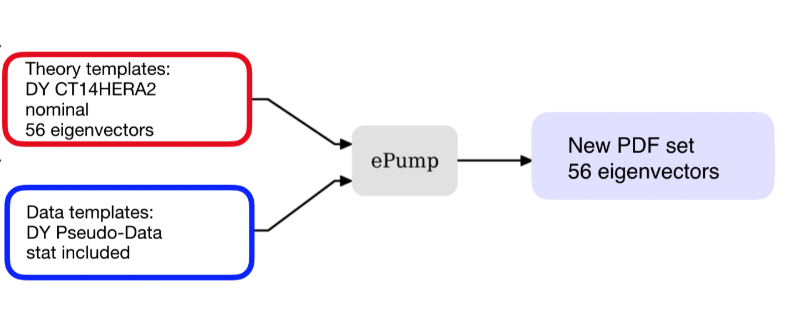
How to use ePump
Theory Files:
Theory predictions for each
of 56 eigenvectors
Data Files:
Standard Data file, including
Correlated errors
(Auxiliary Theory Files may also be included to update predictions for observables not included in fit.)

Slide 7
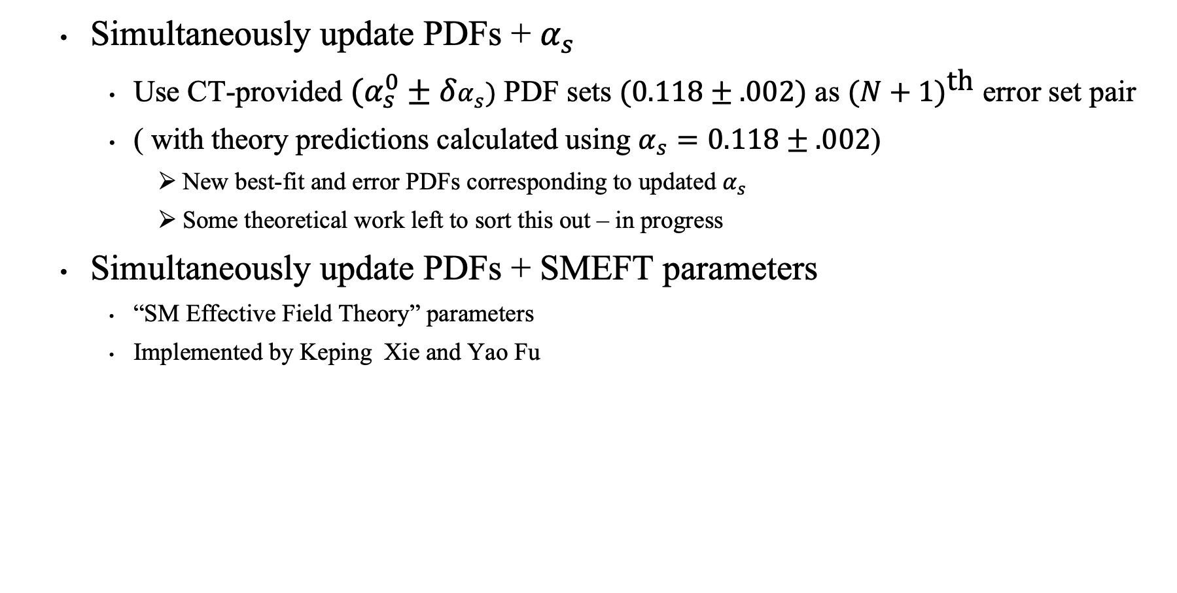
Enhancements of ePump
(in progress)
  Simultaneously update PDFs + $α_{s}$
    Use CT-provided $(α_{s}^{0}±δα_{s})$ PDF sets $(0.118±.002)$ as ${(N+1)}^{\text{th}}$ error set pair
    ( with theory predictions calculated using $α_{s}=0.118±.002$)
      New best-fit and error PDFs corresponding to updated $α_{s}$
      Some theoretical work left to sort this out – in progress
  Simultaneously update PDFs + SMEFT parameters
    “SM Effective Field Theory” parameters
    Implemented by Keping Xie and Yao Fu

Slide 8
ePump website
https://epump.hepforge.org/
Carl Schmidt (MSU)
C.-P. Yuan (MSU)
*Keping Xie (U.Pitt)
*Yao Fu (USTC)

Slide 9
Backups

Slide 10
ePump: OptimizePDFs
  Exp analysis may require great many runs with Error PDFs (~56)
    But may be insensitive to certain flavors or combinations
  OptimizePDFs
    creates an optimized set of error PDFs for the relevant observables
    gives a criterion for choosing a reduced set (~6-10) which contains most of the relevant dependence for the observables.
Th1
Th2
Best fit PDFs (unchanged)
T₁(1),T₁(2)…
T₂(1),T₂(2)…
Optimized Error PDFs (~56)
Using current best-fit/error PDFs
OptimizePDFs
Current Best fit PDFs (g,u,d,…)
Criterion for error PDF set
reduction
Current Error PDFs (~56)

