Slide 1
RF check and preliminary thermal calculation of the CC cavities and RF rotator
Ping Wang, Alexej Grudiev
10.10.2022

Slide 2
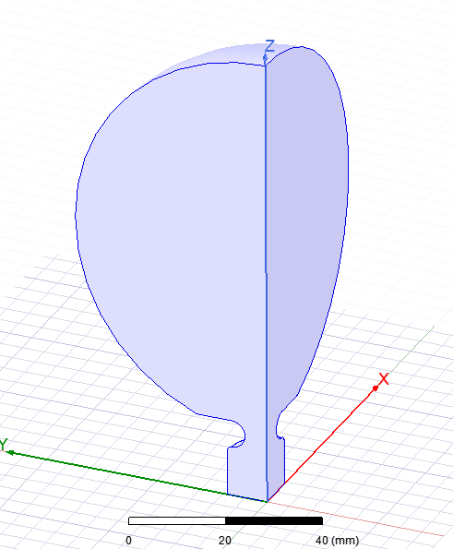
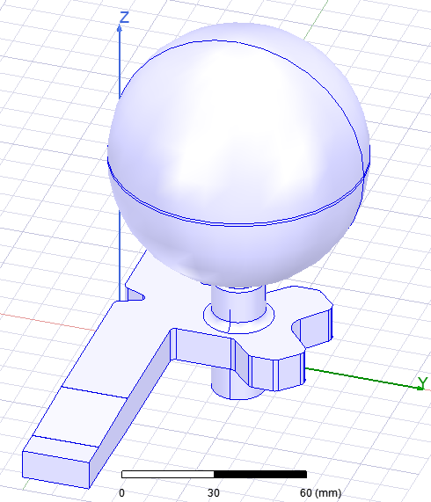
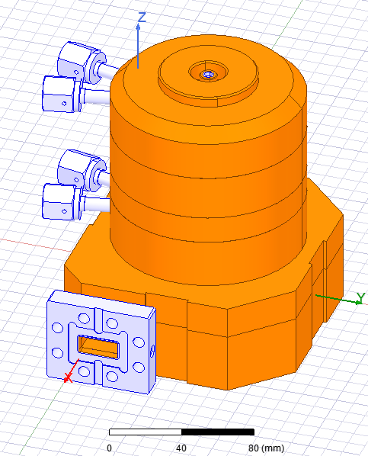
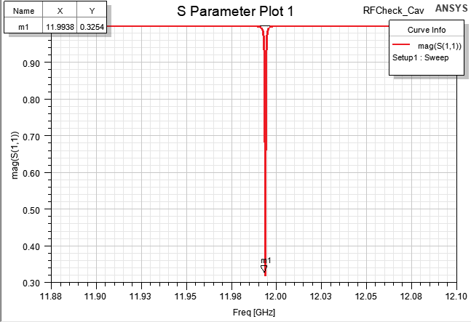
RF check of the spherical CC
From RF model
f0 = 11.9937 GHz
Beta=1.95
Q₀=70936
f0 =11.9938 GHz
Beta=1.9304
Q0 =70944.6

Slide 3
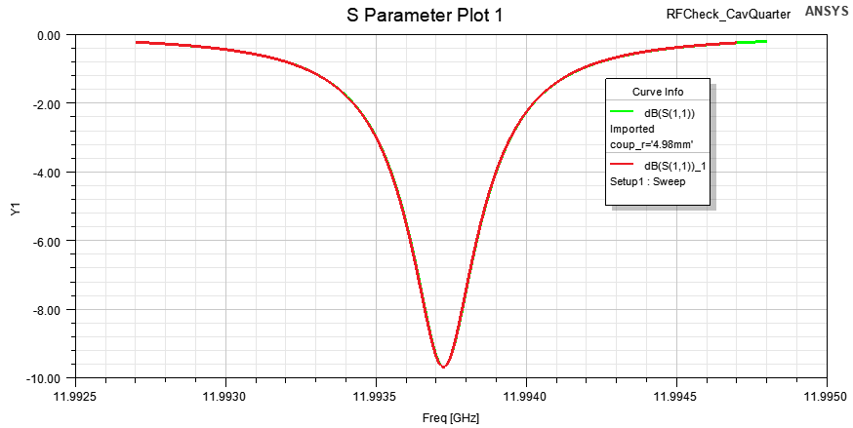
RF check of the spherical CC
The s11 of RF model and the s11 from mechanical are identical.

Slide 4
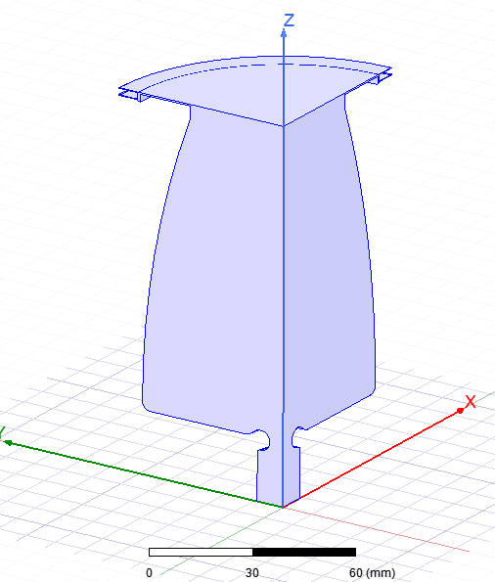
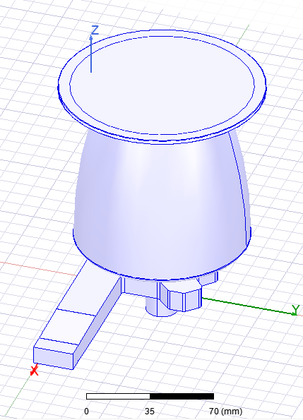
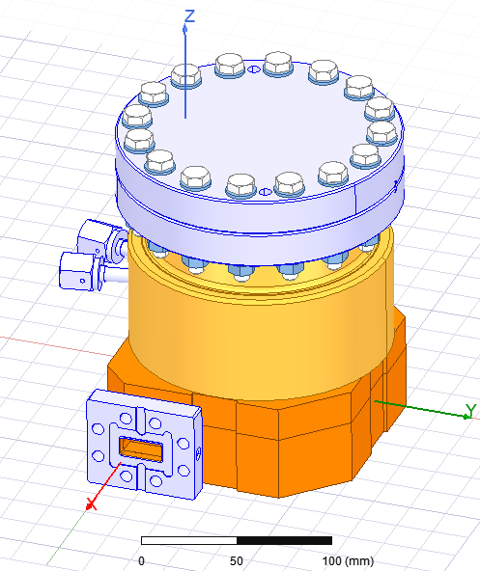
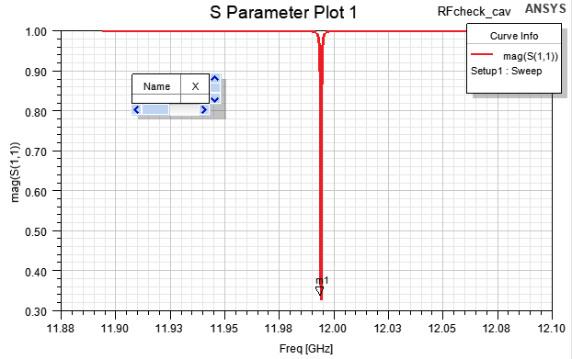
RF check of the bowl CC
From RF model
f0 = 11.9941 GHz
Beta=1.97
Q0=74700
f0 =11.9941 GHz
Beta=1.9717
Q0 =74694.5

Slide 5

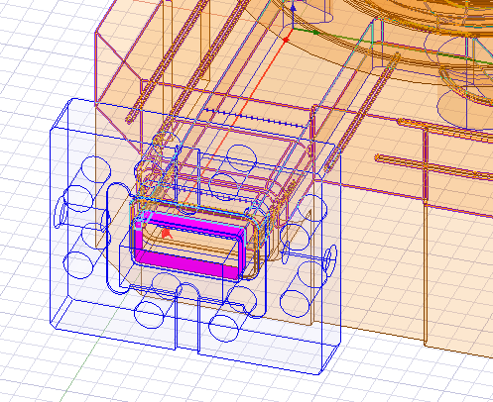
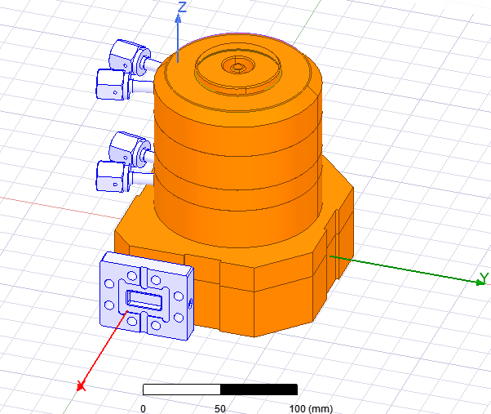
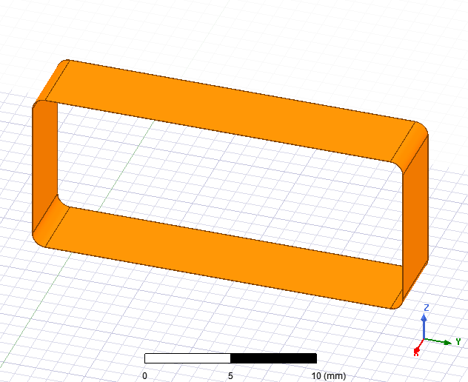
Deleted parts in the mechanical model before the thermal calculation

Slide 6
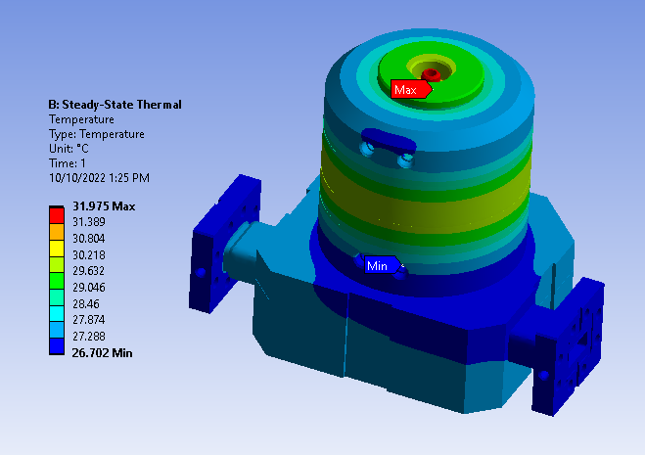
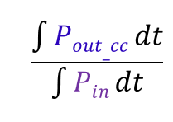
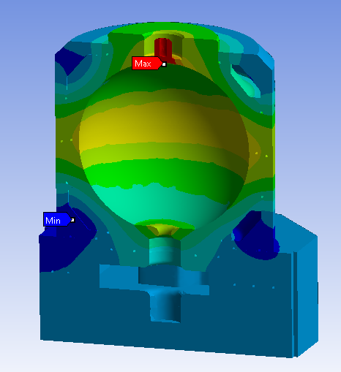
Preliminary thermal calculation of the spherical cavity
Parameters of the klystron
Peak power [MW] | 50
Pulse length [μs] | 2.0
Repetition rate [Hz] | 50
Average power [kW] | 5.0
= 0.52
Ploss= 50e6*2e-6*50*(1-0.52) = 2.4 kW

