Slide 1

Final remarks and Next steps

Slide 2
Workshop organized 19-30 Sept. 2022
first week joined with EIC, mixte format
122 participants from many countries
USA, RF, CERN, Germany, France, Switzerland, UK, China, Italy, etc.
Goals
-- Foster collaboration
-- review beam polarization in existing colliders and collider projects
(circular for optics and simulations, all for polarimetry)
for FCC
take note of the motivation, targets
establish status and plans for each of EPOL WPs
establish open questions
confirm or ascertain
Specifications for « hardware »
-- simulations, optics, corrections, BPMs
-- wigglers
-- depolarizer
-- polarimeter (location, LIR, laser, detector, DAQ)
-- running mode
Establish deliverables for
mid term review FCC week 2023
Feasibility study delivery end 2025

Slide 3
USA | 31
BINP | 22
CERN | 20
Germany | 9
France | 8
Switzerland | 5
UK | 4
China | 4
Italy | 3
India | 3
Iran | 3
Turkey | 2
Poland | 2
Japan | 2
Canada | 2
Spain | 1
Marocco | 1
113 participants
and 122 contributions
absolutely impossible to give
proper credit to all.

Slide 4
Collaborations and synergies
Outside FCC:
EIC – joint workshop for the first week!
SuperKEKb (generally a test of the FCC-ee design)
-- present (operations)
-- and future (precision polarization program)
CEPC
VEPP-4M
ANKA-KARA
spin simulations, polarization measurements,
depolarization and beam energy measurement
operations and diagnostics and more
Thanks to all contributors
from these projects!

Slide 5
Collaborations and synergies
and within CERN/LEP&LHC&FCC
-- Experience from LEP (polarimeter, operations, deplarizer and wigglers)
-- Experience from LHC (gigantic improvement on BPM and operations)
-- synergies with FCC efforts towards high luminosity
(alignment&orbits, optics, BI, BPMs, experiments...)
-- Cornerstone for FCC-ee precision and monochromatization!
are there any more SM-coupled particles?
and any more source of masses for particles?

Slide 6
Eliana Gianfelice, Ivan Koop, Tatiana Pieloni
Jacqueline Keintzel, Katsunobu Oide, Jorg Wenninger
Thibaut Lefèvre, Aurélien Martens, Dave Gaskell
Patrick Janot, Guy Wilkinson
Angeles Faus-Golfe, Frank Zimmermann

Slide 7
Motivation
Christophe Grojean
FCC-ee FCC-hh FCC-ee and FCC-hh
All needed parameters for precision calculations in the Standard Model are now known – and with highest precision at FCC-ee
➔ PRECISION = DISCOVERY POTENTIAL

Slide 8
PHYSICS TARGETS

Slide 9
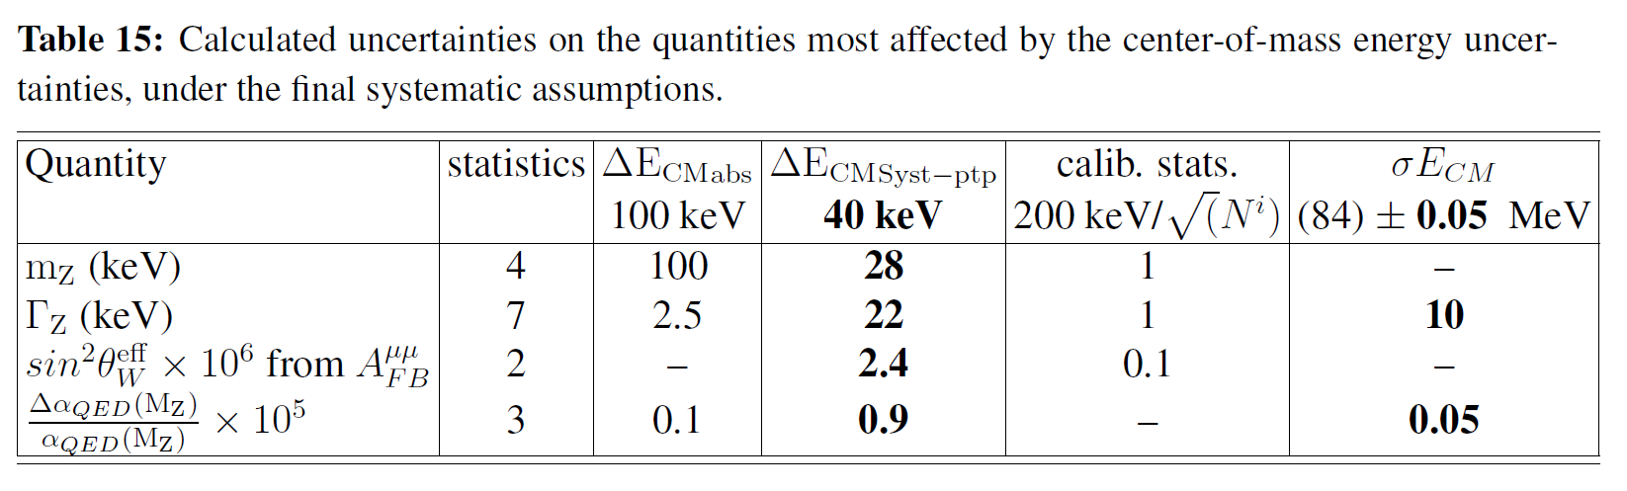
First set of results obtained in the FCC Design Study:
Polarization and Centre-of-mass Energy Calibration at FCC-ee, arXiv:1909.12245
A.L.a.P*) 7 keV 100 keV√N_{m} 85±0.01
4
4
2
3
m_{W}(MeV) 0.250 -- 0.300 --
0.100
A.L.a.P*) = as low as possible , < 100 keV
Next targets:
-- ascertain above results
-- match systematics with available statistics. (Precision = discovery potential)
Most relevant are point to point systematics
-- relationship between resonant depolarization frequency and true beam energy (and spin tune dependence?
simulation, dependence on measurable quantities? design of possible experimental verifications.
-- effect to energy to ECM relationship (OSVDxcollision offsets, energy losses)
-- energy spread
-- W mass vs Z mass.
➔ new targets!

Slide 10
Another target
Wilkinson
Many discussions! Looks more reasonable once it is understood what this means
-- absolute error (not ΔP/P !) P_{Z} = 0.000xx± (<0.00001) polarimeter ?
-- easier to do if beams not polarized. (can depolarizer operate continuously?)
-- luminosity weighted average – involves both beams
Targets: polarimeter measure average over 10⁴ colliding bunches to ±10⁻⁵/shift
--ensure colliding bunch polarization is indeed 0 by construction. depolarizer ?

Slide 11
MONOCHROMATIZATION targets
Where we stand:
With current monochromat.: Δy_{e} ~ 2.5 y_{e}(SM) (0.4σ significance) (per year & per IP)
(4 years 4 IP may not be « just » 4 times better!)
-- can we do better schemes? explore more dimensions of chromatization etc.
-- start implementation of realistic optics
-- verify that scheme can be developed,
-- running requirements
-- measure monochromatization

Slide 12
Working group 1
convened by Elianan GianFelice-Wendt, Ivan Koop, Tatiana Pieloni
resonant depolarization
Spin precession
as measurement of spin tune
relationship between spin-tune and beam energy
affected by various effects
analytic estimates very educational...
need to be verified by realistic simulations!
starting from simulation of realistic closed orbit
simulation of orbit corrections → high luminosity
simulation of spin matching → high polarization
simulation of resonant depolarization experiments
simulation of spin precession
alignment of quads
orbit and other spurious magnetic fields
interference of spin resonances
Wigglers
Depolarizer
specs, cost, integration

Slide 13
simulation of resonant depolarization (including polarimeter errors
here assume 1000 recoil photons each shot at 3kHz. (only vertical polarization)
Z pole
WW threshold
measurement errors look bigger because scale is smaller!
precision Δν/ν = 0.0005/180
ΔE_{beam}= E_{beam} *Δν/ν = 220 keV
per measurement
(depending on polarimeter performance)
precision Δν/ν = 0.00005/103
ΔE_{beam}= E_{beam} *Δν/ν = 22 keV
per measurement
(depending on polarimeter performance)

Slide 14
Resonant depolarization at ANKA/KARA ..............................................................and at VEPP-4M ! (stat. error is 11 eV...)
KIT will welcome ideas for tests with KARA! total sys→ ~7keV at J/psi
There is no reason (a priori that precision cannot be the same (in keV) at FCC-ee than VEPP-4M
since one measures the fractional part of the spin tune.
except for environmental variation, and possibly widening ot the resonant line.
➔ running mode with pilot bunches measured consituously, correct tides (and record corrections!)

Slide 15
Sergei Nikitin has provided RDP parameters (see slides), these need to be matched with actual field, frequency and rate of the depolarizer.
insisted on the need to match the depolarizer scan width to the resonance
otherwise precision is limited by the largest one
-- how do we do that? simulate resonance width? or measure it and how?
-- might be possible to see the depolarization within the scanning step
-- error might be reduced (or measured, then reduced) by scanning resonance in both directions.
this will have implications on polarimeter statistical precision

Slide 16
Precision on RDP (Koop, Nikitin)
we can certainly measure RDP to
<< 10keV precision (Nikitin PC)
one time precision: 10-80 eV

Slide 17
SPIN PRECESSION
It might be possible to excite the depolarizer to achieve a 90 degrees rotation of polarization
vector and let it precess, measure it with 3D spectrometer/polarimeter.
requirements on depolarizer strength, polarization level and precision on polarization need to be established.

Slide 18
Wigglers
location and integration of wiggles and polarimeters (Hofer)

Slide 19
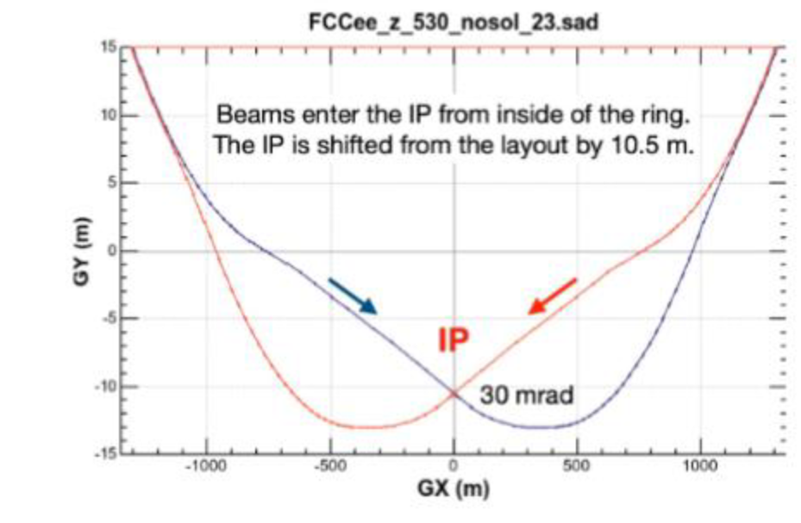
more burning questions for FCC (I)
1. How many polarimeters for FCC-ee?
-- baseline: at least two, one e+ and one e-
-- if more are really needed, consider last strong magnet before the experiments on incoming lines.
++ this might make it easier to propagate the 3D polarization measurement to the IPs.
Location might be problematic for logistics!
Also might be made unnecessary if colliding bunches can be depolarized.
-- lets evaluate cost and operational issues and understand the possible gains before changing the baseline of
2 (e+ and e-) polarimeters! -- a nice place anyway. Investigate with M. Hofer, K. Hanke if this is a feasible location.
(
)
x4
polarimeters?

Slide 20
Alignments, BPMs, orbits and dispersion
Helene Mainaud Durand, Manfred Wendt, Tessa Charles, Michael Hofer
2 mm over 26.7 km !
smoothed to ~150μm

Slide 21
at the Z: 10⁻⁷ error requires y_{rms} = 0.2mm Tessa indicates more like 150 microns

Slide 22
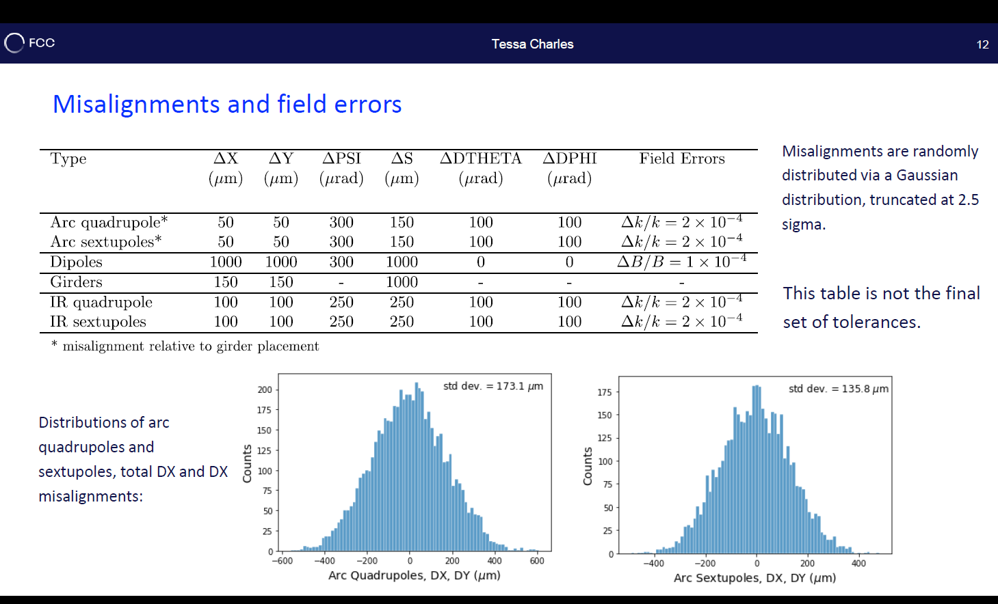

Slide 25
SIMULATIONS
SLIM, SITROS, BMAD, MADx, SGOUBY, etc.
WG1 are pursuing several spin simulation codes
towards a realistic simulation of polarization,
spin resonances, determination of the
relationship between spin tune and beam energy,
simulation of the effects of imperfections on this relation,
implementation of correction algorithms and of the
resonant depolarization and spin precession measurement!
One first result is that we need to speed up simulations!

Slide 26
WG2: from beam energy to centre of mass energy
Keintzel, Oide, Wenninger
Energy losses
-- Synchrotron radiation
-- Impedance
-- beastrahlung
-- beam-beam attraction
Collision offsets and opposit sign vertical dispersion

Slide 27
many simplifying assumptions
-- ΔBS same for all IP
-- energy losses same for all arcs
-- γ⁴ effect ignored
Δ_{RF} = 4Δ_{SRi} + 4Δ_{SRe} + 4Δ_{BS}
E-J = E0- + ΔRF/2 - ΔSRi - ΔBS/2
E+J = E0+ + ΔRF/2 -4 ΔSRi - 3 ΔSRe -7 ΔBS/2
BoostJ = E-J - E+J = E0- - E0+ + 3 ΔSRi + 3 ΔSRe + 3 ΔBS
BoostA= E0- - E0+ + ΔSRi + ΔSRe + ΔBS
(other two ibid with reverse sign)
considerable information in the Boosts measured by the experiments!
-- ECM shift due to # in SR in vs ext
-- all Ecm are the same
-- boosts measure the energy losses
-- differences between the rings will show up.

Slide 28
Dmitri Shatilov
so far we have 6 measurements.
E0 is measured from RDP
(or/and) from precession frequency for e+ and e-
What do we gain with having both?
Analysis of systematics
Boosts are measured at all IPs
Additional measurements
1- beamstrahlung dump/monitor might be able to measure total BS energy or at least inform about variations
2- beam energies are measured in polarimeters and can provide test of linearity over short range of energy.
3. possibly an undulator? P. Raimondi
4. beam positions for pilot bunches vs. colliding bunches,

Slide 30
LEP ------------------------------------------------------------------- → LHC
this summed up 4 years of hard work at LEP
(and three different fills)......................................................................within a single fill at LHC and just with the BPMs!
The enormous progress in diagnostics is one main source of confidence that the precision at FCC can be
pushed by > two orders of magnitude wrt to LEP → target 10⁻⁷ precision

Slide 31
WG3 Polarization Measurements
Aurélien Martens, Thibaut Lefèvre
Dave Gaskell(EIC)

Slide 32
Four different tasks
-- determine polarization level
and observe resonant depolarization
1000 scatters / turn on pilot bunch give
P± 0.01/turn
-- measure polarization of colliding bunches
→ average of all bunches to be determined to ±<0.00001 in a shift of 8hrs.
e.g. kick 50 bunches for 1000 scatters at 3kHz
-- measure spin precession after 90 degrees kick
1000 scatters on one bunch may be improved to 10000 scatters on one bunch.
-- measure end point of electrons for local Ebeam
all the above should be enough
Muchnoi

Slide 33
Polarimeter detectors
to be considered:
-- backgrounds
-- space resolution
-- photon vs electron detector
-- multi vs single event mode?
this is only ±1mm at 100 m distance

Slide 34
Polarimeter detector – the challenge
Two different methods:
-- single event: possibly a time coincidence between a photon and an electron.
➔measurement of photon and electron energy and position. sum of energies = Ebeam.
-- issue with backgrounds (SR photons and beam gas electrons)
-- Multiple scatters at the same time (1000). Method used at LEP. How do we make the transverse beam profile asymmetry of the scattered electrons?
-- which detector? pure segmented calorimeter enough with detection at different depth in absorber? Cherenkov (SLC ILC) Many detector systems were shown

Slide 35
WG4 Measurements in Particle Physics Experiments.
-- Dimuons and more generally di-lepton give access to
-- the center-of-mass energy distribution (energy spread)
-- centre-of mass boosts
-- André Sailer showed measurements with di-electrons
should be integrated in all dilepton pair measurements.
It was recently pointed out that they also allow to test monochromatization

Slide 36


Measuring the centre-of-mass energy spread
In the EPJ paper (AB and Eliana Gianfelice) http://cds.cern.ch/record/2789651, we assume that x_{m} is the horizontal
coordinate x (we know this would work if beams are colliding head-on without crossing angle,
but this not the preferred scheme). In this case we could have the following situation.
The beam is artificially spread around x for the monochromatization (σ_{x} ~ ±100 μm) while the detector
should be able to measure the production point of each event with a precision of ±3μm inn the x,y and z directions
Monochromatization D_{x}(e+) = - D_{x}(e-)
<ECM>(x) ~constant
σ_{ECM} (x)~constant ~ <σ_{ECM} (x)>
Boost measurement:
<(E(e+)-E(e-)> ∝ x (D_{x}(e+)-D_{x}(e-))
rms((E(e+)-E(e-))(x) ~constant << <rms((E(e+)-E(e-))>
$$E_{e^{−}}$$
x
~200 microns
$$E_{e^{+}}$$
this is very elegant: we can measure from the {boost of the muon pairs vs. x} the true energy spread *and*
verify the variation of boost across the beam crossing point -- this is the very principle of monochromatization.
NB we can and should also maybe verify the ECM is constant vs x, s, t Detailed analysis is needed to ascertain the errors.

Slide 39
and ... our first monochromatization optics!!

Slide 40
Next steps..
Resume bi Weekly meetings starting 13 October 2022 15h30
Guy Wilkinson and Jacqueline Keintzel will convene (and Jorg will give advice)
→ please help by volunteering!
2. Need to assemble two type of documents (contributions from WG conveners)
-- one specification document on requirements for EPOL tasks (JK to assemble)
-- wigglers
-- BPMs
-- Depolarizer
-- polarimeters
-- particle physics detectors
-- description documents for each of the above from the WGs as appropriate
+ cost estimate for most important items.
+ description of running schemes, operations etc.. incl. summary of precisions
3. all should be submitted to FCC CDS + (arxiv or journal if new scientific content)
cross-referencing,
live documents

Slide 41
Next steps (II)
4. some PR: Courrier article on the EPOL workshop and the precision ECM determination
(Guy &Jacqueline editors)
5. provide talks and speakers for upcoming conferences
-- FCC physics workshop (Krakow January 2022)
-- PAC, ICHEP etc.
Volunteers!!!

Slide 42
2d FCC EPOL Workshop
Program committee
WP1 Eliana Gianfelice, Ivan Koop, Tatiana Pieloni,
WP2 Jacqueline Keintzel, Katsunobu Oide, Jorg Wenninger
WP3 Aurélien Martens, Thibaut Lefèvre, Dave Gaskell
WP4 Patrick Janot, Guy Wilkinson
WP5 Angeles Faus-Golfe, Frank Zimmermann
General :
Alain Blondel, Elke Aschenauer, Tor Raubenheimer,
Vadim Ptitsyn, Todd Satogata, Frank Zimmermann
Many thanks to the programme committee!
113 registered participants from many participating institutes from different continents (> success!)

Slide 43
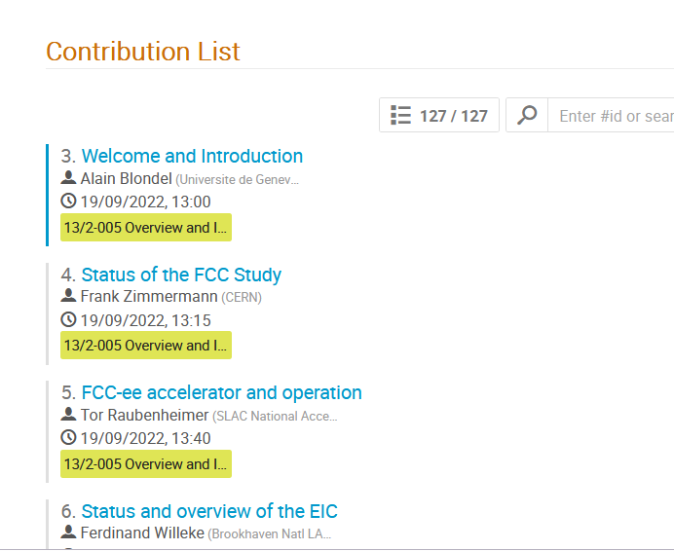
2d FCC EPOL Workshop
113 registered participants
from many participating institutes
from different continents (> success!)
and many contributions...
many thanks to all contributors
for working so hard!

