Slide 1

MQXFBP3 test results
F. Mangiarotti, G. Ninet, V. Desbiolles, S. Juberg, L. Fiscarelli, G. Willering,
P. Rogacki, R. Keijzer, V. Di Capua, S. Russenschuck
on behalf of the test & measurements team
2022.10.11 – EDMS 2784114

Slide 2
Overview
Tests performed over three cool downs:
Training and ramp rate studies
Splice, magnetic field, VI measurements
Current cycling
Total time in SM18: about 13 weeks
~6 w at cold
~3 w cool down/warm up
~2 w preparation / final tests
~2 w cover flange issues

Slide 3
Quench performance

Slide 4
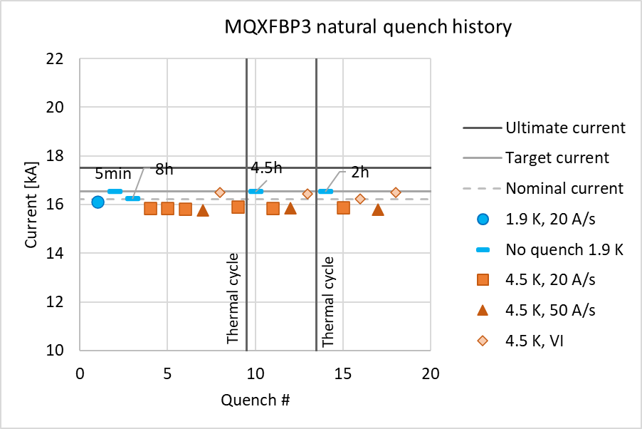
Natural quench history
MQXFBP3 reached target current after 1 quench at 1.9 K
Afterwards, it consistently reached the target current at 1.9 K, including after thermal cycles and at 50 A/s
Quench levels at 4.5 K: VI, 20 A/s and 50 A/s are also consistent
Quenches at 20 and 50 A/s, 4.5 K are in the inner layer pole turn or block, near the center in coil P4. Quenches with VI current cycle are in coil P3.

Slide 5
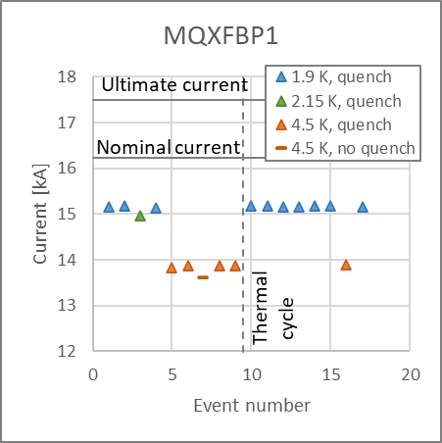
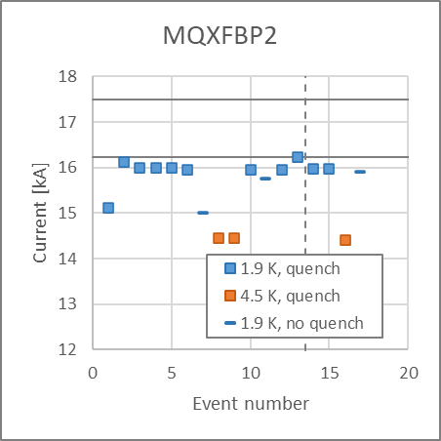
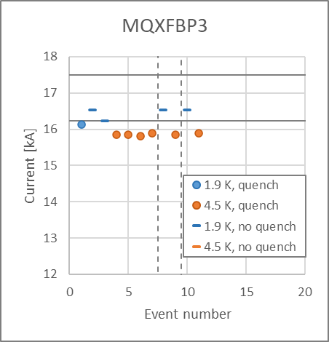
Quenches at nominal ramp rate
At 1.9 K: MQXFBP1 and BP2 were limited below nominal current (~15 and ~16 kA respectively). BP3 reached the target current (nominal + 300 A)
At 4.5 K: the three magnets are limited below nominal current: 13.8, 14.2 and 15.8 kA, respectively.
All magnets kept perfect training memory after thermal cycle.

Slide 6
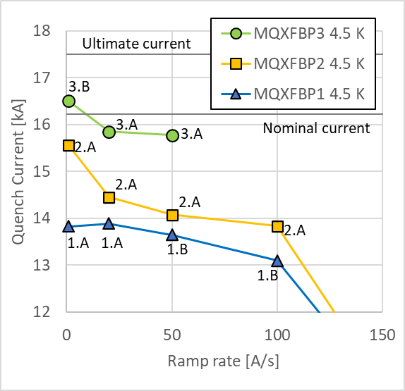
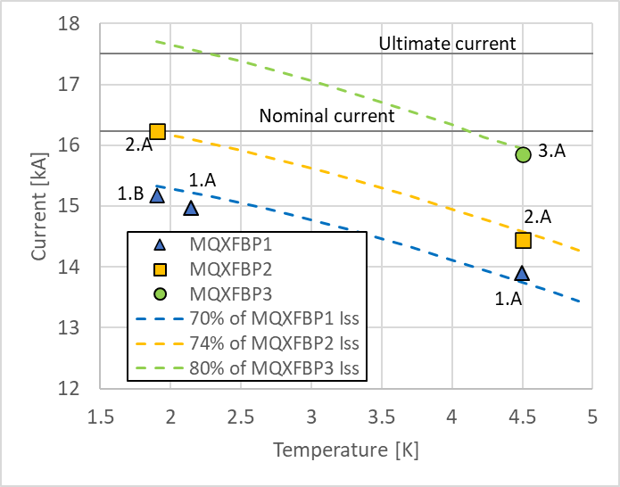
Ramp rate and temperature dependency
Point labels indicate quench location.
Ramp rate and temperature dependency very similar between the three magnets.
Quench level extrapolation for BP3 at 1.9 K: above ultimate current.

Slide 7
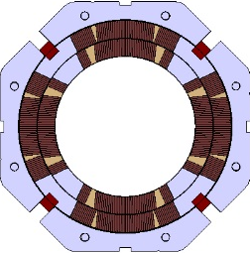
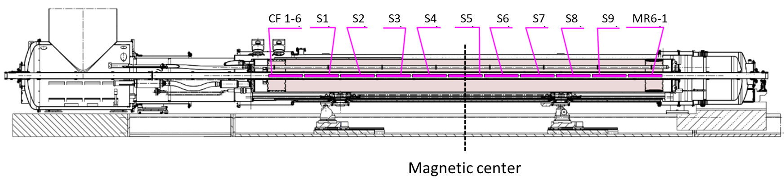
Recurring quenches as of BP3.CD2
MQXF… |  | 1 A/s | 20 A/s (VI) | 20 A/s | 50 A/s | 100 A/s
BP1 | 1.9 K |  | 1.A | 1.B
 | 2.15 K |  | 1.A
 | 4.5 K | 1.A | 1.A | 1.A | 1.B | 1.B
BP2 | 1.9 K | Several, P1 | 2.A | 2.A | 2.A | 2.A
 | 1.9 K trim | No quench |  | 2.C
 | 4.5 K | 2.A |  | 2.A | 2.A | 2.A
 | 4.5 K trim | 2.B |  | 2.C
BP3 | 4.5 K | Several, P3 |  | 3.A
P2
P1
CS
NCS
CS view
P3
P4
Side view
Notes:
20-100 A/s quenches were in coil P1 in the same location that is limiting the performance.
150-200 A/s quenches were in a different coil, and they were caused by a too large heating power that heats up the coil faster than it can be cooled – the quench location is not related to damage or degradation in the conductors, but just to cooling and heating of the impregnated coil.

Slide 8
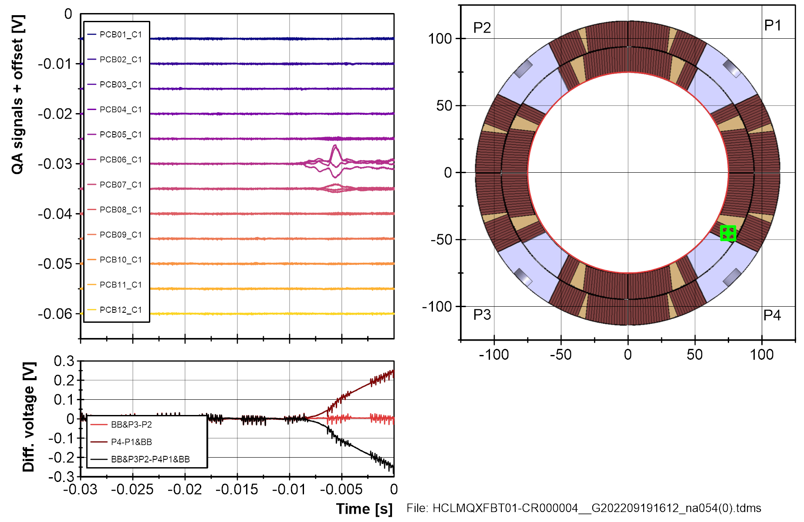
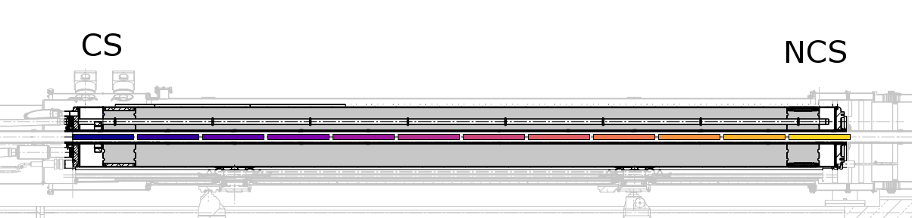
3.A
Quenches at 20 and 50 A/s at 4.5 K

Slide 9
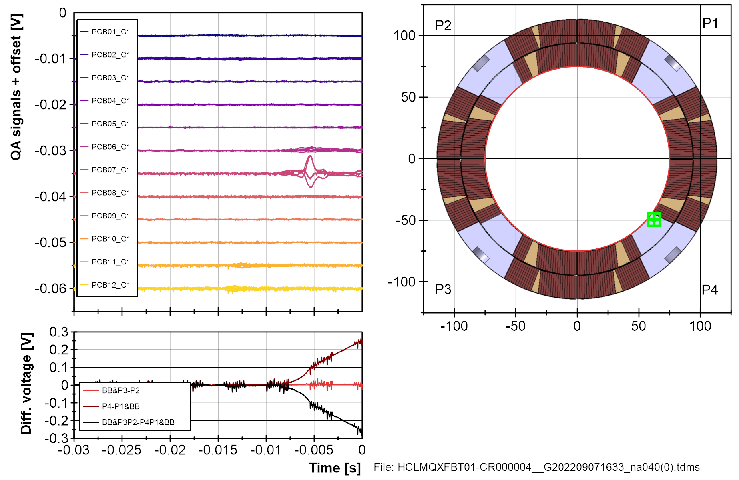
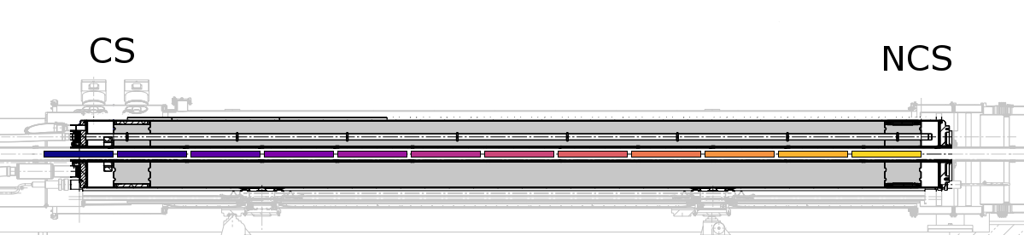
3.A
Quenches at 20 and 50 A/s at 4.5 K
QA displaced.

Slide 10
Voltage buildup during quench
Shown: quenches in short models and prototypes BP2 and BP3 around 16 kA, at 20 A/s, inner pole turn or block
Voltage buildup in both prototypes is similar to that of short models, hinting towards local limitation in the prototypes
“Bump” already seen in short models

Slide 11
V-I measurements

Slide 12
Raw data and noise compensation schemes
During VI measurements we record the voltage of the coils.
Most of the noise is common to the four coils, so we do a “numerical bucking” by comparing each coil to the others.
We calculate the average and error bands in each current plateau. Results in next slides

Slide 13
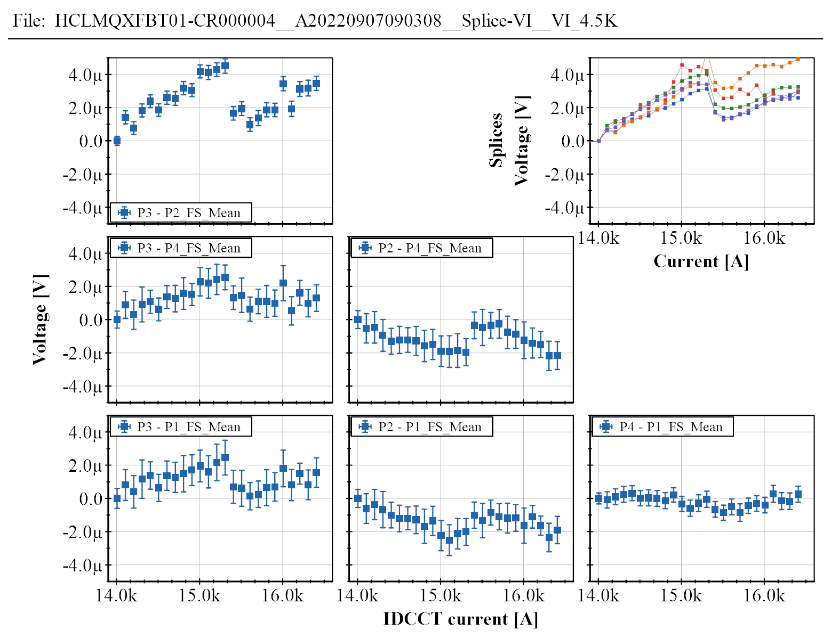
CD 1
P2
P4
P3
P1
Showing all combinations of Coil x – Coil y
Top right: five splice signals, for reference
The signals present a rather large drift (see for instance P3-P2 around 15.3 kA), still under investigation

Slide 14
CD 1
Showing all combinations of Coil x – Coil y
Top right: five splice signals, for reference
The signals present a rather large drift (see for instance P3-P2 around 15.3 kA), still under investigation

Slide 15
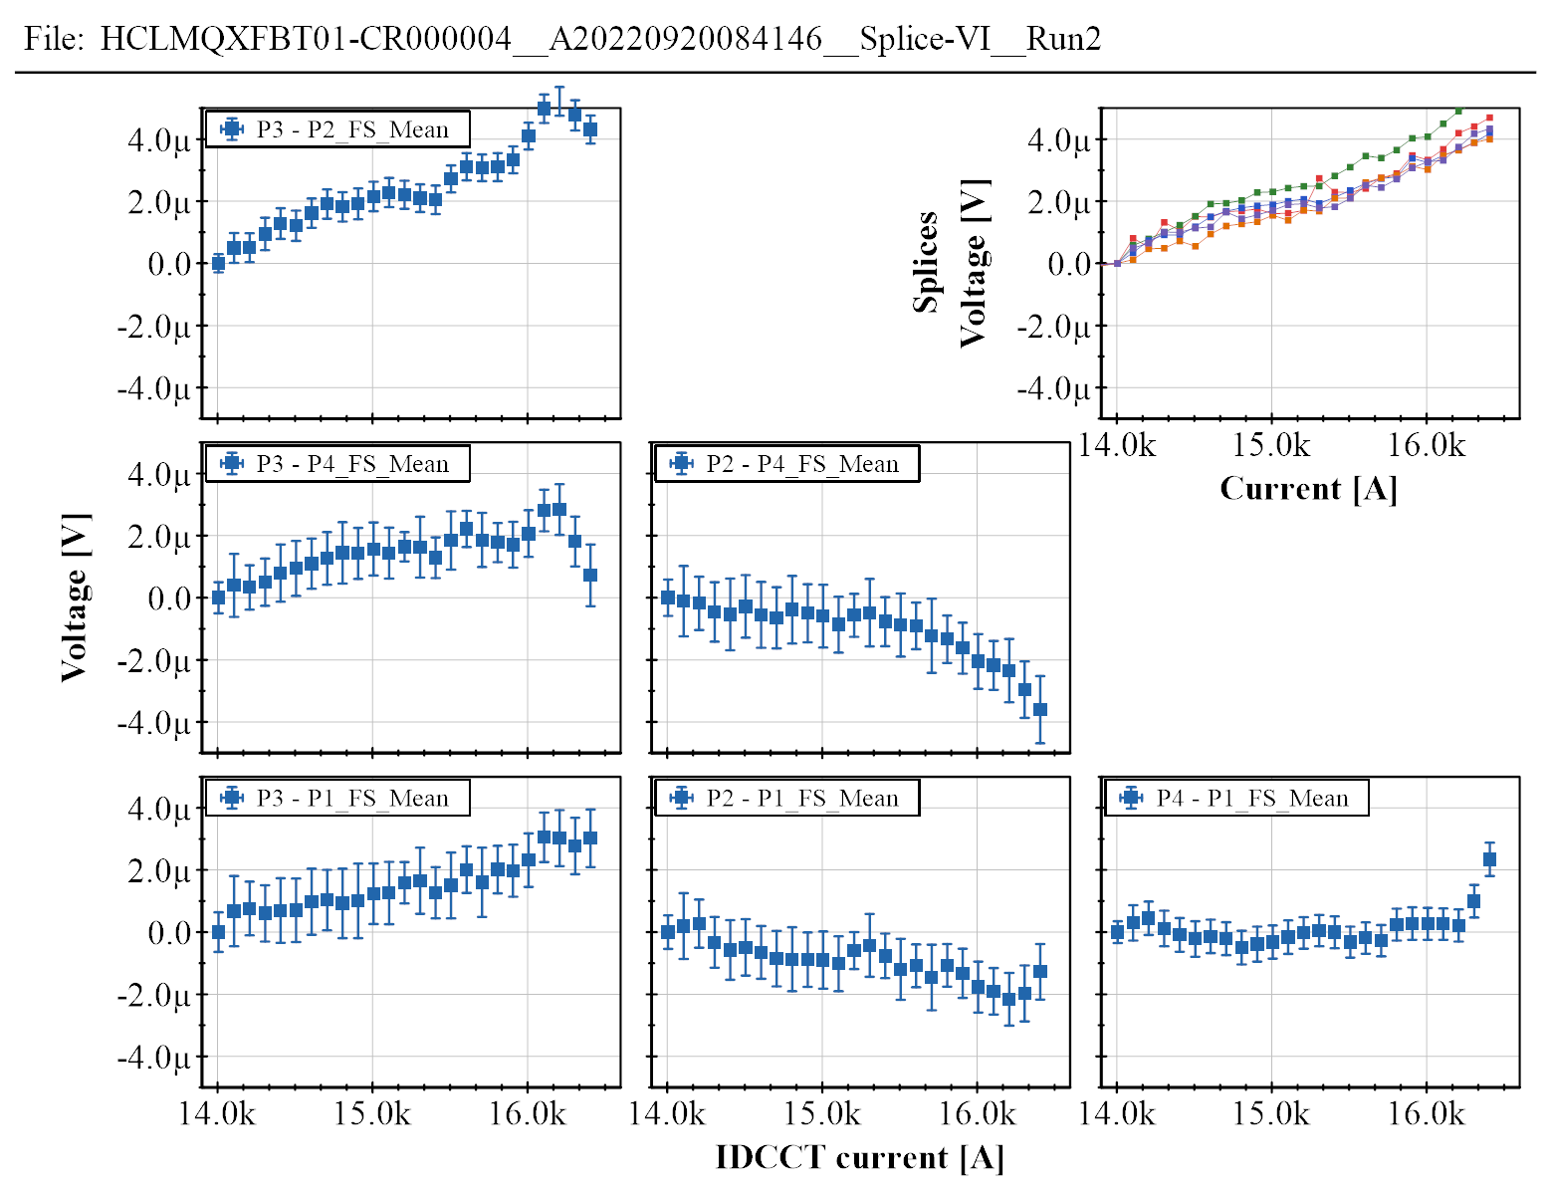
CD 2

Slide 16
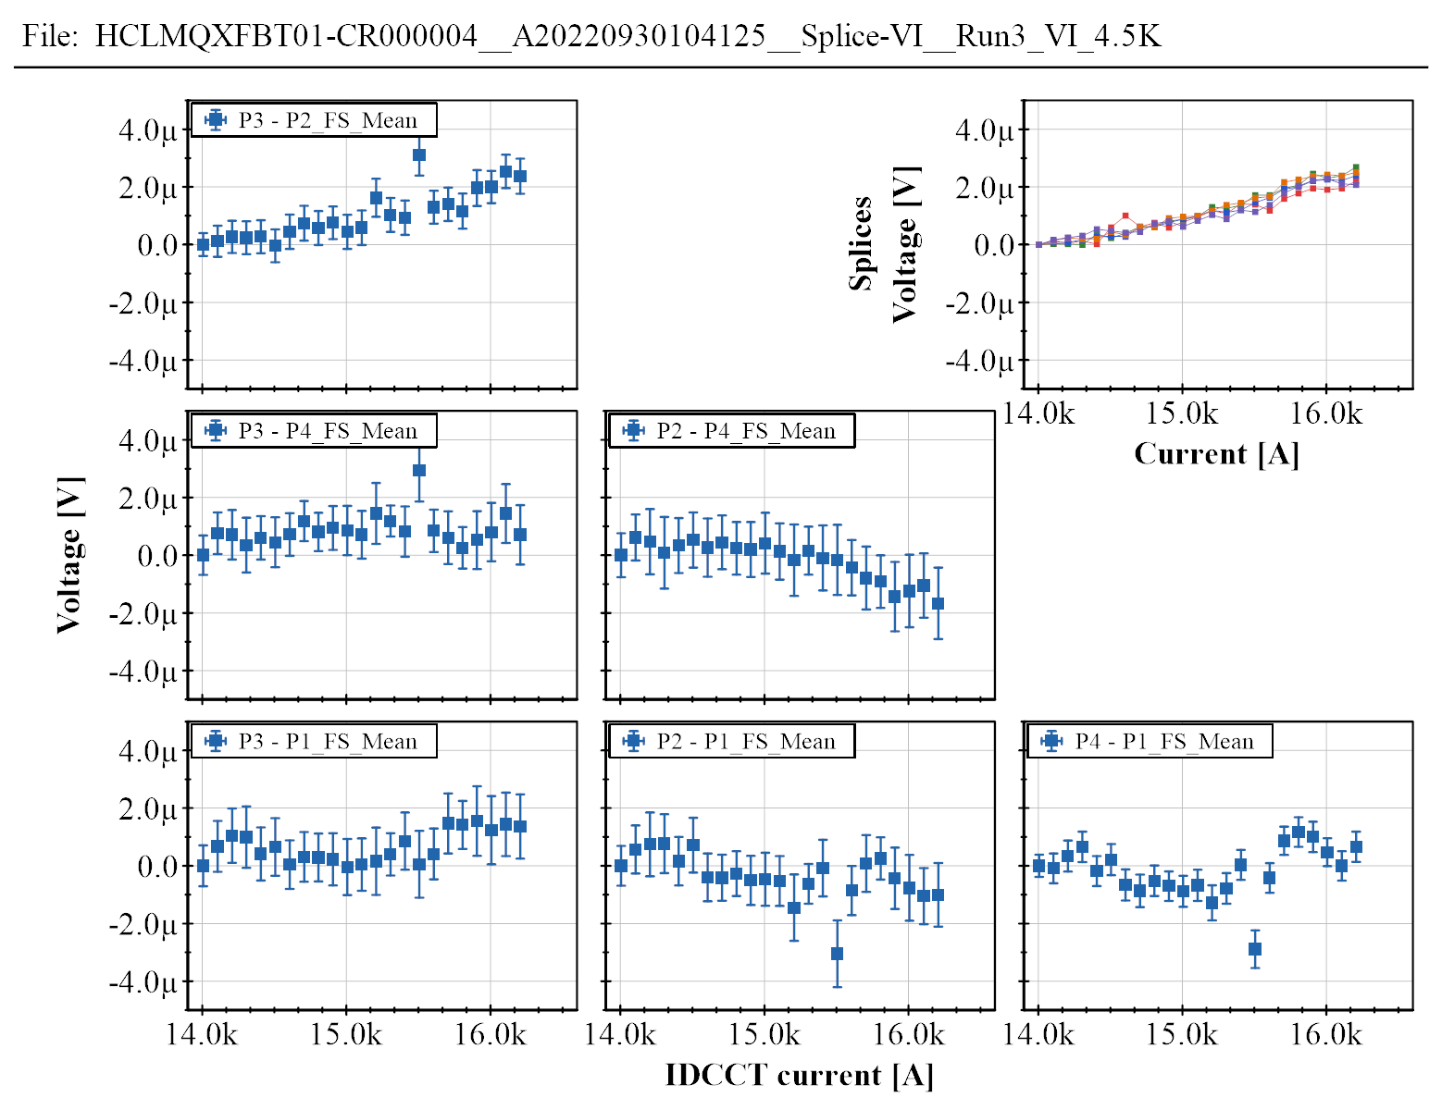
CD 3

Slide 17
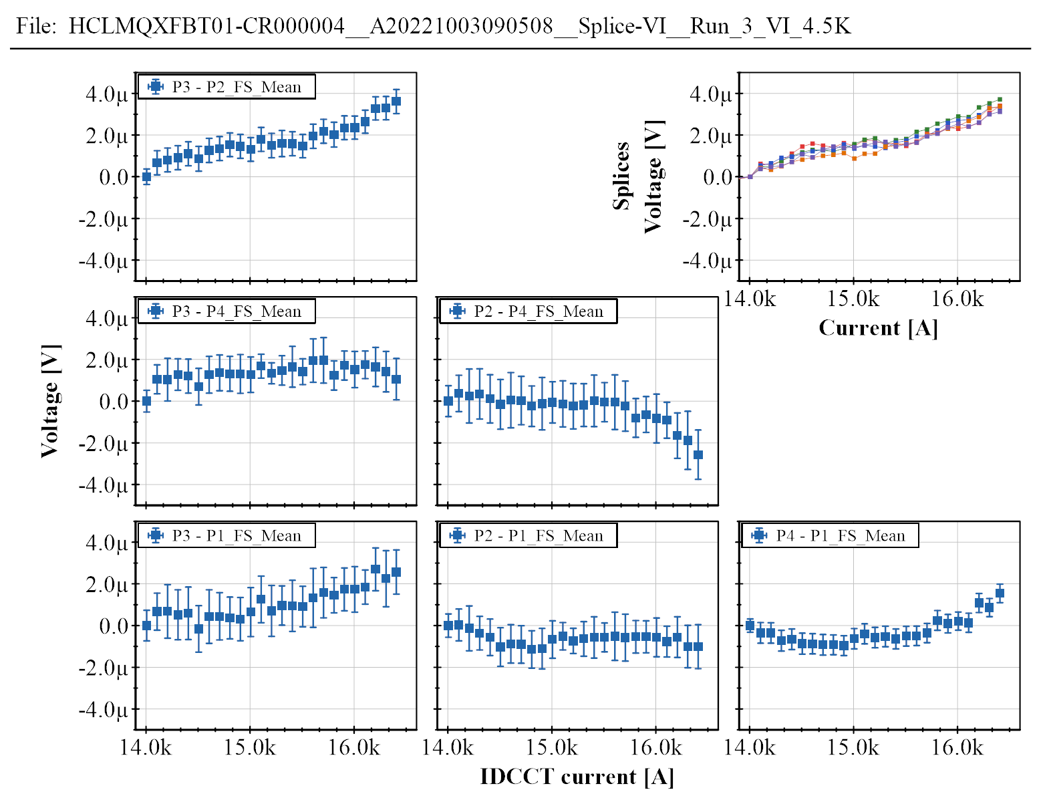
CD 3 bis

Slide 18
All combined
Blue: CD1
Brown: CD2
Green: CD3
Dark green: CD3 bis
All points seem to be within the drift levels
P3-P2 response looks very similar to the splices
Drift investigation ongoing

Slide 19
Electrical insulation tests

Slide 20
Standard HV tests
# | Equipment | Polarity+ | Polarity- | Test type | Target voltage | Maximum voltage reached | Result
1 | Portable | Coil | Ground | Plateau | 460 V | 460 V | >5 GΩ
3 | Rack | Coil + all QH | Ground | Plateau | 1100 V | ? | Not OK
9 | Portable | Coil | Ground | Plateau | 1900 V | 1954 V | 15 GΩ
10-15,17 | Portable | QH one by one except YT123 | Ground | Ramp 500 V/min | 1100 V | 1127 V | OK
16 | Portable | QH YT123 | Ground | Ramp 500 V/min | 1100 V | 1027 V | Not OK
18 | Portable | All QH except YT123 | Ground + Coil + QH YT123 | Ramp 500 V/min | 2300 V | 2241 V | Not OK
Decision: do not use YT123, and limit the test voltage of the other QH to coil at 1900 V (instead of the nominal 2300 V)
21 | Portable | All QH except YT123 | Ground + Coil + QH YT123 | Plateau | 1900 V | 1954 V | 50 GΩ
24 | Portable | Coil | Ground + all QH | Plateau | 1840 V | 1890 V | 90 GΩ
Successive tests (at the end of CD1, at the start and end of CD2 and CD3) were performed in the same conditions (lines 21 and 24), with similar results.
At the end of CD3 a special investigation was done, see next slide.
See NCR EDMS 2773498

Slide 21
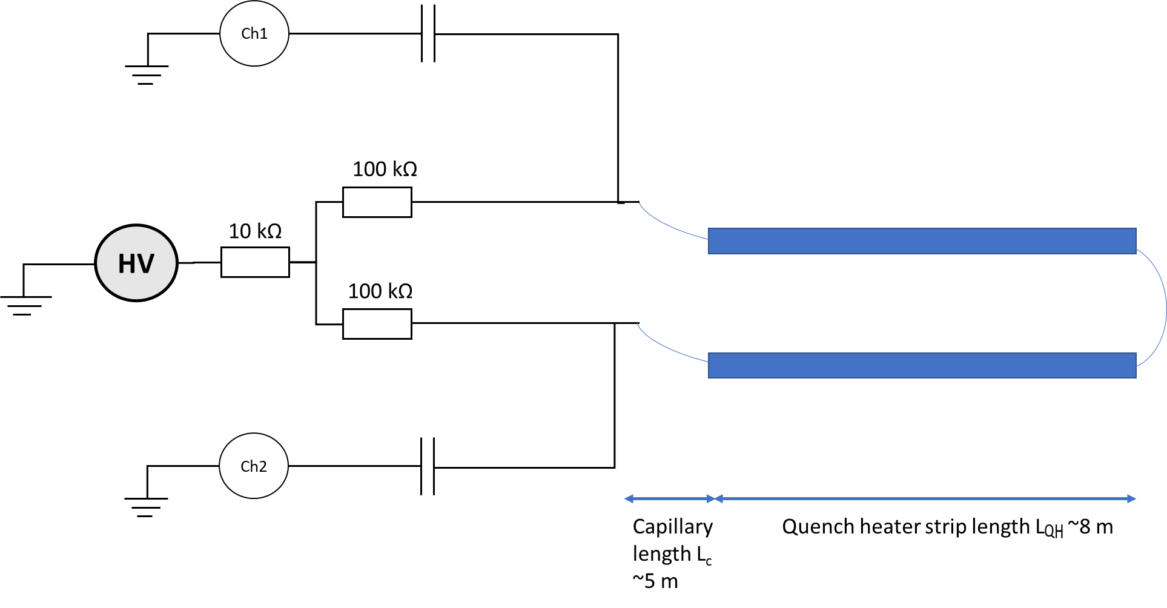
Special HV investigation
Solid or dashed curve
Dotted curve
Green and black: reference discharge at the connector
Red: breakdown in YT123 (~900 V).
The delay between the two terminals is only slightly shorter (~5-10 ns shorter) than in the reference discharge. This suggests that the fault is likely to be just below the IFS box.
Similar findings for YT124 – however the fault disappeared after one breakdown at 1.9 kV.
All other QH (including YT124 after the breakdown) passed the test at 2.3 kV.
See report by M. Bednarek and V. Desbiolles (EDMS 2785911)

Slide 22
Other test results

Slide 23
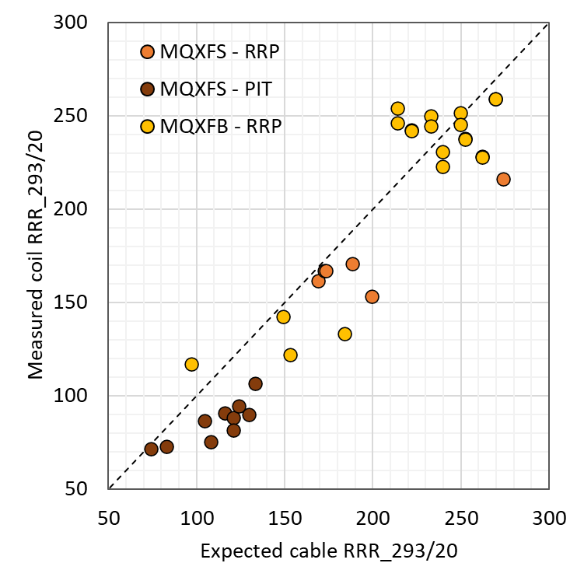
RRR (293 to 20 K)
Pole | Coil | WS CC | WS CoC | SM18 WU2 | SM18 WU3
P3 | 118 | 290 | 249 | 259 | 259
P2 | 117 | 290 | 215 | 238 | 237
P4 | 119 | 299 | 225 | 228 | 228
P1 | 115 | 241 | 203 | 242 | 242
MQXFBP1
Similar values to MQXFBP2
Error bars: under study

Slide 24
Conclusions

Slide 25
Conclusions
Performance:
  Increasing performance MQXFBP1 → BP2 → BP3.
  MQXFBP3 reached the target current (nominal current + 300 A) at 1.9 K and 20 A/s ramp. It operated during 4.5 hours at target current and during 8 hours at nominal current.
  All MQXFB magnets tested so far show a very fast training (maximum 1 quench)
Thermal cycle:
  All magnets showed perfect training memory after thermal cycle
  The coils limitation level, ramp rate dependency, and V-I measurements unchanged after thermal cycle
Limitation:
  All MQXFB magnets so far show a performance limitation in one or more coils, in the inner layer pole turn or pole turn block, near the mechanical center of the magnet.
  Coil heads are consistently performing well

Slide 26
Extra slides

Slide 27
Quench antenna and localization

Slide 28
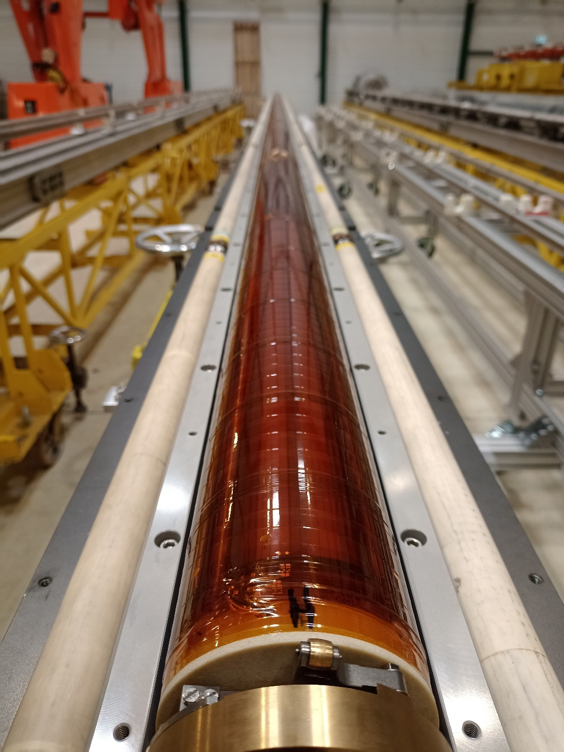
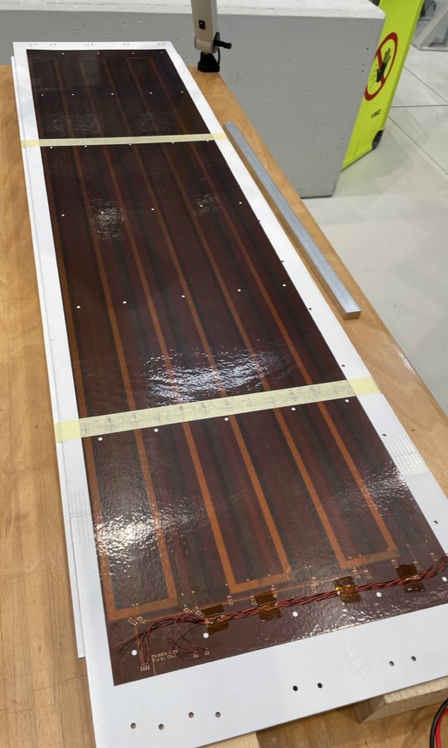
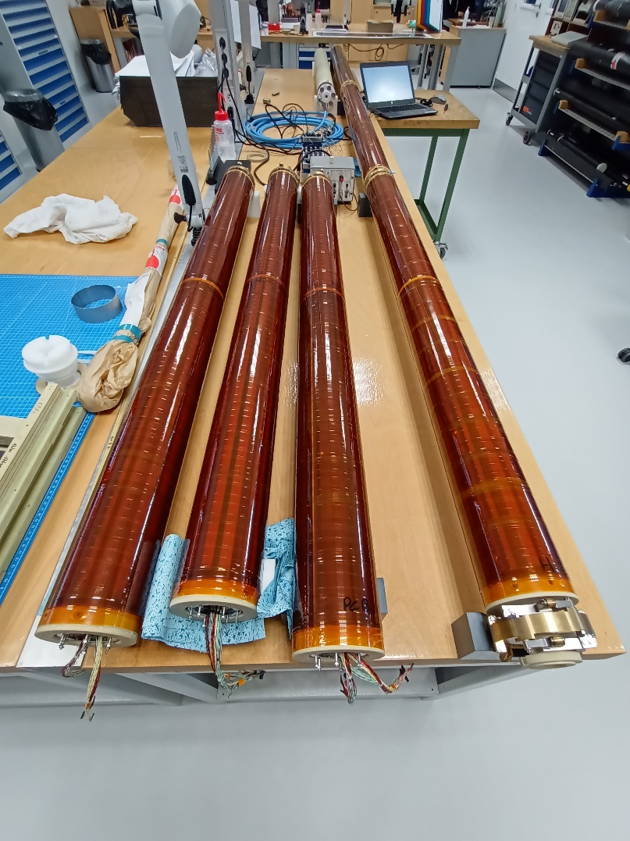
Multipole Sensitive Quench-Antenna
Sensitivity mostly to B3, A3, B4, A4 through coil design (analogue bucking and use of Flex PCBs)
Compromise between noise (PC, vibrations, etc), resolution in radial direction, and signal strength.

Slide 29
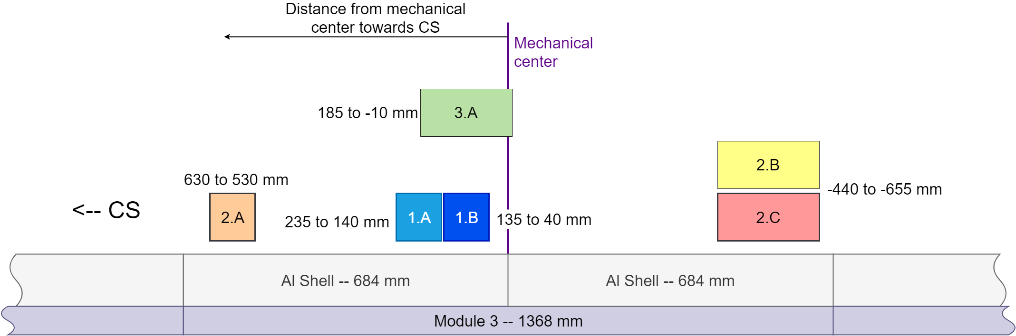
Longitudinal quench localization
On repetitive quenches we can narrow down the longitudinal position of the quench by shifting the quench antenna position.
Higher precision (±50 mm) with the standard quench antenna due to higher density of coils.
CF4
CF3
The limiting locations in all three magnets are at the central 1.5 m of the magnet.
No quench, no limiting location found at any of the coil heads.

Slide 30
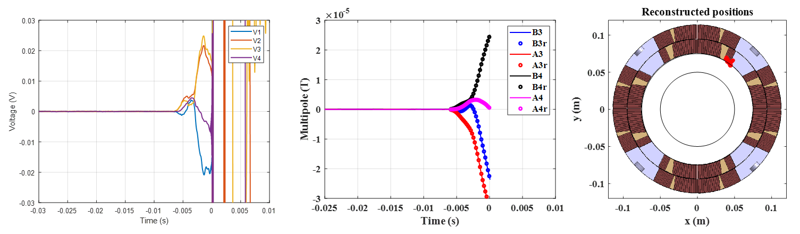
Cross-section quench localization
QA voltage signals
Reconstructed multipoles
Reconstructed quench position
P2
P1
In MQXFBP1 and BP2 we relied on voltage taps for quench localization in the cross section.
In MQXFBP3 we use the multipole quench antenna. A first prototype was validated in MQXFBP2 (see above) and implemented as main QA in MQXFBP3. Quench location can be identified within a few turns.
In all cases, the performance limiting location is in the inner layer pole turn (BP1 and BP2) or pole turn block (BP3).
CS view
P3
P4

Slide 31
Quenches during VI measurements

Slide 32
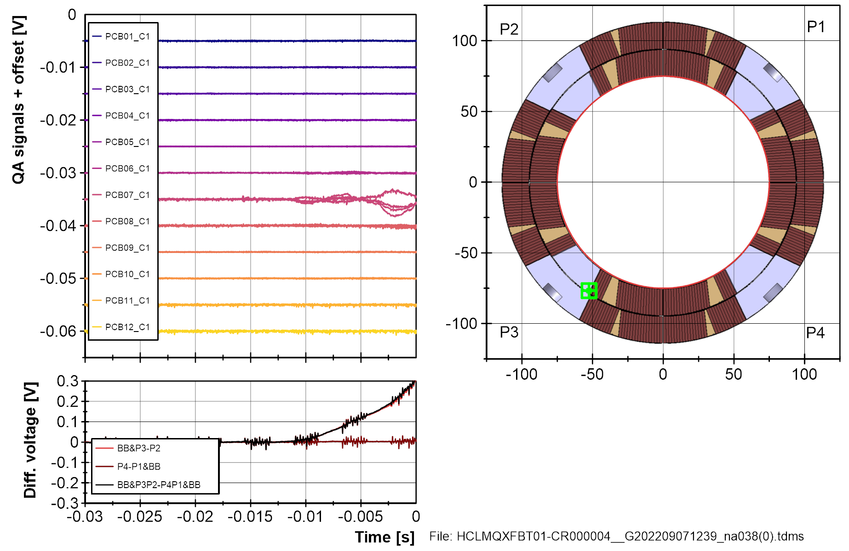
First VI quench, during CD1.

Slide 33
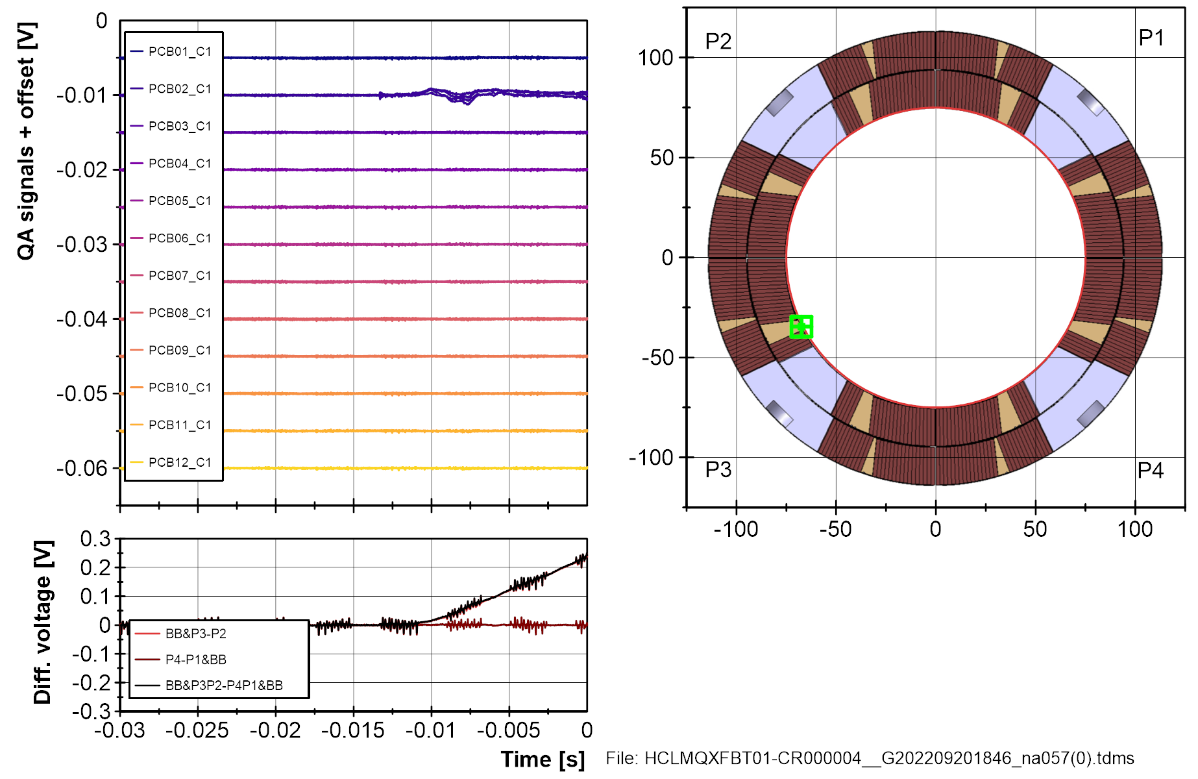
Second VI quench, during CD2.

Slide 34
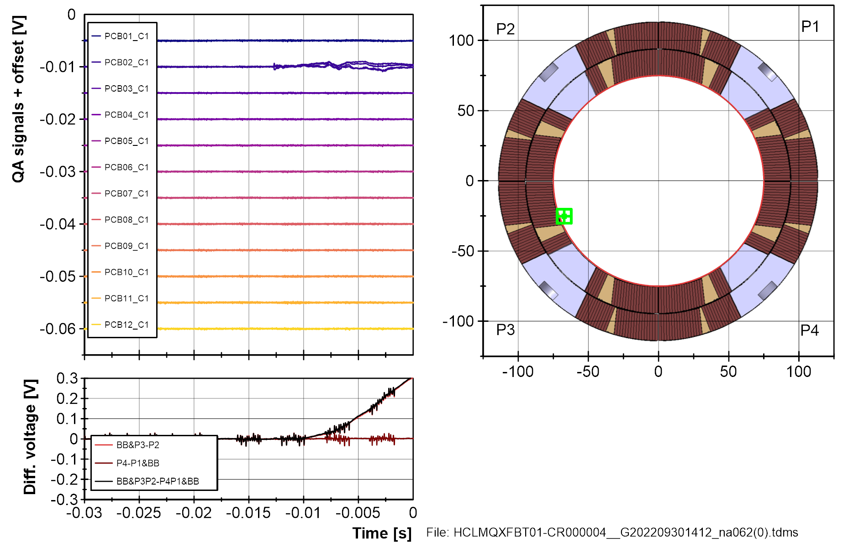
Third VI quench, during CD3.

Slide 35
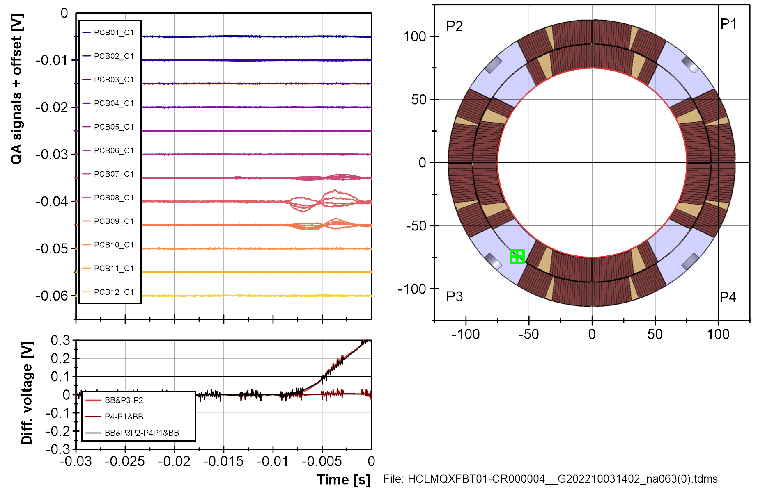
Fourth and last VI quench, during CD3.
QA displaced.

